Slide 1
Electron Sources and Injectors.
Lecture I
Dr. Boris Militsyn
STFC Accelerator Science and Technology Centre (ASTeC)

Slide 2
Course outline I
Lecture I
  Electron beams and their application in science, technology, society
  Characterisation of beam parameters and beam observables
  Specifications of the beams for different applications
  Dynamics of electron beams, emittance and space charge dominated regime
Lecture II
  Generation of the electron beams
  Electron emission – thermionic, photoemission, field emission
  Ultimate parameters of the emitted beams
  Beam acceleration
  Impact of emission process on beam parameters

Slide 3
Course outline II
Lecture III
  Physics of thermionic emission, thermionic cathodes
  Space charge dominated emission, Child-Langmuir low
  Thermionic injectors: DC High Voltage, pulsed HV, RF
  Modulation of emitted beams
  Thermionic injector for scientific and technological applications
Lecture IV
  Physics of photoemission
  Photocathodes and their main parameters
  Acceleration of emitted beams, DC, RF
  Ultimate achievable beam parameters

Slide 4
Course outline III
Lecture V
  Physics of field emission
  Brightness of emitted beam
  Field emission based injector for electron microscopy
  Emittance compensation
  Emittance linearisation
  Beam bunching. Space charge limit on the beam parameters.
Lecture VI
  Codes for beam dynamics simulations in the electron injectors (ASTRA, GPT, OPAL)
  Simulation of electron emission. Different emission models.
  Beam parameters characterisation
  Examples of simulation problems

Slide 5
Application of the electron beams
Everyday live
  Old fashion TVs - obsolete
  Microwave ovens
High power RF devices (magnetrons, klystrons, IOTs etc.)
Particle accelerators for scientific applications
  High energy physics
  Free Electron Lasers
  Facilities for accelerator research (Wake filed accelerators etc.)
Particle accelerator for siciety
  Accelerators for industrial applications – cutting and welding
  Accelerators for medical applications
    X-ray diagnostic
    Radiotherapy
  Accelerators for security
Imagining devices
Analytical tools (electron microscopes, surface analysis tools etc.)

Slide 6
Requirements to the electron beams
Energy (momentum)
  Energy(momentum) spread
Current/bunch charge
  Average current
  Peak current
Beam brightness (emittance)
  Beam size
  Beam divergence
Bunch length (in CW and pulsed modes)
Temporal beam structure (DC, single pulse, train pulse etc.)
Operation mode (24x7,from time to time)

Slide 7
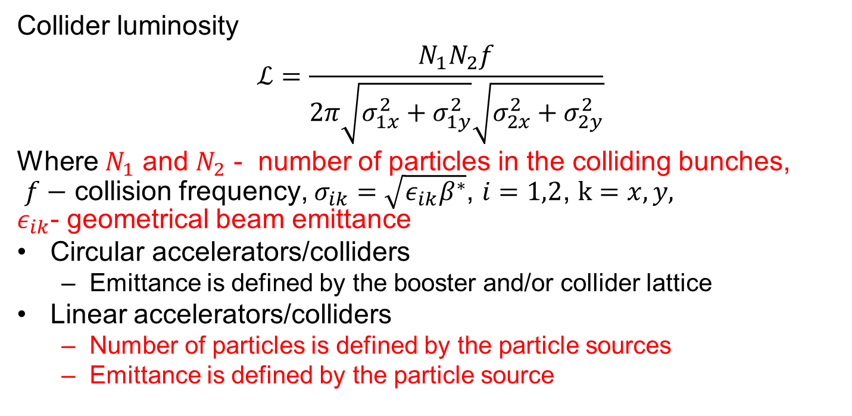
High Energy Physics colliders
Collider luminosity
$$ℒ=\frac{N_{1}N_{2}f}{2π\sqrt{σ_{1x}^{2}+σ_{1y}^{2}}\sqrt{σ_{2x}^{2}+σ_{2y}^{2}}}$$
Where $N_{1}$ and $N_{2}$ - number of particles in the colliding bunches,
$f−$ collision frequency, $σ_{ik}=\sqrt{{ε_{ik}β}^{∗}}$, $i=1,2$, $k=x,y,$
$ε_{ik}$- geometrical beam emittance
Circular accelerators/colliders
  Emittance is defined by the booster and/or collider lattice
Linear accelerators/colliders
  Number of particles is defined by the particle sources
  Emittance is defined by the particle source
Notes:
E=500 MeV, N=10**10, beta=1 cm, f=1 MHz, L=10**32, required geometrical emittance=8*10**-10 m*rad

Slide 8
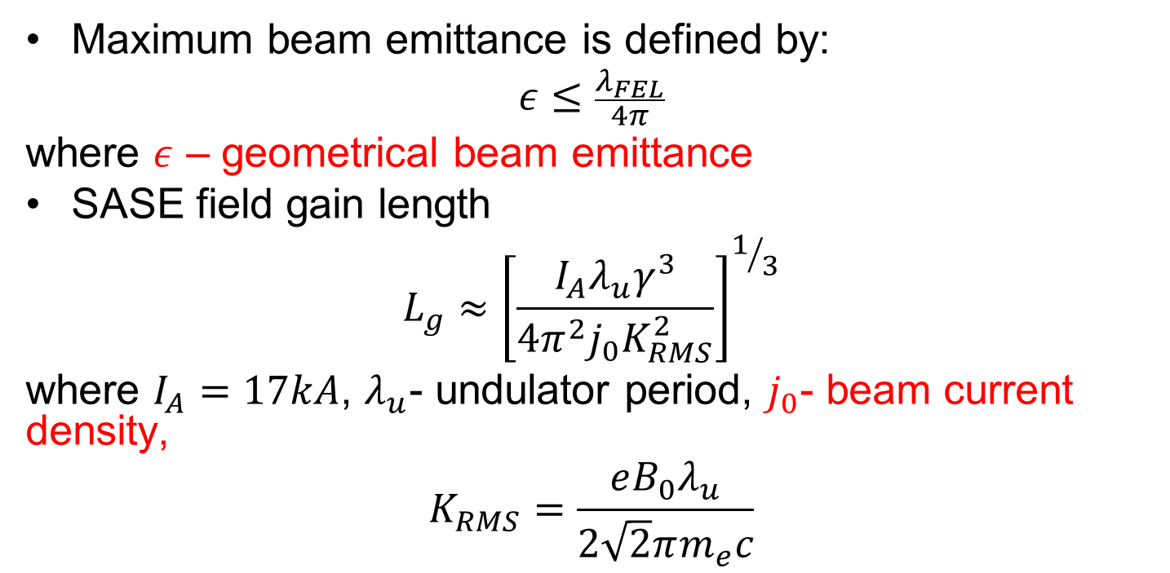
Drivers for Free Electron Lasers
Maximum beam emittance is defined by:
$$ε≤\frac{λ_{FEL}}{4π}$$
where $ε$ – geometrical beam emittance
SASE field gain length
$$L_{g}≈{\left[\frac{I_{A}λ_{u}γ^{3}}{4π^{2}j_{0}K_{RMS}^{2}}\right]}^{1/3}$$
where $I_{A}=17kA$, $λ_{u}$- undulator period, $j_{0}$- beam current density,
$$K_{RMS}=\frac{eB_{0}λ_{u}}{2\sqrt{2}πm_{e}c}$$
Notes:
Required 14 nm FEL, geometrical emittance should be less than 1.1e-9 m*rad. Driver energy 1 GeV, Undulator period 50 mm, K=1, required gain length 1m. Current density 170 kA/mm**2 . At the beamsize 0.1 mm it gives peak current 5.3 kA.

Slide 9
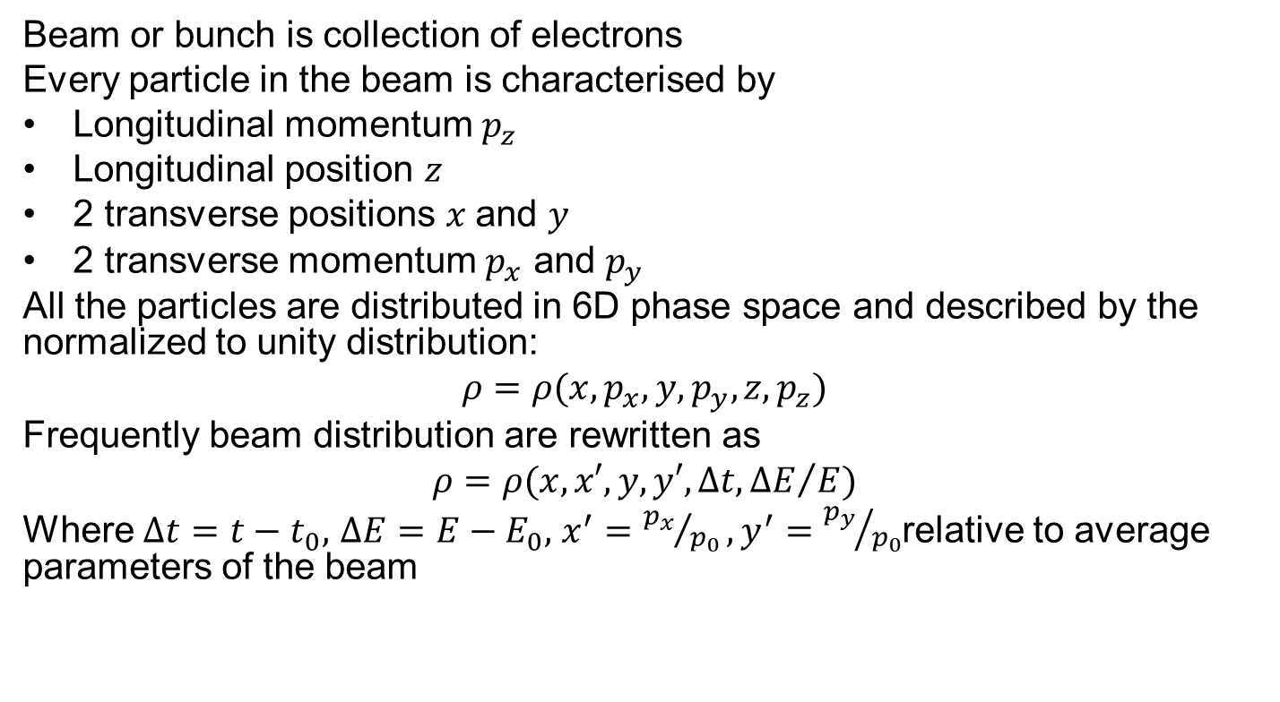
Characterisation of the electron beam
Beam or bunch is collection of electrons
Every particle in the beam is characterised by
Longitudinal momentum $p_{z}$
Longitudinal position $z$
2 transverse positions $x$and $y$
2 transverse momentum $p_{x}$ and $p_{y}$
All the particles are distributed in 6D phase space and described by the normalized to unity distribution:
$$ρ=ρ(x,p_{x},y,p_{y}, z,p_{z})$$
Frequently beam distribution are rewritten as
$$ρ=ρ(x,x′,y,y′, ∆t,{∆E}/E)$$
Where $∆t=t−t_{0},$ $∆E=E−E_{0},$ $x^{′}={p_{x}}/{p_{0}},y^{′}={p_{y}}/{p_{0}}$relative to average parameters of the beam

Slide 10
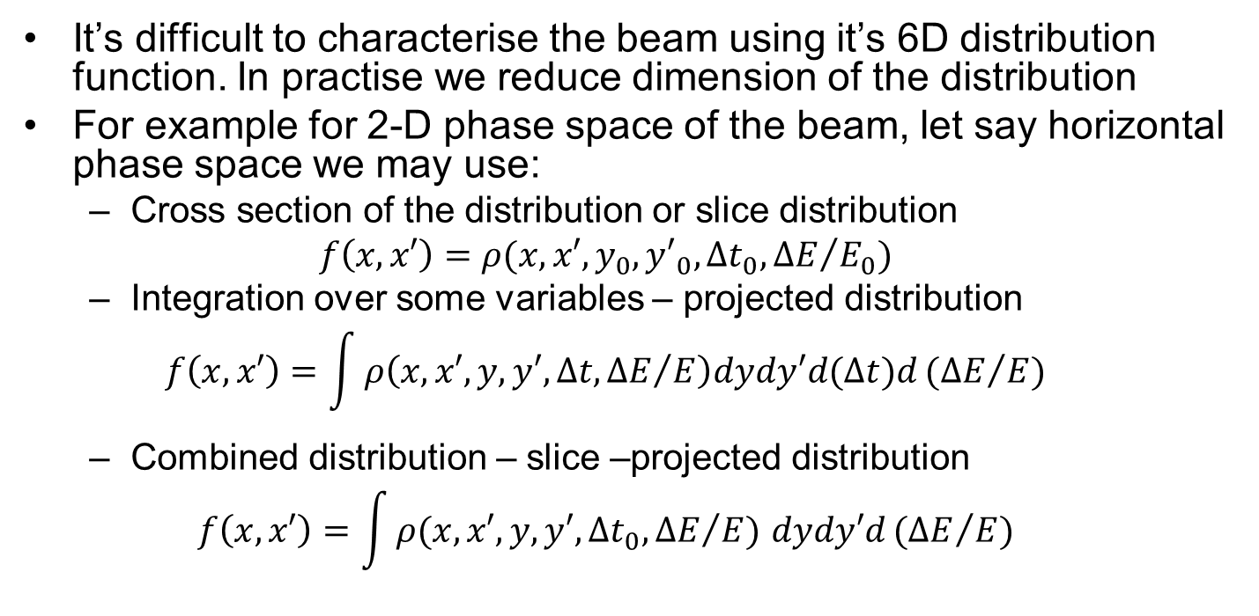
Characterisation of the electron beam
It’s difficult to characterise the beam using it’s 6D distribution function. In practise we reduce dimension of the distribution
For example for 2-D phase space of the beam, let say horizontal phase space we may use:
  Cross section of the distribution or slice distribution
  $$f\left(x,x′\right)=ρ(x,x′,y_{0},{y′}_{0}, ∆t_{0},{∆E}/{E_{0}})$$
  Integration over some variables – projected distribution
  $$f\left(x,x′\right)=\int{ρ\left(x,x′,y,y′, ∆t,{∆E}/E\right)dydy′d(∆t)d}{(∆E}/E)$$
  Combined distribution – slice –projected distribution
  $$f\left(x,x′\right)=\int{ρ(x,x′,y,y′, ∆t_{0},{∆E}/E) dydy′d}{(∆E}/E)$$
Notes:
6D distribution is very difficult to imagine and to manipulate with so people are frequently using reduced dimension distributions.

Slide 11
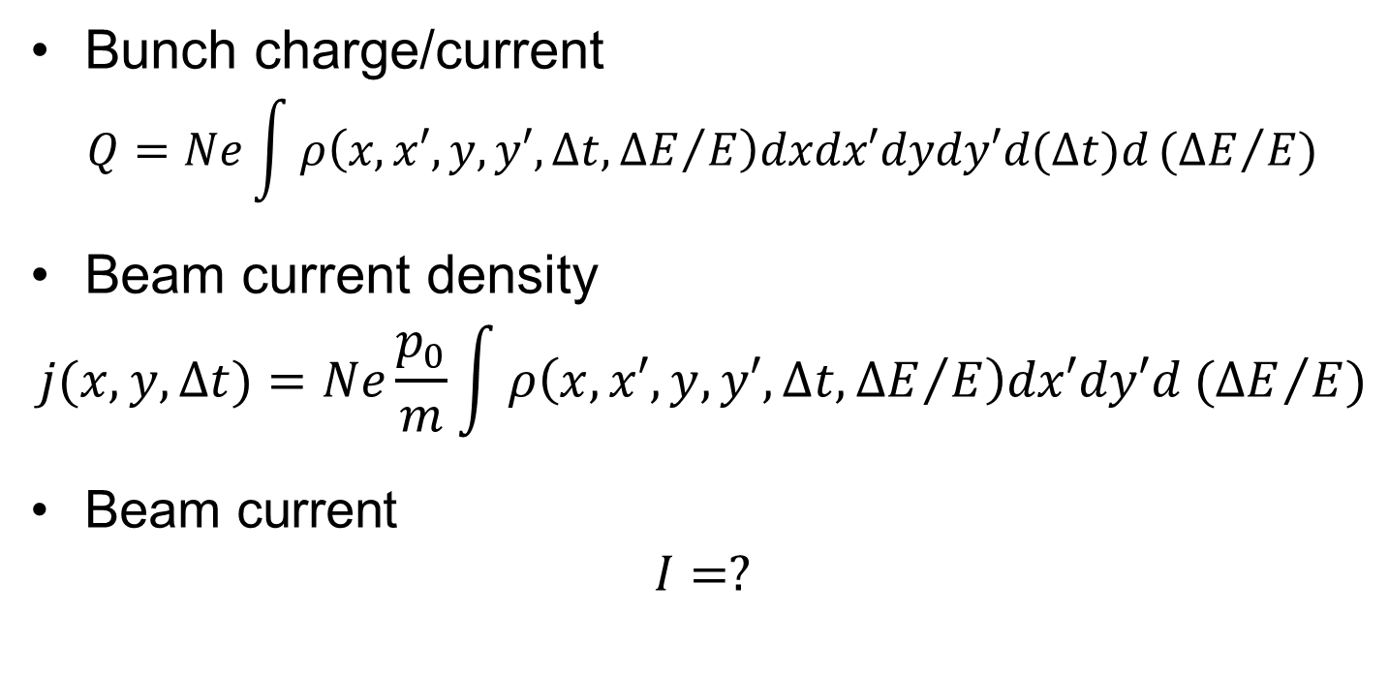
Beam observables I
Bunch charge/current
$$Q=Ne\int{ρ\left(x,x′,y,y′, ∆t,{∆E}/E\right)dxdx′dydy′d(∆t)d}{(∆E}/E)$$
Beam current density
$$j(x,y,Δt)=Ne\frac{p_{0}}{m}\int{ρ\left(x,x′,y,y′, ∆t,{∆E}/E\right)dx′dy′d}{(∆E}/E)$$
Beam current
$$I=?$$

Slide 12
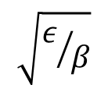

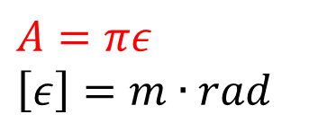
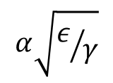

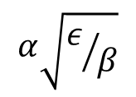

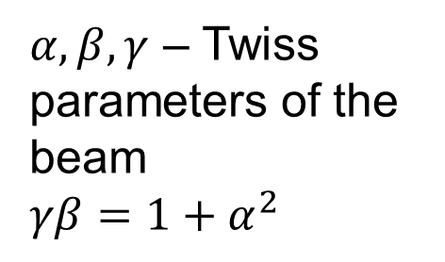

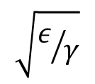
Phase space presentation of the beam
$$x′$$
$$A=πε$$
$$\left[ε\right]=m∙rad$$
$$ε=γ<x^{2}>+2α<xx^{′}>+β<{x′}^{2}>$$
$$α\sqrt{ε/γ}$$
$${x′}_{max}=\sqrt{γε}$$
$$\sqrt{ε/β}$$
$$α\sqrt{ε/β}$$
$$x$$
$α,β,γ$ – Twiss parameters of the beam
$$γβ=1+α^{2}$$
$$\sqrt{ε/γ}$$
$$x_{max}=\sqrt{βε}$$

Slide 13
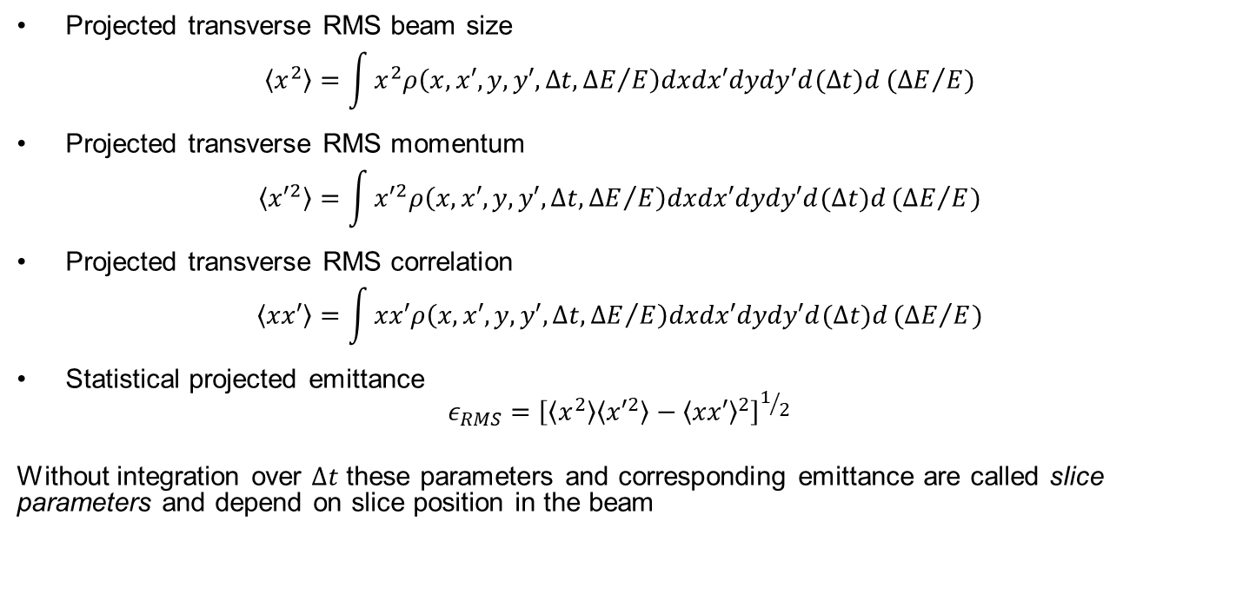
Beam observables II
Projected transverse RMS beam size
$$\left\langle x^{2}\right\rangle =\int{x^{2}ρ\left(x,x′,y,y′, ∆t,{∆E}/E\right)dxdx′dydy′d(∆t)d{(∆E}/E)}$$
Projected transverse RMS momentum
$$\left\langle {x′}^{2}\right\rangle =\int{{x′}^{2}ρ\left(x,x′,y,y′, ∆t,{∆E}/E\right)dxdx′dydy′d(∆t)d{(∆E}/E)}$$
Projected transverse RMS correlation
$$\left\langle xx′\right\rangle =\int{xx′ρ\left(x,x′,y,y′, ∆t,{∆E}/E\right)dxdx′dydy′d(∆t)d{(∆E}/E)}$$
Statistical projected emittance
$ε_{RMS}={\left[\left\langle x^{2}\right\rangle \left\langle {x′}^{2}\right\rangle −{\left\langle xx′\right\rangle }^{2}\right]}^{1/2}$
Without integration over $∆t$ these parameters and corresponding emittance are called slice parameters and depend on slice position in the beam

Slide 14
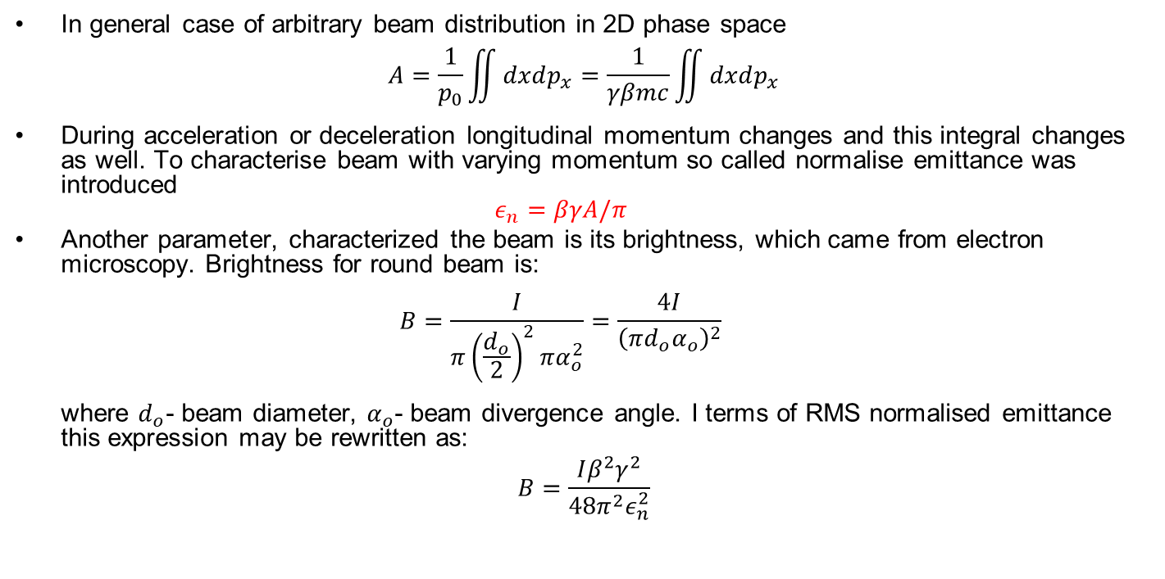
Normalised emittance and brightness
In general case of arbitrary beam distribution in 2D phase space
$$A=\frac{1}{p_{0}}\iint{dxdp_{x}}=\frac{1}{γβmc}\iint{dxdp_{x}}$$
During acceleration or deceleration longitudinal momentum changes and this integral changes as well. To characterise beam with varying momentum so called normalise emittance was introduced
$ε_{n}=βγA/π$
Another parameter, characterized the beam is its brightness, which came from electron microscopy. Brightness for round beam is:
$B=\frac{I}{π{\left(\frac{d_{o}}{2}\right)}^{2}πα_{o}^{2}}=\frac{4I}{{\left(πd_{o}α_{o}\right)}^{2}}$
where $d_{o}$- beam diameter, $α_{o}$- beam divergence angle. I terms of RMS normalised emittance this expression may be rewritten as:
$$B=\frac{Iβ^{2}γ^{2}}{48π^{2}ε_{n}^{2}}$$

Slide 15
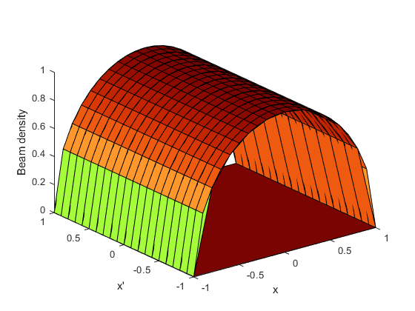
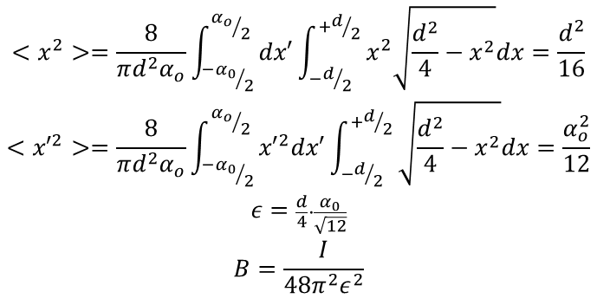
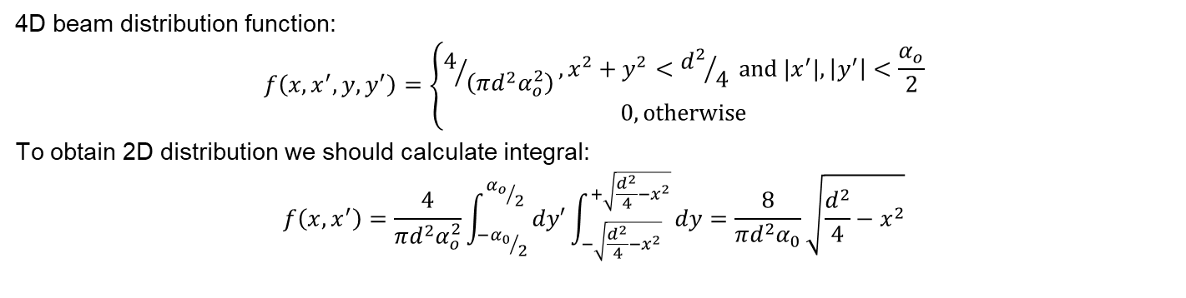
Emittance and bright- ness of round beam
4D beam distribution function:
$$f\left(x,x^{′},y,y^{′}\right)=\left\{\begin{matrix}4/{\left(πd^{2}α_{o}^{2}\right)}, x^{2}+y^{2}<{d^{2}}/{4 }and |x^{′}|,\left|y^{′}\right|<\frac{α_{o}}{2} \\ 0, otherwise\end{matrix}\right.$$
To obtain 2D distribution we should calculate integral:
$$f\left(x,x^{′}\right)=\frac{4}{πd^{2}α_{o}^{2}}\int_{{{−α}_{0}}/2}^{{α_{o}}/2}{dy′\int_{−\sqrt{\frac{d^{2}}{4}−x^{2}}}^{+\sqrt{\frac{d^{2}}{4}−x^{2}}}{dy}}=\frac{8}{πd^{2}α_{0}}\sqrt{\frac{d^{2}}{4}−x^{2}}$$
$$\begin{matrix}<x^{2}>=\frac{8}{πd^{2}α_{o}}\int_{{{−α}_{0}}/2}^{{α_{o}}/2}{dx′\int_{−d/2}^{+d/2}{x^{2}\sqrt{\frac{d^{2}}{4}−x^{2}}dx}}=\frac{d^{2}}{16} \\ <{x′}^{2}>=\frac{8}{πd^{2}α_{o}}\int_{{{−α}_{0}}/2}^{{α_{o}}/2}{{x′}^{2}dx′\int_{−d/2}^{+d/2}{\sqrt{\frac{d^{2}}{4}−x^{2}}dx}}=\frac{α_{o}^{2}}{12} \\ \begin{aligned}ε=\frac{d}{4}∙\frac{α_{0}}{\sqrt{12}} \\ B=\frac{I}{48π^{2}ε^{2}}\end{aligned}\end{matrix}$$

Slide 16
Generation of the electron beams
Emission
  Thermo-electronic emission
  Photo-emission
  Field emission
  Gas/plasma phase emission
Preliminary acceleration
  DC field
  Pulsed field
  RF field
Beam conditioning
  Focusing
  Emittance preservation and compensation
  Compression (velocity bunching/magnetic compression)
Acceleration

Slide 17
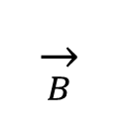
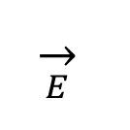
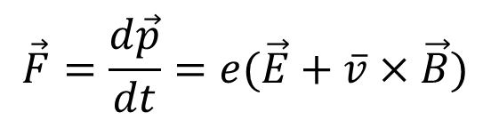
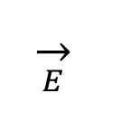
Typical electron source
Focusing solenoid
Booster-accelerator
$$\overset{→}{B}$$
$$\overset{→}{E}$$
$$\overset{→}{E}$$
Cathode
Anode
$$\vec{F}=\frac{d\vec{p}}{dt}=e(\vec{E}+\overline{v}×\vec{B})$$
Fields are the sum of both external and internal (space charge) fields

Slide 18
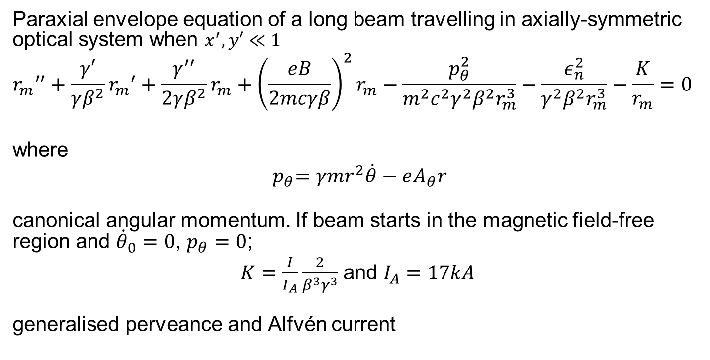
Beam envelope evolution
Paraxial envelope equation of a long beam travelling in axially-symmetric optical system when $x^{′},y′≪1$
$${r_{m}}^{′′}+\frac{γ′}{γβ^{2}}{r_{m}}^{′}+\frac{γ^{′′}}{2γβ^{2}}r_{m}+{\left(\frac{eB}{2mcγβ}\right)}^{2}r_{m}−\frac{p_{θ}^{2}}{m^{2}c^{2}γ^{2}β^{2}r_{m}^{3}}−\frac{ε_{n}^{2}}{{γ^{2}β^{2}r}_{m}^{3}}−\frac{K}{r_{m}}=0$$
where
$${ p}_{θ}=γmr^{2}\dot{θ}−eA_{θ}r$$
canonical angular momentum. If beam starts in the magnetic field-free region and ${\dot{θ}}_{0}=0$, $p_{θ}=0$;
$K=\frac{I}{I_{A}}\frac{2}{β^{3}γ^{3}}$ and $I_{A}=17kA$
generalised perveance and Alfvén current

Slide 19
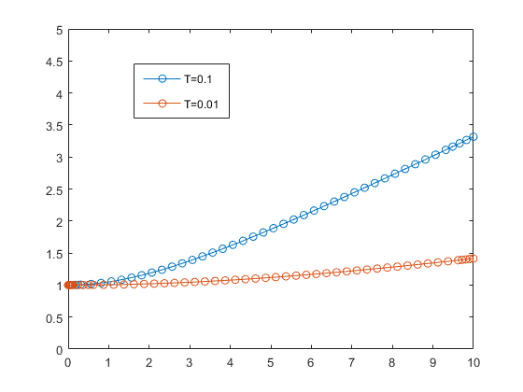
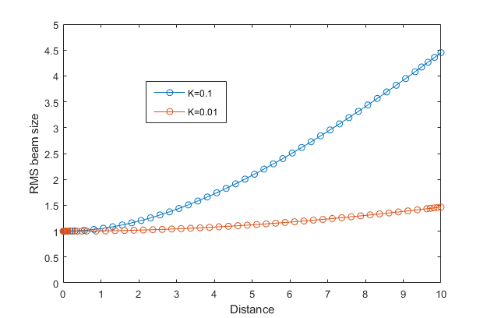
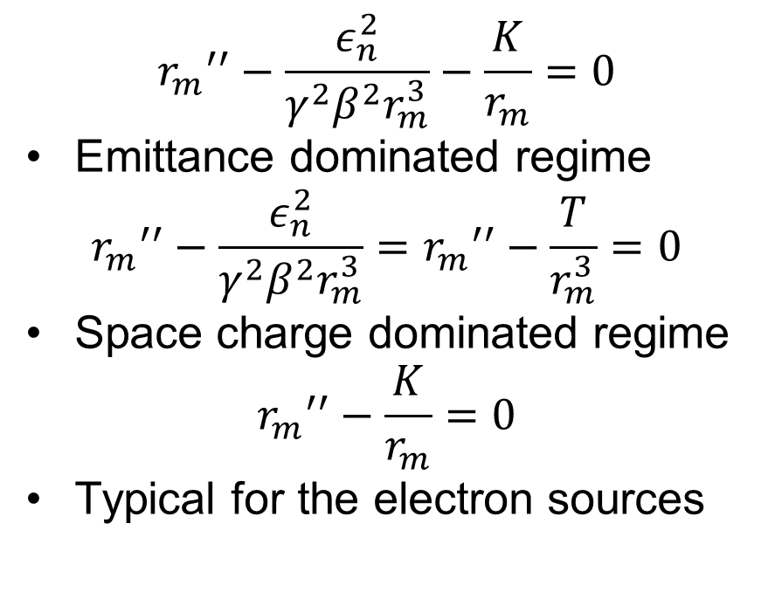
Beam in drift space
$${r_{m}}^{′′}−\frac{ε_{n}^{2}}{{γ^{2}β^{2}r}_{m}^{3}}−\frac{K}{r_{m}}=0$$
Emittance dominated regime
$${r_{m}}^{′′}−\frac{ε_{n}^{2}}{{γ^{2}β^{2}r}_{m}^{3}}={r_{m}}^{′′}−\frac{T}{r_{m}^{3}}=0$$
Space charge dominated regime
$${r_{m}}^{′′}−\frac{K}{r_{m}}=0$$
Typical for the electron sources

Slide 20
Literature
M. Reiser, Theory and Design of Charged Particle Beams, ISBN 0-471-30616-9

