Slide 1
Introduction to Machine Learning
Emmanuel Olaiya
Rutherford Appleton Laboratory
13th June 2022

Slide 2
Agenda
Today
1130 – 1225: Lecture on Introduction to Machine Learning

Slide 3
Agenda
Today, Monday 13th June, this afternoon
Tutorial walkthrough
1400 - 1540
We will have breaks
1600 - 1730

Slide 4
Content
What is the goal of this lecture
To introduce you to Machine Learning
In one lecture you can’t learn everything so the goal here is to summarise some main points
The idea is for there to be a tutorial to follow (this afternoon) so you can implement and run Machine Learning models on a computer. Learn by doing!
There will be little to no implementation details in this lecture. This will be saved for the tutorial

Slide 5
Contents
What is Machine Learning
Challenges with data
Loss function
Training data
Deep Neural Nets
Recurrent Neural Nets
Convolutional Neural Nets

Slide 6
What is AI/Machine learning
AI (Artificial Intelligence) is a broad term that includes machine learning. AI is the idea that a machine can be similar to the human brain. Machine Learning (ML) is a product of AI’s evolution
Machine learning is the science of enabling machines to learn algorithms which are not explicitly programmed
Examples of ML use: face recognition, speech to text, internet search engines, spam filters, web browser personal recommendations, voice recognition. The list goes on ..
This talk focuses on machine learning!
Machine learning has been around for decades. So why is it taking off now?

Slide 7
Why is Machine Learning Taking Off Now?
Feasibility and accessibility
Data
Data is at the core of machine learning. Recent advances in data capture, data management and data storage have resulted in an exponential increase in data. Also disks are becoming faster, cheaper with larger capacities
Hardware
Once you have the data you still need a large amount of computing power to do the number crunching. For a long time the required computing power was unavailable.
Enter the GPU (Graphics Processing Unit). Invented by Nvidia in 1999, GPUs can speed up significantly the training of neural nets (more about this in later slides)
Algorithms
With the hardware and data we are now seeing rapid development of sophisticated algorithms

Slide 8
Types of Machine Learning
Consider the types of Machine Learning
Supervised v Unsupervised
Supervised: the data you train your algorithm with also contains the solutions, called labels
Examples:k-Nearest Neighbors, Linear Regression, Logistic Regression, Decision Trees, …
Unsupervised: the data you train your algorithm on is unlabeled
Examples: K-Means, DBSCAN, t-SNE, ...
Batch v Online Learning
Batch: your algorithm is incapable of learning incrementally. All the data is used. If more data is acquired updating the algorithm requires retraining and then relaunching. This is offline learning.
Online: your algorithm is capable of learning incrementally. It can learn on the fly using new data. Online learning is great for systems that need to adapt or change rapidly eg. stock price modeling

Slide 9
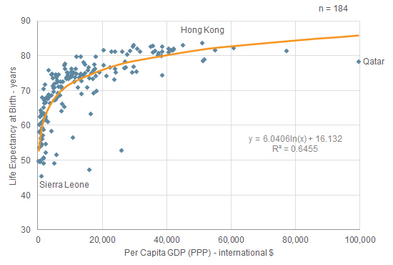
Types of Machine Learning
Instance v Model-based Learning
Instance: the system learns the examples by heart and then generalises to new cases eg. t-SNE
Model-based: build a model of these examples and the use that model to make predictions eg. Linear Regression, etc.
Model-based learning: Data of life expectancy v GDP. Fit a function to the data. Function can be used to make predictions
Neural nets are model based
Let’s look at the architecture of Deep Neural Nets (DNNs) by taking Multilayered Perceptrons (MLPs) and Convolutional Neural Nets (CNNs) and Recurrent Neural Nets (RNNs) as examples

Slide 10
Challenges with the Data
Insufficient training data
Humans require little data in order to learn. This is not the case for Machine Learning. For example object recognition in images
Solution: Sorry, you just need more data
Non representative data
You have to be careful that the training data is a good representation of the application data
Solution: ensure it is representative, eg. train on a subsample of the application data, compare test and run data
Poor quality data
Significant errors, outliers, noise etc
Solution: Clean data. eg. remove outliers. Be careful not to bias data!

Slide 11
Challenges with the Data
Overfitting the data
A complex model that describes the training data very well but describes general cases poorly
Solution: simplify model, use regularisation, use dropout for DNN, the list goes on ….
Underfitting the data
Model is too simple. Consequently doesn’t describe the data well
Solution: Make the model more descriptive. Add more features (variables that describe the data), add more layers/nodes in the case of DNNs, more and larger features for CNNs, smaller feature strides for CNNs, the list goes on ….

Slide 12
Testing and Validating
How do you know how well your model will perform on new cases?
Test it out!
One can split the data into a test set and a training set.
Train with the training data and use the test set to see how the model will perform
One risks overfitting to the training sample
We can do better than that
Split the data into three samples, a training sample, a validation sample and a test sample
Train on the training sample but pick model parameters based on the best validation sample performance. Then run on the test sample to get an indication of performance in the real world
How do we measure performance!

Slide 13
A Performance Measure (Loss function)
The Loss (Cost) function measures the performance of a Machine Learning model for given data
The Loss function quantifies the error between the model’s predicted values and the data’s true values in the form of a single number
You can define the error!

Slide 14
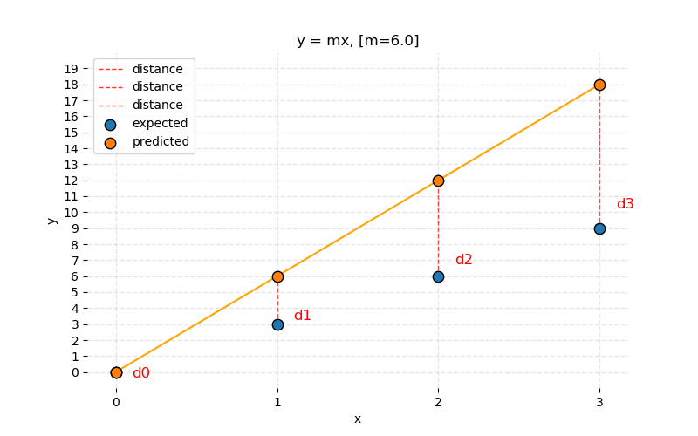
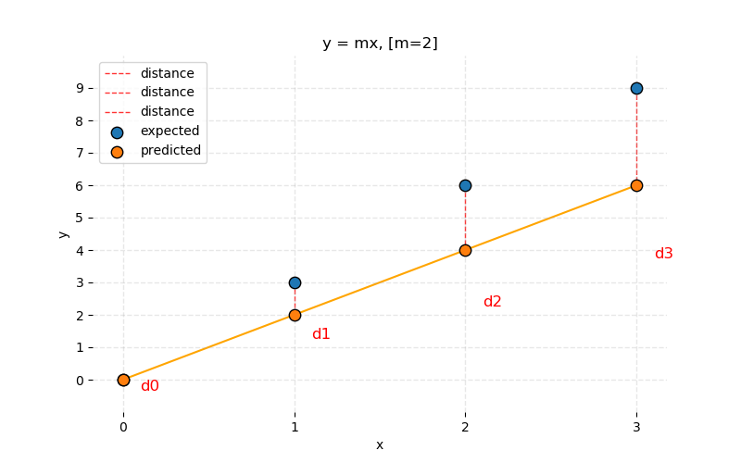
A Performance Measure (Loss function)
Lets take an extremely simple example
We model some data with a straight line through the origin y = mx
We try and find m for data x0 = 0, x1=1, x2 =2, x3 =3 such that y0 = 0, y1 = 3, y2 = 6, y3 = 9
We take an initial guess of m = 6 followed by a guess of m = 2. We see disagreement. How do we express the disagreement mathematically, resulting in a single value? Mean Absolute Error (MAE)?
Lets try Mean Absolute Error (MAE)?
The smaller the value the better! MAE is 1.5 and 4.5 for m = 2 and 6 respectively. Consistent with observations!
The ‘Absolute’ is necessary otherwise you can have negative values or even large positive and negative differences resulting in a small loss

Slide 15
A Performance Measure (Loss function)
What about other Loss functions. For example Mean Squared Error?
Lets compare the Loss between MAE and MSE for data and model in the previous example.
The loss is minimal at m = 3 in both cases which is comforting
MAE the loss contribution is linear compared to the error
MSE the loss contribution from the error is quadratic. Data points with large errors can dominate the loss. Be careful when using MSE if you don’t want modeling of the error tails to dominate
Pick a loss function, that best minimises errors of the data as a whole
One critical condition! The loss function must be differentiable everywhere!

Slide 16
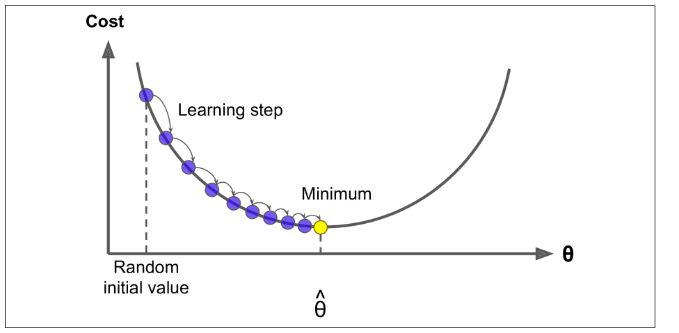
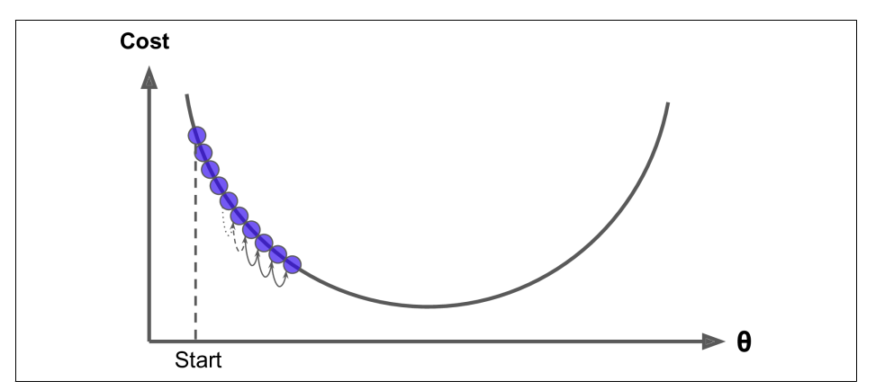
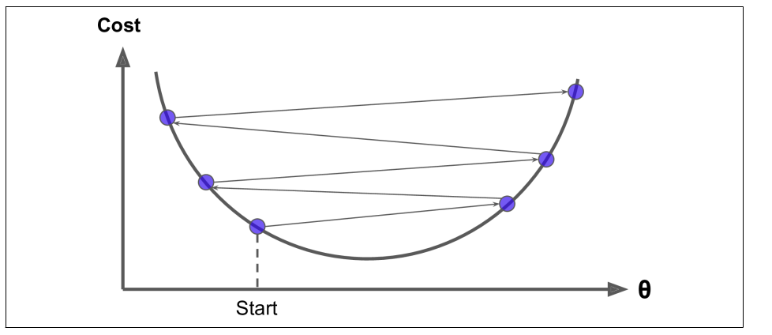
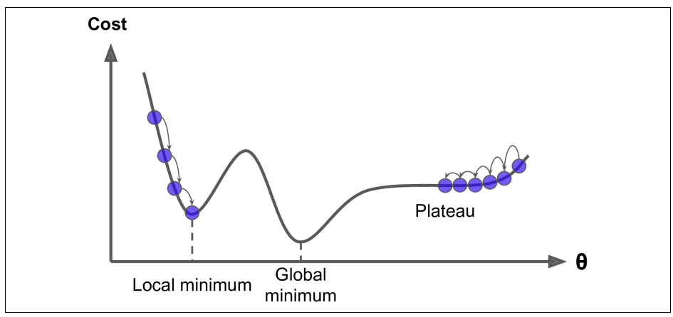
Training
In the previous model we saw that the correct answer for m has the smallest loss. How do we obtain the smallest (minimum) loss
One option is to use Gradient Decent. Take the local loss gradient with respect to the parameter vector (in the previous case m) and step (learning rate) in the direction of the negative gradient. Repeat until the gradient is 0. You are at the minimum, best parameter. Same procedure is followed with a multi parameter space. This is how we train the multiple parameters of a neural net
Things to consider
Learning rate too small. Takes a long time to get to the minimum
Learning rate too large and you will jump around the minimum
Be careful settling at local rather than global minima

Slide 17
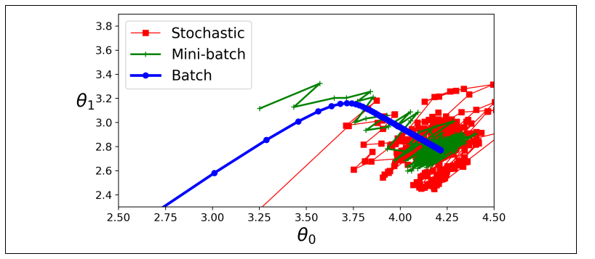
Training
Batch Gradient Decent calculates the partial derivative of the cost function using all the data at each step
For large datasets this is slow but you converge at a more precise minimum
Stochastic Gradient Decent calculates the partial derivative using a random instance at each step
Much quicker but the gradients are more erratic. Once it gets to the minimum it will bounce around with the final value not being optimal
Good for getting out of local minima
Mini batch Gradient Decent calculates the partial derivative based on a small random batch of events.
Fast and reasonable accurate

Slide 18
Neural Networks and Deep Learning

Slide 19
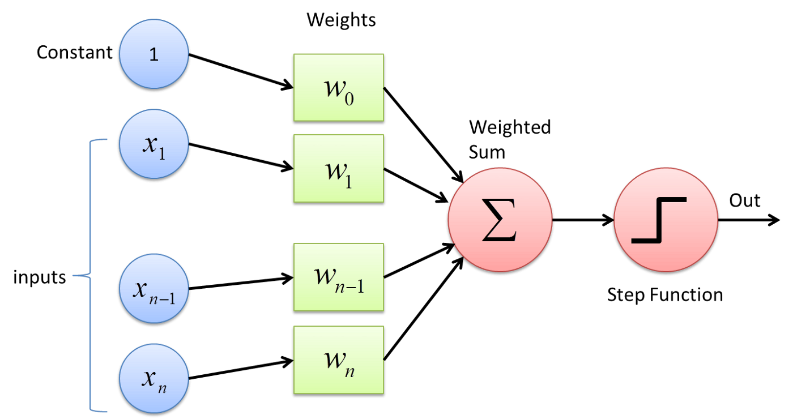
The Perceptron
The Perceptron inspired by the biological neuron is the simplest Artificial Neural Network (ANN)
It consists of
Inputs
Weights and bias
Summed weights
Activation function (Step function)

Slide 20
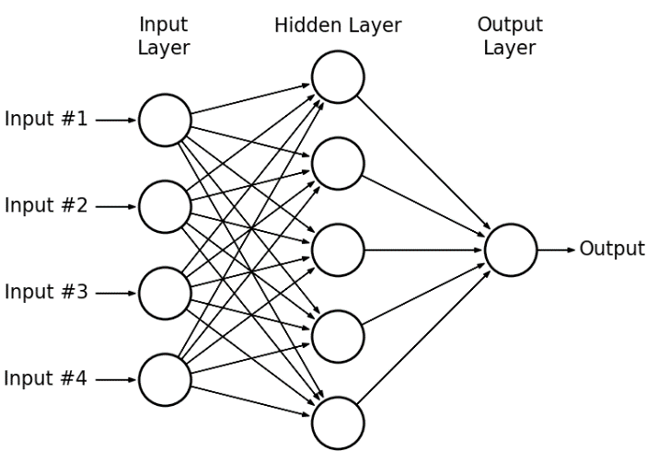
Multi-Layer Perceptron (MLP)
The Perceptron could be used to solve simple problems such as simple linear binary classification
However the Perceptron does struggle with some trivial problems
What about having layers of neurons and stacking them (like in a biological neural network)?
This is a Multi-Layered Perceptron which is more sophisticated than the perceptron
The MLP consists of an input layer, one or more layers of nodes (hidden layer) and an output layer. When a Neural Network consists of many hidden layers it is referred to as a Deep Neural Network (DNN)

Slide 21
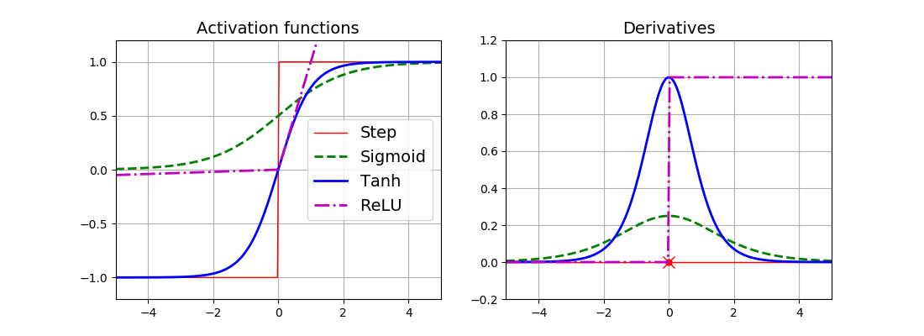
Activation Functions
In order to train an MLP Gradient Decent is used where error calculations are propagated forward through the Neural Net and then back again.
In order to use Gradient Decent the step activation function has to be replaced with something that doesn’t have a zero gradient everywhere. You then have a powerful Neural Network!
Below are some differentiable activation functions used to replace the step function
Classification: Sigmoid and tanh
Regression: ReLU
21
21

Slide 22
Multilayer Perceptron (MLP)
Regression with DNN
Typically use ReLU or Leaky ReLU activation function for the nodes in the hidden layers
One or more outputs depending on the number values you want to estimate
The output node typically doesn’t have an activation function so the output is free to output any range. You can use activation functions on the output if you want to restrict the output value

Slide 23
Multilayer Perceptron (MLP)
Classification with DNN
The output node typically uses a sigmoid/logistic activation function constraining the output to a range between 0 and 1 which can be interpreted as a probability.
Can have multiple output nodes for multi classification tasks

Slide 24
Black Box Myth
One of the criticisms of Neural Nets is that they are a black box. “We have no idea what they are doing inside”
This of course is not true
They can be complex, but complexity is not obscurity!
Equation for a classification NN with one layer of two nodes and an output
If we so wished we could train this NN and output its weights. Plug the weights into the adjacent equation and use the equation instead. They should behave the same!
$f_{NN}$ = σ($b_{2}$ + $W_{2}\text{σ}$($b_{1}+ W_{1}x$))
Activation (classification): $σ\left(x\right)=\tanh\left(x\right)$, Sigmoid ($1/{1+ e^{−x}}$)
Activation (regression):RELU
Input: $x =\left[\begin{matrix}x_{1,1} \\ x_{2,1}\end{matrix}\right]$
Weight: $W_{1}=\left[\begin{matrix}W_{1[1,1]} & W_{1[1,2]} \\ W_{1[2,1]} & W_{1[2,1]}\end{matrix}\right]$
Bias: $b_{1}$ = $\left[\begin{matrix}b_{1[1,1]} \\ b_{1[2,1]}\end{matrix}\right]$
$${f_{NN}=σ}_{2}\left(b_{2[1,1]}+ \left[\begin{matrix}W_{2[1,1]} & W_{2\left[1,2\right]}\end{matrix}\right]σ_{1}\left(\left[\begin{matrix}b_{1[1,1]} \\ b_{1[2,1]}\end{matrix}\right]\text{+}\left[\begin{matrix}W_{1[1,1]} & W_{1[1,2]} \\ W_{1[2,1]} & W_{1[2,2]}\end{matrix}\right]\left[\begin{matrix}x_{1,1} \\ x_{2,1}\end{matrix}\right]\right)\right)$$

Slide 25
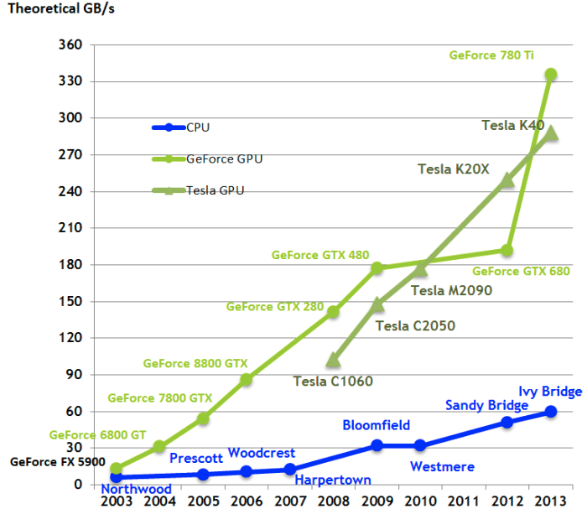
GPU v CPU
Arithmetic Logic Unit (ALU)
Small number of compute cores
MIMD (Multiple Instruction Multiple Data)
Optimised for serial operations
Low latency
Large number of compute cores
SIMD (Single Instruction Multiple Data)
Built for parallel operations
High throughput
Let’s look at an MLP to demonstrate the high throughput of a GPU!

Slide 26
GPU v CPU
Consider this output layer of the neural net
Output is a vector calculated from the matrix equation on the LHS
Each element of the vector can be calculated on a computing core
In this simple case this can be done easily on a CPU
However repeating this process sequentially over many data points is very slow on a CPU
Because we want to run the same instruction, it is much faster to run in parallel on the many GPU cores

Slide 27
Some Training Problems
Vanishing/Exploding Gradients
When training calculated gradients can get smaller and smaller so the movement across the loss function and the training doesn’t converge. This is the vanishing gradients problem
In some cases the opposite can happen and the gradient can get so large and the algorithm diverges. This is the exploding gradients problem
Vanishing/Exploding Gradient aids
The weight initialisation (normal, mean 0, sigma of 1) was seen to be a problem. Variance of weights keeps increasing from layer to layer until the activation saturates at the top layers. Different initialisations are used with specific activation functions to help with the problem
Batch Normalisation, before or after the activation function, inputs are zero centred and normalised, then scaled and shifted
Choice of activation function. Activation functions that saturate with 0 derivatives can cause problems. Use alternative activation functions with this in mind such as Leaky ReLU instead of ReLU

Slide 28
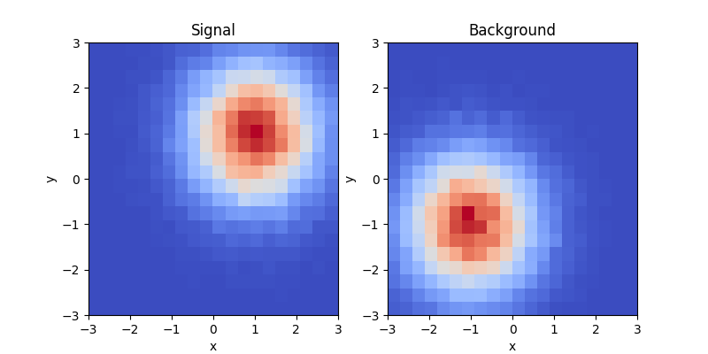
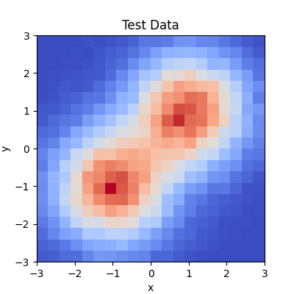
Simple DNN Classification example
Generate a data sample with two categories (we will walk through this in the tutorial)
Signal: Gaussian distributed with a mean x,y value of 1 and sigma of 1. Label events 1
Background: Gaussian distributed with a mean x,y value of -1 and sigma of 1. Label events 0
Build a DNN
2 inputs (x,y)
1 hidden layer of 100 nodes. ReLU activation for each node
1 output (1,0), signal or background. Sigmoid activation at node
Train DNN
Run over data sample. Batch gradient decent 100 epochs
Test!
Use trained DNN on a new data sample of signal and background. Can identify correct label 92% of the time

Slide 29
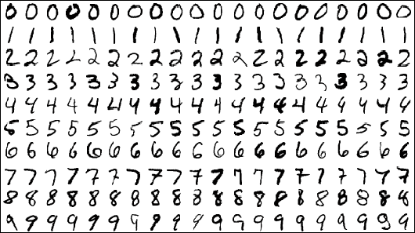
Classification with the MNIST Dataset
The MNIST (Modified National Institute of Standard and Technology ) database is a large database of handwritten digits that is commonly used for training various image processing systems
Even though these are images we can still train a DNN to be able to identify them (tutorial walkthrough)
Each image is 28x28 pixels so we just assign an input for each pixel
For example we can construct a DNN as follows
Number of inputs = 28 x 28
Two hidden layers; 1st hidden layer = 300 nodes, 2nd = 100 nodes
Ten outputs (one for each number), sigmoid activation function
With a training sample of 44000 events running over a large test sample the DNN has an accuracy > 90%
Not bad! But we can do better!

Slide 30
Deep v Wide Neural Nets
A Neural Net with just a single hidden layer can model complex functions as long as you have enough neurons in a layer
However for really complex functions deep networks have a higher parameter efficiency
For the same number of parameters, deeper networks are more powerful
Prefer deeper rather than wider NNs!

Slide 31
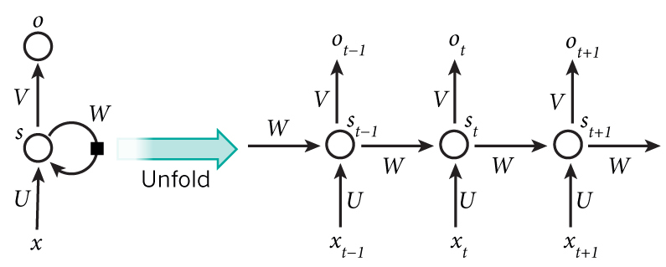
Recurrent Neural Nets (RNNs)
In a MLP the operations flow in a forward direction, from input to output
A Recurrent Neural Net (RNN) looks the same but also has connections that feed back from the output to the input
Lets look at a simple RNN composed of one neuron
At each time step (also called a frame) the neuron receives the inputs as well as the inputs from the previous step. Obviously there is no previous step initially
The above image shows the RNN unfolded through time
We have a network where each data output is related to the previous input
We have some information/memory of the past output

Slide 32
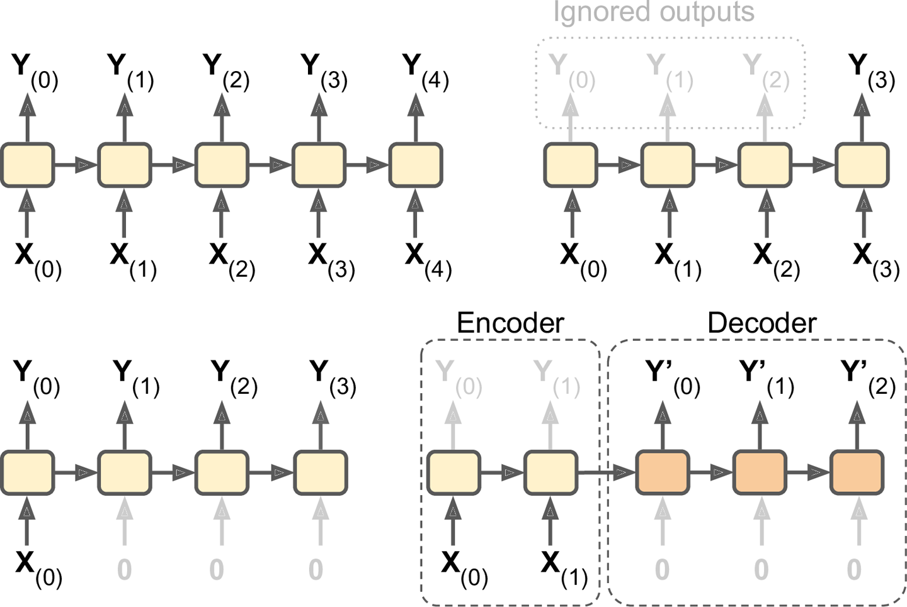
Input Output Sequences
A RNN can take a sequence of inputs and produce a sequence of outputs. This is known as a sequence-to-sequence network (top left). Useful for predicting time series such as stock prices
Can feed in a sequence and ignore all outputs except the last one. This is a sequence-to vector network (top right). For example a book review. Was it a good or bad review
Conversely you can input a vector and output a sequence (bottom left). This can be an image that is input and the output is a caption
Also you can have a sequence-to-vector network followed by a vector-to-sequence network (bottom left). An example of this is translating one language to another. This is an Encoder-Decoder

Slide 33
Recurrent Neural Networks
Lets use an RNN to look at previous outputs to predict the next output
Generate a batch of time series data using the equation
x(t) = 0.5 * sin((t - a) * (p * 10 + 10)) # wave 1
+ 0.2 * np.sin((t - b) * (q * 20 + 20)) # wave 2
+ 0.1 * (r – 0.5) # noise
The parameters, a,b,p,q and r are constants randomly set between 0 and 1 for each time series
Consequently each time series looks different
Lets take a look at a few samples

Slide 34
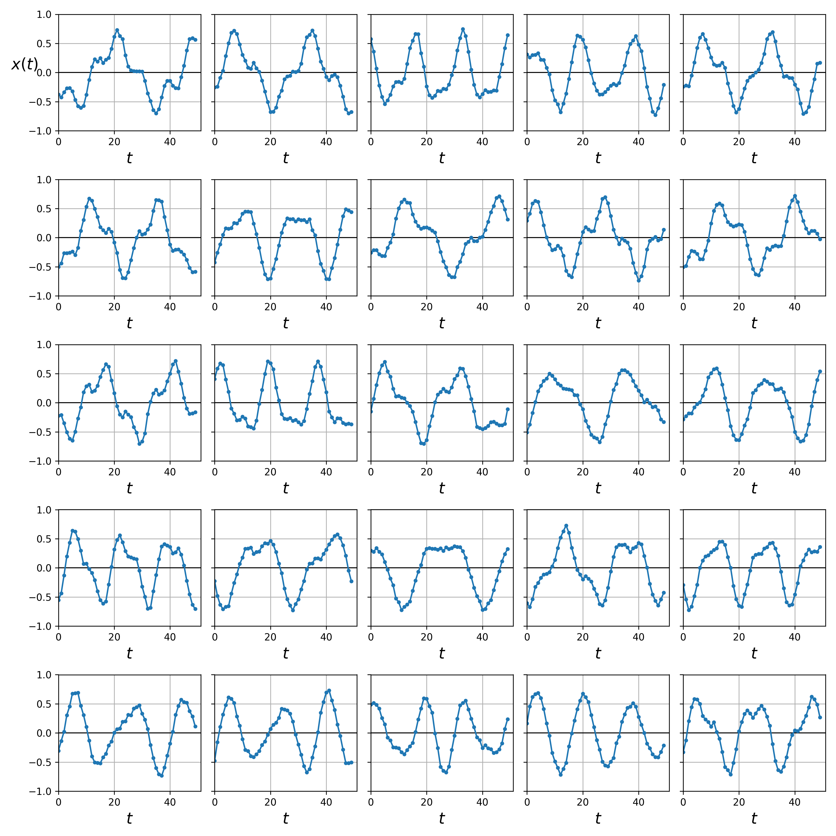
Recurrent Neural Networks
Each of the 25 time series is generated by the equation on the previous page
We generate thousands of these series to train the RNN
Can we model this series with an RNN?
(tutorial walkthrough)

Slide 35
Recurrent Neural Networks
Data is a series of 50 points. Lets use an RNN to predict the next data point (51st). We have training data with the 51st point. Lets use the training data to train an RNN using the 50 data points against the 51st. This is a vector-to-vector network
We can construct an RNN that looks like:
One input (x(t))
2 layers, each with 20 nodes
One output (x(t+1))
Whilst the RNN has an output at each point we only train against the last output. That is what we are interested in!

Slide 36
Recurrent Neural Networks
Lets take 3 previously unseen time series and predict the 51st data point
Looks good
We can’t rely on looks alone. We compare the loss along with other test for many test samples

Slide 37
Recurrent Neural Networks
Ok, what about predicting the next 10 points
We can construct an RNN that looks like:
One input (x(t))
2 layers, each with 20 nodes
Ten outputs (x(t+1), x(t+2), ….., x(t+10))
We train against outputs 51 to 60 . That is what we are interested in!

Slide 38
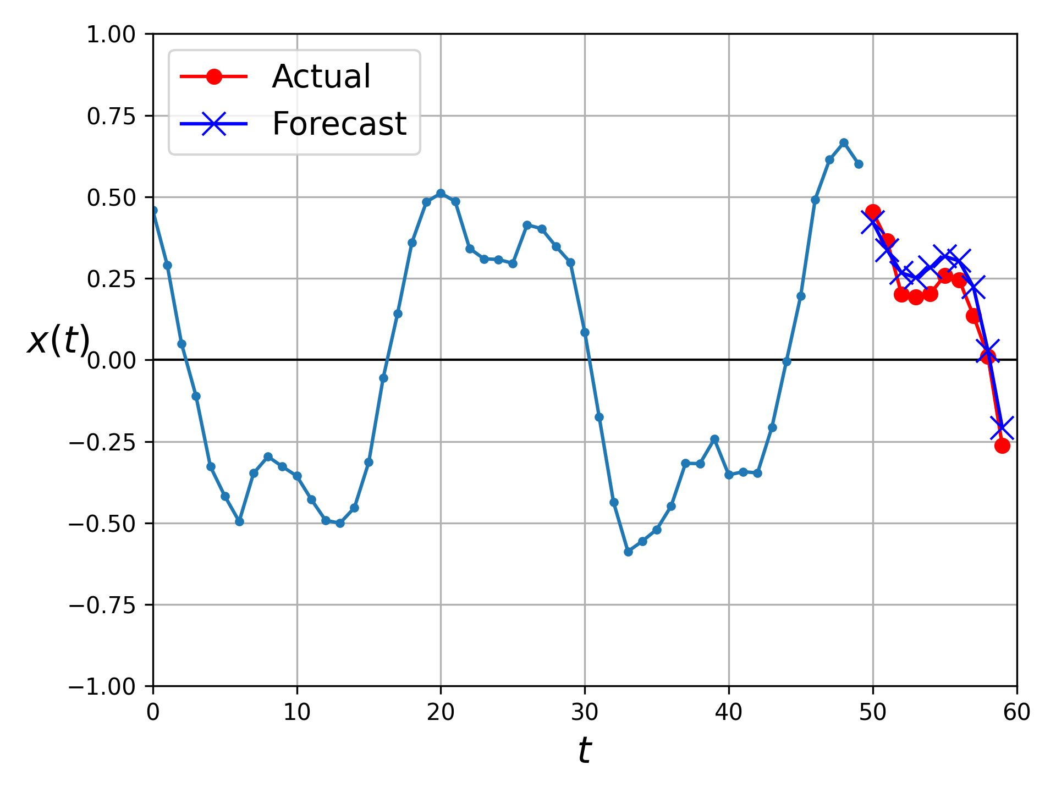
Recurrent Neural Networks
Lets look at a time series from our test data and predict the 51st to 60th data points
Looks good

Slide 39
Recurrent Neural Networks
We can do better! Rather than training to predict the next 10 steps at the very last step we can train the model to predict the next 10 steps after every step. This is then a sequence-to-vector network
There is more information and we should see a more accurate prediction
Lets not worry about the implementation here. Just note we now look at all steps and train against the next 10 values
Lets look at the results

Slide 40
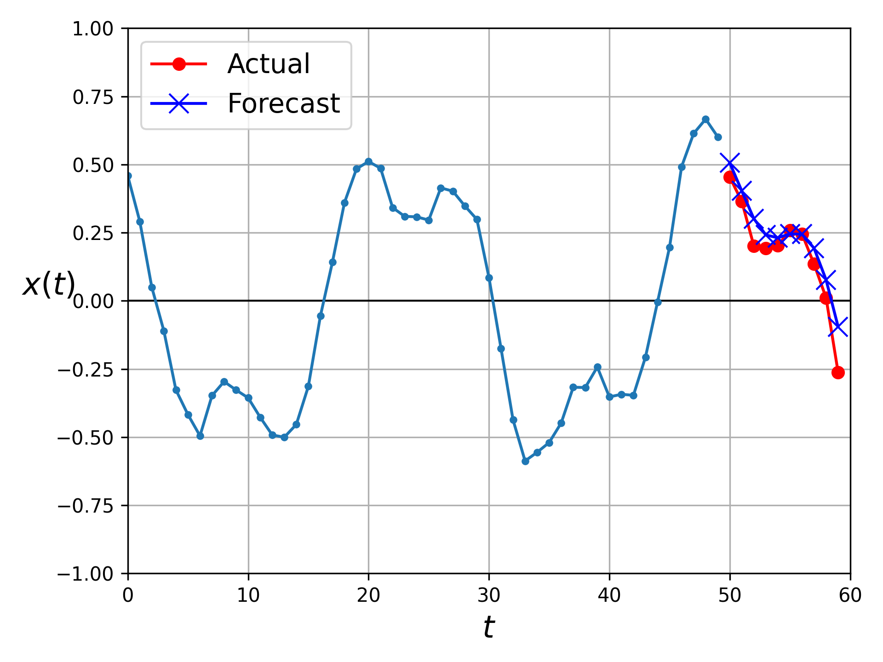
Recurrent Neural Networks
Look at the test time series again and predict the 51st to 60th data points
You can see this looks better and trust me so is the loss!

Slide 41
Recurrent Neural Networks
RNNs are great for learning patterns and making predictions
Time series, NPL (talk about this another time) ...
Even though they are not designed for this RNNs are also used for training against data that varies in size (number of steps)
However for really long data series the RNN forgets about the early input by the end and breaks down
Don’t have time here but rather than simple RNN cells discussed here one can use memory cells such as Long Short-Term Memory (LSTM) cell and Gated Recurrent Unit (GRU) cell to prevent the break down
Convolutional layers can also be used to to improve the long term memory

Slide 42
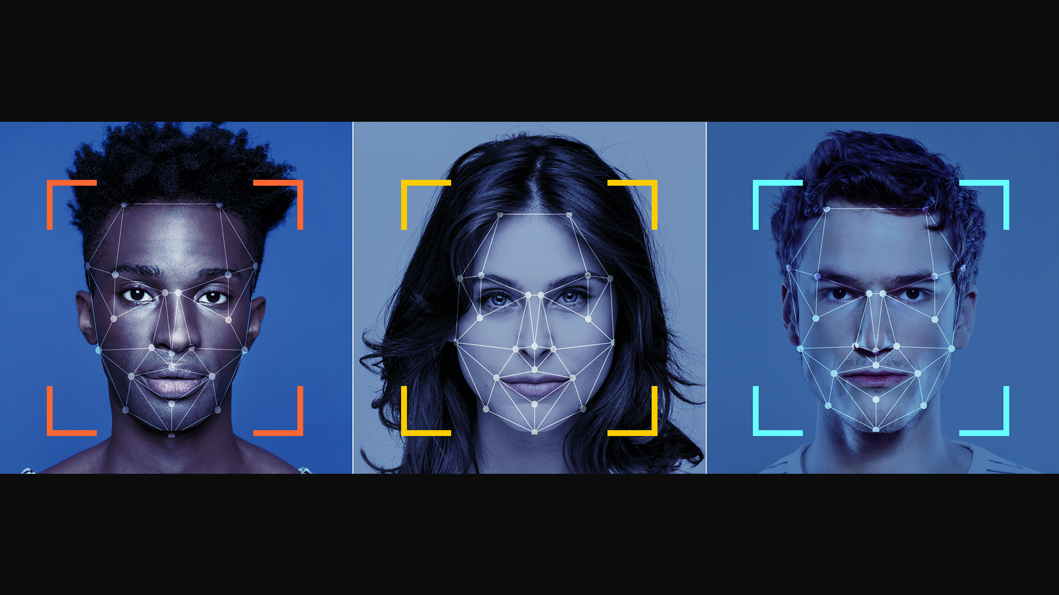
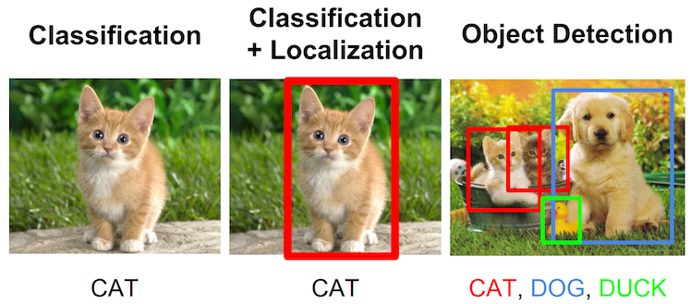
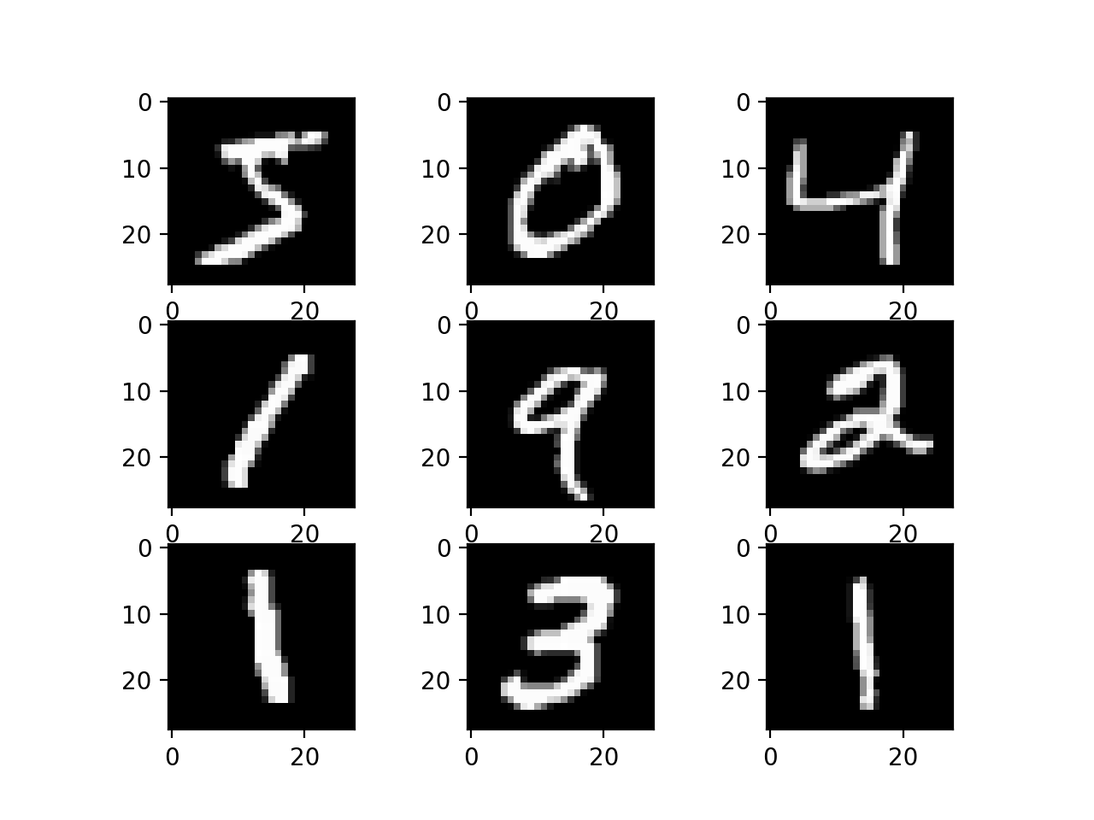
Convolutional Neural Nets
A Convolutional Neural Net is a class of Neural Network mainly applied to analysing visual images
We may be familiar with their use with
Face recognition
Object detection
Identifying numbers/text in images

Slide 43
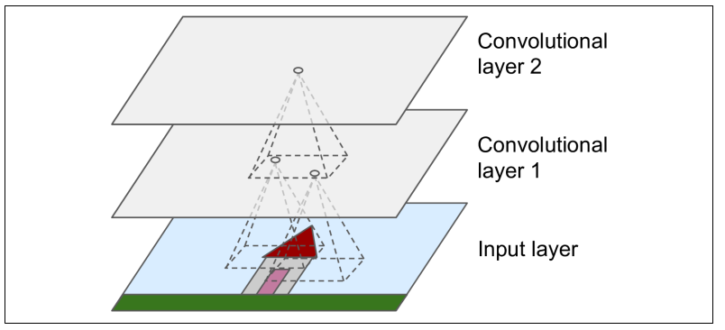
Convolutional Neural Nets
How do CNNs work?
An n dimension filter (n=2 for the image above) scans across your data/image taking the product. The output forms the first convolutional layer. This process is repeated with different filters on the first convolutional layer to output a second convolutional layer. We can proceed producing as many convolutional layers as we see fit
What is the point of this?
Reducing the model’s complexity

Slide 44
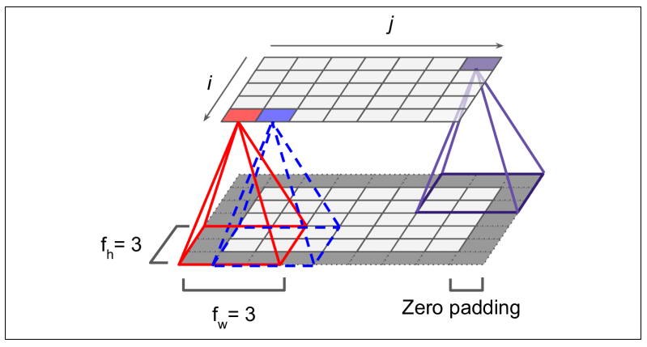
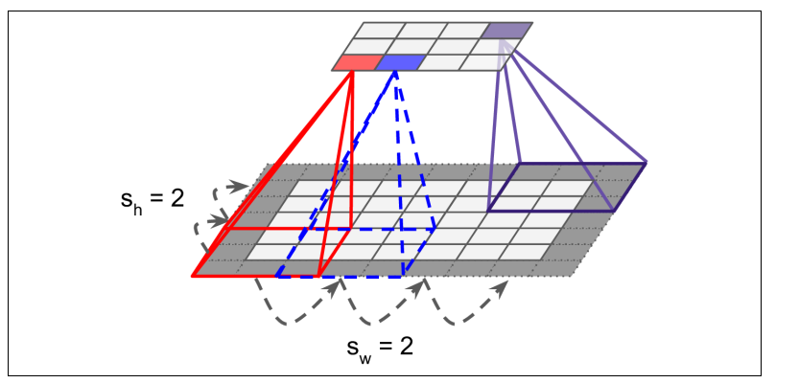
Filters
How do filters work?
Converting low level feature into higher level features
Smaller filter is a larger approximation of the data
With zero padding (adding zeros around the layer) and a step size of 1 the next convolutional layer will same size. Without zero padding the next convolutional layer is reduced in size
You can also specify the step size (stride) of the scan. Increasing the step size will reduce the size the next convolutional layer
The filters are the weights and the contents of the convolutional layers are referred to as the neurons. Unlike in a MLP you have a set of weights (filter) that is applied to all neurons in the layer. The filter values are set during training
You can work with a less weights compared to a MLP

Slide 45
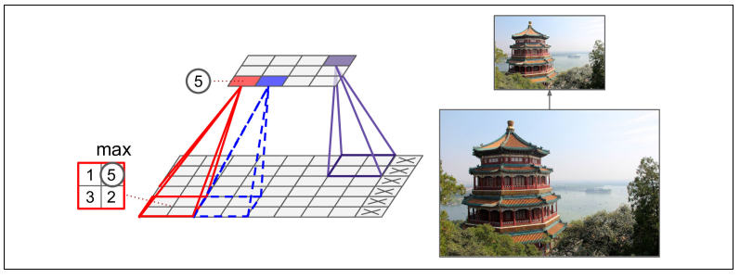
Pooling
You can reduce the load even further by pooling
This reduces the computational load, memory usage
The principle is the same as a filter. You specify a field and scan over the layer applying pooling and output the result to another layer
There no weights for pooling. For example you have:
Max pooling: Output the maximum value
Ave pool: Output the average value
Max pooling example

Slide 46
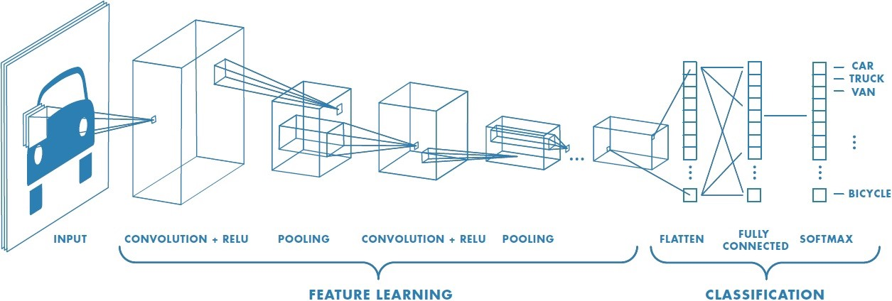
CNNs Putting it all together
The last layer is then fed to a MLP and trained on data where the output can be used for regression or classification
Apply filters to the RGB components of the image to produce the 1st convolutional layer
Apply pooling to the 1st convolutional layer to reduce the layer size
Apply filters to the pooling output to produce the 2nd convolutional layer
Apply pooling and then feed the output to a DNN with outputs for classification

Slide 47
Classification with the MNIST Dataset
Lets look at the MNIST database again (tutorial walkthrough)
This time we will feed the images to a convolutional net that looks like:
Two convolutional layers of 32 and 64 feature maps respectively
Max pooling of the 2nd layer with a field size of 2x2
The pooling output is fed to a MLP hidden layer with 64 nodes with relu activation
The output has ten nodes with a logistic activation function
A reasonable straightforward CNN!
After training and testing this simple CNN has an accuracy of 99%

Slide 48
Convolutional Layers
Seen many of the components of a CNN before: deep neural nets and their activation functions.
The most important building block is the convolutional layer
Neurons in the first convolutional layer are not connected to every single pixel in the input image but only connected to the receptive field (filter). Unlike when compared to a DNN. Results in less weights!
In return each neuron in the second convolutional layer is connected only to neurons in the receptive field of the first layer
This architecture allow low level features in the input to be built into successively higher level features as you add convolutional layers

Slide 49
Summary
Machine Learning is a huge, expanding, exciting field
Lots of other exciting topics, Decision trees, Support Vector Machines, Autoencoders, Graph Neural Networks …..
Using Machine Learning we can build some powerful models for regression and classification
We looked at different methods (MLP, RNN, CNN) to perform classification and regression tasks
Machine Learning is having a large impact on our lives today and I don’t think it is going anywhere soon!

