Slide 1
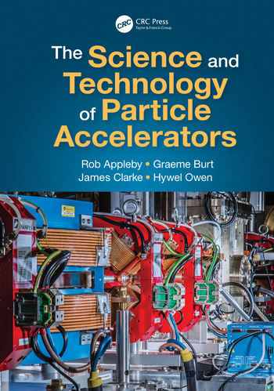
CI-ACC-101.1
Particle Accelerators – History and Principles
‘Particle accelerators are built for the sole purpose of endowing nuclear particles with large quantities of kinetic energy’ – John Livingood
Hywel Owen, UKRI-STFC-ASTEC-AP
Accelerator Science and Technology Centre
hywel.owen@stfc.ac.uk, @hywelowen
11th October 2021
Cockcroft Institute Lecture Series

Slide 2
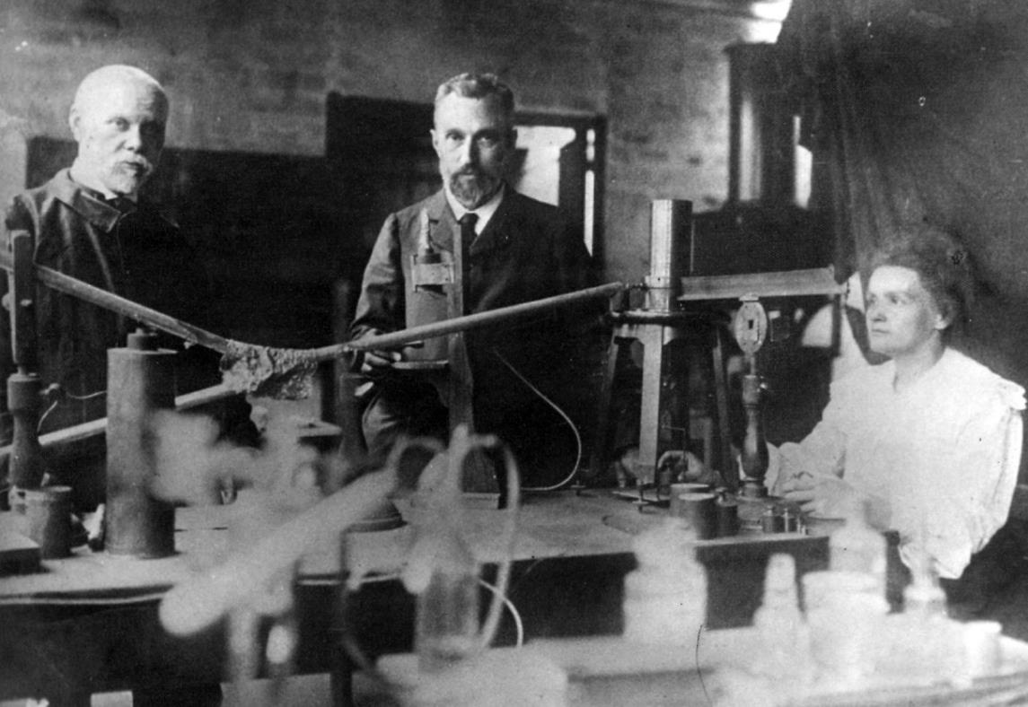
Radioactivity: Becquerel + 2 Curies

Slide 3
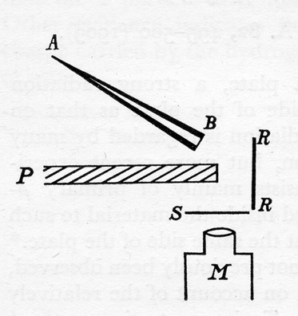
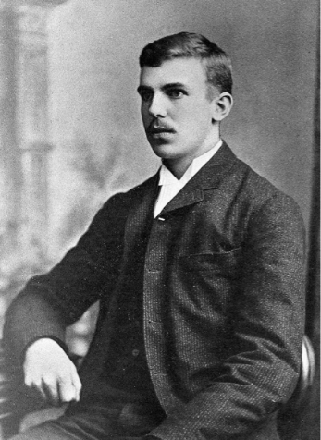
Splitting the atom - Manchester
“it has long been my ambition to have available for study a copious supply of atoms and electrons which have an individual energy far transcending that of the alpha- and beta-particles from radioactive bodies”

Slide 4
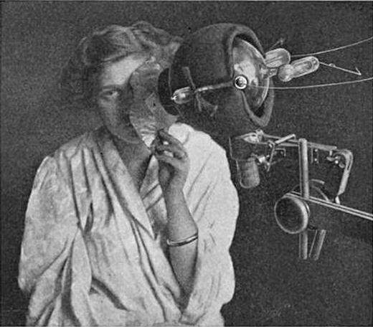
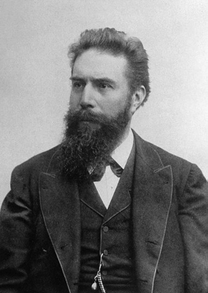
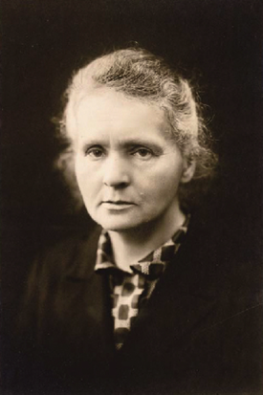
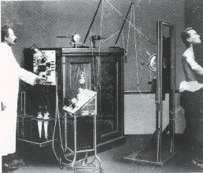
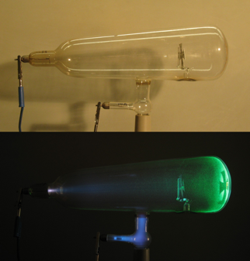
A little history…
Very quickly after Roentgen’s discovery of X-rays and Marie Curie’s discovery of radioactivity, they were both being used to treat disease, including cancer

Slide 5
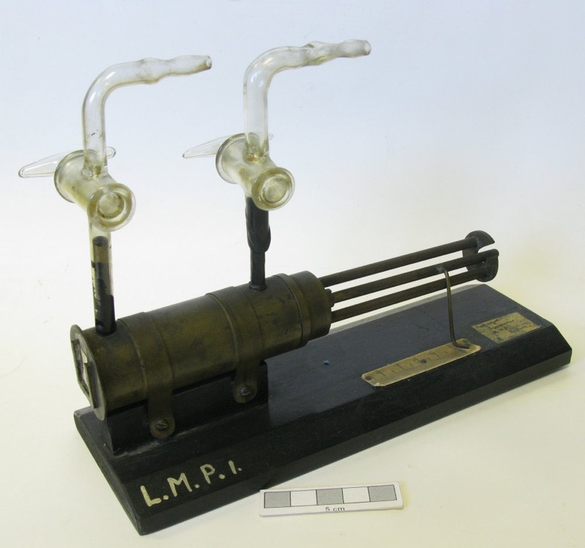
Rutherford and Chadwick’s Apparatus

Slide 6
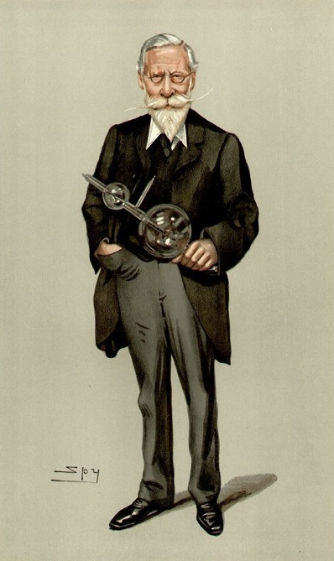
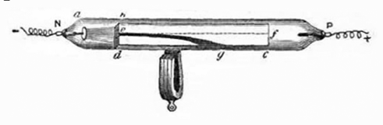

William Crookes

Slide 7
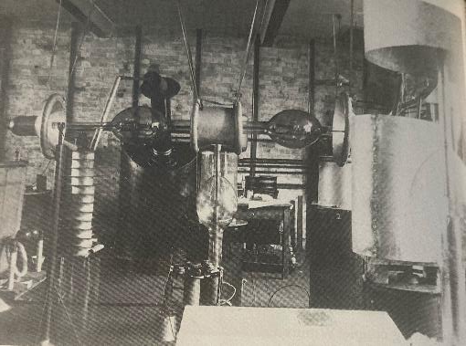
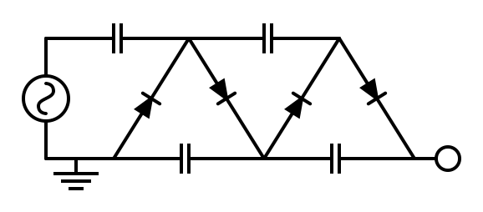
Walton, Rutherford, Cockcroft
In 1928, George Gamow proposed that alpha particles could tunnel through the nuclear energy barrier. John Cockcroft saw Gamow give a lecture in January 1929 at the Cavendish laboratory (Cambridge), and realised that voltages of only a few hundred keV could deliver nuclear transmutations, rather than the many MeV they previously thought was needed.
Rutherford agreed with Cockcroft’s calculations, and convinced Walton to abandon his linear accelerator idea. Using a £1000 university grant they bought a 300 kV transformer which they then rectified to DC. A small beam of low-energy protons was then accelerated downwards to 280 keV and into some light targets (Li and Be). However, this didn’t work.
Cockcroft invented a voltage multiplier to obtain up to 700 keV, which was enough. The atom was split, making alpha particles that Walton observed while sitting in the lower observation cabin.

Slide 8
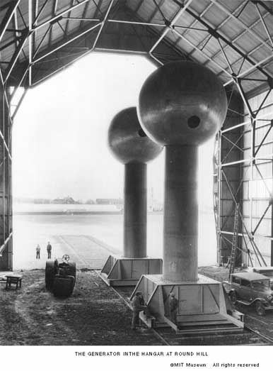
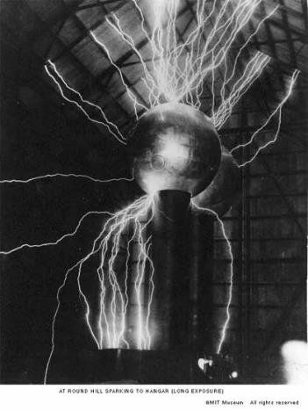
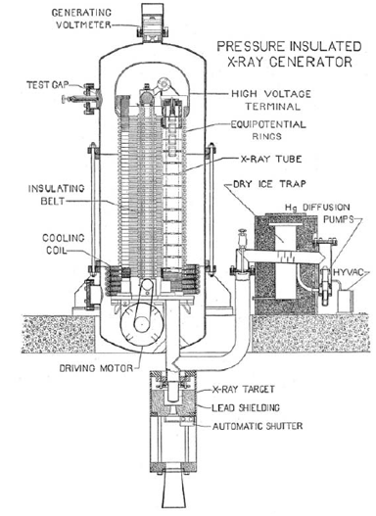
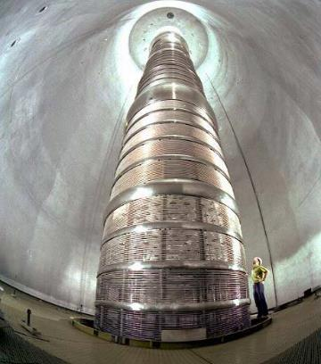
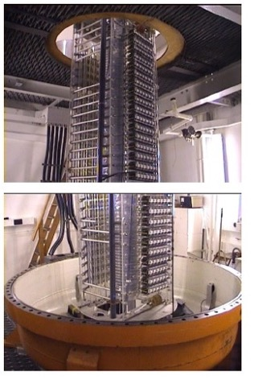
DC Acceleration
Cockcroft-Walton
Li + p → He + He
Robert Van de Graaff’s Patent
MIT Round Hill Van de Graaff
Birmingham dynamitron
3 MeV, 1 mA protons
ORNL Tandem VdG

Slide 9
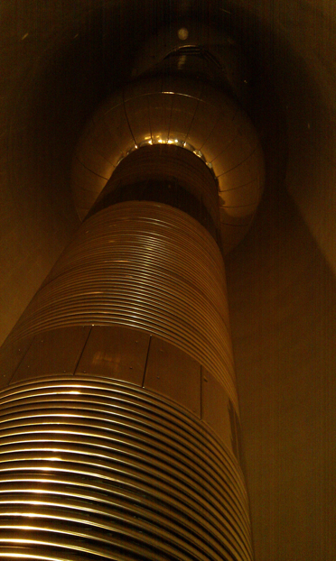
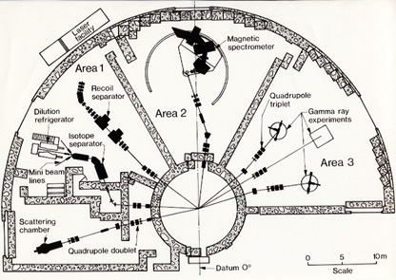
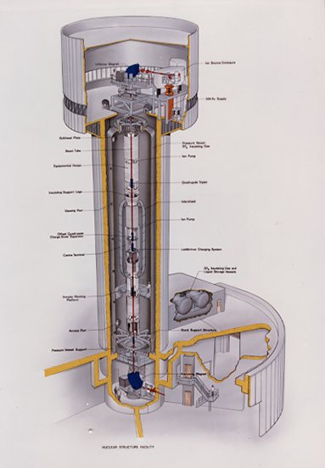
Daresbury VdG
NSF: 20 MV Van de Graaff

Slide 10
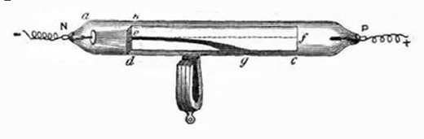
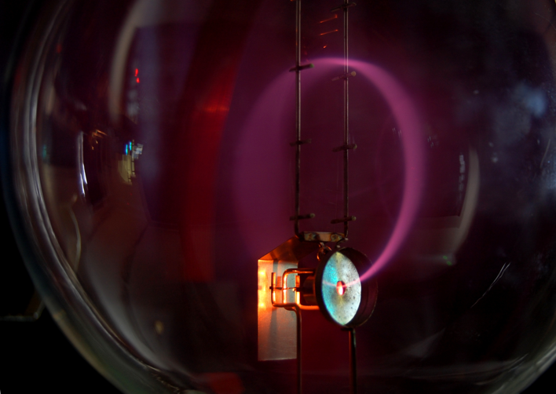

Lorentz Force – the fundamental equation for accelerators

Slide 11
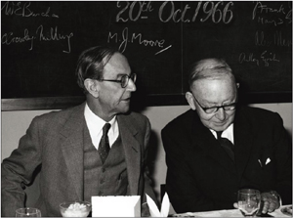
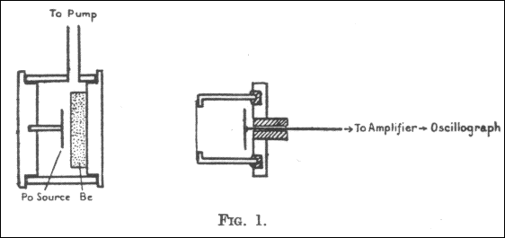
Chadwick apparatus – discovery of the neutron
Chadwick and Cockcroft,
At Daresbury 20th Oct 1966

Slide 12
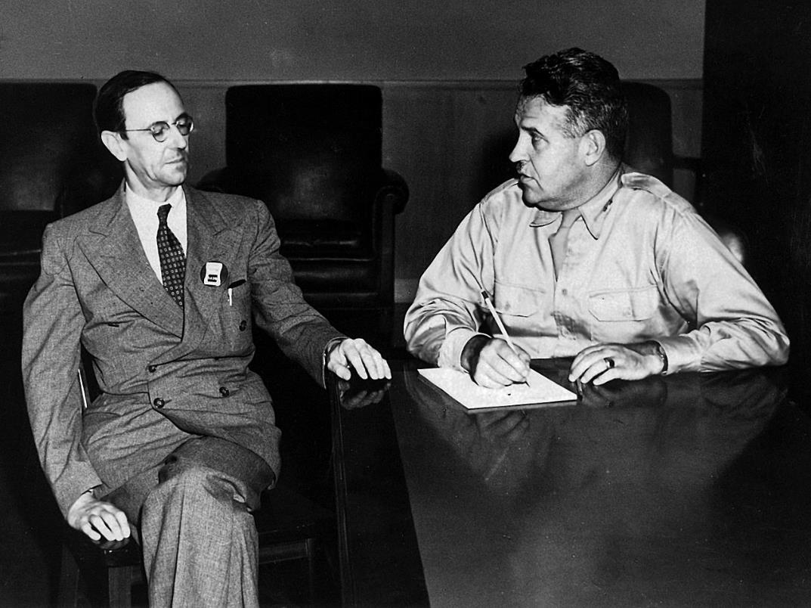
James Chadwick and Leslie Groves

Slide 13
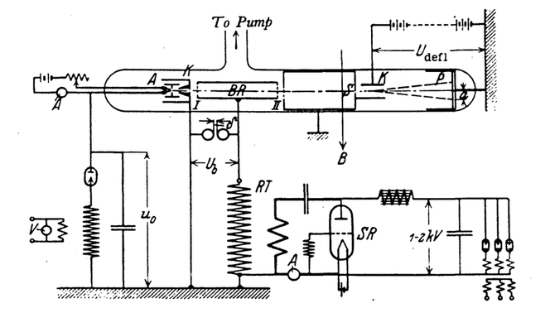
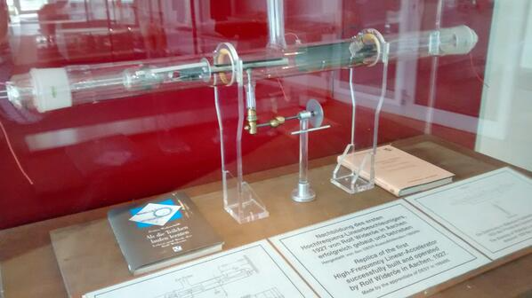
Rolf Wideroe’s Linac
Replica of original linac, at National Physical Laboratory

Slide 14
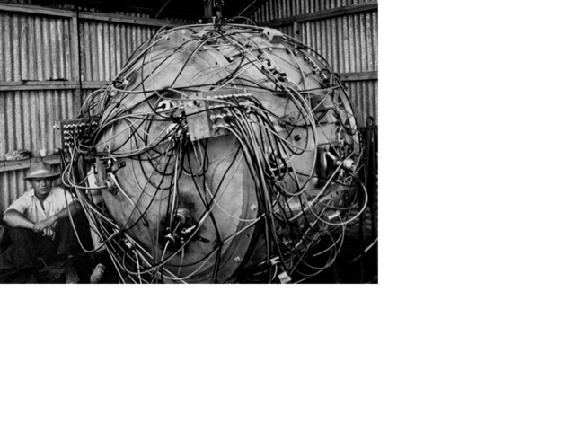
Louis Alvarez

Slide 15
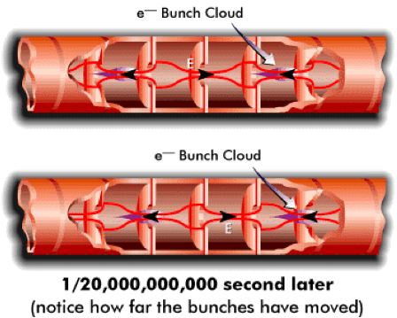
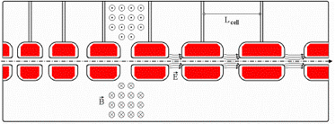
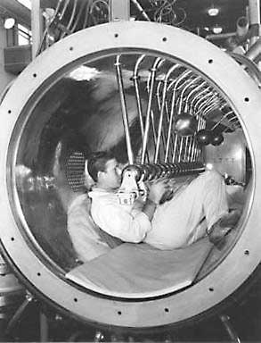
Alvarez structure
(with drift tubes)

Slide 16
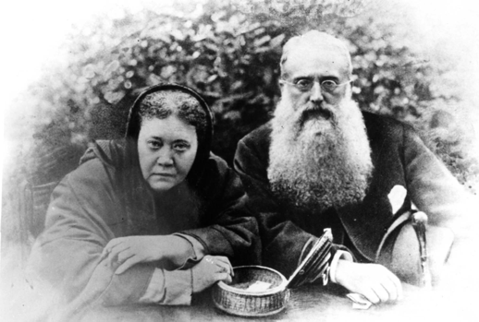
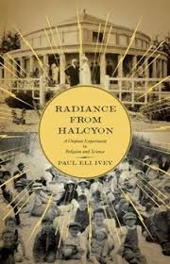
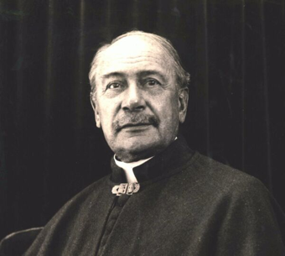
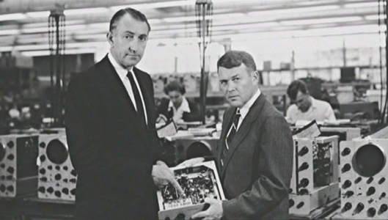
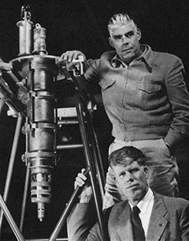
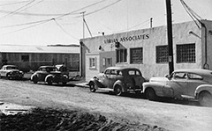
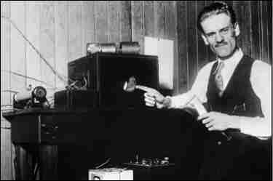
Radiance from Halcyon
1937

Slide 17
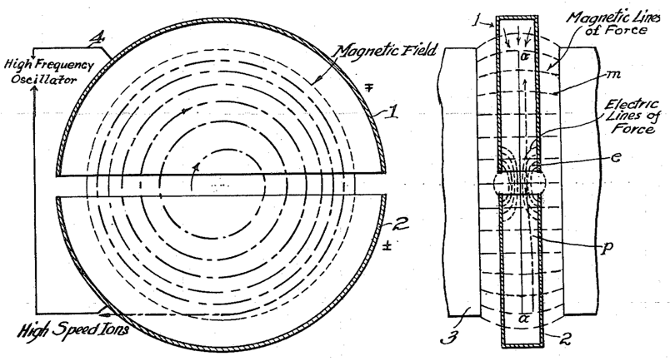

Round and round we go... Cyclotrons (protons)
Ernest O. Lawrence,
Milton Livingston
‘Lawrence got his Nobel Prize. I just got a PhD.’
(but in 8 months)

Slide 18
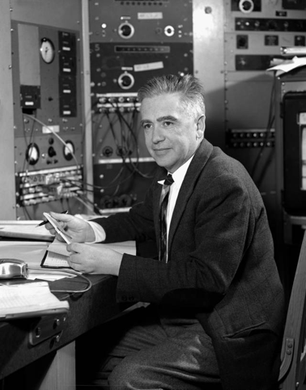
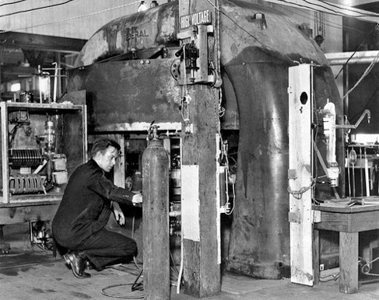
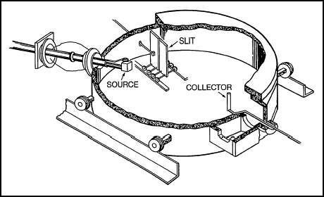
Emilio Segrè and the 37-inch cyclotron deflector foil
‘In February 1937 I received a letter from Lawrence containing more radioactive stuff. In particular, it contained a molybdenum foil that had been part of the cyclotron's deflector. I suspected at once that it might contain element 43. The simple reason was that deuteron bombardment of molybdenum should give isotopes of element 43 through well-established nuclear reactions. My sample, the molybdenum deflector lip, had certainly been intensely bombarded with deuterons, and I noted that one of its faces was much more radioactive than the other. I then dissolved only the material of the active face, in this way achieving a first important concentration of the activity. ‘

Slide 19
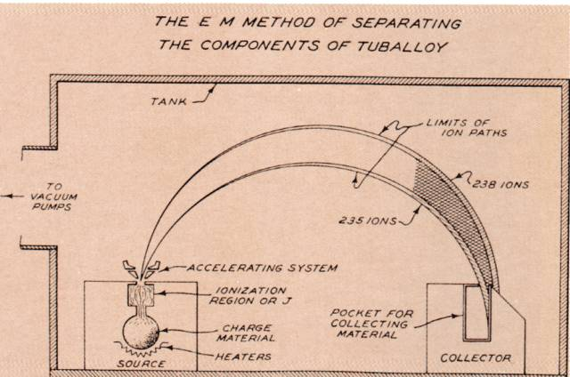

Slide 21
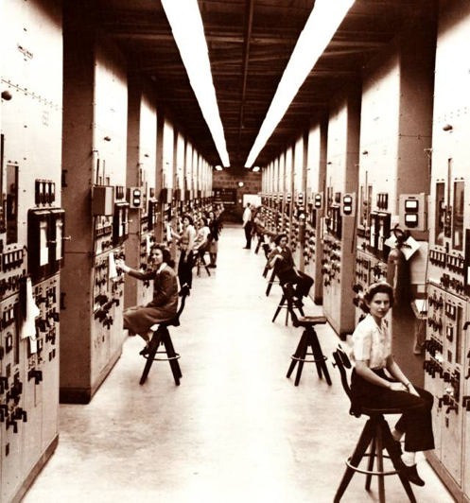
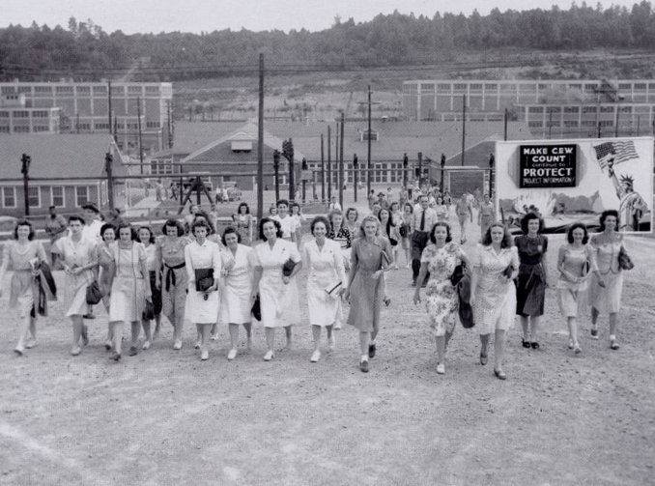

Slide 22
Glow from the 11-inch cyclotron

Slide 23
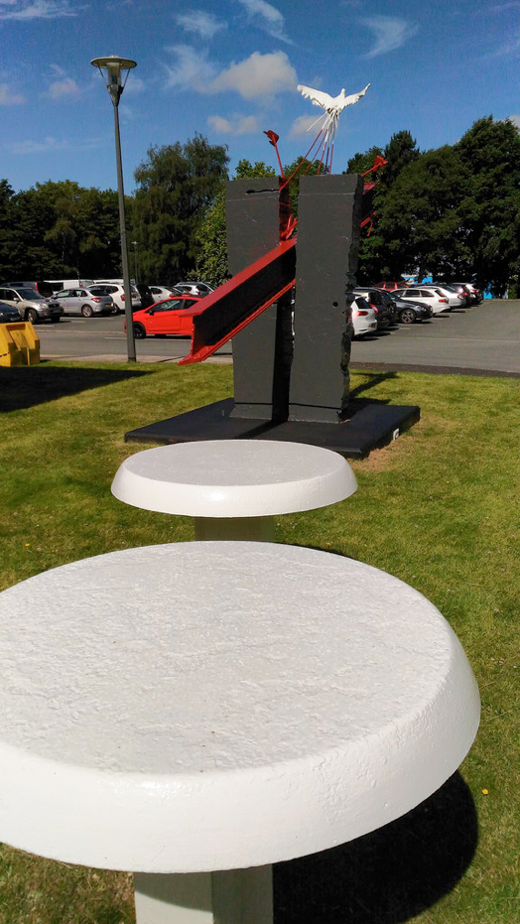
Arthur Dooley: ‘Splitting the Atom’ (1974)
Liverpool 37” cyclotron, 20 MeV, 1939

Slide 24
60-inch cyclotron
20 MeV, 1939

Slide 25
By 1948 they were already getting quite large…

Slide 26
’Big Science’ and Ernest Lawrence
LANL
LLNL
LBNL
Oak Ridge (calutron)

Slide 27
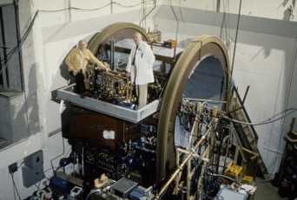
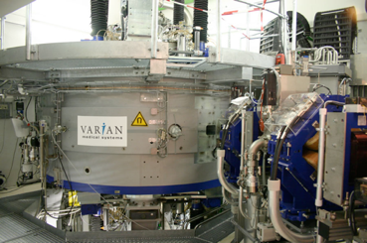
Henry Blosser – Superconducting Cyclotrons

Slide 28

The Betatron (electrons)
2 MeV betatron, Donald Kerst
Slepian, 1922
Wideroe, 1928
Kerst, 1940
22 MeV betatron

Slide 29



Electron Betatrons...

Slide 30
Electron FFAG, with Chandrasekhar and Bohr
Kerst proposed in 1956 to have colliding beams

Slide 31

The earliest synchrotrons
Goward & Barnes’s original e- synchrotron
(converted from betatron)
Woolwich Arsenal, London, 1946

Slide 32
Bill Hansen and the 1 MeV Linac, 1947 (6 MeV)
Proposed the cavity resonator for acceleration
(beware of beryllium)

Slide 33


Harry Kaplan
Radiotherapy pioneer
Gordon Isaacs, 1957
The first external-beam radiotherapy patient

Slide 34




Phase stability
Veksler
Cockcroft
Ed McMillan
Vladimir Veksler
Marcus Oliphant
Synchrophasotron, Dubna, 1957
First planned proton synchrotron
1.3 GeV Birmingham, 1953

Slide 35

Glasgow 350 MeV e- Synchrotron – 1st in Europe (1954)

Slide 36

Synchrophasotron control room, Dubna

Slide 37
Cosmotron – first GeV proton accelerator, 1953 (3 GeV)
Also, 1st extracted beam

Slide 38


The Bevatron (6 GeV): a Large Weak-Focusing Synchrotron (1954)
(Ed McMillan on the left)
Discovered the antiproton (Chamberlain, 1955)

Slide 39
NIMROD (RAL, UK): p+, 7 GeV, 1960

Slide 40

Before Daresbury, 1964

Slide 41




You are here… (thanks to Cockcroft)
(founding of Daresbury Laboratory, 1964)

Slide 42

NINA at Daresbury Laboratory; e-, 5 GeV, 1966

Slide 43


The founding of Daresbury

Slide 44

Strong Focusing
Ernest Courant, Milton Livingston, Hartland Snyder, John Blewett

Slide 45




Nick Christofilos, and Particles in Space
Starfish Prime (1.4 MT) a.k.a. the ‘Rainbow Bomb’
- knocked out Ariel 1, the first British satellite, and Telstar 1, the first TV satellite
..turning the Earth into a giant particle accelerator, to knock out incoming nuclear weapons
Artificial ‘Beta injection’ into inner radiation belt; particles remained trapped for 5 years!

Slide 46
Digging the first foundations for CERN, May 1954

Slide 47


Slide 48

ADA – the first electron storage ring

Slide 49

Storage Ring Colliders (1963)
Gerard O’Neill

Slide 50

Gersh Budker
Invented electron cooling
Founded INP Novosibirsk
with Boris Chirikov

Slide 51


Stochastic Cooling; Simon van der Meer (1970s)

Slide 52


The General Electric Synchrotron
‘If the accelerator tube of the 100-MeV betatron at Schenectady had not been opaque, the visual observation would probably have been made three years earlier by Westendorp or Blewett soon after the publication of your letter to the Physical Review (Phys. Rev. 65:343, 1944). Unfortunately they were not able to see through the silvered wall of the betatron donut.’

Slide 53



Goward’s original synchrotron
(converted from betatron)
Woolwich Arsenal, London
The DIAMOND synchrotron: 561.6m, 3 GeV electrons
(RAL, Oxfordshire)
Designed here at Daresbury!

Slide 54

Julian Schwinger and Matthew Sands
‘My laboratory is my ballpoint pen’

Slide 55




The first X-ray beamline – Daresbury, 1970s
The original synchrotron radiation gang
First X-Ray Beamline on NINA
SRS, Daresbury (1980-2008); world’s 1st X-ray facility

Slide 56
Achromats
Renate Chasman
Phys. Perspect. 10 (2008) 438

