Slide 1

Describing a crystal to a computer: How to represent and predict material structure with machine learning
Keith T Butler

Slide 2
How do we represent materials
Molecules
  Pictures
  IUPAC names
  Ad hoc names
Materials
  Cif file
  Coordinate
  Lattice
  Wyckoff

Slide 3
What does an algorithm expect
Nodes
A vector of data

Slide 4
Elemental properties

Slide 5
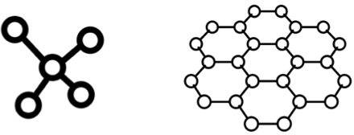
Polymorphism

Slide 6
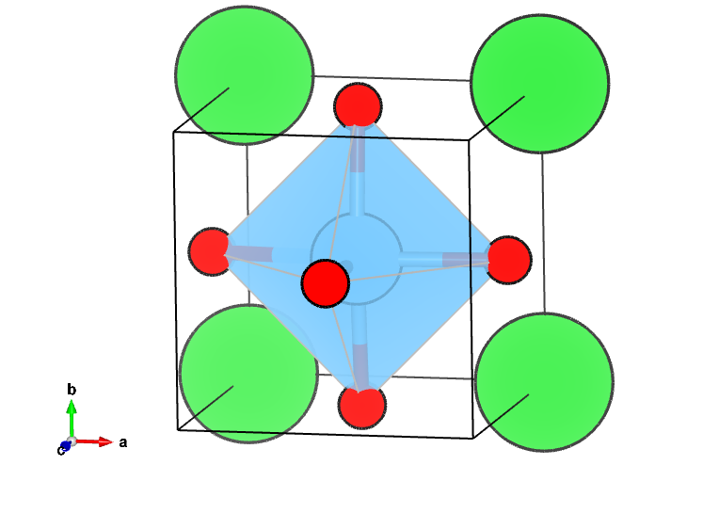
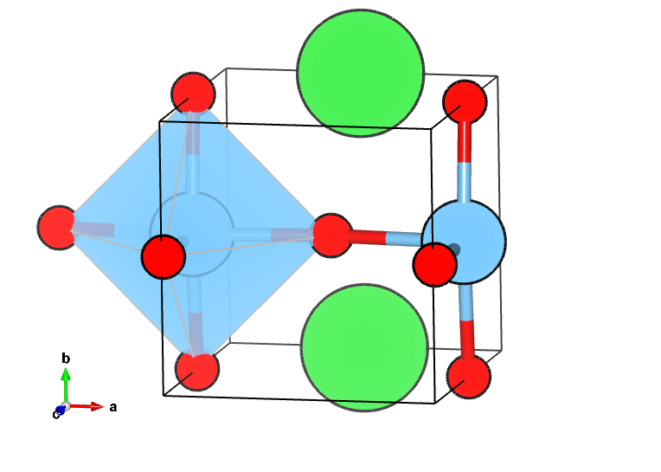
Why don't traditional structure representations work?

Slide 7
What do we need to represent a structure
Invariant
Unique
Machine readable
Ease of computation
Continuous
Invertible - for generative models

Slide 9
SMILES
Remove H
Break cycles and number
Branches as parentheses
Depth first branch search

Slide 10
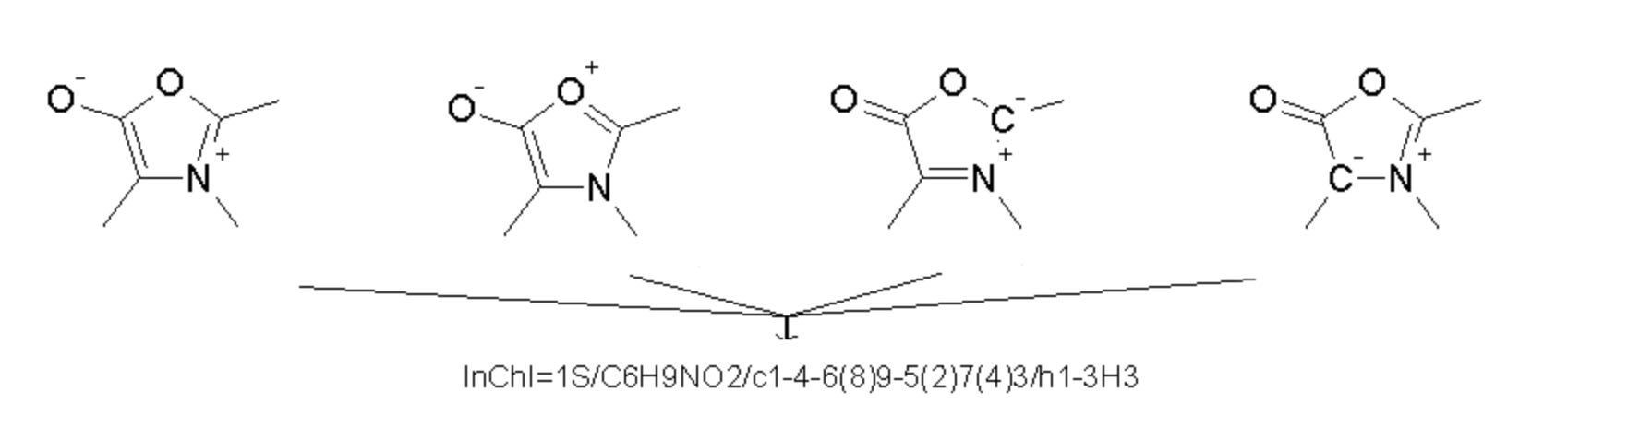
InChI
InChI provides a precise, robust, IUPAC approved structure-derived tag for a chemical substance
https://www.inchi-trust.org/about-the-inchi-standard/

Slide 11
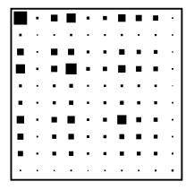
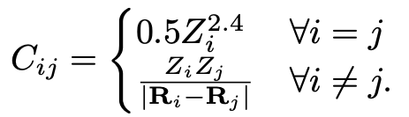
Coulomb matrix
Not unique/invarient

Slide 12
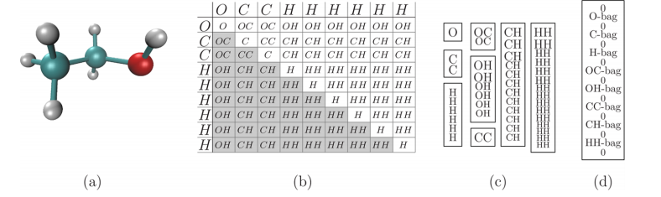
Bag of bonds
Expand the matrix to include pairs of molecules
Make lists of all pairs, zero padded to be the same length
As long as a rule exists for ordering chemicals we end up with an invariant representation

Slide 13
Augmented graphs
Chem. Sci., 2018,9, 513-530
Notes:
Core structures of graph-based models implemented in MoleculeNet. To build features for the central dark green atom: (A) graph convolutional model: features are updated by combination with neighbour atoms; (B) directed acyclic graph model: all bonds are directed towards the central atom, features are propagated from the farthest atom to the central atom through directed bonds; (C) Weave model: pairs are formed between each pair of atoms (including not directly bonded pairs), features for the central atom are updated using all other atoms and their corresponding pairs, pair features are also updated by combination of the two pairing atoms; (D) message passing neural network: neighbour atoms' features are input into bondtype-dependent neural networks, forming outputs (messages). Features of the central atom are then updated using the outputs; (E) deep tensor neural network: no explicit bonding information is included, features are updated using all other atoms based on their corresponding physical distances; (F) ANI-1: features are built on distance information between pairs of atoms (radial symmetry functions) and angular information between triplets of atoms (angular symmetry functions).

Slide 14
Comparing molecular representations
Chem. Sci., 2018,9, 513-530

Slide 15
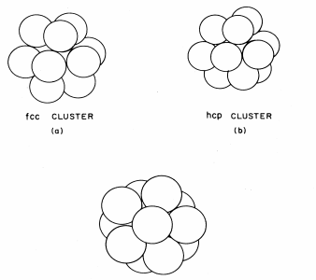
Local structure descriptors
Originally developed to analyse MD simulations
Looking at amorphous systems
Use bond spherical harmonics to provide a unique description of the environment
Phys. Rev. B 28, 784 1983

Slide 16
Local structure descriptors
Smooth overlap of atomic potentials
Can compare similarity of local environments by interaction of the densities
Phys. Chem. Chem. Phys., 2016, 18, 13754-13769

Slide 17
SOAP
Use with sketch map to look at similarity of structures
Phys. Chem. Chem. Phys., 2016, 18, 13754-13769

Slide 18
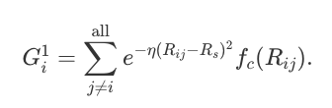
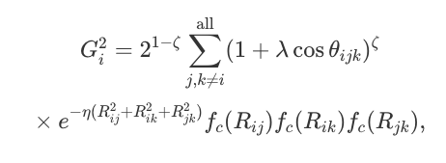
Behler Parinello Functions
Convert coordinates into a system of radial and angular terms
These can serve as input vectors for a neural network
Drawback, new representations needed for each environment
Phys. Rev. Lett. 98, 146401 2007

Slide 19
Radial distribution functions
Description of the correlation between sites
Can be expanded in spherical harmonics
Coefficients of the polynomials provide a description of the environment
Not mathematically complete, but provide a relatively inexpensive description
Phys. Rev. B 96, 014112 2017

Slide 20
Property labelled fragments
Define connectivity - Voroni + radii
Build a graph
Define nodes, lines and clusters
Dress with weighted atomic properties
Include description on lattice - volume, a,b,c,angles
Total ~3000 descriptors
Nature Communications volume 8, Article number: 15679 (2017)

Slide 21
Property labelled fragments
Show promise across a range of thermo and electro chemical properties
Quite susceptible to new environments though
Weak for 2D materials
Nature Communications volume 8, Article number: 15679 (2017)

Slide 22
Electronic structure descriptors
Encode band structure based on eigenvalues at high symmetry points -> bar code
Encode DoS as a histogram of length 256 across a set energy range from the Fermi energy
Chem. Mater., 2015, 27 (3), pp 735–743

Slide 23
Materials cartography
Combine electronic fingerprints with structural fingerprints
Construct a graph based on Tanimoto distance
Chem. Mater., 2015, 27 (3), pp 735–743

Slide 24
Beyond Screening
Science 2018. 361, 360-365

Slide 25
Generative Models (I)
Autoencoder model includes an encoding and a decoding network
A neural net encodes the system as vectors in a latent space
Fill the uncovered spaces of the latent space - generate new molecules
Science 2018. 361, 360-365

Slide 26
Generative models (II)
Generator competes against a discriminative model
Both models train in alternation
Goal of generator: to structure noise producing data that discriminator cannot classify better than chance
Science 2018. 361, 360-365

Slide 27
Generative models (III)
Learn to predict the next characters in a SMILEs string
Must complete the string in order to predict properties - use a MCTS
Evaluate properties on the end of the string and update the weights and rewards for subsequent actions
Science Advances 2018, 4, eaap7885 DOI: 10.1126 sciadv.aap7885

Slide 28
Recommended reading
“Inverse molecular design using machine learning: Generative models for matter engineering” DOI: 10.1126/science.aat2663
“On representing chemical environments” DOI: 10.1103/PhysRevB.87.184115
“MoleculeNet: a benchmark for molecular machine learning” DOI: 10.1039/C7SC02664A
Zotero public group: https://www.zotero.org/groups/2283015/chemical__material_structures_for_machine_learning

Slide 29



Thank You
@keeeto2000
http://keeeto.github.io
https://github.com/keeeto
https://www.mixcloud.com/keith-butler2/

