Slide 1
Short range wakefield issues in the ILC BDS beamline.
T. Okugi, KEK
Crab cavity meeting @2021/06/25
The effect of short range wakefield in ILC BDS has been studied in several simulations.Since the ILC BDS is a transport line and the bunch length is short, the effect of capacitive impedance (large structures) is relatively small in general.
There are 2 type (static and dynamic) of the beam size growth by the wakefield in the beam transport line as ILC BDS.
Simulations have shown that the beam size increase due to static wakefield in ILC250 can be compensated by changing the position of wakefield knob (a compensating structure placed on the mover).
The simulation shows that the beam size increase due to dynamic wakefield in ILC250 can be compensated by various feedbacks.
These compensations for the beam size increase due to wakefield at ILC have been experimentally demonstrated at the ATF2 beamline.
If the calculated time domain wake potential (0.3mm bunch length) for the crab cavity is available, the effect of wakefield due to the crab cavity can be added to the existing simulations.

Slide 2
backup

Slide 3
Static wakefield effect
The wakefield is generated by the misalignment and/or the beam orbit offset of vacuum component.
Bunch tail is kicked by the wakefield, generated by the beam.
The kicked amplitude is proportional to the beam position offset w.r.t. the chamber center.
Dynamic wakefield effect
The wakefield is generated by the beam orbit jitter of the beam.
The effect is superposed, because polarities of (y, y’) are changed for IP angle jitter, simultaneously.
Bunch tail is kicked by the wakefield, generated by the beam.
The kicked amplitude is proportional to the beam angular jitter amplitude.

Slide 4
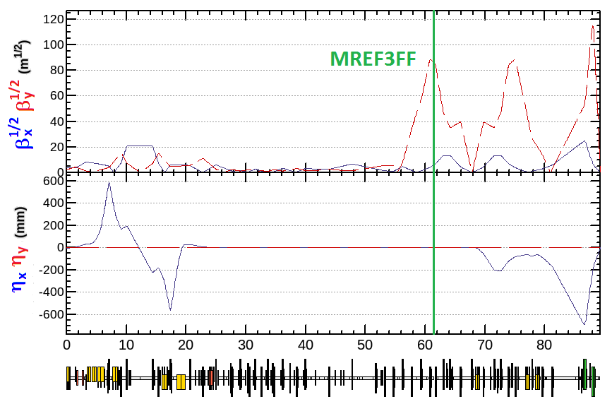
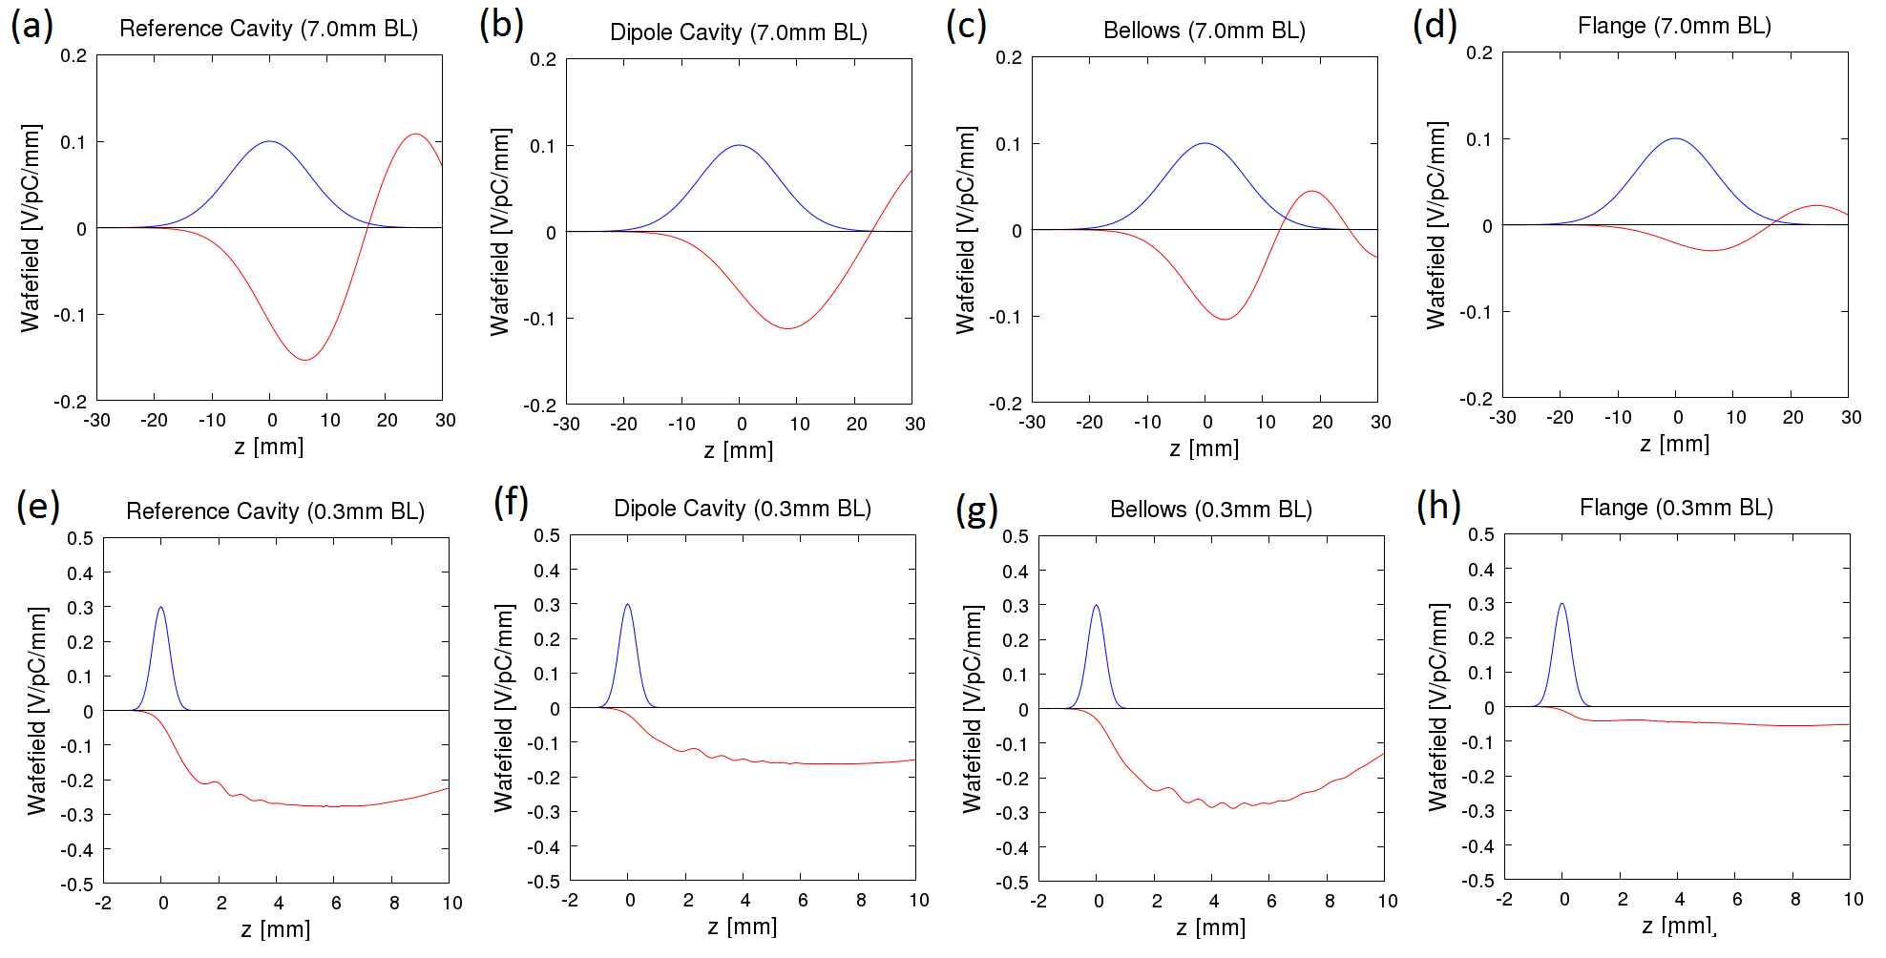
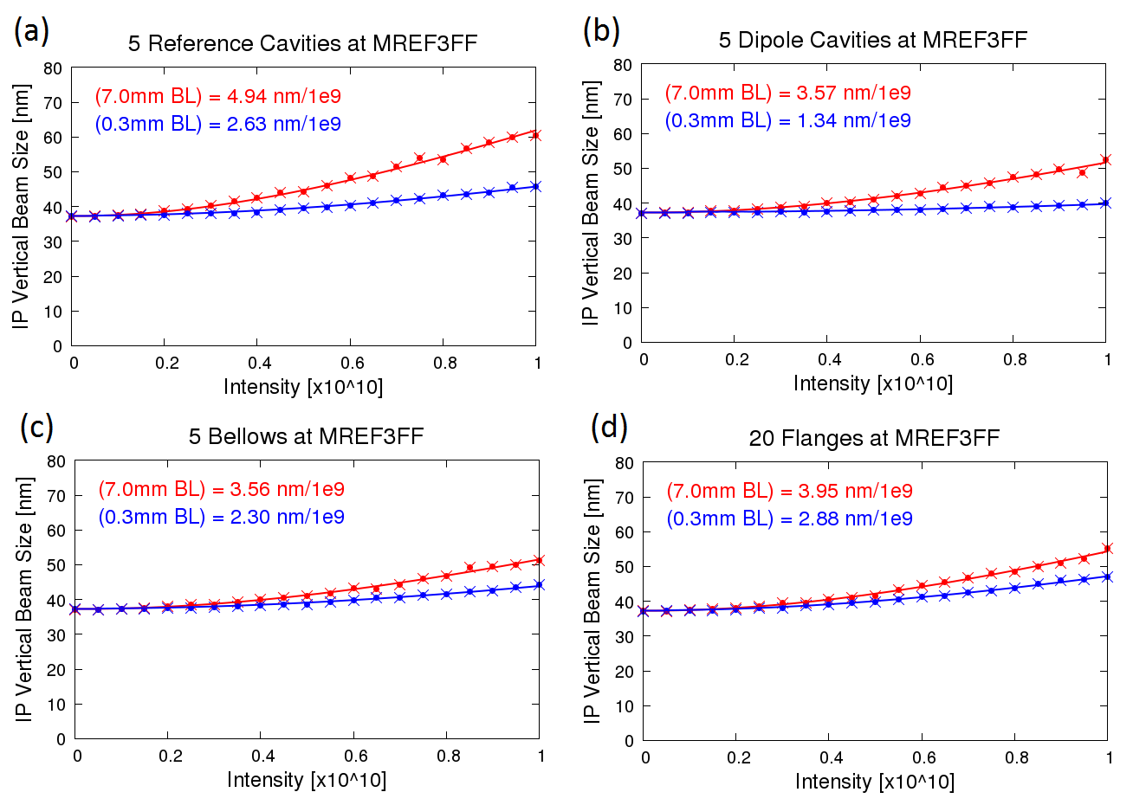
Wakefield effect for ATF2/ILC bunch length
The effect was Simulated by putting wakefield source on ATF2 beamline.
Initial beam, which charge is $N=1×{10}^{10}$, has 30% of angular jitter
Tracking simulation
The difference is the bunch length only.
Results of dynamic intensity dependence simulation
The effect of wakefield kick for 0.3mm is smaller than that for 7mm.
The effects of bellows and flange gap are larger for ILC bunch length.
The effect of the capacitive impedance to shorter bunch is small
in the “beam transport line”.

Slide 5
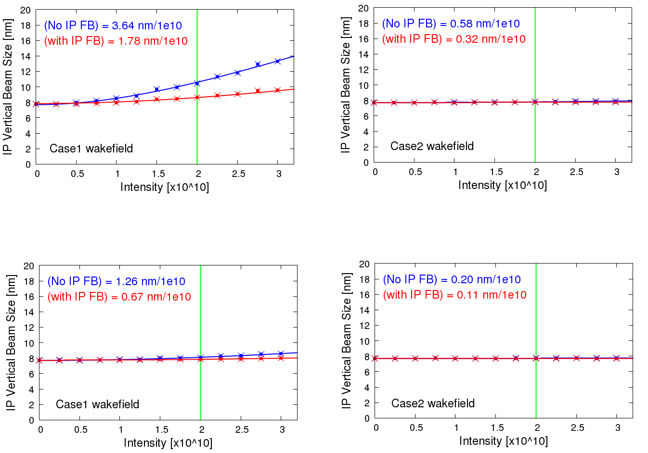
ILC dynamic intensity dependence correction
Case 1
Case 2
30% angle jitter
FONT 2-dimensional (y-y’)
upstream FB
10% angle jitter
Case 1
Case 2
FONT IP position FB
FONT 2D (y-y’)
upstream FB
The dynamic effect of the wakefield is evaluated to be reduced to enough level by simulation.

Slide 6
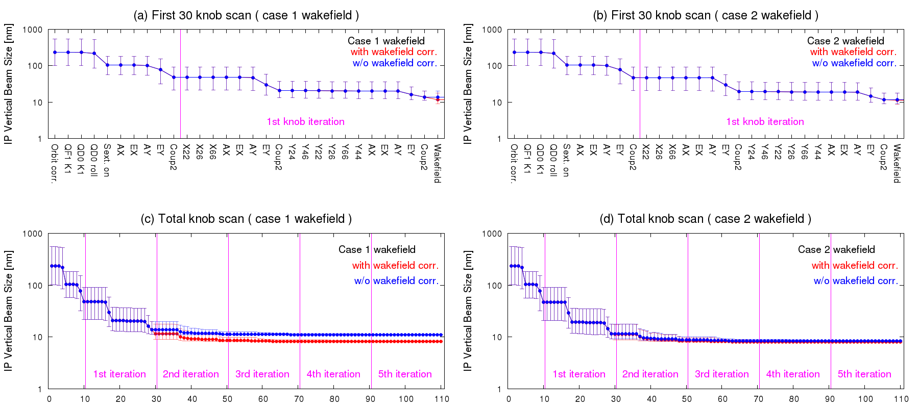
ILC static intensity dependence correction
Beam tuning was applied at nominal beam charge (N=2e10) with wakefield knob (ref. cavity).
Quadrupole Errors
Sextupole Errors
Dipole Errors
Alignment (x,y) | $$100 μ\text{m}$$
K1 strength | $$0.01\%$$
K2 strength | $$0.01\%$$
Rotation | $$100 μ\text{rad}$$
Quad-BPM | $$10 μ\text{m}$$
Alignment (x,y) | $$100 μ\text{m}$$
K2 strength | $$0.01\%$$
Rotation | $$100 μ\text{rad}$$
Sext-BPM | $$10 μ\text{m}$$
Alignment (x,y) | $$100 μ\text{m}$$
Rotation | $$100 μ\text{rad}$$
Dipole-BPM | $$100 μ\text{m}$$
Vacuum chamber position error
$$300μ\text{m}$$

