Slide 1

Regularization in Machine Learning
Tyrone Rees
SCD Computational Mathematics

Slide 2
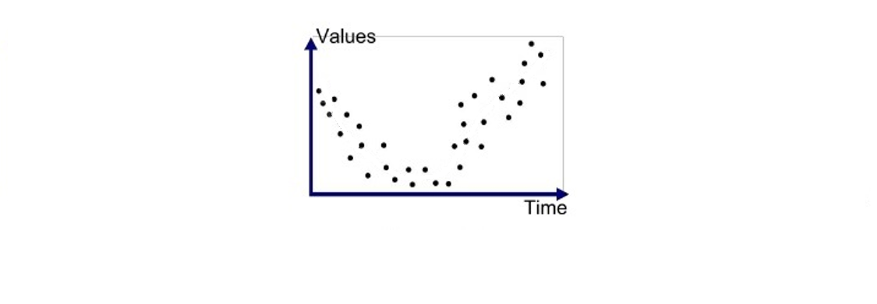
What is overfitting?
https://medium.com/greyatom/what-is-underfitting-and-overfitting-in-machine-learning-and-how-to-deal-with-it-6803a989c76

Slide 3
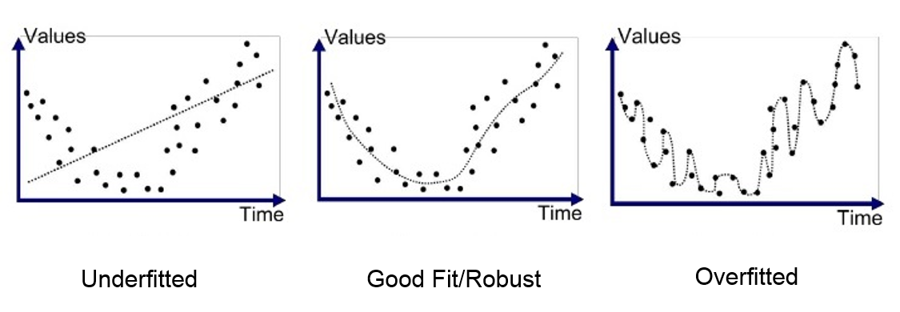
What is overfitting?
https://medium.com/greyatom/what-is-underfitting-and-overfitting-in-machine-learning-and-how-to-deal-with-it-6803a989c76

Slide 4
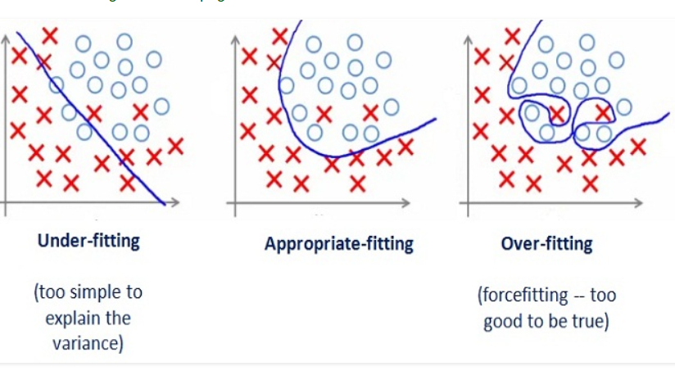
What is overfitting?
https://medium.com/greyatom/what-is-underfitting-and-overfitting-in-machine-learning-and-how-to-deal-with-it-6803a989c76

Slide 5
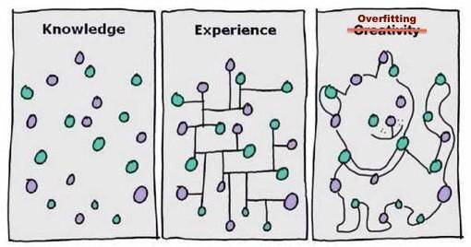
How can we detect overfitting?

Slide 6
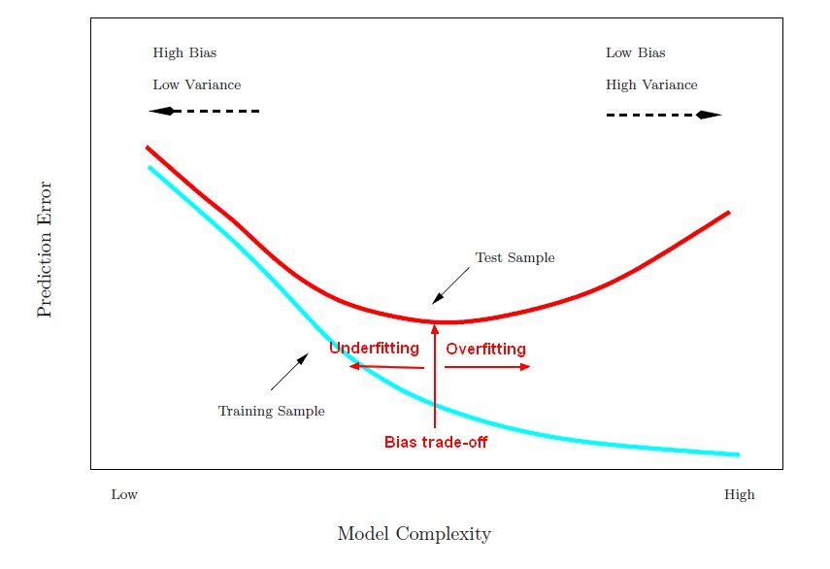
Test and trial sets
All data
Training set
Test set
https://gerardnico.com/data_mining/overfitting

Slide 7
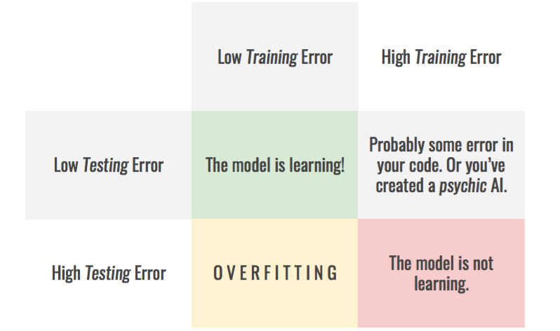
https://hackernoon.com/memorizing-is-not-learning-6-tricks-to-prevent-overfitting-in-machine-learning-820b091dc42

Slide 8
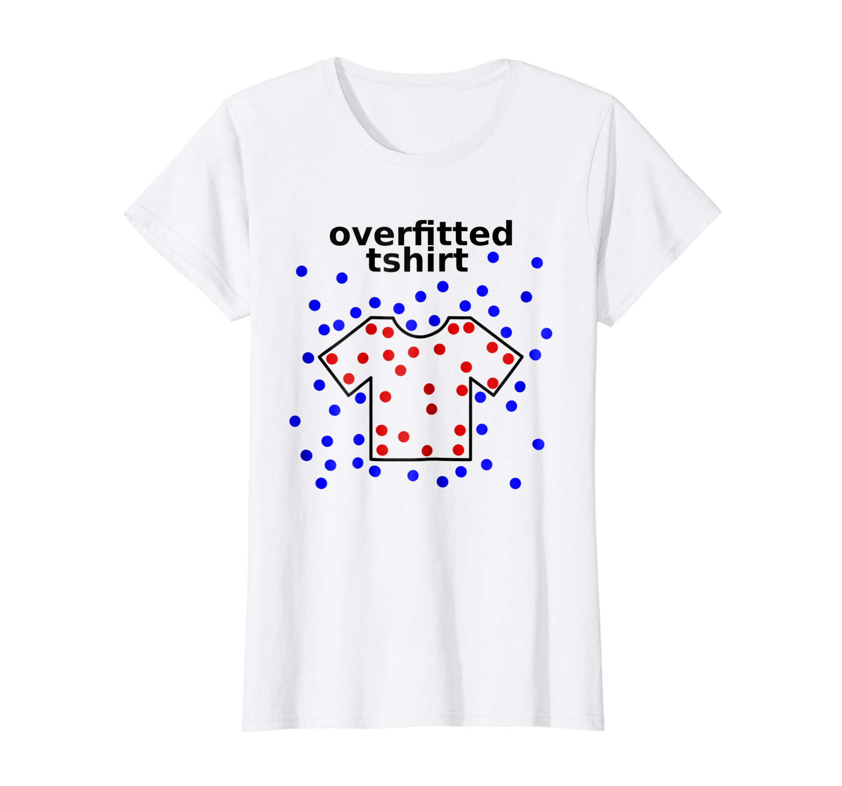
How can we avoid overfitting?
https://www.amazon.com/Munch-Gifts-Machine-Learning-Overfitted/dp/B07G6YJ8QH

Slide 9
Regularization
“Regularization is any modification we make to a learning algorithm that is intended to reduce its generalization error but not its training error.”
Ian Goodfellow (Google)

