Slide 1
SciML – Tech Update
23-01-19
Keith Butler & Jeyan Thiyagalingam

Slide 2
Updates
Libraries and Frameworks
Hardware
Papers
Upcoming trends in Scientific ML
Notable Projects
(Planned) Future Sessions

Slide 3
Libraries and Frameworks

Slide 4
Upcoming Ones
TensorFlow 2.0
AutoKeras
Flux 0.1.0?

Slide 5
TensorFlow 2.0 (Highlights)
TF1 and TF2 are, in general, not compatible. But
  A conversion tool will be available
  Introduction of tf.compat.v1 module will be maintained (LTS)

Slide 6
TensorFlow 2.0 (Highlights)
TF1 and TF2 are, in general, not compatible. But
  A conversion tool will be available
  Introduction of tf.compat.v1 module will be maintained (LTS)
Eager execution – imperative model
tf.enable_eager_execution()

Slide 7
TensorFlow 2.0 (Highlights)
TF1 and TF2 are, in general, not compatible. But
  A conversion tool will be available
  Introduction of tf.compat.v1 module will be maintained (LTS)
Eager execution – imperative model
Better / simplified / cleaned / less confusing API
  Unified optimizers across keras and tf.keras
  Unified RNNs – ditto

Slide 8
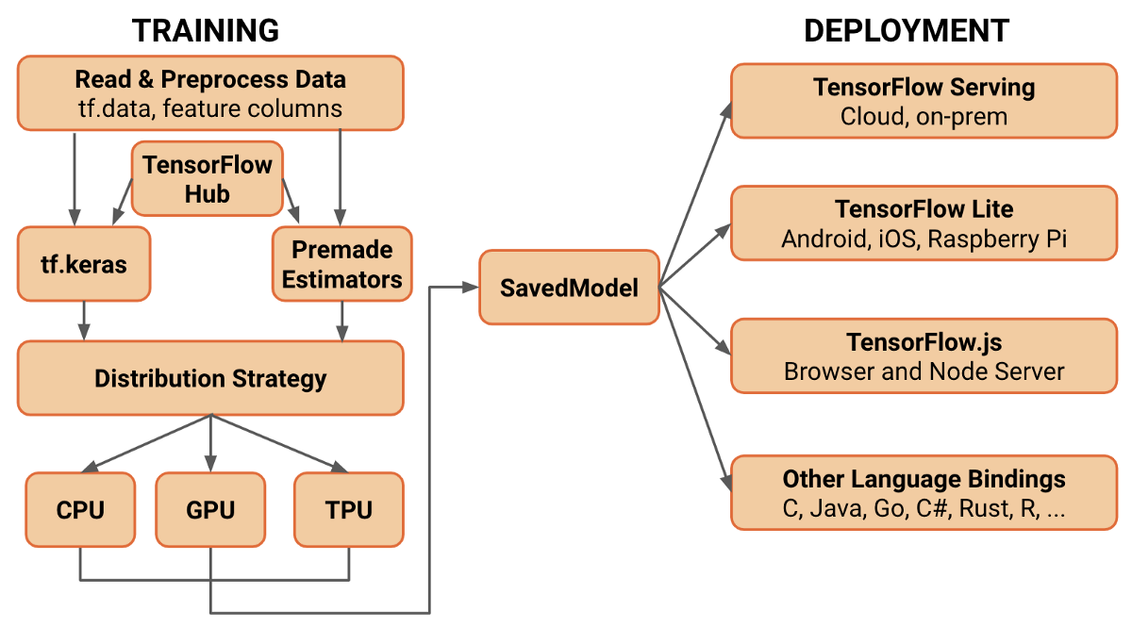
TensorFlow 2.0 (Highlights)
Improved architecture
Training and Deployment aspects are packaged together

Slide 9
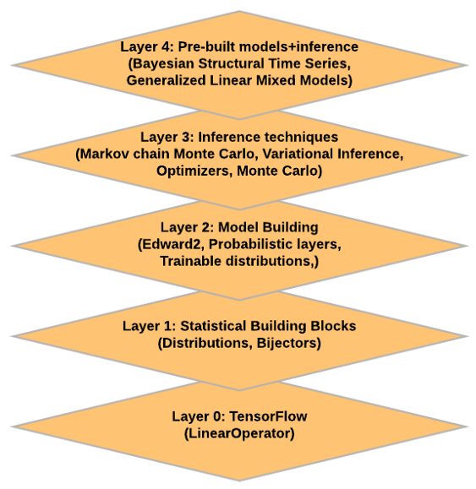
TensorFlow 2.0 (Highlights)
Strong integration with Keras
Better support for distributed learning
TensorFlow serving over HTTPS
Support for ragged tensors
Better / Improved TensorFlow Probability
  Another (perhaps better) PPL
  PyMC or R-Stan
  Statistical (variational) inferencing

Slide 10
TensorFlow 2.0 (Highlights)
Strong integration with Keras
Better support for distributed learning
TensorFlow serving over HTTPS
Support for ragged tensors
Better / Improved TensorFlow Probability
RC / PR will be available soon .. But
  TF 2.0 APIs can be used already
Additional support for estimators, boosted trees, random forests, mixed precision (int8 support), SIMD, DGX2 ☺
Possibly (!) better support for DRL
# pip install tf-nightly-2.0-preview

Slide 11
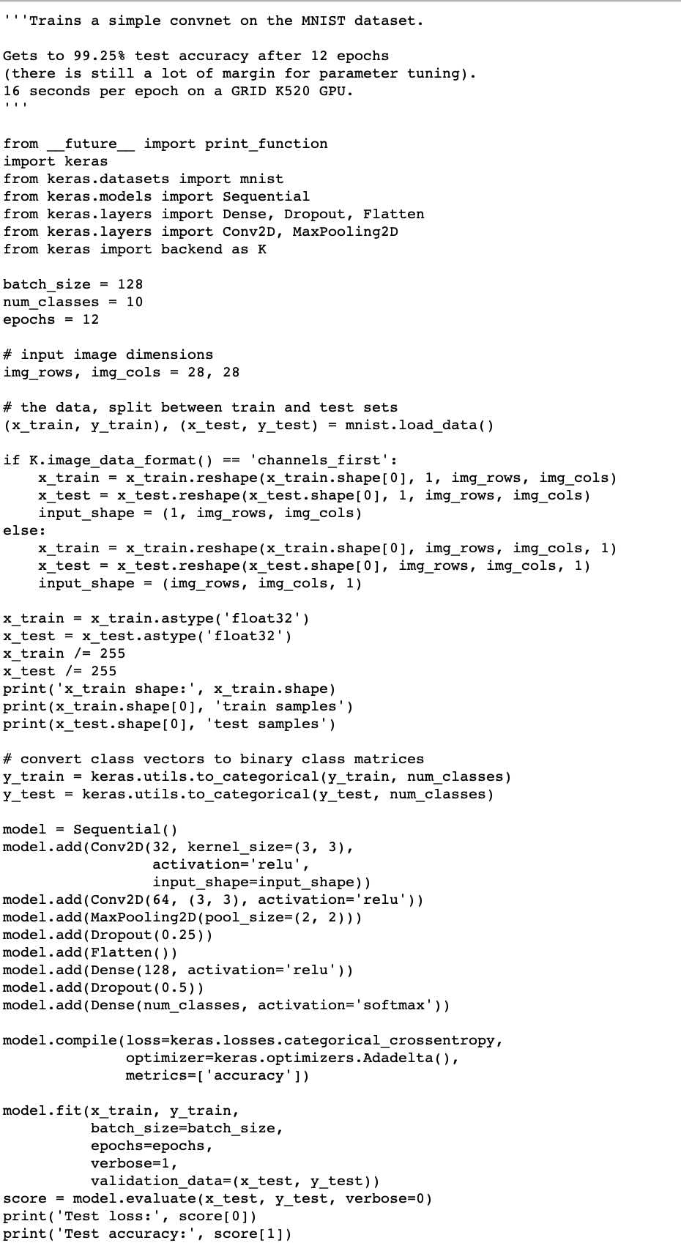
AutoKeras
MNIST with Keras + TF

Slide 12
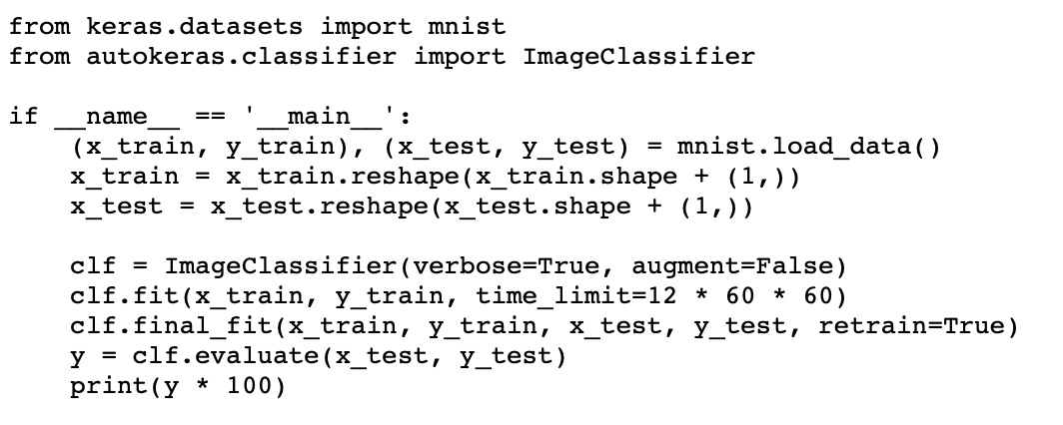
AutoKeras
MNIST with Keras + TF
Vs AutoKeras

Slide 13
AutoKeras
The idea is to automate ML with minimal effort
Feed data directly into auto-keras and it will find the model for you

Slide 14
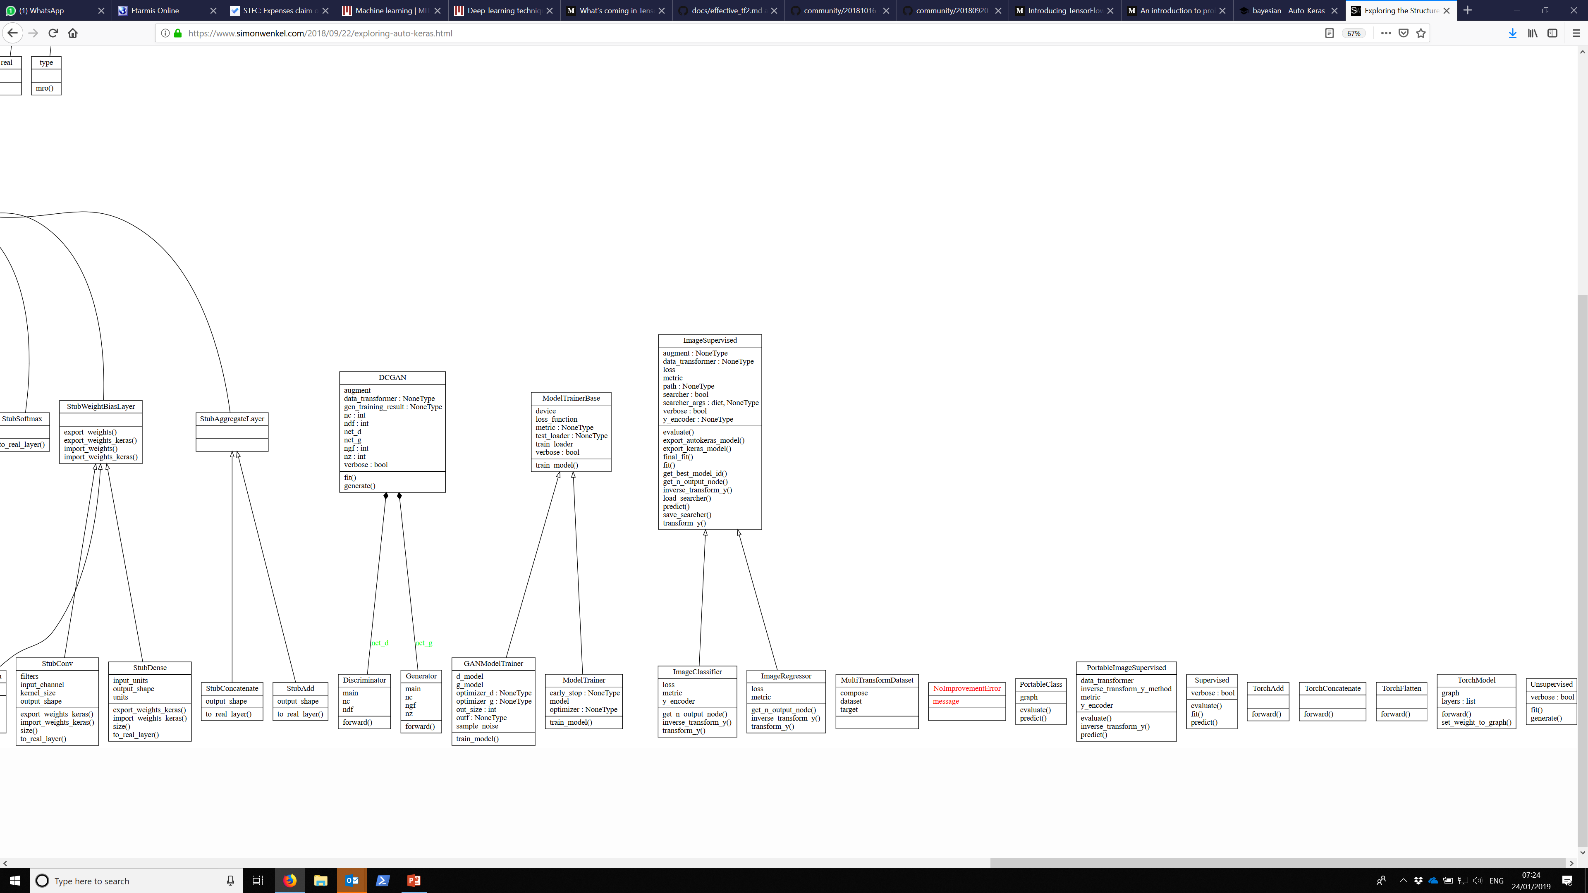
AutoKeras

Slide 15
Other AutoML Efforts
Auto-Sklearn
Google’s AutoML
AutoWeka
See: automl.org

Slide 16
Julia Flux
Julia has become one of the popular languages in 2018 (pick and mix)
Flux is a Julia-specific software stack / layer meant for machine learning
Very early days, but if you are Julia fan, you may want to check this out

Slide 17
Libraries that are losing traction
Shogun
Apache Singa
Apache Mahout

Slide 18
Hardware @ STFC

Slide 19
DGX2 @ STFC
DGX2 has been ordered
STFC will host it and will be shared with ATI users
Will become operational by May/June 2019
Extra storage of 300TB

Slide 20
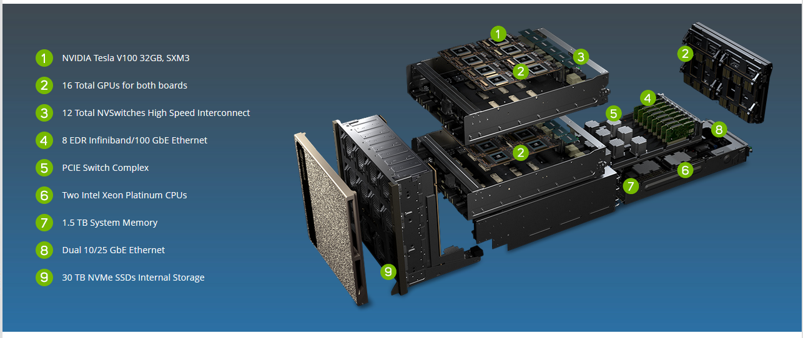
DGX2 @ STFC
DGX2 has been ordered
STFC will host it and will be shared with ATI users

Slide 21
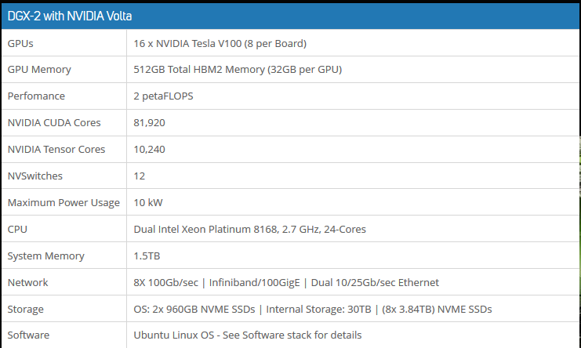
DGX2 @ STFC

Slide 22
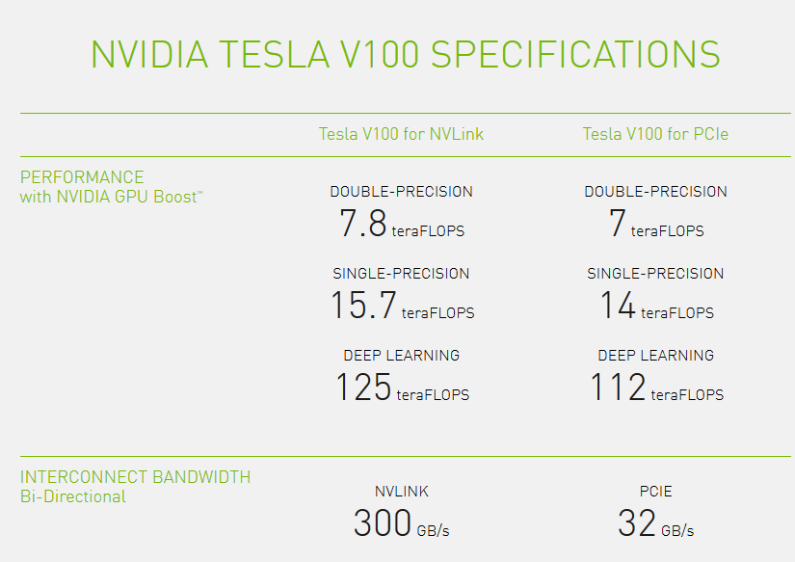
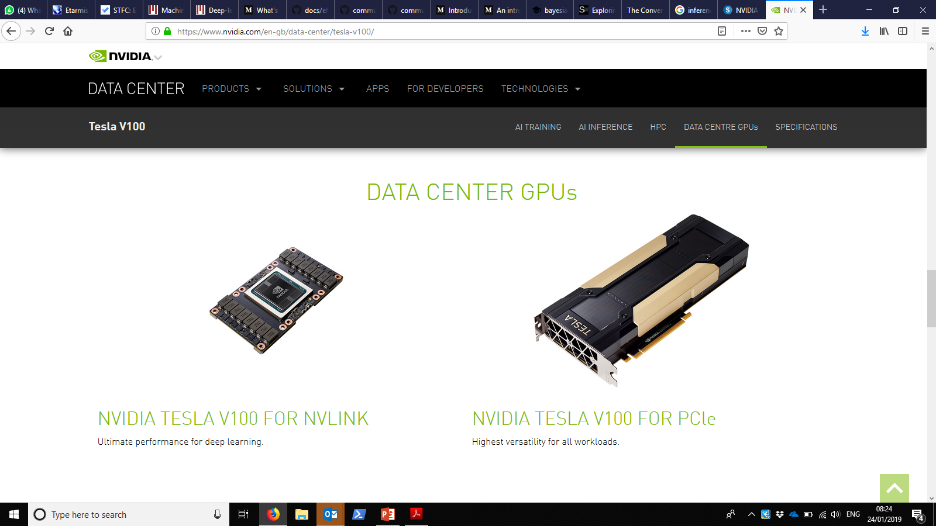
V100s

Slide 23
Papers worth Reading

Slide 24
Scaling Deep Learning without Increasing Batch Size
Alexander Heye, CCPE, December 2018
Scaling the training with data size is a main concern in the ML community
Increasing the batch size is one option
But that degrades the quality of the training
This paper explores other options:
  Hyper-parameter optimization
  Dataset segmentation
  Model parallelism
  Hierarchical fine tuning
https://doi.org/10.1002/cpe.5147

Slide 25
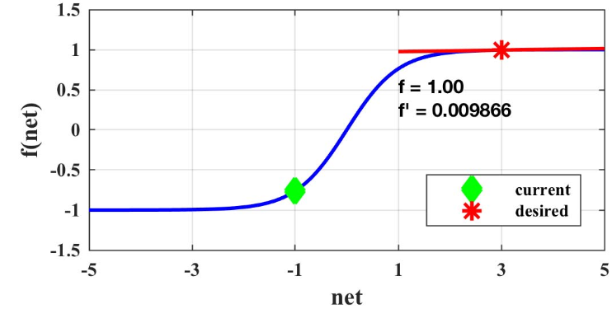
Neural Network Training With
Levenberg–Marquardt and Adaptable
Weight Compression
James S. Smith, Bo Wu and Bogdan M. Wilamowski
IEEE Trans. Neural Networks and Learning Systems, 30(2), Feb 2019
Addresses the flat-spot problem
  Happens in certain activation functions
  Renders the neural network not to converge
Proposes LM with Weight Compression to push the neuron activations out of the out of the saturated region
DOI: 10.1109/TNNLS.2018.2846775

Slide 26
Projects worth knowing about

Slide 27
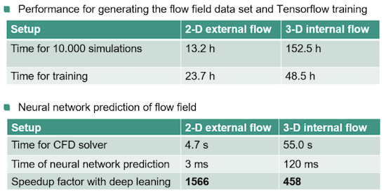
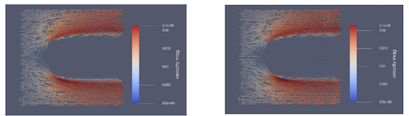
UberCloud
Deep Learning For Fluid Flow Prediction In The Cloud
CFD problems are very demanding both in terms of computing power and simulation time
This project is about predicting the fluid flow around a given shape of the object
Aim is to cut down the simulation time by third using NNs
Simulated vs Predicted by NNs
InsideHPC, Jan 2019

Slide 28
Upcoming Trends in Scientific ML
XAS (this time!)

Slide 29
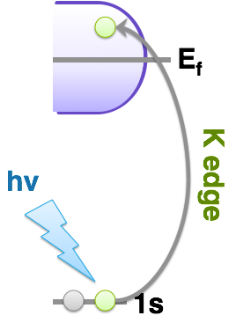
Machine learning for XAS
X-ray absorption spectroscopy
Excite core electrons in an atom to unoccupied orbitals
Measure the frequencies at which X-rays are absorbed
Subject to quantum mechanical transition rules - symmetry

Slide 30
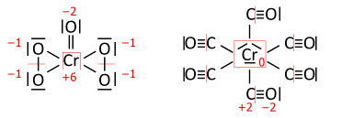
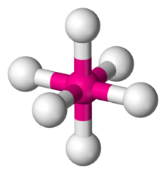
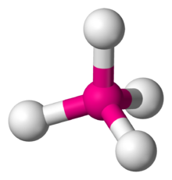
What is XAS good for?
Electronic structure (oxidation state)
Geometric structure (local environment)

Slide 31
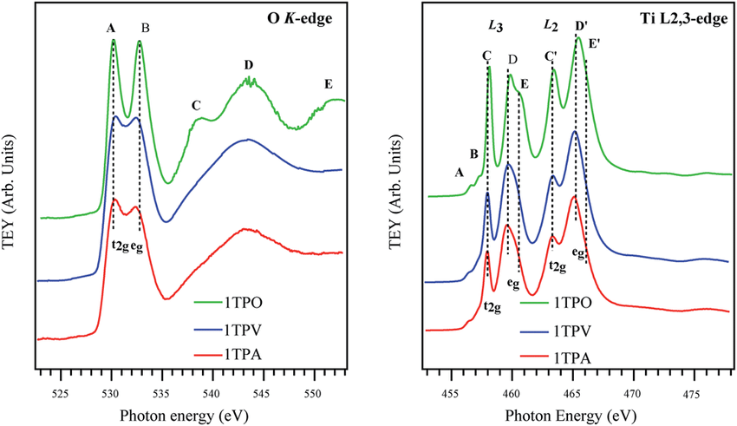
Understanding XAS
y = f(x)
x = f^-1(y)

Slide 32
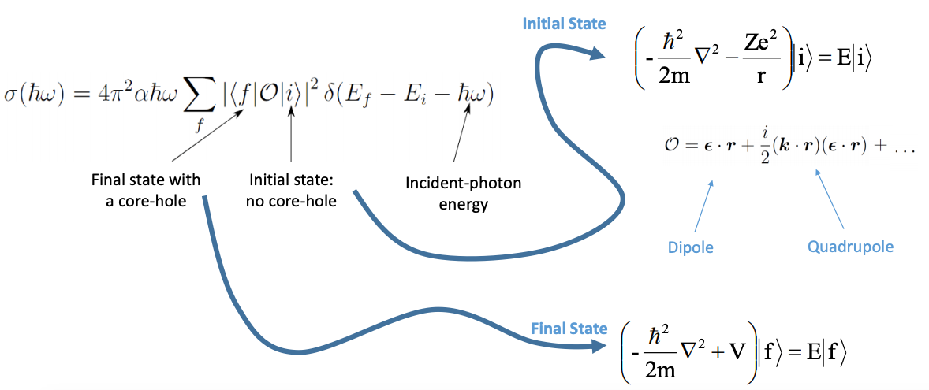
Simulating XAS
Quantum mechanics
https://agenda.infn.it/event/12156/contributions/12392/attachments/9158/10357/Stellato_Bari_13Dec17.pdf

Slide 33
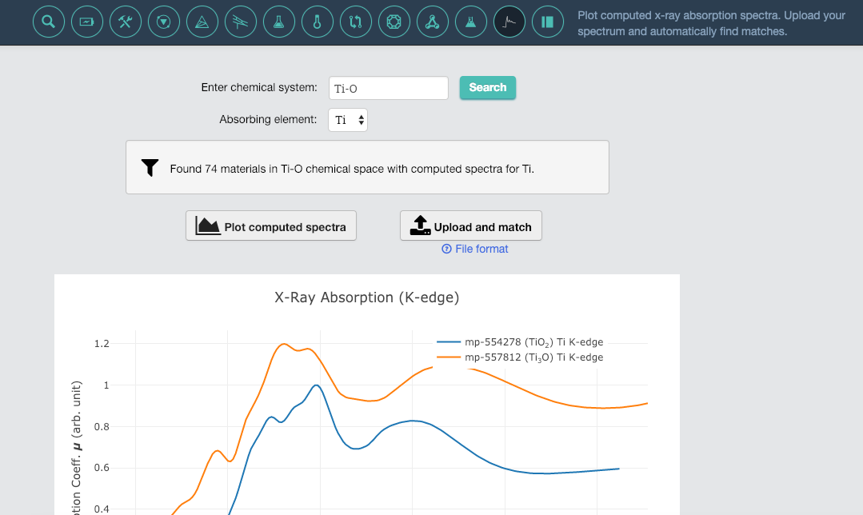
An XAS Database
https://materialsproject.org/#apps/xas
Scientific Data volume 5, Article number: 180151 (2018)

Slide 34
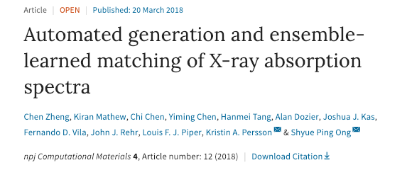
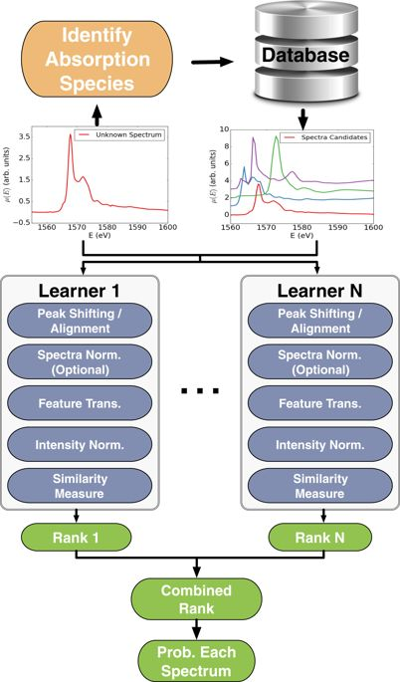
ML for XAS Analysis
Pick out element
Attempt to match all spectra containing that element
Good success in identifying oxidation state and coordination environemnt

Slide 35
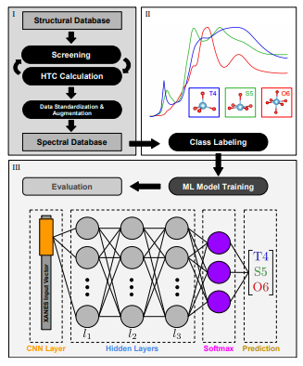
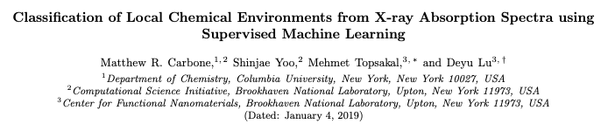
ML for XAS
Matches site specific spectra
In principle can work for previously unknown structures
Compare a MLP and CNN – quite similar results
Limited by the accuracy of the calculated spectra – GGA DFT
http://arxiv.org/abs/1901.00788

Slide 36
Upcoming (Planned) SciML Sessions
Planning to run a SciML sessions on
  GBMs
  CNNs
  In-depth TensorFlow
  RAPIDS

