Slide 1



Thin film SRF developments
Oleg B. Malyshev
ASTeC/CI
On behalf of a TF SRF team at DL
Advanced RF UK roadmap community meeting
7th June 2021

Slide 2


Introduction
Present state

Slide 3
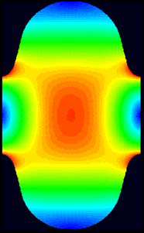
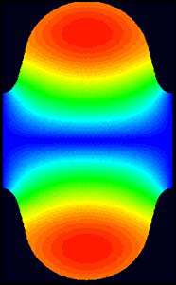
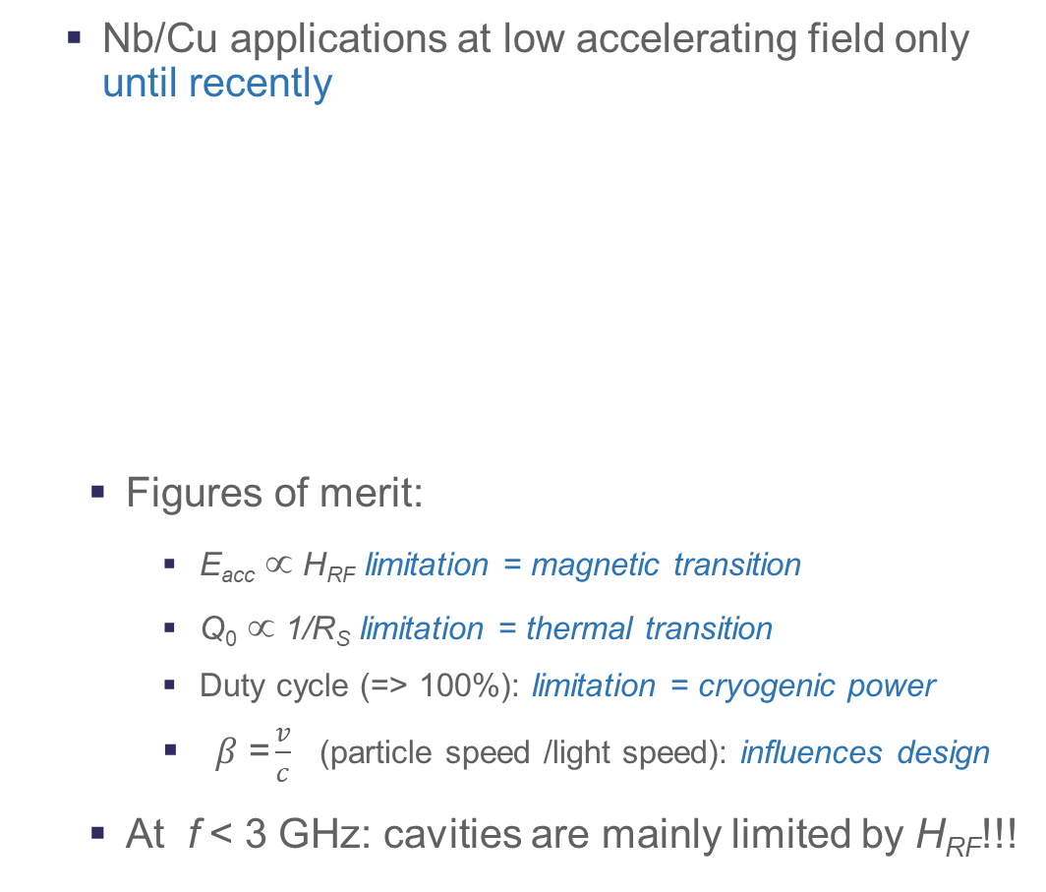
Bulk Nb: monopoly since > 50 years
Nb/Cu applications at low accelerating field only until recently
  Figures of merit:
    E_{acc} ∝ H_{RF} limitation = magnetic transition
    Q₀ ∝ 1/R_{S} limitation = thermal transition
    Duty cycle (=> 100%): limitation = cryogenic power
    $β\text{ =}\frac{v}{c}$ (particle speed /light speed): influences design
  At f < 3 GHz: cavities are mainly limited by H_{RF}!!!
Nb : Limits @ 2 K, 1.3 GHz :
E_{acc} ~ 55 MV/m (± 5 MV/m)
(Geometry : H/E_{acc} ~ 42 Oe/(MV/m))
R_{s} = R_{BCS} + R_{rés}.
max.field
Q₀
Investment +
Power consumption
Q₀ ↑ Costs ↓
B_{peak}
High field dissipations
E_{peak}
E Field
B Field
0
P = cst, ↑
quench
E_{acc}
Investment
E_{acc} ↑ Costs ↓
Courtesy of C. Antoine (CEA, France)

Slide 4
Ultimate limits in SRF
SC phase diagram
  All SC applications except SRF: mixed state w. vortex
    Vortices dissipate in RF !
  SRF => Meissner state mandatory !
  H_{C1} = limit Meissner/mixed state
    Nb highest H_{C1} (180 mT)
  “Superheating field” (H_{SH}) : Metastable state favored by H// to surface
    Difficult to get in real life
  Effect of temperature
Mixed state w.Vortex
(i.e. N. cond. flux line + screening currents)
H
H_{C2}
H_{SH}
H_{C1}
T_{C}²
T²
Meissner state
Screening current over λ, no magnetic field deeper
Courtesy of C. Antoine (CEA, France)

Slide 5
Superconductors for SRF
Material | T_{C} (K) | µ₀H_{SH} (mT)@ 0 K
Pb | 7,1 | 100
Nb | 9,2 | 219,0
NbN | 17,1 | 214,0
Nb₃Sn | 18,3 | 425,0
MgB₂ | 39,0 | 170,0
Pnictides | 38,0 | 756,0
Ba_{0.6}K_{0.4}Fe₂As₂
Cuprates YBaCuO | 93,0 | 1050,0
High H_{SH} => High E_{acc}… in theory
High T_{C} => High Q₀
Courtesy of C. Antoine (CEA, France)

Slide 6
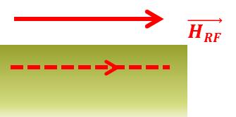
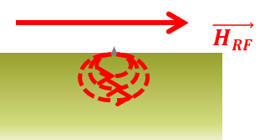
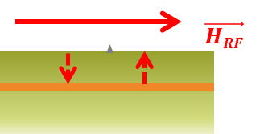
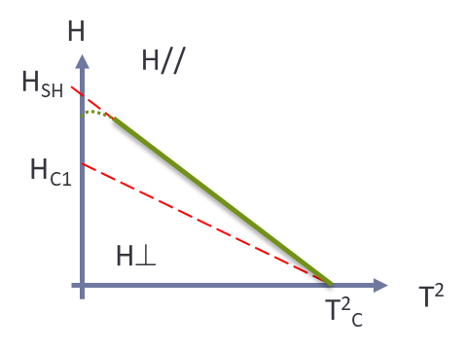
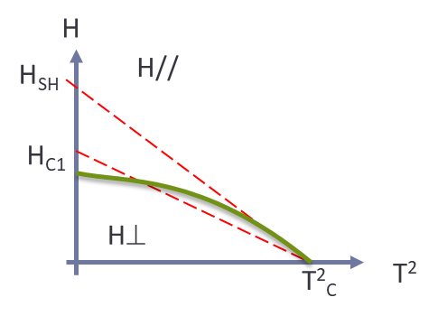
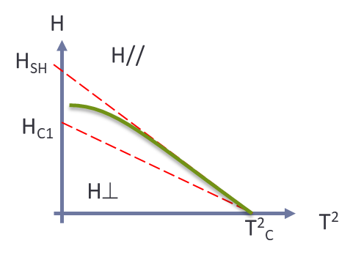
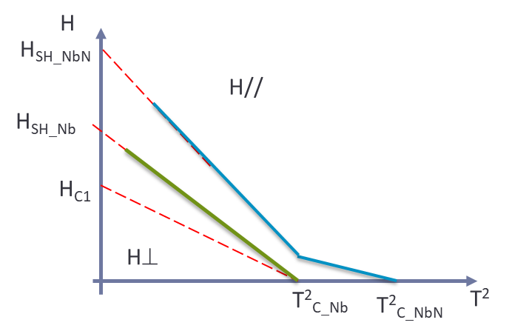
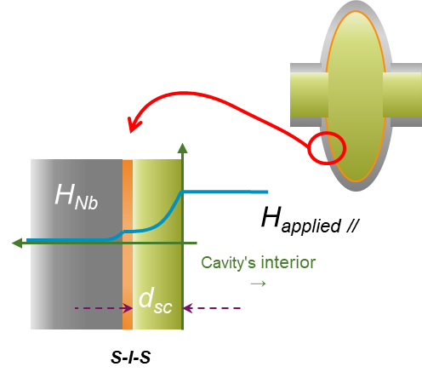
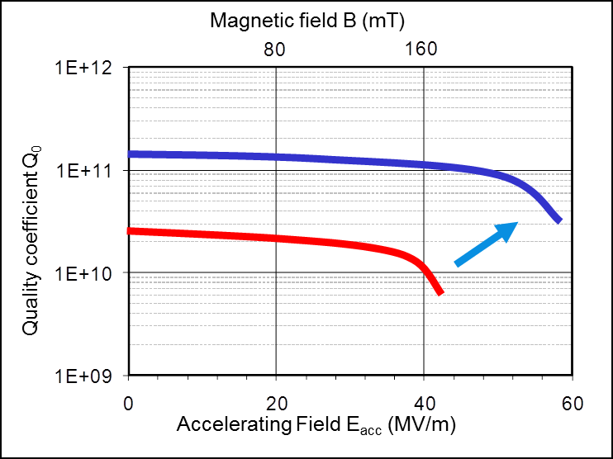
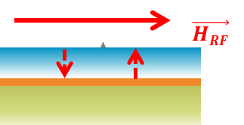
Multilayers concept, or how to make theory face reality
Courtesy of C. Antoine (CEA, France)

Slide 7
Superconducting Thin Film Coating for Radio Frequency Cavities (TF-SRF) at STFC/DL/CI
Main goal:
  to enable STFC for the superconducting thin film coated cavity production and testing
Main objectives:
  Developing coating technology for superconducting thin films (STF)
    Deposition of Nb, Nb₃Sn, NbTiN, Mg₂B, … and SIS structures
    Thin film characterisation
    AC/DC superconductivity evaluation
  Developing cavity deposition expertise
    Copper cavity production,
    Polishing and cleaning
      Class 5 clean room
    Building deposition facilities
    Optimising deposition parameters
  SRF testing at DL
    1.3 GHz cavity testing as 1st step
    Scaling up to a routine cavity coating and testing

Slide 8
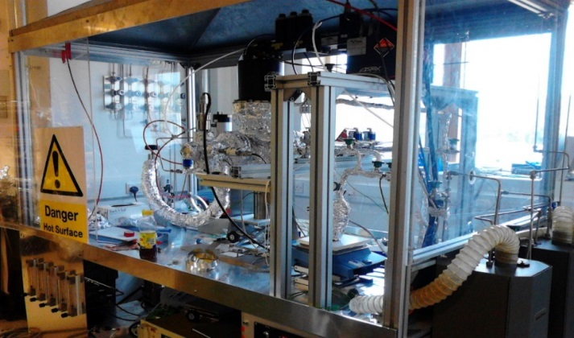
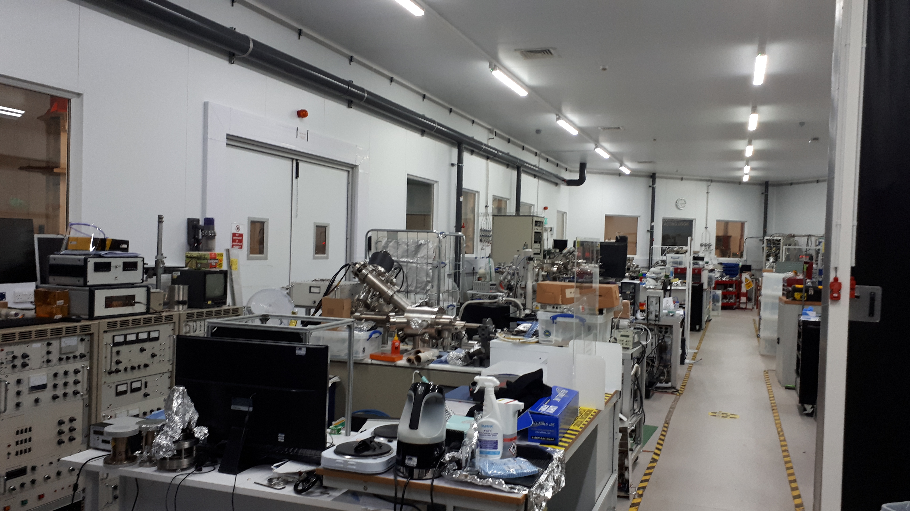
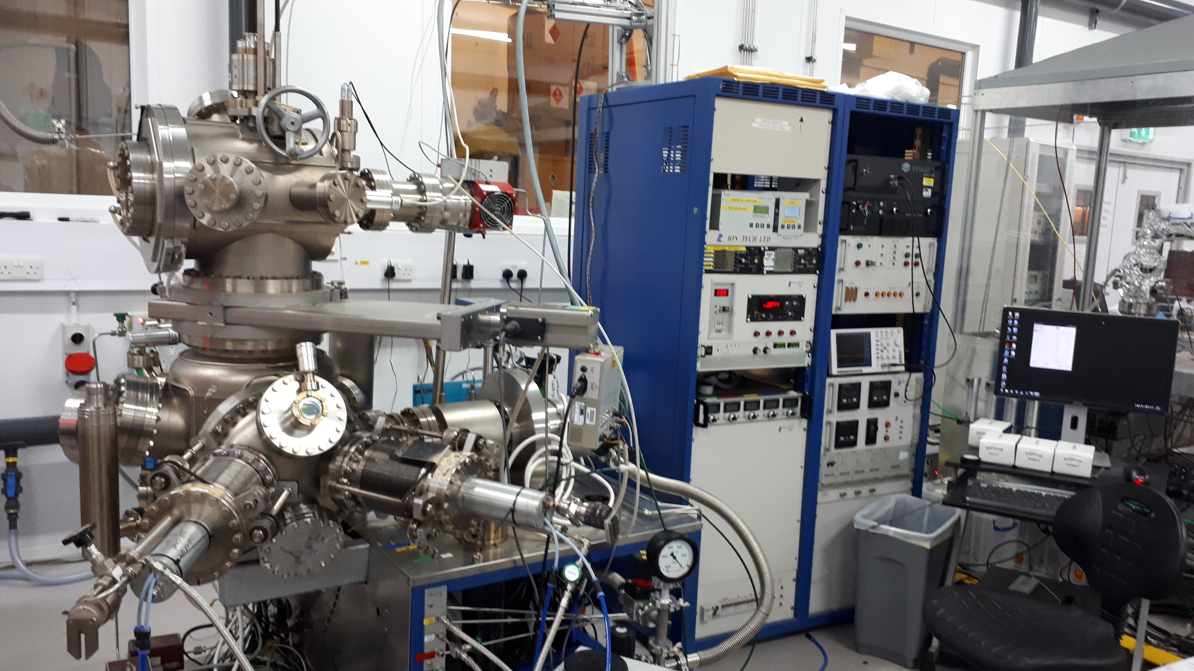
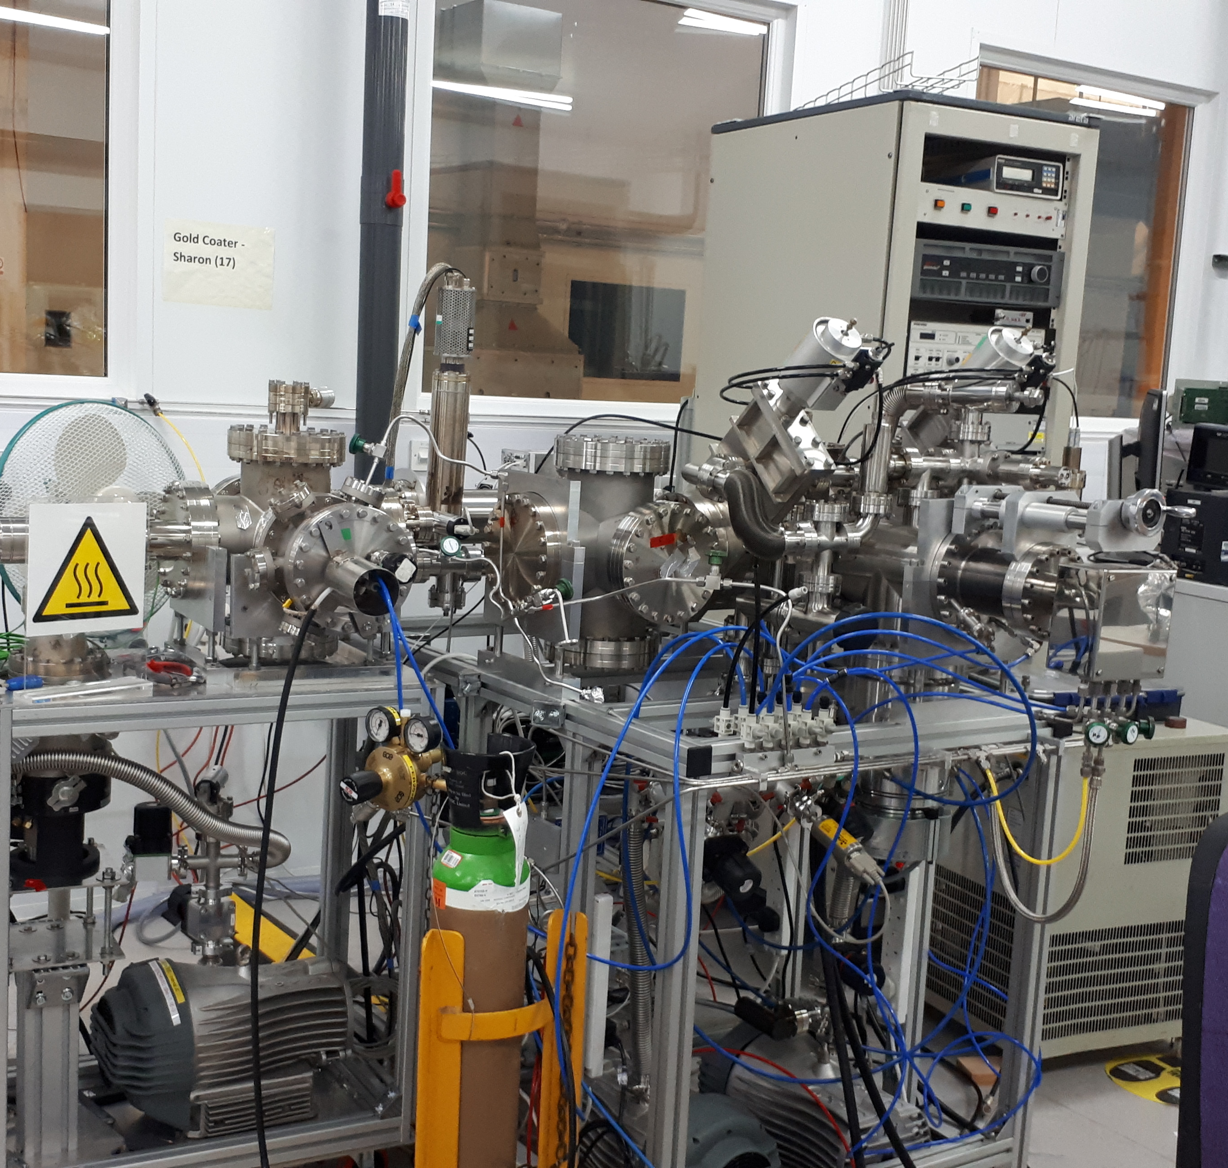
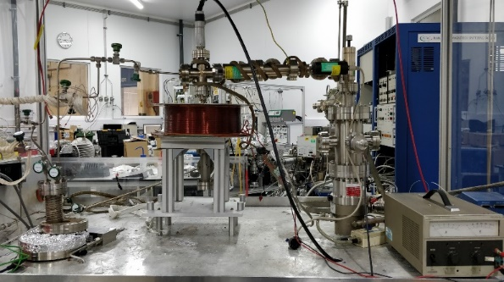
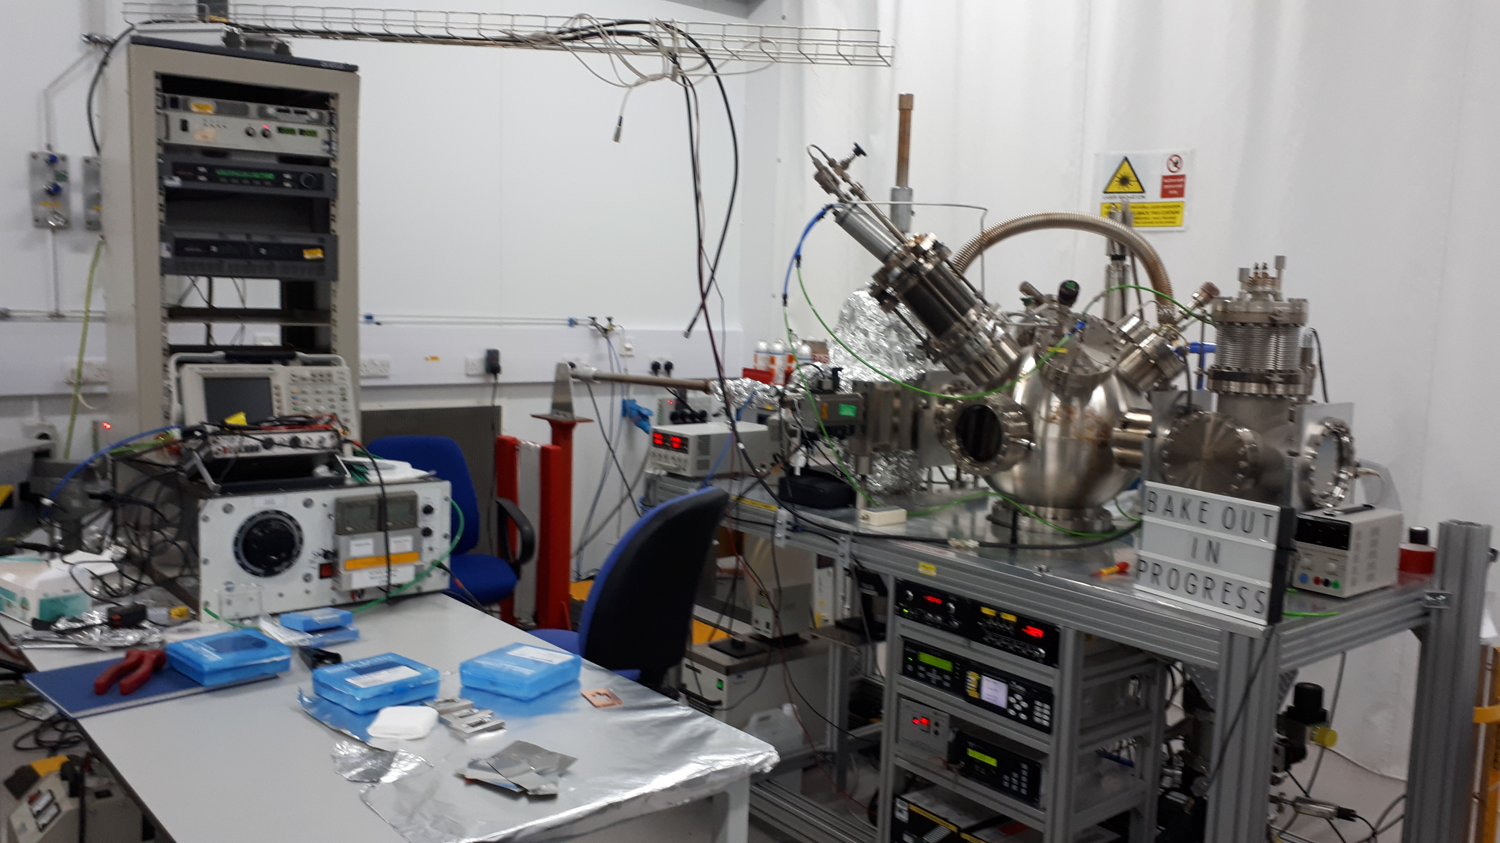
Thin Film Deposition in VISTA
Stablished and coordinated by R. Valizadeh (ASTeC)
CI collaborators: Prof J. Bradley and Dr V. Danak (Liverpool University)
Participants: A. Hannah, J. Conlon, F. Walk, F. Lockwood Estrin
Chemical Vapour Deposition (CVD)
Physical Vapour Deposition (PVD)
VISTA laboratory
Hybrid Physical Chemical Vapour Deposition (HPCVD) Facility
PVD deposition
PVD deposition

Slide 9
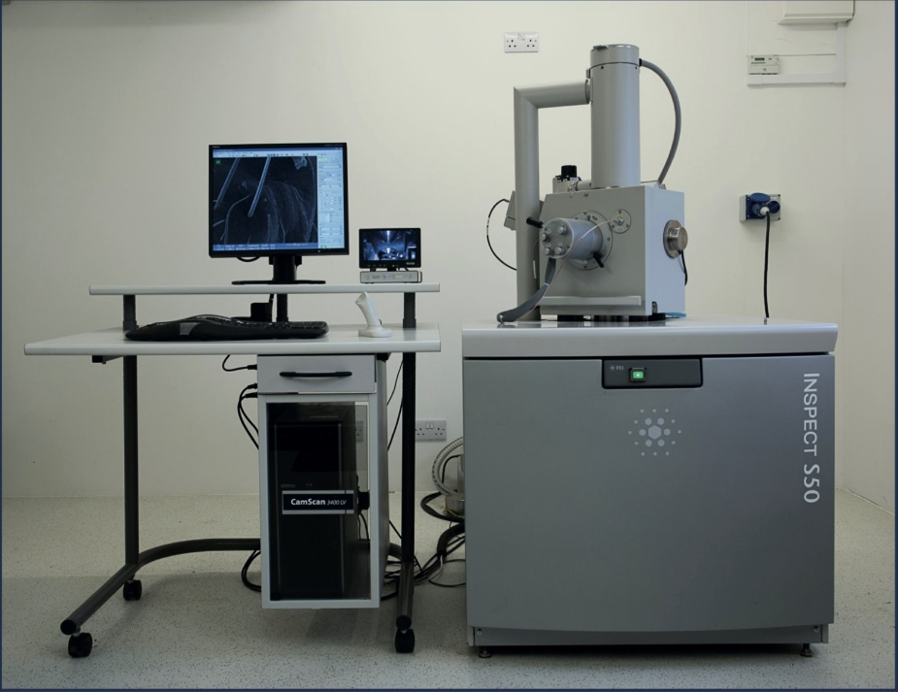
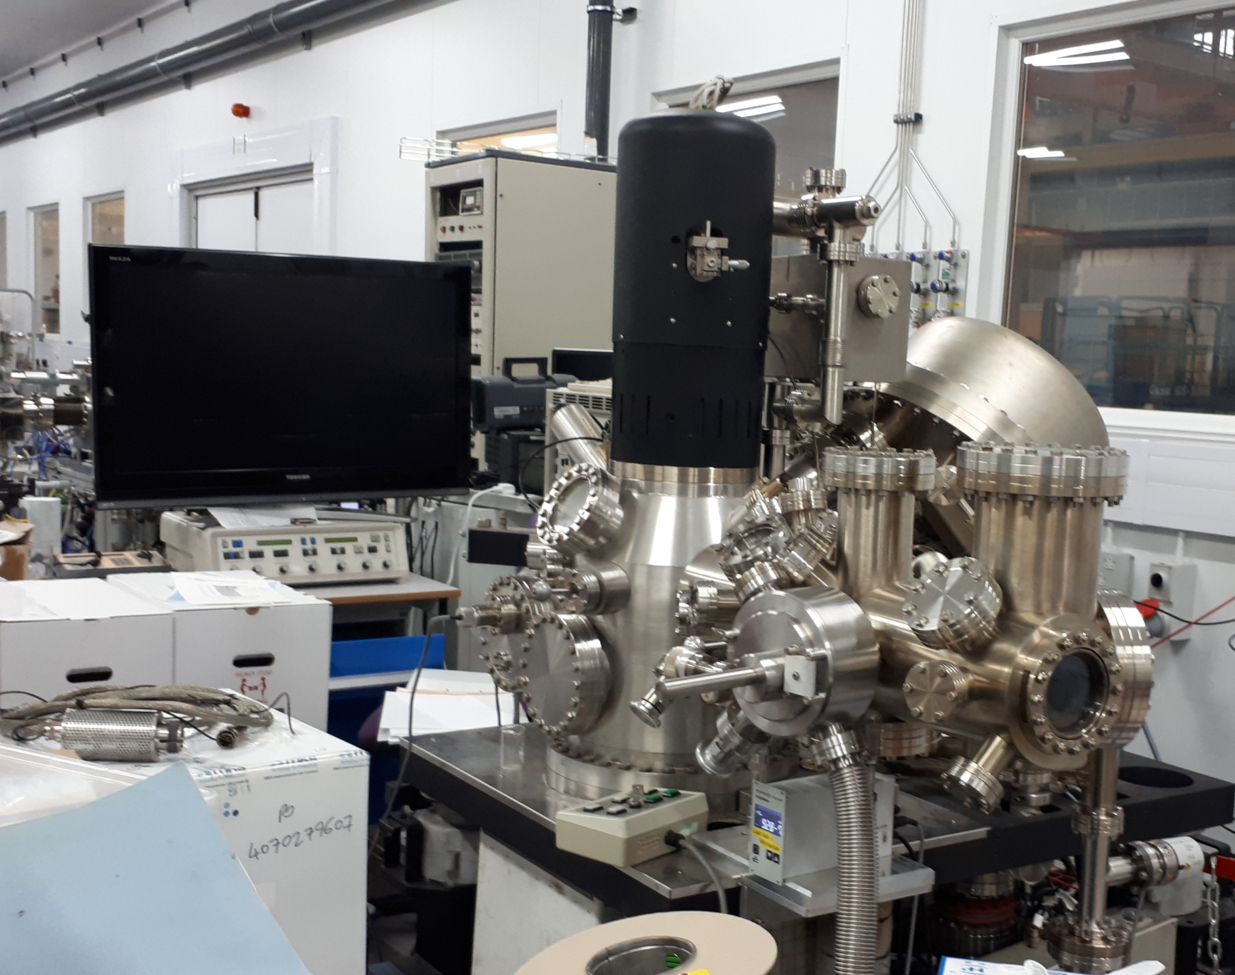
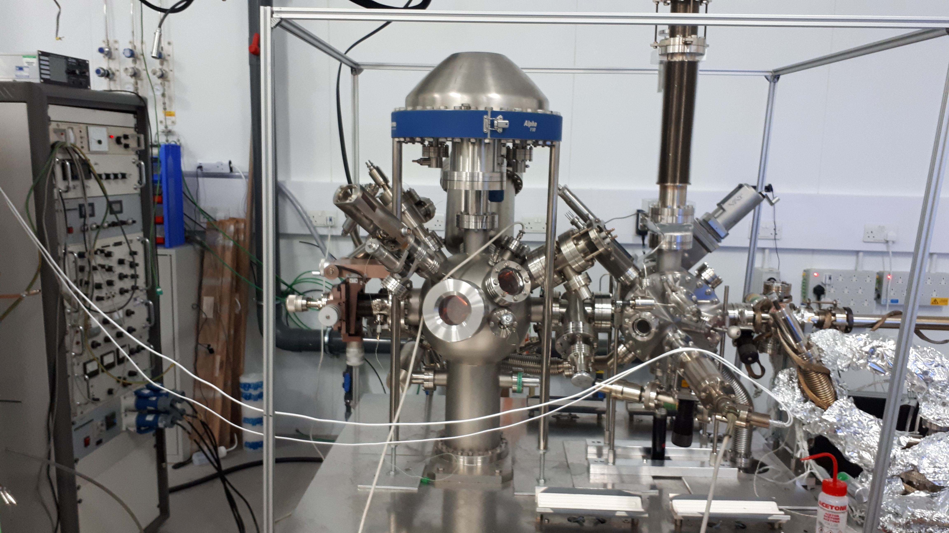
Thin Film Characterisation in VISTA
Stablished and coordinated by R. Valizadeh (ASTeC)
CI collaborators: Prof J. Bradley and Dr V. Danak (Liverpool University)
Participants: A. Hannah, J. Conlon, F. Walk, F. Lockwood Estrin , G. Stenning
Auger, XPS
FEI inspect S50 SEM
Auger
More characterisation facilities are available through collaborations with
The Materials Characterisation Laboratory at ISIS (RAL)
CI universities
Other UK universities
International collaborations
Courtesy of R. Valizadeh

Slide 10
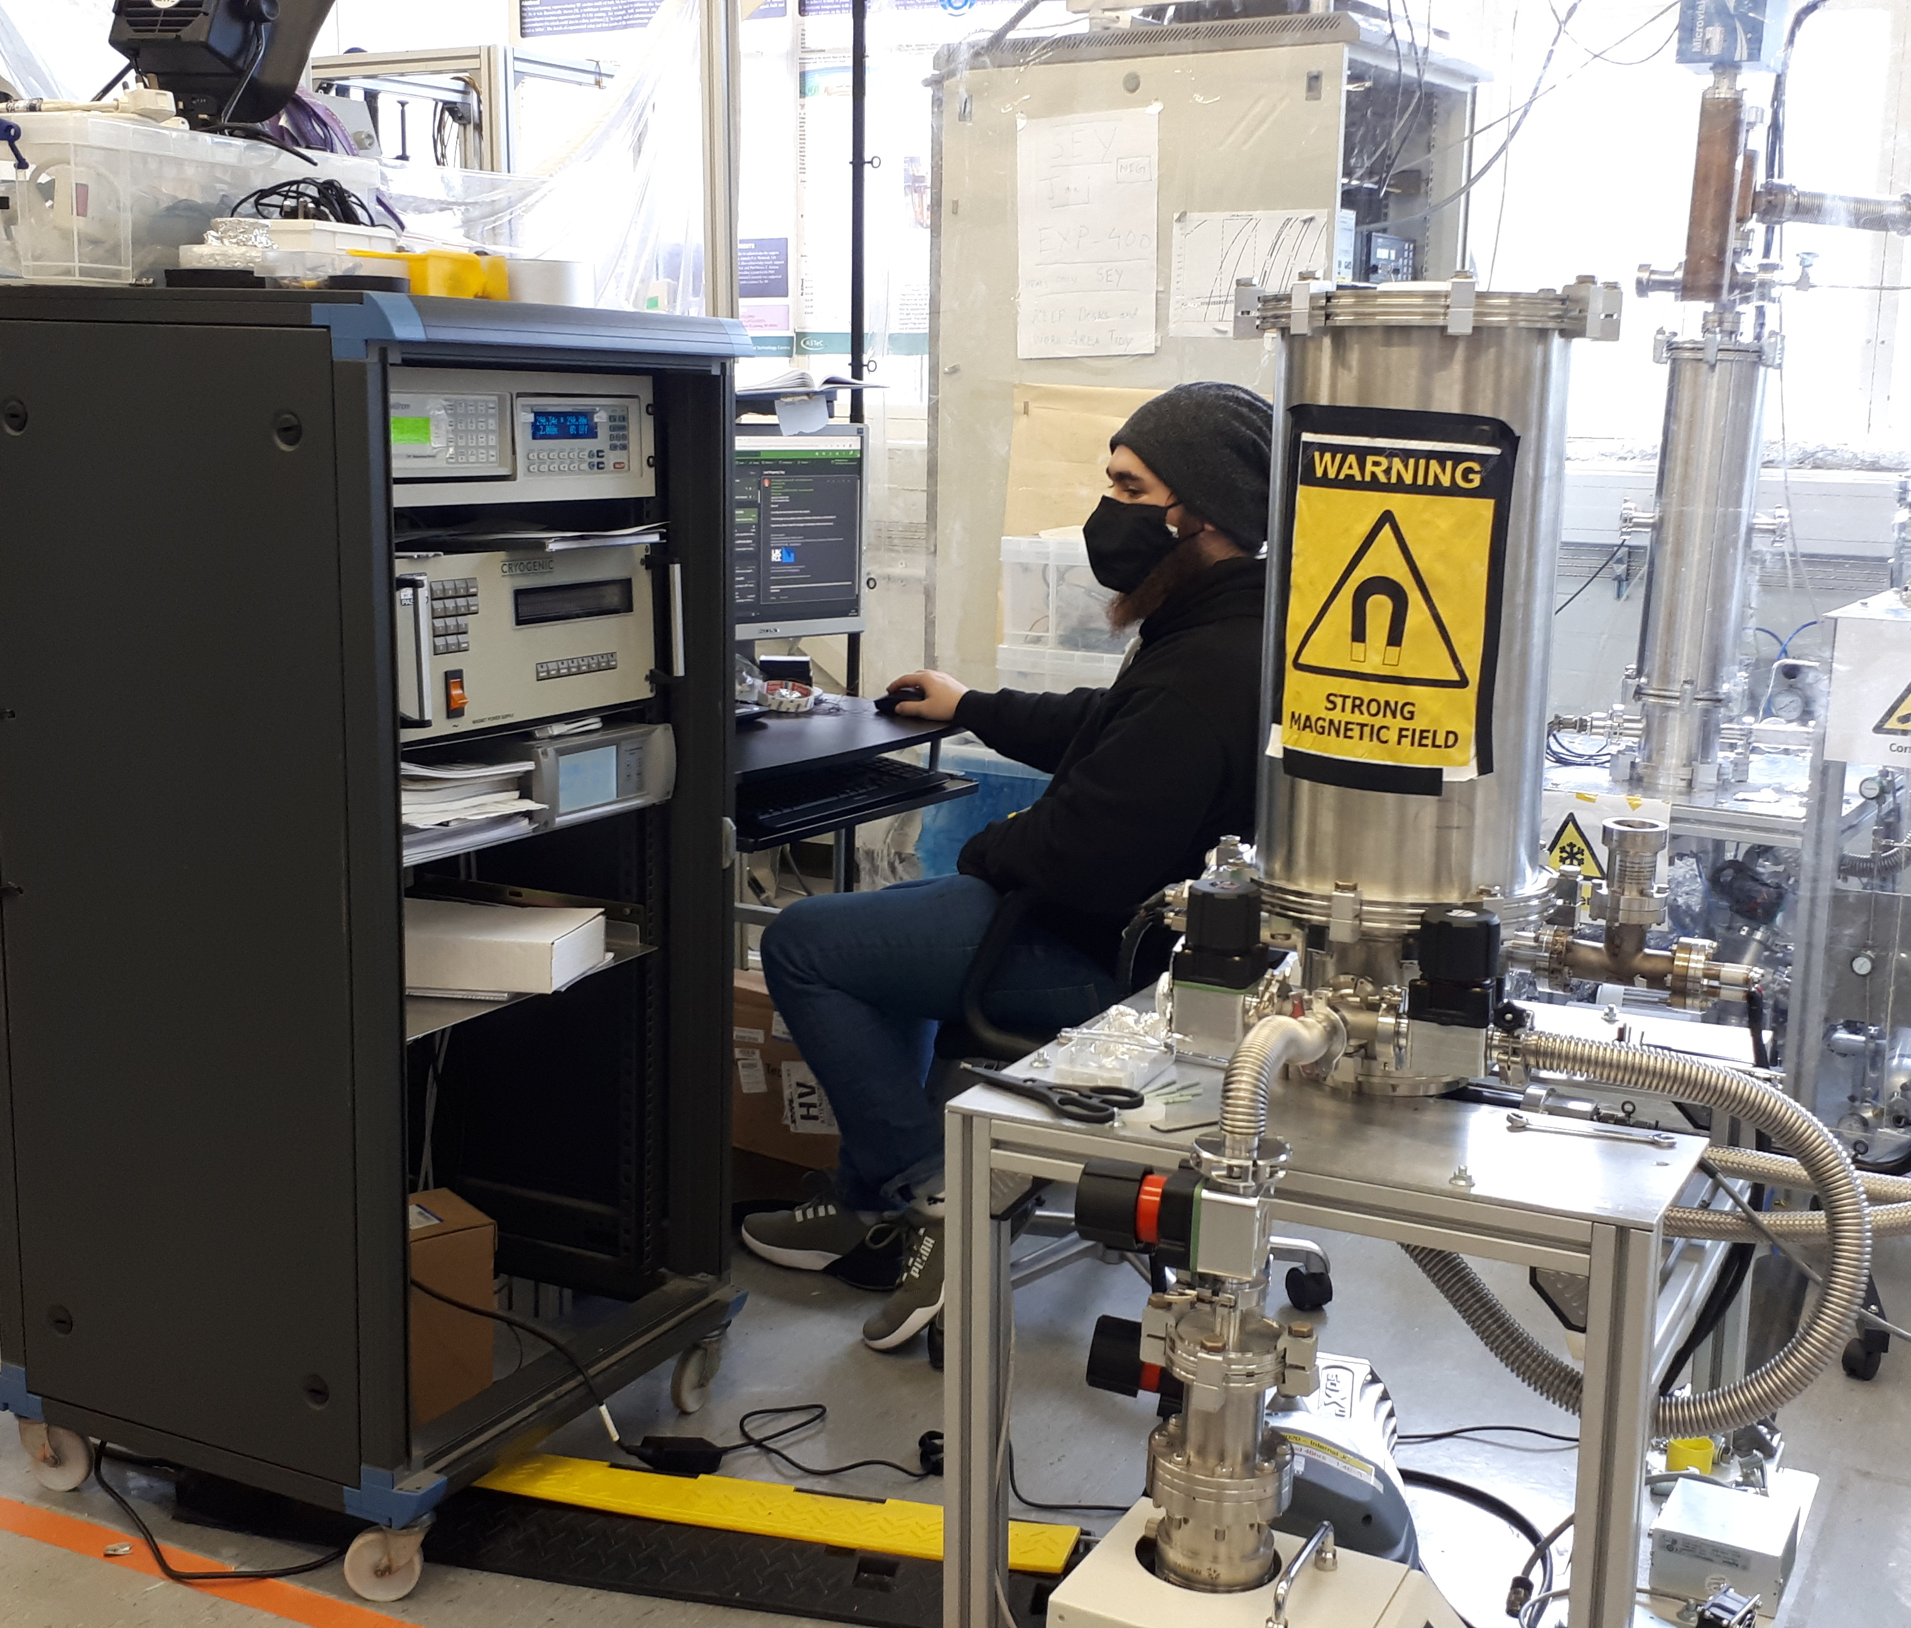
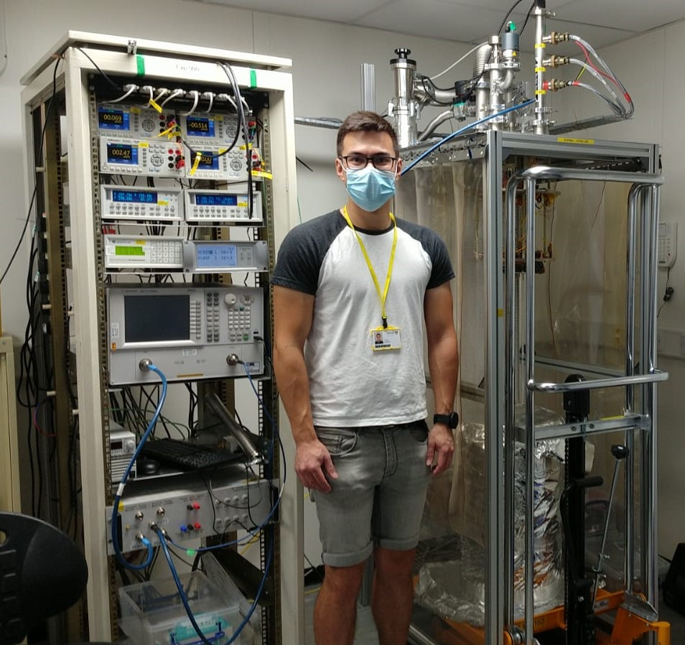
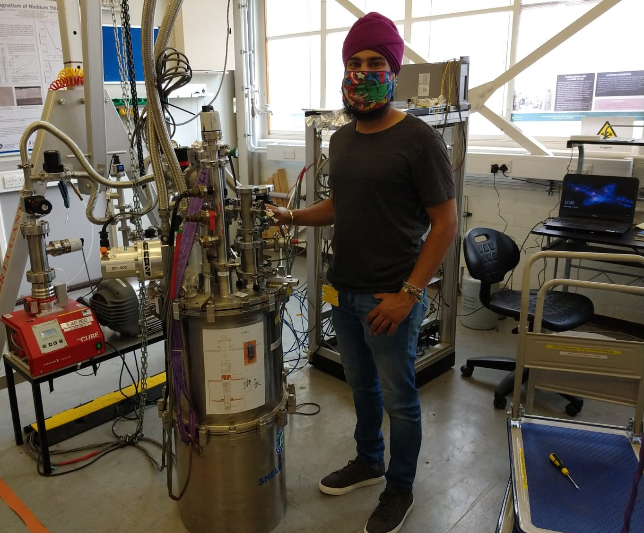
Superconducting Properties Evaluation
Coordinated by O.B. Malyshev (ASTeC)
CI collaborators: Prof G. Burt (Liverpool University)
Participants: T. Sian, D. Turner, D. Seal, P. Goudket, L. Smith, J. Conlon,
S. Pattalwar, N. Pattalwar, A. May, K. Dumbel, J. Wilson, G. Stenning
CryoLab
CrabLab
RRR
+ 3 other experiments
Magnetic field penetration facility
R_{S} measurements with 7.8 GHz cavity
Courtesy of T. Sian

Slide 11
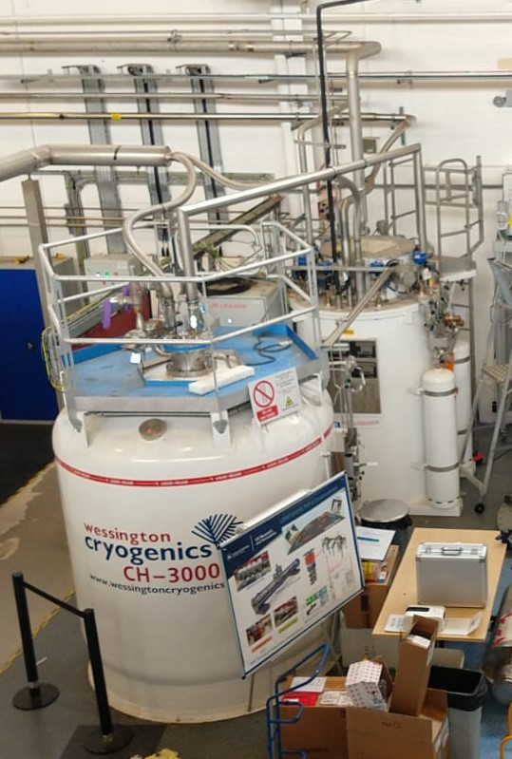
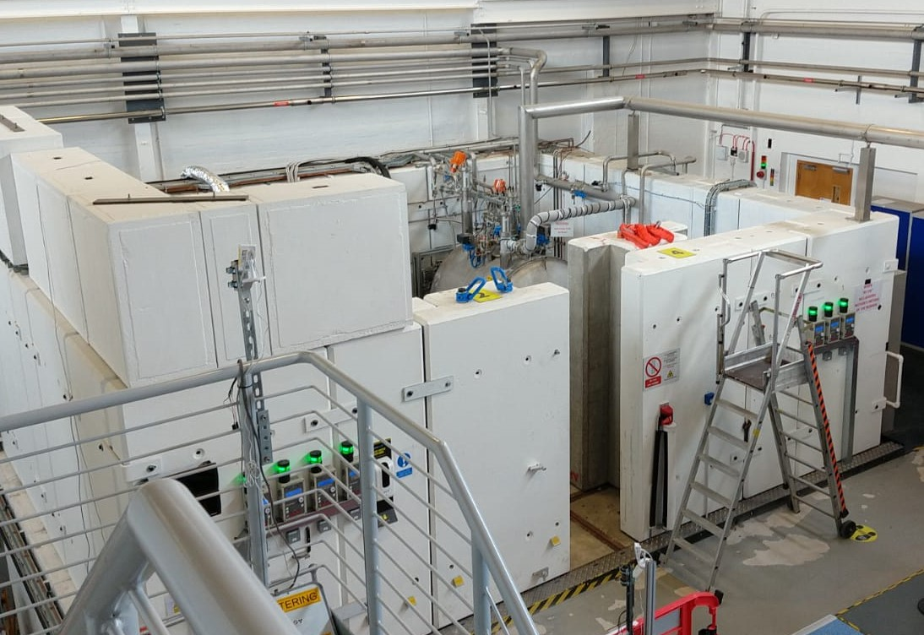
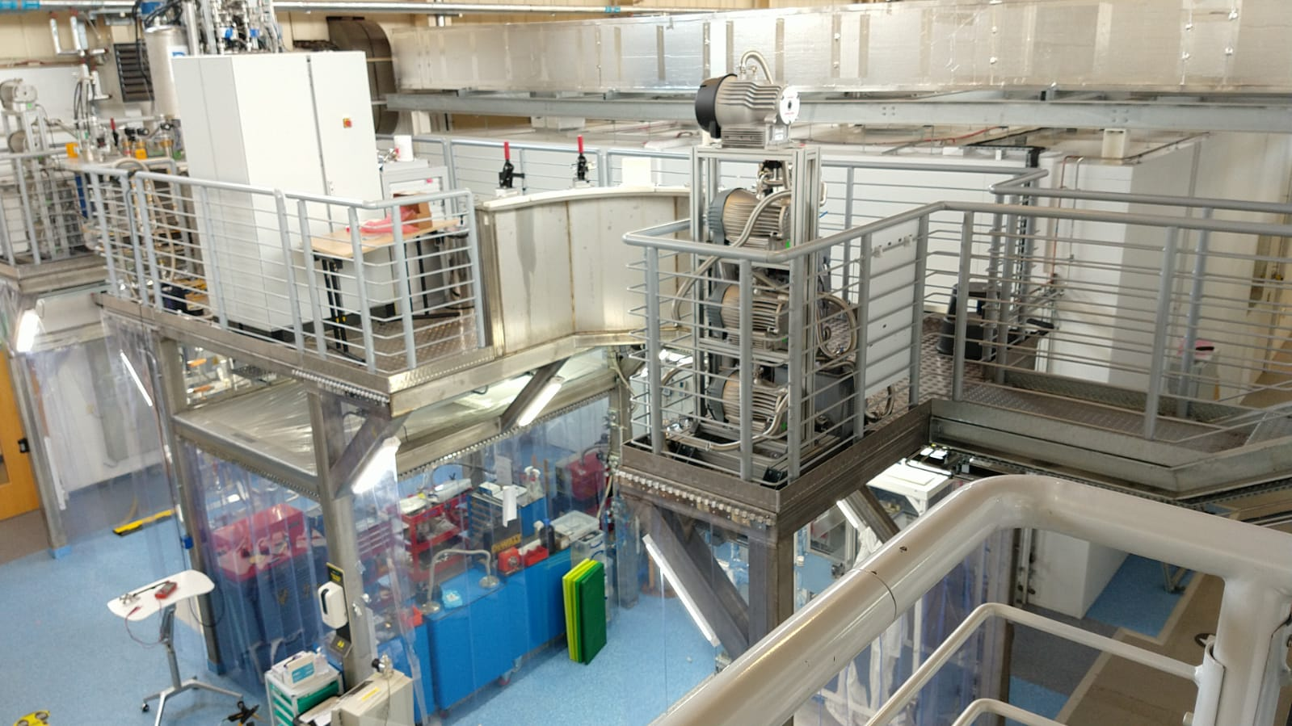
Superconducting Cavity Evaluation in SuRF lab
He liquefier and
LHe storage Dewar
SRF bunker
Clean room and assembly area
Courtesy of T. Sian

Slide 12
Superconducting Thin Film Coating for Radio Frequency Cavities (TF-SRF)
Main goal: to enable STFC for the superconducting thin film coated cavity production and testing
  Coating technology – well developed
  Thin film characterisation – routine
  AC/DC superconductivity evaluation – operational
  RF test on planar samples at 7.8 GHz – facility testing
  Cavity deposition – ongoing develoment
  6 GHz split cavity – design completed, manufacturing at ETC
  1.3 GHz cavity RF testing – in bits
  Scaling up to a routine cavity coating and testing – in plans
  SRF testing at DL – operational

Slide 13
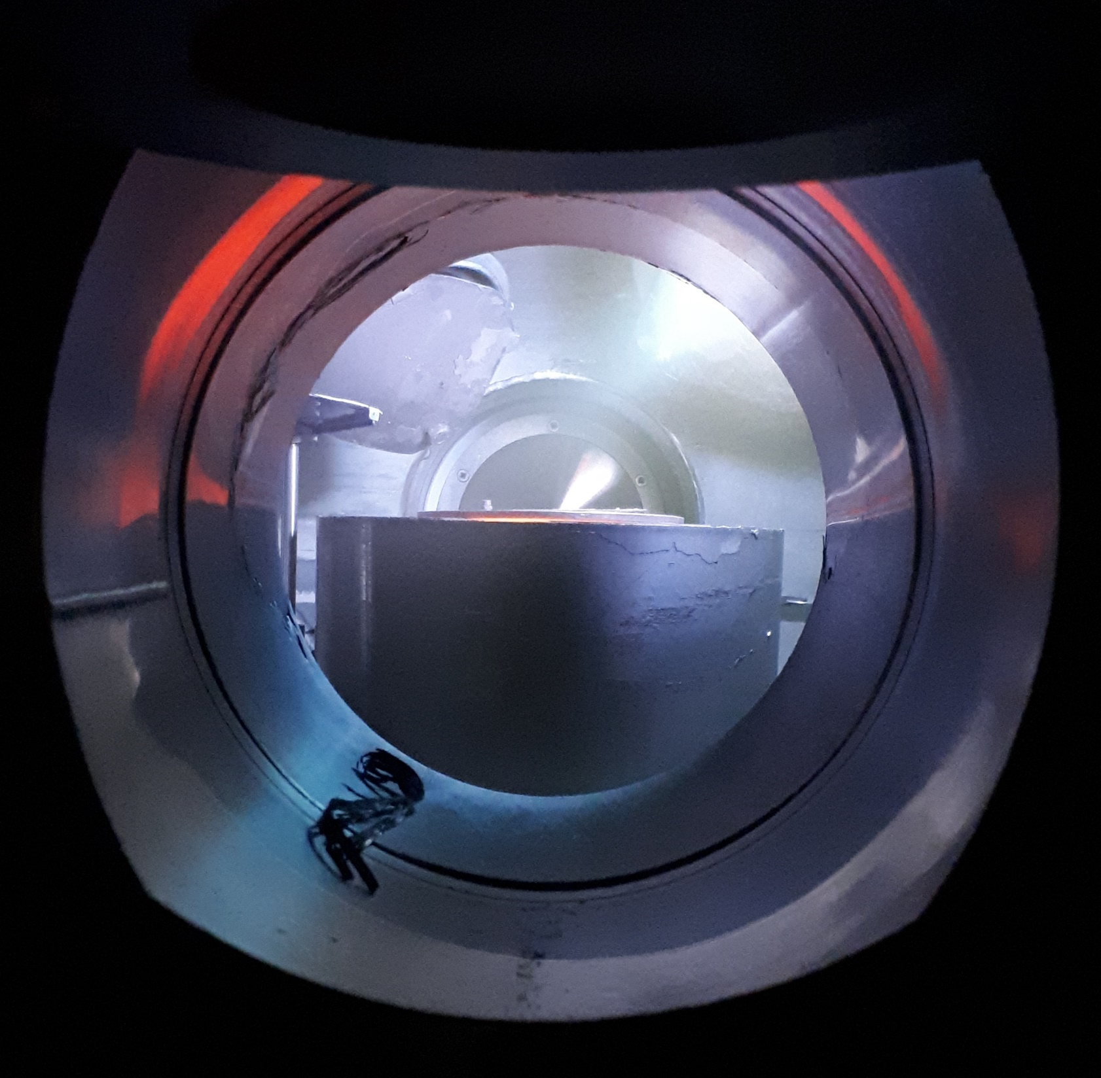
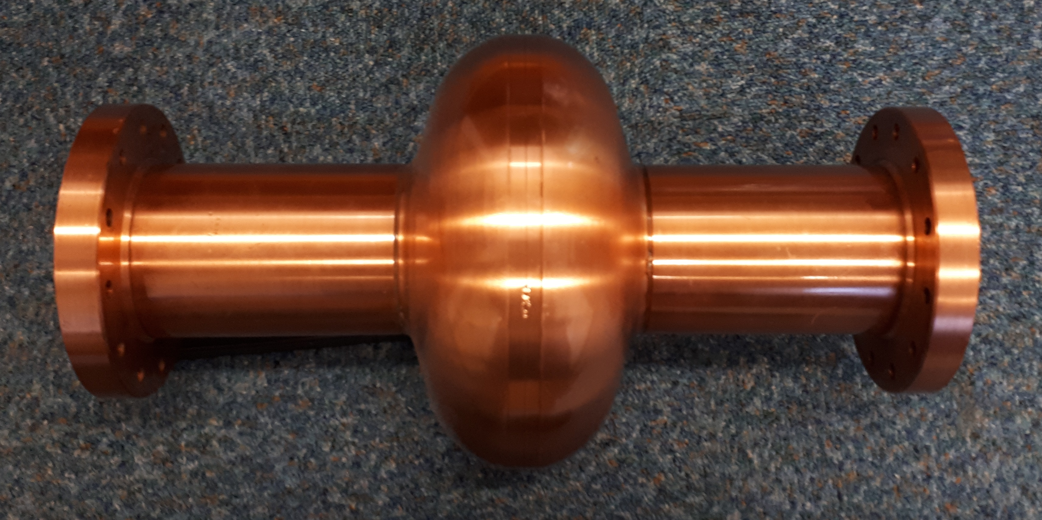
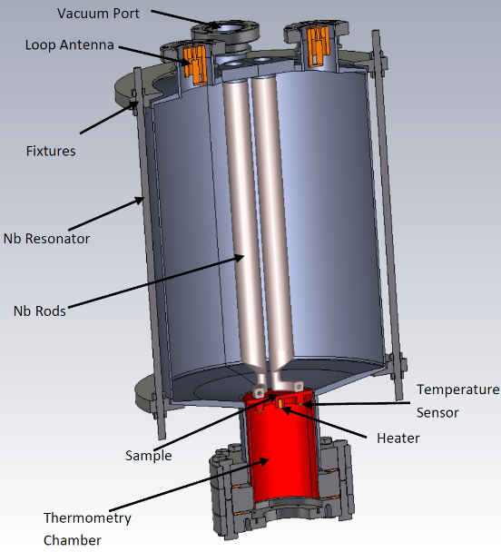
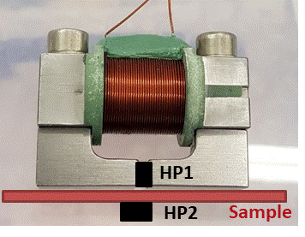
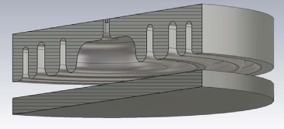
International collaborations
I.FAST WP9: Innovative superconducting cavities (01/05/2021-30/04/2025)
The main emphasis is on applying the result of ARIES to RF cavity deposition and testing
Thin film deposition
PVD: DC, pulsed, HIPIMS…
Film characterisation
SEM, FIB, AFM,
Real cavity measurement
Cavity deposition
(PE)CVD, (PE)ALD
XPS, XRD, RBS, TEM…
Superconducting RF properties evaluation
Superconducting properties measurement
RRR, H_{c}, H_{fp}, H_{sh}, …
QPR at CERN
QPR at HZF
HW cavity at ASTeC
Nb, NbN, Nb₃Sn, MgB₂, SIS, etc.
Surface preparation
Cleaning, etching,
Polishing, passivating
DC magnetic susceptibility,
Field penetration
Nb film laser treatment
Film deposition
1.3 GHz cavity for STF deposition
ARIES WP15: (01/05/2017-30/04/2021)
The main emphasis is on a systematic study of correlation between
SEM image of a NbN thin film
QPR
DC magnetisation
Test cavity

Slide 14













 | IFAST WP9 Partners | Leading | Participating
1 | CEA (Saclay, France) | WP, Tasks 1 and 4 | Task 1, 2, 4, 6
3 | IEE-SAS (Bratislava, Slovakia) |  | Tasks 2-6
4 | INFN/LNL (Legnaro, Italy) | Task 2 | Tasks 1, 2, 3, 5, 6
5 | INFN/LASA (Milano, Italy) |  | Tasks 2, 3
6 | Piccoli S.r.l. (Noale (VE), Italy) |  | Tasks 2, 3
7 | Helmholtz-Zentrum Berlin (Berlin, Germany) | Task 6 | Tasks 1 and 6
8 | RTU (Riga, Latvia) | Task 5 | Task 5
9 | University Siegen, (Siegen, Germany) |  | Tasks 2, 3, 6
10 | UKRI/STFC/ASTeC (Daresbury, UK) | WP, Tasks 1 and 3 | Tasks 1, 2, 3, 5, 6
11 | Lancaster University (Lancaster, UK) |  | Tasks 1 - 3
12 | Jlab (Newport News, Virginia, USA) |  | Tasks 1, 2
13 | PTI (Physics-Polytechnic Institute, Minsk, Belarus) |  | Tasks 1, 2
14 | MEPHI (National Research Nuclear University, Moscow, Russia) |  | Tasks 1 - 3
15 | Helmholtz-Zentrum Dresden-Rossendorf (Dresden, Germany) |  | Tasks 1 – 3, 5

Slide 15
A path towards the goal
(1) Superconducting thin film development

Slide 16
Copper surface preparation
Mechanical polishing
Fine mechanical polishing
  tumbling
  diamond turning
Chemical polishing:
  SUBU5 solution,
  Electropolishing (EP),
Laser polishing
  not proved yet
Combination of different techniques
Needs to be developed at STFC

Slide 17
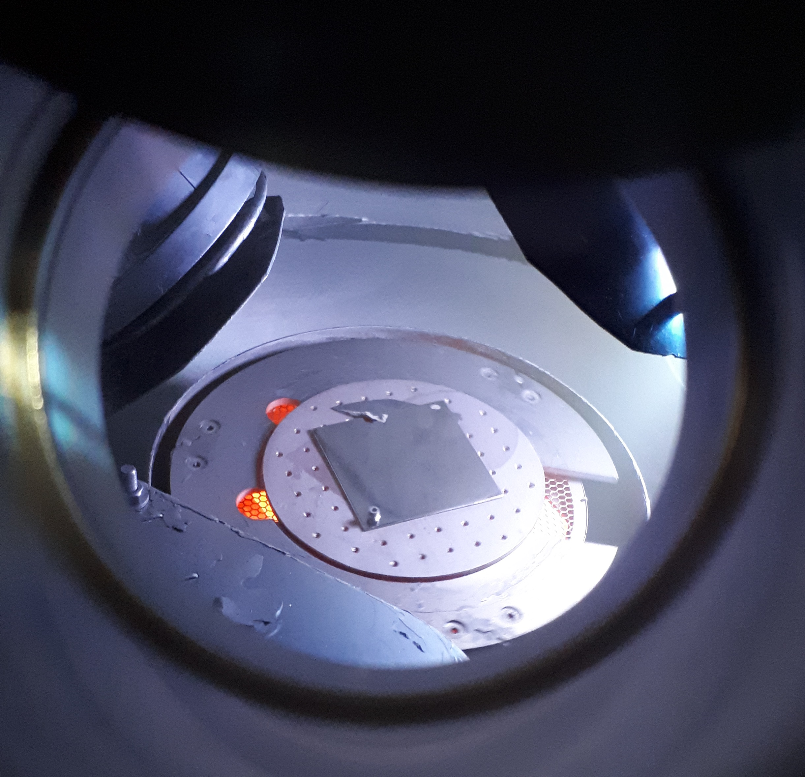
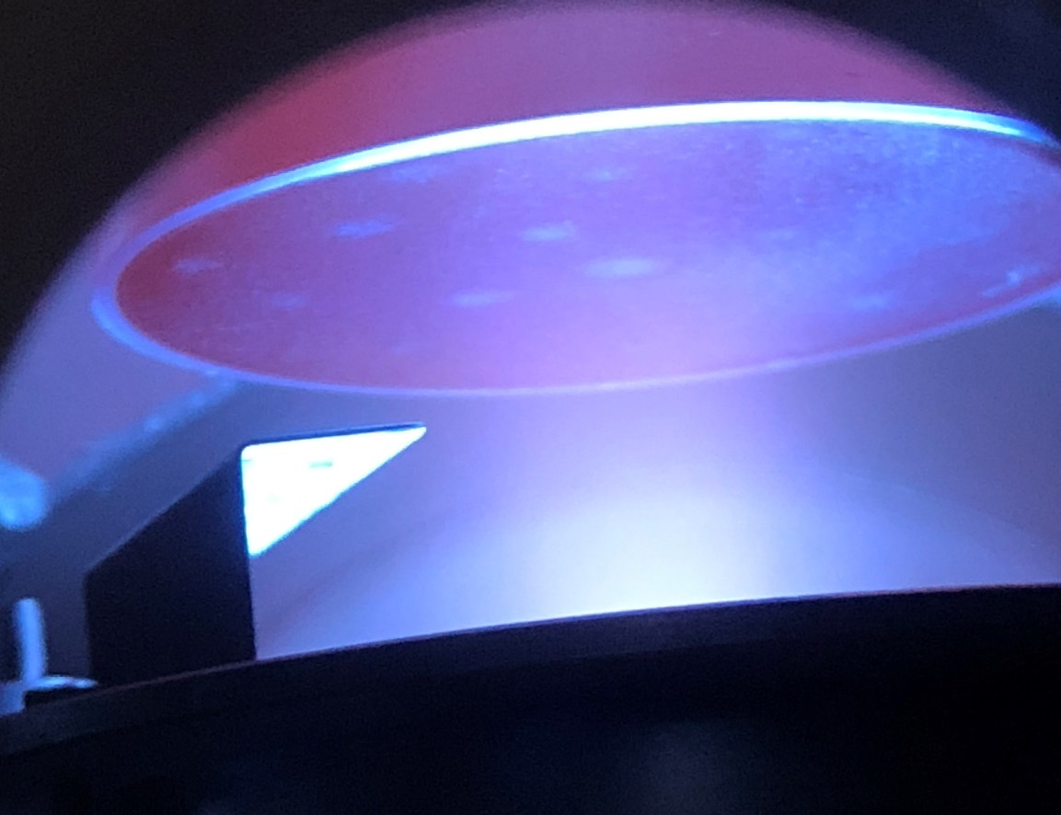
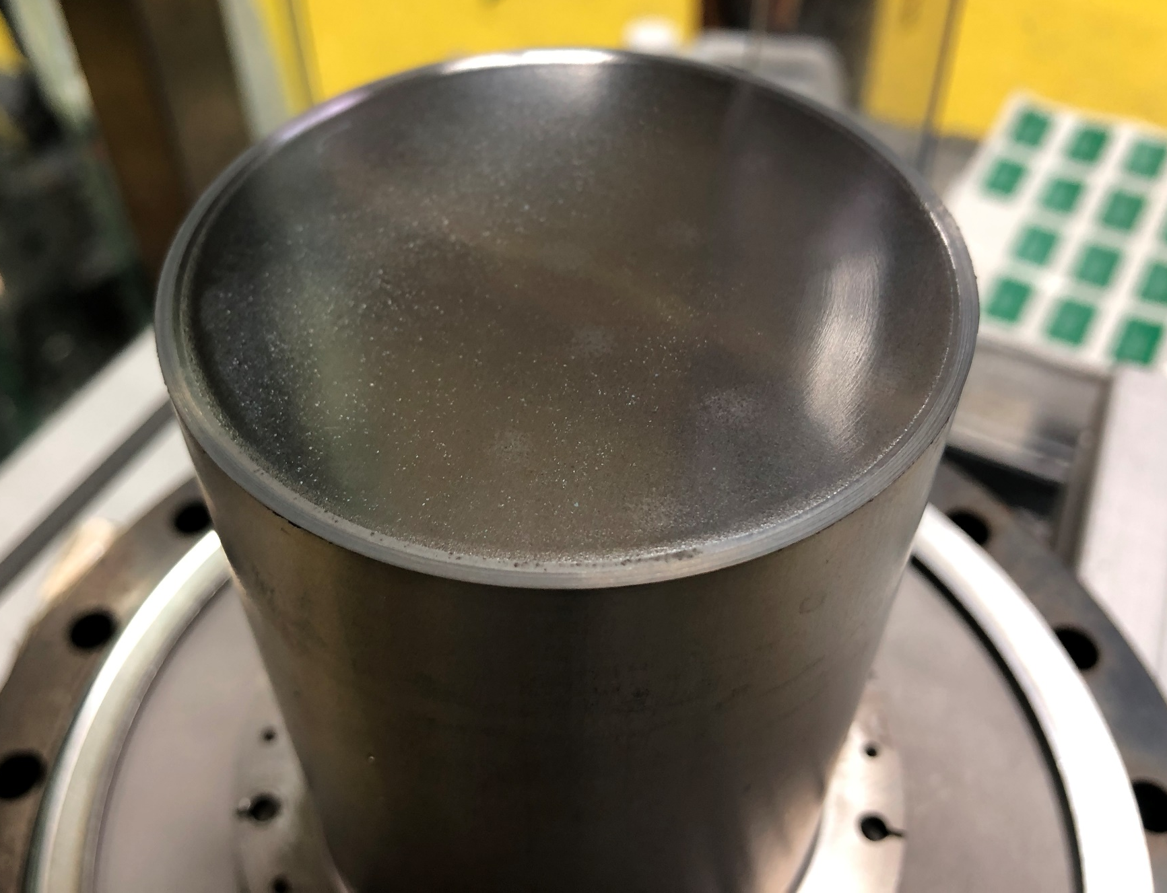
Thin film development
Techniques:
  PVD: DC, pulsed, HIPIMS…
  (PE)CVD, (PE)ALD – under development
  Combimed: PCVD
Materials:
  Nb
  NbN, Nb₃Sn, NbTiN, V₃Sn, MgB₂, etc.
  SIS structures
Deposition facilities
  For planar samples
  For QPR samples
A sample during the Nb deposition
Courtesy of R. Valizadeh (STFC)
A QPR sample during and after the Nb TF deposition
Courtesy of R. Valizadeh (STFC)

Slide 18
Thin film characterisation -1
Techniques:
  SEM, FIB, AFM,
  XPS, XRD, RBS, TEM
X-section SEM of Nb₃Sn deposited on Cu
X-section SEM of Nb₃Sn with a Nb underlayer as double structure on Cu
Courtesy of R. Valizadeh (STFC)

Slide 19
Thin film characterisation - 2
High resolution SEM of ion milled X-section of SIS multilayer structure (Nb/AlN/Nb₃Sn) deposited on Ta.
(b) EDX chemical mapping of the X-section. Courtesy of R. Valizadeh (STFC)

Slide 20
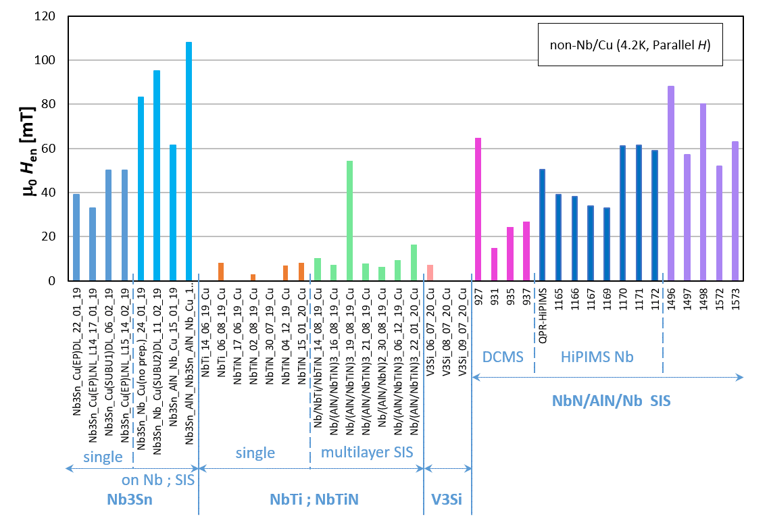
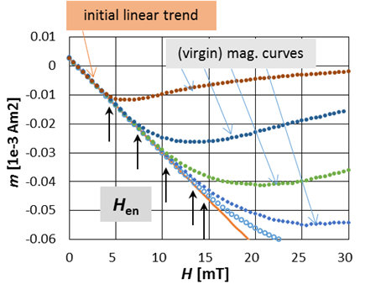
Thin film DC superconducting properties -1
PPMS (Physical Property Measurement System)
  Virgin DC magnetisation curve: B_{en}(~B_{c1 perp}), [B_{p}, B_{c2}]
The Materials Characterisation Laboratory at ISIS (RAL)
IEE-SAS (Bratislava, Slovakia)
Nb/Cu
H_{en} for non-Nb STF produced within ARIES WP15
Courtesy of E. Seiler (IEE, Slovakia)
Determination of the characteristic field H_{en} from the virgin magnetization curves

Slide 21
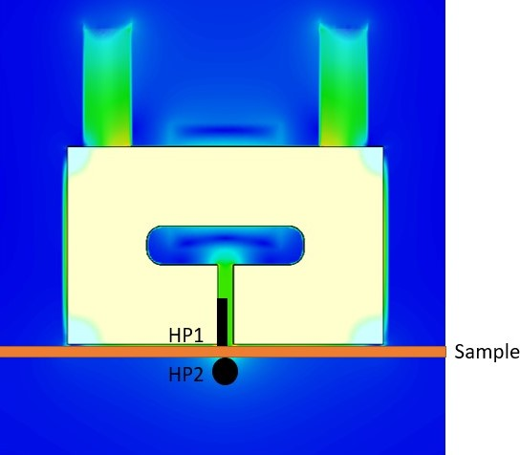
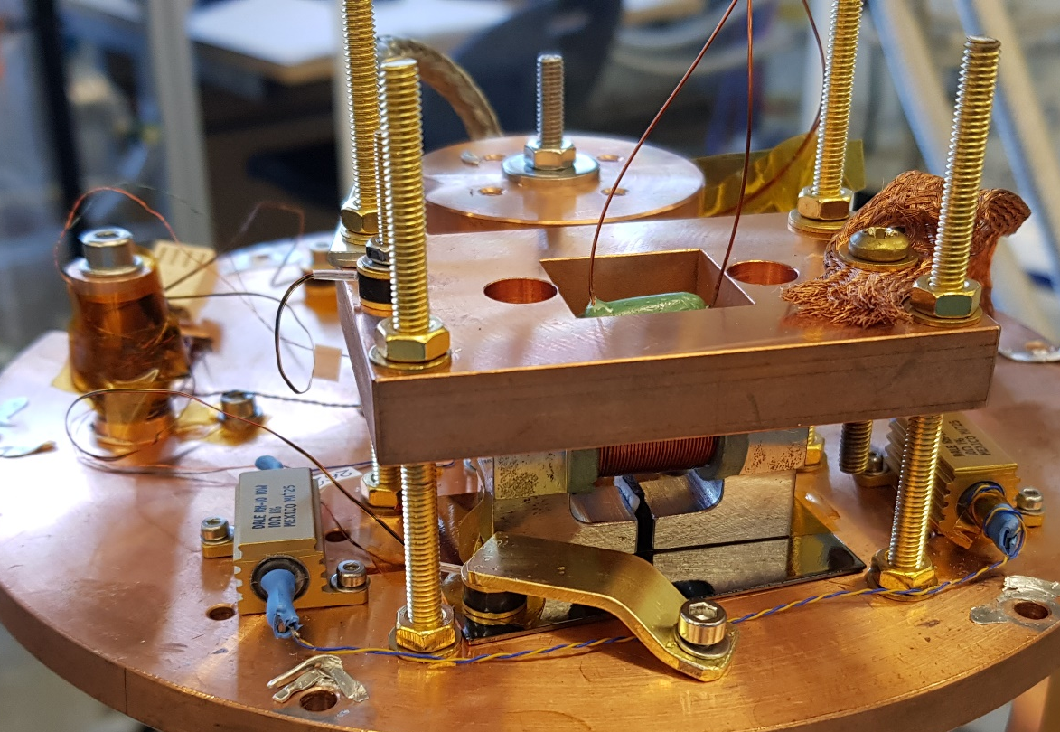
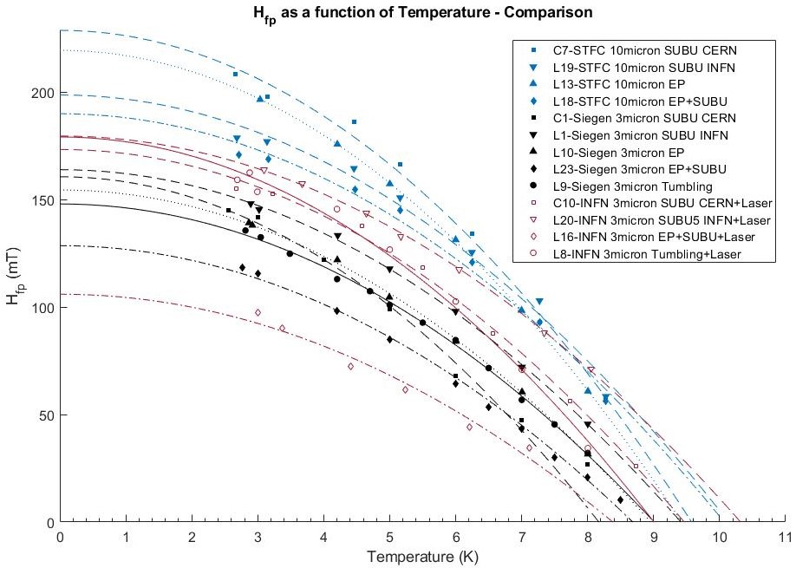
Thin film DC superconducting properties - 3
Magnetic field penetration facility for the planar samples
  TF samples can be compared in conditions similar to ones in the cavity
    DC magnetic field parallel to the surface
    Magnetic field applied from one side of the sample (similar to an SRF cavity)
  Field local to the sample surface
    Avoids edge effect
    Allows possibility of sample scanning
  Applied and penetrated field measured by Hall probe sensors
Courtesy of D. Turner (LancU/STFC)

Slide 22
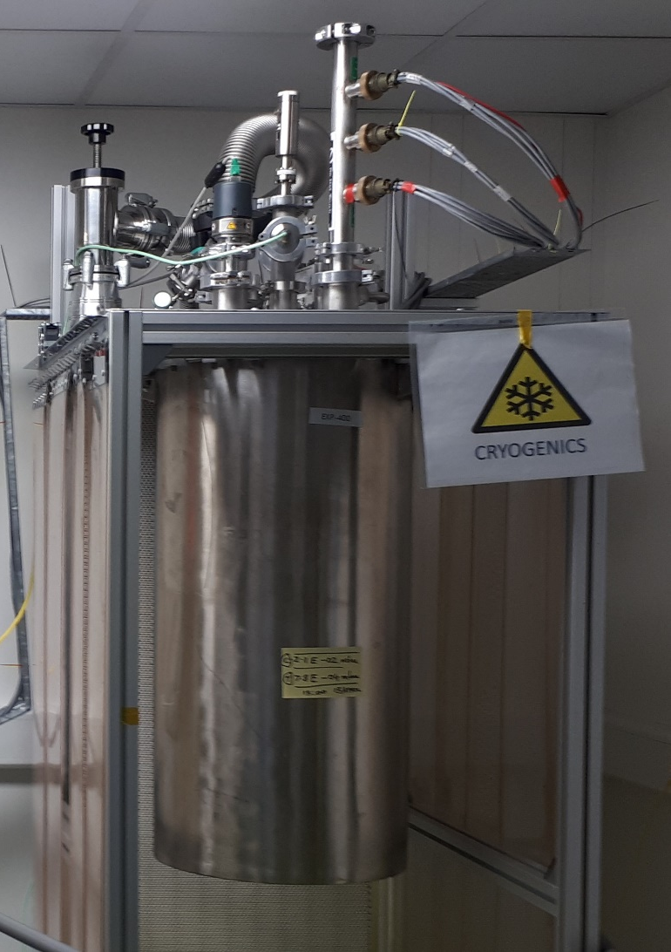
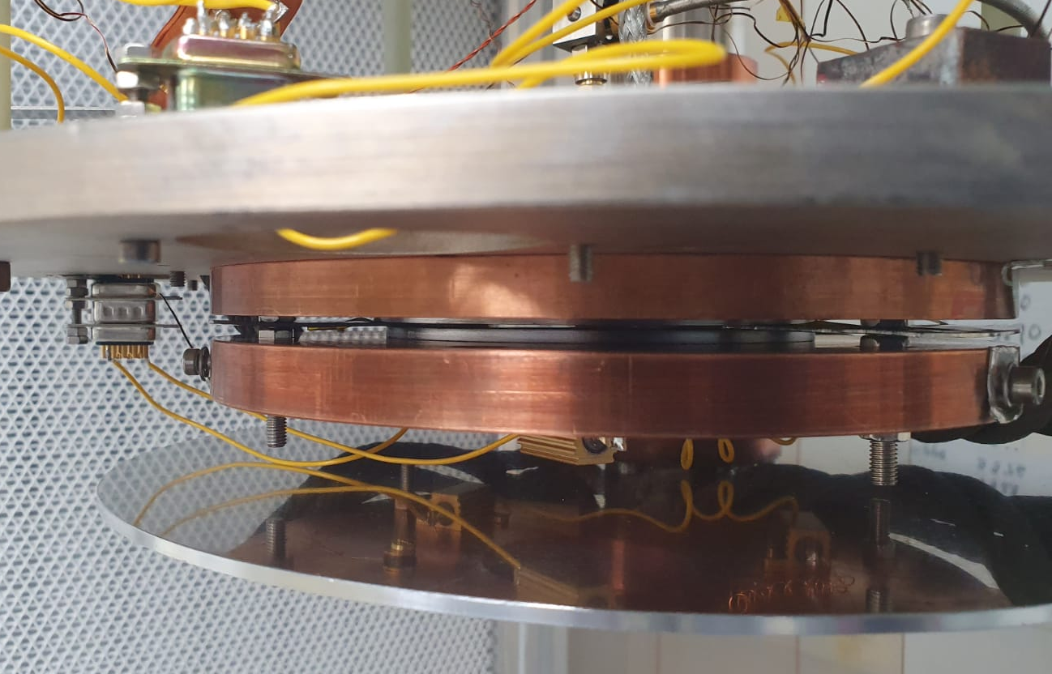
Thin film RF superconducting properties - 1
A radiofrequency (RF) cavity and cryostat dedicated to the measurement of superconducting coatings at 7.8 GHz (CrabLab/DL/STFC)
  Operation with a closed-cycle refrigerator.
  Low power measurements with an emphasis on fast turn-around time (~2 days for each sample).
  A cooldown demonstrated
    T_{cavity} = 4.0 K and T_{sample} = 4.0 K.
  Flat Sample – a disk diam. 100 mm
RF testing with a bulk Nb sample is in progress
Cavity Plate
Sample
Sample Plate
Pill-box cavity in a new facility with a closed-cycle refrigerator in STFC

Slide 23
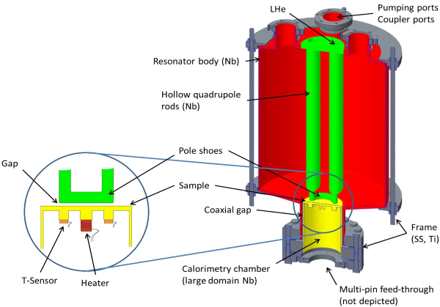
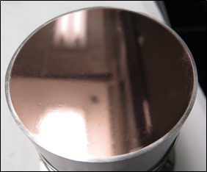
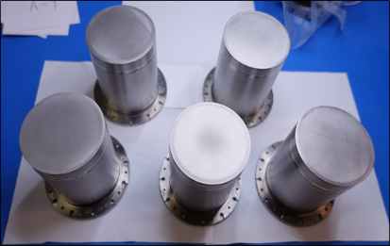
Thin film RF superconducting properties – 2a
QPR quadrupole resonator for RF testing in planar surface
HZB (Germany)
CERN (Switzerland)
f ≈ 416, 832 and 1248 MHz
Result: R_{s}(T,H)
  R_{s} obtained from a heat loss
Requires a special sample
Effort consuming
Low turnout
  ~1 sample in a month
Courtesy of O. Kugeler (HZB)

Slide 24
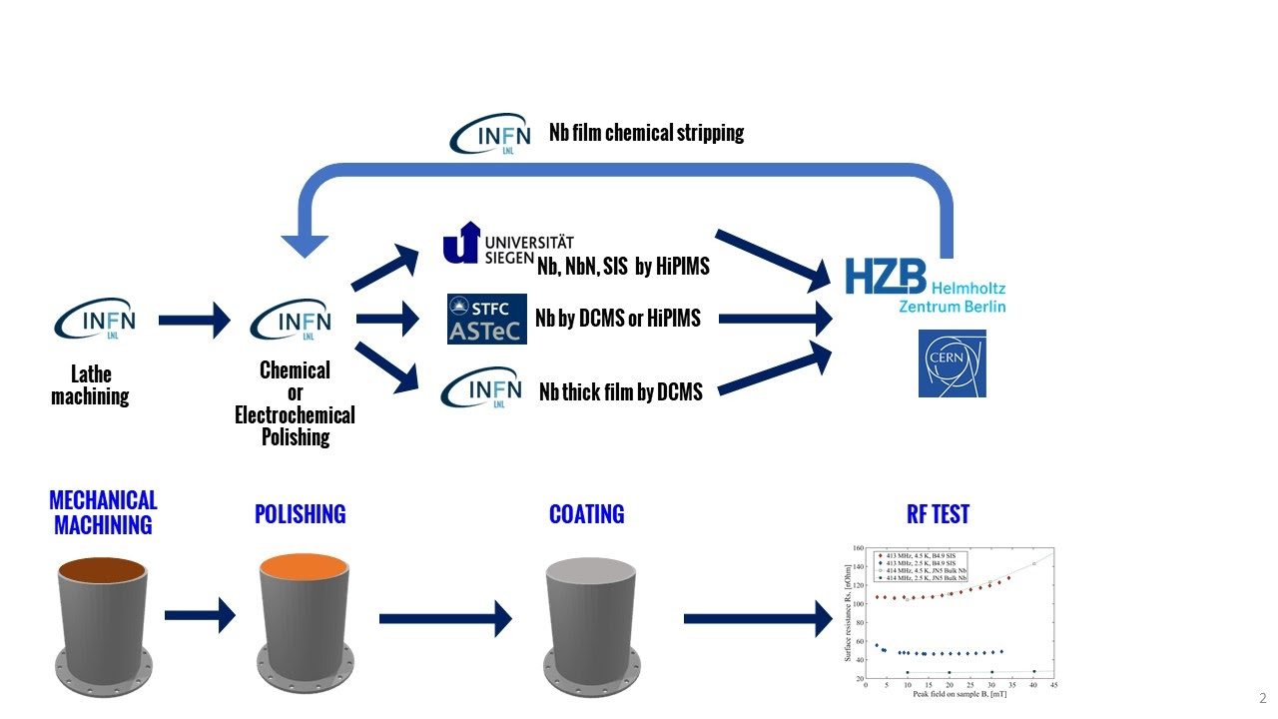
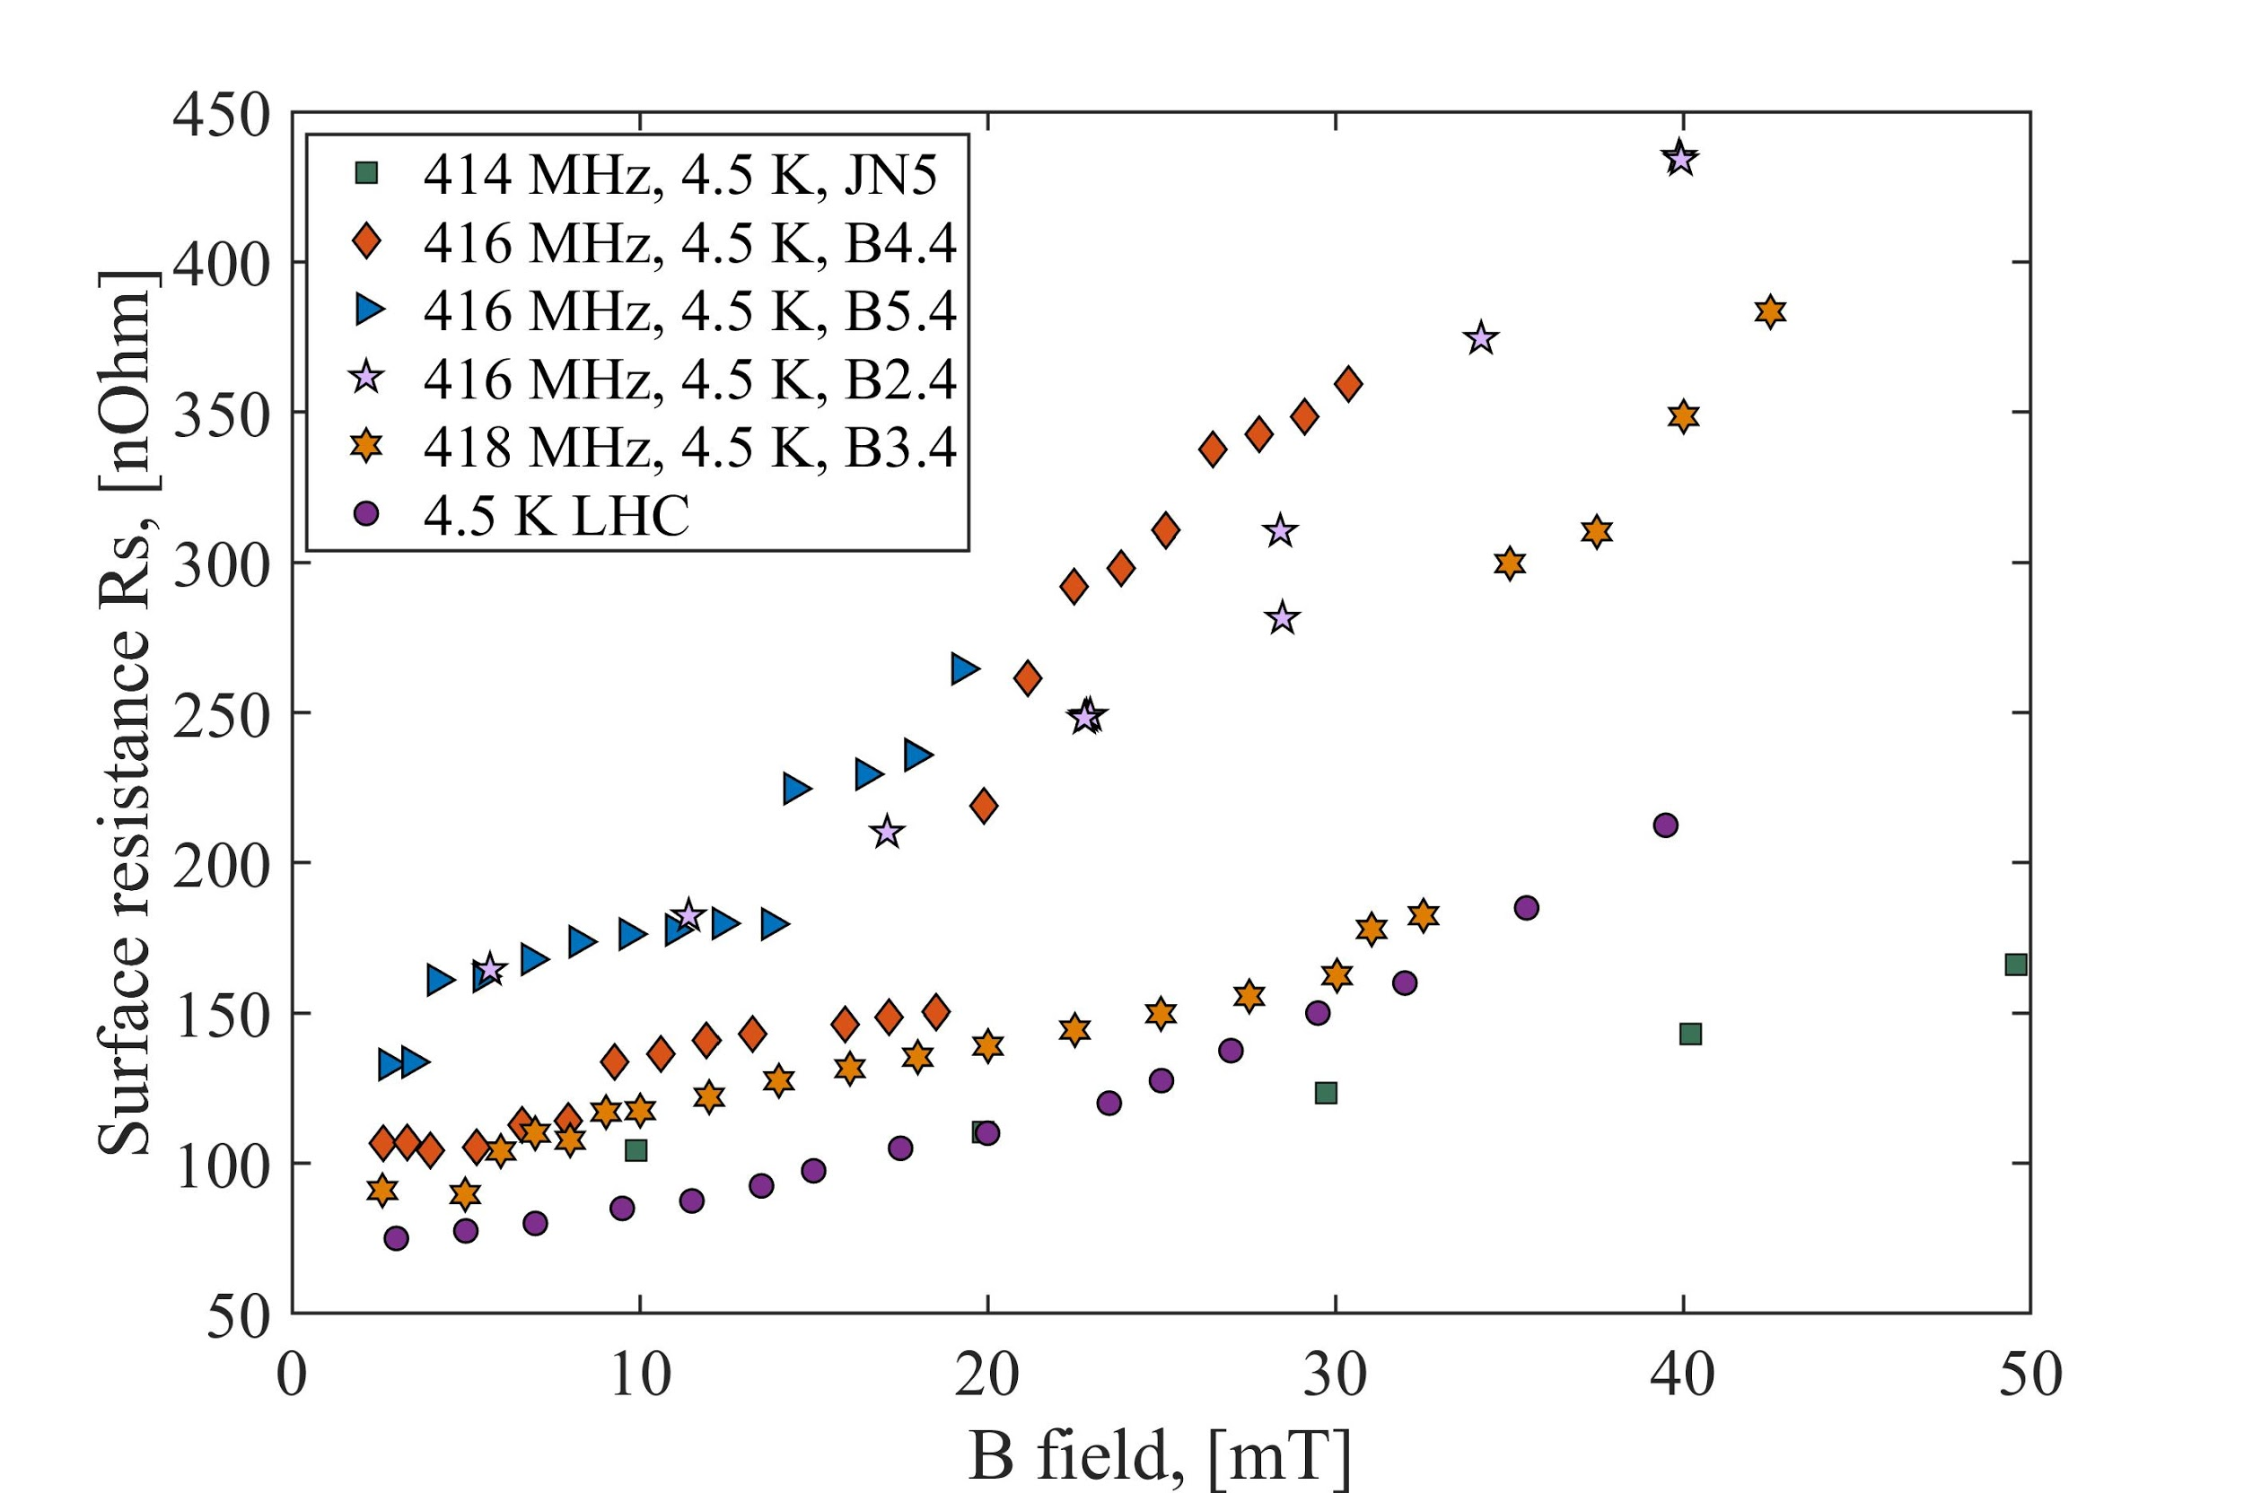
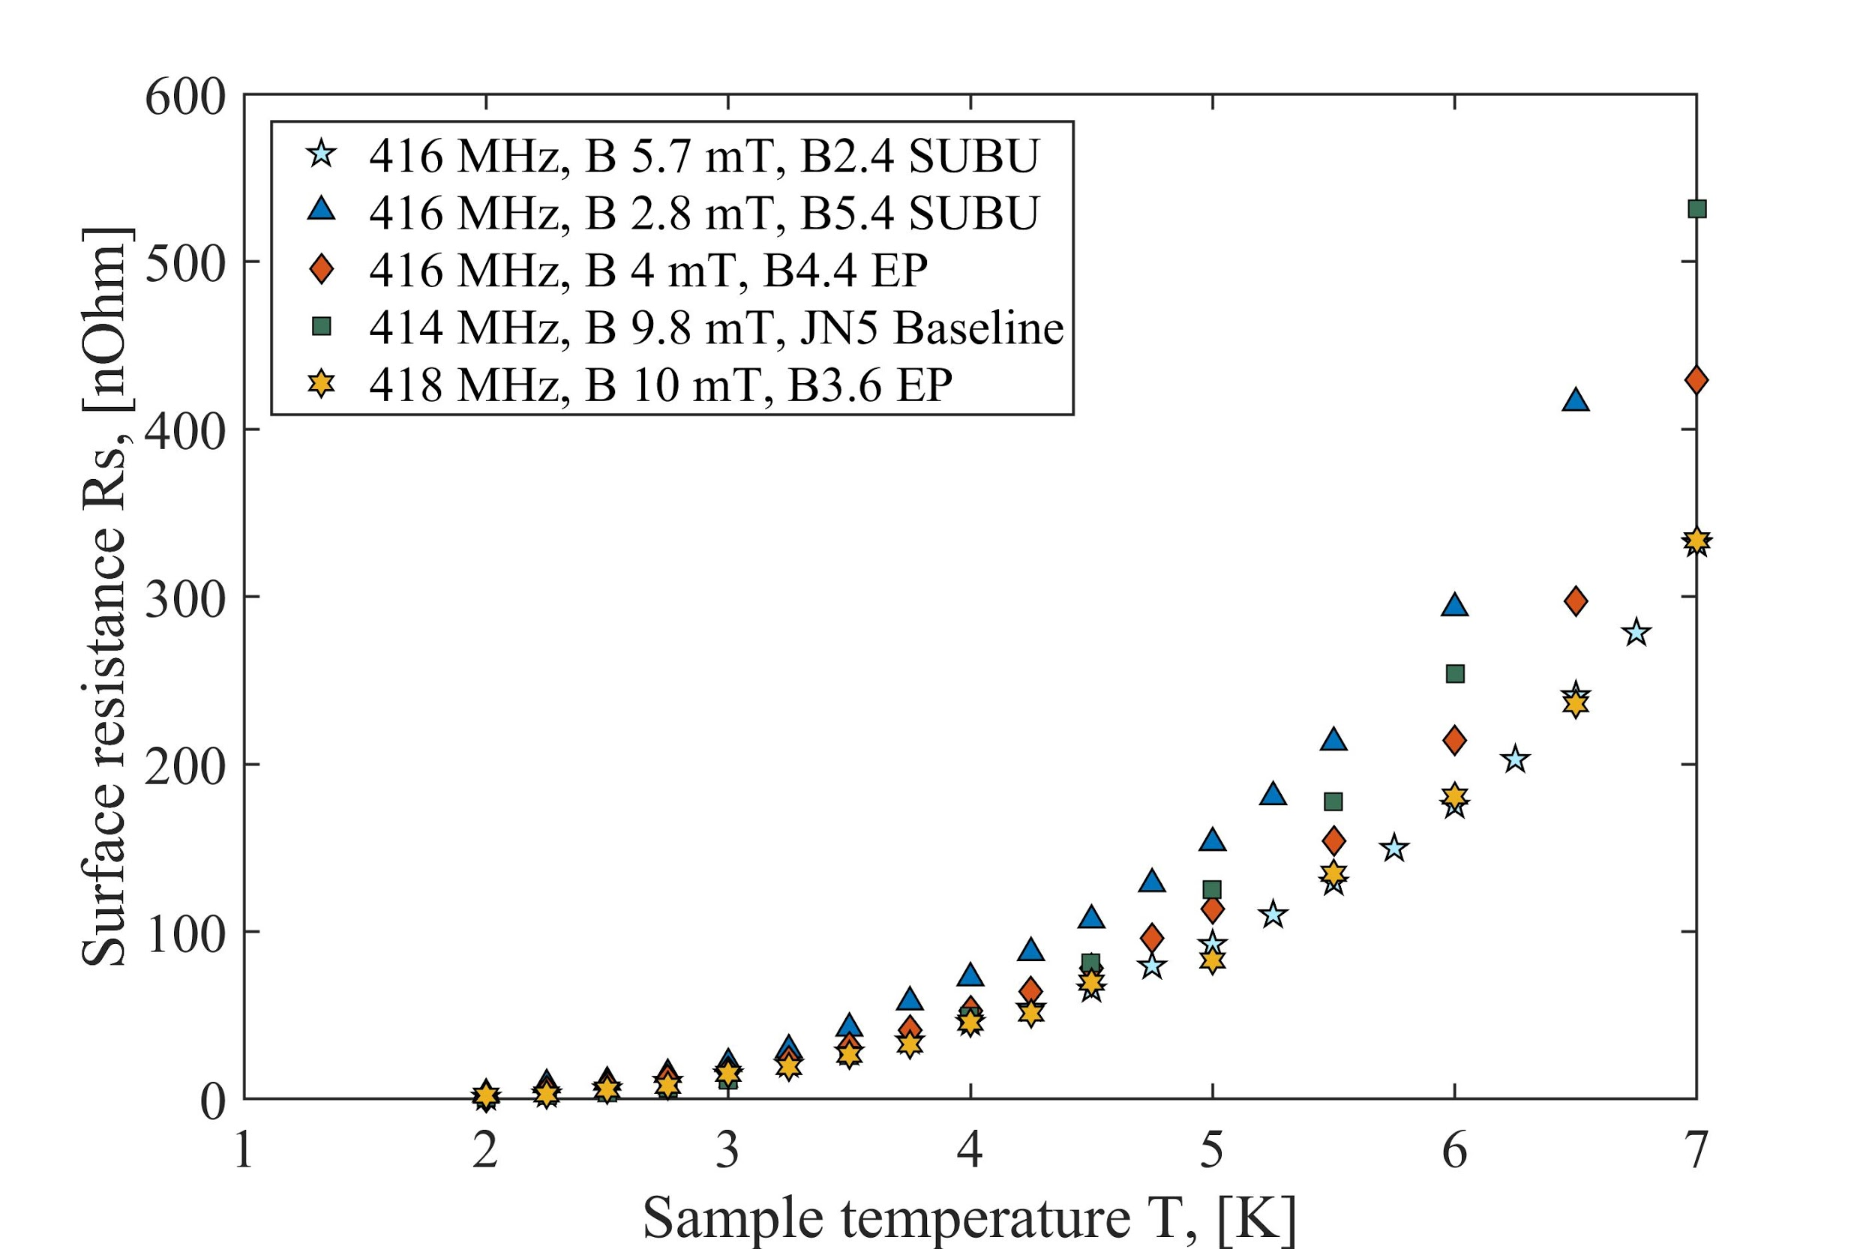
Thin film RF superconducting properties – 2b
QPR sample deposition and testing within ARIES and I.FAST
HZB (Germany):
  QPR sample production and
  RF testing facility
LNL/INFN (Italy)
  QPR sample polishing
Thanks to ARIES WP15 and IFAST WP9 collaborations
ASTeC deposited samples:
  Two Nb films tested
  SIS sample will be tested soon
Courtesy of C. Pira (LNL/INFN)
Surface resistance as a function of (a) magnetic field at T = 4.5 K and (b) temperature at low field
for Nb coated samples within ARIES WP15 (Courtesy of D. Tichonov, HZB )

Slide 25
A path towards the goal
(2) Superconducting thin film coated cavity

Slide 26
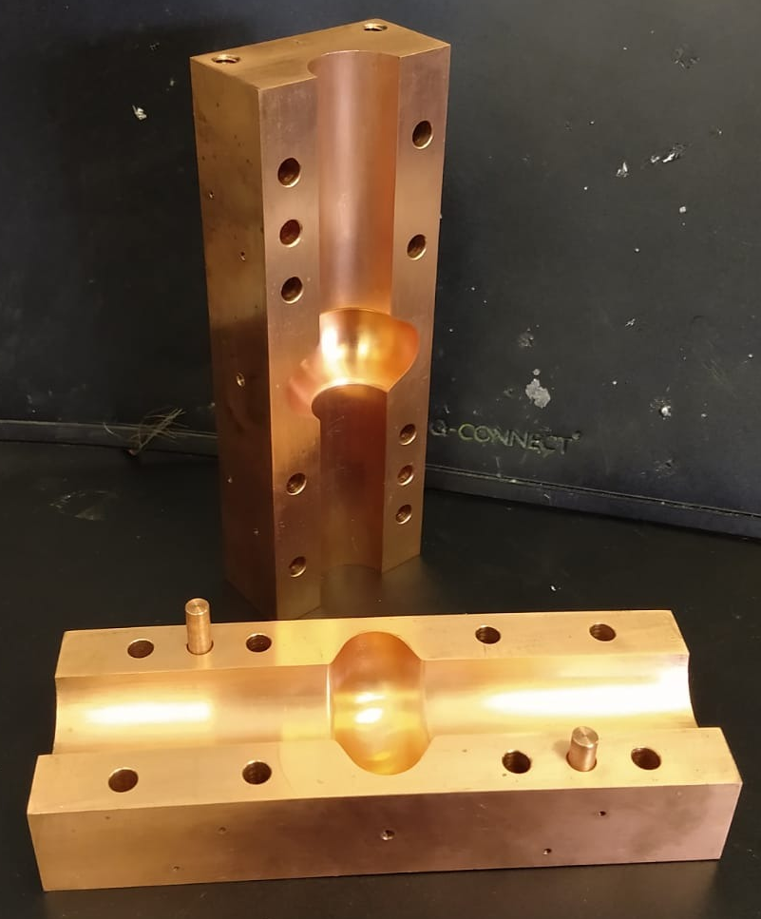
6 GHz split cavity
Split cavity:
  Easy to coat with either conventional planar magnetron or in tubular geometry used for RF cavities
  Easy to inspect
  Cavity design: G. Burt, P. Goudket, T. Sian
  3 cavities has been manufactured
Testing in EXP900 – dry cryostat
  Parts produced in ETC – in progress
  Scheduled fully operational and tested: ASAP but not later than May 2022
  Cleanliness: crablab environment
  Cryochamber vacuum: ~10⁻⁷ mbar
  Cryogenic temperature ~4 K is available
  Limited power (radiation safety SHE limits)
  RF:
    VNA - OK
    Amplifier - TBD

Slide 27





Development of 6 and 1.3 GHz cavity coating
Cylindrical Magnetron has been built
Trial Nb thin film depositions on cylindrical surfaces are ongoing
Cylindrical magnetron in low power (DC) sputtering mode
Plasma dominated by argon emission
Cylindrical magnetron in high power (HIPIMS) sputtering mode
Plasma dominated by niobium emission

Slide 28

1.3 GHz cavity testing
Aiming a high power test
  Required fully operational in ~2 years (May 2023)
  Main Delivery for IFAST WP9: a prototype testing (by March 2025)
  Cryostat and insert:
    Available, to be inspected and vacuum cleaned
    Copper cavity will be provided by I.FAST partners: PTI and LNL/INFN
    Where to store - TBD
  Clean room access – hot topic
  Bunker (SuRF) – hot topic
  RF amplifier (TBD)
  Cryogenics (TBD)

Slide 29
A path towards the goal
(3) Scaling up to a routine cavity coating and testing

Slide 30
Cavity coating and testing
Where this technology could be applied?
  In UK based accelerators: UK-XFEL, ISIS upgrade, …
  As a part of UK participation in the international and overseas projects
What will be required:
  New deposition facilities (and space for them)
  Clean room (access to existing or building a new one)
  RF bunker (access to one at SuRF lab or a new bunker)
  LHe supply and GHe recovery line
  Staff
  Finance:
    There will be significant saving on cavity production
    It could bring contracts to STFC and UK industry

Slide 31
Conclusions
A significant progress since the programme started in 2014
  An ongoing systematic study of correlation between deposition parameters and superconducting properties:
    Small sample depositing, characterising and testing
    Mastering Nb deposition
    Development in non-Nb films: Nb₃Sn, NbTiN, Mg₂B, …
    Depositing SIS structures: Cu-Nb-AlN-Nb₃Sn
  Cavity deposition scheduled for end of this year
  6-GHz low RF power testing facility is almost ready, a few parts under are production
  1.3-GHz RF testing facility (full power) is under reconditioning
A few problems delaying the progress:
  Clean room
  Bunker
  LHe supply and GHe recovery line
More support required to speed up the programme

Slide 32




Slide 33






Science and Technology Facilities Council
@STFC_matters
Science and Technology Facilities Council

