Slide 1


Ka-Band Systems for Accelerators
Alejandro Castilla
Lancaster University

Slide 2
Outline
Overcoming the power limitations at Ka-band:
  Gyro-klystrons:
    Cavity based.
    Coaxial.
  Klystron upconverters
  «Pulse gymnastics» and power transport.
Structures:
  Wakefields and geometry constraints.
  Classic design examples (XLS).
  Other alternatives.

Slide 3
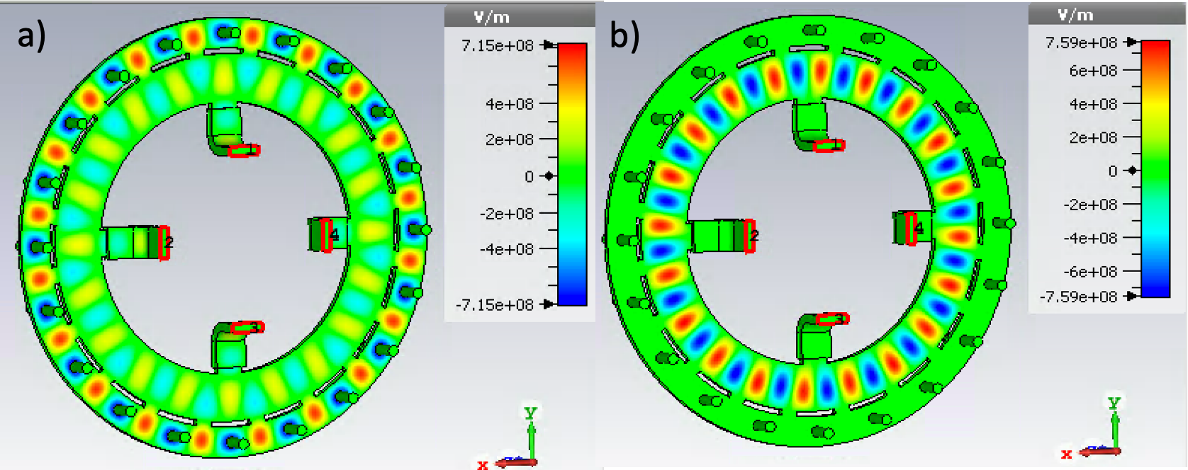
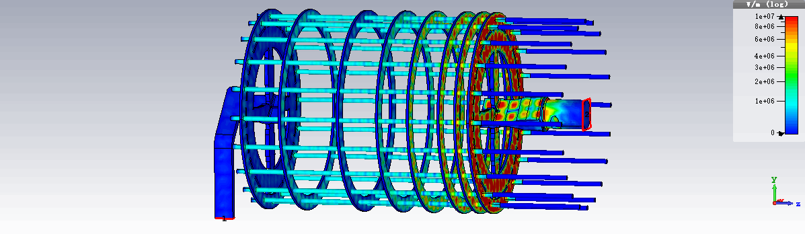
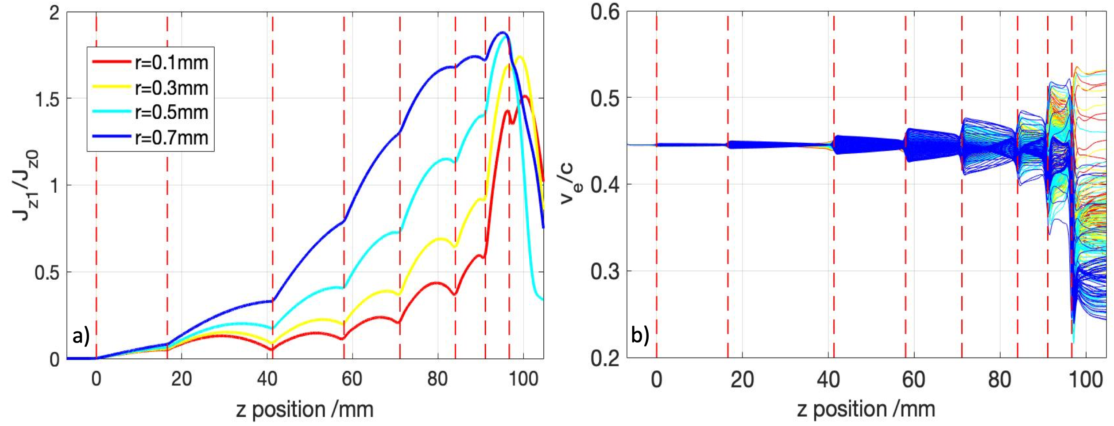
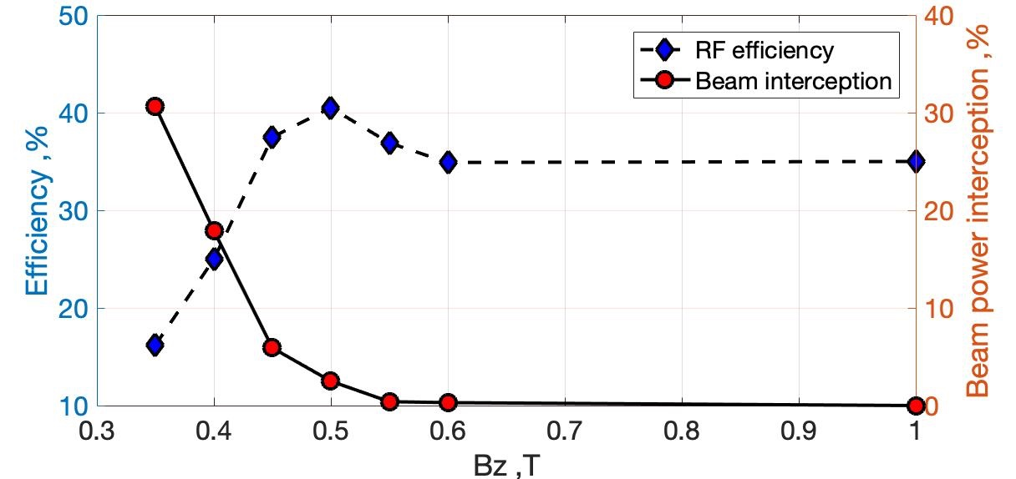
HOM multi-beam klystron
(J. Cai (LU) and I .Syratchev, CERN)
TM20,0 mode chosen for a 20 beam MBK.
We couple via an external waveguide wrapped around the inside of the cavity fed to two feed waveguides.
There is some beam interception in the last cell so a higher magnetic field is required.
We find that 0.55 T gives an efficiency above 35%, while limiting beam loss.

Slide 4
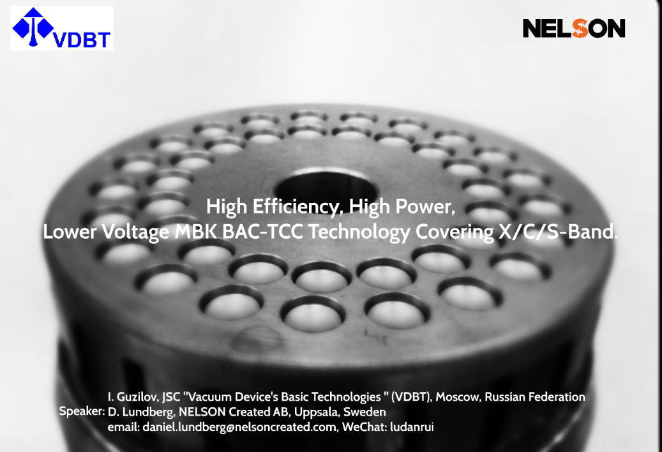
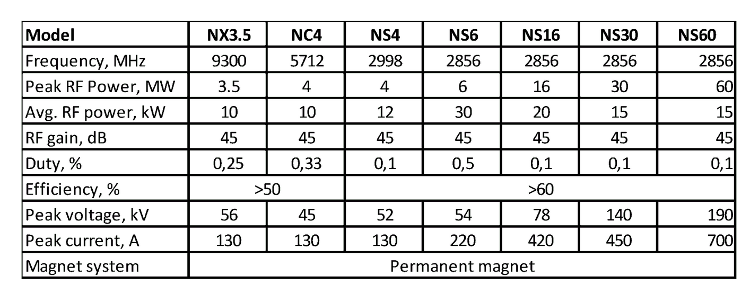
Commercial MB-klystron examples
MBK technology with large number of beam is commercialized for decades (example below):
40 beams
https://indico.cern.ch/event/675785/contributions/3022050/attachments/1666171/2671179/HG2018-DanielLundberg.pdf

Slide 5
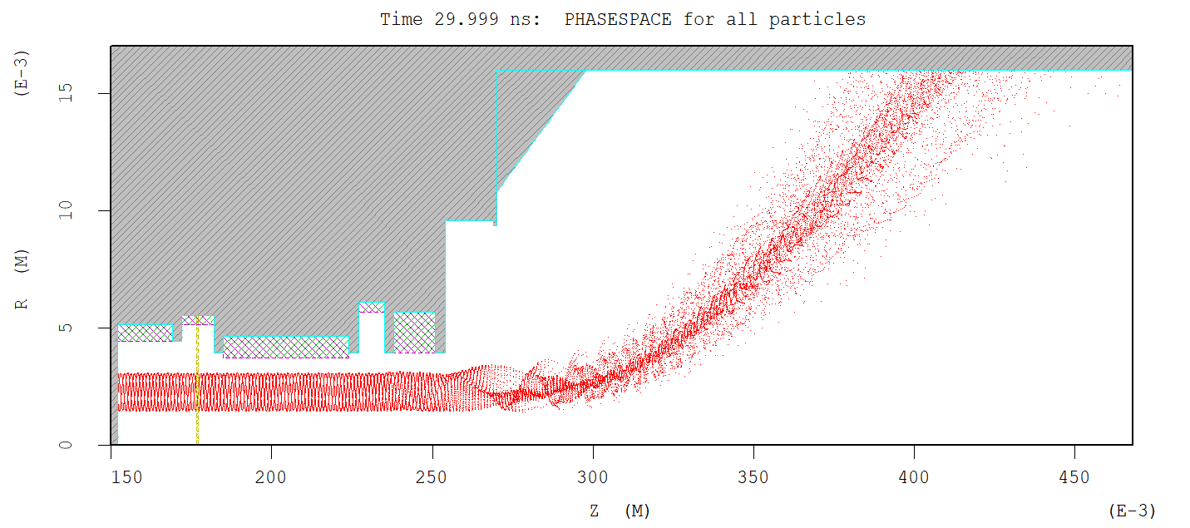
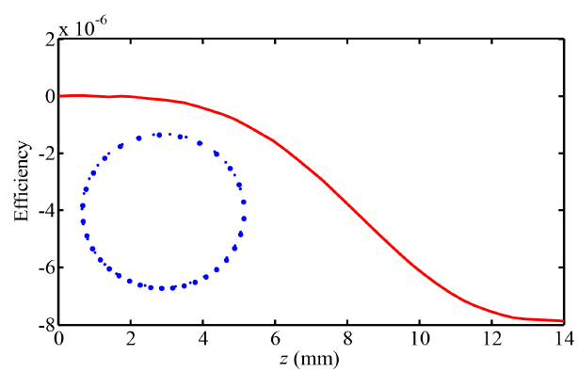
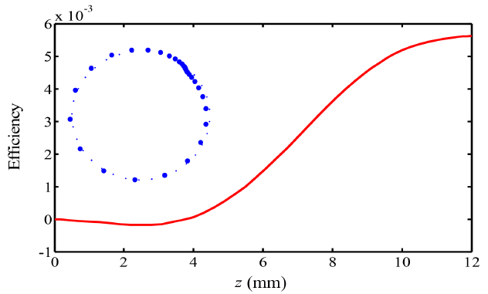
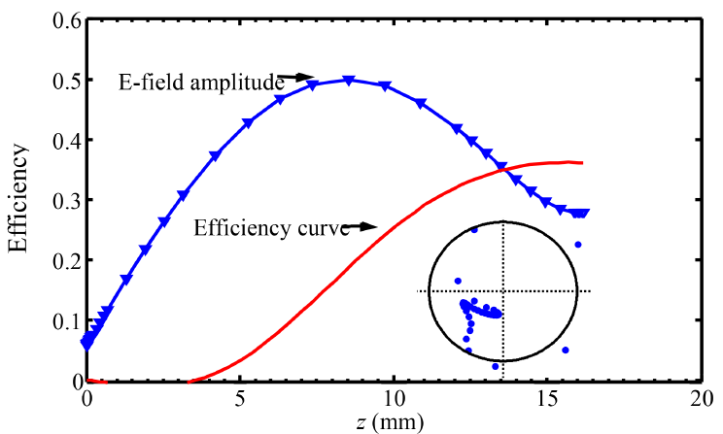
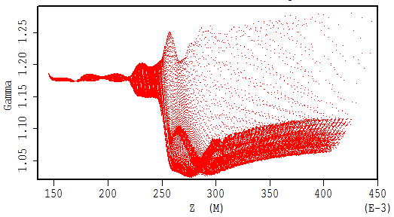
Gyro-klystron
(L. Zhang, L.J.R. Nix, and A. Cross, UOS)
MAGIC simulation
Bunching in input cavity and intermediate cavity
Input cavity
Output cavity
Intermediate cavity
Bunching in output cavity, and the efficiency.
Energy loss
Bunching in azimuthal direction, TE modes.
Lower axial velocity results in larger cavity size.
Operating frequency determined by the external magnetic field.
Open output cavity, high power capability.
Notes:
Based on the cyclotron resonance maser instability.

Slide 6
(L. Zhang, L.J.R. Nix, and A. Cross, UOS)
Ka-Band Gyrotron Experiments
Harm onic | Cavities (Output mode) | Interaction | Freq (GHz) | Power (MW) | Effic (%) | Gain (dB) | Institute | PRF (Hz) (duty) | t [ms]
2 | 2 (TE_{0,2}) | Gyro-klystron (Cylindrical) | 19.8 | 32 | 29 | 27 | Univ of Maryland | >0.1 | 1.5
3 | 2 (TE_{0,3}) | Gyro-klystron (Cylindrical) | 29.6 | 1 | 1 | 12 | Univ of Maryland | >0.1 | 1.5
1 | 4 (TE_{0,1}) | Gyro-klystron (Cylindrical) | 34.9 | 0.2 | 25 | 56 | NRL, USA | 5 | 2
1 | 2 (TE_{0,1}) | Gyro-klystron (Cylindrical) | 28.0 | 0.08 | 9 | 30 | CPI, USA | >0.1 | 1.5
1 | 4 (TE_{0,1}) | Gyro-klystron (Cylindrical) | 93.0 | 0.1 | 33 | 32 | CPI, USA | 1100 (10%) | 90
2 | 4 (TE_{0,2}) | Gyro-klystron (Cylindrical) | 34.9 | 0.25 (5 av) | 24 | 36 | UESTC, China | 250 (2%) | 80
1 | 2 (TE_{7,3}) | Gyro-klystron (Cylindrical) | 37.5 | 1.5 | 7 | - | Saratov Univ, Rus | >0.1 | 1
1 | 2 (TE_{0,2}) | Gyro-klystron (Cylindrical) | 35 | 0.75 | 24 | 25 | IAP, Gycom | >0.1 | 1
1 | 3 (TE_{5,3}) | Gyro-klystron (Cylindrical) | 30.0 | 15 | 40 | 35 | IAP, Gycom | >0.1 | 0.5
1 | 1 (TE_{0,3}) | Gyrotron Oscillator | 36.0 | 4 | 10 | - | Strathclyde, UK | 330 .003% | 0.1
Notes:
Gyrotron klystrons based on a cylindrical cavities are much more mature.
Better suited for operation at high pulse repetition frequencies of ~1kHz.

Slide 7

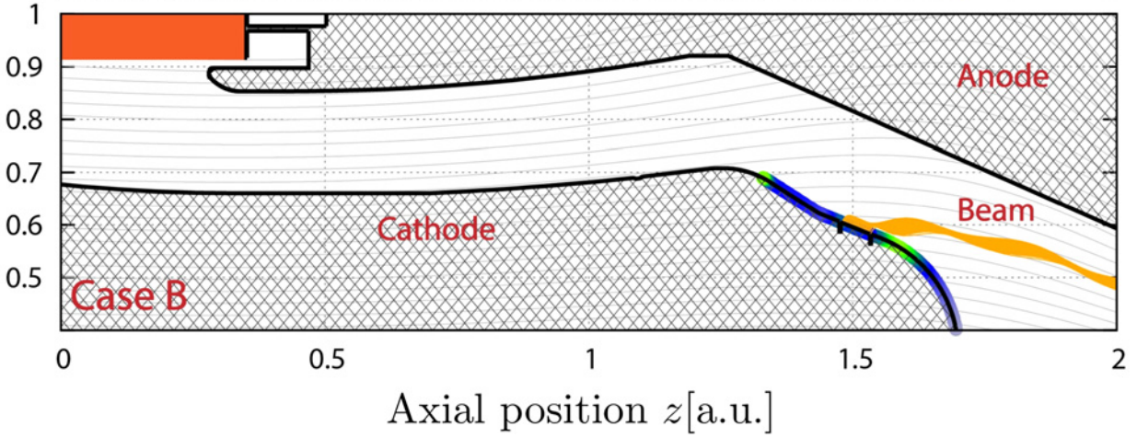
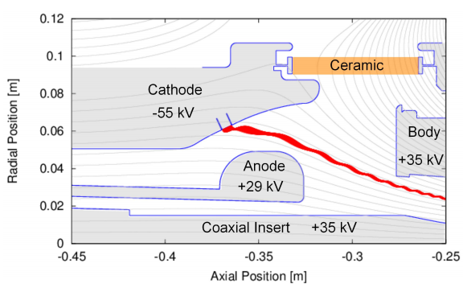
A 150 MW coaxial gyro-klystron
Going from a few MWs to 100s of MWs:
  Higher beam voltage.
  Higher beam current.
  Energy recovery.
  Manage thermal stress.
Co-axial cavity alleviates problems associated with :
  Highly overmoded circuits.
  Crosstalk between the cavities.
  Self-excitation of the drift section.
IMIG removes inner conductor support pins (and e-beam interception) that need to be in place for a coax. GK based on a MIG.
Inverted Magnetron Injection Gun (IMIG) enables larger thermionic cathode emitter ring resulting in a larger beam: current (770A) and voltage (500kV)
Beam voltage / Beam current | 500 kV / 770 A
Output power | 150MW
Output frequency | 17.1GHz
Gain | 49dB
Efficiency | 40%
Cyclotron Harmonic | 2nd
-410kV
+90kV
-150kV
+90kV
Girish P. Saraph, Wes Lawson, Michael Castle, Jack Cheng, Jeff P. Calame, Gregory S. Nusinovich, “100-150MW designs of two and three-cavity gyroklystrons amplifiers operating at the fundamental and second harmonics in X and Ku-bands”, IEEE Transactions on Plasma Science, 24 , No 3, June 1996
Notes:
100MW lco-axial gyro-klystrons are much less well developed.
Could produce 100MW level power in Ka-band.
Rep Rates of ~50Hz, using the XBOX type pulsed modulators at CERN.

Slide 8
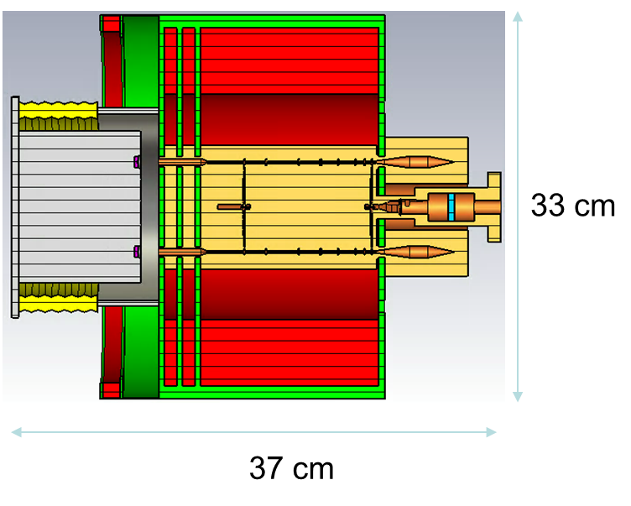
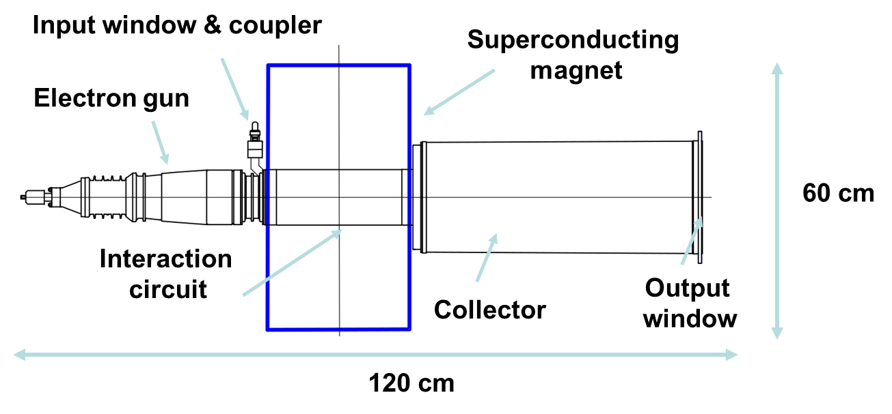
XLS Ka-band final source designs
(L. Zhang, L.J.R. Nix, and A. Cross, UOS. J. Cai (LU) and I .Syratchev, CERN)
MB-Klystron
RF Source | Klystron | Gyro-Klystron | Units
Beam Voltage | 60 | 150 | kV
Beam Current | 120 | 50 | A
Efficiency | 35 | 43 | %
Bandwidth | 50 |  | MHz
Repitition rate | 1 | 1 | kHz
Magnetic field | 0.55 | 1.46 | T
Magnet diameter | 33 | 60 | cm
Oil tank required? | No | Yes | --
Length | 37 | 120 | cm
Phase stability @100 ppm mod. Stab. | 0.38 | 0.34 | deg
Amplitude stability | 1 | 1 | %
Output Power | 2.5 | 3.2 | MW
Gyro-Klystron
None meets phase specs with 10⁻⁴ mod. voltage ripple.
PSI reports 15 ppm mod. stability.
Further work required.

Slide 9
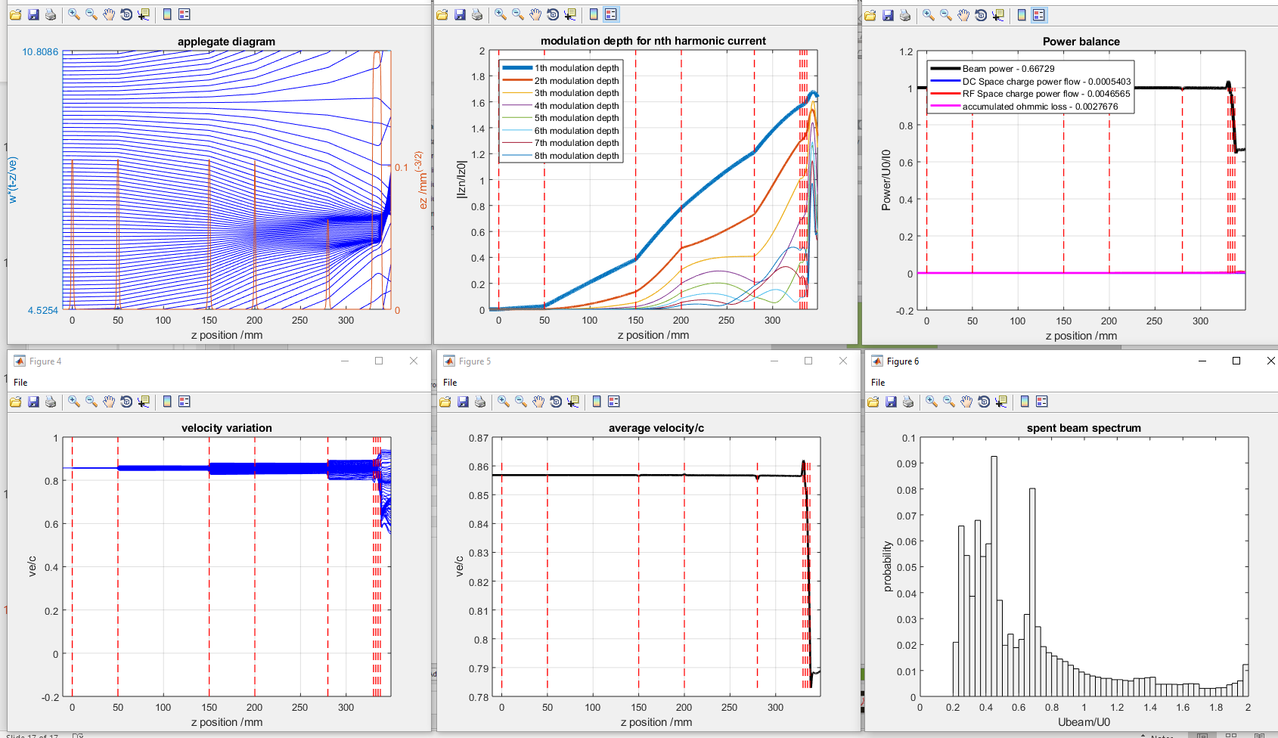
First look into a Ka-Band klystron upconverter
(G. Burt and J. Cai, LU)
4 cavities, 480kV, 50 A beam with 1.2 mm beam tube radius:
  Based on a 200 A, X-band klystron design from INFN.
  Using CERN-KlyC code: ~30% efficiency and ~10 MW output.

Slide 10
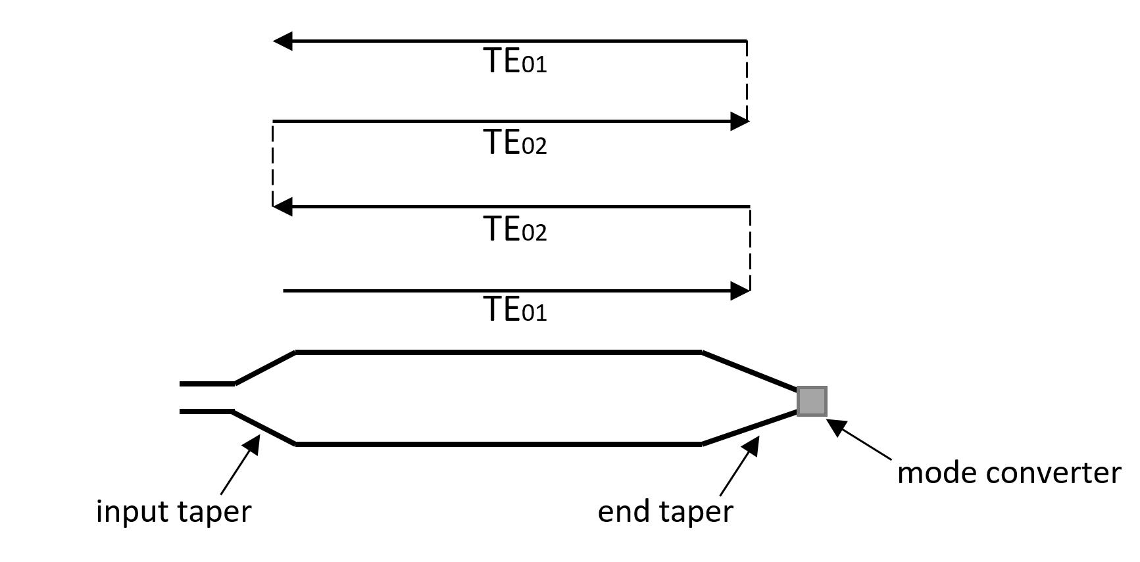
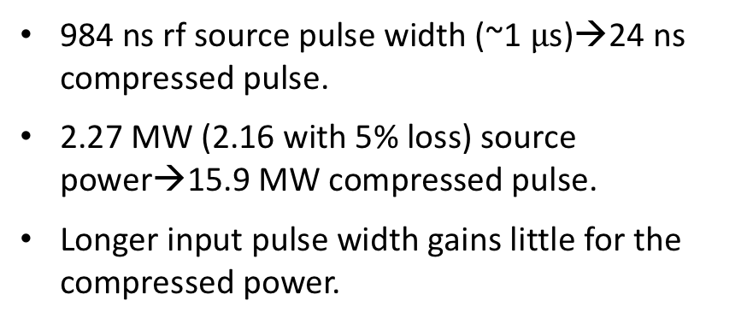
Over-moded SLEDII Pulse compressor
(X. Wu and W. Wuensch, CERN)
984 ns rf source pulse width (~1 $μ$s)→24 ns compressed pulse.
2.27 MW (2.16 with 5% loss) source power→15.9 MW compressed pulse.
Longer input pulse width gains little for the compressed power.
RF source width [ns] | Compression ratio | Power gain (average) | Compressed Power
192 | 8 | 5.16 | 11.1456
288 | 12 | 5.92 | 12.7872
384 | 16 | 6.38 | 13.7808
480 | 20 | 6.68 | 14.4288
600 | 25 | 6.94 | 14.9904
696 | 29 | 7.09 | 15.3144
792 | 33 | 7.21 | 15.5736
888 | 37 | 7.30 | 15.768
984 | 41 | 7.37 | 15.9192
1080 | 45 | 7.43 | 16.0488
1200 | 50 | 7.49 | 16.1784
1296 | 54 | 7.52 | 16.2432
1392 | 58 | 7.55 | 16.308
1488 | 62 | 7.58 | 16.3728
TE01&TE02 dual-moded SLEDII pulse compressor.
Radius of the delay line = 25 mm.
Length of the delay line = 1.71 m.

Slide 11
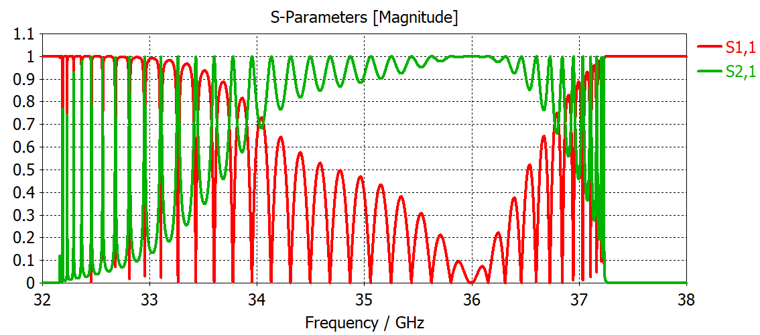
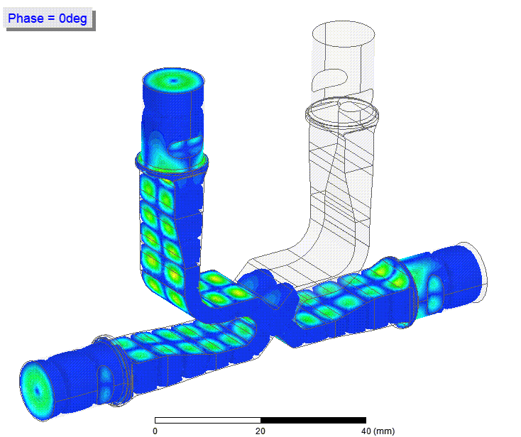
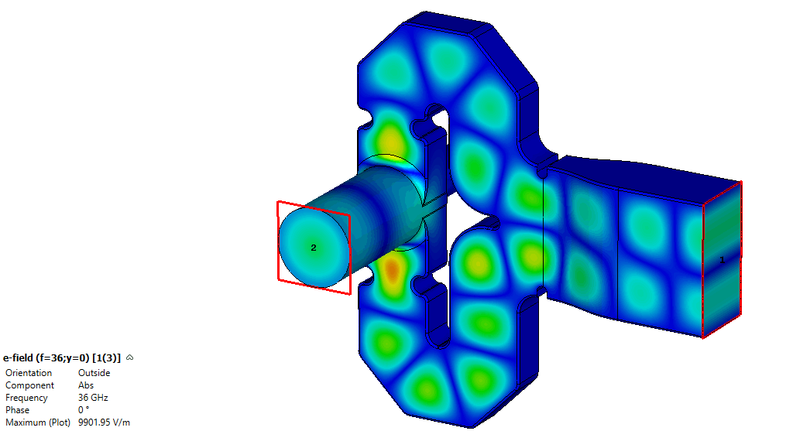
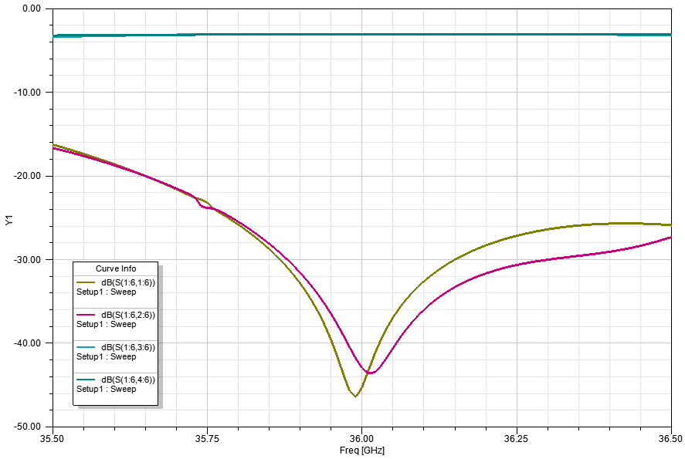
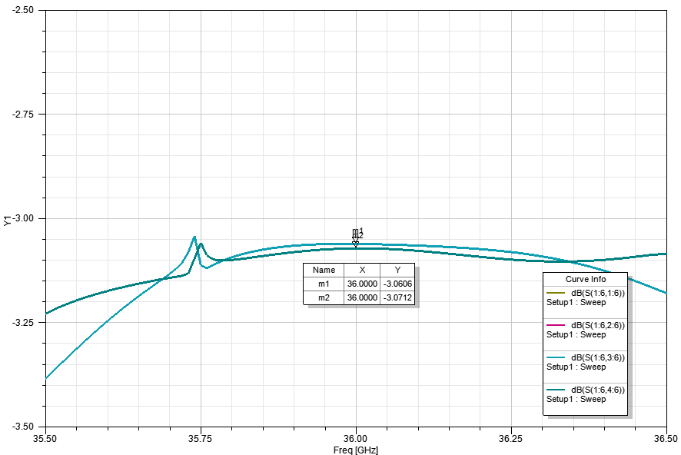
H01 Power transport and couplers
3dB TE01-TE20 Hybrid
for PC and power combiner
(J. Cai (LU), I .Syratchev, and A. Grudiev, CERN)
Fitted TE20 – TE01 circular mode converter couplers for direct connection to low loss transport network.

Slide 12
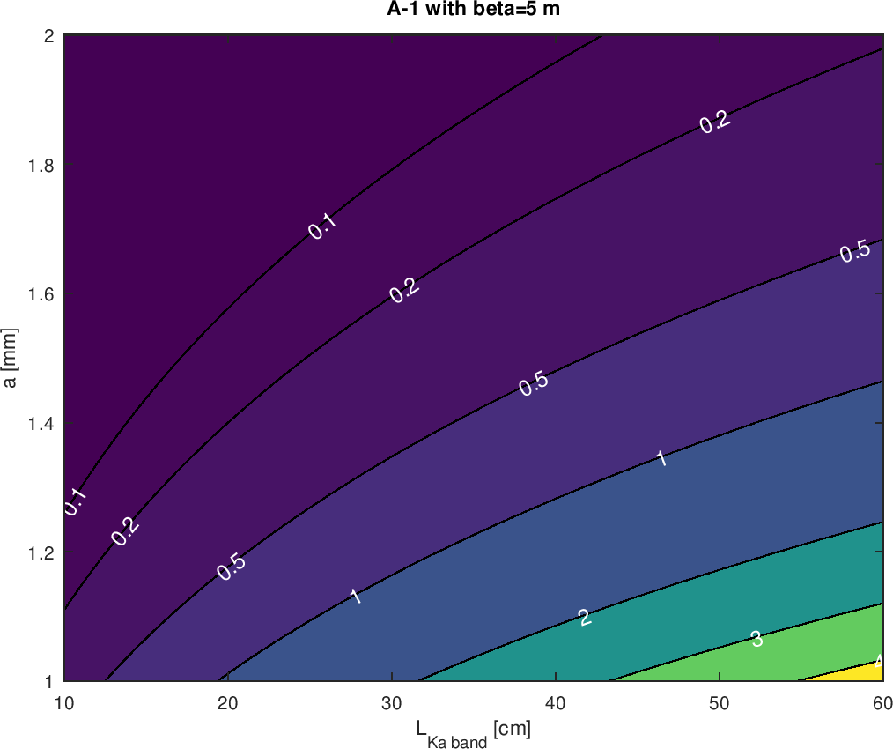
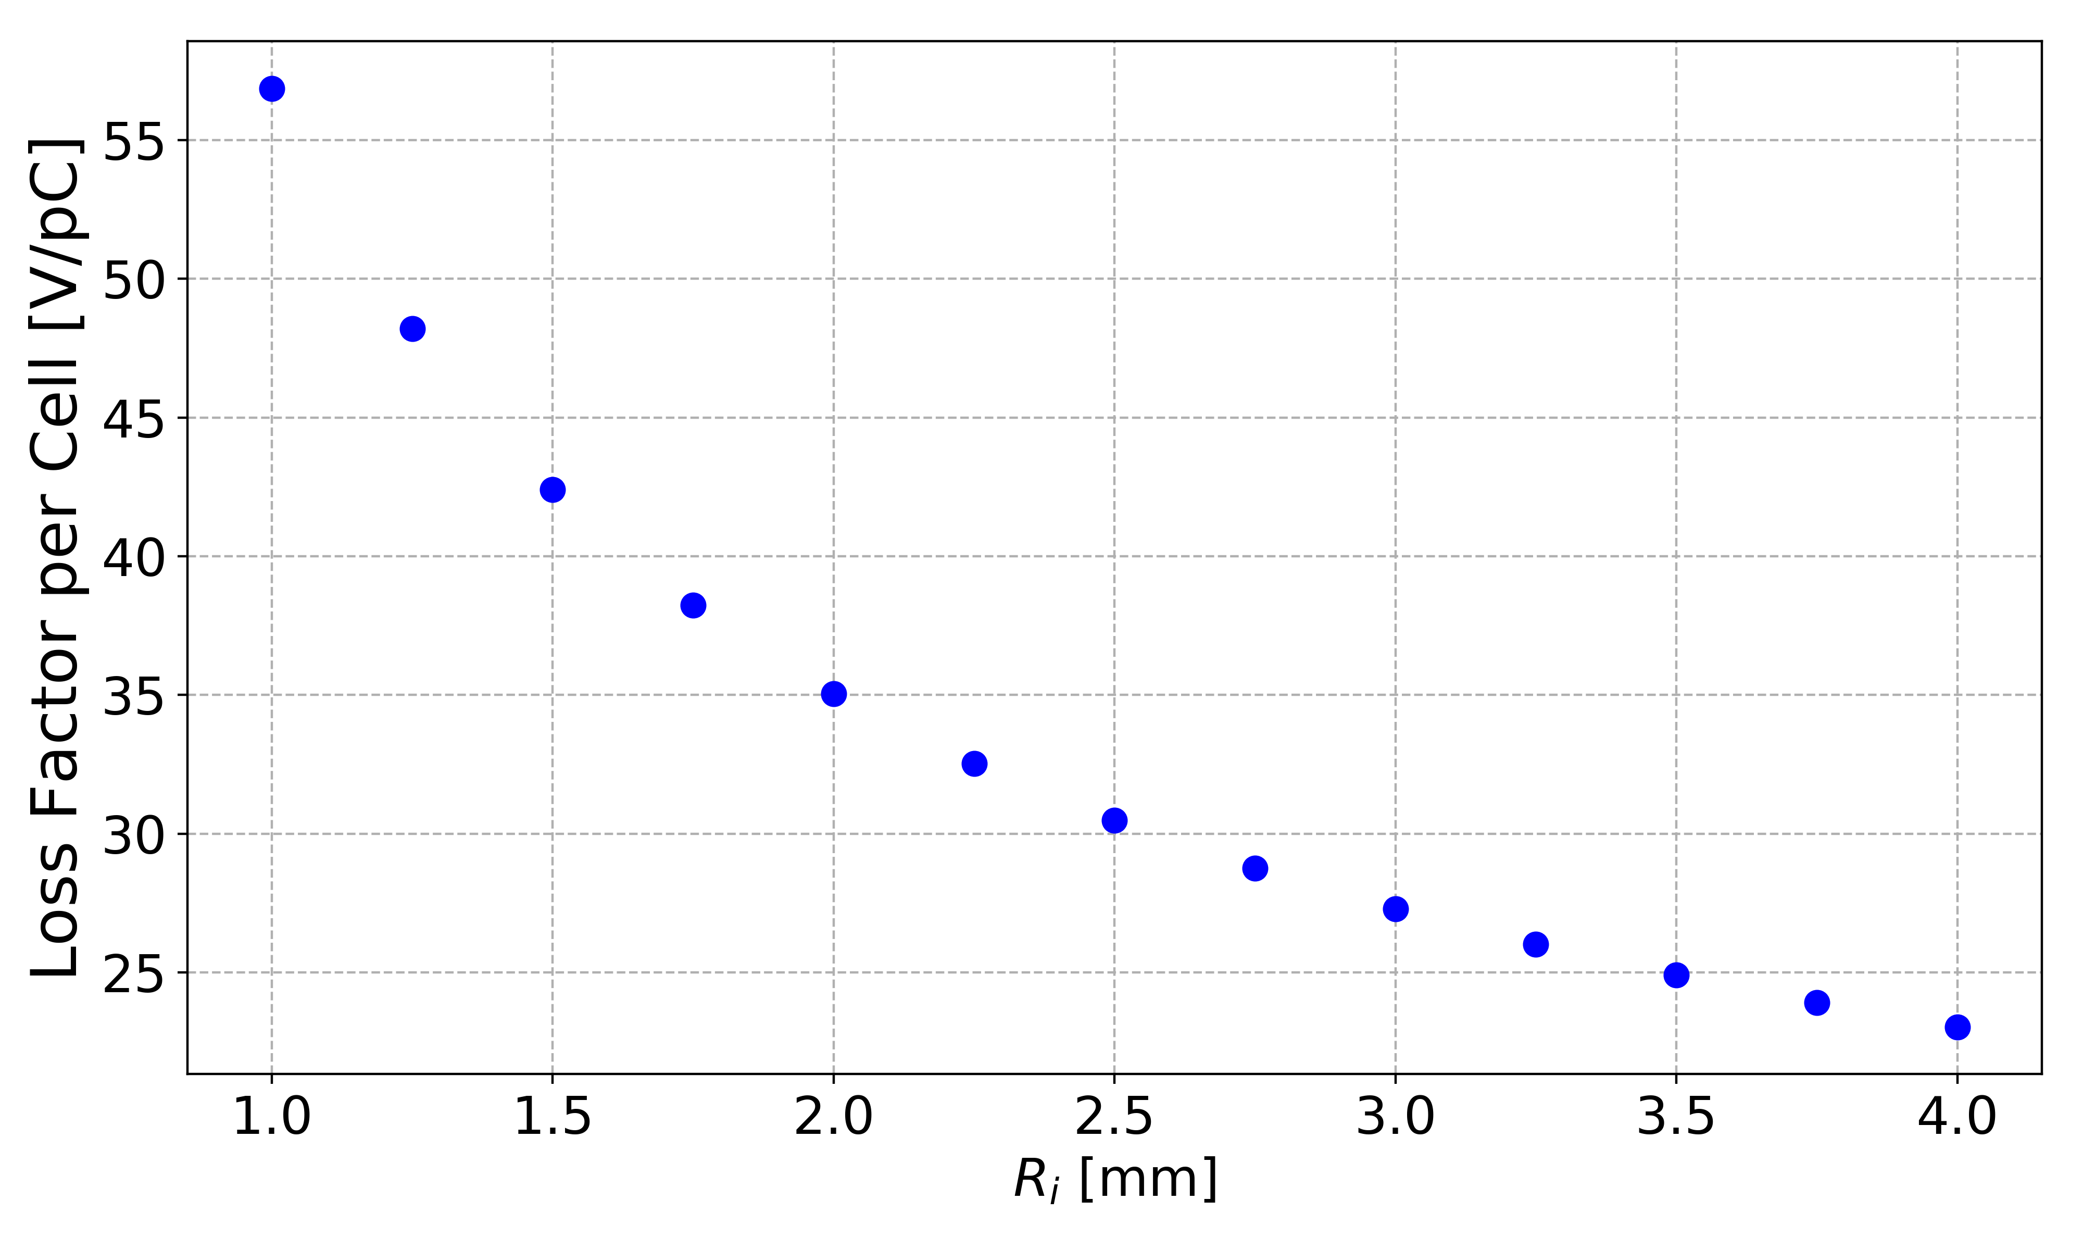
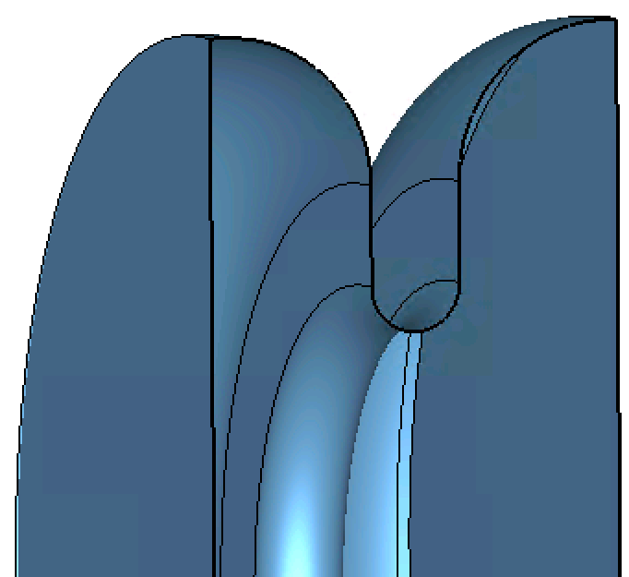
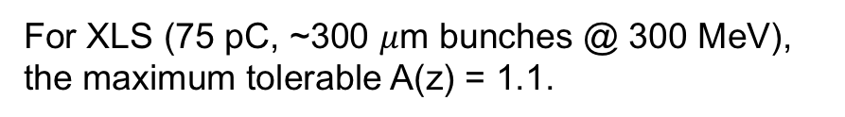
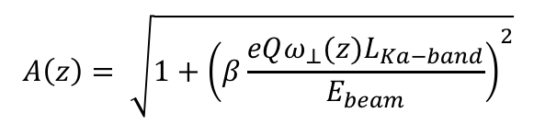
Wakefields: Ka-band Action amplification factor
(A. Latina, CERN)
Bunch-tail betatron amplification due to short range wakefields can lead to BBU.
$$A\left(z\right)= \sqrt{1+{\left(β\frac{eQω_{⊥}(z)L_{Ka−band}}{E_{beam}}\right)}^{2}}$$
For XLS (75 pC, ~300 $μ$m bunches @ 300 MeV), the maximum tolerable A(z) = 1.1.

Slide 13
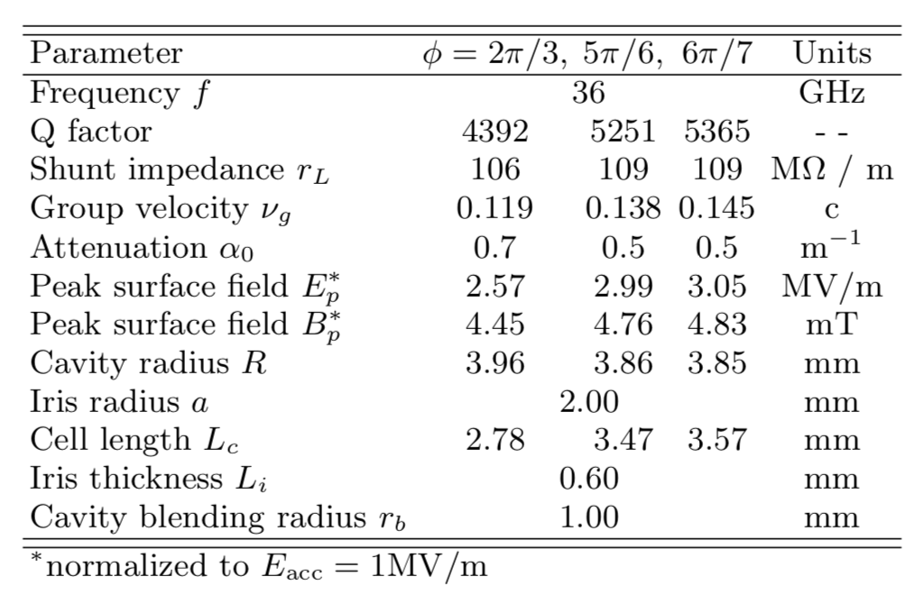
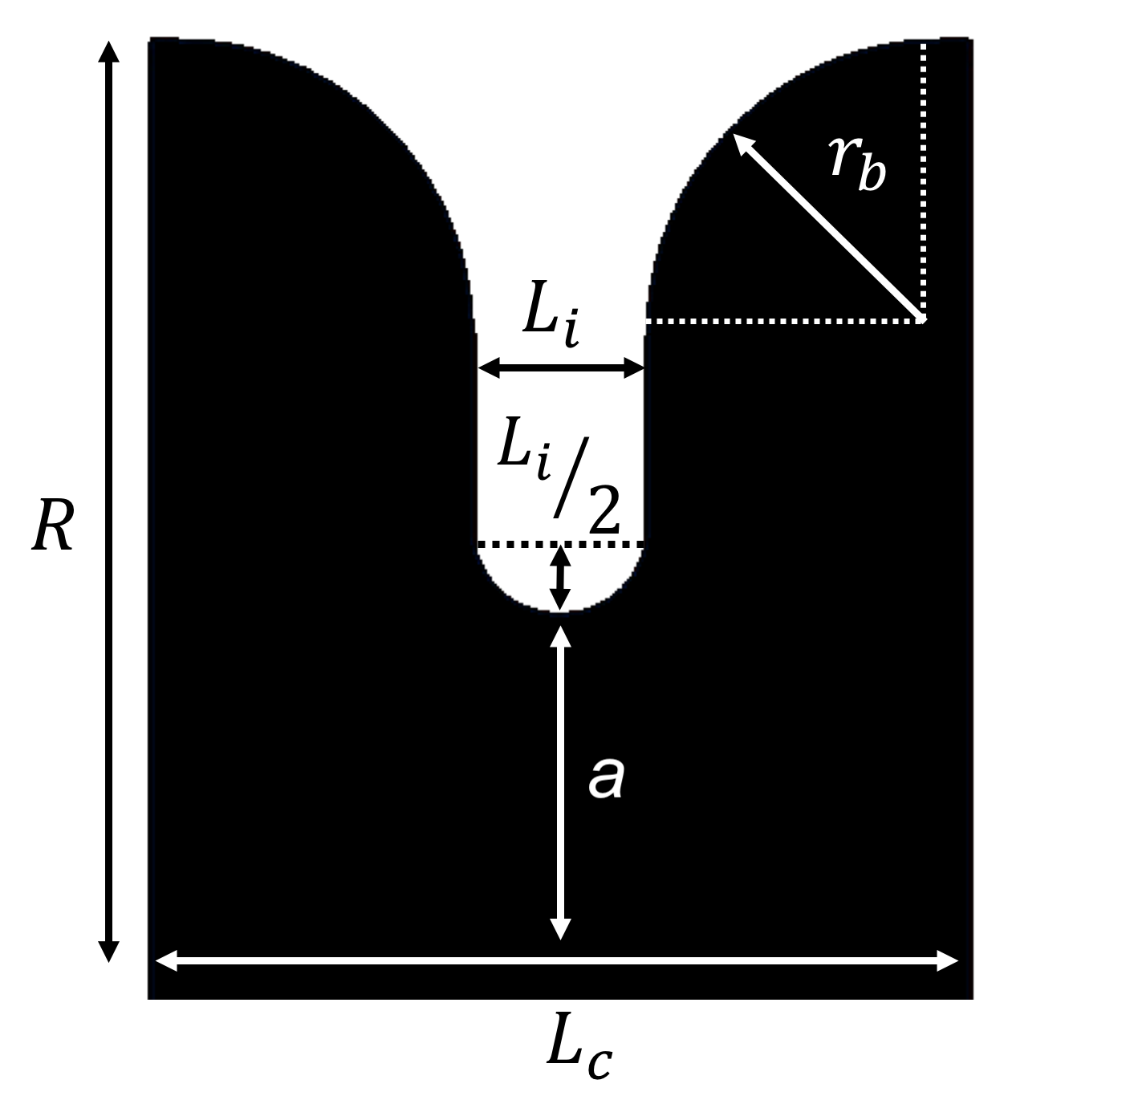
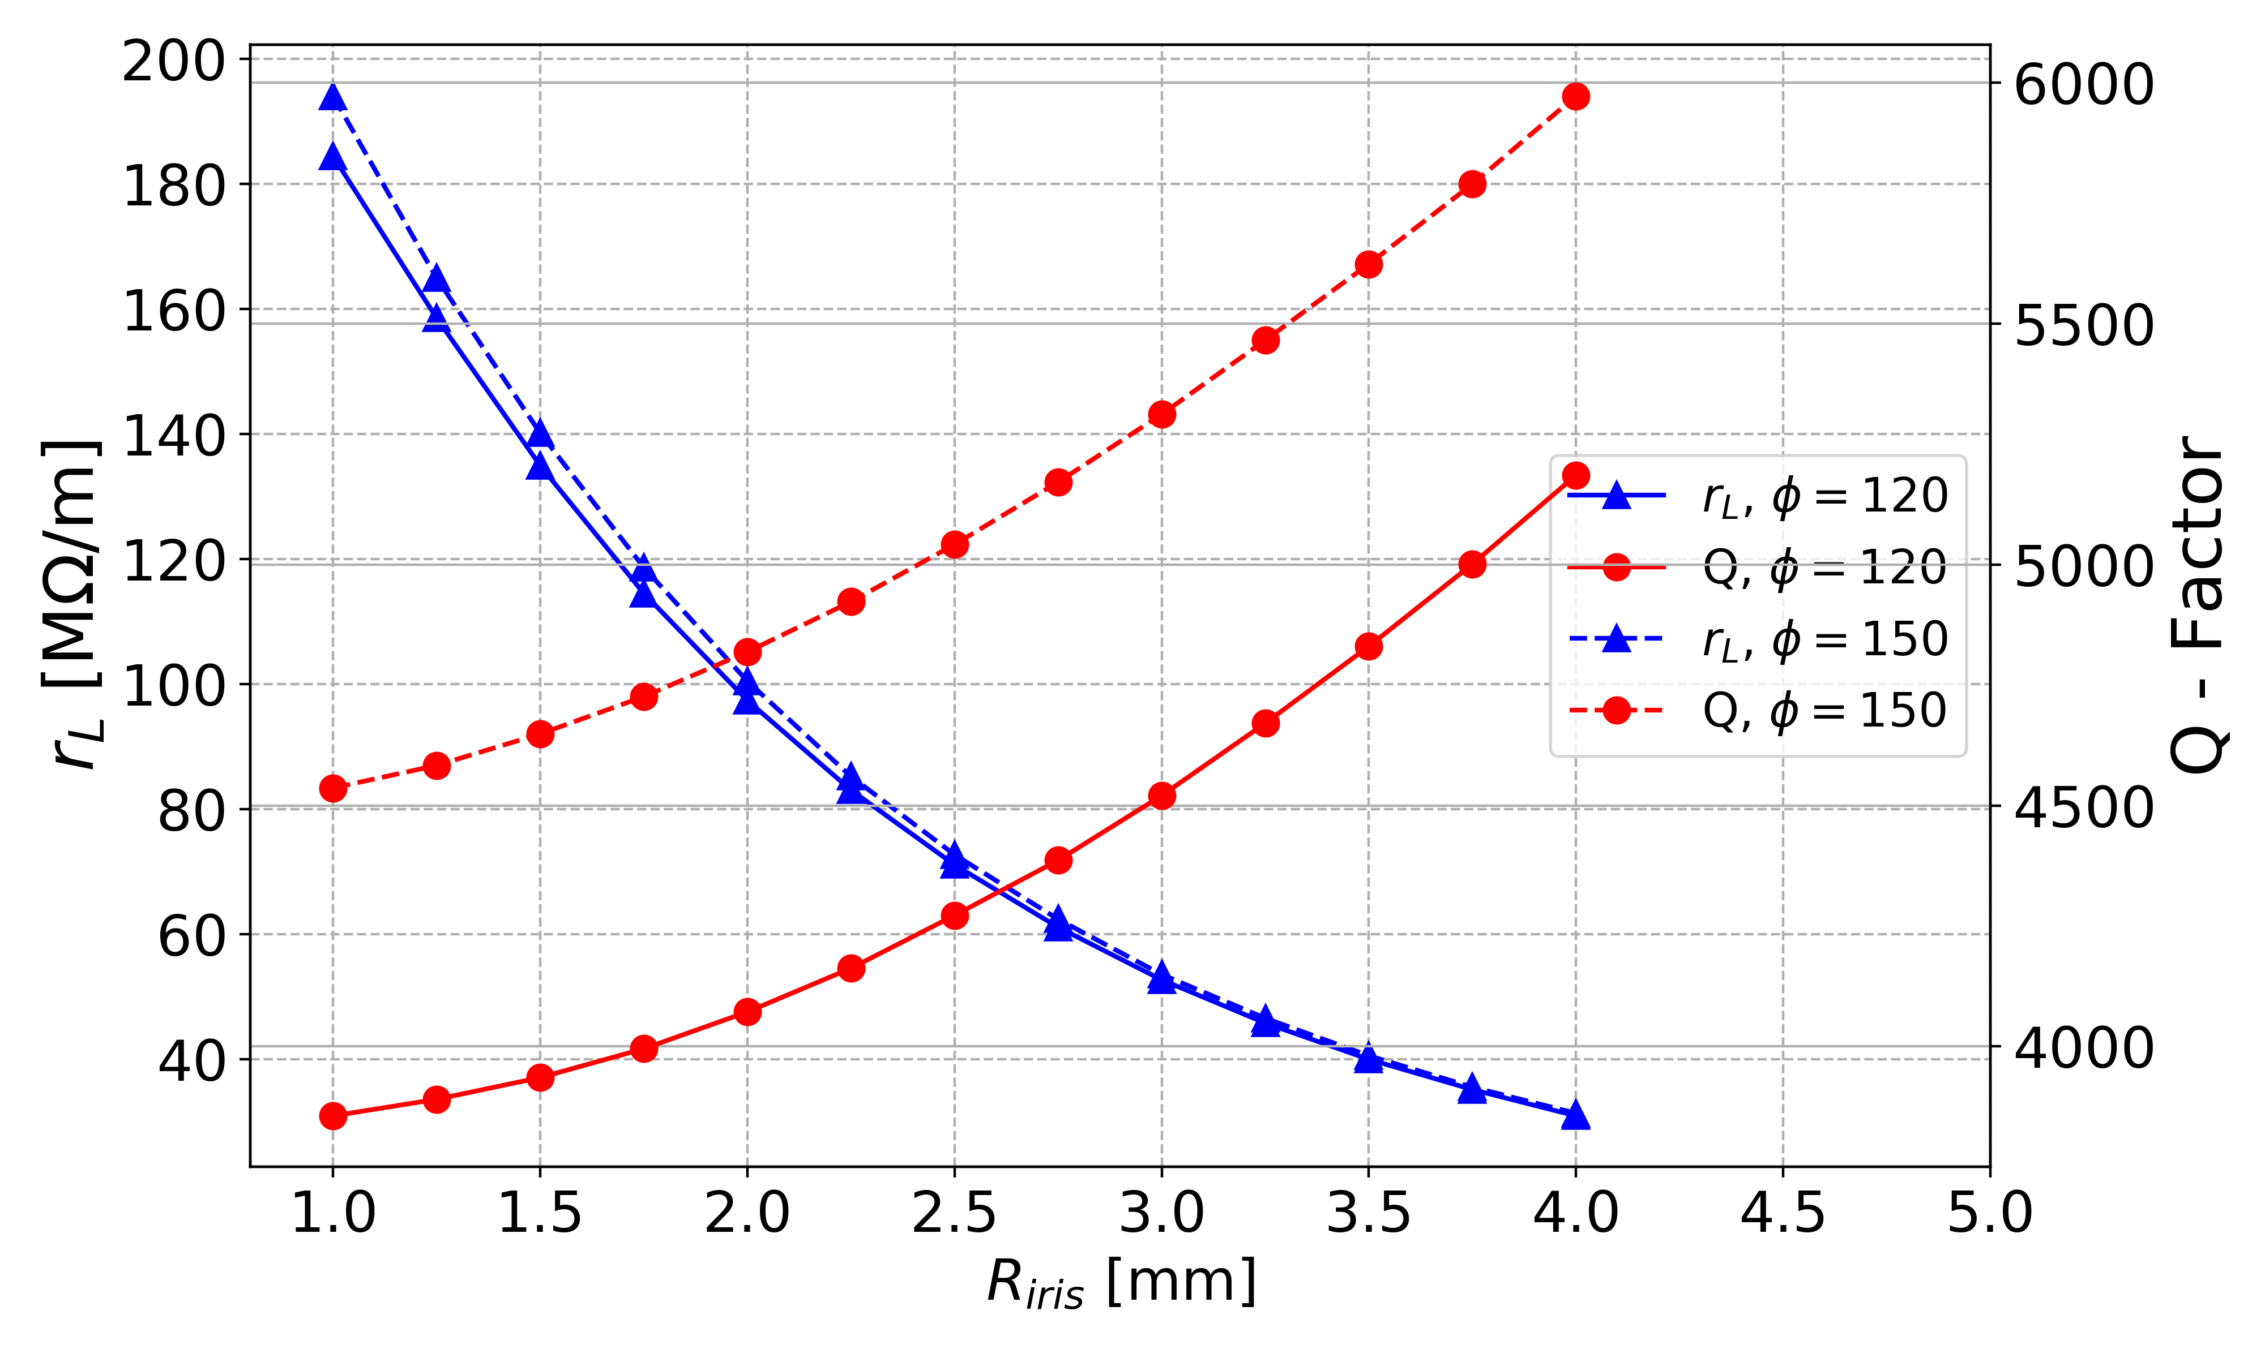
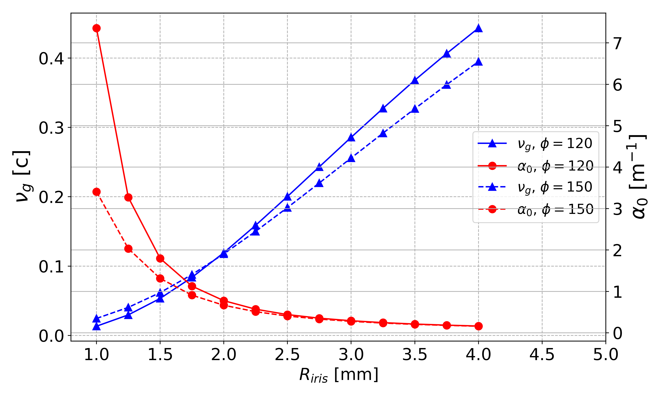
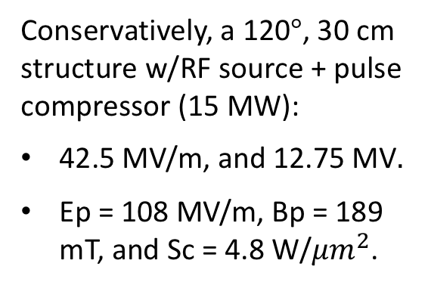
Travelling wave structure design
Conservatively, a 120$°$, 30 cm structure w/RF source + pulse compressor (15 MW):
42.5 MV/m, and 12.75 MV
Ep = 108 MV/m, Bp = 189 mT, and Sc = 4.8 W/${μm}^{2}$.

Slide 14
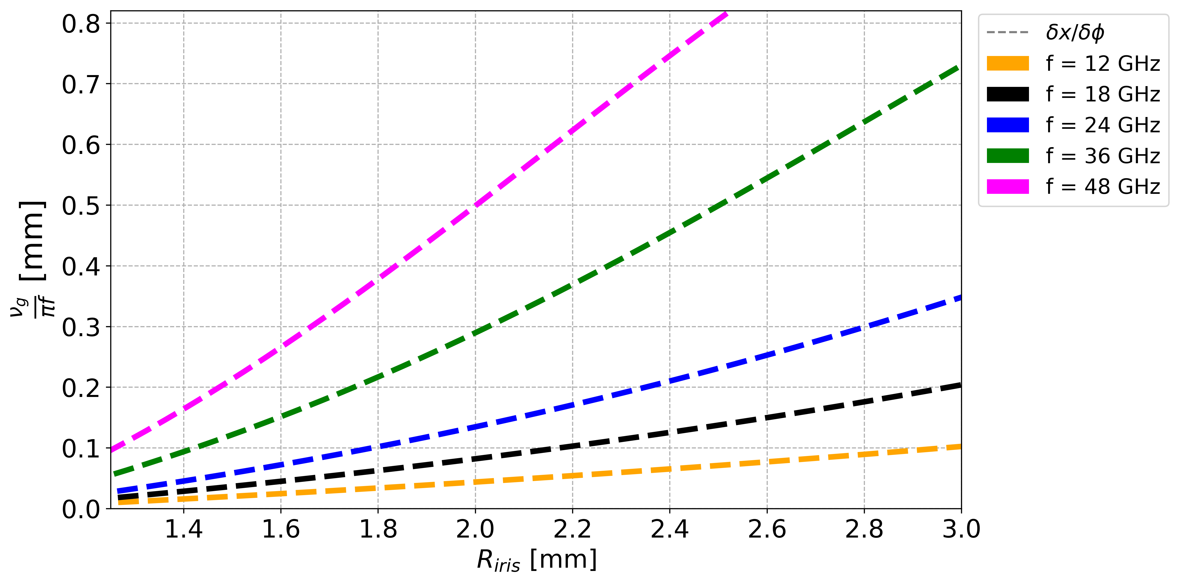
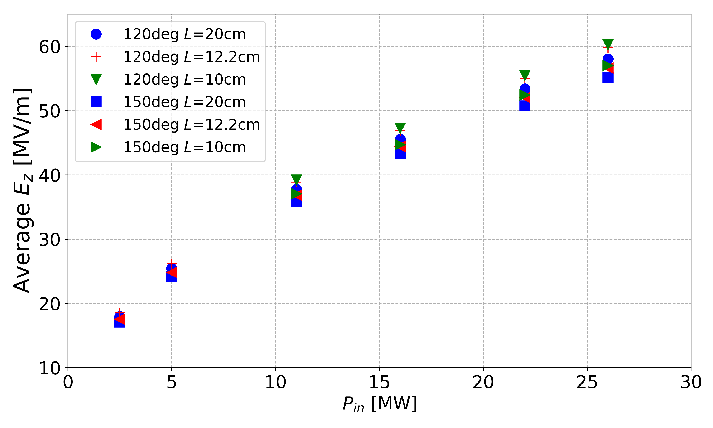
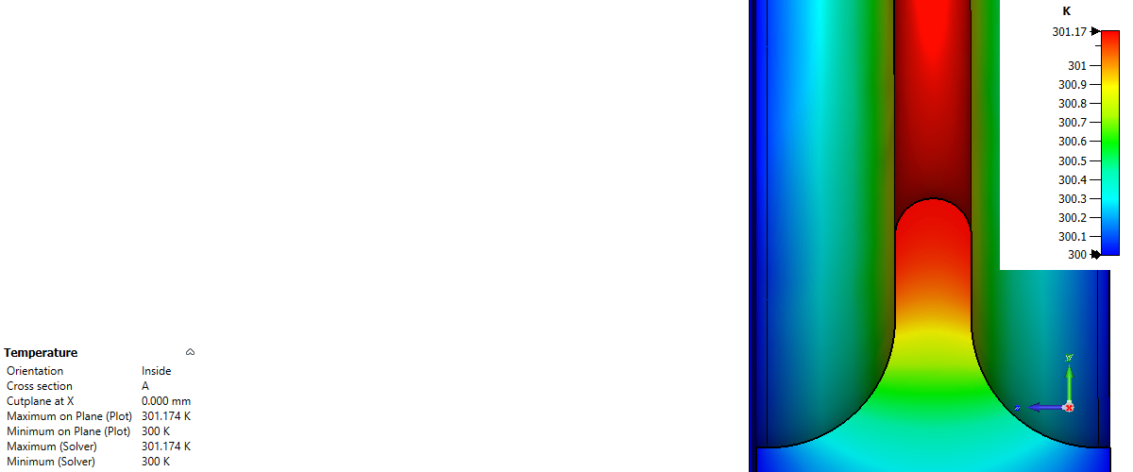
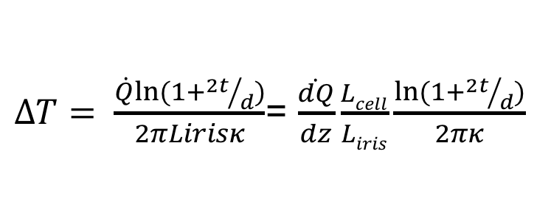
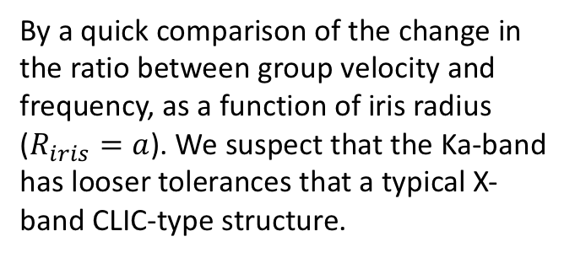
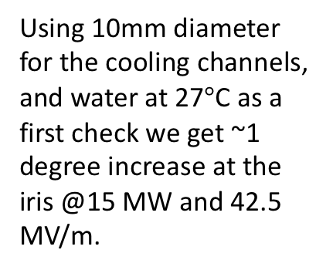


Ka band TWS tolerances and thermal
TWS with $a=$ 2 mm
$ΔT= \frac{\dot{Q}ln⁡(1+{2t}/d)}{2πLirisκ}$= $\frac{\dot{dQ}}{dz}\frac{Lcell}{Liris}\frac{ln⁡(1+{2t}/d)}{2πκ}$
By a quick comparison of the change in the ratio between group velocity and frequency, as a function of iris radius ($R_{iris}=a$). We suspect that the Ka-band has looser tolerances that a typical X-band CLIC-type structure.
a
Using 10mm diameter for the cooling channels, and water at 27$°$C as a first check we get ~1 degree increase at the iris @15 MW and 42.5 MV/m.
$$L_{i}$$
t

Slide 15

Standing-wave structure option
(B. Spataro and M. Behtouei, INFN-LNF. X. Wu, CERN)
Using a 9-cell standing-wave structure: length=37.44 mm.
a [mm] | 2 | Q | 5941
b [mm] | 3.86 | Epeak/Eacc | 2.67
L [mm] | 4.16 | Rs [MΩ/m] | 97
r0 [mm] | 1 | Filling time [ns]* | 121
t [mm] | 0.667
t
r0
b
a
*to fill 99% of the max electrical field
L
Design specifications:
Use 1000 ns 2.27 MW source power (2.16 MW with 5% loss), pulse compressor and standing-wave structures to achieve 12.75 MV linearising voltage.
The number of standing-wave structures should be even number to avoid circulator.

Slide 16
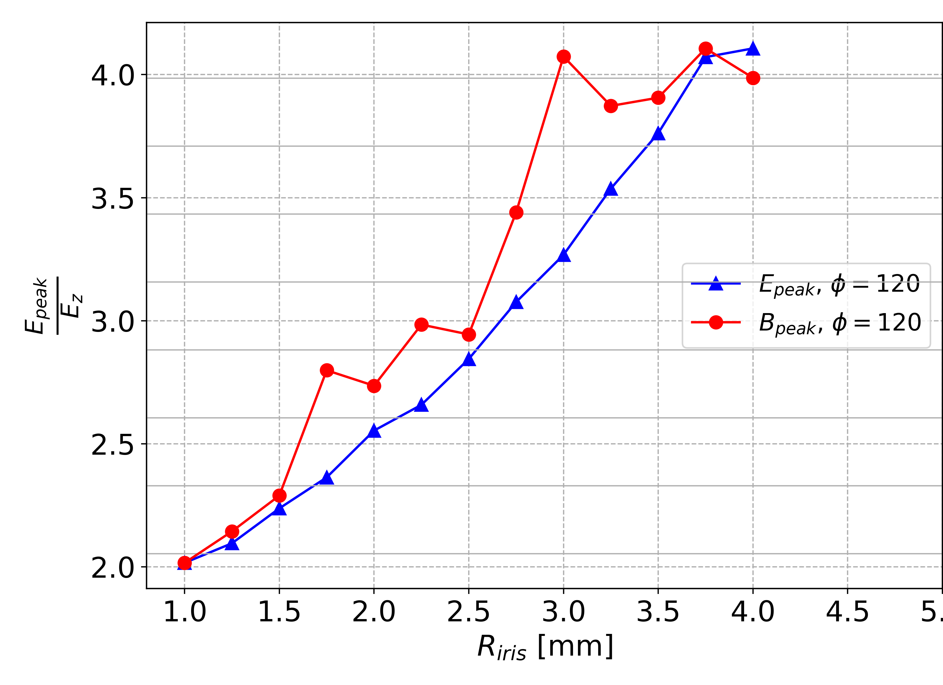
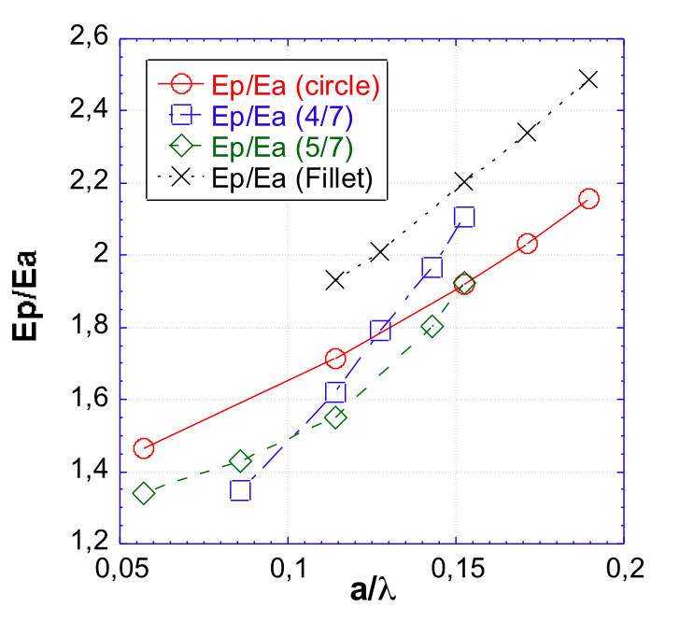
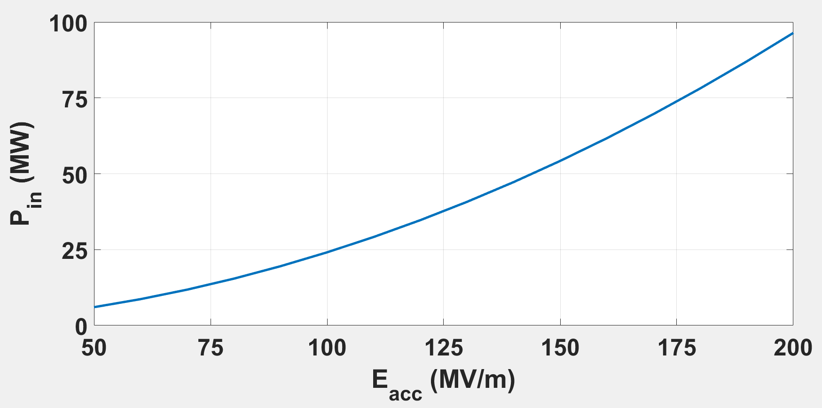


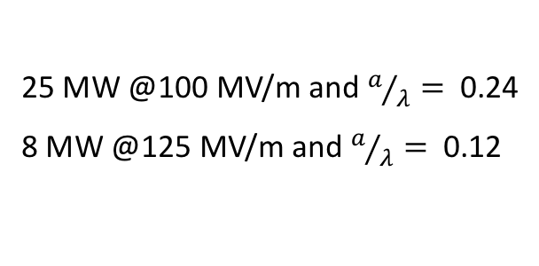


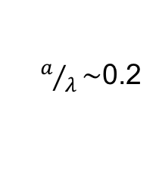

Ka band limitations (Ep = 320 MV/m @50 ns pulse)
A quick look to the TW single cell
Small aperture SW single cell
$E_{z,max}=160$ MV/m
$E_{z,max}=78$ MV/m
$E_{z,max}=128$ MV/m
$λ_{Ka−band}≈$ 8.33 mm.
$a/λ\sim$0.2
Constant impedance, hence average Ez for a given power depends on length.
$E_{z,max}=246$ MV/m
L =250 mm
25 MW @100 MV/m and $a/λ=$ 0.24
8 MW @125 MV/m and $a/λ=$ 0.12
(B. Spataro and M. Behtouei, INFN-LNF)

Slide 17
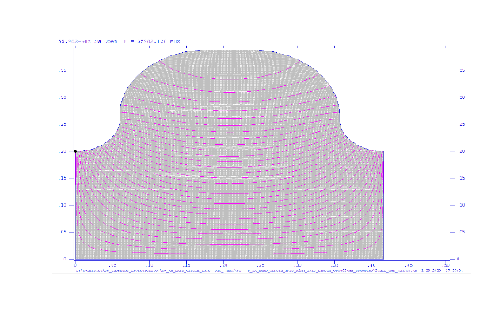
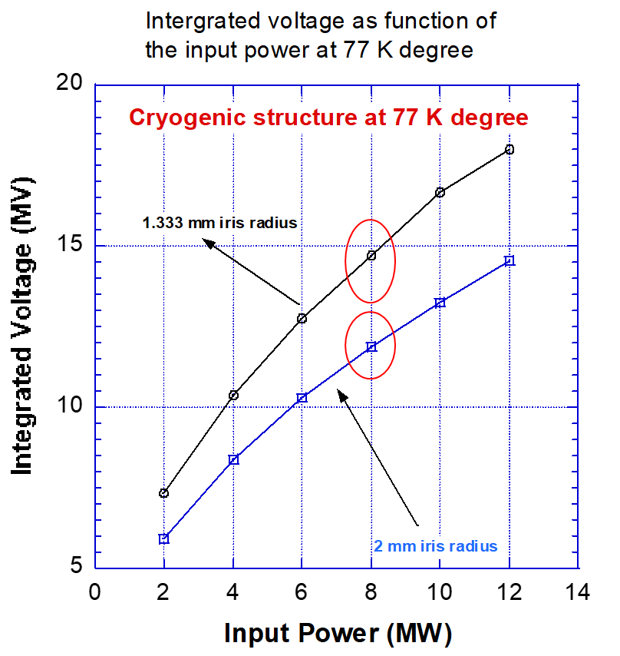
Comparison of the integrated voltage as function of the input power of two 8 cm cryogenic structures with different irises radii (cryogenic option).
More interesting options
(B. Spataro and M. Behtouei, INFN-LNF)
12 GHz enhancement Factor at 77 K ~ 2.2 (may be lower at 36 GHz).
With a 1.333 mm iris radius @ 8 MW:
the integrated voltage is ~ 15 MV.
With a 2 mm iris radius @ 8 MW:
the integrated voltage is ~ 12 MV.
If we have two structures (to cancel reflections with a hybrid) we could operate with only 5.6 MW which could be achieved with a 1 MW RF source + PC.

Slide 18

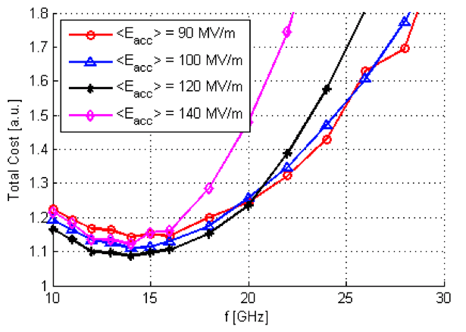
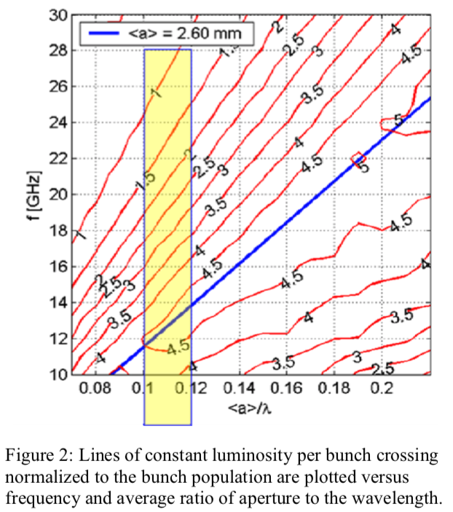
With the CLIC specific parameters (multi bunch), there is a struggle between beam dynamics and aperture, that handicaps high frequencies.
Lessons from good ol‘CLIC
A LINAC’08 paper describes the CLIC economics behind moving from 30 to 12 GHz: [LINK]

Slide 19
Wrapping up
Make R&D on Ka-band accelerators great again! (remember the CLIC 30 GHz era, got up to 150 MW beam driven in CTF3).
Power is perhaps the key component:
  Important advances in amplifier research have been made in the last 3-4 years.
    Cavity based gyro-klystrons are front runners if we care about rep. rates.
    Coaxial gyro-klystrons come close if we want 100’s of MW.
    Klystron upconverters are another option.
  Low loss RF networks needed.
  Pulse compression schemes to increase available power.
Short structures with small apertures and high gradients:
  Watch out for the wakefields.
  Cryogenic-Cu could also help to operate at higher gradients.

Slide 20


Funded by the
European Union
Special thanks to the CompactLight colleagues for providing a great deal of the material used in this presentation.

Slide 21
Gyrotron Klystrons based on cylindrical cavities
Manfred Thumm,“State-of-the-Art of High-Power Gyro-Devices and Free Electron Masers”, Journal of Infrared, Millimeter, and Terahertz Waves, (2020)
W. Lawson, J. P. Calame, G. S. Nusinovich, and B. Hogan, “Reflections on the University of Maryland’s program investigating gyro-amplifiers as potential sources for linear colliders”, Terahertz Science and Technology, ISSN 1941- 7411, Vol.10, No.1, (2017)
M. Garven, J. P. Calame, Khanh T. Nguyen, Bruce G. Danly, Baruch Levush, and F. N. Wood, “Experimental Studies of a Four-Cavity, 35 GHz Gyroklystron Amplifier”, IEEE Trans on Plasma Science, 28, Nos. 3, (2000)
Yu.M. Guznov, Yu.Yu. Danilov, S.V. Kuzikov, Yu.V. Novozhilova, A.S. Shevchenko, N.I. Zaitsev, A.G. Rozhnev, and N.M. Ryskin,“High-Power Ka-band Gyroklystron Oscillator with Time-Delayed Feedback, International Vacuum Electronics Conference, (2013),
YU Sheng, NIU Xin jian,LI Hong fu, Zhao Qing, LuoYong, Deng Xue, Xu Yong, Wang Hui, Xie Zhong lian, Wang Li, Liu Ying hui,Yang Ming, “Simulation Design And Experiment of An 8mm Gyroklystron Amplifier”, Acta Electronica Sinica, vol. 34, no. 12A, Dec. 2006.
J. Wang, Y. Luo, “The study of a Ka-band high power TE01-TE02 gyroklystron”, Proc. 15th IEEE Int. Vacuum Electronics Conference (IVEC 2014), Monterey, CA, USA, P3.3, (2014)
L. Wang, K. Dong, W. He, J. Wang, Y. Luo, A. W. Cross, K. Ronald, A. D. R. Phelps et al, “Design of a Ka-band MW-level high efficiency gyroklystron for accelerators”, IET Microwave, Antennas Propagation, Vol. 12 , 11, pp. 1752-1757, (2018)
L. Nix, L. Zhang & A.W. Cross, “Magnetron Injection Gun for high- power gyroklystron”, IEEE Transactions on Electron Devices, vol. 67, no. 11, pp. 5151-5157, Nov. 2020, doi: 10.1109/TED.2020.3025747.
S. N. Spark, A. W. Cross, A. D. R. Phelps, “Megawatt, 330 Hz PRF tunable gyrotron experiments,” International Journal of Infrared and Millimeter Waves, vol. 15, no. 12, pp. 2003 2019, (1994)
Victor L. Granatstein and Igor Alexeff, “High Power Microwave Sources”, Artech House, (1987)
M. Blank, B. G. Danly, B. Levush, J. P. Calame, K. Nguyen, D. Pershing,; J. Petillo, T. A. Hargreaves, R. B. True, A. J. Theiss, G. R. Good, K.. Felch, B. G. James, P. Borchard, P. Cahalan, T. S. Chu, H. Jory, W. G. Lawson, and T. M. Antonsen, Jr., “Demonstration of a 10 kW average power 94 GHz gyroklystron amplifier,” Phys. Plasmas, 6, 4405, (1999)
G.G.Denisov, N.I.Zaitsev, T.P.Ahmedzhanov, Yu.M.Guznov, G.I.Kalynova, A.N.Kuftin, M.A.Moiseev, A.S.Shevchenko, “Frequency Multiplication in Relativistic Gyro-Klystron Operating with Combination of TE-TM Modes”, 2013 IEEE 14th International Vacuum Electronics Conference (2013), 21st to 23rd of May, 2013.

Slide 22
Coaxial Gyrotron Klystrons
Girish P. Saraph, Wes Lawson, Michael Castle, Jack Cheng, Jeff P. Calame, Gregory S. Nusinovich, “100-150MW designs of two and three-cavity gyroklystrons amplifiers operating at the fundamental and second harmonics in X and Ku-bands”, IEEE Transactions on Plasma Science, 24 , No 3, June 1996
Michael Read, Gregory Nusinovich, and Laurence Ives, “Design of an inverted magnetron gun for a high power gyroklystron,” in Proc. 6th Workshop High Energy Density and High Power RF , vol. 691, AIP Proc., S. H. Gold and G. S. Nusinovich, Eds., Berkeley Springs, WV, , pp. 136–140., June 22–26, 2003
Olgierd Dumbrajs and Gregory S. Nusinovich,“Coaxial Gyrotrons: Past, Present, and Future (Review)”, IEEE Transactions on Plasma Science, 32 , No 3, June 2004.

Slide 23
Thank you!

