Slide 1

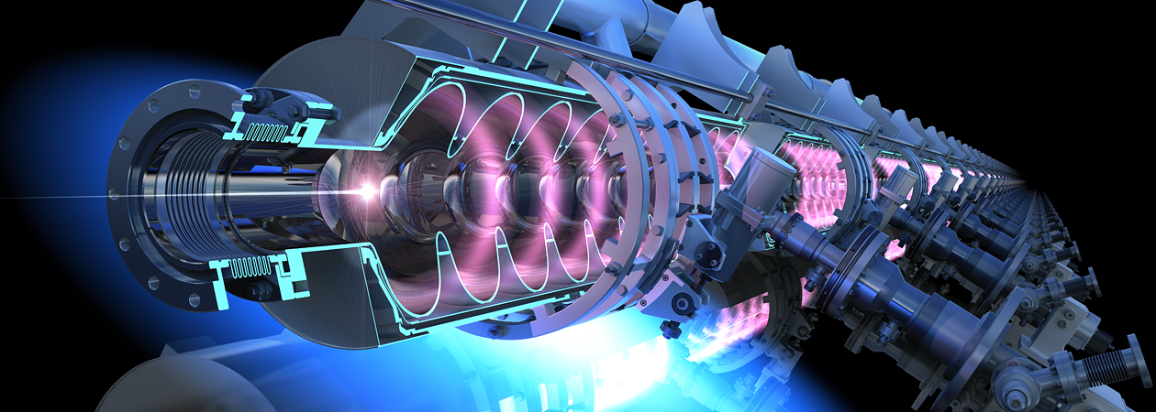
Superconducting RF for Colliders
Peter McIntosh
STFC Daresbury Laboratory
Advanced RF UK community meeting
7th June 2021
Notes:
The abstract pattern can be removed or repositioned if required. Be careful to ‘Send to Back’ so that it does not obscure any important information.

Slide 2
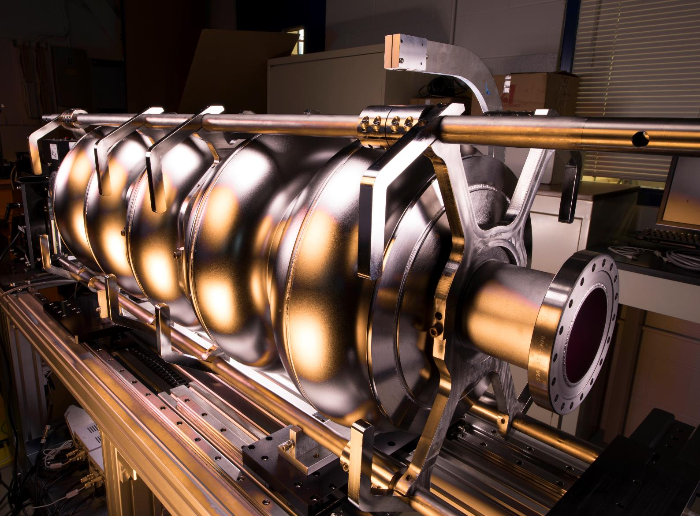
Agenda
1 International Linear Collider (ILC)
2 High Luminosity LHC (HL-LHC)
3 Future Circular Collider (FCC)
4 Electron Ion Collider (EIC)
5 SRF Infrastructure
6 UK Industry SRF Developments
7 UK Opportunities and Conclusions
Notes:
PLEASE DELETE/REPLACE PHOTO CREDIT IF CHANGING THE IMAGE.

Slide 3
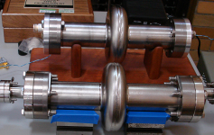
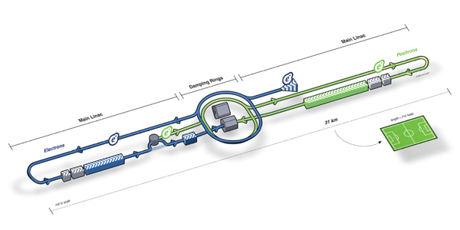



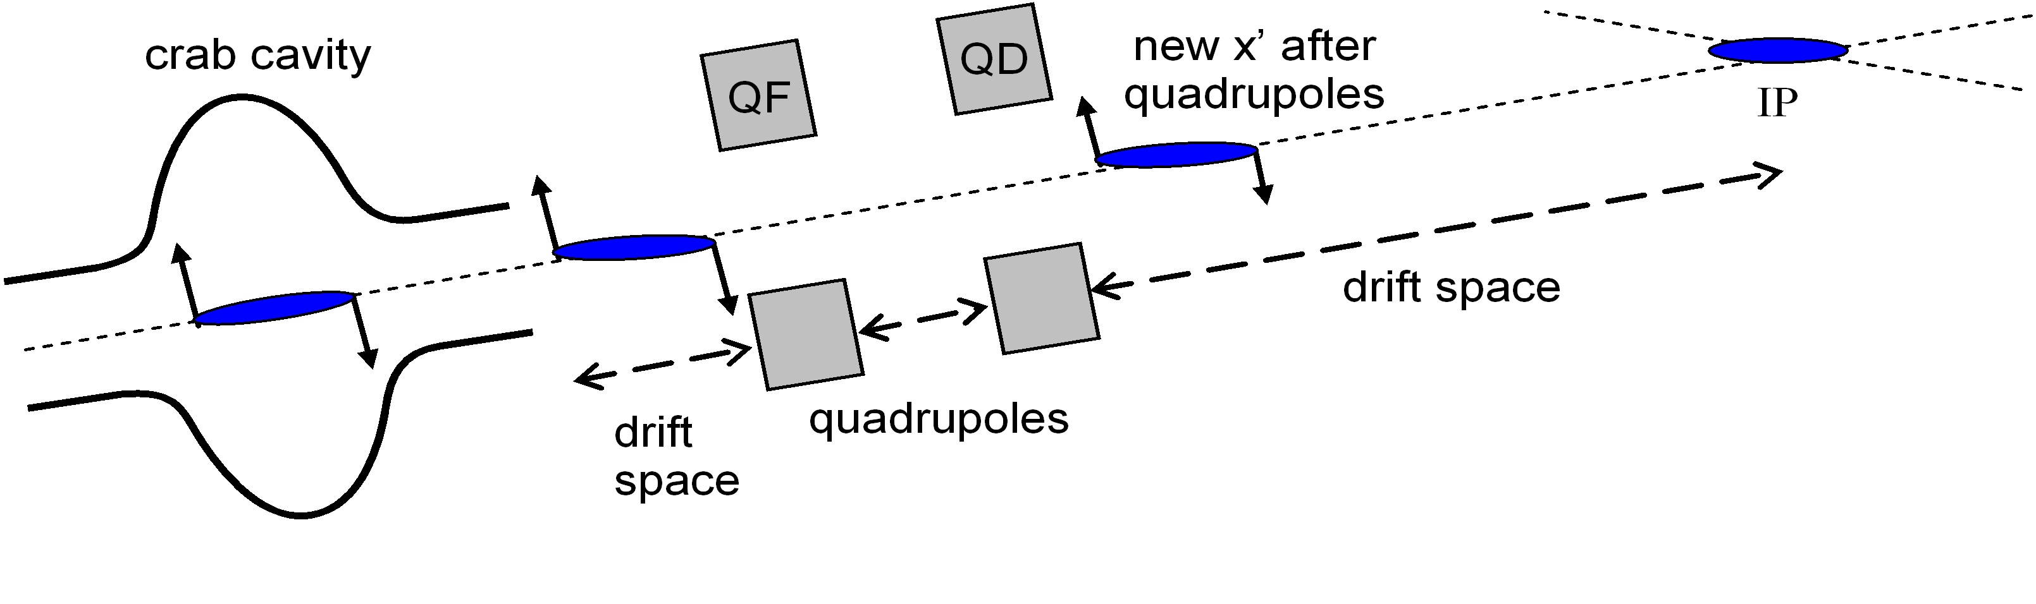
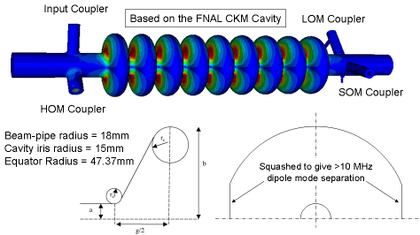
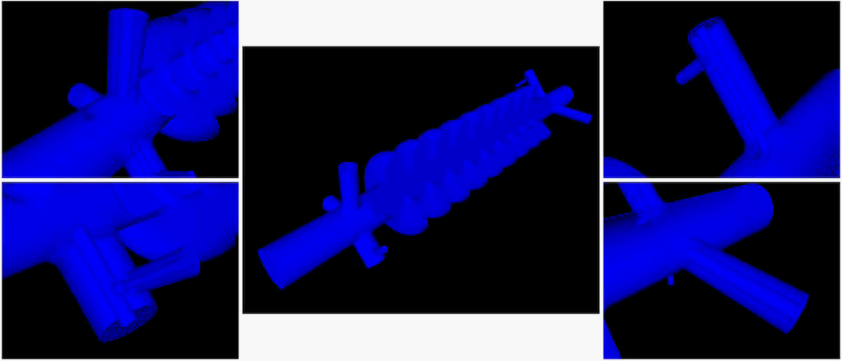
ILC Crab Cavity
(2004 - 2010)
3.9 GHz Single-cell
ILC Crab Cavities

Slide 4
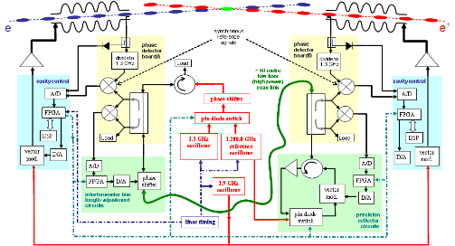
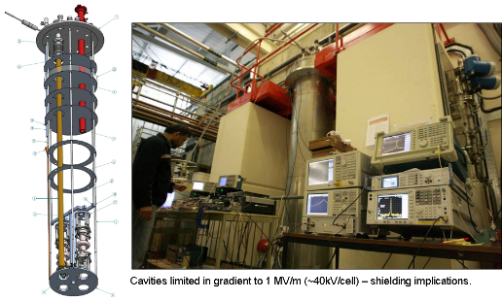
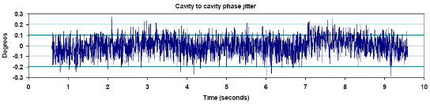
ILC Crab System Verification
ILC crab cavity zero crossings need synchronisation to 94 fs for 2 % luminosity loss budget.
Independent phase lock for both cavities:
  Target ⇒ 0.100º r.m.s.
  Locked ⇒ 0.080º r.m.s.
Performance fundamentally limited by the RF source.
4

Slide 5
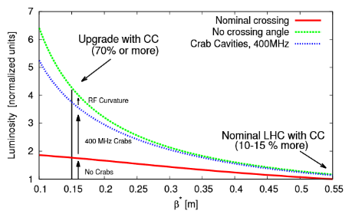
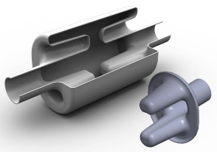
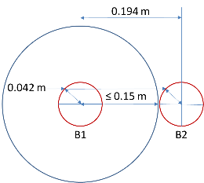
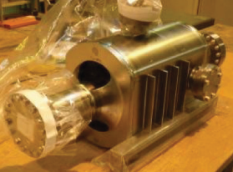
HL-LHC Crab Cavity Cryomodule
(2010-2025)
LHC luminosity upgrade will utilise local crab cavities at the detector IPs to increase Luminosity performance.
Beam separation at IP is however very restrictive – needs to be transversely compact.
Low frequency required (400 MHz) due to 7.5 cm bunch length.
UK 4-Rod Cavity Design
Unfortunately not selected for
HL-LHC
LHC Beam Separation at IP

Slide 6
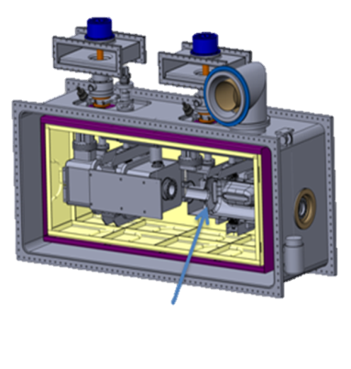
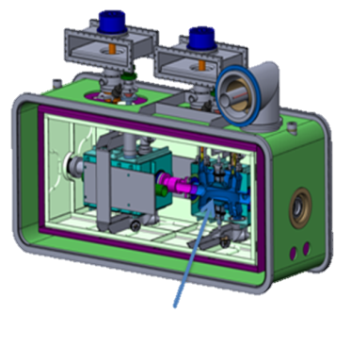
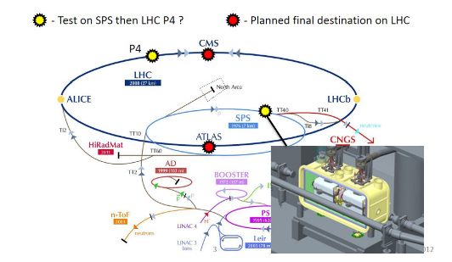




HL-LHC CC Cryomodule
First prototype cryomodule (RFD) tests completed on SPS in mid 2018.
First ever evaluation of crab cavities with a proton beam!
A 2-cavity pre-series RFD cryomodule design being developed and manufactured at Daresbury (2021).
STFC also providing 4 production DQW cryomodules for installation during LHC LS3 (2024-25).
RFD
DQW

Slide 7
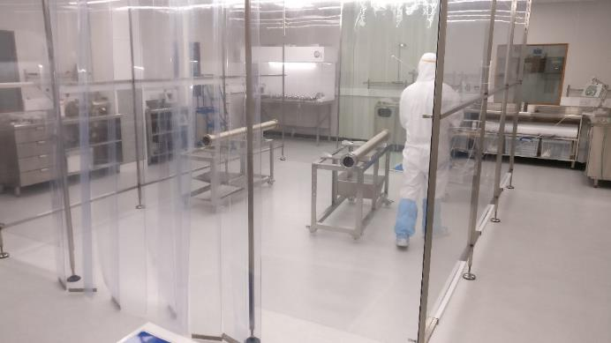
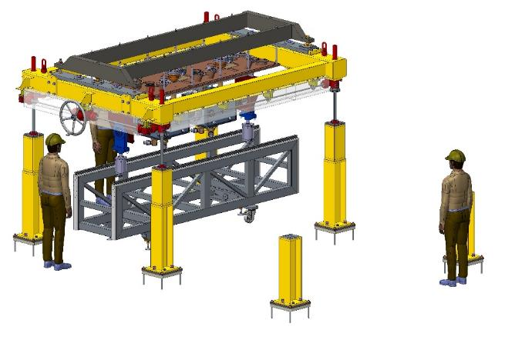
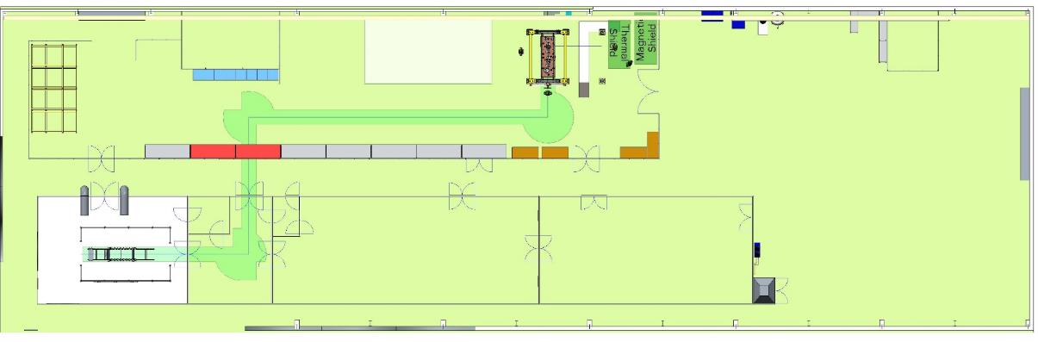
HL-LHC CC Cryomodule Assembly Facility @ DL
ISO4 Cleanroom extended to 6m
Cavity String Lifter Design Complete
Assembly Area at DL
Magnet Test Lab
Alignment Area

Slide 8
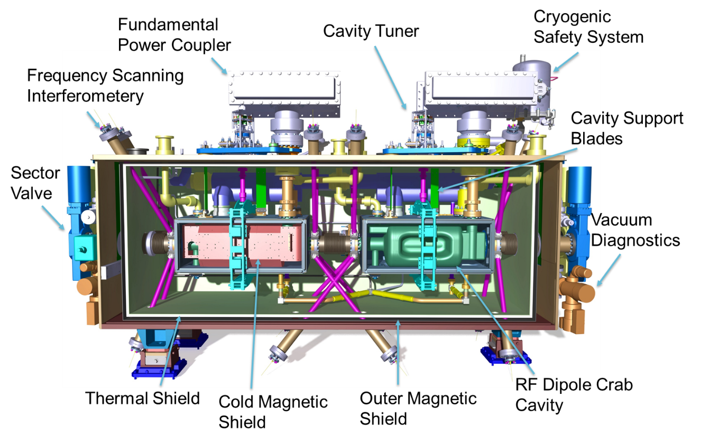
HL-LHC RFD CC Cryomodule Design
Leading UK contributions

Slide 9
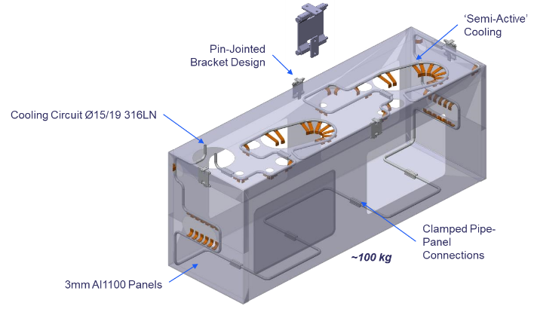
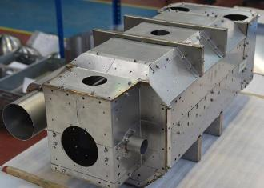
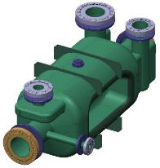
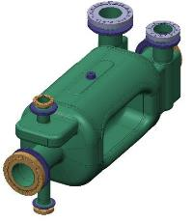
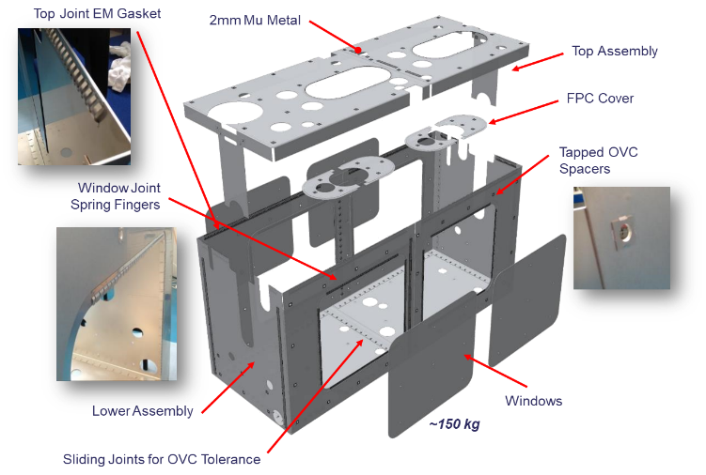
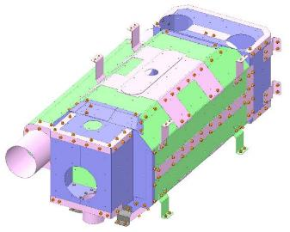
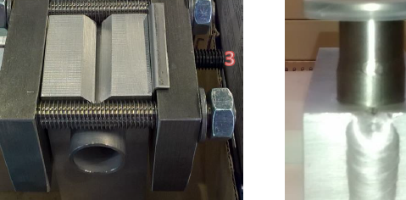
Thermal Shields
Al1100 panels give significant cost & weight savings for series production
SS316 Cooling circuit for cryoline integration & pressure safety.
HL-LHC CC Cryomodule
RFD Cold Magnetic Shields
STFC designed & issued to CERN in Apr16 (SPS Prototype).
Cavity design changed, shield designs required revision.
Warm Magnetic Shields
New Parts
Modified Parts
Unchanged

Slide 10
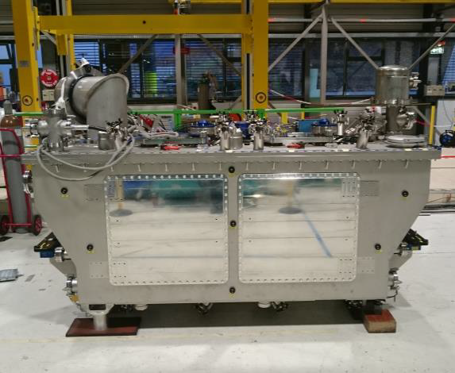
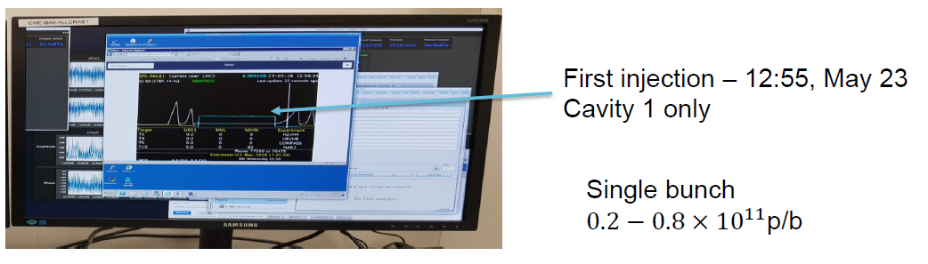
First HL-LHC CC Test on SPS – May 2018

Slide 11
UK Crab Expertise
ILC v2
FCC
EIC
HL-LHC (Production)
ILC CC
2008
HL-LHC (Prototype)
CLIC
VELA
2004 2020
2021 2040

Slide 12
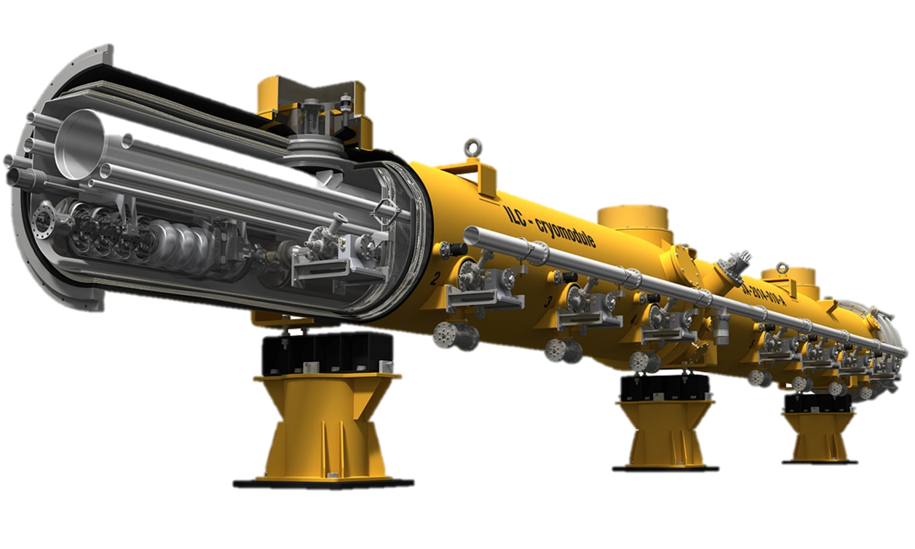
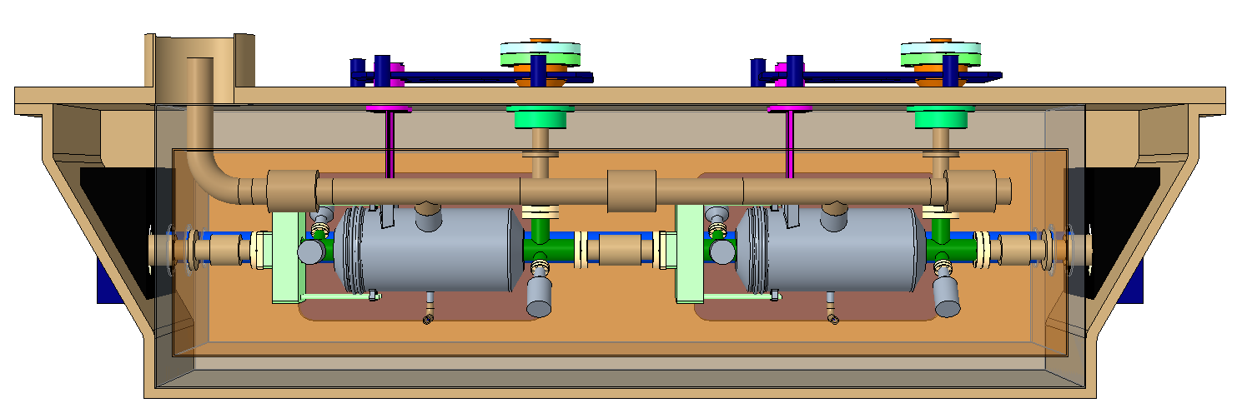
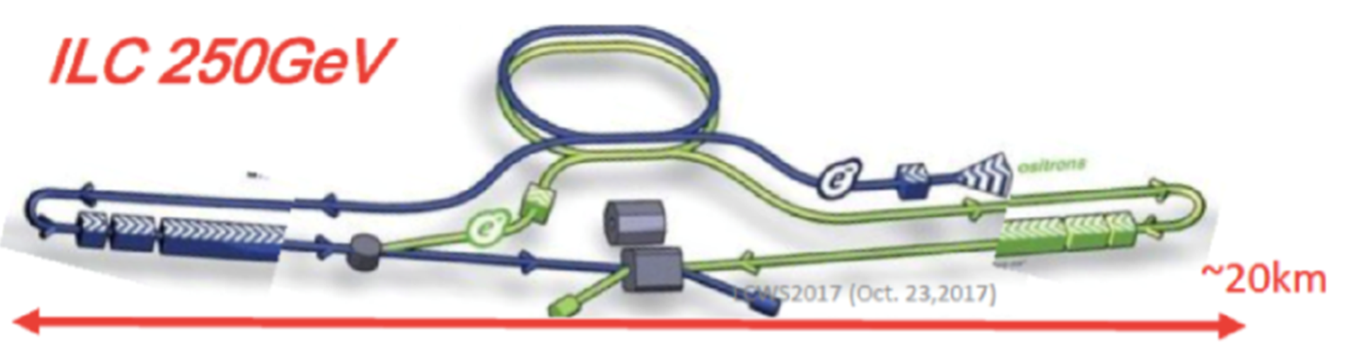
The ILC SRF Linac (>2022)
N2-doping
possibility to increase ILC performance even further!
250 GeV ILC CoM
Frequency (GHz) | 1.3
Cavity Gradient (MV/m) | 31.5
Q Factor | >10¹⁰
Cryomodule length (m) | 12.65
Number of Cavities | ~8000
Number of Cryomodules | ~900
Eu-XFEL
1.3
23.6
>10¹⁰
12.65
800
100
2-cavity Crab Cryomodule

Slide 13
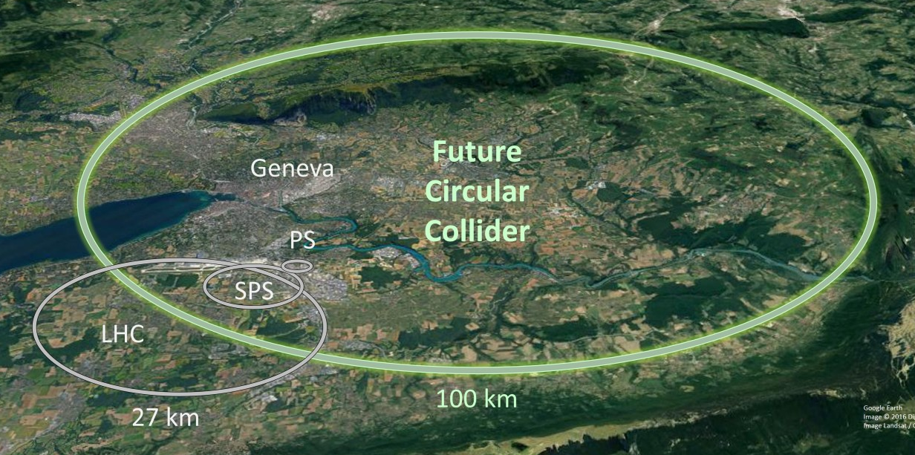
FCC SRF Challenges
Low impedance deflecting cavities (hh)
FPC 1 MW CW with variable coupling
High Efficiency Power Sources
Multi-purpose flexible cryomodules
Innovative fabrication techniques (Hydroforming, Spinning, SRF coatings) (ee)
Cavity performance (N-doping, baking, Thin films, A15’s)
HOM Damping, Heating and Impedance
Is a harmonic system required?

Slide 14
FCC SRF Challenges
Low impedance deflecting cavities (hh) – UK Expertise
FPC 1 MW CW with variable coupling
High Efficiency Power Sources – UK Involved
Multi-purpose flexible cryomodules – UK Expertise
Innovative fabrication techniques (Hydroforming, Spinning, SRF coatings) (ee) – UK Involved
Cavity performance (N-doping, baking, Thin films, A15’s) – UK Involved
HOM Damping, Heating and Impedance – UK Expertise
Is a harmonic system required? – UK Expertise

Slide 15
FCC-hh Crab cavity
Wide Open Waveguide (WOW) Cavity

Slide 16
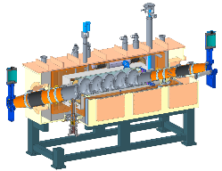

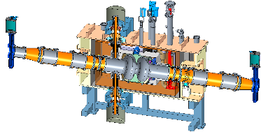
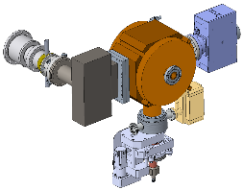
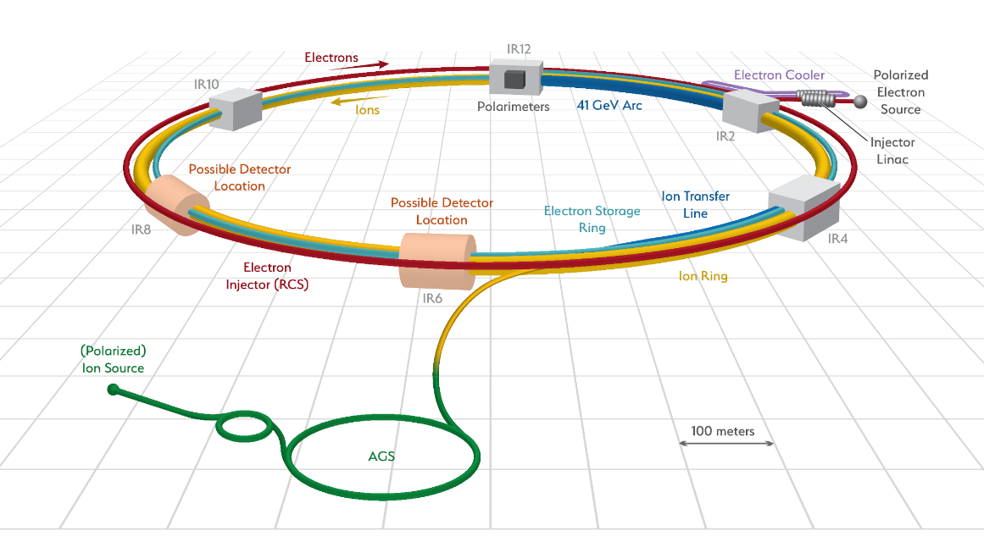
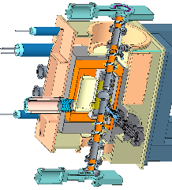
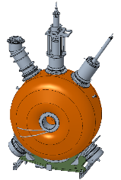
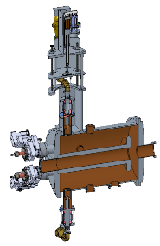
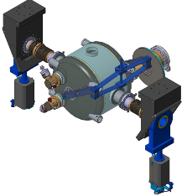

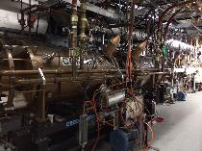
EIC RF Systems
Hadron - 591 MHz bunch compression cavity
Hadron Cooling - 591 MHz acceleration cavity
Electron - 591 MHz electron storage cavity
Injector - 571 MHz bunch compression cavity
Electron - 1773 MHz 3rd harmonic cavity
Hadron - 197 MHz bunch compression cavity
Both rings – 400 MHz crab cavity
Hadron – 24.5 MHz acceleration cavity
Rapid Cycling Synchrotron - 591 MHz acceleration cavity
Hadron – 49.2 MHz and 98.5 MHz bunch splitter cavity

Slide 17
EIC Crab Cavity Systems
eRHIC RF system | RF sub system | Freq [MHz] | Type | Location | # of Cavities
Electron Storage Ring | Fundamental | 591 | SRF, 2-cell | IR-10 | 14
 | Third Harmonic | 1773 | SRF, 1-cell | IR-10 | 5
Rapid Cycling Synchrotron | Fundamental | 591 | SRF, 5-cell | IR-10 | 3
Pre-Injection LINAC | Bunch Compression 1 | 114 | Copper, capacitor loaded | IR-2 | 1
 | Bunch Compression 2 | 571 | Copper, 1-cell | IR-2 | 1
 | 400 MHz LINAC | 2856 | SLAC type LINAC | IR-2 | 8 x 3m sections
Hadron Ring | Capture/Acceleration | 24.6 | Copper, Quarter Wave | IR-4 | 2
 | Bunch Splitter 1 | 49.2 | Copper, Quarter Wave | IR-4 | 2
 | Bunch Splitter 2 | 98.5 | Copper, Quarter Wave | IR-4 | 2
 | Bunch Compression 1 | 197 | Copper, 1-cell | IR-4 | 12
 | Bunch Compression 2 | 591 | SRF, 5-cell | IR-10 | 2
Crab Cavity | Hadron | 394 | SRF, Double Quarter Wave | IR-6 | 8
 | Electron | 394 | SRF, Double Quarter Wave | IR-6 | 2
Hadron Cooling | SRF Booster | 118 | SRF, Quarter Wave | IR-2 | 2
 | Bunch Compression | 591 | Copper, 1-cell | IR-2 | 1
 | Fundamental | 591 | SRF, 5-cell | IR-2 | 9
 | Third Harmonic | 1773 | SRF, 5-cell | IR-2 | 2

Slide 18
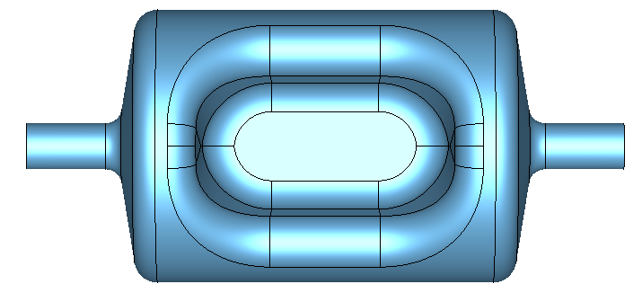
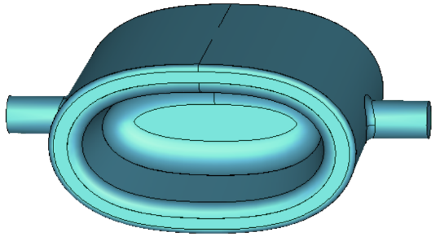
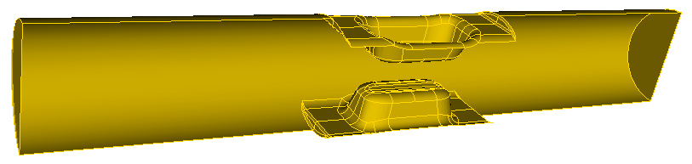
EIC Crab Cavity
Two frequencies 394 and 197 MHz.
US are evaluating the possibility to open the beampipe port of the cavity to damp HOMs by propagating to external absorbers.
HOM ports/couplers can be eliminated, using SiC absorbers outside the cryomodule instead (same as ESR cavities for example).
Considering using 320mm ID beampipe, with TE11 cutoff at 549 MHz and TM01 cutoff at 717MHz.
  All HOM frequencies need to be above these numbers.

Slide 19
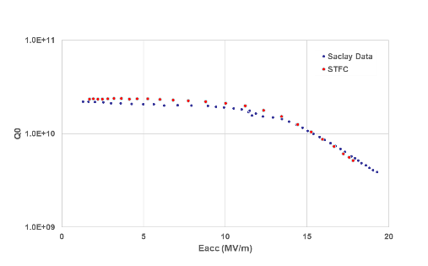
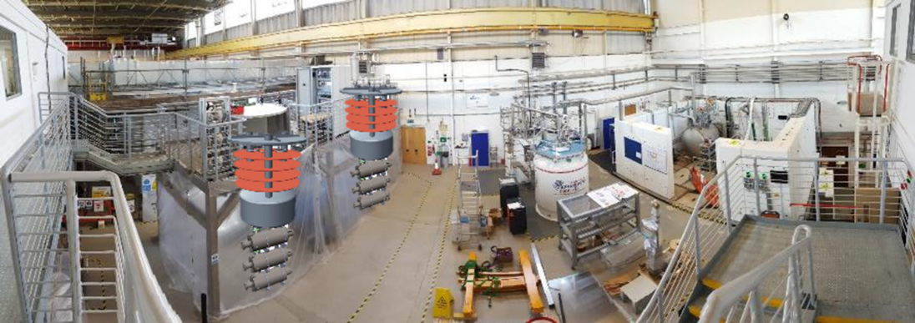
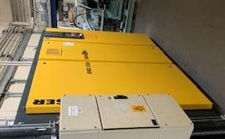
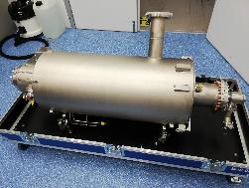





Finalising commissioning, validated with prototype (2) and Pre-Series (4) cavities.
Cavity Manufacture
Manufactured 40 cavities (45%):
32 DL, 8 DESY
Testing
13 have been tested
  7 DL, 6 DESY
5 meet ESS specifications, 7 (most recent) require reprocessing/test:
      Being evaluated with vendor.
First UK HB Cavity issued to CEA in Mar21!
SRF Cavity Testing @ Daresbury
SuRFLab Test Facility for ESS
Cryogenic Insert
(x2)
Test Bunker
3
4
1
2
Cleanroom/HPR
Cryo Liquefier
Notes:
Replace this guidance text with your own bullet pointed content.
For further guidance please see https://www.bdadyslexia.org.uk/advice/employers/creating-a-dyslexia-friendly-workplace/dyslexia-friendly-style-guide

Slide 20


UK Delivery of PIP-II HB650 Cryomodules
HB650 Cryomodule
HB650 Cavity
Coupler interface
Helium jacket
5-cell high-purity
Niobium cavity
Tuner
Cavity | PIP-II
Frequency (MHz) | 650
Cavity Beta | 0.92
Gradient (MV/m) | 19.9
Quality Factor Qo | 3 x 10¹⁰ (N2 Doped)
Number of Cells | 5
Cavity Dynamic Load (W) | <22
Cavity Length (m) | 1.42
Number of Cavities | 18 (+2)
Cryomodule (CM) | PIP-II
Operating Temperature (K) | 2
Number of Cavities | 6
Energy Gain (MeV) | ~110
Dynamic Load (W) | 130
Static Load (W) | 32
CM Length (m) | 9.8
Number of Cryomodules | 3

Slide 21




SRF Infrastructure Evolution
Superconducting RF Lab (SuRFLab) – PIP-II
ISO4
Outer vessel integration
String to support & shields
Cavity string assembly

Slide 22








UK Industry SRF Development (2010 - 2013)
STFC Innovations (Mini-IPS) funded activity with Shakespeare Engineering (UK) to fabricate a single-cell 1.3 GHz validation structure in Dec 2010.
3 cavities fabricated:
  #01 BCP processed/tested at Jlab.
  #03 EP processed/tumbled at FNAL.
First bulk Niobium SRF cavities to have ever been fabricated* in the UK!
Courtesy: P Kniesel (Jlab) – 31/1/2011
* Except for EBW!
Multipacting
(15 – 17 MV/m)

Slide 23





UK Industry SRF Development (2019 – 2022)
PIP-II – 650MHz high beta cavity
2-cell 1.3GHz test cavity
The Welding Institute
Demonstrate successful EBW of SRF cavities:
  Demo-1: 2-cell 1.3 GHz and
  Demo-2: PIP-II Demonstrator
NAMRC
All EBW tooling
Demonstration of Nb - NbTi EBW processes.
Shakespeare Engineering
Pressing, machining and manufacture of all cavity components.
Tuning and dimensional verification of all components.
PIP-II 650MHz cavity demonstrator
All manufacture, including
EBW to be performed in UK!

Slide 24
UK Opportunities & Conclusions
Since 2004, UK developed leading role in SRF crab cavity and cryomodule developments.
  ILC (2008) design and validation completed for TDR.
  HL-LHC, key role in pCM development and test on SPS in 2018.
  HL-LHC delivering pre-series CM in 2021 and production CMs for installation in 2025.
Building UK industry in SRF cavity manufacture.
UK cavity testing and cryomodule integration capability at Daresbury is significantly strengthening (ESS & PIP-II).
Strong UK opportunities now exist for:
  250 GeV ILC post-2022 – Crab Cavities and Main Linac SRF systems
  EIC – Crab cavities at either 197 MHz or 394 MHz
  FCC – Crab cavities, SRF thin-films
Collaborative plans are currently under development!

Slide 25
Thank You
Facebook: Science and Technology Facilities Council
Twitter:@STFC_matters
YouTube: Science and Technology Facilities Council

