Slide 1
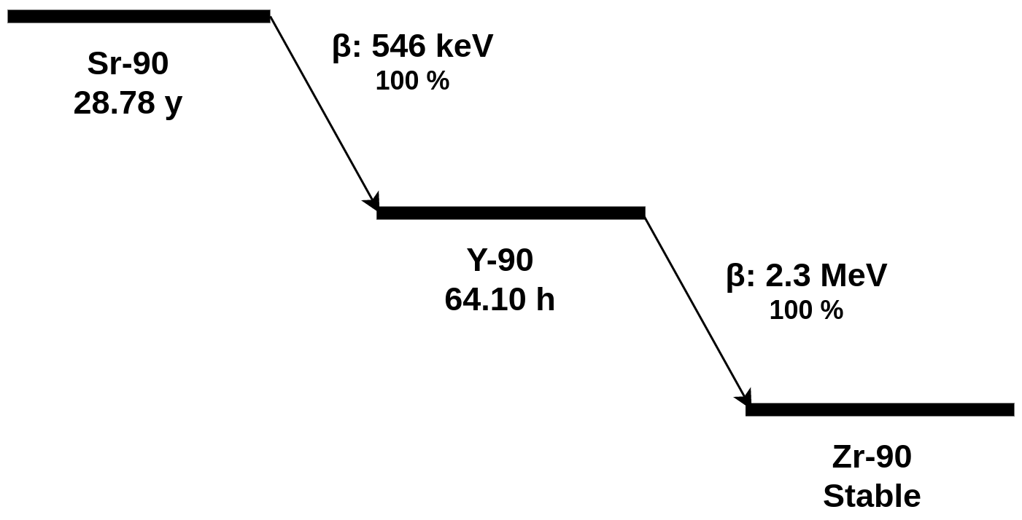
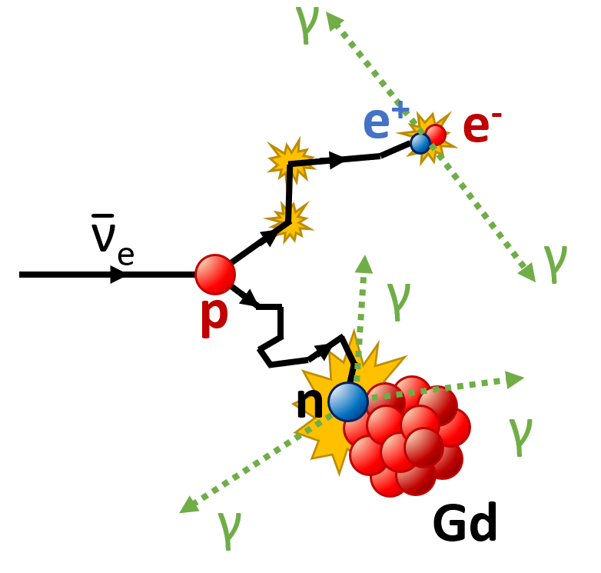
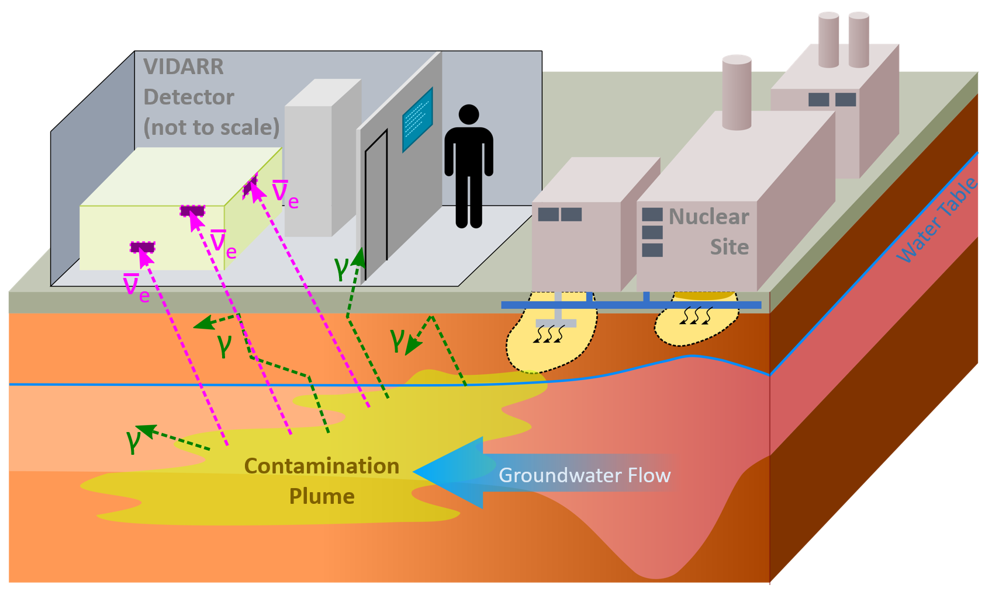
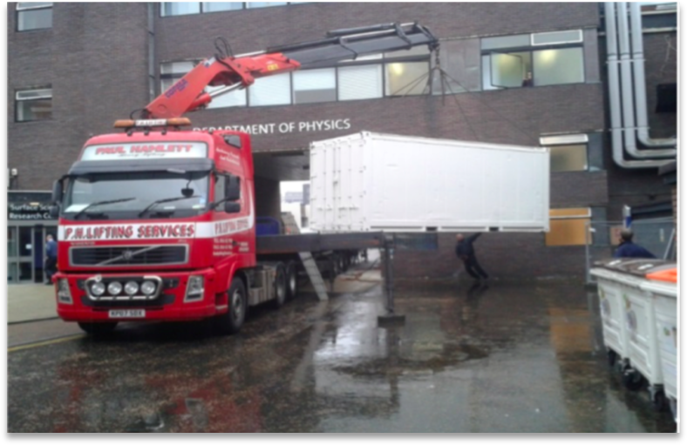
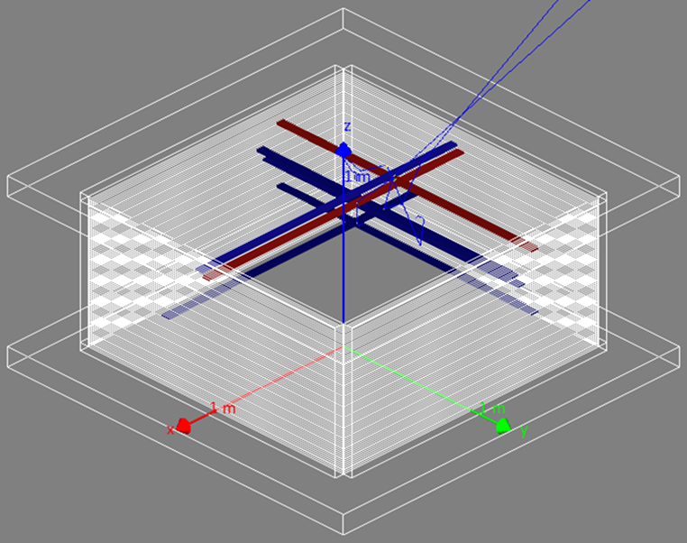
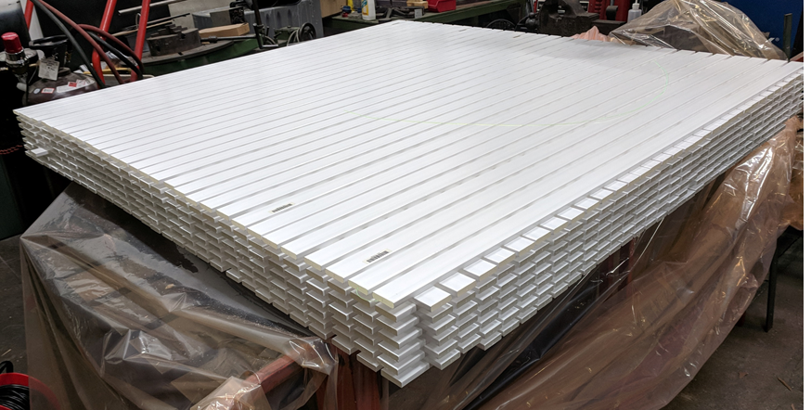
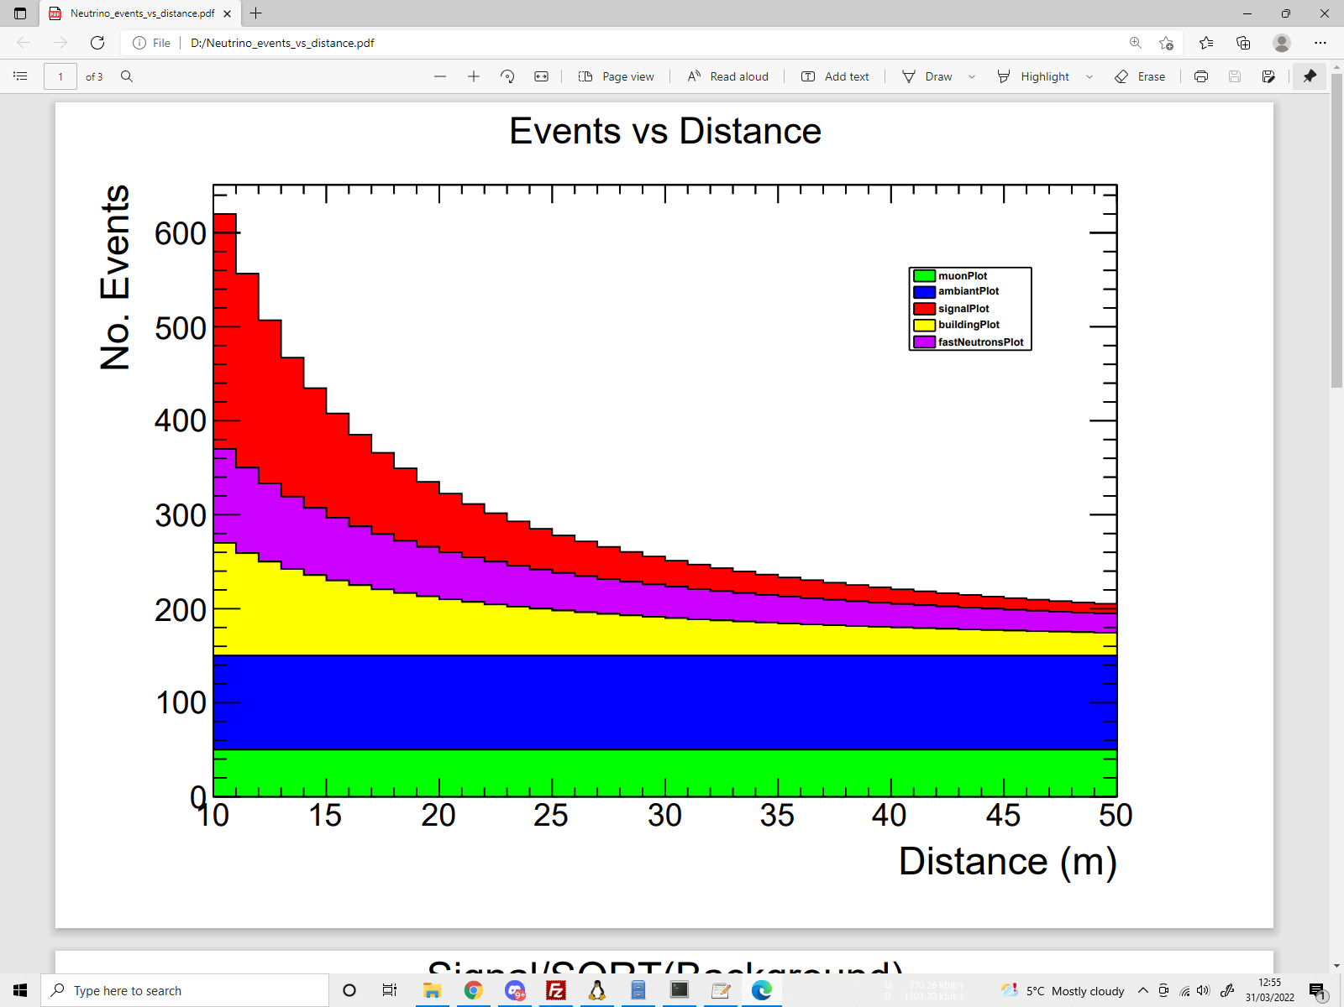
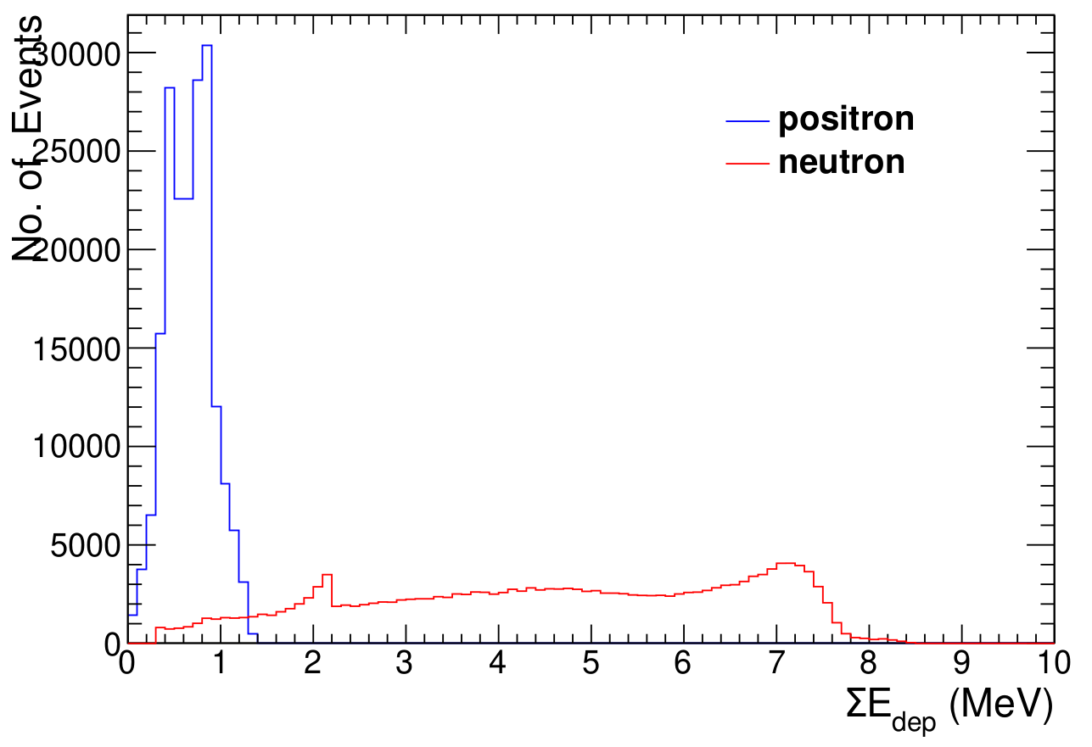
Monitoring Nuclear Sites Via Antineutrino Detection
Joel Dasari
J.Coleman, C. Metelko, R. Mills, Y. Schnellbach
j.dasari@liverpool.ac.uk
1 - Motivation
The VIDARR detector detects fission radionuclides produced antineutrinos using extruded plastic scintillators
Anti-neutrinos are weakly interacting, subatomic, particles which are not shielded by any material and suitable for direct observation.
Already a commercial prototype for inverse beta decay reactor monitoring
Selection and recognition algorithms implemented optimize the detector
Commercial viability as it provides continuous, non-intrusive monitoring even when hidden by meters of shielding
Strontium-90 (⁹⁰Sr) is a high level nuclear waste prominent at nuclear sites
Monitoring activity is beneficial for the environment and safety
2 - Inverse Beta Decay (IBD)
Inverse Beta Decay (IBD) is a well known method for anti-neutrino detection
Detector relies on anti-neutrinos interacting with protons to undergo IBD.
IBD produces
Positron
thermal neutron
Results in distinctive delayed coincidence signal (20–30 μs)
Positron annihilation produces 2 back-to-back gammas
Neutron produces 8 MeV gamma cascade on Gd
Inverse beta decay producing a positron and neutron which is captured by a Gadolinium (Gd) atom
Anti-neutrino emissions from fission products, bypassing the ground and shielding into the VIDARR
3 - VIDARR Detector
Active detection volume is formed of extruded plastic scintillator bars.
Detector specs:
Approx 1m³
1 tonne active mass
MPPC/SiPM readout
Mobile laboratory
Designed for IAEA applications
Test deployed at Wylfa nuclear power plant
Undergoing upgrades
Mass increase
Sensors upgrade
New readout electronics
More shielding
New container
4 - Detector Modelling
GEANT4 used to model:​
Optical response​
Full detector response​
Full detector model:​
Modelling ⁹⁰Sr energy range antineutrinos & IBD events
Detector response to positrons & neutrons​
Event selection & particle identification
Cluster topology
Cluster energy
Reconstruction of event used to distinguish positron & back-to-back gammas
VIDARR loaded for mobile deployment
Geant4 simulation of IBD events in VIDARR. Each highlighted bar shows particle interaction with the scintillator. Red bars are for positrons, blue bars are for neutrons.
VIDARR construction with alternating scintillator layers.
5 - Results
6 - Ongoing Work
Improved input data
Improved measurements of background rates
Onsite background measurements
Nuclear fission waste
Upgraded detector benefits:
New sensors: better quantum efficiency, less noise, higher sensitivity
Better shielding
Bigger detector size (approx double height)
More Gd gamma cascade captured
Signal detection improvement
Improved simulation
Filtering of back-to-back gammas to improve positron energy signal
Improved model for a simulated ⁹⁰Sr source of different volumes
Attempts to separate ⁹⁰Sr component particles based on cumulative energy deposition.
Muons
Ambient
Signal
Building
Positron annihilation back-to-back gamma peak
Fast Neutrons
2 MeV peak neutron-hydrogen interaction
Continuous Gd gamma cascade
Expected antineutrino like signal events with simulated background measurements based of Wylfa power plant deployment (1 day of event counts)
Clear signal at close distances
Small antineutrino cross sections which indicate weak separation at large distances from the source
Background noise can be improved in current detector upgrade and analysis cycle

