Slide 1
The MIGDAL experiment: Preparations for the first observation of the Migdal effect in nuclear scattering
Tim Marley
(Imperial College London / Rutherford Appleton Laboratory)
For the MIGDAL collaboration

Slide 2
Outline
The Migdal effect and dark matter direct detection
Observation of the Migdal effect in radioactive decays
The MIGDAL experiment
Low-pressure gas Optical-TPC
Simulations
Status & summary

Slide 3
The Migdal Effect
Migdal
electron
Neutral
projectile
Direct DM searches use signal from nuclear recoils as a signature of the DM interaction with the detector medium.
When a nucleus moves relative to the electron cloud, an individual electron might be ejected leading to ionisation (Migdal effect).
Sub-threshold nuclear interactions may be accompanied by a more detectable electron recoil.

Slide 4
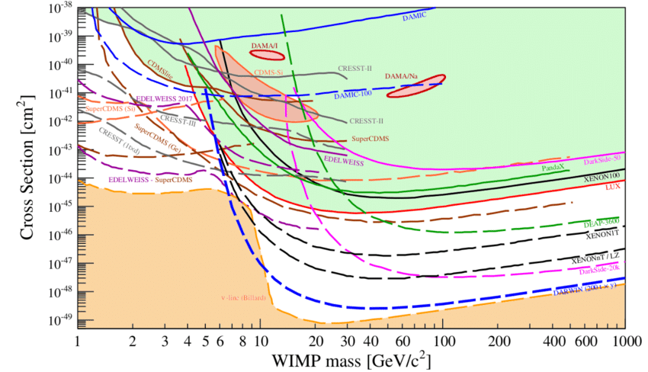
How does this effect help DM searches?
Parameter space reachable in principle by detectors with a low mass target material.
NRs below some very small threshold are not detectable, defining a DM mass threshold which depends on the mass of the target nucleus and quenching.
Migdal electrons can be higher energy and are not affected by quenching.
If Migdal is experimentally confirmed, ionisation electrons can become a signal from low mass DM particles (if the ER background is sufficiently low).
LHCSki 2016 - A First Discussion of 13 TeV Results
THRESHOLD
EXPOSURE

Slide 5
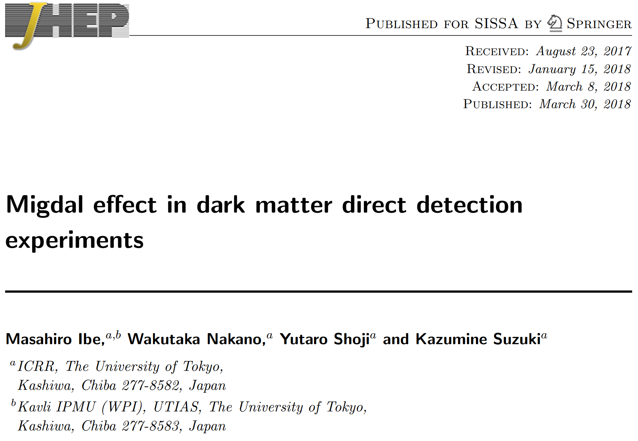
Huge attention from the DM community
Migdal effect calculations reformulated by M. Ibe et al. with ionisation probabilities for atoms and recoil energies relevant to Dark Matter searches.
Papers in the past from:
LUX, XENON1T, EDELWEISS, CDEX-1B, SENSEI, DarkSide, and more
Including targets:
Ge, Si, Xe and Ar
Claiming sensitivity to WIMPs with mass well below 1 GeV.
So far ~100 citations of this paper

Slide 6
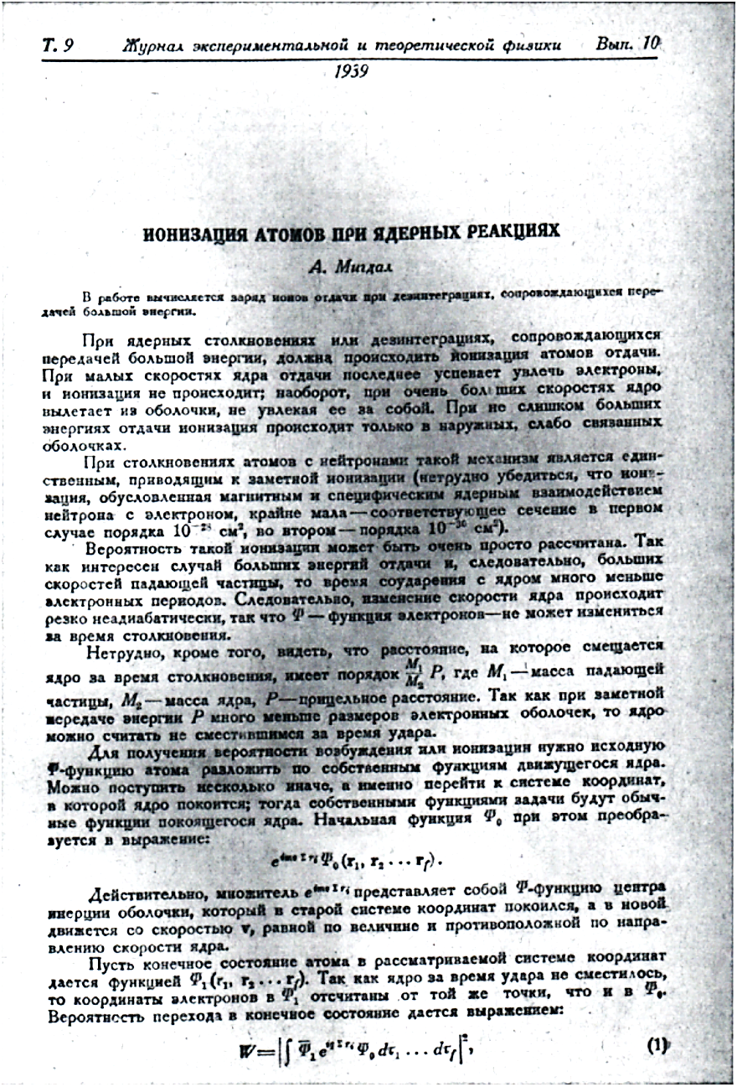
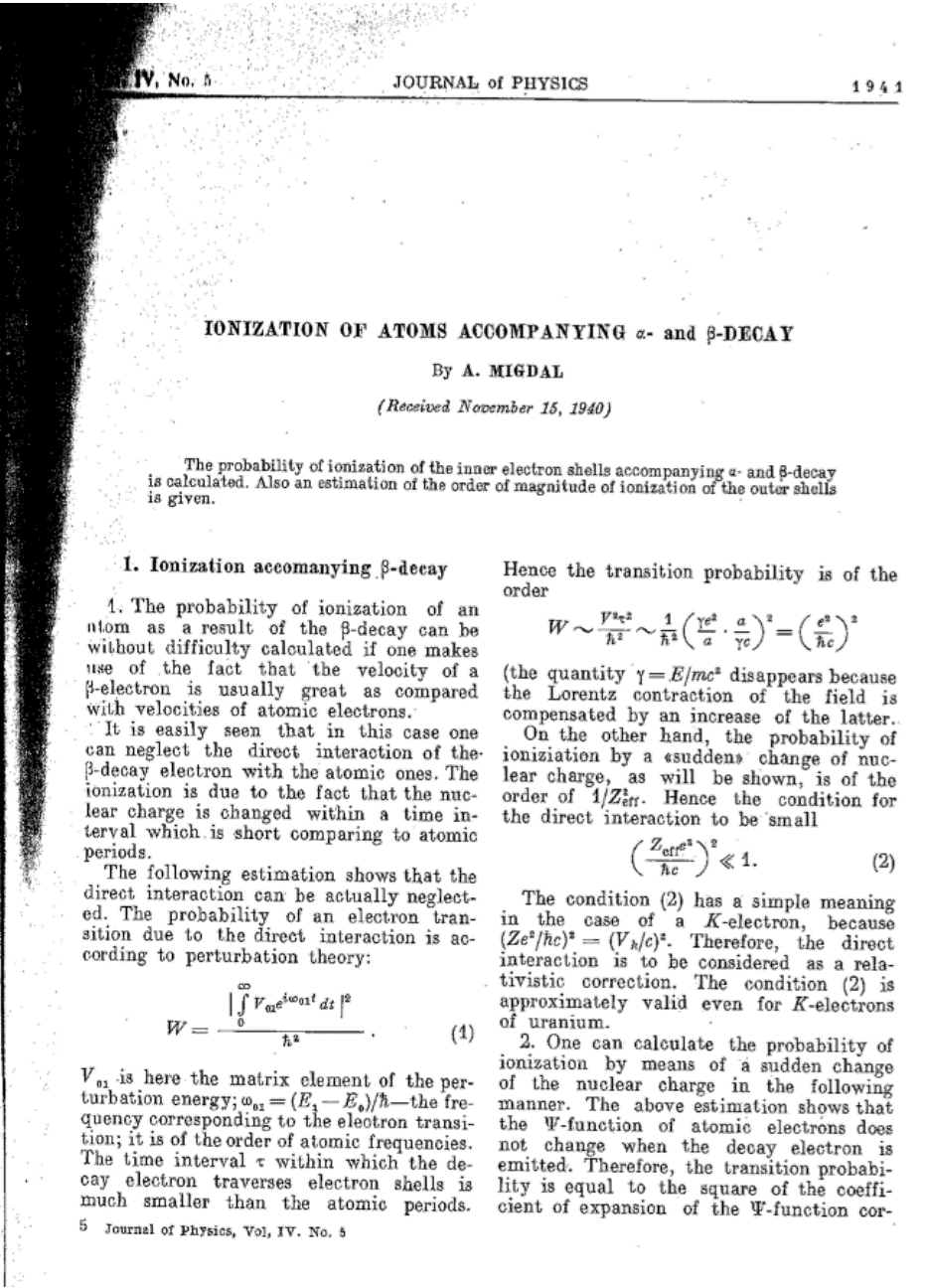
What do we know about the Migdal effect?
A. Migdal publications:
Ionisation in nuclear reactions [1]
Ionisation in radioactive decays [2]
First observations of the Migdal effect in :
Alpha decay [3,4]
Beta decay [5]
Positron decay [6]
Nuclear scattering [x]
Also in A.B. Migdal ”Qualitative Methods in Quantum Theory” Advanced Book Classics CRC Press, 2000
L. Landau and E. Lifshitz ”Quantum Mechanics : Non-relativistic Theory”
[1] A. Migdal Ionizatsiya atomov pri yadernykh reaktsiyakh, ZhETF, 9, 1163-1165 (1939)
[2] A. Migdal Ionizatsiya atomov pri α- i β- raspade, ZhETF, 11, 207-212 (1941)
[3] M.S. Rapaport, F. Asaro and I. Pearlman K-shell electron shake-off accompanying alpha decay, PRC 11, 1740-1745 (1975)
[4] M.S. Rapaport, F. Asaro and I. Pearlman L- and M-shell electron shake-off accompanying alpha decay, PRC 11, 1746-1754 (1975)
[5] C. Couratin et al. , First Measurement of Pure Electron Shakeoff in the β Decay of Trapped 6He+Ions, PRL 108, 243201 (2012)
[6] X. Fabian et al., Electron Shakeoff following the β+ decay of Trapped 19Ne+ and 35Ar+ trapped ions, PRA, 97, 023402 (2018)

Slide 7
Migdal In Galactic Dark mAtter expLoration
Create a dedicated environment for an unambiguous first observation of the Migdal effect in nuclear scattering with a suppressed background.
Phase 1: Observe the effect in CF4 in high energy recoils.
Phase 2: Observe the Migdal effect in CF4 + noble gases.
This experiment is designed for observation
in the most favourable conditions.

Slide 8
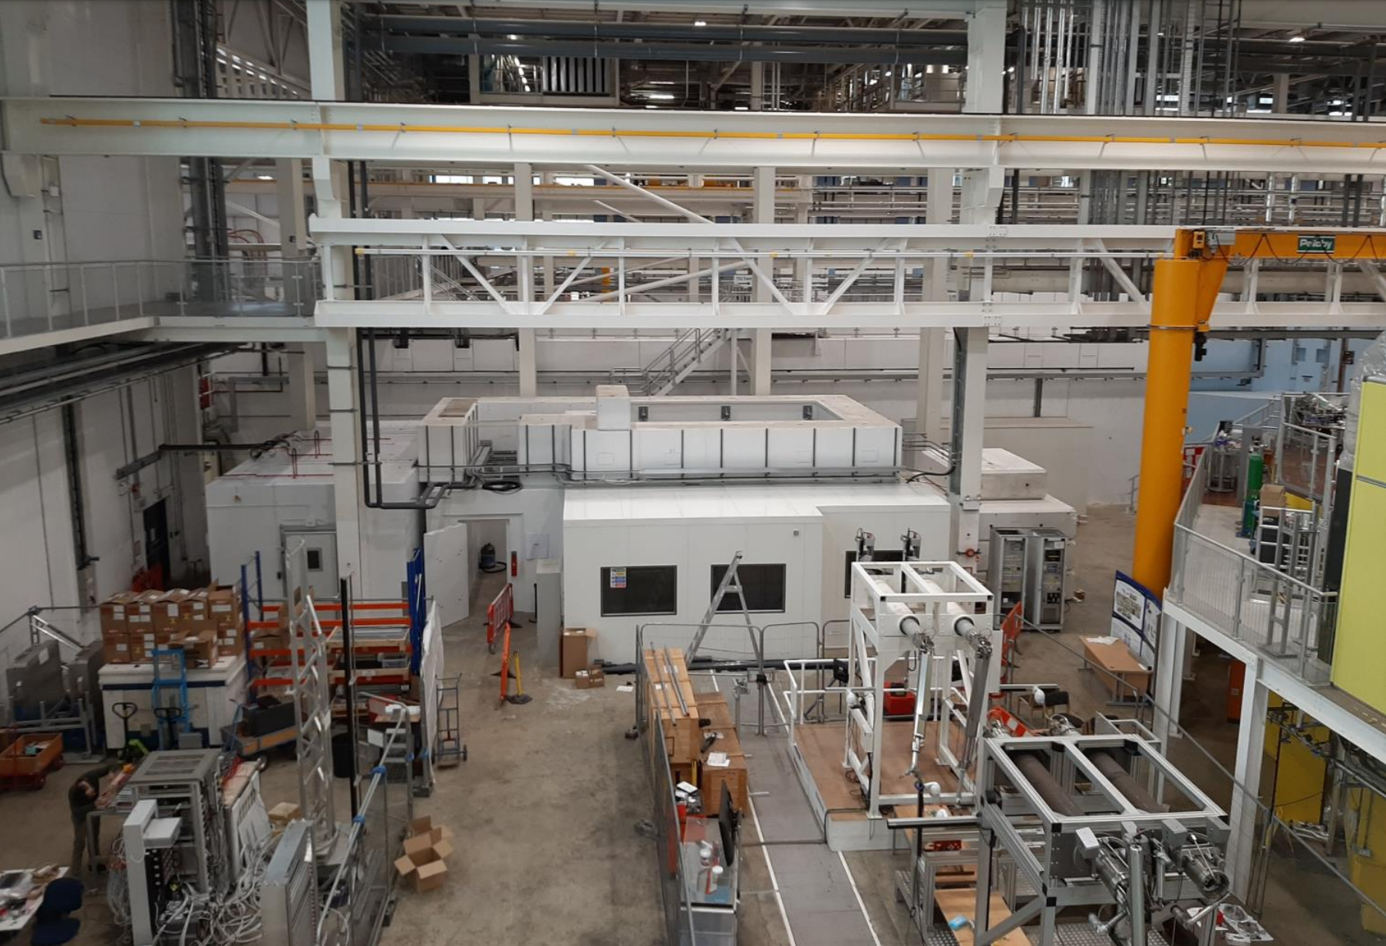
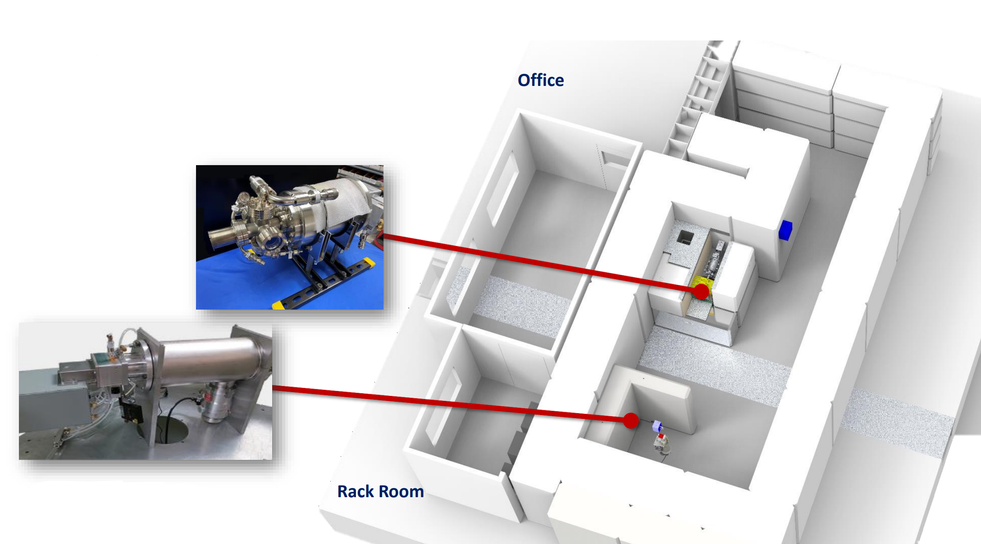
New NILE facility at ISIS, RAL
14.1 MeV DT neutron source
Flux: 10¹⁰ n / sec
Chamber positions
2.45 MeV DD neutron source
Flux: 10⁹ n / sec

Slide 9
Experimental goal
Direct observation of two simultaneously created tracks of the ionisation electron and the nuclear recoil originating from the same vertex using GEM-based OTPC.
Nuclear recoil
Nucleus
Neutron
D-T/D-D
source
Migdal electron
From same vertex

Slide 10
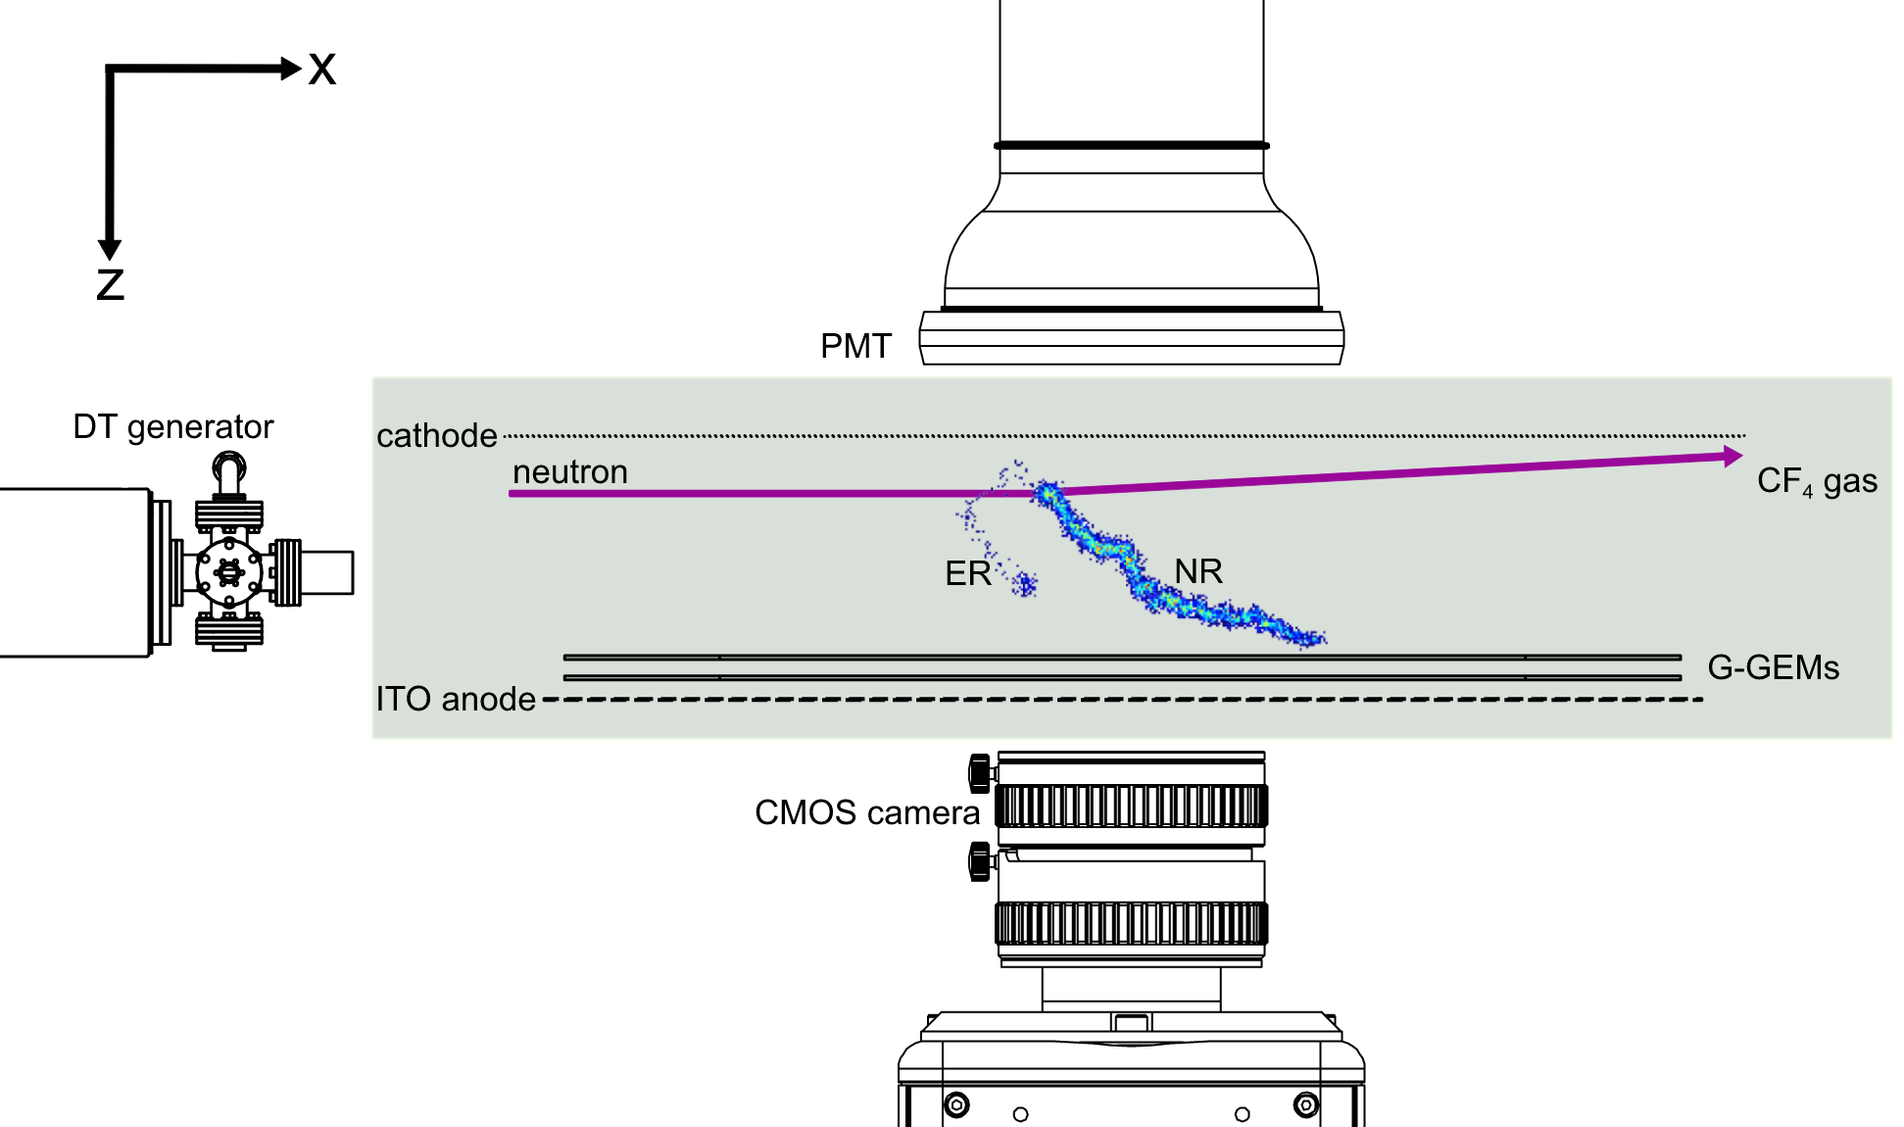
Optical Time Projection Chamber
This is a schematic of the Migdal OTPC.
The active area of the GEMs is 10×10 cm².
The drift region is 3 cm.
The ITO anode collects charge timing information (3D reconstruction).
The example Migdal event contains a 10 keV electron + 250 keV fluorine recoil which has been scaled-up by a factor of 3.
D-D/D-T generator

Slide 11
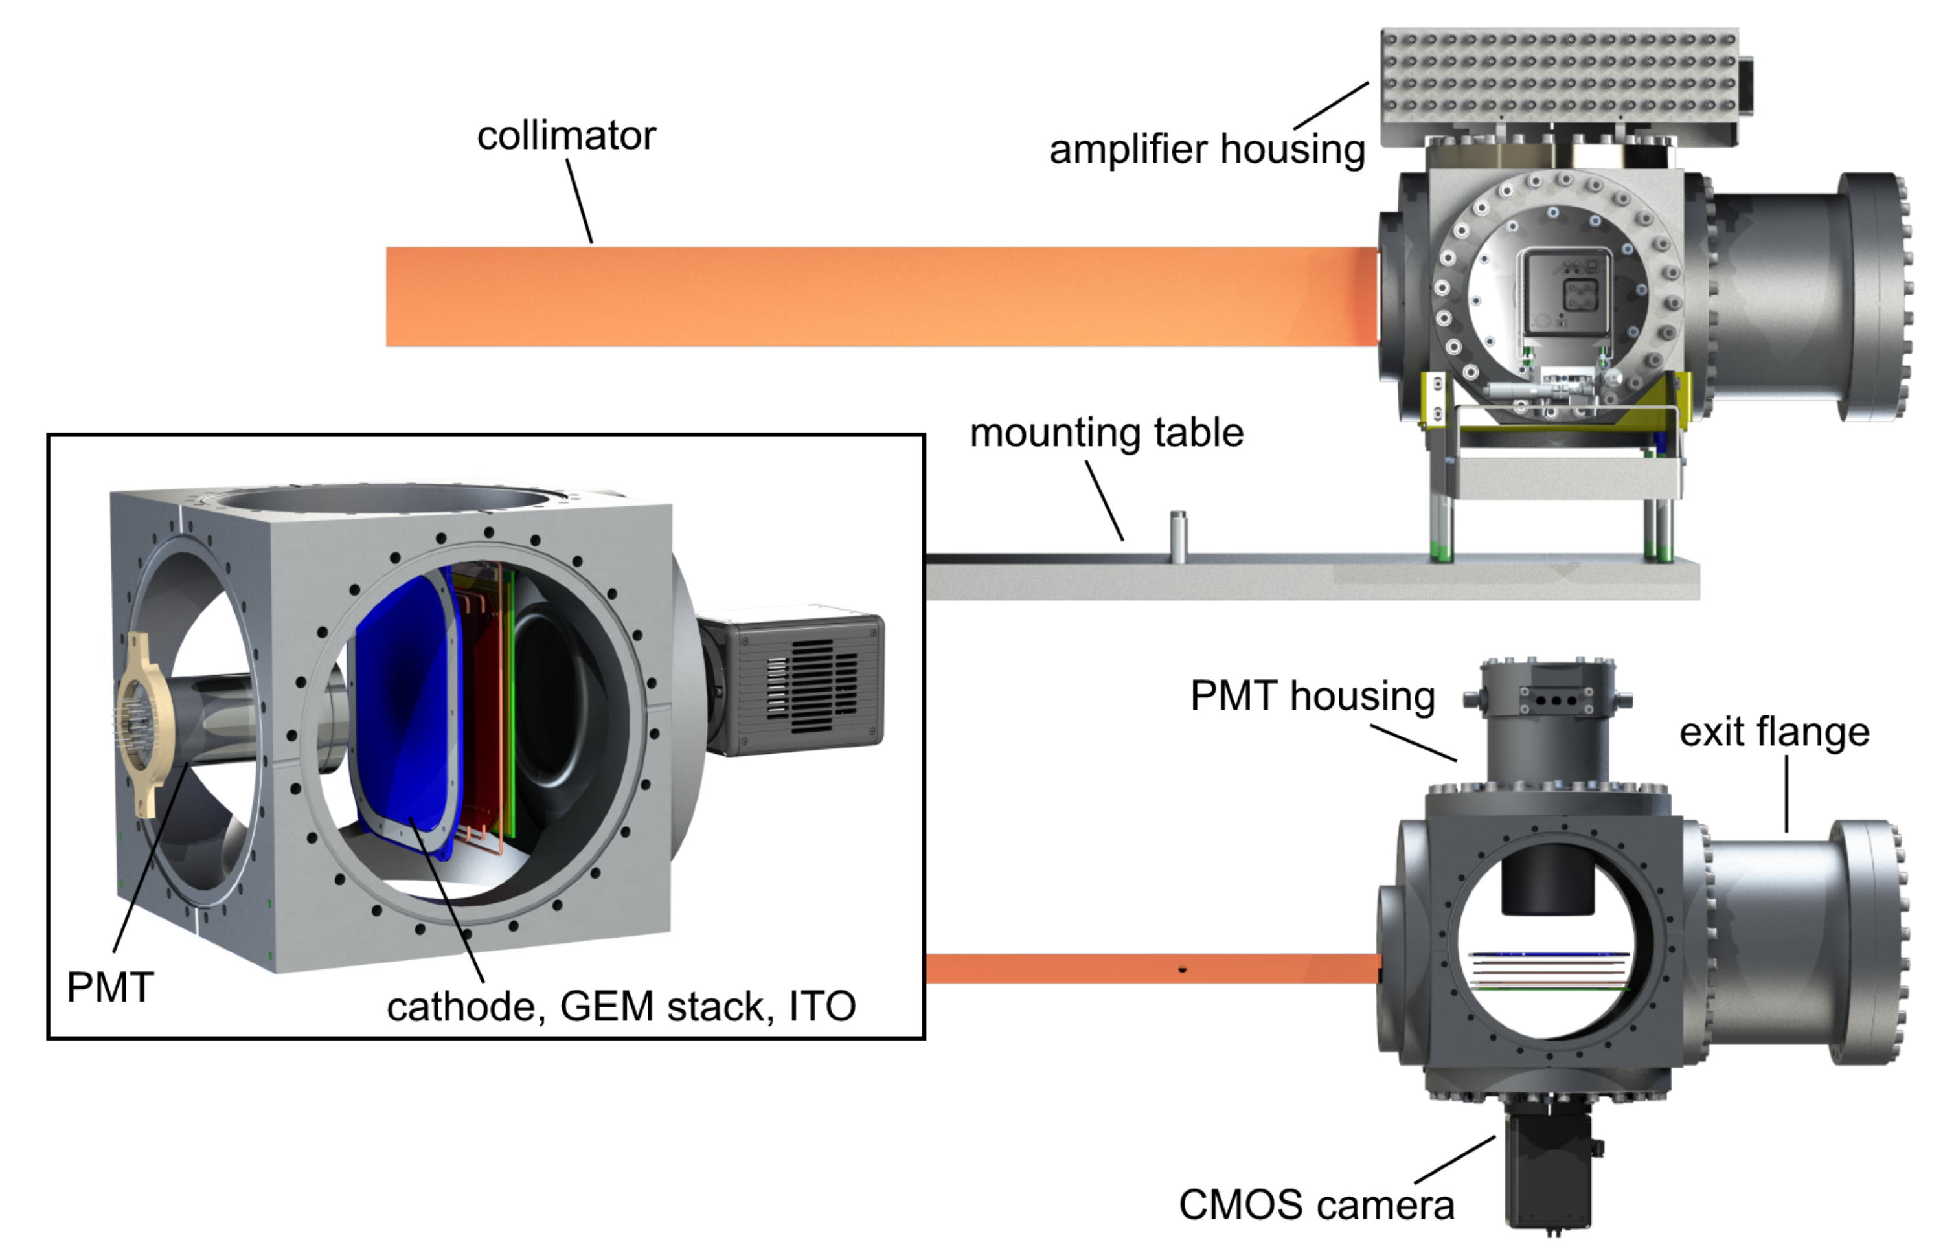
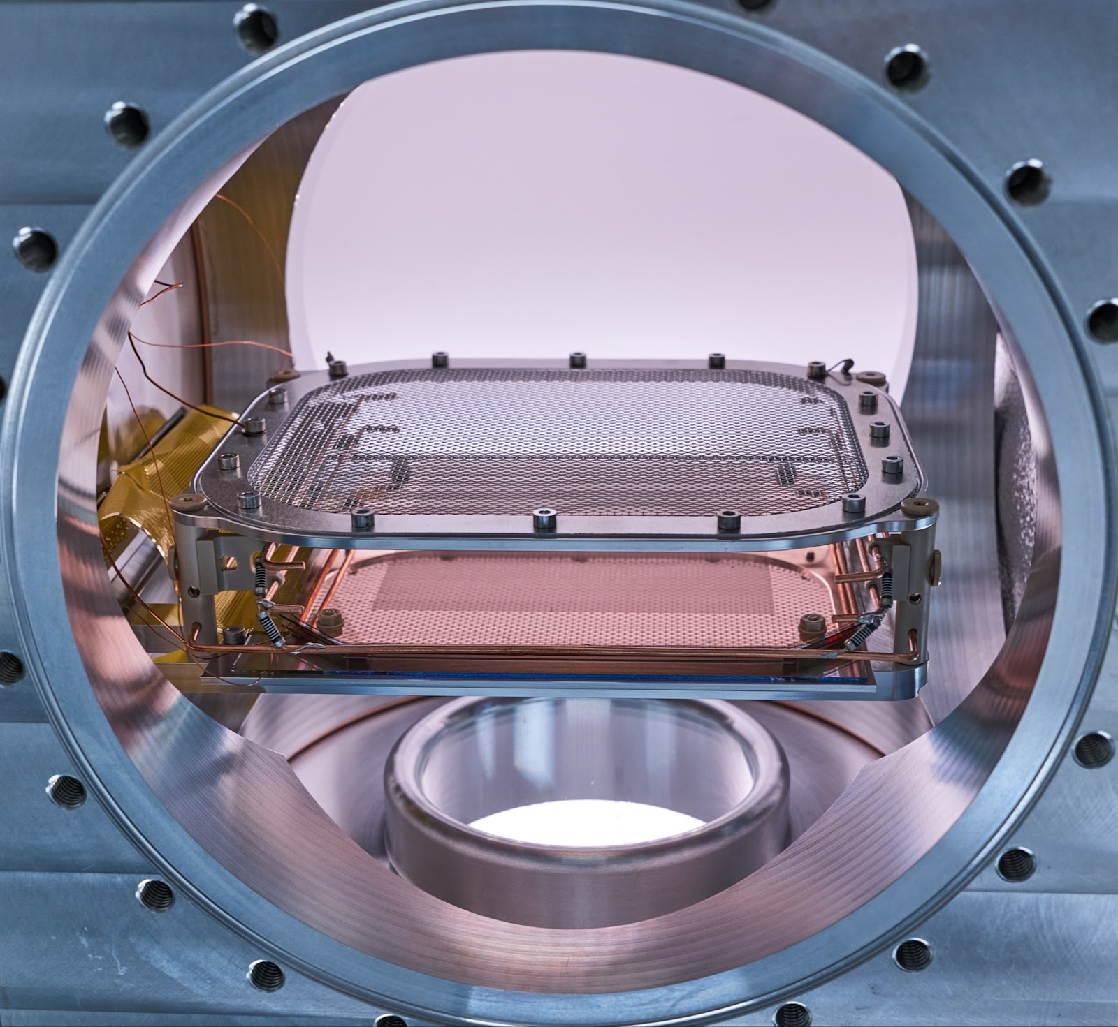
Chamber Design
The neutrons enter the chamber through a 0.4/1.0 m collimator (D-D/D-T).
neutrons from D-D generator: ~ 10⁹ n/s.
NR event rate in the TPC ~ 60 NR/s.
Migdal rate ~ 18 events/day (D-D).
Camera is the Hamamatsu Orca-Fusion with a Schneider Xenon f/0.95 lens.
TPC is compact to minimise diffusion and maximise event rate.

Slide 12
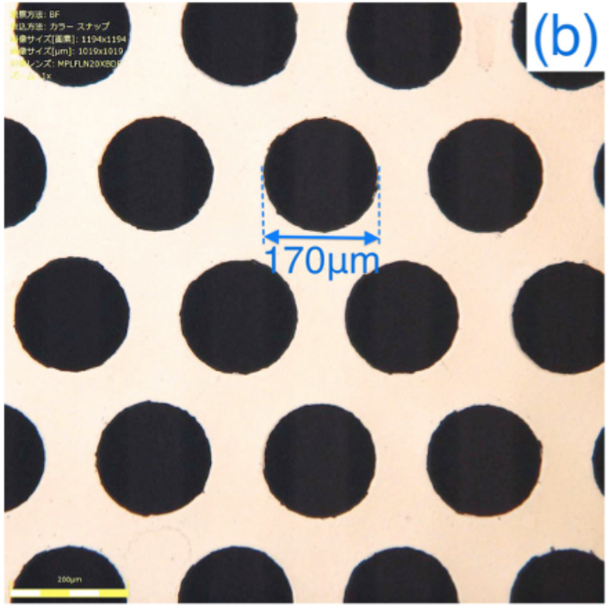
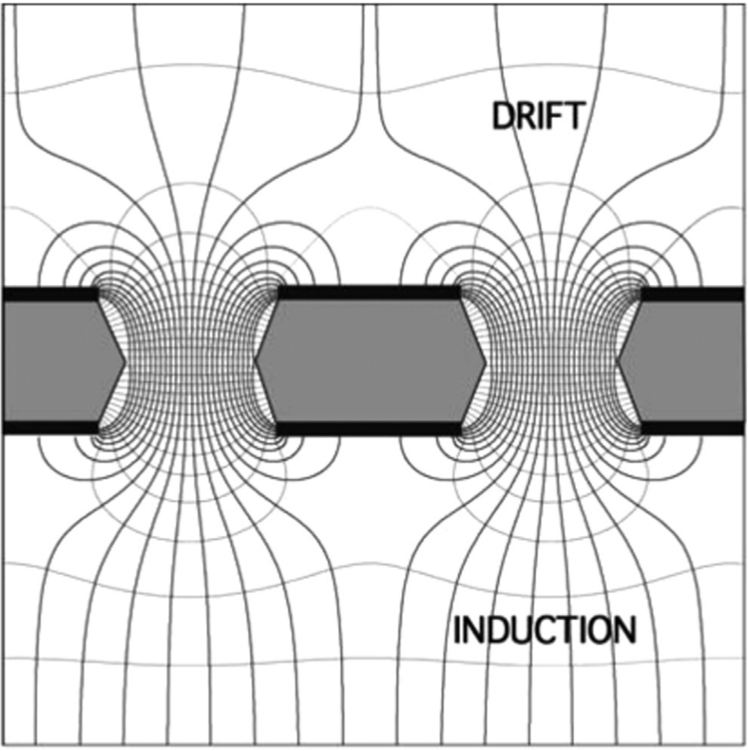
Looking inside the chamber
Looking at the GEM surface from the cathode.
0.55 mm thick glass with 2 um copper on both sides.
We can see the GEM holes here:
170 µm diameter
280 µm pitch

Slide 13
Looking inside the chamber (lights off)
We’re still looking at the GEM (same angle).
Let’s turn on the neutron generator and see some simulated ionisation trails from NRs.
The timing is not realistic here.
150 keV fluorine + 5 keV electron event.

Slide 14
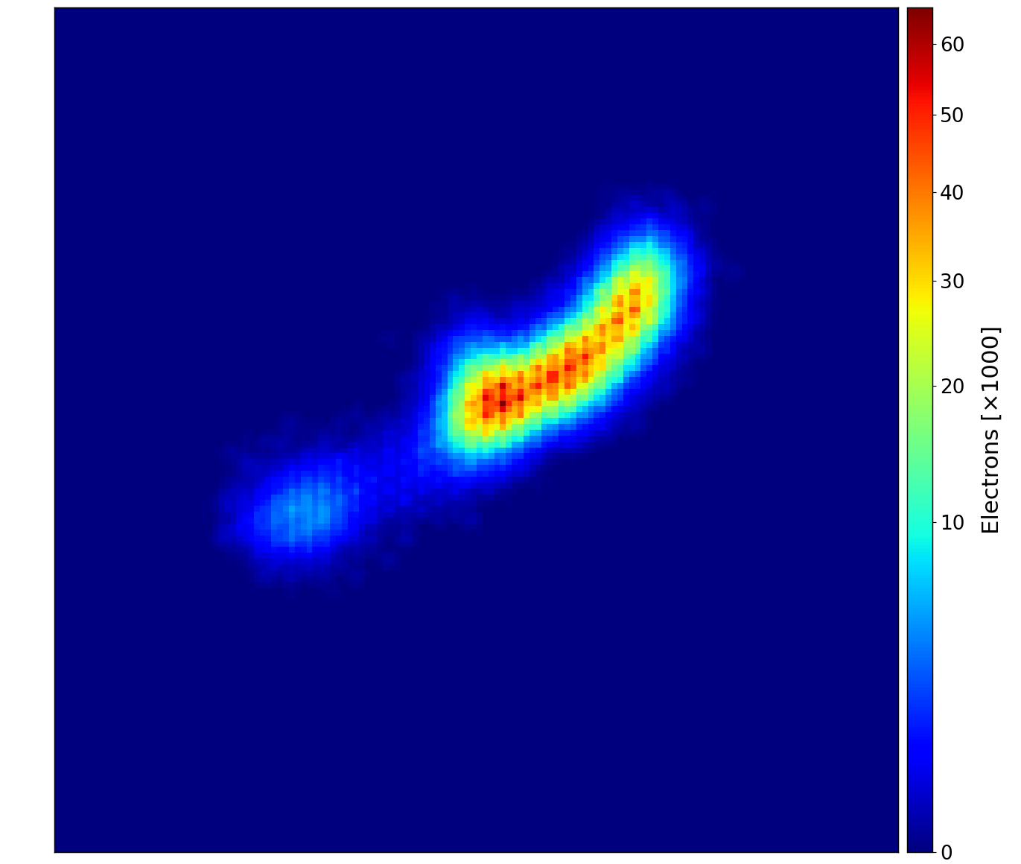
The Migdal event as an image
4 mm
4 mm
High dynamic range required
Secondary barely leaves penumbra
150 keV F
5 keV e⁻
Visible difference in dE/dx
Low-intensity ‘bridge’
Linear-scale colour map
Log-scale colour map

Slide 15
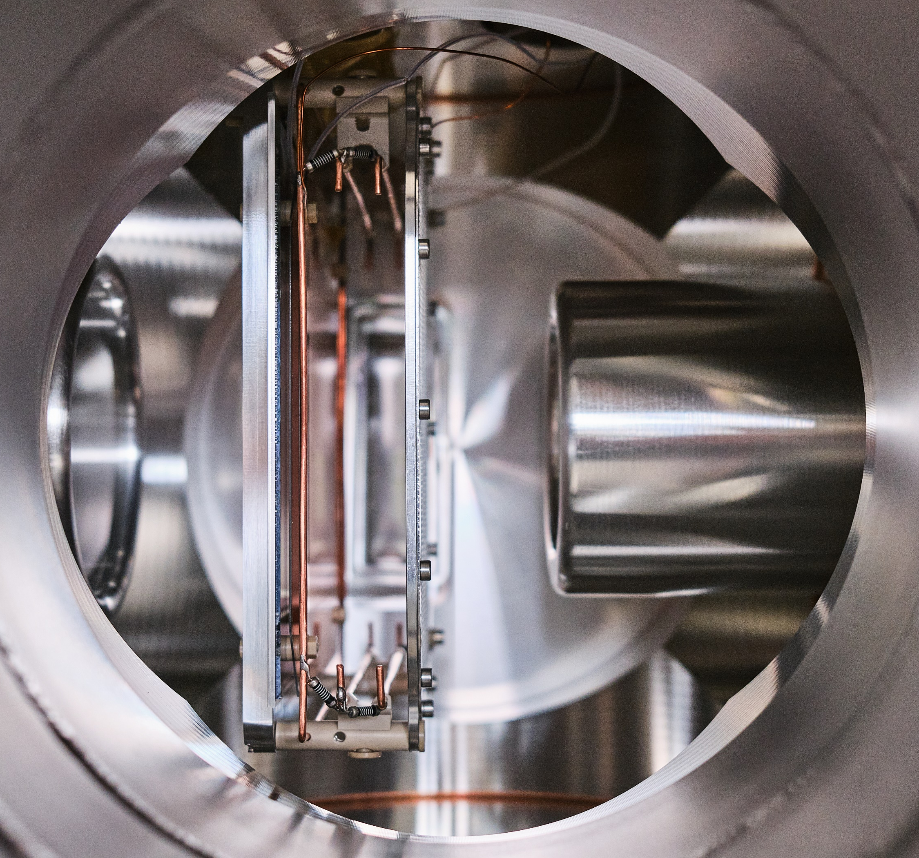
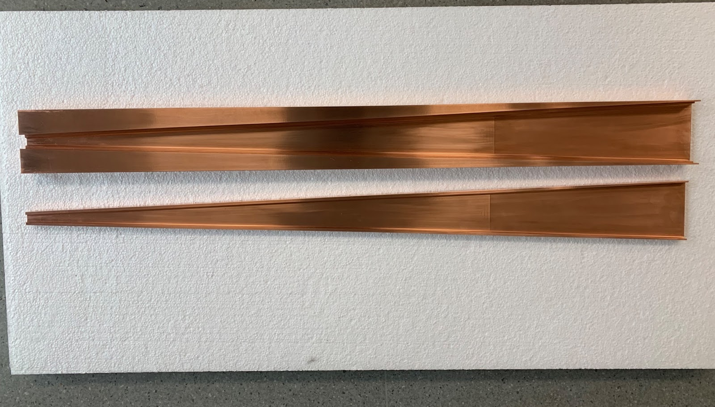
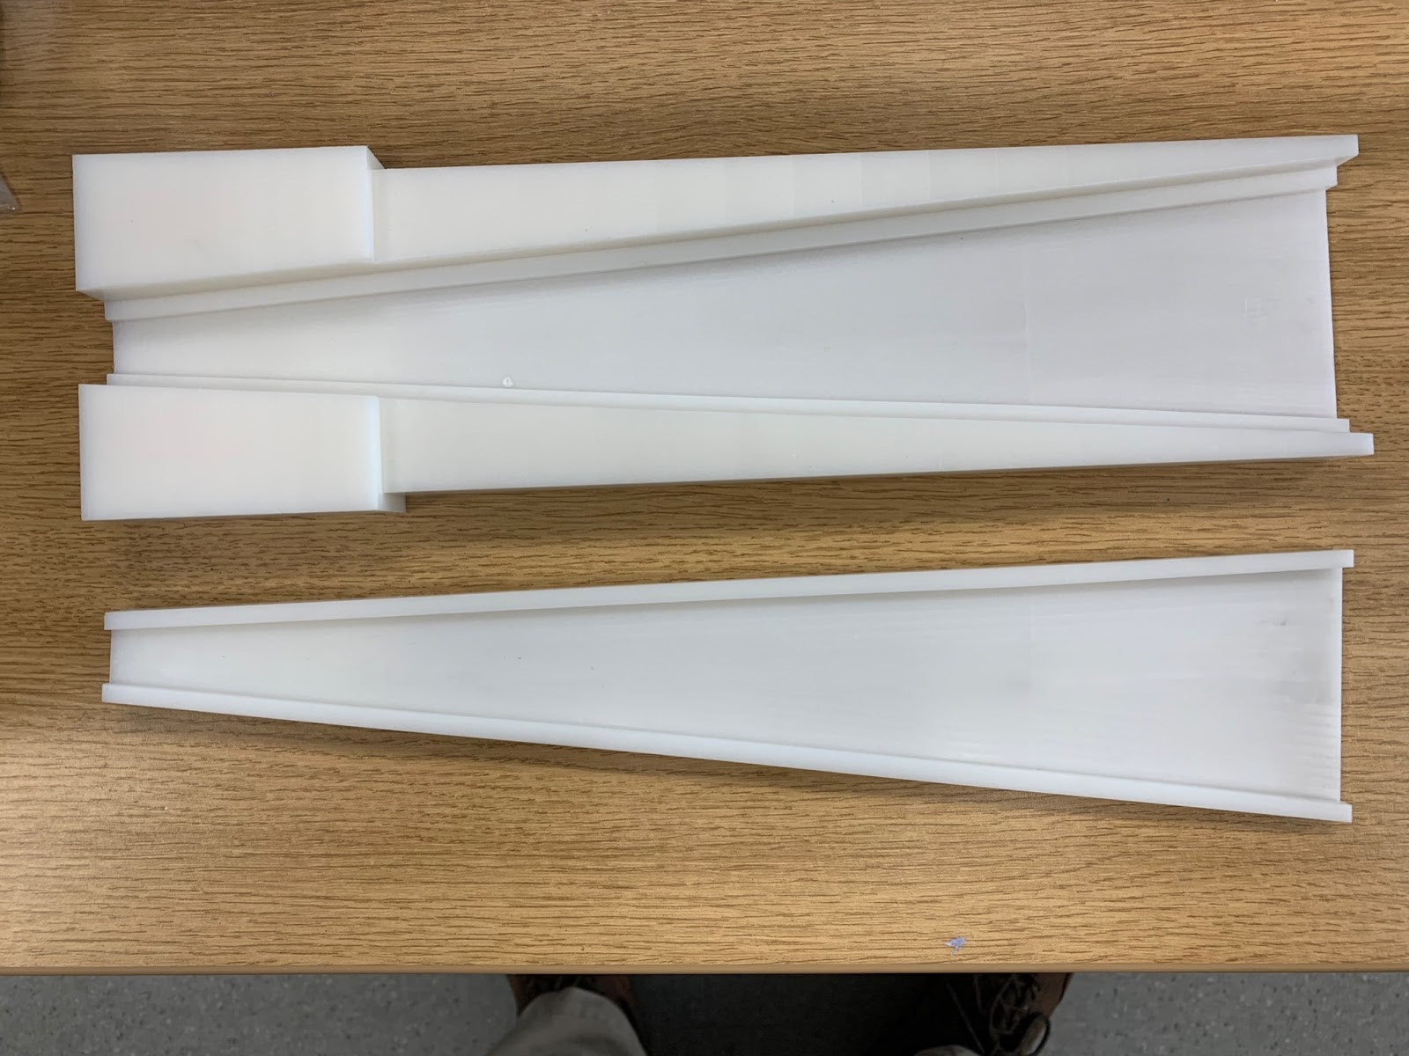
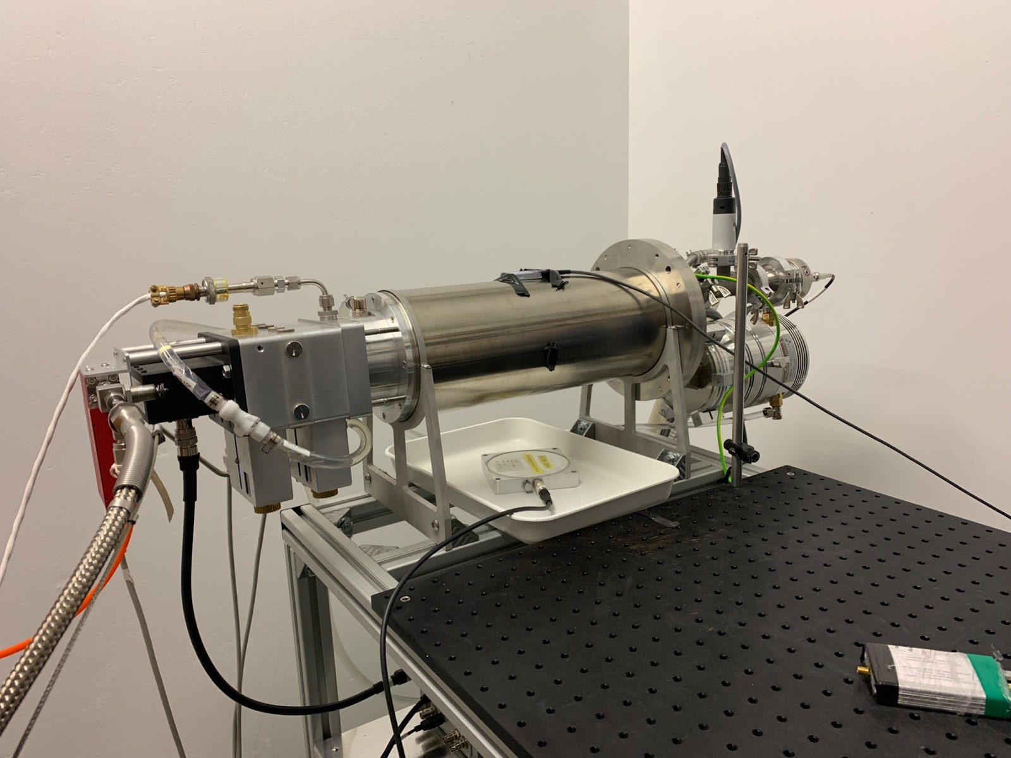
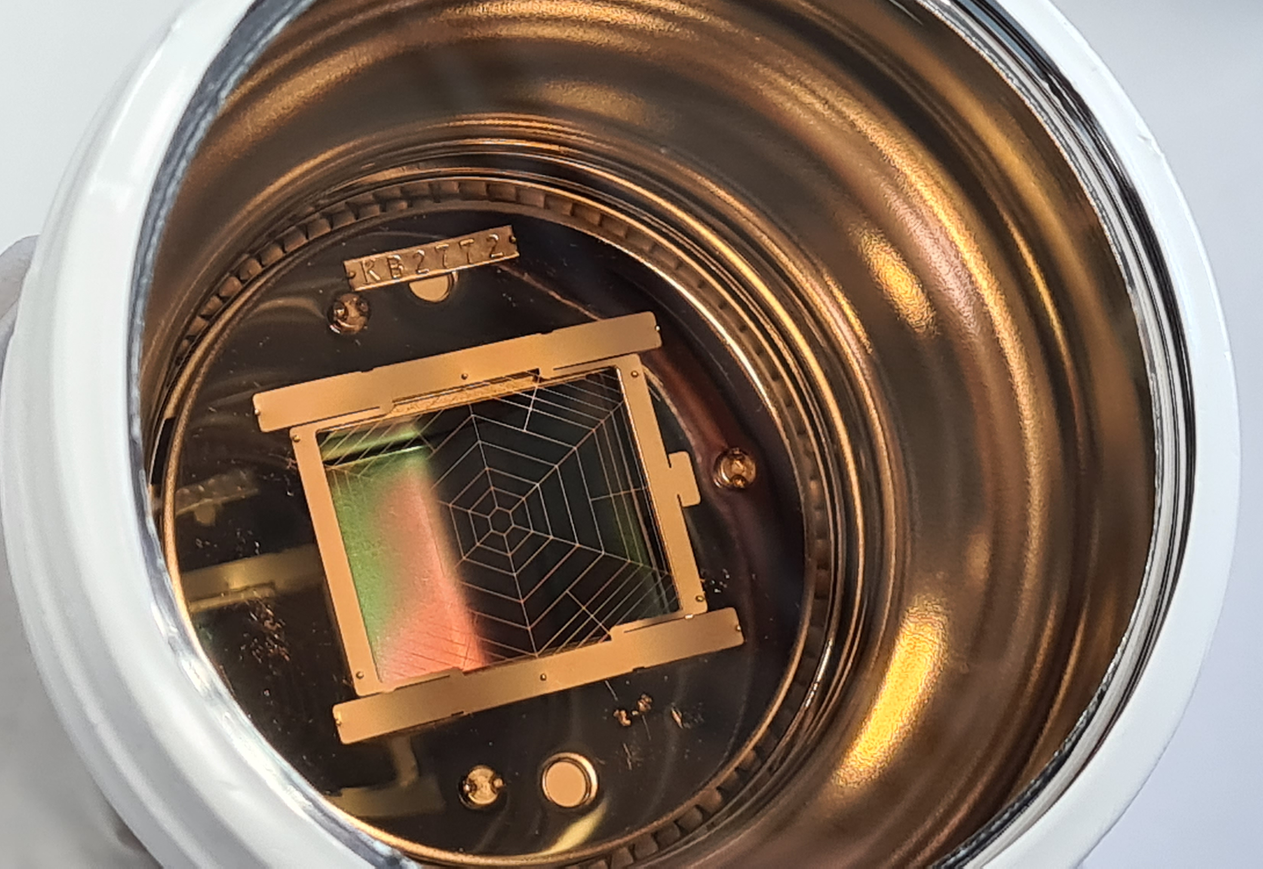
Status & Summary
Design & background simulations are complete.
End-to-end simulations are ongoing.
Detector has been assembled.
Calibration with Fe-55 and fission-fragment source are about to begin.
Runs with neutrons from D-D soon, D-T later.
D-D generator
D-D collimator
D-T collimator
PMT

Slide 16
Backup

Slide 17
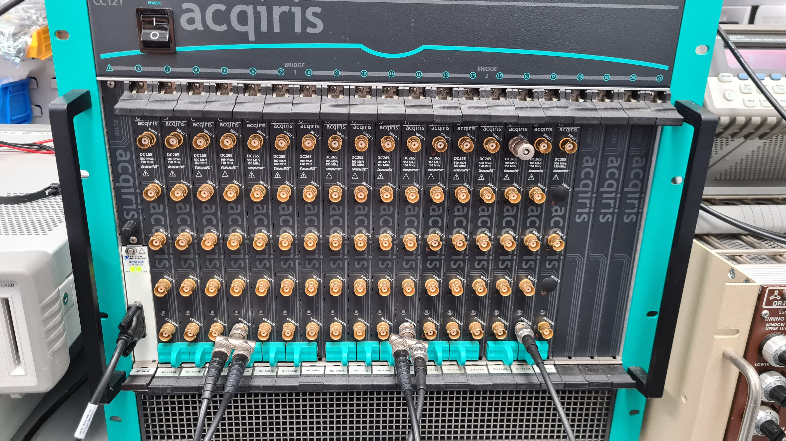
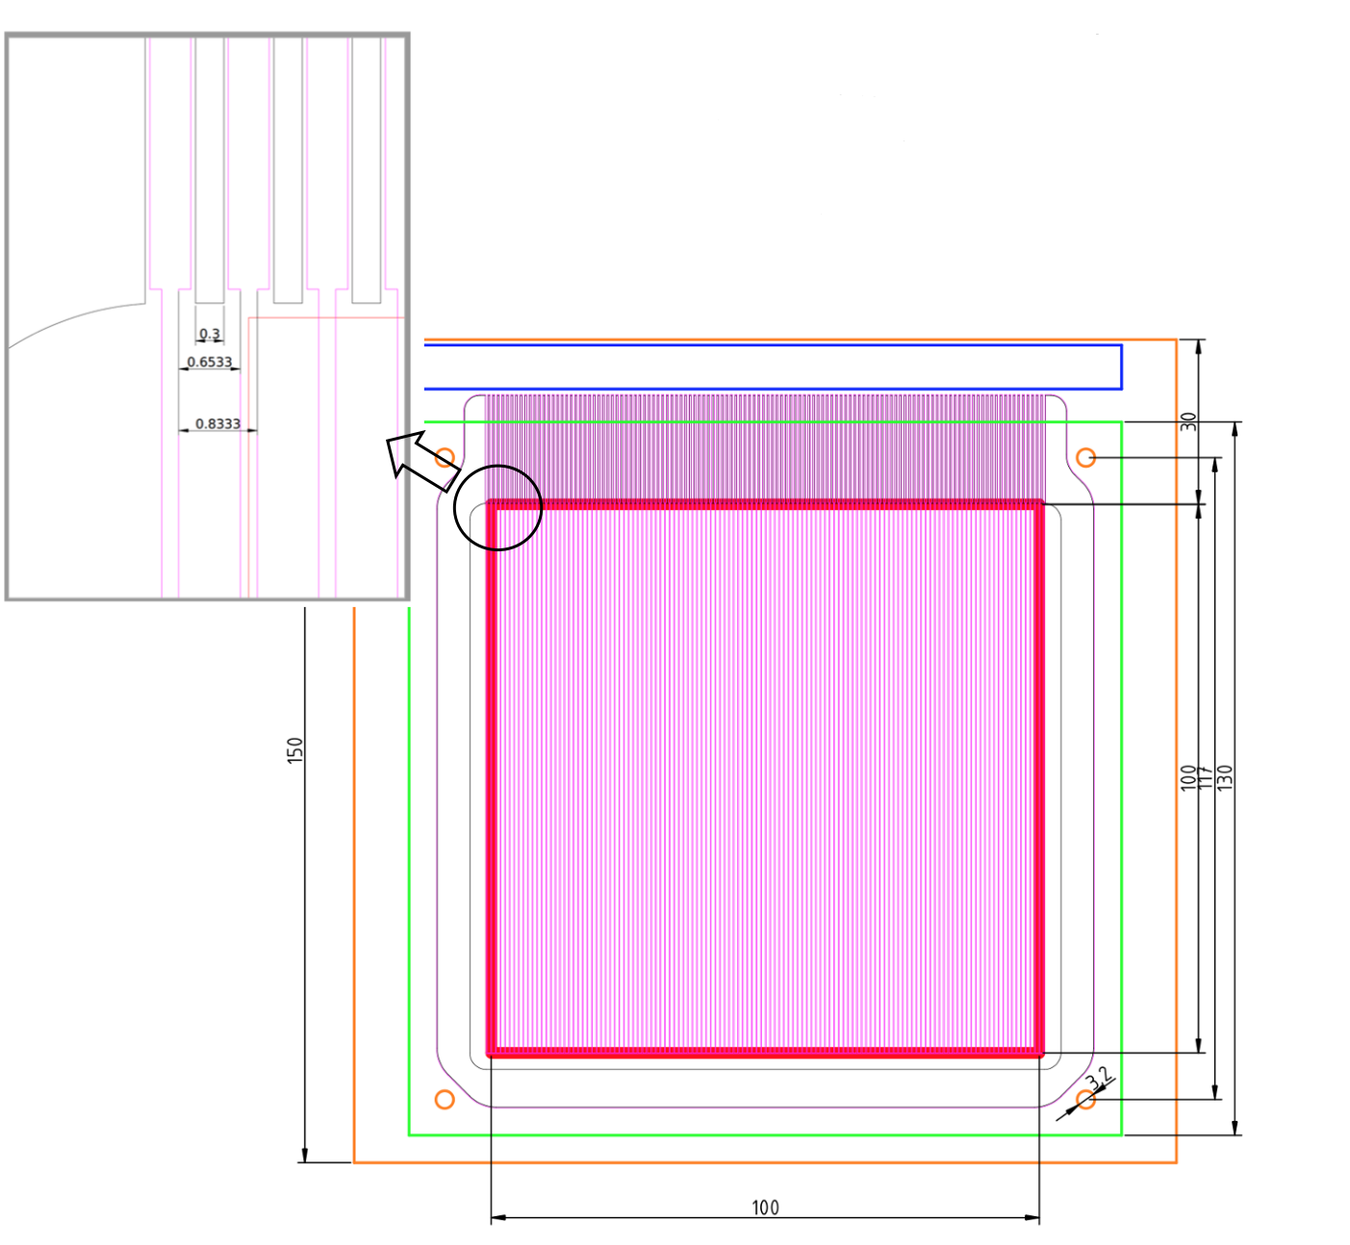
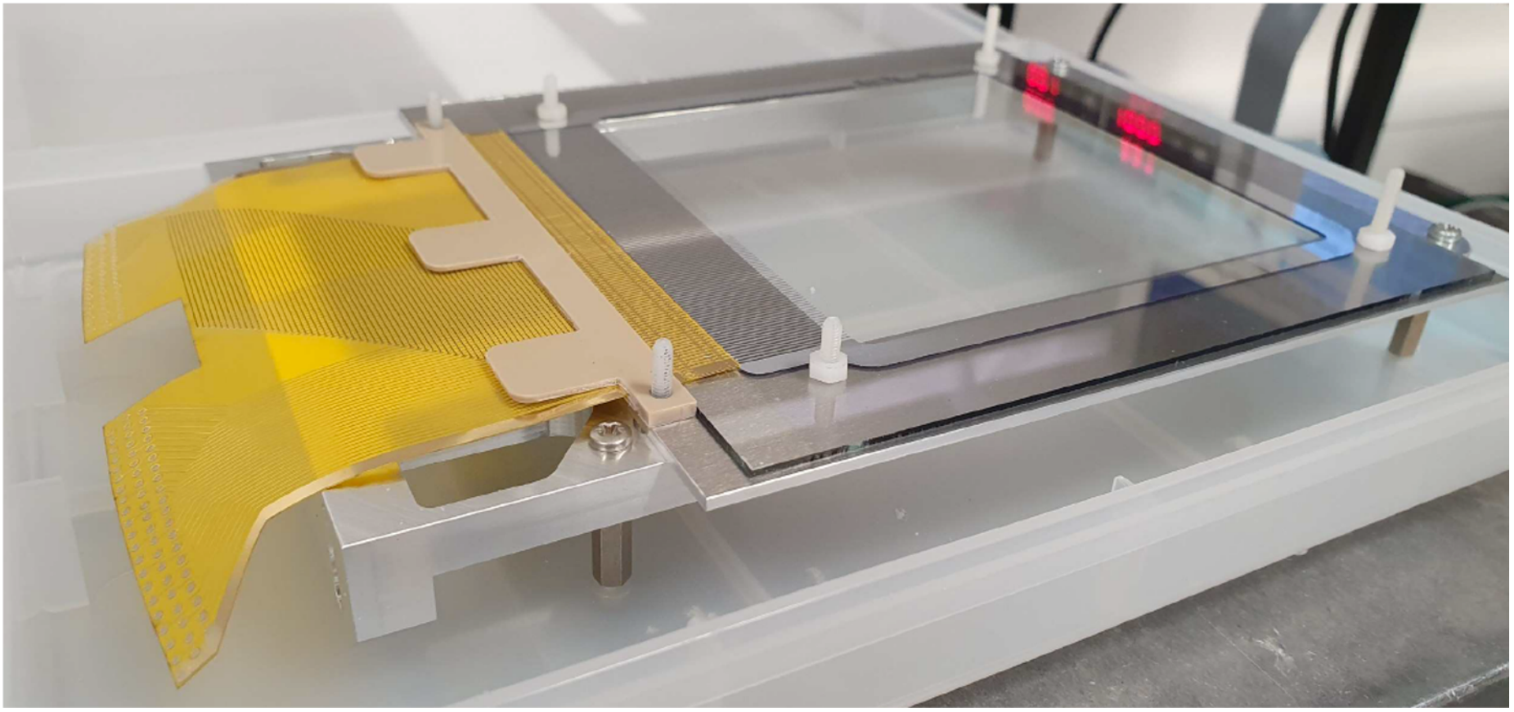
ITO
1.1 mm thick ITOGLASS 04 (transparent for camera).
Metallised with Cr and Aluminium for wire bonding.
120 strips connected to Acqiris 60 channel digitizer.
Pulses digitized with 2 ns sampling rate.

Slide 18
Background (only considering camera)
Photons are produced from inelastic neutron scattering inside the detector itself. These photons are the dominant source of background for Migdal search as they can produce Compton electrons near NR vertices (looks like Migdal to our camera).
Potential background rate: 21 ± 2 events/day (reduces greatly with timing information from ITO & FPGA).
Shielding
neutron
Generator
NR
electron
Shielding
neutron
Active volume
photon

Slide 19
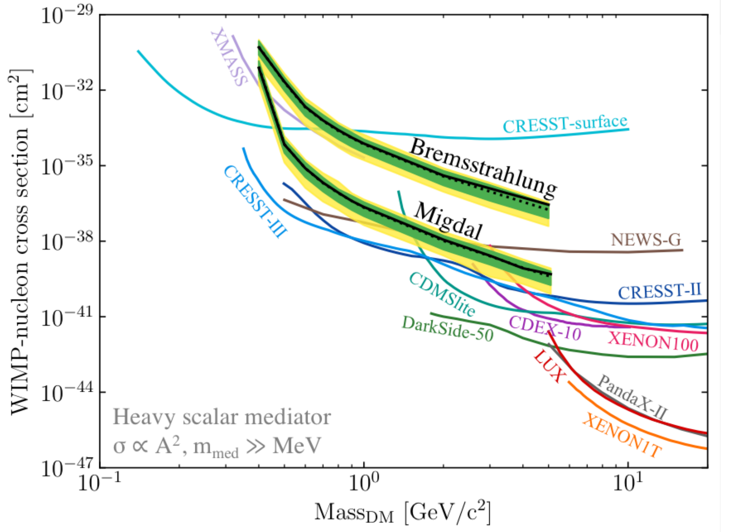
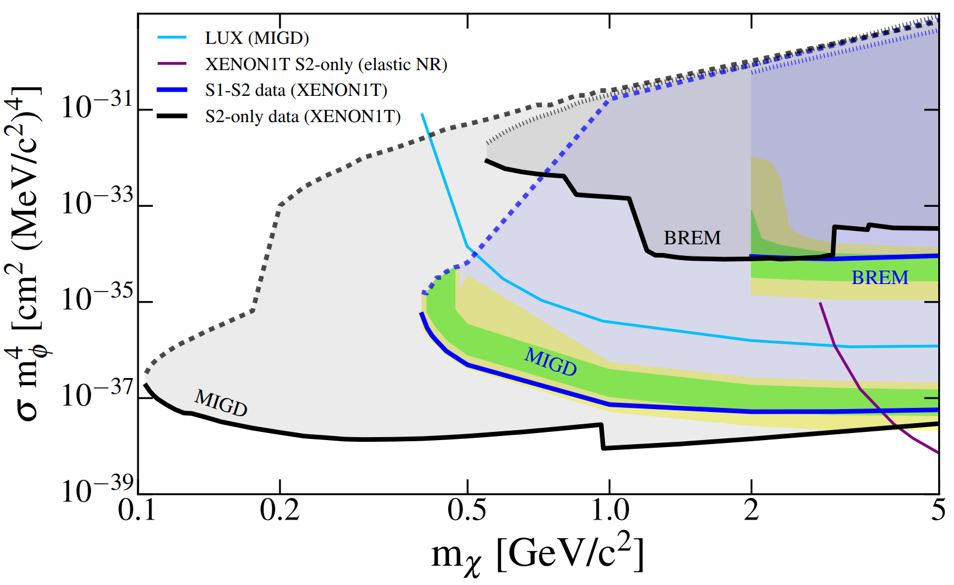
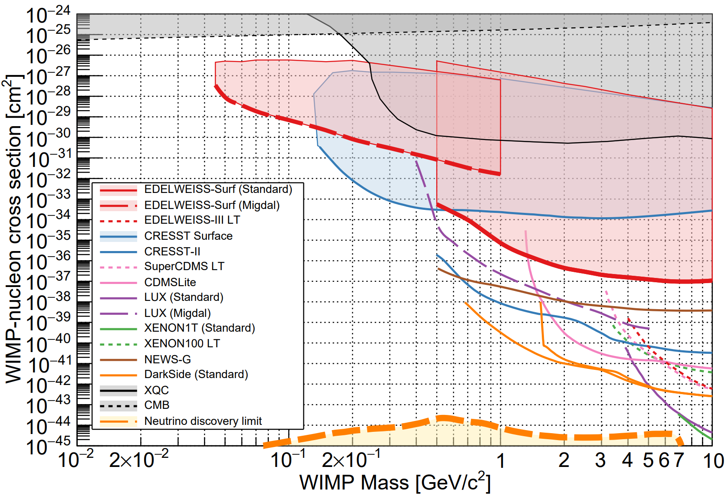
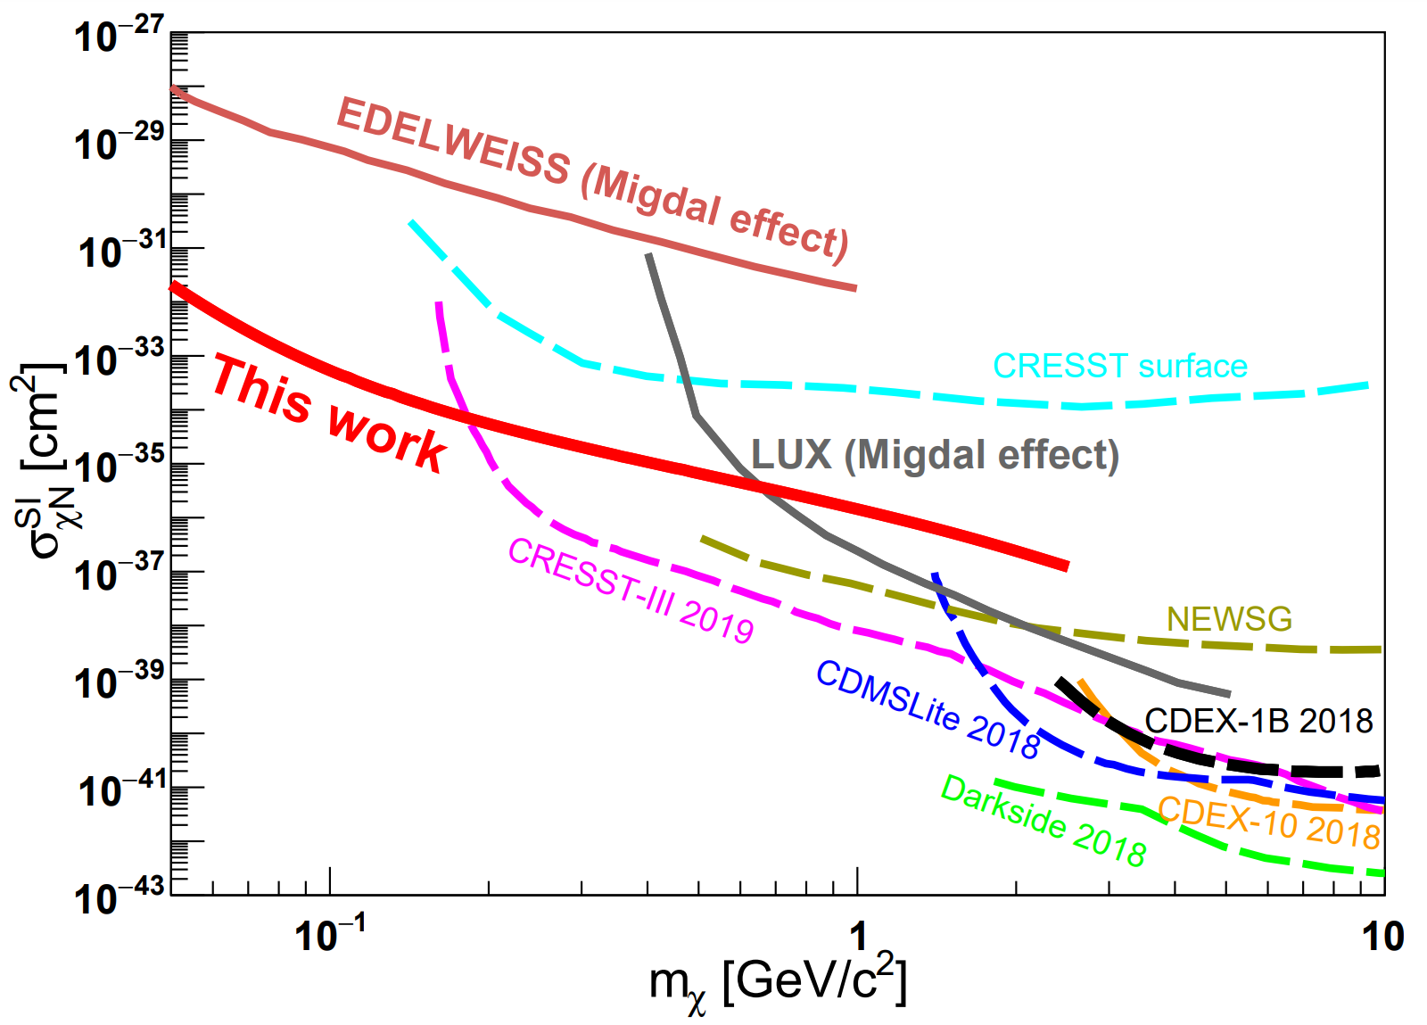
DM sensitivity extension
LUX (Xenon) “Results of a Search for Sub-GeV Dark Matter Using 2013 LUX Data” https://arxiv.org/pdf/1811.11241.pdf
XENON1T (Xenon) “A Search for Light Dark Matter Interactions Enhanced by the Migdal effect or Bremsstrahlung in XENON1T” https://arxiv.org/pdf/1907.12771.pdf
EDELWEISS (Germanium) “Searching for low-mass dark matter particles with a massive Ge bolometer operated above-ground” https://arxiv.org/abs/1901.03588
CDEX-1B (Germanium) “Constraints on Spin-Independent Nucleus Scattering with sub-GeV Weakly Interacting Massive Particle Dark Matter from the CDEX-1B Experiment at the China Jin-Ping Laboratory” https://arxiv.org/pdf/1905.00354.pdf

Slide 20
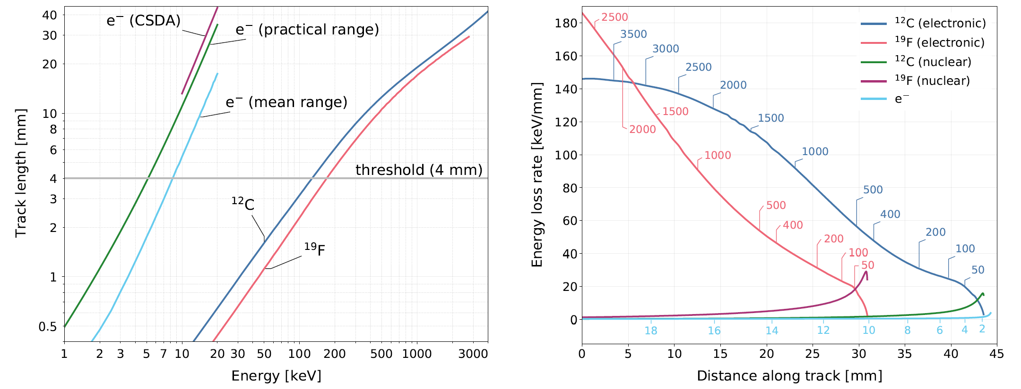
Track length and dE/dx
Electrons with energies 5 - 10 keV have track lengths between 4 - 10mm.
Nuclear recoils with energies E > 150 keV have track length > 4 mm.
dE/dx for nuclear recoils is highest at the beginning, but highest at the end for electrons.

Slide 21
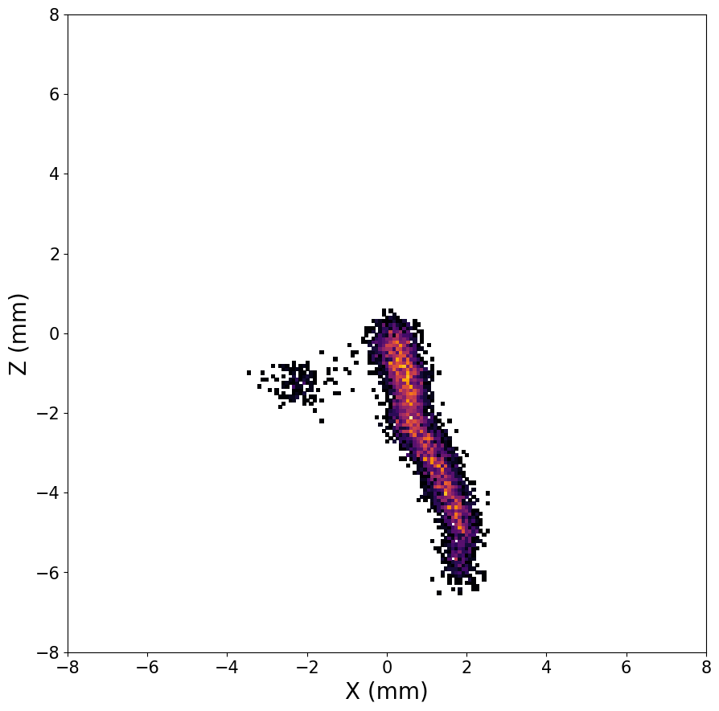
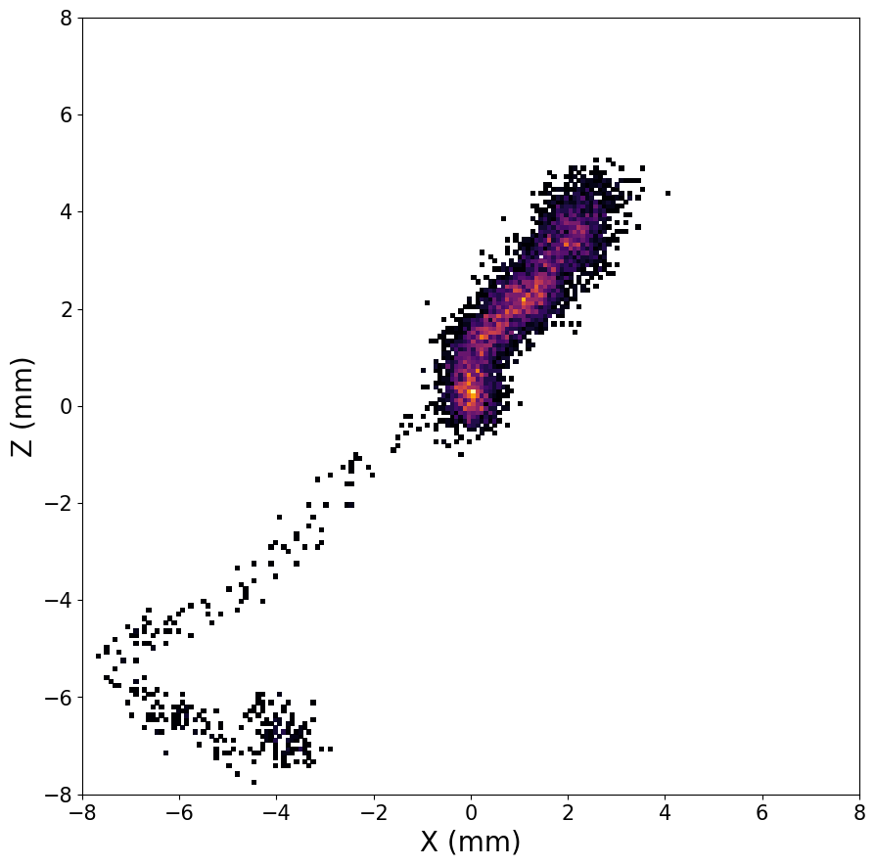
Migdal rates
Generator | NR (Hz) | non-NR (Hz) | Migdal events (per day) above 3 and 5 keV
DD | 62 | 4 (front only) Full setup simulations still in progress | 75 / 18
DT | 78 | 100 | 42 / 10
250 keV F recoil
5 keV Migdal e⁻
250 keV F recoil
10 keV Migdal e⁻
Assumptions:
Pure CF4
Pressure: 50 Torr
Temperature: 293.15 K.
Above is an example Migdal signal topology after 10 mm drift in pure CF₄ at 50 Torr.
Simulated with SRIM & Garfield++ (NR) and DEGRAD (e⁻)
To the right are calculated Migdal rates in events/day for nuclear recoils with E_{r} > 150 keV, and Migdal electrons with E_{e} > 5 keV.

Slide 22
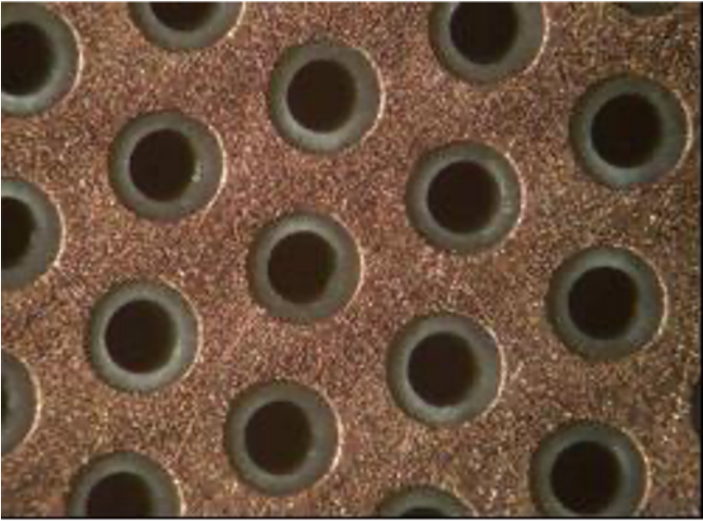
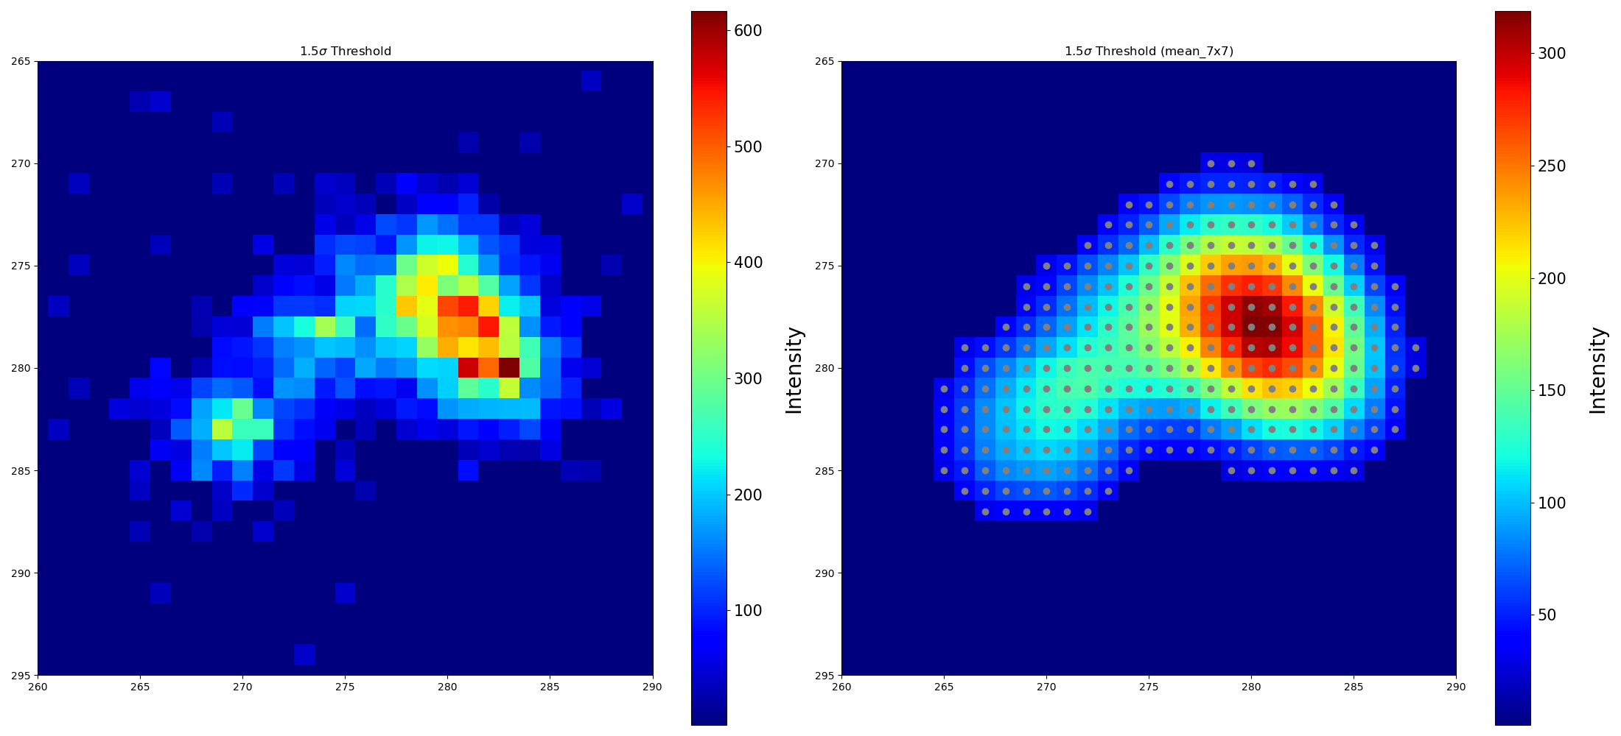
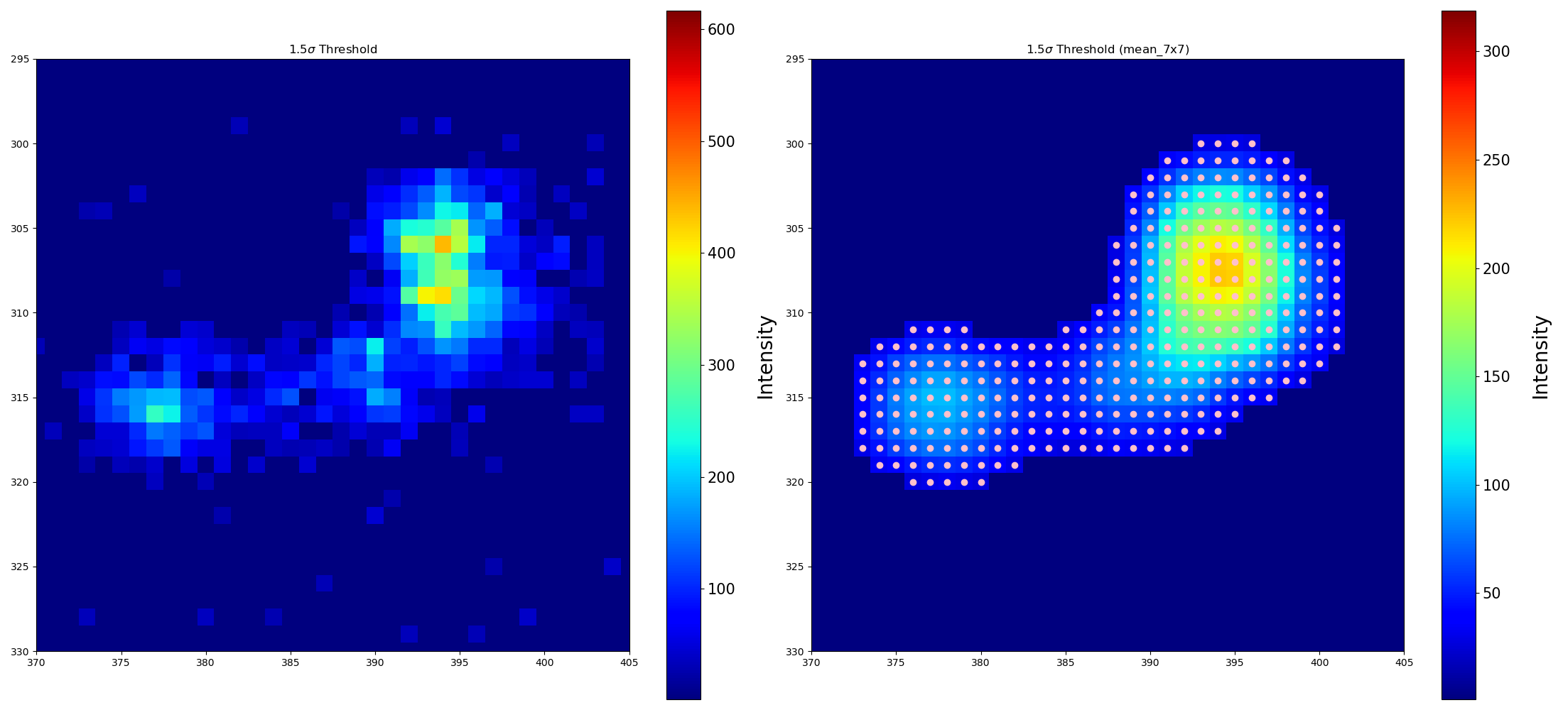
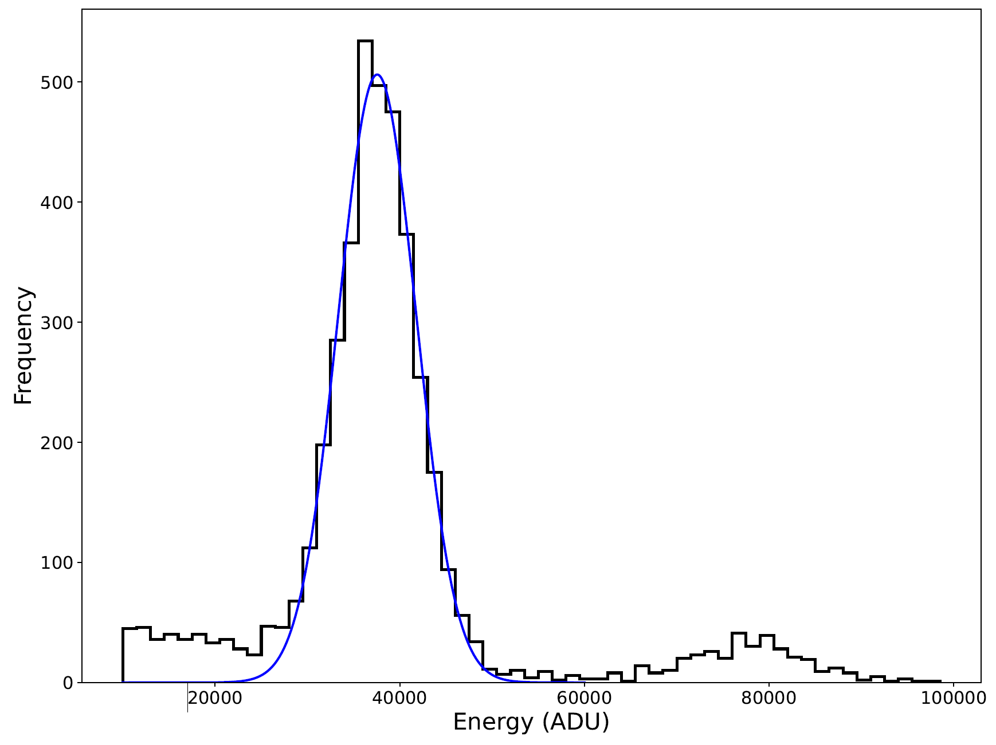
GEM tests with ⁵⁵Fe source
Glass GEM
Thick GEM
0.55 mm thick glass with 2 um copper on both sides.
Pitch: 280 um
Hole diameter : 170 um
1 mm thick PCB with 20 um copper on both sides.
Pitch: 700 um
Hole diameter : 400 um
27% energy
resolution
Images of low energy electron tracks produced by 55Fe x-ray source in 50 Torr CF4. Track head and tail structure is clearly resolvable.
IOP HEP/APP - 05/04/2022

