Slide 1
Saturation corrections in the LUX-ZEPLIN experiment
Aiham K. Al Musalhi
IOP HEPP & APP Annual Conference 2022
Illustration by Sandbox Studio, Chicago with Ana Kova

Slide 2
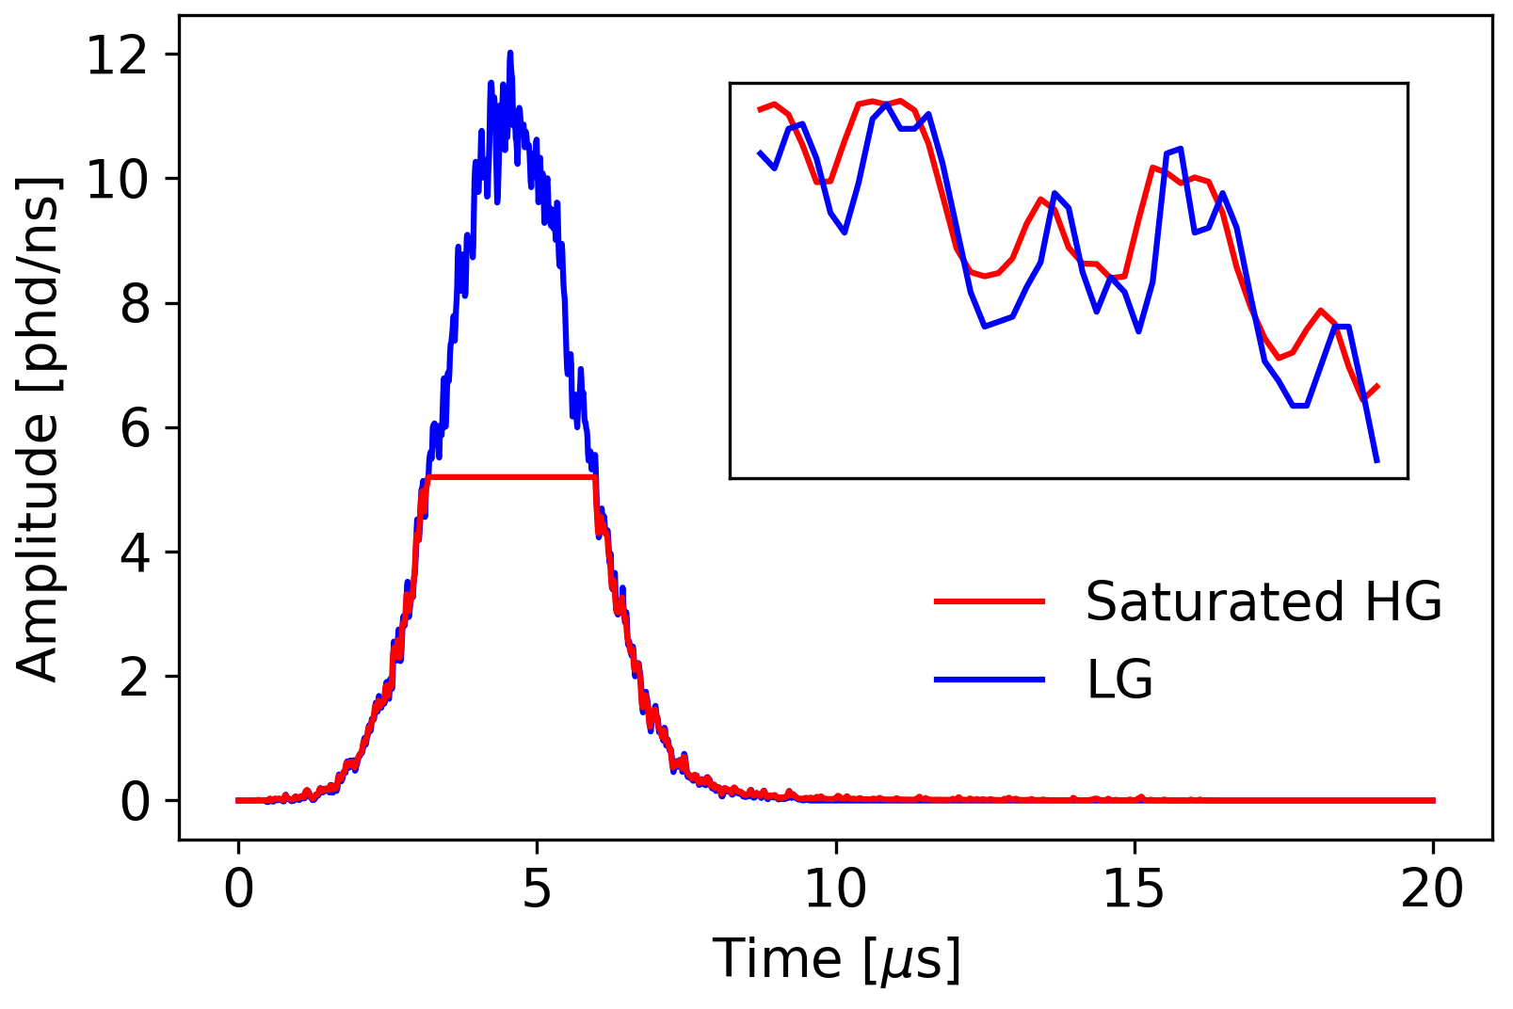
Introduction
LZ designed for WIMPs, with nuclear recoil energies of $𝒪(10)$ keV_{nr}
PMTs operated with dual-gain output:
 | Area gain | Shaping (FWTM)
High gain (HG) | 40 | 60 ns
Low gain (LG) | 4 | 30 ns
Signals from ~200 keV_{ee} events can exceed 2 V dynamic range of DAQ $⇒$ ADC saturation
Impacts reconstruction and resolution of position and energy, relevant for high-energy searches and backgrounds, when LG can saturate

Slide 3
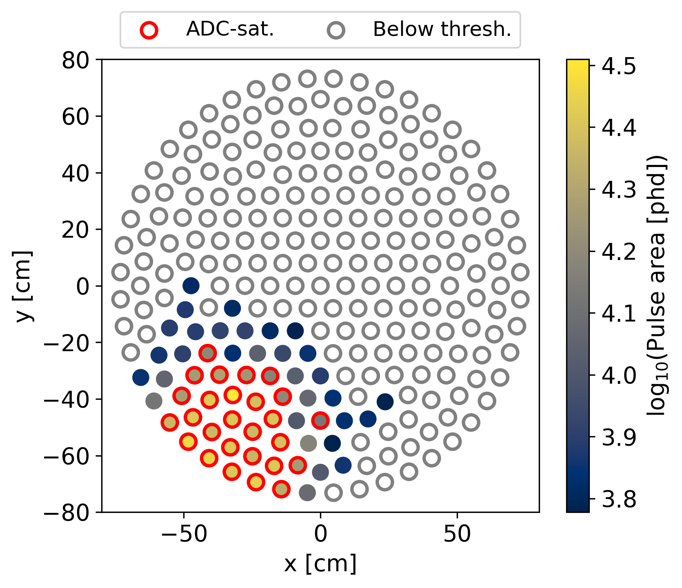
Proposed method (1)
Various possible approaches for saturation correction, e.g. functional fits, machine learning
This approach uses the nearest non-saturated neighbour as a template waveform
⇒ assumes neighbouring PMT signals have comparable widths
PMTs addressed in order of proximity to interaction vertex, starting with the furthest

Slide 4
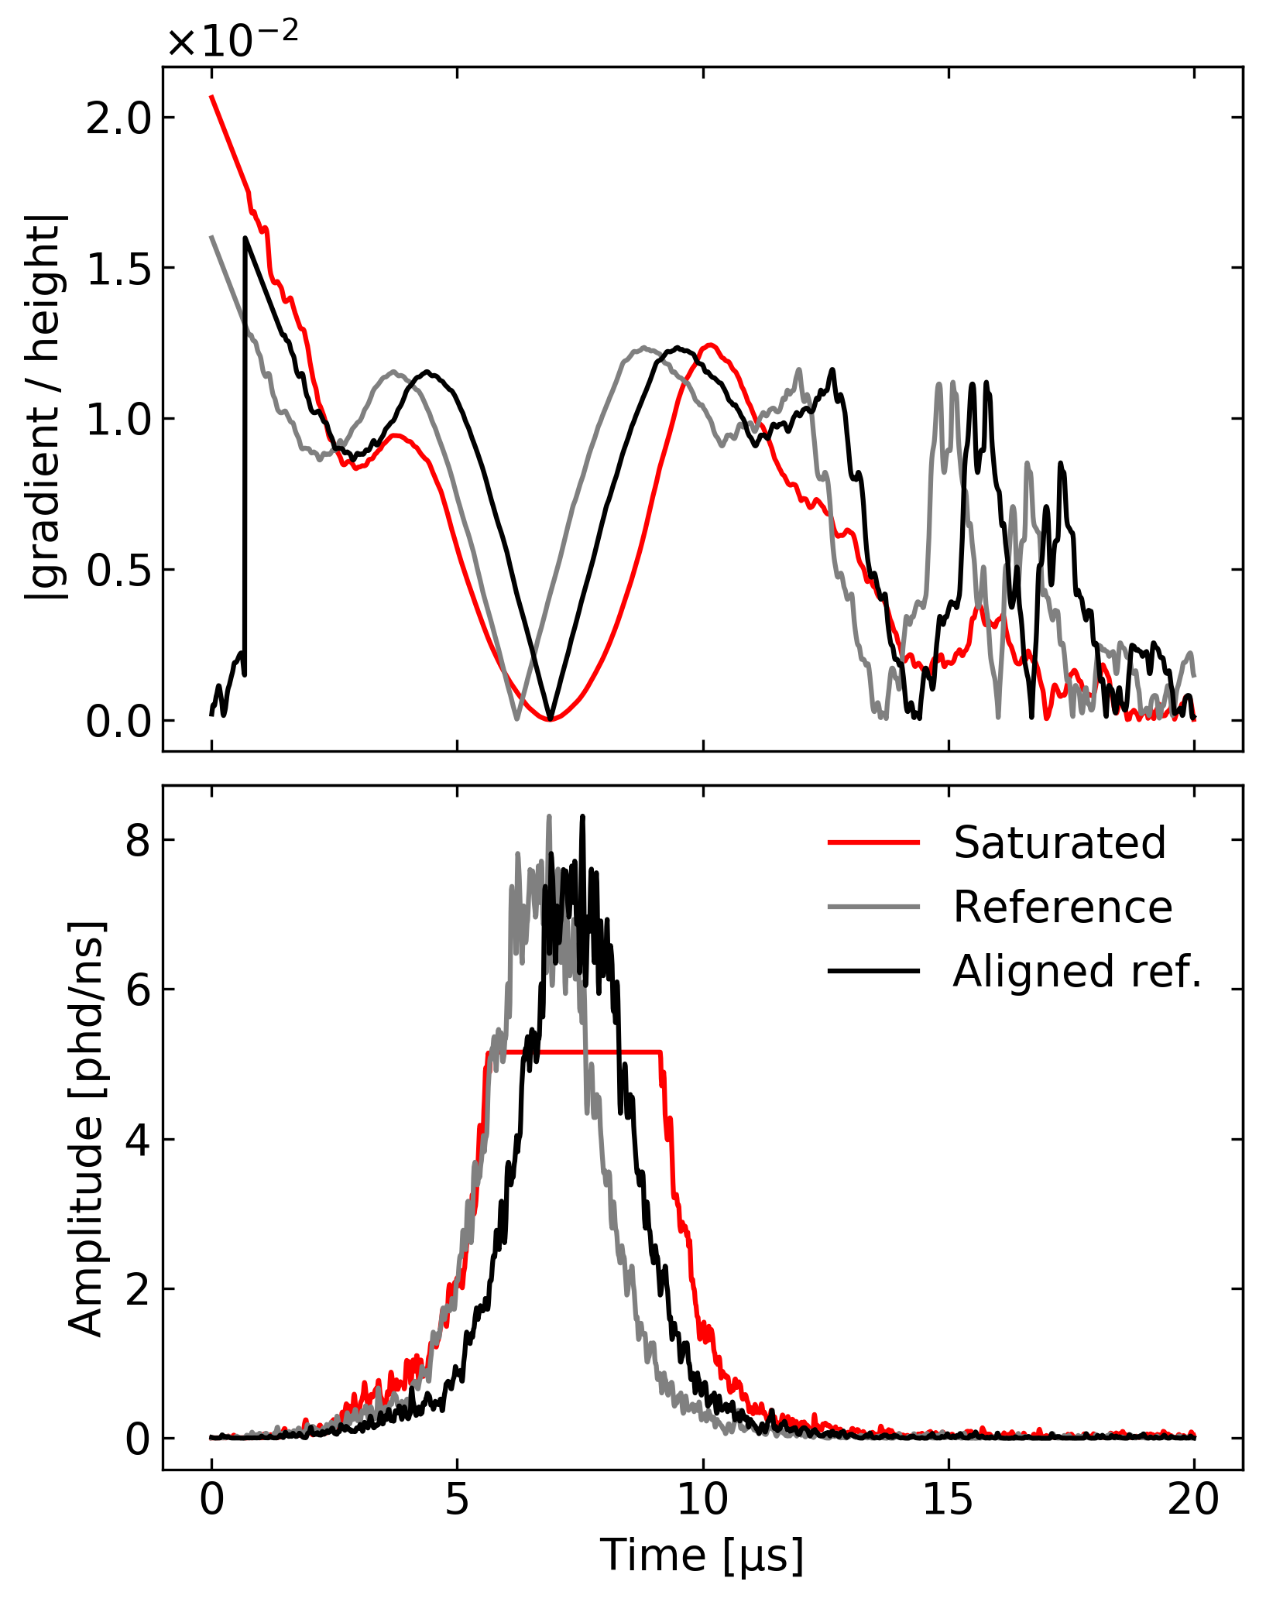
Proposed method (2)
For a given saturated signal, the reference must first be aligned
Utilise smoothed gradient/height space, with match point at absolute minimum
⇒ assumes peaks are approximately Gaussian
Possible complications expected for: – asymmetric waveform shapes – double-peaked waveforms

Slide 5
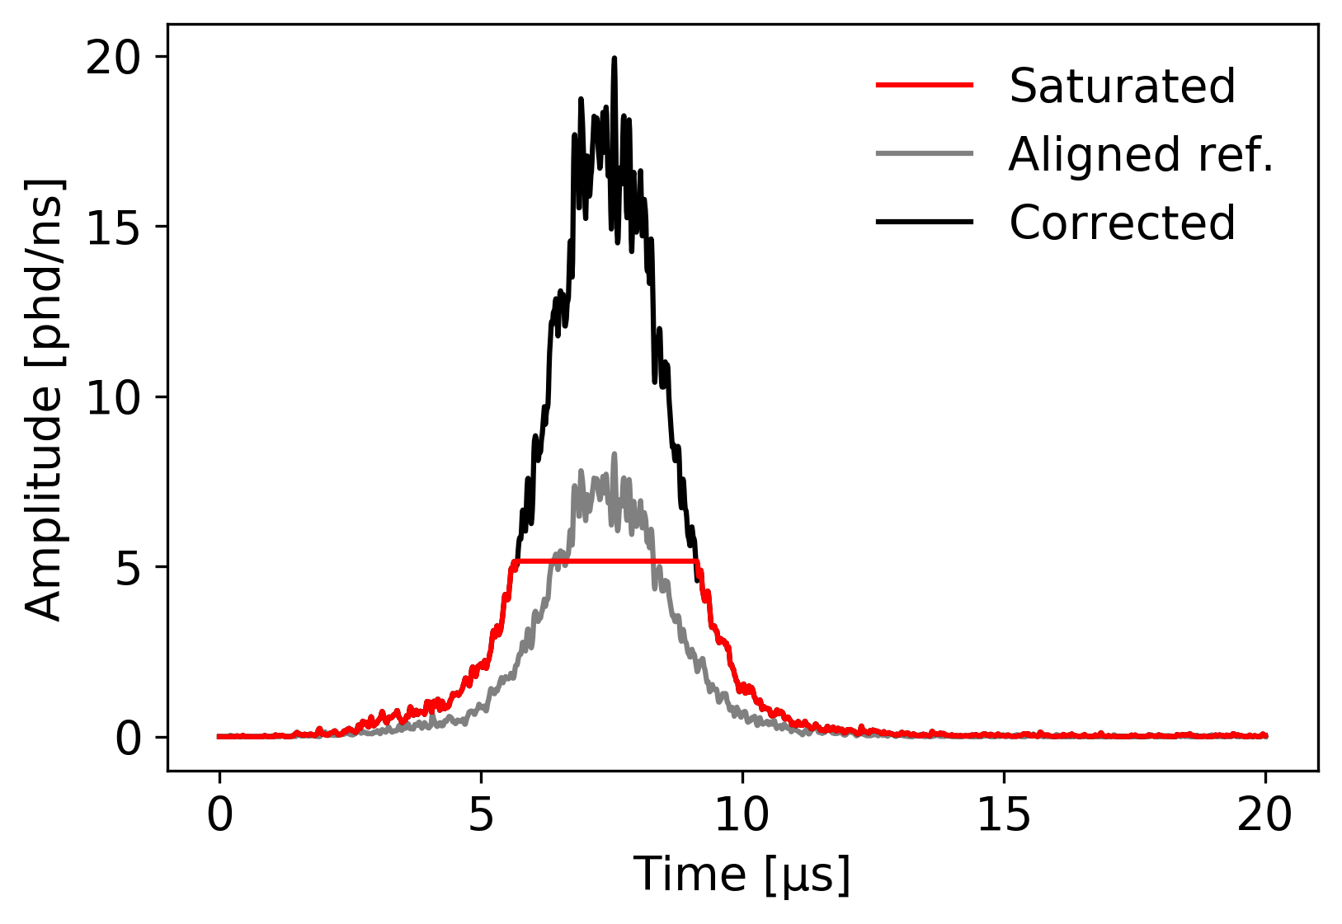
Proposed method (3)
Aligned waveform is scaled up such that rises intersect at start of saturated interval
Original rise and tail are stitched at intersection points (where possible*)
*otherwise defaults to discontinuous cut-off
PMT updated with result; may be used for subsequent corrections $⇒$ could lead to systematic error
What does this look like for the entire cluster?

Slide 6
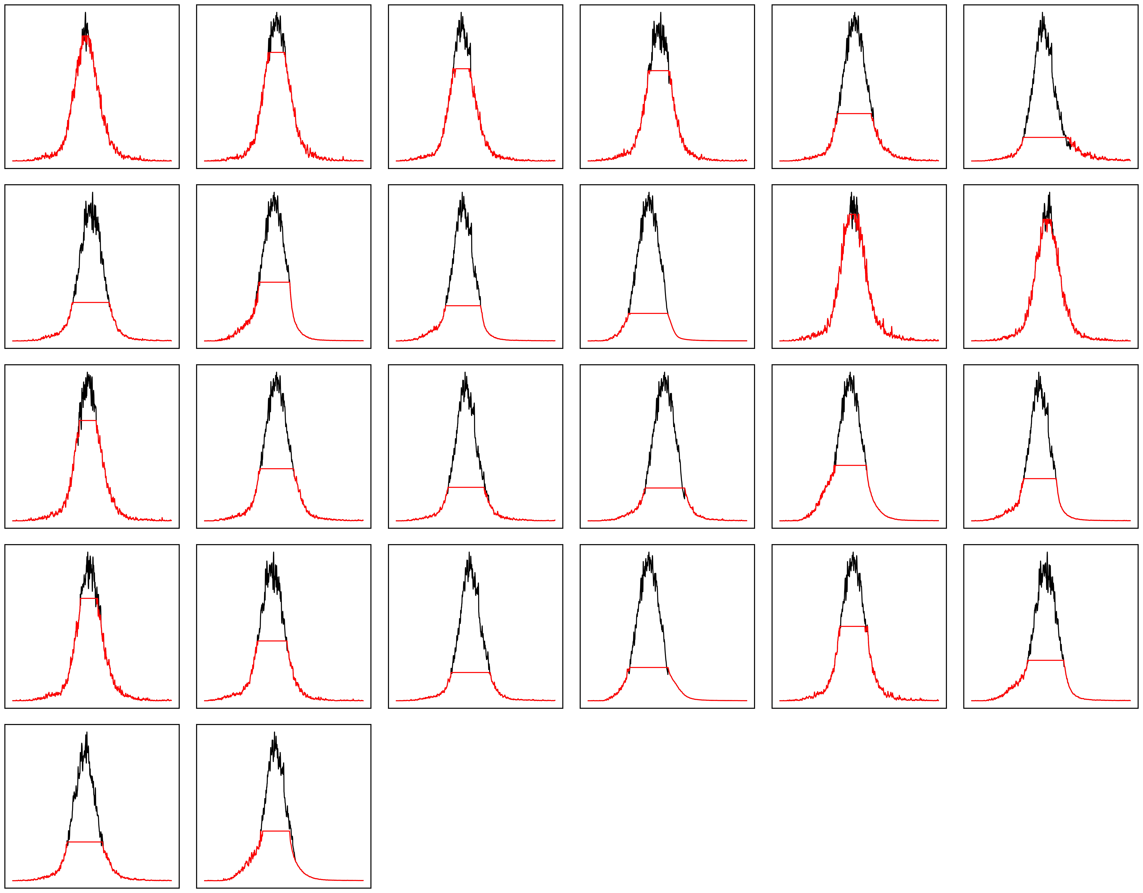
Single-event example
Total of 27 saturated waveforms considered
Negligible saturation if $<$10 saturated samples
Outcomes appear qualitatively good, but…
Is it possible to verify if these
estimates are reasonable?

Slide 7
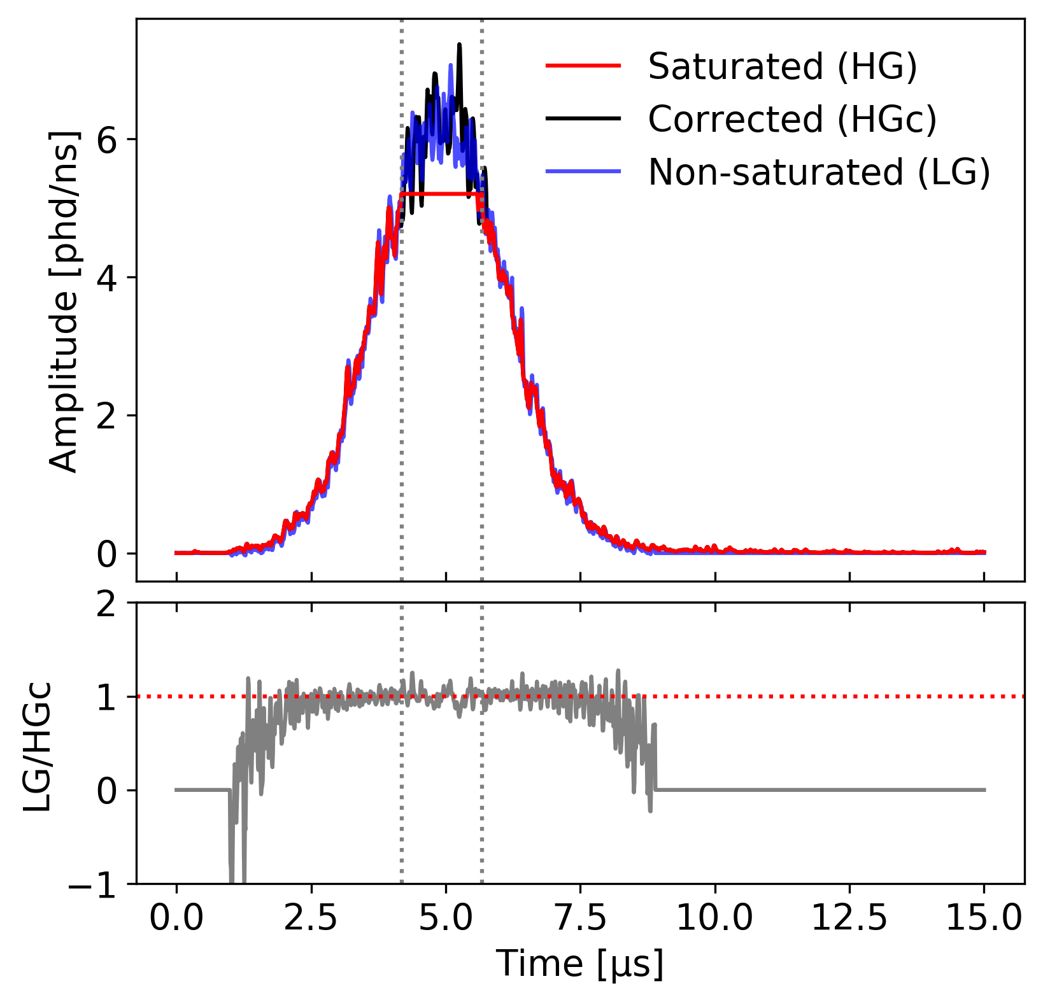
Validation with LG
Consider events with saturated HG and non-saturated LG
Use LG waveform as proxy for true shape to validate method
Accuracy of method mainly depends on energy (maximum amplitude) and depth (pulse width)
Along with pulse area, use peak height/width ratio as a metric

Slide 8
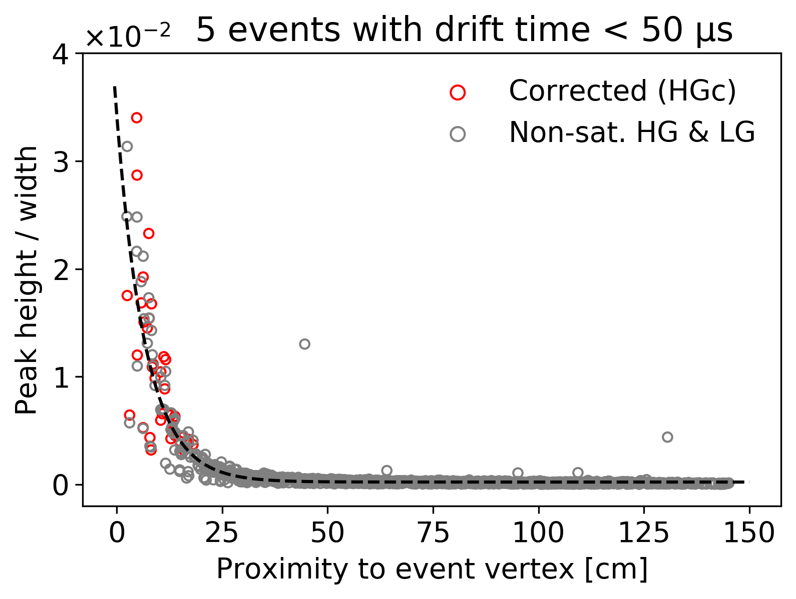
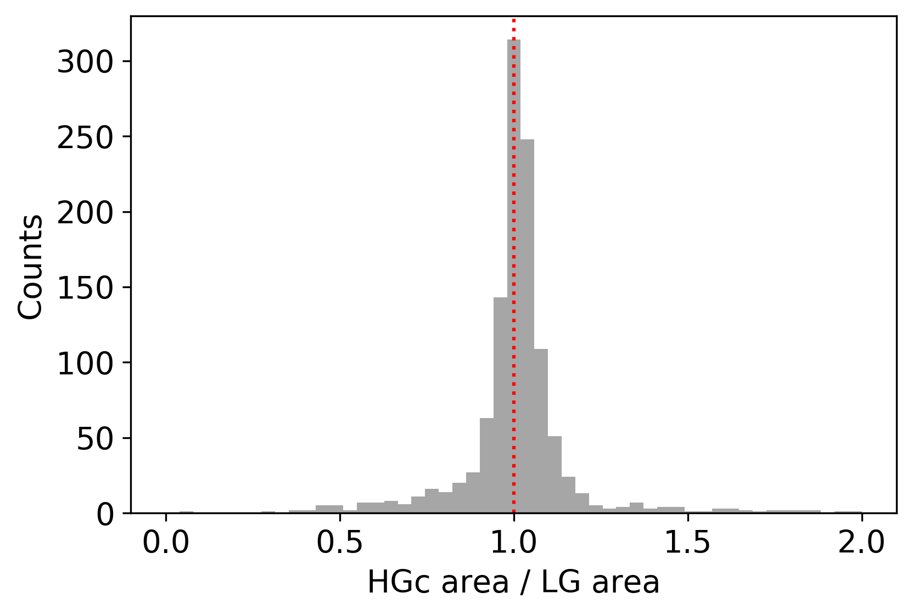
Validation with LG
Corrected area is fairly consistent with expectation – ratio at: (1.008 ± 0.005)
Peak height/width behaviour is similar between corrected and non-saturated cases

Slide 9
Summary
Demonstrated a simple method to correct for ADC saturation
Enhances high energy searches and background characterisation
What’s next?
Assess for a large set of high-energy events; measure impact on energy resolution
Investigate variations in performance with energy, position, etc.

Slide 10
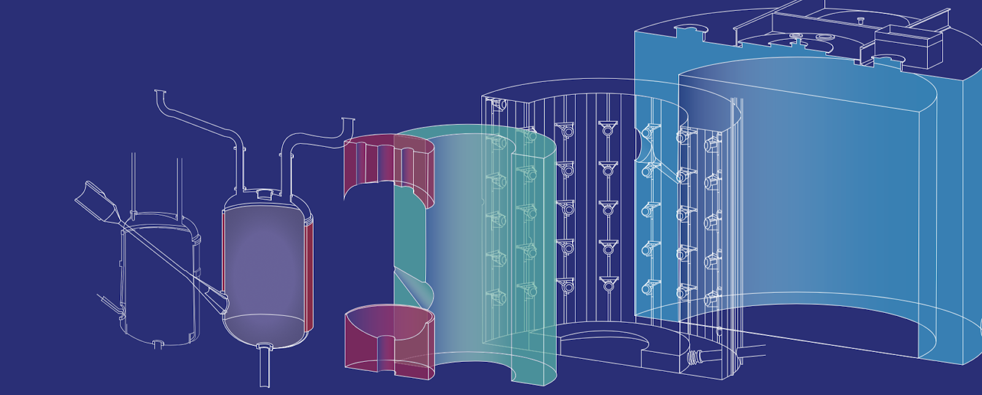
Thanks for listening!
and to our sponsors
& 35 participating institutions

