Slide 1
A Phase Shear detection system for the MAGIS-100 and AION experiments
Gedminas Elertas on behalf of AION & MAGIS collaborations

Slide 2
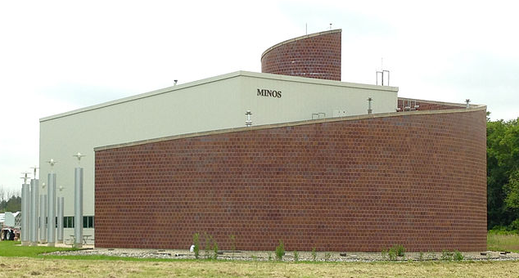
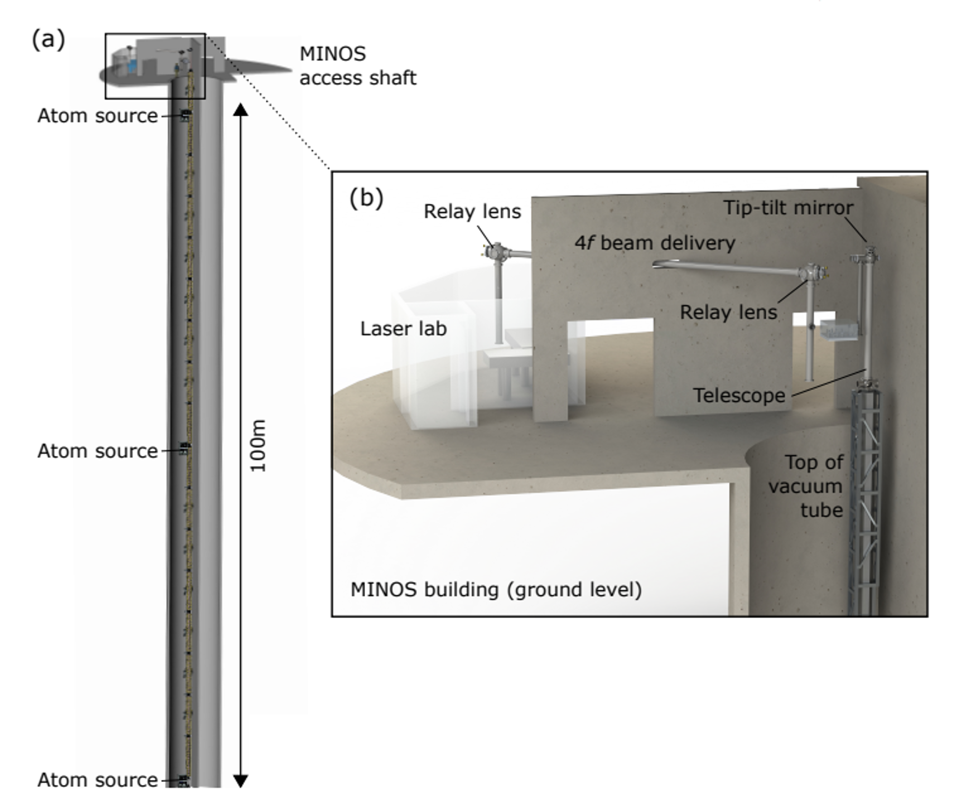
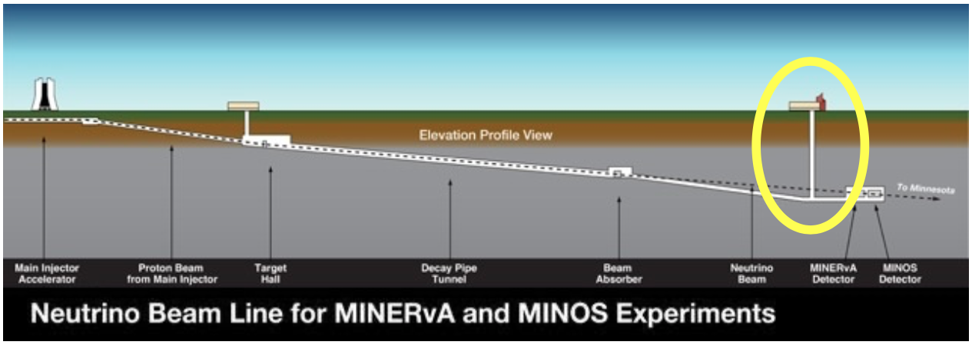
MAGIS-100 at Fermilab
Use MINOS access shaft, & Fermilab infrastructure
Experiment currently under construction
3 interferometers & 100 m laser baseline

Slide 3
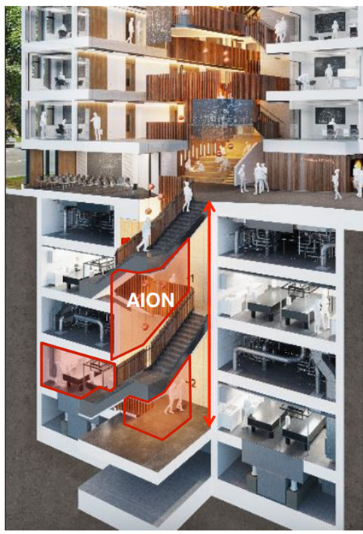
AION: Atom Interferometer Observatory & Network
AION-10 planned construction at Beecroft building, Oxford
Location of AION-100 TBD (Daresbury, Boulby, CERN…?)
Network with MAGIS for improved sensitivity to DM & GWs
AION
MAGIS
AION Paper (2018)
https://arxiv.org/abs/1911.11755
Notes:
100m baseline – MINOS access shaft – LARGE NOT LARGEST
Sensitivity proportional to interrogation time
3 interferometers, 3 Sr atom sources
Differential measurements
Networking with AION in UK
Atom Interferometer Observatory & Network

Slide 4
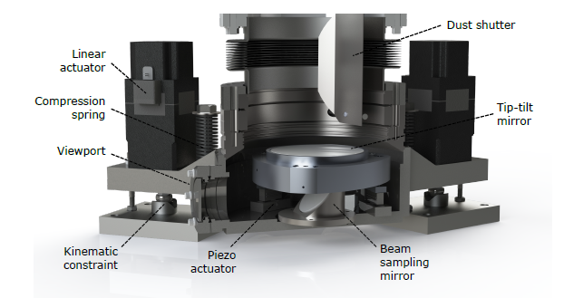
Retro-reflection Phase-shear Platform
UHV chamber housing retro-reflection mirror
Mirror needs precise control for
Phase-shear imaging
Interferometry beam monitoring and alignment
Coriolis corrections

Slide 5
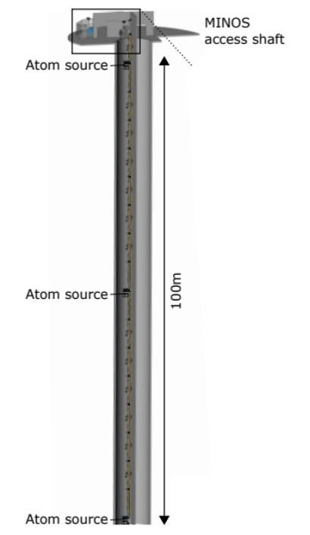
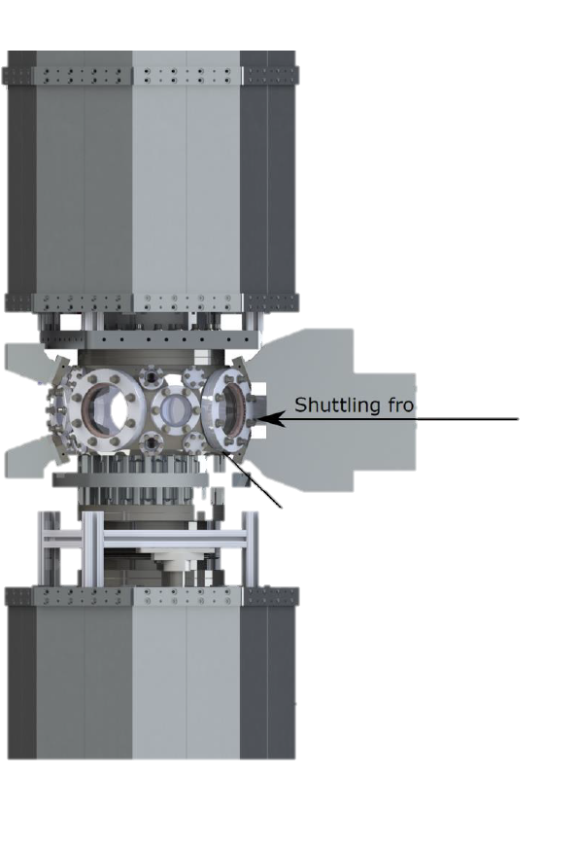
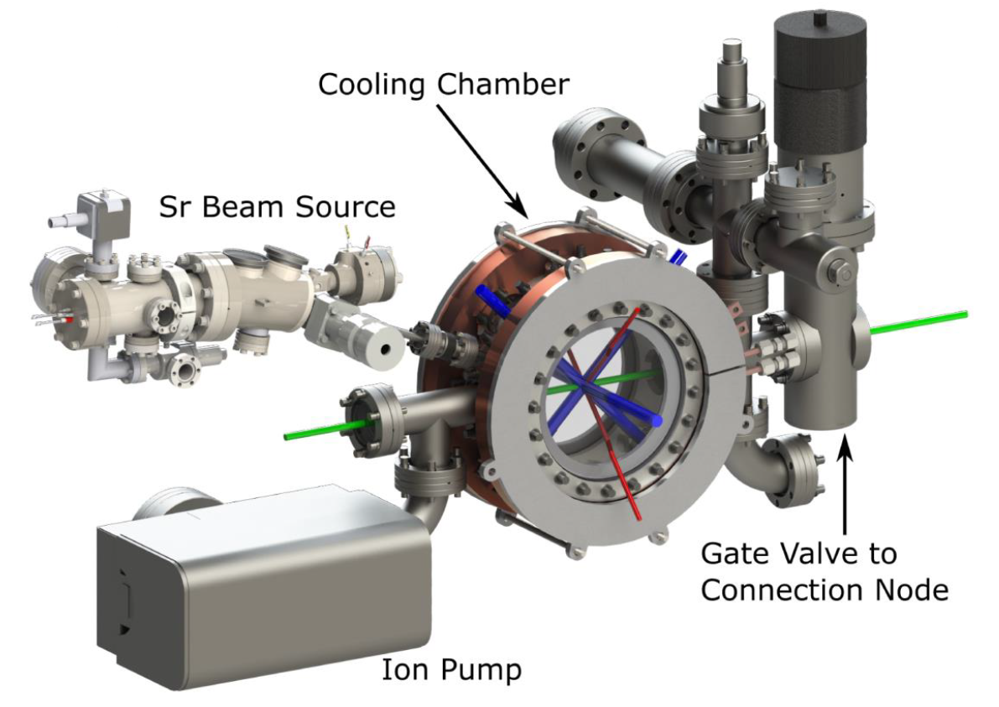
Retro-reflection Phase-shear Platform
100 m vacuum tube
The platform is the last component of the vacuum system
Located below the third atom source/connection node
Connection node
Atom source
Retro-reflection phase-shear platform

Slide 6
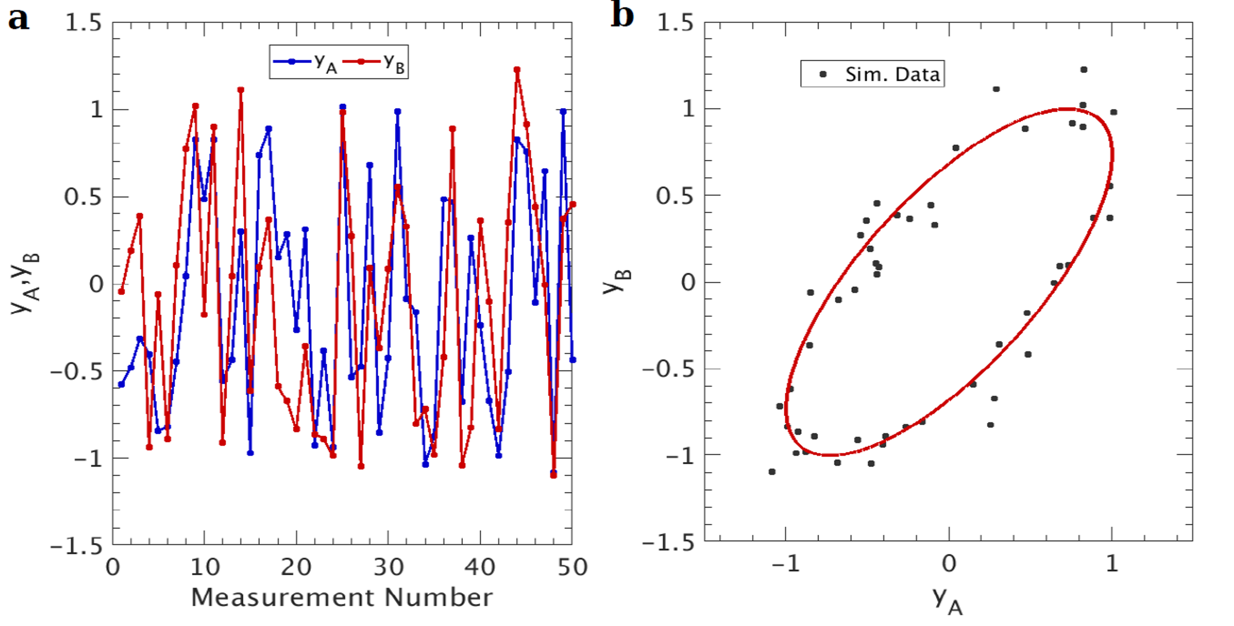
Phase Measurement with Gradiometer
One interferometry laser beam is used for multiple atom sources
Common mode subtraction
Signal from each source is sinusoids that parametrically describes an ellipse
Ellipse fitting for differential phase measurement
Hundreds of data points to make a reliable measurement
$$y_{A}=A\sin\left(φ_{common}\right)+B$$
$$y_{B}=C\sin\left(φ_{common}+φ_{diff}\right)+D$$
J. Tinsley 2019
Notes:
It is possible to obtain a reliable value for delta phi with an ellipse containing few hundreds of points. [https://journals.aps.org/pra/pdf/10.1103/PhysRevA.89.023607]
B and D gives centre of the ellipse

Slide 7
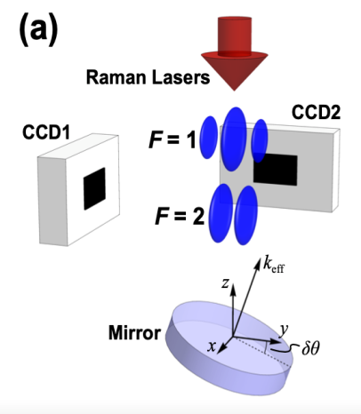
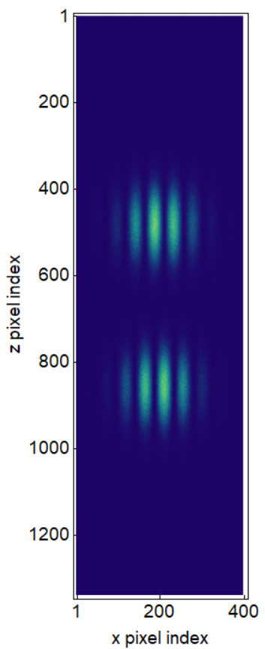
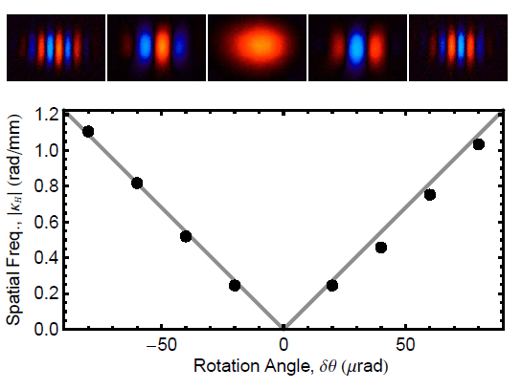
Phase Shear Readout
Can be considered as analogues of optical phase shear plate, but for atomic states
The phase shear in atomic case is introduced by tilting the retro-reflection mirror at the last interferometry pulse
Results in spatial fringes on atom cloud of both excited and ground state
These spatial fringes encodes interferometer phase allowing for single shot phase and contrast readout
http://dx.doi.org/10.1103/PhysRevLett.111.113002
Notes:
k is wavevector of the spatially varying component of the phase
Phy0 interferometer overall phase
k is set by the tilt angle

Slide 8
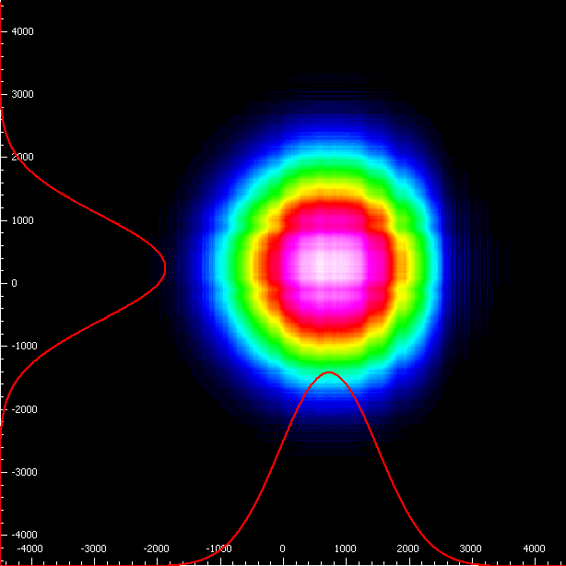
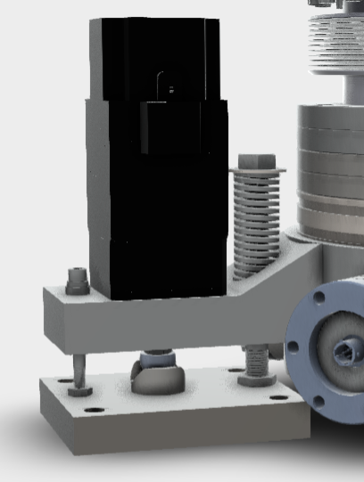
Interferometry Beam Monitoring & Alignment
Monitor the interferometry beam specs:
Shape
Size
Position
Alignment
Interferometry beams are aligned together with the steering platform at the top
Using stepper motor to tilt the whole platform
Stepper motor

Slide 9
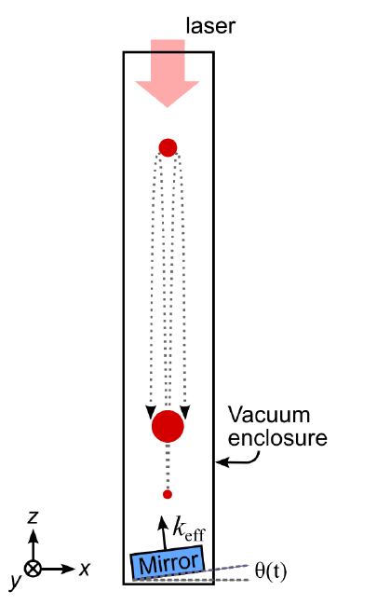
Coriolis Force Compensation
Coriolis force - a leading order systematics
The rotation of the beam angle has to match the direction of gravity
Rotation of normal at Fermilab: 54.178 µrad/s
Free fall time over 100 m rise and drop: 2*sqrt(2l/g) = 9.032 s
Rotation of normal during 9.032s free fall: 489.3 µrad
Solution:
Tilt the retro-mirror to counter the Coriolis force
In-vacuum PZT used to tilt just the mirror
Dickerson, Susannah M., et al. Physical review letters 111.8 (2013)
Notes:
Lab frame: Atoms experience Coriolis force
Atom frame: Lab rotates, while gravity points towards the centre of the Earth

Slide 10
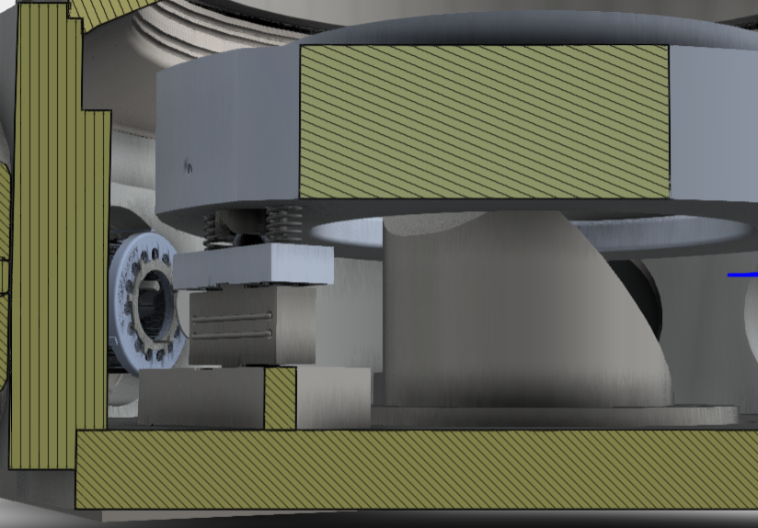
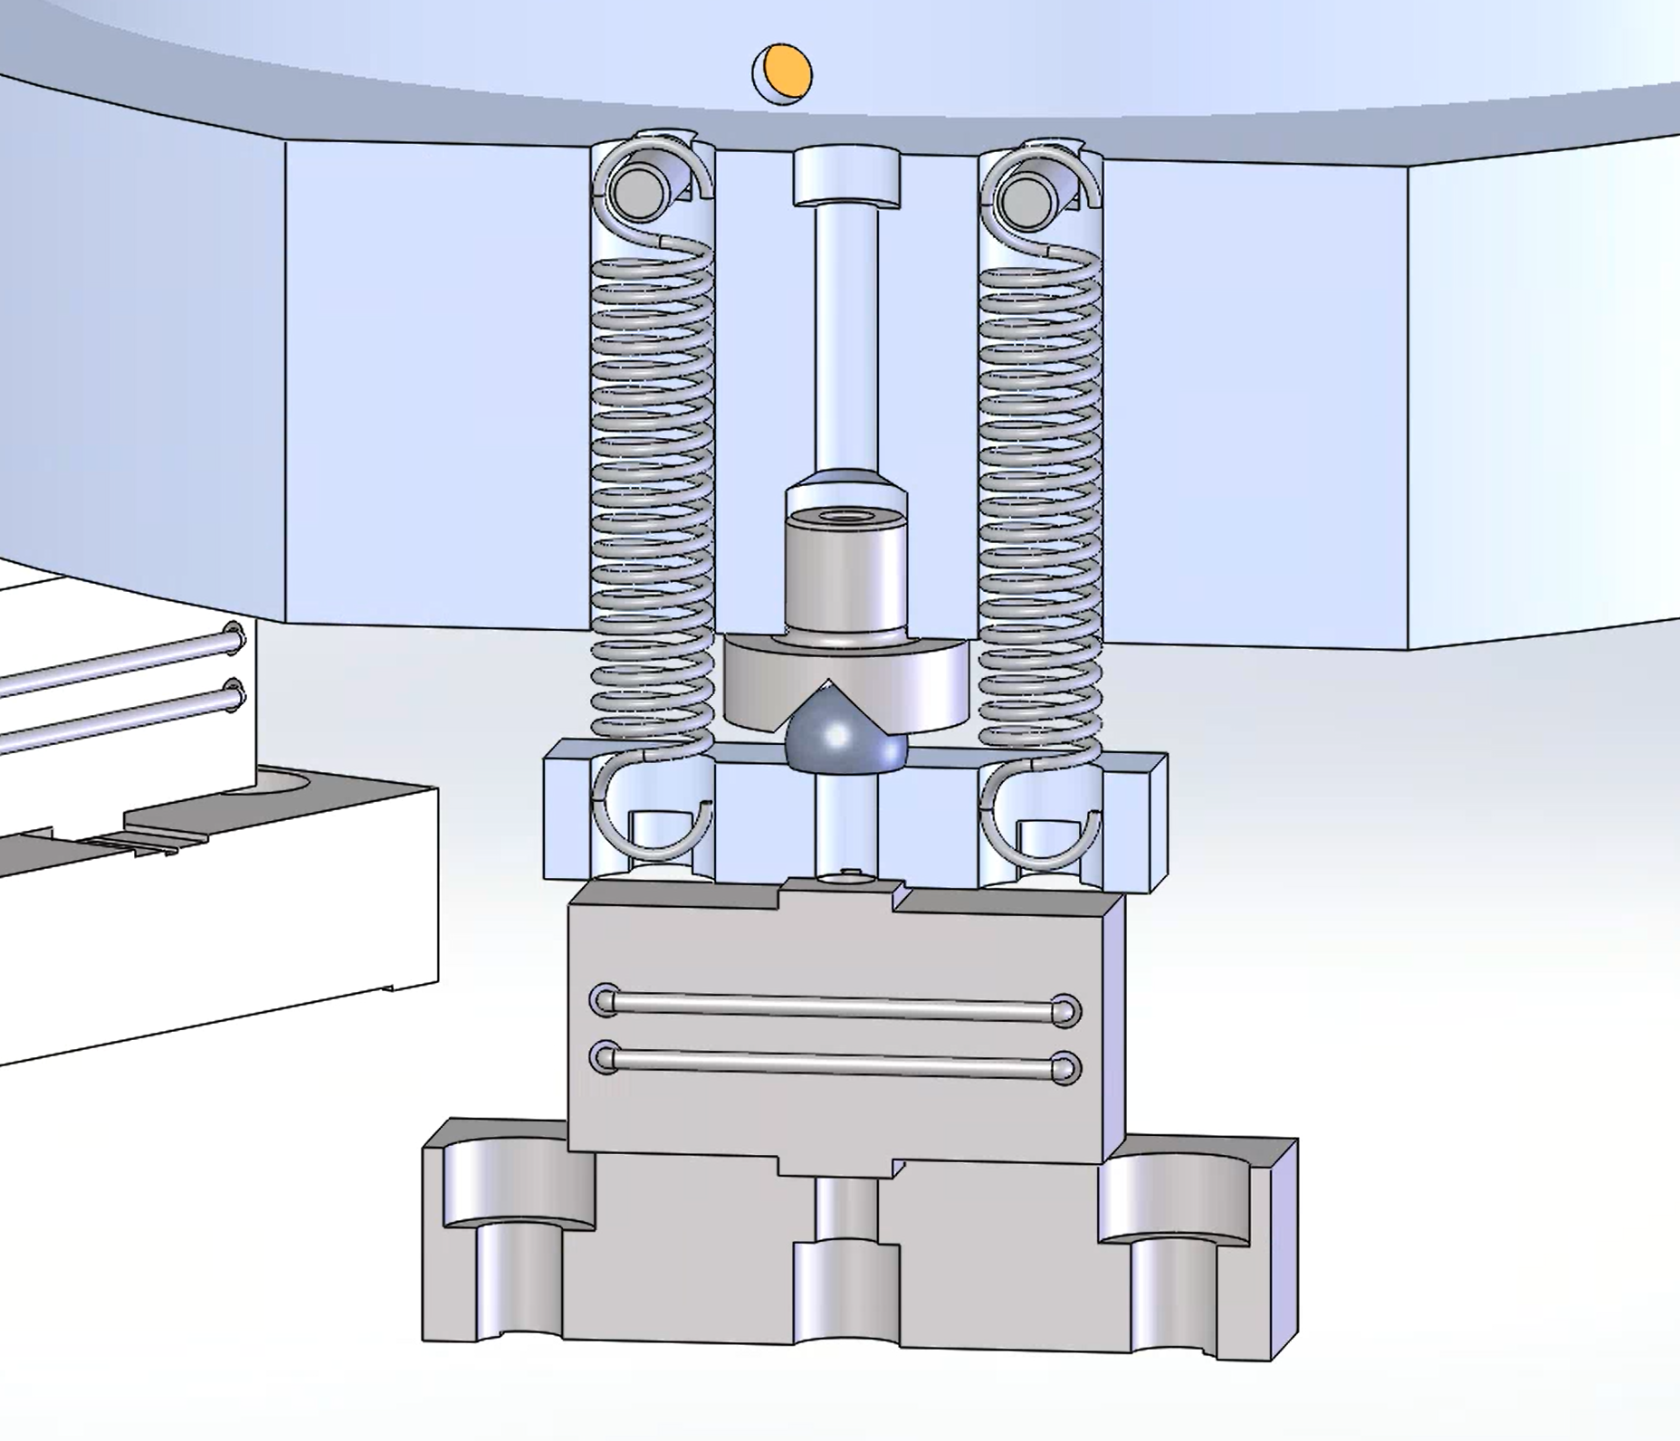
Specifications
UHV at 10⁻¹¹ Torr
Fast actuation: 1.3 mrad,
<100 ms settling time
Fast actuation achieved with in-vacuum PZT actuators
Slow actuation for alignment: ±1 degree range
Actuation achieved with out of vacuum stepper motors
All actuators remotely controlled
In-vacuum PZT actuator
Stepper motor

Slide 11
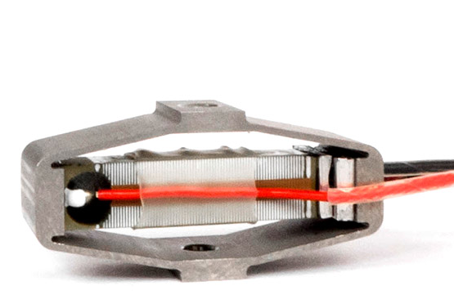
Expectations for PZT
Tripod design to have a clear aperture
3 actuators for redundancy and longevity (10 years)
50 nrad precision with a total range of 1.3 mrad
Optical feedback loop is going to be employed to reach ultimate precision
Controller has to be compatible with both strain gauge and voltage feedback
PZT actuator:
Cedrat Technologies
APA60SM
In-vacuum
Strain gauge attached
Notes:
Ramp rate of 10 um/ms if possible
Repeatability of 5 nm if possible

Slide 12
High Precision in Vacuum Optics
University of Liverpool sourcing high precision in vacuum optics for interferometry beam
Highly specified 2 lenses and 5 mirrors
λ/1000 flatness
AR coated for 6 different wavelengths
UHV compatible
Custom sizes and shapes
Optics has been specified and vendor found –
4 inch mirror

Slide 13
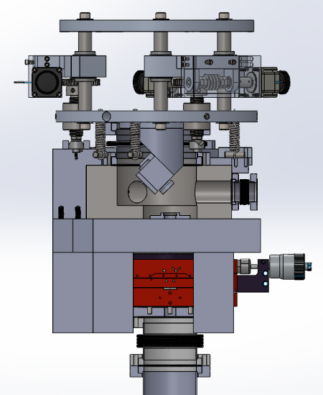
Steering Chamber
Steering chamber located at the top of MAGIS vacuum system
Employs linear actuators and in-vacuum PZT
Mainly used to align/steer the interferometry beam
Main chamber and other components will be machined at Liverpool
Notes:
Worm drive turning the lead screw
Range of few degrees, with accuracy of 15 µrad
MCL in vacuum PZT for Coriolis force compensation
Range 10 mrad, resolution 20 nrad

Slide 14
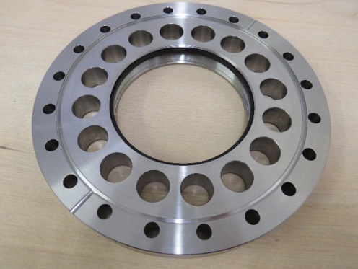
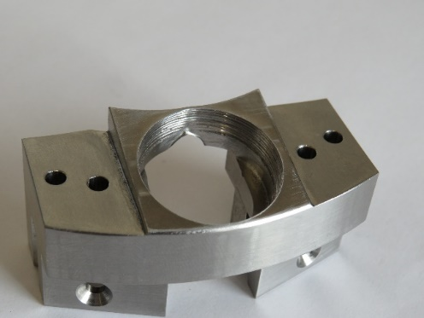
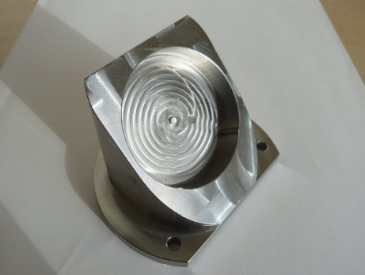
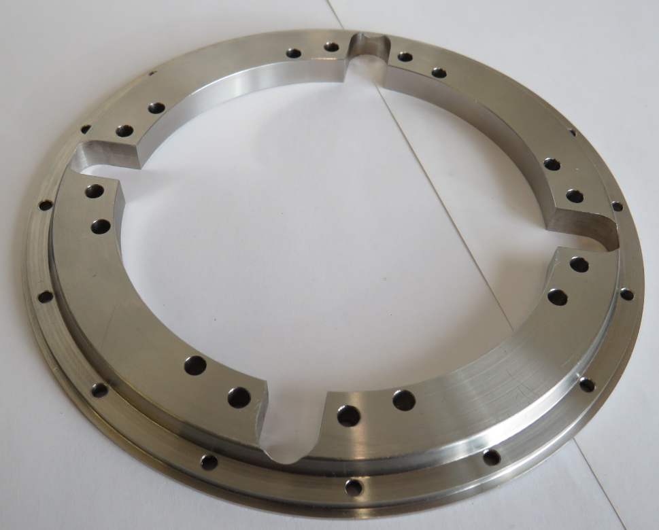
Parts made by Liverpool Detector Development Manufacturing Facility
Lens flange mount
In-vacuum mirror mount
In-vacuum beam sampling mirror mount
Heavy duty groove grabber plate
Notes:
Add 4th pic

Slide 15
Summary
AION and MAGIS is going to use phase shear readout technique
Single shot phase measurement
The design of retro-reflection phase-shear platform is completed and submitted to the Liverpool workshop
Equipment has been specified and being ordered
Vacuum chamber is being machined at Liverpool
The design of top steering (via tip-tilt) platform is in review
Will be machined at Liverpool
Sourced required high precision optics for MAGIS
Purchase imminent

