Slide 1
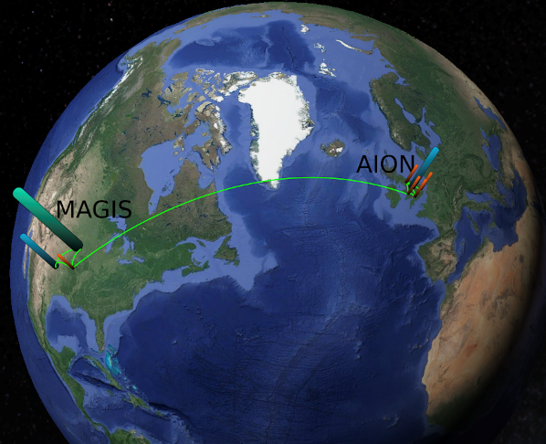

MAGIS-100/AION Systematics and data pipeline
Jeremiah Mitchell
University of Cambridge
On behalf of the collaborations
5 April 2022
IOP HEPP & APP 2022

Slide 2
Outline
Cambridge contributions to MAGIS-100
  Computing and timing system
  Data pipeline design
Long baseline systematics
  Laser wavefront aberration
  Vibrations and gravity gradient noise (GGN)

Slide 3
MAGIS-100 detector layout
Simultaneous control
  Laser system
  Atom sources
  Phase-shear readout
  Imaging: science, diagnostic
Slow control monitoring
  Environmental diagnostics
Will have similar needs for AION-10 and beyond
Mahiro Abe et al 2021 Quantum Sci. Technol. 6 044003

Slide 4
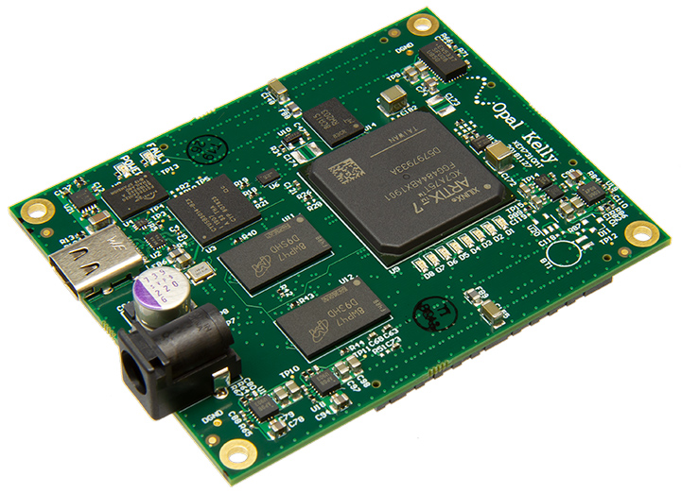
Computing and timing
Hardware timing control system
Run control server
10 Core Xeon processor
32 GB DDR4 ECC RAM
16 TB RAID 10 SSD storage (8TB usable)
Dual 10 Gigabit ethernet
Based around Xilinx Series 7 FPGA (Artix-7)
USB 3.0 Data rate
Integrated DDR3 SDRAM (1GB)
200 MHz system clock (5 ns)

Slide 5
Data pipeline
Store run configurations
Measurement sequence data
  Calibration/Measurement status
  Environmental monitoring and events
  Precise time and event tagging
  Run sequence images: science and diagnostic
Run control server
Long term storage
Data

Slide 6
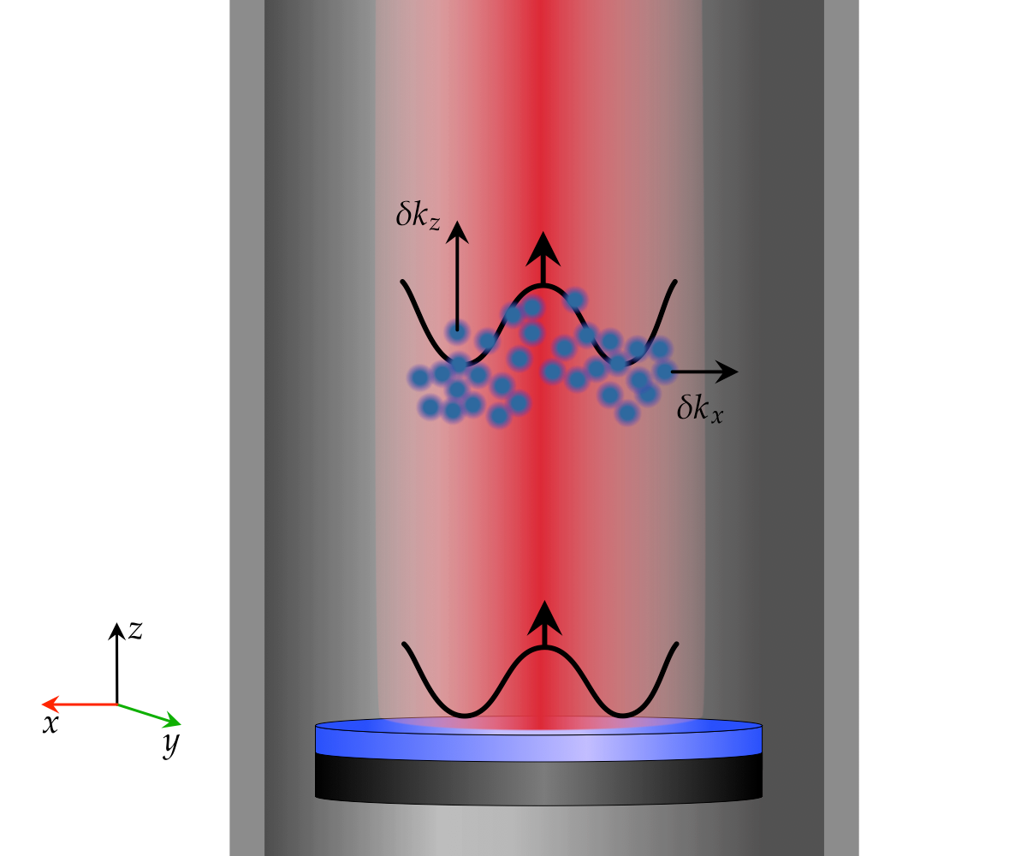
Systematics for long baseline atom interferometry
Laser wavefront aberrations
Seismic vibration
Gravity gradient noise (GGN)

Slide 7
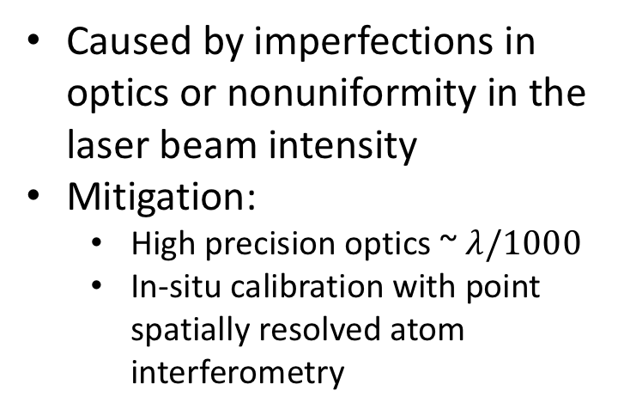
Laser wavefront aberrations
Caused by imperfections in optics or nonuniformity in the laser beam intensity
Mitigation:
  High precision optics ~ $λ/1000$
  In-situ calibration with point spatially resolved atom interferometry
Effective transverse momentum
Effective longitudinal momentum

Slide 8
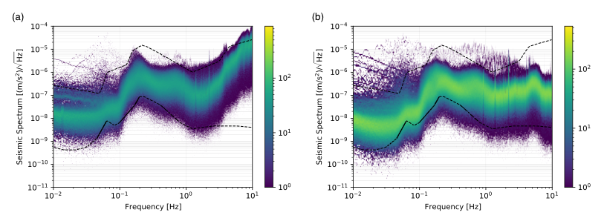
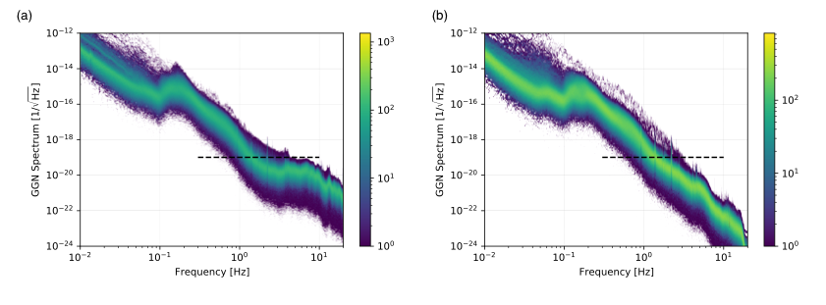
Vibration and inferred GGN
Above ground and below ground vertical seismic amplitude spectra
Inferred GGN from the vertical displacement noise acquired at MAGIS-100 site
J. Mitchell et al 2022 JINST 17 P01007, E02001

Slide 9
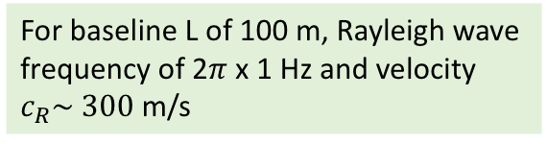
GGN
GGN is a perturbative noise sourced by seismic ground motion
Causes anomalous strain signal interfering with gravitational wave or ultralight dark matter measurements
Current potential mitigation:
  Calibration and fitting to exponential amplitude decay
  Active correlated seismometer array
For baseline L of 100 m, Rayleigh wave frequency of 2$π$ x 1 Hz and velocity $c_{R}\sim 300$ m/s
J. Mitchell et al 2022 JINST 17 P01007, E02001

Slide 10

Summary
University of Cambridge focusing on the data acquisition, monitoring and control for MAGIS-100 using expertise in high-energy physics
Understanding the full networking potential of AION and MAGIS-100 and their associated systematics

