Slide 1
MAGIS & AION: Long Baseline Atom Interferometry Experiments
Leonie Hawkins, University of Liverpool
On behalf of the collaborations
IOP HEPP & APP Conference 2022

Slide 2
Science Motivation
MAGIS/AION
Pathfinder for mid-band frequency gravitational wave detector (0.03 – 3 Hz) between aLIGO and LISA

Slide 3
Dark Matter Detection
Affects fundamental constants (m_{e} and ⍺), altering atomic energy level separation
Additionally:
Gravitational waves cause strain in light travel time
Both cause phase shift
measure with atom interferometry

Slide 4
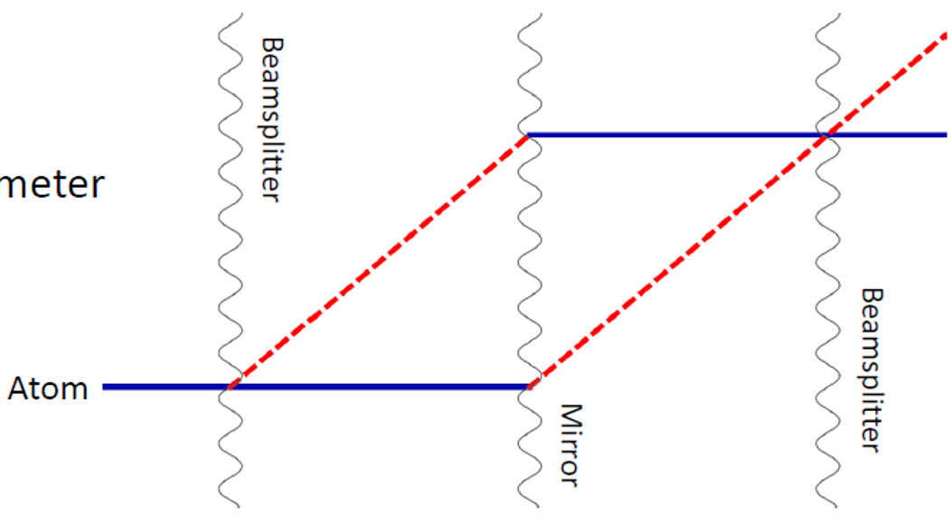
Atom Interferometers as a Gradiometer
Atoms in superposition of states
Analogous to light interferometers
Multiple atom interferometers across single baseline
Employs Sr atoms
Take ratio of measurements
Cancel various systematics
Sensitivity increases with baseline length
Notes:
More detail on diagram – single photon transitions, etc.

Slide 5
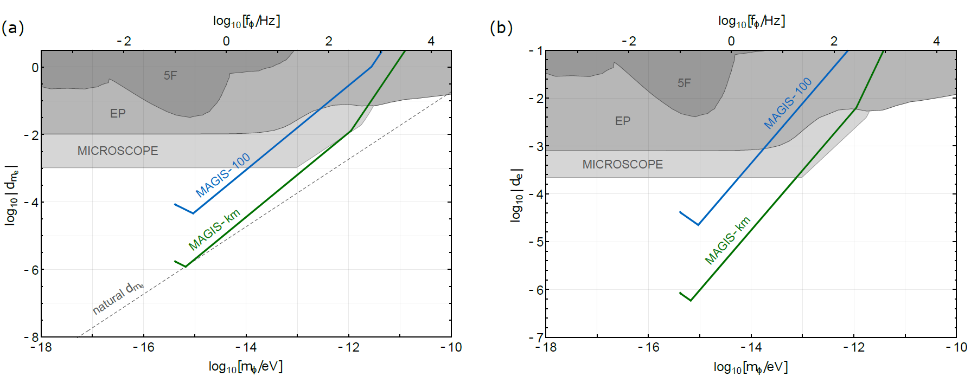
Sensitivity via Coupling to m_{e} and ⍺
/AION-100
AION-100/
/AION-km
/AION-km
Improve sensitivity to DM particles with mass < 10⁻¹⁵ eV or frequency < 0.1 Hz by 2 orders of magnitude

Slide 6
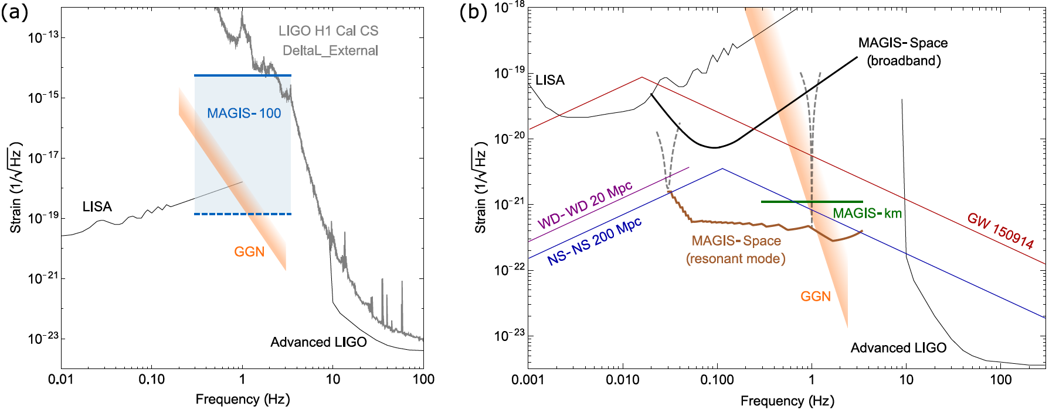
Sensitivity to Gravitational Waves

Slide 7
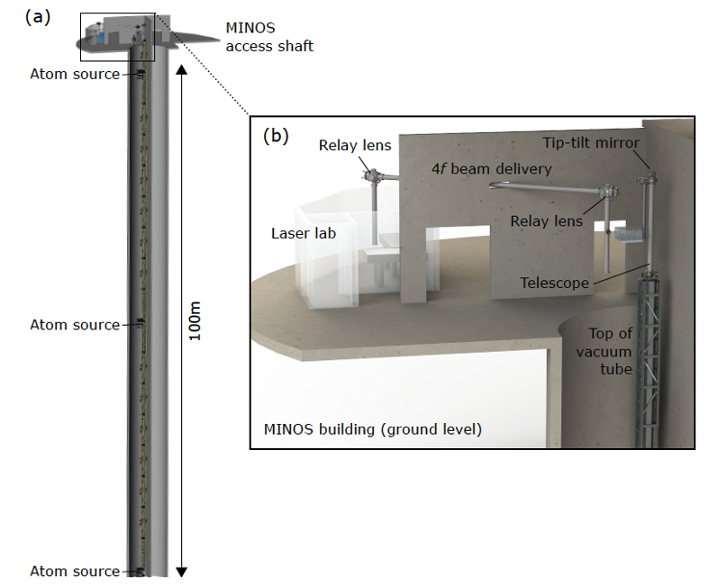
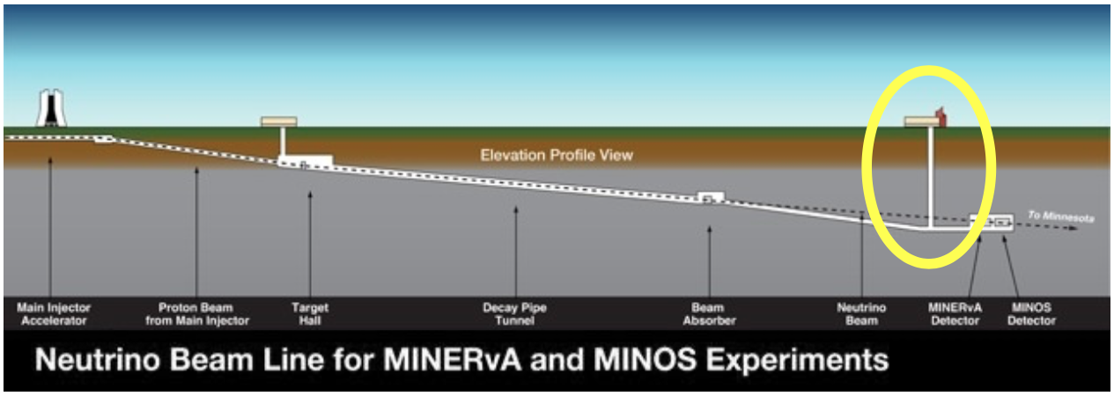
MAGIS-100 at Fermilab
Use MINOS access shaft, & Fermilab infrastructure
Experiment currently under construction
3 interferometers in order to categorize systematics
MAGIS-100 Paper (2020)
https://arxiv.org/abs/2104.02835
Notes:
100m baseline – MINOS access shaft – LARGE NOT LARGEST
Sensitivity proportional to interrogation time
3 interferometers, 3 Sr atom sources
Differential measurements
Networking with AION in UK

Slide 8
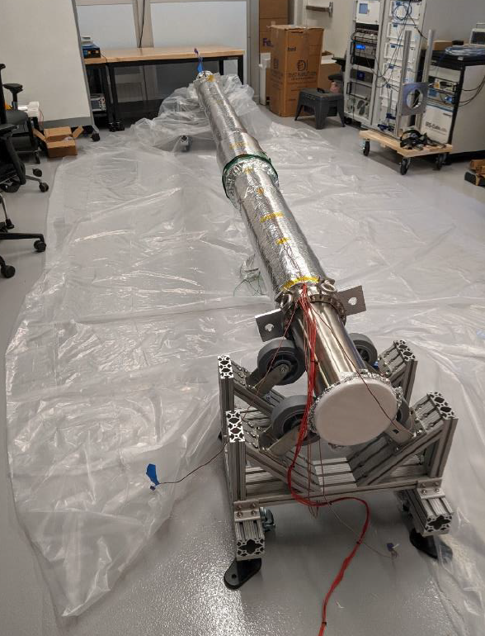
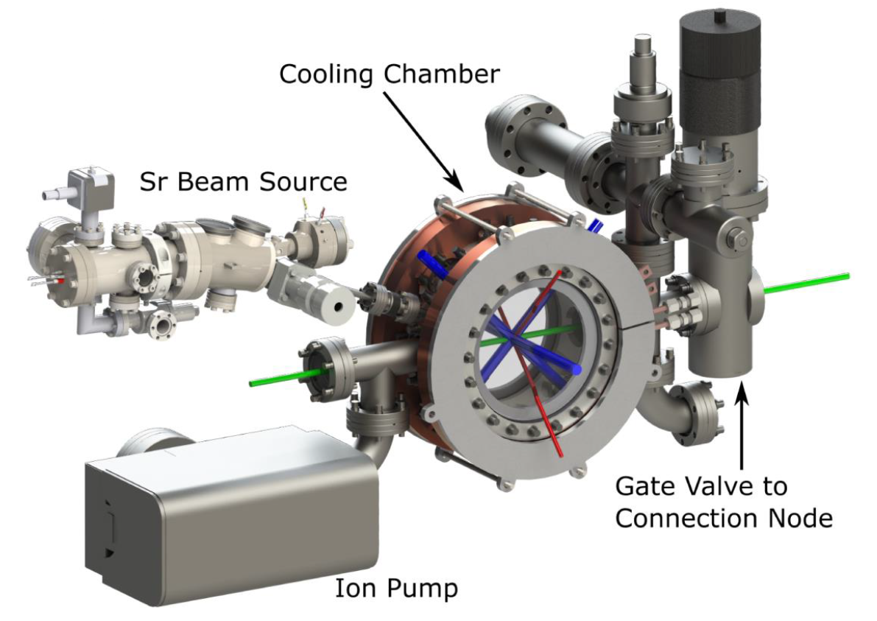
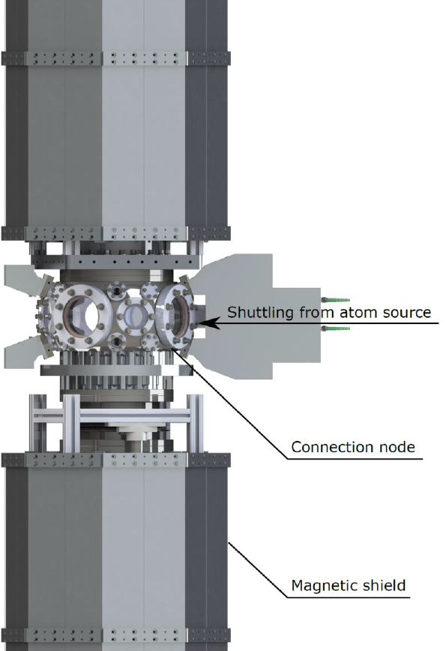
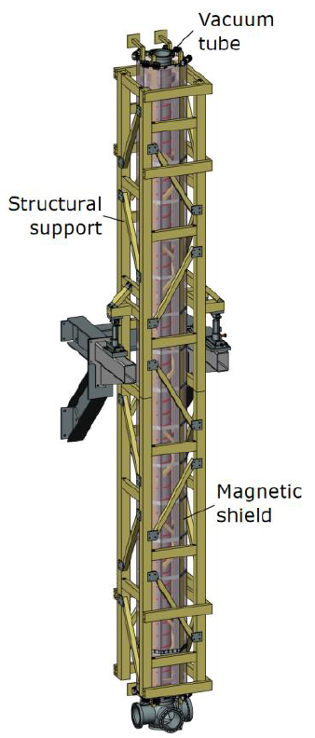
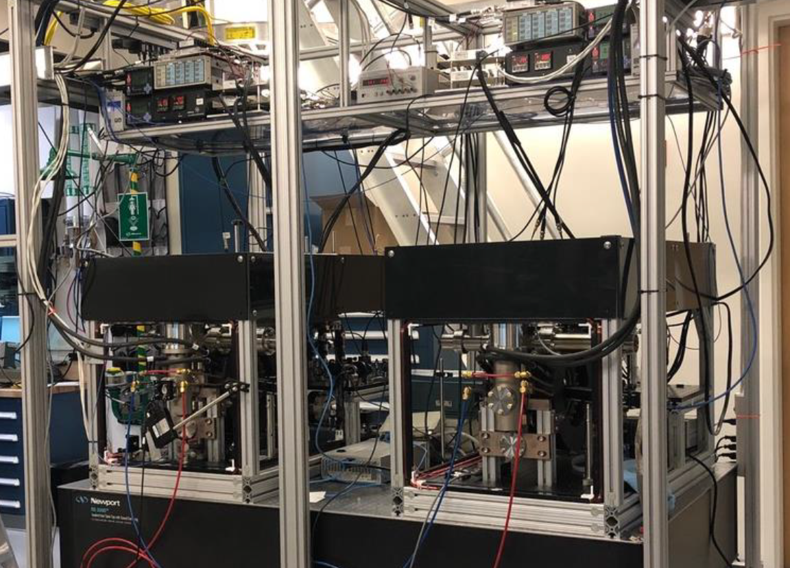
Progress on MAGIS-100
Atom source design & construction
Atom launch design
Mechanical support structure
Prototype beam pipe section

Slide 9
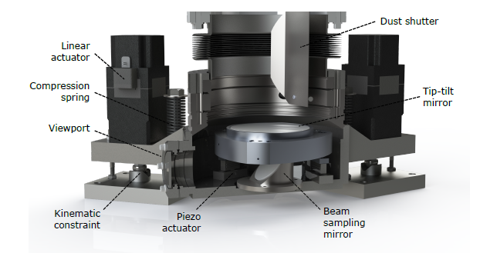
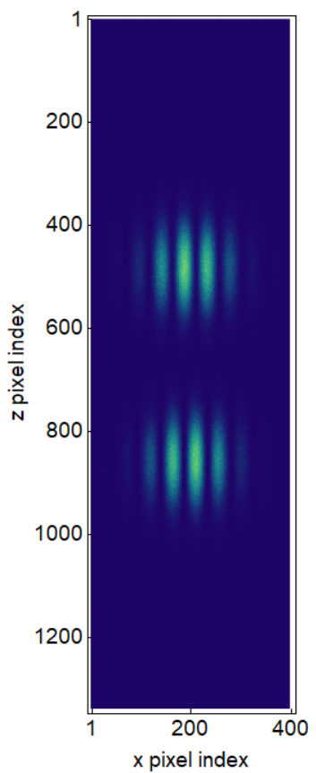
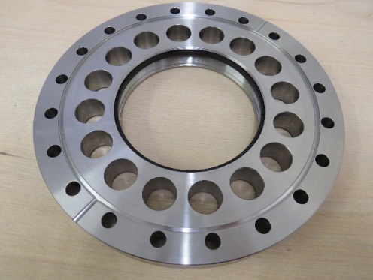
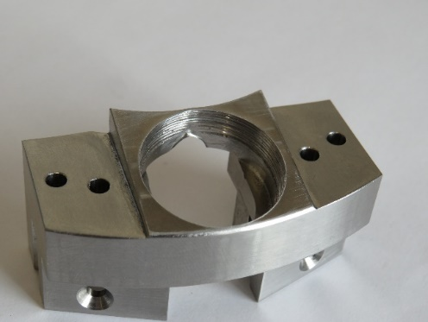
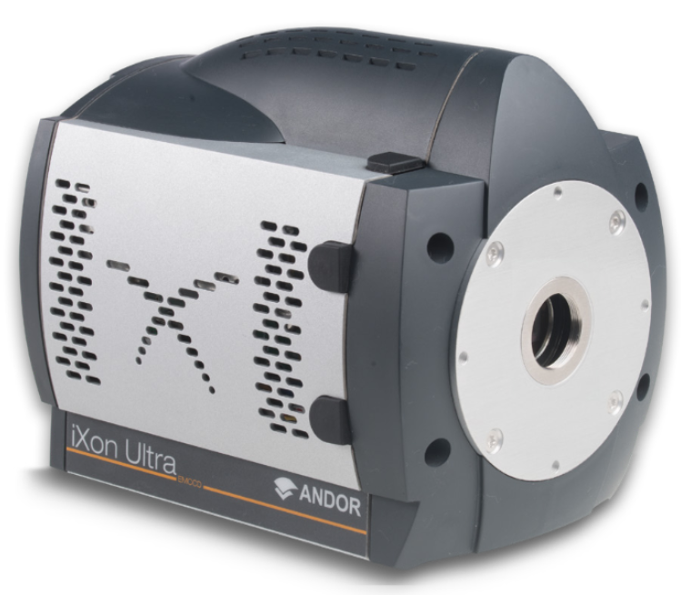
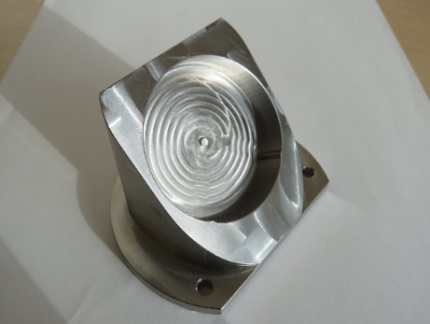
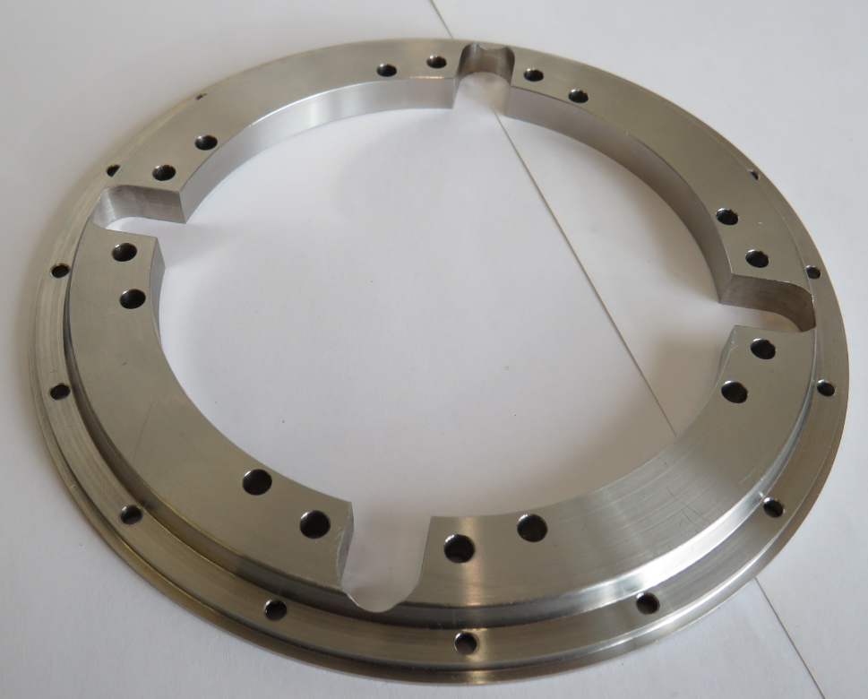
UK Progress To deliver the detection sub-system
Liverpool:
Develop phase shear imaging platform
In-vacuum opto-mechanics
Oxford:
Deliver detection cameras
Cambridge:
DAQ and computing
UK contributing to physics simulations
Modelling signal, noise & systematics
Lens flange mount
In-vacuum mirror mount
In-vacuum beam sampling mirror mount
Heavy duty groove grabber plate

Slide 10
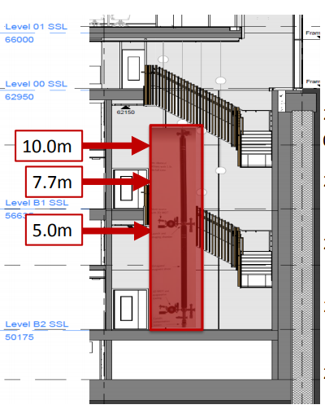
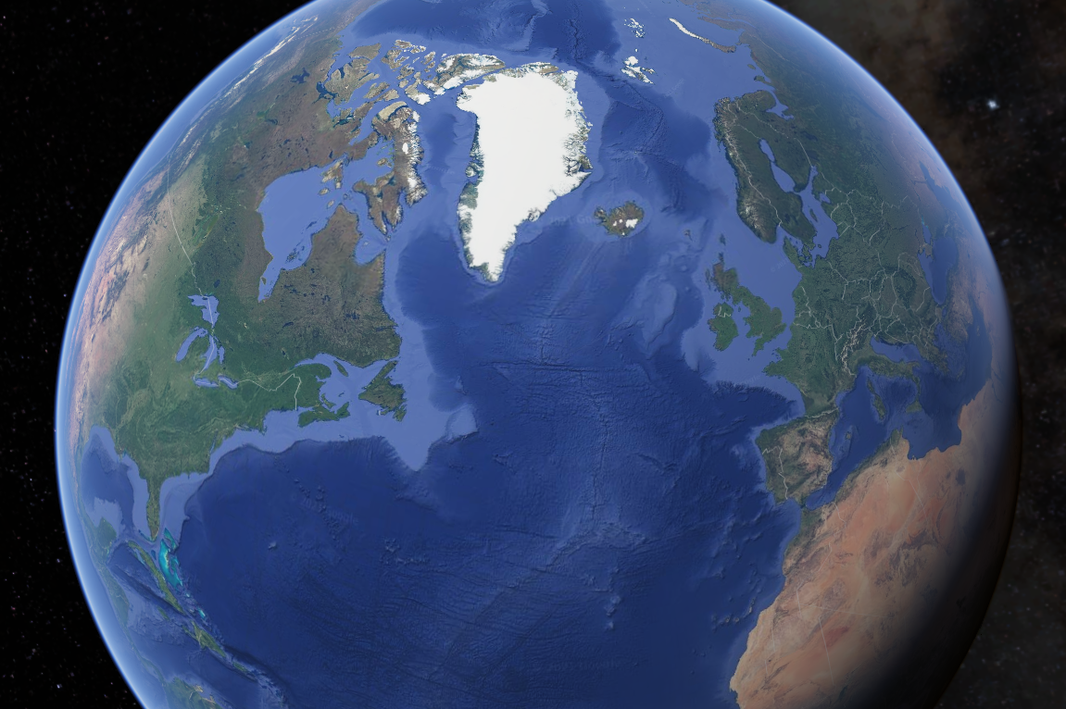
Atom Interferometer Observatory & Network
5 new Sr labs established
Currently constructing prototype (AION-1)
AION-10 planned construction at Beecroft building, Oxford
Location of AION-100 TBD (Daresbury, Boulby, CERN…?)
Network with MAGIS for improved sensitivity to DM & GWs
AION
MAGIS
AION Paper (2018)
https://arxiv.org/abs/1911.11755
Notes:
100m baseline – MINOS access shaft – LARGE NOT LARGEST
Sensitivity proportional to interrogation time
3 interferometers, 3 Sr atom sources
Differential measurements
Networking with AION in UK

Slide 11
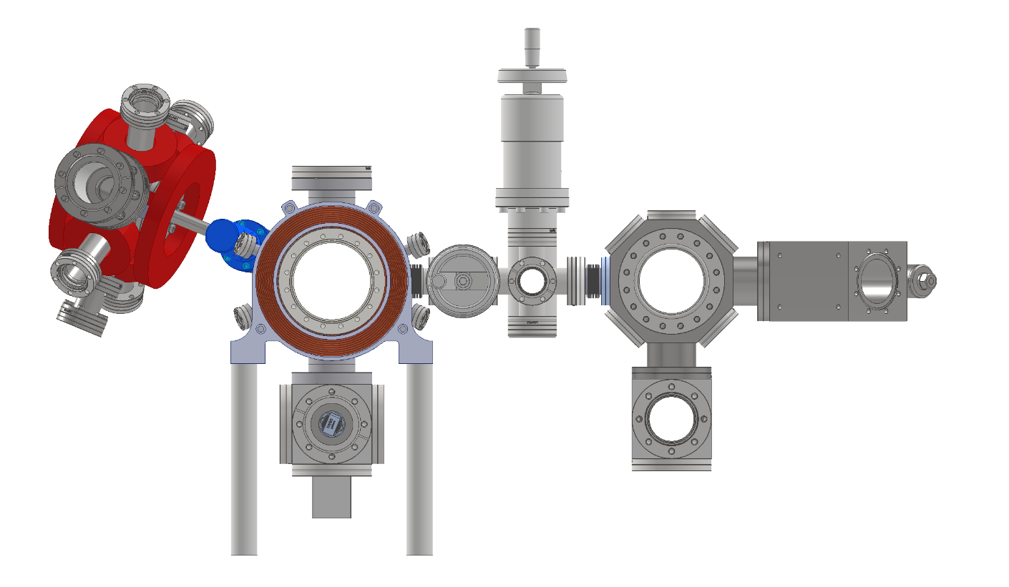
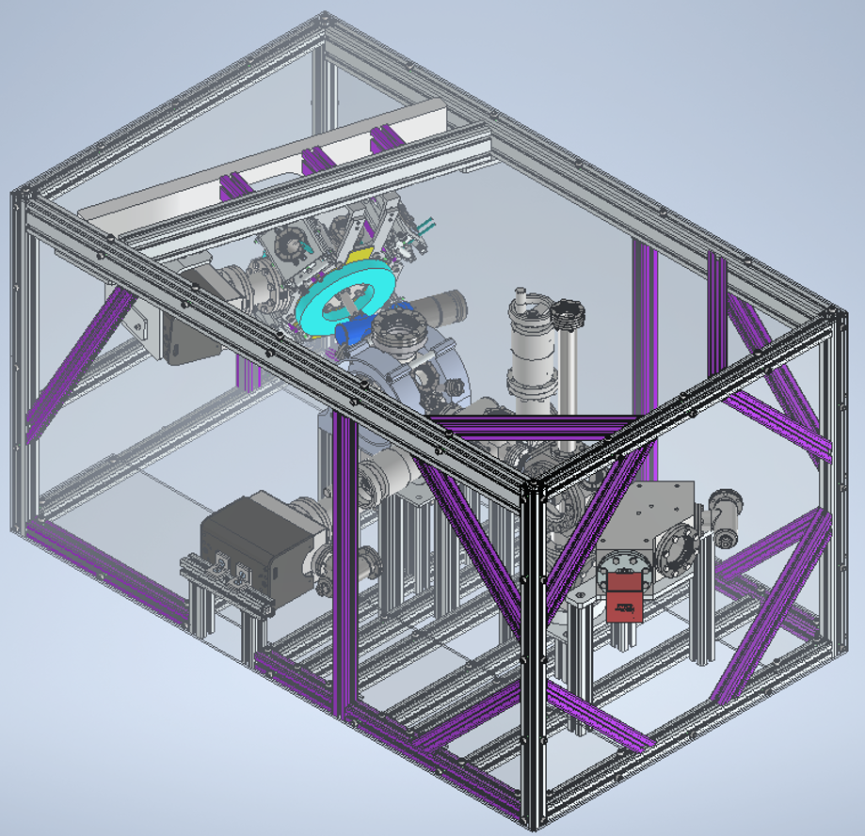
Progress on AION
Transport
2D MOT source
3D MOT
Interferometry chamber
AION prototype under construction
Demonstrate interferometry with Sr
Develop technology for 10m & future 100m devices
Each institution responsible for different subsystem
Oxford, Liverpool, Cambridge, Imperial College, Birmingham, RAL & Kings College
Vacuum system & support frame for prototype under construction

Slide 12
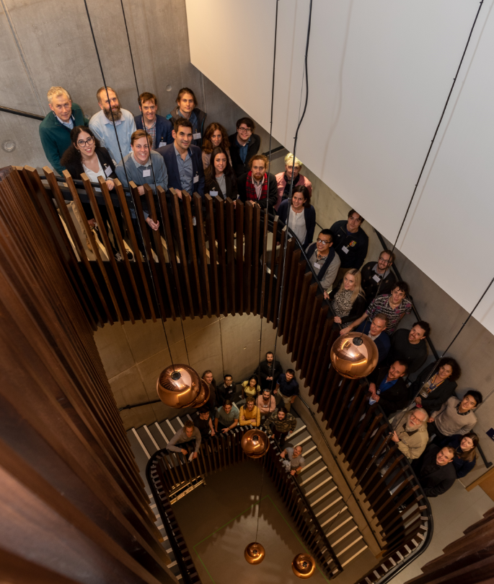
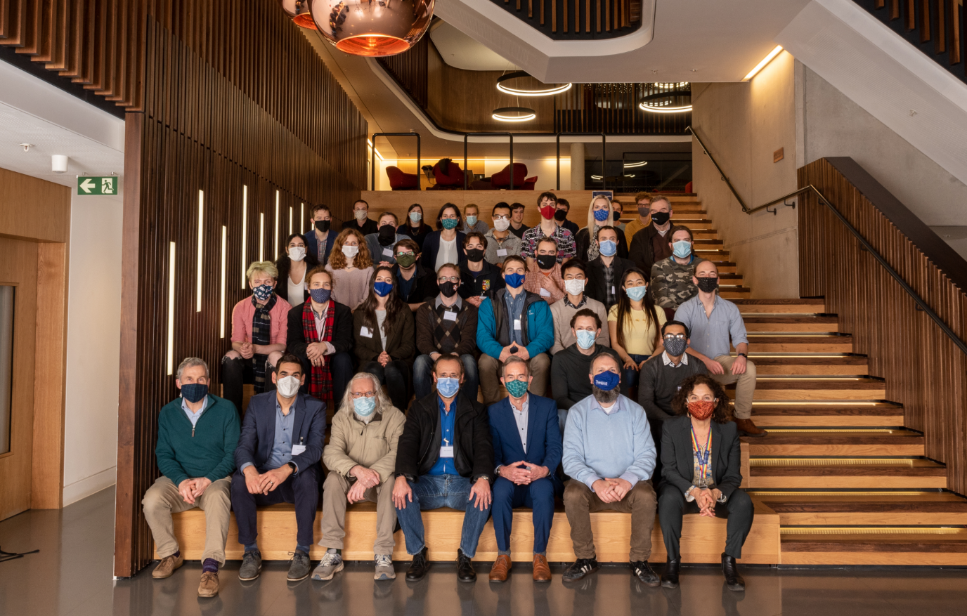
Atom Interferometer Observatory & Network
Notes:
100m baseline – MINOS access shaft – LARGE NOT LARGEST
Sensitivity proportional to interrogation time
3 interferometers, 3 Sr atom sources
Differential measurements
Networking with AION in UK

Slide 13
Summary: MAGIS & AION
Large baseline atom interferometry projects
Searching for ultralight dark matter
Test bed for gravitational wave detection
Aim to network between MAGIS and AION
MAGIS-100 design and fabrication of parts underway
AION prototype under construction
AION-10 to be built at Oxford

Slide 14
Questions?

Slide 15
Backup Slides

Slide 16
Gravitational Wave Detection
Laser
Mid-band frequency gravitational waves (30 mHz – 10 Hz), between LIGO and LISA
2L/c term represents laser propagation time
Atoms as inertial reference points & clocks
GW cause strain in light travel time – phase shift
Atoms
Common interferometer laser beam
Measurement baseline
Atoms
Laser

Slide 17
Alternative Dark Matter Detection Methods
Effects on fundamental constants – scalar
Causes accelerations to test masses – vector
Using isotopes of strontium
Comparing accelerations
Precessions of nuclear spins – pseudo scalar
Placing atoms in different spin states

Slide 18
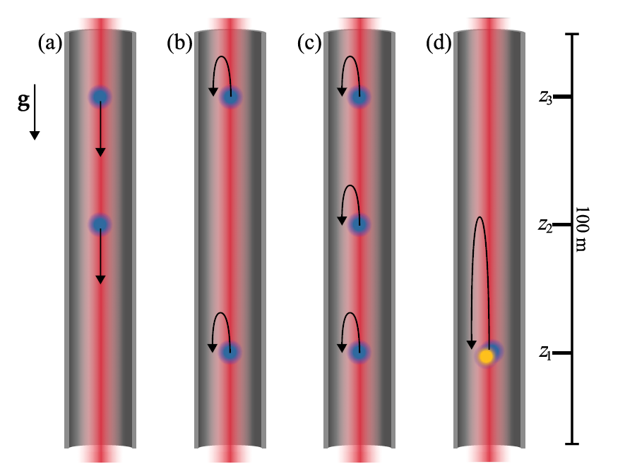
Baseline Configurations
Max drop time gradiometer
Max baseline gradiometer
GGN characterization
Dual species launch – alternative dark matter detection mode

