Slide 1
DEPARTMENT OF PHYSICS & ASTRONOMY
QuARC – A Quality Assurance Range Calorimeter
Saad Shaikh¹, Raffaella Radogna, Fern Pannell, Ruben Saakyan, Spyros Manolopoulos, Derek Attree, Connor Godden, Simon Jolly²
¹saad.shaikh.15@ucl.ac.uk
²s.jolly@ucl.ac.uk

Slide 2
No Disclosures

Slide 3
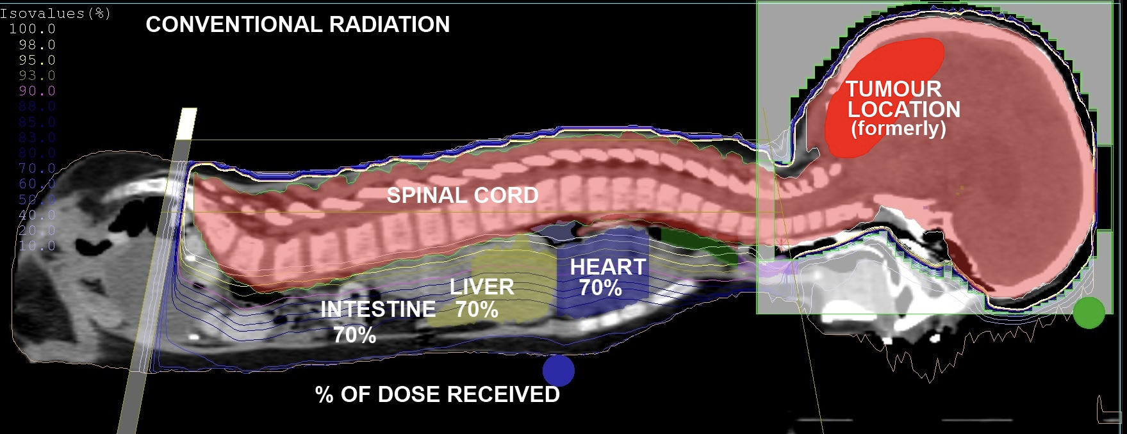
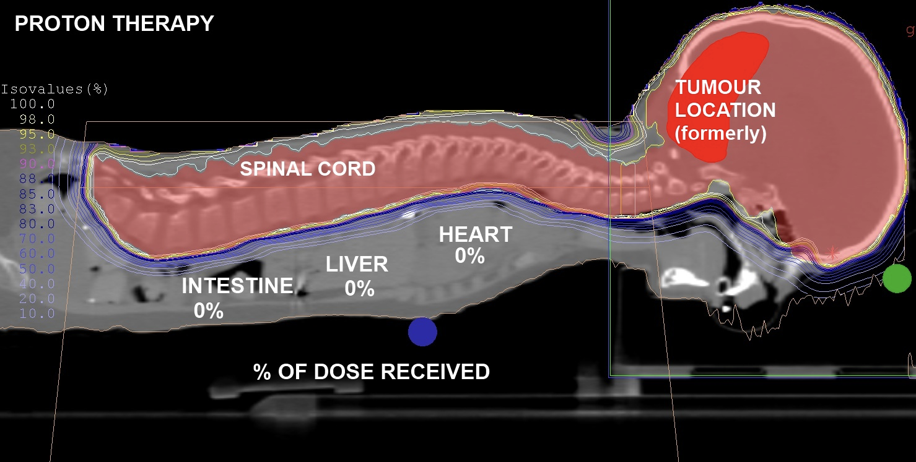
Proton Therapy
Superior dose conformity compared to conventional X-ray radiotherapy.
Range uncertainties prevent taking full advantage of dose localisation benefits.
Clinic must perform daily beam range Quality Assurance (QA).
  Measure proton range in water for selection of treatment energies.
  Water chosen as proxy for human tissue.
Beam QA either fast or comprehensive.
Can we do both?

Slide 4
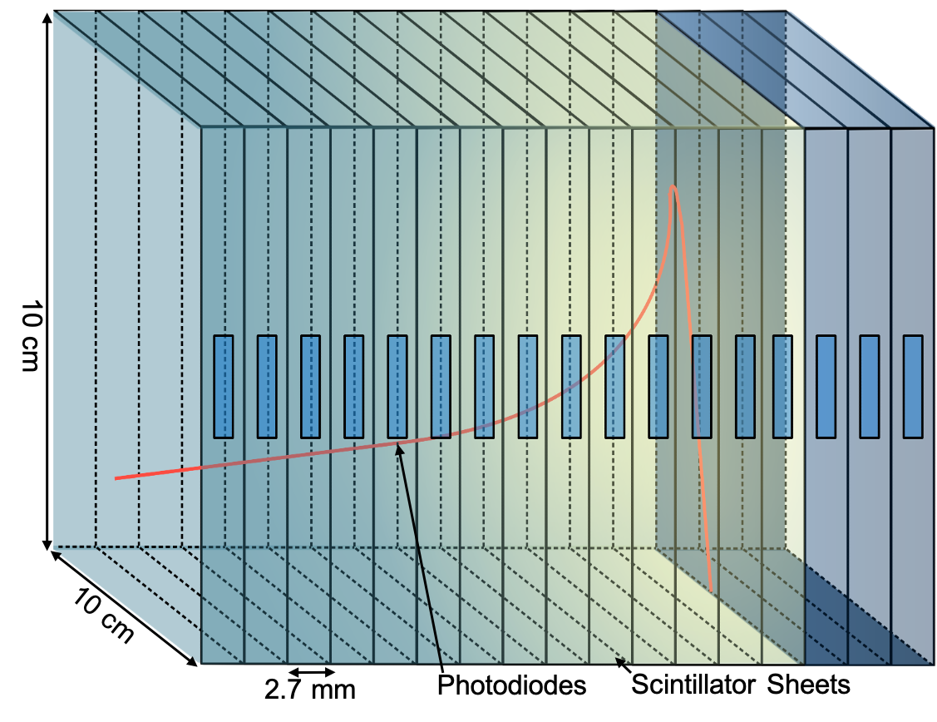
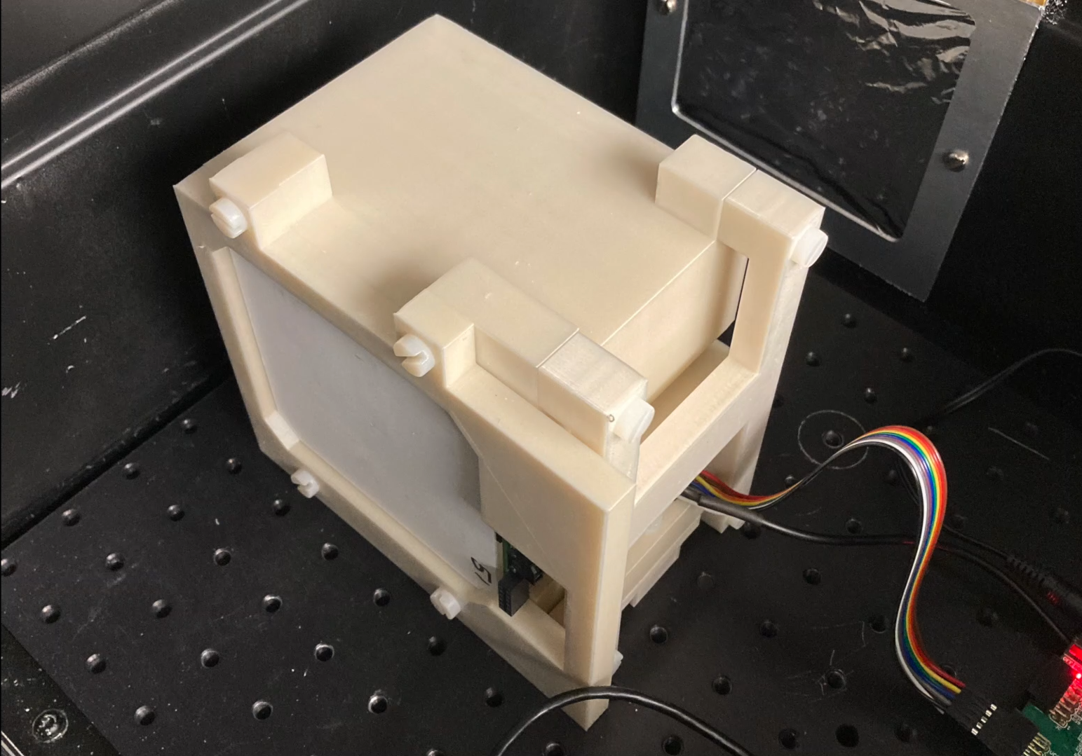
QuARC
Measure proton range using a series of optically-isolated polystyrene scintillator sheets.
Light output of each sheet proportional to proton energy deposition, with some quenching effects.
  Fit data with analytical depth-light model [1].
  Set light quenching to zero to reconstruct Bragg depth-dose curve and measure proton range.
Photodiodes coupled to fast, modular electronics and an FPGA to read light levels at over 5 kHz.
Key benefits:
  Plastic scintillator inexpensive and water-equivalent.
  Range reconstructed with single beam delivery.
  Easy detector setup and no optical artefacts.
Notes:
The goal here is to reconstruct the proton depth-dose distribution however, the light output is subject to quenching effects, especially around the Bragg peak.
We get around this by fitting the data with a version of Bortfeld's Bragg model that accounts for quenching effects using Birks' law.
We can then remove the quenching corrections to recover the original dose-depth curve, which gives us the proton range.

Slide 5
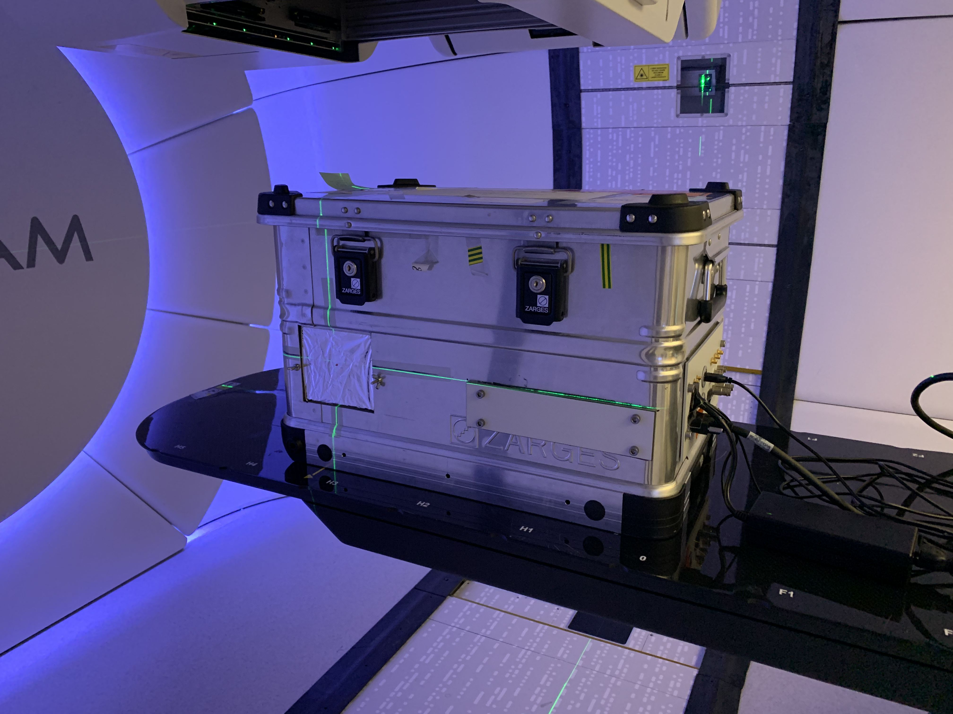
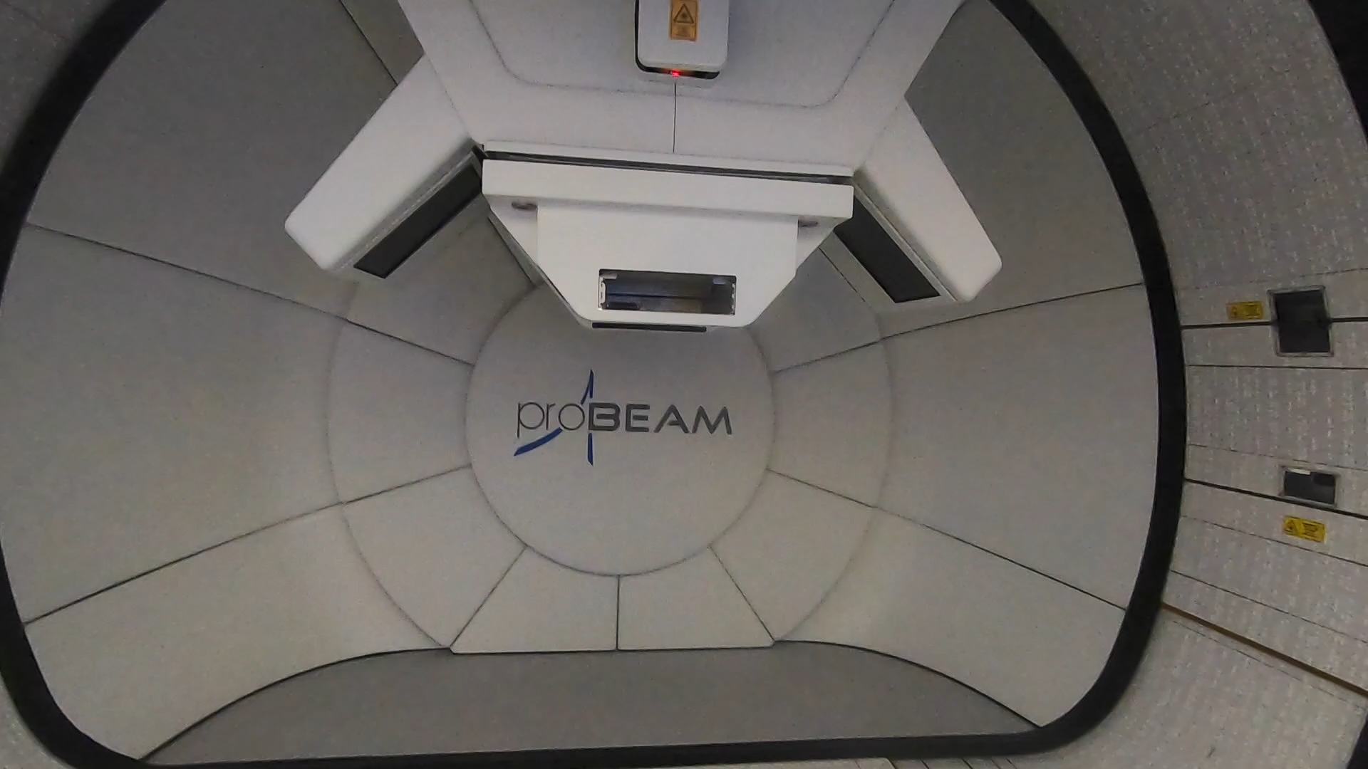
UCLH Beam Tests
Beam tests at UCLH in April and November 2021 to evaluate performance of photodiodes.
Use one detector module (32 sheets, 92 mm total depth) to test pencil beam energies between 70-110 MeV.
Determine range reconstruction accuracy and demonstrate fast live range reconstruction capabilities.

Slide 6
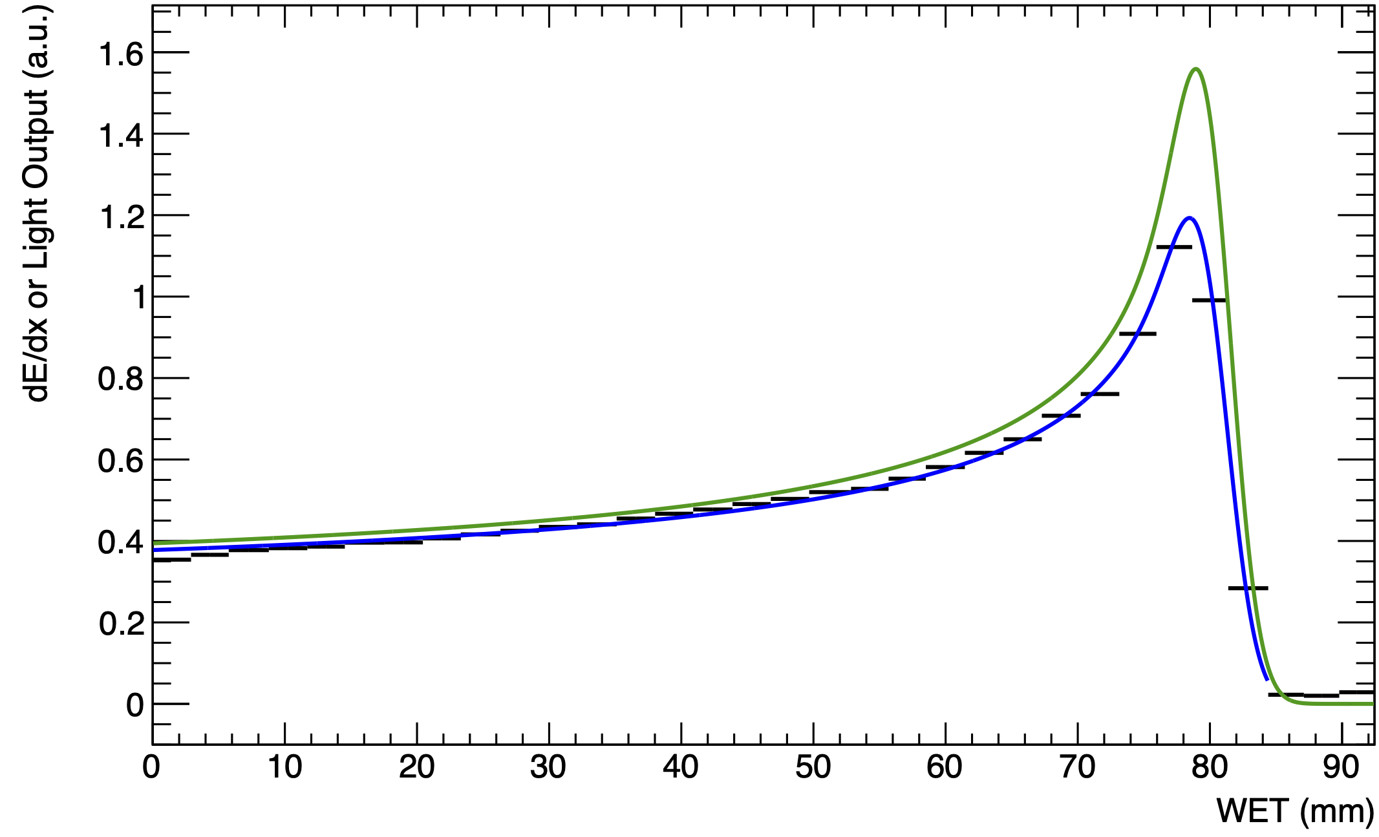
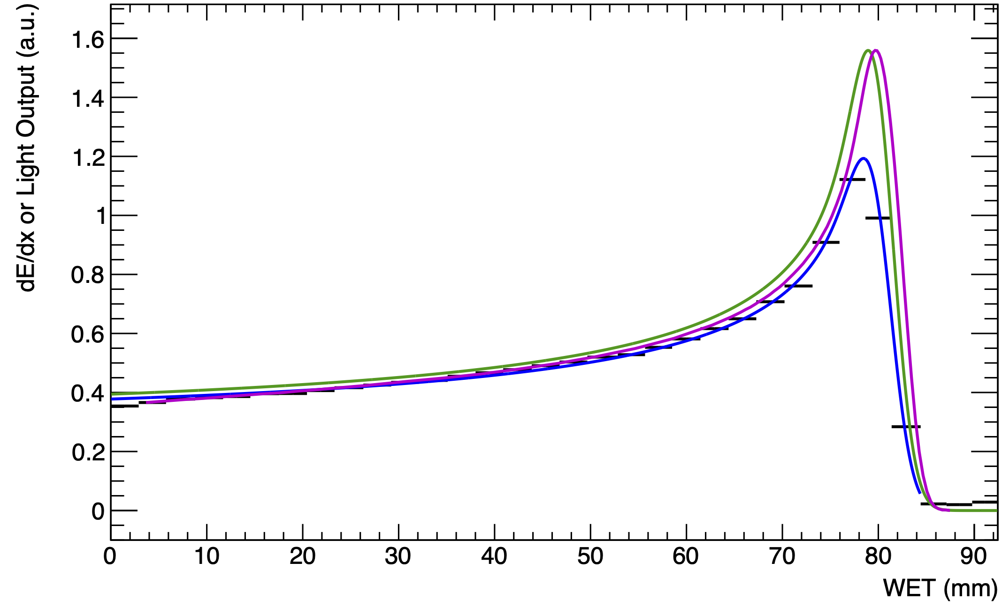
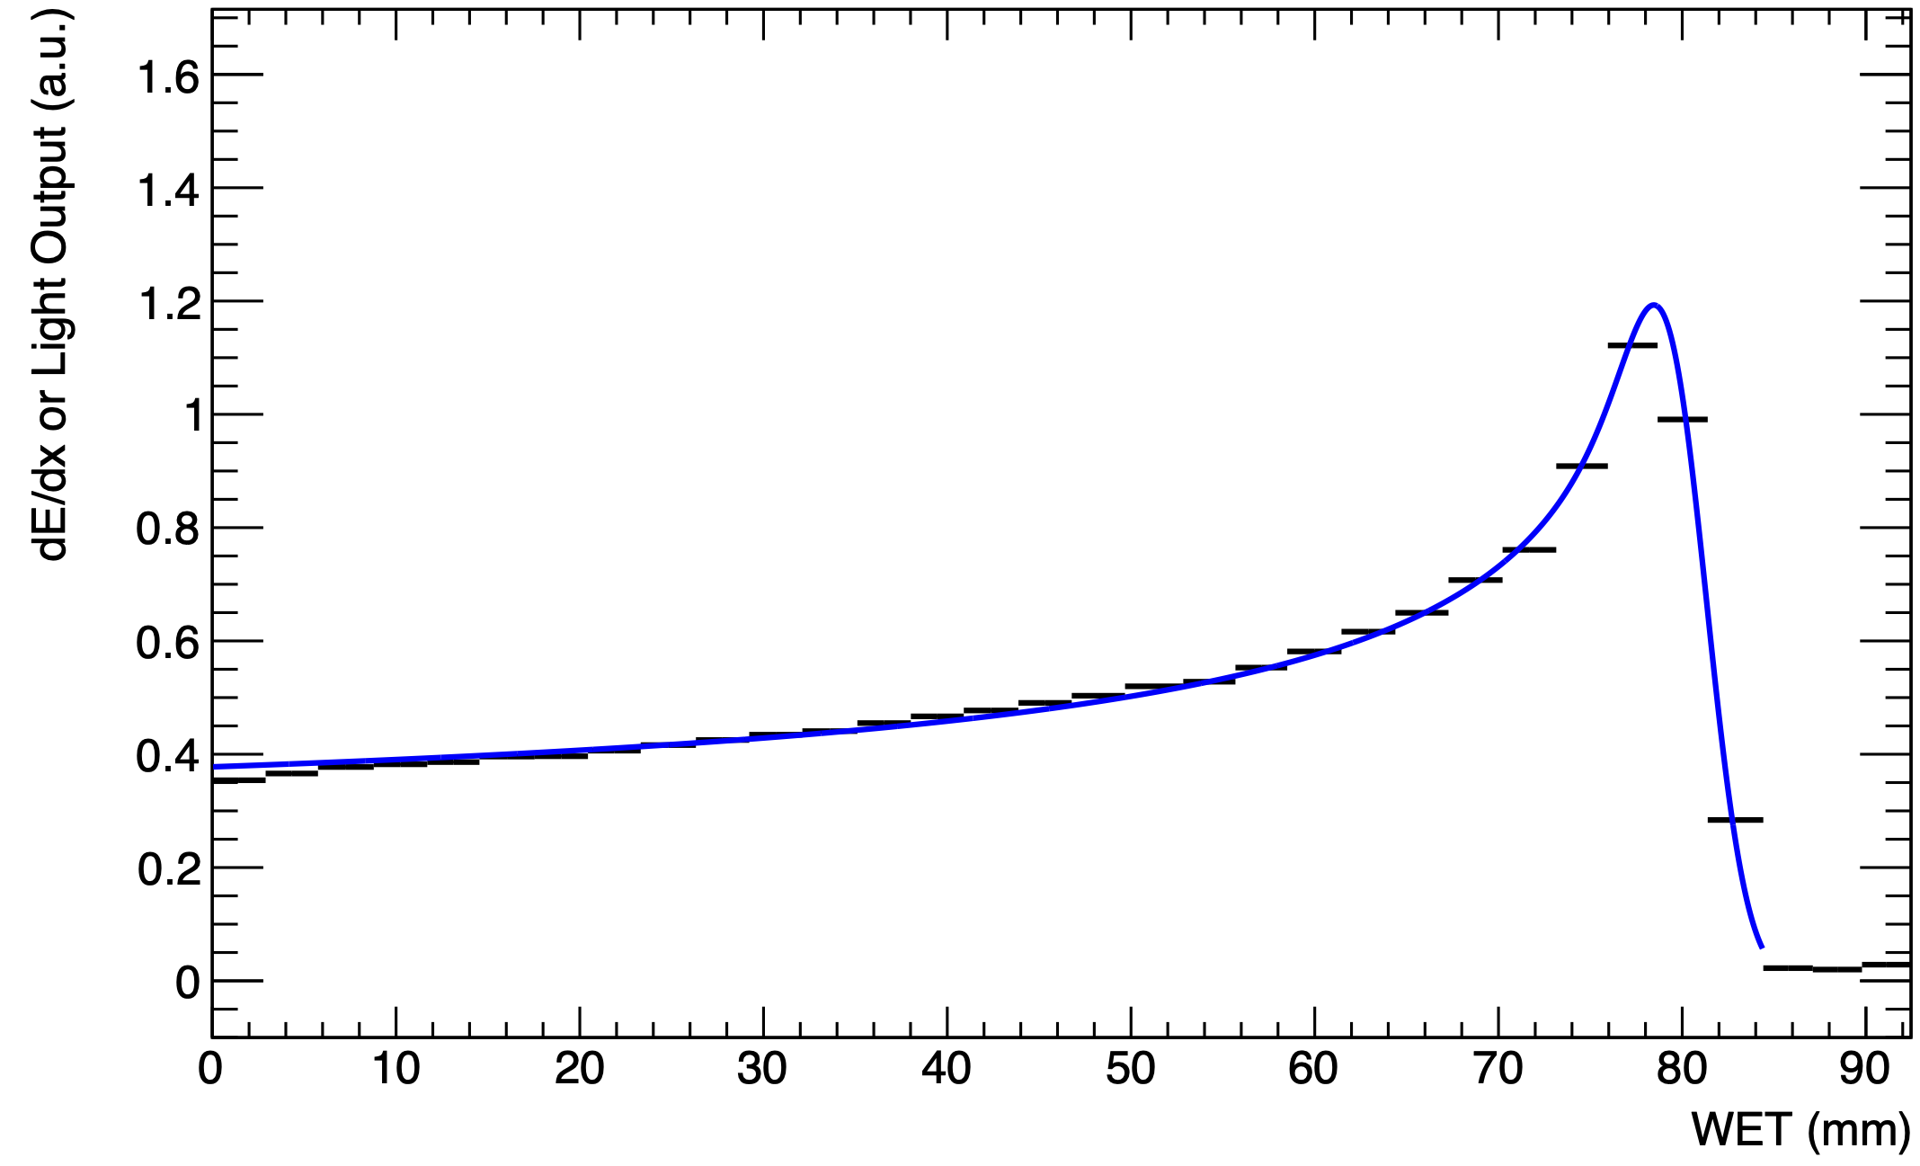
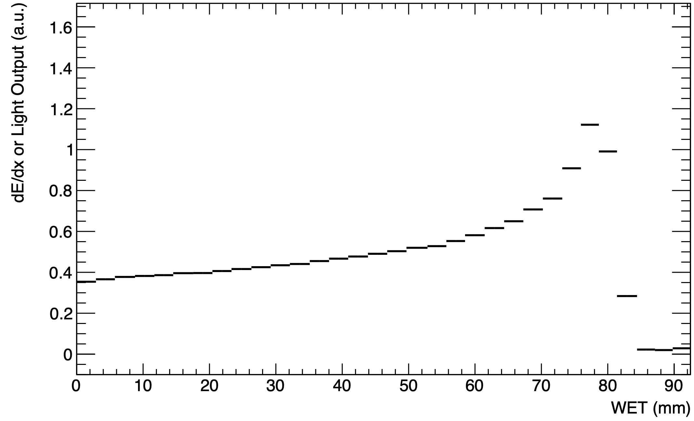
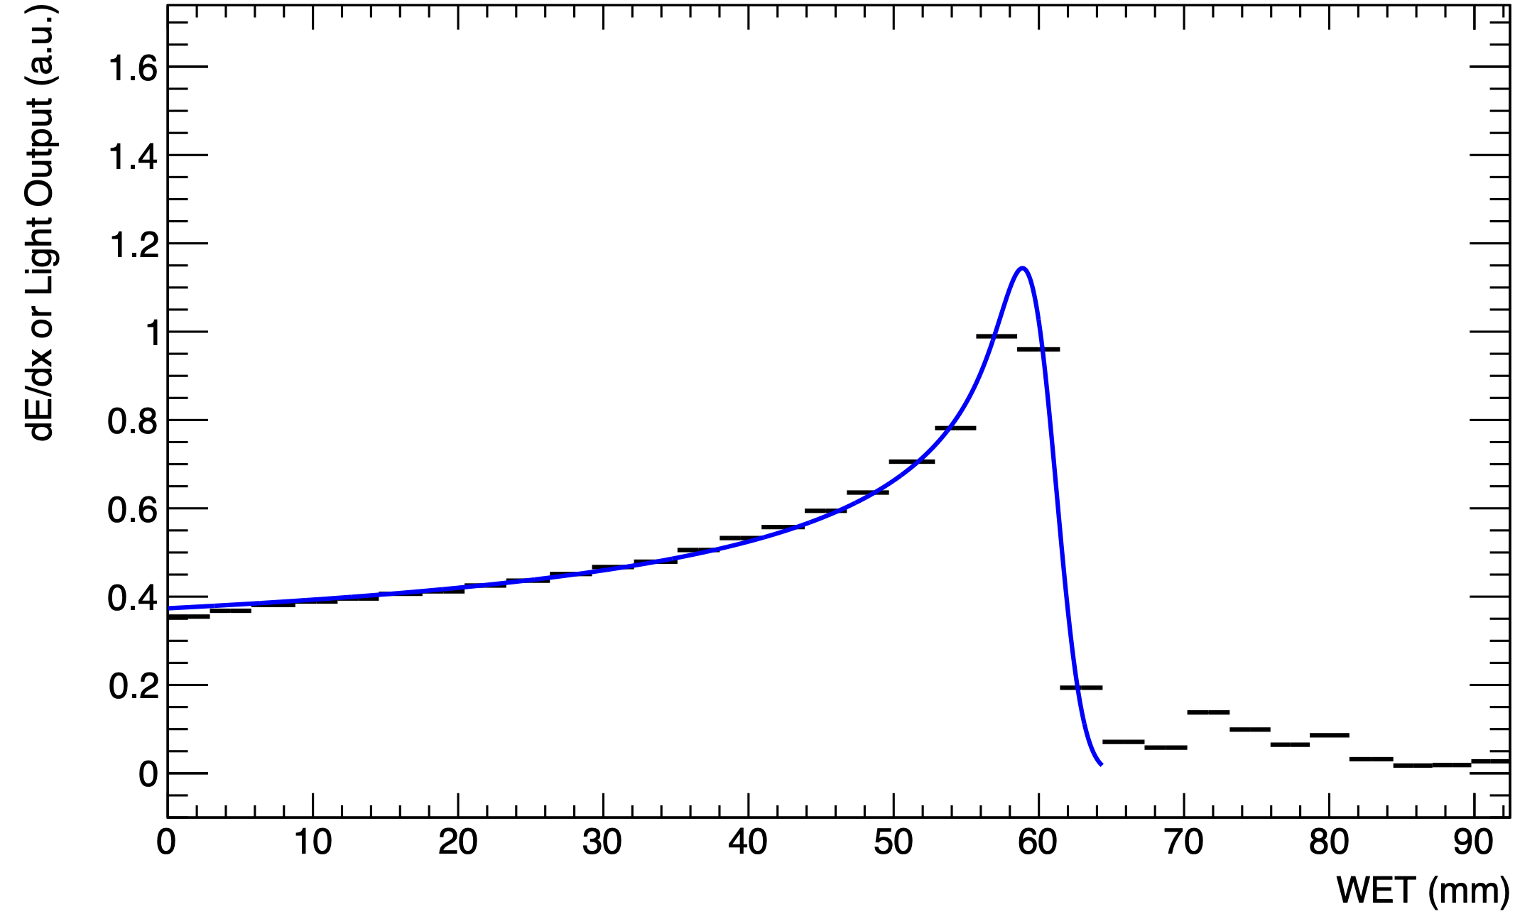
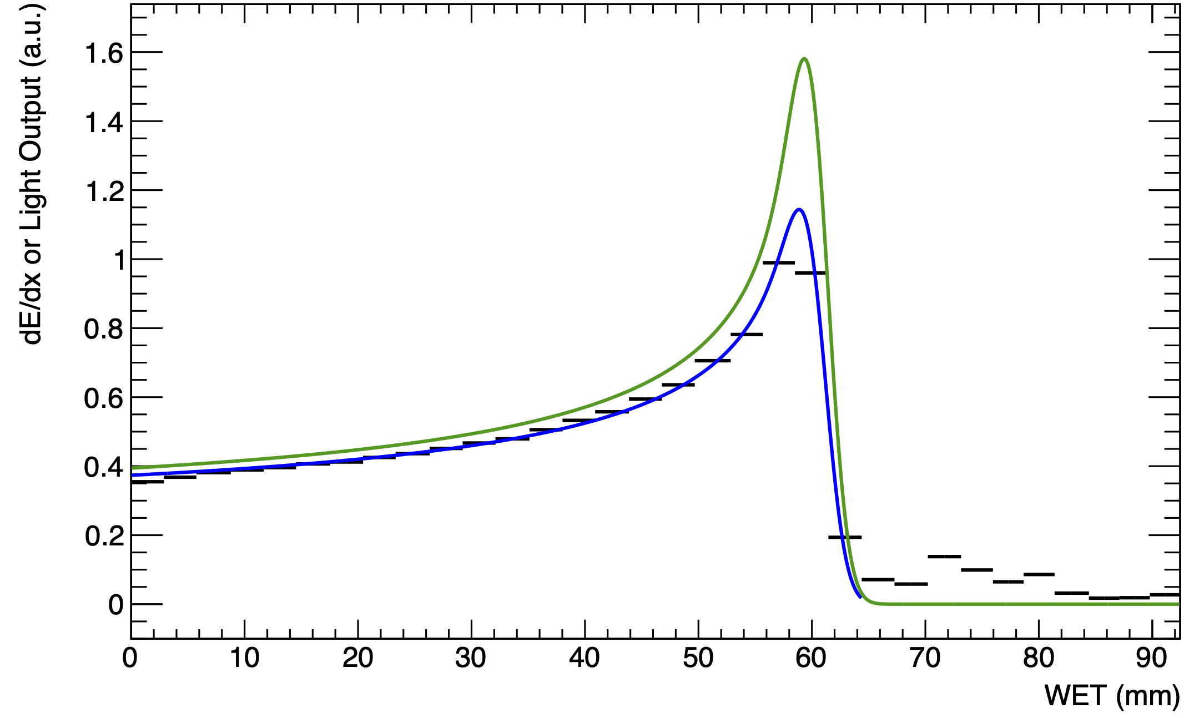
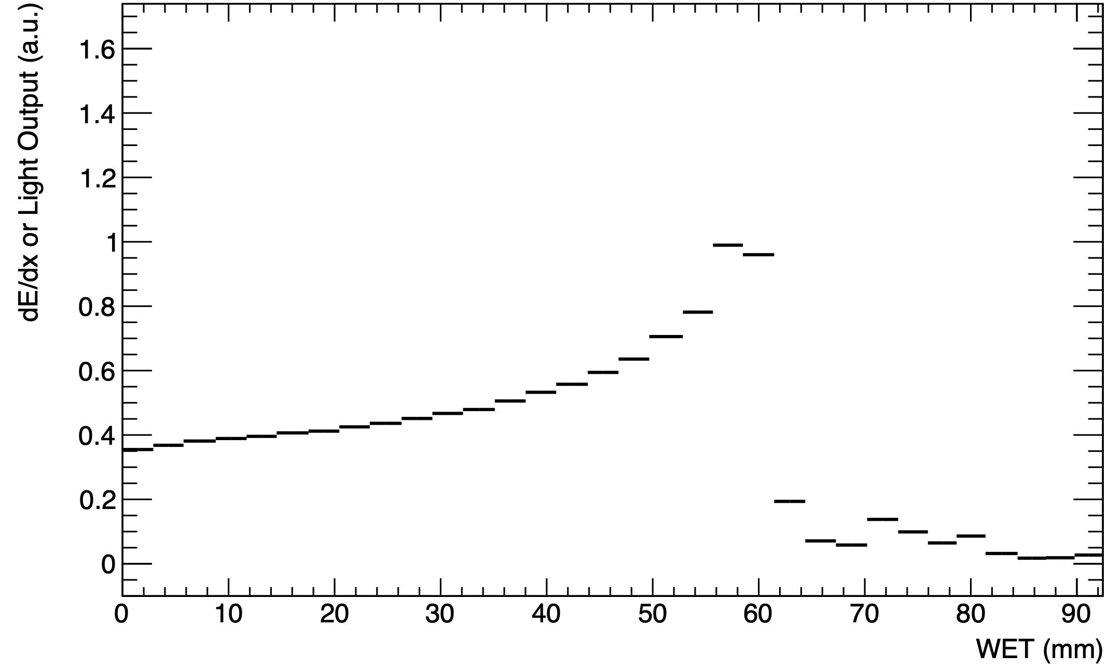
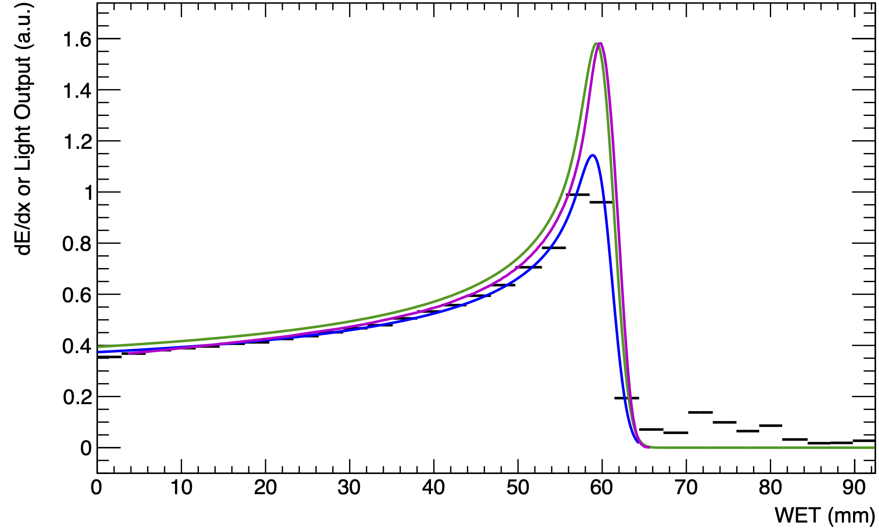
Results
105 MeV
Legend:
  Black: Sheet Average Light Output
  Blue: Fitted Quenched Depth-Light Curve
  Green: Reconstructed Depth-Dose Curve
  Magenta: UCLH Reference Dose Curve
Generally good fits, however, tend to underestimate range by about 0.5 mm.
Reconstructed range well despite poor signal-to-noise ratio.
  Light levels peak at 1% of total headroom.
  Background electronic noise after peak.
Water-Equivalent Thickness (mm)
UNPUBLISHED DATA – DO NOT COPY OR DISTRIBUTE
90 MeV
Water-Equivalent Thickness (mm)

Slide 7
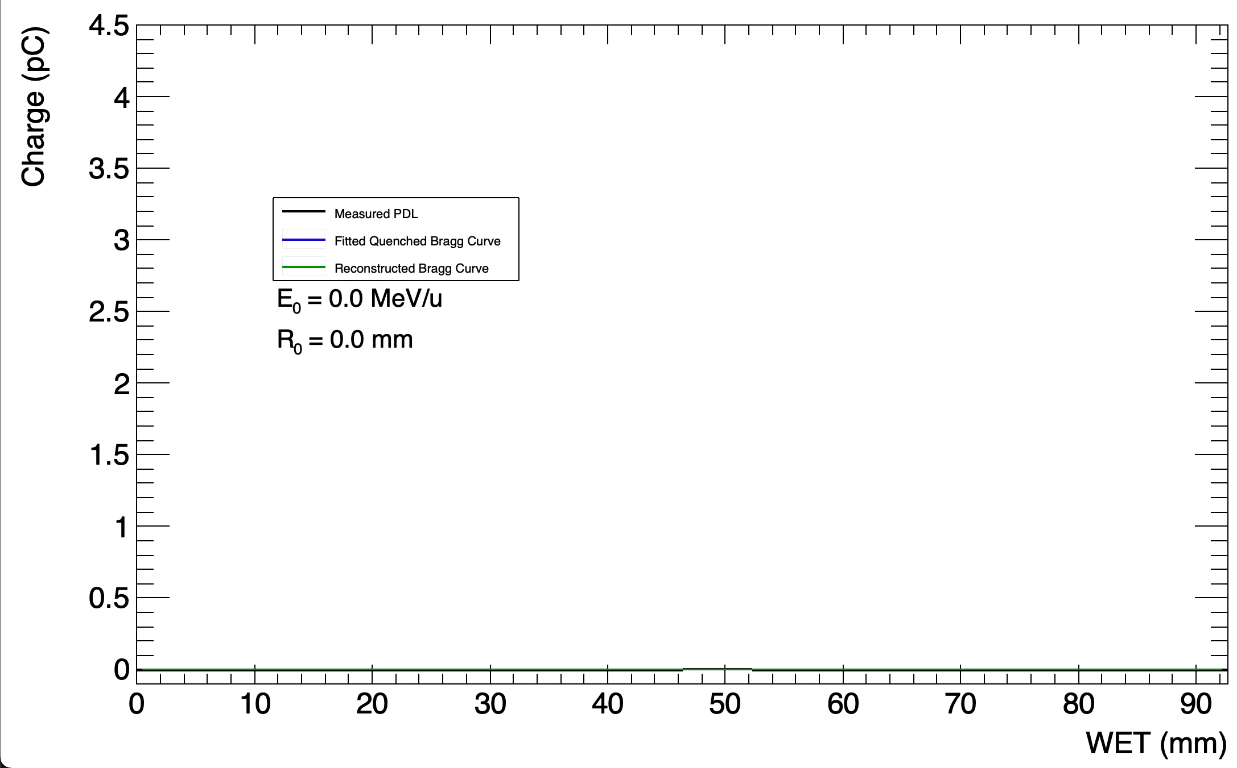
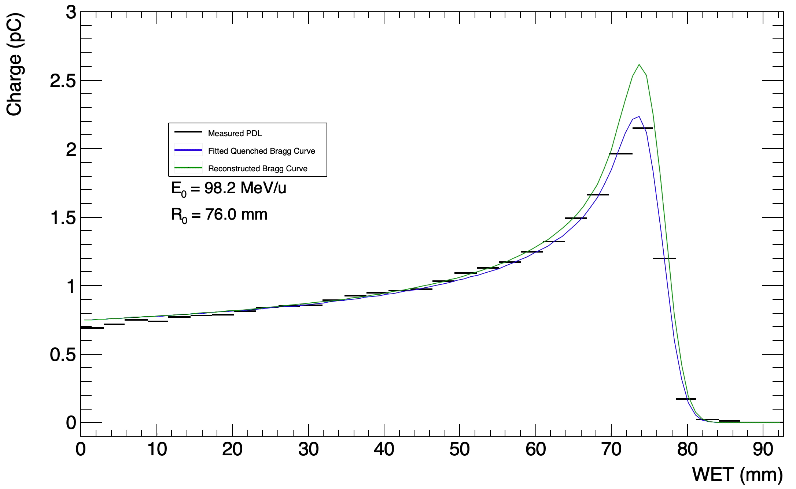
Live Fitting
RANGE-STEP “TREATMENT PLAN”
SINGLE-ENERGY PENCIL BEAM
UNPUBLISHED DATA – DO NOT COPY OR DISTRIBUTE

Slide 8
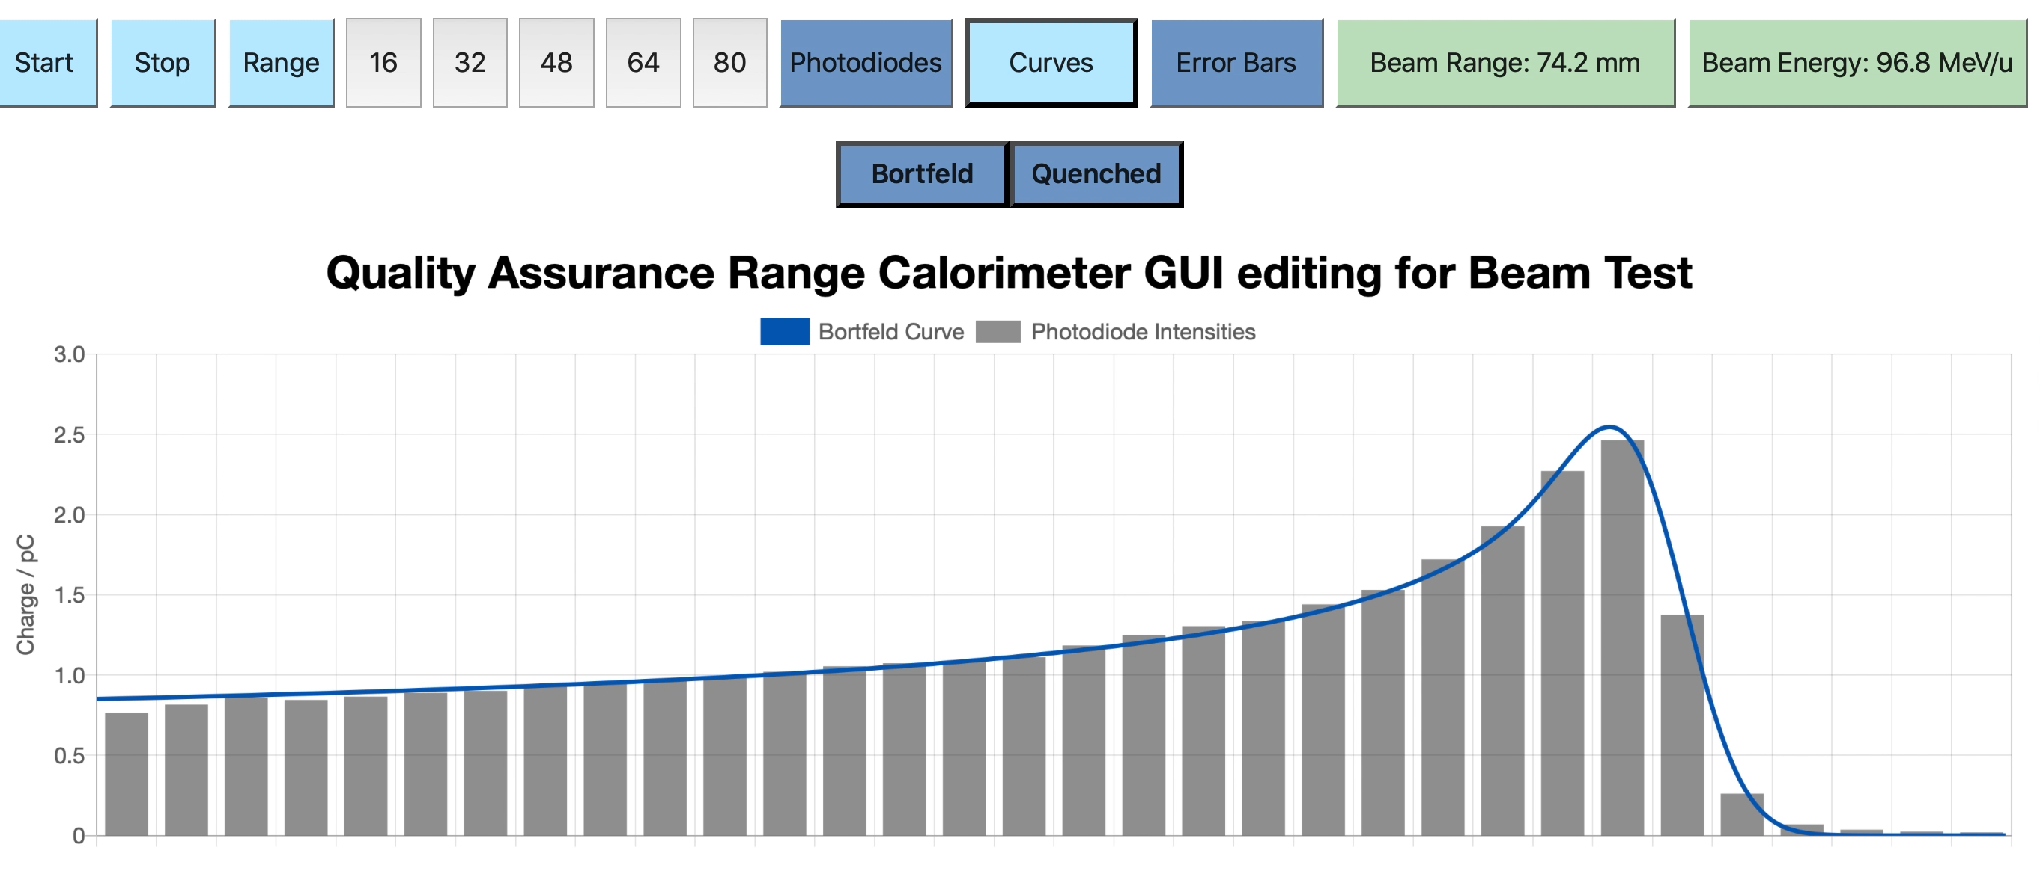
Web GUI
FPGA transfers data to PC, which performs fit using ROOT.
Provide simple display to view live fit results.
Detector hosts web-page on LAN, to allow any device on network to access live display.
Detector control soon to be implemented in GUI.
DEVELOPED IN JAVASCRIPT BY FERN PANNELL
UNPUBLISHED DATA – DO NOT COPY OR DISTRIBUTE

Slide 9
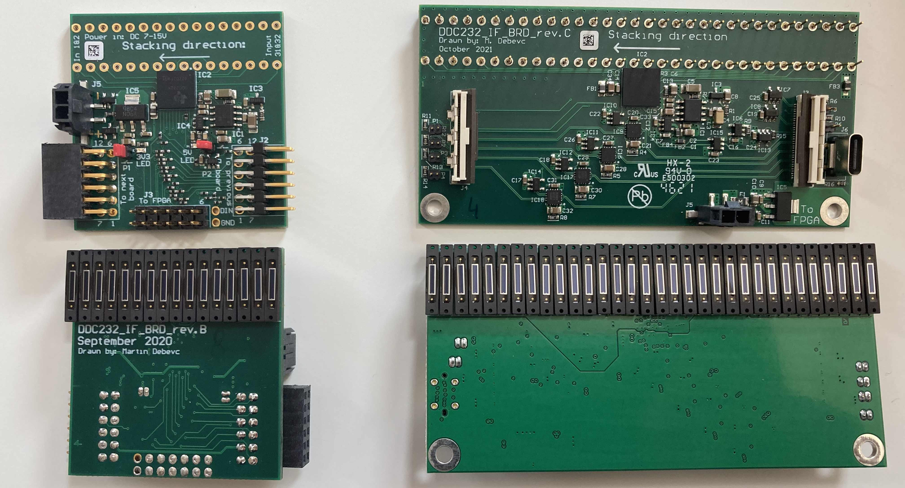
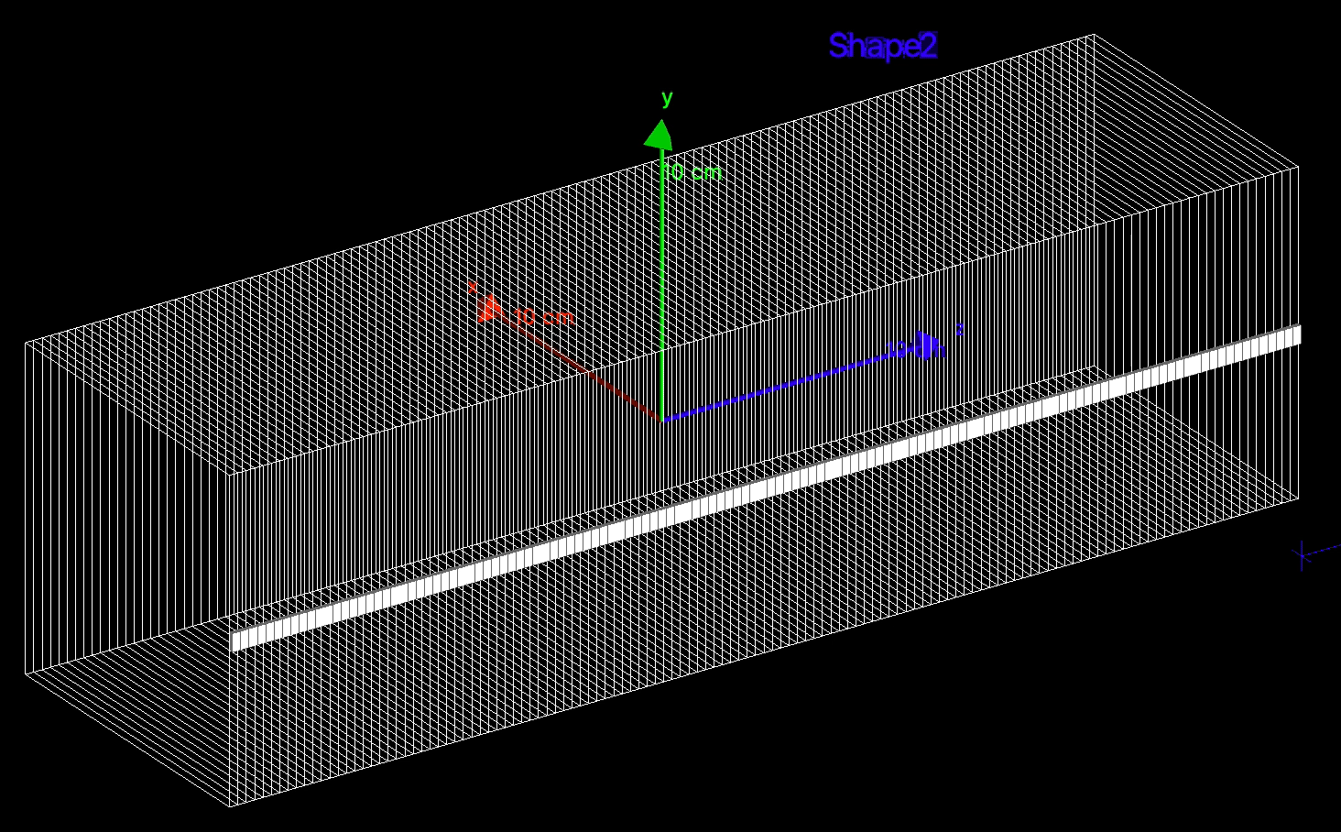
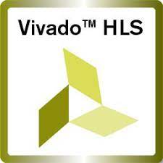
Conclusions & Next Steps
Detector able to reconstruct proton ranges at 40 Hz (between 70-110 MeV).
New version of photodiode ADC boards for improved signal integrity and daisy-chaining capabilities.
Further beam tests to optimise light output and characterise detector performance.
Detector simulation in GEANT4.
FPGA implementation of fitting routines.

Slide 10
Thank you for listening!
Questions?
https://www.hep.ucl.ac.uk/pbt/QuarcBuildAndTest.mp4
References:
L. Kelleter and S. Jolly. “A Mathematical Expression for Depth-Light Curves of Therapeutic Proton Beams in a Quenching Scintillator”. In: Medical Physics 47.5 (Feb. 2020), pp. 2300–2308. DOI: 10.1002/mp.14099
L. Kelleter et al. “A Scintillator-based Range Telescope for Particle Therapy”. In: Physics in Medicine & Biology 65.16 (Aug. 2020). DOI: 10.1088/1361-6560/ab9415.
S. Jolly et al. “Technical Challenges for FLASH Proton Therapy”. In Physica Medica 78 (2021). DOI: 10.1016/j.ejmp.2020.08.005

Slide 11
Backup Slides

Slide 12
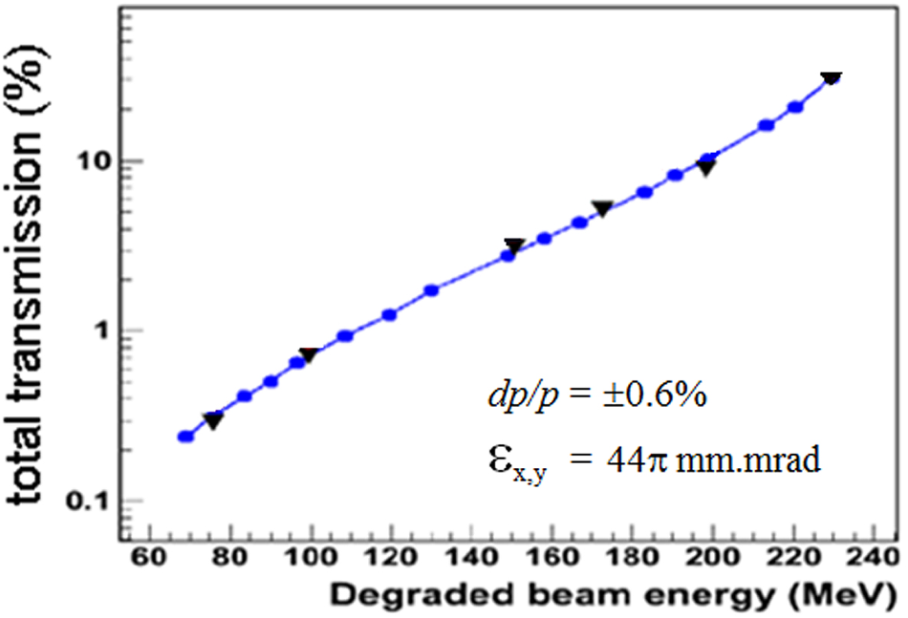
Scaling to FLASH
Actual dose-rate for FLASH not yet fully determined – most estimates around 40 Gy/s.
  Corresponds to a current of 600 nA to the patient.
Measurements made with clinical beam at UCLH around 300 nA beam current.
  Approx. 1% transmission ratio to treatment room.
Therefore, can expect 600/(300*1%) = 200 factor increase in scintillator light output.
  Light output scales linearly with dose-rate.
https://iopscience.iop.org/article/10.1088/0031-9155/61/14/N337

