Slide 1
HEPP & APP Annual Conference 2022
3rd – 6th April 2022
PlomBOX - development of a low-cost Complementary Metal-Oxide Semiconductor (CMOS) device for environmental monitoring
Adriana Dias
on behalf of TRACE collaboration

Slide 2
TRACE Collaboration
(Tools and Research to Assay Contamination in the Environment) [1]
Aguilar-Arevalo A.⁷, Alba Posse E.^{1,10}, Alvarez M.¹, Arnaldi H.², Asorey H.^{2,8}, Bertou X.², Colque A.¹, Deisting A.⁶, Dias A.^{6,*}, D'Olivo J.C.⁷, Favela-Pérez F.⁷, Gándola Y.¹, Garcés E. A.⁴, Gasulla J.^{1,9}, Gómez Berisso M.², González Muñoz A.⁴, Guerra-Pulido J. O.⁷, Gutierrez S.², Jois S.⁶, Lipovetzky J.², Lovera J.², Lovino M.B.², Marín-Lámbarri D.J.⁴, Marpegan L.², Martín D.¹, Martinez Montero M.⁷, Mejía Muñoz S.¹, Monroe J.⁶, Nadra A.^{1,10}, Paling S.⁵, Pregliasco R.², Rumi G.², Rossen A.³, Santos J.¹, Scovell P. R.⁵, Tallis M.², Teijeiro A.¹, Triana M.¹, Vázquez-Jáuregui E.⁴
¹ Universidad de Buenos Aires, Facultad de Ciencias Exactas y Naturales, Instituto de Biociencias, Biotecnología y Biología Traslacional (iB3), Argentina.
² Centro Atómico Bariloche and Instituto Balseiro, Comisión Nacional de Energía Atómica (CNEA), Consejo Nacional de Investigaciones Científicas y Técnicas (CONICET), Universidad Nacional de Cuyo (UNCUYO), Argentina
³ Laboratorio de Experimental de Tecnologías Sustentables. Centro de Tecnología del Uso del Agua. Instituto Nacional del Agua. Argentina
⁴ Instituto de Física, Universidad Nacional Autónoma de México, Mexico
⁵ Boulby Underground Laboratory. Science and Technology Facilities Council, England, United Kingdom
⁶ Royal Holloway. University of London, United Kingdom
⁷ Instituto de Ciencias Nucleares, Universidad Nacional Autónoma de México, México
⁸ Instituto de Tecnologías en Detección y Astropartículas, Comisión Nacional de Energía Atómica (CNEA), Consejo Nacional de Investigaciones Científicas y Técnicas (CONICET), Universidad Nacional de San Martín (UNSAM), Argentina
⁹ Centro de Investigaciones del Medio Ambiente (UNLP-CONICET), Argentina
¹⁰ Consejo Nacional de Investigaciones Científicas y Técnicas, Argentina
[1] https://plombox.org/aboutus/
Adriana Dias

Slide 3
Contents
Motivation
PlomBOX Set Up
Design of a Lead sensitive Bacterium
Optical Metrology Components (Data Acquisition)
Mobile Phone Application (Slow Control)
Field Evaluation
Summary and Future Steps
Adriana Dias

Slide 4
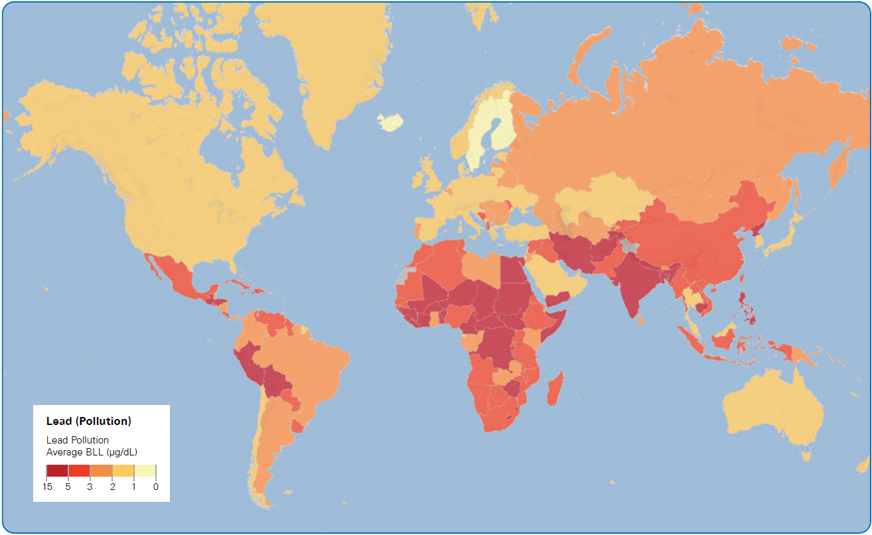
1. Motivation
26 million people are at risk of lead exposure in low- and middle-income countries [2].
World Health Organisation (WHO) has set an upper limit of 10ppb for lead in drinking water [3].
Children’s Average Blood Lead Levels by Country (μg/dL) [4]
GOAL : Develop PlomBOX, a low-cost sensor to measure the concentrations of lead in drinking water.
[2] Pure Earth. Fact Sheet: Lead. 2019. [accessed 04 February 2019]. URL: http://www.pureearth.org/fact-sheet-lead-2015/
[3] Geneva: World Health Organization. "Guidelines for drinking-water quality, 4th edition, incorporating the 1st addendum". WHO Library Cataloguing-in-Publication Data (2017). Licence: CCBY-NC-SA 3.0 IGO.
[4] Institute of Health Metrics and Evaluation (IHME) 2019
4
Adriana Dias

Slide 5
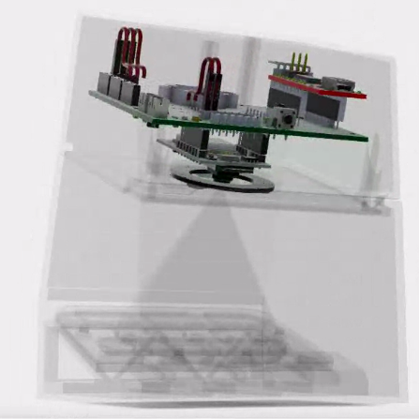
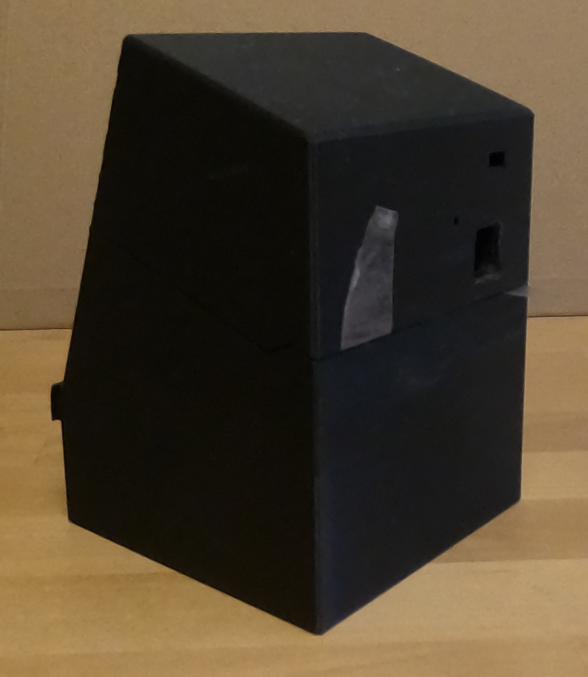
1. Motivation
2.
4.
3.
Wi-Fi
1.
1. Develop a genetically modified strain of Escherichia coli (E. coli), sensitive to lead concentrations up to WHO's limit
2. Develop optical metrology components (Data Acquisition System – DAQ), using a microprocessor module (ESP32) with a camera module
3. Develop a mobile phone application that works as the slow control for the sensor’s DAQ system. Develop server based data analysis
4. Integrate steps 1 and 2 into the PlomBOX casing
5
Adriana Dias

Slide 6
2.1. Design of lead sensitive Bacterium
This step involved:
Developing a genetically modified strain of E. coli sensitive to lead;
Developing a bacterial strain, with colourimetric reporter systems;
When bacteria comes in contact with lead, the reporter produces a signal
6
Adriana Dias

Slide 7
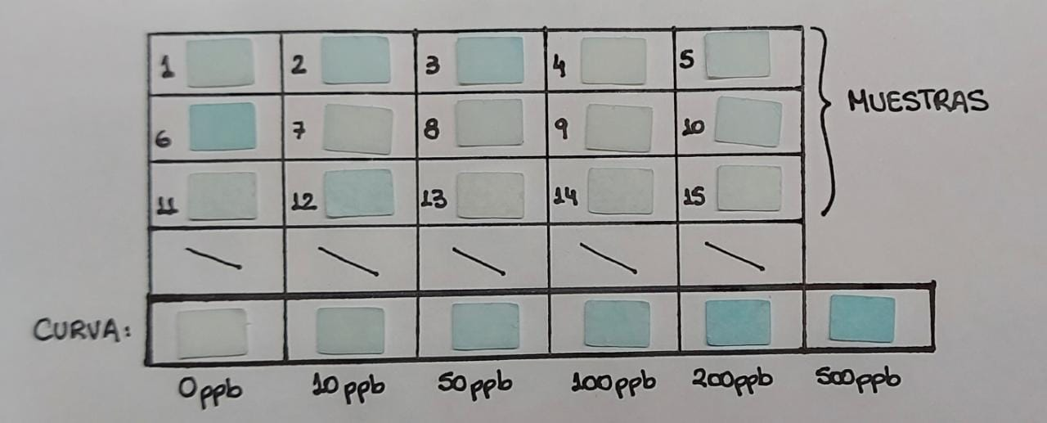
2.1. Design of lead sensitive Bacterium
Colourimetric reporter
Sample absorbs light and only emits one wavelength
Used β-galactosidase (β-gal) protein;
Higher intensity of blue colour represents higher concentration of lead in the water;
Currently improving measurements between 0 and 50 ppb – region relevant to WHO limit (10 ppb)
Muestras: 15 samples of bacteria reacting to unknown lead concentrations
Curva: Lead curve showing bacteria response from 0 to 500ppb
7
Adriana Dias

Slide 8
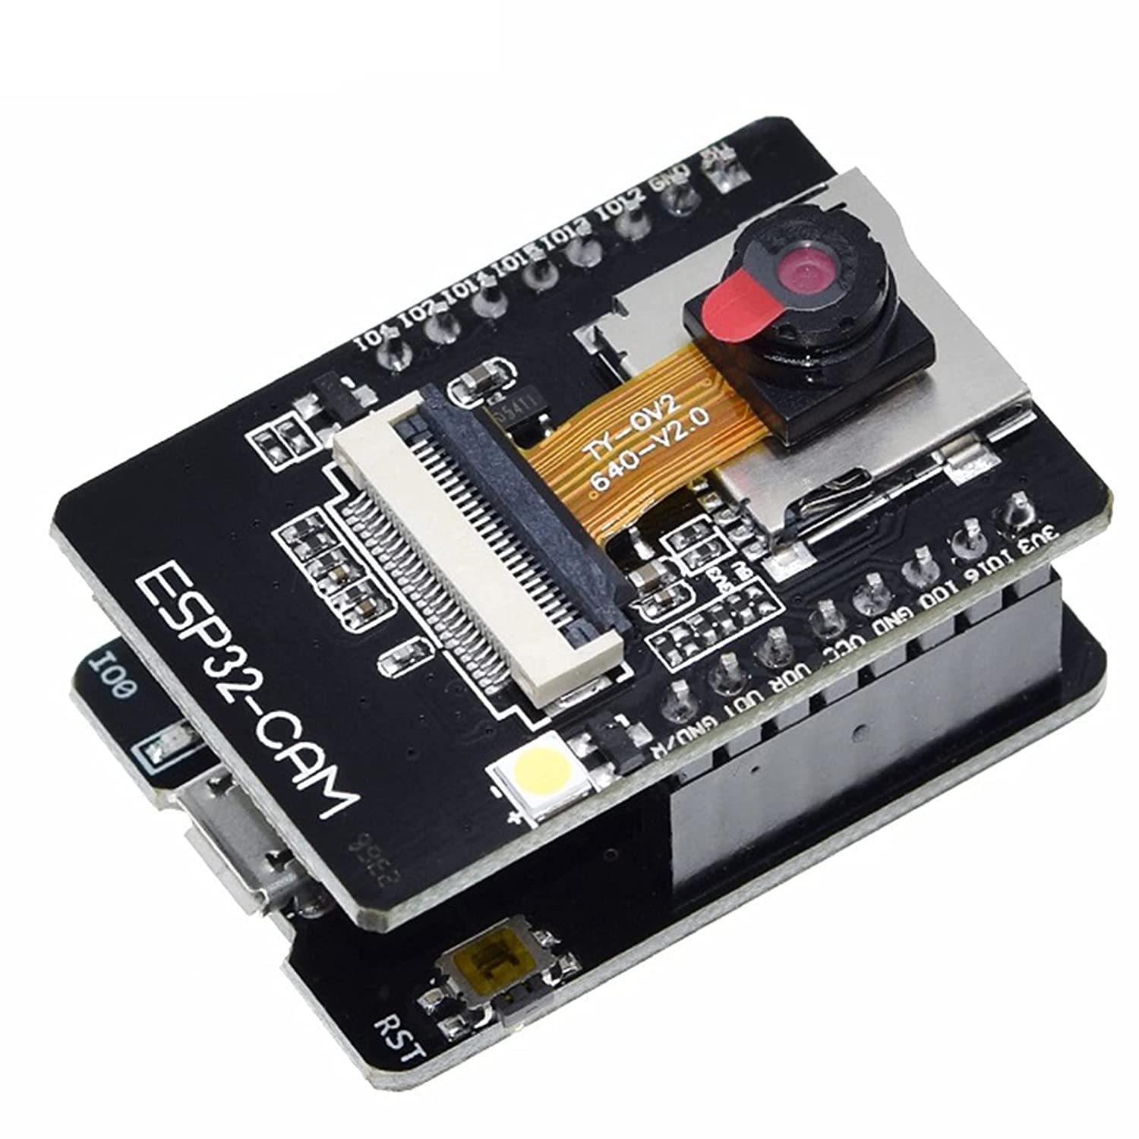
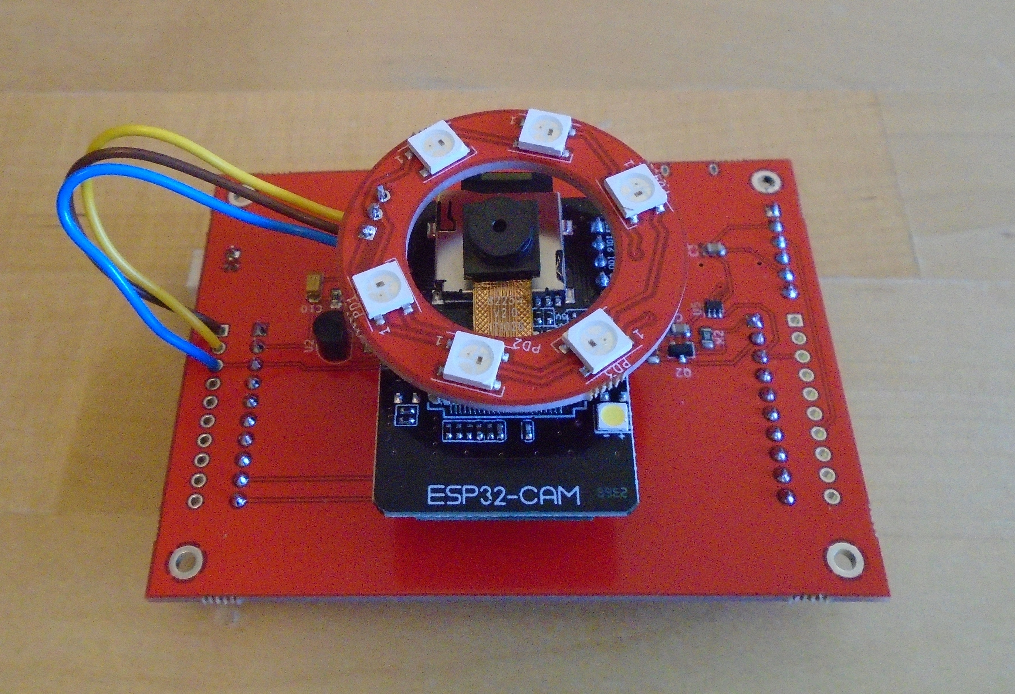
2.2. Optical Metrology Components (CMOS sensor)
This step involved:
Characterising commercial off-the-shelf detectors. Developing a simplified optical measurement system. The PlomBOX uses a microprocessor module (ESP32) coupled with a camera module.
Developing an embedded low-cost electronic system for the PlomBOX prototype, which is 3D printed
Left: ESP32-CAM device; Right: photo of the printed circuit board (PCB) and ESP32-CAM device, with light emitting diode (LED) for sample illumination
8
Adriana Dias

Slide 9
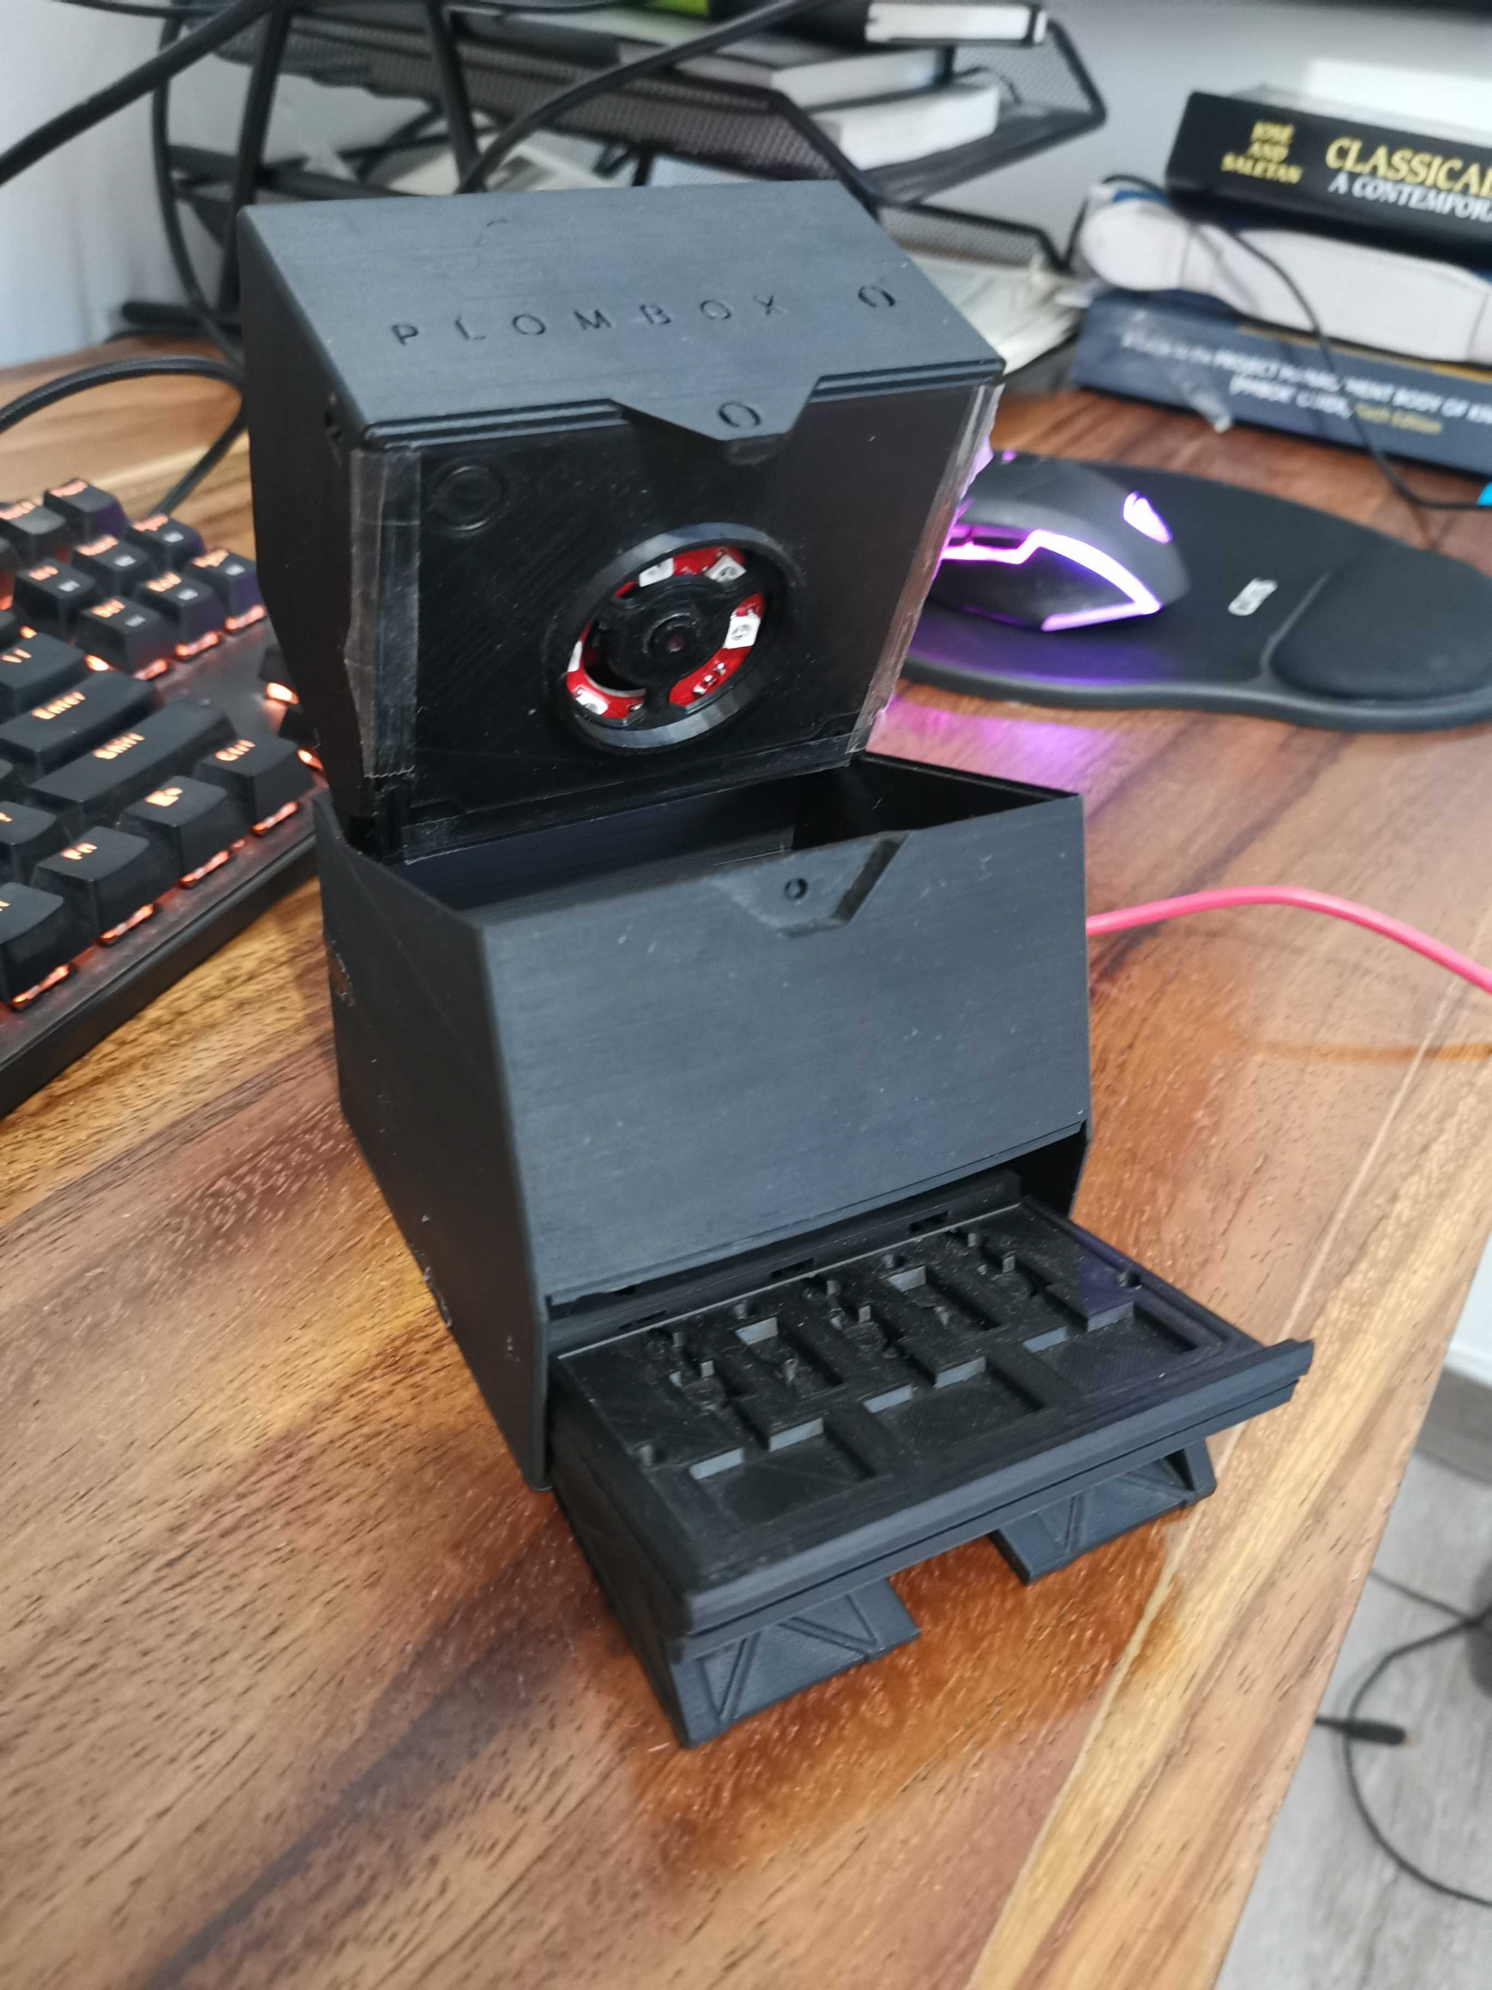
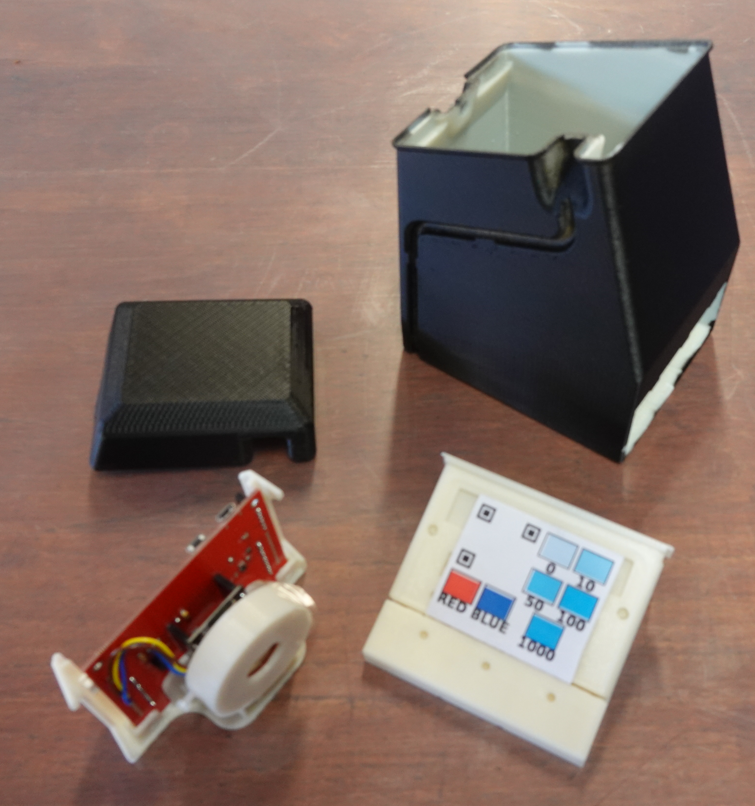
2.2. Optical Metrology Components (CMOS sensor)
PlomBOX casing designed to be 3D printed – aim to have drawings be open source
Boxes are printed using Acrylonitrile butadiene styrene (ABS) plastic
PCB and LED holder are separate from bacteria tray
Left: version 1 of the PlomBOX casing; Right: version 2 of the PlomBOX casing, with bacteria tray and PCB holder shown
9
Adriana Dias

Slide 10
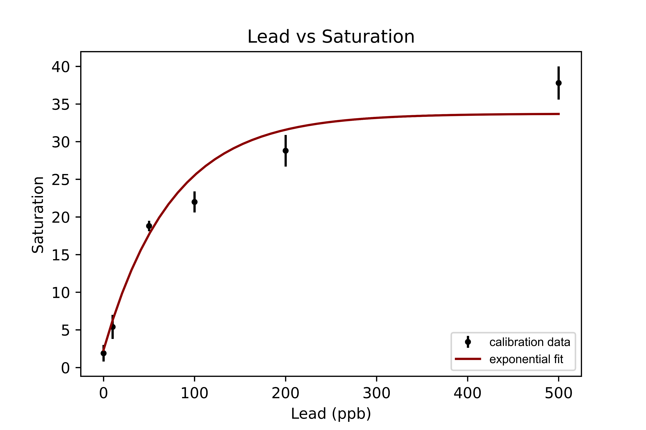
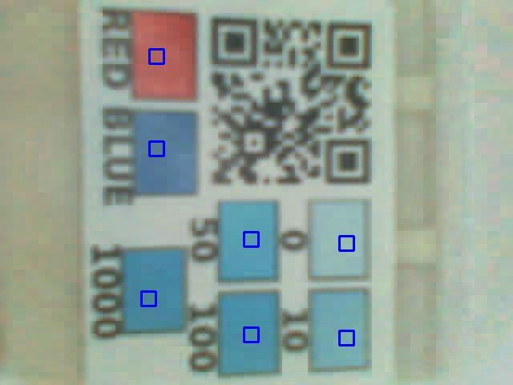
2.3. Mobile Phone Application (PlomApp)
This step involved:
Developing an Android Mobile Phone Application using Java and Android Studio
Wi-Fi
Wi-Fi
Red, Green, Blue (RGB) to Saturation, Hue, Value (SHV) conversion
9 ppb
10
Adriana Dias

Slide 11
2.3. Mobile Phone Application (PlomApp)
This step involved:
Developing an Android Mobile Phone Application using Java and Android Studio
Video showing PlomApp taking data and receiving SHV result from the server
11
Adriana Dias

Slide 12
3. Field evaluation - in situ water samples
/9j/4AAQSkZJRgABAQEBLAEsAA
PlomBOX project is collaborating with the National Institute of Water in Buenos Aires
Five home’s water supplies were assayed in Buenos Aires in December 2021
Lead concentration was analysed through Atomic Absorption Spectrophotometry, with results to be compared with PlomBOX’s bacteria response
12
Adriana Dias

Slide 13
4. Summary and Future Steps
Different bacteria constructions show that a measurement of lead concentration can be made in the WHO relevant concentration range by a colourimetric change of genetically modified bacteria.
A low-cost electronic metrology system using a ESP32-CAM module has been developed which is inexpensive yet powerful, to undertake all data acquisition functions
A mobile phone application, PlomApp, was developed to work as the slow control of the PlomBOX, whilst requiring minimum user input
We still aim to:
Integrate the PlomBOX elements in a final prototype
Calibrate water sample results using conventional chemistry led assay devices, as well as Particle Physics precision techniques such as Germanium and Inductively Coupled Plasma Mass Spectrometry (ICP-MS) detectors
13
Adriana Dias

Slide 14
Thank you for your attention!
Adriana Dias
adriana.dias.2011@live.rhul.ac.uk
linkedin.com/in/adriana-dias-5945129b/
Research funded by STFC Global Challenges Research Fund (Foundation Awards, Grant 588 ST/R002908/1) , by DGAPA UNAM grants PAPIIT-IT100420 and PAPIIT-IN108020, by CONACyT grants 589 CB-240666 and A1-S-8960 and by EPSRC GCRF Research Translation Award EP/T015586/1

