Slide 1
Performance and Upgrade of the CMS Electromagnetic Calorimeter
Charlotte Cooke
University of Bristol and Rutherford Appleton Laboratory

Slide 2
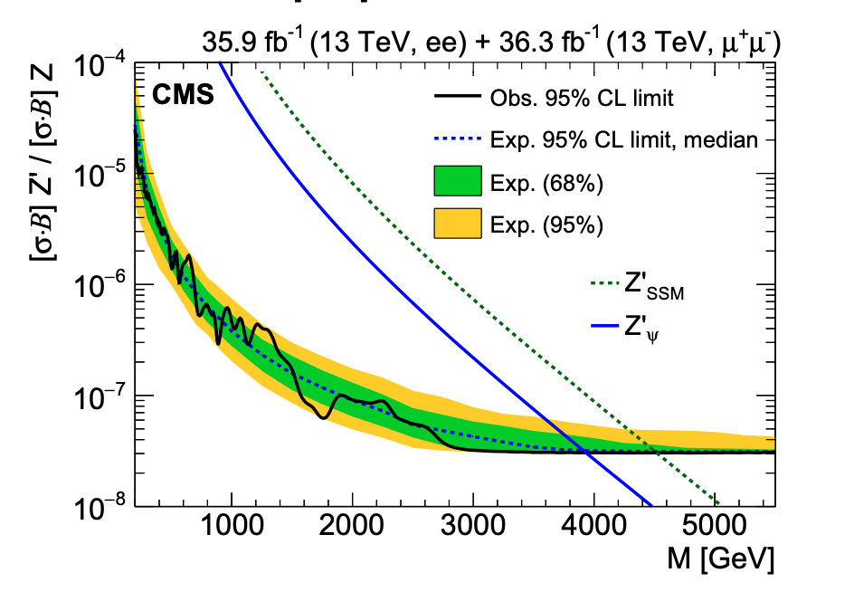
Introduction
Lead tungstate (PbWO₄) crystal calorimeter
Provides excellent energy resolution
In harsh radiation environment
Over a wide range of energies from O(100 MeV) to O(1 TeV)
Achieved 1% mass resolution for low-mass Higgs in γγ decay channel
My work specifically concerns the Z’ search – looking for new high mass resonances decaying to two leptons
CMS requires electron candidates to pass a set of dedicated high energy electron criteria (HEEP ID)
The upper limits (95% CL) on the product of production cross section and branching fraction for a spin-1 resonance with a width equal to 0.6% of the resonance mass.
From JHEP 06 (2018) 120
arXiv:1803.06292
endcap
barrel supermodule
Notes:
In Run 2, CMS was able to place a mass limit on spin-1 Z’_{SSM} of 4.50 TeV (95% CL) using both the dielectron and dimuon channels.
Hermetic and compact detector with coverage up to |η| = 3.0
Barrel region:
Contains 61,200 crystals
Uses avalanche photodiodes as photodetectors
Endcap region:
Contains 14,648 in 4 half-disk “Dees”
Uses vacuum phototriodes

Slide 3
High Energy Electron Positron (HEEP) ID
Aim: check if “ultra legacy” (better calibrated) Run 2 (2015-2018) data improves efficiency and data/MC agreement
HEEP ID basics:
Simple, robust ID
Subdetector based rather than particle flow
Uses information from ECAL, HCAL and tracker
Requires that the lateral spread of energy deposits in the ECAL is consistent with that of a single electron and that the track is matched to the ECAL deposit
Notes:
Only the first longitudinal depth is used for the HCAL isolation, because the second one suffered from higher detector noise.
Sigma ietaieta etc are shower shape variables. Disabled if a saturated crystal is within the 5x5 crystal matrix
Dxy – impact parameter relative to the centre of the luminous region in the transverse plane

Slide 4
HEEP ID Efficiency Method
Tag and Probe Criteria
Additional Considerations
Using Z->ee events
Tag passes HEEP ID V7.0
Tag is a barrel electron
Tag is matched to a 32 GeV electron trigger
Probe passes the acceptance criteria ($η_{SC}$ and E_{T}) of the HEEP ID
The invariant mass of the tag and probe is in the window 70<M(ee)<110 GeV/c²
All possible combinations of tag and probe in an event are selected
MC reweighted according to trigger turn on curve, pileup and cross section
Jets estimated from data looking at same sign pairs failing the HEEP ID
CMS standard scale and smearing corrections are applied to match MC to data
Efficiency defined as
$$ε=\frac{N_{passing probes}}{N_{all probes}}$$

Slide 5
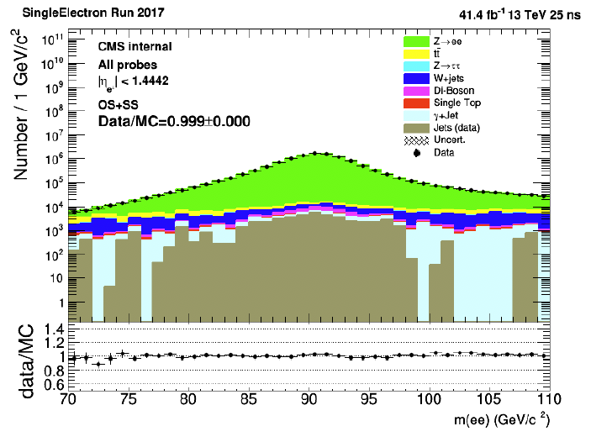
HEEP ID using Ultra Legacy Data (Barrel)
Number / 1 GeV/c²
M(ee) (GeV/c²)
2017 end of year calibration (EOY)
2017 ultra legacy calibration (UL)
Work in progress
Notes:
Note Z->ee and Z->mu mu combined on RH plot

Slide 6
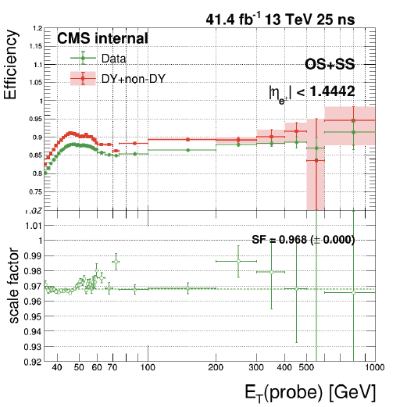
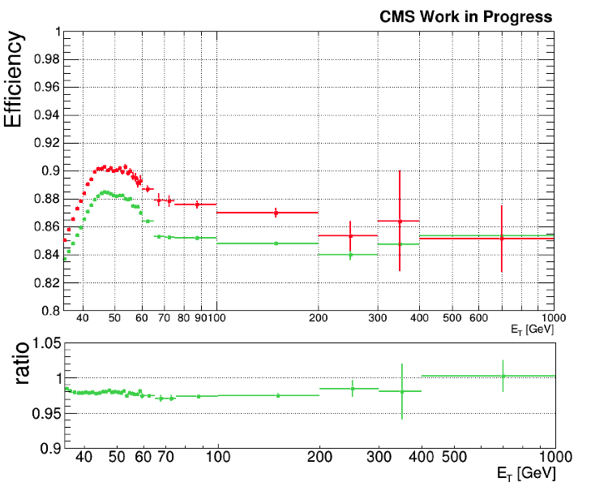
HEEP ID using Ultra Legacy Data (Barrel)
2017 end of year calibration (EOY)
2017 ultra legacy calibration (UL)
Work in progress
Notes:
Flatter scale factor with UL than had with EOY
Very close to 1 in largest Et bin

Slide 7
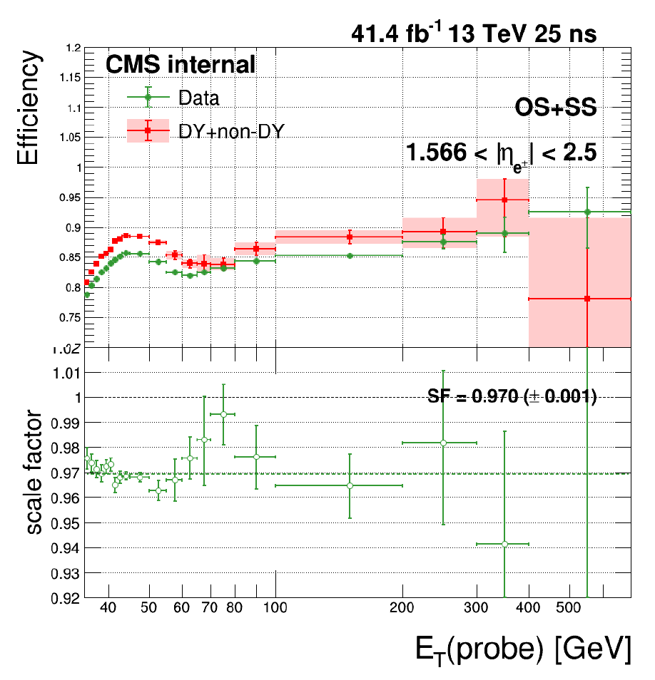
HEEP ID using Ultra Legacy Data (Endcap)
2017 end of year calibration (EOY)
2017 ultra legacy calibration (UL)
Work in progress
Notes:
Better agreement – particularly at low up to peak and in last bin

Slide 8
Phase II ECAL Upgrade Overview
Refurbish ECAL barrel supermodules during Long Shutdown 3 (2026-2028)
Keep the lead tungstate crystals in the barrel
Reduce temperature from 18^{O}C to 9^{O}C to keep noise below 250 MeV
Replace the on and off detector electronics
Maintain performance from Phase I and meet trigger requirements
Use new radiation hard ASICS
Factor of 4 increase in sampling rate (160 MHz) to meet Phase II trigger requirements
$\sim$30 ps timing resolution
Single crystal info to trigger
More advanced algorithms in off detector FPGAs
Notes:
Need to upgrade the ECAL to maintain it’s current efficiency, resolution and background rejection.
Will be replacing the endcaps with HGCAL due to significant radiation damage over the course of Phase I
The barrel has not suffered the same level of radiation damage, so the lead tungstate crystals will stay for Phase II
Both the on and off detector electronics will be replaced
New, radiation hard ASICs will provide a factor of 4 increase in sampling rate, bringing it up to 160 MHz.

Slide 9
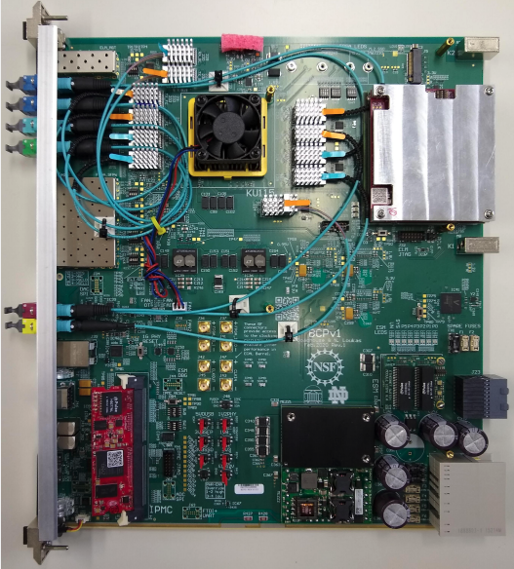
Trigger Primitive Algorithms
FPGA (KU115)
Algorithms include:
Spike rejection
Pulse shape and Swiss-cross
Conversion of digitized pulse data into transverse energy
Precise timing measurement
Basic clustering of localised energy
TP encoding and shipping to L1 trigger system
Generation and transmission of clock and control signals to the FE
I work on the algorithms in bold which are being developed in high level synthesis (HLS)
Embedded
Linux
Mezzanine
(ZYNC)
FireFly
optics
1 Gb
ethernet
switch
IMPC (ZYNC)
BCP V1

Slide 10
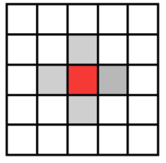
Swiss Cross and Pulse Shape
Spike: anomalous APD signal caused by direct impact on photodiode
Swiss cross:
Previously used offline and in high level trigger
Uses the swiss cross variable $(1−E_{4}/E_{1})$
Pulse Shape:
Uses a linear discriminant variable to distinguish between EM showers and spikes
Tested 300 channels in software and 72 channels on hardware
Cut placed at 0.95 separates spikes and EM showers with high efficiency
From: the Phase-2 Upgrade of the CMS Barrel Calorimeters TDR
Resource estimates for KU115 FGPA
 | DSP | FF | LUT
Utilisation (%) | 16 | 8 | 13

Slide 11
Algorithm Testing
We have developed a software framework to test HLS algorithms in CMS simulation and reconstruction framework against C++ counterparts
Using test beam data with prototype Phase II electronics
Validation plots allow for a quick and easy comparison of the two algorithms
Variables checked are:
Pulse shape spike flag
Swiss cross spike flag
Number of clusters
Cluster eta
Cluster phi
Cluster Et
Number of crystals in a cluster
CMS Work in Progress
Events
Plot showing difference in Et between HLS and C++ due to overflow in HLS algorithm (now fixed)
Difference in Et (ADC Counts)
Notes:
Not yet possible to test algorithms on BCPs
C++ code written independently – not just comparing apples and apples

Slide 12
Clustering Algorithm
Test beam studies found a 3x3 cluster provides good resolution for EM showers
Can use same 3x3 crystal region as swiss cross
Clustering requirements:
Seed has a greater Et than any crystals it shares a side with (corners not considered)
Seed Et > 0.25 GeV
Seed is not an pulse shape spike
CMS Work in Progress
2018 ECAL Test Beam

Slide 13
Clustering Algorithm
Tested in software with no discrepancies in over 50000 events from 2018 ECAL test beam
Hardware test (with swiss cross) planned for this summer
CMS Work in Progress
CMS Work in Progress
Difference in Eta (crystals)
Difference in Et

Slide 14
Conclusion and Next Steps
HEEP ID
UL performance similar to that seen in EOY
Scale factor observed to be flat vs Et
ID needs to be verified at start of run 3
Due to upgraded HCAL and pixel detectors, new calibrations and alignment
Algorithms
First versions of algorithms tested and working
Further software and hardware tests of HLS algorithms, including the use of more recent test beam data
Further optimisation to reduce resource usage

Slide 15
Backup Slides

Slide 16
High Energy Electron Positron (HEEP) ID
Variable | Barrel | Endcap
E_{T} | > 35 GeV | > 35 GeV
η range | |η_{sc}|< 1.4442 | 1.566<|η_{sc}|< 2.5
isEcalDriven | =1 | =1
|Δη_{in}^{seed}| | < 0.004 | < 0.006
|Δφ_{in}| | < 0.06 | < 0.06
H/E | < 1/E + 0.05 | < 5/E + 0.05
full 5x5 σ_{iηiη} | n/a | <0.03
full 5x5 E^{2x5}/E^{5x5} | > 0.94 OR E^{1x5}/E^{5x5} > 0.83 | n/a
EM + Had Depth 1 Isolation | <2+0.03*Et +0.28*rho | < 2.5 +0.28*rho for Et<50 else < 2.5+0.03*(Et-50) +0.28*rho
Track Isol: Trk Pt | <5 | <5
Inner Layer Lost Hits | <=1 | <=1
|dxy| | <0.02 | <0.05
Aim: check if “ultra legacy” (better calibrated) Run 2 (2015-2018) data improves efficiency and data/MC agreement
HEEP ID basics:
Simple, robust ID
Subdetector based rather than particle flow
Uses information from ECAL, HCAL and tracker
Requires that the lateral spread of energy deposits in the ECAL is consistent with that of a single electron and that the track is matched to the ECAL deposit
Notes:
Only the first longitudinal depth is used for the HCAL isolation, because the second one suffered from higher detector noise.
Sigma ietaieta etc are shower shape variables. Disabled if a saturated crystal is within the 5x5 crystal matrix
Dxy – impact parameter relative to the centre of the luminous region in the transverse plane

Slide 17
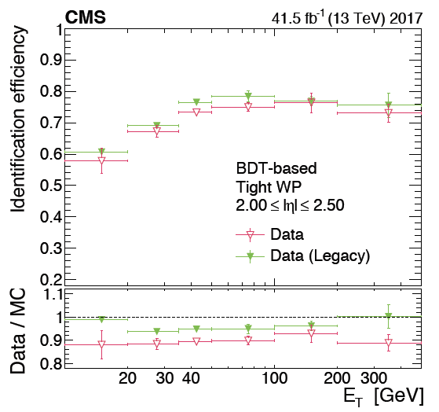
Ultra Legacy Data
Recalibrated ECAL using Run 2 data
Well known resonances of $π_{0}$ and Z were used calibrate crystals on a per year basis
Evaluating impact of UL calibration on Z' analysis:
UL provides better electron energy resolution, especially in forward region
UL may also improve HEEP ID efficiency and data/MC agreement
Tight BDT-based electron identification efficiency (upper panel) and data-to simulation correction factors (lower panel)
From arXiv:2012.06888
Dielectron mass resolution from Z -> ee events
From arXiv:2012.06888

Slide 18
32 GeV Electron High Level Trigger Turn on Curve for Run D
CMS Work in Progress
- Barrel
- Endcap

Slide 19
Jets
Jets can be misidentified as electrons or protons
This background is calculated using a data driven method
P(jet misIDed as electron) $≈$ P(jet misIDed as positron)
Same sign and opposite sign have same number of events and topographical features
Shape and normalisation of SS region can be used to calculate the shape and normalisation of the SS+OS region
Notes:
In reality, there is a small bias towards positively charged jets due to the LHC being a proton-proton collider, but this study is not sensitive to this effect.)

Slide 20
Jets – SS Method
Start from tag and probe pairs in data with the same requirements as detailed in the section above
Require same sign pairs
Require that probe fails the HEEP ID
Subtract all MC from the data, with the MC also having the same sign and probe failing HEEP ID requirement. In any cases where the MC is greater than the data, set that bin value to 0.
Multiply this result by two to account for both the same sign and opposite region to jets
Attribute this result to jets

Slide 21
Scales and Smearings
Due to imperfections in the MC simulation, there are small differences between the data and MC for both their resolution and response.
The data also has conditions that vary over time, causing a slight change in response while the MC conditions are static. To correct for both of these effects, energy corrections known as scale and smearing are applied.
Scaling:
Data scaled to match MC response
Dependent on run, eta and shower shape
Smearing:
MC smeared to match data resolution
Dependent on eta and shower shape

Slide 22
Data and MC Samples

Slide 23
Pulse Shape (LD) Algorithm
Uses a second order polynomial to distinguish between EM showers and spikes
Tested 300 channels in software and 72 channels on hardware using MP7
Small discrepancy between C++ and HLS implementations when the LD value is at the threshold
Occurs approximately 1 in 2650 events
Should still meet required >99% spike rejection
 | DSP | FF | LUT
Utilisation (%) | 16 | 8 | 13
Resource estimates for 300 channels on 1xKU115
Notes:
Most mature algorithm in terms of development
Couldn’t use this method before due to lower sampling rate – insufficient difference in pulse shape between EM showers and spikes

Slide 24
Swiss Cross Algorithm
Previously used offline and in HLT
Can now use in L1 due to single crystal granularity for trigger
Uses the swiss cross variable $(1−E_{4}/E_{1})$
Cut placed at 0.95 separates spikes and EM showers with high efficiency
Tested in software with no discrepancies over 2800 events
HLS implementation currently being reworked to reduce resource usage

Slide 25
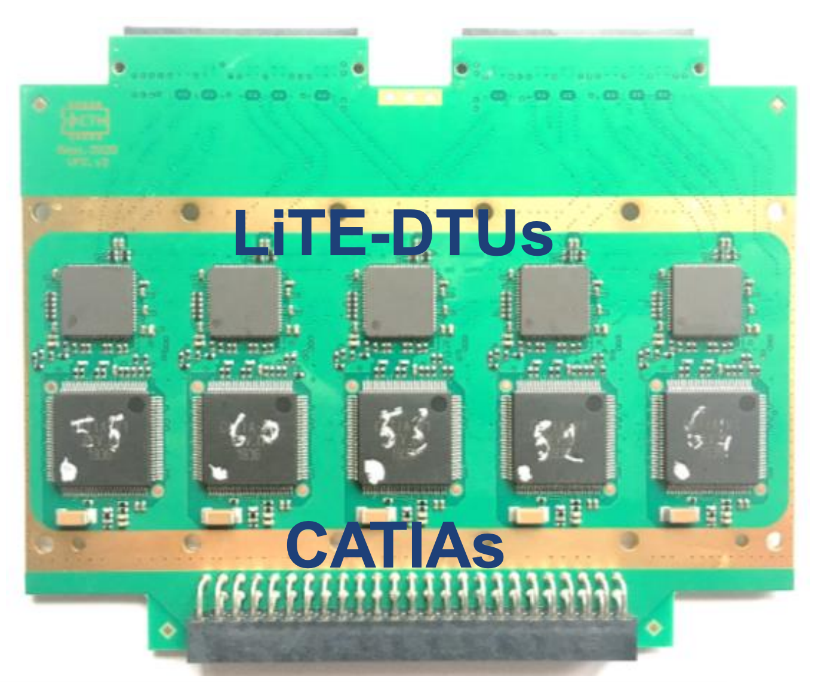
Frontend Electronics
CATIA
Pre-amplifier ASIC
Minimal shaping to obtain best time resolution and spike rejection
Beam test to tune absolute gain in 2021
v1r4 submitted in November 2020
v2r0 submission foreseen in June
LiTE-DTU
Data conversion, compression and transmission ASIC
ADC Sampling at 160 MHz
v1.2 being tested with CATIA v1r0 on VFE
v2.0 submission planned in July
Feature list frozen and implementation underway
Notes:
Combination of two gives spike rejection
Lossless compression – less bits for noise samples

Slide 26
Backend Electronics
Barrel calorimeter processor (BCP)
Each board handles signals from 600 crystals
BCPv1 is currently being tested
Uses one KU115 FPGA
Integration tests largely finished
Currently working on simulation of ECAL Barrel synchronisation
BCPv2 will use one VU13P instead of 2xKU115 originally envisioned
Provides nearly 3 times the memory, 30% more logic cells and 11% more digital signal processing
FPGA (KU115)
Embedded
Linux
Mezzanine
(ZYNC)
FireFly
optics
1 Gb
ethernet
switch
IMPC (ZYNC)
Notes:
Simulate ECAL Barrel synchronization
LiTE-DTU <-> lpGBT-emu <-> BCPv1
o Define the synchronization procedure and build the state machine in BCP
o Verify that the synchronization works / find and fix any issue
o Develop firmware for the interface with LiTeDTU
Also need to develop BCPv2

Slide 27
Other algorithms
Multifit algorithm
See CMS DN-2020/012 for full details
Does both amplitude and timing reconstruction
Template fit with multiple components contributing to the signal
Method has been used in Phase I for HLT and offline reconstruction
Successful test of HLS using CMSSW
 | DSP | FF | LUT
Utilisation (%) | 54 | 21 | 35
Resource estimates for 300 channels on 1xKU115
Notes:
An illustration of three consecutive pulses arriving in one channel of the ECAL readout, forming the superimposed waveform in blue. Gray vertical lines indicate some nominal bunch-crossing timing, and all pulses are shown with the same phase relative to these nominal bunch crossing timings (as is assumed in the linearized multifit). The other assumption described above implies that when finding the amplitude for the red pulse in the center, only the two adjacent pulses are considered, and thus only the twelve samples indicated with blue diamonds are used in the calculation. y-axis units are arbitrary.

Slide 28
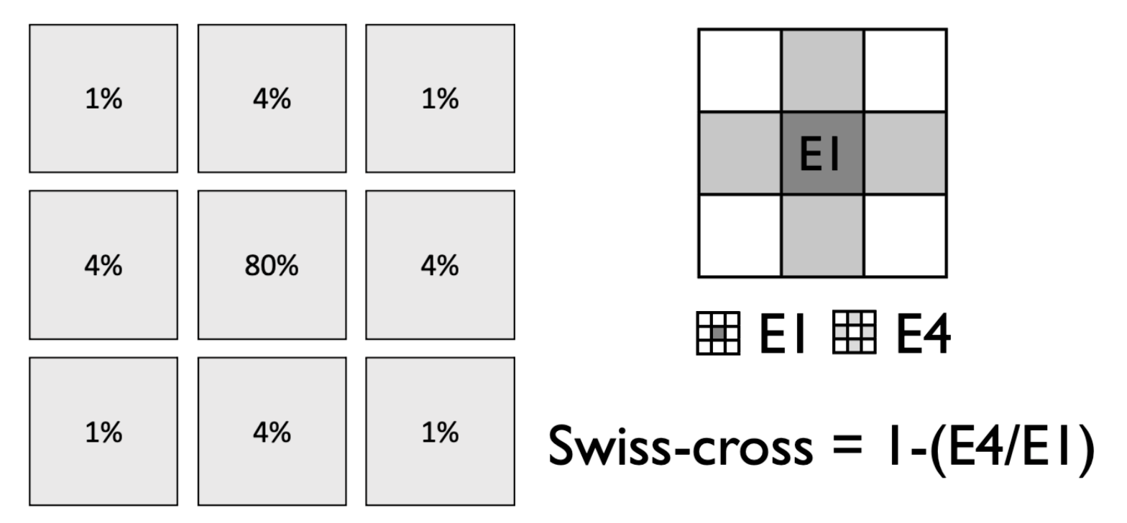
Spikes
Spikes occur when particles impact directly on the APDs in the ECAL barrel giving a large signal
Presents issues for triggering
Need >99% spike rejection in Phase II

Slide 29
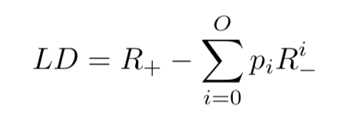
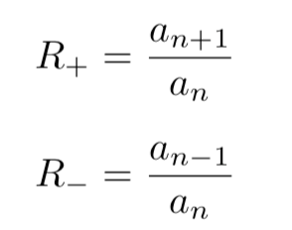
LD Algorithm Formulae
Where O is the order of the polynomial, pi is the polynomial weights and
The a are the three consecutive sample, with an being the peak. The weights are chosen such that the scintillation pulses are set around 0, which gives spikes an LD value around -0.5 due to the difference in shape.

Slide 30
Example Clustering Algorithm Output

