Slide 1
Particle Astrophysics Advisory Panel Report
Christopher McCabe
(substituting for Stephen Fairhurst)

Slide 2

Particle Astrophysics Programme (PAAP)
PAAP supports research in:
  Gravitational Waves
  Very high energy gamma-ray astronomy
  Direct dark matter searches
  Neutrino astronomy
  Cosmic Microwave Background*
  Theory
  *CMB research is a new addition to the PAAP remit. It was added in response to the April 2021 community questionnaire.

Slide 3
PAAP Membership
Stephen Fairhurst (Chair, Cardiff) – Gravitational waves
Jon Lapington (Leicester) – Gamma-ray astronomy
Sergey Burdin (Liverpool) – Direct dark matter
Ed Daw (Sheffield) – Wave-like dark matter
Laura Kormos (Lancaster) – Neutrino astronomy
Blake Sherwin (Cambridge) – CMB
Christopher McCabe (KCL) – Theory
Special thanks to all of the support from:
Alex Murphy (Science Board Rep), Alisa Johnson, Karen Clifford & Jenny Hiscock (STFC)

Slide 4
PAAP Membership
Many of us are leaving the panel this calendar year.
Please consider applying.
Applications are encouraged from early career researchers.
https://www.ukri.org/about-us/stfc/how-we-are-governed/advisory-boards/call-for-applications/

Slide 5
Summary of PAAP Activities
The Particle Astrophysics Roadmap
  Initial town hall meeting, Jan 2021
  Instrument proformas and individual questionnaires submitted, April 2021
  Presentation of initial recommendations at PA Town Hall, July 2021
  Roadmap draft circulated, Nov 2021
  Community feedback, Nov 2021
  Final community feedback, Mar 2022
Other Activities
  Input to UKRI Infrastructure Panel

Slide 6
Summary of PAAP Activities
Status of the roadmap:
  “A close to final draft of the Particle Astrophysics roadmap”: there are some typos to fix and wordsmithing to do
  We welcome comments on the final draft until Friday 15th April
  Please email any comments to jenny.hiscock@stfc.ukri.org

Slide 7
Summary of PAAP Activities
We particularly welcome comments on the experimental timelines figure
Timeline based on information from the April 2021 experimental proformas so let us know if any dates have changed

Slide 8
Programme-level recommendations
Particle Astrophysics has enormous potential for growth, in terms of the size of the UK community, its leadership roles in international experiments and in terms of addressing the burning scientific questions that cross into this field.
There is a distinct lack of breadth. Typically, only one project per science area receives significant STFC funding and in neutrino astronomy, funding is insufficient to support significant UK involvement in any large scale experiment.
Recommendation 3.1: We recommend re-balancing the overall STFC science portfolio to allow increased levels of funding for Particle Astrophysics. This will ensure continuing UK leadership within existing experiments, while also increasing the breadth and depth of Particle Astrophysics research.
Recommendation 3.2: We recommend that STFC should provide large, strategic investment in future Particle Astrophysics observatories and experiments to ensure continuing UK leadership over the long term.

Slide 9
Programme-level recommendations
Many comments from the community raised concerns that since Particle Astrophysics research sits at the crossroads of Particle Astrophysics and Astronomy, there are times where Particle Astrophysics priorities and requirements are over-shadowed by its larger, neighbouring fields.
Recommendation 3.3: STFC should ensure that Particle Astrophysics expertise is well represented on funding panels, particularly the PPGP Experimental and Theory and AGP Observation grant rounds. Particle Astrophysics priorities, as laid out in this roadmap, should be clearly communicated to the panel members, and the importance of long-term strategic investment emphasised.

Slide 10
Funding-scheme recommendations
Recommendation 3.5: The task of planning for a sustainable future for activities currently funded under QTFP programme should be prioritised by STFC, EPSRC and UKRI. A funding line for successful QTFP projects should be identified, which must not have a detrimental impact on the existing Particle Astrophysics programme.
Recommendation 3.6: STFC should identify a mechanism to provide low-level funding to exploratory research for enable initial investigations. The revival of the previous PRD scheme would go some way towards filling this need. A second funding stream, with a funding cap in the low tens of thousands, to support very early-stage development, should also be introduced.
Recommendation 3.7: Cooperation between agencies supporting space missions should be fostered through cross-representation on relevant committees. Additionally, the funding mechanisms and processes underlying the dual-key approach should be made more transparent via monitoring and evaluation of regular published reports.

Slide 11
Field-specific recommendations
Recommendation 4.1: aLIGO, including upgrades to A+ and post A+ sensitivity, remains the highest priority for the UK GW community. STFC should ensure that future funding enables UK scientists to maintain their long-standing leadership, in both the exploitation of aLIGO data and development of instrumental upgrades.
Recommendation 5.1: To maintain UK leadership in VHE gamma-ray astronomy leadership over the next 10-20 years participation in CTA is essential. In the short term, investment is urgently needed in CTA construction to ensure UK access to the key science projects, allowing the UK community to maintain leading roles and benefit fully from CTA science returns. In the longer term, there may be upgrade investment needed for CTA, and continuing support will be required for exploitation and operation.

Slide 12
Field-specific recommendations
Recommendation 6.1: Support LZ operations/exploitation as the highest priority. Support DarkSide-20k operation/exploitation upon successful completion of the construction phase.
Recommendation 6.2: Support UK participation with a significant leadership role in design, construction and operation of at least one large-scale direct dark matter search experiment. STFC should ensure that decisions are made in a timely manner so that leadership roles are possible.
Recommendation 7.1: The UK High-Energy Neutrino (UHEN) consortium represents a concerted effort by members of the community to support one large-scale future neutrino astronomy experiment []. We recommend that STFC supports this effort through appropriate funding, both for the near-term experiments that require travel and computing funding in order to maintain a community of trained early-career scientists, and PPRP funding to enable the UK to play a significant role in a longer-term large-scale experiment.

Slide 13
Field-specific recommendations
Recommendation 8.1: Major UK contributions to the Simons Observatory via SO:UK are the cornerstone of the UK CMB research programme and should be strongly supported. To maximize the scientific impact of UK involvement and leverage current UK strengths, the panel also recommends further funding of scientific exploitation and technical development work for SO.
Recommendation 9.2: […] not all areas of PA theory can be neatly classified as either Astrophysics or Particle Physics and that there will be core areas of PA theory that will necessarily appear to be on the borderline of the panel’s remit. We would encourage the panels to consider mechanisms to prevent world-leading areas of PA theory from falling between the cracks of the two panels.

Slide 14
CMB Community Concerns
We have included the Cosmic Microwave Background (CMB) as one of the topics in the PA Roadmap. It was not included in the 2016 Roadmap.
There is concern about the impact this will have on funding, both for CMB research and for other areas of PA. CMB research is currently funded through Astronomy, and the community doesn’t see a need for this to change.

Slide 15
Technology development & Computing
Historic funding levels have placed the UK in a situation where we are currently surfing on a wave of earlier technology development. We are rapidly being overtaken by those who have invested in this area, both in people and infrastructure.
Recommendation 10.3: UK expertise in particle astrophysics instrumentation should be enhanced by extending funding opportunities and fellowships for experimentalists and instrument specialists. This is necessary in order to maintain the UK’s international competitiveness.
Since the last roadmap, there has been a significant development in the UK of a community of Research Software Engineers (RSEs). In 2020 STFC awarded its first RSE Fellowship. RSEs are vital across Particle Astrophysics research.
Recommendation 10.5: STFC should provide a greater level of support for specialist computing staff, particularly RSEs, within Particle Astrophysics. Continued, long-term support, such as through RSE Fellowships, is vital to retain the computing specialists required to ensure the success of Particle Astrophysics experiments and observations.

Slide 16
Thanks to all that have contributed to the process
  Advanced LIGO (aLIGO)
  Atom Interferometer Observatory and Network (AION)
  Cherenkov Telescope Array (CTA)
  Cherenkov Telescope Array (CTA) Galactic Plane Survey
  Cosmic Explorer (CE)
  DarkSide
  DarkSphere (NEWS-G)
  Einstein Telescope (ET)
  Laser Interferometer Space Antenna (LISA)
  LUX-ZEPLIN (LZ)
  Pulsar Timing Array (PTA)
  Quantum-enhanced Interferometry (QI)
  Quantum Sensors for the Hidden Sector (QSHS)
  Quantum Technologies for Neutrino Mass (QTNM)
  QUEST-DMC
  Simons Observatory (SO)
  Southern Wide-field Gamma-ray Observatory (SWGO)
  UK High-Energy Neutrino (UHEN)
  Xenon Futures
101 individual submissions to a roadmap questionnaire in May 2021
Attendance at a Roadmap focused PA town hall in July 2021
Individual feedback on the draft roadmap, provided in November 2021 both via written submission and at PAAP “office hours”
19 experimental submissions of a roadmap proforma in May 2021

Slide 17
Summary of PAAP Activities
  Apply to join the PAAP panel
  We welcome feedback on the Roadmap until Friday 15th April.
  Email comments to jenny.hiscock@stfc.ukri.org
  Questions / Comments?

Slide 18
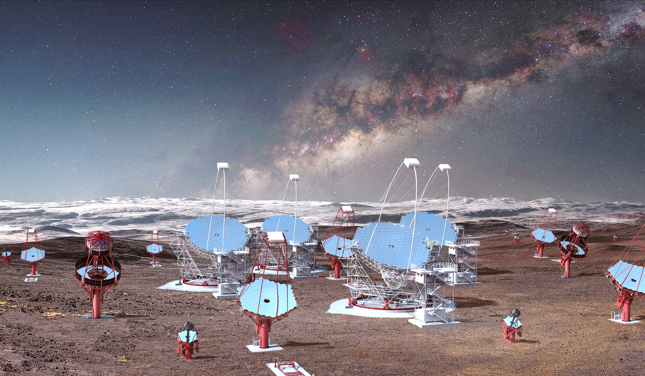
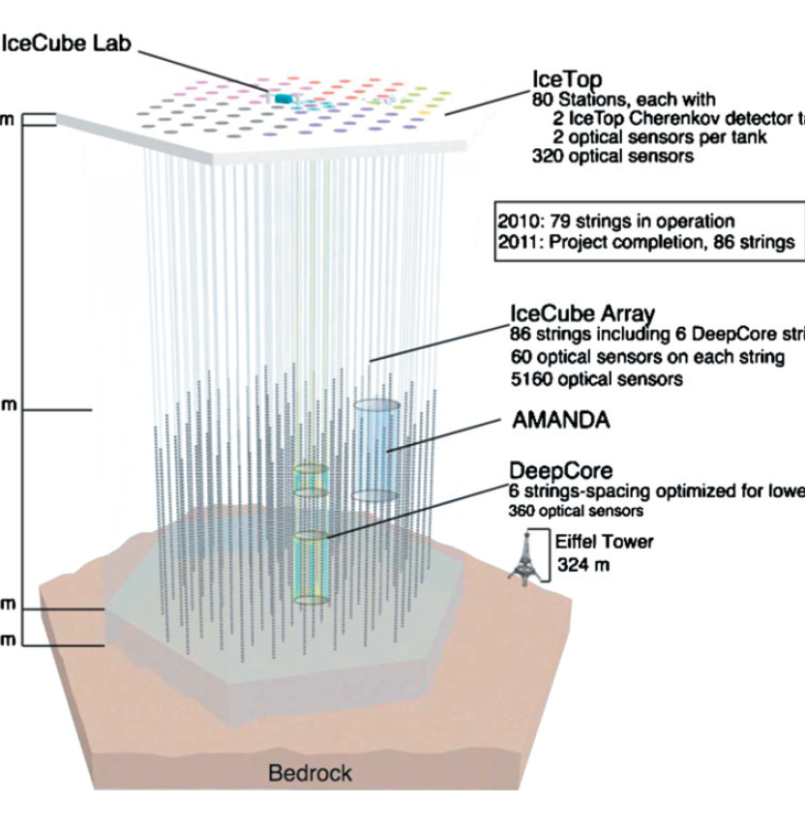
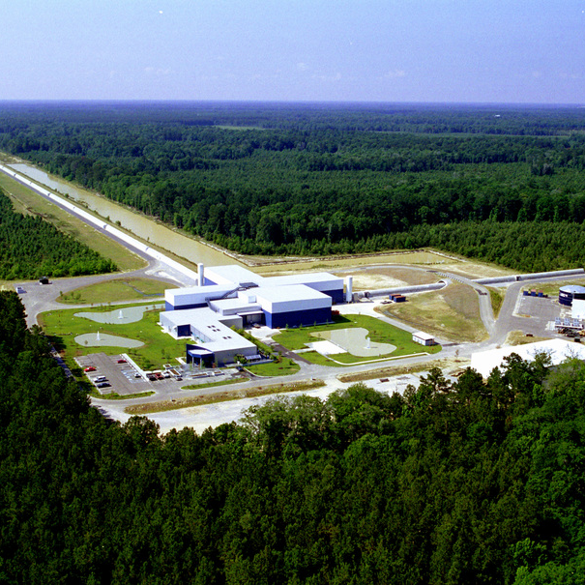
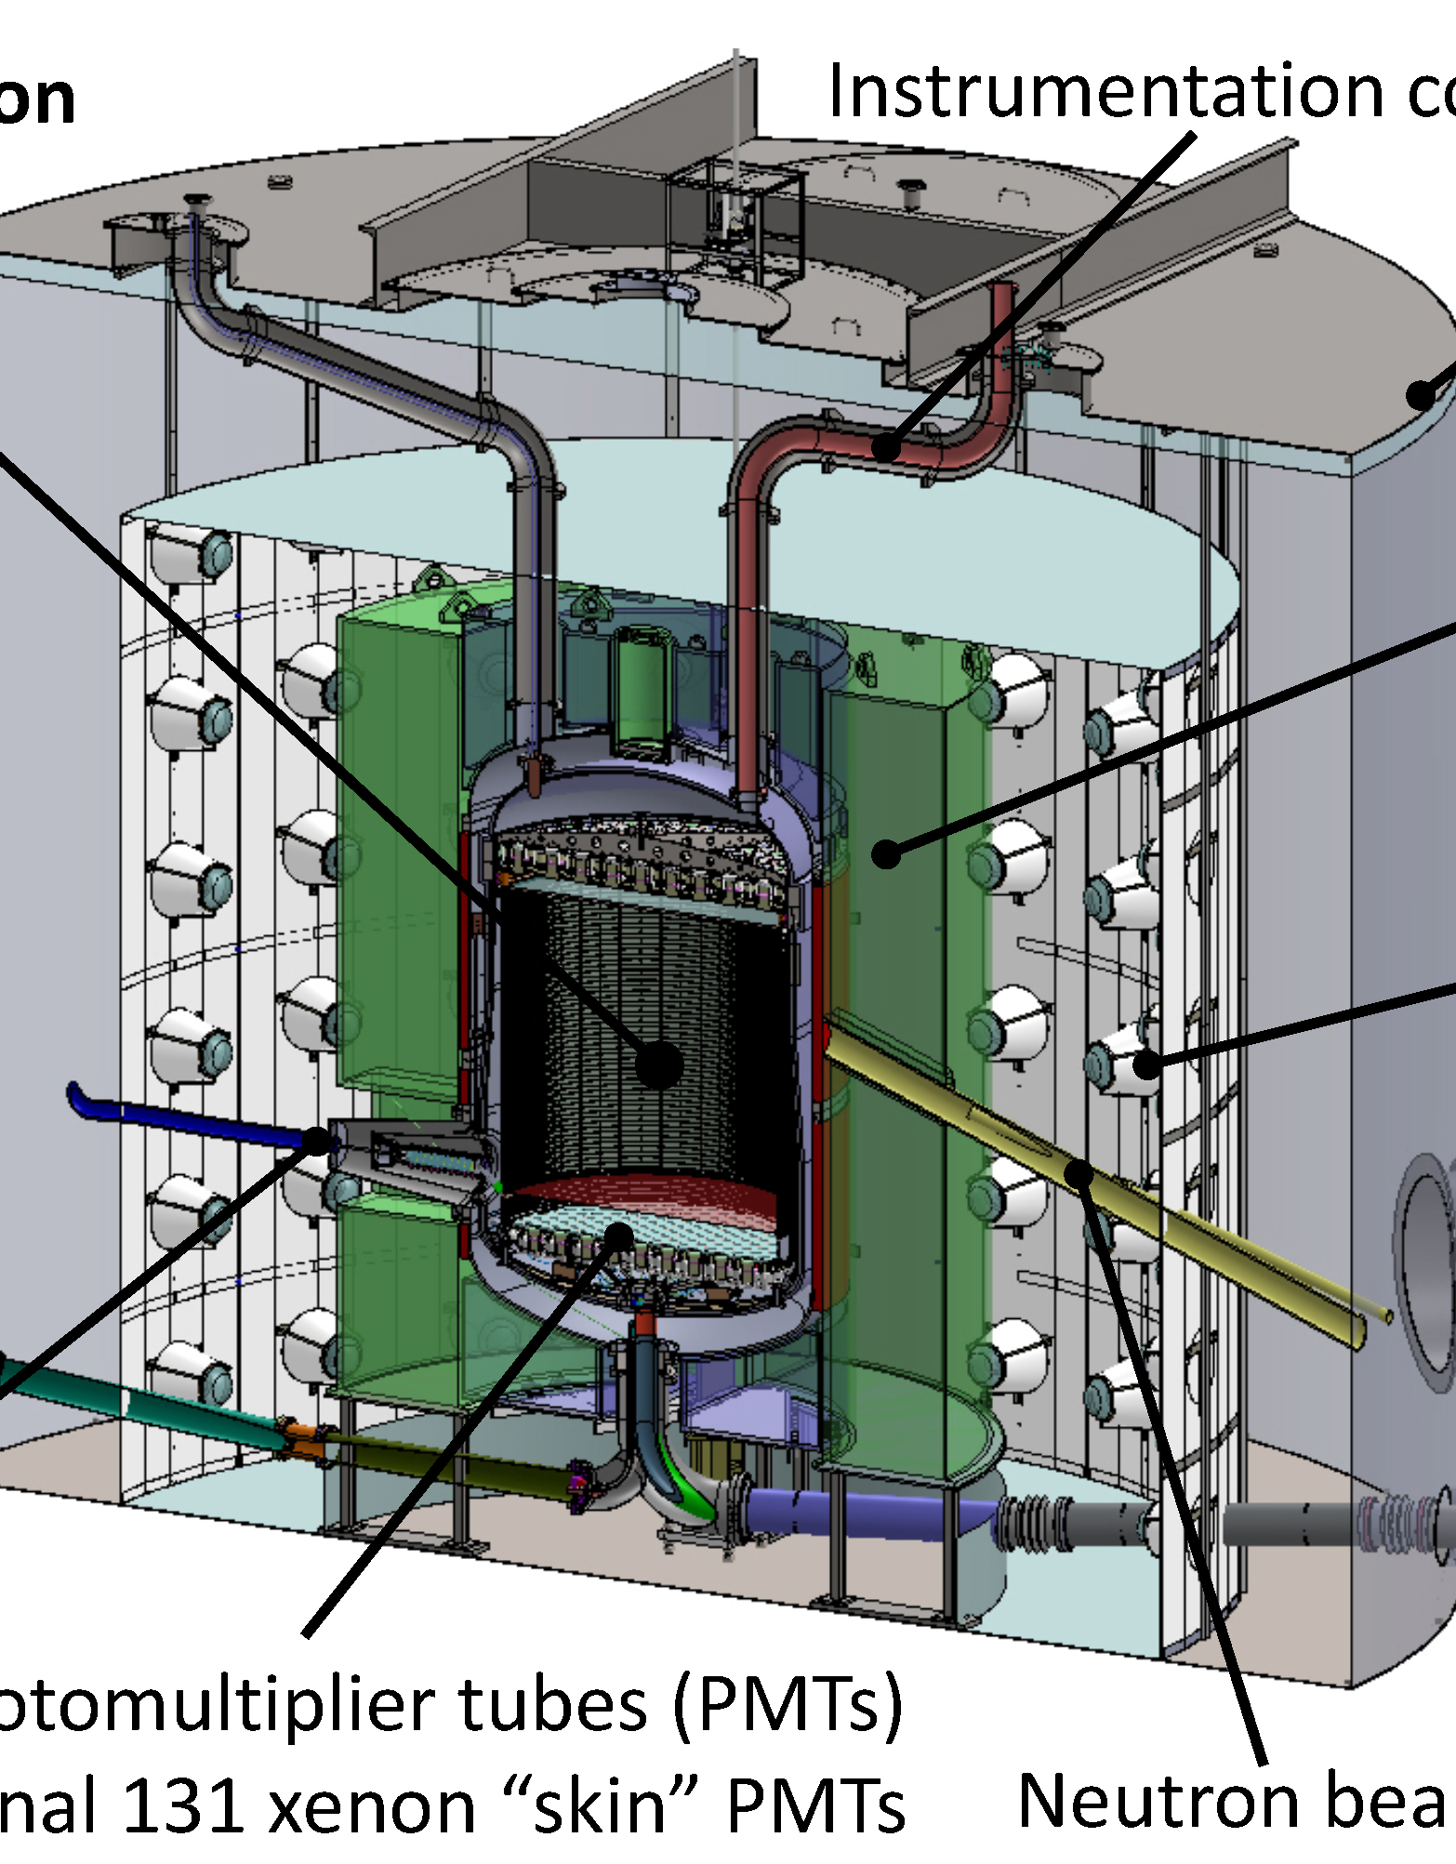
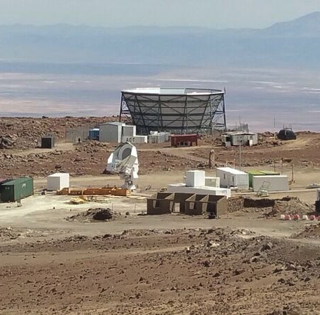
Backup slides:
Physics highlights

Slide 19
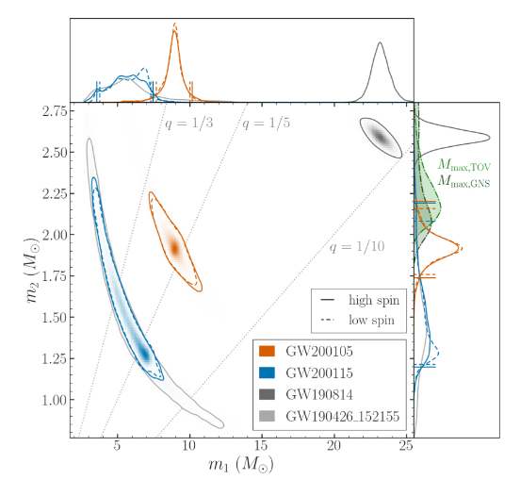
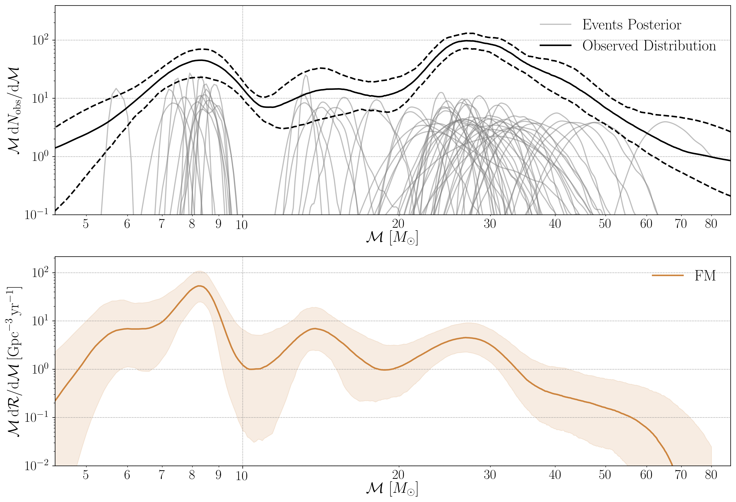
Gravitational Wave Astronomy
90 GW candidate events observed in GWTC-3
First observation of Neutron Star—Black Hole systems
Unveiling the population of Black Holes in binaries
Beginning to observe structure in the black hole mass distribution
R. Abbott et al 2021 ApJL 915 L5
R. Abbott et al 2021, arXiv: 2111.03634
Chirp mass

Slide 20
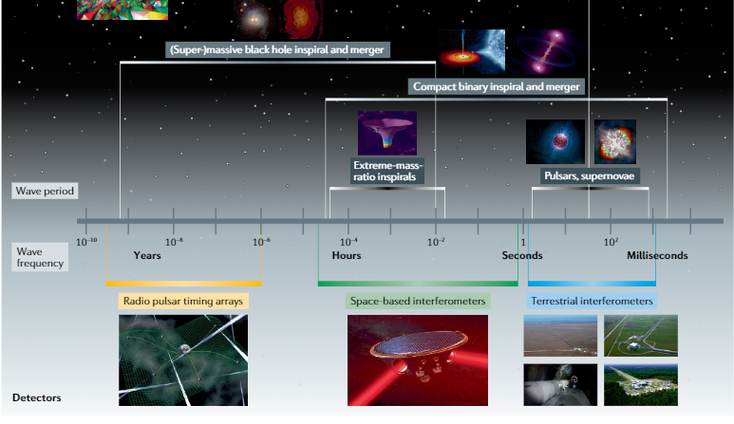
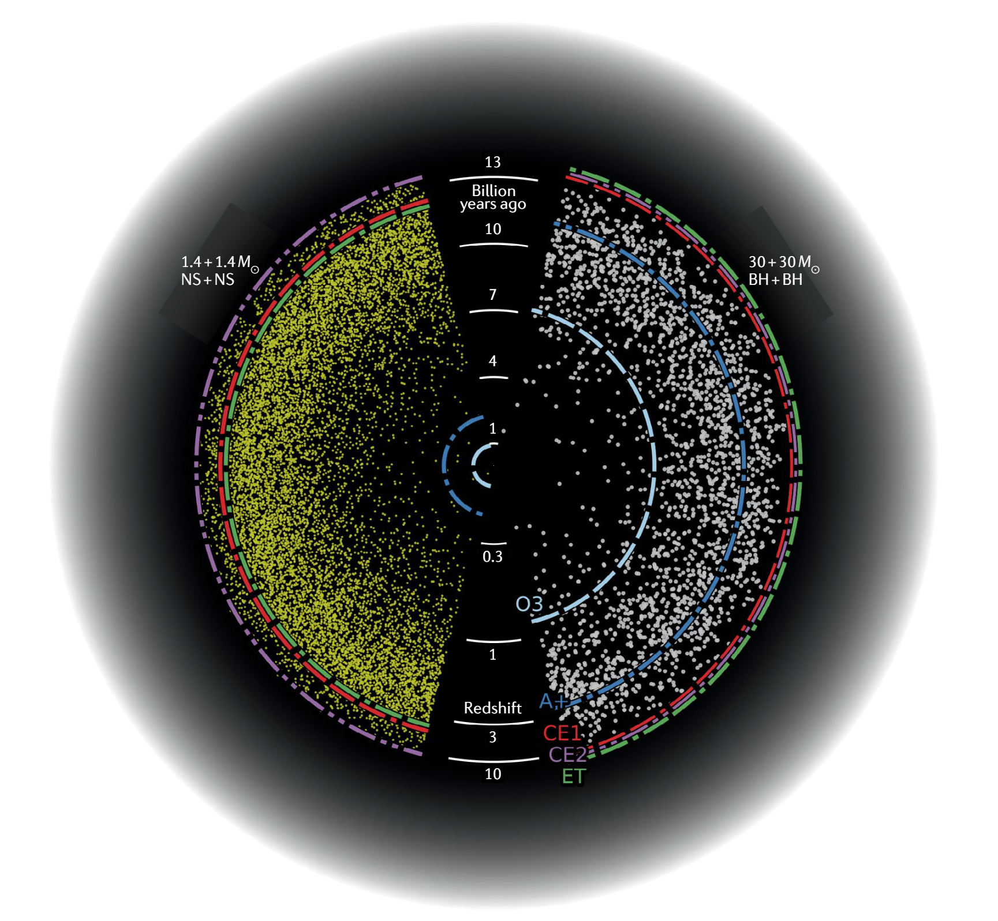
Gravitational Waves:
Future Detectors
Detailed science case for next generation terrestrial interferometers, Einstein Telescope and Cosmic Explorer
(Kalogera et al, arXiv:2111.06990)
ET included in ESFRI Roadmap
From Gravitational-wave physics and astronomy in the 2020s and 2030s

Slide 21

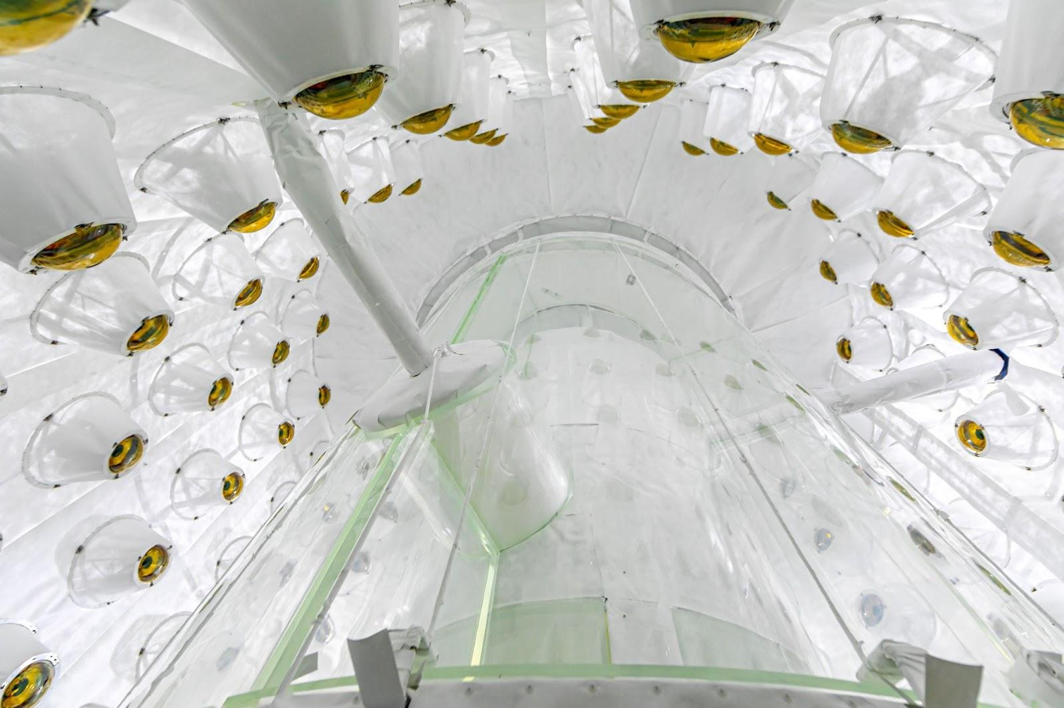
Dark Matter: LUX-ZEPLIN (LZ) & XENON FUTURES R&D
LZ Outer Detector embracing the Xenon Detector
LZ has started physics data-taking at SURF, after a decade of design, construction and commissioning – first results expected in 2022, operations until 2026
Xenon Futures R&D project developing
UK contributions to the future experiment

Slide 22
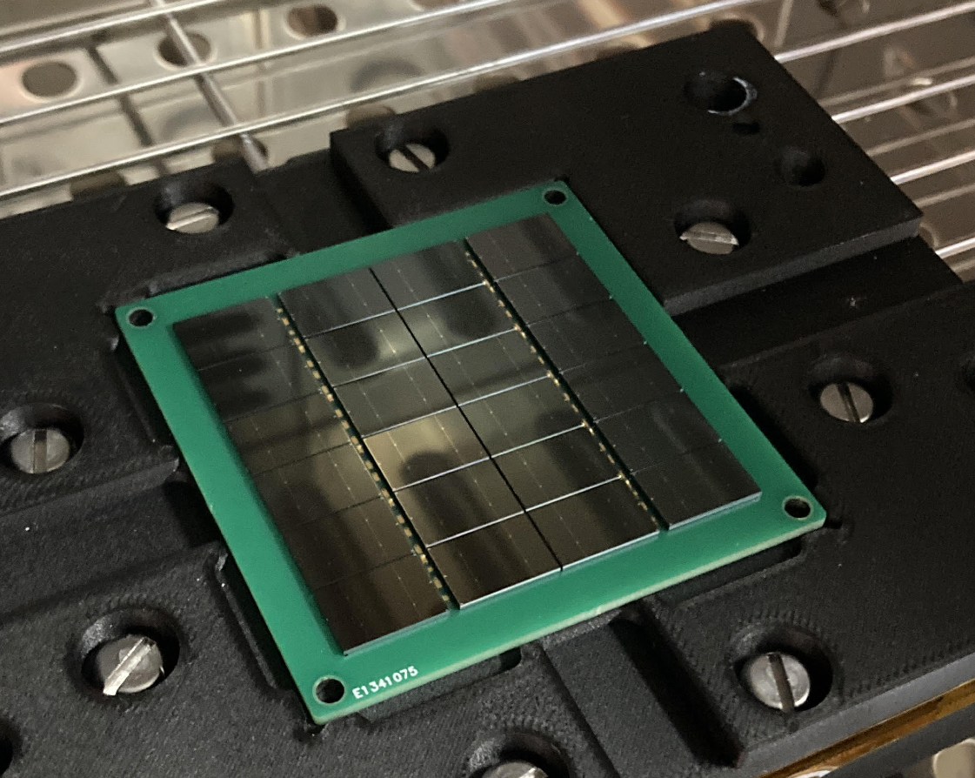
Dark Matter
DarkSide-20k
NEWS-G
Development of neutron veto optical modules in the UK
Ø140 cm detector installed at SNOLAB
Detector commissioning on-going
Physics data-taking to follow
Veto Photo-Electronics @ Liverpool

Slide 23
Quantum Technologies for Fundamental Physics (QTFP)
Four QTFP projects have have connections to dark matter (DM) searches
Ultra-light axion-like
particles, other hidden
sector wave-like DM
Ultra-light hidden
sector scalar wave-
like candidates
Light QCD axions &
Other hidden-sector
wave-like DM
Sub-GeV WIMP
particle-like dark matter
AION
QI
QSHS
QUEST-DMC
Atom interferometry over multi-metre distance scales using Strontium.
Laser interferometry over multi-metre distance scales using squeezed light.
Dark matter axion to photon conversion in a resonator in a high magnetic field
Coherent interaction
of WIMPs with
Superfluid He-3
41 months funding to build 10m prototype.
41 months funding to build 2m prototype, and
develop transition edge
sensors for ALPS2
41 months funding to build 10mk, 20cm bore 8T test detector for
20-40 micro-eV axions.
41 months funding for
detector construction,
first science run
in surface facility.
LIGHTER
HEAVIER
All four groups are exploiting quantum technology for low noise readout. QI uses squeezed light, AION
uses coherent atomic beams, QSHS uses microwave quantum sensors, Quest DMC uses quantum readout

Slide 24
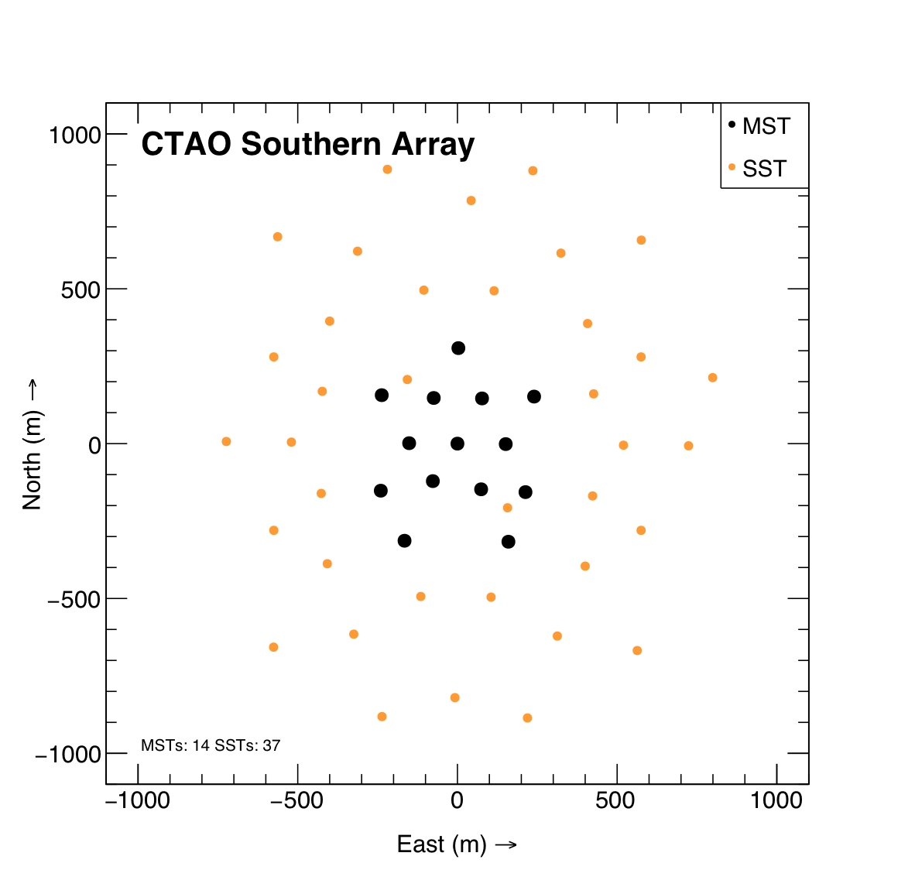
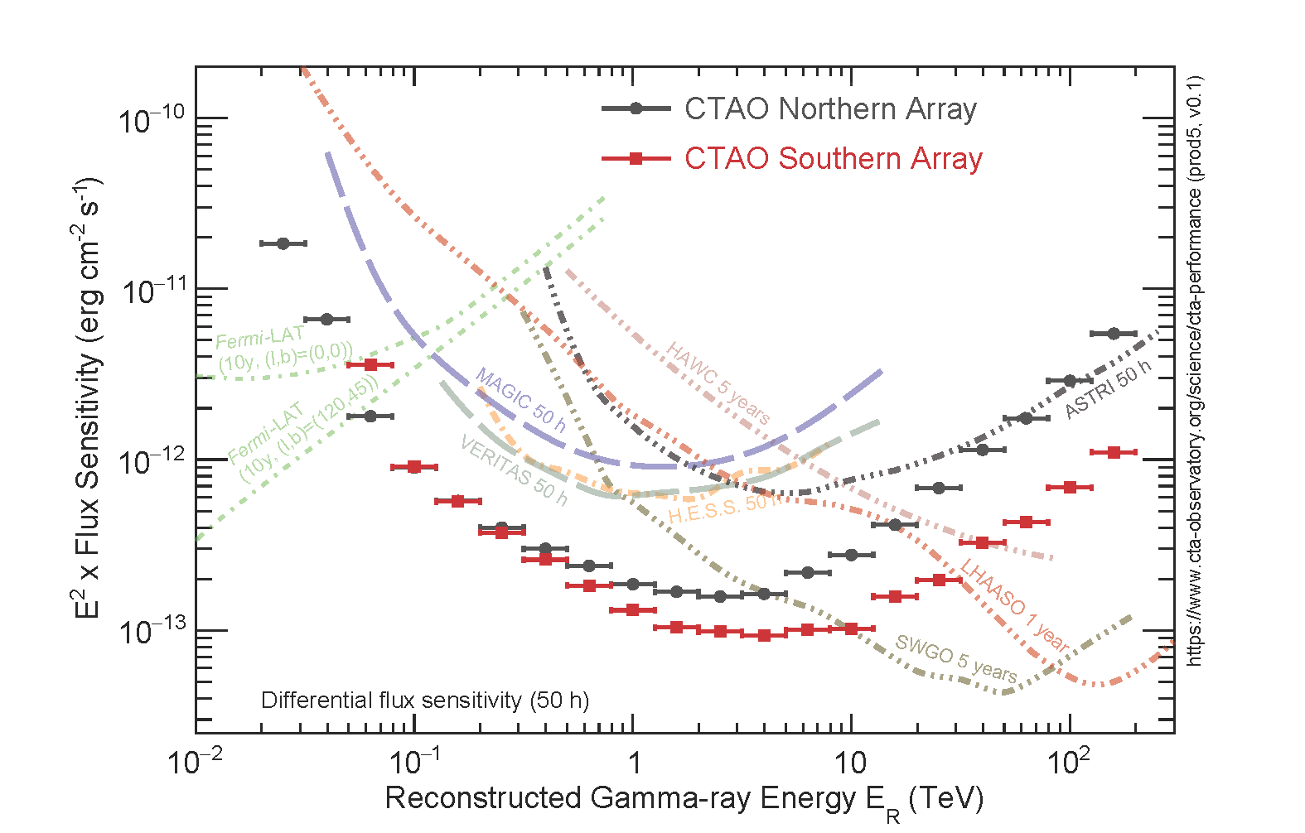
Gamma-ray astronomy
– CTA Realization
Agreement on Alpha Configuration of the CTA arrays
CTAO Southern Array comprises 14 MSTs + 37 SSTs
Cost Book and IKCs ratified by CTAO Council and BGR
Final application for CTAO-ERIC imminent
CTAO South Alpha Configuration array layout
Alpha Configuration sensitivity simulations

Slide 25
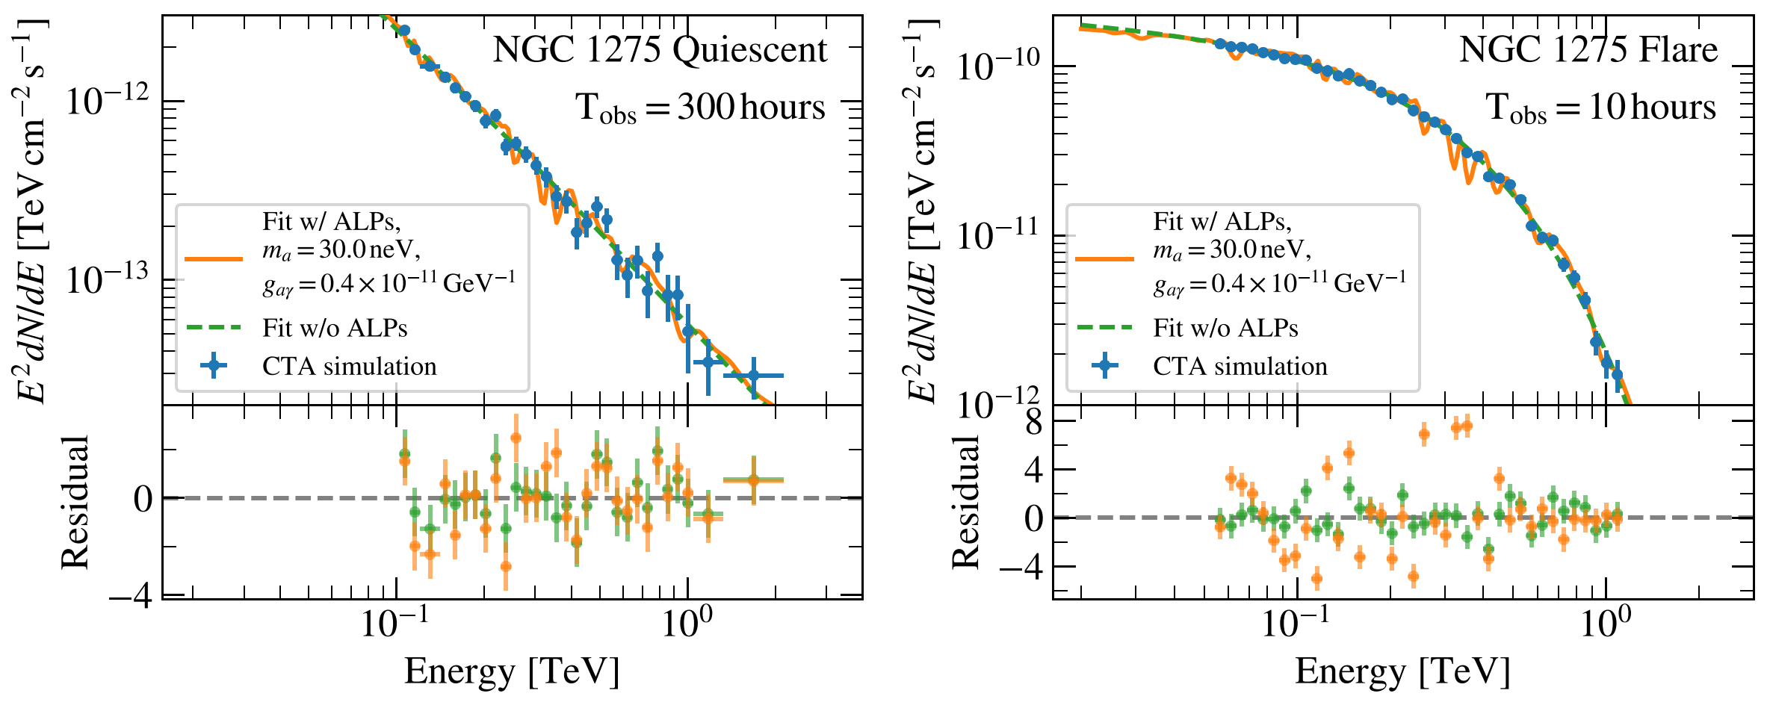
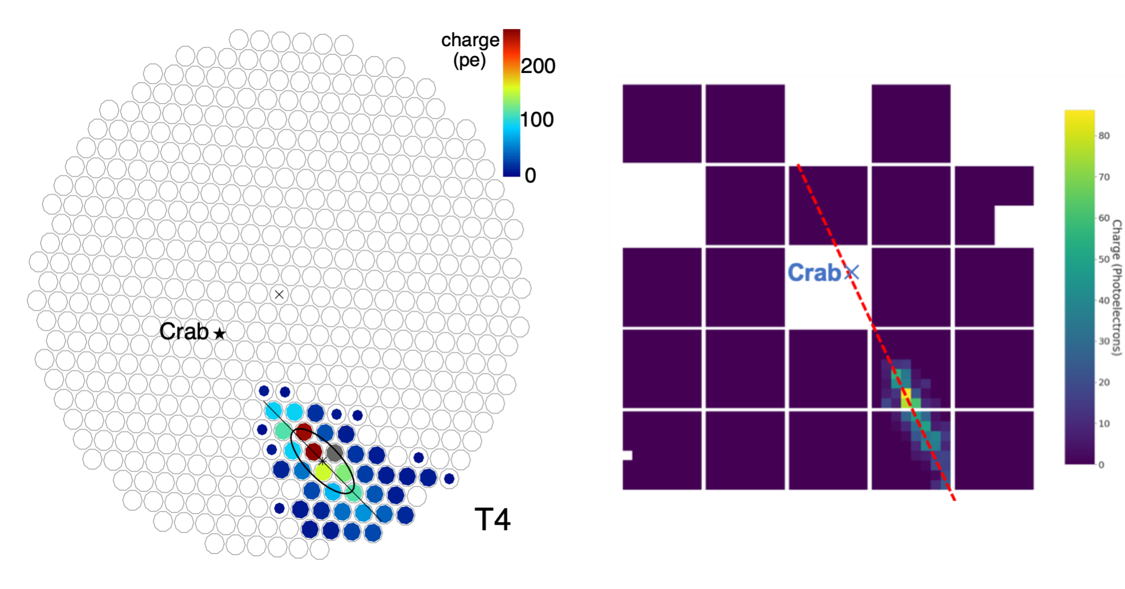
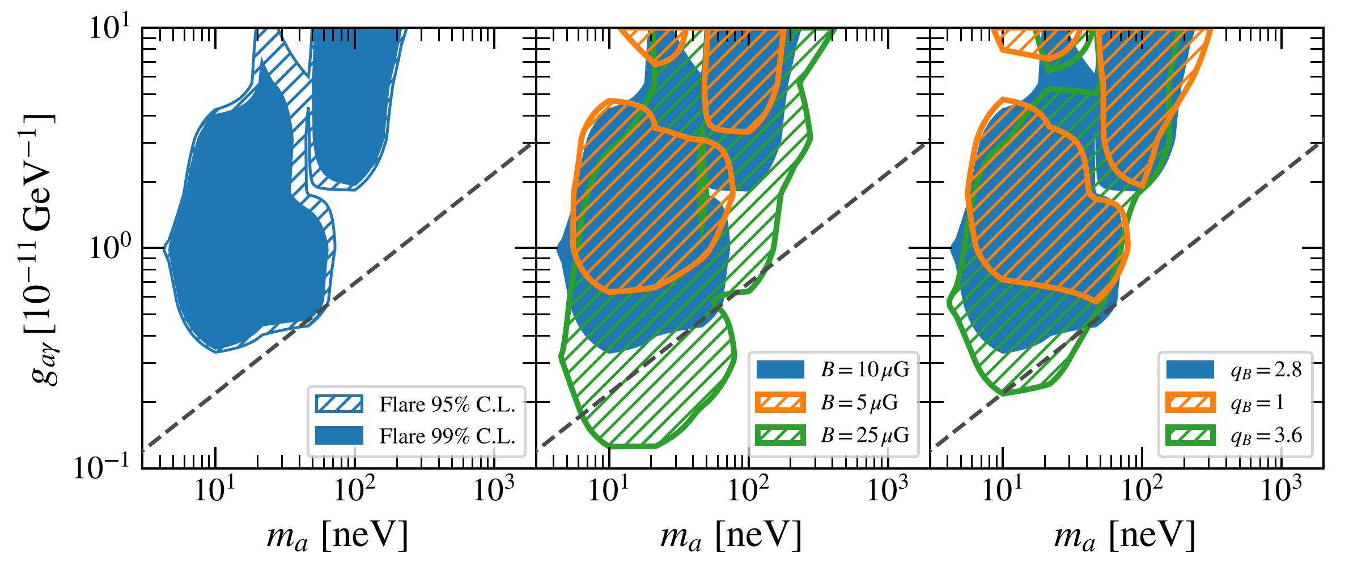
Gamma-ray astronomy
– CTA Science
Left: Sensitivity of CTA to axion-like particles (ALPs)
  Simulations of ALP signatures in NGC 1275
Right: Detection of the Crab Nebula by the pSCT
  Crab Nebula detection - statistical signiﬁcance of 8.6σ
Simulated spectra of the radio galaxy NGC 1275
Sensitivity of CTA to ALP-induced irregularities
Comparison of the same Cherenkov event by:
  Veritas (left); pSCT (right)
pSCT using modified UK-designed CTA-SST electronics
Projected CTA constraints on ALP parameter space
H. Abdalla et al J. Cosmol. Astropart. Phys 2021(02)
C.B. Adams et al arXiv:2012.08448

Slide 26
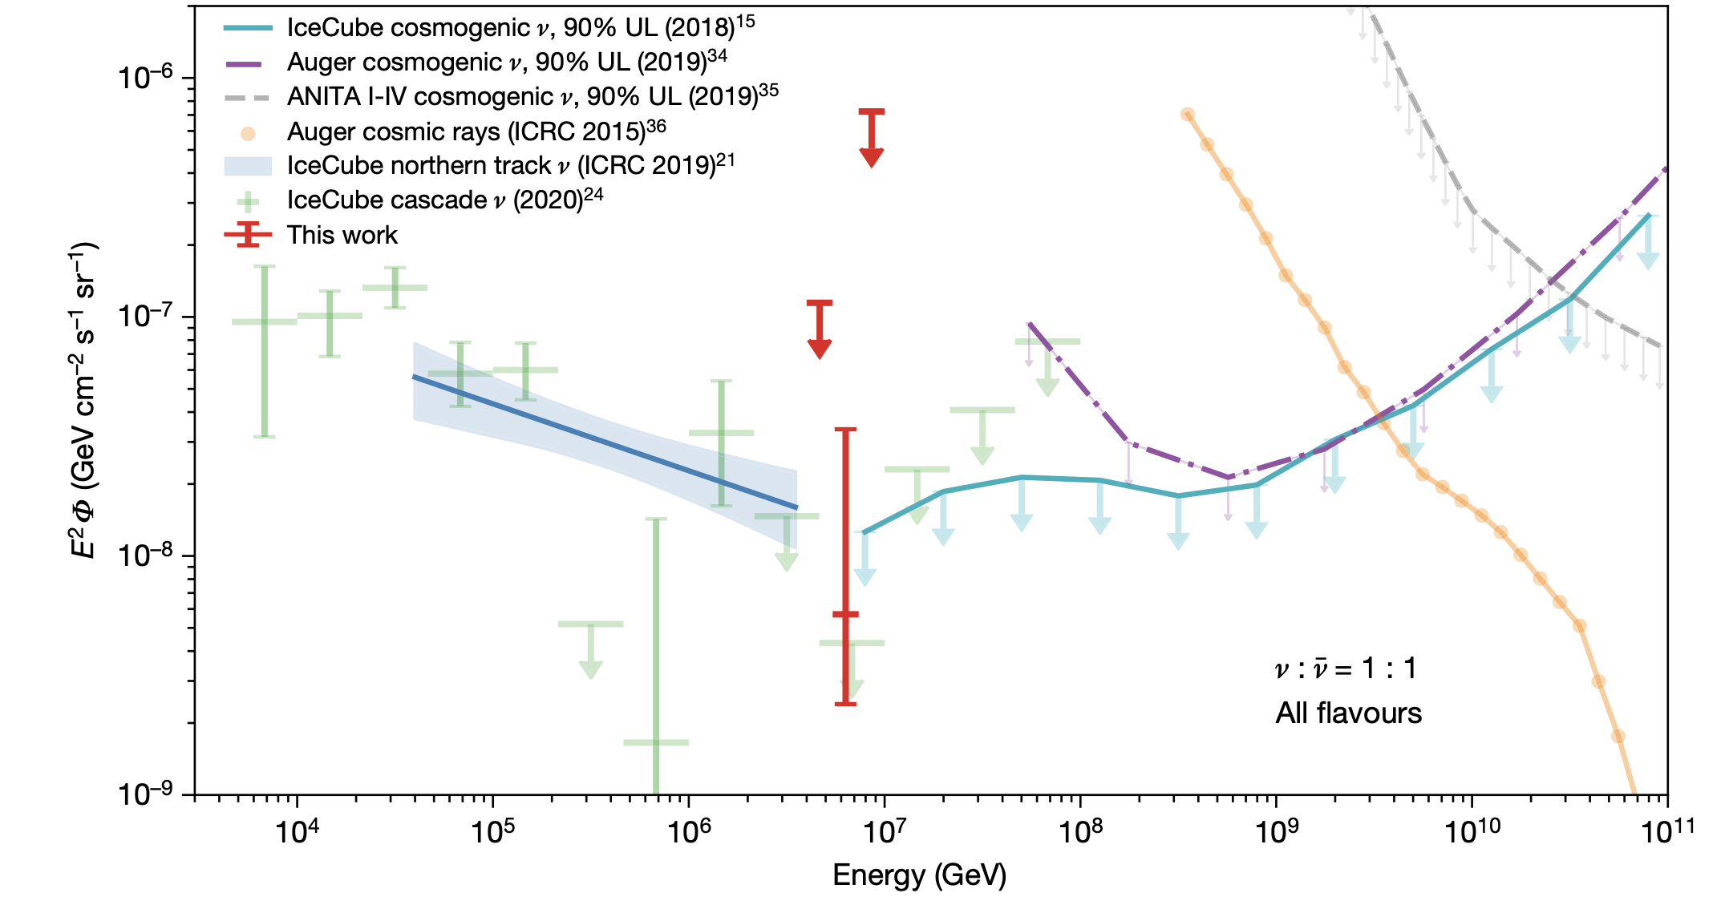
Detection of a particle shower at the Glashow resonance with Ice Cube
Neutrino
Astronomy
Nature 591, 220-224 (2021)
W production directly probes the antineutrino fraction, constraining the neutrino production models.
Glashow resonance ~6.3 PeV is above the reach of terrestrial accelerators, so observation of W production at the Glashow resonance also tests the SM.

Slide 27
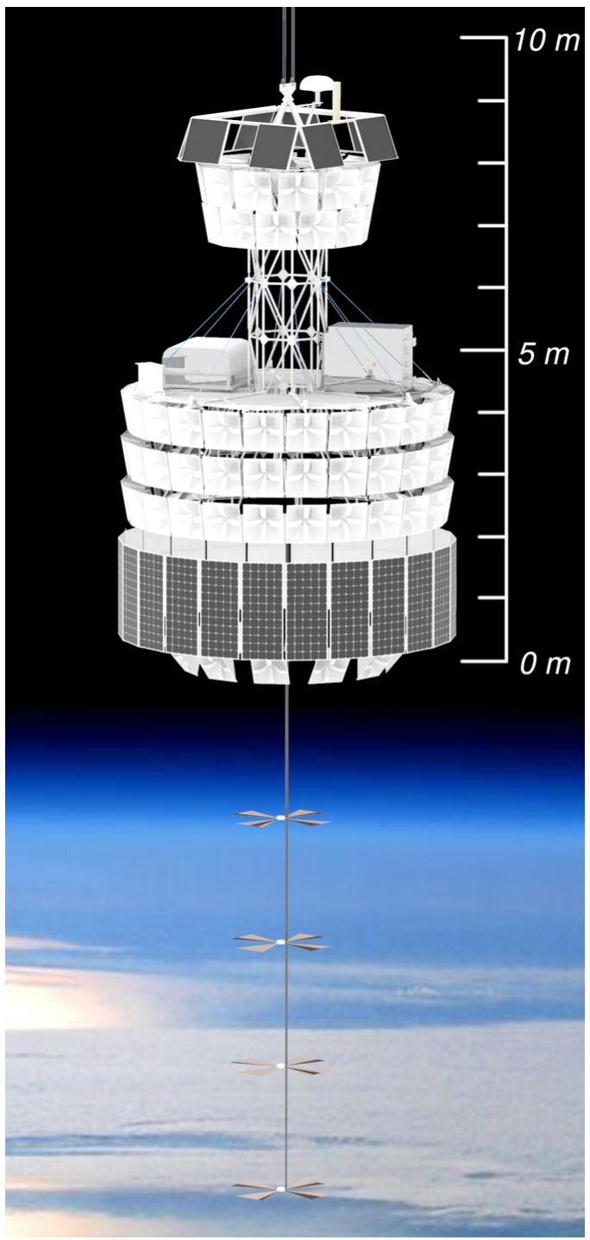
Neutrino Astronomy
PUEO launch date: Dec 2024.
will be the most sensitive survey of cosmic ultra-high energy neutrinos ever conducted.
improved sensitivity is a result of a number of novel features compared to ANITA, including a larger antenna array and a beam-forming trigger. PUEO will be able to measure or rule out a number of viable UHE models, providing better understanding of the UHE accelerators throughout the entire universe.

Slide 28
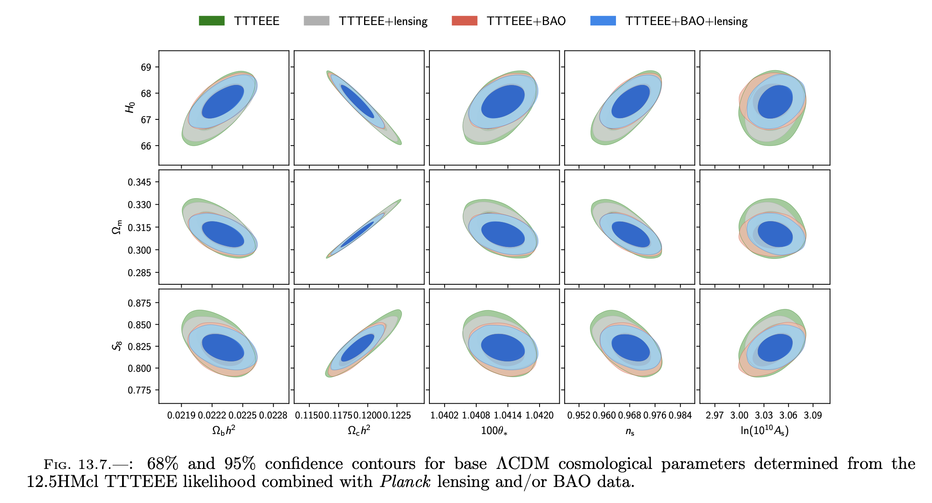
Cosmic Microwave Background
Final refinements of Planck CMB power spectrum, lensing, and cluster cosmology analyses, co-led by UK researchers, have provided leading constraints on cosmological parameters
Gratton, Efstathiou 2021

Slide 29
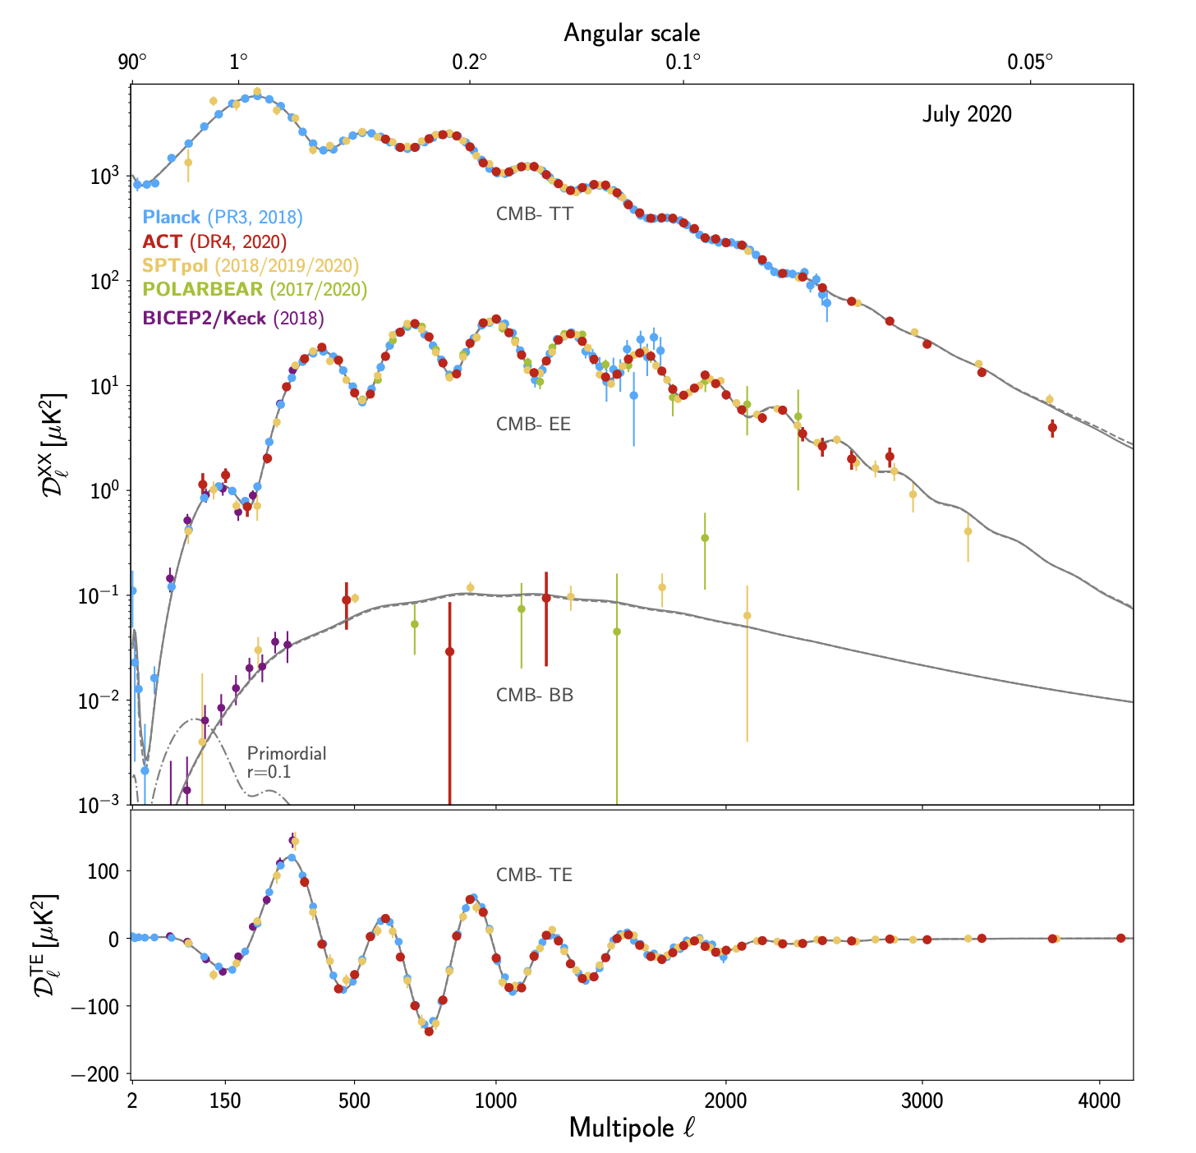
Cosmic Microwave Background
New ACT, SPT results have provided an independent test of Planck measurements (see spectra at right); BICEP significantly advanced search for primordial gravitational waves. Planck will soon be surpassed by measurements from such ground-based CMB experiments
Generally, results give precise confirmation of LCDM. But: 4+ sigma tensions with low redshift expansion rate/H0 measurements still not resolved – key open question, though more data coming.
Aiola et al. 2020

Slide 30
Theory
Continues to support the PA experimental effort by informing the directions that should be pursued now and in the decades ahead
UK theorists play a leading role in connecting open questions in cosmology and fundamental physics to observables
Exploring CMB spectral distortions as a probe of particle physics, new dark matter models and interactions, and primordial perturbations; efforts to connect upcoming CMB light relic constraints with bounds on new physics models
Continued progress in more accurate waveform modelling to allow for precision physics tests with future GW data
Alves Batista et al arXiv:2110.10074

Slide 31
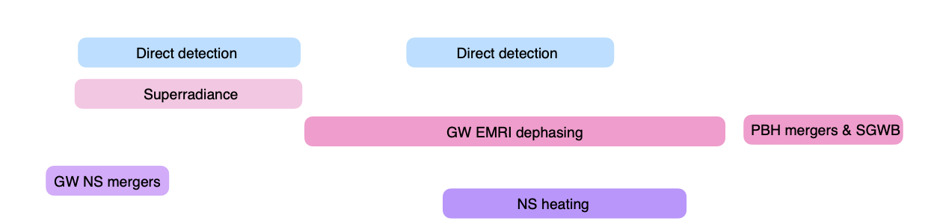
Continues to support the PA experimental effort by informing the directions that should be pursued now and in the decades ahead
UK theorists continue to develop new ideas for DM detection across the vast parameter space with existing (xenon/LZ) and new technologies (QTFP programme); and develop new mechanisms to explain the observed DM abundance
Alves Batista et al arXiv:2110.10074
Continued progress in exploring models of dynamical dark energy and modified gravity; with screened theories, theorists have recently shown that laboratory experiments are complementary to astrophysical and cosmological constraints
Briddon, Burrage et al arXiv:2110.11917

