Slide 1
STFC Update
HEPP/APP Town Hall
Mark Thomson
Executive Chair
5 April 2022
Notes:
The abstract pattern can be removed or repositioned if required. Be careful to ‘Send to Back’ so that it does not obscure any important information.

Slide 2
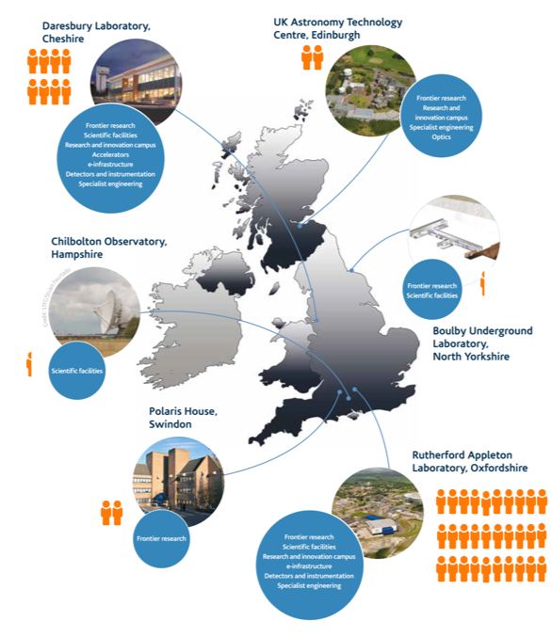
STFC’s is a complex organisation
STFC’s split personality:
Science Funding: fundamental research in particle physics, astrophysics, nuclear physics and space science
Managing relationships with major international research facilities
Science Delivery: operating UK’s major multi-disciplinary research facilities and national laboratory capabilities
Annual budget of ~£800m and 2,650 staff
approx. 30% of UKRI staff
>85% are scientists, engineers and technicians
1660 at the Rutherford Appleton Lab

Slide 3
STFC and Covid Recovery
Notes:
The abstract pattern can be removed or repositioned if required. Be careful to ‘Send to Back’ so that it does not obscure any important information.

Slide 4
Return to BAU operations
Our sites remained “open” throughout the pandemic with various levels of restrictions. The success of the vaccine programme means that we have now returned to business-as-usual (BAU) operations
Mar 20
Jun 20
Aug 21
Apr 22
We are here
Level 5
Level 4
Level 3
Level 2
Level 1
Site
Closure
To all bar security and critical infrastructure support
Suspension of activities at sites
To all bar critical maintenance for safe and timely re-activation of facilities. Reduce exposure as far as possible
Hybrid
Working
Controls to prevent spread on-site, Departments operating to deliver viable operations through home, site and hybrid working
Normal Site
Operations
Restrict occupational exposure to Covid-19 risk off-site
Business
as Usual
Some international travel restrictions may still be in place

Slide 5
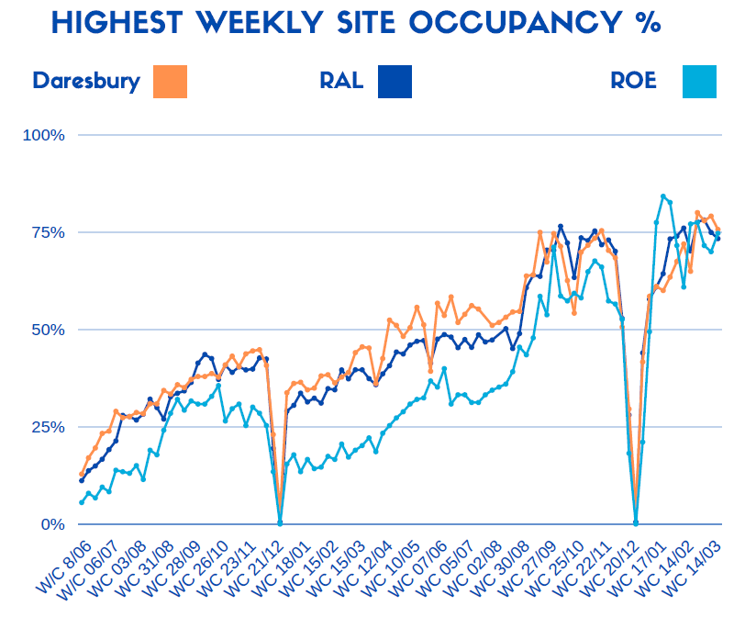
STFC site occupancy
STFC sites during the pandemic
Our policy has been to be as “open as is safely possible” to preserve operational efficiency and minimize project delays
Attendance at site at least once for week commencing x March 2022:
RAL –1,480 staff and 3,716 people including contractors & visitors
Daresbury – 413 staff and 660 people including contractors & visitors
UK ATC – 87 staff and 292 people including contractors & visitors

Slide 6
Living with Covid
We are at now Alert Level 1 “Business as Usual”:
All formal covid measures have ceased, with the emphasis on staff taking personal responsibility and remaining vigilant
We will continue to provide hand sanitisers at high usage points around our sites and use CO₂ monitors to ensure good ventilation levels
general-purpose hygiene measures, rather than specifically for Covid
Expect
numbers of users will continue to ramp up
gradual ramping up of visits to our sites through summer, including schools
Large events (like this one) now may be run on STFC sites
“Non-essential” overseas has resumed (subject to latest Foreign Office Advice)
Our sites are already back to something like “old normality”

Slide 7
Corporate Update
Notes:
The abstract pattern can be removed or repositioned if required. Be careful to ‘Send to Back’ so that it does not obscure any important information.

Slide 8
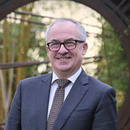
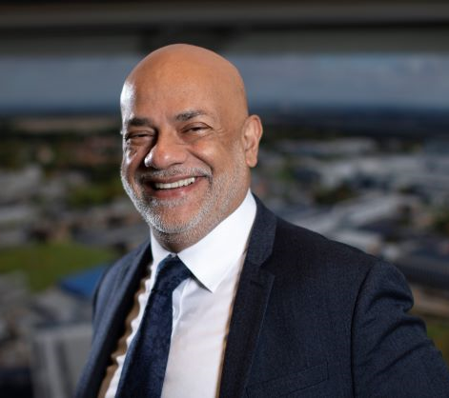
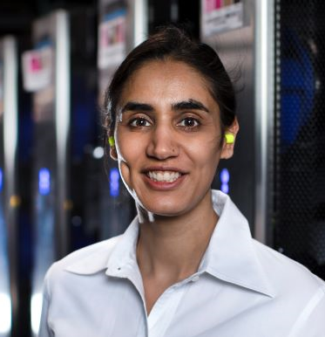
Appointments
STFC Executive Chair
Professor Mark Thomson re-appointed as Executive Chair of STFC for a further two years from April 1 2022 to March 31 2024
STFC Council
After four years of service, David Rugg and Dick Elsy have left STFC Council
Two new Council members joined 1 April:
Hitesh Thakrar, an experienced investor in the technology sector
Angeli Möller, Data & AI in healthcare professional
STFC Council now has gender parity and over 40% ethnic diversity

Slide 9
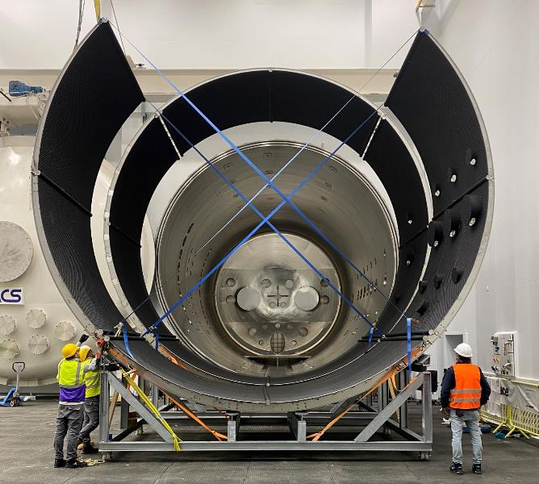
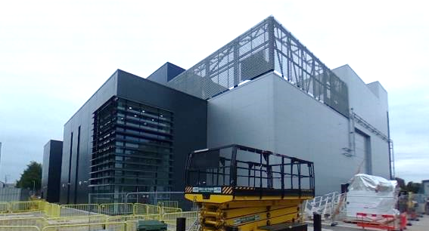
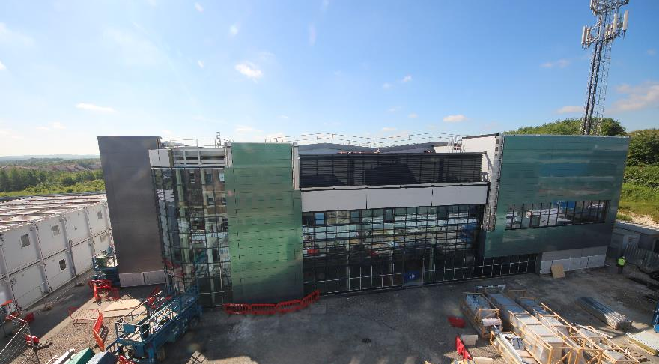
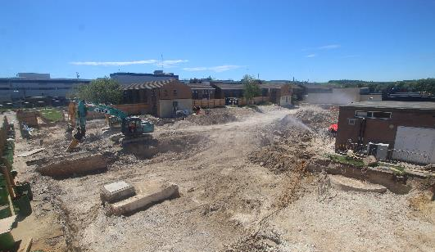
Major construction projects
Rutherford Appleton Laboratory
National Satellite Test Facility (NSTF)
>£100M investment in new world-class facility
Nearing completion
Extreme Photonics Application Centre (EPAC)
£80M investment in world-leading laser facility
Building complete, laser system is now the priority
National Quantum Computing Centre (NQCC)
£90M investment in new QC centre
Construction now started
Daresbury Laboratory
Hartree National Centre for Digital Innovation
£200M investment in industry-focused AI/Supercomputing
Includes new super-computer centre

Slide 10
Equality, Diversity and Inclusion
EDI remains a key priority for STFC:
UKRI’s vision is for a research and innovation system that:
everyone feels included, is heard, respected and able to be their real self
different people, ideas, ways of thinking, skills and perspectives are valued
people and ideas thrive, are supported and encouraged
everyone can participate in, contribute to, and benefit from, our investments in research and innovation.
A draft UKRI EDI strategy completed consultation on 28 March – over 260 responses
STFC is developing the next phase of our EDI action plan
We want to improve diversity across all our advisory boards and peer review panels
looking to our communities to help

Slide 11
Panel Membership Call
We are currently recruiting to our panels and committees
STFC panels, committees and boards perform a vital function for STFC
We need to have a balance and diversity of knowledge, skills and experience to enable our panels to be effective
Benefits include:
Inputting into the development of our strategic priorities and our national and international science programmes
Gaining an understanding of the peer review process
An opportunity to broaden professional networks and experience
Influencing research culture in the UK and abroad
Deadline for application 15 May 2022: ukri.org/about-us/stfc/how-we-are-governed/membership-call

Slide 12
Horizon Europe
Update
The government position remains that the UK wishes to associate to Horizon Europe and is ready to do so
Current complicated by wider negotiations
In the interim, UK entities are eligible and encouraged to continue applying for Horizon Europe funding through the usual means
On Tuesday 15 March, the government announced an extension to the Horizon Europe UKRI funding guarantee
This covers first and second wave of eligible, successful UK applicants to the Horizon Europe programme, who have been unable to sign grant agreements with the EU
Important for the UK research community to continue to apply to Horizon Europe

Slide 13
Conflict in Ukraine
Notes:
The abstract pattern can be removed or repositioned if required. Be careful to ‘Send to Back’ so that it does not obscure any important information.

Slide 14
Ukraine
We are all shocked by the illegal and immoral Russian invasion of Ukraine and the terrible impact it is having on its citizens
At UKRI level:
UKRI supports the UK government response
UKRI has paused all Russian grants, pending a detailed review of all UKRI funded Russia projects and related collaborations
Within STFC:
We are doing everything we can to support all our colleagues who have direct connections with the region​
​We have emphasised the need to remain respectful, compassionate and understanding towards colleagues, particularly with respect to staff with close connections to Ukraine and Russia

Slide 15
Ukraine and Science
Minister Freeman announced government policy on scientific collaboration with Russia on 27th March
“Our aim is to introduce measures that will negatively impact the Russian state, and individuals and organisations with strong links to the Kremlin, but not to sanction individual Russian scientists or innovators with benign research interests.”
What this means for STFC as an organisation (under review):
STFC and STFC departments will not enter any new collaborations with Russian institutes or businesses
all existing links between STFC and Russian institutes will be suspended
visits to STFC sites from researchers at Russian institutes should be cancelled
individual scientific collaborations between individual STFC staff and individual researchers based in Russian institutes will be considered on a case-by-case basis

Slide 16
Ukraine and CERN
Impact on CERN:
Background:
Russia was an Observer State
1,067 scientific users from some 30 institutes and universities in Russia participate in the scientific programme at CERN, representing 9% of all users
Russia contributes to LHC experiments and LHC accelerator complex
CERN Council have already:
condemned the actions of Russia and Belarus
suspended Russia’s observer status
suspended the observer status of JINR and will not exercise its reciprocal rights
At the June CERN Council:
Will consider the suspension of the International Cooperation Agreements and the related Protocols and Addenda as well as any other agreements, including mutatis mutandis experiment Memoranda of Understanding, allowing for the participation of the Russian Federation and the Republic of Belarus and their national institutes in the CERN scientific programme, the Council will consider additional information and an action plan, and will further analyse the full consequences of such decision.

Slide 17
Ukraine and CERN
Impact on CERN programme:
Suspension of relations with Russia will have an impact on the LHC programme and the LHC experiment operations and upgrades:
potential to delay the HL-LHC upgrade
potential to delay the HL-LHC experiment upgrades, where Russia are major contributors to large systems for the experiments
potential impact on experimental operations if key individuals are unable to contribute
potential shortfalls in M&O funding
Impact is recognized, but:
“The CERN Council emphasised that the unprovoked and premeditated attack on Ukraine has caused widespread loss of life and a humanitarian crisis. Therefore, the Council stressed that its decisions are taken to express its solidarity with the Ukrainian people and its commitment to science for peace.”

Slide 18
Frontier Science Highlights
Notes:
The abstract pattern can be removed or repositioned if required. Be careful to ‘Send to Back’ so that it does not obscure any important information.

Slide 19
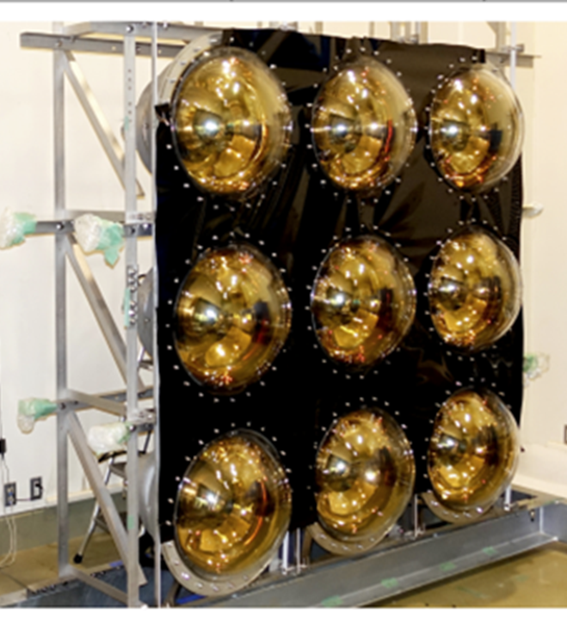
Particle Physics Programme
Highlights
The 2021 Particle Physics experiment Consolidated Grant has been announced.
£68M to support university groups and for M&O to the experiments.
Another challenging round and many groups have seen a reduction in staff effort.
There are significant risks to the delivery of UK international commitments.
The 2022 Particle Physics Theory Consolidated Grant is underway
Completed Mid-term reviews for ATLAS and CMS Phase 2 Upgrades including consideration of extended LHC schedule
Completed review of Hyper-K Construction – potential to fund from UKRI Infrastructure Fund
A mid-term review of DUNE will take place in October
The PPAP roadmap has been updated in response to the updated European Strategy for Particle Physics

Slide 20
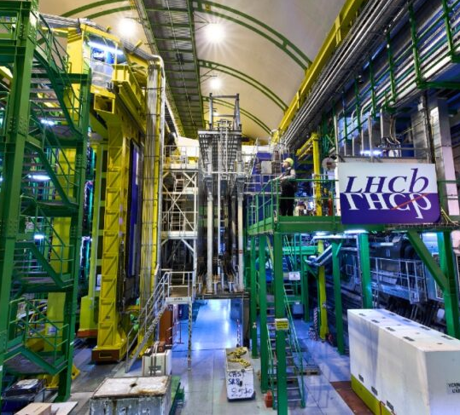
CERN
Highlights
STFC & BEIS are co-developing a UK Strategy for CERN:
To describe the vision for the UK’s membership of CERN and how we will get there
Aim for publication on gov.uk by the end of 2022
Addressing UK’s low industrial return from CERN:
In 2021, we completed autopsy of historic tenders to understand barriers to success and wider issues
Our team are now working with CERN on an action plan
Similar issues exist for the UK “HR return” and we are working on a skills return autopsy to describe the current picture and barriers to success.
VIP visits to CERN have included Minister for International Trade and the Science Minister George Freeman

Slide 21
Particle Astrophysics Programme
Highlights
Gravitational waves exploitation funded through consolidated grants
the current round awarded £7.6M plus £1.32M for ALIGO operations from Oct 2021 – Sept 2024
Projects across PA areas:
CTA pre-production (VHE gamma ray): £2.97M including extensions, end date was March 2022
ALIGO+ (GW): UKRI FIC award of £10.17M, Jan 2019 – Dec 2022
Two dark matter R&D projects Xenon Futures £630k, DarkSide UK £781k, both April 2021 – March 2024
Community representation is through particle astrophysics advisory panel (PAAP), who are just finishing a major update to their roadmap.
Notes:
STFC particle astrophysics covers Gravitational Waves, Dark Matter, VHE Gamma Ray, Neutrinos, and Theory.
Most exploitation is funded through the particle physics and astronomy consolidated grants

Slide 22
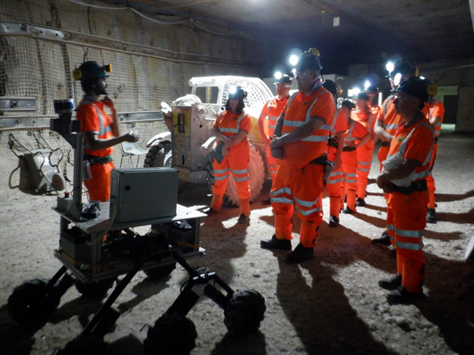
Boulby Underground Lab
Highlights
Ongoing science programme:
Astroparticle physics and Ultra-low background radiation science (for Dark Matter and material screening)
Earth and environmental science
Astrobiology and planetary exploration
AIT-NEO project - a US/UK study to develop neutrino detection techniques for nuclear security applications:
Due to earlier than planned closure of EDF power stations, Boulby will now host a smaller technology demonstrator
Plans for future expansion are being developed, including a community-led feasibility study, completed June 2021. Site has potential to host a major international next-generation rare-event project (e.g world-leading Dark Matter).

Slide 23
UKRI and STFC Fellowships
Highlights:
10 Ernest Rutherford Fellowships awarded - in the fields of particle physics, astronomy, solar & planetary science, and cosmology
11 new Stephen Hawking fellows awarded (joint STFC & EPSRC scheme)
Round 6 UKRI Future Leadership Fellowships awards to be announced in May
7 of 9 EPSRC Fellowship proposals sponsored by NQCC have been shortlisted for peer review. It is expected successful proposals will start in October
5 awards for STFC Centres for Doctoral Training for Data Intensive Science
220 DTP Doctorate Students awarded
UKRI has announced a consultation in the Post Graduate Research “New Deal”
Opportunity for physics community to respond with views.

Slide 24
Particle Physics: funding, financial sustainability and strategy
Notes:
The abstract pattern can be removed or repositioned if required. Be careful to ‘Send to Back’ so that it does not obscure any important information.

Slide 25
Context: Spending Review 2021
BEIS Allocations
BEIS research and development budgets announced 14 March
Headline figures:
* Includes ODA, ** includes Horizon Europe and Euratom Research and Training
 | 2022/23 (£m) | 2023/24 (£m) | 2024/25 (£m) | Total (£m)
UKRI | 7,908 | 8,373 | 8,865 | 25,146
BEIS Programmes* | 3,798 | 3,866 | 3,894 | 11,558
UK Contribution to EU Programmes** | 2,349 | 2,321 | 2,113 | 6,783

Slide 26
Context: Spending Review 2021
What does it mean for UKRI?
SR outcome should be viewed positively, particularly given the wider economic background
strong message from government about its commitment to research and innovation
FY22/23 allocation is slightly lower than FY21/22, but core R&D has been protected
Positive trends in FY23/24 and FY24/25 – new opportunities across UKRI
UKRI has given indicative allocations to councils and cross-cutting funding lines, but these are subject to BEIS sign off
Not certain, but now have a reasonable picture of the next three years
3-year settlement makes a big difference

Slide 27
Context: Spending Review 2021
What it could mean for STFC?
Things are going to be very tight in FY22/23
electricity cost inflation is a challenge
overall budgets are very tight, but the situation is manageable
Facilities: aim to operate ISIS ,CLF and Diamond at full capacity in 22/23
further energy cost increases in FY23/24 and FY24/25 are a significant risk
Infrastructure: aim to initiate a number of infrastructure projects, subject to funding through the UKRI infrastructure fund and infrastructure fund prioritisation
could include Diamond-II, ISIS Endeavour, Vulcan 2020, Hyper-K, …
Core Programme: strong desire to provide an uplift in national particle physics, nuclear physics and astronomy consolidated grants in FY23/24 and FY24/25
exploring what might be possible, but “sustainability” arguments are clear
Slightly speculative as the devil is in the details

Slide 28
Sustainability of the PPAN programmes
Over the past 10 years
international subscriptions have increased, e.g. CERN up by 40%
budgets have been essentially “flat” and costs of research have increased, e.g. PDRA costs up by over 40%
purchasing power of UK particle physics and astronomy programmes have decreased by approximately 30%
Impact over 10 years
number of PDRAs supported through CG has decreased by about 20%
at a time when the numbers of academics in AP and PP have increased
to protect numbers of early career researchers, STFC has:
reduced low TRL technology development to almost zero
squeezed academic FEC

Slide 29
A tipping point for national programmes?
I do not believe the current situation is sustainable
all levers (R&D and FEC “flexibility”) have been used up
if trends continue for another 5 or 10 years…
Require a different approach
As part of STFC’s SR input, I argued that we need to think about our international subscriptions (CERN) and national PP programme as a single programme, e.g. UK investment in particle physics
our national programme (e.g. consolidated grants) leverages the value from the (significantly larger) international subscriptions
a relatively small (e.g. 1 – 2 %) “above-inflationary” increase in the total programme (national + international), directed at our national programme has a very large impact
The economic marginal productivity case for increased investment in our national programme is compelling

Slide 30
What are we doing
We have
Reduced some non-core activities, will take advantage of cross-UKRI initiatives
We will
Rebalance our current R&D and commercialization activities, which are currently skewed heavily towards commercialization
rapidly ramp up a new “PRD-like” blue-skies technology R&D scheme, aiming for ~£2.5m pa within this SR period
matched by a simplify the approach to funding commercialization activities and look to build stronger pathway to Innovate UK
Subject to affordability (post SR), we are planning to:
prioritise year-on-year “above inflationary” increases in CG funding, starting from FY23/24:
this will leverage more value from international subscriptions

Slide 31
What are we doing
Light-touch Strategic Review of Particle Physics:
In consultation with STFC Council, we have initiated a light-touch strategic review of particle physics:
Will provide guidance on a refreshed strategic framework for particle physics
Will not prioritise projects – this is not a project prioritization exercise
Covers particle physics, including Dark Matter searches, and the accelerator and computing disciplines that support the field
Will report back to STFC Council this autumn
Prime aim is to consider how to best ensure the long-term health of PP in the UK
Review Panel consists of:
Brian Foster, University of Oxford, Review Chair
Sinead Farrington, University of Edinburgh
Nigel Glover, Durham University
Mark Lancaster, University of Manchester
Jocelyn Monroe, Royal Holloway University of London
Monica D’Onofrio, University of Liverpool
Mitesh Patel, Imperial College London
Alfons Weber, University of Mainz

Slide 32
What are we doing
Strategic Review of Particle Physics – Terms of Reference:
Lessons learnt from the last ten years regarding the scientific and/or investment decision-making processes within STFC
Considerations that determine the appropriate balance between R&D, capital construction, M&O and scientific exploitation
Ensuring the UK programme effectively leverages the investment in the membership of CERN?
Appropriate levels of early-stage technology R&D funding.
How and when should the UK engage in R&D phase for the next generation of colliders/experiments
Essential elements within the strategic framework
Key international decision points in the coming decade that will affect forward planning and influence the shape of the future UK particle physics programme
Community input + webpage
Already a great deal of material in the PPAP report – so adopting a light-touch approach
Community views on the questions above can be submitted through: https://www.surveymonkey.co.uk/r/RWQMCFN

Slide 33
Summary
Notes:
The abstract pattern can be removed or repositioned if required. Be careful to ‘Send to Back’ so that it does not obscure any important information.

Slide 34
Summary and outlook
Positive news
Returning to (new) normal working and in-person meetings !
We will soon have 3-year spending review allocations to STFC
overall picture is reasonably positive
not just a roll-over of funding or activities
UKRI Infrastructure Fund provides a route for investment in research and innovation infrastructure across the entire research system from social sciences to fundamental physics
Concerns
Direct and indirect impacts of the Russian invasion of Ukraine
Inflationary pressures
Overall
STFC is in a pretty good place – a number of reasons for optimism

