Slide 1
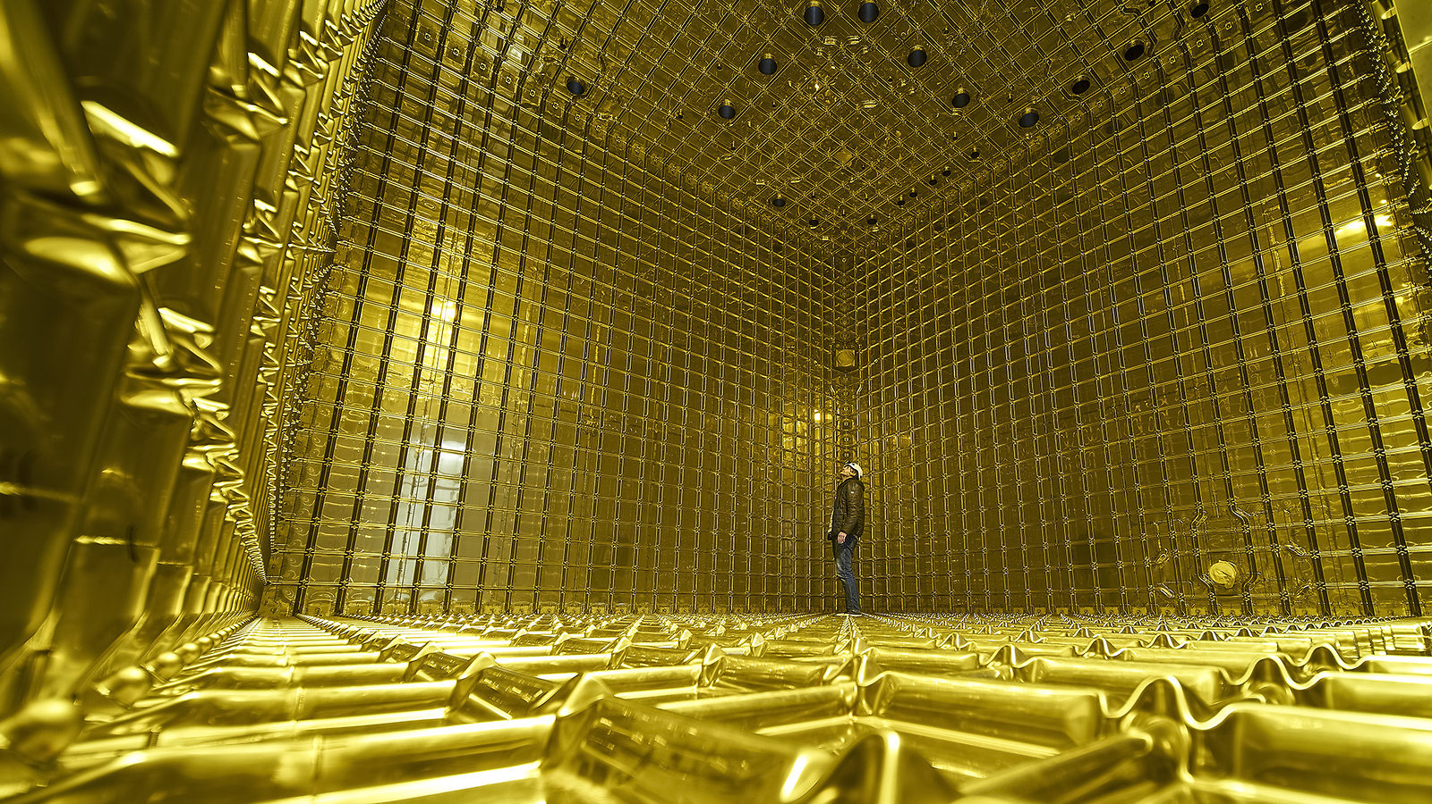
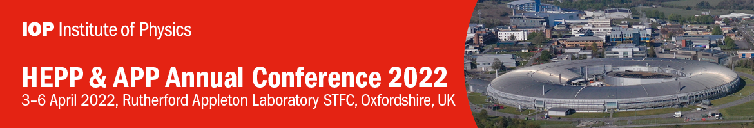
Neutrino Oscillation Experiments
Stefan Söldner-Rembold, University of Manchester

Slide 2
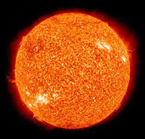
Pontecorvo–Maki–Nakagawa–Sakata Matrix
See talk by Melissa Uchida this morning
θ₁₃: mixes 𝜈_{e} with 𝜈₃
δ: complex phase
θ₁₂: “solar mixing angle”
mixes 𝜈_{e} with 𝜈₁ and 𝜈₂
θ₂₃: “atmospheric mixing angle”
mixes 𝜈_{𝜇} with 𝜈_{𝜏}

Slide 3
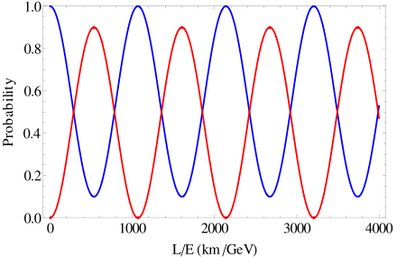
Neutrino flavour oscillations
Rate driven by mass splitting Δm²
Amplitude driven by mixing angle sin²(2θ)

Slide 4
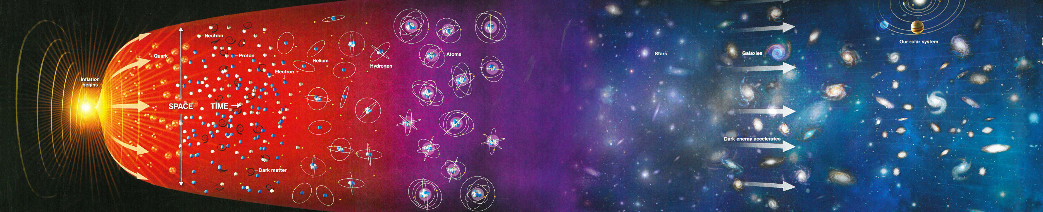
The PMNS Matrix and CP violation
complex CP phase
CP Violation involving neutrinos might provide support for Leptogenesis
as mechanism to generate the Universe’s matter-antimatter asymmetry.
Caveat:
No direct evidence for Leptogenesis, since a model is needed to connect the low-scale CPV observed here to high-scale CPV for heavy neutrinos that lead to Leptogenesis.

Slide 5
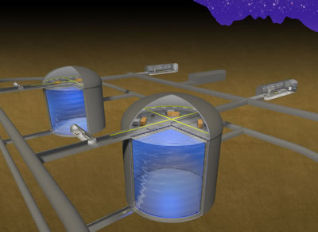
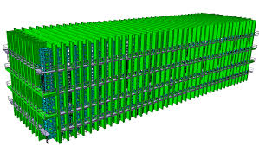
Optimizing detectors for neutrino oscillations
L/E(1st max) = 500 km/GeV
L/E (2nd max) = 1700 km/GeV
L ≈ 300 km
no matter effects.
use narrow width neutrino beam (off axis) with E < 1 GeV
observe first oscillation maximum
“counting experiment”
Water Cherenkov (HK)
L = 1300 km
matter effects
use broad-band neutrino beam (on axis).
observe first and second oscillation maximum.
unfold CP and MO effects through energy dependence
Liquid argon (DUNE)

Slide 6
ν_{𝜇} → ν_{e} appearance sensitive to δ

Slide 7
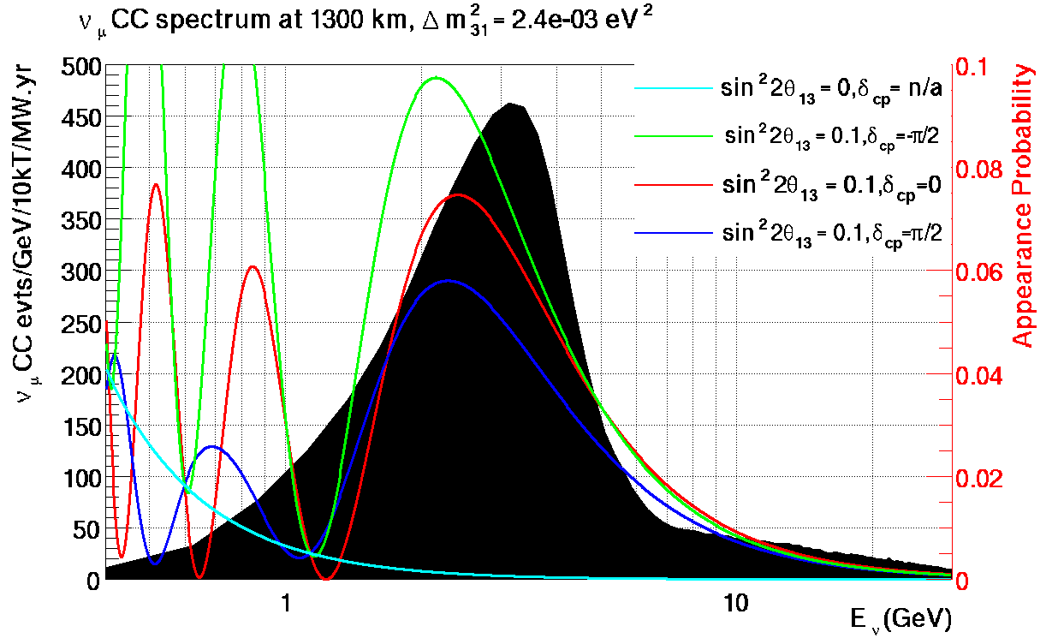
ν_{𝜇} → ν_{e} appearance sensitive to δ

Slide 8
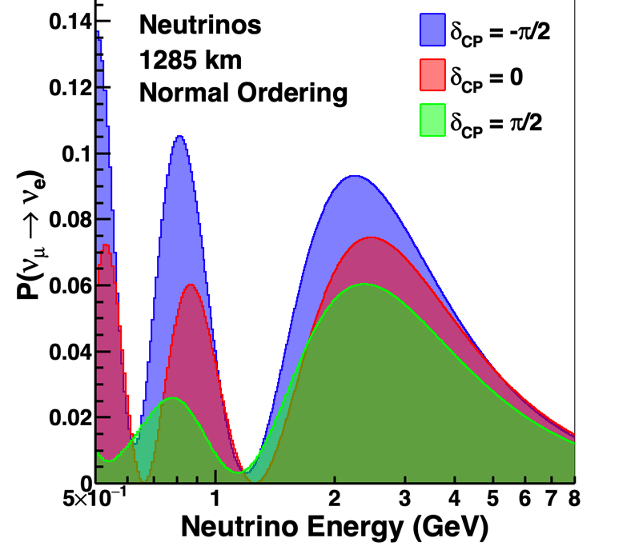
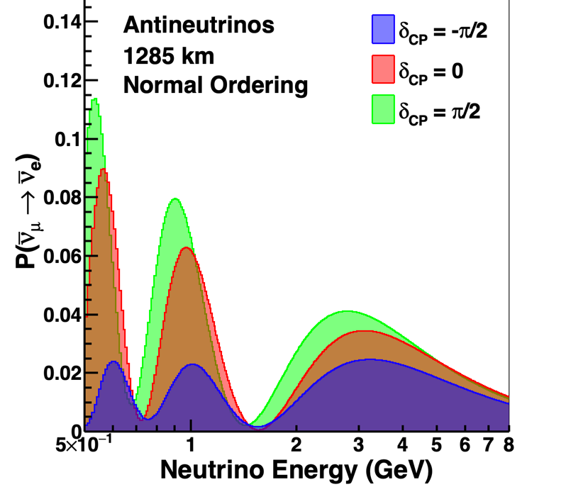
ν_{𝜇} → ν_{e} appearance sensitive to δ

Slide 9
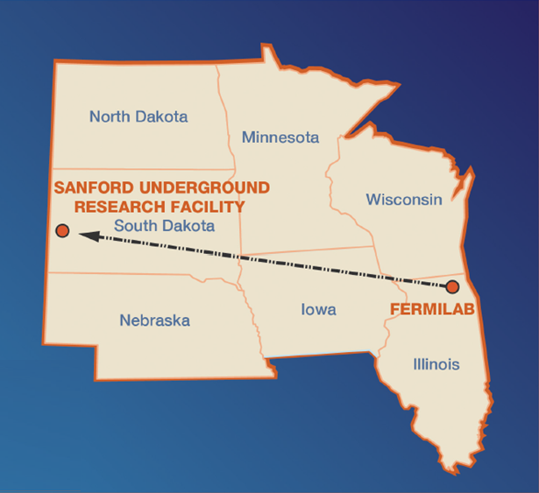
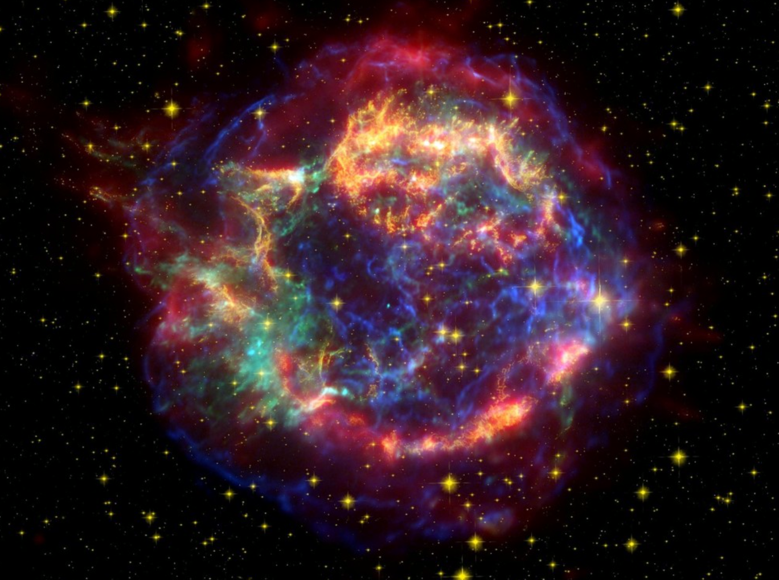
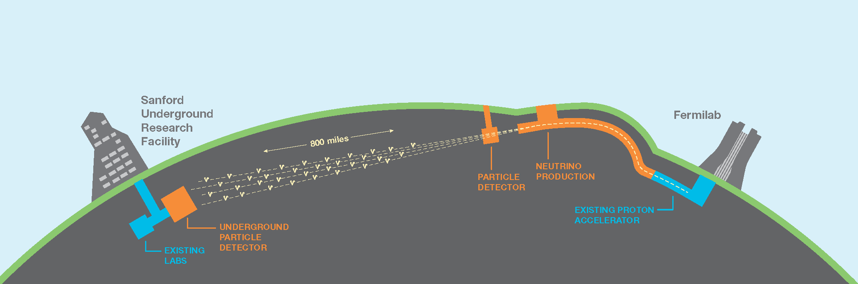
DUNE in a Nutshell
May 2018
1300 km
FD
ND
  A high-power, wide-band neutrino beam (~ GeV energy range).
  A ≈ 70 kt liquid-argon Far Detector in South Dakota, located 1478 m underground in a former gold mine.
  A Near Detector located approximately 575 m from the neutrino source at Fermilab close to Chicago.

Slide 10
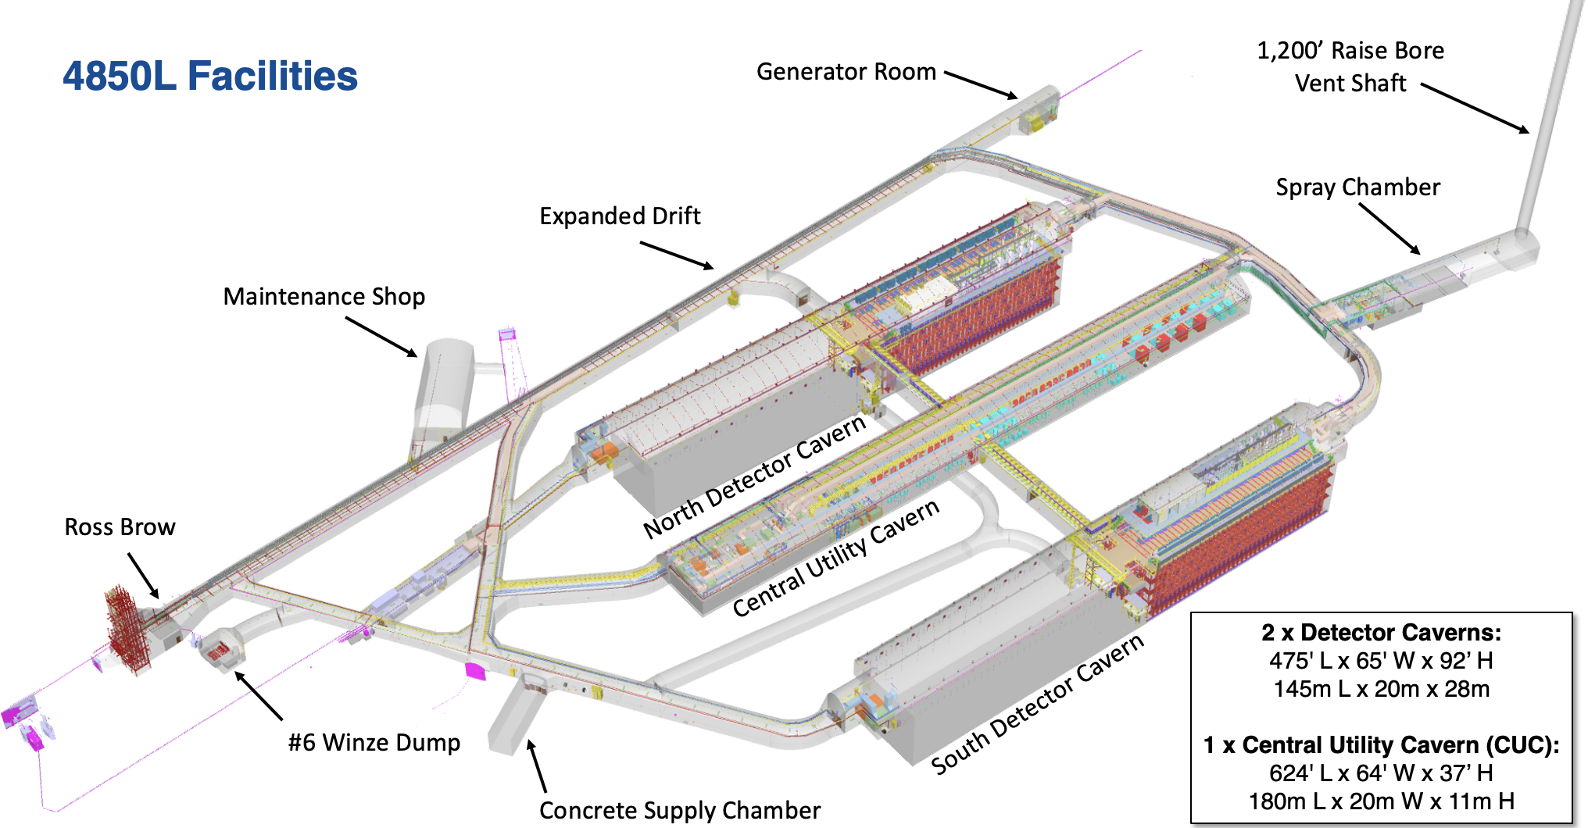
DUNE Caverns

Slide 11
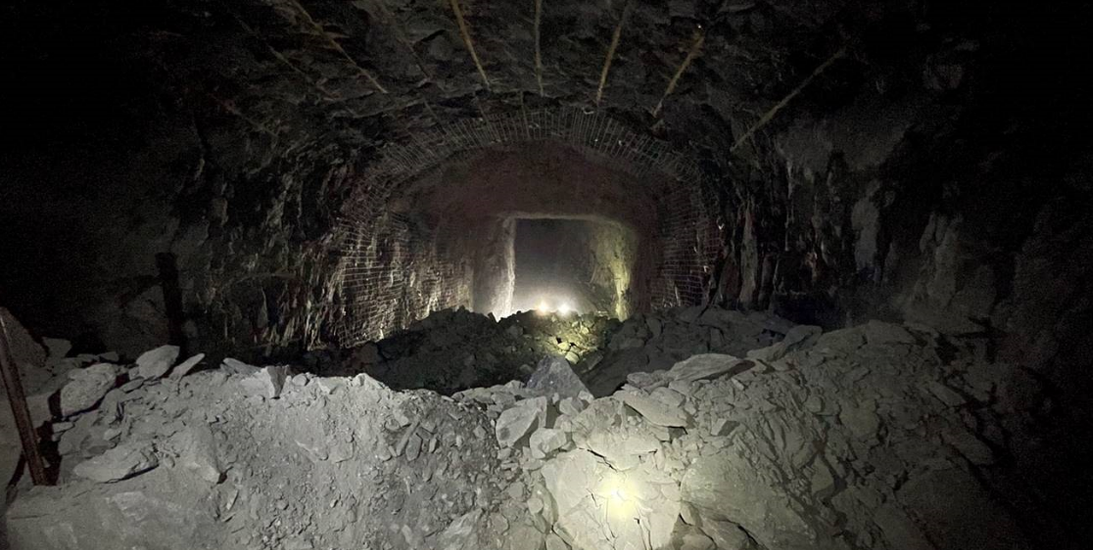
Central Utility Cavern Pilot Drift Breakthrough
12 Feb 2022

Slide 12
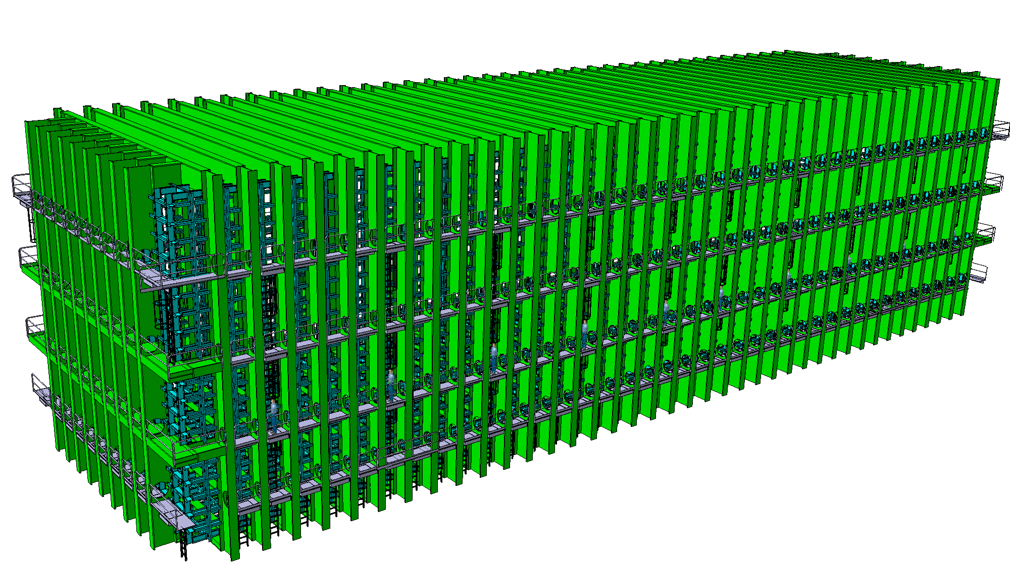
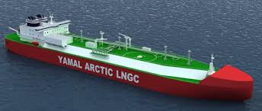
Four cryostats filled with liquid argon
Each of the four cryostats contains 17,000 tons of liquid argon at 89 K (-184°C or -299°F)
External Dimensions: 19 m x 18 m x 66 m

Slide 13
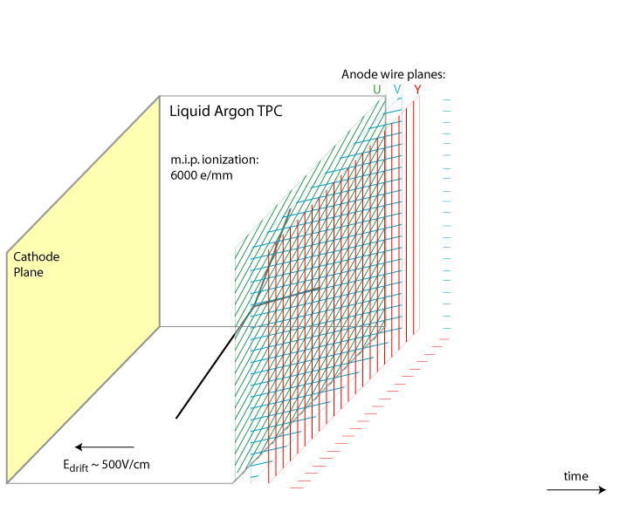
DUNE: Liquid-argon Time Projection Chamber
See talk by Melissa Uchida
170 kV
(=500 V/cm)
time
3.4 m → 2.13 ms

Slide 14
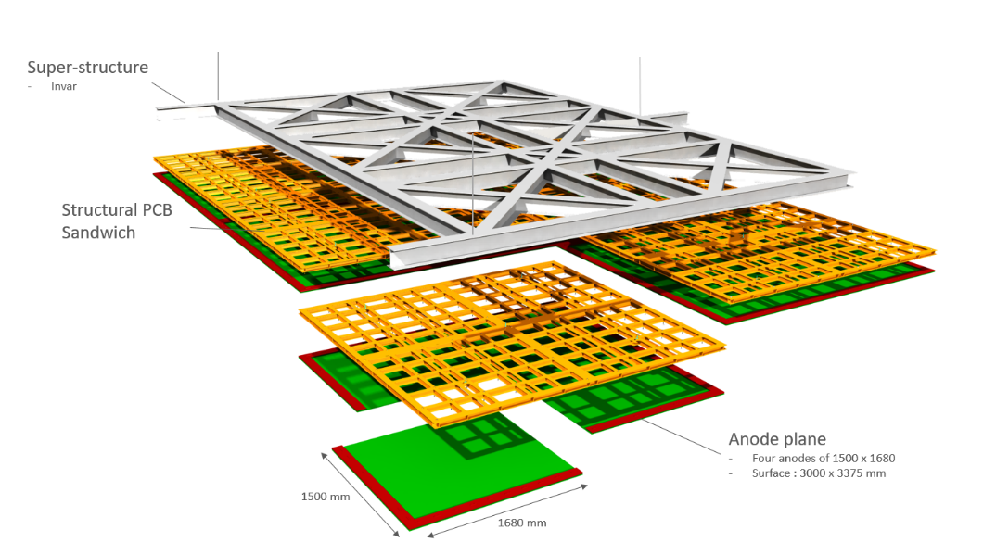
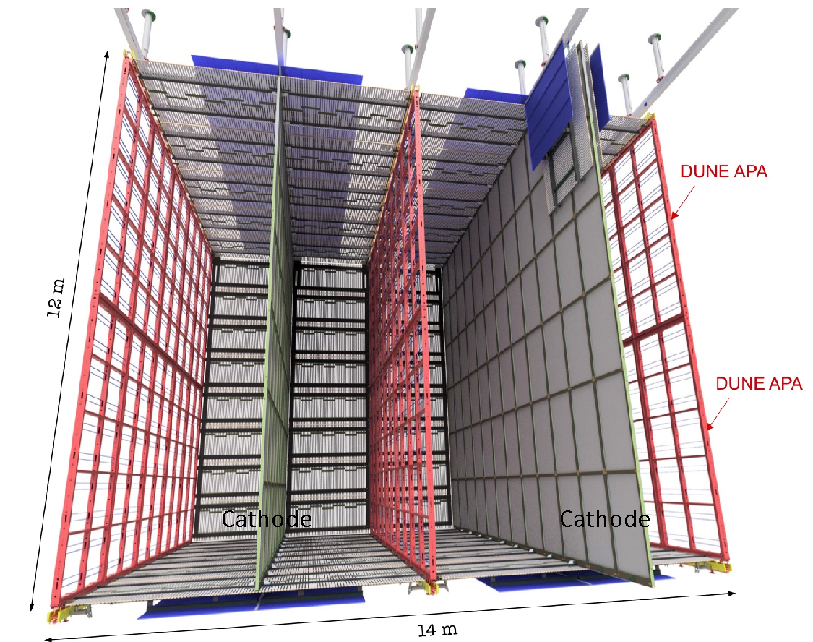
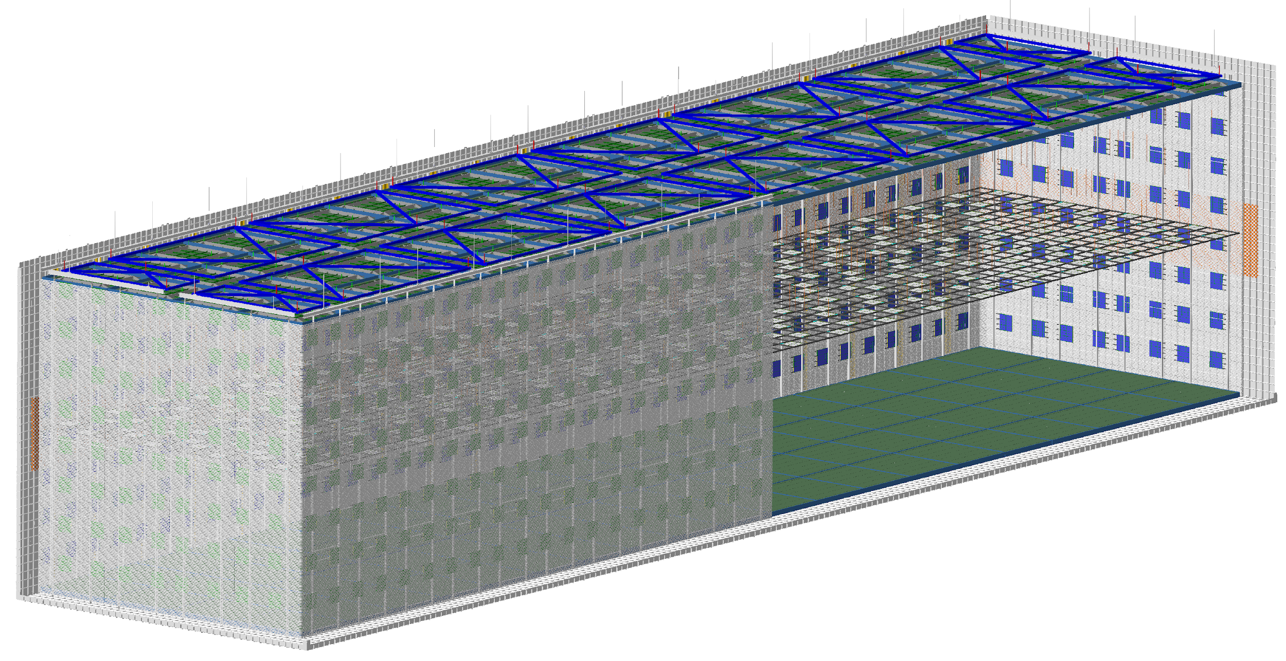
Horizontal and Vertical Drift
Cathode
APA
CRP
Cathode
Charge produced in neutrino interaction drifts horizontally and is read out by large wire planes (APAs).
Charge produced in neutrino interaction drifts vertically and is read out by strips on printed circuit boards mounted on a charge readout plane (CRP).

Slide 15
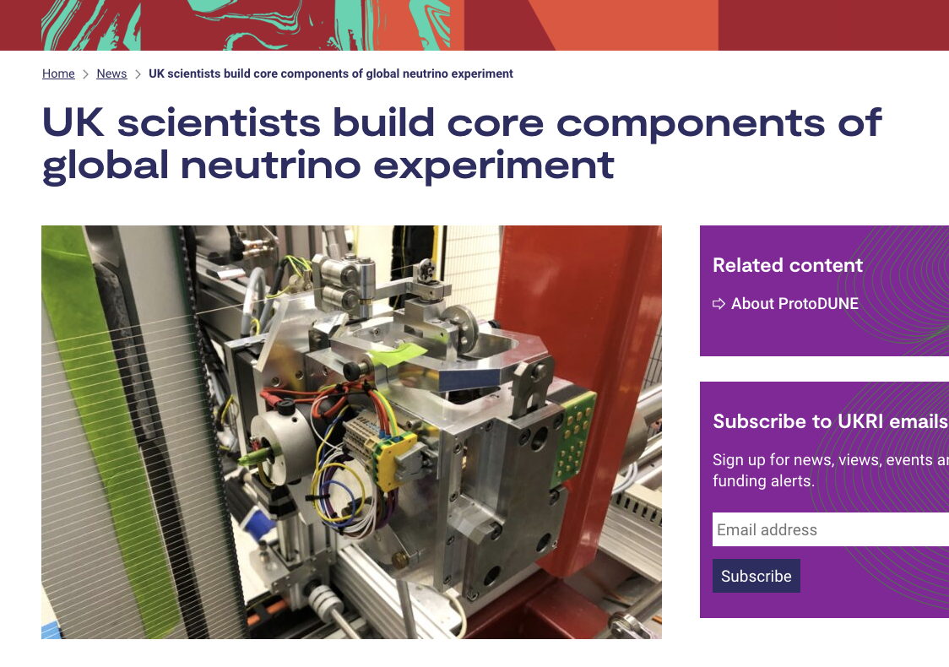

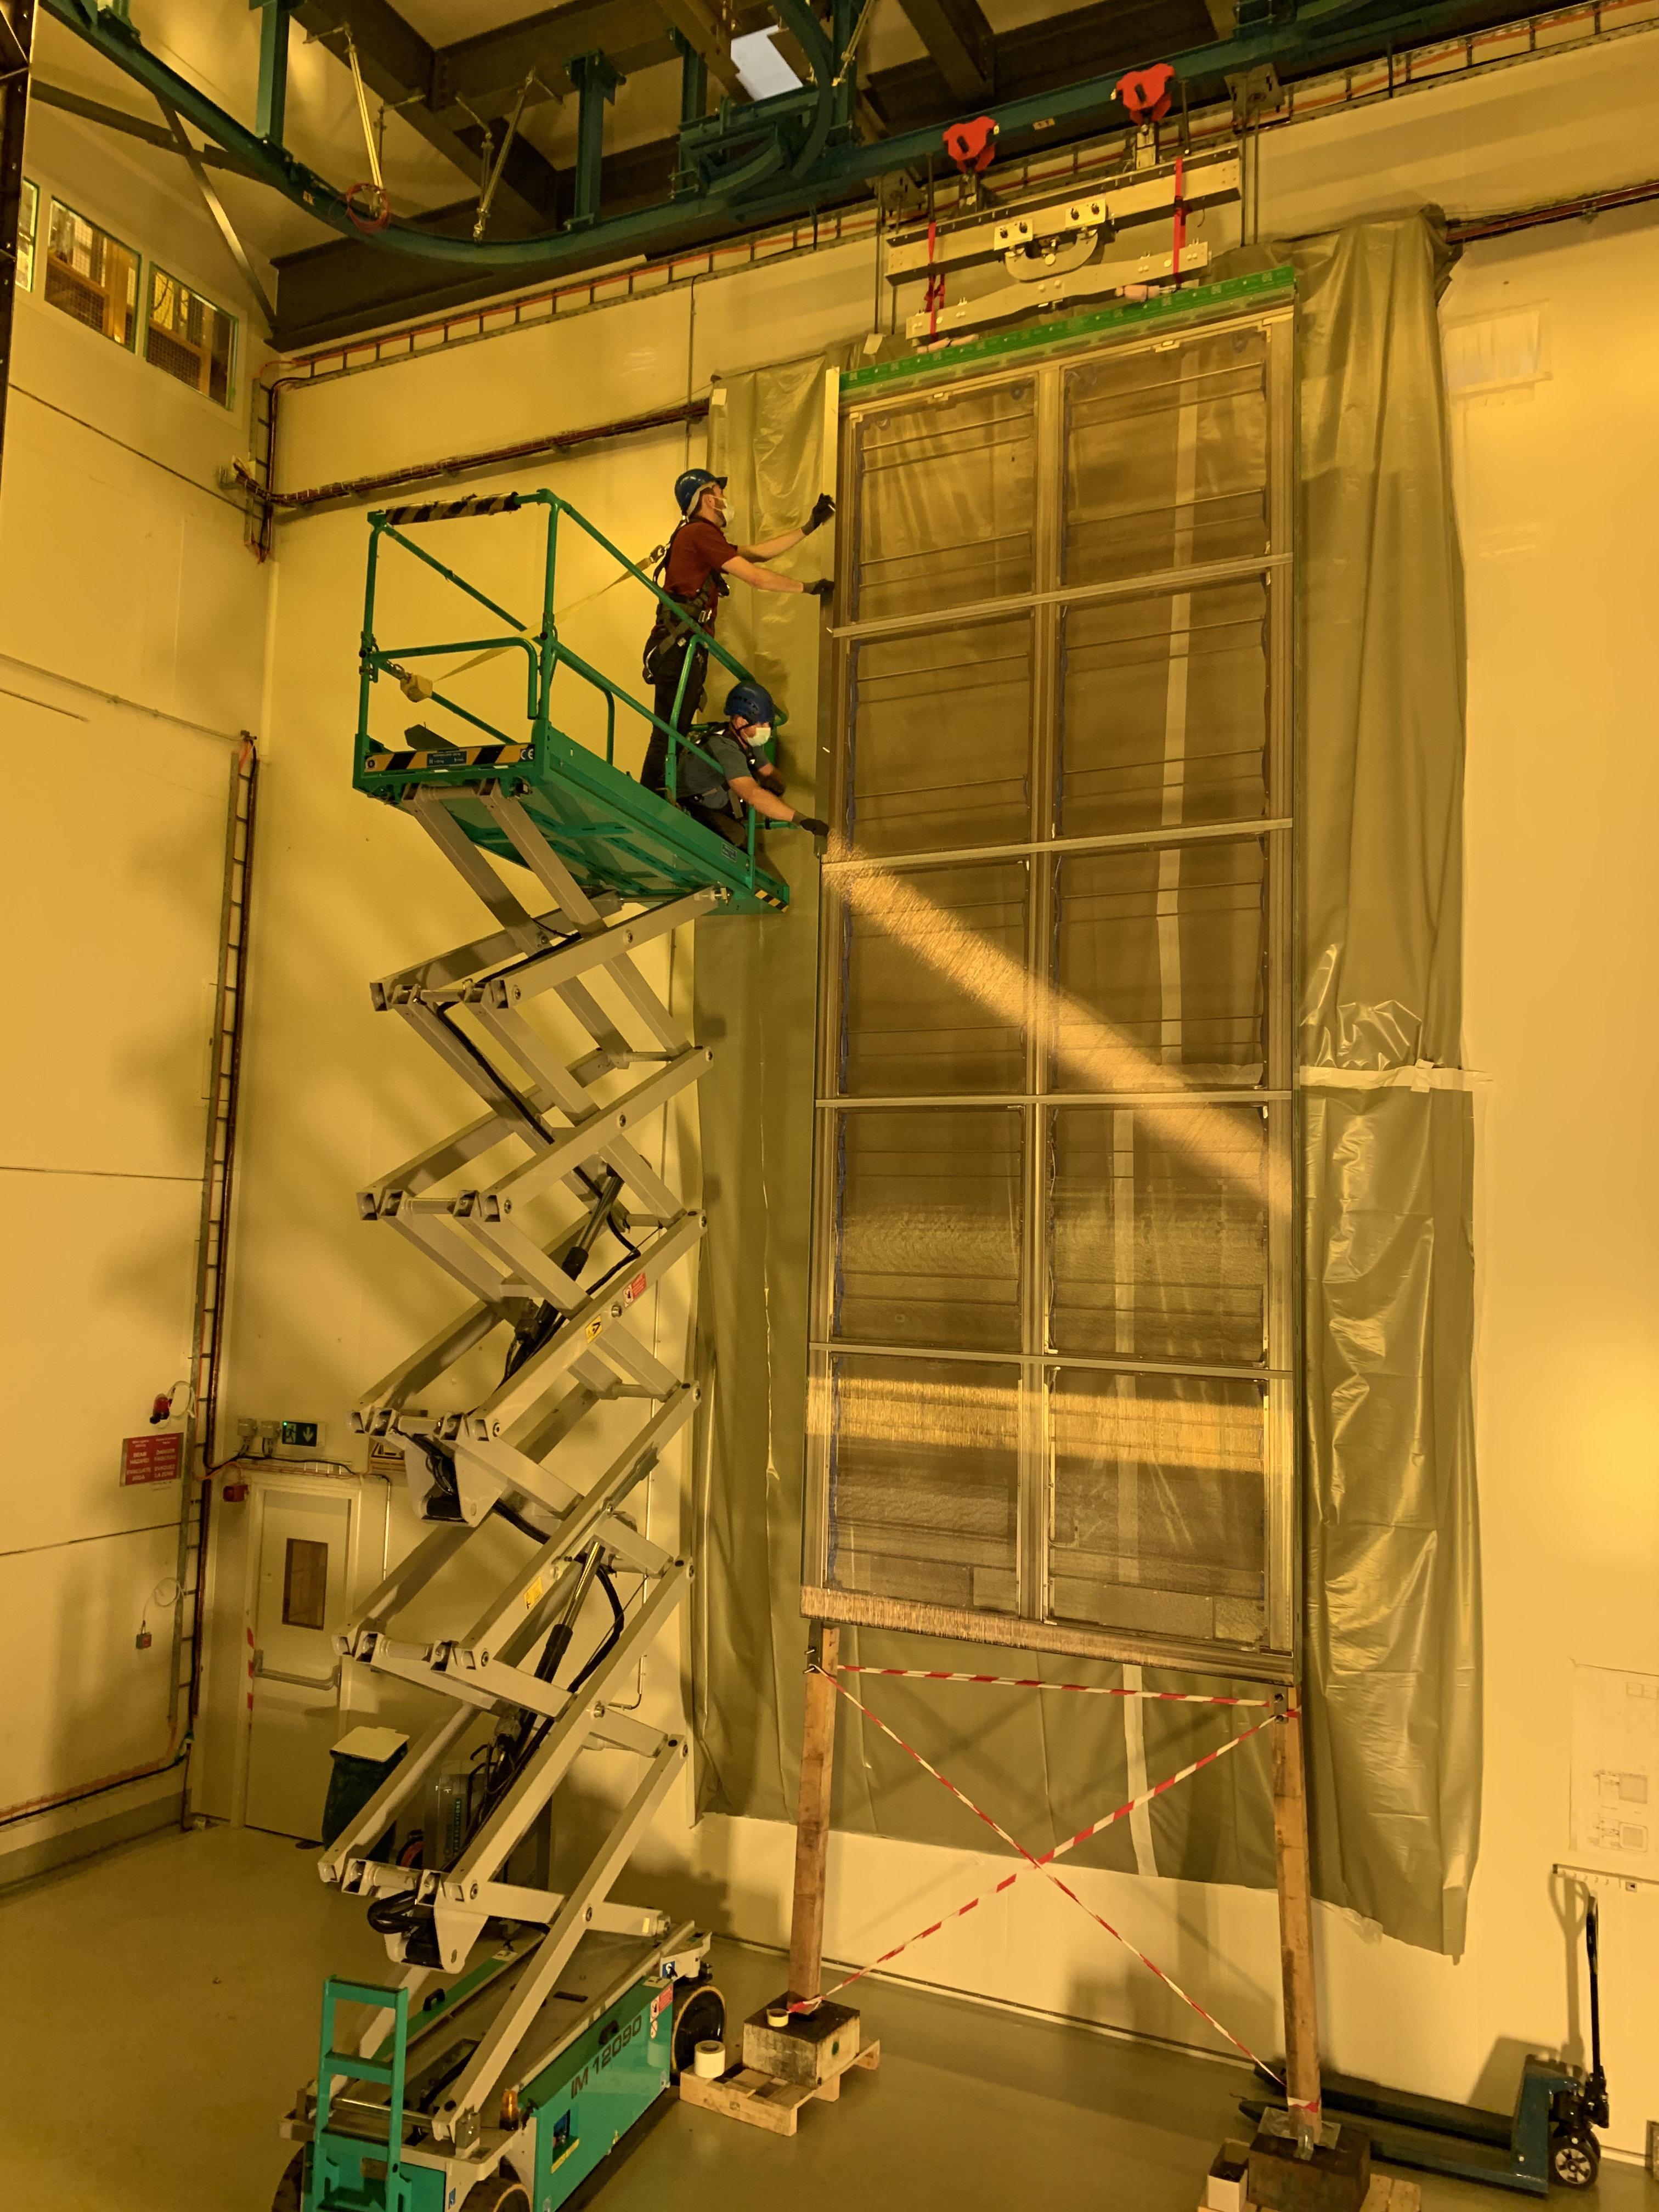
Module 1: Horizontal Drift
ProtoDUNE at CERN
150 Anode Plane Assemblies (APA)
130 in UK and 20 in US

Slide 16
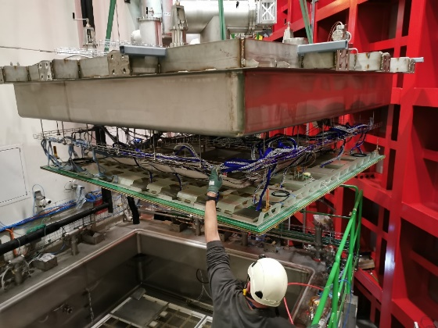
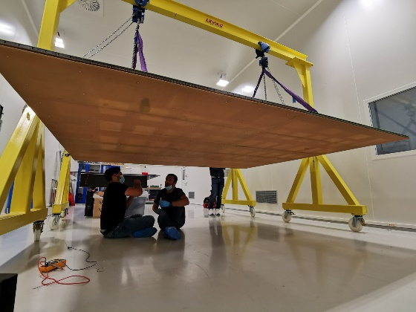
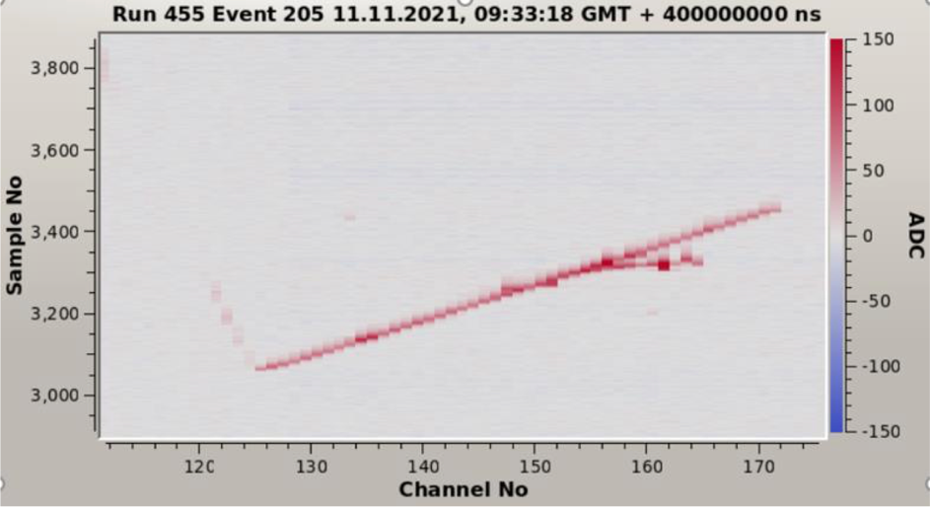
Module 2: Vertical Drift
Successful tests at CERN, leading to design of ProtoDUNE Module-0 for Vertical Drift.

Slide 17
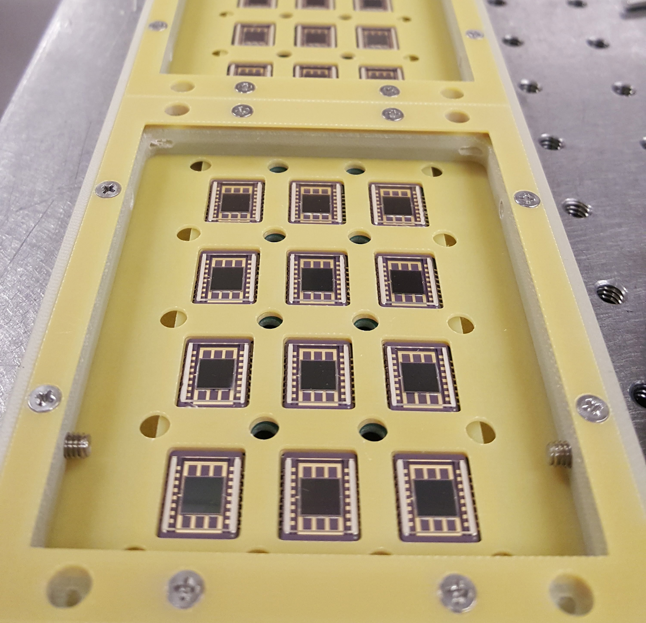
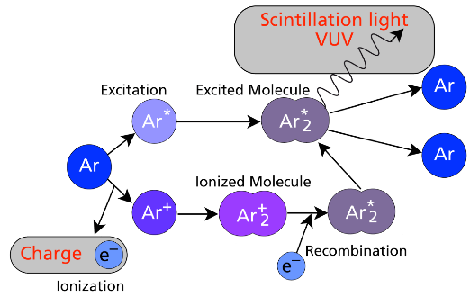
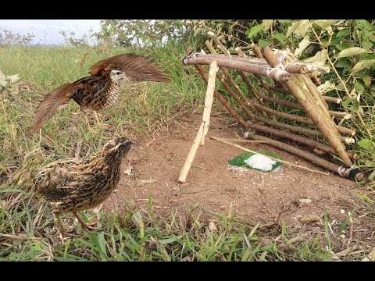
Photon Detection
128 nm
LArTPCs rely on light for event reconstruction and timing.
“Arapuca” light trap technology developed by Brazilian groups.

Slide 18
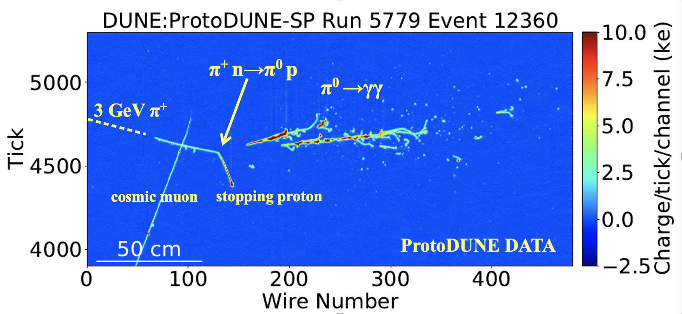
A ProtoDUNE-HD Data Event
Reconstruction of events performed by PANDORA framework with the use of Grid computing resources, both areas UK-led.

Slide 19
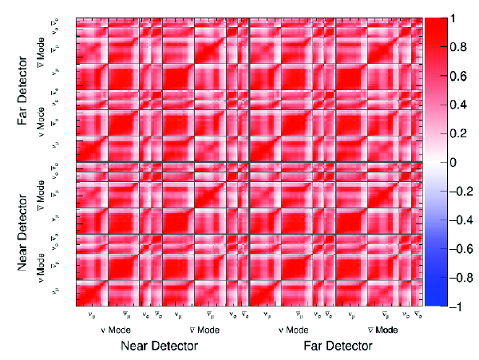
DUNE Phase I Near Detector
We expect to replace TMS by a gas-argon TPC for Phase-II.
TMS measures muons not captured by ND-LAr
TMS/LAr sideways movement (PRISM) probes different neutrino energies
Systematics
SAND provides on-axis monitoring of time-stability of beam
ND-LAr measures neutrino interactions on argon using TPC technology (equivalent to FD).
Near Detectors constrain systematic uncertainties for long-baseline oscillation analysis
    Neutrino flux & cross-section, and detector systematics
In addition, >100 million interactions will also enable a rich non-oscillation physics programme (e.g. BSM).

Slide 20
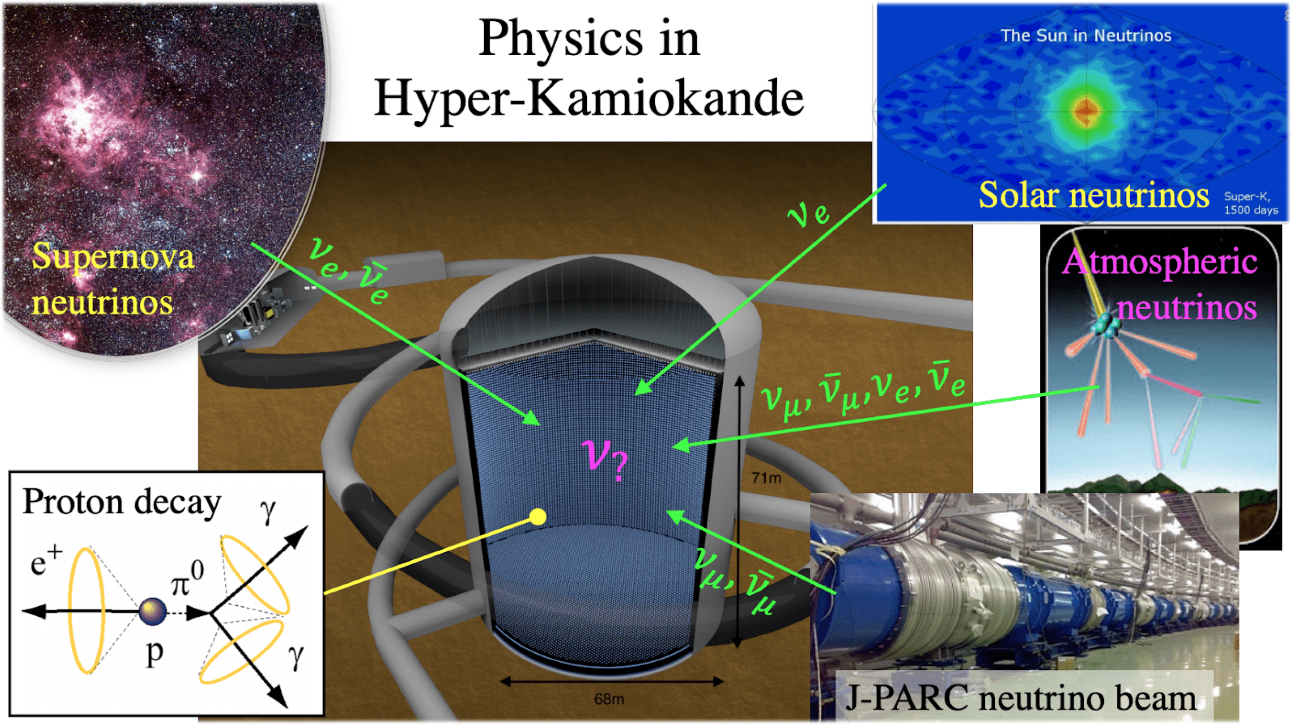
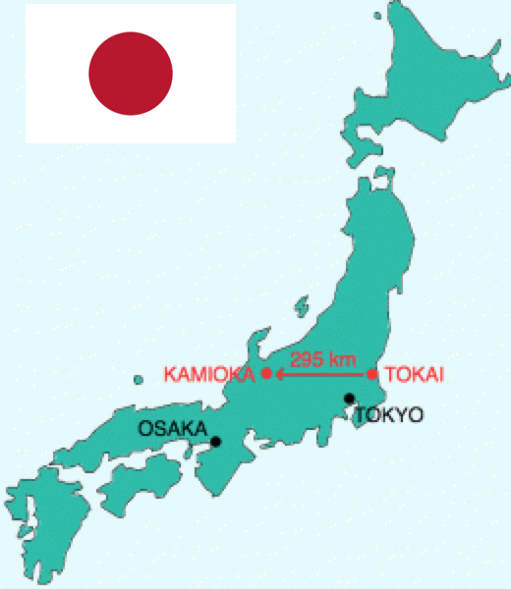
HyperKamiokande in a Nutshell
Thanks to
Francesca Di Lodovico
8.4 times larger fiducial mass (190 kiloton) than SK with double-sensitivity PMTs
New (IWCD) and upgraded (@280m) Near Detectors to control systematic uncertainties.
J-PARC neutrino beam to be upgraded from 0.5 to 1.3 MW

Slide 21
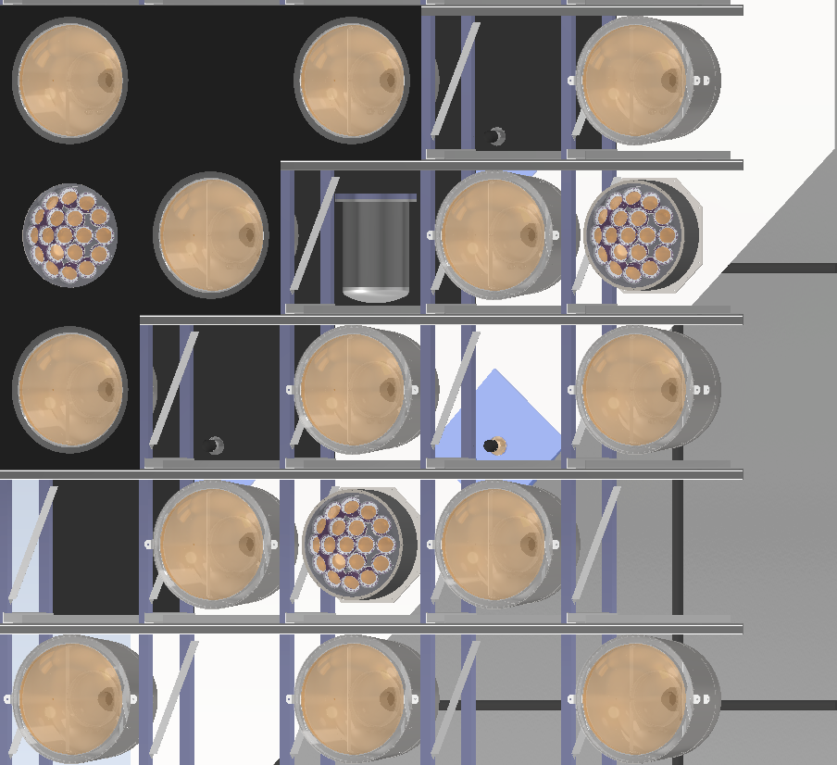
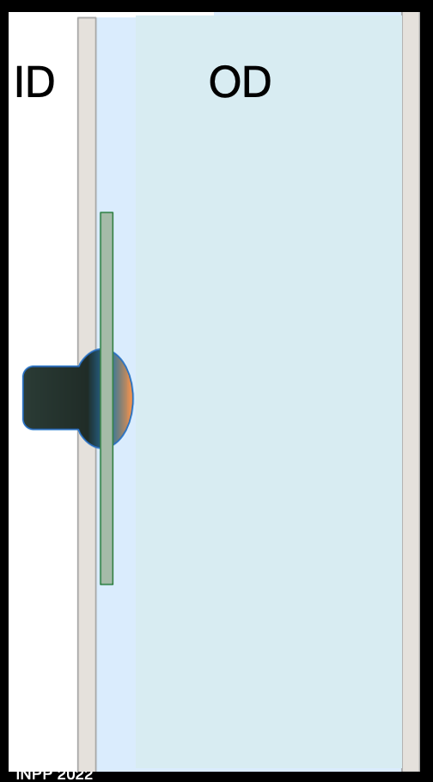

HyperKamiokande
50 cm PMTs
Electronics
Outer Detector
mPMT
)

Slide 22
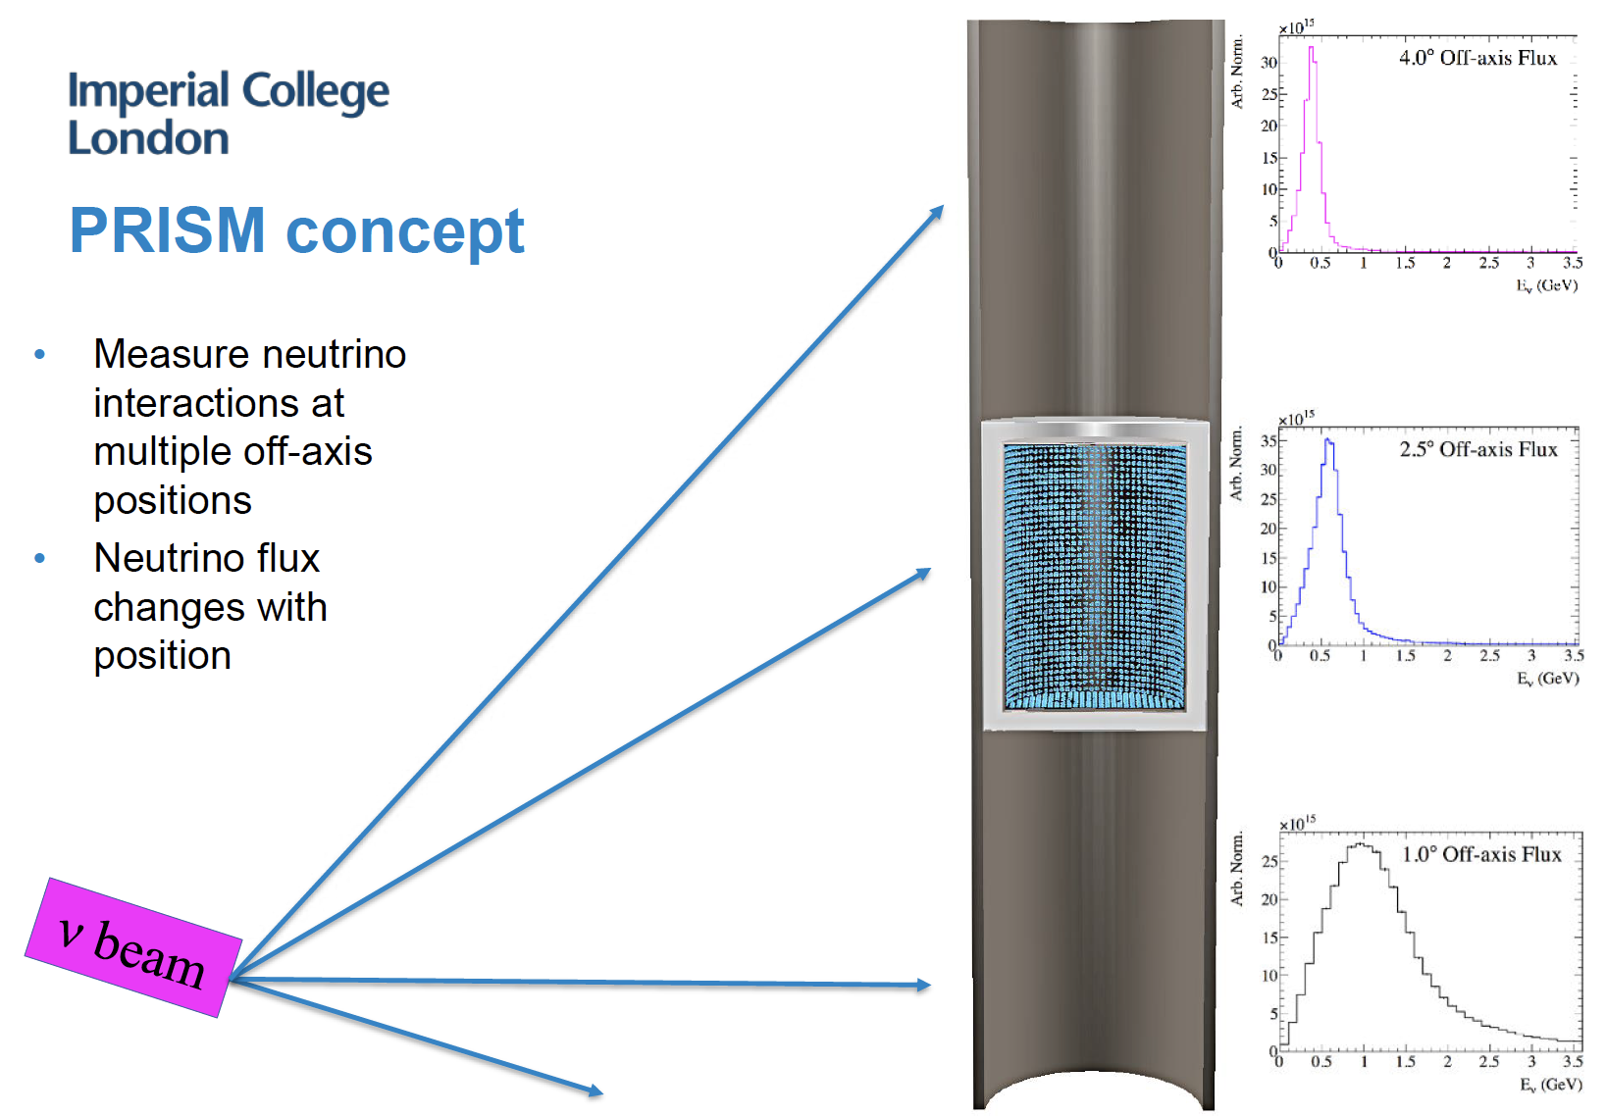
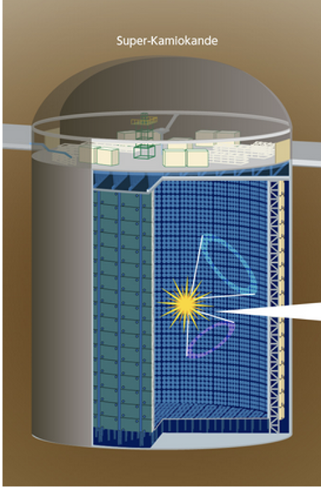
  PMT frame moving inside 10 m wide and 50 m high cylinder with water
  ICWD located at ~1-2 km, scanning the beam from 1˚ to 4˚ off-axis angle

Slide 23
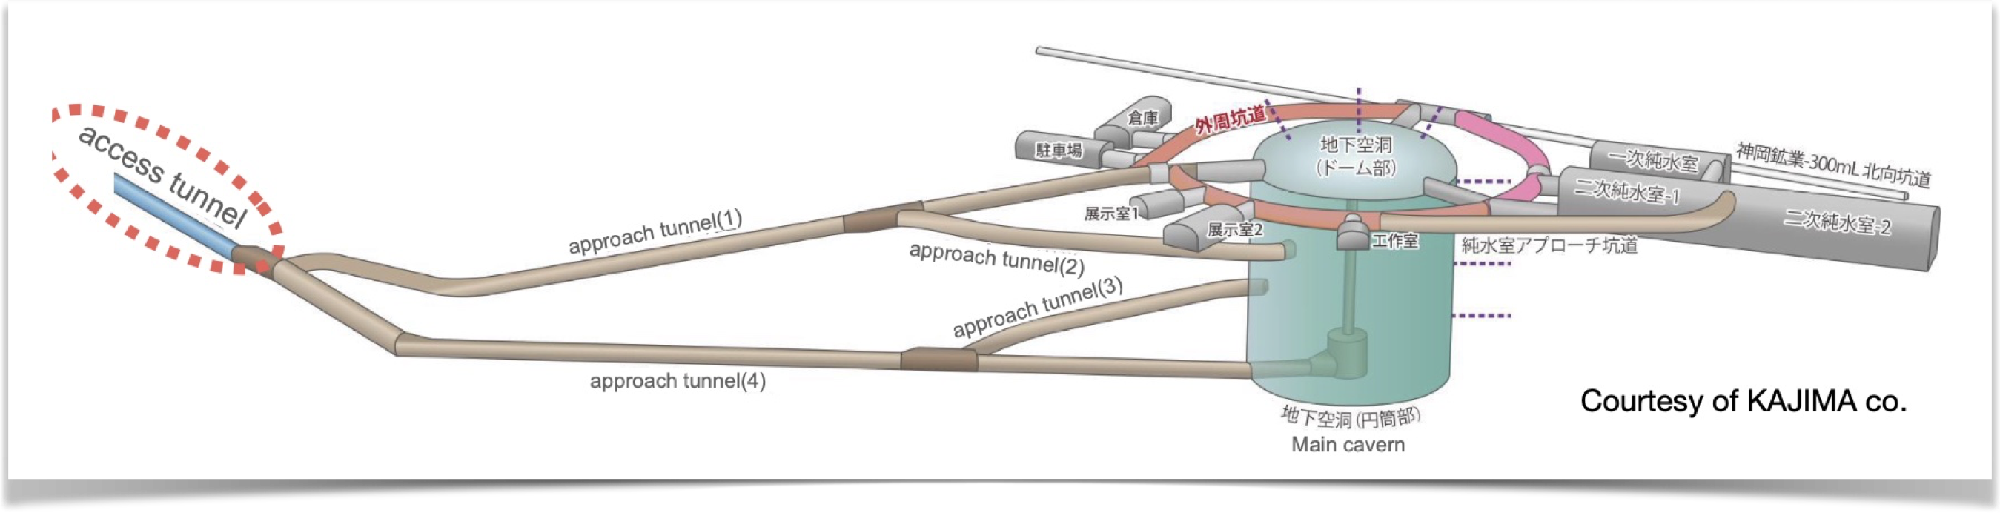
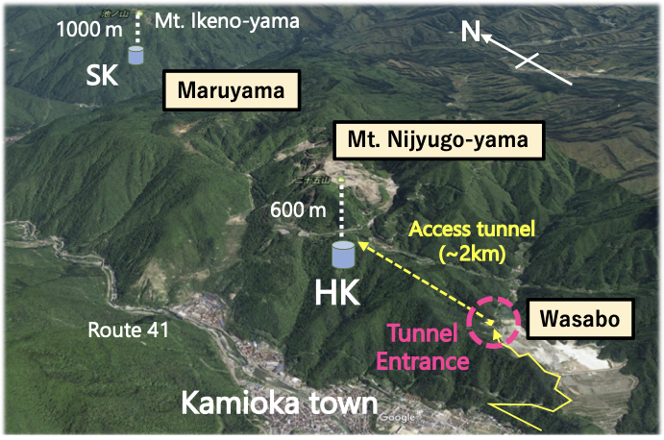
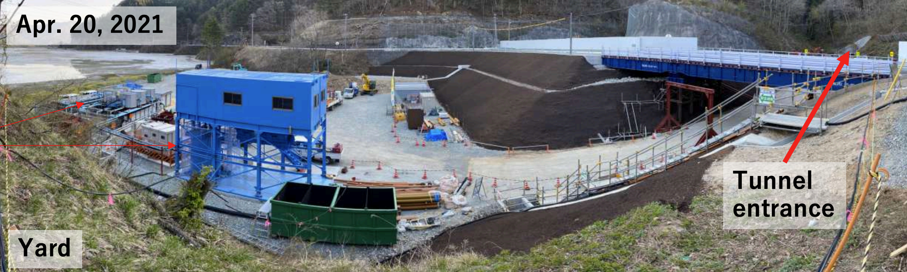
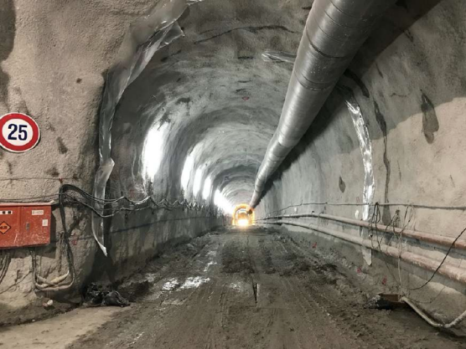
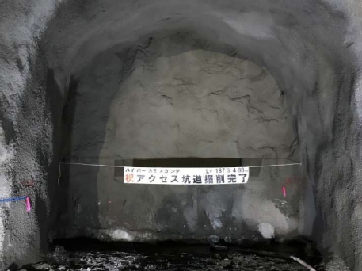
HK Access Tunnel
1 Nov 2021
Start of tunnel excavation
Access tunnel (1873 m) completed in February 2022 and work on approach tunnel has started.
25 Feb 2022 2021
Start of tunnel excavation

Slide 24
How to make a neutrino beam
Protons on target → charged pions → neutrinos
Since neutrinos cannot be focused, we focus the charged pions so that the decay products travel forwards, using a magnetic focusing horn.
Neutrino flux depends on hadronic cross sections, description of beam line..
Major UK contributions (through STFC/RAL) to PIP-II, neutrino beam targets.

Slide 25
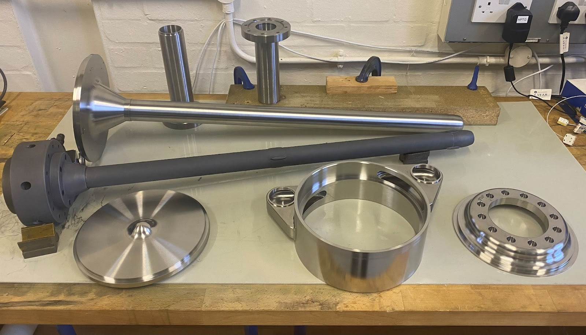
How to make a neutrino beam
T2K 1.3 MW prototype target production
All graphite and titanium parts ready for final assembly and welding.

Slide 26
Schedules
DUNE Phase I:
  Far Detectors (first two modules) operation in 2029
  Beam (1.2 MW) in 2030
  Near Detector (SAND, TMS+NDLAr, PRISM) in 2031
DUNE Phase II:
  Modules 3 and 4
  Beam upgraded to 2.4 MW
  Upgrade to Near Detector (gas-argon)
HyperKamiokande:
  Commissioning 2026
  Far Detector operation in 2026

Slide 27
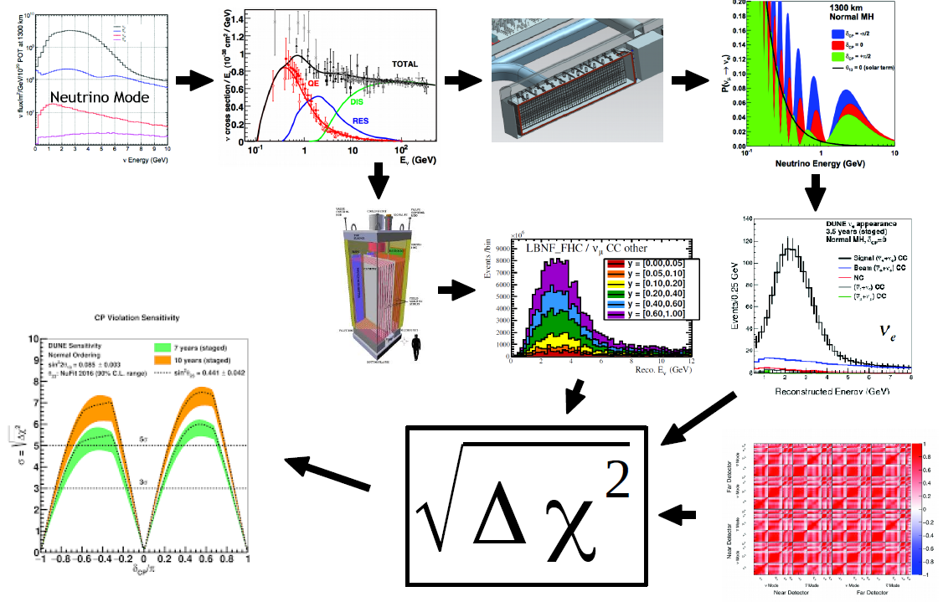
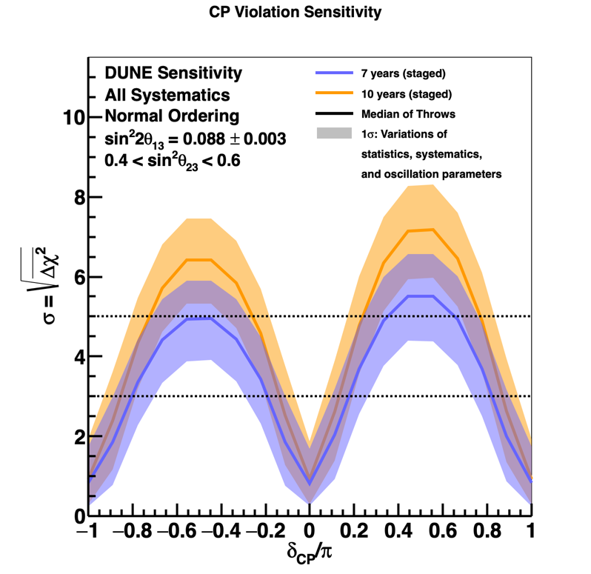
𝜈 Flux 𝜈-Ar Interactions Far Detector Oscillations
ND and FD Spectra
Near Detector
Final Sensitivity
Statistical Test
Systematics

Slide 28
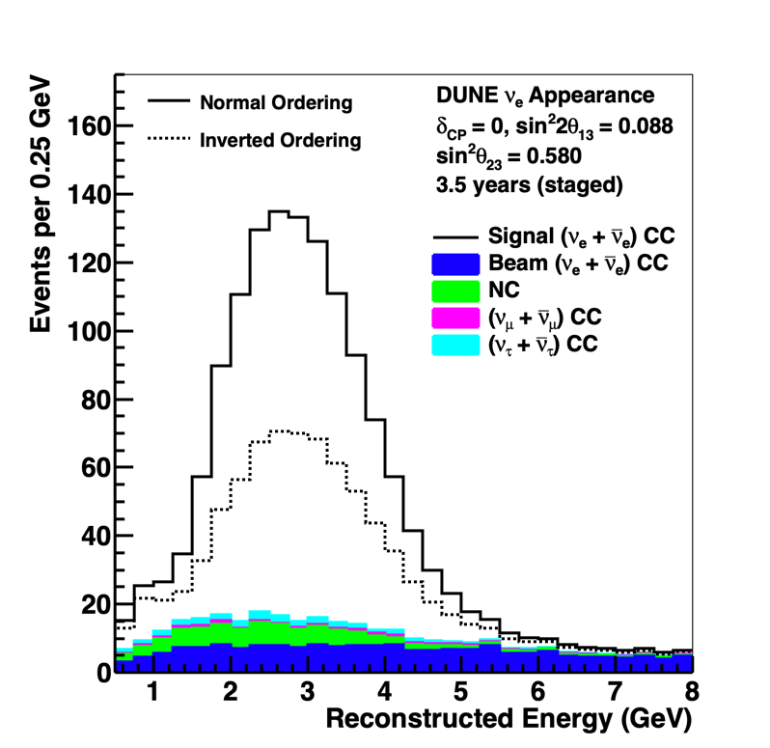
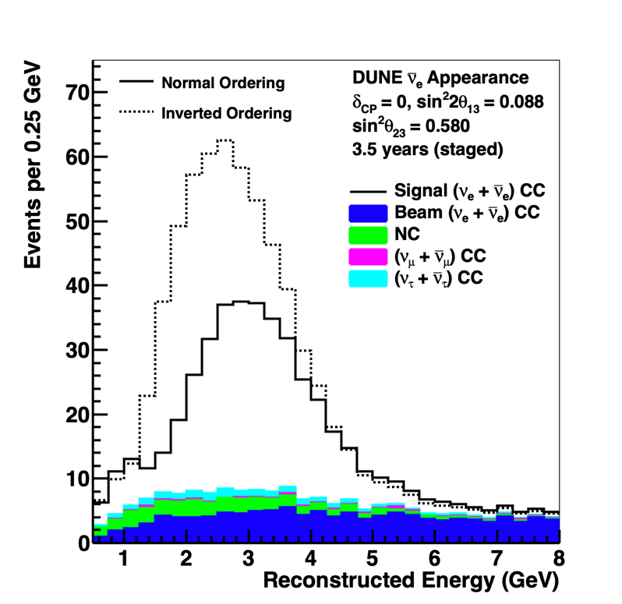
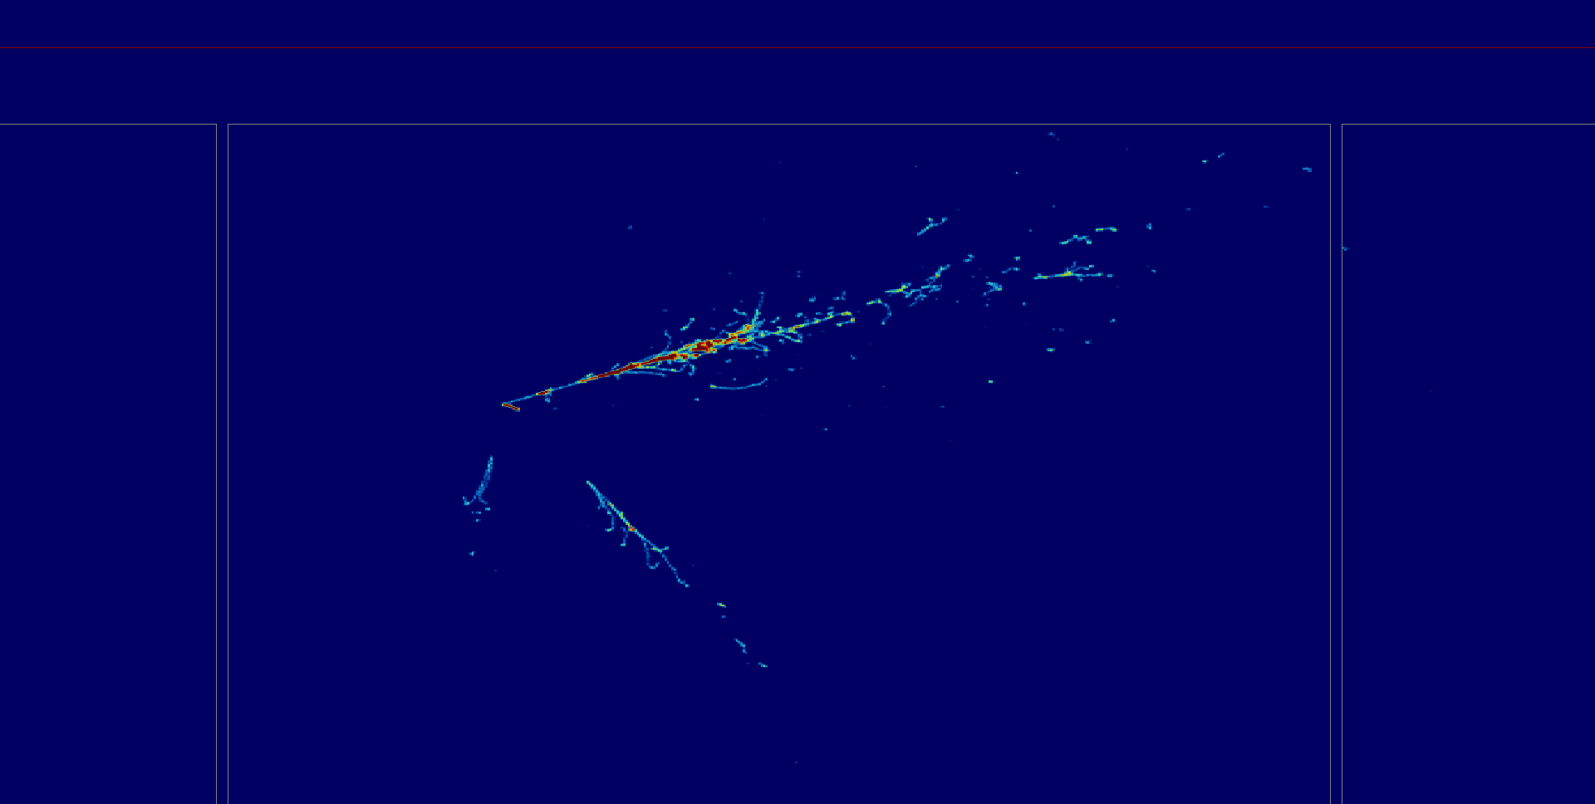
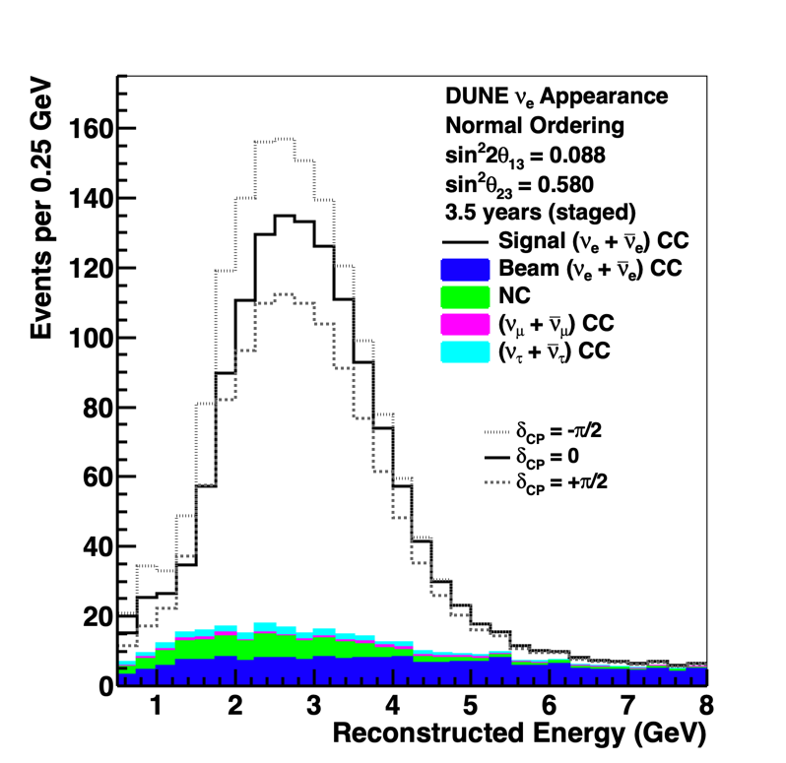
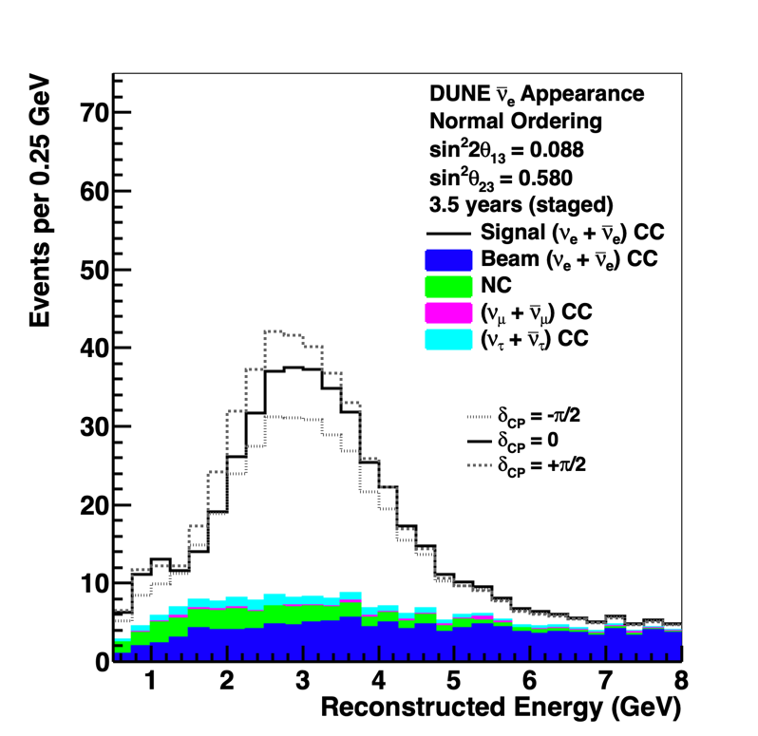
DUNE simulation
7 years
variation with
mass ordering
𝜈_{e}
𝜈͞
𝛍
DUNE FD1-HD simulation
2.5 GeV ν_{e}→e p π⁰
𝜈_{e}
𝜈͞ ‍
𝛍
variation with 𝛿_{CP}
DUNE: Science and Status

Slide 29


DUNE: Sensitivity to CP Violation
5σ discovery potential for CP violation over >50% of δ_{CP} values
7-16° resolution to δ_{CP}, without reliance on other experiments

Slide 30



DUNE: Unitarity tests
Daya Bay unc.
World-leading precision on Δm²₃₂ and θ₂₃, including octant, and novel PRISM technique that is less sensitive to systematic effects
Ultimate reach does not depend on external θ₁₃ measurements, and comparison with reactor data directly tests PMNS unitarity

Slide 31

HK: Sensitivity to CP Violation
Due to short baseline HK cannot resolve MO/CP degeneracy.
If MO unknown, beam analysis less sensitive for some values of δ.
Joint atmospheric and beam analysis increases sensitivity.

Slide 32


Other mass hierarchy measurements
JUNO: Snowmass2021 JUNO LOI
Super-K: PTEP Vol. 2019, Iss. 5 (2019)
JUNO can determine mass ordering by differentiating rapid wiggle with unprecedented energy resolution.
Large water Cherenkov detectors can model ν_{e}/ν_{e} flux and cross sections and look for a small differences in the up/down asymmetry

Slide 33






Operating Long-baseline experiments
T2K baseline:
295 km
NOvA baseline:
810 km

Slide 34



NOvA Experiment
NuMI beam: ν_{μ} or ν̅_{μ}
Two functionally identical, tracking calorimeter detectors
  Near: 300 T underground
  Far: 14 kT on the surface
  Placed 14 mrad off-axis to produce a narrow-band spectrum (peak at 2 GeV)
810 km baseline
  Longest baseline of current experiments.

Slide 35



Slide 36


Slide 37
ν_{μ} and ν̅_{μ} disappearance at the NOvA Far Detector
ν_{μ}
ν̅_{μ}
211 events, 8.2 background
105 events, 2.1 background

Slide 38
ν_{e} and ν̅_{e} appearance at the NOvA Far Detector
ν_{e}
ν̅_{e}
Total Observed | 82 | Range
Total Prediction | 85.8 | 52-110
Wrong-sign | 1.0 | 0.6-1.7
Beam Bkgd. | 22.7
Cosmic Bkgd. | 3.1
Total Bkgd. | 26.8 | 26-28
Total Observed | 33 | Range
Total Prediction | 33.2 | 25-45
Wrong-sign | 2.3 | 1.0-3.2
Beam Bkgd. | 10.2
Cosmic Bkgd. | 1.6
Total Bkgd. | 14.0 | 13-15
>4σ evidence of ν̅_{e} appearance

Slide 39


Oscillation Samples in T2K Far Detector (SK)

Slide 40
NOvA and T2K
NOvA does not see strong neutrino/antineutrino asymmetry in electron neutrino appearance.
T2K observes more electron neutrino appearance than electron antineutrino appearance.
Current data are inconclusive – expect some improvements with further running.
Need next-generation experiments to discover CPV and resolve mass ordering.

Slide 41

Neutrino Observatories
Rich non-accelerator physics programme studying neutrinos from a supernova, solar, atmospheric neutrinos..
Measurement at early times tests mass ordering and supernova burst model.
HK and DUNE are complementary in their sensitivity.
Detector requirements different from beam physics.
HyperK
Time (ms)

Slide 42

…the Neutrino Platform was established by CERN in response to the recommendation in the 2013 Strategy and has successfully acted as a hub for European neutrino research at accelerator-based projects outside Europe.
Europe, and CERN through the Neutrino Platform, should continue to support long baseline experiments in Japan and the United States.
In particular, they should continue to collaborate with
the United States and other international partners towards the successful implementation of the Long-Baseline
Neutrino Facility (LBNF) and the Deep Underground Neutrino Experiment (DUNE).

