Slide 1
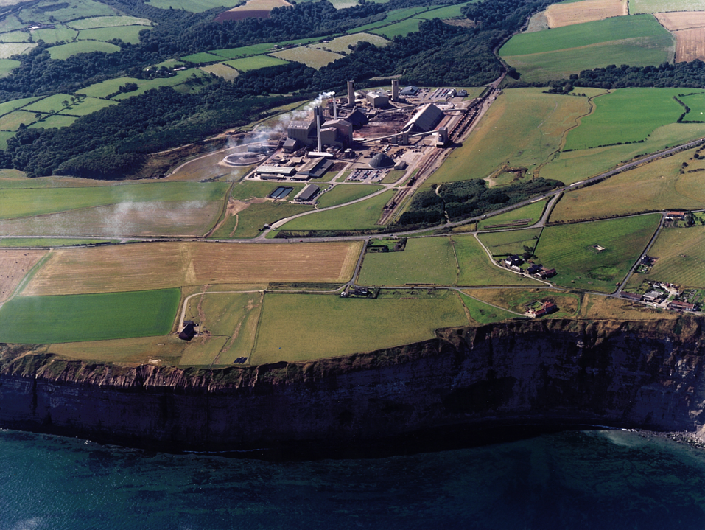


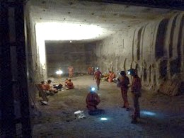

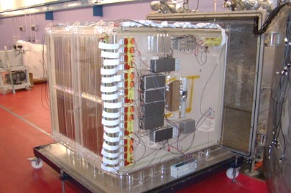
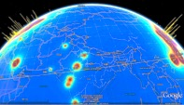
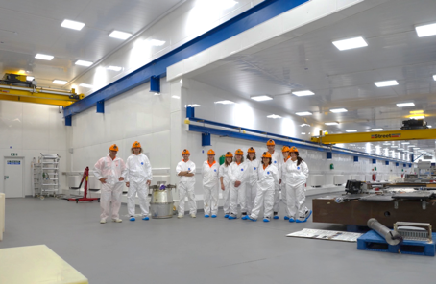
Sean Paling
STFC Boulby Underground Science Facility
Hartlepool Nuclear Power Station
Astroparticle physics & ultra low background studies
Earth and environmental science, Astrobiology and planetary exploration
CYGNUS
Dark Matter
Detector
The search for
Dark Matter & beyond
Boulby Underground Laboratory:
The UK’s deep underground science facility. Status, plans and opportunities for growth
Underground lab @ Boulby

Slide 2


Boulby Underground Laboratory:
Status and plans for the UK’s deep underground science facility
About the facility
Current science programme:
  Astroparticle physics and Low Background science
  Earth & Environmental Science
  Astrobiology & Planetary Exploration Studies
Future plans:
  Small, medium & large (Expansion for Future DM/0vBB)
STFC Boulby April 2022

Slide 3

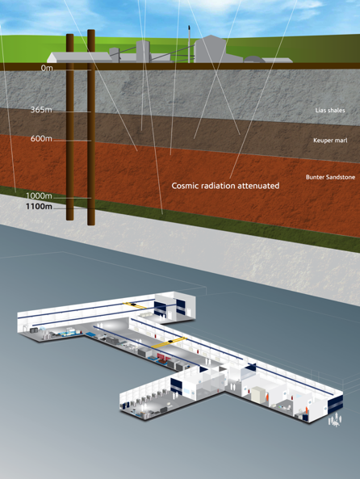
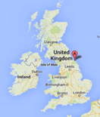

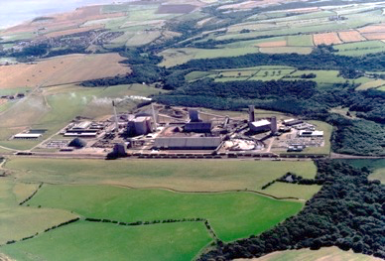


Boulby Underground Laboratory
The UK’s deep underground science facility operating in a working polyhalite & salt mine.
1.1km depth (2805 mwe). With low background surrounding rock-salt
Operated by the UK’s Science & Technology Facilities Council (STFC) in partnership with the mine operators ICL
Polyhalite
Deepest mine in Britain
Permian Evaporites
Factor ~10⁶ reduction in cosmic ray flux
vs. surface
A QUIET place in the Universe

Slide 4
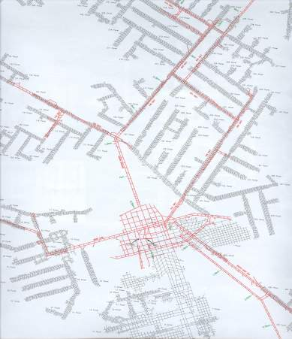
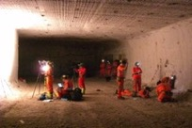
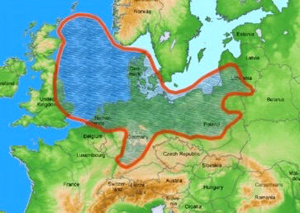
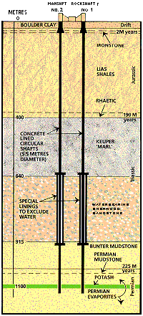



Boulby Geology & Mining
Major local employer. Open since 1968. Originally mining potash (KCl) for fertiliser. Now first and only producers of polyhalite
Excavations are in Salt (NaCl) & Potash (KCl) Permian evaporite layers left over from the Zechstein Sea.
Typical Boulby Salt Roadway
Potash
Zechstein Sea
KCl
Mine Shafts
Rock-Salt
NaCl
Polyhalite
New Lab
(2017)
Boulby Geology
K₂Ca₂Mg(SO₄)₄·2H₂O

Slide 5
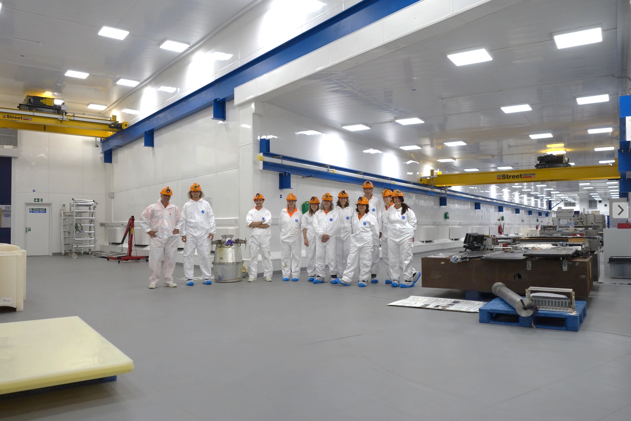
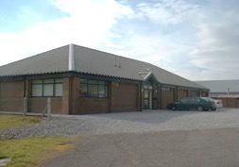
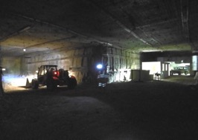


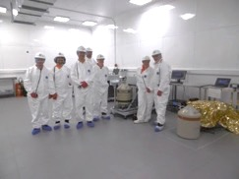
Office space, chemistry & clean prep lab, storage and staging space, IT room, conference room,
Surface support and staging building
3000m³ Outside Experimentation Area
Outside Experimentation Area
Boulby Underground Lab Facilities 2020:
>4000m³ class 1k & 10k clean room lab space
100Mb Internet AC, Air filtration, 5T & 10T lifting, LN generation, fume hood & clean prep 3000m³ Outside Expt. Area. Power & internet
BUGS+ Material screening

Slide 6


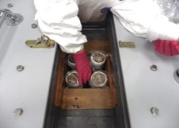
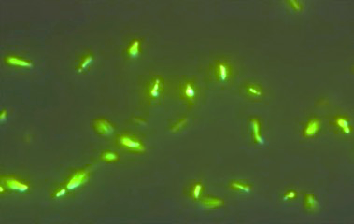

Underground Science @ Boulby Mine
DRIFT/CYGNUS: Directional Dark Matter
Spherical Proportional Counters (NEWS-G) R&D
BUGS: Ultra-low background material screening
AWE(Ge): Atmospheric gamma spectroscopy
RESOURCE: Salt cavity energy storage study
Deep Carbon: Muon tomography for CCS+
AIT-NEO: Neutrino detection for nuclear security
BISAL: Geo-microbiology / Astrobiology studies
MINAR: Space Exploration Tech. Development
Etc... (More to come).
DRIFT-II
BUGs Screening LZ PMTs
ULB screening of LZ PMTs
Life in Boulby salt…
Astrobiology & planetary exploration
A busy & growing multi-disciplinary science programme: Astrophysics and Low Background science, Earth and Environmental Science, Astrobiology and Planetary Exploration.

Slide 7
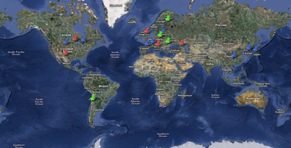
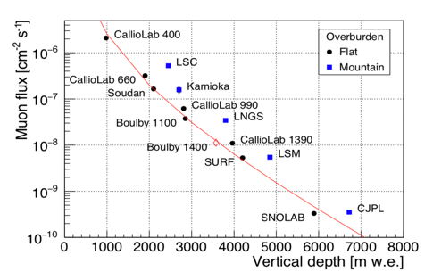
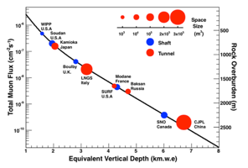
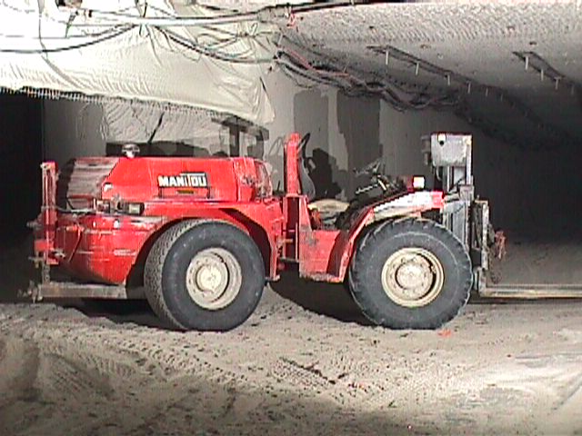

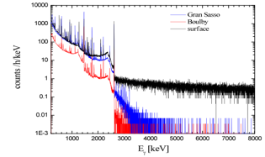


Boulby Facility Details…
• The UK’s deep underground science facility. One of 4 in Europe, <15 in the world.
• Supports work of >10 collaborative projects (astrophysics to climate, geology, environment etc), >40 institutions, >170 scientists & students.
Facility funded and operated by the Science & Technology Facilities Council (STFC).
The World’s Underground labs
Operations, H&S & science programme managed by 10 (+2) onsite staff and supported by Rutherford Appleton Lab (PPD).
Mine operators ICL-UK provide wide-ranging operational & high level support.
How does Boulby Compare?
Low Radon levels (3 Bq/m³)
Diverse science programme.
Science and Industry partnership
Gamma
Spectra

Slide 8
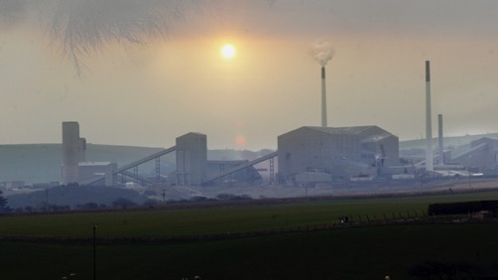
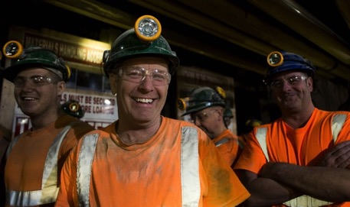
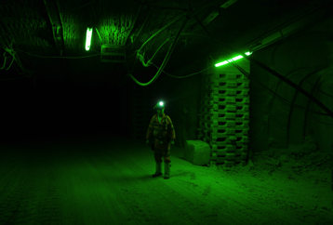
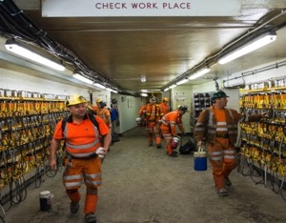
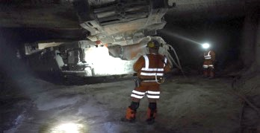
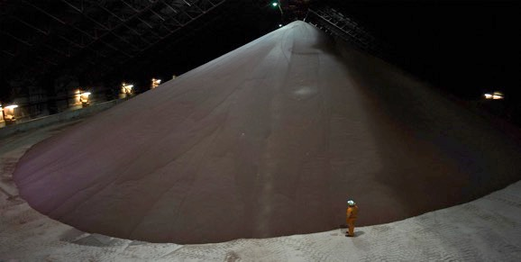
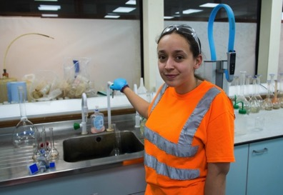

Working alongside
mining at Boulby…
STFC-Boulby Lab responsibility:
Run and maintain the lab
Facilitate / Support Science
Health & Safety
Operations Impact
Outreach & Media
CPL/ICL support us:
Keep the mine operating and safe
Emergency H&S
Materials transportation
High level support

Slide 9
Boulby Underground Laboratory:
Status and plans for the UK’s deep underground science facility
About the facility
Current science programme:
  Astroparticle physics and Low Background science
  Earth & Environmental Science
  Astrobiology & Planetary Exploration Studies
Future plans:
  Small, medium & large (Expansion for Future DM/0vBB)
STFC Boulby April 2022

Slide 10
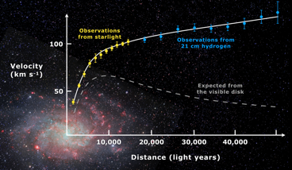
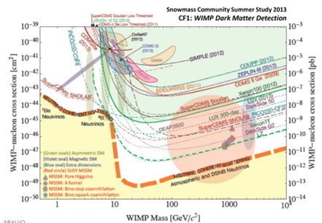
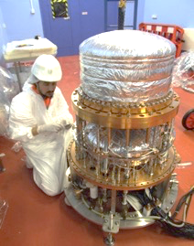

Boulby Dark Matter Studies…
Boulby has hosted Dark Matter search studies for over two decades. Including the NAIAD, DRIFT & ZEPLIN experiment programmes.
Boulby now hosts CYGNUS directional DM programme, NEWS-G/Dark-Sphere R&D and providing ULB material screening for other studies, inc LUX-ZEPLIN (LZ)
Galactic
rotation curves
ZEPLIN-III @ Boulby
Alpha
DM-Ice
ZEPLIN-II & III: The world’s first
2-phase Xenon dark matter detectors (Finished 2011)
Expect ~ 20 million / hand / second
WIMP wind
1 per month hit!
World DM particle search limits and future projections
ZEPLIN-III @ Boulby

Slide 11

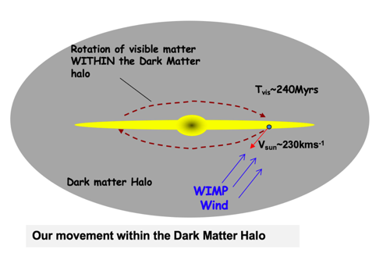
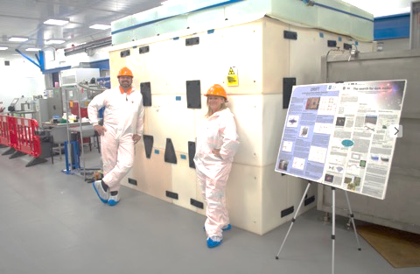
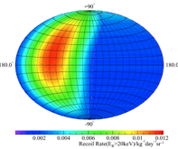
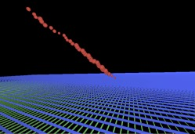
Dark Matter Studies @ Boulby.
DRIFT/CYGNUS: R&D for DIRECTIONAL Dark Matter detection.
STATUS: Programme operating at Boulby since 2001. Limit-setting and conducting system performance & scale-up R&D. Plans for further R&D & expansion / collaboration (CYGNUS).
DRIFT-IId @ Boulby
Dual (1m³ total) Negative Ion DRIFT TPC
Directional detection
Alpha track
Occidental College, New Mexico, Colorado State, Hawaii, Wellesley, Sheffield, Edinburgh, Boulby
Simulated data
WIMP flux
Status: CYGNUS detector R&D, exploring issues and technologies for future scale-up
Directional DM detection – providing the most powerful direct detection signature
Notes:
DRIFT/CYGNUS directiona Dark Matter programme
Long running programme at Boulby – been developing at many eyars.
Current veriosn DRIFT –II-d 1m3 negative ion DRIFT TPC. Low pressure gas lenthing WIMPS tracks such that can be imagd by MWPC no either sise of cathode. Alpha look like this –
Reason interexte in Directionality is fo course – extraordinatry proof requires extraordinatry evidence… Inistropy. Also posible means of getting below enutrino floor
Very difficult thing to do of course – low pressure gas means target mass I flow – for DRIFT-iid with CF4 now – 200 g of target.
So status of DRIFT-Iid, explore issues and technlogies for scale up

Slide 12
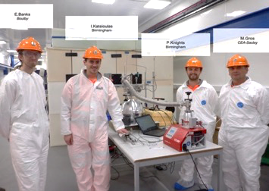
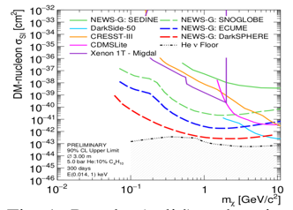
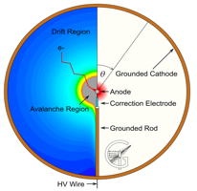

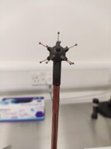
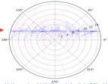
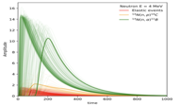
NEWS-G
SPC Sensitivities
Spherical Proportional Counter (SPC) studies @ Boulby
DarkSPHERE
k. Nikolopoulos
I. Katsioulas, P. Knights, T. Need, R. Ward
University of Birmingham
And wider NEWS-G Collab.
Neutrino Floor
Al-S30 R&D Detector
Purpose-made gas filter
Direction of R&D at Boulby
Instrumentation development alongside NEWS-G at SNOLAB
  Multi-anode sensor
  Gas mixtures & filtration
Working towards scaled-up detector at Boulby, 3m diam. DarkSPHERE
Establishing Electro-forming Capability at Boulby for Dark SPHERE and beyond
(I. Katsioulas, This conf.)
11-anode sensor
Copper Oxide
H₂O removal
Molecular sieve O₂ removal
SPC concept: Variable target Low E_{th}, Low mass sensitivity
Simulation study of neutron interactions in the S30 at Boulby
Neutron Beam
4 MeV

Slide 13
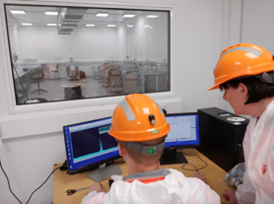
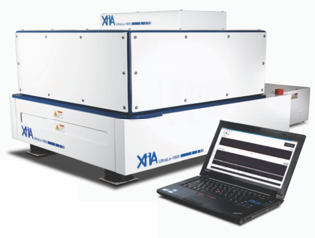
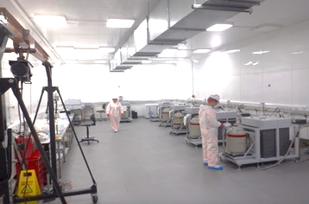

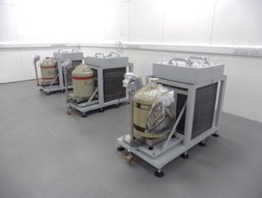
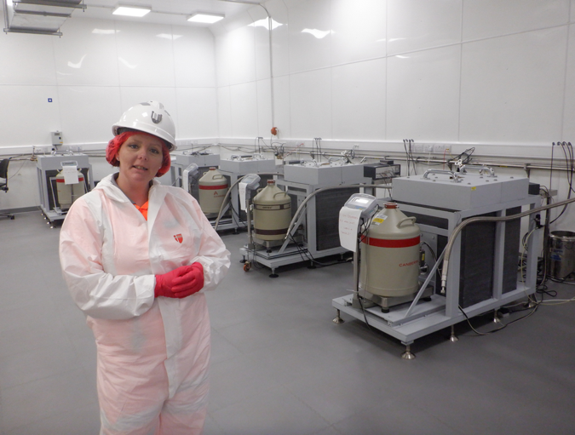
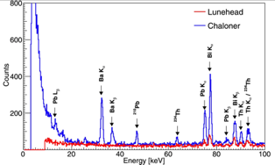
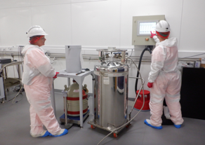

<0.0001
alphas/cm²/hr
XIA alpha particle counter
(XinRan Liu, this conf).
8 ULB Ge detector systems, 2 XIA alpha counters, Rn emanation, ICPMS to come
BUGS (Boulby UnderGround Screeening). World-class material screening for current and future ULB experiments. Towards PPT sensitivity for G3 DM and Neutrino experiments
LZ PMTs
Aiming for ALL key ULB screening systems under one (1.1km) roof.
S.M.Paling - Boulby@stfc.ac.uk
BUGS Lab

Slide 14






Multi-Disciplinary Studies
RESOURCE: Rock engineering feasibility study of salt cavity compressed gas sustainable energy storage
Boulby, British Geology Survey (BGS), Cambridge, Manchester.
ERSaB: Gamma spectroscopy & low background counting environmental radioactivity studies
Low Background Science,
Earth & Environment Science, Astrobiology & Planetary Exploration...
Boulby, Scottish Universities Env. Research Ctr (SUERC), Atomic Weapons Estab. (AWE)
Life in Boulby Salt…
MINAR: Space Technology
Development
Boulby, Edinburgh, NASA, York, ICL etc.
Plus Misc. Geology & Geoscience (& more to come)…
BISAL: Astrobiology / Geo-microbiology. Studies of life in salt, life on Earth & beyond
STFC Boulby April 2022

Slide 15







MINAR V. 9th to 20th October 2017
MINAR - SPLIT
MINAR – Pac Man, HABIT & many more
MINAR - Pancam

Slide 16










MINAR VII & VIII. 2018 - 2020
NASA-JPL
Signatures of life studies
Lulea University
KORE rover 3D area mapping
LA Nat Hist. Museum
Fluid inclusions in salts
Edinburgh University MUFFHINS water activity monitoring payload
MINAR – CLUPI
KORE 3D Mapping
MINAR - Pancam

Slide 17
Boulby Growth Potential & Plans….
Develop as a truly internationally-important centre for astro-particle physics and pure and applied multi-disciplinary science.
Expand in all current science theme areas:
  Astro-particle Physics & Low Background Science
  Earth & Environmental Science
  Astrobiology & Planetary Exploration Studies
For Astro-particle Physics & Low Background Science:
  Develop BUGS to give world’s best support for future ULB projects
  Host/support new medium-scale projects: (BOLEYN, DarkSPHERE+)
  EXPAND to host Next Generation Dark Matter & Rare Event Studies & more.
STFC Boulby Underground Lab 2022
Notes:
Boulby is supported by STFC and industry. Located on the North East coast of England
A growing multi-displinary science programme addressing global challenges and STFC / RCUK priority themes.
High impact science projects: astrophysics to studies of geology, geophysics, climate, the environment, life on Earth and beyond.

Slide 18



Future Science...
Continue current studies, PLUS…
Expanded MINAR & Planetary exploration technology development. Links to mining / industry, Robotics.
RESOURCE+: Advanced salt cavity test facility for studies of compressed gas energy storage.
Misc. Geoscience R&D: geological repositories / waste containment, geothermal energy and more.
BUGS+: Expanding ultra low background material screening and environmental gamma spectroscopy.
Misc. applied low background studies: AWE-Ge/RECON, Muon Tomography, QCLB (Quantum Computing)
Misc: medium scale astro-particle studies: DarkSPHERE, AION, LEGEND, AIT-NEO / BOLEYN,
Large scale EXPANSION: Next Gen DM / 0vBB decay +
Robotics
DRIFT-II
RESOURCE: Salt cavity energy storage
AIT-NEO
Neutrinos & nuclear non-proliferation
Develop as a truly multi-disciplinary facility for Astrophysics and Low Background science, Earth and Environmental Science, Astrobiology and Planetary Exploration Technology Development.

Slide 19


AIT-NEO (WATCHMAN)
World antineutrino flux levels
A WATer CHerenkov Monitor of ANtineutrinos
Design, excavation, installation & operation 2019 to 2027(+)
A ~6kT Gd-loaded water (& WBLS) detector looking at
anti-neutrinos from nearby nuclear reactors
~20 m
Vertices within 50cm
ΔT ~30μs
NEW ~6kT prototype detector: R&D for anti-neutrino monitoring of nuclear reactors for global nuclear non-proliferation purposes & more

Slide 20


AIT-NEO (WATCHMAN) Status…
AIT-NEO recent happenings:
2018-Present: Detector design and performance studies. (L. Kneale, C. Toth, S. Wilson, Y Schellback). Studies of new site location, geology, designs, costs and schedule
June 2021: NEW news from EDF of Hartlepool closure in 2024 due to new understanding of aging rates.
December 2021: News of early closure (2028) of next nearest power stations (Heysham 2 and Torness).
BOLEYN.
~30T antineutrino technology testbed.
. (A Scarff, this conference)
Status & Next Steps
Full AIT-NEO now not likely to go ahead at Boulby
Continued collaborative (US/UK) work undertaken on technology demonstrators – inc 30T system @ Boulby
‘BOLEYN”: Boulby antineutrino detection technology testbed. Engineering, operation, technology, fill medium and low-background studies.
Installation –> operation @ Boulby: 2022-2024

Slide 21






Next Generation Rare Event Studies @ Boulby
Towards EXPANDING Boulby to host MAJOR international Dark Matter, neutrino & fundamental science projects from 2028+
LZ, SURF. USA
10 T Liquid Xenon
Boulby-FS study: Infrastructure design, feasibility & costing studies for next generation Dark Matter and/or 0vBB detectors
Study undertaken
2020-2021
50+ T Liquid Xenon
Dark Matter
Expansion bringing to the UK:
HIGH-impact, world-leading science
BIG fundamental science questions
LARGE multi-national collaborations
MAJOR local & national investment, impact and visibility
0𝒱BB
Next generation DM and/or 0vBB at Boulby?
E.g. LZ / XENON / DARWIN / G3

Slide 22






Boulby Feasibility Study (Boulby-FS)
Boulby-FS Study Overview:
Context and need: Dark Matter (DM), Neutrinoless Double Beta Decay (0vBB)
Infrastructure specifications for potential projects (LXe & LAr DM, Ge 0vBB, and more)).
Conceptual designs for excavations and outfitted labs – in 1.1km (Salt) and 1.4km (Polyhalite) layers
Staffing and surface facility needs.
Detailed costs and schedules.
Submitted to STFC June 2021
New lab in Salt?
New lab in Poly?
Government ‘fit’: Levelling Up, Strength in Places, Build Back Better
Results: It IS feasible, well motivated and timely.
Outfitted facility: £100m+ (Inc contingency, VAT)

Slide 23



Next Generation Dark Matter(+)
@ Boulby?
Status & Next Steps
Next steps funding request submitted to UKRI in 2021.
Future (3 year) work includes:
  Next step facility conceptual designs (1.1km & 1.4km)
  Scoping, networking, community engagement.
  Business case, economic impact studies, risks → Submission to BEIS
Boulby Future: UKRI Bid
Now seeking community:
Attention / understanding
Support..
Collaboration & involvement...

Slide 24





Thank You….
.
Please Contact us…
Email: Boulby@stfc.ac.uk
Web: www.stfc.ac.uk/boulby
Facebook: Boulby Underground Laboratory
You Tube: Boulby Underground Laboratory
Sean Paling
STFC Boulby Underground Laboratory

Slide 25


Boulby Underground Lab Backgrounds
Cosmic ray muon backgrounds:
Measured as (3.79 ± 0.04(stat) ± 0.11 (sys)) × 10⁻⁸ cm⁻². s⁻¹ (2850 ± 20 mwe)
H. Araujo, et al., Astroparticle Physics 29 (2008) 471–481.
Radon:
Measured as 2.5 +/- 1.6 Bq.m⁻³ (year round)
Internal reports (JIF Lab 2015)
Neutrons:
Simulations based on U/Th content:
1.2 x 10⁻⁶ neutrons.cm⁻²s⁻¹ (>500keV @rock/cavern bndry).
Gammas:
Germanium detector survey of Boulby JIF Lab Area Flux = 0.128 cm⁻²s⁻¹
M.J. Carson et al., Astrop. Phys 21 (2004) 667.
Measured as: (1.72 ± 0.61(stat) ± 0.38(sys)) x 10⁻⁶ cm⁻²s⁻¹
M.J. Tziaferi et al., Astrop. Phys 27 (2007) 326-338.
D. Malczewski et al. J. Radioanal. Nucl. Chem. 298 (2013) 1483-1489.
Sean Paling, Paul Scovell - 2021

