Slide 1


High Intensity Muon Beam Physics
Mark Lancaster

Slide 2

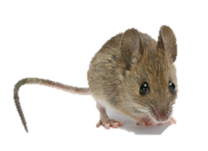
ATLAS/CMS
B-Factories
Theory
𝜈 Experiments
Muon Experiments

Slide 3
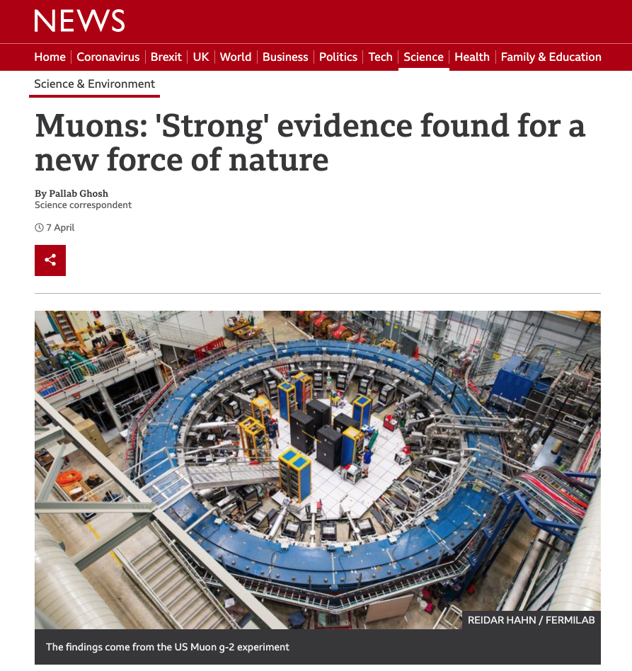
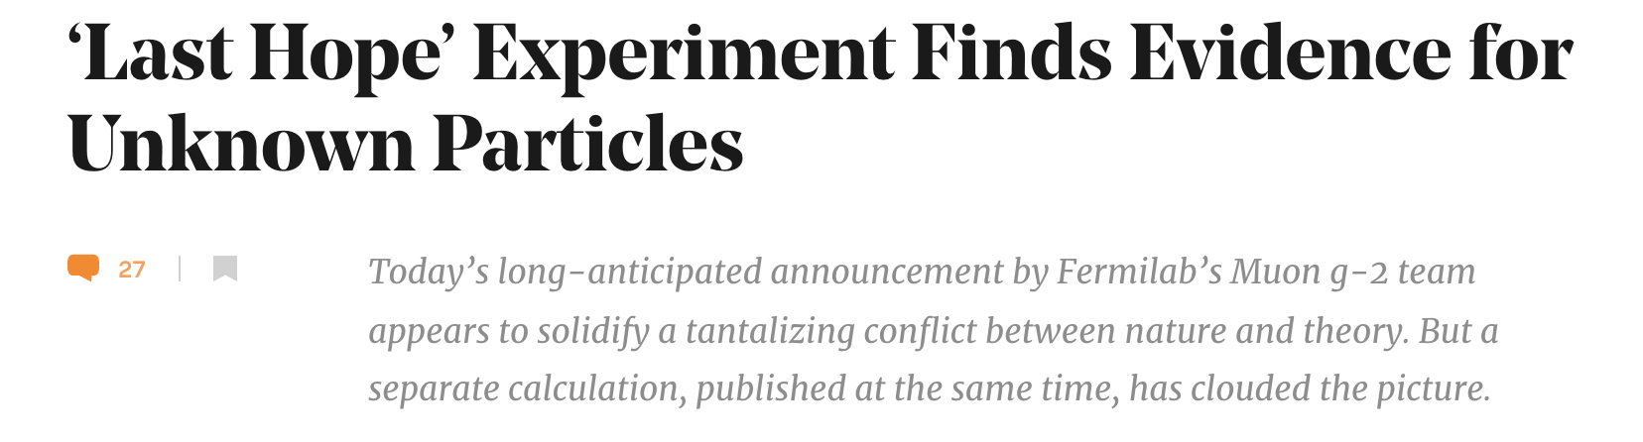
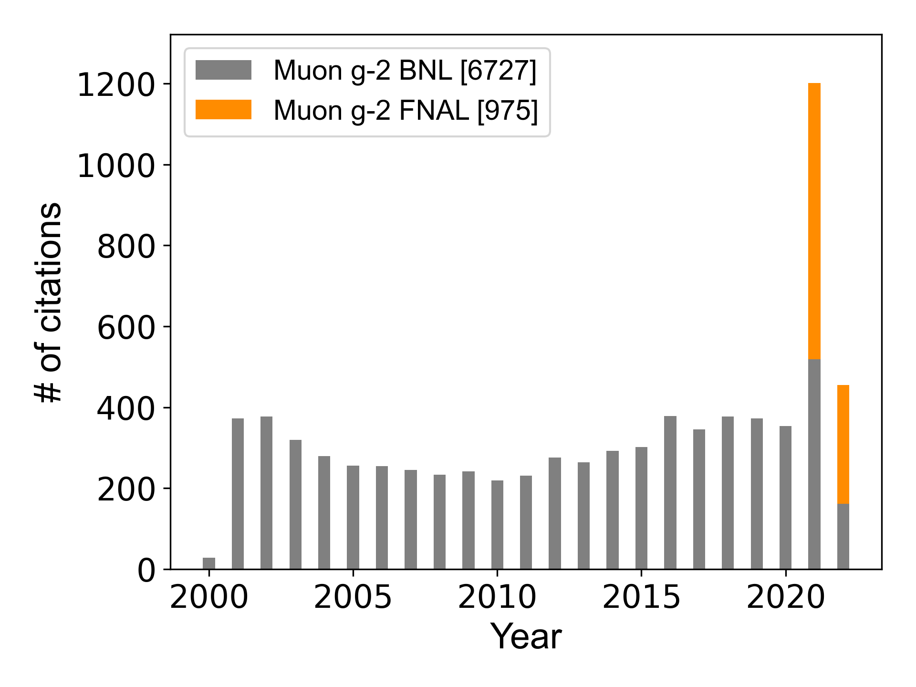
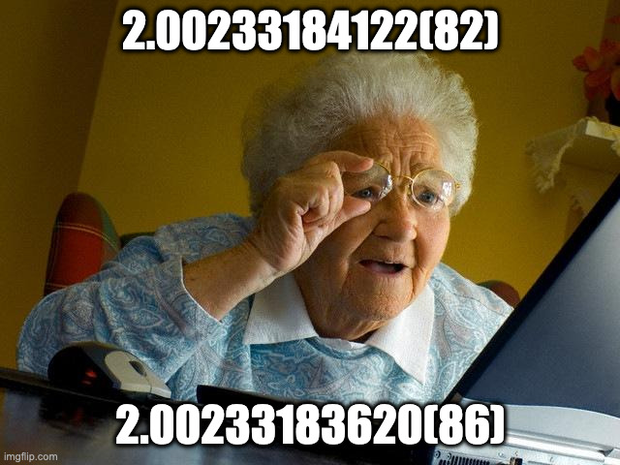

Slide 4

$ 0.5-1B of Muon Experiments
CERN
PSI
MUonE
MEG
MuMass
CREMA
MUSE
Mu3e
MuEDM
J-PARC
DeeMe
Museum
COMET
g-2
FNAL
g-2
Mu2e
Notes:
Mixture of pulsed beams and DC beams.

Slide 5
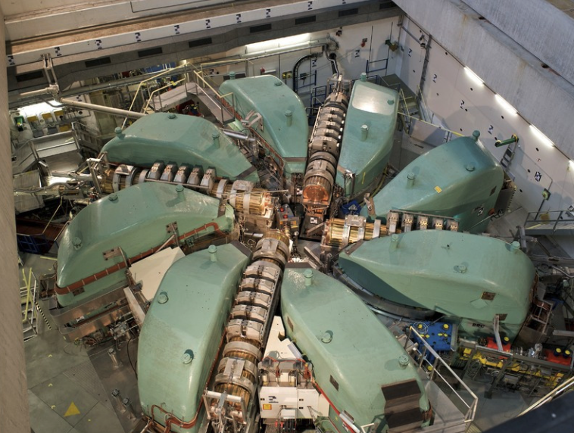
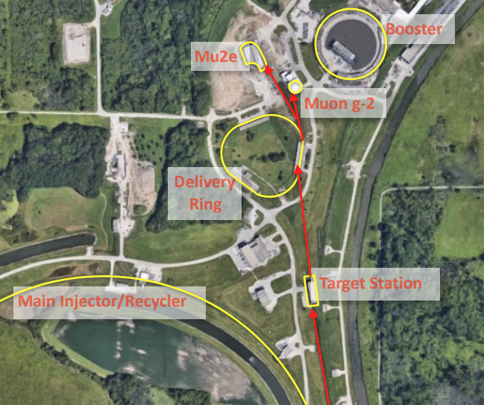
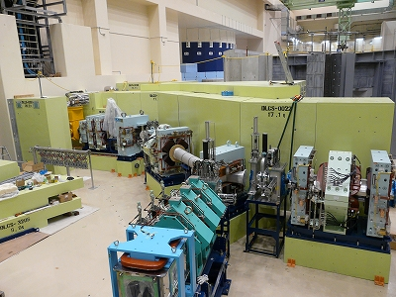
Two Types of Measurement
Looking for a deviation from precise SM prediction e.g. (g-2), LFU
Looking for a signal that is essentially zero in the SM
e.g. muon electric dipole moment (EDM) or charged lepton flavour violation (CLFV)
PSI: ~ 10⁸ μ/sec [DC]
FNAL/JPARC: ~ 10¹⁰ μ/sec [Pulsed]
Notes:
Like all measurements the muon programme is searching for chinks in the SM to search for BSM physics – doing it with two different types of measurement

Slide 6
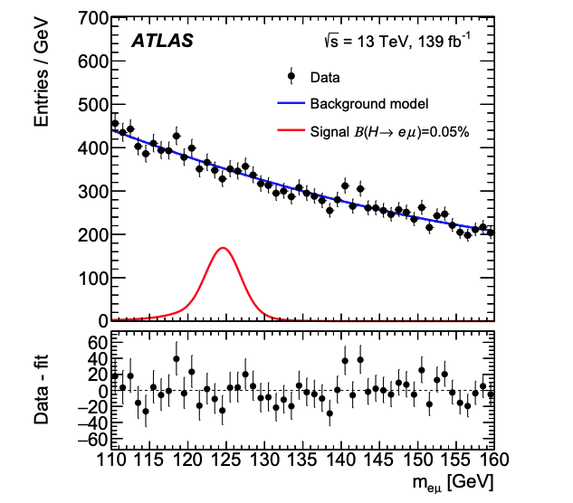
Why Muons ?
Can be produced in large numbers and live long enough
arXiv:1909.10235
Harnik, Kopp, Zupan, arXiv:1209.1397
BR limit: 6.1 x 10⁻⁵
Mu2e/COMET have sensitivity to BR (. ) of 10⁻¹⁰

Slide 7
Comparison with Taus
To probe similar regions of parameter space typically requires the 𝜏 BR sensitivity
to be O(10³) beyond near-future capabilities.
Goto et al., arXiv:1412.2530
BUT It is vitally important that 𝜏-interactions as well as μ-interactions are studied.
The 3rd generation may well be peculiar.

Slide 8
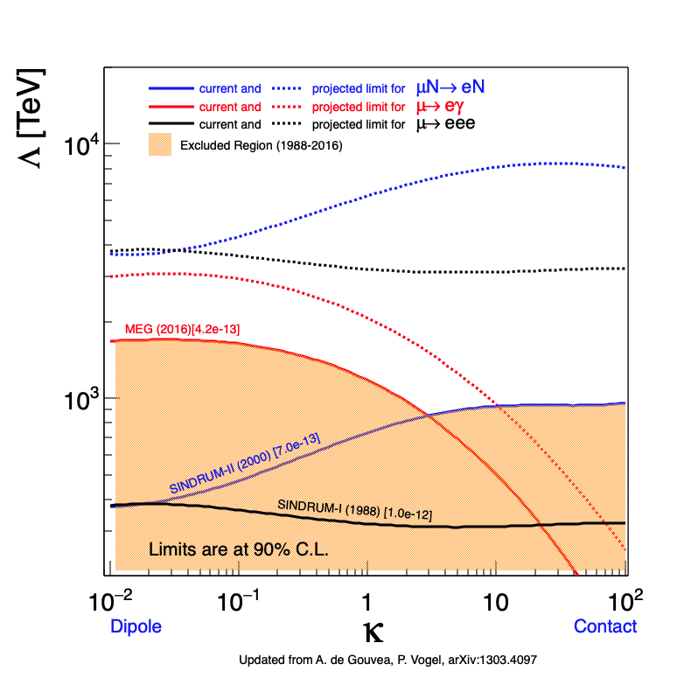
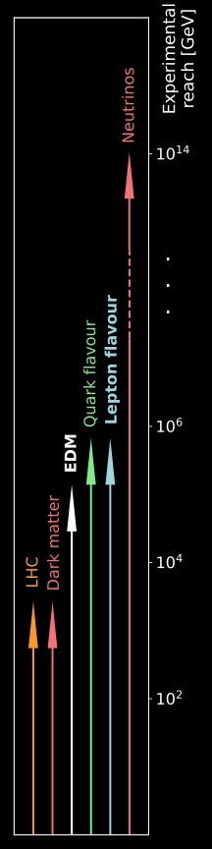
Access to high mass scales

Slide 9
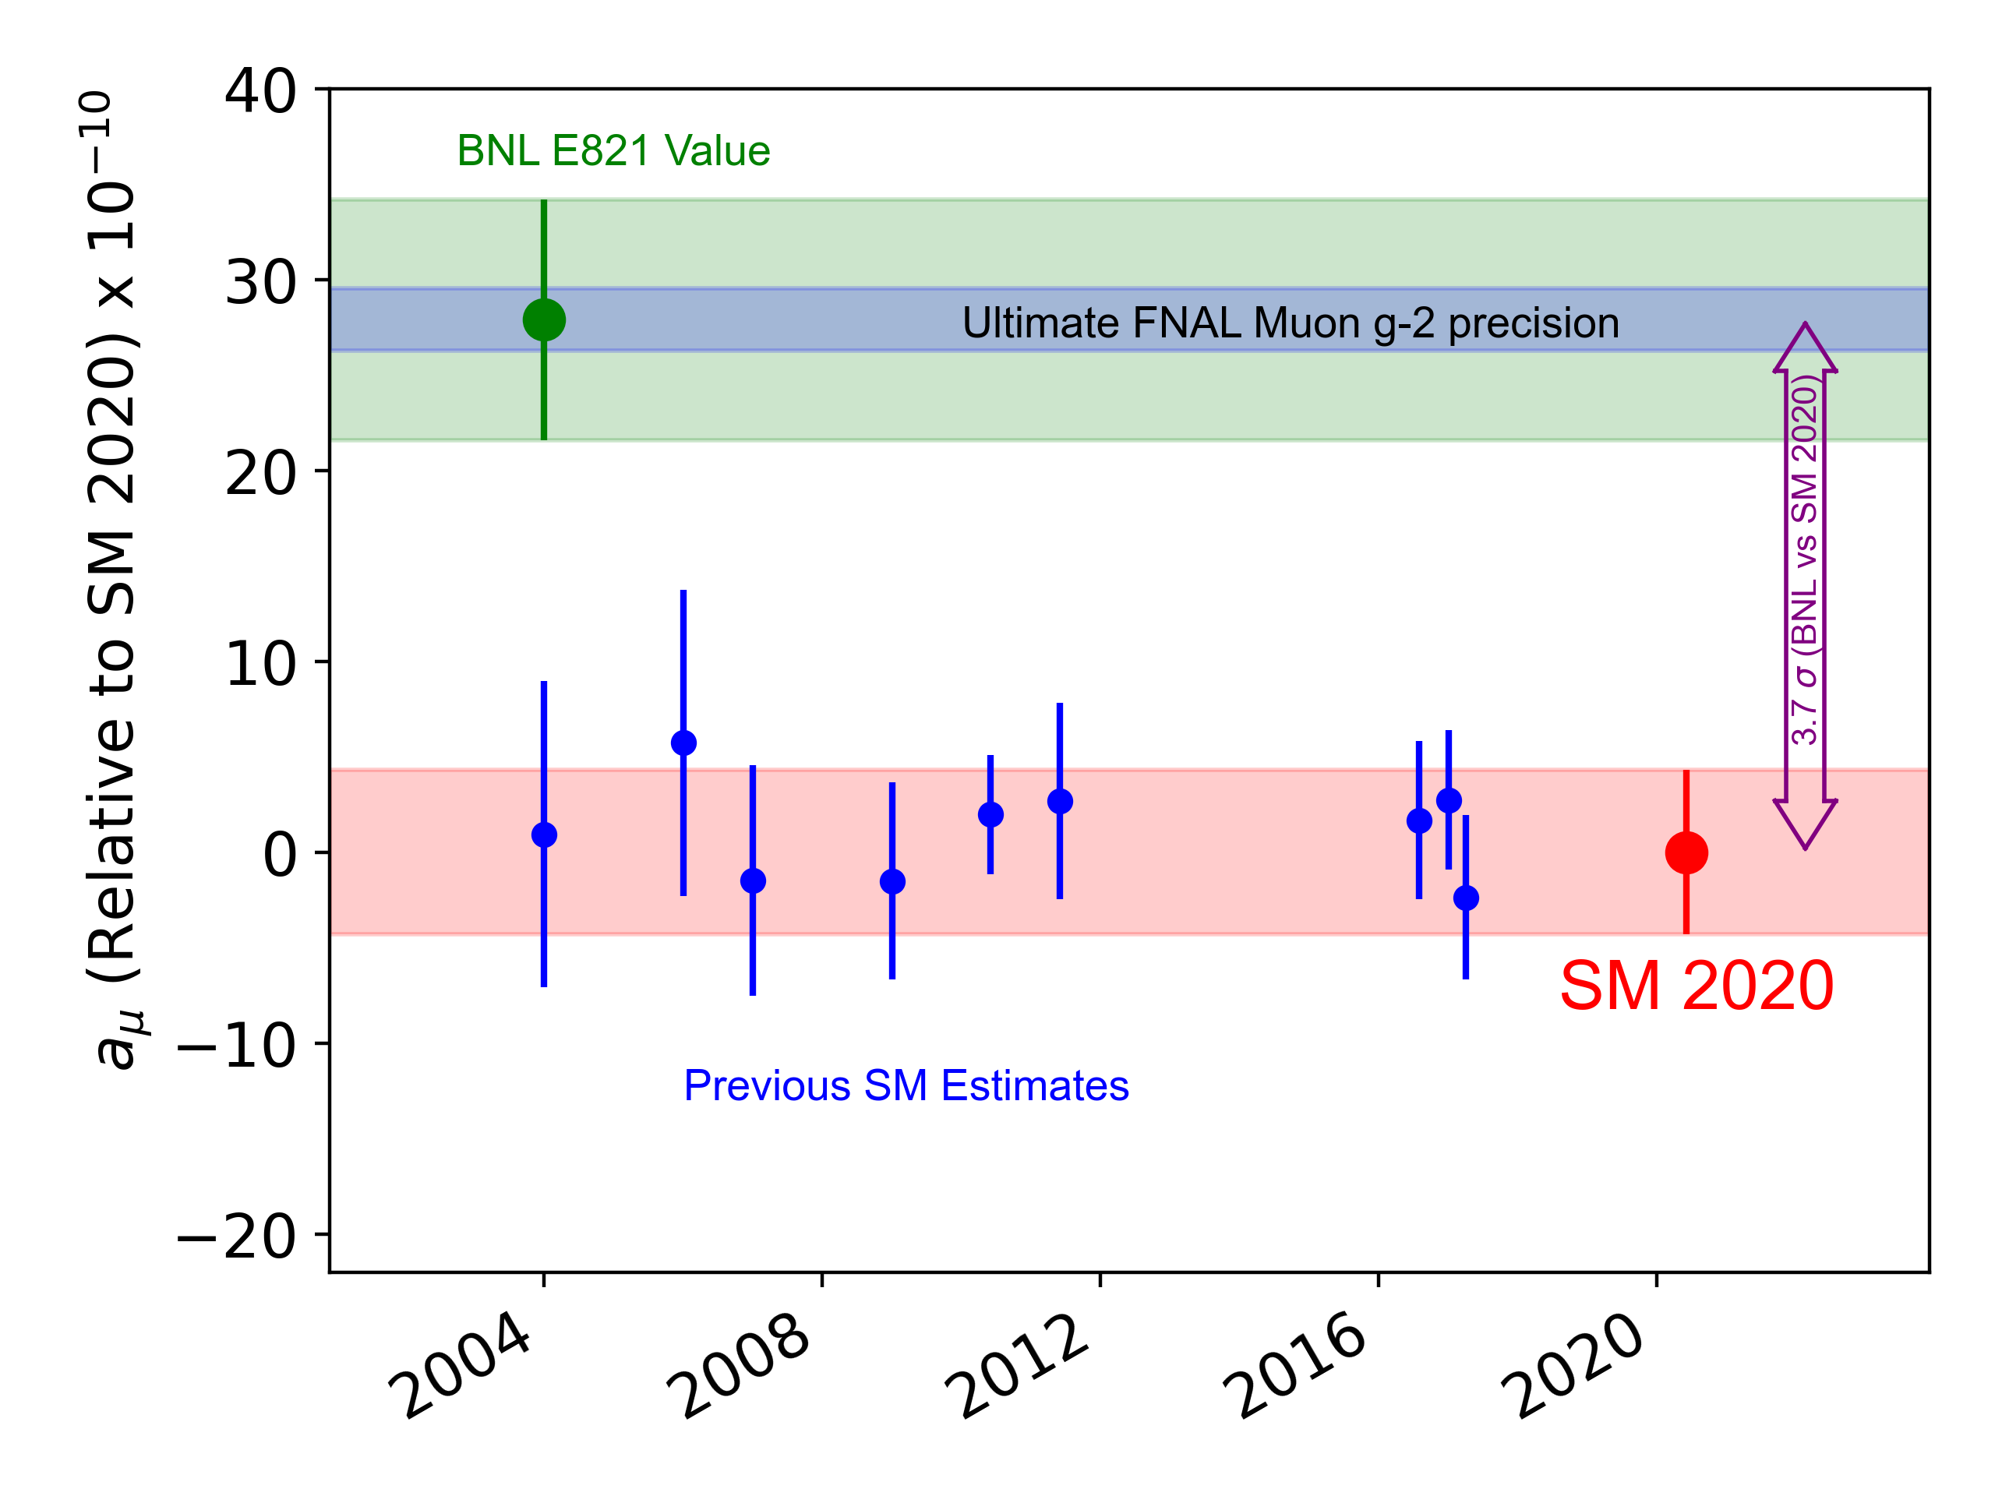
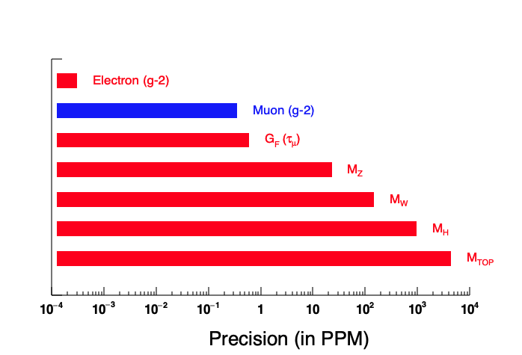
Muon g-2
Most precise quantity measured at a particle accelerator
Latest FNAL measurement based on a dataset of similar size to BNL ~ 10 billion μ⁺
Notes:
Most precise measurement at a particle accelerator.

Slide 10
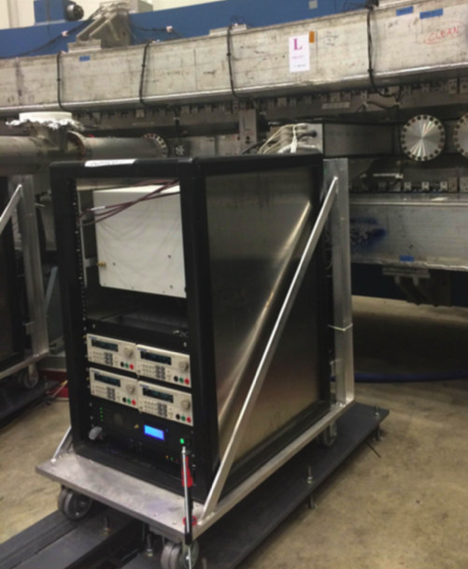
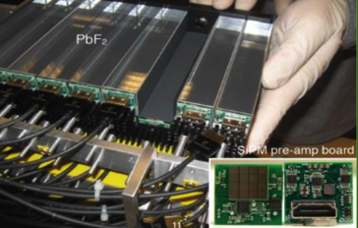
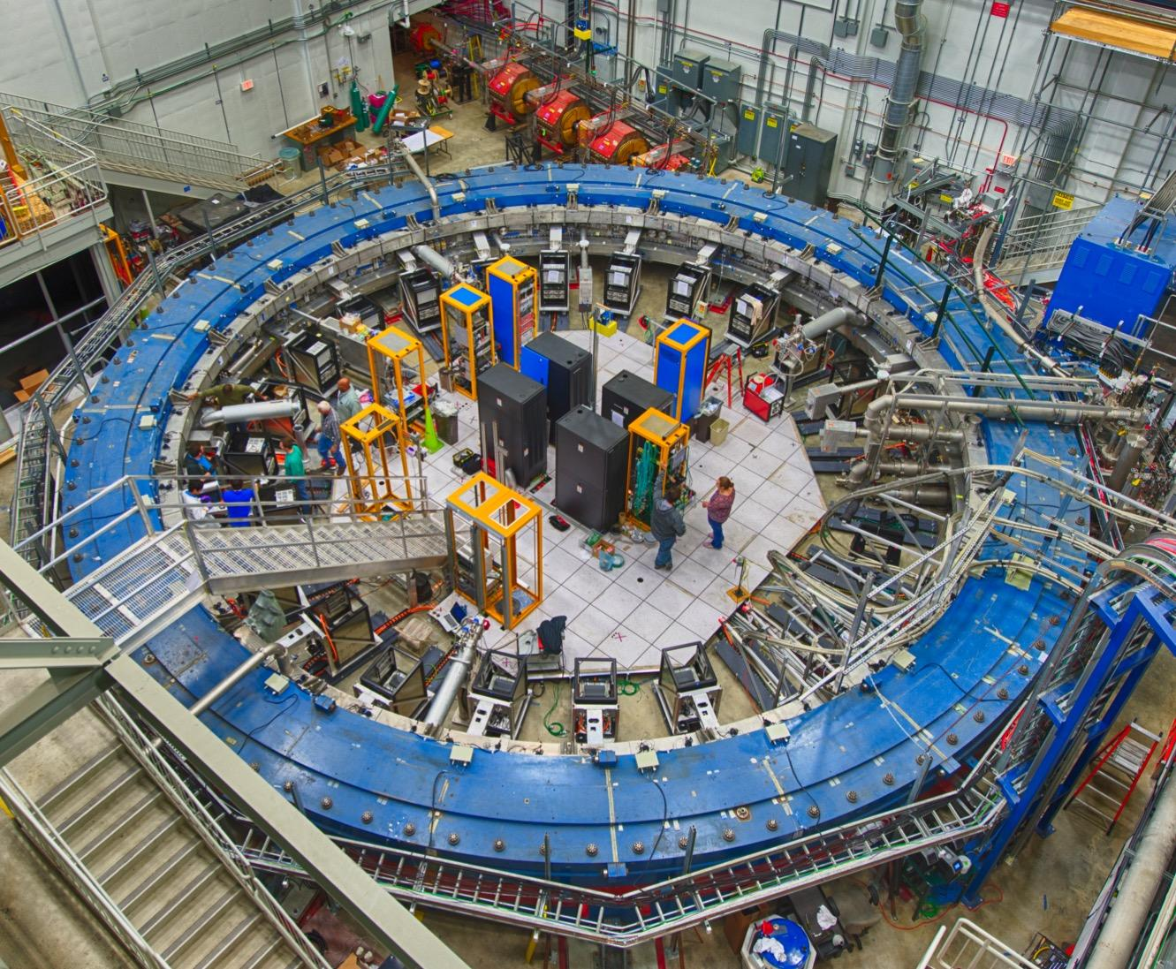
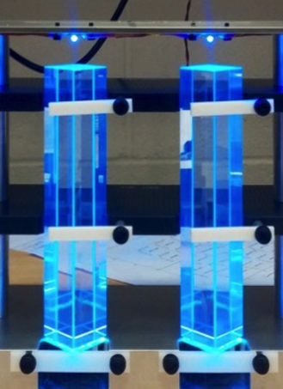
FNAL g-2 Experiment
μ⁺

Slide 11
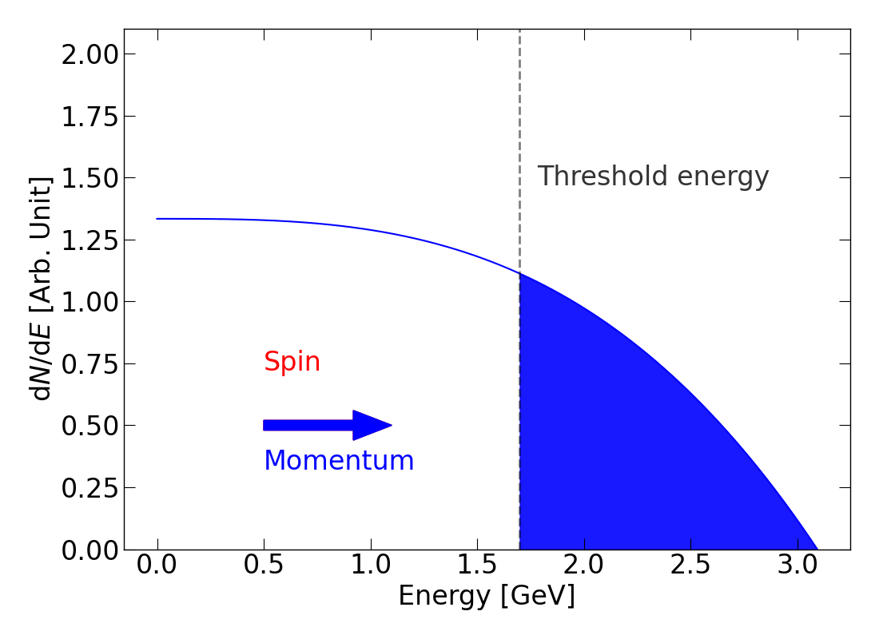
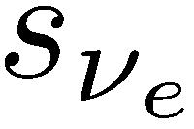
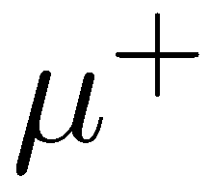
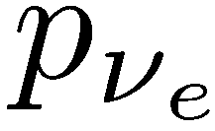
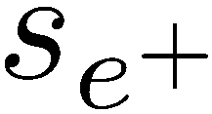
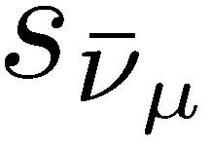
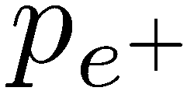
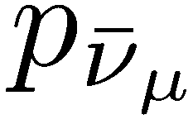
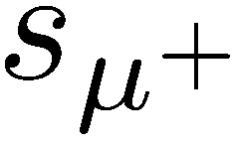
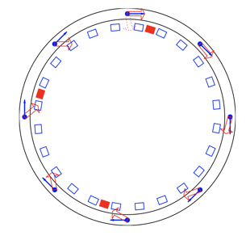

Measuring ω_{a}
e⁺ preferentially emitted in direction of muon spin
The number of high momentum positrons above a fixed energy threshold oscillates at precession frequency
Simply count the number above an energy threshold vs time
Simply measure the time and energy of decay positrons and count the number above an energy threshold

Slide 12
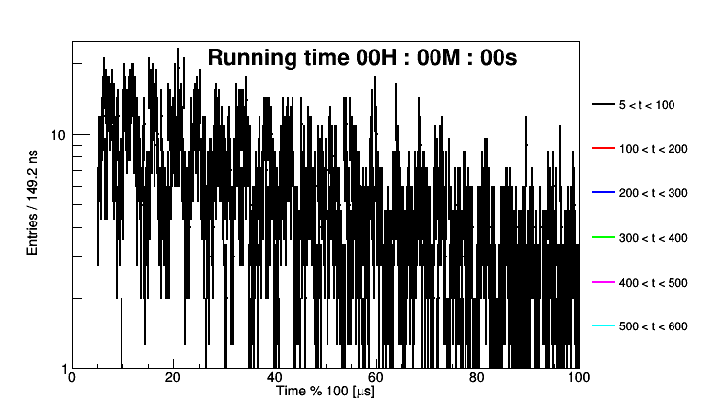
Precession in 1 hour of data

Slide 13
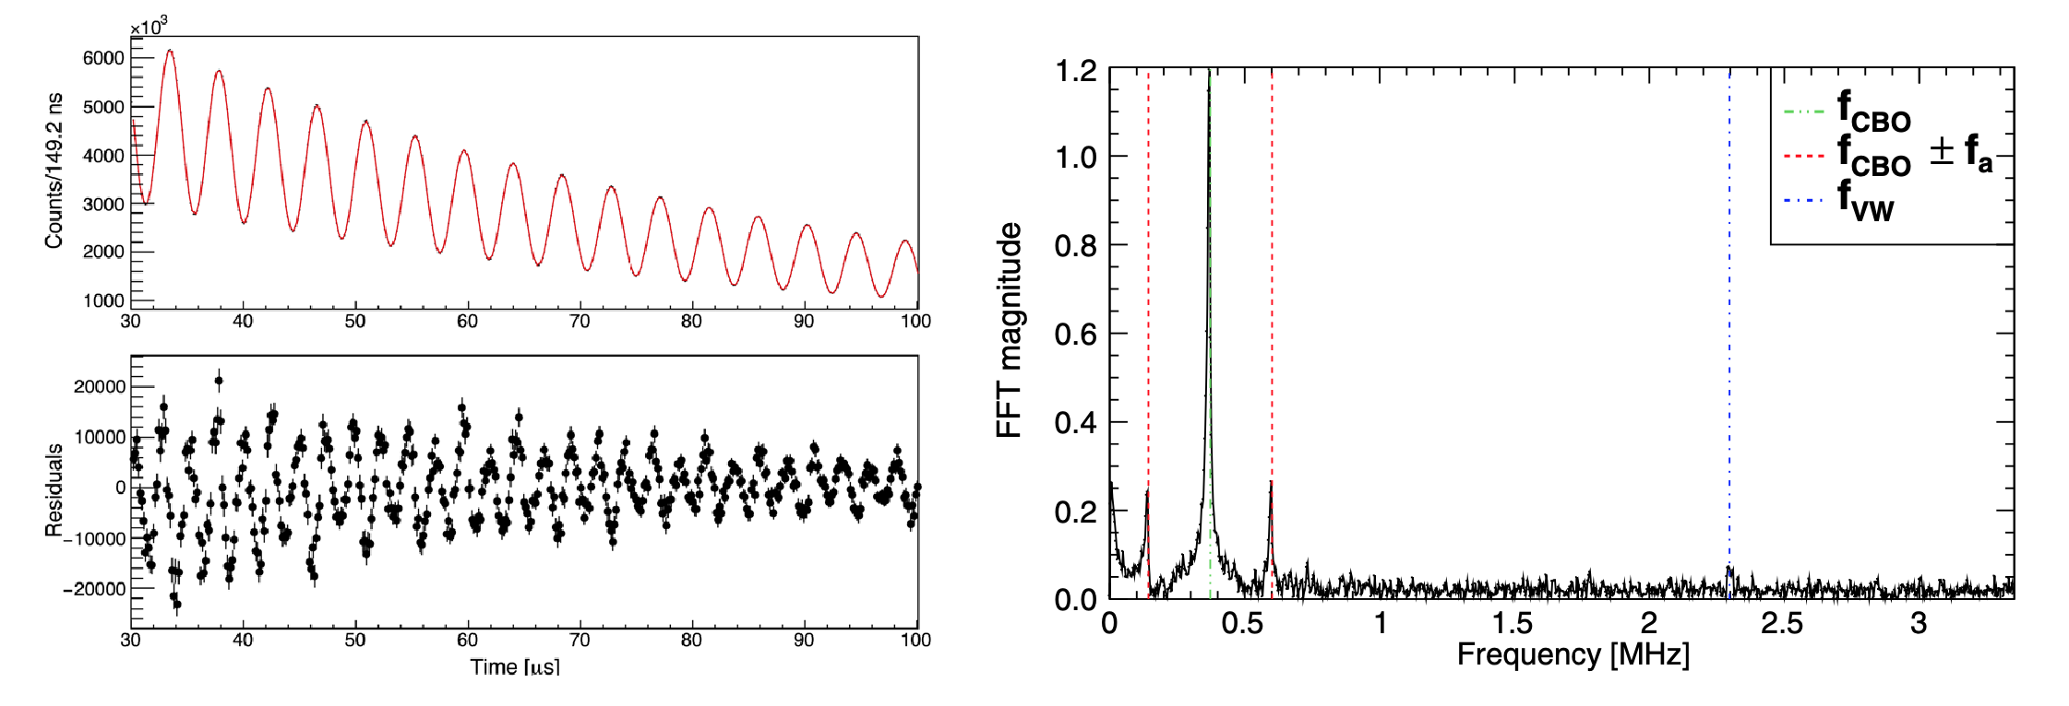
Results of 5 parameter fit
Add additional 17 terms in fit to describe:
Muons lost from storage ring not by decaying
Pileup (concurrent, multiple e⁺ in same calorimeter crystal)
Vertical and radial beam motion
And get

Slide 14
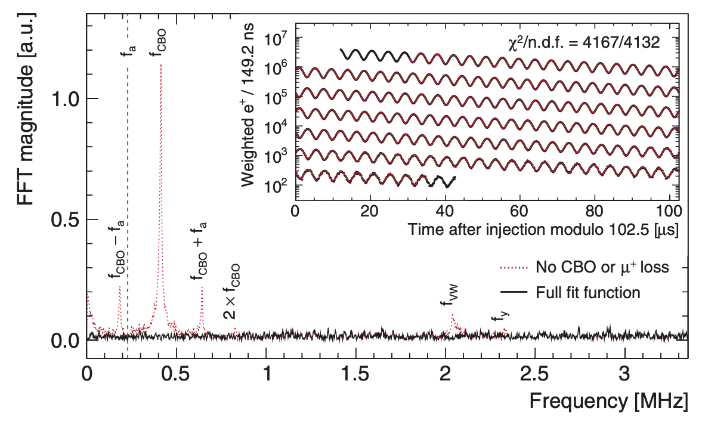
Resulting 22 Parameter Fit
Phys. Rev. D 103, 072002 (2021)
Statistical uncertainty from this fit : 434 ppb
Largest correction to data is : 489 ppb (total correction is 456 ppb)
Total systematic uncertainty is : 157 ppb (aim was 100 ppb)
Deviation from SM (with BNL) : 2150 ppb

Slide 15
Systematic Uncertainties
~ 80 effects considered significant in determining the systematic uncertainty.
Dedicated runs taken for some of them e.g. at different beam momentum.
Total systematic uncertainty 157 ppb. Those above 30 ppb are below
Source | Systematic Uncertainty (ppb) | Improvements undertaken
Calorimeter pileup | 35
Beam Mean Momentum & Spread | 53 | Increased kicker voltage: 130-161 kV
Drift of beam over measurement | 75 | Replaced damaged quadrupole resistors
Transient B-field (from kicker) | 37 | Improved magnetometer
Transient B-field (from quadrupoles) | 92 | More extensive measurements / damping
Total | 140
Other effects at 10-20 ppb also significantly improved by better temperature control
in the experimental hall.

Slide 16
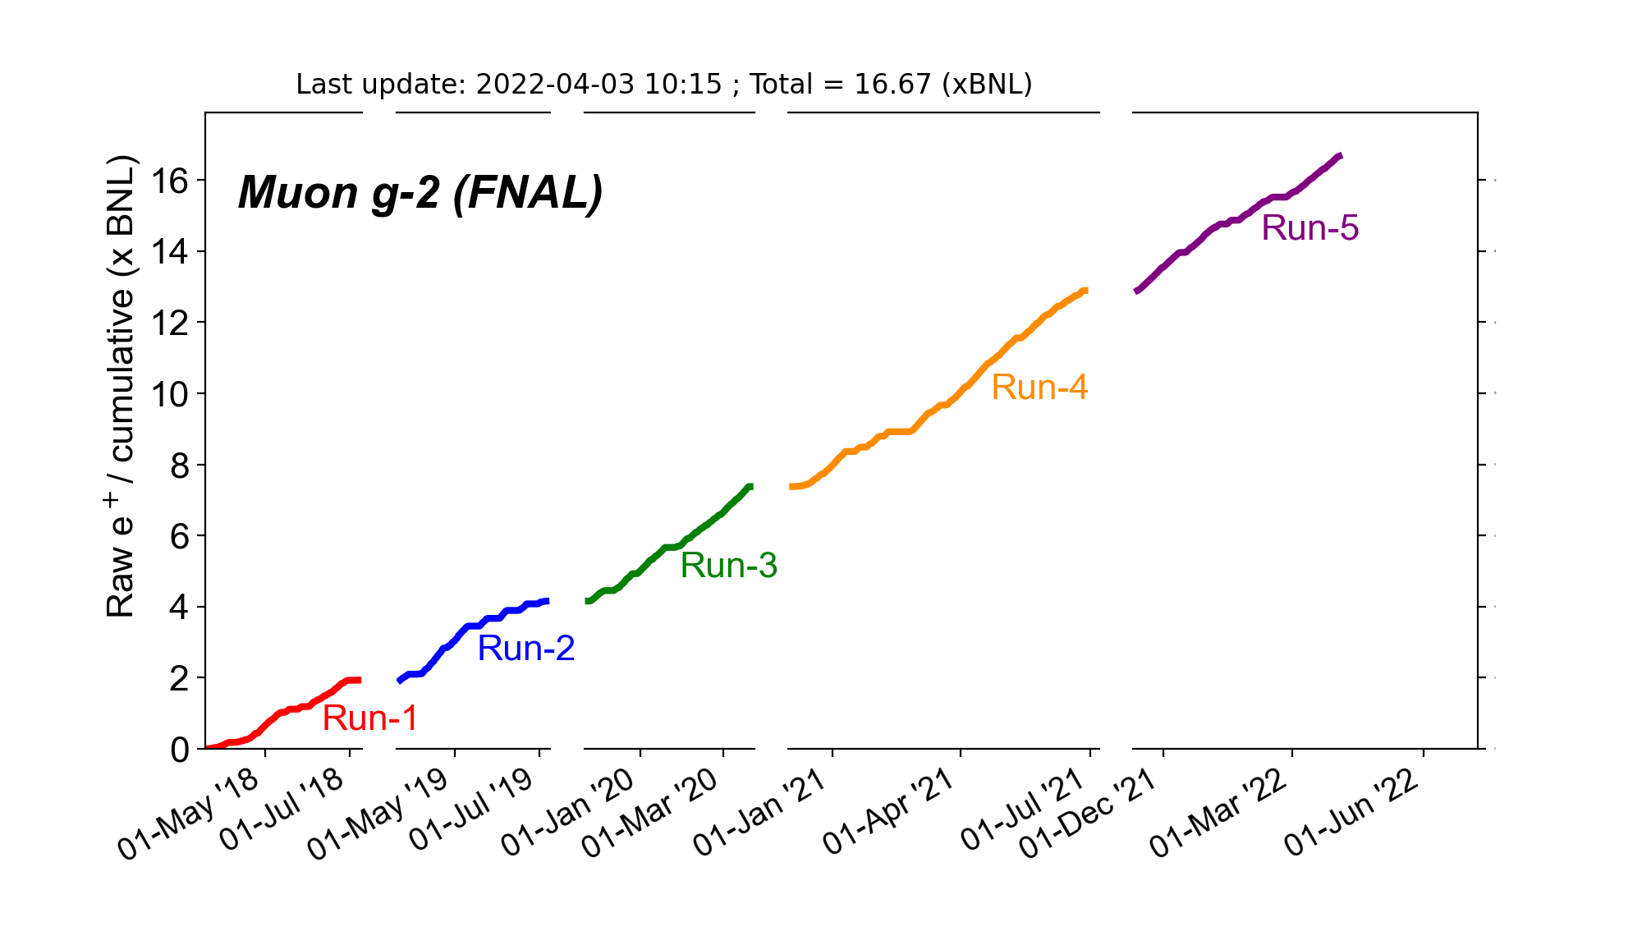
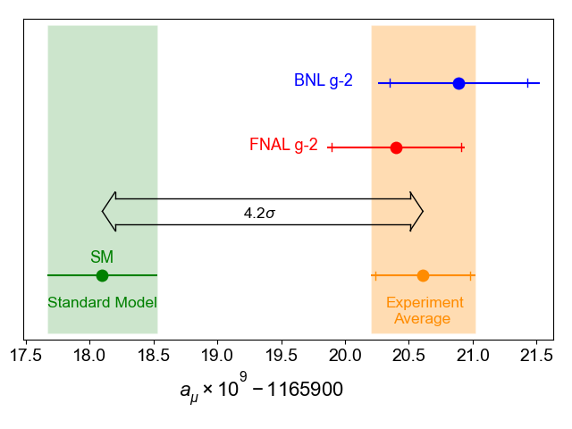
Next FNAL measurements
Exp-SM discrepancy: 2150 ± 350 (expt) ± 370 (theory) ppb (with BNL measurement)
Discrepancy is of comparable size to the SM EWK contribution to g-2.
Run-2/3 is now being analysed : should reduce statistical uncertainty by ~ 2 and
so get uncertainty: 215 (stat.) ⨁ 100 (sys.) ~ 240 ppb (vs 460 ppb Run-1)
With final dataset (Run 1-6) expect stat. to be approx. same as syst i.e.100 ⨁ 100 ppb

Slide 17
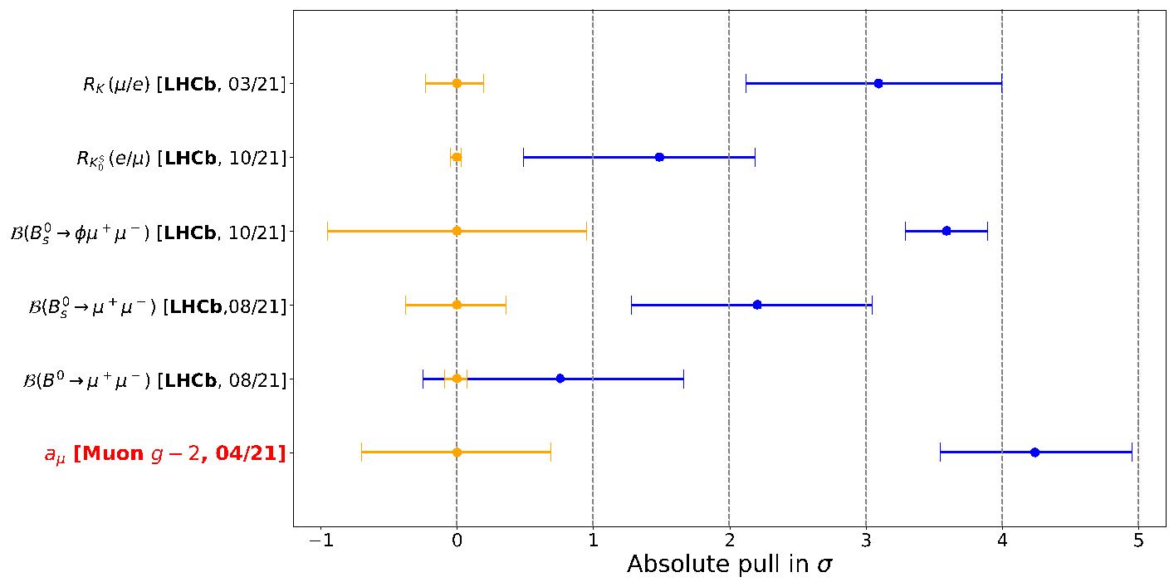
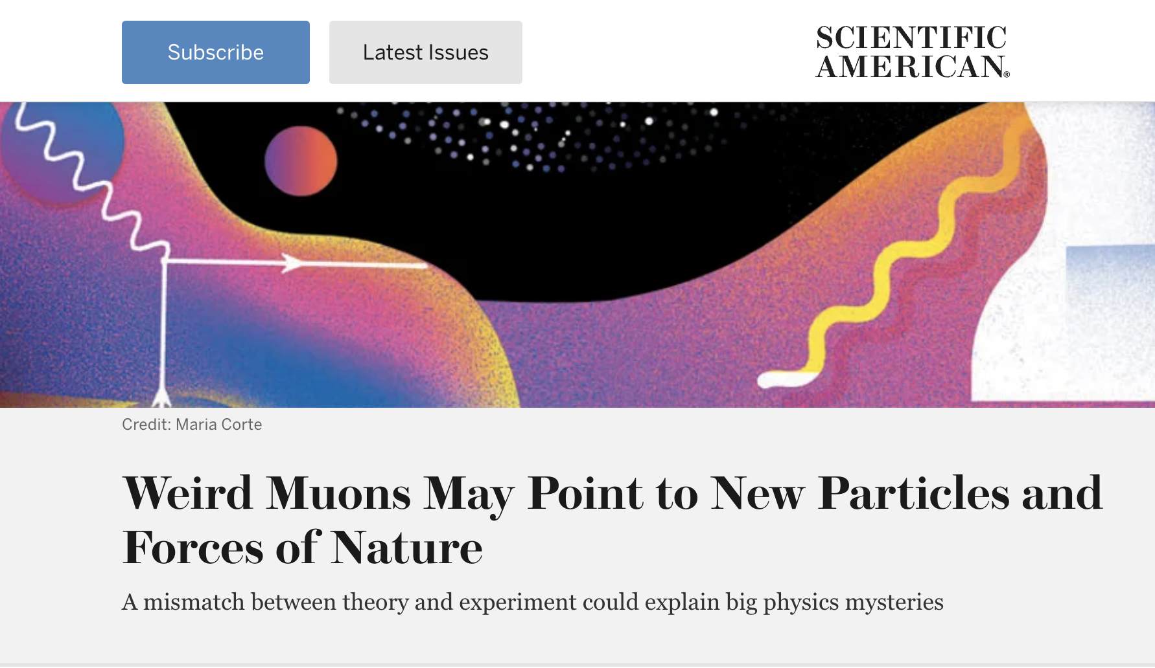
Theory & Interpretation
“If you look at it in comparison to any other ideas, it’s not worse than the others ….”
“However, this dampening of supersymmetric enthusiasm is not entirely warranted…”
“I'm quite appalled by this procession of zombie SUSY models dragged out of their graves…”
“I think it has a very good chance to be real. But it's hard to pick a model - nothing strikes me as attractive”

Slide 18
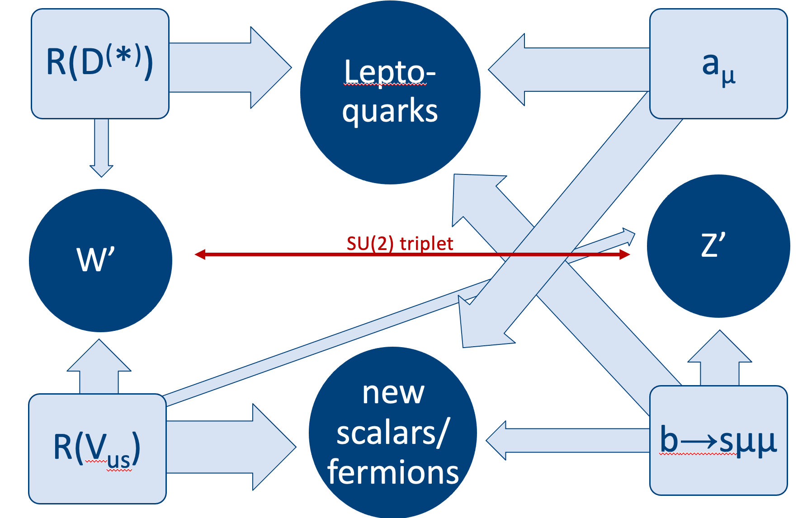
Theory & Interpretation
TeV Leptoquarks
Z’, ALPs
LHC evading SUSY
Tweaked Higgs extensions ...
The fact that discrepancy is ”large” (~ EWK contribution)
and existing experimental constraints mean that BSM
models tend to be in non-traditional parameter regions….
Andreas Crivellin
ML
And …. low energy
(keV-MeV)
phenomena

Slide 19
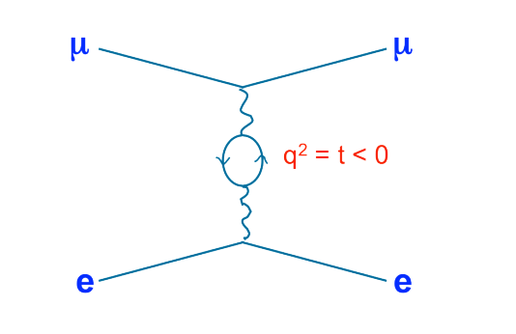
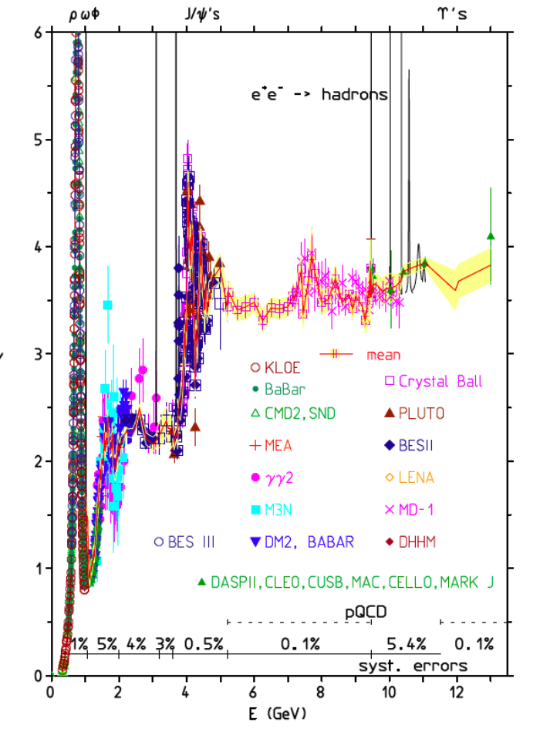
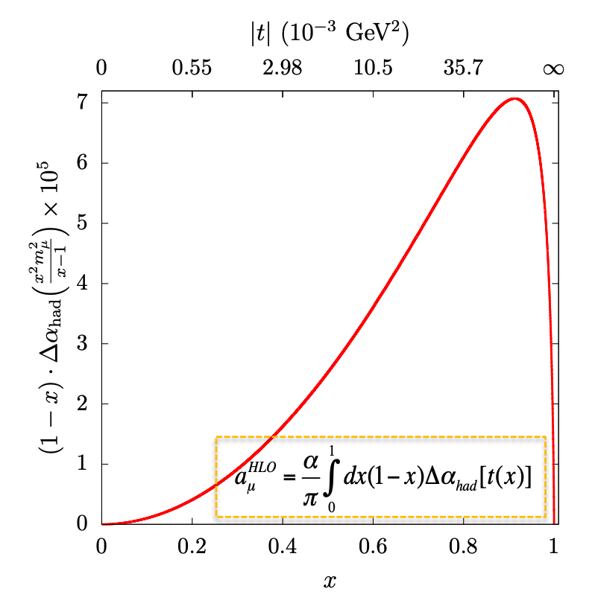
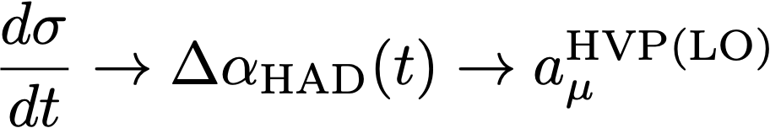
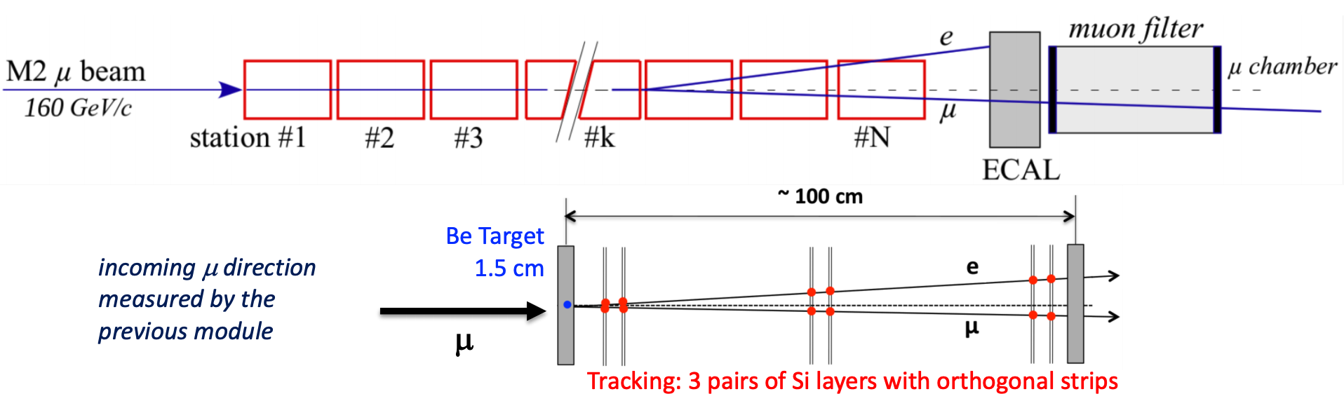
Cross checking the theory with experiment (MUonE)

Slide 20
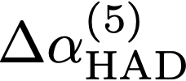
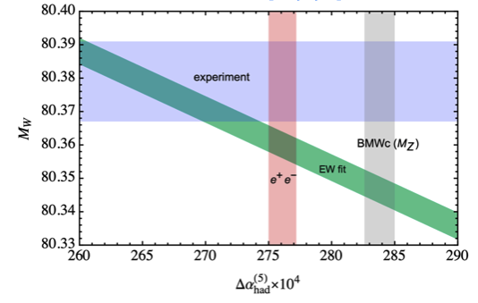
SM Prediction
Implication of BMW results is that there are issues with
the e⁺e⁻ measurements (below 0.7 GeV) or applied
radiative corrections or a fundamental flaw in the theory
If this is true then is affected and so are the
global EWK fits
Tension in SM M_{W}, M_{H} vs measured M_{W}, M_{H}
The analysis of e⁺e⁻ data can be made to match the
BMW lattice prediction if the measured cross
sections below 0.7 GeV are shifted by 7%.
In this region there is data from 9 independent
experiments: the most precise experiments
(KLOE, BaBar, CMD, SND, ….) quote cross section uncertainties of 0.5-1%...

Slide 21

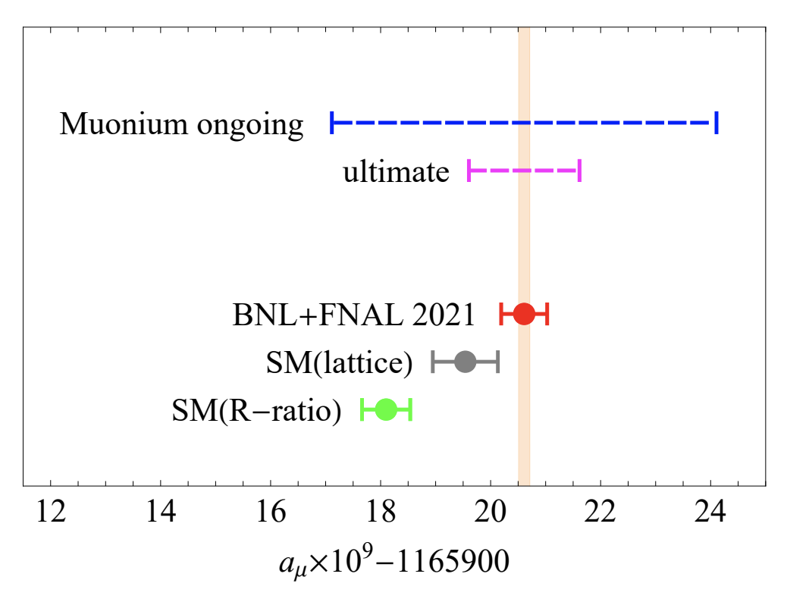
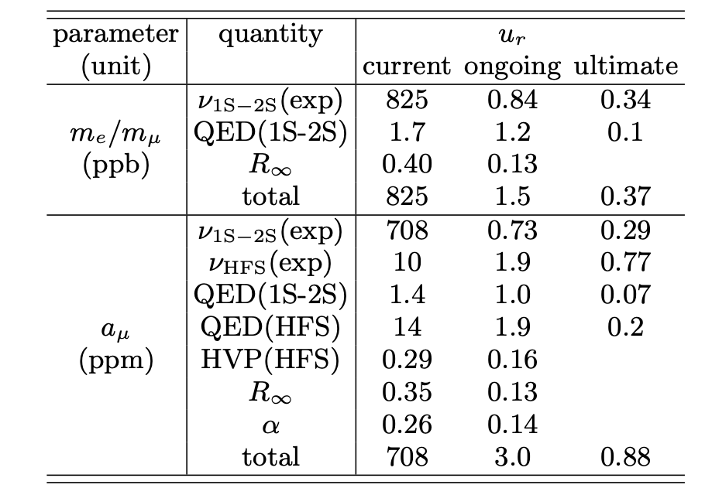
Muonium (μ⁺e⁻) Spectroscopy
Experiments at PSI (1S-2S) and JPARC (Hyperfine 1S splitting) provide key quantities:
allowing extraction of (g-2) from the data.
They can also potentially achieve ppm sensitivity to (g-2)
Needs factor of two improvement in the current experiments: Mu-MASS (PSI) and MuSEUM (JPARC)
and x10 improvement in QED theory (radiative recoil in Lamb shift) to improve R∞
arXiv: 2106.11998
BSM effects are suppressed
Experimental limits mostly statistical in producing sufficient muonium atoms.

Slide 22
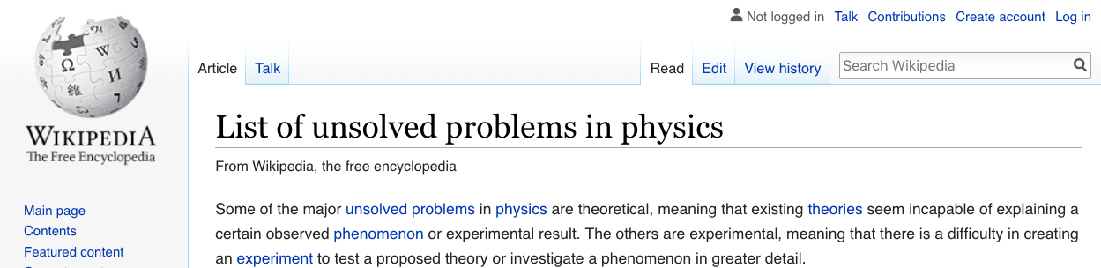
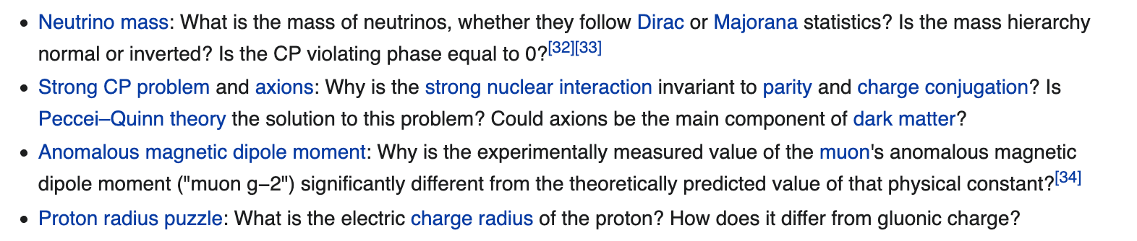
The other muon anomaly

Slide 23

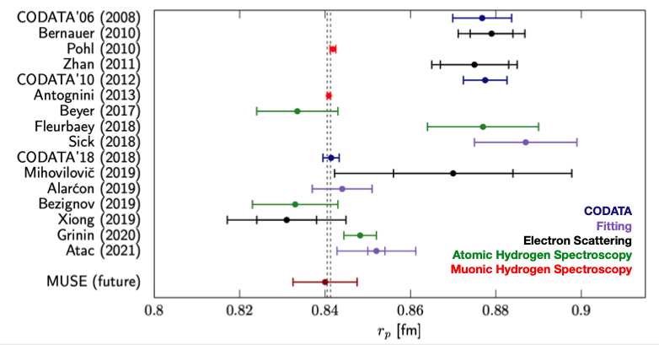
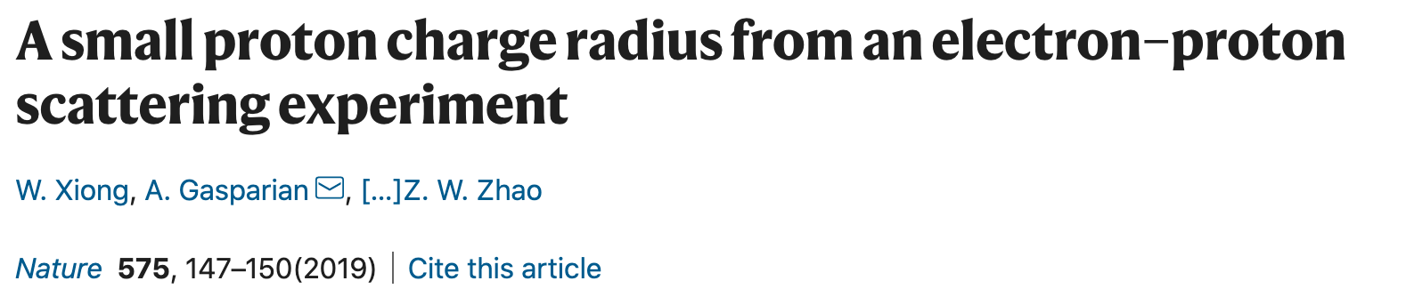

Muonic hydrogen : proton radius
Most recent results point to a smaller radius, but there remain issues in the data, questions about the radiative corrections, and a lack of understanding about what might be wrong with earlier results

Slide 24
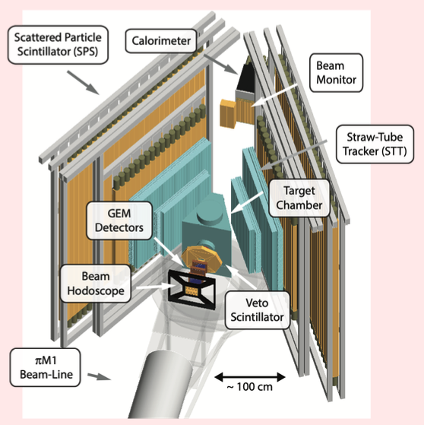
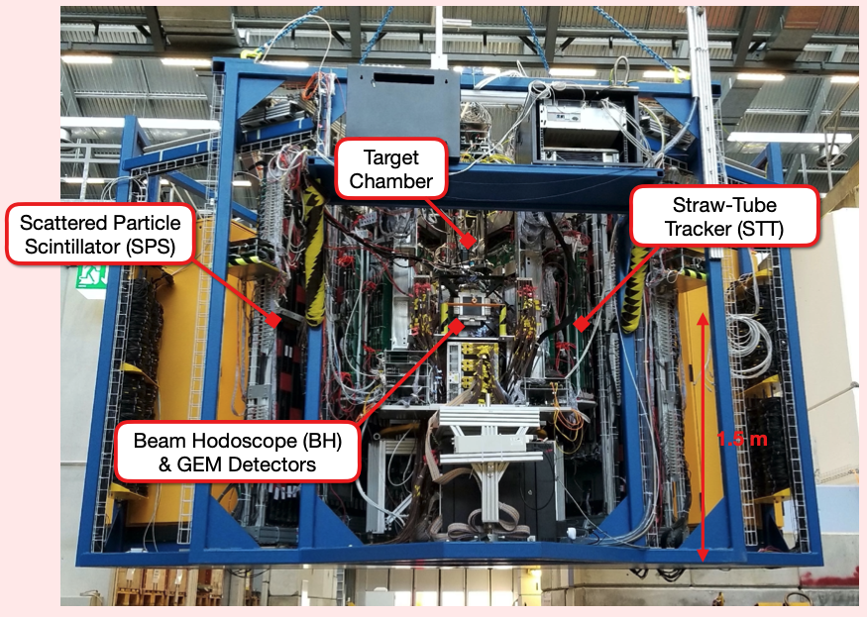
Muse Experiment at PSI
To measure e^{+/-}p and μ^{+/-}p scattering with the same experiment : 0.002 < Q² < 0.08 GeV² at the PiM1 beamline
First data recently taken with more in 2022/3
Notes:
Two photon exchange from a comparison of e+p and e-p results

Slide 25




Charged Lepton Flavour Violation (cLFV)
In SM: neutrino oscillations (masses) are intimately connected with charged lepton flavour violation
MUON cLFV
and also in BSM:
And thus to extensions to the Higgs sector.

Slide 26

Charged Lepton Flavour Violation (cLFV)
Ratio of the 3 different CLFV processes is model dependent and depend on model parameters.
O(10⁴) improvement
driven by new
technology
Being probed by MEG ( ), Mu3e ( ), DeeMe/COMET/Mu2e ( )

Slide 27



MEG-II
MEG-I (2016) : BR (μ→e𝛾) < 4.2 x10⁻¹³ (90%CL)
MEG-II to reach 6x10⁻¹⁴

Slide 28



MEG-II
Resolutions confirmed in
engineering runs
Improved detector resolution and granularity
Higher beam intensity achievable: 7 x 10⁷ μ/s
New positron tracker
New detector for RMD
New TDAQ system
Improved photon detector

Slide 29


MEG-II : X(17)
J. Phys. Conf. Ser. 2018, 1056, 012028 (⁸Be*)
J. Phys. Conf. Ser. 2020, 1643, 012001 (⁴He*)
Possible interpretation : 17 MeV boson (BR ~ 6 x 10⁻⁶)
Li₂O layer on Cu substrate in PSI proton beam
MEG-II has improved resolution compared to Atomki
Data to be taken in 2022 prior to CLFV running.
MEG-II GEANT4: mass resolution: 0.5 MeV
Notes:
Blue old data,red new data

Slide 30


μN → eN/ : DeeMe

Slide 31



DeeMe
Phase-1 : C-target
Phase-2 : SiC target
Expect x10 in sensitivity and then x100
First running in 2022

Slide 32




COMET
Phase-I
Phase-II

Slide 33





Mu2e
Production Solenoid
Transport
Solenoid
Detector
Solenoid &CRV
Tracker
6m
Al-Stopping
Target
Calorimeter

Slide 34


Mu2e / COMET-I
Beam commissioning 2023
Physics running 2024

Slide 35





Mu3e
10³ improvement in limit - Phase-I & further factor of ~ 10 with HIMB 10¹⁰ mu/sec upgrade
Commissioning now : physics run: 2024

Slide 36



MuEDM at PSI
”Frozen spin” technique disappears (g-2) using judicious E-field choice
X
$$\vec{ω}=\frac{q}{m}\left[a\vec{B}+\left(\frac{1}{1−γ^{2}}−a \right)\frac{\vec{β}×\vec{E}}{c}+\frac{η_{d}}{2}\left(\frac{\vec{E}}{c}+\vec{β}×\vec{B}\right)\right]$$
Signature: vertical oscillation

Slide 37

Conclusions
Interesting time for muon physics: strengthened evidence for deviation from SM in muon g-2 : 4.2𝜎
FNAL (g-2) already has x15 data of first publication and more to come.
Also much work being undertaken on the SM prediction.
MEG-II, DeeMe will have data in next year.
And then subsequently from Mu2e, COMET-I, Mu3e, JPARC g-2, Muon EDM
Wed PM (Parallel)
George Sweetmore (g-2)
Dominika Vasilkova (g-2)
Roden Derveni (COMET)
Benjamin Gayther (Mu3e)
”This could be the discovery of the century.
Depending, of course, on how far down it goes”

