Slide 1
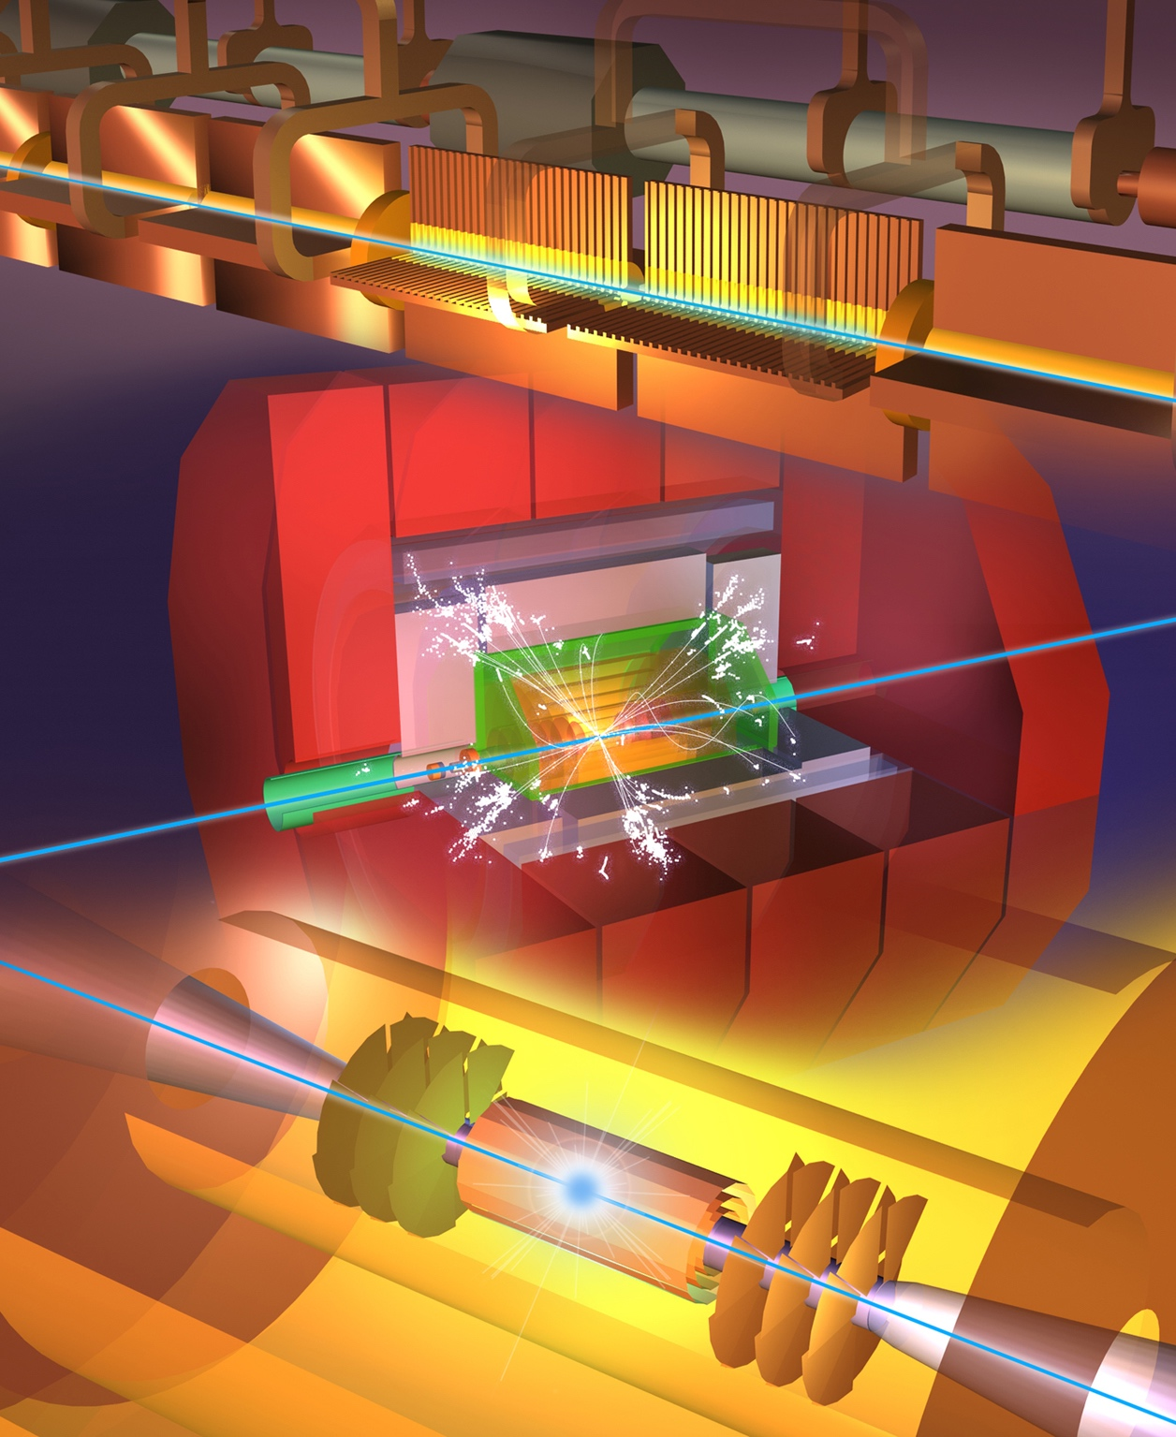
Future Colliders
Mike Lamont
IOP HEPP & APP Annual Conference
4th April 2022

Slide 2
European Strategy for Particle Physics update 2020
… an electron-positron Higgs factory is the highest-priority next collider for the field, followed by a hadron collider at the energy frontier in the longer term
should investigate the technical and financial feasibility of a future hadron collider at CERN with a centre-of-mass energy of at least 100 TeV and with an electron-positron Higgs and electroweak factory as a possible first stage.
The timely realisation of the electron-positron International Linear Collider (ILC) in Japan would be compatible with this strategy
Two possible energy-frontier colliders have been studied for implementation at CERN, namely CLIC and FCC...
In addition to the high field magnets the accelerator R&D roadmap could contain: an international design study for a muon collider, as it represents a unique opportunity to achieve a multi-TeV energy domain beyond the reach of e+e- colliders, and potentially within a more compact circular tunnel than for a hadron collider.

Slide 3




LEGEND
CERN ExistingLHC
LHC
FCC
Muon Collider
CLIC
FCC
CLIC
Muon Collider ring
Muon Acceleration ring

Slide 4

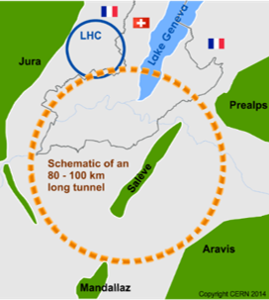
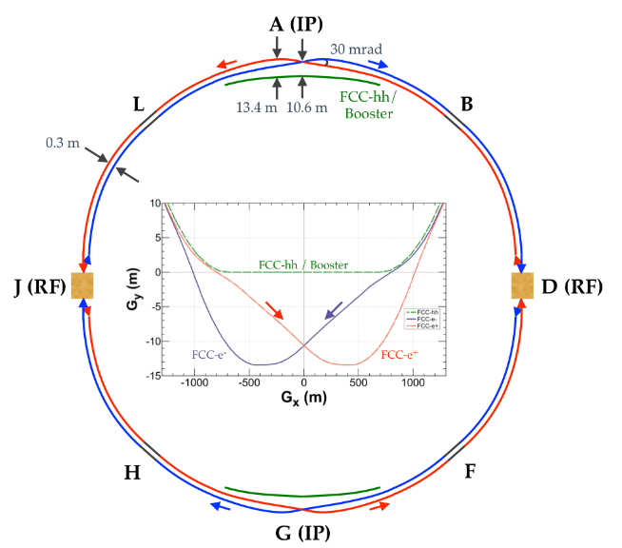
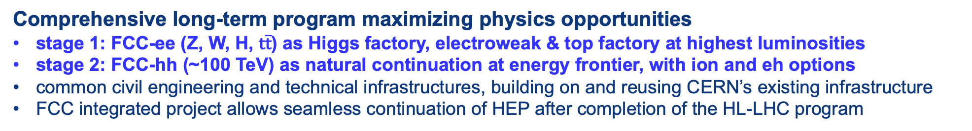
FCC integrated project: inspired by LEP-LHC
Comprehensive long-term program maximizing physics opportunities
stage 1: FCC-ee (Z, W, H, $\text{t}\overline{\text{t}}$) as Higgs factory, electroweak & top factory at highest luminosities
stage 2: FCC-hh (~100 TeV) as natural continuation at energy frontier, with ion and eh options
common civil engineering and technical infrastructures, building on and reusing CERN’s existing infrastructure
FCC integrated project allows seamless continuation of HEP after completion of the HL-LHC program
FCC-hh
FCC-ee
2020 - 2045
2045 - 2060
2070 – 2090++
Notes:
The FCC study and program comprises of two accelerators: the Lepton Collider FCC-ee and the Hadron Collider FCC-hh.
The aim of this setup is devise a comprehensive, cost-effective program to maximizing the physics opportunities.

Slide 5
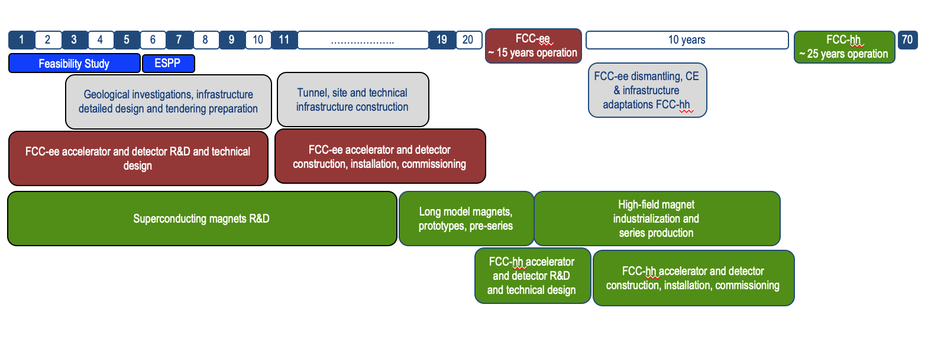
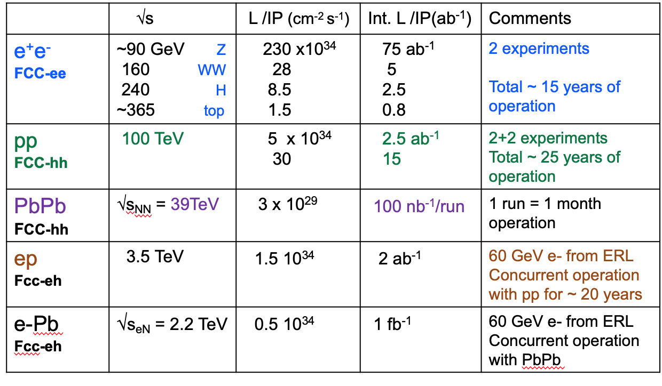
Timeline of the FCC integrated programme
Technical
schedule
2-4 experiments
20-30
Feasibility Study: 2021-2025
If project approved before end of
decade → construction can start
beginning 2030s
FCC-ee operation ~2045-2060
FCC-hh operation 2070-2090++

Slide 6
FCC Feasibility Study (2021-205): high-level objectives
demonstration of the geological, technical, environmental and administrative feasibility of the tunnel and surface areas and optimisation of placement and layout of the ring and related infrastructure;
pursuit, together with the Host States, of the preparatory administrative processes required for a potential project approval to identify and remove any showstopper;
optimisation of the design of the colliders and their injector chains, supported by R&D to develop the needed key technologies;
elaboration of a sustainable operational model for the colliders and experiments in terms of human and financial resource needs, as well as environmental aspects and energy efficiency;
development of a consolidated cost estimate, as well as the funding and organisational models needed to enable the project’s technical design completion, implementation and operation;
identification of substantial resources from outside CERN’s budget for the implementation of the first stage of a possible future project (tunnel and FCC-ee);
consolidation of the physics case and detector concepts for both colliders.
Results will be summarised in a Feasibility Study Report to be released at end 2025

Slide 7

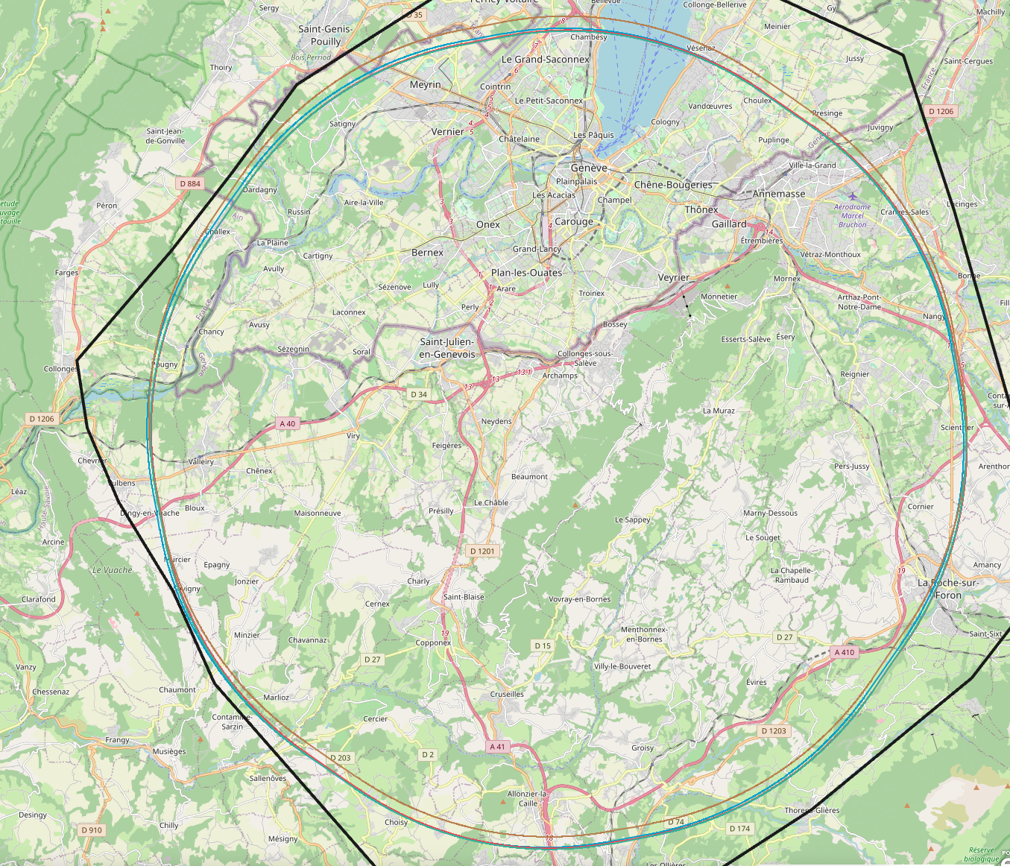
Preferred implementation scenario
In June 2021, an international committee independently reviewed the results of placement studies, and recommending a specific, 91-km long layout with a four-fold symmetry and eight surface sites
Further studies and analysis during last months have not brought up any obstacles and the preferred implementation scenario is kept.
Traffic and transport
Urbanistic aspects
Availability and connections to services
Environmentally protected zones
Water reservoirs and protection zones

Slide 8
Parameters of baseline scenario
Number of surface sites | 8
Number of arc cells | 42 x 8
Arc cell length | 213.045 m
LSS@IP (PA, PD, PG, PJ) | 1400 m
LSS@TECH (PB, PF, PH, PL) | 2160 m
Arc length | 9 616.586 m
Sum of arc lengths | 76 932.686 m
Total length | 91 172.686 m

Slide 9
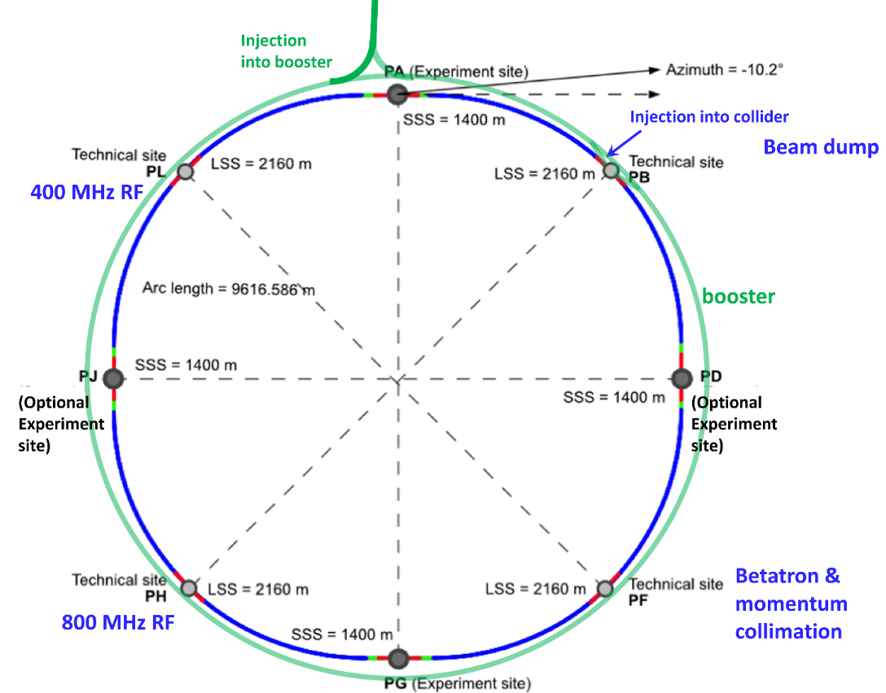
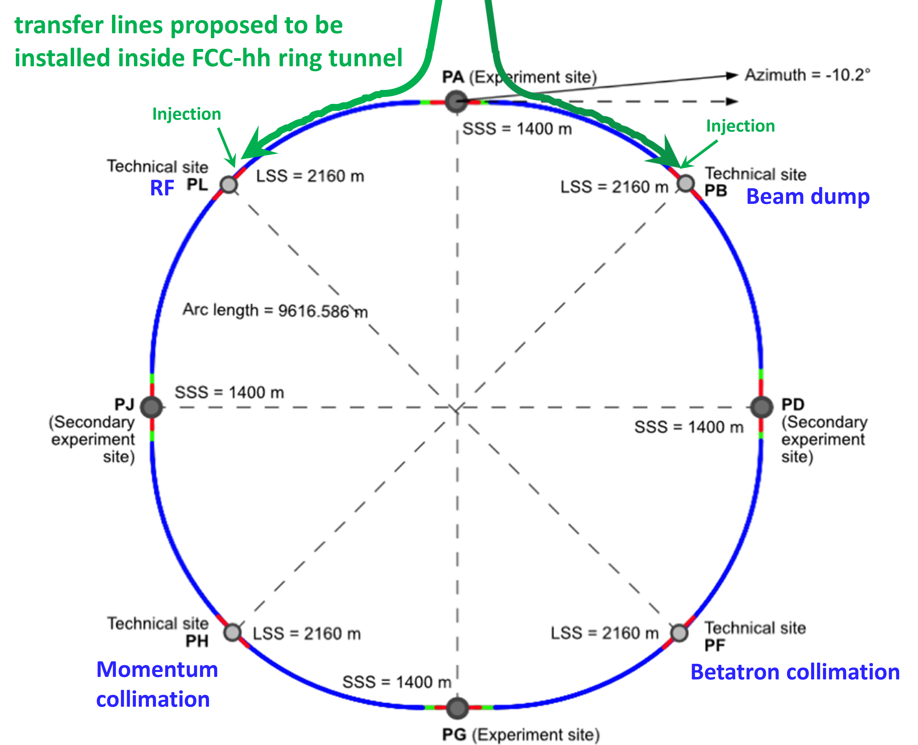
Layout optimization – 4-fold periodicity, synergies ee & hh
injection-tunnel near PA; 400 MHz RF in PL; 4 exp. caverns for both
FCC-ee
FCC-hh

Slide 10
Next steps related to implementation studies
Accelerator design
Scaling and adaptation of the CDR design (FCC-ee and FCC-hh) to the new layout.
Integration with injector complex (LHC and/or SPS tunnels)
Update of requirements on technical infrastructure for all surface points
Technical infrastructure
Update of system parameters for all surface sites
Scaling of CDR concepts to new parameters
Verification of availability and connections to services
Civil engineering and associated activities:
Adaptation of CE project to 8-site layout, taking specific surface site location into account
Update of construction concept (excavation methods, TBM lowering, etc.) and schedule

Slide 11
Plans for on-site activities
Surface sites
Visual inspections (non-invasive) as basis for site layout planning and preparation of on site activities (2022).
Initial state analysis (non-invasive) as first step of environmental evaluation process (2022 - 24).
Zones for high-risk area geological investigations
Visual inspections (non-invasive) for detailed planning of site investigations (2022).
Environmental impact studies (non-invasive), restricted to site investigations (2022 - 23).
High-risk area investigations (invasive), drillings and seismic investigations (2023 - 25)
Surface geodetic reference network
Visual inspections (non-invasive) to identify optimum placement of network pillars (2022).
Installation of network pillars (invasive), restricted to site investigations (2023 - 25).

Slide 12



Feasibility Study Timeline
2021 |  |  |  | 2022 |  |  |  | 2023 |  |  |  | 2024 |  |  |  | 2025
Q1 | Q2 | Q3 | Q4 | Q1 | Q2 | Q3 | Q4 | Q1 | Q2 | Q3 | Q4 | Q1 | Q2 | Q3 | Q4 | Q1 | Q2 | Q3 | Q4
CDR baseline design adaptations for
new implementation scenario
Status reports &
study planning ,
FCC Week: implementation, main parameters baseline design documentation
high-risk areas site investigations, environmental evaluation & impact study with host states
mid-term review:
general coherency, cost update
detailed design towards CDR
cost and schedule for phase 1
FCC Week & Review: key technology R&D programs
FS Report
Release FSR
cost and schedule update

Slide 13
Muon Collider
First proposed 50 years ago by Gersh Budker and then developed by Alexander Skrinsky and David Neuffer
Muon Collider Collaboration
(1997, Bob Palmer et al)
“generated a reservoir of expertise and enthusiasm that the current international effort on physics, machine and detector studies can not do without”
Muon Accelerator Program (MAP)
(2011 Mark Palmer et al)
Muon Collider Working Group
(2017, asked by LDG to prepare the Input to the European Strategy Update)

Slide 14
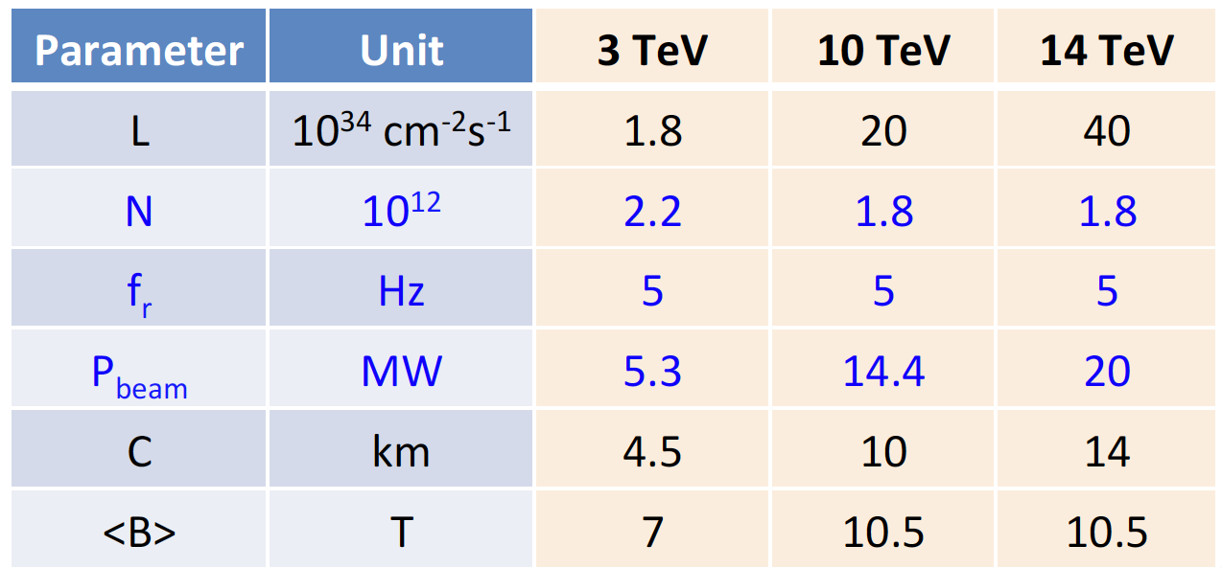
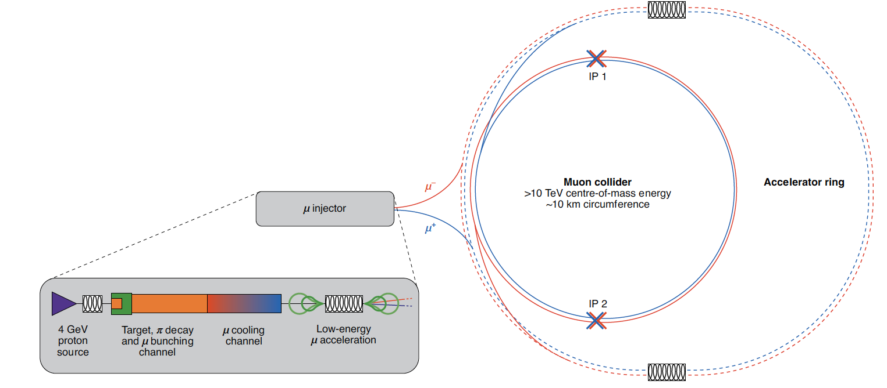
Muon Collider
At the start of 2021, the muon collider study was initiated at CERN. In consultation with institutes from different member states a Memorandum of Cooperation was finalised, and several institutes, including CEA and INFN, have signed.
Muon collider study goals: work on the main challenges
determine by end 2025 (as input to next European Strategy) if investment in muon collider test facility and CDR is justified from a scientific perspective.

Slide 15
Muon Collider Timeline
Develop concept to make informed decision by next EU strategy
Address:
Innovative design
Technology challenges
Cost drivers
Power drivers
Design demonstrator facility
site identiﬁed at CERN
- global collaboration

Slide 16
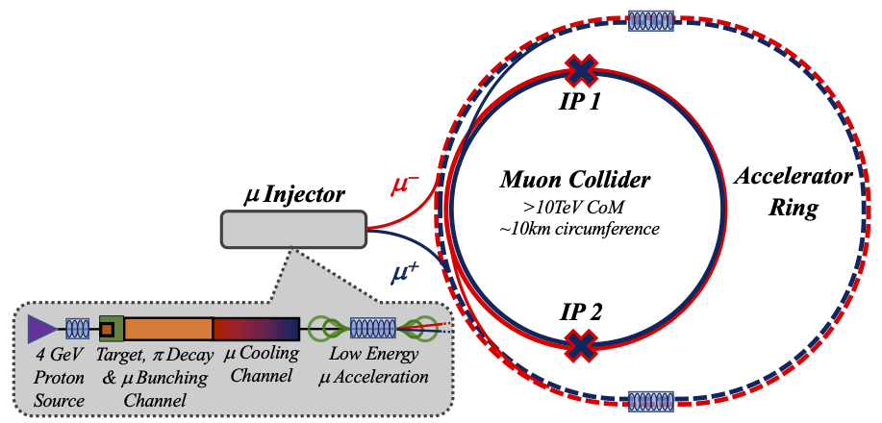
Challenges
4) Drives the beam quality
start from MAP design
optimize as much as possible
2) Beam-induced background
1) Dense neutrino flux
mitigated by mover system and site selection
3) Cost and power consumption limit energy reach
e.g. 32 km accelerator for 10 TeV, 10 km collider ring
Also impacts beam quality
16

Slide 17
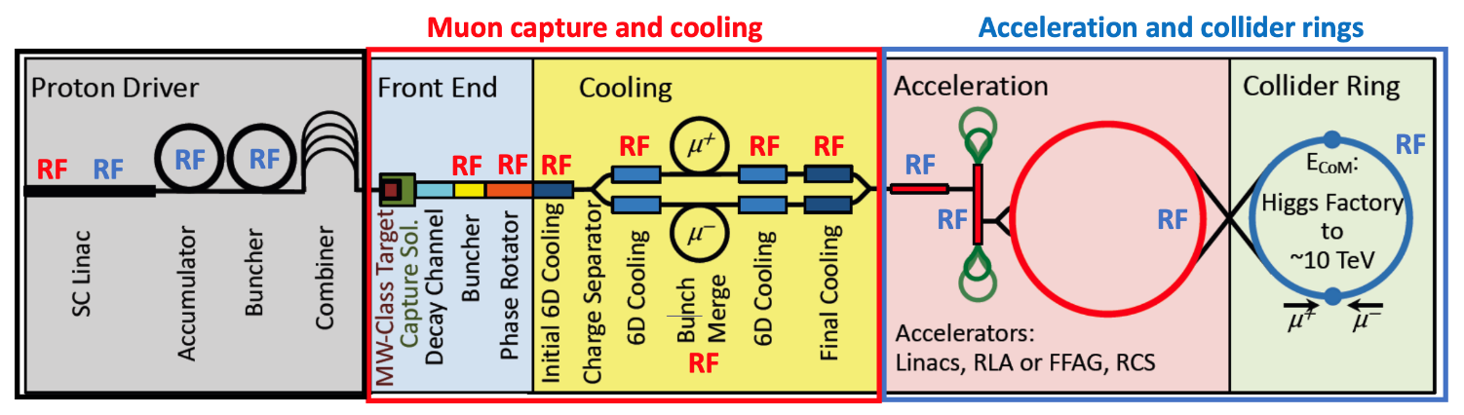
Methodology
Start from the MAP scheme
Extend understanding of open points, e.g.
  Neutrino Radiation
  Integration of RF, magnets and target
  Selection of cooling techniques & technologies
  Deepen study of fast acceleration, investigate alternatives
  Rely on parallel programmes (e.g. HFM) for technologies which are common to other projects/fields.

Slide 18
Progress
Prepared the European Roadmap for Accelerator R&D
Technical progress in several areas:
Team of civil engineers, radiation and FLUKA experts, beam physicists started addressing the neutrino flux challenge
Design of collider ring lattice is ongoing
Longitudinal beam dynamics and RF concept in high-energy complex started
MDI studies started, losses in collider ring, impact on target
Final cooling system work
Power converter studies
Collective effects, final cooling absorber design, magnets started
Looking towards Roadmap implementation…
18
Daniel Schulte

Slide 19
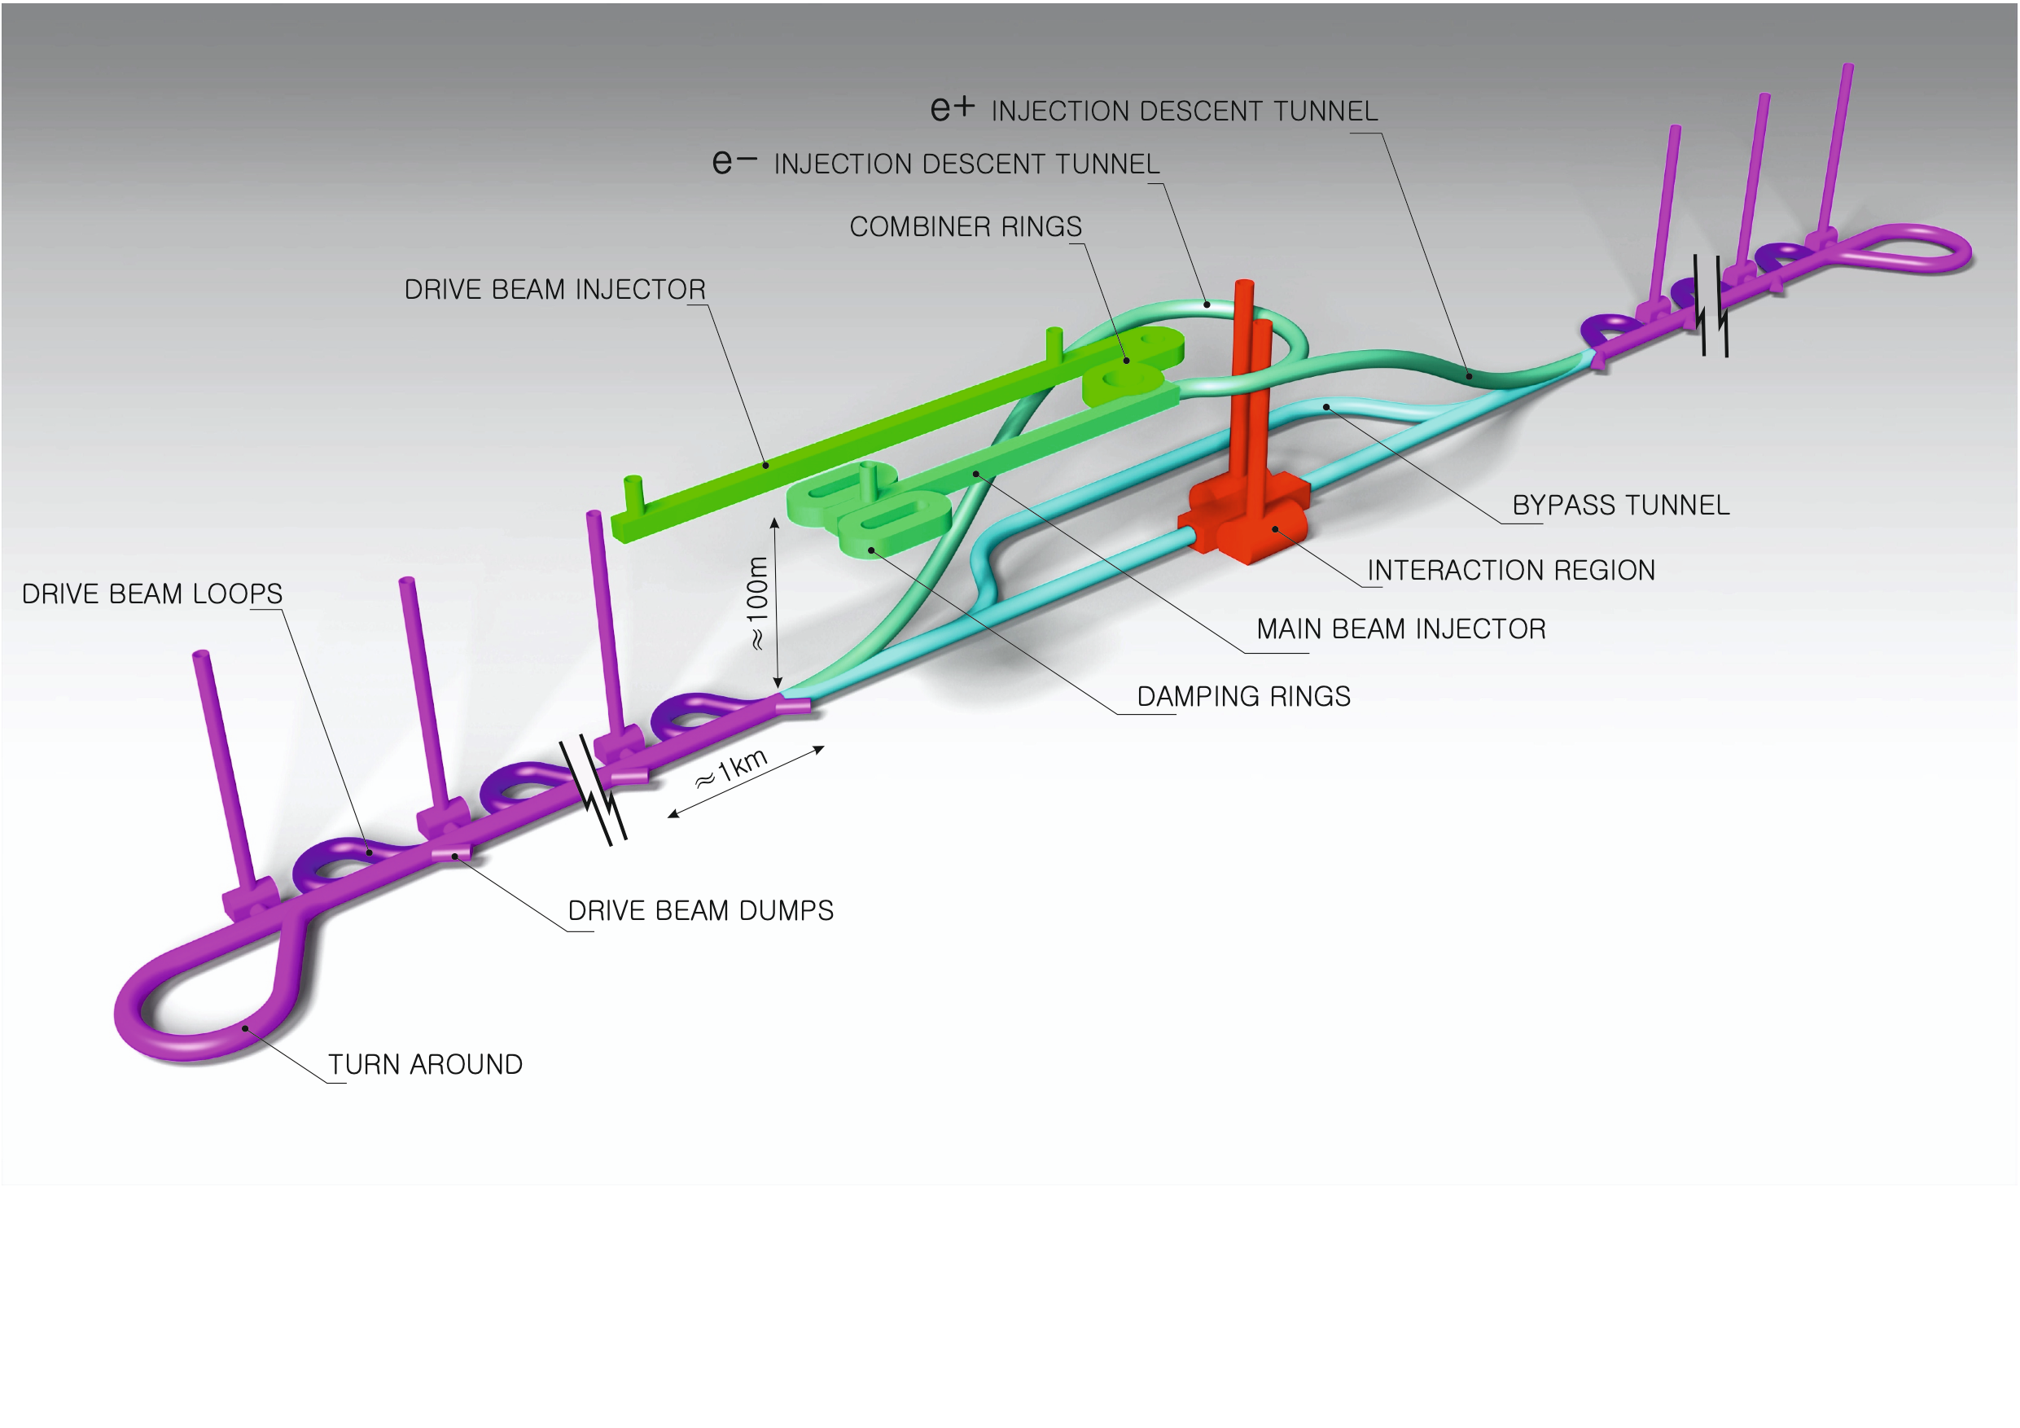

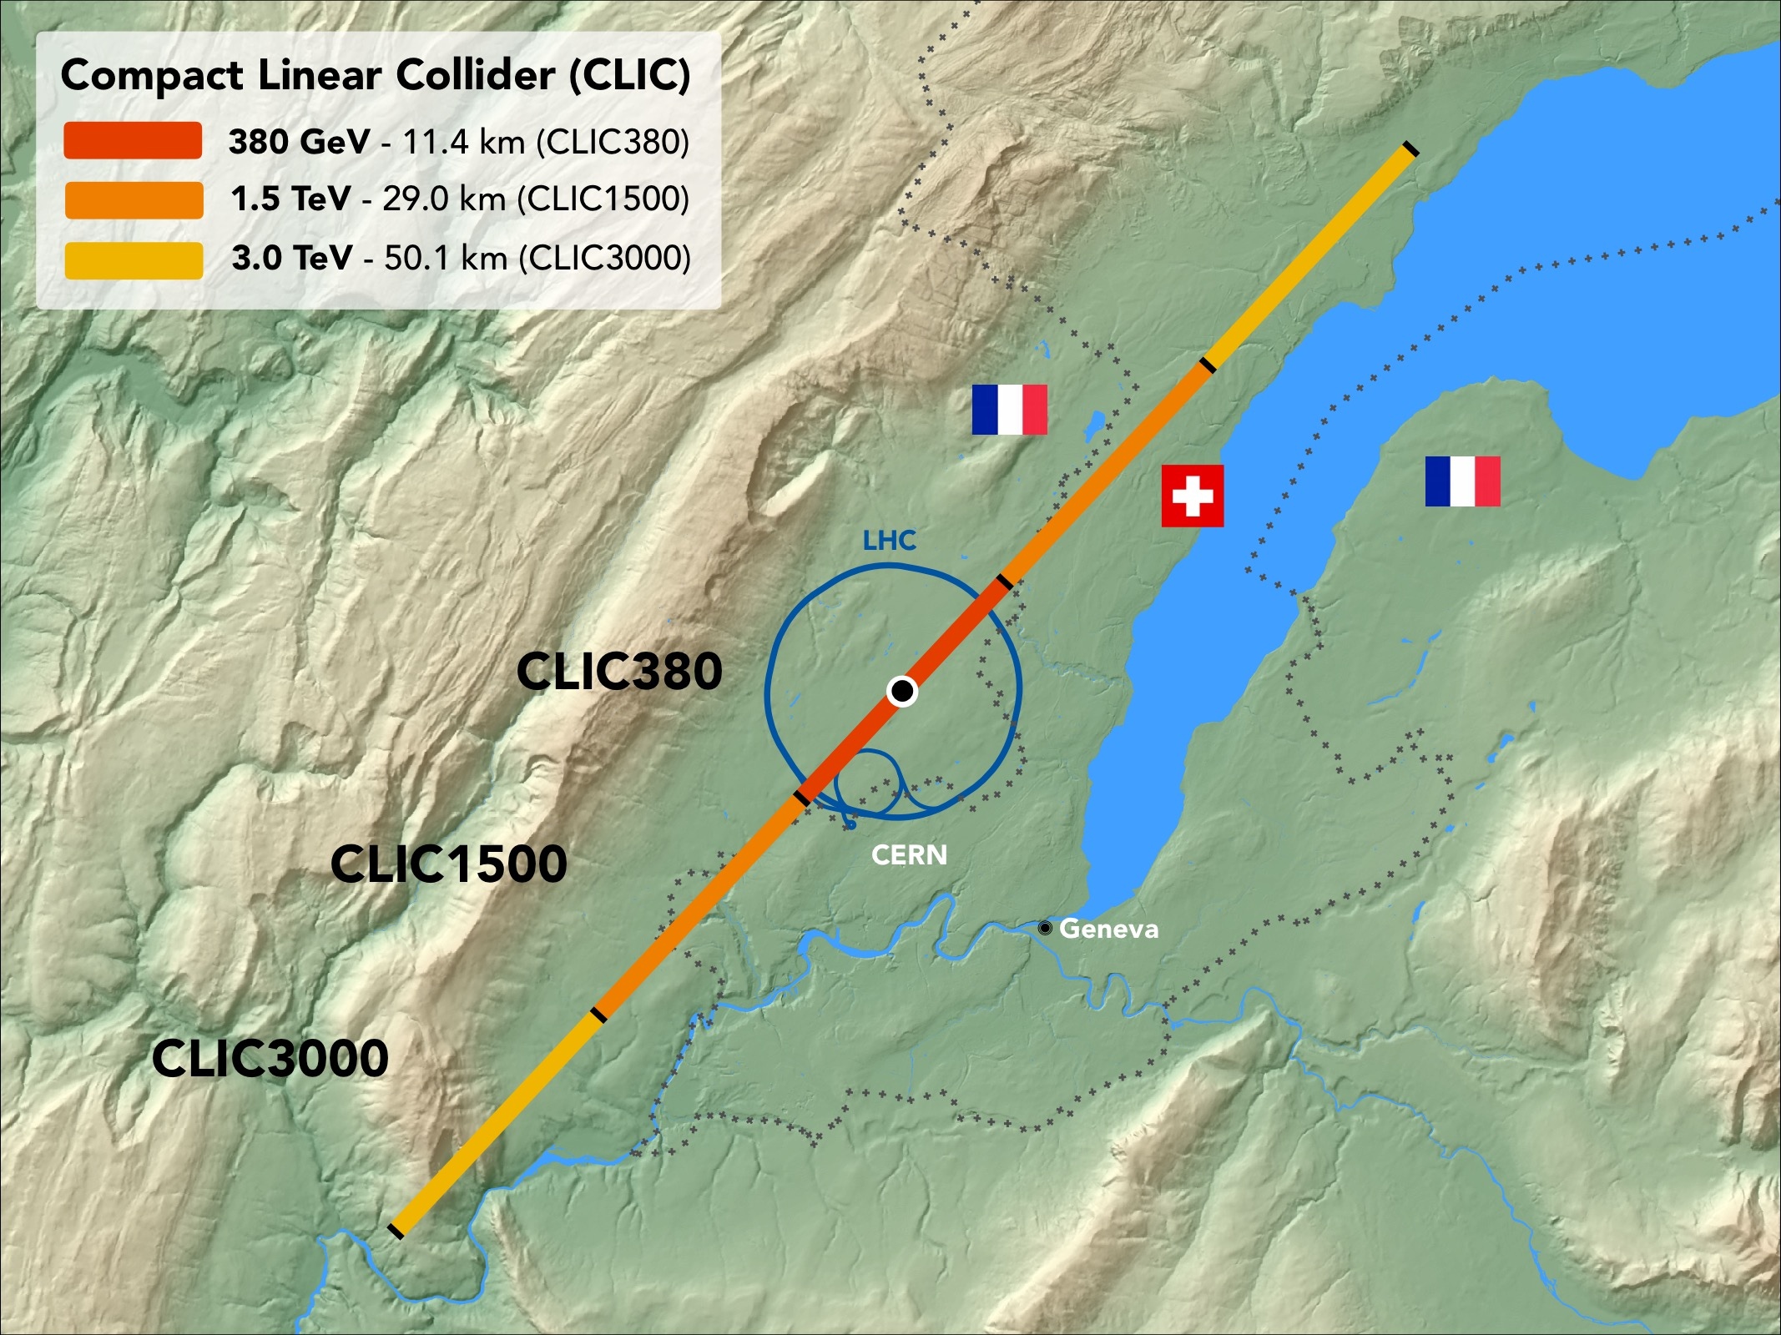
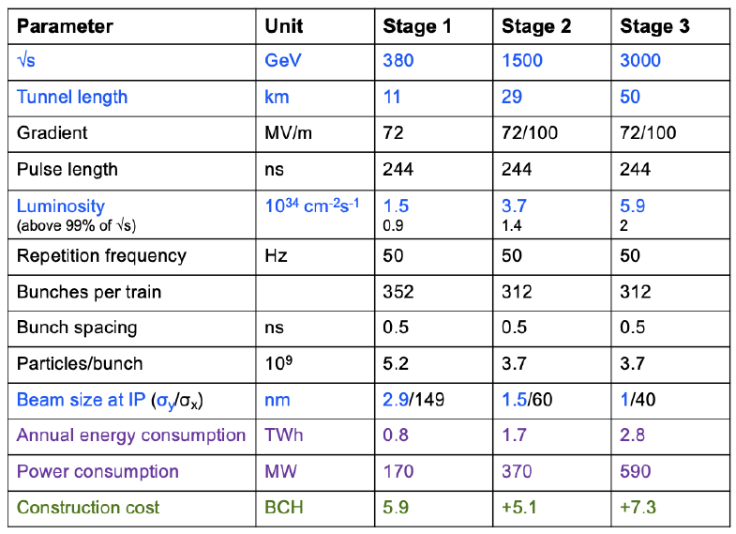
CLIC
The 2021-2025 CERN linear collider programme is defined in accordance with the ESPP update. The programme will maintain and further develop CLIC as an option for a Higgs/top accelerator facility at CERN and pursue high‑gradient R&D and nanobeam technology more generally for compact applications in research, medical and industrial accelerators.
Steinar Stapnes

Slide 20
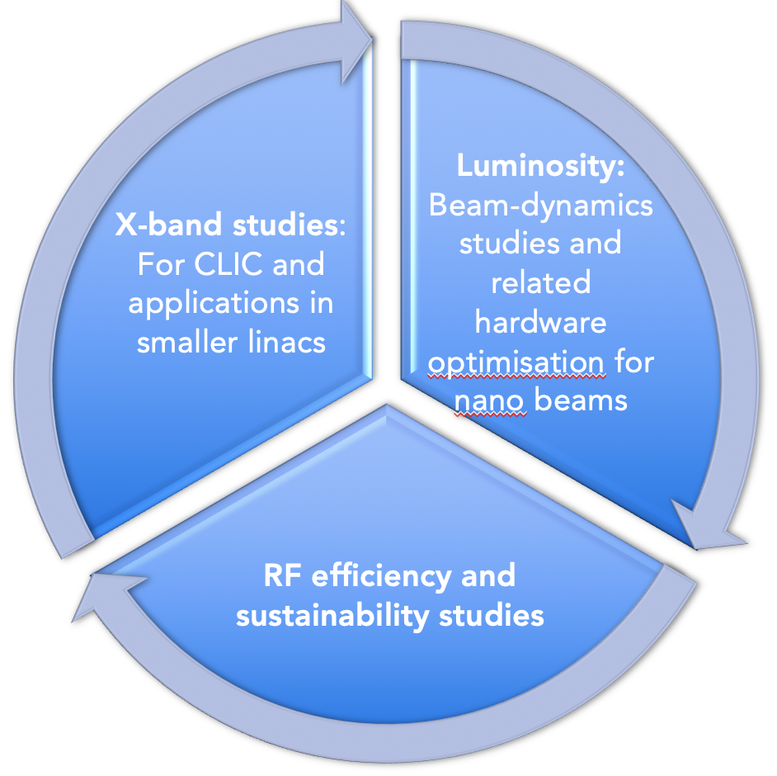
CLIC Project Readiness 2025-26
Project Readiness Report as a step toward a TDR – for next ESPP
Assuming ESPP in 2026, Project Approval ~ 2028, Project (tunnel) construction can start in ~ 2030.
Focusing on:
The X-band technology readiness for the 380 GeV CLIC initial phase
Optimizing the luminosity at 380 GeV
Improving the power efficiency for both the initial phase and at high energies
The CLIC study is mature, see for example: https://arxiv.org/abs/2203.09186 (Snowmass)
Goals for the studies by ~2025, key improvements:
    Luminosity numbers, covering beam-dynamics, nanobeam, and positrons - at all energies.
Energy/power: 380 GeV well underway, 3 TeV to be done, L-band klystrons
Sustainability issues, more work on running/energy models and carbon footprint
X-band progress – for CLIC, smaller machines, industry availability, including RF network
R&D for higher energies, gradient, power, prospects beyond 3 TeV
Cost update, only discuss changes wrt Project Implemention Plan
Low-cost klystron version – reoptimize for power, cost, fewer klystrons ?

Slide 21
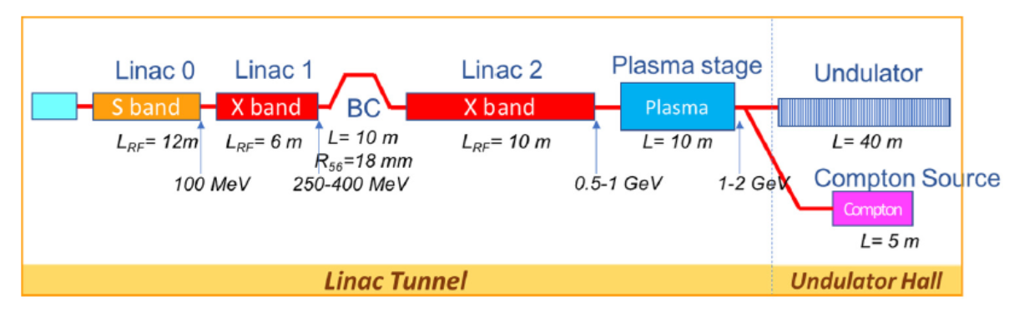
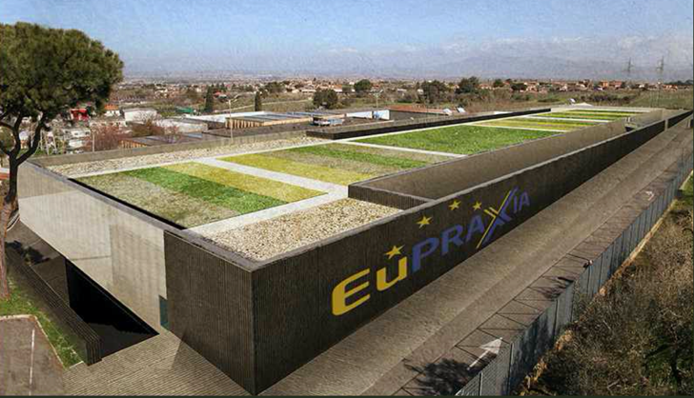
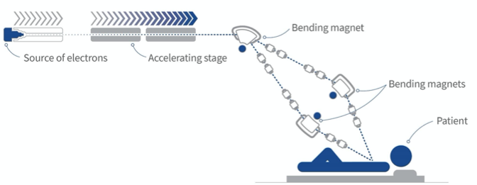
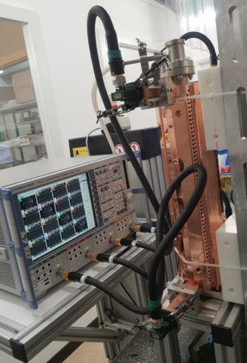
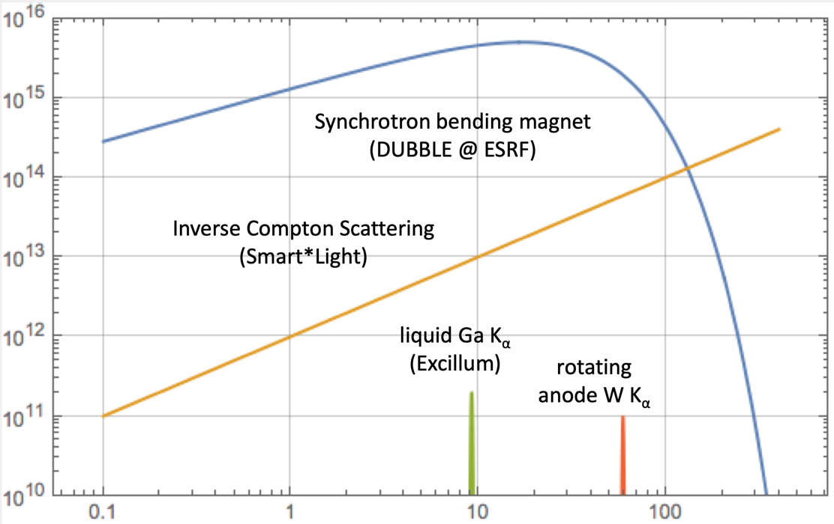
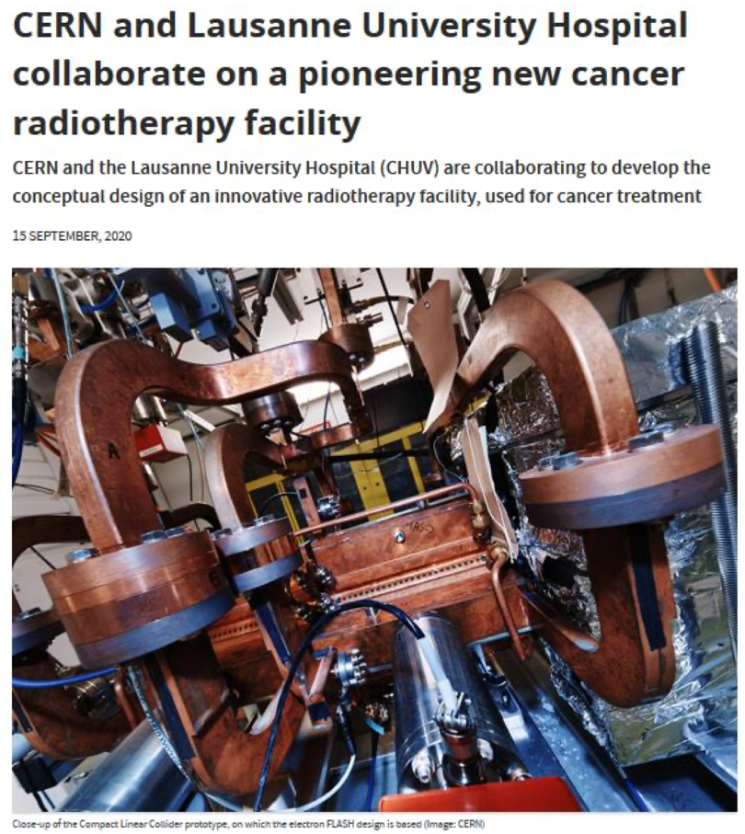
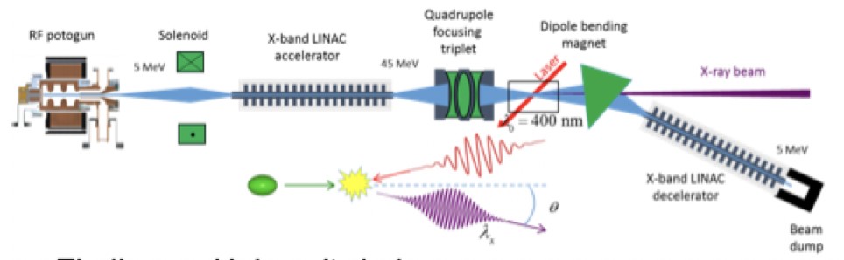
Applications – injector, X-band modules, RF
CompactLight Design Studies 2018-21 (right)
INFN 1 GeV linac
Design Studies for ICS, SmartLight in Eindhoven
DEFT, at CHUV
XBOX test-stations, for example Melbourne, LNF, …
Linearizer and Deflectors, e.g. PSI, DESY, CLARA, more
Recent: Neutron Imaging, DESY energy compressors
AERES, IFAST and EuroLabs
X-band accelerating modules
Notes:
Size of investments

Slide 22
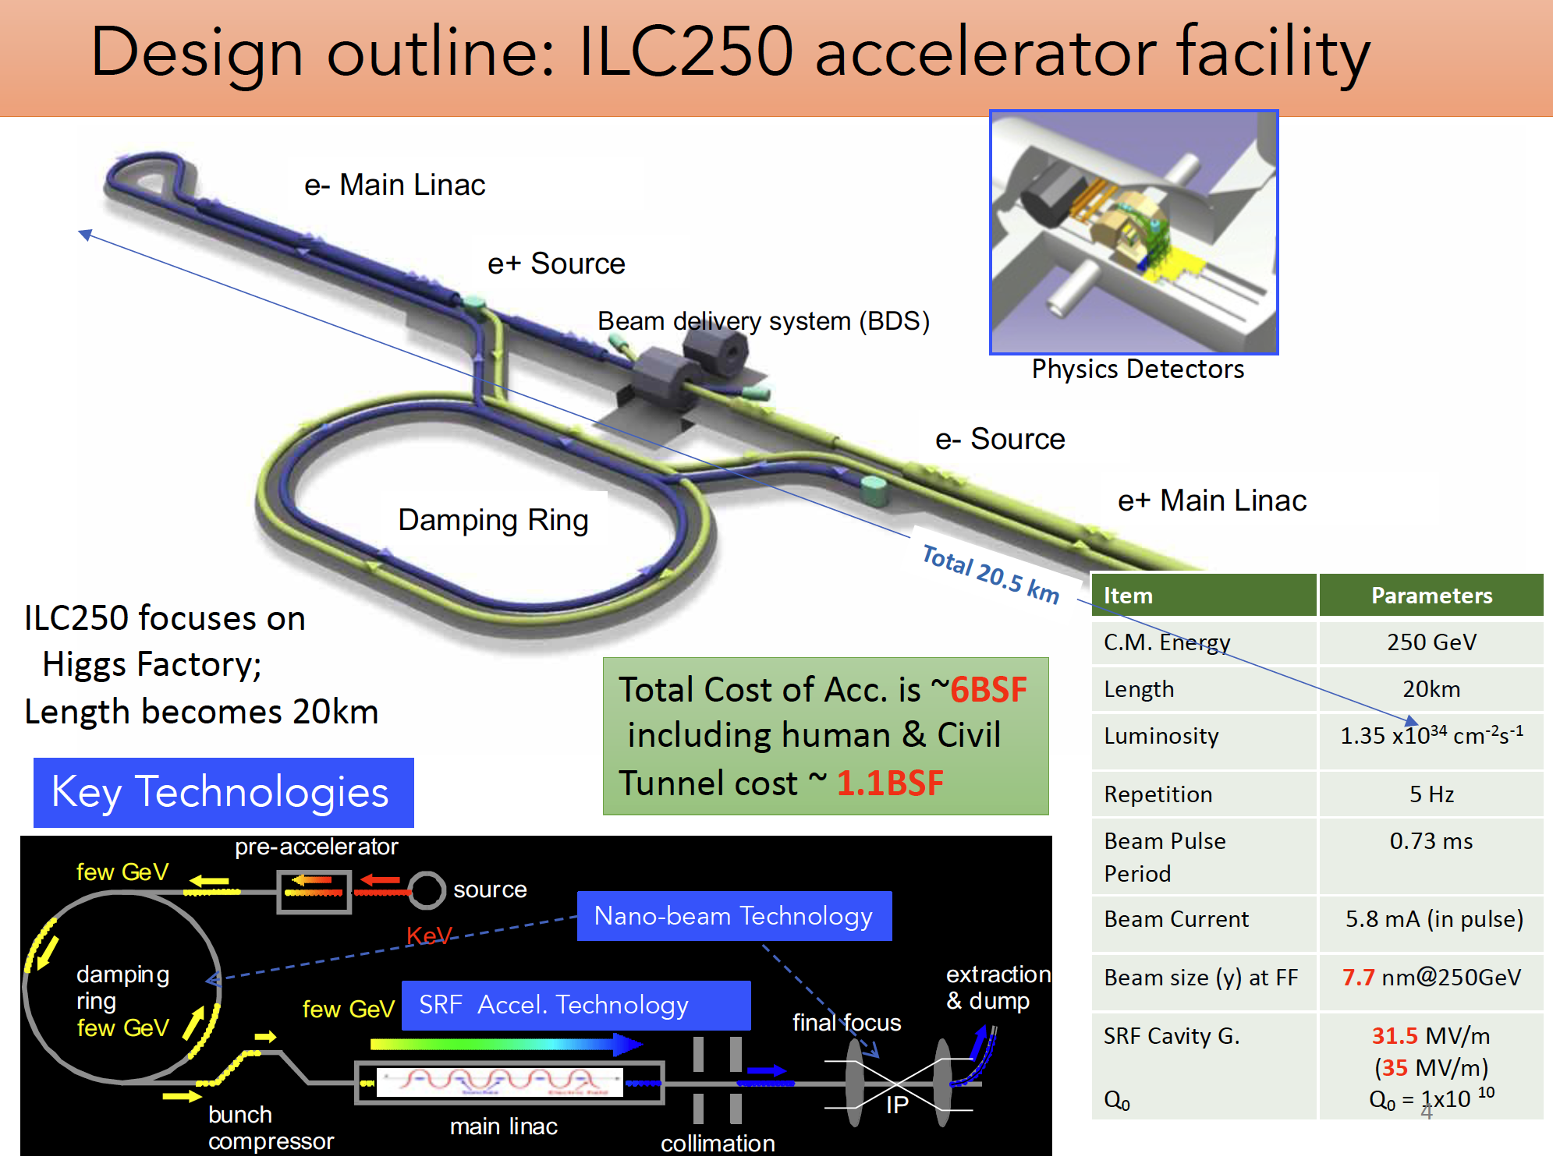
Shoji Asai (U.Tokyo,
ILC-Japan)

Slide 23
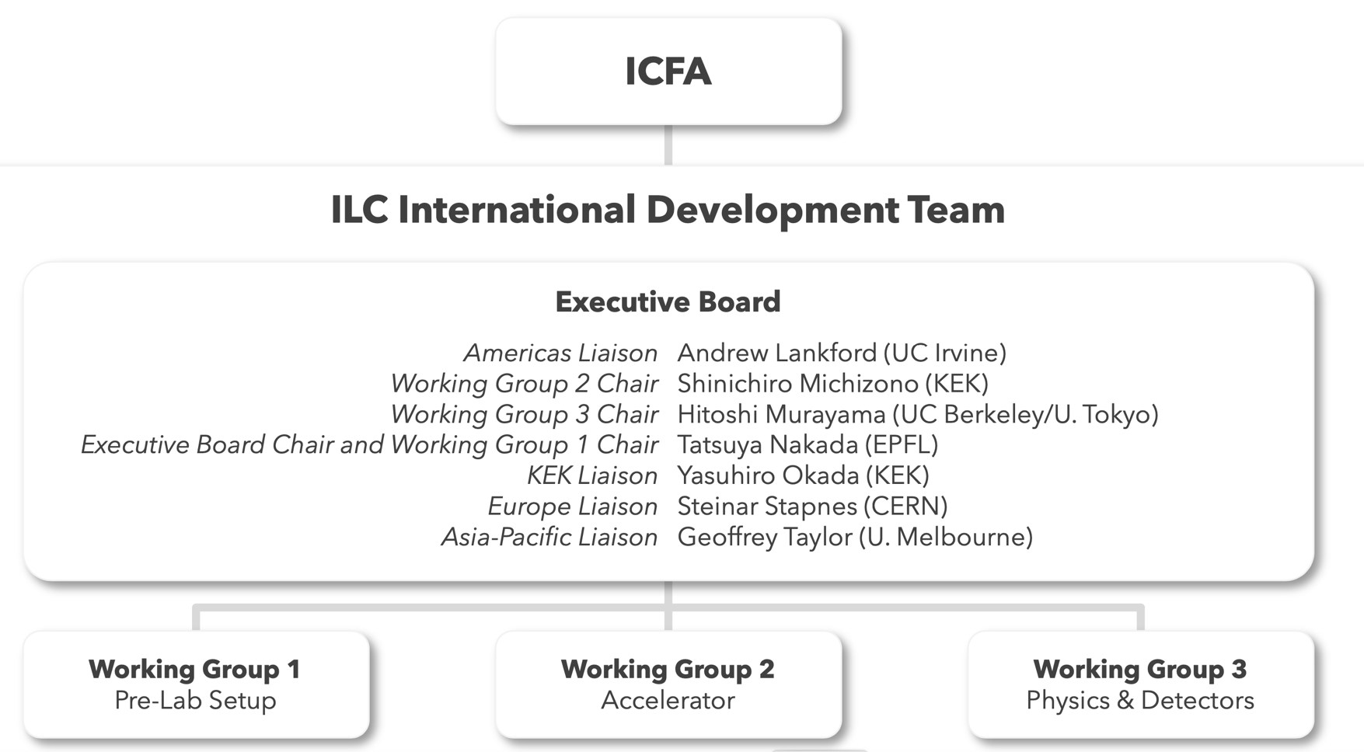
ILC
Since August 2020, ICFA has been supporting the Japanese community proposal to host the ILC in Japan as a global project by setting up the International Development Team.
IDT produced in May 2021 a proposal for the ILC Pre-lab as an interlaboratory organisation with a small headquarters in Japan, which should:
  complete the engineering designs for the machine and civil construction
  provide support for the intergovernmental negotiation of the organisation, governance, and sharing of the cost and responsibilities.
IDT has been supporting the Japanese community effort to promote the ILC in Japan, and organising the international activities in machine, physics and detector.
ILC Pre-lab was not established by the end of 2021 as planned.
Tatsuya Nakada (EPFL)
IDT Executive Board Chair
SPC March 22

Slide 24
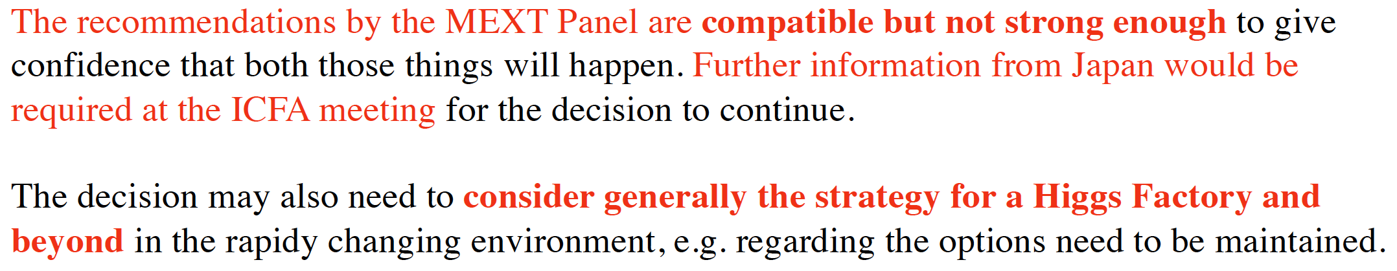
IDT thoughts
Tatsuya Nakada (EPFL)
IDT Executive Board Chair
ICFA should continue its support for the Japanese community effort to host the ILC in Japan in the present form, only if:
1. there is a new prospect to move towards the Pre-lab with a minimum delay,
  ⇒ regular interaction between MEXT and potential foreign partner governments for developing a common understanding for the path towards the ILC;
2. some of the time-critical Pre-lab work packages can be started soon, such that the delay in the ILC project would be minimized,
  ⇒ a substantial increase in the MEXT budget to KEK for ILC R&D that would allow some of the accelerator work packages to start as a collaborative effort between KEK and other interested laboratories

Slide 25
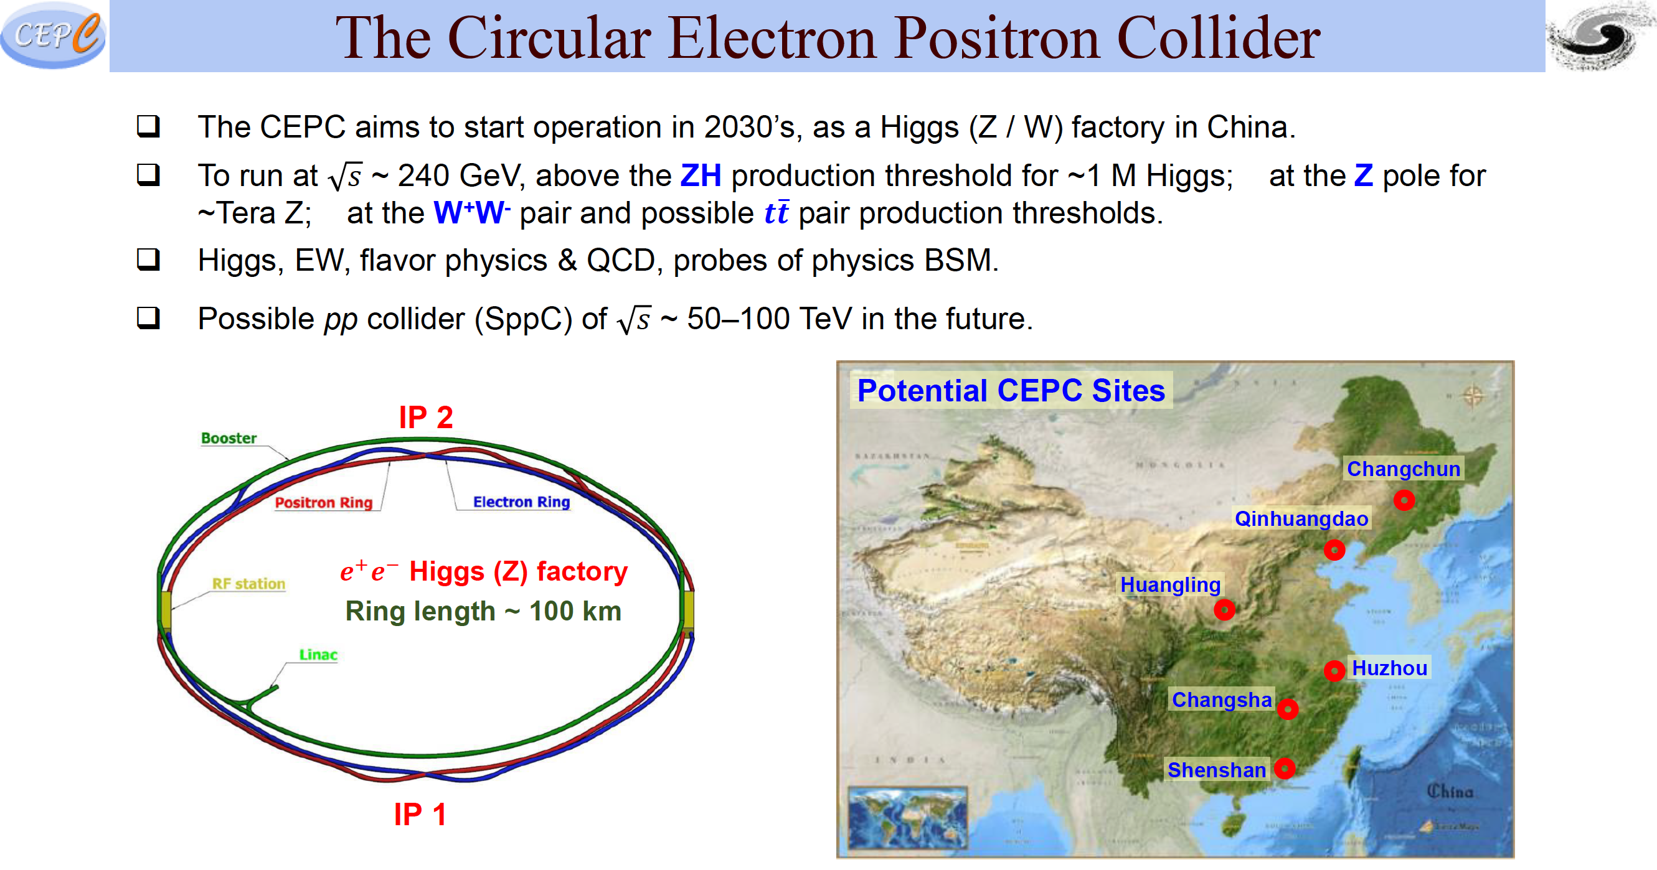
Jianchun Wang (IHEP, CAS)

Slide 26
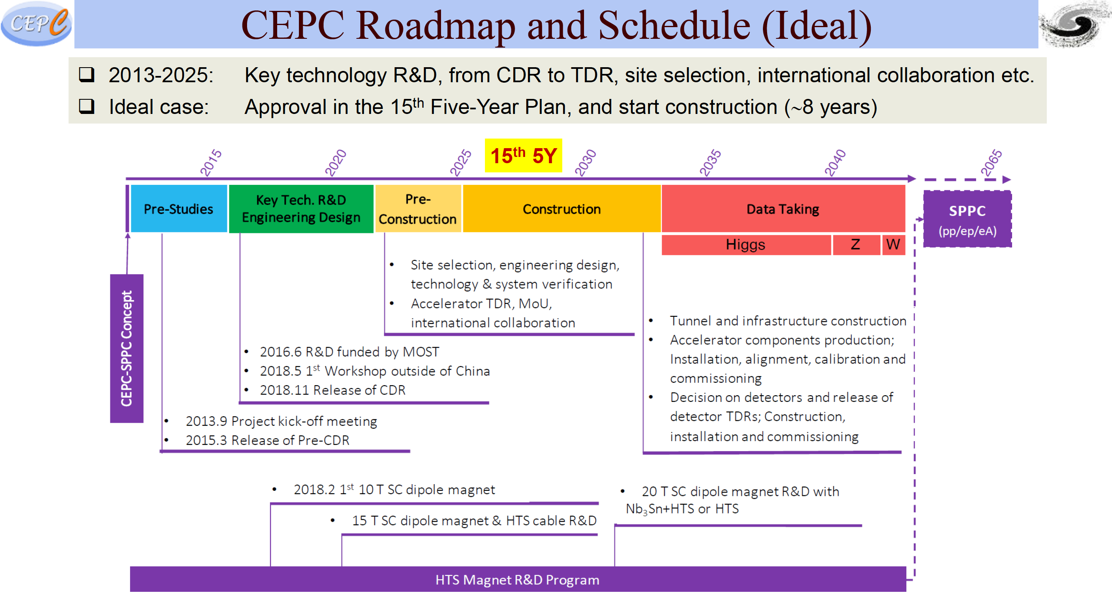

Slide 27
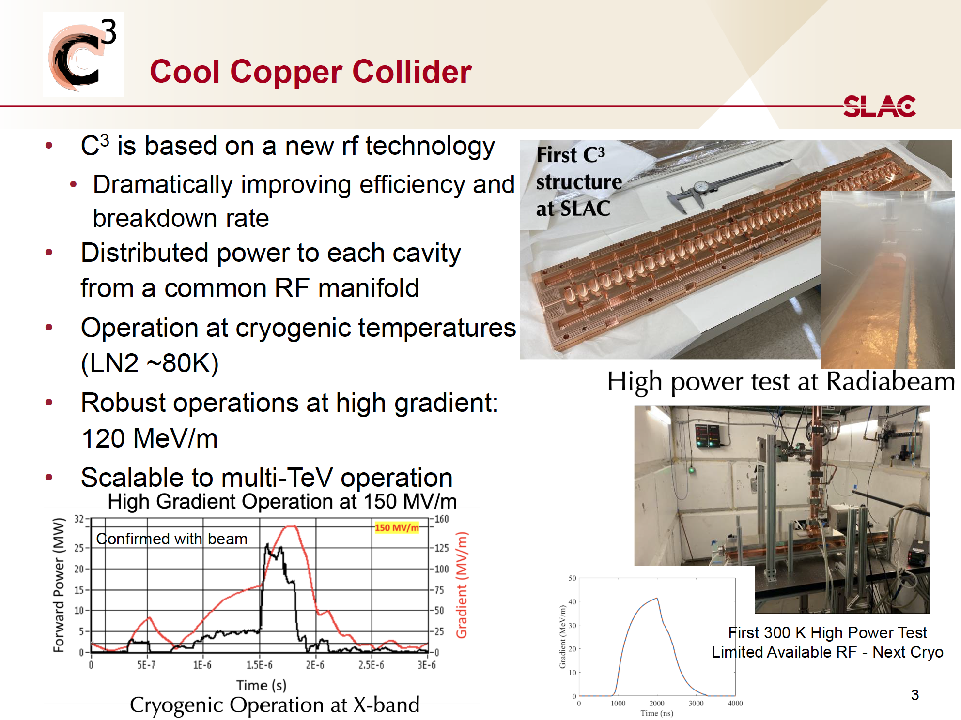
Emilio Nanni (SLAC)

Slide 28
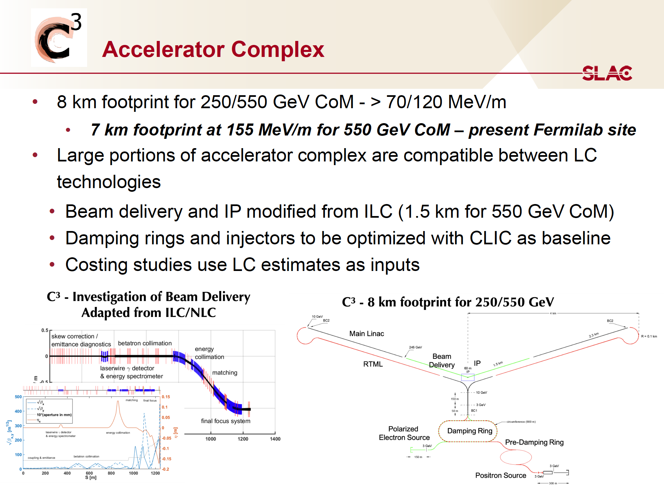
See: C3: A “Cool” Route to the Higgs Boson and Beyond ArXiv 2110.15800 (2021)

Slide 29
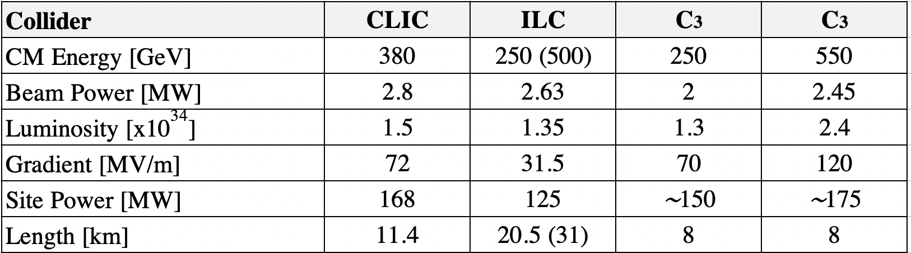

Slide 30
Conclusion
Higgs factory options
  Plan A1: FCC-ee
  Plan A2: ILC
  Plan B: CLIC
  Plan C: CepC, C³
Multi-TeV
  e+e- : CLIC, C³
  muons: Muon Collider
  protons: FCC-hh, SppC
Spoilt for choice!

