Slide 1
IOP Nuclear Physics Group Committee
Who are we?
Committee is diverse with members from academia and industry both in the UK and internationally.
Dr David Sharp – Chair
Dr James Benstead – Secretary
Dr Stefanos Paschalis – Treasurer
Dr Liam Gaffney – Member
Dr Jack Henderson – Member
Dr Athoy Nilima – Member
Dr Rachel Montgomery – Member
Dr Lee Packer. - Member
Dr Philippos Papadakis – Member
Mr Malik salaam - Member
Dr James Smallcombe – Member
Dr Waris Ali - ECR

Slide 2
What do we do?
What does the IOP Nuclear Physics Group Committee Do?
Supports conferences and workshops organised by group members – have applied for £12k for next years events.
Events organised by a single group:
Half-day event £500
One-day event* £1000
Multi-day conference £1000 for the first day, plus £500 for each additional day
Joint events organised by more than one group:
Half-day event £750
One-day event* £1500
Multi-day conference £1500 for the first day, plus £750 for each additional day
Supports early career researchers through the awards of ECR prize and student conference prizes. (£500 budget).
IOP has small pots of money for ECRs to attend conferences, do outreach etc. Have a look here https://www.iop.org/about/support-grants#gref

Slide 3
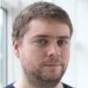
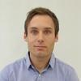
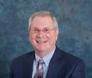
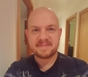
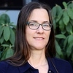
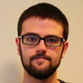
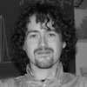
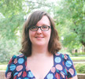
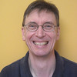
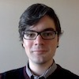
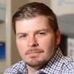
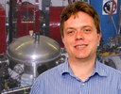
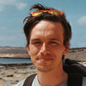
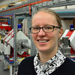
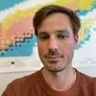
UK Lockdown Nuclear Seminars
Thanks to James Smallcombe
http://lockdownseminars.co.uk
46 speakers from 34 institutions spread over 14 countries and 5 continents.
>1,700 live views and >3,000 recorded video views
Additional 14 student speakers. Has now become the NPG Colloquia series online

