Slide 1
A fellow’s perspective [Generic origin-story title]
Jack Henderson

Slide 2
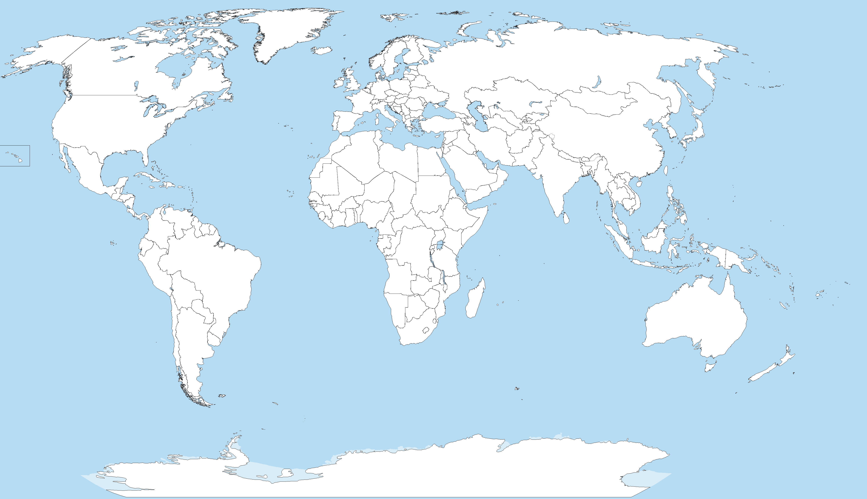

Slide 5
Moving beyond postdocs

Slide 6
Moving beyond postdocs
First non-postdoc application: University of Surrey lecturer in 2016 – not shortlisted but useful feedback

Slide 7
Moving beyond postdocs
First non-postdoc application: University of Surrey lecturer in 2016 – not shortlisted but useful feedback
First fellowship application: Ernest Rutherford Fellowship in 2017 with University of Surrey – not shortlisted but laid some useful groundwork for future applications

Slide 8
Moving beyond postdocs
First non-postdoc application: University of Surrey lecturer in 2016 – not shortlisted but useful feedback
First fellowship application: Ernest Rutherford Fellowship in 2017 with University of Surrey – not shortlisted but laid some useful groundwork for future applications
Second fellowship application: Internal University of Surrey fellowship – shortlisted, interviewed but unsuccessful (“didn’t match with the goals of the programme”)

Slide 9
Moving beyond postdocs
First non-postdoc application: University of Surrey lecturer in 2016 – not shortlisted but useful feedback
First fellowship application: Ernest Rutherford Fellowship in 2017 with University of Surrey – not shortlisted but laid some useful groundwork for future applications
Second fellowship application: Internal University of Surrey fellowship – shortlisted, interviewed but unsuccessful (“didn’t match with the goals of the programme”)
Third fellowship application: UKRI Future Leaders Fellowship with University of Surrey – successful!

Slide 10
Moving beyond postdocs
Summary:
Steady progression, including failing multiple times
Hard, but important not to become disheartened (support from colleagues and host institution *really* helps)
All three fellowship applications were very similar:
Don’t throw everything out with an unsuccessful application
Luck plays a huge role
First non-postdoc application: University of Surrey lecturer in 2016 – not shortlisted but useful feedback
First fellowship application: Ernest Rutherford Fellowship in 2017 with University of Surrey – not shortlisted but laid some useful groundwork for future applications
Second fellowship application: Internal University of Surrey fellowship – shortlisted, interviewed but unsuccessful (“didn’t match with the goals of the programme”)
Third fellowship application: UKRI Future Leaders Fellowship with University of Surrey – successful!

Slide 11
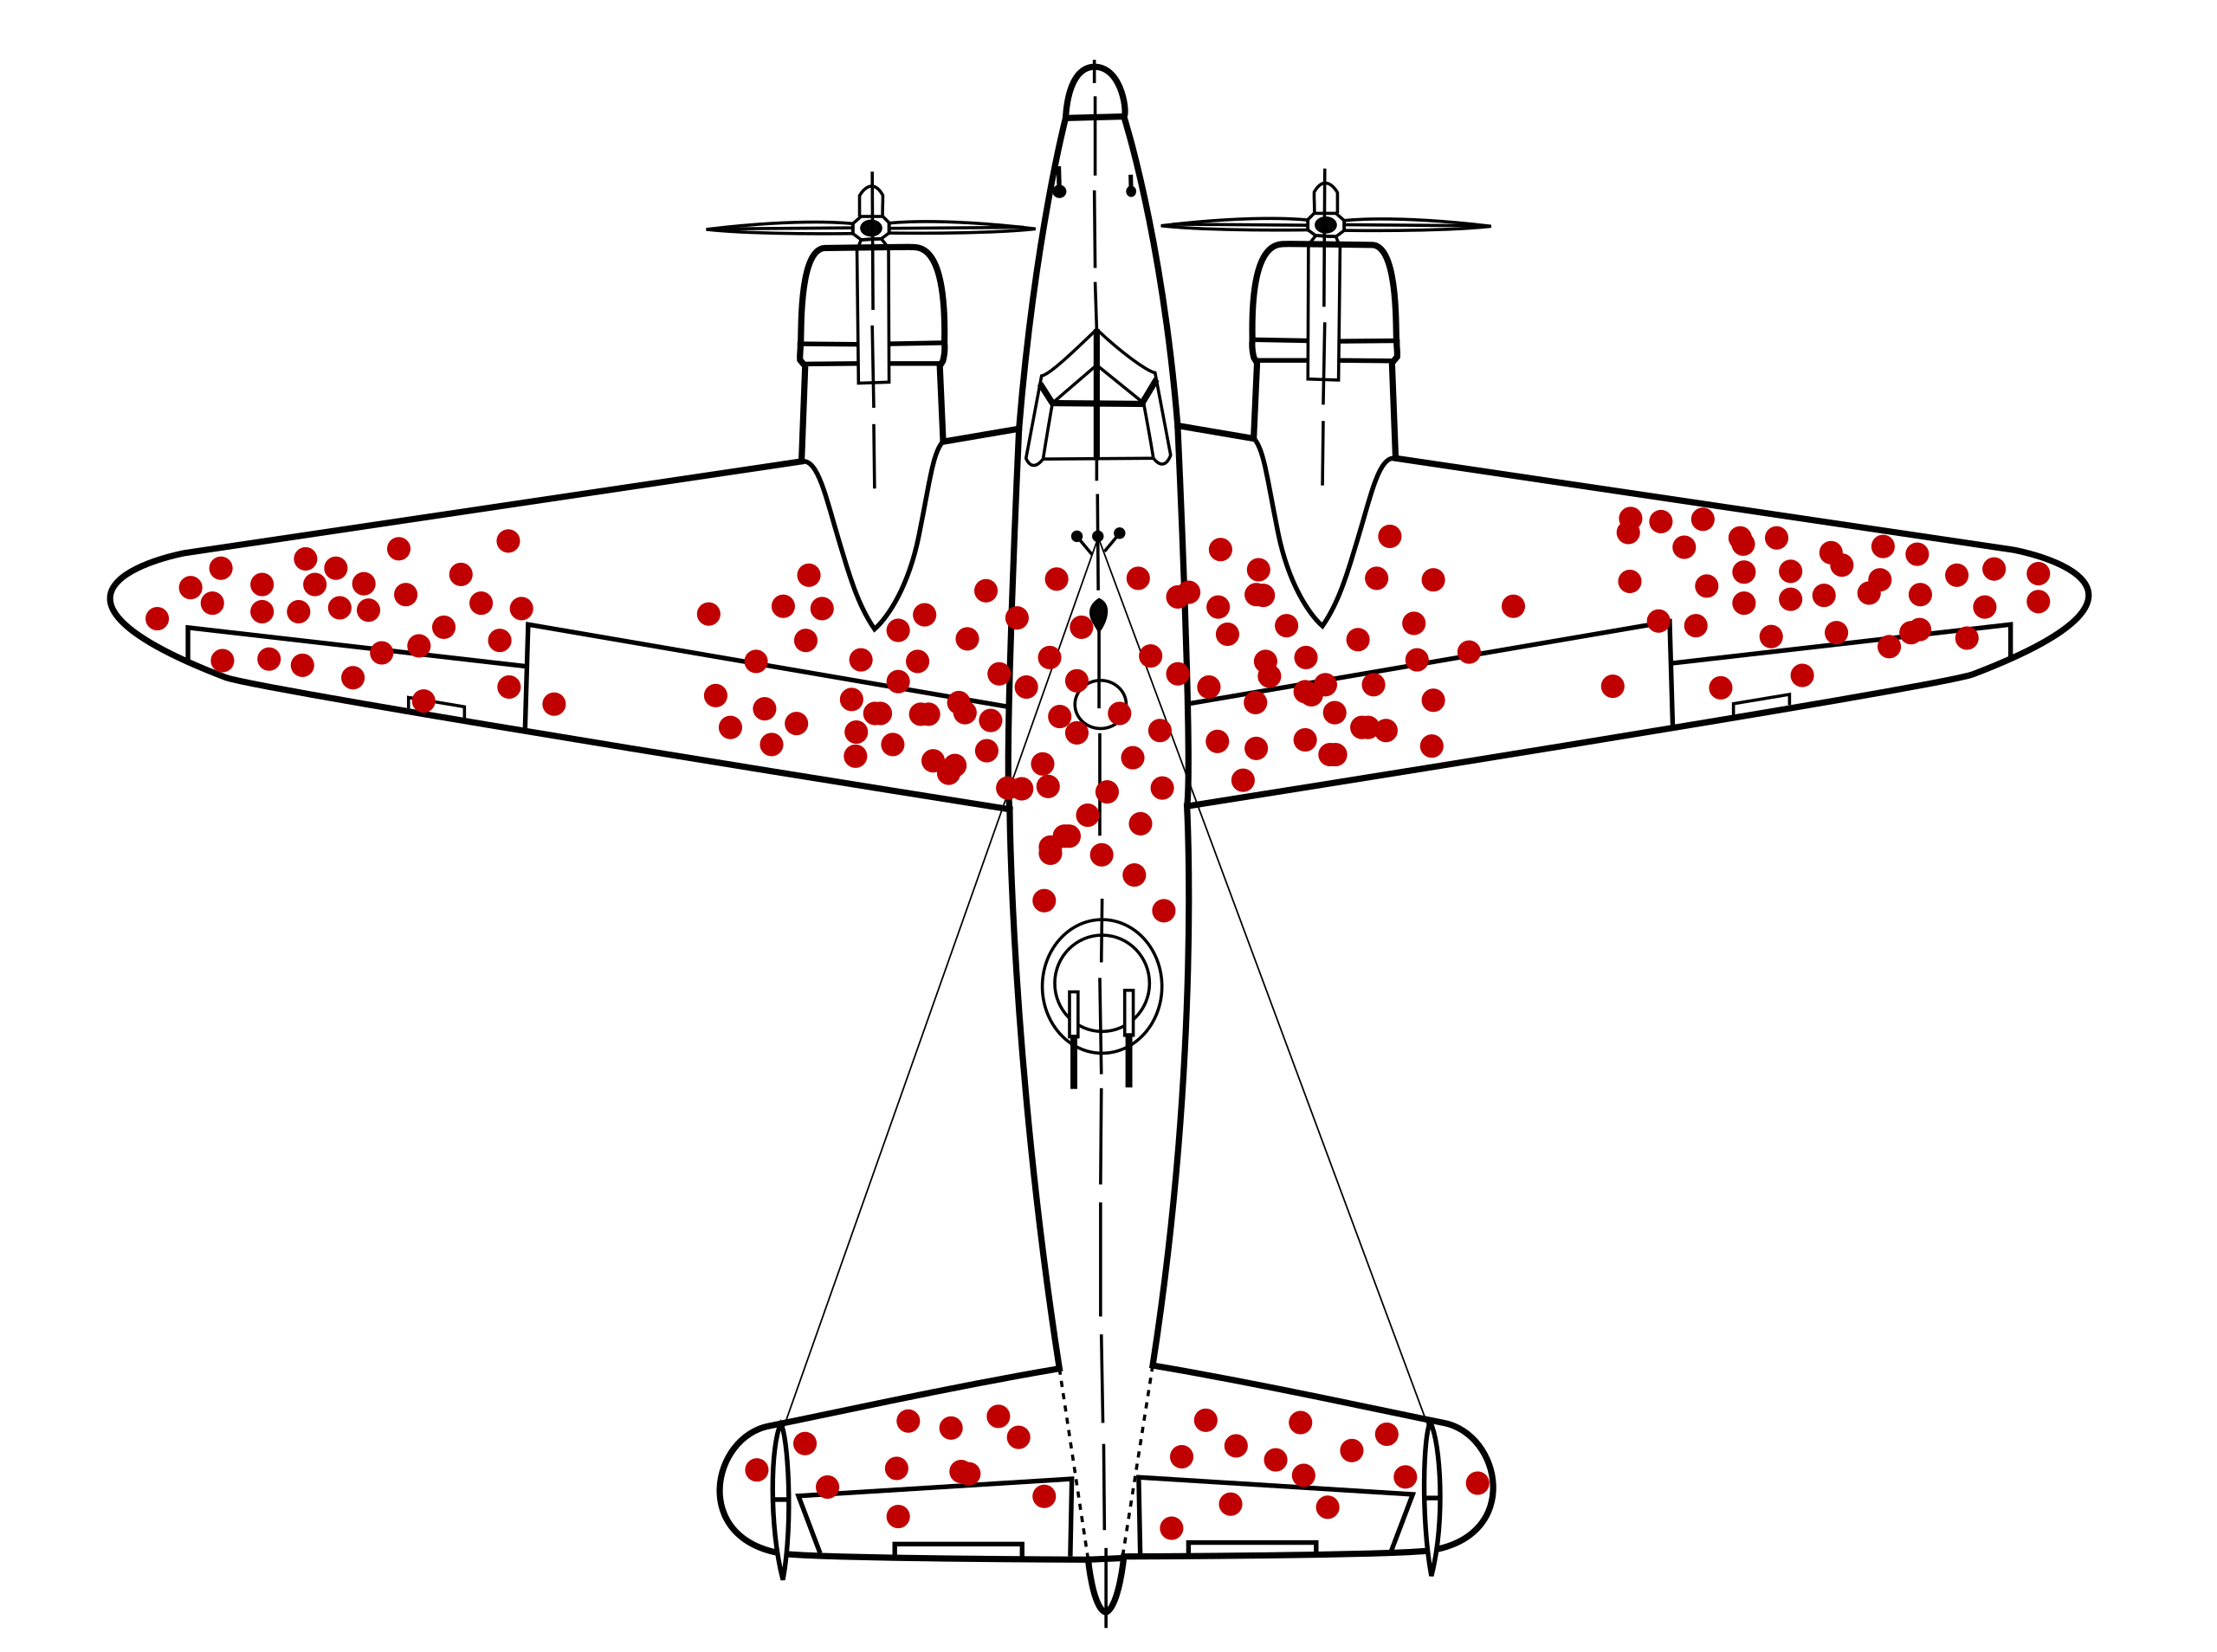
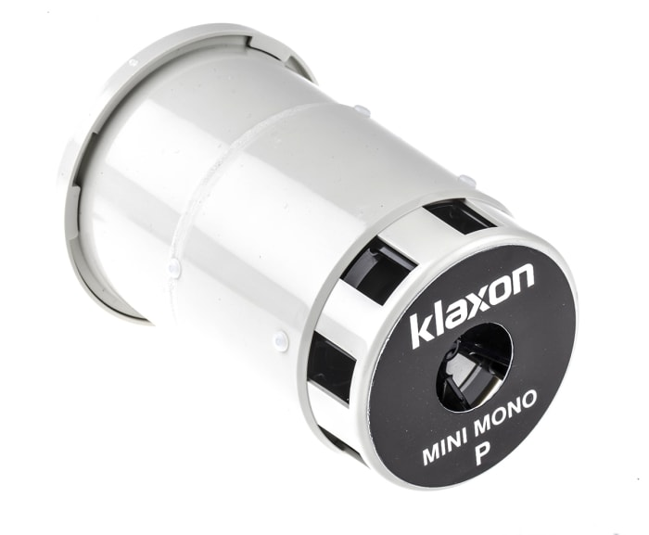
Moving beyond postdocs
Summary:
Steady progression, including failing multiple times
Hard, but important not to become disheartened (support from colleagues and host institution *really* helps)
All three fellowship applications were very similar:
Don’t throw everything out with an unsuccessful application
Luck plays a huge role
First non-postdoc application: University of Surrey lecturer in 2016 – not shortlisted but useful feedback
First fellowship application: Ernest Rutherford Fellowship in 2017 with University of Surrey – not shortlisted but laid some useful groundwork for future applications
Second fellowship application: Internal University of Surrey fellowship – shortlisted, interviewed but unsuccessful (“didn’t match with the goals of the programme”)
Third fellowship application: UKRI Future Leaders Fellowship with University of Surrey – successful!

Slide 12
Fellowship application process
Roughly the same for all types:
Initial application/internal application – varies by fellowship/institution
Full application to funding body
Application reviewed and referee reports sent back to applicant
Response to reviewers
Shortlisting
Interview
… profit?
6-12 months
Get a case for support (basically the project outline) ready well in advance and get people you trust to provide feedback

Slide 13
My application(s)
Dual experimental programmes: deformation and isospin symmetry
Applications/detector development: novel scintillators for neutron detection
My hook: work at FRIB and TRIUMF, “coming home”
Timeliness: FRIB and ARIEL upgrades coming online … and two recent high-impact journal publications
I’m happy to share my application, please reach out if you’re interested

