Slide 1

Perspectives of an Ernest Rutherford Fellow
Career overview – including rejections
Research interests
Accomplishing my future goals
David Sharp
david.sharp@manchester.ac.uk
1
Notes:
1

Slide 2


A little about myself
Ph.D. 2008-2012
Physicist - Smiths detection, 2012-2013
PDRA - Nuclear Physics Group, 2013-Sept 2020
Ernest Rutherford Fellow - Started October 1st 2020

Slide 3
Career steps post Ph.D. - Handling rejection.
Ph.D. 2008-2012
Physicist - Smiths detection, 2012-2013
PDRA applications
Rutgers. ✗
Yale. ✗
Berkeley. ✗
TRIUMF (Vancouver). ✗
Halifax (Canada). ✗

Slide 4
Career steps post Ph.D. - Handling rejection.
Ph.D., 2008-2012
Physicist - Smiths detection, 2012-2013
PDRA applications
Rutgers. ✗
Yale. ✗
Berkeley. ✗
TRIUMF✗
Halifax (Canada). ✗
PDRA - Nuclear Physics Group, 2013-Sept 2020

Slide 5
Lessons from failed fellowship applications
PDRA - Nuclear Physics Group, 2013-Sept 2020
STFC Ernest Rutherford Fellowship Take I (2016).
CERN Fellowship (2017).
Royal Society URF (2019) and STFC Ernest Rutherford Fellowship Take II.

Slide 6
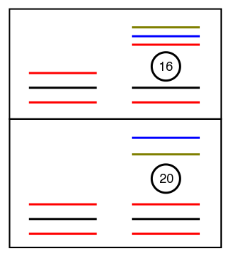
Fellowship research themes
Study of light exotic nuclei to extract how individual protons behave.
What is driving the evolution of shell structure?
How well can we describe the new phenomena in terms of the fundamental interactions between neutrons and protons?
The interactions between protons and neutrons is likely the main driver between changing shell structure.
²⁴O
Key ingredients for describing shell structure.
Many body problem.
np, pp, nn interactions.
Central and tensor components.
3N forces.
Z=8
³⁰Si
p_{3/2}
f_{7/2}
What can experiment provide.
TBME’s – constrain particular interactions.
Single-particle energies – energy centroids of observed states.
Occupancies – reaction cross sections.
d_{3/2}
s_{1/2}
Z=14
d_{5/2}
protons
neutrons

Slide 7
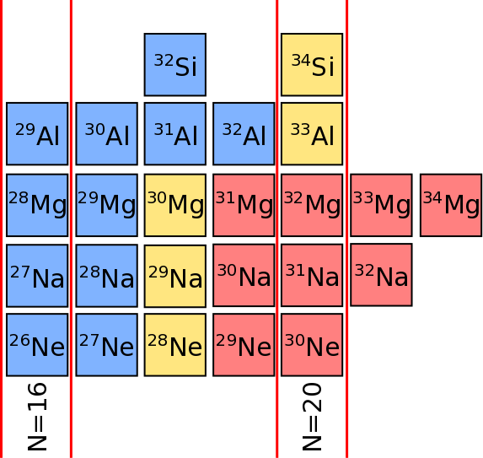
Fellowship research themes
Study the evolution of the N=16 and 20 shell closures, and evolution of single-particle states in to N=20 island of inversion where deformed ground states based on intruder configurations begin to dominate.
Data fairly well described by shell model calculation but also by simple models that account for finite geometry of potential well.
Require data protons to quantify the magnitude of shifts in neutron energies due to filling of proton orbits.
Neutron single-particle data exists but lacking for protons – reactions that probe these are more challenging.
[P.T.MacGregor, D.K.Sharp et. al, accepted PRC Lett.]

Slide 8
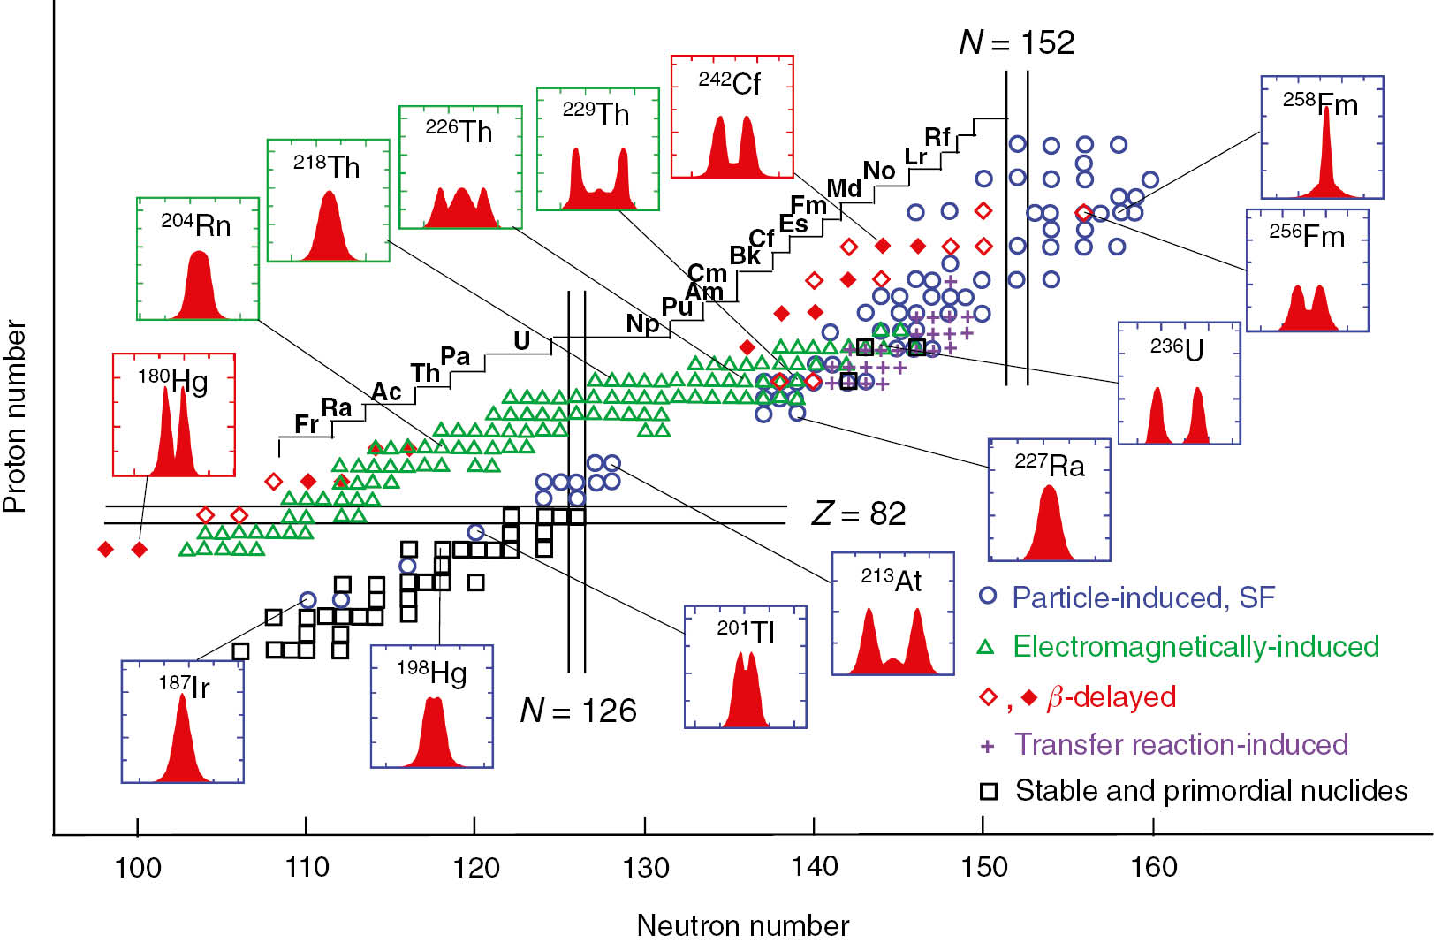
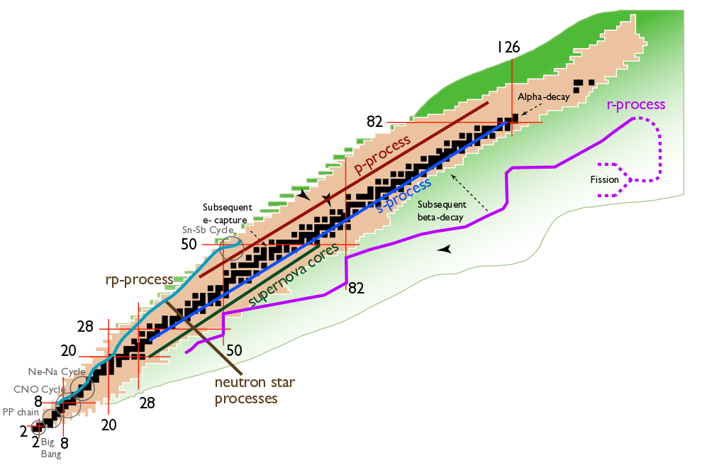
Fellowship research themes
(2) Study fission process in neutron-rich nuclei.
How well do we understand models of fission?
Can we extract information in more exotic systems to improve our understanding?
Fission plays an important role in the r-process
Limits the mass of nuclei produced.
Fission recycles material within the r-process.
Knowledge of fission pathways is limited
Goal is to employ new techniques to access fission barriers and fragment distributions in neutron-rich actinides to improve our fundamental understanding of this process.
Properties of fission important in a number of different disciplines.
Nuclear energy.
Security.
Isotope production.
Use transfer reactions to induce fission.

Slide 9
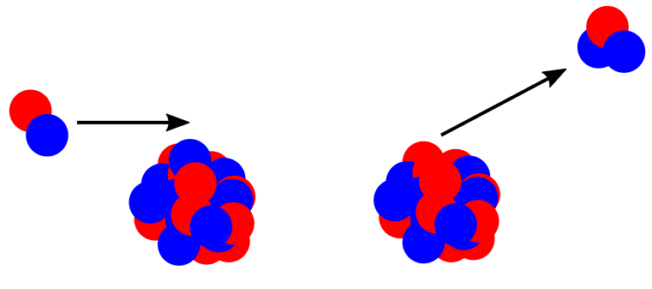
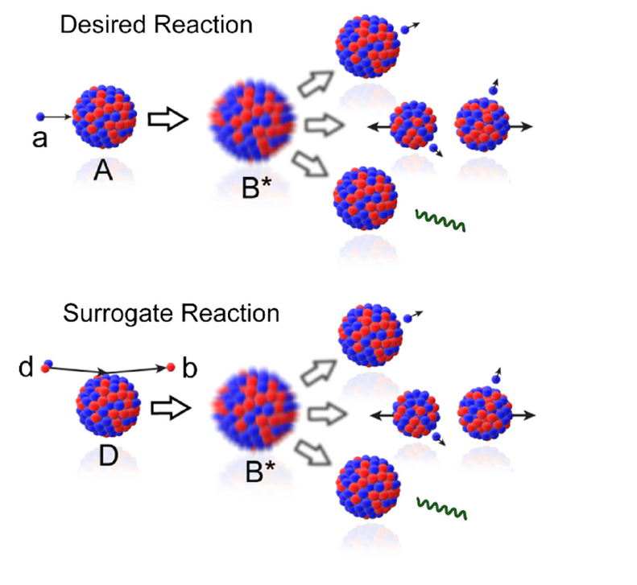
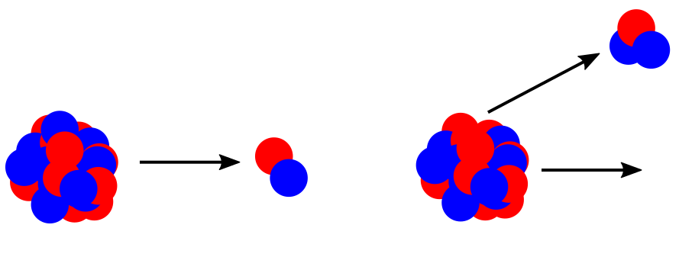
Transfer reactions
(d,³He) reactions
³He
Transfer induced fission via the (d,pF) reaction.
d
Beam
Target
Recoil
n
Selective reactions.
Access to quantum numbers of populated states.
Cross sections proportional to how full/empty that orbital is of protons.
p
³He
d
Beam
Target
Recoil
Transfer reactions can also be used to induce fission in heavy nuclei.
Removes need for neutrons – difficult to work with.
Allows access to short-lived nuclei.
Directly probe fission barriers.
Fragment distributions.
Fundamental information on fissioning state.
Measurements in inverse kinematics where target is now beam (and vice-versa) allow study of short-lived nuclei.
Challenging due to low cross sections and competing reactions channels.

Slide 10
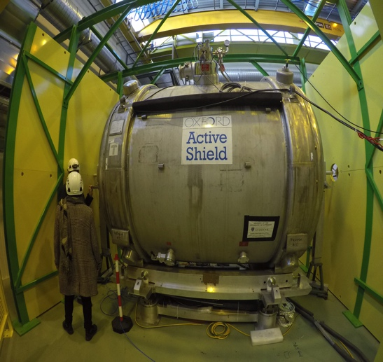

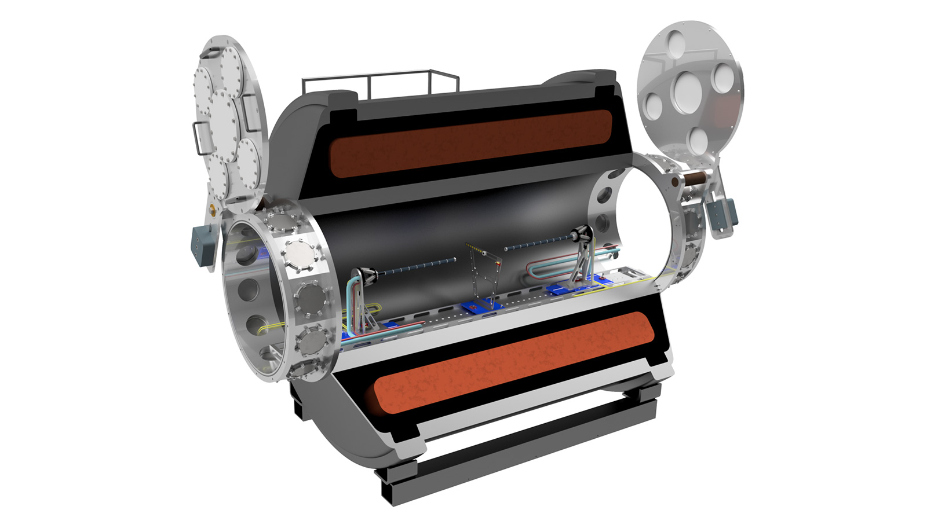
Where?
Taking advantage of new opportunities and new techniques.
ISOLDE@CERN
Facility for Rare Isotope Beams, USA
STFC ISOL-SRS project.

Slide 11
How to accomplish my research goals
Exploitation
Write good proposals and use solenoid spectrometers at ISOLDE/Argonne/FRIB to complete the relevant measurements.
R&D
Improve upon existing techniques through developing new technology.
Funding
Exploitation – generally small pots of money for consumables and travel. Royal Society Research Grants (£20k).
R&D Requires larger amounts of funding (£250-500k). More difficult to find these opportunities within STFC funding (usually). Leverhulme (£500k). ERC? (£2M)
STFC Developing Nuclear Physics Priorities (£250k) a great opportunity for ECR’s and would welcome more calls of these kinds of size.
Decent size grant.
Experience of project management.
Prepares for future larger scale project bids to PPRP or ERC.

Slide 12
Thanks for listening
Road to obtaining a fellowship (at least for myself) contained a fair amount of disappointment along the way – don’t be disheartened. Though everyone will have different experiences.
More varied avenues of funding from STFC benefits ECRs and more would be welcome.
Personal research focus is at Radioactive Beam Facilities (10-20 MeV/u), ISOLDE and FRIB as well as ANL.

