Slide 1
UK Nuclear Physics Early Career Researcher Forum
Institute of Physics
1st and 2nd of November, 2021
Welcome!

Slide 2
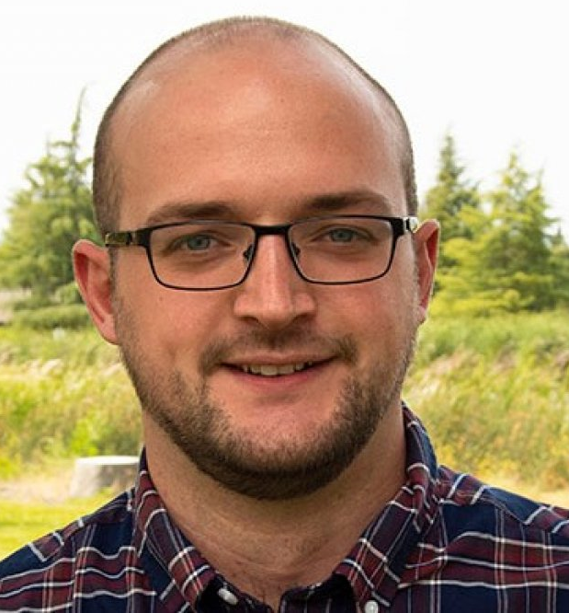
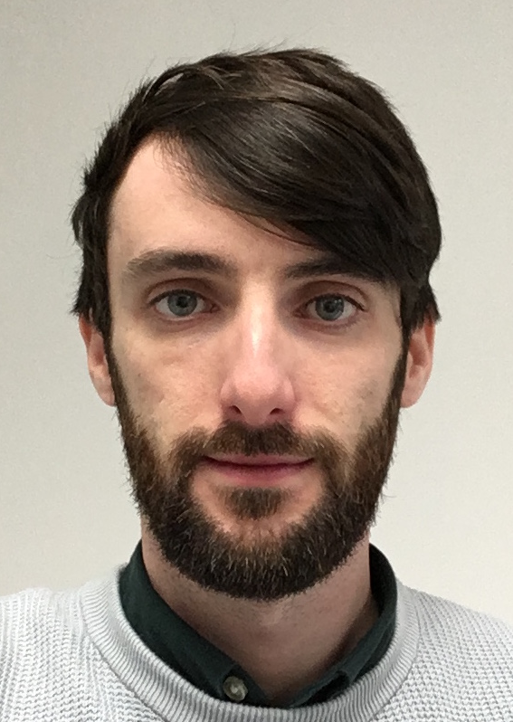
Organizing committee
Jack Henderson, University of Surrey
Liam Gaffney, University of Liverpool
Rachel Montgomery, University of Glasgow
David Sharp, University of Manchester
Nick Zachariou, University of York
Feel free to ask us any questions…

Slide 3
Goals
Offer career development support for ECRs
Learn about some future science directions… and discuss
See everyone!
Foster new collaborations?

Slide 4
Event
Lunch (today) and coffee breaks provided
Drinks reception from 5-6.30pm this evening (beer, wine)
Split up for dinner (organize into manageable groups) – those interested can recombine later

Slide 5
Food options?
Wing-Wing – Korean Fried Chicken (20 min walk)
Dishoom – Indian Street Food (5 min walk, might be *very* busy)
Flat Iron – Steaks (next door)
Bombay Burrito - ????
… anywhere else

Slide 6
Careers panel
We have convened a panel with experience of UK NP to answer your questions regarding career development and funding in the UK:
Kieran Flanagan (University of Manchester)
Laura Harkness-Brennan (University of Liverpool)
David O’Donnell (University of the West of Scotland)
Marina Petri (University of York)
Arnau Rios (ex-University of Surrey) – remote
Daria Sokhan (University of Glasgow) – remote
Introduction to STFC NP by David Ireland (University of Glasgow)

Slide 7
Questionnaire
At the end of the workshop, we will send a questionnaire to all attendees
Opportunity for feedback on the ECR forum. Suitable venue? Format? Etc.
… and anonymous feedback on being an ECR in UK nuclear physics. Will be communicated at the 2022 Warwick meeting.

Slide 8
Health & Safety
Please follow COVID-19 precautions
Face coverings when moving around the building
Leave space between yourself and others during sessions

