Slide 1


Silicon sensors R&D
G. Casse
PPTAP Detectors Workshop, 3rd June 2021

Slide 2
OUTLINE:
Currently on the menu:
  Hybrid sensors, monolithic, further options
Coming major challenges;
  Time resolution, speed, granularity, radiation tolerance, mass.
Who makes and will make HEP sensors:
  Industrial and TRO landscape and perspectives (guess)
R&D strategy:
  Open, largely independent, bounded with predetermined choices (e.g. CMOS technology focus)?
  Continuity and sinergies
  Strongly connected with industry, role for TRO (fabrication and/or integration)?
  Funding

Slide 3
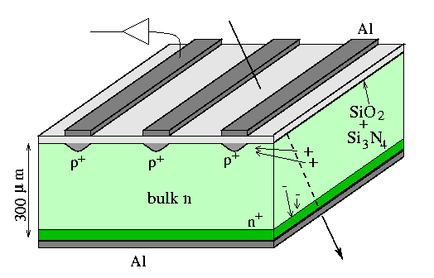
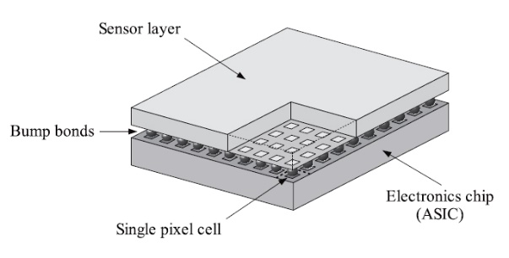

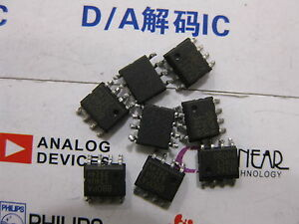
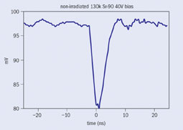

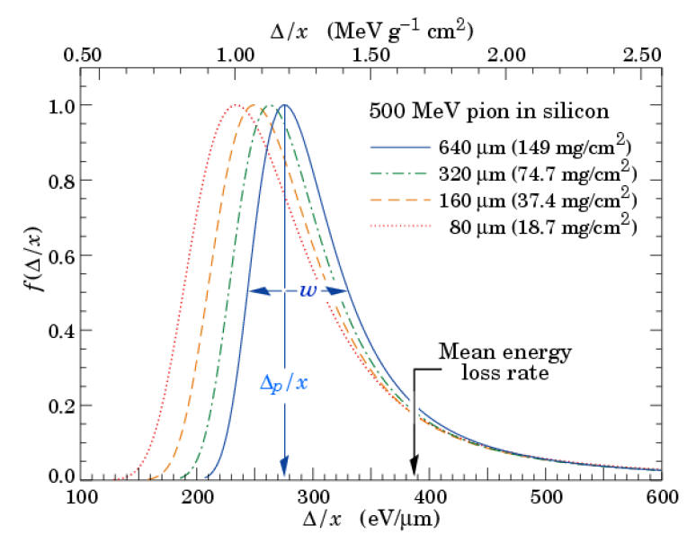
Silicon detectors
A complete detector is made of:
Diodes
Analogue amplifiers
Digital readout

Slide 4
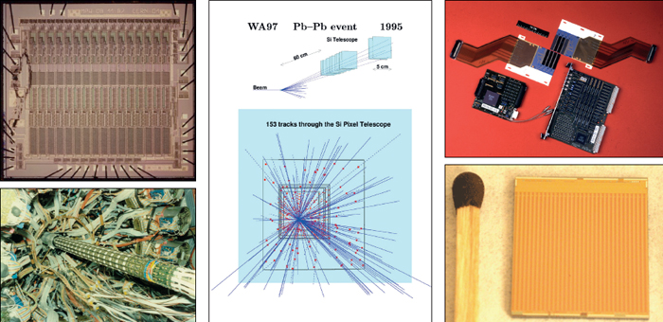
The Spectacular success of Silicon detectors
Silicon detector systems have many ingredients, but a crucial element is that the improvement of silicon detectors is linked to the evolution of CMOS technology.

Slide 5
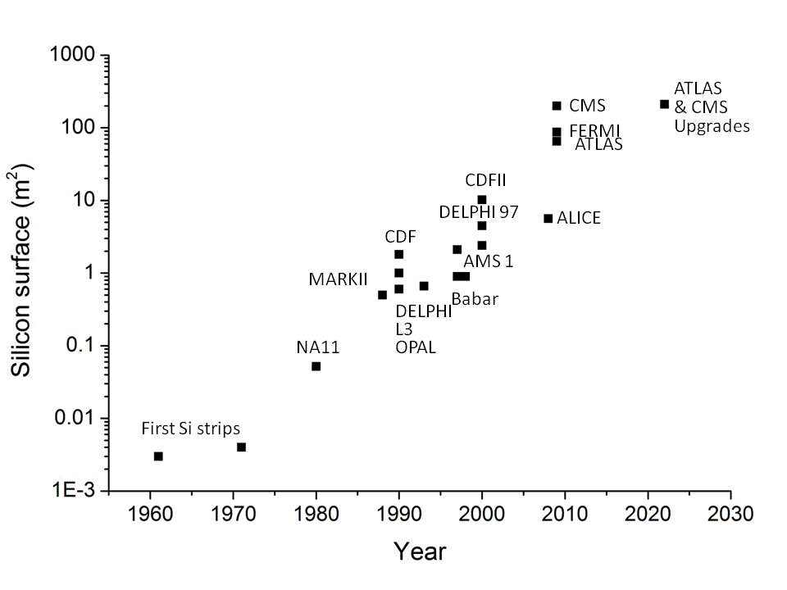
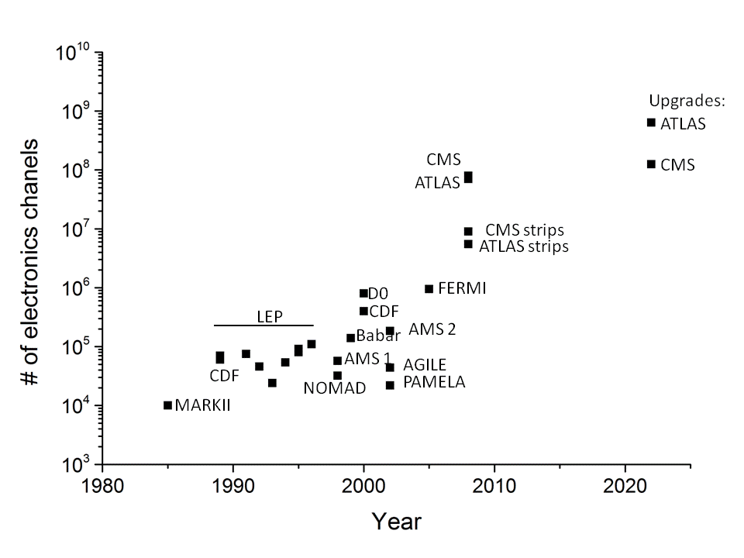
The Spectacular success of Silicon detectors
UA2
A virtuous interaction between technology and experiment needs: technology improvements allow better physics performance and experiment requirements push on the technology.
BUT: CMOS technology evolution is driven by motivations outside physics.

Slide 6

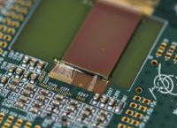
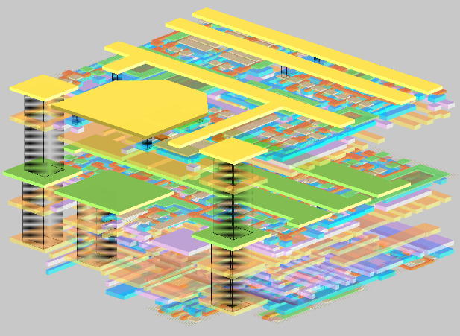
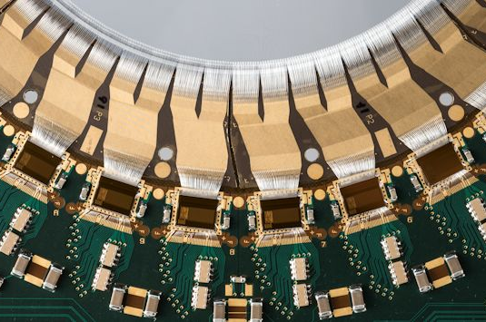
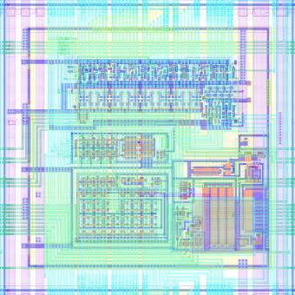
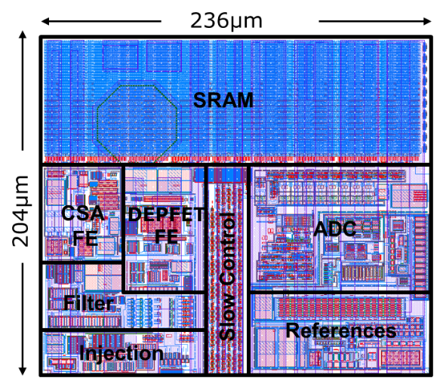
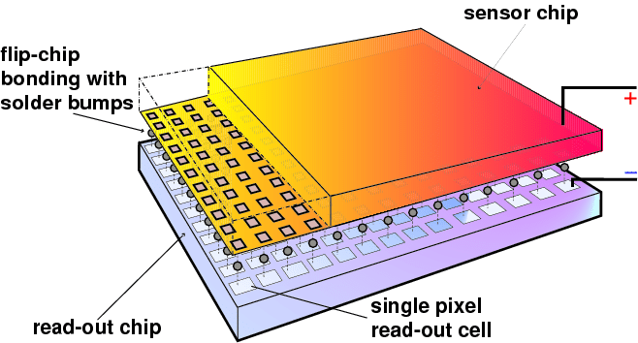
Silicon detectors and Readout Electronics arrangements
Sensitive diode, Analogue circuit and Digital circuits are the ever present elements.
Monolithic solution
Monolithic solution
M
The hybrid solution

Slide 7
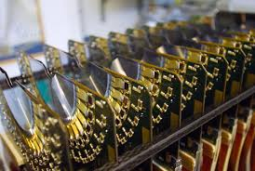
Examples and typical sizes of the different architectures
Monolithic solution
40 – 110 μm pitch, 1 – 4 cm long strips. Readout: Beetle chip, 0.25 μm CMOS.
Pixel sensor (200 μm thick) and FE-I4 (400 μm thick) readout hybrid (bump-bonded) assembly. 130 nm CMOS, 20x18.8 mm^{2,} 26880 pixel, size 50x250 μm²).
MAP sensor 50 μm thick, 80 x 80 μm². R&D for mu3e, 180 nm CMOS.
Size matters (and cost), detector geometries are adapted to the area to be covered.

Slide 8
Increasing Granularity
If hybrid: traditional technologies offer small room for improvement.
New technologies for vertical connection (bump bonding too coarse).
  Industrial or RTO ?
  Technology mix.
If monolithic: limited by the size (and available nodes) of the analogue circuit.
50 µm

Slide 9
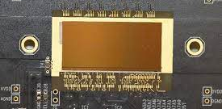
Increasing Granularity
Current achievement on large area detector:
ALPIDE for ALICE:
A 28x28 µm² pixel size monolithic sensor to equip the ALICE silicon tracker (about 10 m²).
Technology TJ 180 nm (CMOS imaging).

Slide 10
Speed (rate)
Currently > 50 ns.
Dependent on size and technology.
Hybrid technologies can optimisation every layer: fast collection at the diode, fast analogue circuit (trading off with power), digital readout solutions.
Low capacitance connections still needed.
Monolithic: design optimisation can yield improved speed.

Slide 11

Low mass
Hybrid technologies only with new interconnection solutions.
Monolithic: intrinsically suited for reduced mass.
Both the Mupix (80x80 µm² pixels) and ALPIDE (28x28 µm² pixels) are 50µm thick.

Slide 12
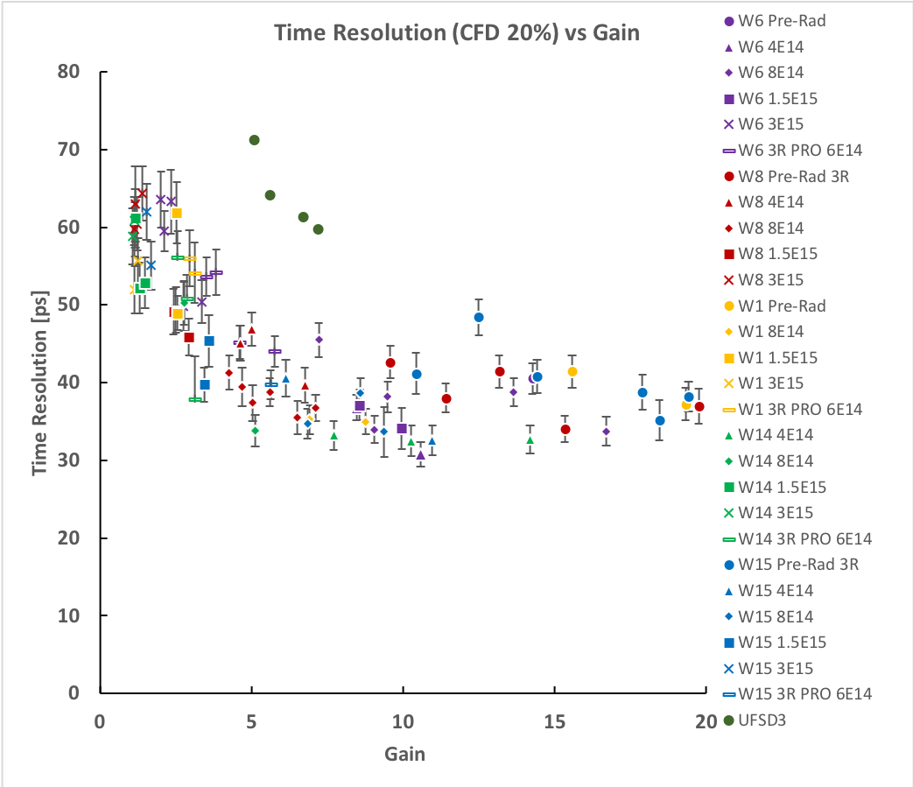
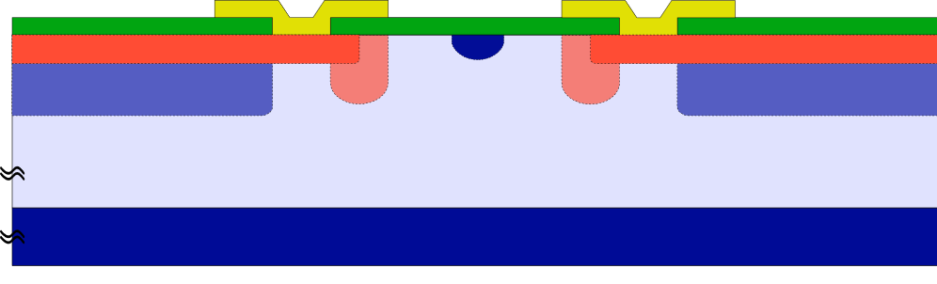
Time resolution
Timing resolution depends on the gain value and on the holes drift velocity (∝Vbias)
Hybrid technologies are showing good performance.
Dedicated CMOS readout chips, sensors diodes developed by RTO’s.
Two major challenges:
Radiation tolerance
Fill factor
Boron + Carbon
co-impantation
Virtual GR
p-stop
JTE
Metal pads
Boron
(wide Gain implant profile)
n⁺
n⁺
p⁺ gain layer
p⁺ gain layer
Boron
(narrow Gain profile)
Pixel 1
p⁻ ⁻
Pixel 2
p⁺⁺ substrate
Gallium
(B+C @ 8e14 neq)
Max G
nominal
no-gain region
Max G
Gallium + Carbon
co-implantation
Charge
G=1
Space

Slide 13
Time resolution
Monolithic: working towards 4D tracking performance (< 30 ps).
University of Geneva, IHP, SiGE technology.
N. Cartiglia, ECFA, 23 April 2021

Slide 14
Radiation tolerance
Hybrid technologies are showing performance to 2-3x 10¹⁶ n_{eq} cm⁻².
Monolithic: should be able to approach 10¹⁶ n_{eq} cm⁻².
The 1Y pFCC target (> 10¹⁷ n_{eq} cm⁻²) need to be met by all elements of the sensors, current data measured with fresh electronics and irradiated diodes do not show viable solutions.

Slide 15
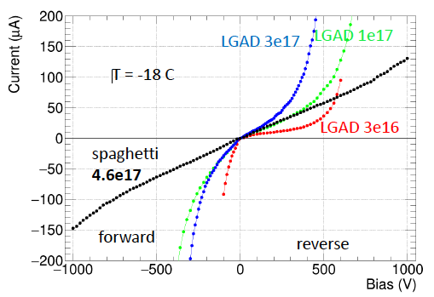
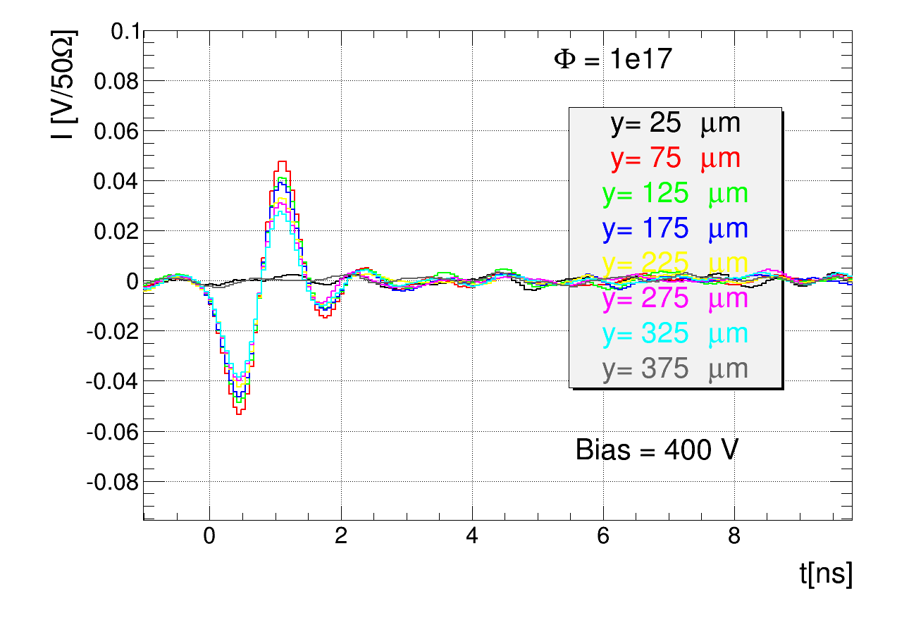
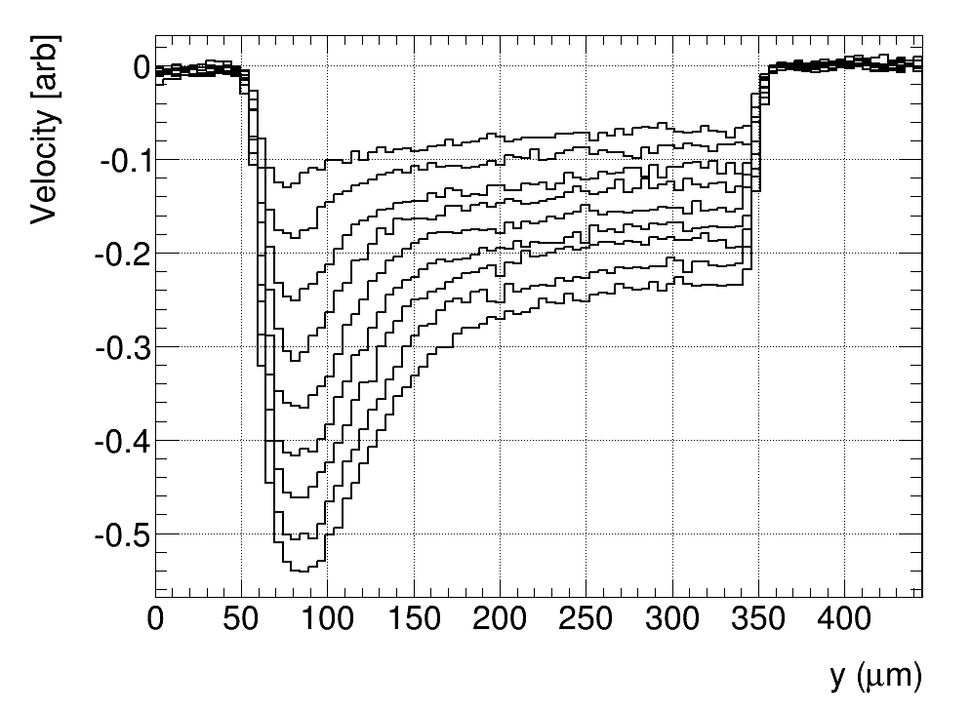
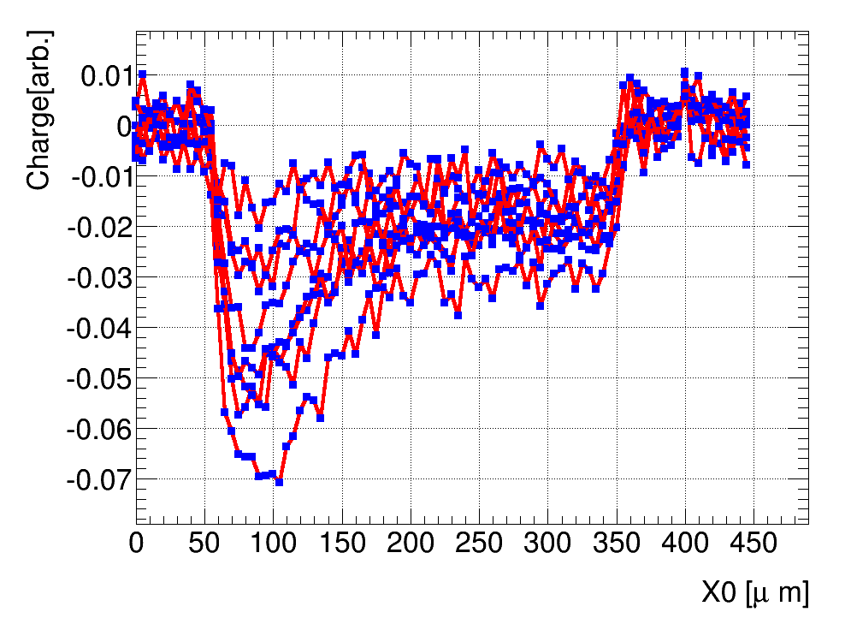
Radiation tolerance
Key points: measurements with detectors up to 4.6x10¹⁷ n_{eq}/cm² (neutrons):
Reduction of (zero field) mobility
More degradation with protons than neutrons
Adverse effect on charge multiplication
Diminishing SCR and highly resistive ENB
Saturation effects wrt projections at low fluence:
Effective acceptor introduction rates reduced (~100)
Current much lower than anticipated.
Reduced trapping time degradation
From M. Mikuz et al.

Slide 16
Manufacturing of sensors and electronics
Setting the scene: Who makes sensors and who makes electronics
Custom diode arrays foundries
Commercial large scale CMOS manufacturers
HPK, CIS, CNM, CSEM, FBK, Micron, MPI, SINTEF, VTT, …..
IMEC, IBM, TSMC, AMS, TJ, LF, GF, …..
Commercial large scale CMOS manufacturers for DD-CMOS
TJ, LF, other disappeared, IHP a research institute

Slide 17
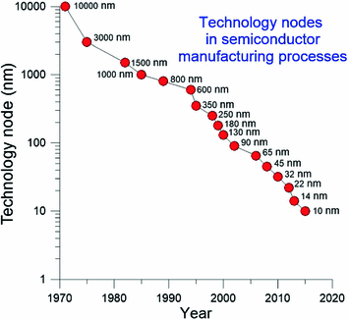
Focus on a few technologies (one)?:
Is there a role for RTO’s or small silicon foundries? Will sensing diode separated from active elements continue ? Is there room and funding for RTO’s to upgrade to keep fulfilling their R&D role ? Is it possible to catch-up with CMOS technology ? Is it even sensible to do so, or rather follow a different strategy ?
What will be missed?
Without small and friendly fabs, 3D column, LGAD, arguably > 10¹⁶ n_{eq} cm⁻², and other solutions would have not been developed.
Many possibilities, but what is financially sustainable?

Slide 18
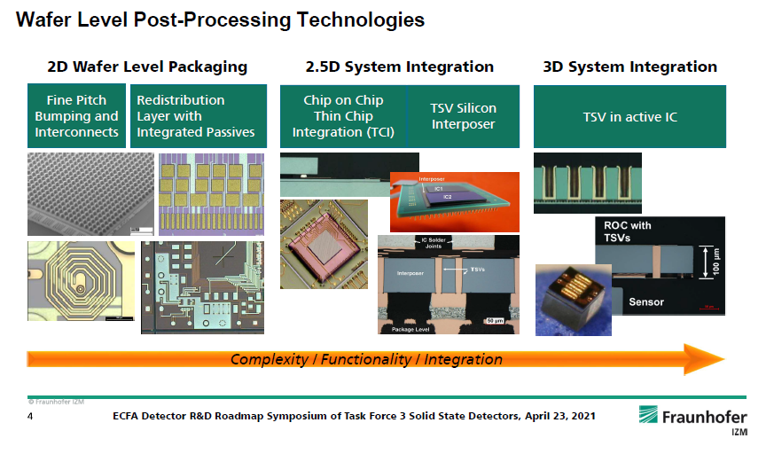
Manufacturing of sensors and electronics
What are the emerging solutions in sensing (industry)?

Slide 19
Future HEP sensors ?
CMOS now studying nodes at the 3nm feature size.
Current node exploited by HEP is the 65nm.
Common assumption: try to follow CMOS technology:
needed?
huge investment: how risky?
Is vertical integration the only compatible solution for exploiting extreme CMOS nodes?

Slide 20
Future HEP sensors ?
RTO’s key to many current achievements:
disappearing?
Change focus (e.g. 3D packaging)?
Funding RTO’s upgrades?
Sensors for different experiments and layers have very different geometries and performance requirements.
How to preserve deploying a variety of solutions?
Funding: coming from scientific research resources from national and supranational organizations. Is there any possible synergy with industry (sensor market is over 400 b€/y).
How to preserve research effectiveness : whom, with whom, with what funding, synergies, industrial planning (research phase, different production sizes, continuity, technology choices, disappearance of technologies…), talent retention …

Slide 21
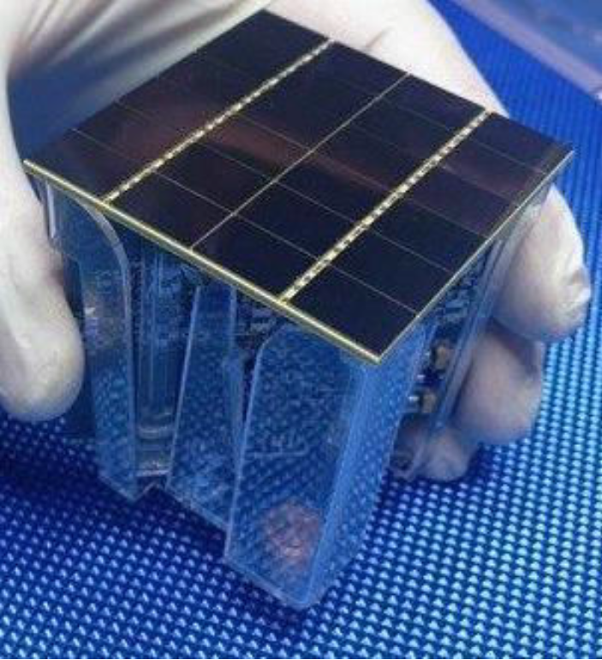
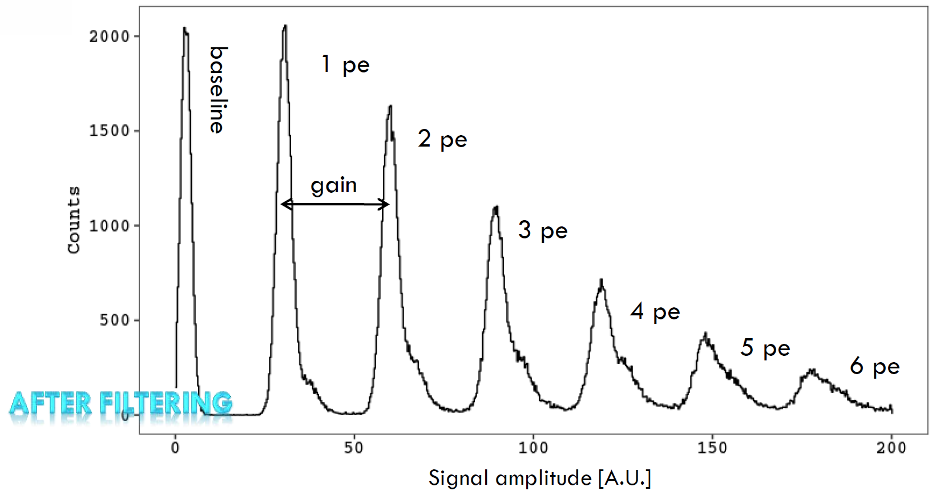
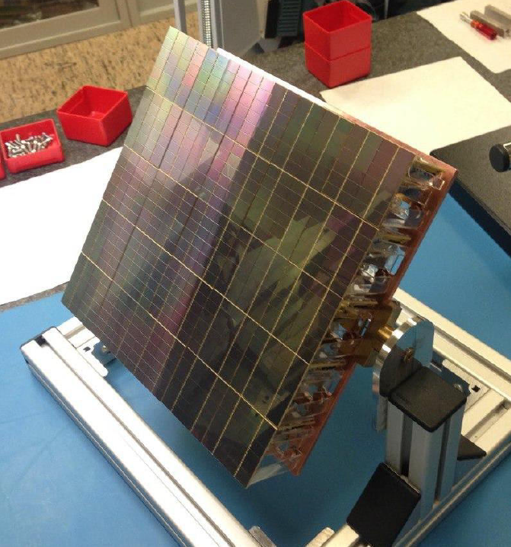
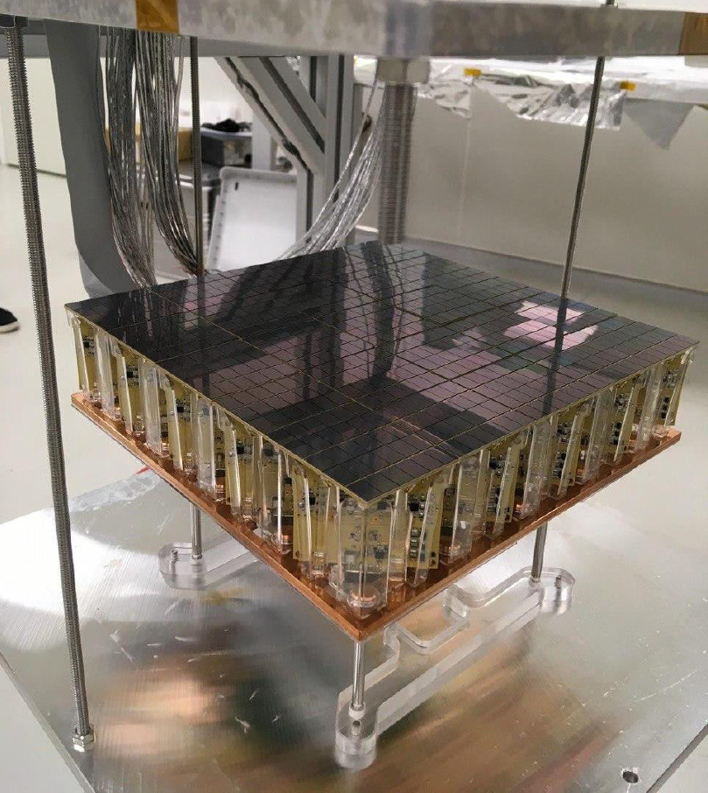
One example of sensors with direct industrial interest: SiPM
Big experiment requirements: DarkSide 20k, nEXO.
Total Area = 24 cm²
1 readout channel
SNR = 24.1
Measurements from LNGS
24x 12x8 mm² SiPMs (~ 1 cm²)
Front-end cryogenic pre-amplifier with differential output
Proto0 - motherboard

Slide 22
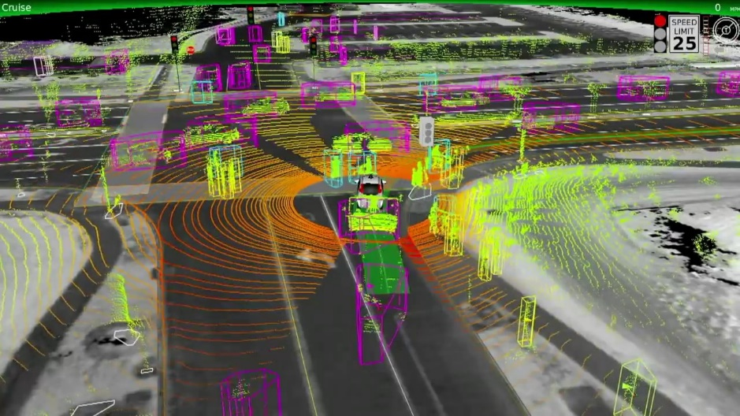
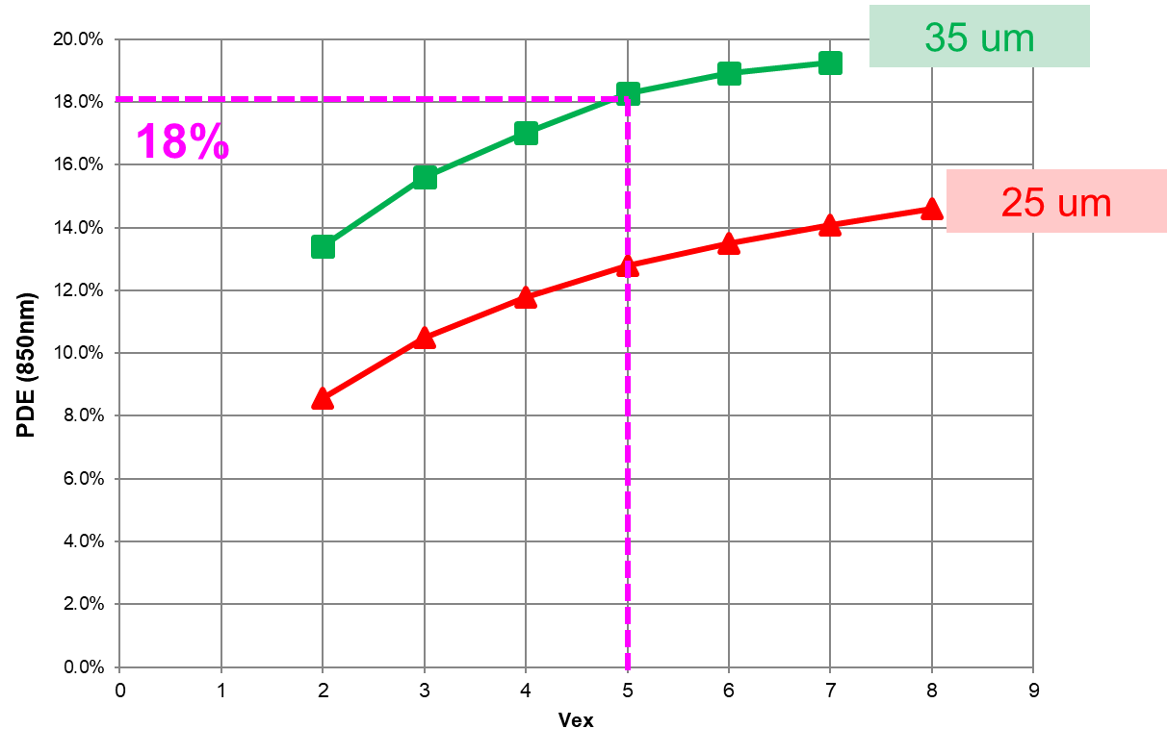
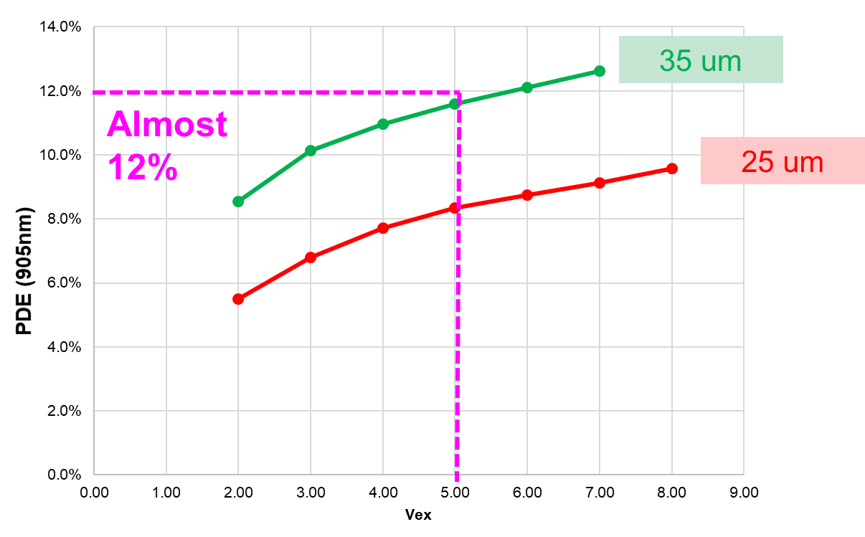
One example of sensors with direct industrial interest: SiPM
SiPMs are one of the most promising candidates for automotive LiDAR systems, which will enable autonomous driving in the future.
FBK NIR-HD SiPMs already provide state-of the-art sensitivity at 905 nm.
Extreme interest from industry (OEMs).
Strong R&D effort is ongoing to provide next-generation performance in the NIR (confidential).
From FBK SiPM presentations
PDE at 850 nm
PDE at 905 nm

