Slide 1
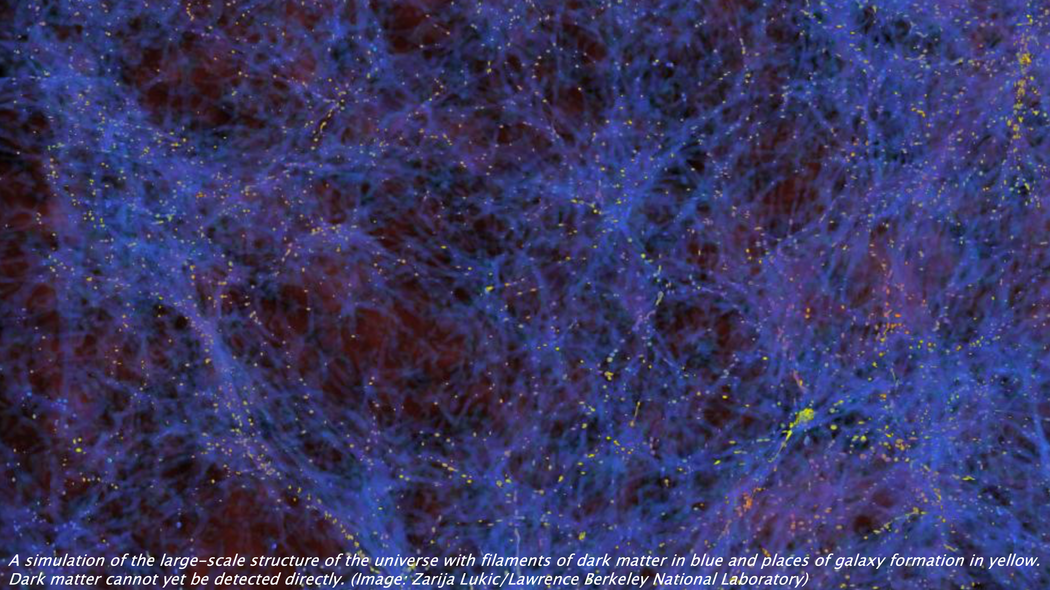
Collective Excitations
for
Fundamental Physics
Ivette Fuentes, University of Southampton

Slide 2
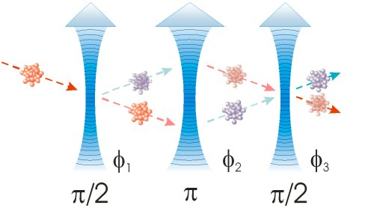
Atom interferometer: quantum spatial interferometery
Single particle detector, local
Interferometry in the spatial domain: limited by time of flight
Compatible with Newtonian physics

Slide 3
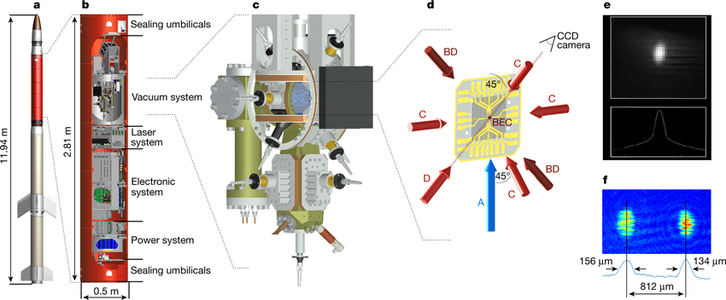
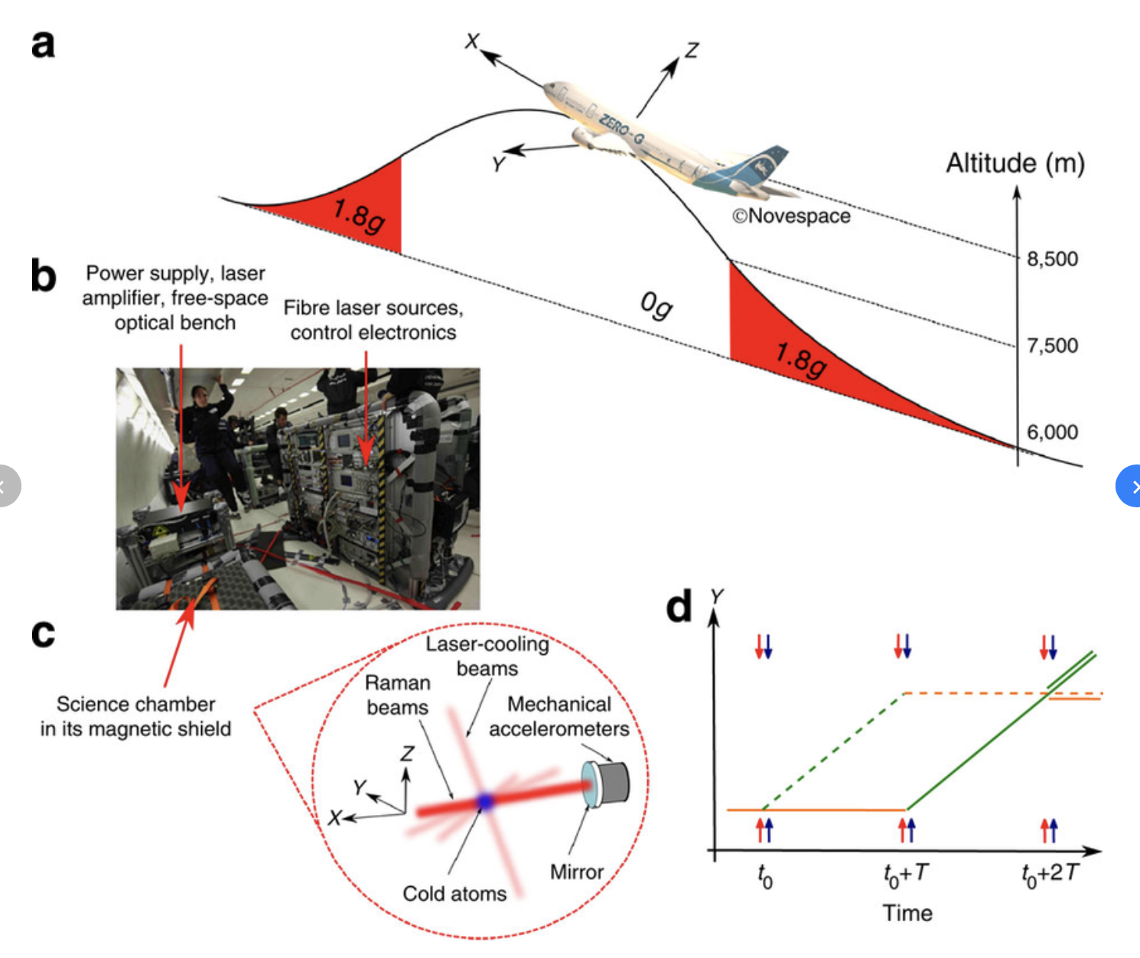
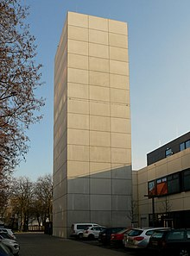
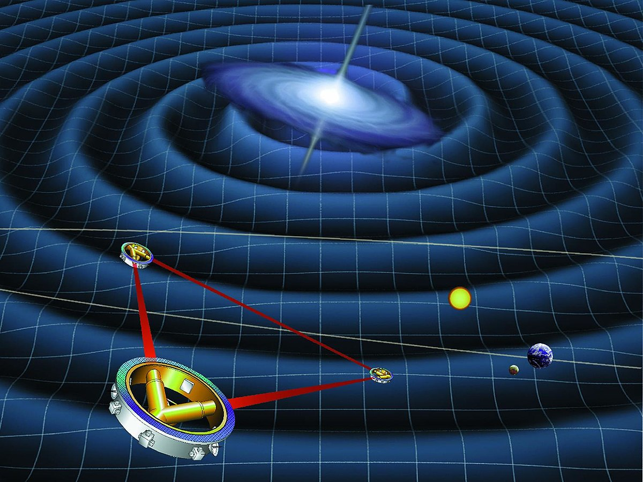
Need to be big

Slide 4
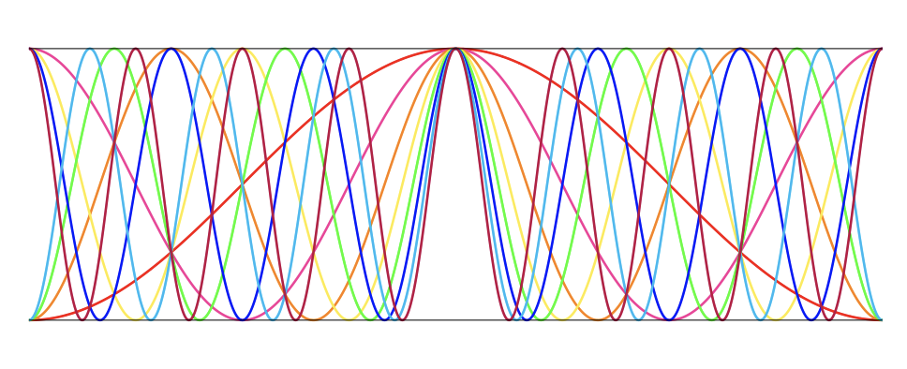
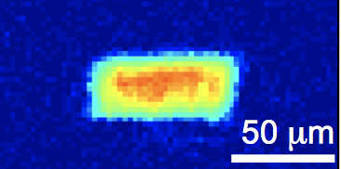
Quantum frequency interferometry
Howl & Fuentes arXiv:1902.09883
Example
Uses interactions: collective excitations, entanglement between atoms
Interferometry in the frequency (time) domain, non-local
We use resonances of quantum modes
Compatible with General Relativity: underpinned by QFT in curved spacetime

Slide 5
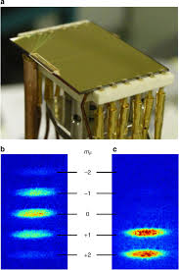
BECs and quantum frequency interferometry
Example
Applications in GR using BEC phonons
Continuous source gravitational wave detector
Dark energy
Proper acceleration
Local gravitational fields (UK patent No.1908538.0)
Gravitational gradient (UK patent No. 2000112.9)
Curvature
Spacetime parameters
Dark Matter
Detector can be miniaturized
High sensitivity
High resilience to noise
Howl & Fuentes arXiv:1902.09883
Demonstrate Quantum Field Theory in Curved spacetime!

Slide 6
Quantum Weber Bar

Slide 7
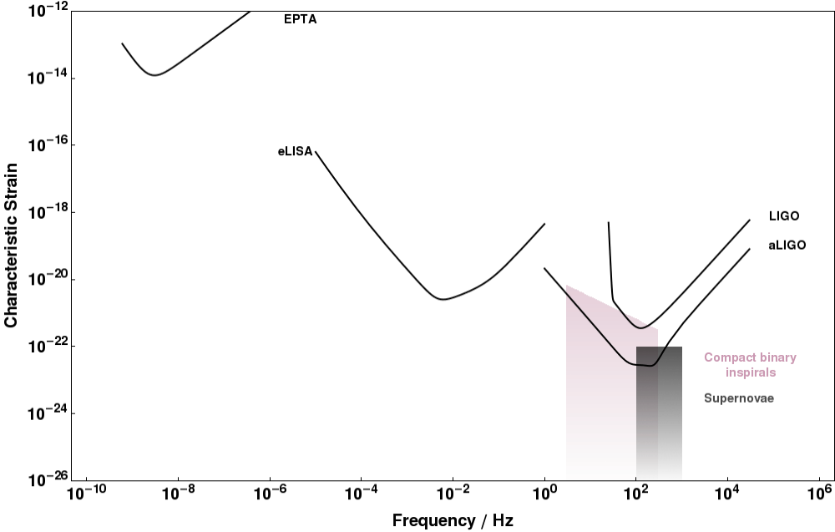
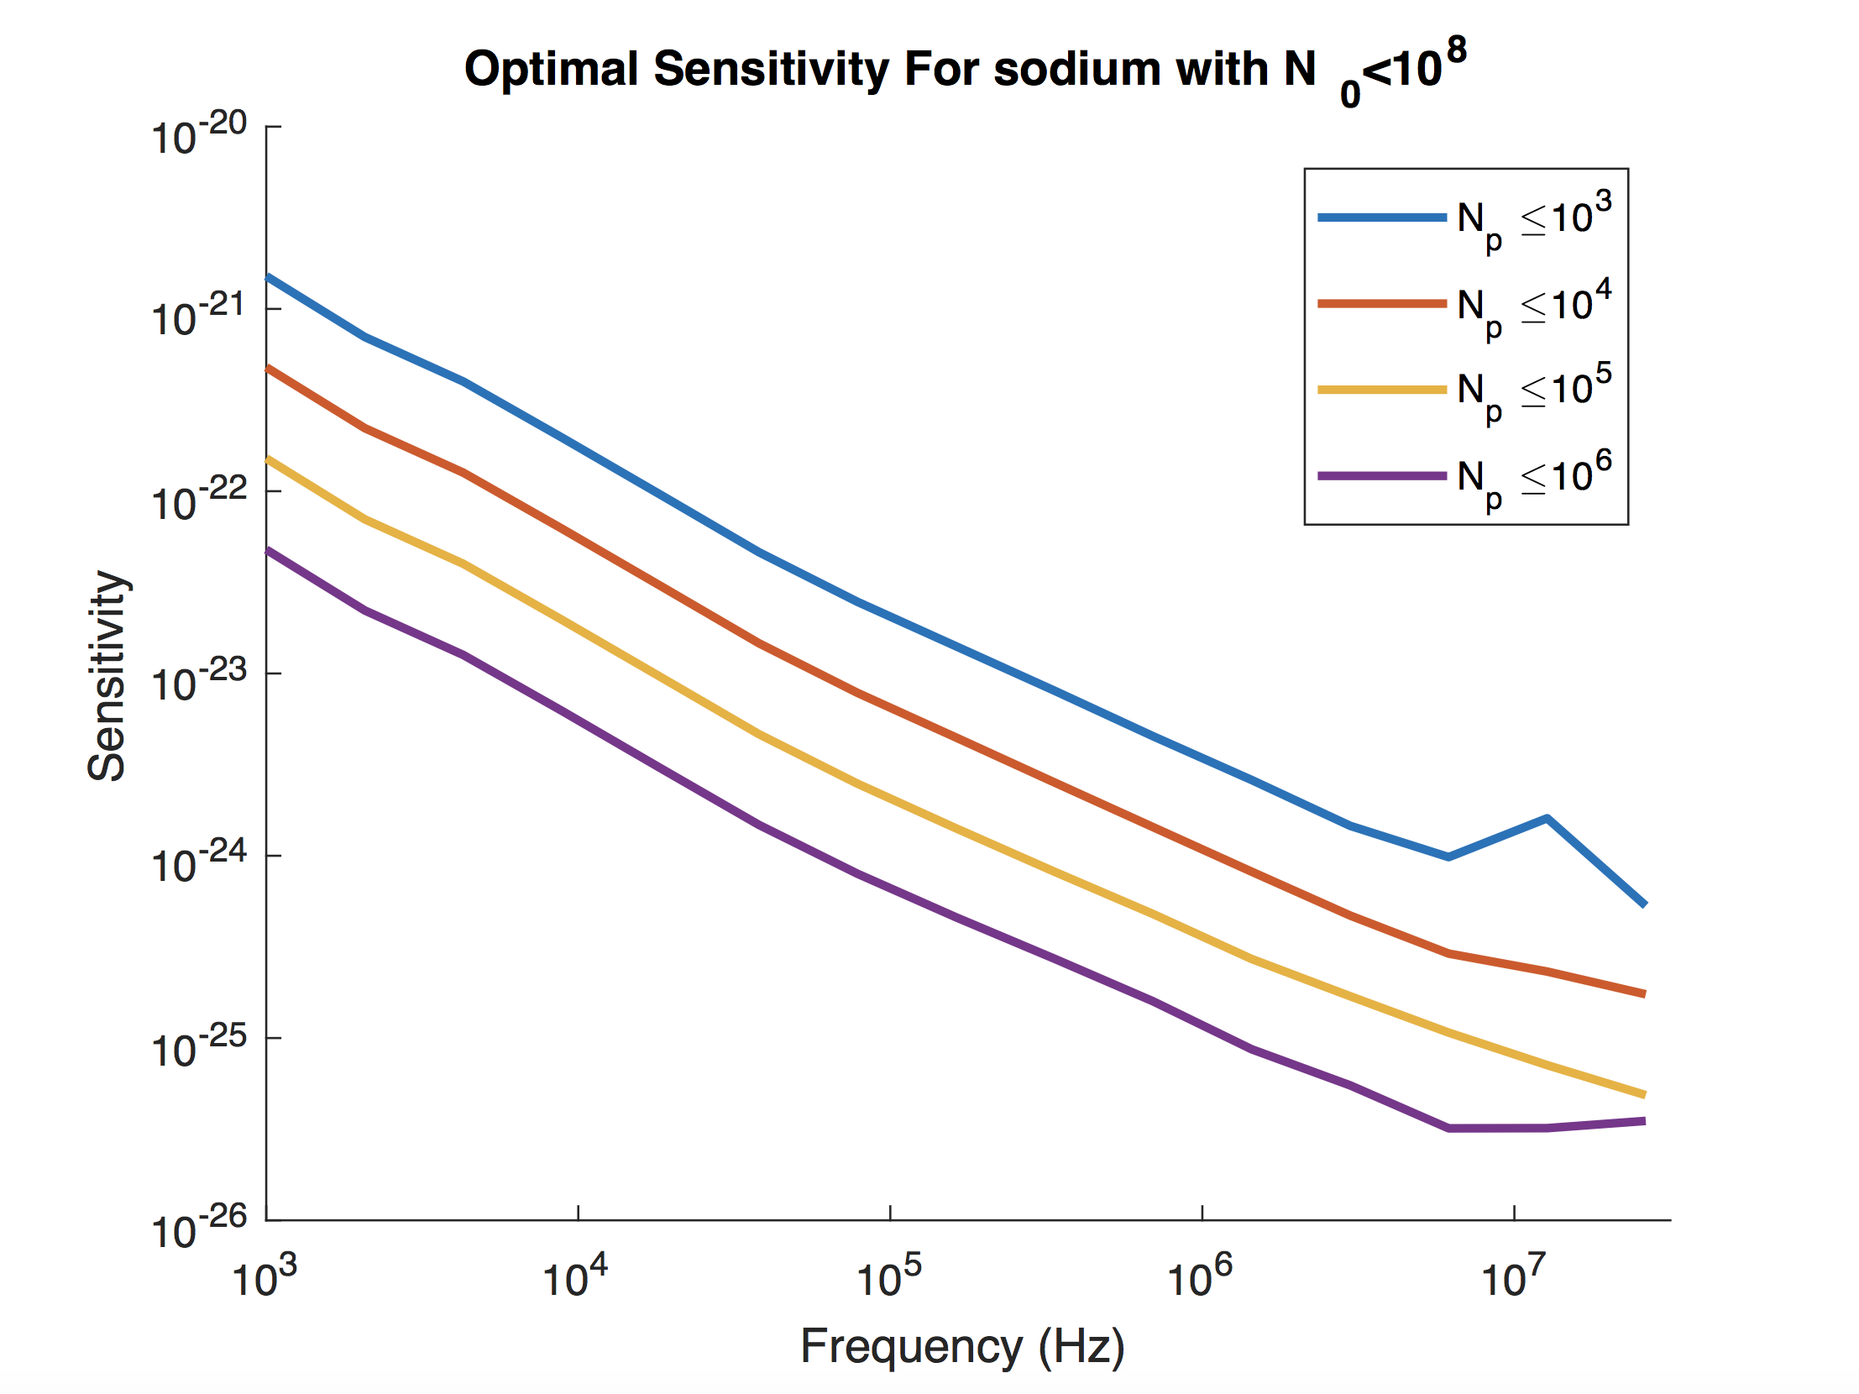
Search for yet unknow sources
Know sources: 10 kHz
Exotic sources:
primordial black holes
boson stars
Early Universe Cosmology
Phase transitions
Preheating after inflation,
Cosmic strings
Dark matter
Ultralight ${10}^{−8}$- ${10}^{14}$ Hz
Decay: Penrose CCC

Slide 8
Constraining dark matter

Slide 9
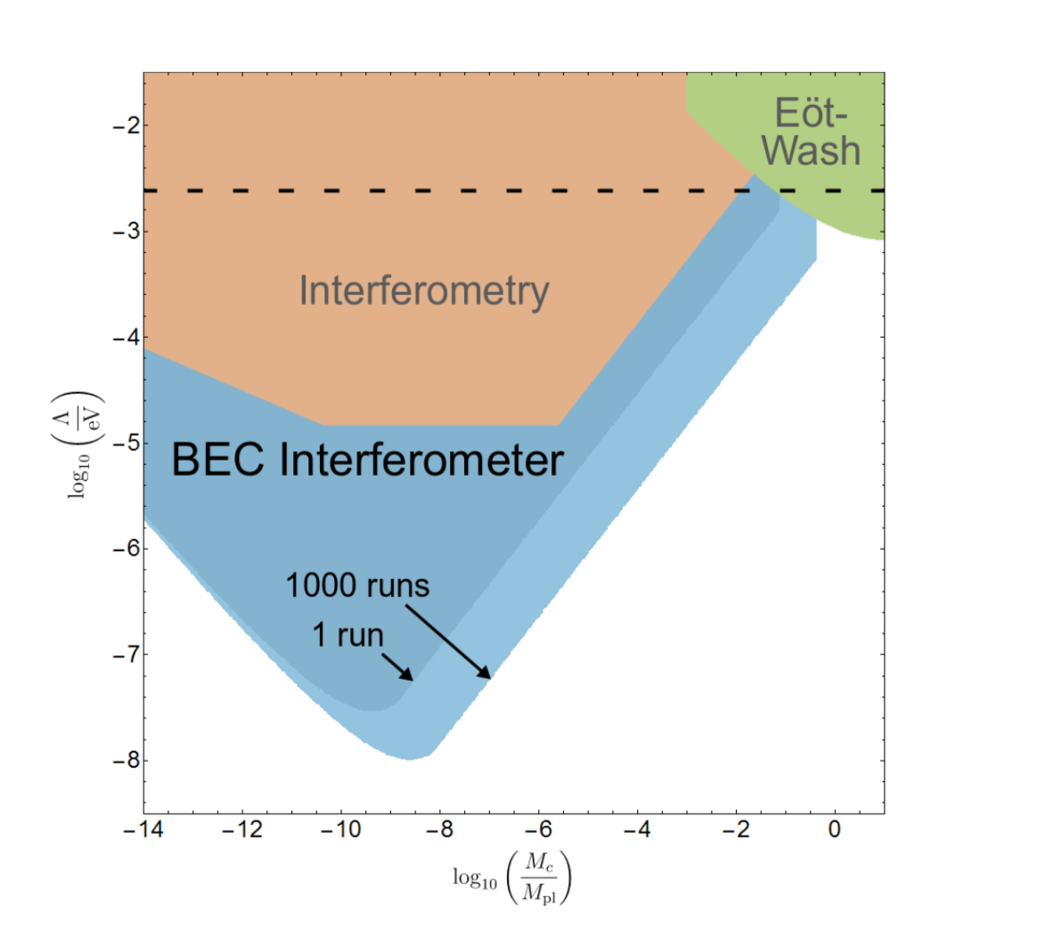
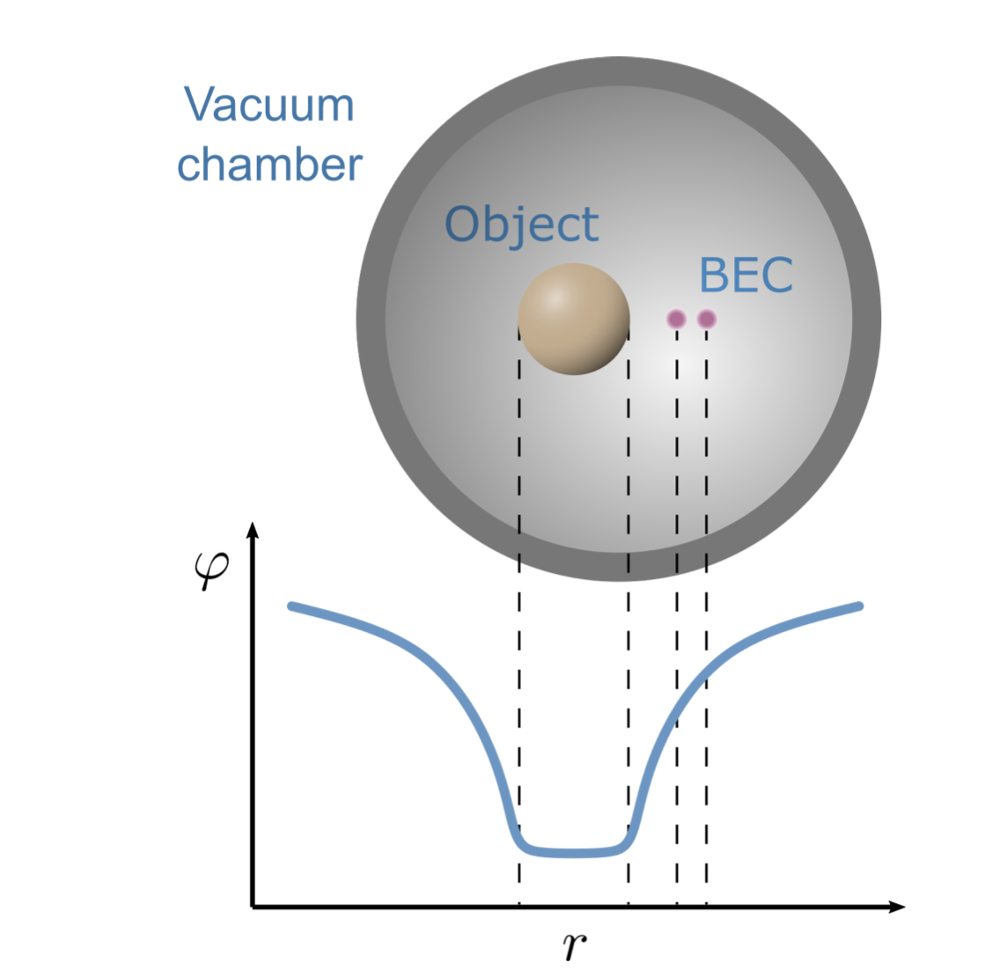
Constraining dark energy
Hartley, Käding, Howl, and Fuentes, arXiv:1909.02272
Constraints for the parameter space of the chameleon model n = 1. The brown area corresponds to constraints from atom interferometry and the green area to those from E ̈ot-Wash experiments. The dotted line indicates the DE scale Λ = 2.4 meV. New constraints predicted in this work are coloured in blue, where dark blue corresponds to 1 run of the experiment

Slide 10
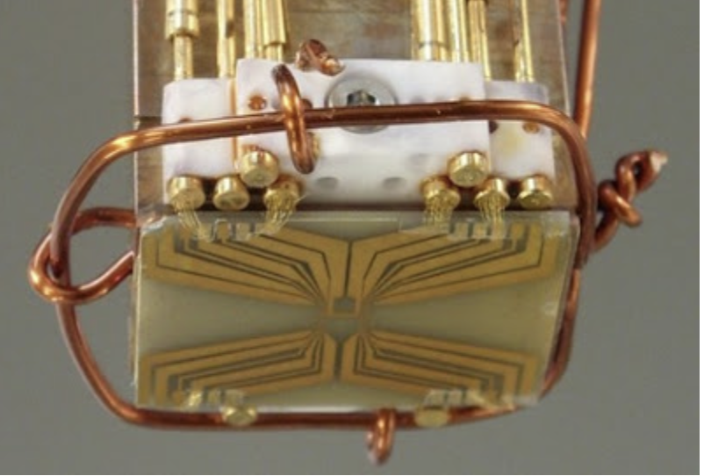
Commercial applications
Phononic gravimeter:
Same sensitivity but much smaller system.
UK patent No. 1908538.0
Paradigm change on how to measure the gravitational field and its gradient using quantum systems
Phononic gradiometer:
Improves the state of the art by at least two orders of magnitude
UK patent application No. 2000112.9

