Slide 1
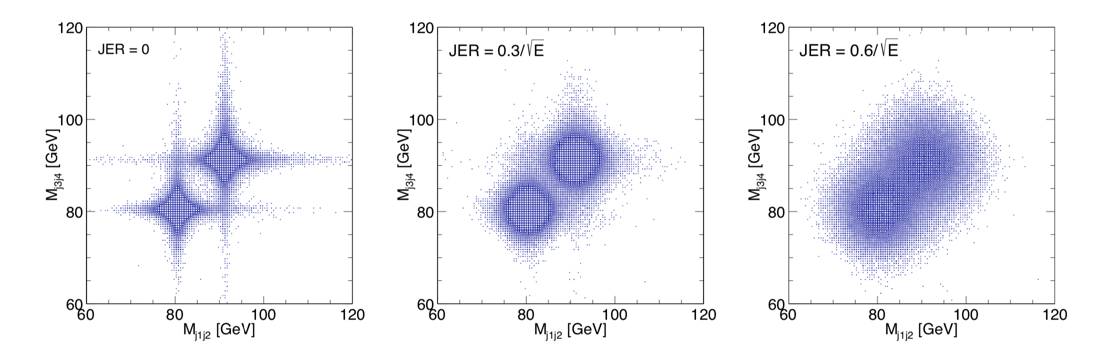
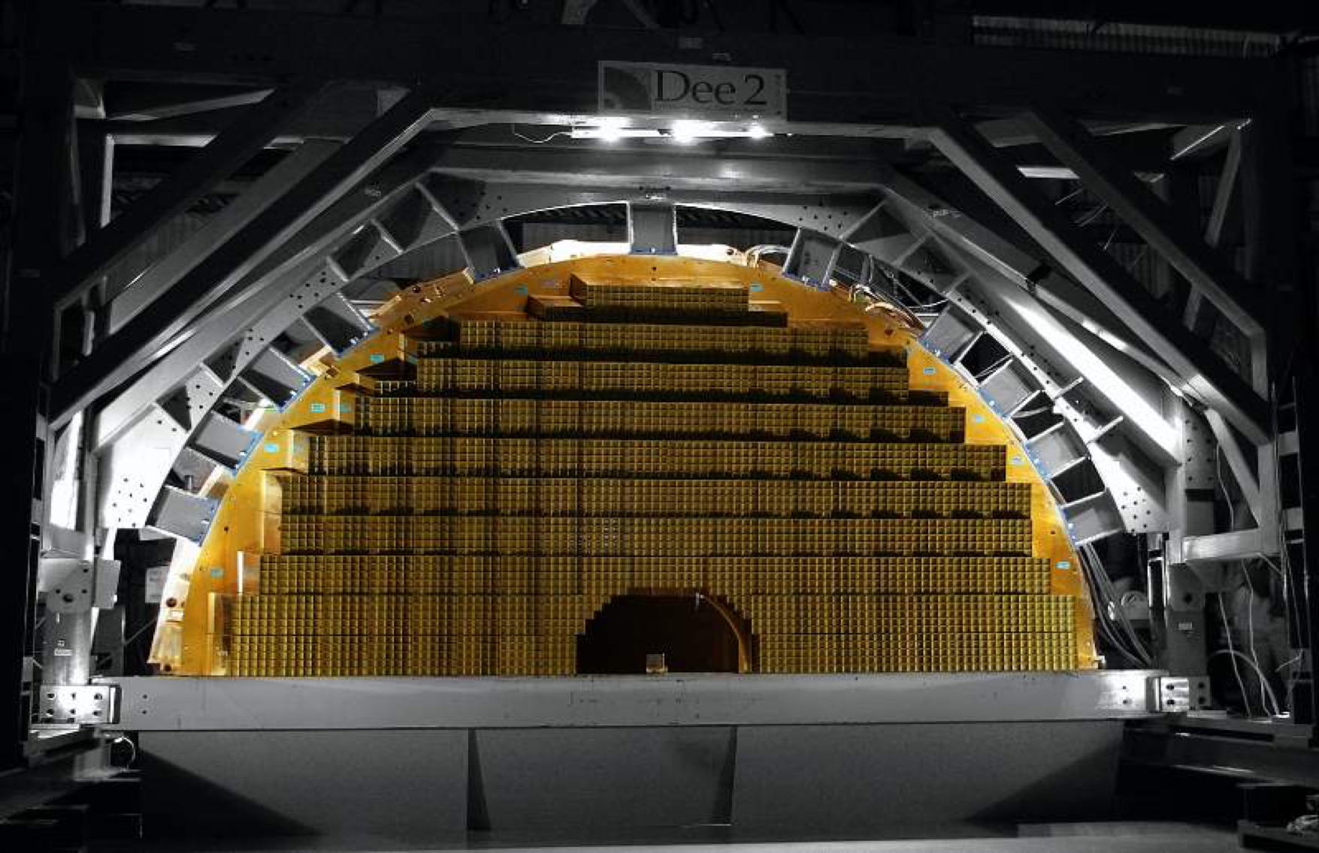
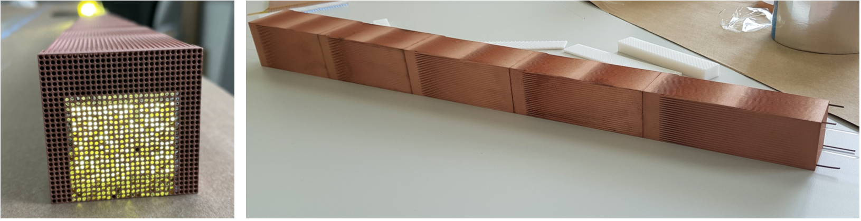
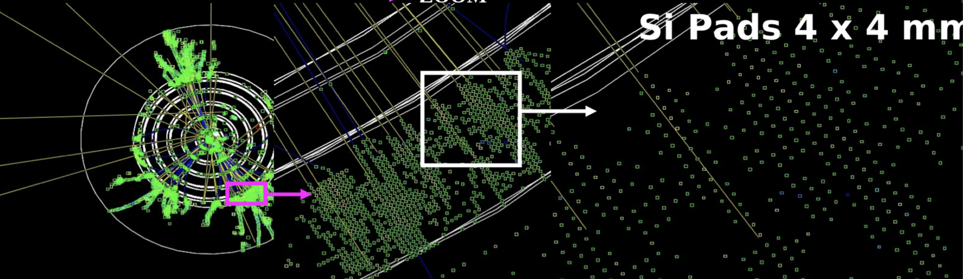
Calorimetry - UK ongoing R&D and perspective
Crystal
Dual Readout
Silicon
Nigel Watson (Birmingham)
with thanks to Iacopo Vivarelli (Sussex), David Petyt (RAL), Hiroki Yokoyama (Utrecht), Tim Rogoschinki (Frankfurt)

Slide 2

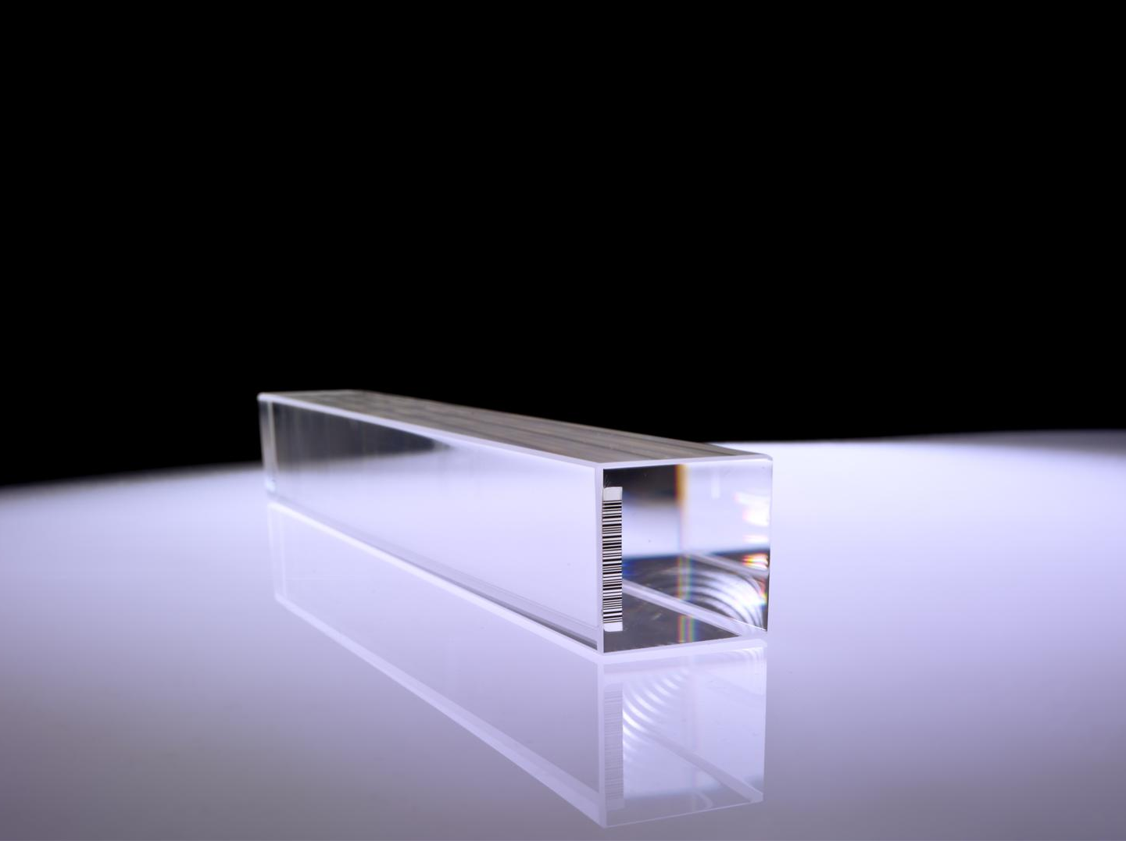
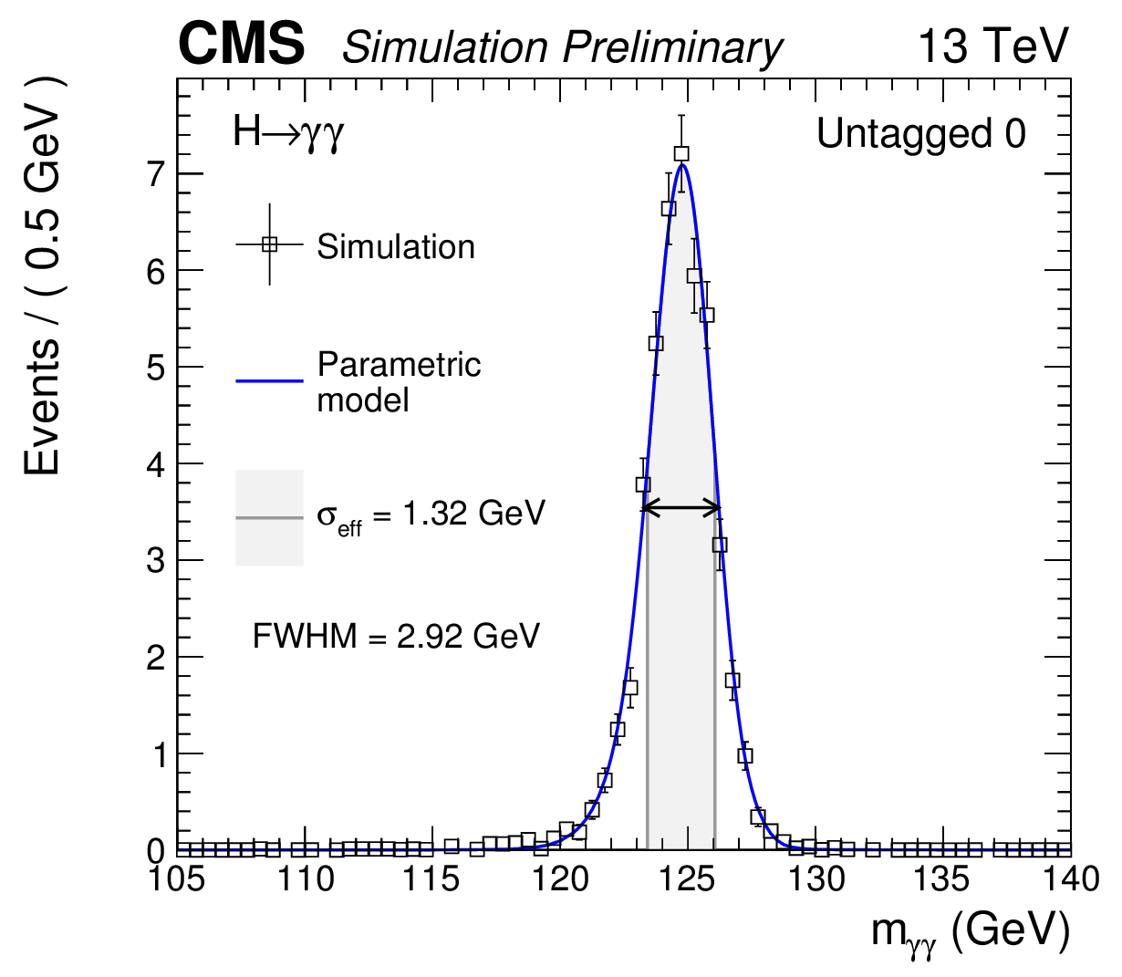
CMS Crystal ECAL
[David A. Petyt]
The CMS ECAL was designed with challenging goals:
  Extreme energy resolution in the harsh LHC radiation environment
    achieve 1% mass resolution for low-mass Higgs in the γγ decay channel
  Hermetic and compact detector with coverage up to |η| = 3.0
Lead tungstate (PbWO4) crystal calorimeter
    compact, fast, radiation tolerant
  Radiation and magnetic field tolerant APD and VPT photodetectors
  Provide crystal energy sums at 40 MHz to trigger on electrons and photons
Lead Tungstate (PbWO4) crystal
H→γγ Mass resolution ~1%

Slide 3
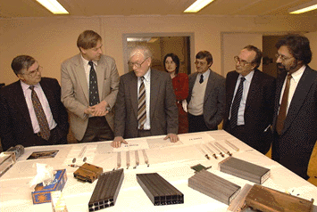
[David A. Petyt]
UK contributions to CMS ECAL
UK institutes: Bristol, Brunel, Imperial College, RAL
UK has played a leading role in ECAL design, construction and operation
  UK led the design, construction & installation of ECAL endcaps (EE), in partnership with RAL TD
  RAL led development and testing of VPT photodetectors for EE (with Research Institute Electron, St Petersburg) and designed/operates the VPT High Voltage system
  UK involved in Lead tungstate crystal R&D, performance characterisation and calibration
  UK designed & manufactured radiation-hard, low noise front-end pre-amp ASIC for whole ECAL
  Crystal and photodetector expertise directly followed on from previous experience on LEP
  Almost 30 years of UK involvement in CMS and ECAL (from initial Letter of Intent)
From concept…
…to reality
3.2 m
4 x 3662 PbWO4 crystals

Slide 4
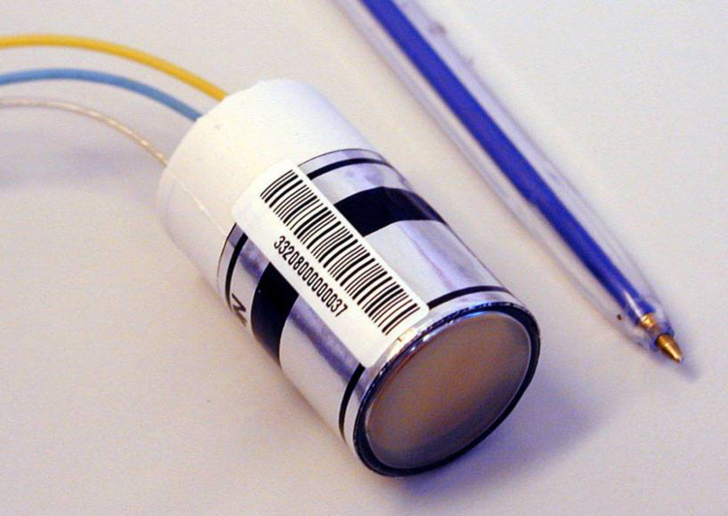
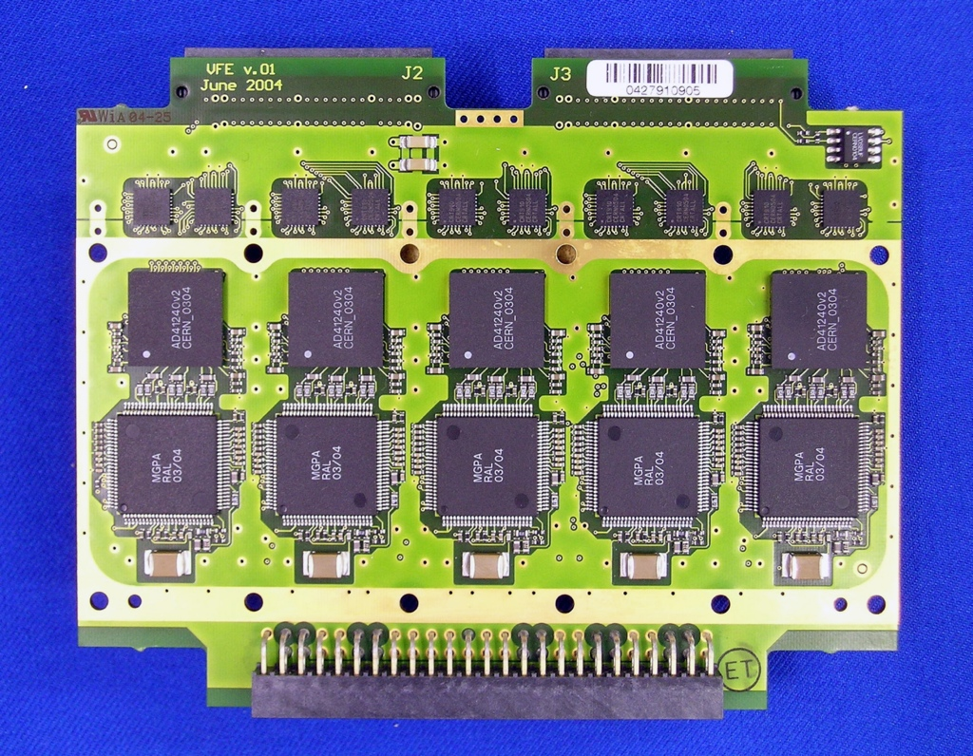
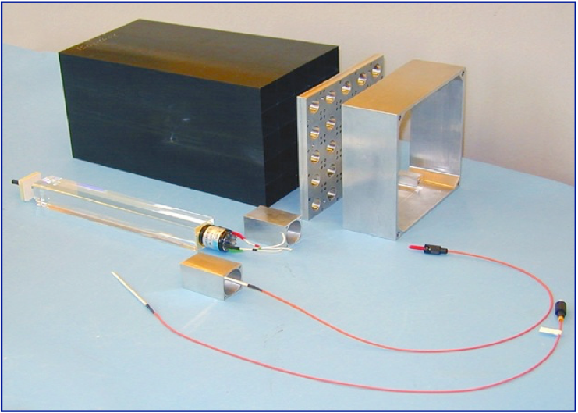
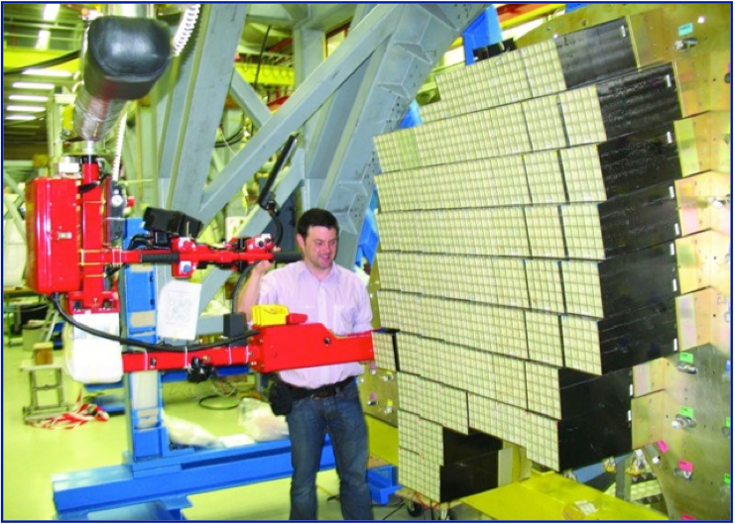
[David A. Petyt]
Selected UK contributions
one of 14648 EE Vacuum Phototriodes (VPTs)
Very-front-end card with UK-designed MGPA pre-amplifier ASICs
Elements of a EE supercrystal
(5x5 channels)
Endcap mechanics and
construction

Slide 5
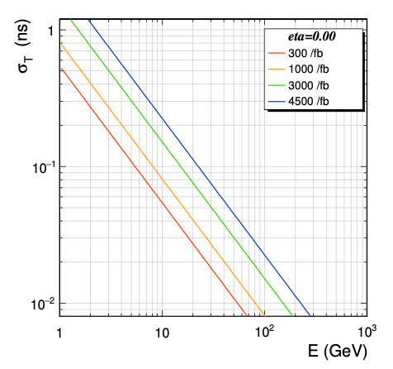
[David A. Petyt]
ECAL crystals are capable of precise timing
CMS ECAL crystals and APDs can provide precise time information
  intrinsic resolution: ~20 ps
ECAL timing distribution system not designed for sub-ns
  achieved ~150ps, limited by timing distribution to front-end boards
Phase-2 upgrade prioritises precise timing resolution
  Crystals and APDs remain in Barrel
  ECAL will use redesigned FE preamp and ADC to minimise pulse shaping and over-sample signal pulse
  dedicated timing distribution to achieve 30ps
  ageing (APD noise increase) gradually degrades performance
ECAL time resolution measured from test beam
Phase-2 ECAL time resolution vs luminosity

Slide 6
[David A. Petyt]
Plans for HL-LHC - crystal ECAL
RAL/Bristol continue support for crystal ECAL Barrel (through HL-LHC, with upgraded on-/off- detector electronics)
  Main deliverable: more advanced ECAL energy clustering and noise rejection algorithms for calorimeter trigger (firmware and software)
  Specification of optical fibre router system, allowing clustering and geometry-based noise rejection algorithms across boundaries.
  Develop ECAL reconstruction code for GPUs/FPGAs etc.
Significant UK effort for HGCAL – see AMM /PD talks
  Specific UK interest in trigger algorithms and online/offline reconstruction

Slide 7
[David A. Petyt]
Future calorimetry plans:
RAL perspective
RAL CMS group: no calorimeter hardware project planned beyond HL-LHC at present
  RAL detector expertise is crystal calorimetry (much smaller group than during CMS construction).
    Could contribute ideas and 20+ years of CMS experience, if significant interest in a crystal based calorimeter for ILC/FCC-ee within the UK community
    Strong links to CERN calorimeter groups, likely be a significant driving force in any crystal or fibre-based calorimeter for future projects based at CERN
      See M. Lucchini talk at ECFA TF6 symposium for a survey of R&D activities
  Very significant trigger expertise, can be leveraged for future projects
    Hardware/firmware/algorithm expertise, in both calorimeter, tracker and trigger systems
    Potential interest in algorithms that combine tracker and calo signatures in future L1 trigger systems

Slide 8
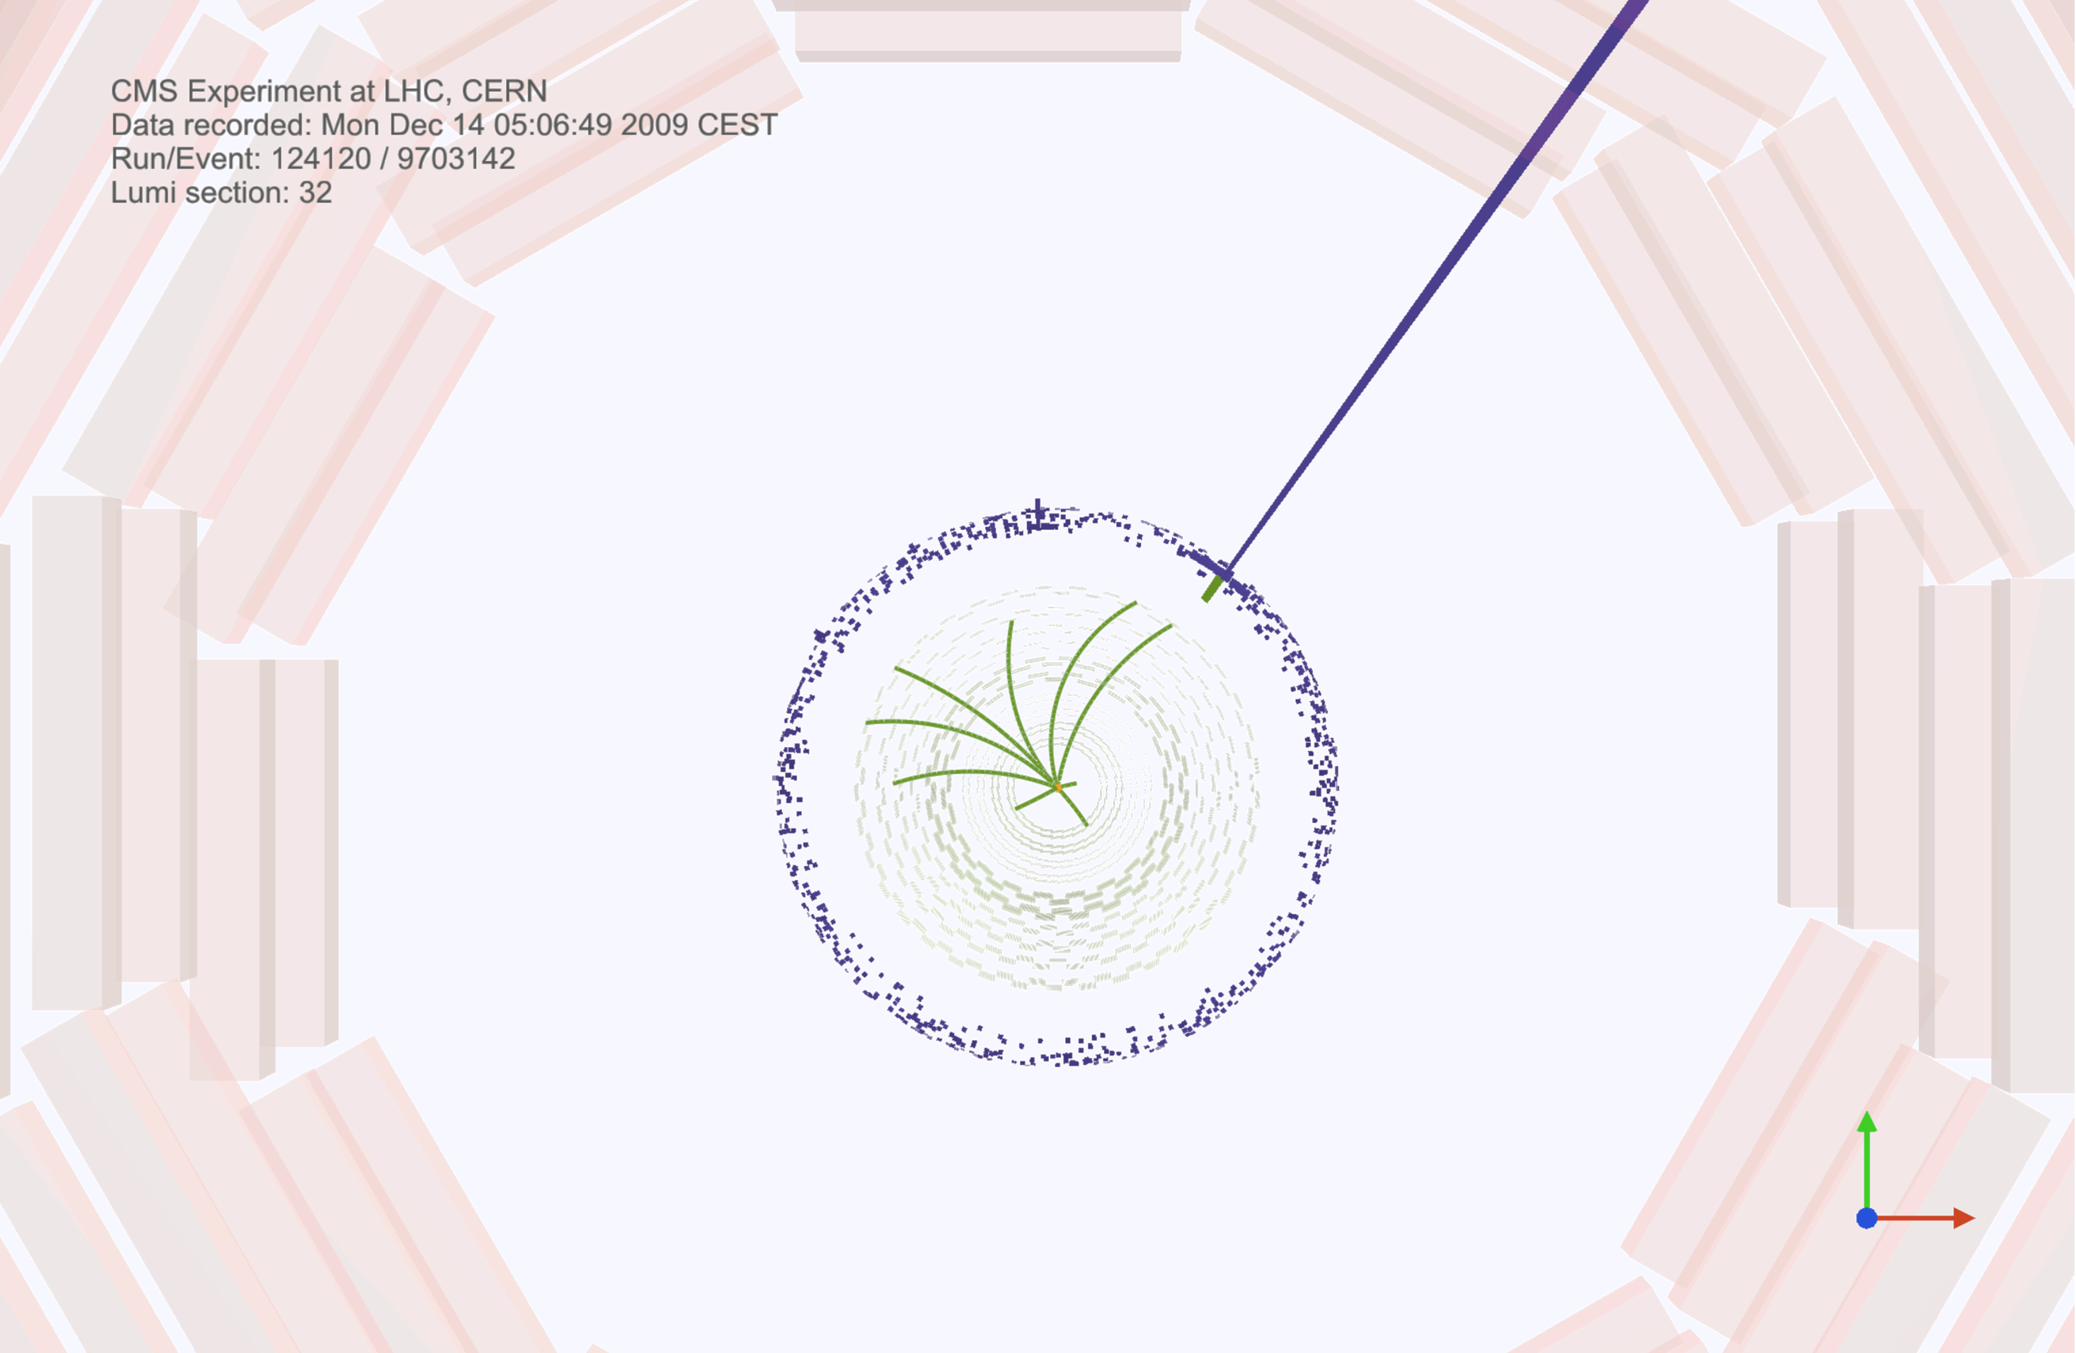
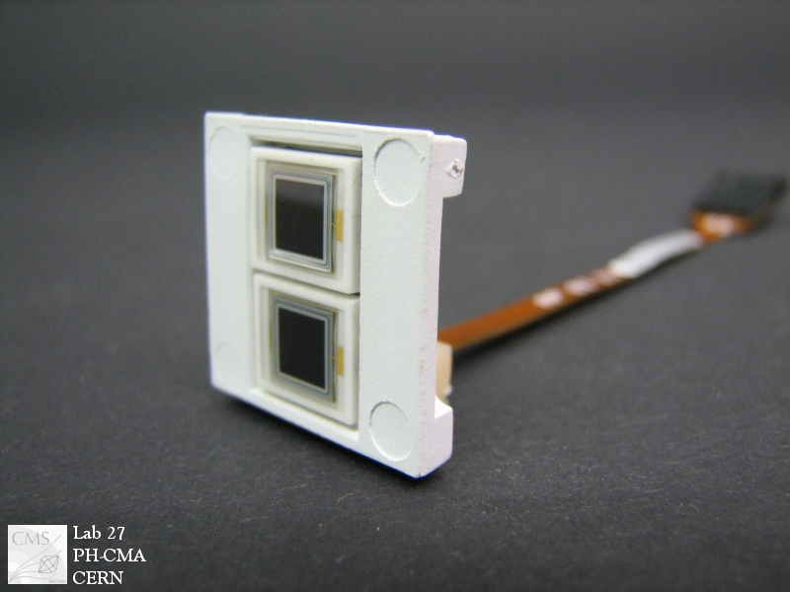
[David A. Petyt]
Expertise e.g. ECAL spikes
Anomalous “spikes” observed in ECAL Barrel
  large apparent energy deposits, non-physical topological and timing signatures
Caused by direct ionisation of APD active volume by collisions products (chiefly hadrons/pions)
Mitigation was challenging, especially for L1 trigger:
  no possibility to cure at source - APDs inaccessible
  spikes typically hit 1 of 2 APDs per single ECAL crystal. However, decision was made to sum these signals rather than read them out individually to reduce cost
  eventually found a way to remove spikes using extra unused feature of ECAL front-end ASIC
  D
ECAL APD “spike”
ECAL APD capsule
single ECAL channel with 600 GeV equivalent energy
ECAL energy deposits
        Lessons learned: Must rigorously check system in test beam campaigns. Self-triggering would have revealed this problem. Build sufficient flexibility in on-detector and off-detector electronics to deal with unexpected signals. Add redundancy to readout signals?

Slide 9
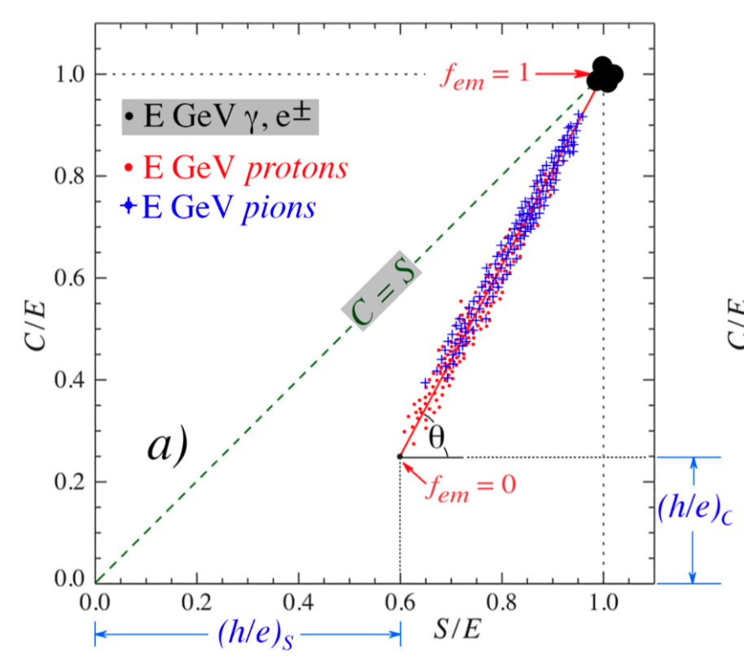
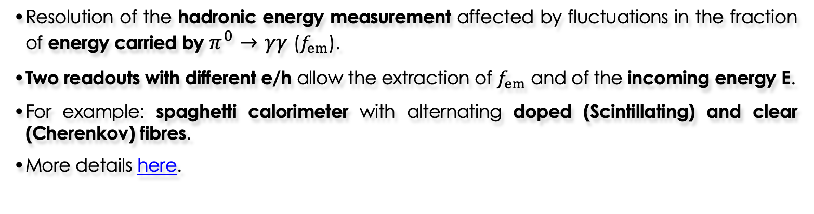
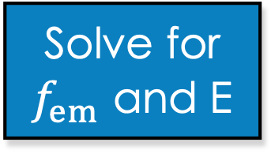


Dual readout - the principle
[Iacopo Vivarelli]
Resolution of the hadronic energy measurement affected by fluctuations in the fraction of energy carried by $π^{0}→γγ$ ($f_{em}$).
Two readouts with different e/h allow the extraction of $f_{em}$ and of the incoming energy E.
For example: spaghetti calorimeter with alternating doped (Scintillating) and clear (Cherenkov) fibres.
More details here.
$$E_{S}=E\left(f_{em}+{\left(\frac{h}{e}\right)}_{S}(1−f_{em})\right)$$
$$E_{C}=E\left(f_{em}+{\left(\frac{h}{e}\right)}_{C}(1−f_{em})\right)$$
Solve for $f_{em}$ and E

Slide 10
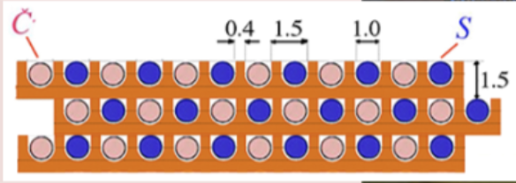
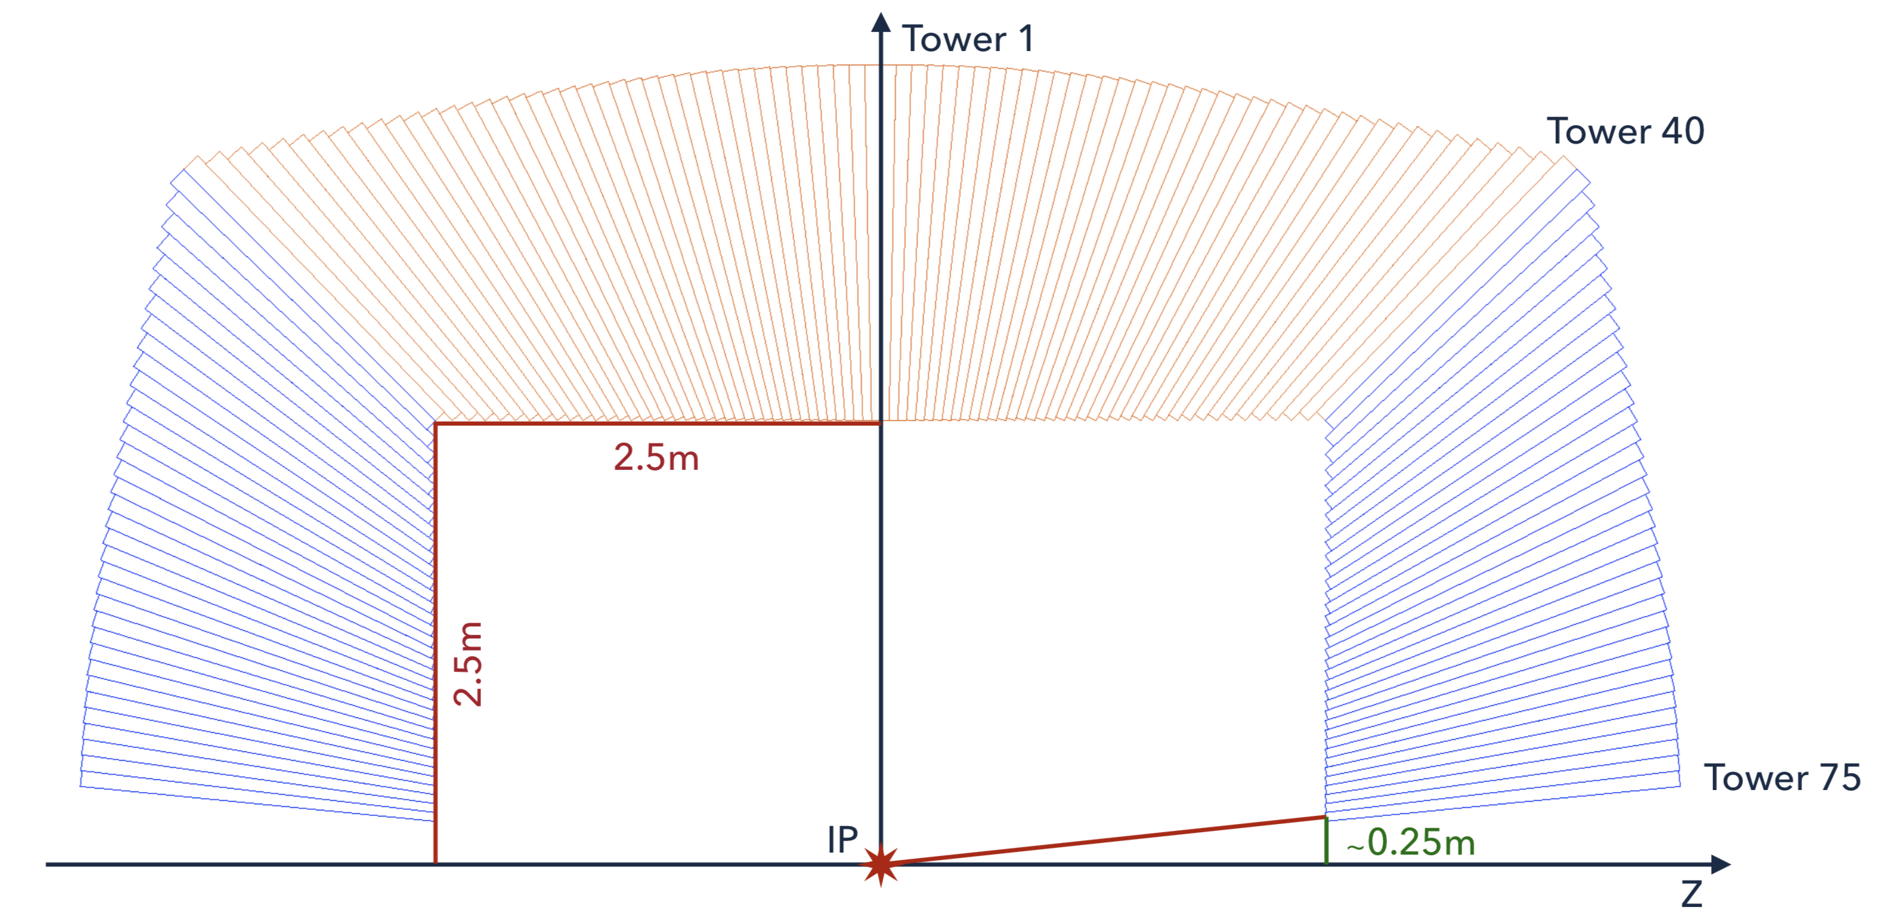
Dual Readout (fiber) calorimeter
[Iacopo Vivarelli]
Embedded in IDEA detector concept (in FCC and CEPC CDRs)
  Cu absorber, 1 mm fibers, 1.5 mm pitch, read by SiPM
  Single device for EM and HAD calorimetry.
Read out the single fibre: 130 M channels.
  Ideal fibre grouping still to be determined.
  Excellent angular resolution, lateral shower shape sensitivity.
  However no longitudinal segmentation .
3D-printed prototype of a tower

Slide 11
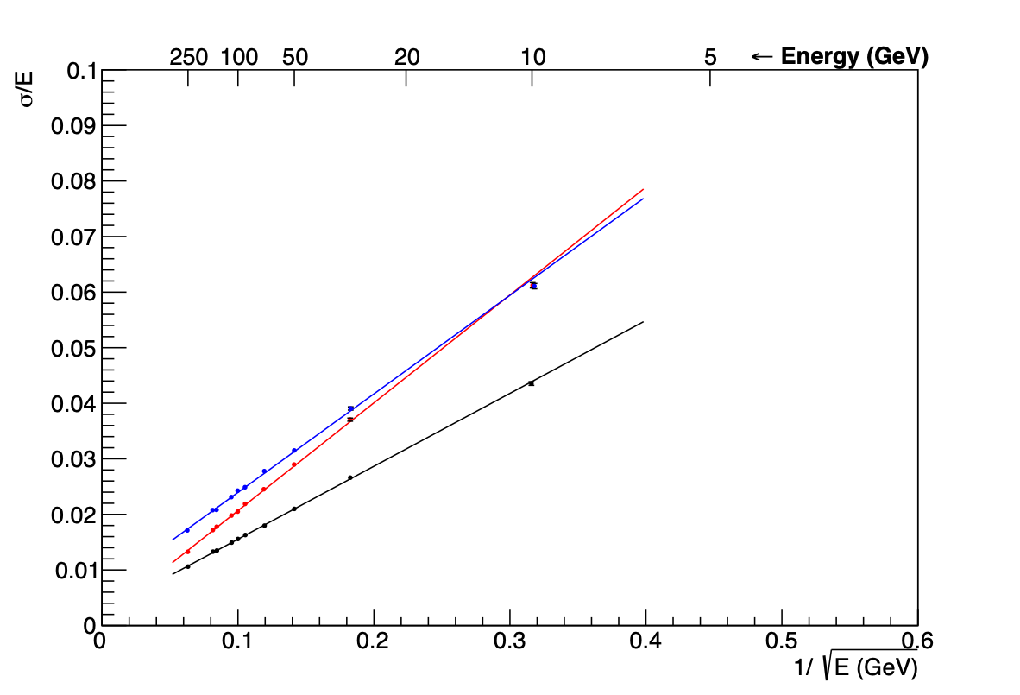
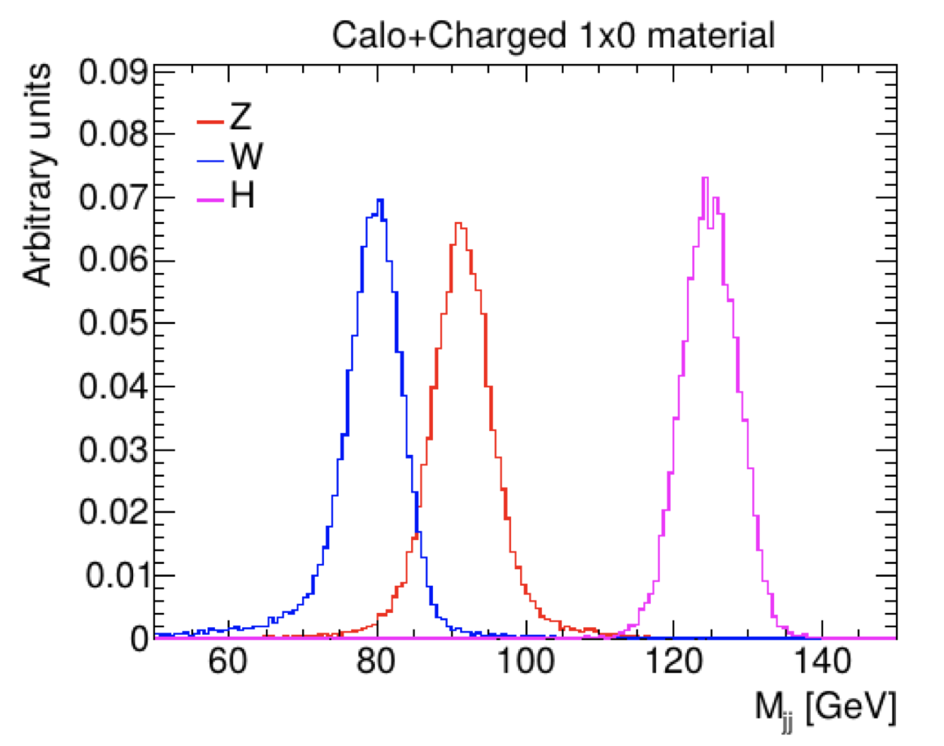
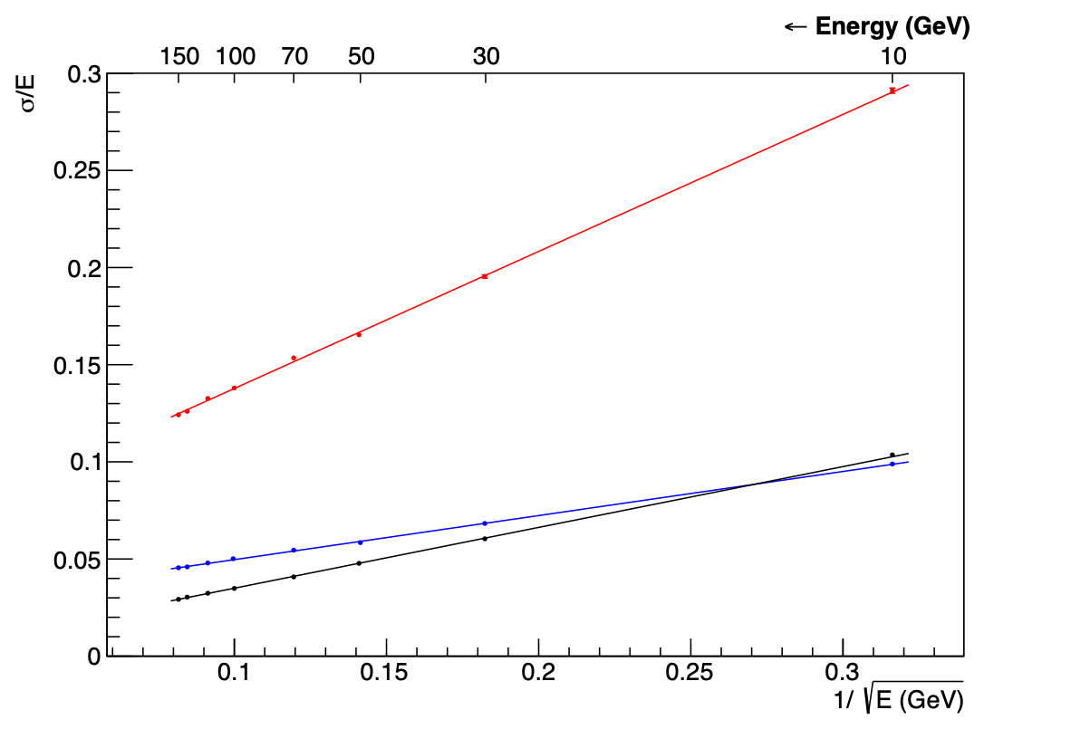
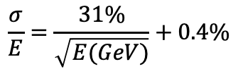
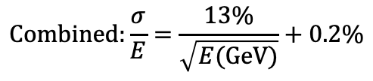


A glance at the performance
[Iacopo Vivarelli]
single electrons
Jets
$$S:\frac{σ}{E}=\frac{18\%}{\sqrt{E(GeV)}}+0.6\%$$
$$C:\frac{σ}{E}=\frac{19\%}{\sqrt{E(GeV)}}+0.1\%$$
$$Combined:\frac{σ}{E}=\frac{13\%}{\sqrt{E(GeV)}}+0.2\%$$
single pions
Combined
$$\frac{σ}{E}=\frac{31\%}{\sqrt{E(GeV)}}+0.4\%$$
Cherenkov
Competitive energy resolution:
  Universal response to hadrons
  Very good pi/e separation and tau identification performance
and also electronics all outside the calorimeter:
  No need for cooling and services in the calorimeter volume
Scintillation

Slide 12
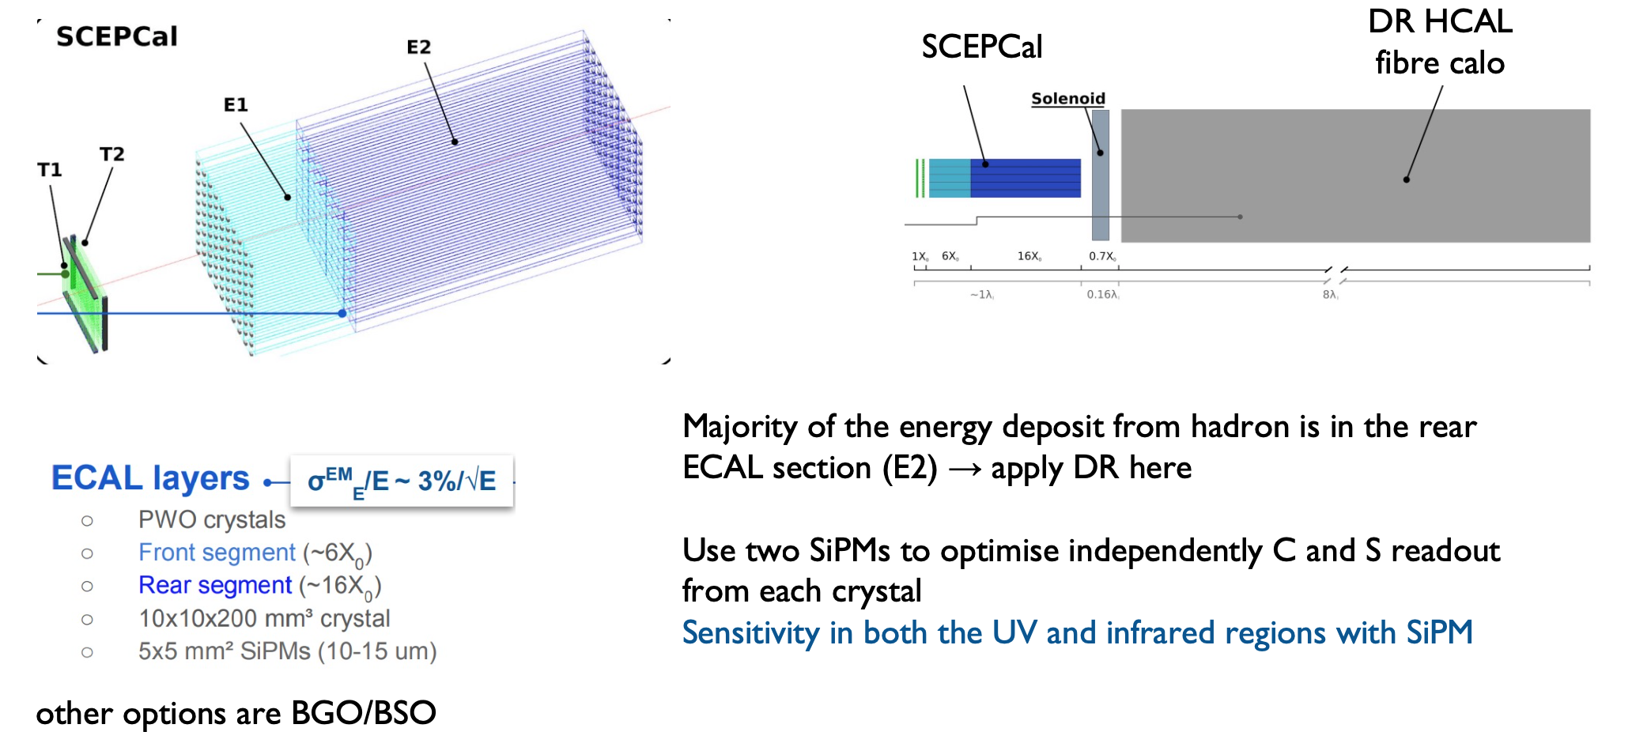
Under investigation: crystal-based EM layer
[Iacopo Vivarelli]

Slide 13
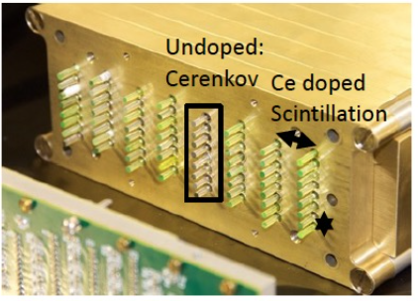
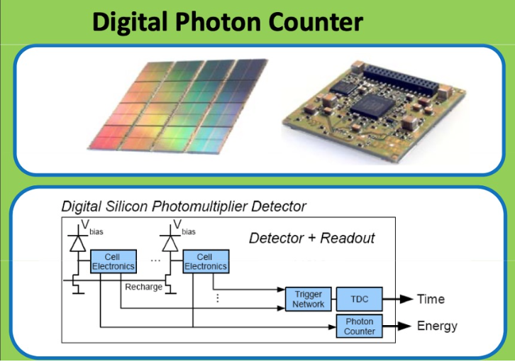
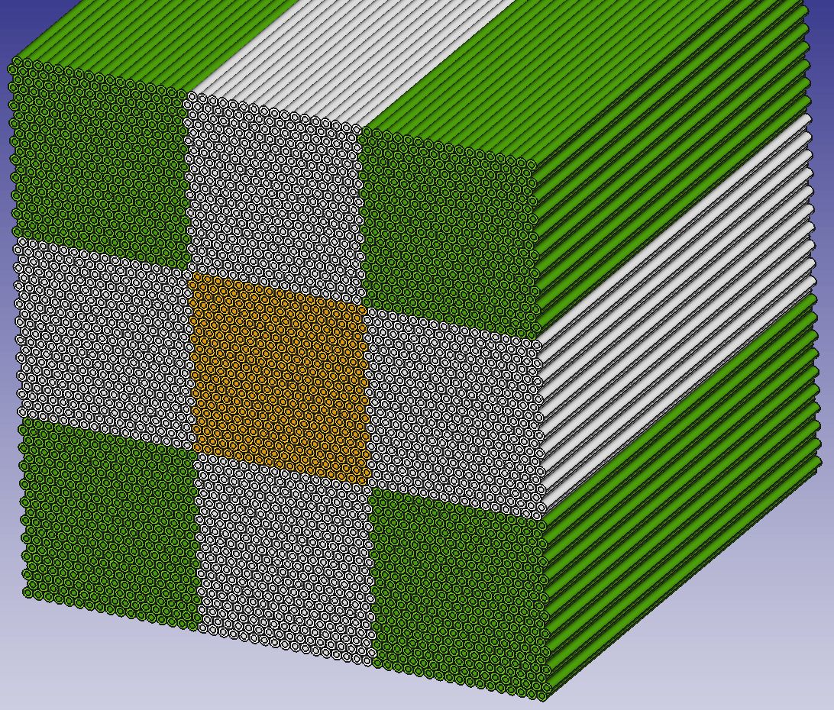
Items for R&D – Dual Readout
[Iacopo Vivarelli]
Cherenkov light is never enough:
  crystal fibers (LuAG) can achieve 4x ph/GeV than PMMA currently in use.
  Improved SiPM response in UV region for cheap desirable.
Integrated (digital) SiPM:
  Simplified readout, improved trigger capabilities.
Scalable readout architecture
For more details see G. Gaudio’s talk at TF6 ECFA
Test beam(s) foreseen for summer 2021 testing capillary tube, EM-size prototype.
Active in the UK: Sussex with contributions on simulation and characterisation of the fibers + SiPM and TDAQ/Monitoring for TB.
Funding:
  Europe: AIDAinnova + (limited) national funds (mainly Italy, Croatia)
  Korea: substantial grant aimed at delivering a hadronic scale prototype

Slide 14
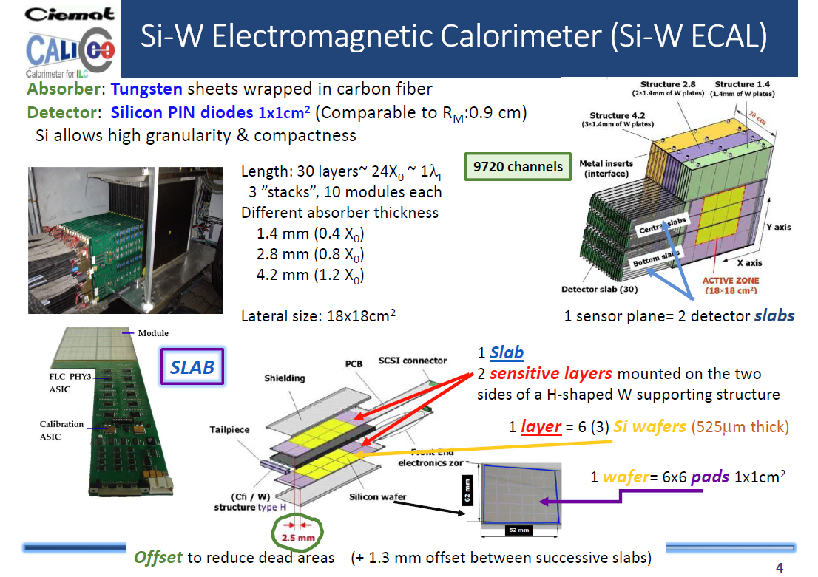
2005 - ECAL Physics prototype
Notes:
Examples of original physics prototype ECAL, from 2005, see https://inspirehep.net/literature/802597
Note time between first idea and prototype to being used in CMS HGCal

Slide 15
~15 years later → CMS HGCAL
Message: need ongoing R&D funding - non-project specific
2005 - ECAL Physics prototype
Notes:
Examples of original physics prototype ECAL, from 2005, see https://inspirehep.net/literature/802597
Note time between first idea and prototype to being used in CMS HGCal

Slide 16

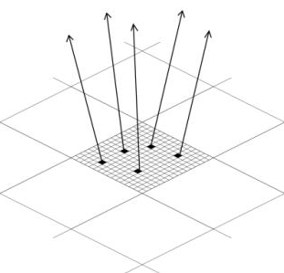
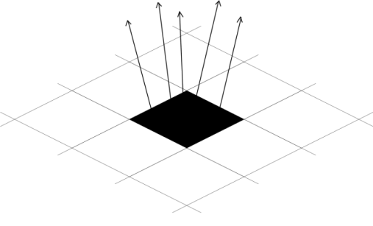
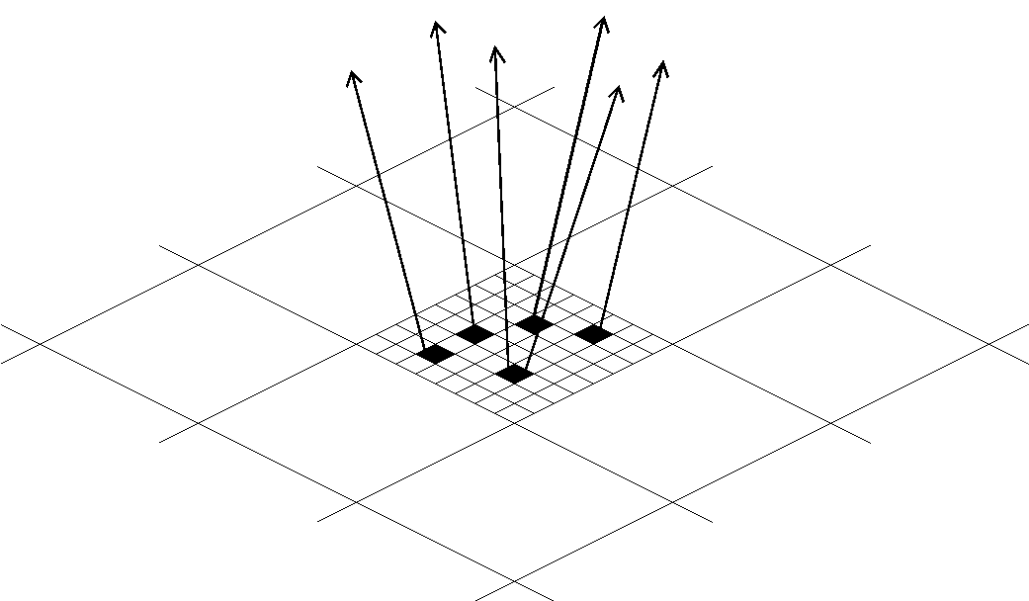
DECAL Concept – cost /performance for SiW ECAL
Swap ~0.5x0.5 cm² Si pads with small pixels
  at most one particle/pixel,1-bit ADC/pixel - digital
How small to avoid saturation/non-linearity?
  EM shower core density at 500GeV ~100/mm²
  Pixels must be <100x100μm²
    Used baseline 50x50μm²
    Gives ~10¹² pixels for ECAL
Simpler construction (no bump bonding)
DECAL prototypes to date 180 nm process → 65nm
Performance gains? Tracking highly boosted decays, e.g. 𝜏, …
AECAL
DECAL N_{pixels}<N_{particles}
DECAL N_{pixels}=N_{particles}
Notes:
A UK initiated project from c. 2005, first fully sensitive deep p-well devices developed by RAL CMOS group

Slide 17
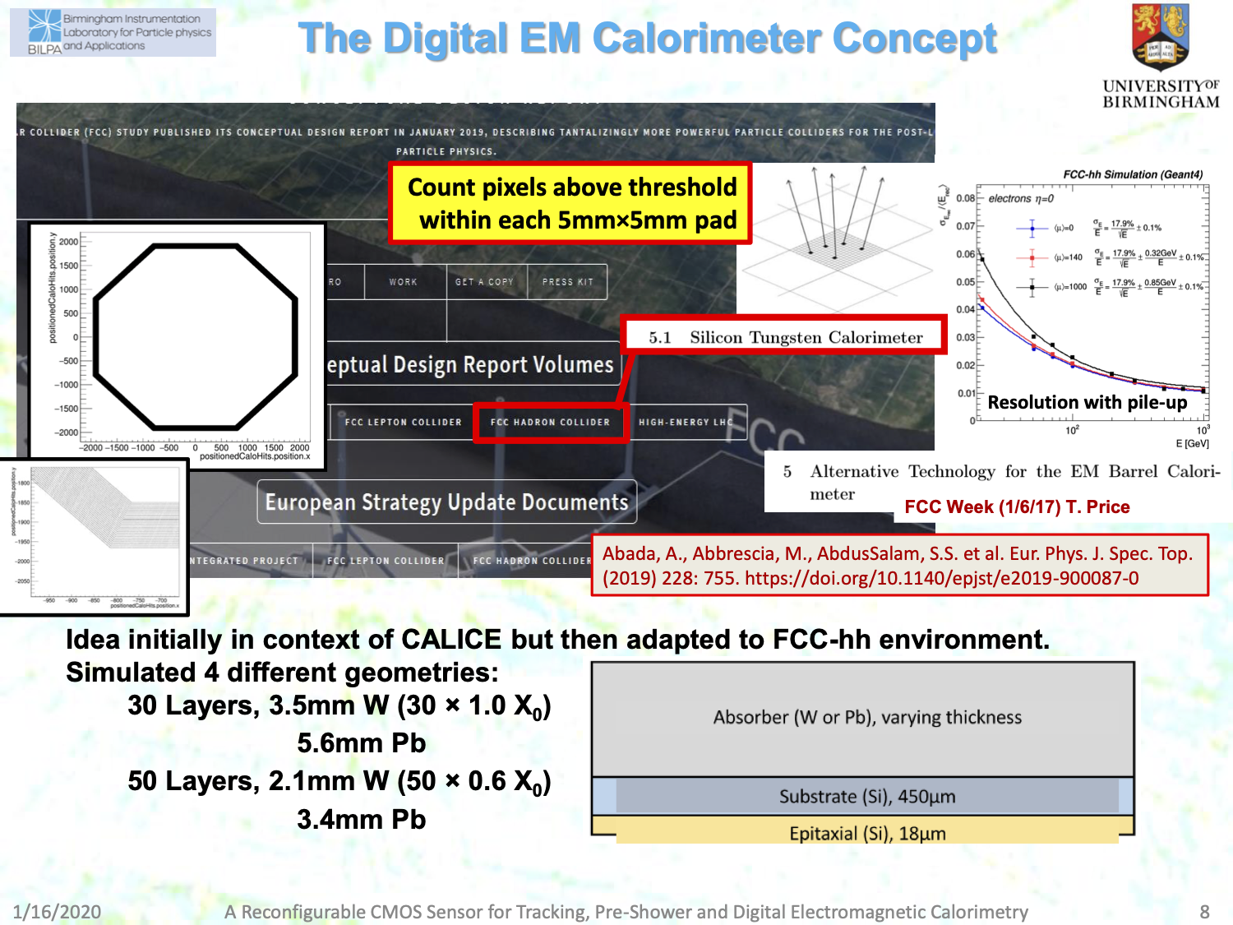
DECAL concept
in FCC-hh CDR
[c/o Phil Allport]
Notes:
Birmingham introduced SiW calorimeter concept to FCC-hh (analogue and DECAL versions)
a lot of detailed studies had been carried out for the CDR including with different pileup scenarious
the DECAL/SiW had the most detailed implementation in the FCC software framework (full description of the geometry, as shown by hitmaps – see picture on the left)

Slide 25
Derived from earlier UK student work

Slide 31
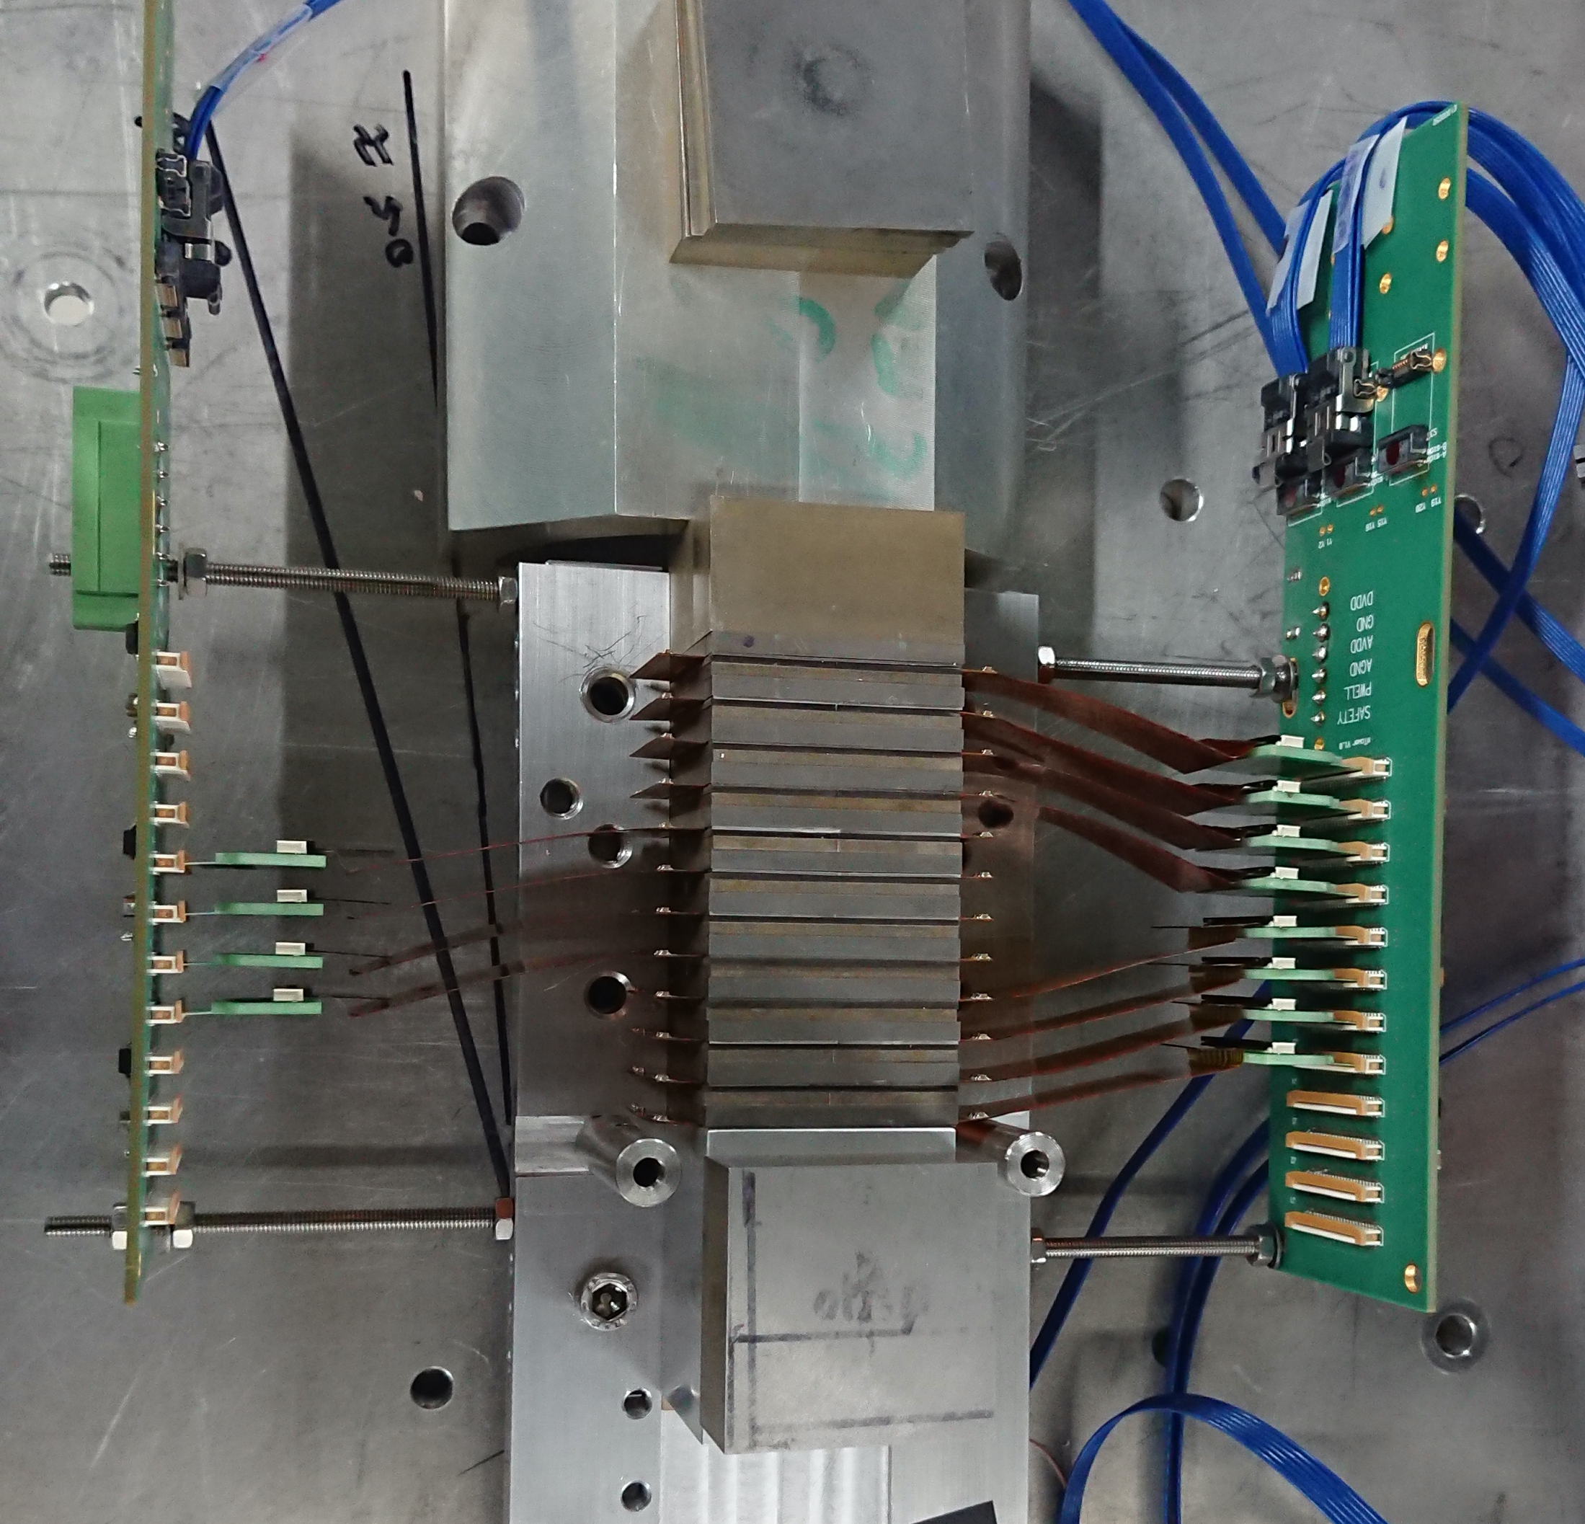
Future Opportunities (DECAL)
EpiCAL-2 prototype
Demonstrates high level integration possible
Using ‘off the shelf’ tracking sensor
Further optimise with new processes and sensor designed with calorimetry/reconfigurability
See e.g. Snowmass submission
SNOWMASS21-IF6_IF0-067

Slide 32
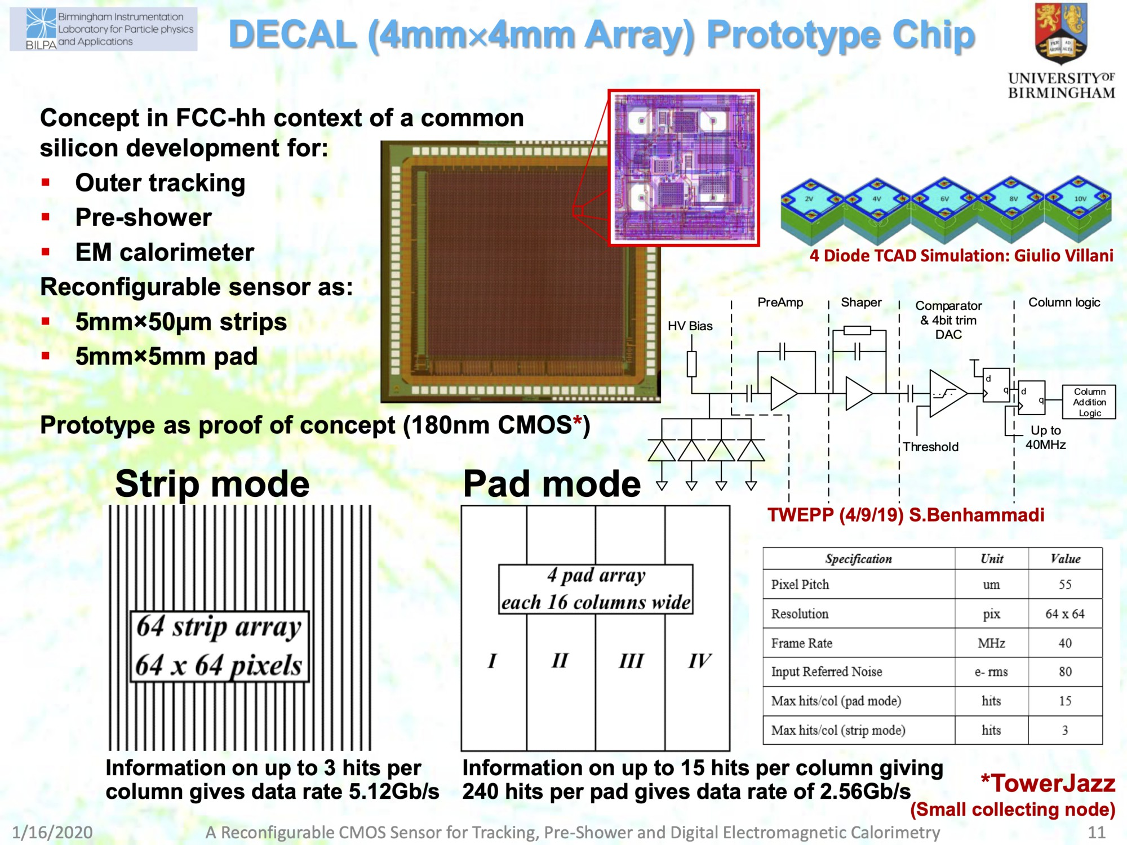
[c/o Phil Allport]
Notes:
Birmingham and RAL developing Rad Had, reconfigurable CMOS MAPS sensors, evolving into 65nm processes

Slide 33
Future Opportunities for UK - SiW
Si-W calorimetry can give excellent PFA performance
  Potential to use same technology for outer tracker/preshower/ECAL
Affordable Si-W (Si-Pb) calorimeters, need sensor costs ~ CHF/cm² (active areas > 10⁷cm²)
  Potentially achievable with CMOS MAPS technologies - large, expanding commercial market
Power needs study, CMOS estimates range ~50-100mW/cm² (no pulsing)
Prototype demonstrating concept of digital ECAL, in same CMOS line as CERN et al, can deliver radiation hardness to > 10¹⁵neq/cm²
Digital EM calorimetry, high potential for future e⁺e⁻ facilities
  Very fast charge collection, potential for triggering
  Ultra-high granularity can benefit physics as well as cost (boosted decays)
  Currently, UK (Birmingham) working with ALICE FoCAL/pCT groups on EpiCAL-2
  Perfect time to lead this novel concept for future projects

Slide 34
Outlook - calorimetry
There are many opportunities in both PFA and Dual-Readout calorimetry for future collider experiments
UK is already contributing in major ways in both areas
  DECAL (CALICE-like) with MAPS technology
  Dual-calo R&D (IDEA)
There are many possibilities for new UK collaborators to make leading contributions
  Hardware development
  Software/Simulation
  Substantial expertise from past and ongoing projects

Slide 35
Backup

Slide 36
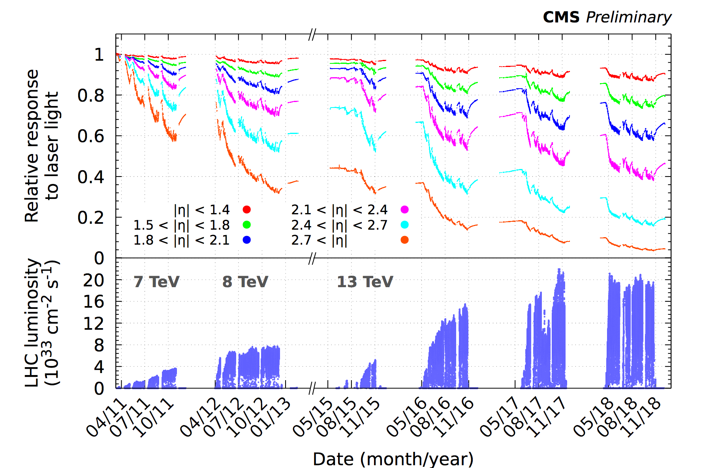
ECAL Calibration challenges
Significant response changes (crystal + photodetector) due to LHC irradiation
  on both short (few h) and longer timescales (EM and hadron damage to ECAL crystals)
Need for both short term and long term corrections - both online and offline
  via dedicated laser monitoring system (corrections within 48h)
  and physics-based calibration using π⁰/η, minimum bias, W, Z events
  special attention must be devoted to high eta region (with largest losses) to prevent biases in jets and MET
Run 1
Run 2
Barrel
endcap region covered by CMS tracker
endcap region relevant for forward jets
These corrections are crucial to maintain stable ECAL energy scale and resolution over time. Requires a dedicated team during LHC operations
Lesson learned - do not underestimate this challenge!

Slide 37
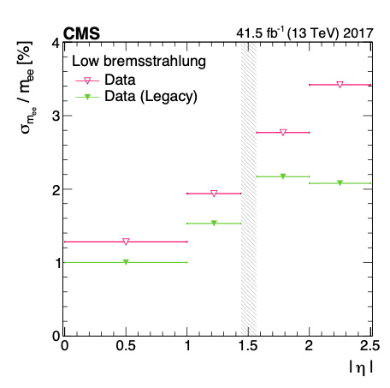
Importance of recalibration
Refined physics-based calibrations using full dataset are derived at the end of each running year
  these are required to obtain optimal energy resolution in all regions of the detector
    they correct for time-dependent drifts in calibrations
Di-electron Z mass resolution before and after end-year recalibration
Lessons learned:
Do not assume that calibrations remain constant!
many relevant observables (pedestals, signal pulse shapes, channel response) can be affected by irradiation and require frequent calibration updates to maintain optimal pulse reconstruction, energy and timing resolution
Note that resolution vs eta largely follows distribution of upstream tracker material:
need to minimise this in future detector designs to preserve intrinsic ECAL resolution

Slide 38
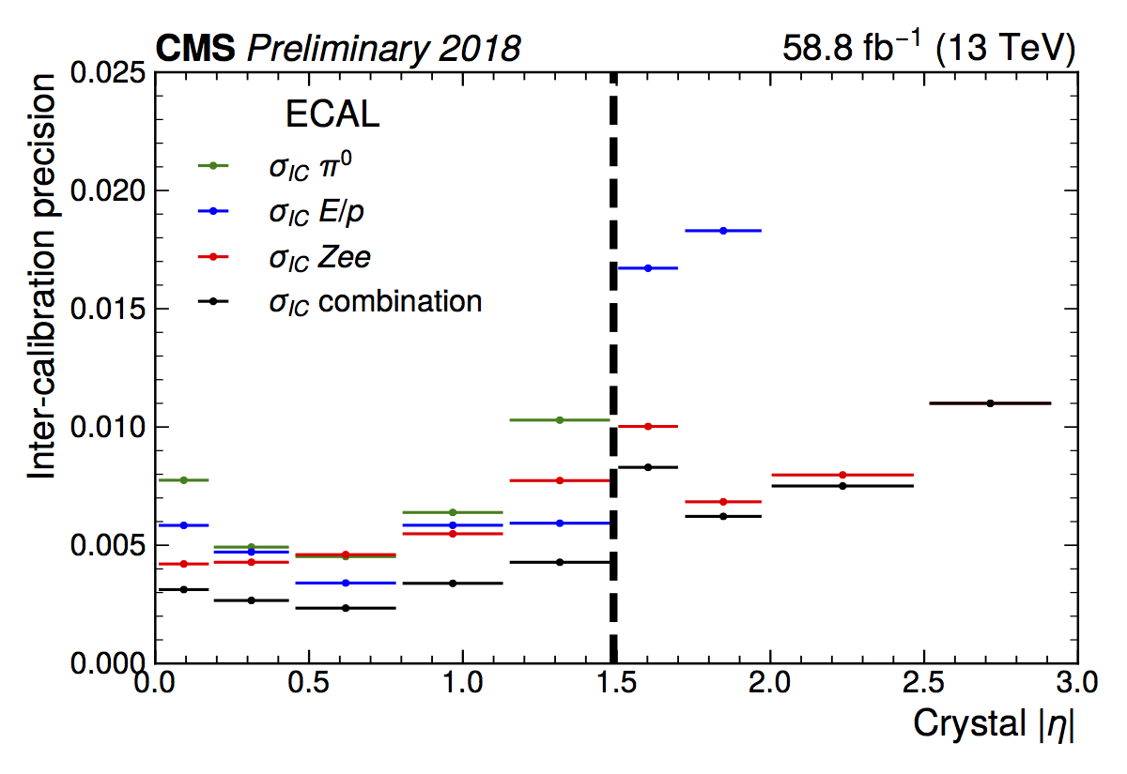
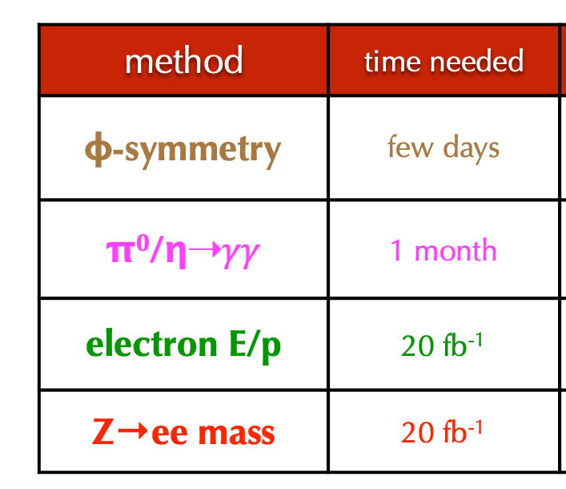
ECAL Calibration methods
ECAL intercalibration sources
physics data are used to equalise the response of each channel in EB and EE
ECAL intercalibration precision
Dedicated calibration streams (with limited event content) are used to collect enough stats.
Can achieve precision of better than 0.5% in EB and 1% in EE with a combination of calibration methods
Lessons learned:
Maintain multiple calibration methods
CMS ECAL experience:
  1) calibration methods involving low energy signals (π⁰/η, phi-symmetry) are affected by noise and pileup (these methods were not usable for |eta|>2.0 in 2018)
  2) some methods (phi-symmetry, E/p from W→eν) suffer from systematics due to uncertainties in tracker material distribution in phi
  3) Z→ee proved to be the most effective all-purpose calibration method in Run 2

Slide 39
ECAL spikes
Anomalous signals (“spikes”) unexpectedly observed in ECAL Barrel: large apparent energy deposits with non-physical topological and timing signatures
Caused by direct ionisation of APD active volume by collisions products (chiefly hadrons/pions)
Mitigation was challenging, especially for L1 trigger:
  no possibility to cure at source - APDs inaccessible
  spikes will typically hit one of 2 APDs serving one ECAL crystal. However, decision was made to sum these signals rather than read them out individually to reduce cost
  eventually found a way to remove spikes using extra unused feature of ECAL front-end ASIC
ECAL APD “spike”
ECAL APD capsule
single ECAL channel with 600 GeV equivalent energy
ECAL energy deposits
        Lessons learned: Must rigorously check system in test beam campaigns. Self-triggering would have revealed this problem. Build sufficient flexibility in on-detector and off-detector electronics to deal with unexpected signals. Add redundancy to readout signals?

Slide 40
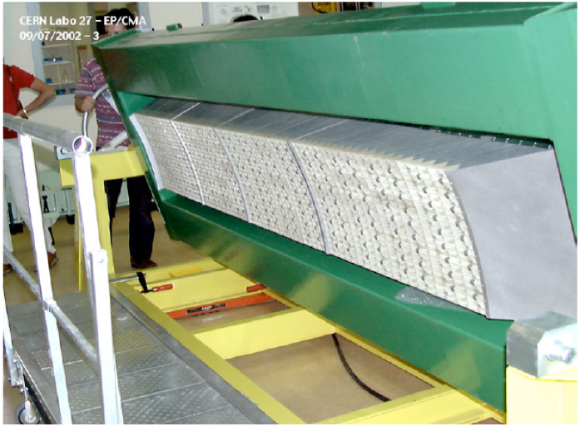
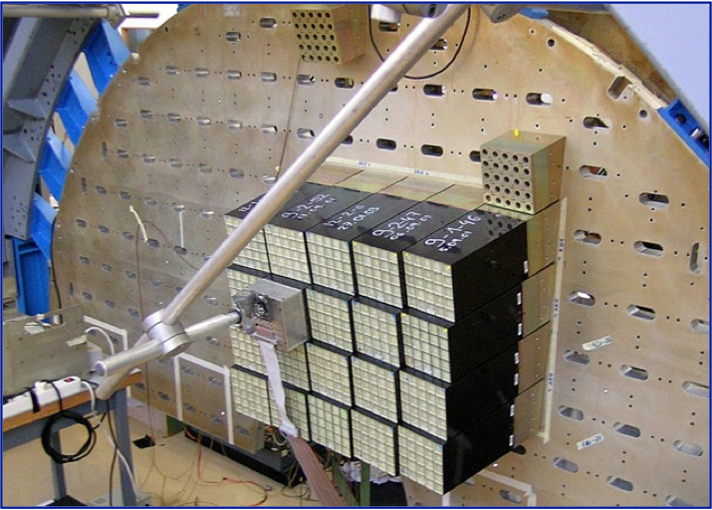
ECAL mechanics
Significant differences in mechanical design of ECAL Barrel and Endcaps
  barrel design incorporated 17 different module types and 17 different crystal shapes
  endcap design involves a single module type and one crystal shape
This has implications for crystal production and detector construction
  much simpler if you only have to deal with a single module/crystal type
Should also consider possibility for partial dismounting/replacement of modules
  ECAL was not designed with this possibility in mind - partial dismounting difficult/impossible
  might be a desirable feature for future detectors if certain regions need to be removed/replaced due to large radiation-induced response losses or other performance issues
Barrel mechanics: 17 crystal types
Endcap mechanics: 1 crystal type

Slide 41
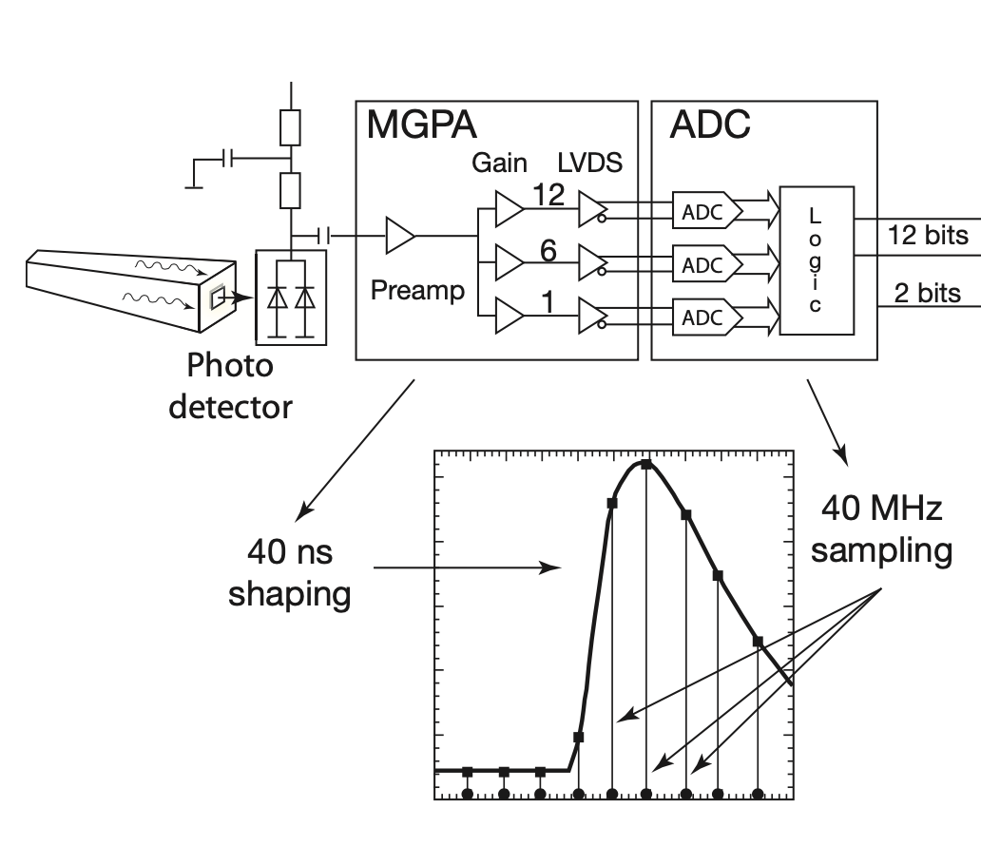
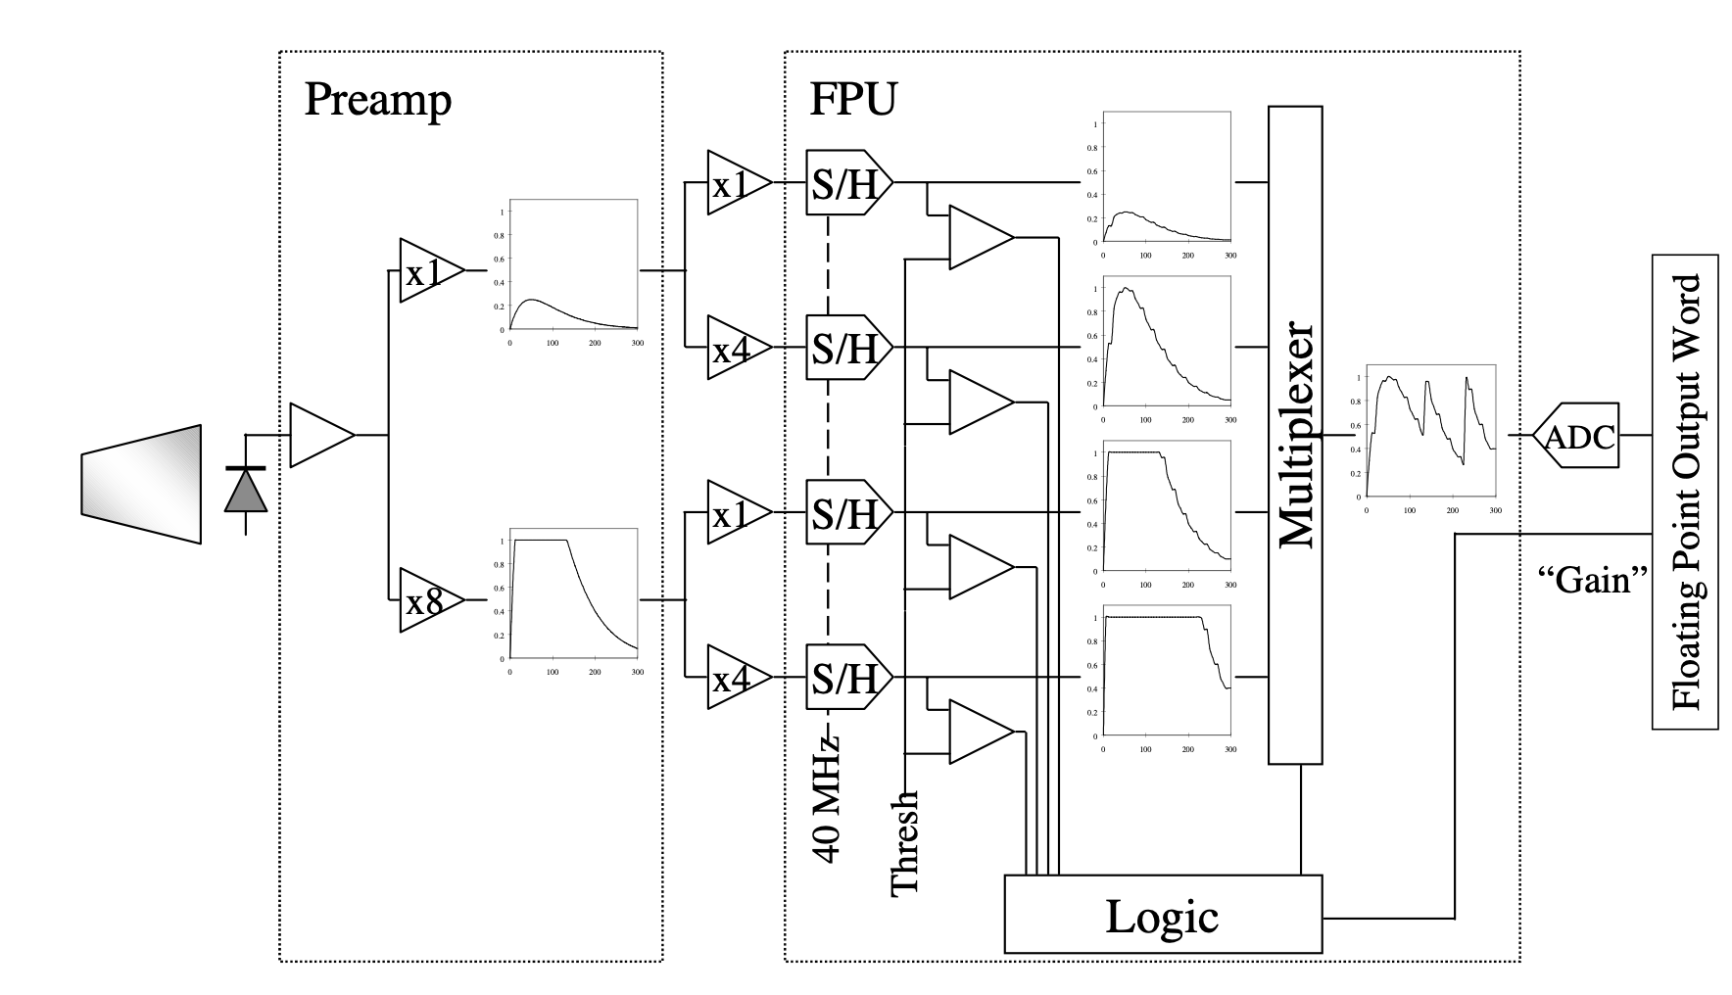
ECAL ASICs
UK involvement in ECAL very-front-end ASICs came about due to noise/performance problems with the original TDR designs
Original preamp and ADC designs had to be dropped and new ASICs developed from scratch
Final very-front-end design
TDR very-front-end design
        Lessons learned:
        Issues with ASICs are not uncommon in HEP - but problems can be minimised by careful and conservative design methodologies. Early full-system tests with detector prototypes are a must to check system performance and identify any noise issues in a realistic data-taking environment

Slide 42
ECAL crystals are capable of precise timing
CMS ECAL crystals and APDs are capable of providing precise timing information
  intrinsic timing resolution: ~20 ps
ECAL timing distribution system was not designed for sub-ns timing measurements
  achieved timing resolution is ~150ps, limited by timing distribution to front-end boards
Phase-2 upgrade prioritises precise timing resolution
  Crystals and APDs will remain in Barrel
  ECAL will use a redesigned front-end preamp and ADC to minimise pulse shaping and over-sample signal pulse
  dedicated timing distribution system to achieve 30ps resolution
  ageing (APD noise increase) gradually degrades performance
ECAL time resolution measured from test beam
Phase-2 ECAL time resolution vs luminosity

Slide 46
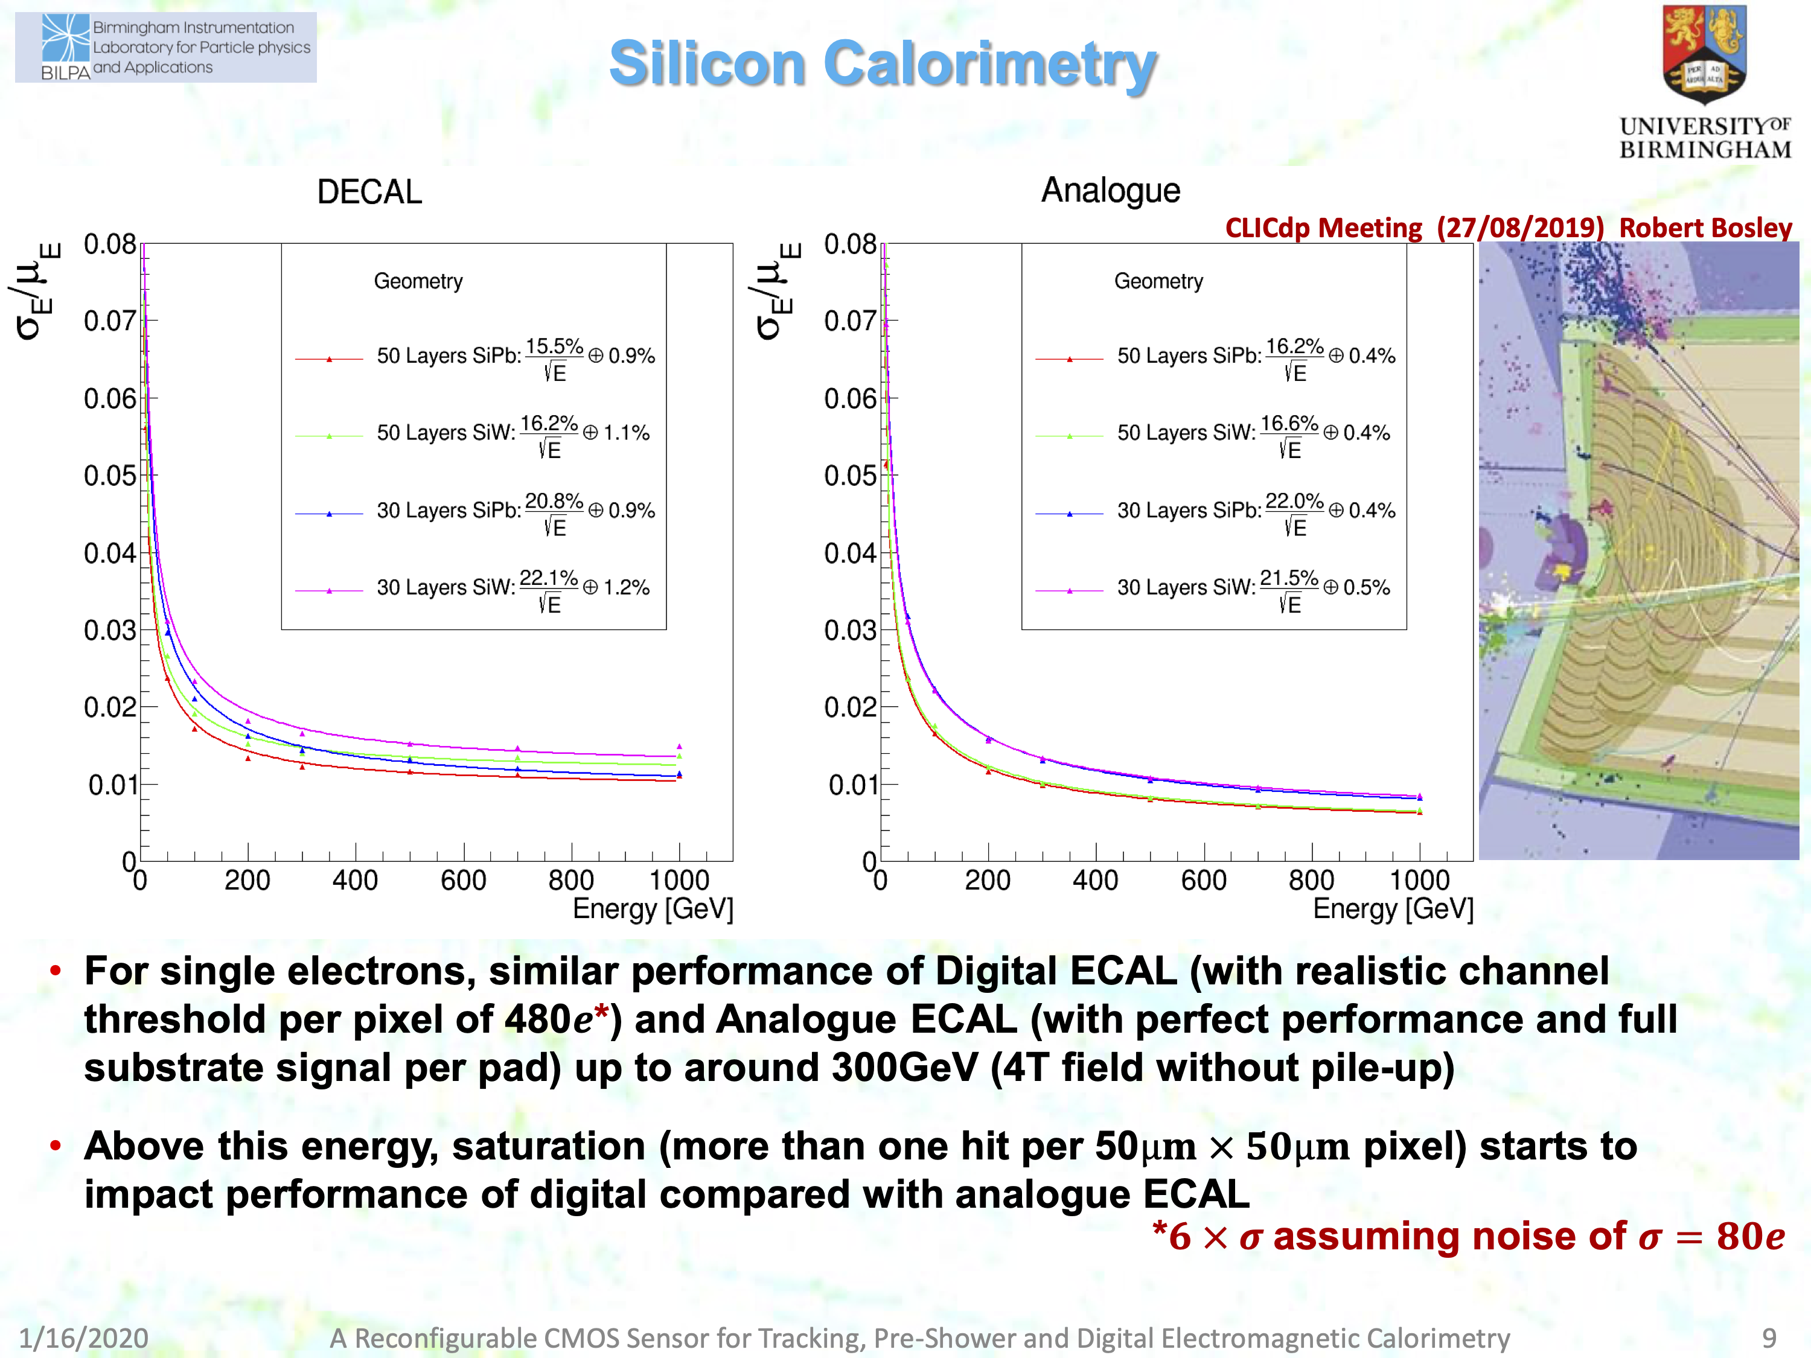
DECAL in full G4 CLIC
Comparable performance to analogue SiW
[c/o Phil Allport]
Notes:
Implemented in full geant4 models of CLIC detector, resolution comparable up to 300 GeV. At higher than ~300 GeV single particle energy, the DECAL has a risk of of saturating: too high a particle density in the core of an EM shower and you are not sensitive to higher energies as each pixel only registers a single hit. If you put in more than one bit per pixel, this problem would be reduced but that needs more memory per pixel and would generate more data volume to read out. In all scenarios, you would have zero suppressing at the front end and having a low noise level per pixel is critical: If you have 10^{11} or more pixels, you want to keep noise level at the 10^{-5} level or lower.

