Slide 1
International nuSTORM and muon collider projects status

Slide 2
Building on Our last community meeting;
Nov20 … preparation of submission to PPAP
International nuSTORM and muon collider projects status

Slide 3
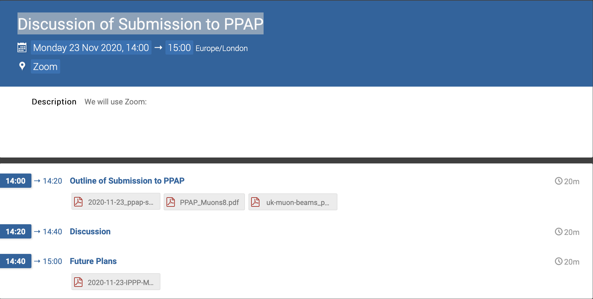
Building on previous community meeting
Established UK interest
Agreed PPAP submission:
  And proposed development of:

Slide 4
The physics case (reprise)
International nuSTORM and muon collider projects status

Slide 5
The Standard Model and beyond
Energy frontier: big advantage over pp because fundamental fermion
Future study of the Higgs:
  Line width; establish single resonance (?) in s-channel with μ⁺μ⁻
  Couplings; requires > 1 TeV for complete, precise study

Slide 6
Neutrinos from stored muons
Scientific objectives:
  %-level (ν_{e}N) cross sections
    Double differential
  Sterile-neutrino/BSM search
    Beyond Fermilab SBN
Precise neutrino flux:
  Normalisation: < 1%
  Energy (and flavour) precise
π ⇢ μ injection pass:
  “Flash” of muon neutrinos

Slide 7
The international Muon Collider Collaboration
International nuSTORM and muon collider projects status

Slide 13

https://muoncollider.web.cern.ch/welcome-page-muon-collider-website

Slide 14
International nuSTORM collaboration update
International nuSTORM and muon collider projects status

Slide 15
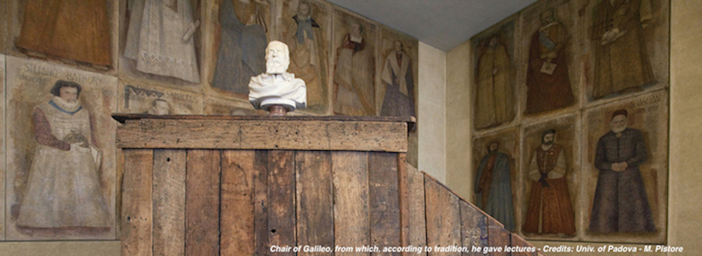
nuSTORM science
XIX International Workshop on Neutrino Telescopes
C. Rogers

Slide 16
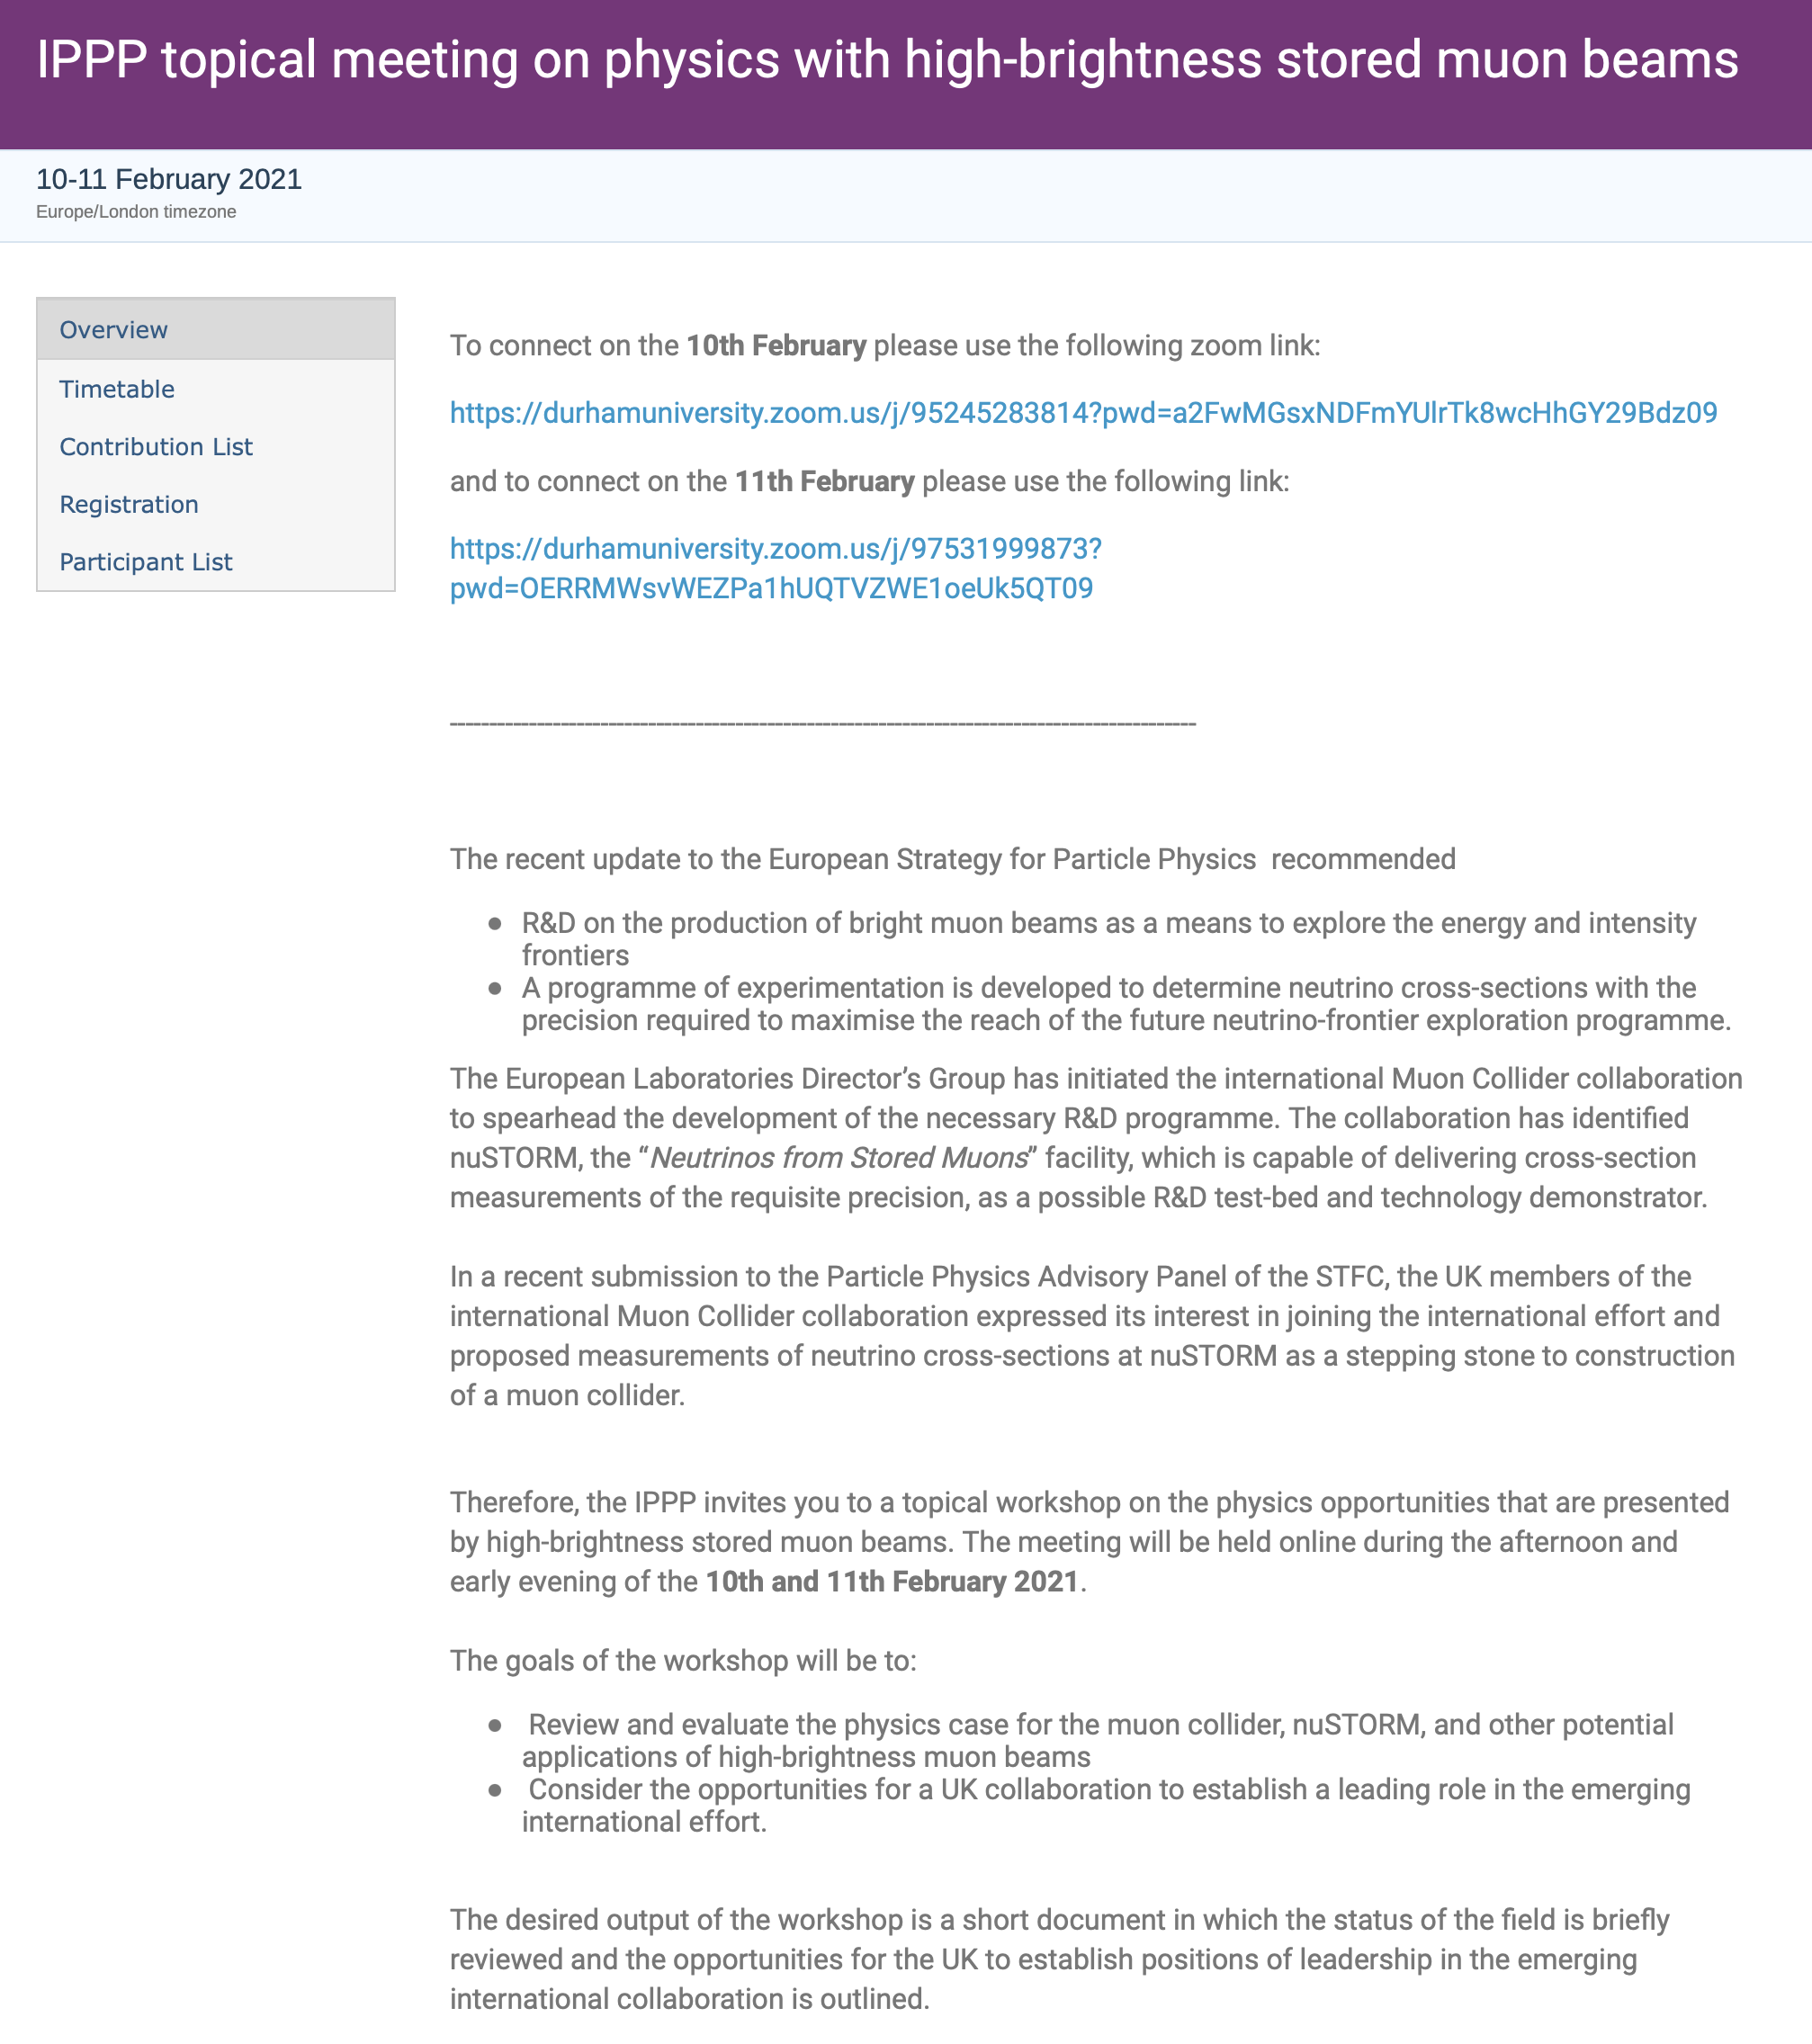
Good start!
Reviewed needs of neutrino programme
& opportunities at the energy frontier
→ Need to quantify benefits …
An important step!
Enthusiasm and interest in community
(e.g. ~60 participants at this workshop)
→ Our ambition …

Slide 17
Agreed during discussion …
Organisers draft 2-pager to:
— Summarises opportunities
— Provide “mandate” for longer workshop
for which ”proceedings” would form
a “white-paper vision” for development of
programme

Slide 19
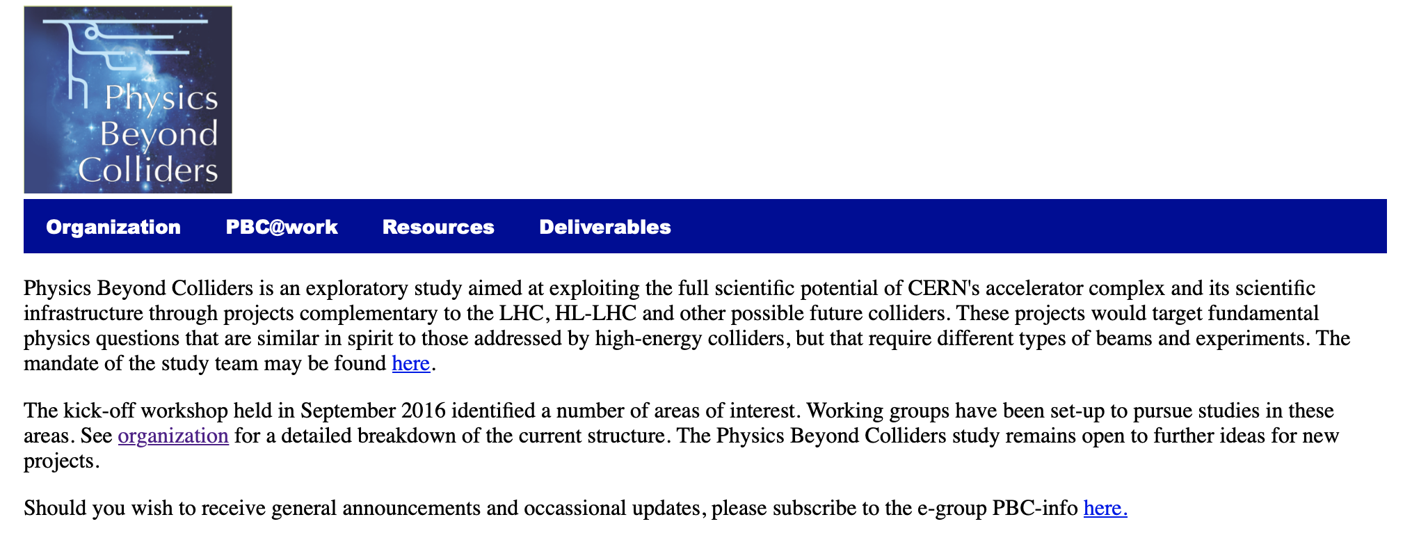
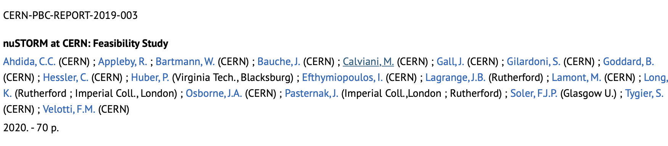
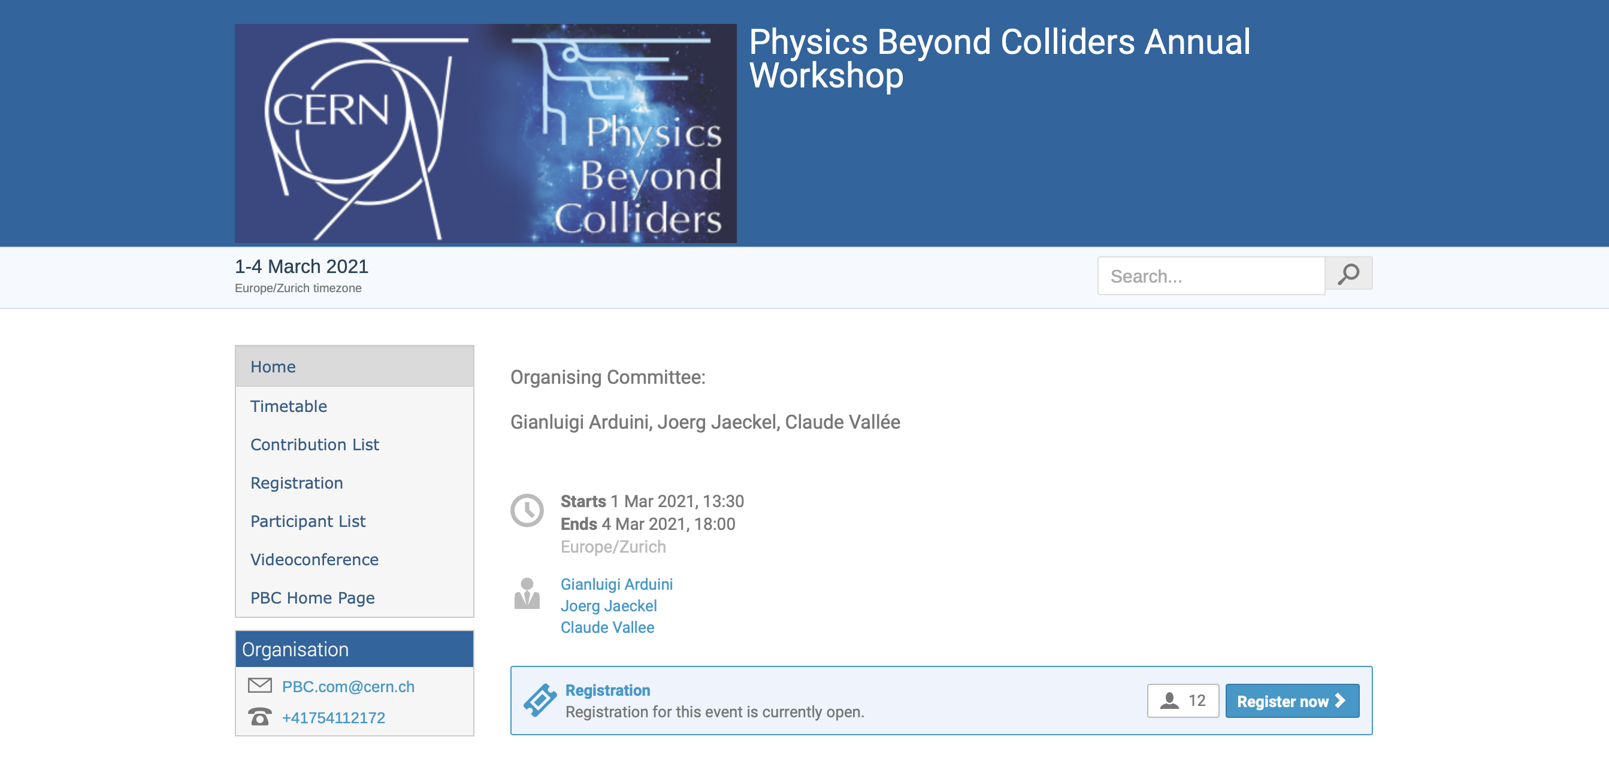
https://pbc.web.cern.ch
https://indico.cern.ch/event/1002356/
Pitch for nuSTORM/ENUBET:
nuSTORM:
Cross sections
BSM with nuSTORM
Demonstrator/accelerator
science test facility for mc

Slide 20
Scientific synergy ENUBET/nuSTORM

Slide 21
Scope
Going forward:
  ENUBET/nuSTORM part of PBC study

Slide 22
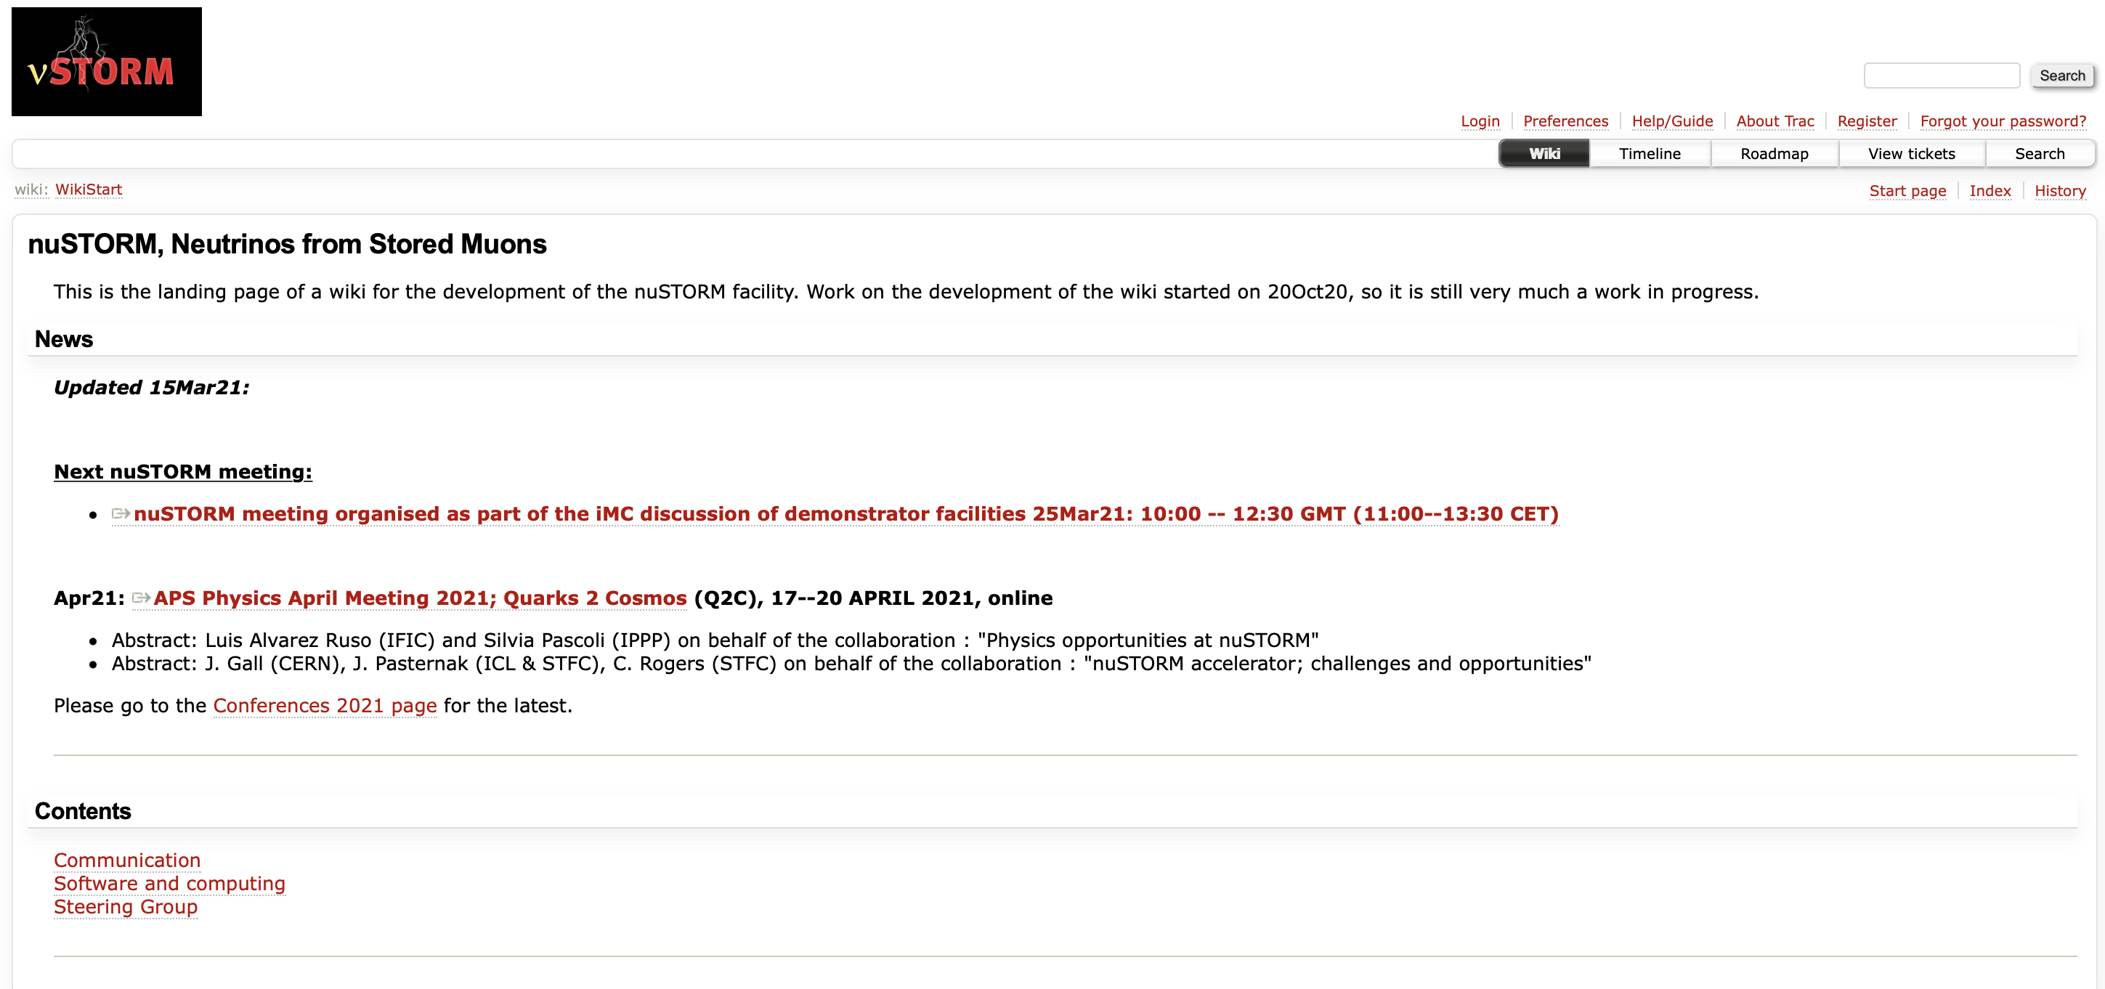
https://www.nustorm.org/trac/

Slide 23
Muon collider demonstrator(s)
International nuSTORM and muon collider projects status

Slide 24
Muon Collider: system/technology demonstrators
Energy frontier and neutrino physics
Collider and neutrino detector development
Accelerator key systems/technology issues:
  High power, pulsed proton beam
  Pion production target and capture:
    Target, high-field solenoid capture
  6D ionization cooling to achieve luminosity goals:
    High-field solenoids, compact lattice
    High-gradient RF in magnetic field
  Rapid acceleration:
    RCS or FFA
  Collider ring:
    Combined function magnets
    Beam protection
    Strong focusing at IP and maintenance of short bunch length

Slide 25
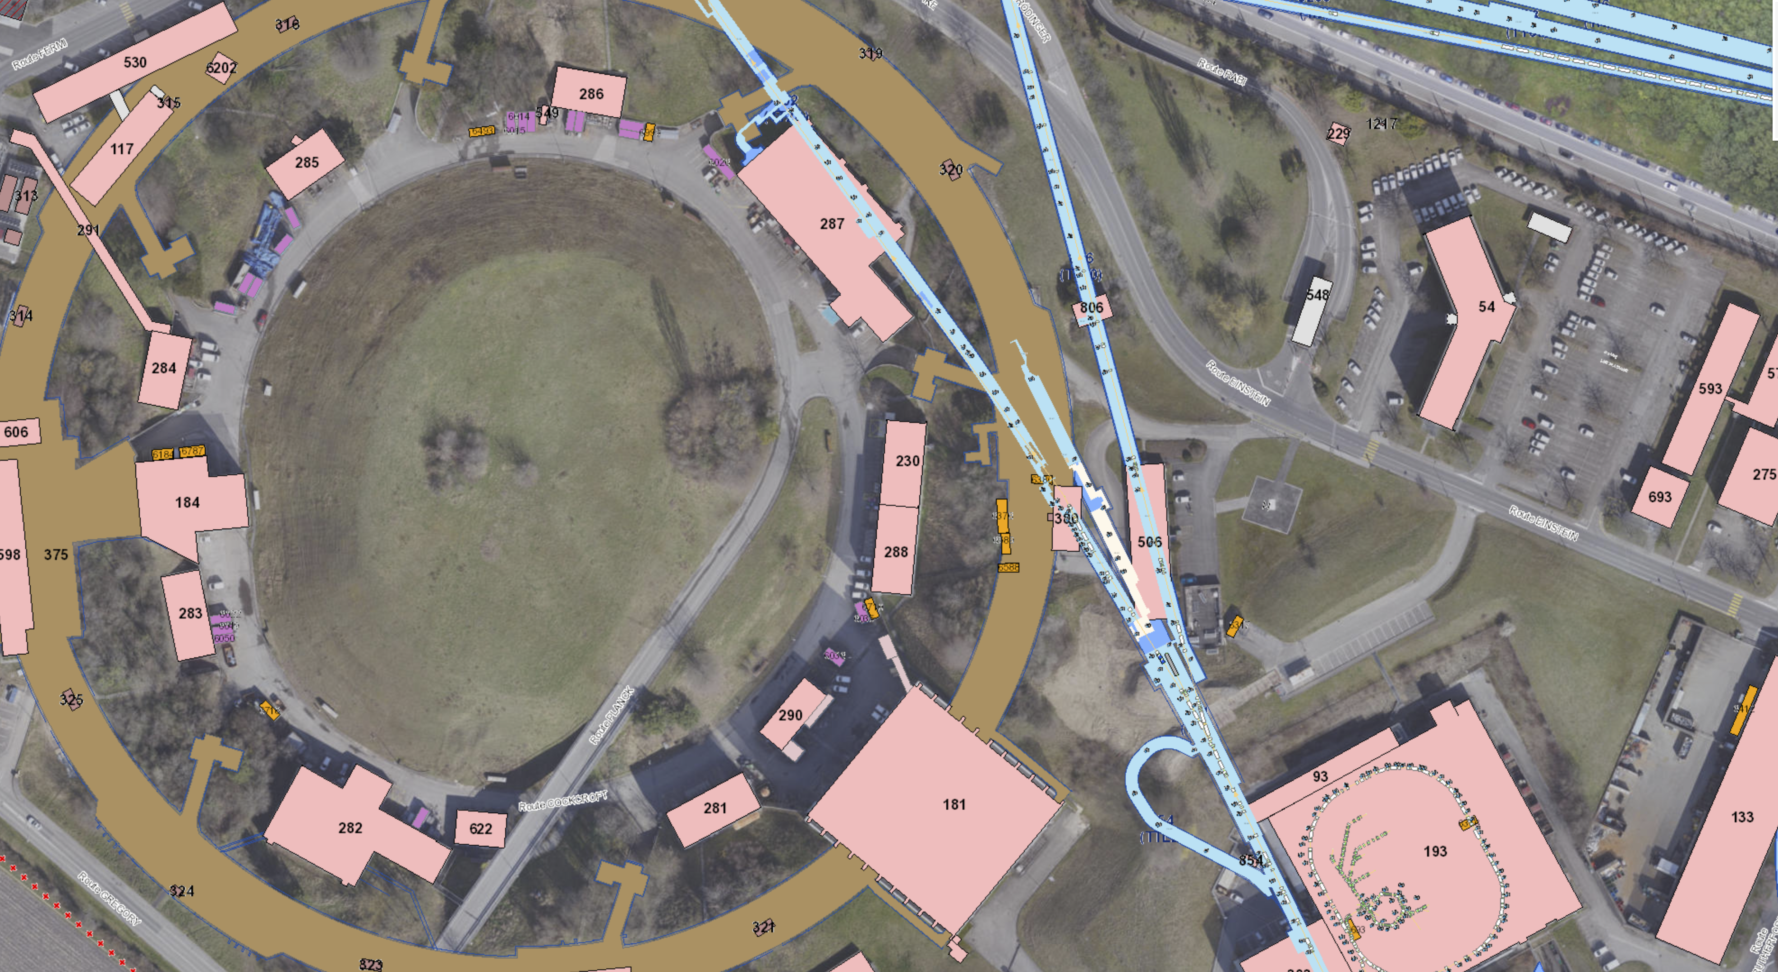

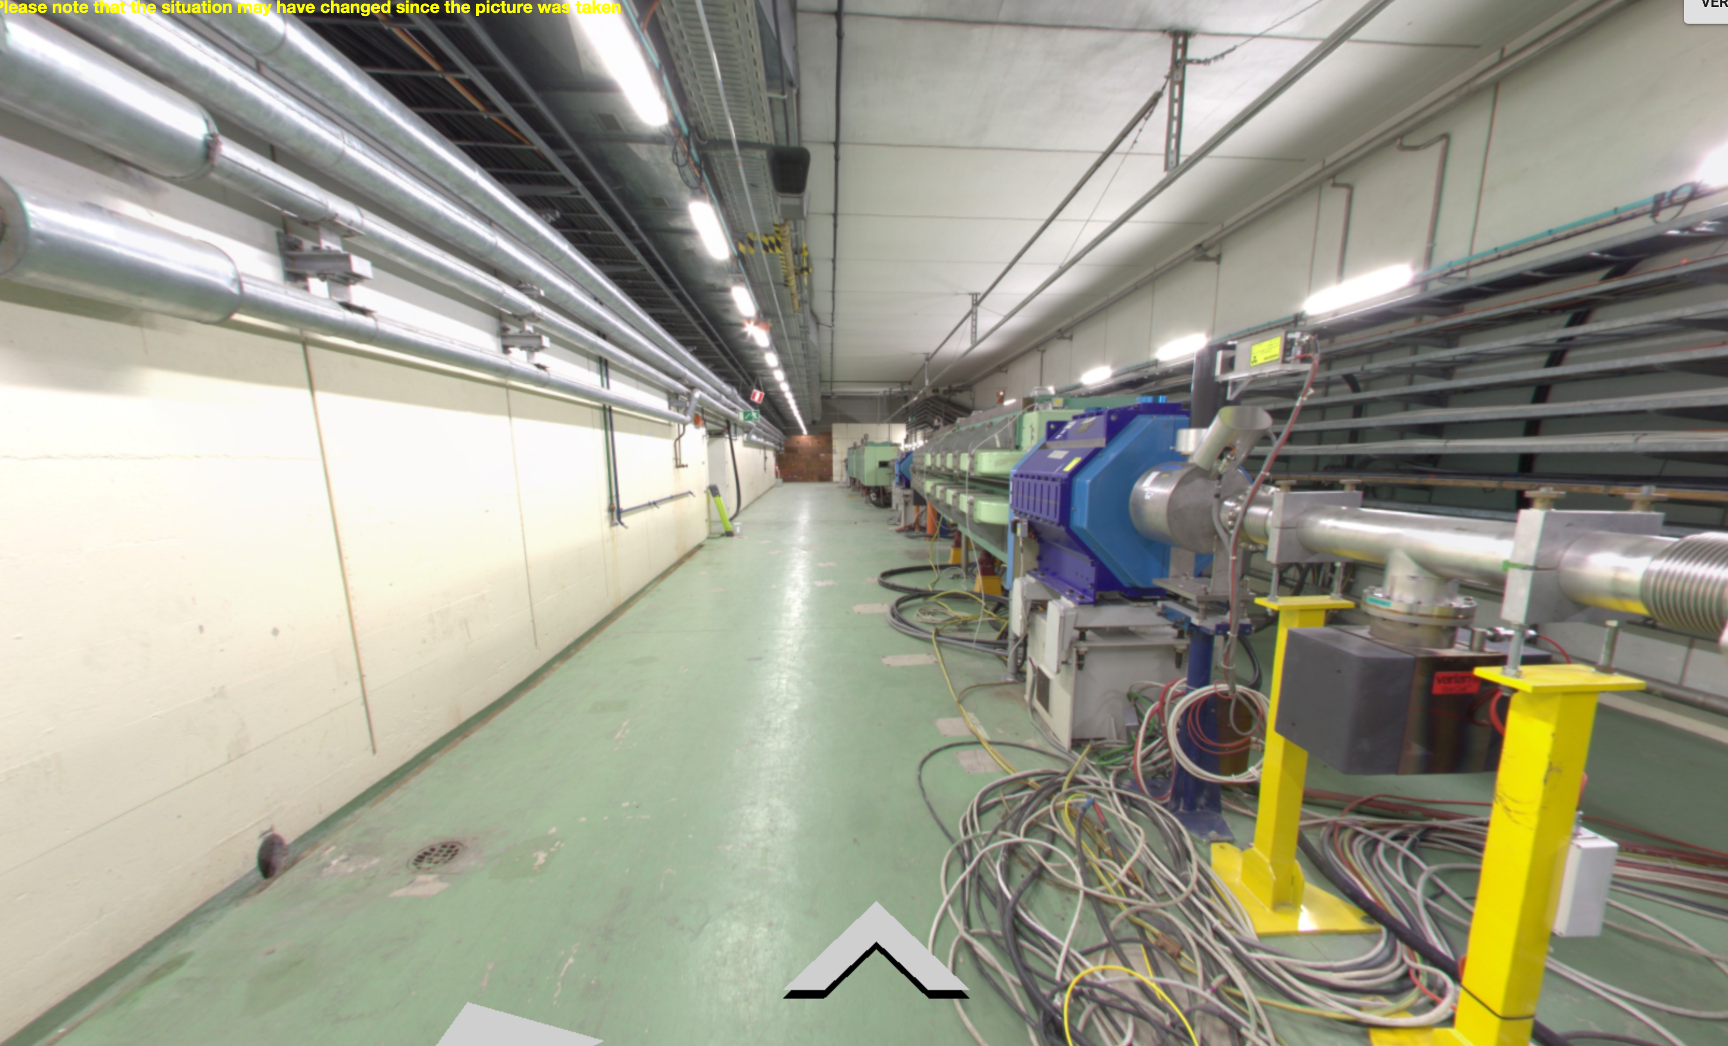
TT10 line to SPS
100 m
MUC Test Facility
Cooling
Target
70 m
Transfer line from TT2
n_TOF target
Extraction to be foreseen before D3
±150 m
D3 dump
M. Calvini (CERN)

Slide 26
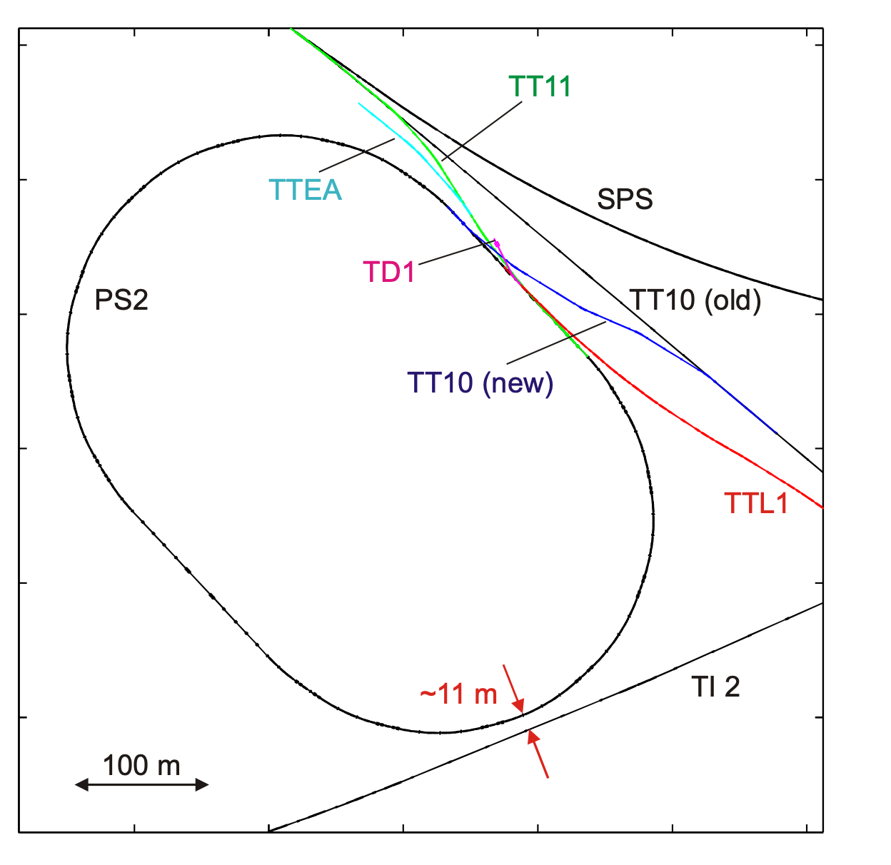
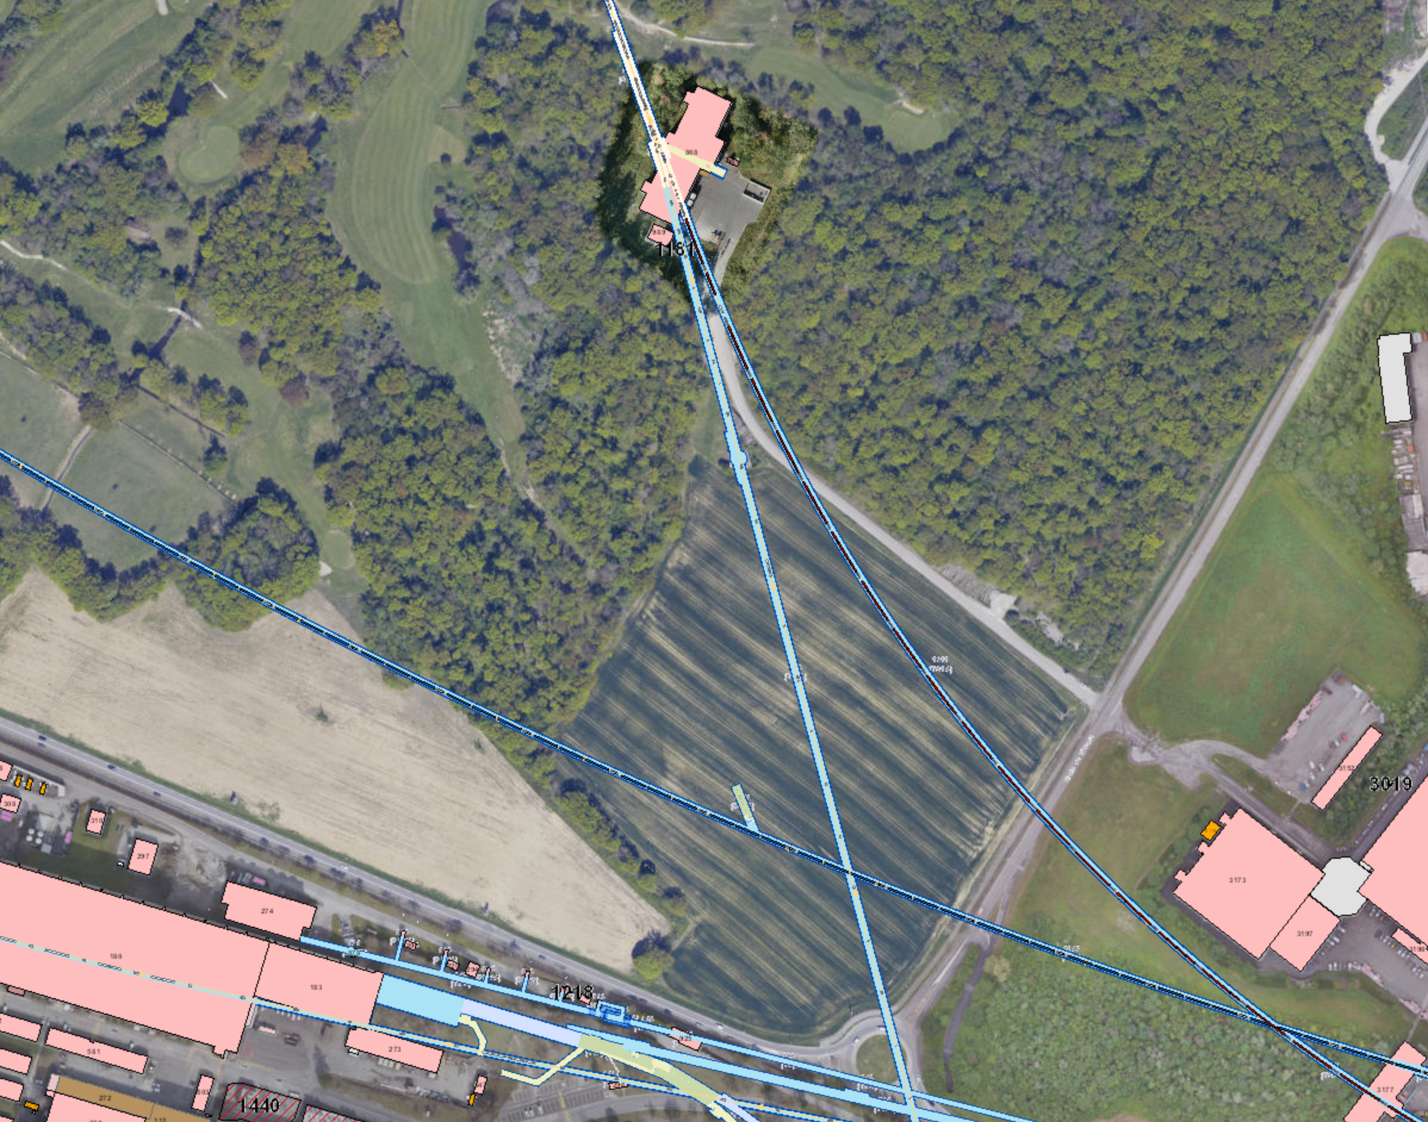
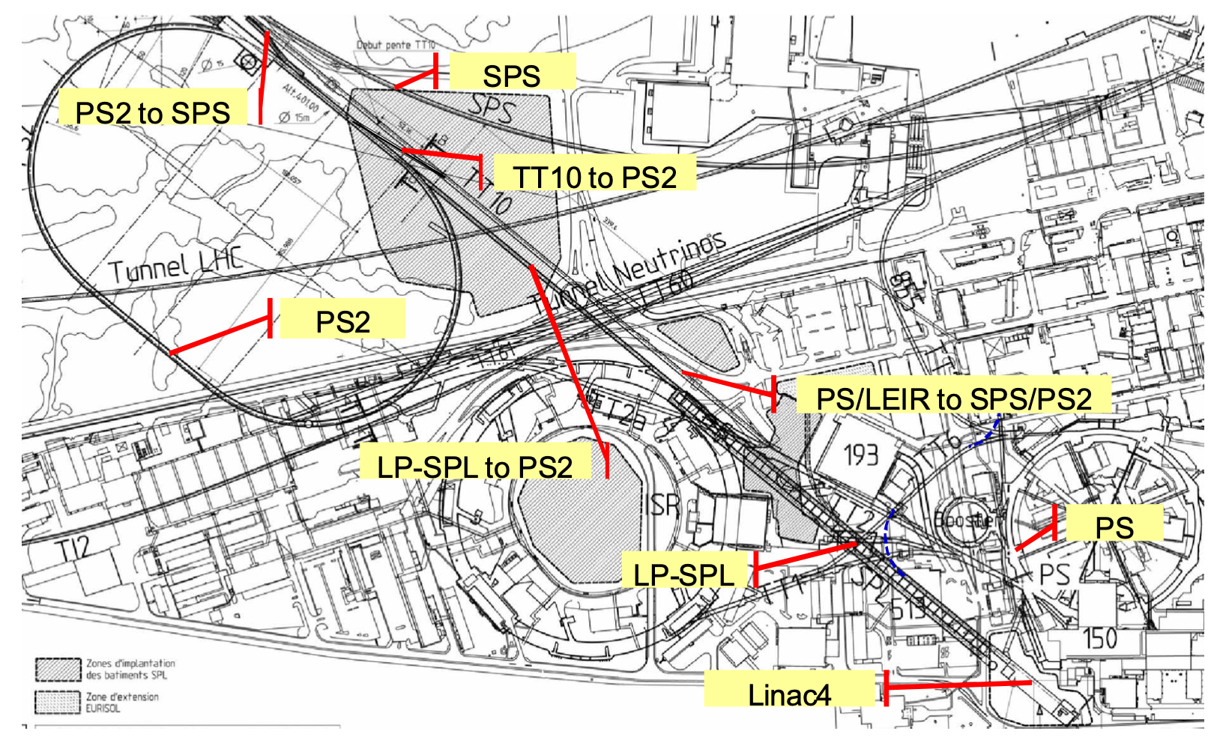
Possibility around TT10
100 m
BA1
MUC Test Facility
sLHC Project Note 0013
200 m
SPS
SPS
TT10 line to SPS
M. Benedikt, LHC Performance Workshop, Chamonix 2010
CERN-AB-2007-061
Dimension & location indicative

Slide 27
6D cooling demonstrator
MICE demonstrated (4D) ionization cooling principle
Now require 6D cooling demonstrator
  Options:
    Rectilinear channel
    Ring cooler

Slide 28
What should we, UK, DO?
International nuSTORM and muon collider projects status

Slide 29
Muon Collider: system/technology demonstrators
← UK strength
Energy frontier and neutrino physics
Collider and neutrino detector development
Accelerator key systems/technology issues:
  High power, pulsed proton beam
  Pion production target and capture:
    Target, high-field solenoid capture
  6D ionization cooling to achieve luminosity goals:
    High-field solenoids, compact lattice
    High-gradient RF in magnetic field
  Rapid acceleration:
    RCS or FFA
  Collider ring:
    Combined function magnets
    Beam protection
    Strong focusing at IP and maintenance of short bunch length
← UK strength
← UK strength
← UK strength
← UK strength
← UK strength

Slide 30
Framework in which to develop UK contributions
Framework established in Nov20 remains excellent basis

Slide 31
And finally, a shameless plug …
Upcoming nuSTORM and Muon Collider meeitngs:
  nuSTORM:
    17May21, 28Jun21, 09Aug21, and 20Sep21
  Muon Collider:
    20/21 May21

