Slide 1
NBI 2022
Tour details & Close-out
Chris Densham
Notes:
The abstract pattern can be removed or repositioned if required. Be careful to ‘Send to Back’ so that it does not obscure any important information.

Slide 2
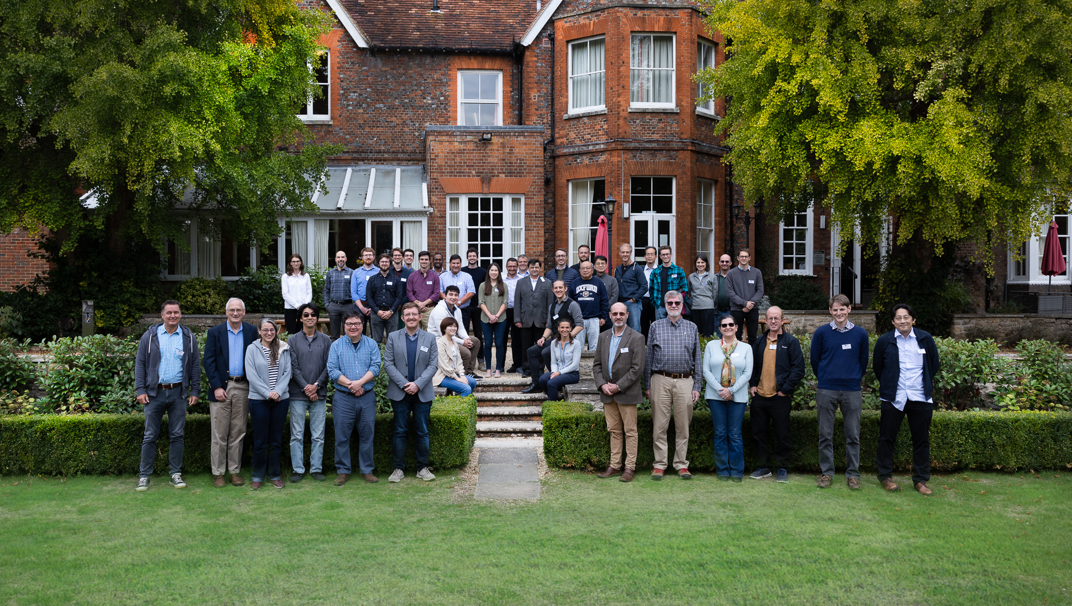

Slide 3
Thursday/Friday transport to RAL
Transport has been arranged for Thursday for those who have requested a tour at either Rutherford Appleton Laboratory or Culham Laboratory
Transport has also been arranged for all those registered for the RaDIATE meetings at RAL on Thursday afternoon and Friday
Pick-up and drop-off will be from Cosener’s House and is arranged for visitors only (ie not for RAL or Culham staff)
Eric Harvey-Fishenden will coordinate the taxi queue – please be ready
Pick-up for return from RAL will be at same place as drop-off – RAL Reception

Slide 4
Thursday/Friday transport to RAL (2)
Pick up to/from Cosener’s House is as follows:
Thursday at 07:50 for guests travelling to RAL for the tour
Thursday at 09:10 for guests travelling to Culham for the MRF tour
A return trip departing at 11:30 has been organised to RAL for the RaDIATE lunch and afternoon meetings.
Thursday at 11:30 for guests travelling to RAL
Thursday at 17:15 for guests travelling back to Abingdon (Cosener’s House) from RAL
Friday at 8:05 for guests travelling to RAL for RaDIATE meetings
Friday at 17:15 from RAL for guests travelling to Abingdon (Cosener’s House)

Slide 5
RAL Site Access for Thursday/Friday (RaDIATE)
Please wear your NBI name badge showing the UKRI/STFC Logo
Please ALSO bring photo ID (e.g. passport) – mandatory for Culham tour

Slide 6
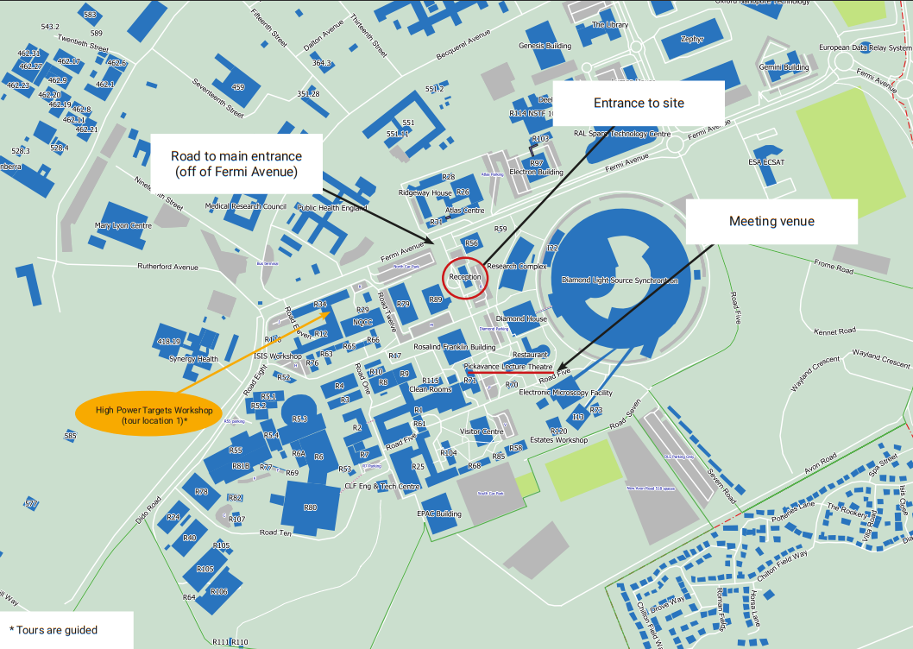
RAL
Site Map
ISIS TS1 foyer

Slide 7
NBI Close-out
Thanks to:
All speakers for sharing ideas and experiences so openly
Conveners for organising sessions
All participants both in person and remote – in particular for asking such good questions
Mike Fitton and Cat Lewin-Williams for all the preparations
Including dealing with some unexpected challenges

Slide 8
And finally – Open Discussion
We have a strong collaboration with centuries of experience within this room
Many new staff with new ideas
Who is missing?
Many similar technical challenges
Many similar, and many different solutions
What can we learn?
What can we do better?

Slide 9
Discussion points
Implement
Operations
Design
Design reviews
Possibility for ‘community’ reviews to select best technical approaches and design concepts?
Manufacture, production and other reviews?
Operations (Alex Gottburg)
How to best incorporate operational experience into designs?

