Slide 1
The HiRadMat Facility and the EURO-LABS Initiative
Carlo A. Mussolini
CERN (BE-EA)
N. Charitonidis
CERN (BE-EA)
P. Simon
CERN (BE-EA)
A. Ebn Rahmoun
CERN (BE-EA)

Slide 2
The raison d’etre
Envisioned in 2010 to “Test LHC collimators in conditions that are equivalent to accident scenarios in the LHC”
Same spill size and structure
Over 10 years more than 41 completed experiments
High-power targetry
Instrumentation
Detectors
Beam-intercepting devices
Machine protection

Slide 3
Why HiRadMat?
TT66 to
HiRadMat
TI2
to LHC
Only area which receives LHC-like beams:
1.5 ns bunch length
25 ns bunch spacing
Up to 288 bunches with 1.2·10¹¹ protons per spill
3.4·10 ¹³ protons per pulse at 440 GeV/c (2.4 MJ)
Other facilities at CERN are served by slowly extracted beams
HiRadMat is not an irradiation facility where high doses are being accumulated, rather a single pulse facility for the instantaneous effects of the beams on the materials
TNC
TNC
HRMT-57
MultiMat2

Slide 4
HiRadMat Facility
TT66 to
HiRadMat
TI2
to LHC
Designed for maximum flexibility:
Assembly, alignment and dry-running at the surface
Target area with remote plug&play connectivity with more than 300 signal connections per experiment
Pulse-to-pulse beam diagnostics enable grazing impacts with <100 µm precision
Shielded environments for sensitive equipment along high speed cameras and laser diagnostics
Short cabling length
Beam Diagnostics
Experimental table
Stand B
Stand C
TNC
TNC
HRMT-57
MultiMat2

Slide 5
HiRadMat Experiments Since LS2 and beyond
Facility upgrade for LIU intensities at HiRadMat
(up to 2.4×10¹¹ protons per bunch)
2021 |  | 2022 |  | 2023 |  | 2024
HRMT54 | EO-BPM | HRMT58 | ATLAS-ITk | HRMT62 | FIREBALL |  | DPA (KEK)
HRMT53 | CHEFT | HRMT55 | BLM3 | HRMT58 | ATLAS-ITk |  | HED-2 (CERN)
HRMT55 | BLM3 | HRMT59 | SMAUG | -- | SMAUG-2 |  | CRY3 (CERN)
HRMT57 | MultiMat2 | HRMT60 | RaDIATE2022 | HRMT26 | TPSG4-2
HRMT56 | HED | HRMT61 | SCcoils
≥1.6×10¹¹
protons per bunch
An upgrade study group is already working towards proposing upgrades to the facility for LIU-type beams
Deliver LIU beam intensity with identical beam spot sizes
Up to 2.4×10¹¹ protons per bunch
~Factor of 2 in beam density!
Experiments eagerly waiting for these kinds of beams
More about the upgrades tomorrow in N. Solieri’s talk

Slide 6
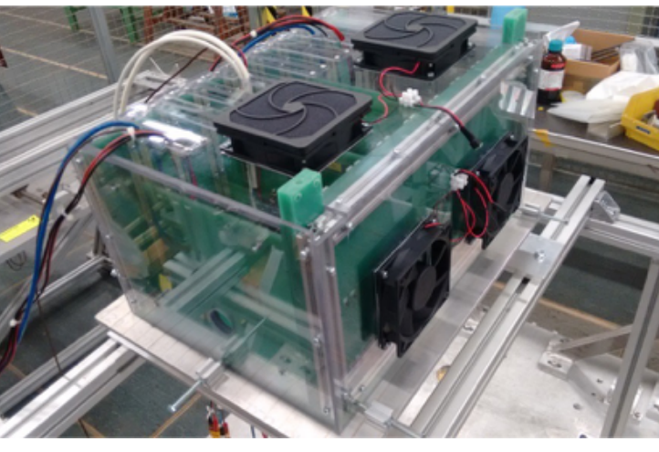
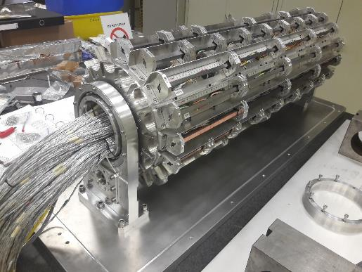
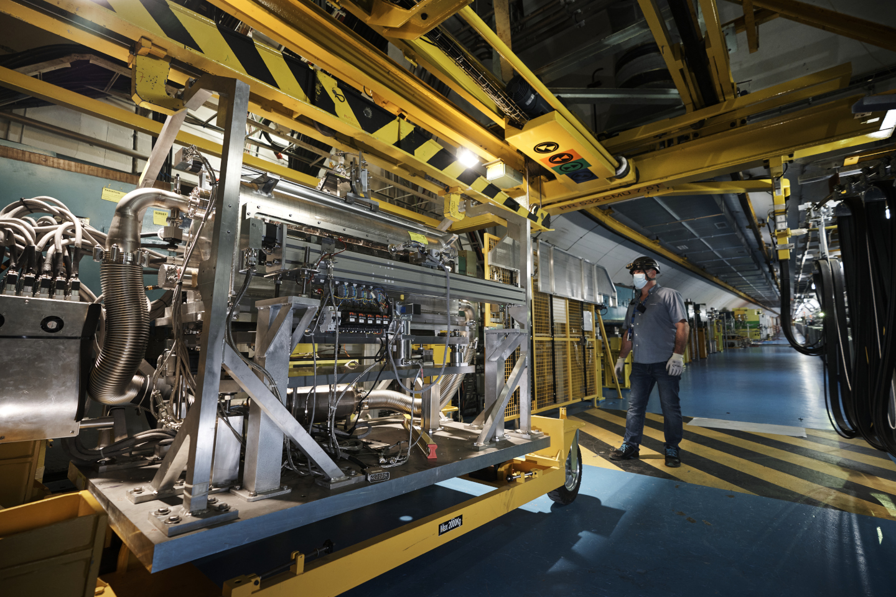
Highlights of some previous HiRadMat experiments

Slide 7
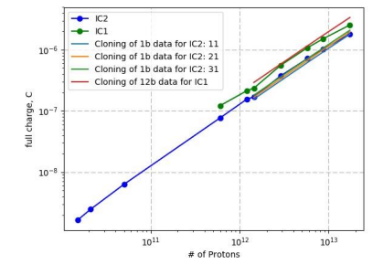
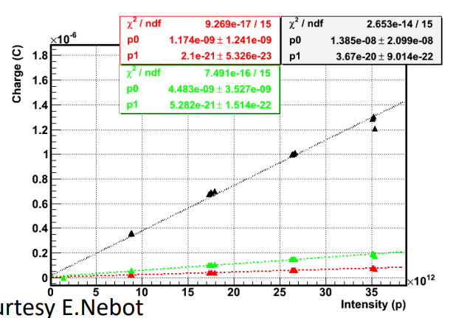
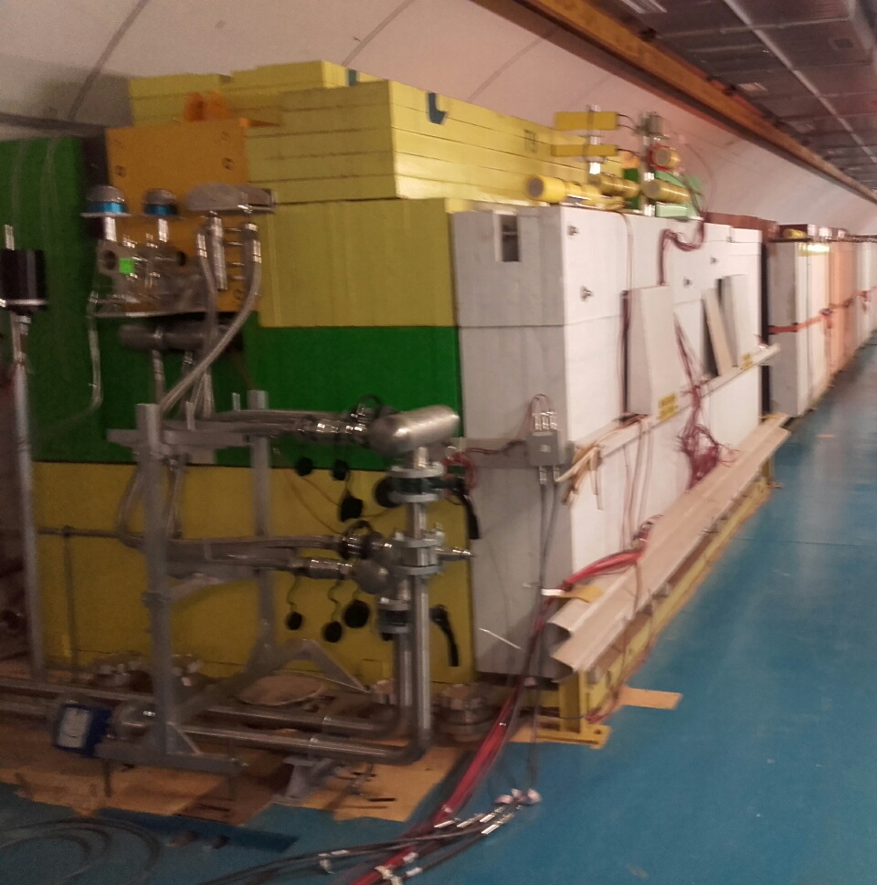
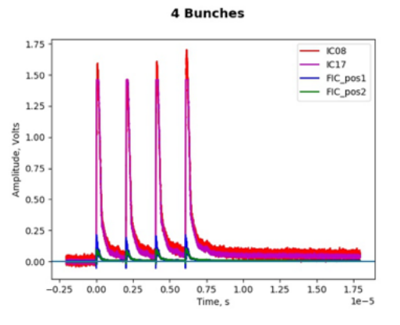
HRMT19 BLM2, HRMT55 BLM3 ESS
2008
2017 production
Validate and calibrate various beam loss monitors (BLMs) under real beam conditions
New series production of ionization chamber BLMs
R&D on ‘little ionization chamber’ for injection regions of (HL-)LHC
Critical infrastructure for beam diagnostics at ESS, GSI and CERN
Close to 1000 BLMs in the LHC alone
“After LS3, literally every 10 meters in the whole accelerator complex, from LINAC4 to LHC, there will be a bright yellow tube.”
On-going measurement campaign in 2022
- Ionization chamber
- Little ionization chamber
- Flat ionization chamber
V. Grishin et al. 2017 Proc. 6th Int. Beam. Instrumentation Conf. (IBIC’17) 454-57
V. Grishin et al. 2018 Proc. 26th Russian Particle Accelerator Conf. (RuPAC’18) 44-48.

Slide 8
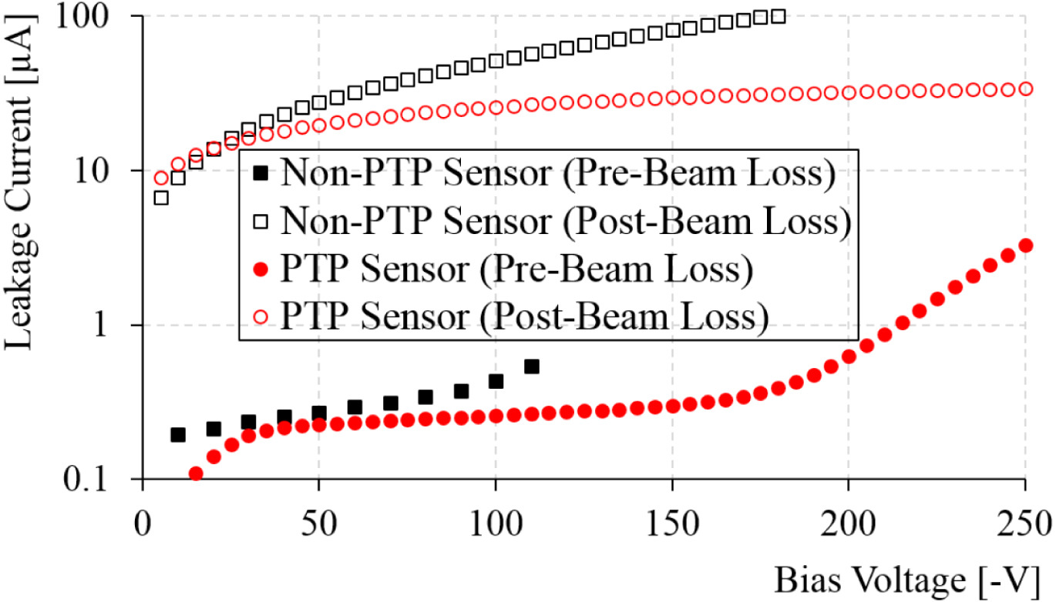
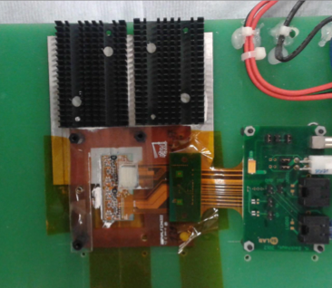
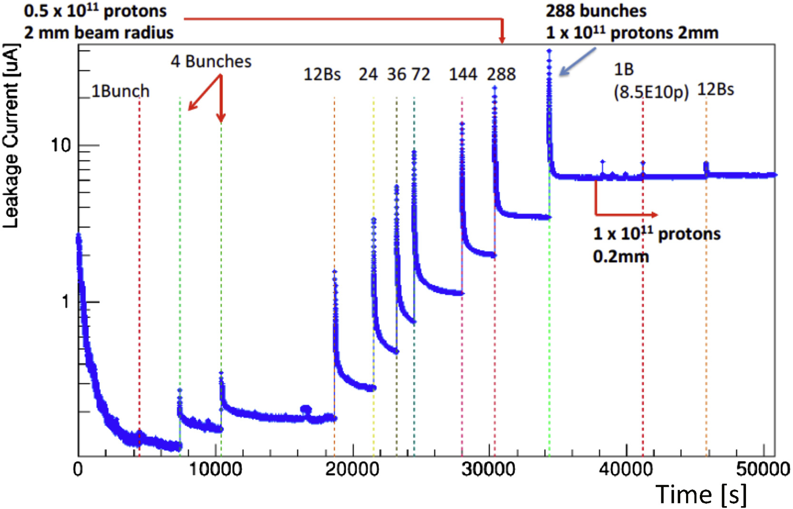
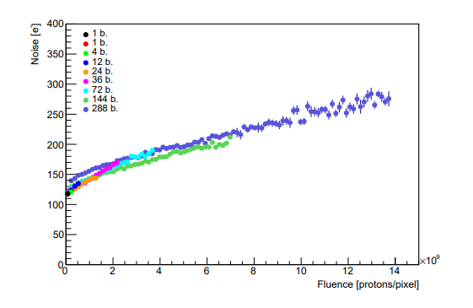
HRMT41/47 ATLASPixRad ATLAS Collaboration
C. Bertella et al. 2019 IL NUOVO CIMENTO 42 C 205
C. Bertella et al. 2019 JINST 14 C05024
J. Fernandez-Tejero et al 2019 NIMA 958 162838
C. Bertella et al. 2019 NIMA 924 236
Heat sink
Irradiation
Direct irradiation of pixel and strip modules at HiRadMat
Simulate beam loss conditions expected at HL-LHC
Investigate detector degradation and damage limit of new generation of pixel modules
Innermost layer (IBL) of the ATLAS Pixel detector
Experiment established a damage limit of 10¹³ MIPs/cm²
Old generation: 10¹⁰ MIPs/cm²
Punch trough protection (PTP) effective
99% survival vs. 40% strip survival, but damaged readout electronics
Beam spot

Slide 9
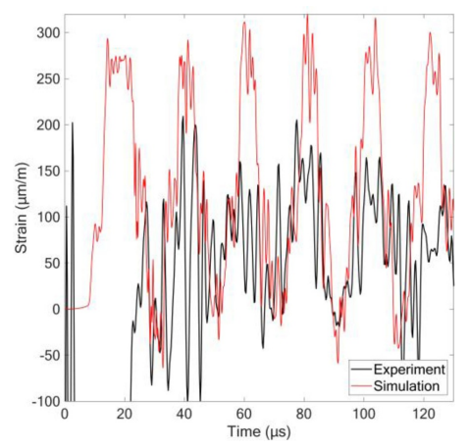
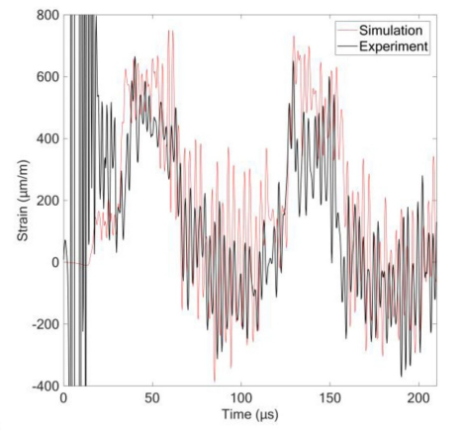
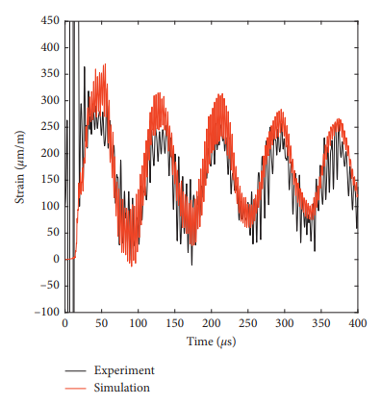
HRMT36 MultiMat U. Malta, Brevetti-Bizz SME Italy
Investigate dynamic response of novel materials for HL-LHC collimator upgrade
16 target stations with 18 different materials ranging from ultra light C foams to heavy W alloys
MoGr, CFC and graphite coated with Mo, Cu, TiN
To derive & extend constitutive models and material properties as input for numerical simulations
Conditions exceeding maximum energy deposition density of LHC injection error
Re-usable multi-purpose testbench
‘revolver barrel’ target station
Experiment installation
W-Ni-Cu alloy, after 12 & 24 b, 2.0 mm
SiC after 36 bunches, 0.5 mm
Ti-Zr-Mo alloy, after 12 bunches, 2.0 mm
SiC
Ti-Zr-Mo alloy
Copper-diamond composite
F. Carra et al. 2017 Proceedings IPAC17 MOPAB005
A Bertarelli et al. 2018 J. Phys.: Conf. Ser. 1067 082021
M. Pasquali et al. 2019 Journal of Dynamic Behavior of Materials 5 266
M. Portelli et al. 2019 Mechanics of Materials 138 103169
M. Portelli et al. 2021 Shock and Vibration, vol. 2021, 8879400

Slide 10
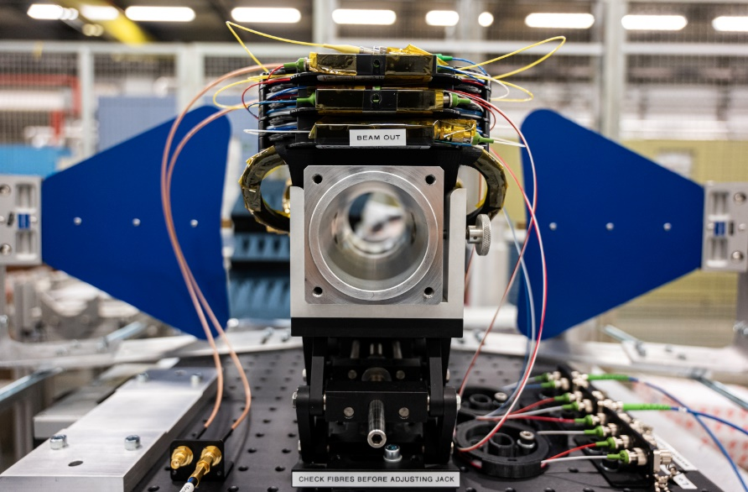
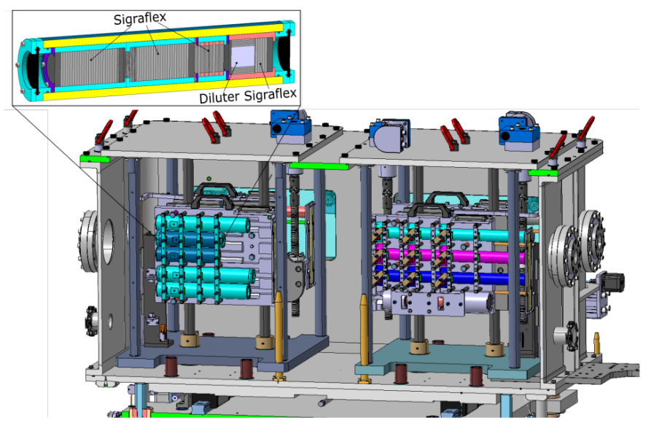
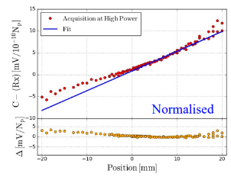
2021 Experiments
HRMT54 – BPM
Royal Holloway University
Prototype electro-optical BPM for intra-bunch beam position measurements at HL-LHC
HRMT57 – MultiMat2
CERN, Sapienza University
Validation of industrial grades and coatings for HL-LHC collimator series production
HRMT56 – HED
CERN
Performance assessment of graphite materials for the HL-LHC beam dump
A. Arteche “High bandwidth PU using EO technologies”
11th HL-LHC Collaboration Meeting, 19-22 Oct 2021
https://indico.cern.ch/event/1079026/
J. Guardia “Results on HRM incl. status of CuCD”
11th HL-LHC Collaboration Meeting, 19-22 Oct 2021
https://indico.cern.ch/event/1079026/
J. Heredia et al. 2021 IPAC2021 3571-3574
P. Andreu Muñoz et al. 2022 IPAC2022 2883-2886

Slide 11
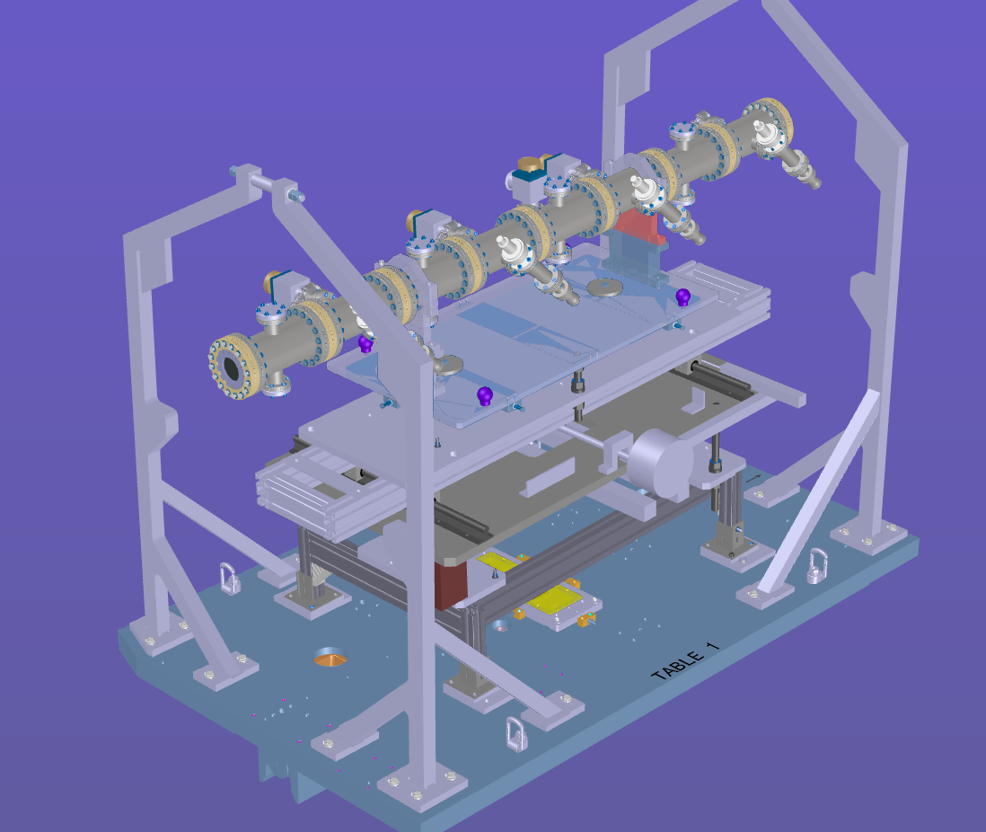
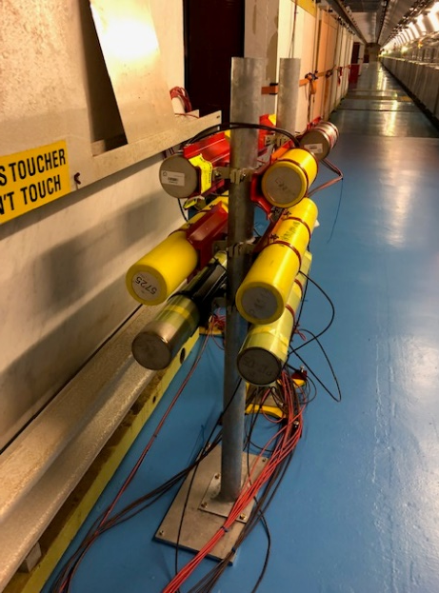
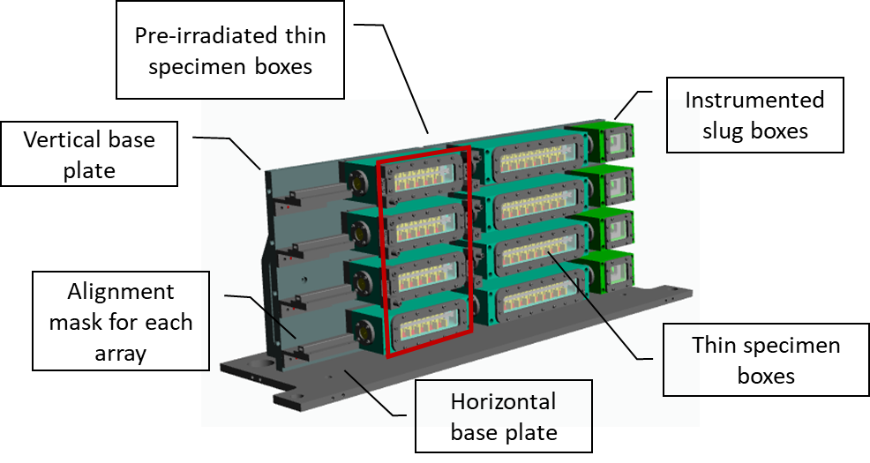
2022 Experiments
ATLAS-ITk
CERN, JSI
Prototype ATLAS beam condition monitor
BLM3
CERN, GSI, ESS
Validation of production BLMs for HL-LHC
SMAUG
CERN
Validation of beam windows for LIU intensities at HRMT
RaDIATE2022
CERN, FNAL, KEK
Thermal shock in pre-irradiated materials
SCcoils
CERN, KIT
Damage limits in SC miniature HL-LHC dipoles (3 K)
Talk by N. Solieri
Wednesday 14:30
NbTi
Nb₃Sn

Slide 12
EURO-LABS Transnational Access at HiRadMat
Transnational Access by ARIES Project has been huge success for HiRadMat
50% of all experiments at HiRadMat supported from 2017 to 2021!
Since 1st September new Transnational Access Program until August 2026!
https://web.infn.it/EURO-LABS/
Support external users with daily subsistence and (some) travel support
Up to ~40 days/experiment*
Additional resources for user support:
CAD integration
Small workshop works
CERN support (Metrology, controls, DAQs, …)
* depending on total no. of experiments requesting support

Slide 13
List of HiRadMat publications and references:
https://cern.ch/hiradmat
Thank you for your attention!
This project has received funding from the European Union’s Horizon 2020 Research and Innovation programme under Grant Agreement no 730871

