Slide 1
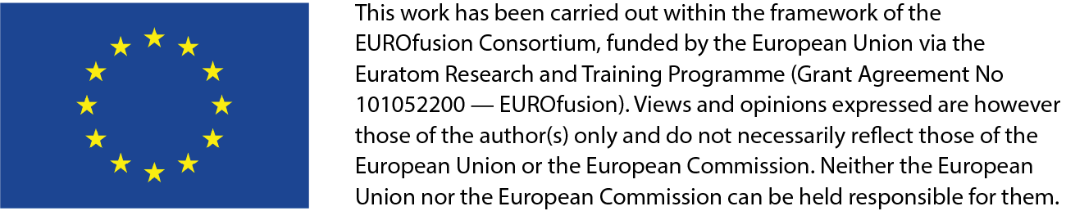
CIEMAT and the IFMIF-DONES Irradiation Facility: Design Status and Near Future
J. Maestre (A. Ibarra) on behalf of CIEMAT and WPENS

Slide 2
Outline
1
Introduction to the IFMIF-DONES Facility
2
The IFMIF-DONES Project Organization
3
Current design status of the Facility
4
CIEMAT contribution and other synergies
5
Planning and near future

Slide 3
Outline
1
Introduction to the IFMIF-DONES Facility

Slide 4

What is?
IFMIF-DONES
IFMIF-DONES
IFMIF-DONES
International
Source
Fusion
Materials
Neutron
Irradiation
Oriented
Facility
DEMO

Slide 5
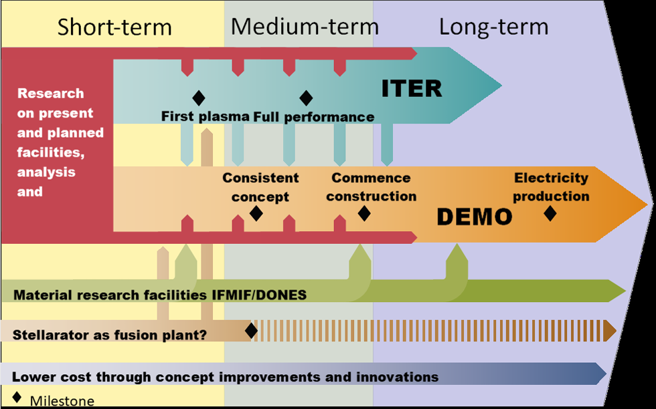
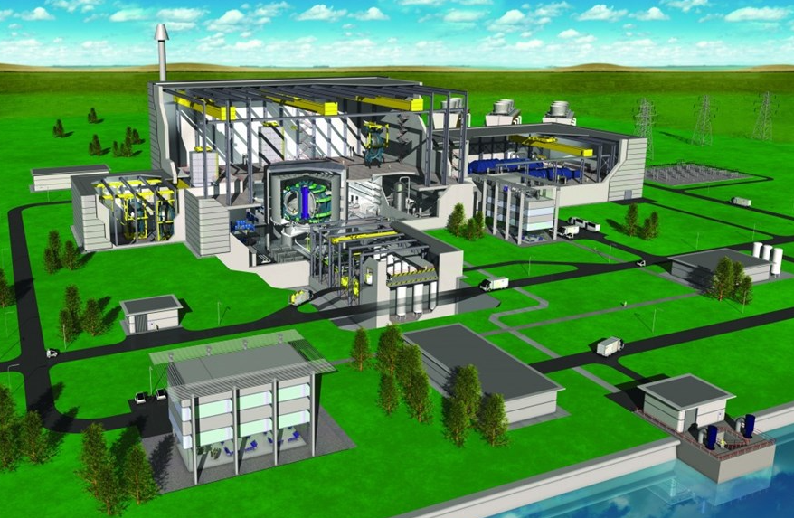
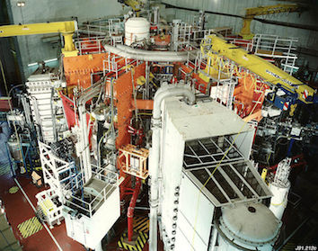
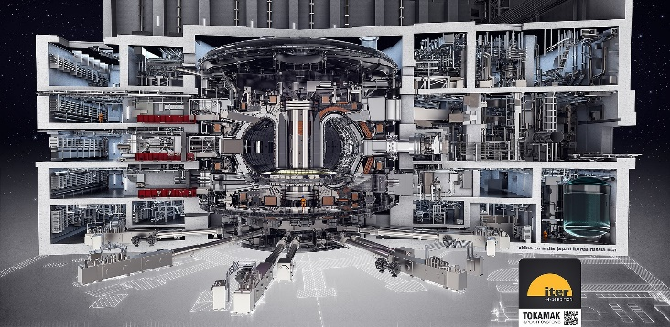
Why and Roadmap
MAGENETIC CONFINEMENT FUSION
Main challenge:
Materials capable of withstanding the thermal loads and irradiation effects that may occur on the chamber walls.
Engineering Standards
See https://www.euro-fusion.org/eurofusion/roadmap/
JET (80 m³)
JET started its operations in 1983. It was designed to study plasma behaviour in conditions close to those required for a fusion reactor. (16MW and Q<1 still)
1-3 dpa/lifetime
~20 dpa/year
ITER (800 m³)
ITER under construction in Cadarache (France). To demonstrate the scientific feasibility of fusion energy (500 MW of power from fusion energy with Q>10) no connected to the grid.
DEMO (~1000-3500 m³):
Being designed to operate continuously providing electricity to the grid (~2-4 GW), showing commercial nuclear fusion is technically feasible. Q>10, 2050

Slide 6
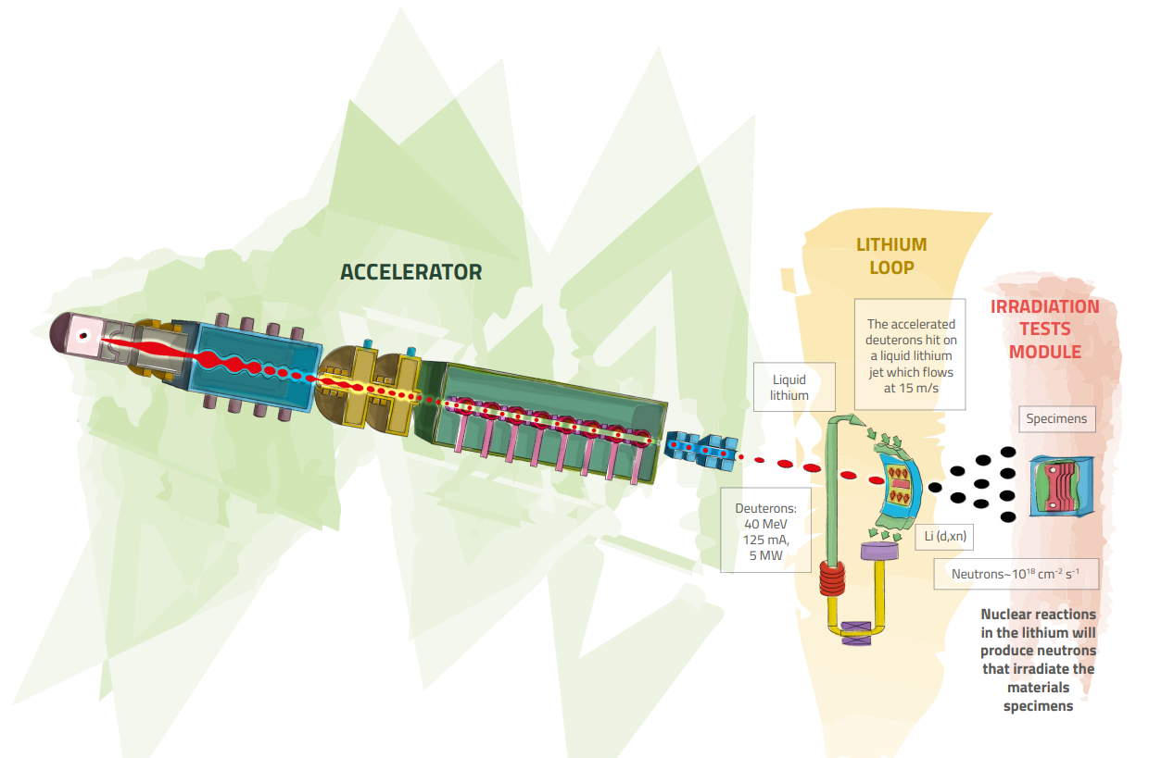
IFMIF-DONES Facility
Accelerator-based fusion-like neutron source for
the qualification of the materials oriented to DEMO
Neutron spectrum up to 55 MeV energy
High Flux Test Module:
20 dpa/fpy in 100 cm³ of material

Slide 7
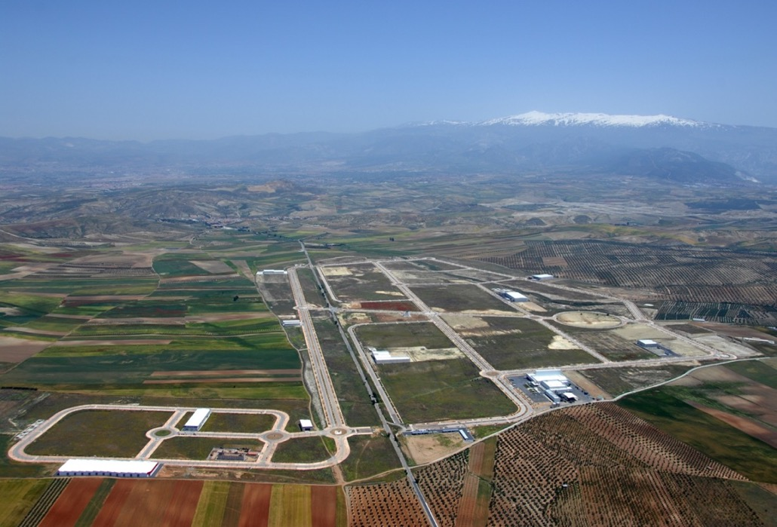
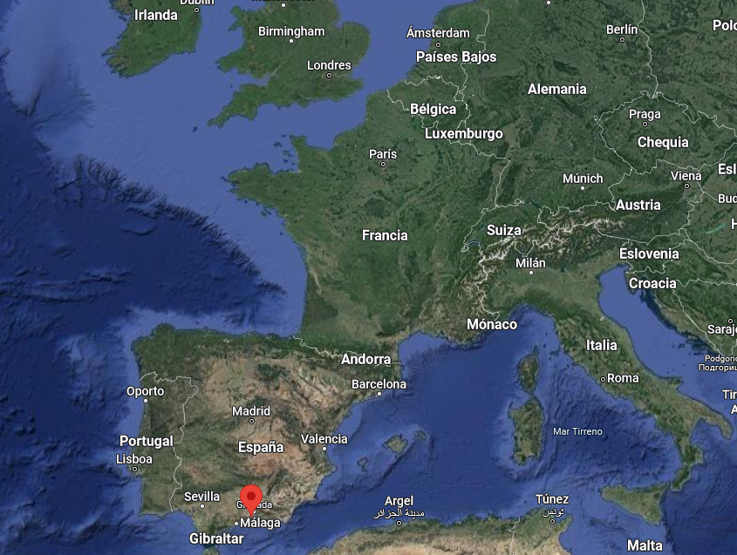
Site
Granada (Escúzar)
Thanks to CIEMAT: Leadership of the Spanish proposal to host the facility in Granada including all the related preparatory work

Slide 8
Outline
2
The IFMIF-DONES Project Organization

Slide 9



Framework
In the last 15 years, key projects are:
IFMIF/EVEDA (included in the BA – 2007 on going ),
WPENS –including specific Industry contract- (EUROfusion WP – 2015 on going)
DONES-PreP (EURATOM CSA – 2019 up to 2021)
DONES-PRIME and DONES-UGR (Spanish funded projects – 2020 up to 2023 on going).
Completed Dec 2021
DONES-PRIME
DONES-UGR
Notes:
DONES-PreP:
- Propose a legal, governance and management framework for the Project
- Propose a financial framework for the Project
- Prepare the required specific Licensing and Permitting
Prepare for the use of Structural Funds
Evaluate possible technical alternatives of strategic interest (For all the possible users)
DONES PRIME-UGR: Local support to the project and first administrative and lab buildings.

Slide 10
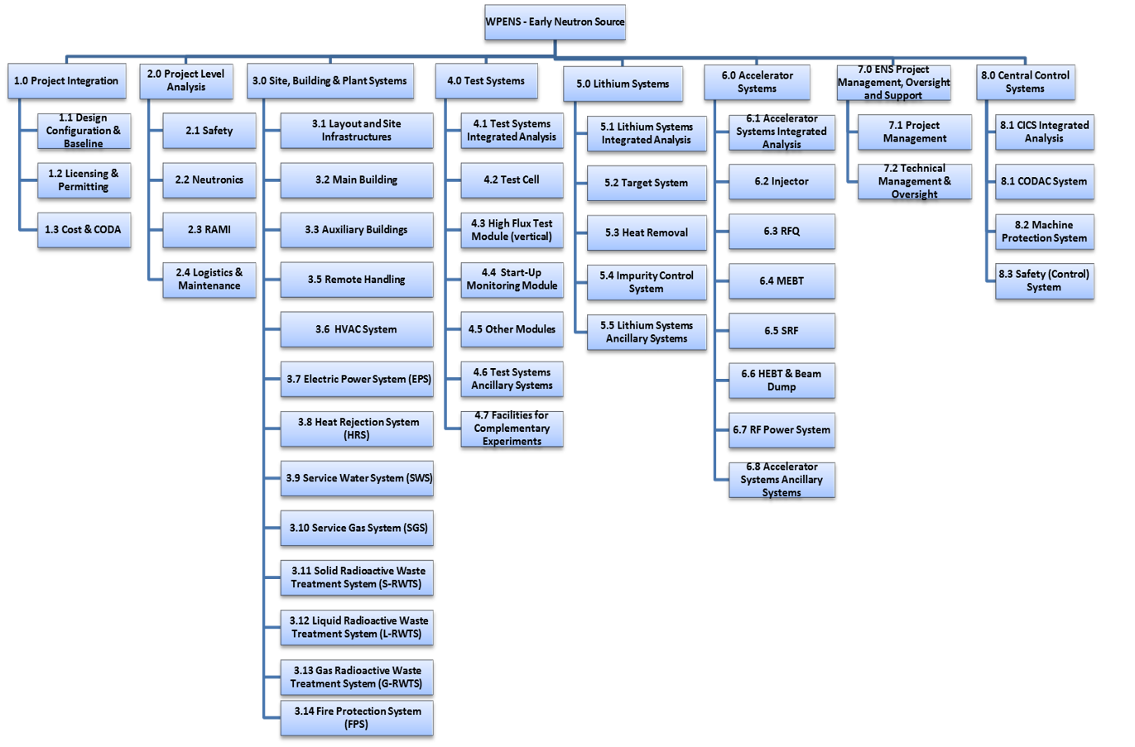
System Organization
Project Leader
Project Management manager + Tech Advisor
Coordinators
System responsible
Research Units
Project is organized based on a PBS (Plant Breakdown Structure)
“In Kind” contribution
Research Units: 17

Slide 11
Outline
3
Current design status of the Facility

Slide 12
Overview of the Facility

Slide 13
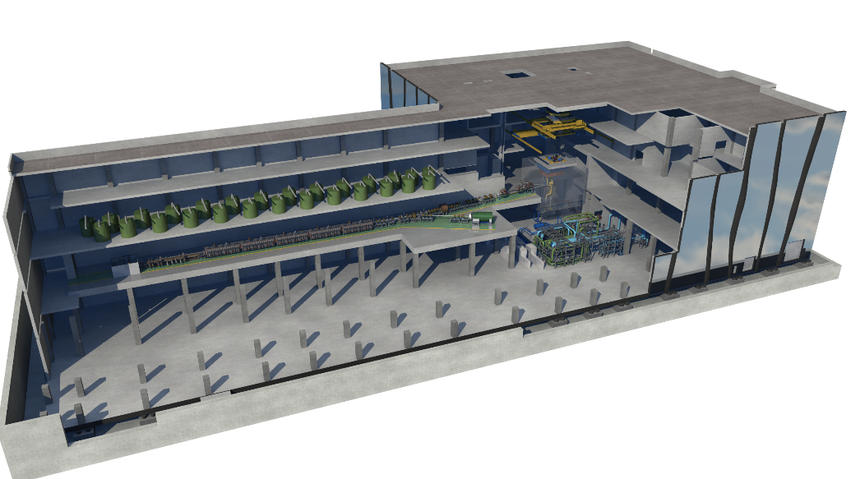
Main Building
Test System
Accelerator System
Lithium System

Slide 14
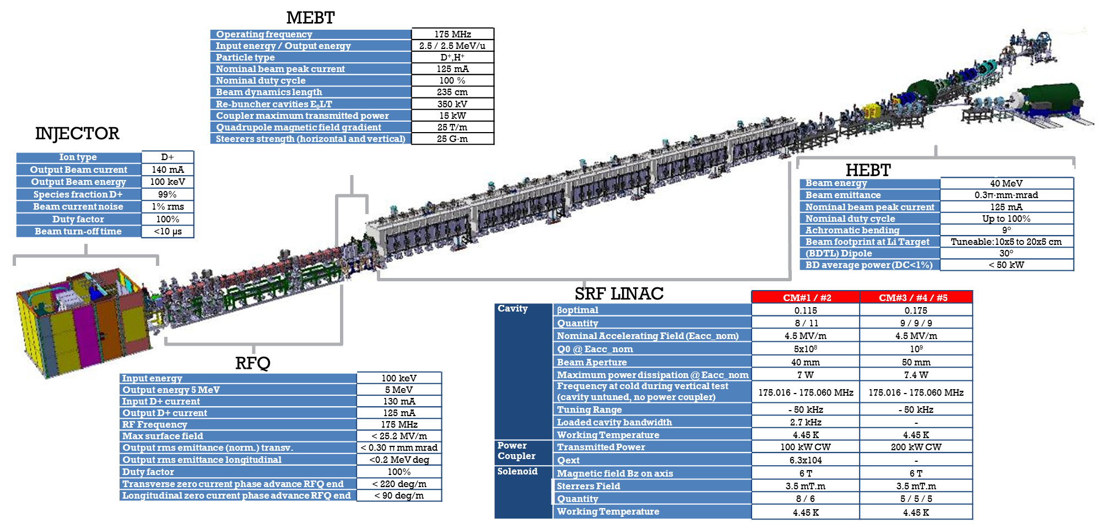
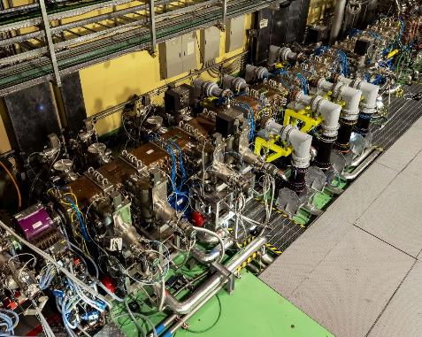
Accelerator System
LIPAC
(in 2019 a world-record has been obtained by accelerating a 125 mA deuteron beam up to 5 MeV, in pulsed mode, with high efficiency)
A very challenging design due to the high 125 mA beam current (5 MW beam power)
Validation results from LIPAc (Rokkasho) as part of IFMIF/EVEDA activities
Notes:
To add information of the Accelerator:
To add comments from LIPAC: LIPAc installation and commissioning has been done in several phases. Presently the full accelerator except the SRF Linac has been installed and it is operating. It has been commissioned with pulsed deuteron beams up to 125 mA current accelerated up to 5 MeV.
RFQ conditioning needs to be completed reaching full power and it has been tested with pulsed beams with 0.1% duty cycle. Same happen with MEBT.

Slide 15
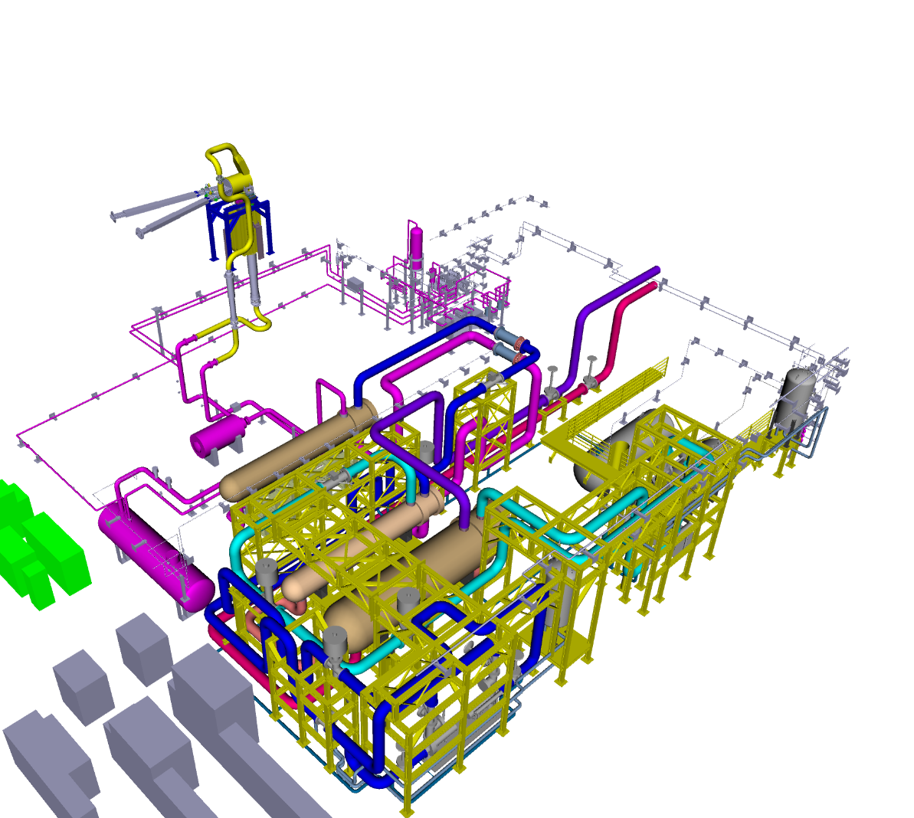
Lithium System
Function:
Provide a continuous Li jet whose interaction with D+ beam generates the Neutron flux
Main parameters:
Li inventory ~12 m³
Li flow rate ~100 l/s
Li jet at 15 m/s (25 mm thickness)
Li working temperature (cold side) ~300 °C
Target System
Impurity Control System
Heat Removal System

Slide 16
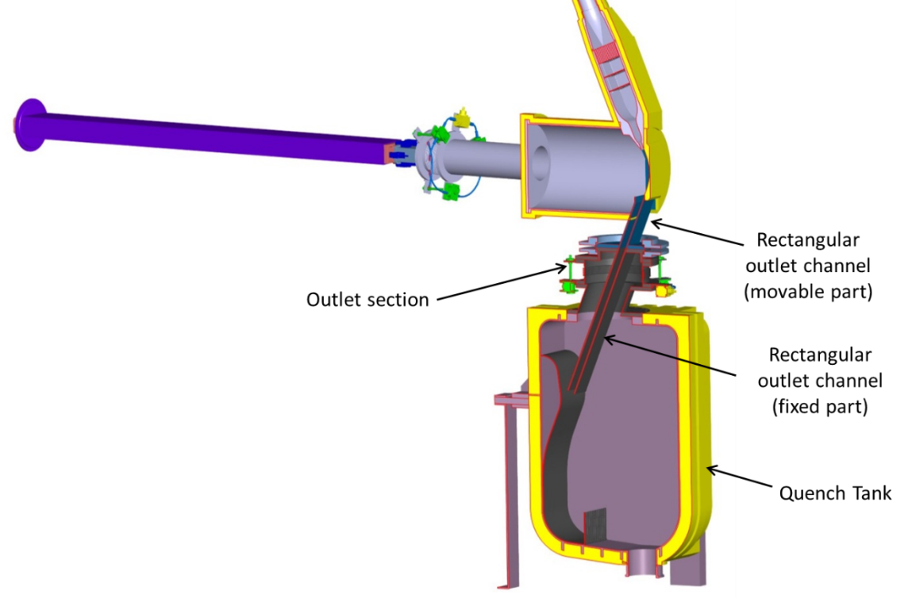
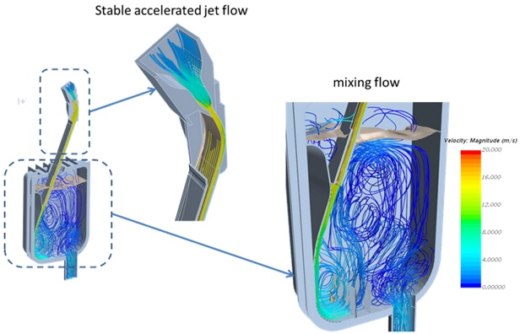
Lithium System
Function:
Provide a continuous Li jet whose interaction with D+ beam generates the Neutron flux
Main parameters:
Li inventory ~12 m³
Li flow rate ~100 l/s
Li jet at 15 m/s
Li working temperature (cold side) ~300 °C
Inlet Nozzle
Beam
Back Plate
Challenges:
Hydro-dynamic stability of the of Li
Management of radioactive impurities in the Li flow
High corrosivity and reactivity of the Li system
Fire-protection system and Lithium recovery system
Target System exposed to extreme conditions: ~20 dpa/fpy; Thermo-mechanical loads

Slide 17
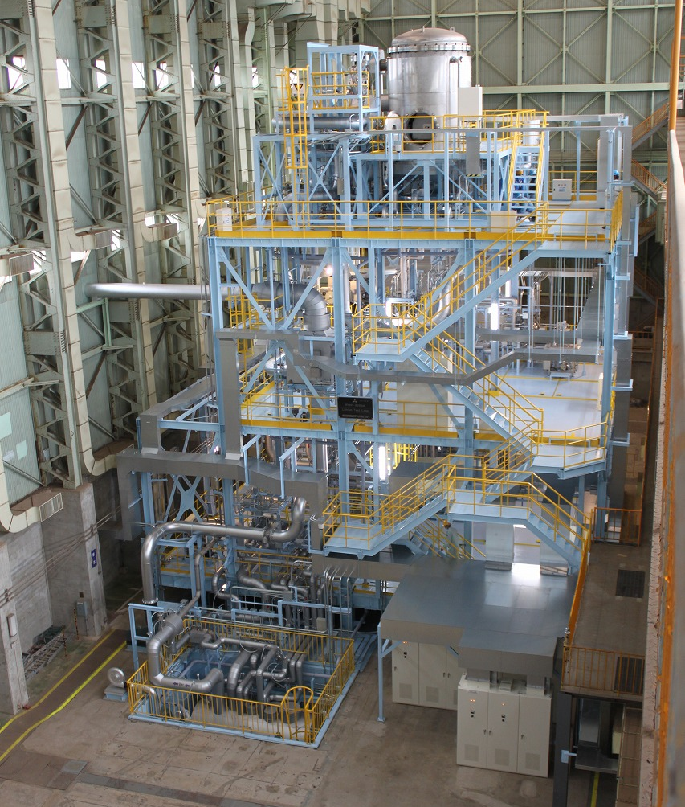
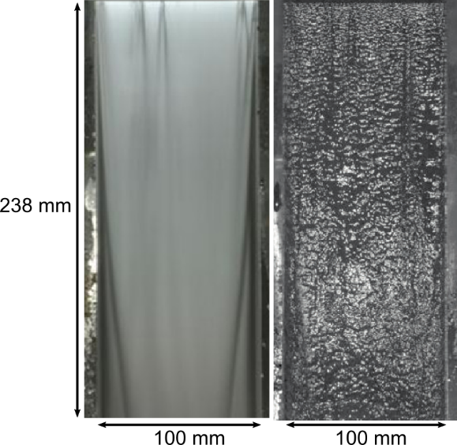
Lithium System
ELTL validation results from IFMIF/EVEDA phase implemented in the design
Lithium loop at scale 1:3
Fluid-Dynamic stability of the Li jet.
Stable and continuos operation of the Li
Pictures of a lithium flow in ELTL taken with 2 s and 10 µs exposure time
[Kondo et al. (2015), Wakai et al. (2016)]
ELTL Facility (Japan)

Slide 18
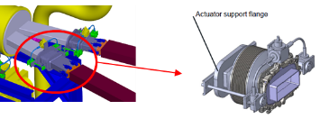
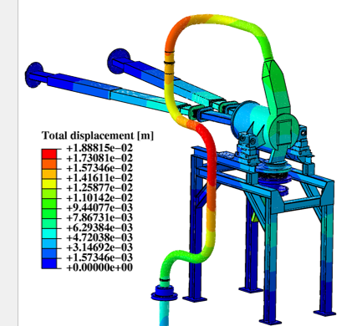
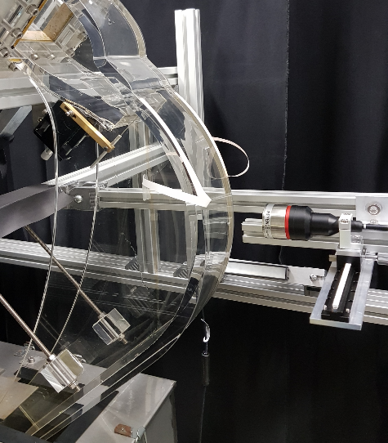
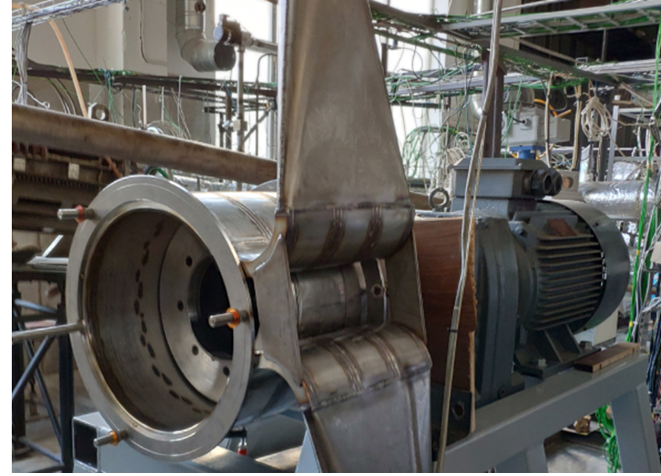
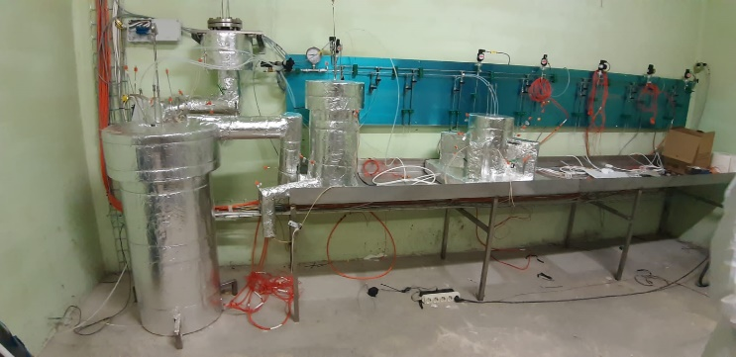
Lythium System
Target System
Coupled fluid-structure thermal- mechanical analysis (and accidental scenarios)
Final design, procurement and testing of the quick disconnecting systems (QDS) on beam ducts
Li jet diagnostics
Courtesy of D. herranz
Heat Removal System
Update of Li loop design considering the new operating temperature (300°C),
RH requirements and building modifications.
Update of EMP and Dump Tank
Courtesy of G. Bongiovi
Chromatic
confocal
Courtesy of B. Brenneis
Purification system
Consolidated design of impurities Traps
Getter qualification
Corrosion tests on Eurofer and 316L (Lifus-6 facility)
Development of monitoring impurity equipment
Courtesy of L. Buldings
Ancillaries system
Update design of the ancillary systems (gas, heating, power and vacuum) due to the new operating condition
Courtesy of P. Fabuzza

Slide 19
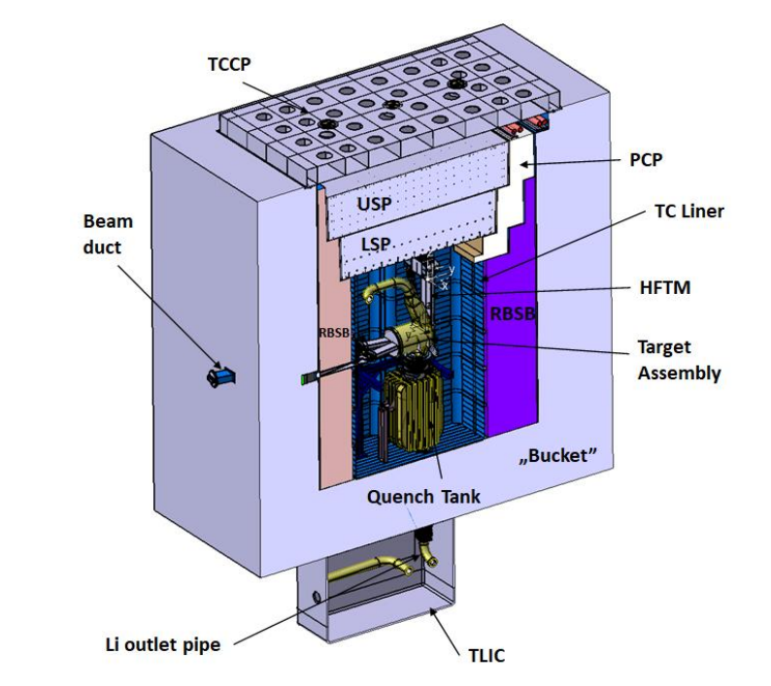
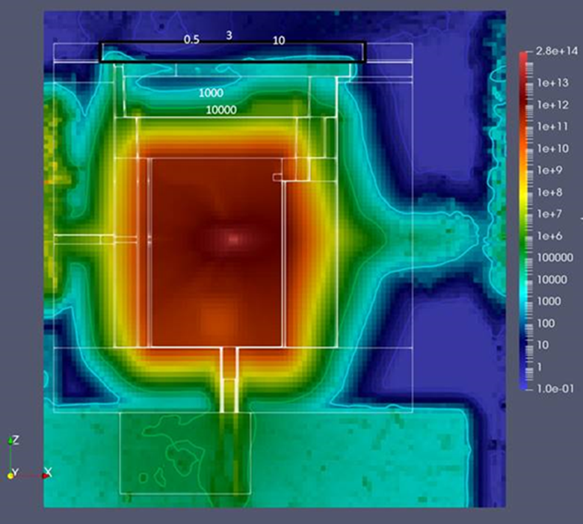
Test System
Main Objetive:
Allocating the stripping reaction Li-D and the module of irradiations (HFTM)
To irradiate large volum of SSTT samples (>800 samples)
Characterization of Neutron and gamma field (STUMM)
1st Confinement barrier
Radiation map
uSv/h
Challenges:
Harsh environment (several MGy/h)
Strict Safety Requirements (Fire prevention and massive Li spillage)
Strict thermo-mechanical stability of all the assembly
Courtesy of Y. Qiu

Slide 20
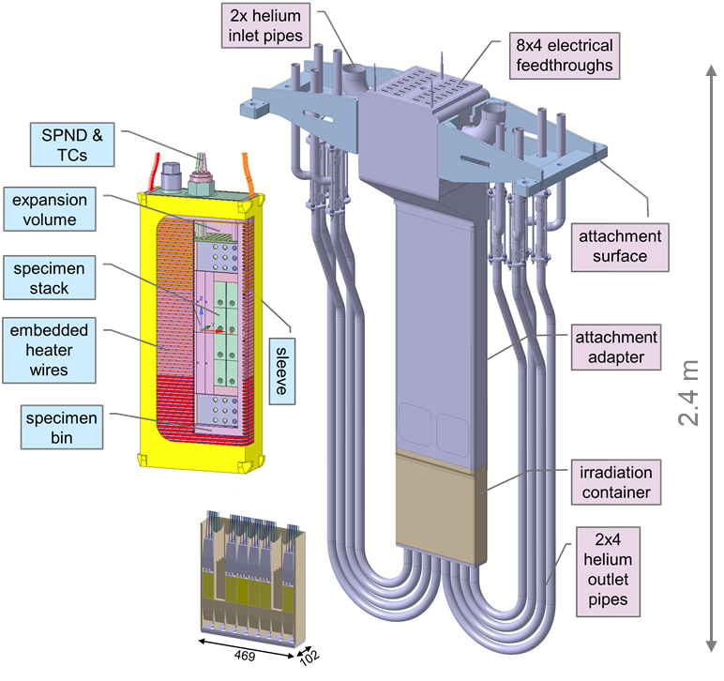
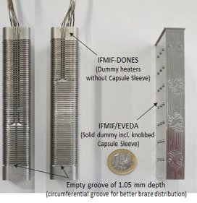
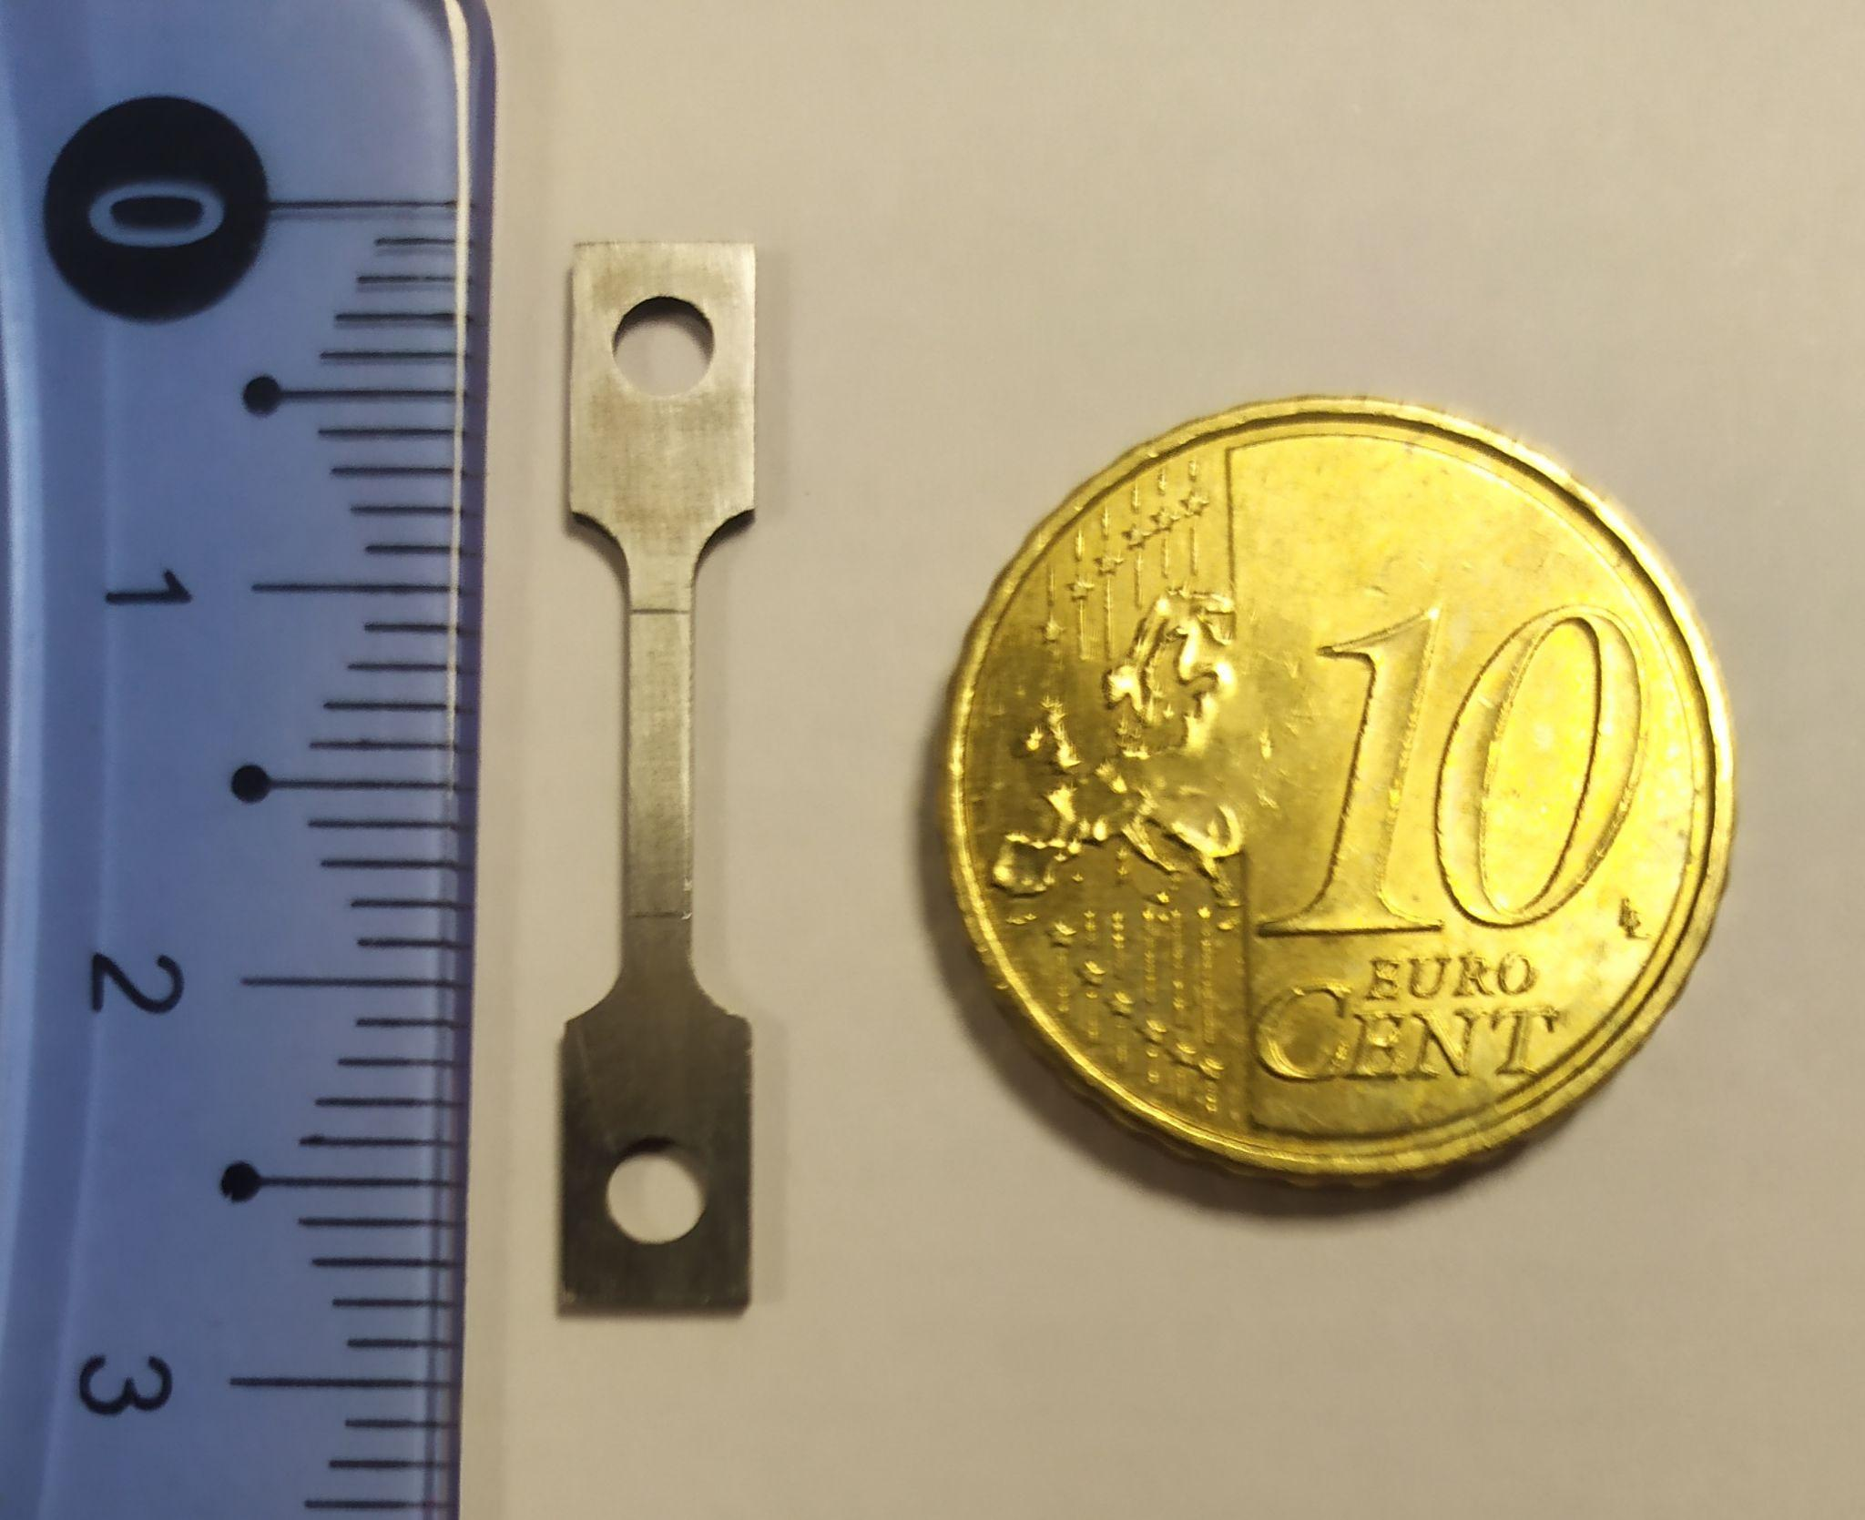
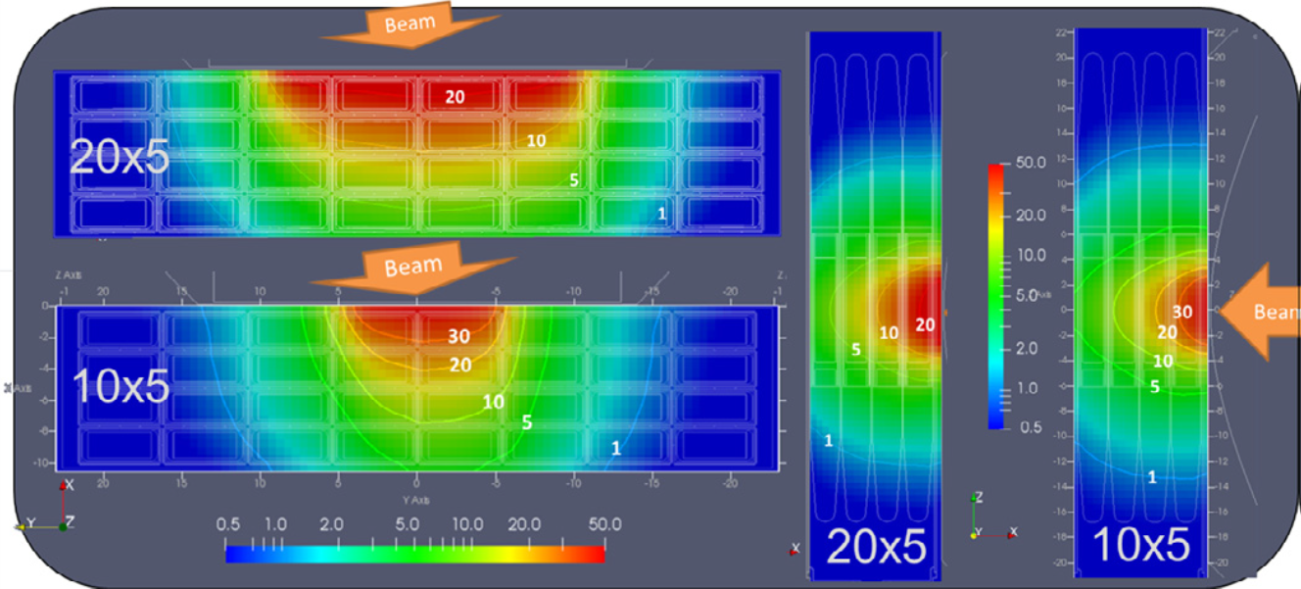
Irradiation modules
Specimen capsule
(Eurofer)
F. Arbeiter (KIT)
The up-to-date design activities of IFMIF-DONES have so far developed the so called High Flux Test Module (HFTM), as the first-to-be-installed irradiation experiment (critical path for Breeding Blanket of DEMO).
MATERIALS
Steel irradiation (conditions matched to DEMO FW)
  12–25 dpa/fpy in 306 cm³ (~ 850 specimens)
  13 appm He / dpa, 53 appm H / dpa.
  250 – 550 °C, sodium immersed specimens
Copper irradiation (divertor heat sink)
  5–30 dpa/fpy (same capsules as for steel)
Tungsten irradiation (armor)
SSTT
HFTM
Controlled temperature by low pressure helium gas
Lifetime: 1year / 2.5 years (53 dpa).
Body made from 316LN (acc. RCC-MRx)
Masses: Total 680 kg, 40 kg irradiation capsules with specimens
Dpa/fpy on Stainless Steel capsules
Courtesy of Y. Qiu

Slide 21
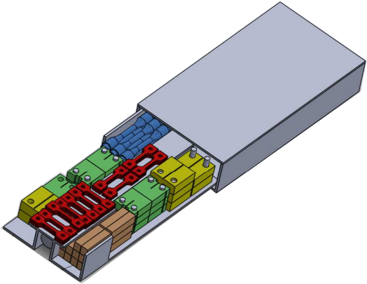
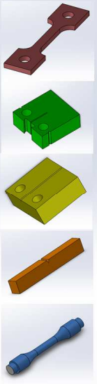
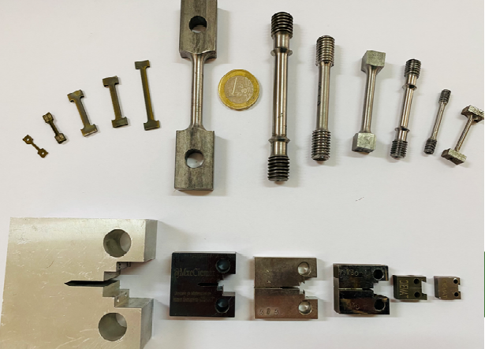
Irradiation modules
The up-to-date design activities of IFMIF-DONES have so far developed the so called High Flux Test Module (HFTM), as the first-to-be-installed irradiation experiment (critical path for Breeding Blanket of DEMO).
Capsule: specimen stack
Specimens
Tensile: 30 (min 12)
MATERIALS
Steel irradiation (conditions matched to DEMO FW)
  12–25 dpa/fpy in 306 cm³ (~ 850 specimens)
  13 appm He / dpa, 53 appm H / dpa.
  250 – 550 °C, sodium immersed specimens
Copper irradiation (divertor heat sink)
  5–30 dpa/fpy (same capsules as for steel)
Tungsten irradiation (armor)
Fracture toughness: 14 (min 12)
Sesors:
Thermocouples
SPNDs
Fracture crack growth: 6 (min 4)
Courtesy of M. Serrano and R. Hernández
Impact: 10 (min 8)
Beyond the limits
Fatigue: 9 (min 8)
Total: 69 SSTT
SSTT Samples (sub-size specimens)
Tensile test
Impact test
Fracture toughness
Fatigue & Fatigue crack growth
Towards Standarization
Courtesy of M. Serrano and R. Hernández

Slide 22
Outline
4
CIEMAT contribution

Slide 23
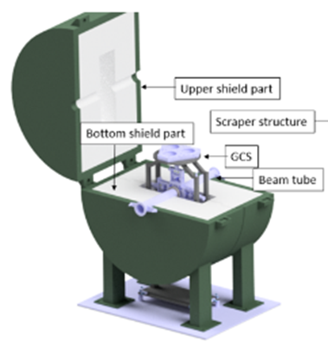
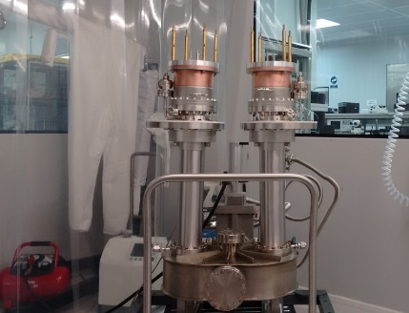
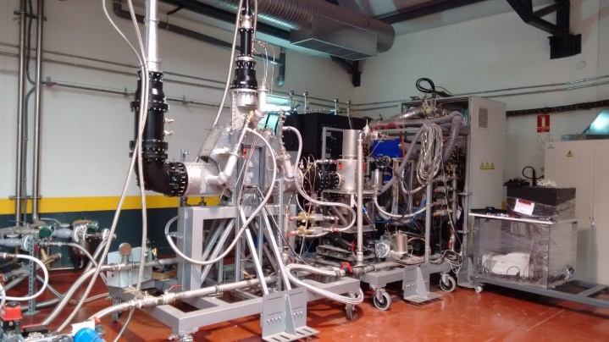
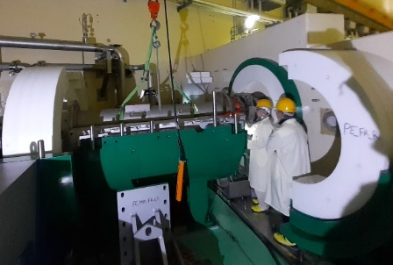
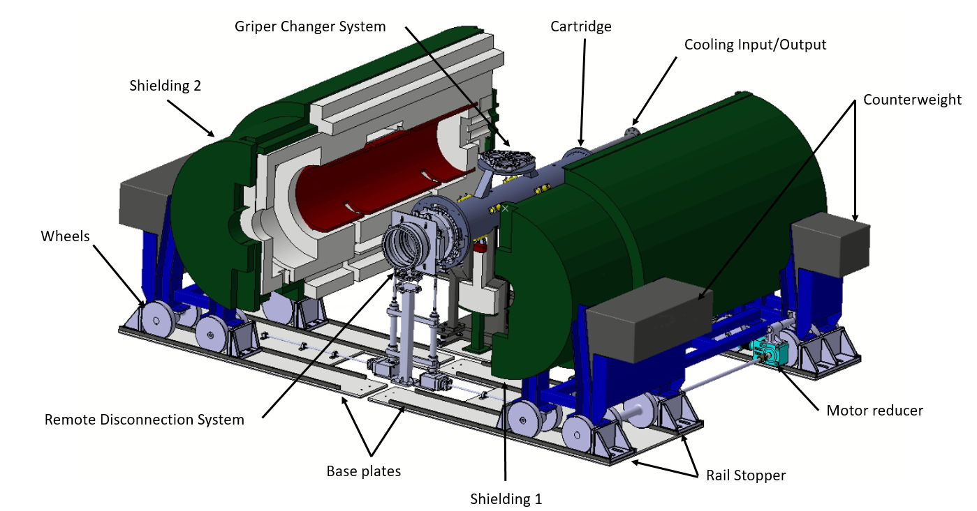
CIEMAT Contribution
Leadership
Project leader (WPENS)
DONES Integration manager
DONES-PreP - European ESFRI Roadmap
Safety & Licencing coordination
Scraper
Accelerator System
Engineering design of IFMIF-DONES:
- Beam dynamics & diagnostics
- Beam intercepting devices
- MEBT
- RF System
- Etc.
LIPAC from design to commissioning:
RF System; MEBT; HEBT; Beam Dump; Diagnostics, superconducting solenoids, etc.
RF coupler Test Bench
CIEMAT HPRF lab.
Beam Dump

Slide 24
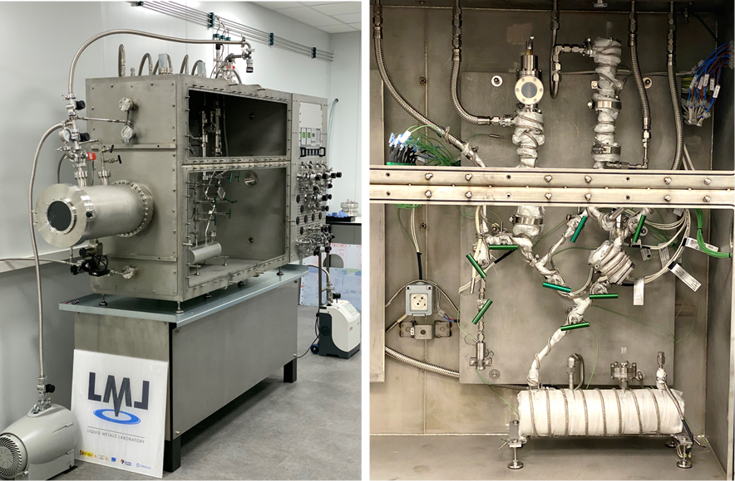
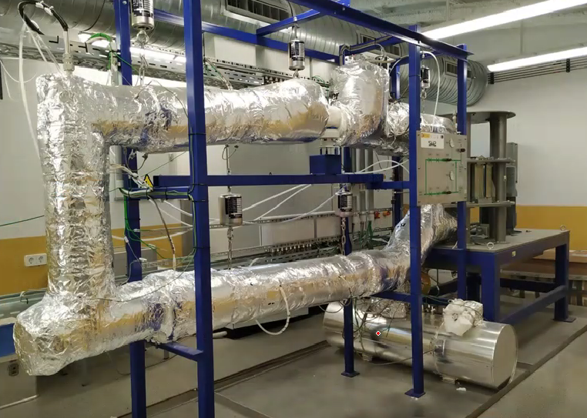
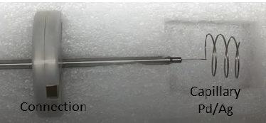
CIEMAT Contribution
Leadership
Project leader (WPENS)
DONES Integration manager
DONES-PreP - European ESFRI Roadmap
Safety & Licencing coordination
H-Trap Test Bench
Accelerator System
Engineering design of IFMIF-DONES:
- Beam dynamics & diagnostics
- Beam intercepting devices
- MEBT
- RF System
- Etc.
LIPAC from design to commissioning:
RF System; MEBT; HEBT; Beam Dump; Diagnostics, superconducting solenoids, etc.
CIEMAT Liquid Metal Lab
Lithium System
Liquid Lithium purification tech. (LITEC)
Others: jet diagnostics, Impurity monitoring systems, etc.
Hydrogen Sensor

Slide 25
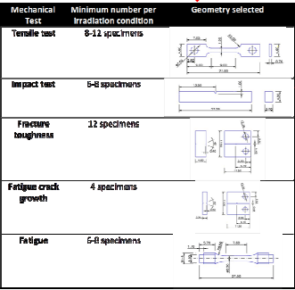
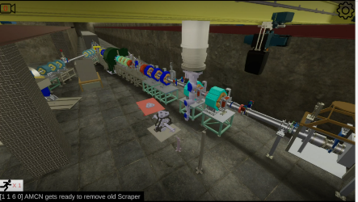
CIEMAT Contribution
Leadership
Project leader (WPENS)
DONES Integration manager
DONES-PreP - European ESFRI Roadmap
Safety & Licencing coordination
SSTT sample design
Accelerator System
Engineering design of IFMIF-DONES:
- Beam dynamics & diagnostics
- Beam intercepting devices
- MEBT
- RF System
- Etc.
LIPAC from design to commissioning:
RF System; MEBT; HEBT; Beam Dump; Diagnostics, superconducting solenoids, etc.
Valeria Lab: DONES virtual simulation
Lithium System
Liquid Lithium purification tech. (LITEC)
Others: jet diagnostics, Impurity monitoring systems, etc.
Test System
DONES Coordinator
Material Qualification: SSTT samples
Transversal activities
RH, Maintenance and Logistics
Safety & neutronics analysis
Control System

Slide 26
Outline
5
Planning and near future

Slide 27
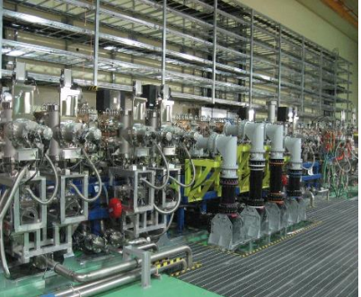
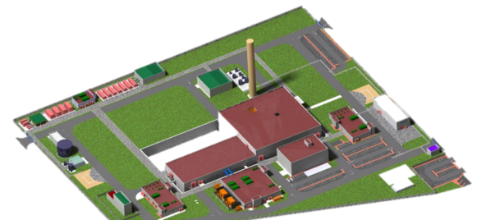

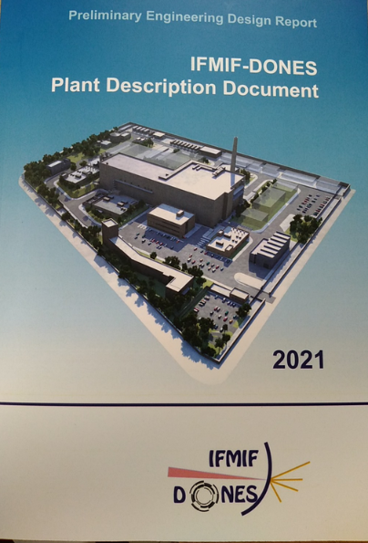
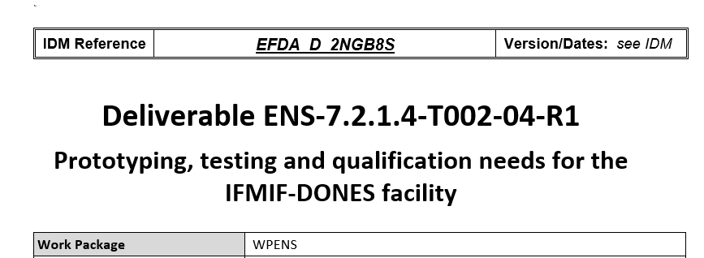
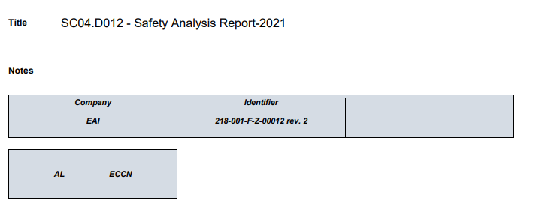
NEAR FUTURE
2007
2014-16
2017
2021
2022
+10 AÑOS
+20-30 AÑOS
IFMIF-EVEDA
EU site agreement: Granada
COMMISIONING
IFMIF-DONES
Reference Design
FACILITY OPERATION
Consorcio IFMIF-DONES
FIRST LABORATORIES AND ADMINISTRAVE BUILDINGS

Slide 28

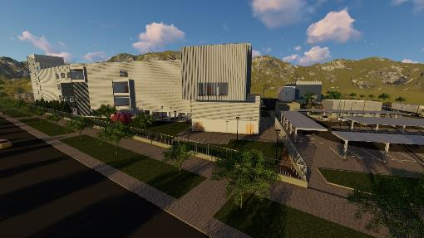
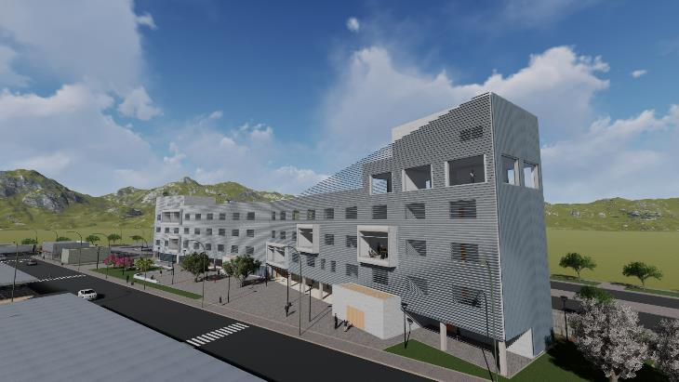
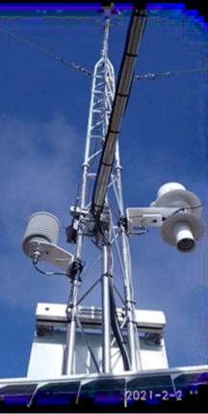
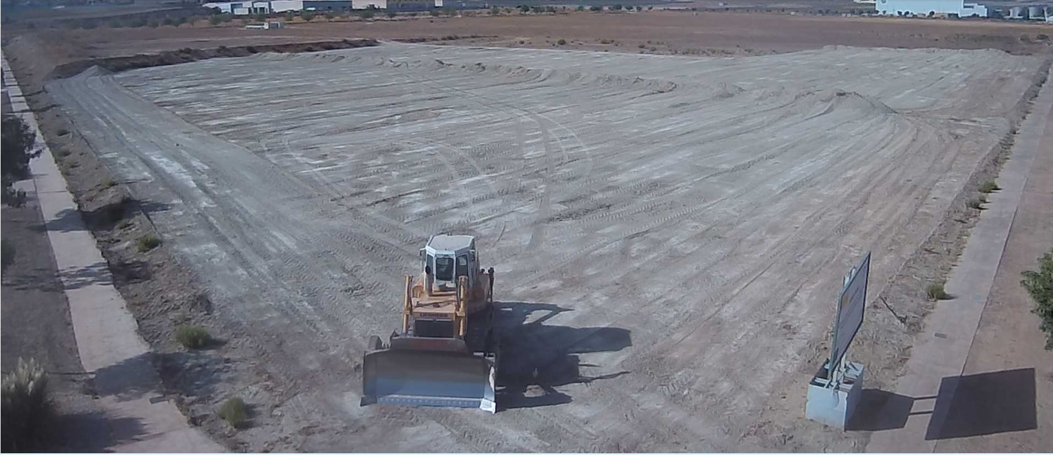
First building DONES-PRIME
Under construction

Slide 29
IFIMIF-DONES
Thanks for your attention

Slide 30

Material Qualification
DESIGN CODES
Neutron-induced damage
1. Fission irradiations
Intensive and broad use of Material Test Reactors (MTR) fission irradiation: EU plans for 50 M€ in the next decade.
Issue:
Number of MTR with reasonable n-fluence and volume is becoming limited!
Limited reproducibility of He-effects on degradation of properties
2. Fusion-like irradiations
Mandatory: a dedicated facility for material qualification that best reproduces a 14 MeV neutrons spectrum with reasonable irradiation volume, fluence, and homogeneity with the objective to validate in-vessel materials
3. Also needed: develop “quasi-standards” of Small Specimen Test Technique (SSTT) towards accepted standards and norms

Slide 31
Current desing status
PLANT DESCRIPTION DOCUMENT
Engineering desing report
Start-Up Monitoring Module (STUMM) prototype to validate the final design and diagnostics,
Quick Disconnecting System (QDS). To validate RH connection system
Multipurpose VaCuum accidental scenarios (MuVaCas). To analyse different possible accidental scenarios related with Vacuum
SRF LINAC High Beta cavity prototyping to validate the final design
Electromagnetic Pump prototype
Li purification prototype loop (LITEC) to test impurities control technology
LIFIRE facility to study Lithium fire risks
ANGEL facility to evaluate Nitrogen trap performance
Valeria lab for virtual reality maintenance and RH modelling
Be in Lithium loop for evaluation of Be behaviour in Lithium
….
Safety Analysis Report 2021

Slide 32




Test System
Test Cell
Optimization and consolidation of the design of Test Cell Removable Shielding Blocks (Maintainability and minimizing neutron streaming)
Experimental activities focused on the thermal behaviour of the TC shielding
Courtesy of T. Dezsi
HFTM
Irradiation campaign of critical components as the capsule heaters at Maria reactor
Integration design
STUMM
Full-scaled prototype of the STUMM (to be finished by end 2023)
Prototype of the Rabbit System with the purpose of testing its mechanical reliability
Courtesy of F. Albeiter
TS Ancillaries
Specific Contract (industrial) aiming at reaching a definition design status
Courtesy of A. Talarowska

Slide 33

Irradiation parameter

