Slide 1
BLIP Status and
Analysis Capabilities at BNL
Dohyun Kim
September 23, 2022

Slide 2
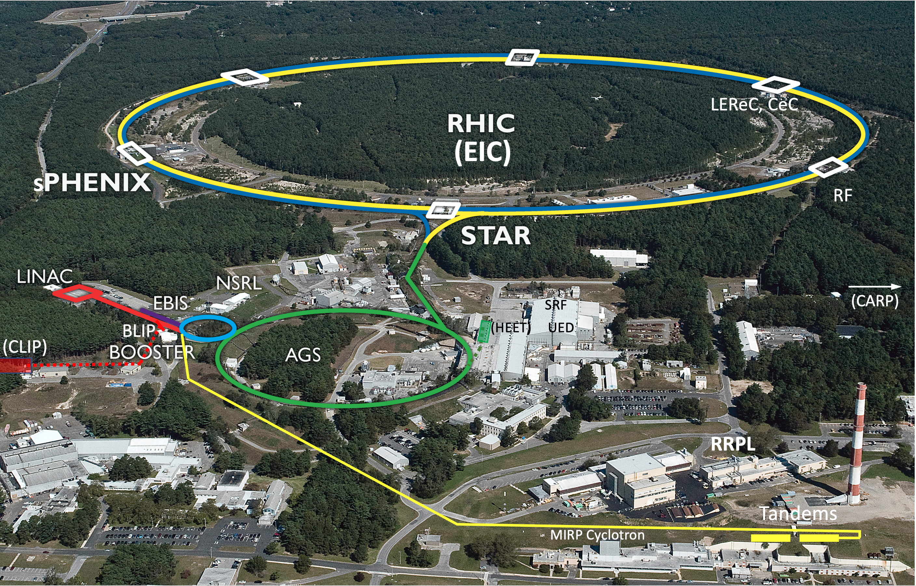
Collider-Accelerator Department facilities
Uniquely flexible and
only hadron collider in
US for exploration of
QCD phase diagram
and proton spin
Injectors also used for
application programs:
- Linac/BLIP for
isotope production
- Booster/NSRL for
space radiation studies
- Tandem for
industrial/academic users
R&D for future facilities
and application
sources, cooling, pol. beams, …

Slide 3
DOE Isotope Program Mission
Produce and/or distribute radioactive and stable isotopes that are in short supply; includes by-products, surplus materials and related isotope services
Maintain the infrastructure required to produce and supply priority isotope products and related service
Conduct R&D on new and improved isotope production and processing techniques which can make available priority isotopes for research and application. Develop workforce.
Ensure robust domestic supply chains. Reduce U.S. dependency on foreign supply to ensure National Preparedness.
Isotopes are forms of the same element that contain equal numbers of protons but different numbers of neutrons in their nuclei, and hence differ in relative atomic mass but not in chemical properties; in particular, a radioactive form of an element.

Slide 4
DOE Isotope Program Production Sites
DOE Mission Essential Function
BNL
Accelerator (BLIP):
Ac-225 Targeted cancer therapy
Ti-44 Sc-44 generator for PET imaging
Y-86 PET imaging
Cu-67 Targeted cancer therapy
Cyclotron (TR-19)
Univ. of Washington Supplier of research isotopes (e.g., At-211)
PNNL
Sr-90 Y-90 generator for cancer therapy
Univ. of Wisconsin
Supplier of research isotopes (e.g., Mn-52)
Michigan State Univ.
FRIB isotope harvesting development
Cyclotron (TR-19)
ANL Accelerator (LEAF)
Cu-67 Targeted cancer therapy
INL
ATR Reactor:
Co-60 Stereotactic radiosurgery, industrial NDA
Y-12 (NNSA Facility)
Li-6 Neutron detection
Li-7 Radiation dosimeters
Rad EMIS – nuclear forensics
ORNL
HFIR Reactor:
Ac-227 Cancer therapy
Se-75 Industrial NDA
Cf-252 Industrial sources
W-188 Cancer therapy
Radioisotopes Inventory:
Ac-225 Cancer therapy
Ra-223 Cancer therapy
Univ. of Missouri (MURR)
Supplier of research isotopes (e.g., Se-75, Lu-177)
LANL
Accelerator (IPF):
Ac-225 Targeted cancer therapy
Ti-44 Sc-44 generator for PET imaging
Cd-109 X-ray fluorescence analyses
As-73 Environmental tracer
Si-32 Oceanographic research
RPF (Radioisotope Proc. Fac.)
Stable Isotopes Inventory:
E.g., Ca-48, Ga-69, Rb-87, Cl-37
Stable Isotope Production:
ESIPP
SIPF
SIPRC
Univ. of Alabama Birmingham
Supplier of research isotopes (e.g., Mn-52)
Plutonium Facility (PF-4):
Am-241 Oil and gas exploration
SRNL (NNSA Tritium Facility)
He-3 Neutron detection
Fuel source for fusion reactors
Lung testing
Started with 6 in 2009

Slide 5
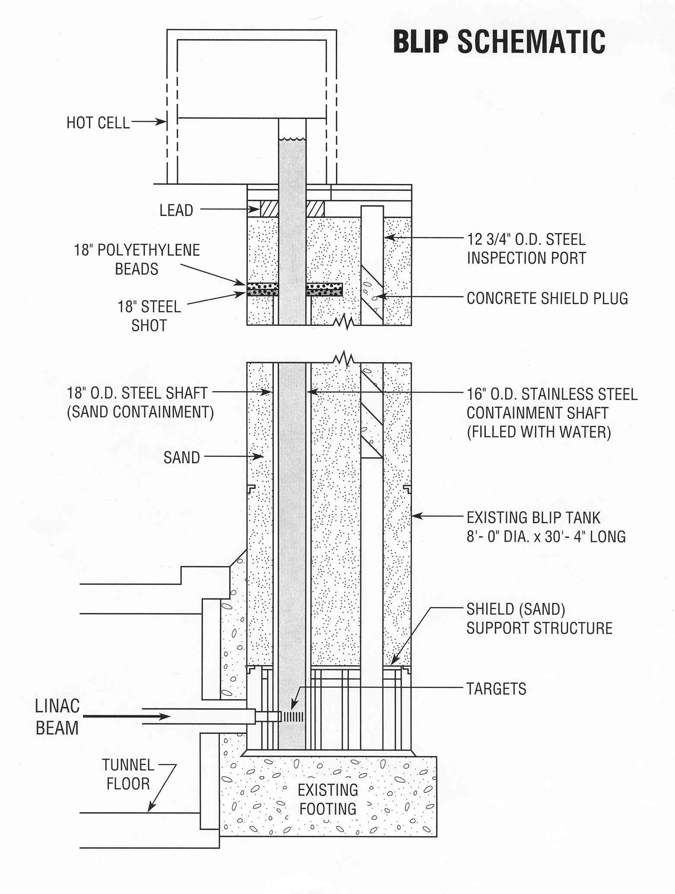
Brookhaven Linac Isotope Producer (BLIP)
First to use a high energy proton accelerator to produce isotopes (1972)
BLIP utilizes the beam from the 200-MeV Linac that injects the Booster, which leads to AGS and RHIC accelerators (nuclear physics)
Excess Booster pulses (~90%) are diverted to BLIP. Energy is incrementally variable from 66-200 MeV
The BLIP beam line is synergistic operation with nuclear physics programs for more cost effective isotope production
In 2016, implemented beam rastering and increased linac current to increase isotope production capabilities

Slide 6
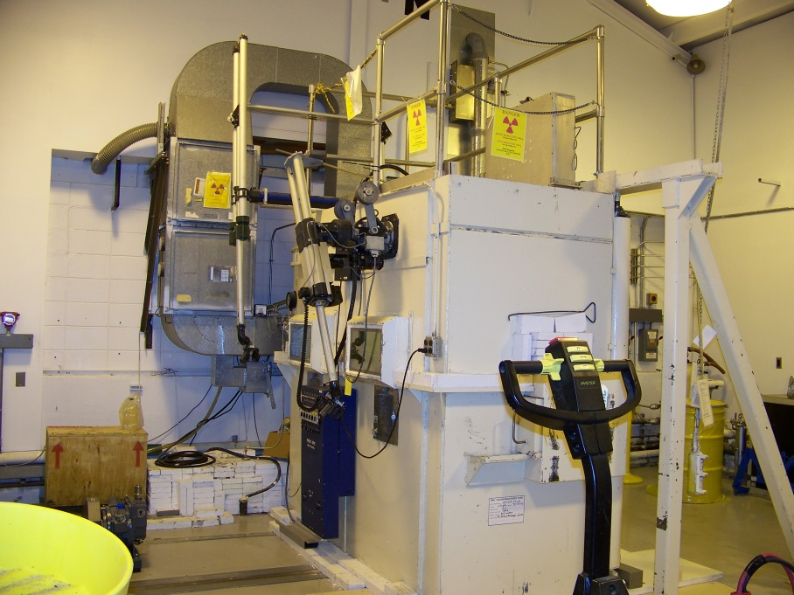
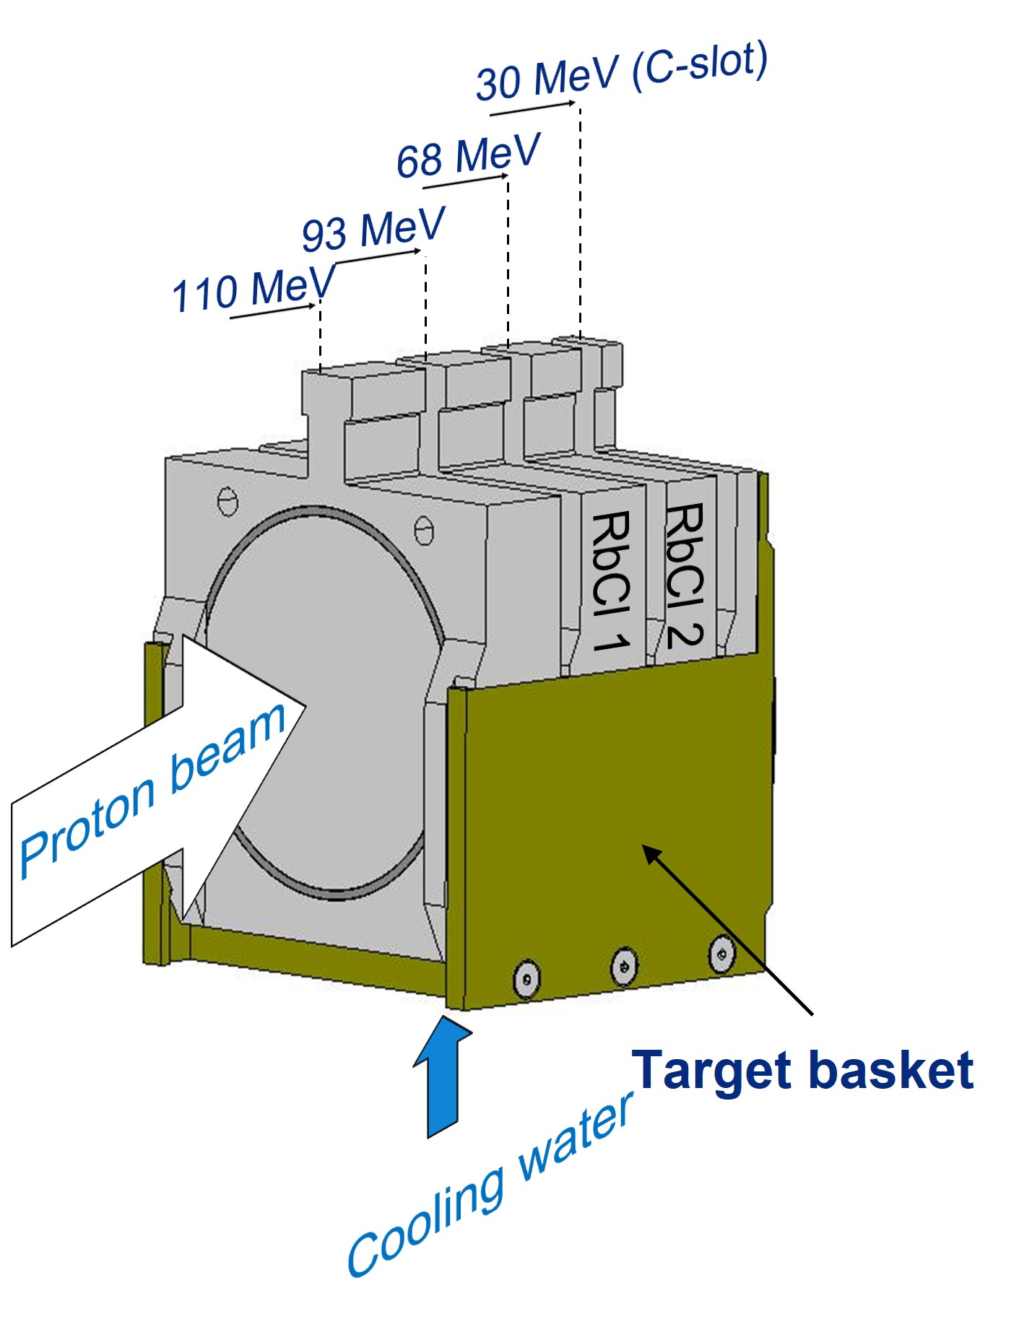
Slide Header

Slide 7
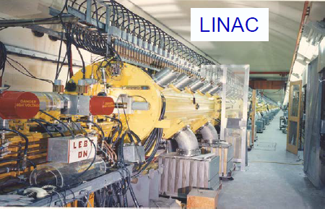
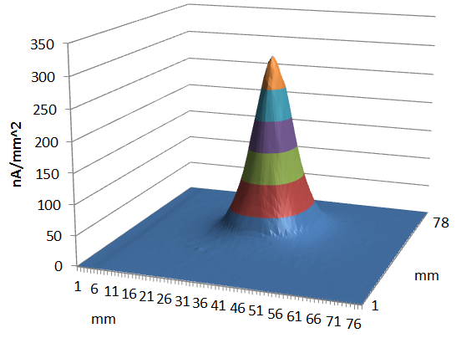
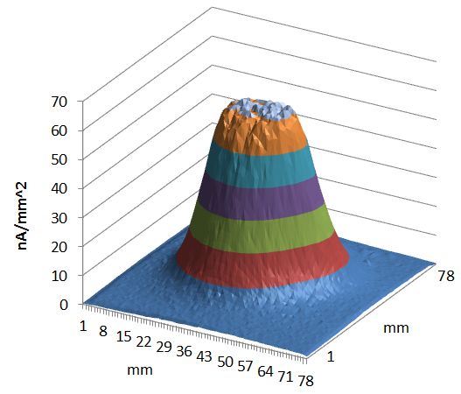
Next BLIP
BNL underwent an Accelerator Improvement Project (AIP)
  Phase 1 complete: Current improved to 165 uA in 2016
  Phase 2 pending: Increase current to
  250 uA
    SAD mod covers up to 320 uA
BLIP Raster Project: Designed, fabricated, installed, and commissioned a BLIP raster system with required beam diagnostics
  By spreading out the power density, a raster scanning system was installed which was beneficial for all targets by improving reliability and yield
  A 50% overall increase in Sr-82 yields was achieved.

Slide 8
Opportunities for Isotope Production and R&D at MIRP Facilities
²²⁶Ra(p,2n)²²⁵Ac
^{nat}Ga(p,xn)⁶⁸Ge
⁷⁵As(p,4n)⁷²Se
⁸⁶Sr(p,n)⁸⁶Y
¹⁸⁶Re/¹⁸⁹Re
⁴⁵Sc(p,2n)⁴⁴Ti
^{nat}Rb(p,xn)⁸²Sr
⁸²Sr - API for Bracco’s Cardiogen-82® generator
⁷⁵As(p,4n)⁷²Se
²³²Th(p,2p6n)²²⁵Ac
⁶⁸Zn(p,2p)⁶⁷Cu

Slide 9
Isotope Program Facility Improvement
Item | Justification | Year | Ops or New $
Hot Cell Upgrade | Increase hot cell capability, provide facility that can meet regulations for FDA product lines | 2018 to 2022 | In progress
Cyclotron | Increase production capabilities at lower energies | 2018 to 2022 | In progress
Linac quadrupole power supply prototypes | Eliminate technical risk, reduce cost of Phase II Intensity Upgrade | 2017 to 2019 | Completed
BLIP cooling and target drive system upgrade | Enhance target cooling and more sustainable operations | 2018 to 2022 | In progress
BLIP Vacuum Upgrade | Improve reliability & maintainability by updating design | 2018 to 2020 | Completed
Linac Intensity Upgrade Phase II | Increase isotope yields and allow more research for stakeholders | 2020 with planning in FY23 | New
Reduce air emissions | Meet environmental expectations | 2019 | New

Slide 10
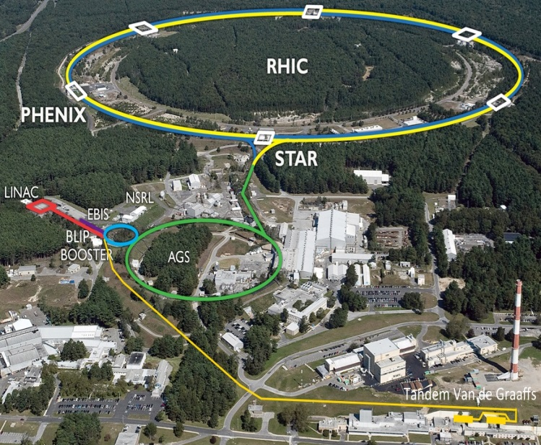
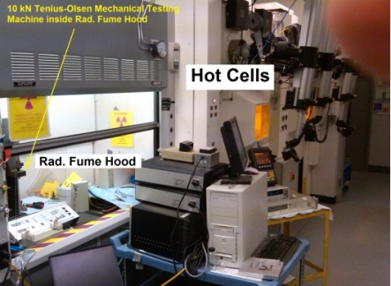
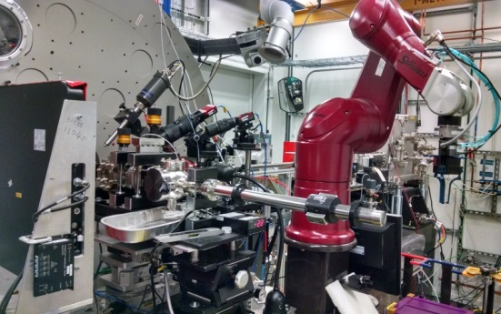
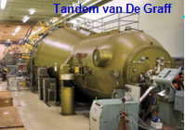
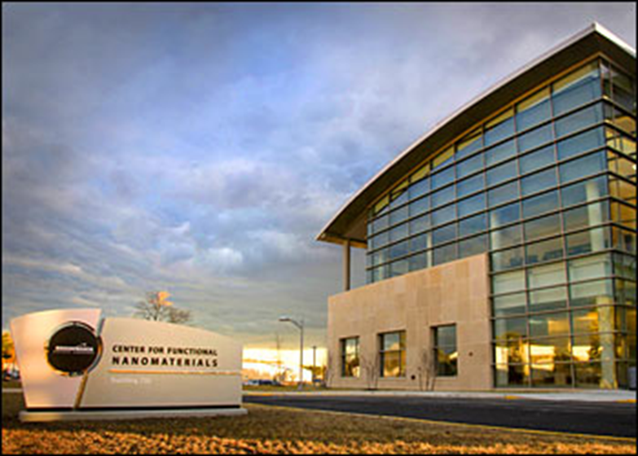
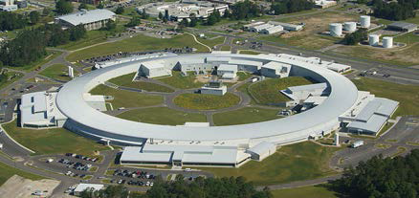
Overview: Irradiation and Post-Irradiation Capabilities

Slide 11
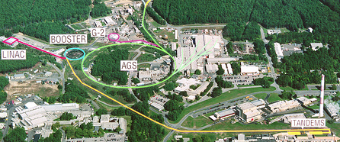
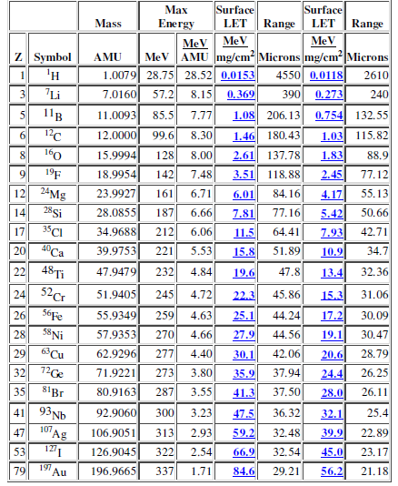
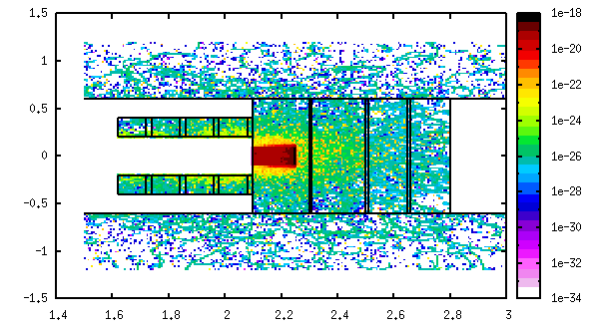
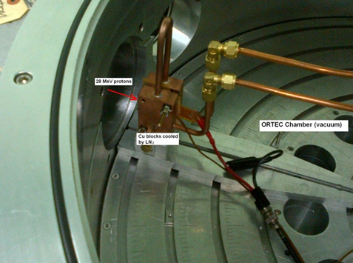
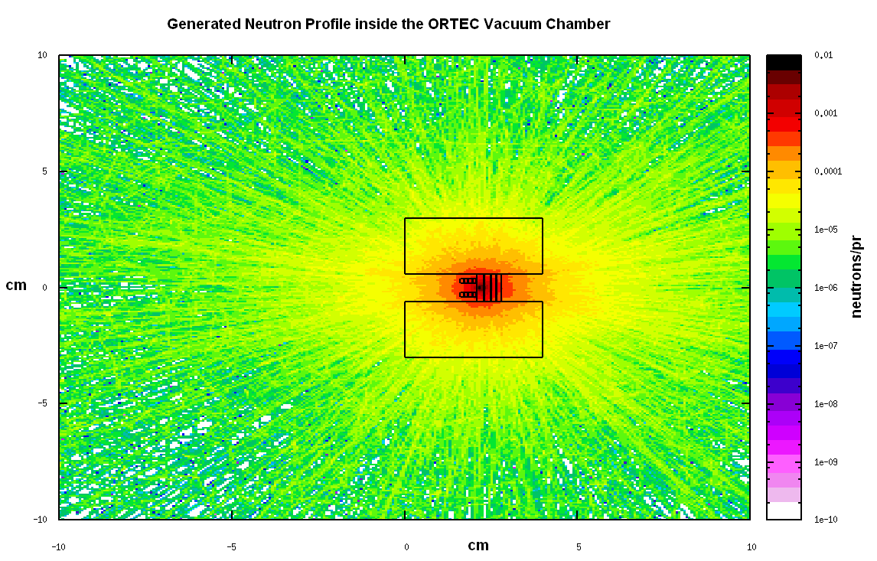
Ion Irradiation at BNL Tandem
28 MeV irrad. at sub-zero temp.

Slide 12
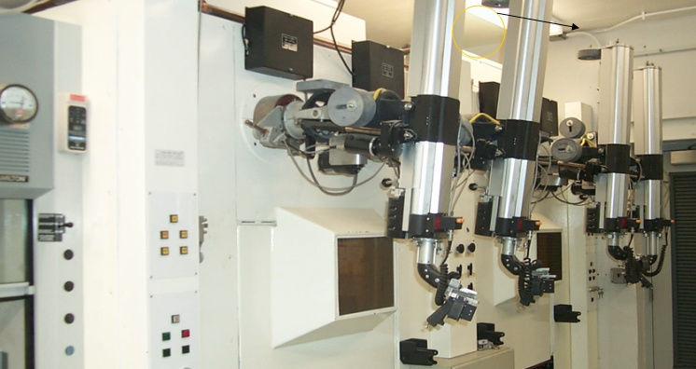
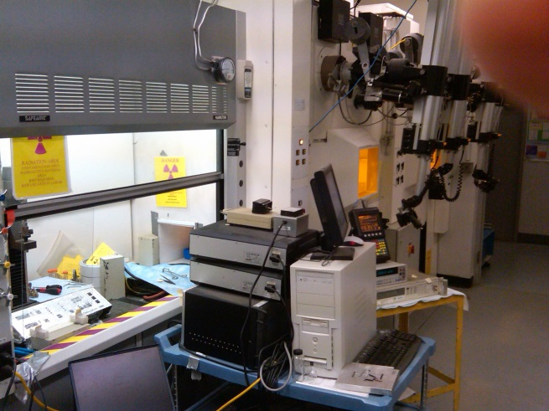
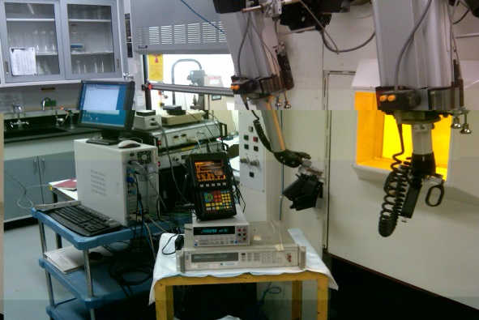
Isotope Extraction and Processing Facility at BNL
Experimental Facility occupies 2 hot cells and a HEPA-filtered fume hood
PLUS
Photon spectra and isotopic analysis
Activity measurements
Weight loss or gain

Slide 13
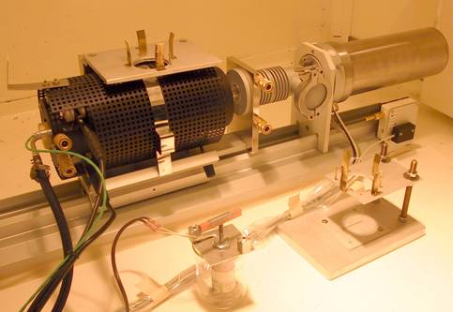
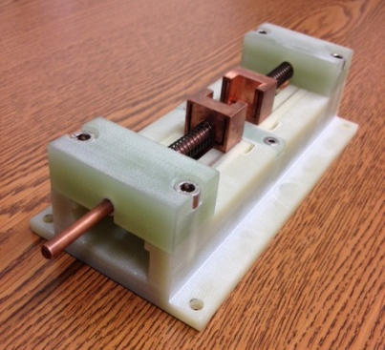
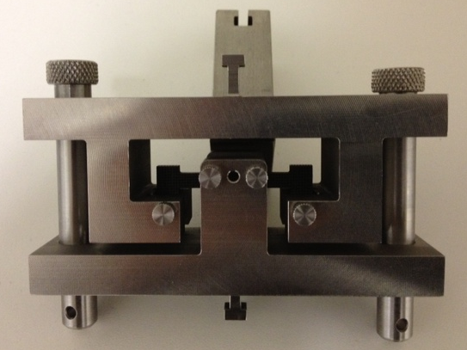
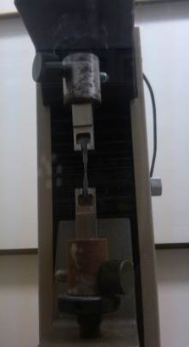
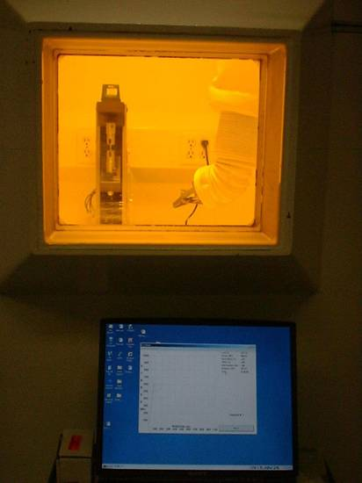
Isotope Extraction and Processing Facility at BNL
Macroscopic PIE analyses performed are:
Stress-strain (tension, 3-point and 4-point bending)
Thermal Expansion and annealing (sensitive dilatometer, Linseis)
Thermal Conductivity (electrical resistivity)
Magnetic Whole probe
Ultrasonic measurements

Slide 14
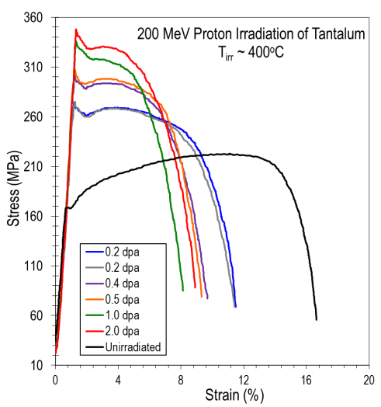
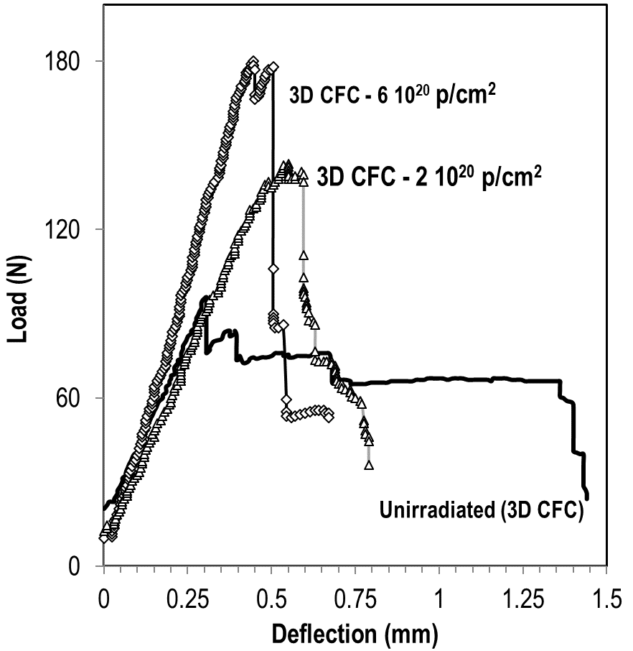

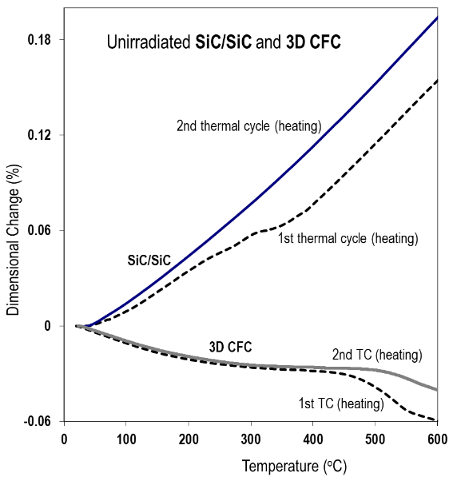
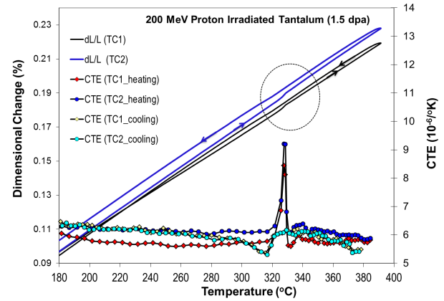
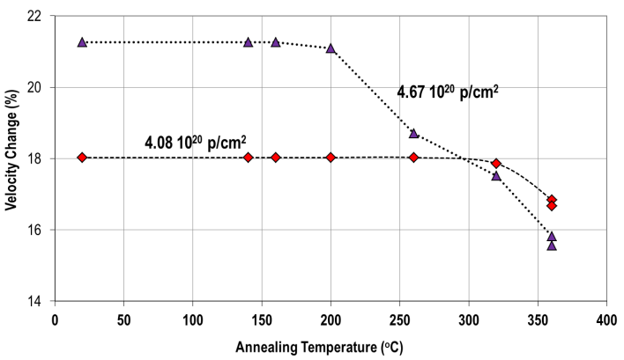
Post Irradiation Evaluation
Mech. Testing
tension
3-point bending
Phase Change
Dimensional stability
Thermal annealing

Slide 15
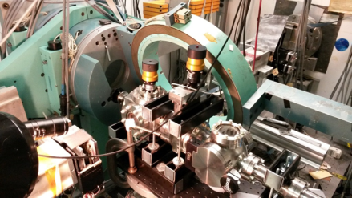

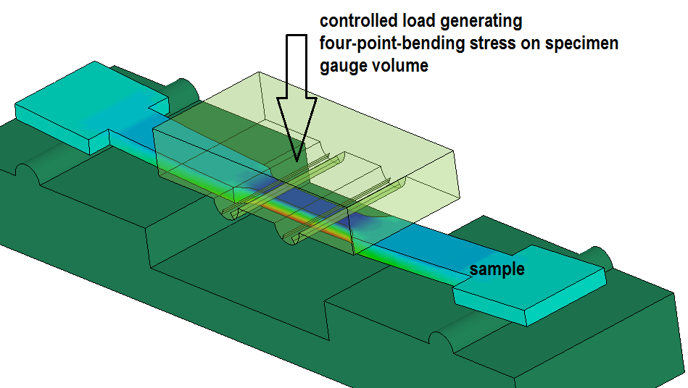
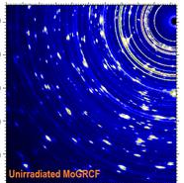
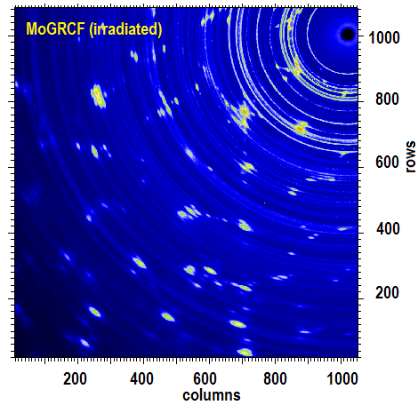
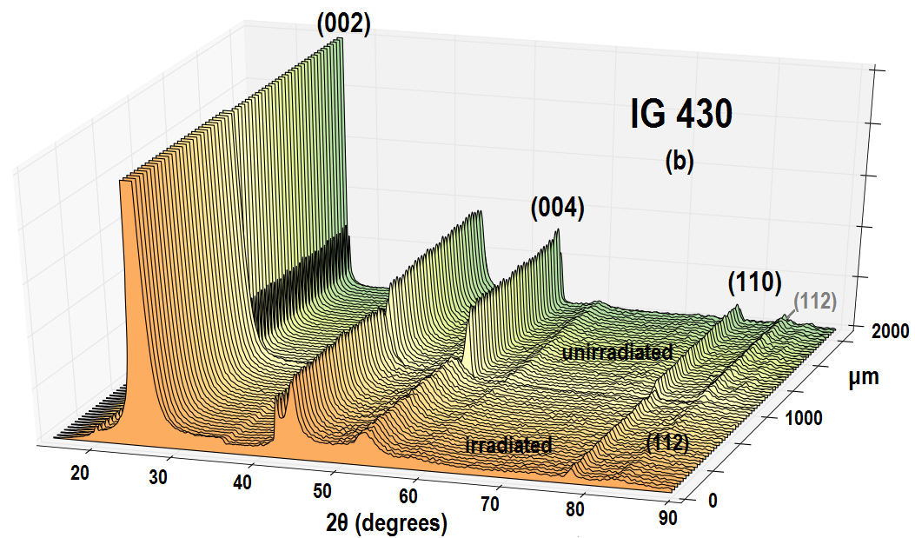
PIE X-ray Diffraction of Irradiation Materials at BNL
NSLS (end of life)
X17B1 Beamline (200 keV, polychromatic beam, EDXRD)
X17A (70 keV, monochromatic X-rays, XRD)
NSLS II (XPD) Beamline
XRD
PDF
X-Ray Tomography*

Slide 16
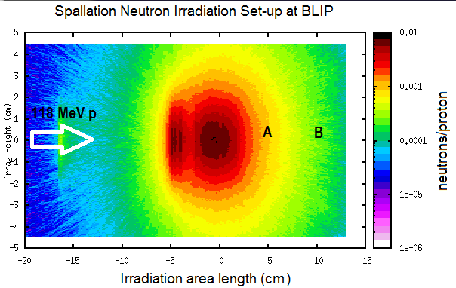
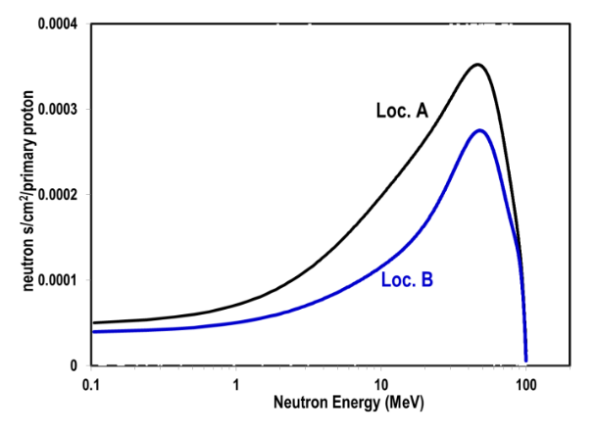
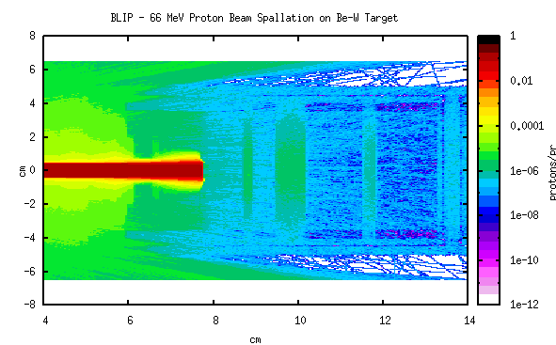
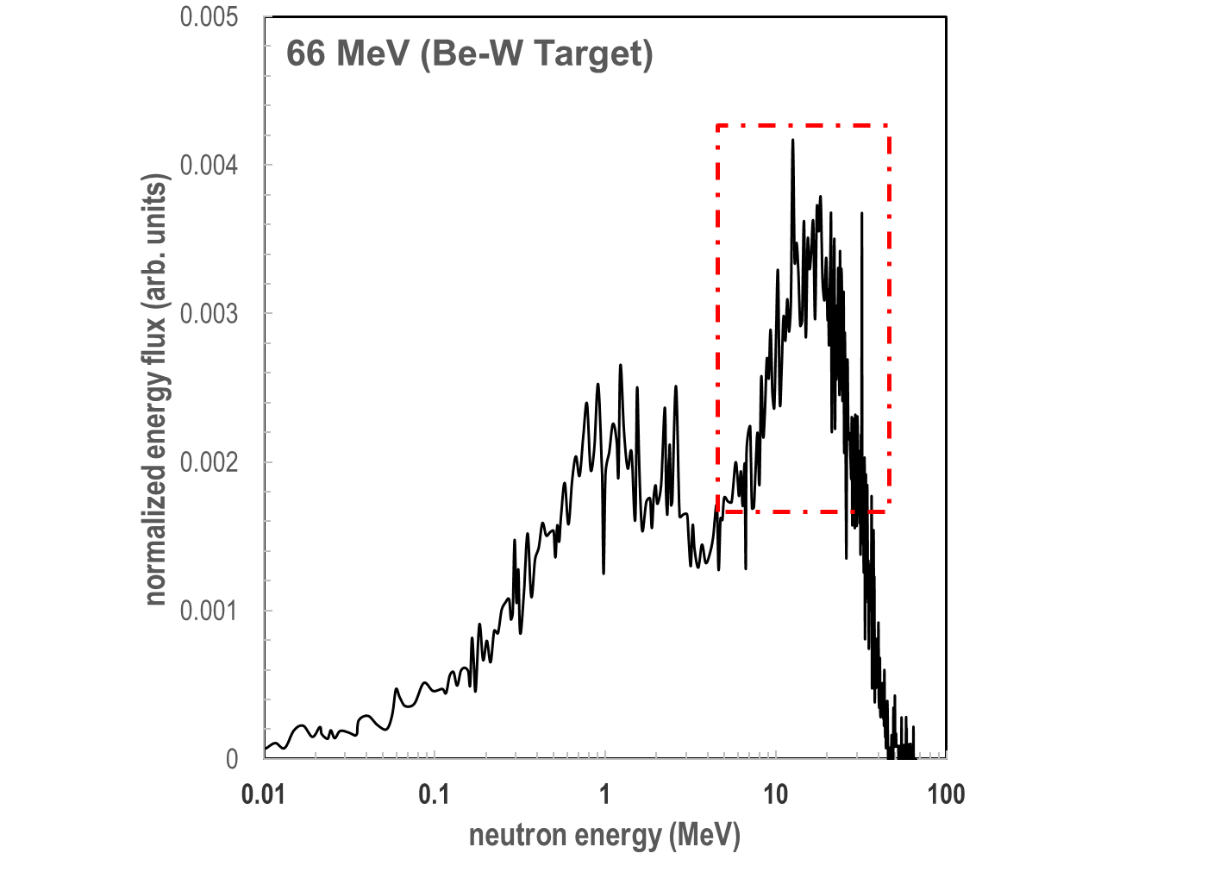
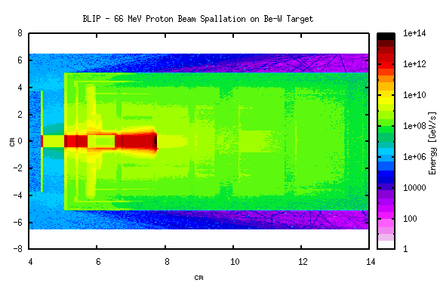
Forward: Fast neutron Spectra for Fusion Reactor Materials
Current capability in irradiating with fast neutrons (constrained by isotope production with beam at 118 MeV, thus fast spectra at 0-degree downstream peaking at ~30 MeV)
Future (explored): Proton beam at 66 MeV with W-Be spallation target
Future capability of the BNL Linac/BLIP to generate spectra peaking around 14 MeV!!
Fusion energy relevant

Slide 17
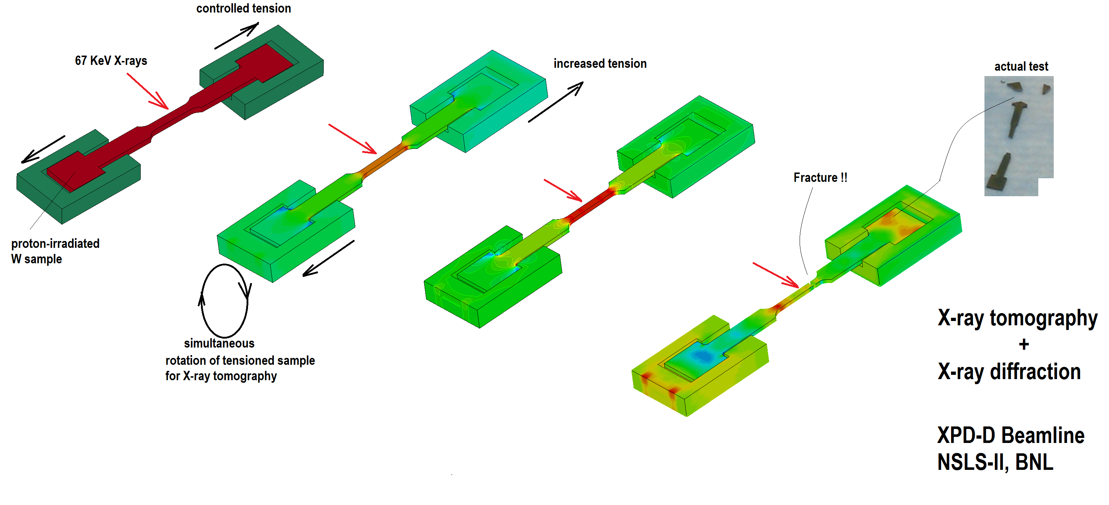
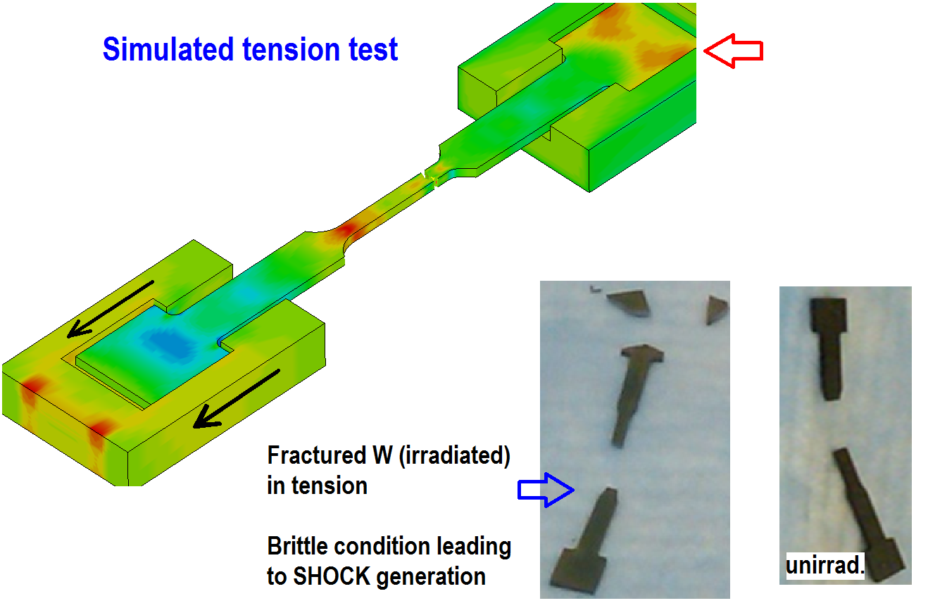
Microstructural Analysis Capabilities: NSLS2
X-ray Diffraction, X-ray tomography, small angle scattering with in-situ multidirectional loading.
Including 3-point, 4-point bending
Tension (to fracture), compression and twisting in addition to the 4-point and 3-point bending
ENABLES observation of the microstructural evolution of the IRRADIATED bulk samples as the material is taken to its limits and eventual fracture.
Crucial commissioning experiment December 9, 2019

Slide 18
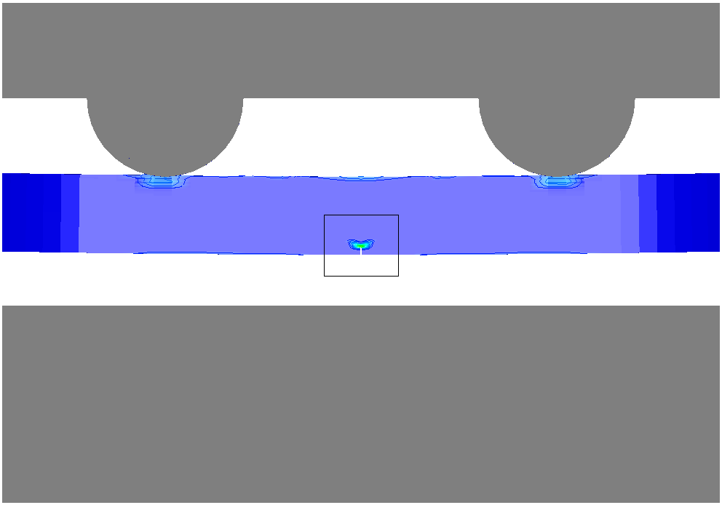
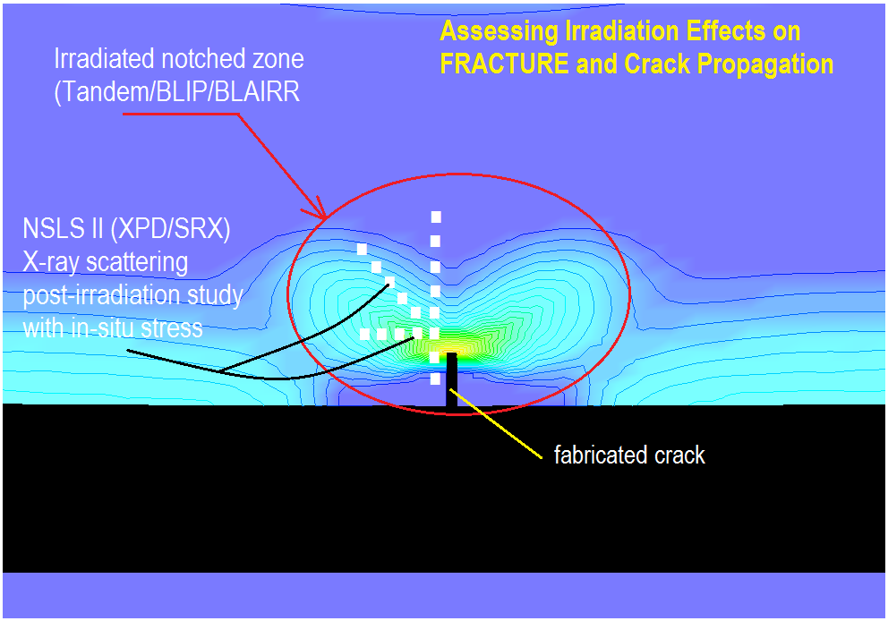
Microstructural Analysis Capabilities: NSLS2
These extreme conditions can be studied under high temperature or different ambient within the volume (chamber)
FRACTURE toughness represents another key focus of the evaluation. BNL between irradiation and X-ray characterization can provide that.
In time for this research, the HEX beam line (in addition to the XPD beamline used to-date at NSLS-II) will come into operation. HEX will enhance the capabilities offering in addition EDXRD and X-ray imaging. The experimental set-up (which was used at NSLS in a similar beamline) will take full advantage of the new capabilities.

Slide 19
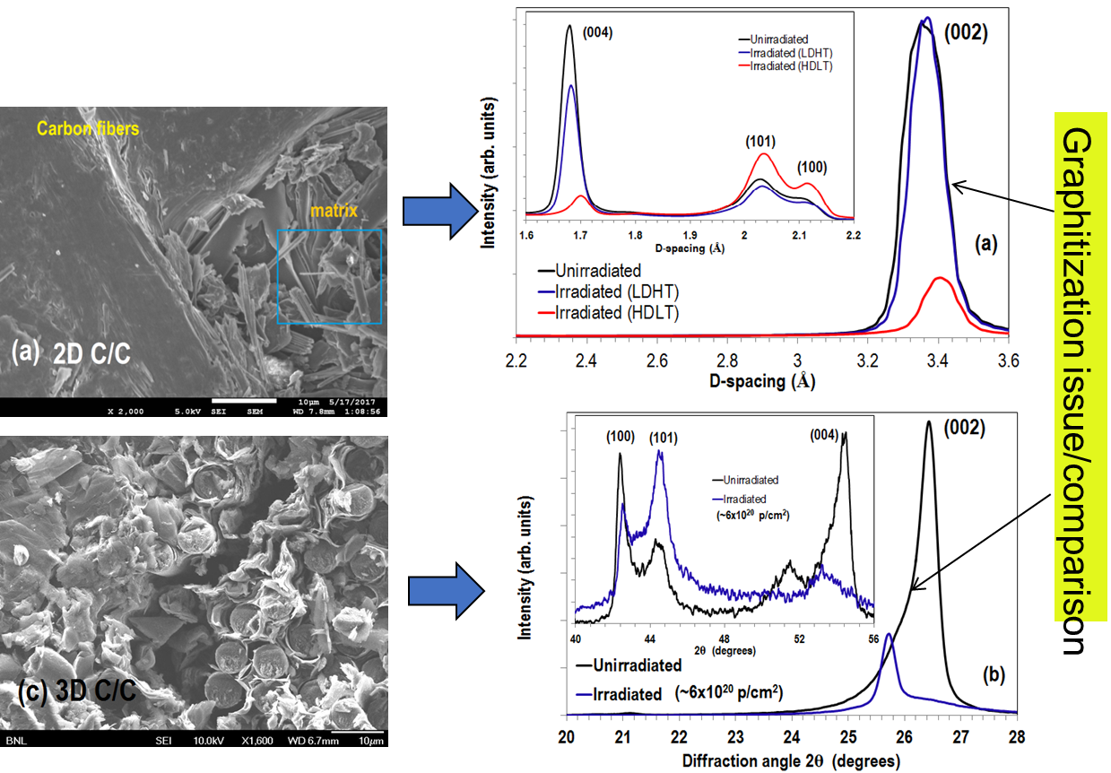
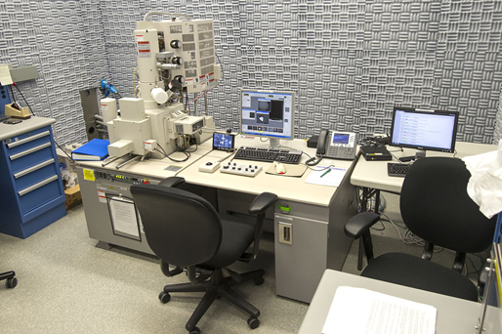
Microstructural Analysis Capabilities: CFN

Slide 20
Looking Forward at BNL
Utilizing the potential of NSLS II and establish/complete the spectrum of extreme conditions at the beamlines (high temperature, high and complex stress states, fatigue, oxidation/corrosion kinetics)
  In-situ multi-dimensional stress capabilities with X-rays adding to the 3- and 4-point bending to include
  Tension to failure
  Compression
  Torsion
  High temperature
  Oxidizing and other environments within the chamber
  X-ray Tomography, Small Angle Scattering
  and with upcoming HEX beamline: EDXRD and X-ray imaging once HEX beamline is commissioned
Bring into the suite of characterization capabilities electron microscopy for irradiated materials.
  The introduction of scanning electron microscopy (SEM) in the TPL laboratory is currently under study in coordination with the BNL Center of Functional Nanomaterials (CFN), a capability that will enhance the characterization of materials at RRPL.
LINAC/BLIP upgrade: reached 205 μA current ➔ UPGRADE goal 300 μA

Slide 21
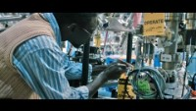
Next RaDIATE meeting at BNL

