Slide 1
Notes:
Stock Image: Abstract Data Visualization Grid

Slide 2
Recent PNNL RaDIATE Activities
HRMT43 and HRMT60 shipments
Work with Beryllium
Bend tests
Sample prep and TEM of Beryllium
Modulus measurements
Work with Ti-Alloys
Publication of work presented in 2019
Atomic Column Imaging
Molecular Dynamics Simulations of Radiation Damage

Slide 3
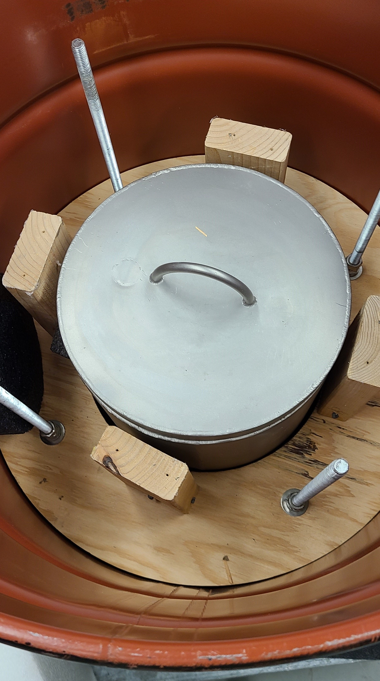
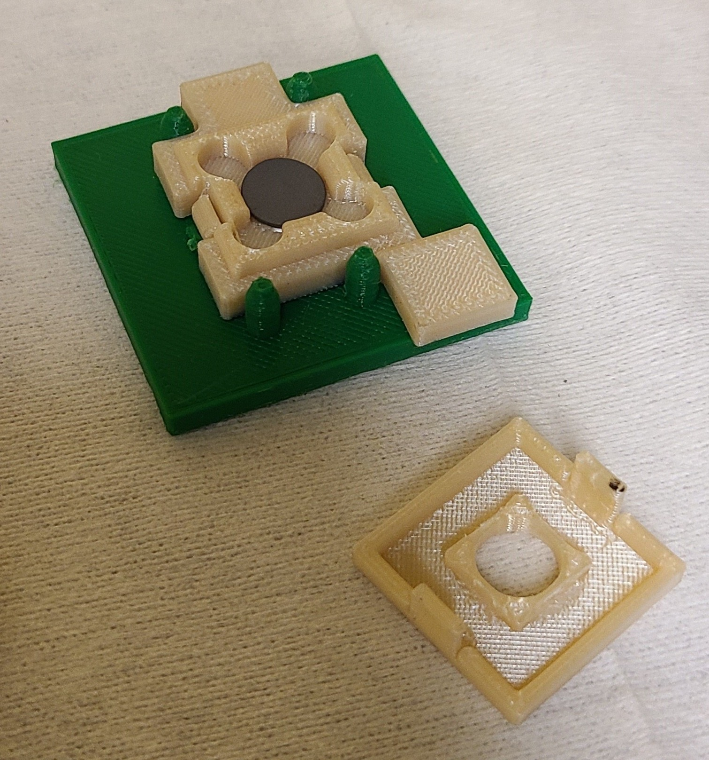
HRMT43 Shipment from CCFE
Three higher-dose samples in the container (N02, F06, C-4)
SiC-coated graphite sample in open holder
Pot designed and built by CCFE within Type A drum
PNNL received six samples from CCFE that were irradiated at CERN in the HRMT43 experiment. – 2 Ti-base alloys from DS Ti-1 BLIP capsule, 2 Ti-base alloys from the Ti-2 BLIP capsule, and 2 SiC-coated graphite samples from the Si capsule

Slide 4
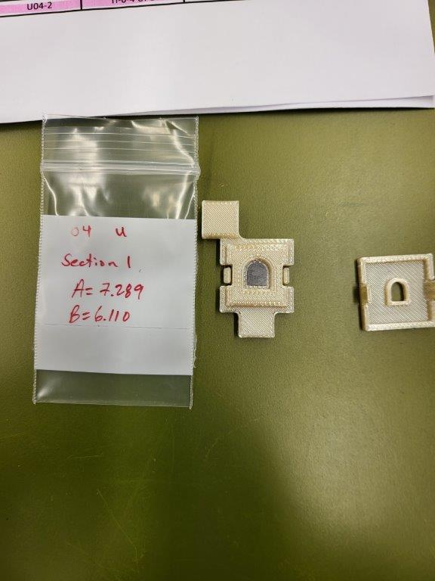
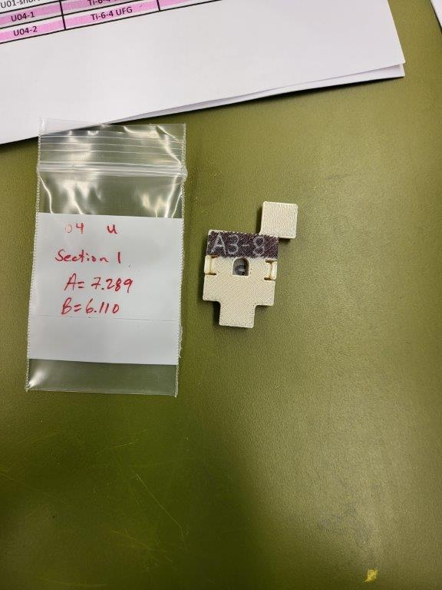
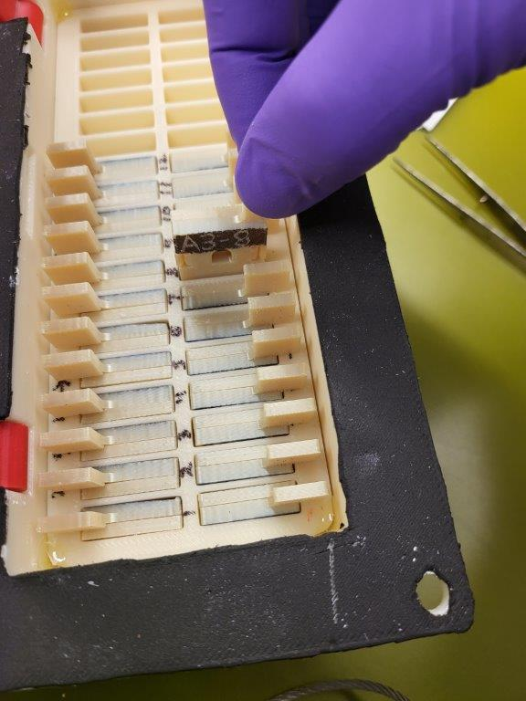
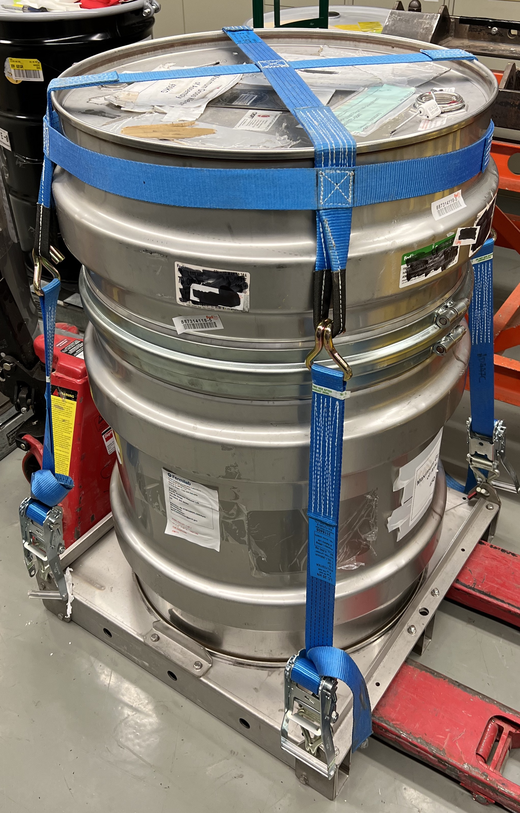
HRMT60 Sample Array
Sectioning and loading of NT-02 graphite fins
Loading of additional samples - 8/24/22
Loading into Drum - 8/24/22
Shipment from Richland to Dulles 9/6/22
Flight from Dulles to Zurich - Pending
Sample in holder base
Sample closed in holder
Enclosed sample being loaded into array
Drum ready for shipment

Slide 5
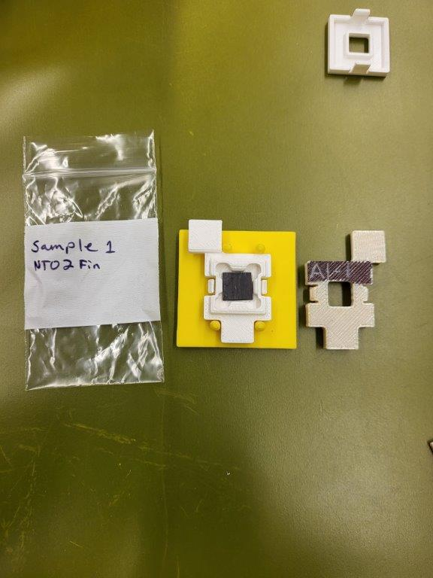
Sectioning and Loading NT-02 Fin Samples
The graphite fins were sectioned with a low-speed saw with a single saddle chuck with light clamping
The sample cross-section was further size-reduced with a wafering chuck
The sample was then test fit to a sample holder and filed down as needed

Slide 6
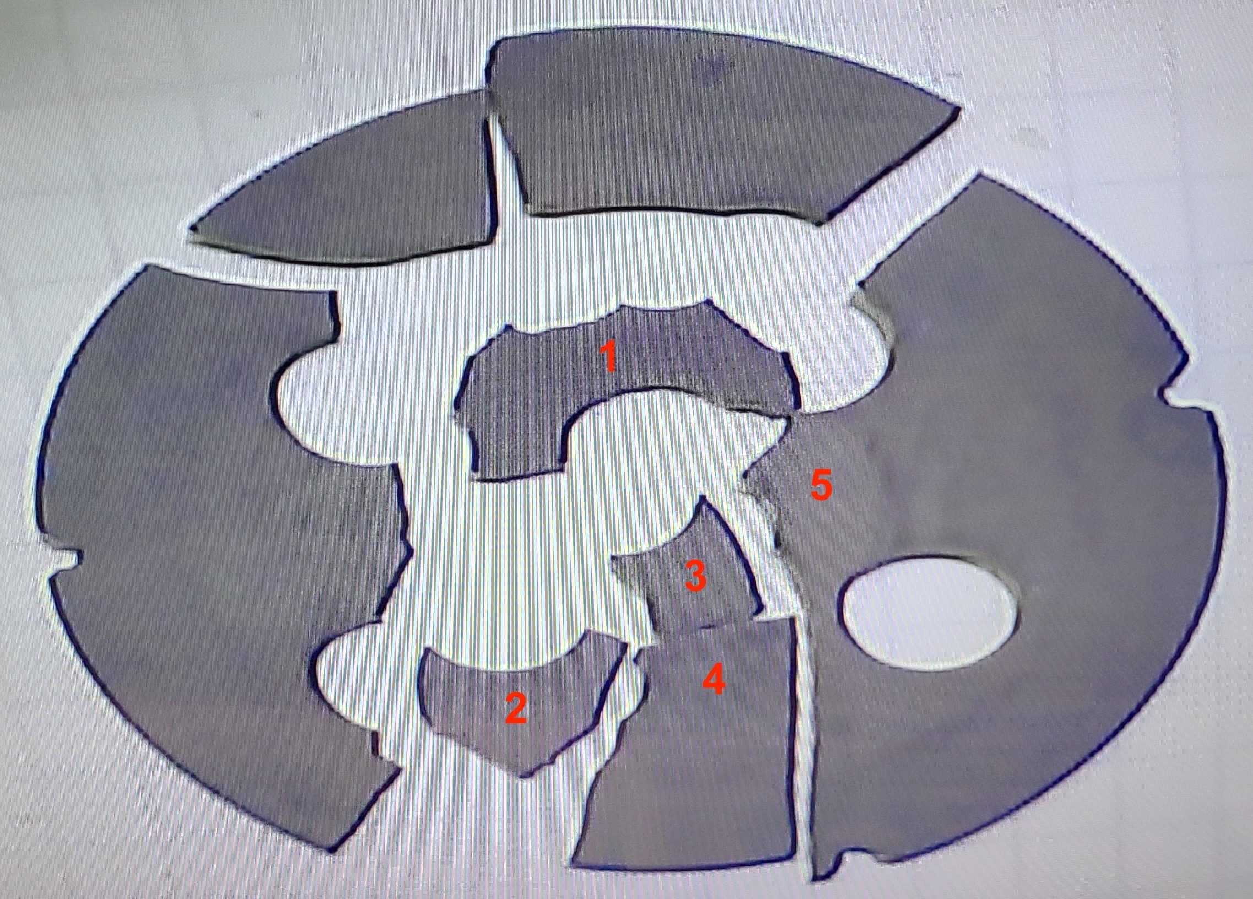
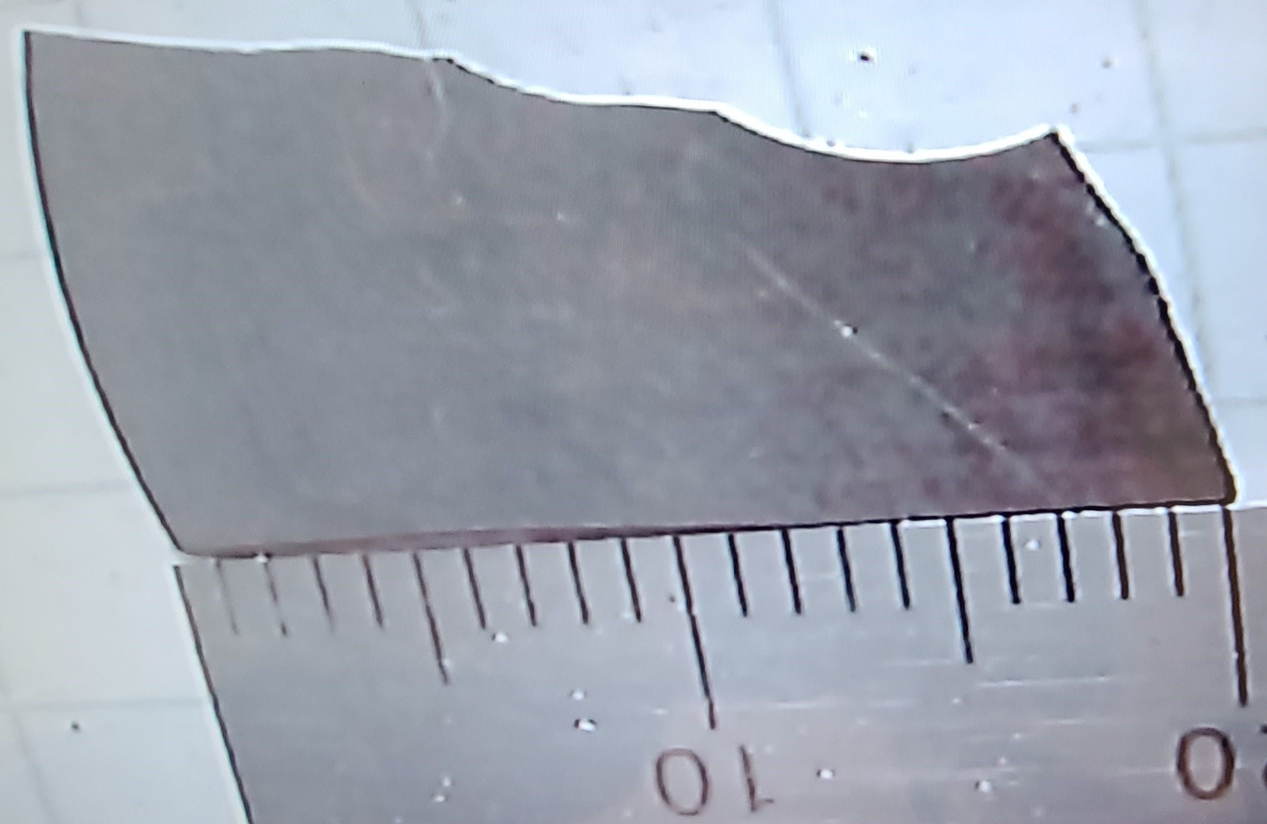
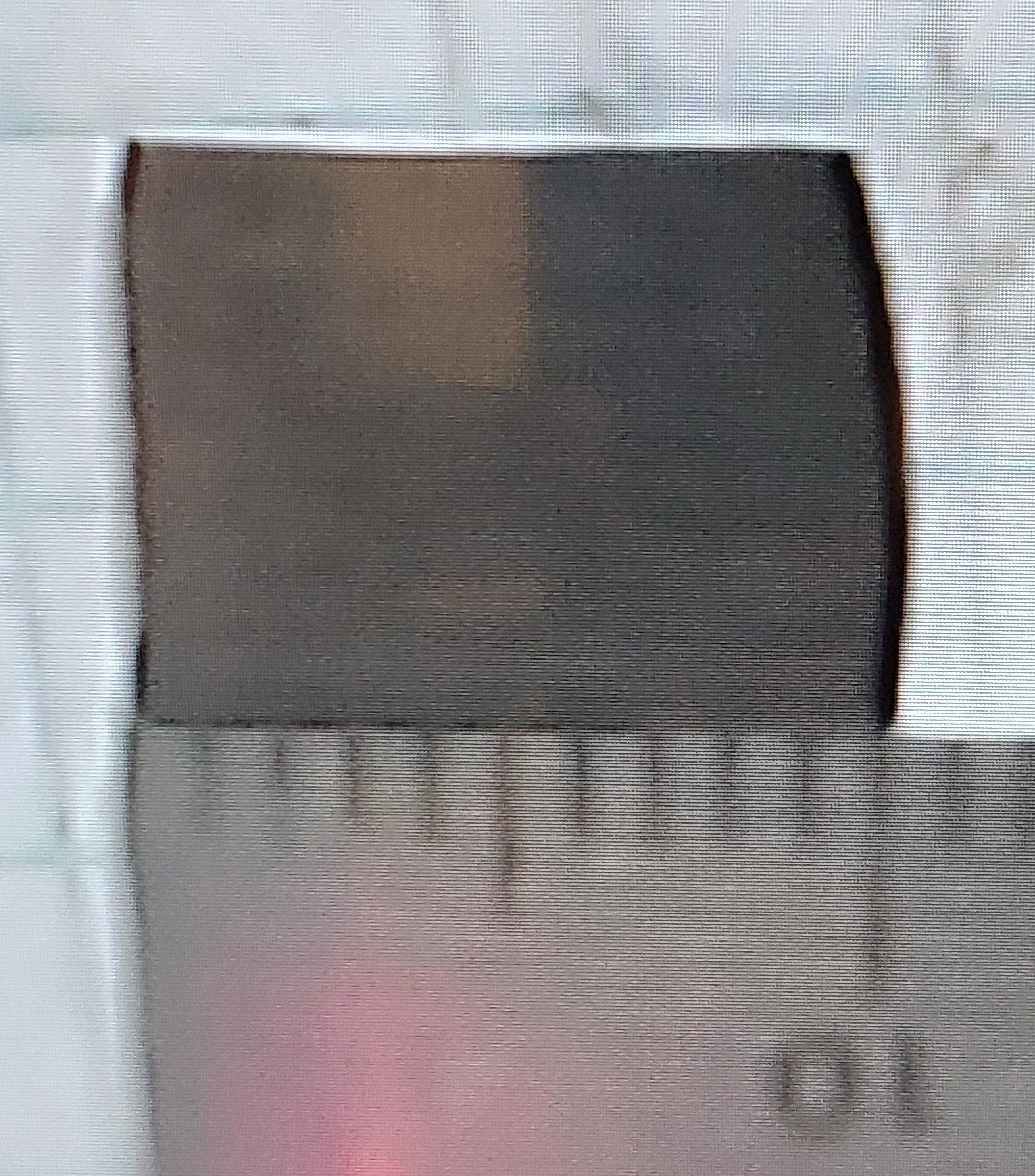
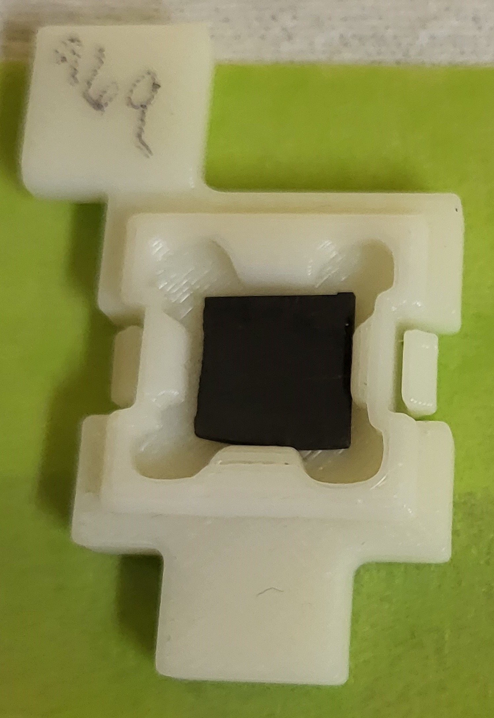
Sectioning and Loading of IG-430 Samples
These samples were cut from the disk used as a sample holder for the SiC-coated graphite samples in the Si capsule
Samples were taken from pieces located as close as possible to the center of the beam
Samples were cut dry with a low-speed diamond saw in a hot cell
Sample dimensions were irregular and custom holders were designed and printed at Fermilab to accommodate each specimen
Test fits with prototype holders printed at PNNL were used to fine-tune the sample holders as needed.

Slide 7
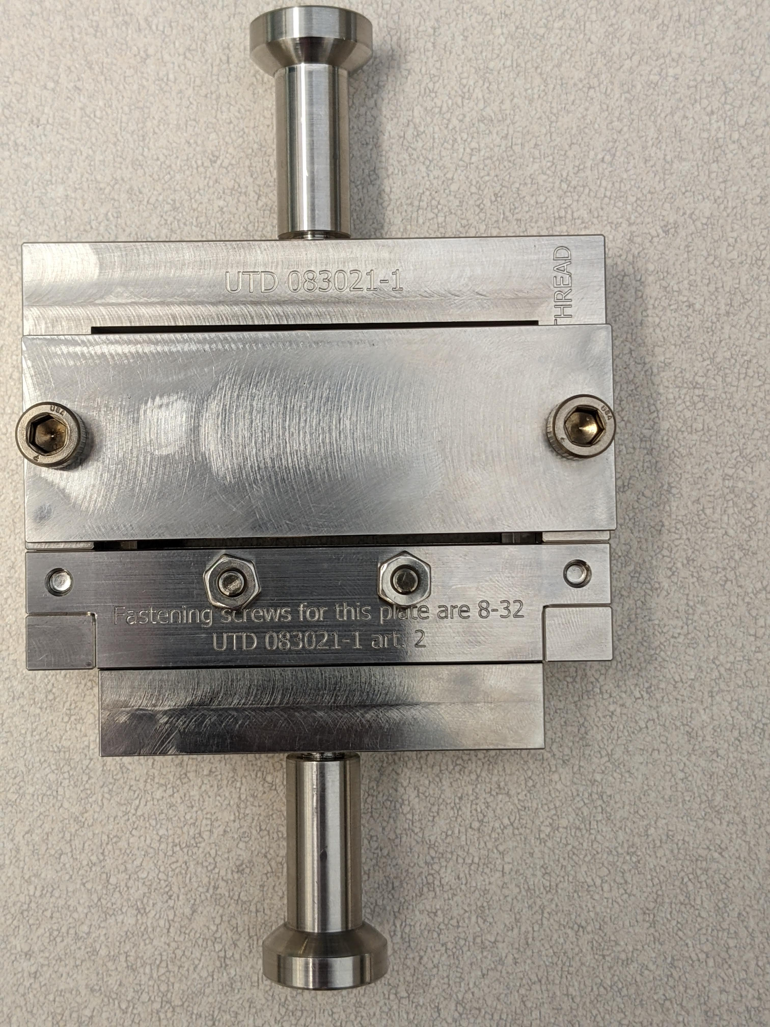
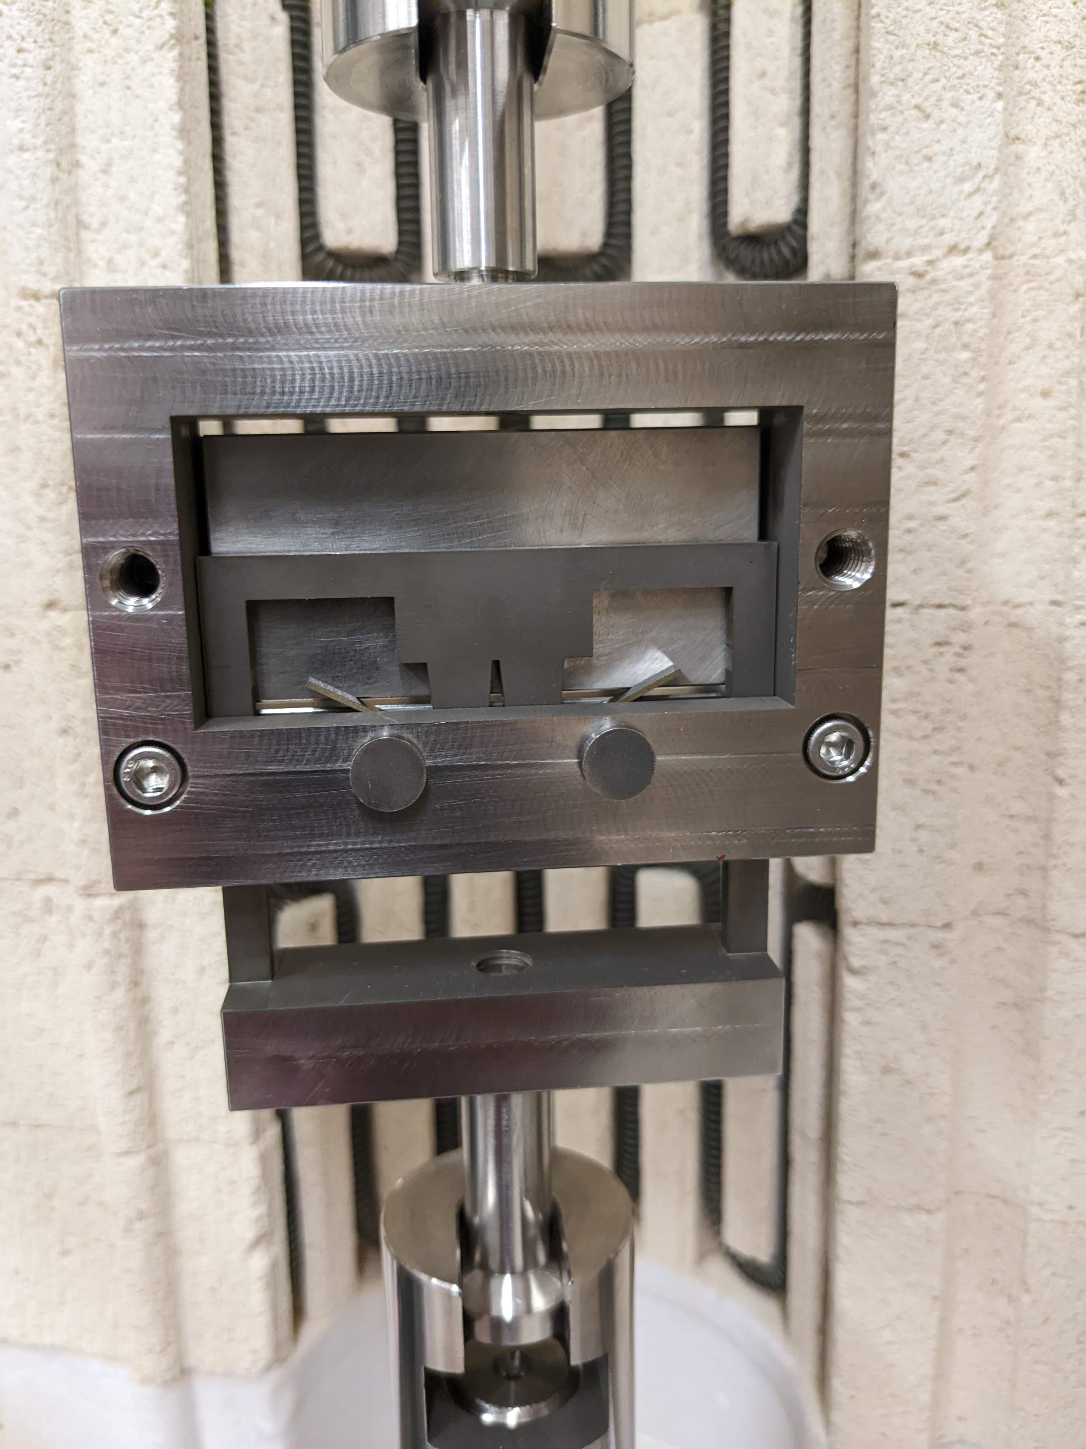
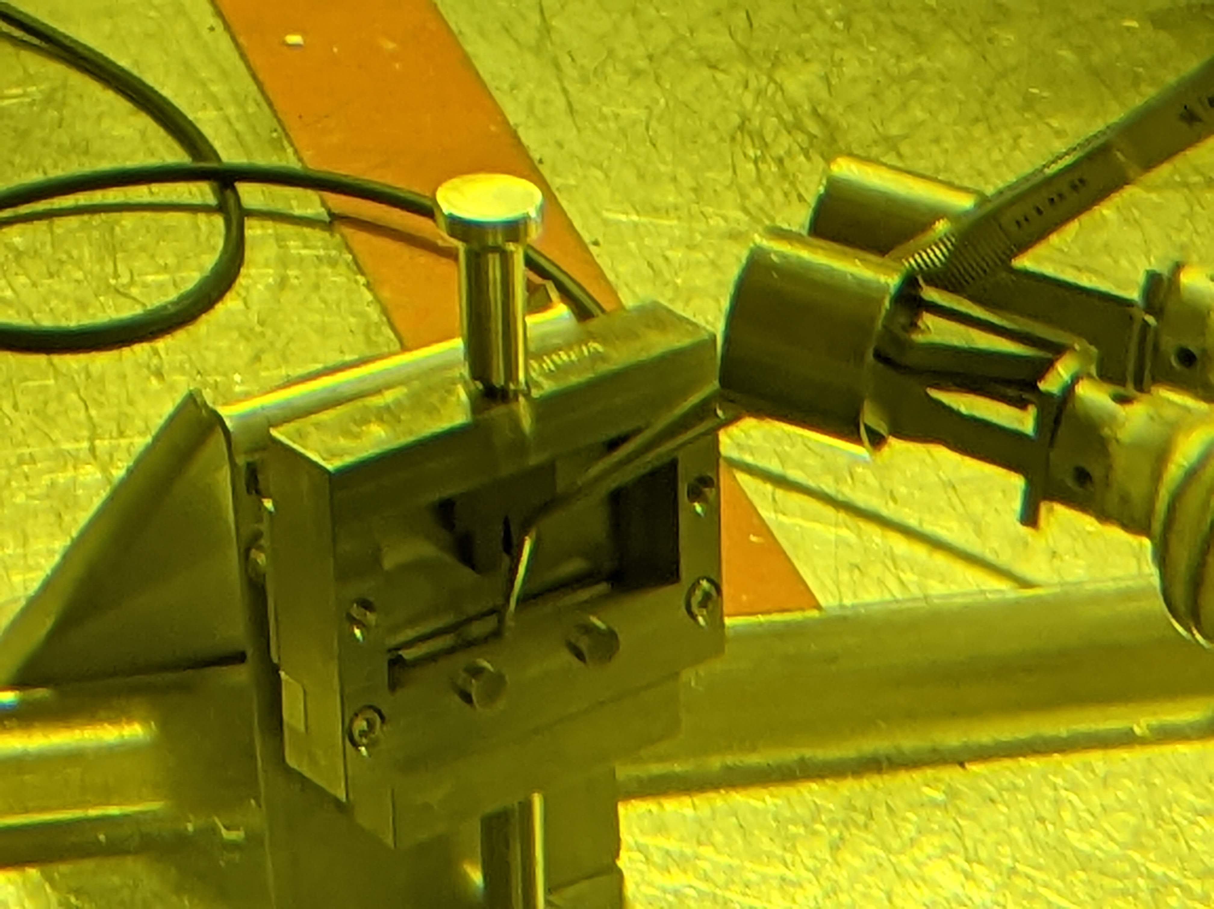
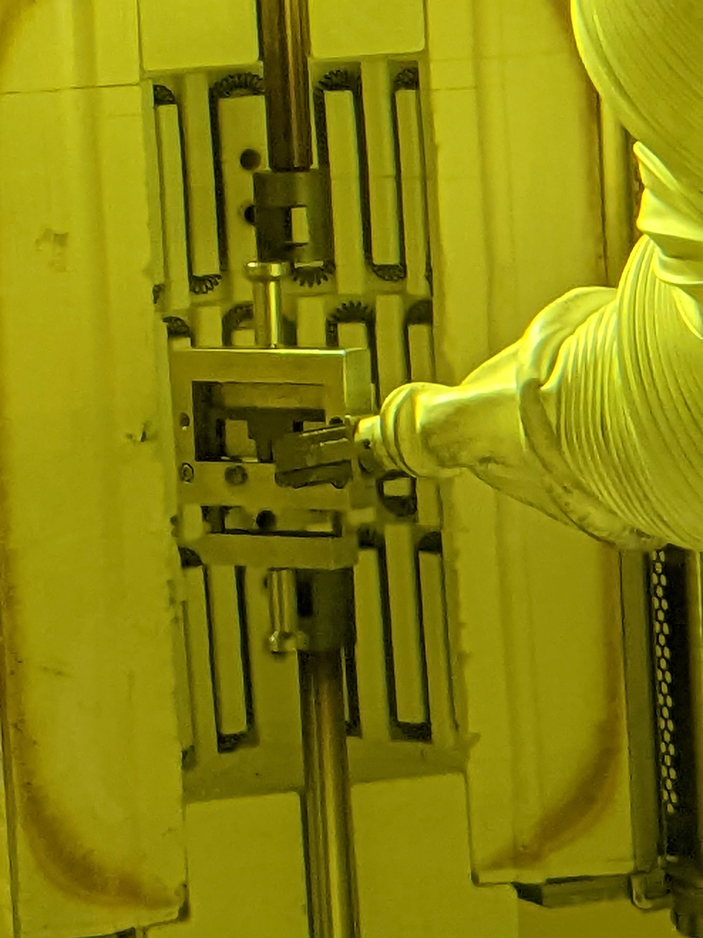
Beryllium Bend Tests
A new four-point bend fixture was designed and fabricated
Tests have been completed with unirradiated stainless steel
The fixture is now in place in the hot cell for testing of irradiated samples.

Slide 8
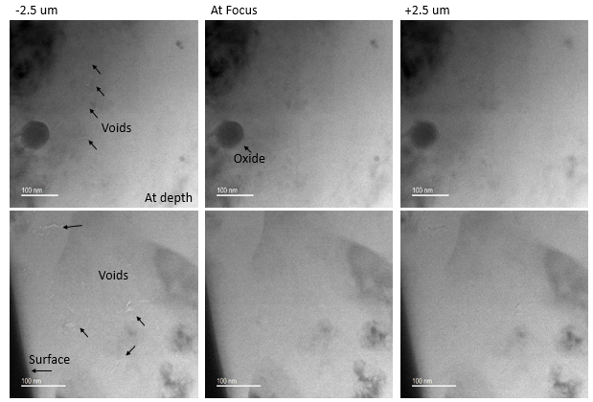
TEM of Beryllium Samples
Under focus – light contrast
Over focus – dark contrast
Large void structures near surface
Smaller at depth in the lamella
Process for sample preparation with electropolishing was developed
TEM analysis of two samples was attempted
TEM

Slide 9
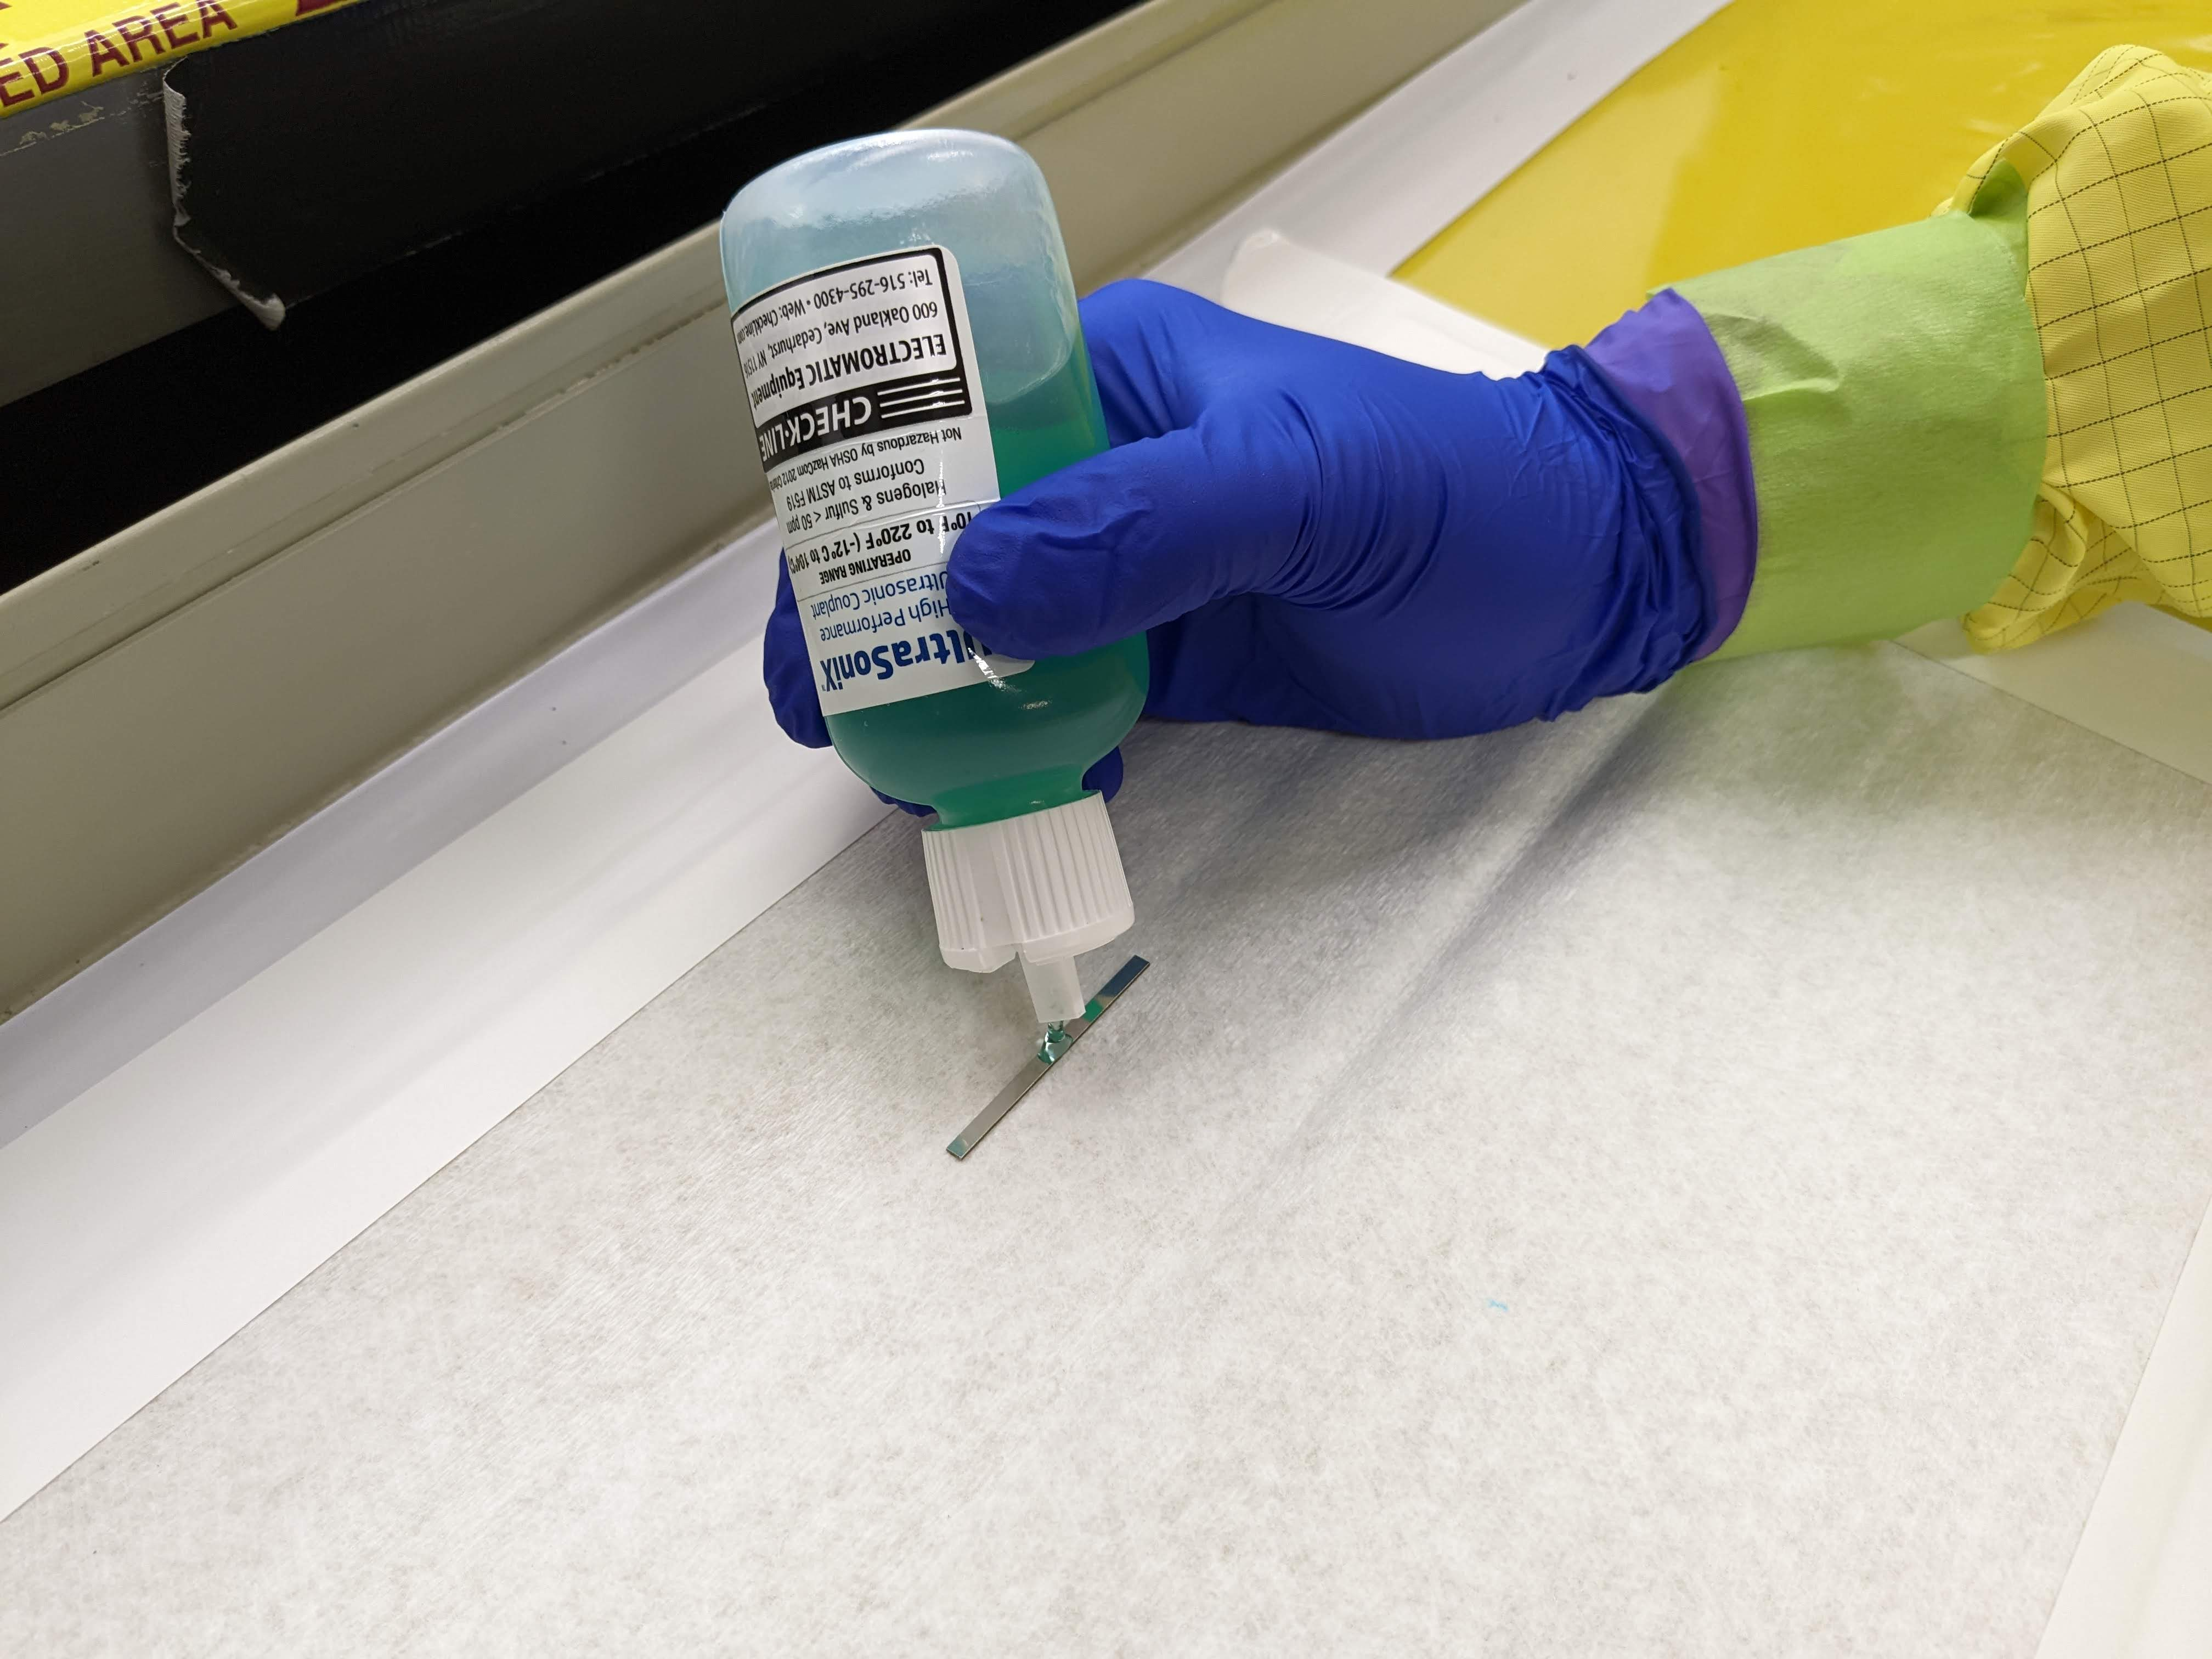
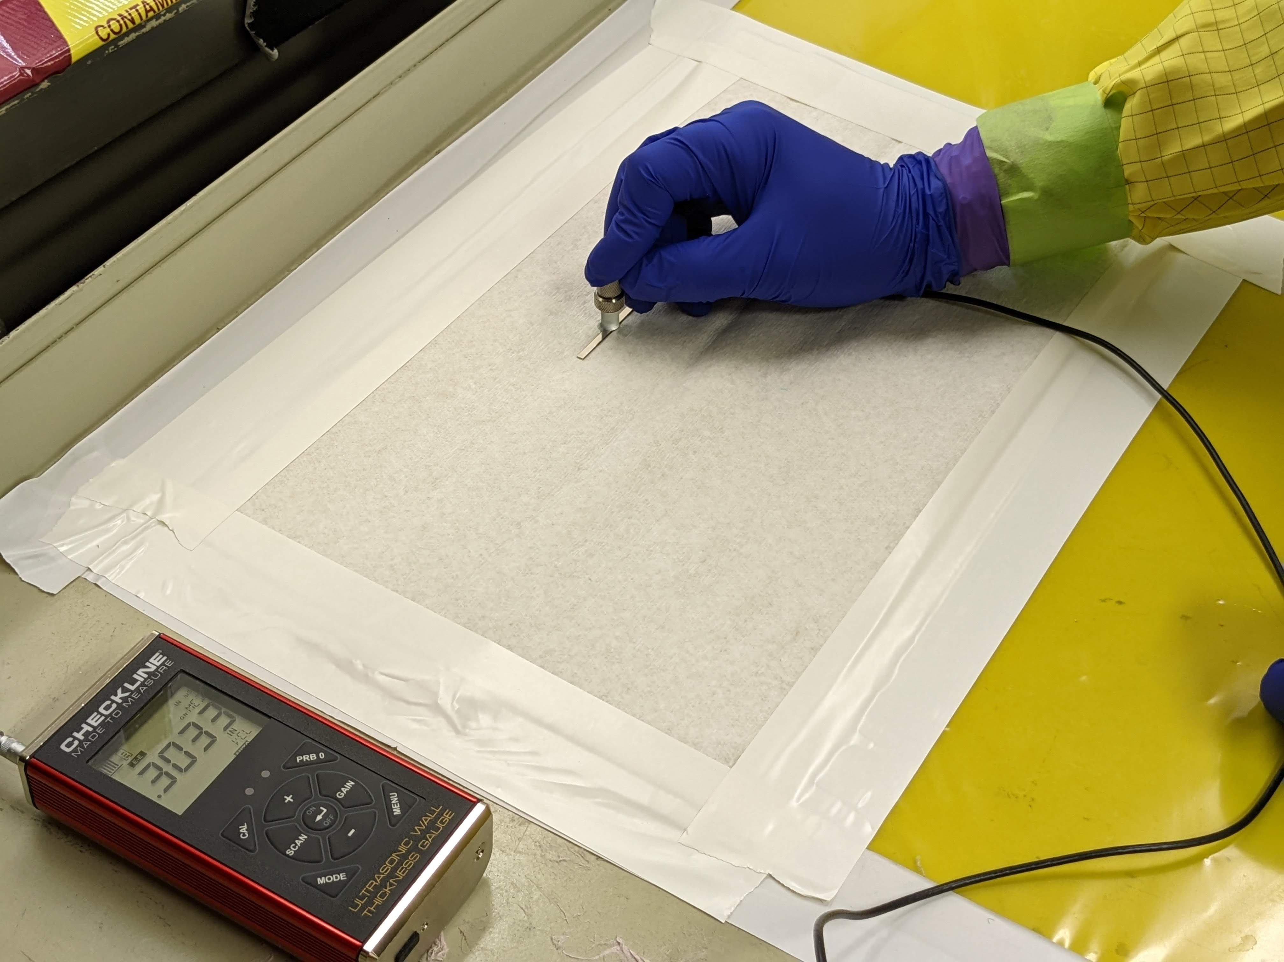
Beryllium Modulus Measurements
Modulus measurements were made on unirradiated and irradiated beryllium bend bars in the hot cell air lock
The results show an 8 – 8.5% increase in modulus after irradiation
Be Grade | Condition | Specimen ID | Sound Velocity (m/s) | Young’s Modulus (GPa) | Average Modulus (GPa) | % Change in Modulus after irradiation
PF60 | Unirradiated | P16 | 13105 | 314 | 310 | 8.06
 |  | P19 | 13101 | 314
 |  | P21 | 13027 | 310
 |  | P23 | 13198 | 318
 |  | P24 | 13081 | 313
 |  | P25 | 12837 | 301
 |  | P29⁺ | 12871 | 303
 |  | P30⁺ | 12924 | 305
 | Irradiated | P3 | 13572 | 337 | 335
 |  | P4 | 13597 | 338
 |  | P10 | 13450 | 331
 |  | P20 | 13535 | 335
 |  | P22 | 13541 | 335
 |  | P26 | 13610 | 339
 |  | P27 | 13547 | 335
 |  | P28 | 13465 | 331
Be Grade | Condition | Specimen ID | Sound Velocity (m/s) | Young’s Modulus (GPa) | Average Modulus (GPa) | % Change in Modulus after irradiation
S-65F | Unirradiated | S2 | 12577 | 289 | 292 | 8.56
 |  | S8 | 12750 | 297
 |  | S10 | 12705 | 295
 |  | S11 | 12593 | 290
 |  | S13 | 12623 | 291
 |  | S16 | 12584 | 289
 | Irradiated | S3 | 13001 | 309 | 317
 |  | S4 | 13209 | 319
 |  | S5 | 13236 | 320
 |  | S9 | 13143 | 316
 |  | S12 | 13208 | 319
 |  | S17 | 13168 | 317
 |  | S19 | 13153 | 316
 |  | S25 | 13168 | 317

Slide 10
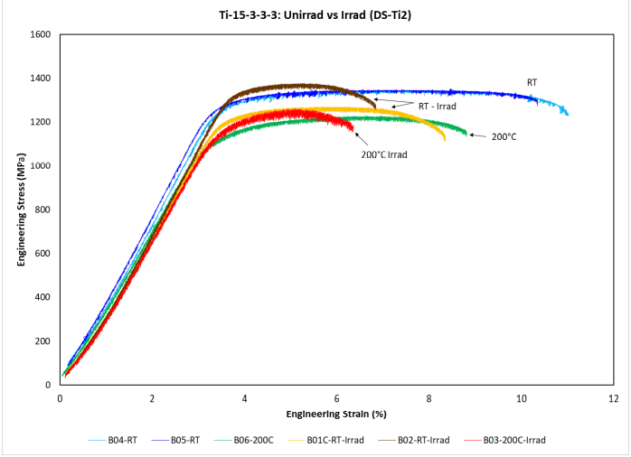
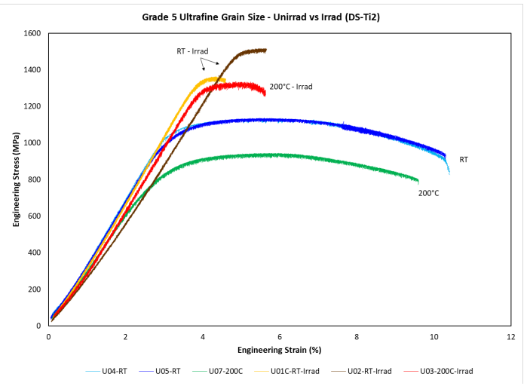
Titanium-Alloy Work Published in JNM
Ti-6-4 showed increased hardness and greater loss of ductility than Ti-3Al-2.5V
TEM showed a higher density of defect clusters in Ti-6Al-4V.
Similar results for Ti-15-3-3-3 show less radiation induced hardening and loss of ductility than Ti-6Al-4V
Ultrasonic measurements showed a 10-15% decrease in modulus after irradiation

Slide 11
TEM of Titanium Sample
Raw HAADF atomic data
FFT of the left panel with the appropriate crystallographic planes annotated
FFT filtered image of the left panel with ball and stick overlays of the omega/beta phases

Slide 12
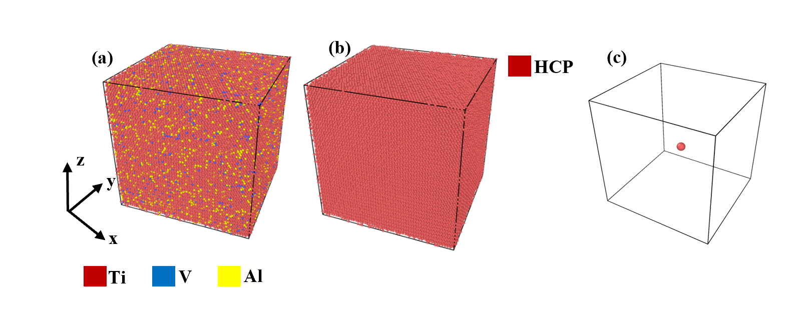
Molecular Dynamics Simulations of Radiation Damage in Ti-Alloys
Relaxed system
Common neighbor analysis shows HCP
The Ti PKA selected for examination
MD simulations show Ti-6Al-4V has a higher irradiation damage than Ti-15V-3Cr-3Al in the ballistic stage. The surviving number of Frenkel pairs is almost equal in both alloys.
The average displacement threshold energy is higher in Ti-15V-3Cr-3Al with a value of 73.5 eV as compared to 66 eV in Ti-6Al-4V.
Ti-6-4 has larger and more void clusters than 15-3-3-3.

Slide 13
Current Work
We will continue with beryllium bend tests
As funds permit – perform microscopy of beryllium samples
As funds permit – perform microscopy and thermal desorption measurements on the SiC-coated graphite samples in support of KEK between now and February.
PIE on the Ti-base alloys deferred until next JFY
We will be hosting three engineers from TRIUMF on November 7th to walk through our hot cell facilities and operations.

Slide 14
Sample Prep – Alan Schemer-Kohrn, Shalini Tripathi, Anthony Guzman
Microscopy – Danny Edwards, Matt Olszta, Kayla Yano
Shipping – Ty Buckendorf
Hot Cell Technicians – Mike Rojas, Robert Cox
Mechanical Testing – Ramprashad Prabhakaran
Modeling – Ankit Roy and Ram Devanathan

