Slide 1
Oxford University
James Marrow
(james.marrow@materials.ox.ac.uk)

Slide 2
Current Work
Graphite
  Deformation mechanisms in graphite crystals (HOPG) and bulk graphites at elevated temperatures
  Effects of irradiation on graphite crystal deformation
Titanium
  Ultrasonic fatigue testing of meso-cantilevers
  Effects of ion-irradiation

Slide 3
HOPG: Spherical Indentation
Strong effect of temperature
(~10 µm diameter

Slide 4
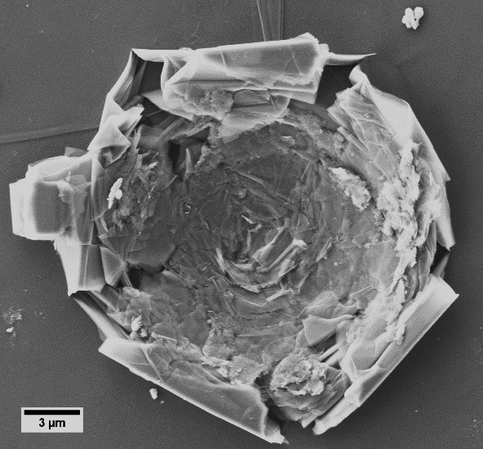
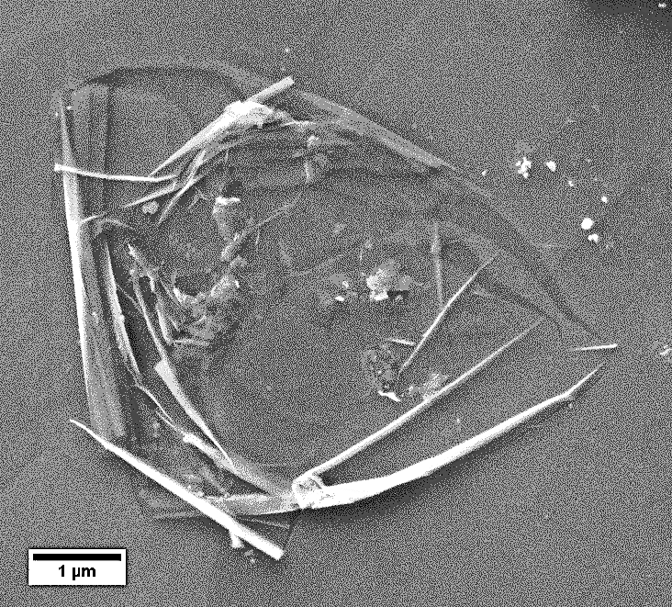
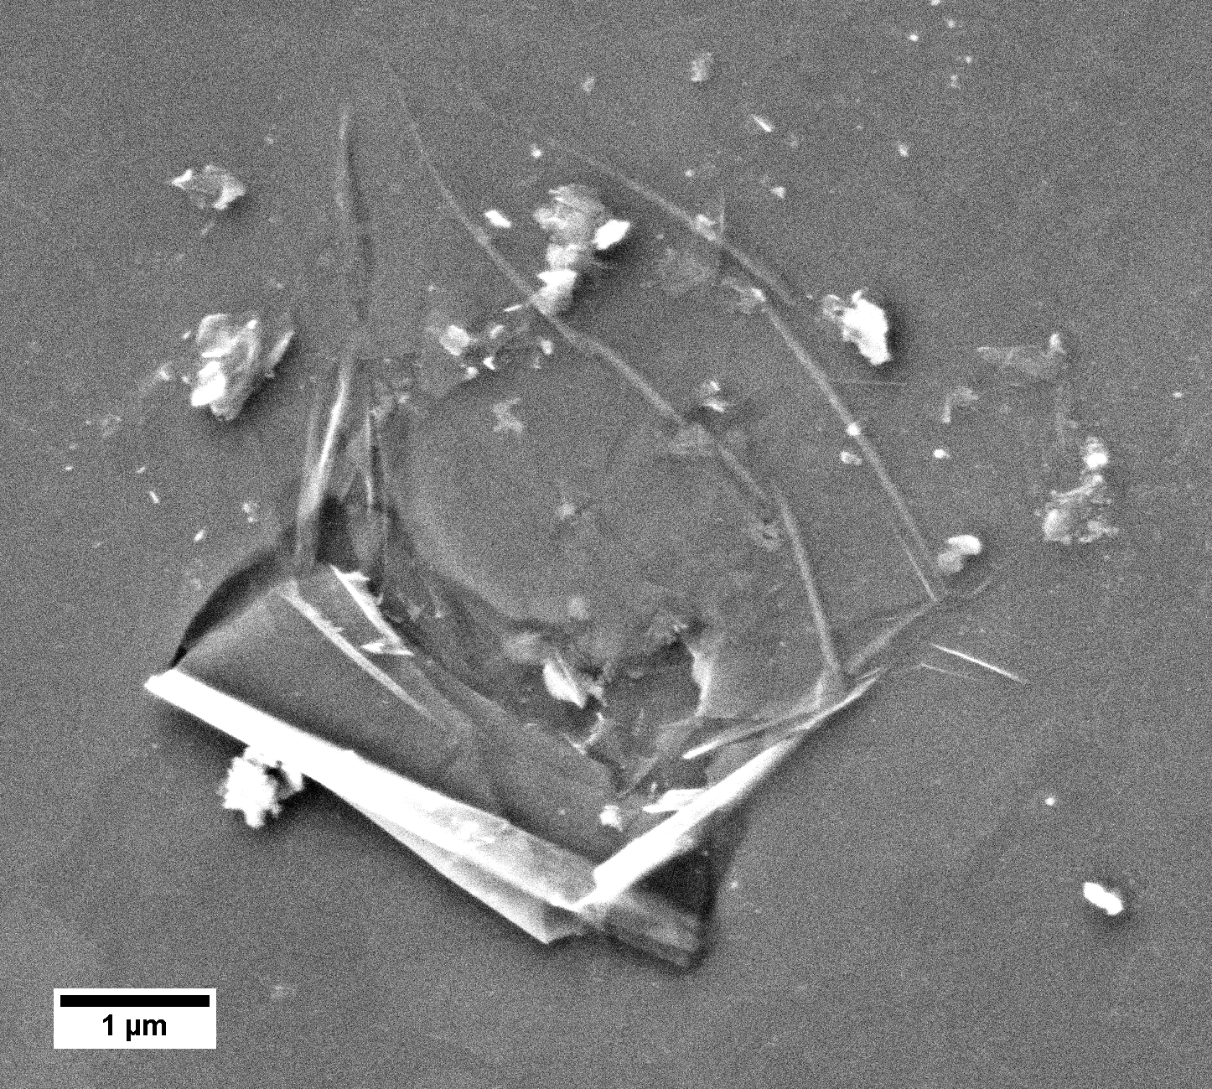
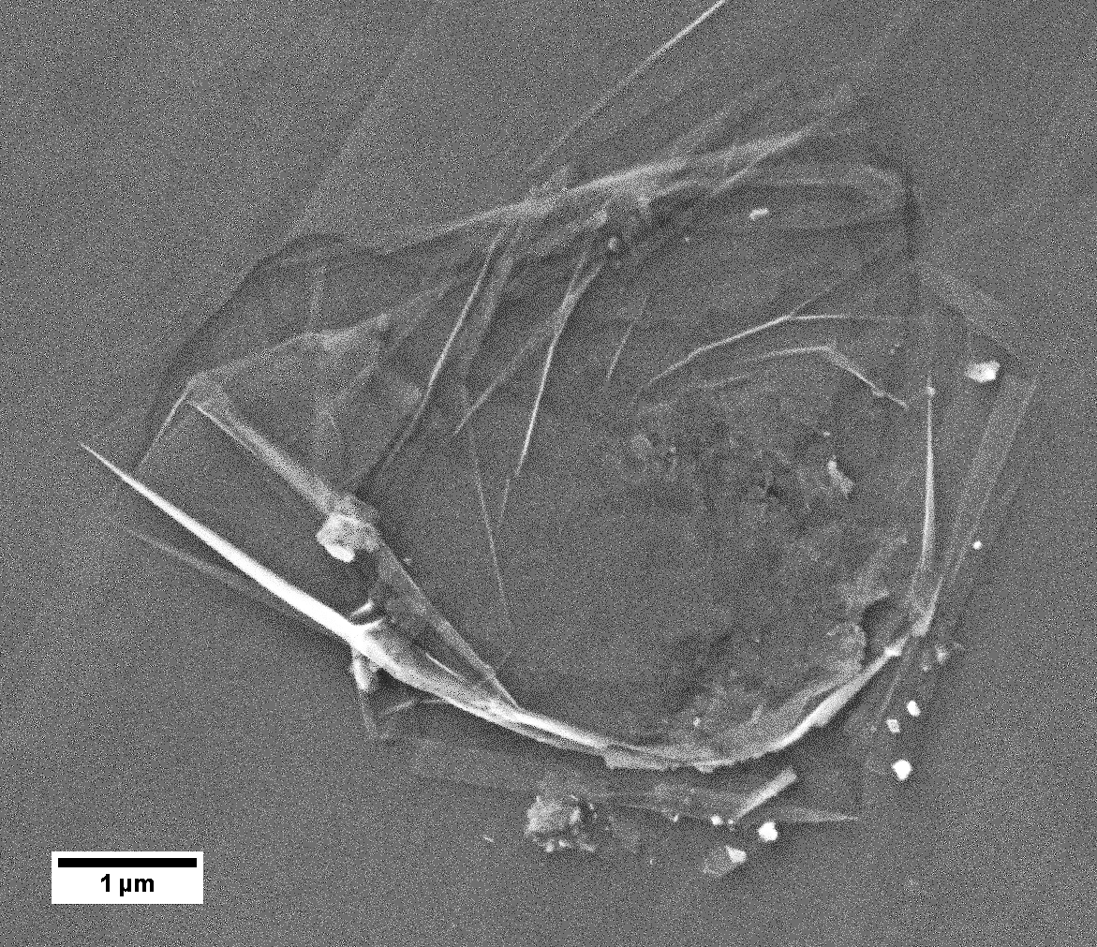
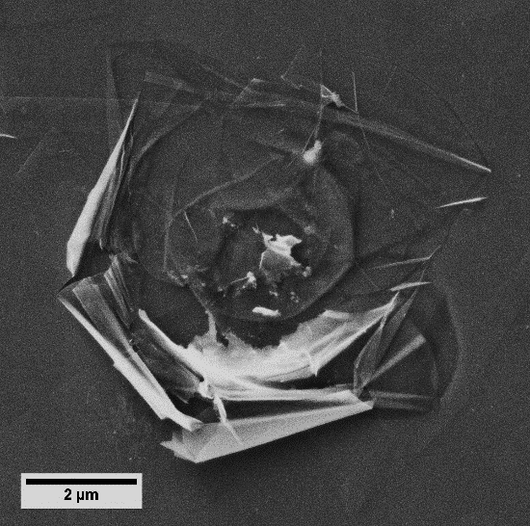
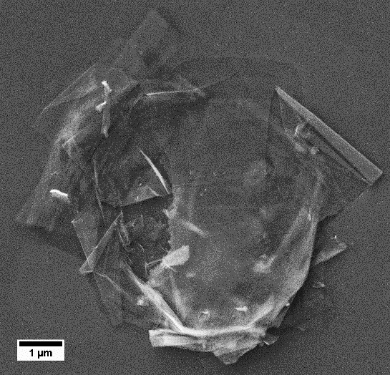
HOPG: Spherical Indentation
Strong effect of temperature
25°C
200°C
300°C
600°C
1 µm
1 µm
1 µm
400°C
500°C
2 µm
2 µm
3 µm
all at 50 mN peak load

Slide 5
HOPG: Spherical Indentation
Strong effect of temperature

Slide 6
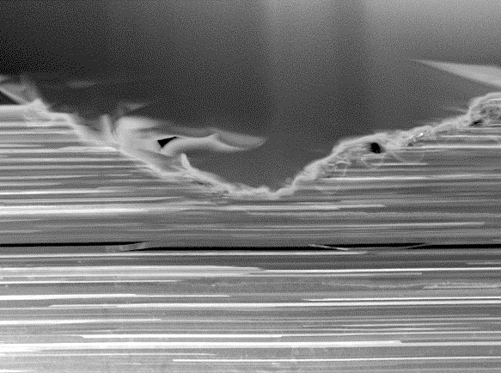
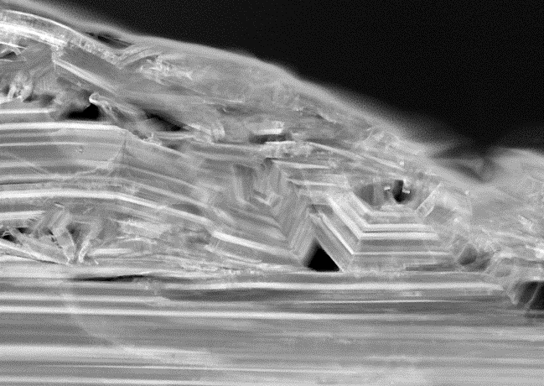
HOPG: Spherical Indentation
Strong effect of temperature
(a)
25°C
100 mN
(b)
200°C
100 mN
Kinking and buckling more prevalent at high temperatures
Postulated mechanism: Effect of temperature on crystal shear modulus C₄₄, relative to C₃₃ and C₁₁
(i)
1 µm
1 µm
25°C
25 mN
(c)
600°C
50 mN
(ii)
0.2 µm
0.5 µm
﻿10.1016/j.carbon.2022.01.067

Slide 7
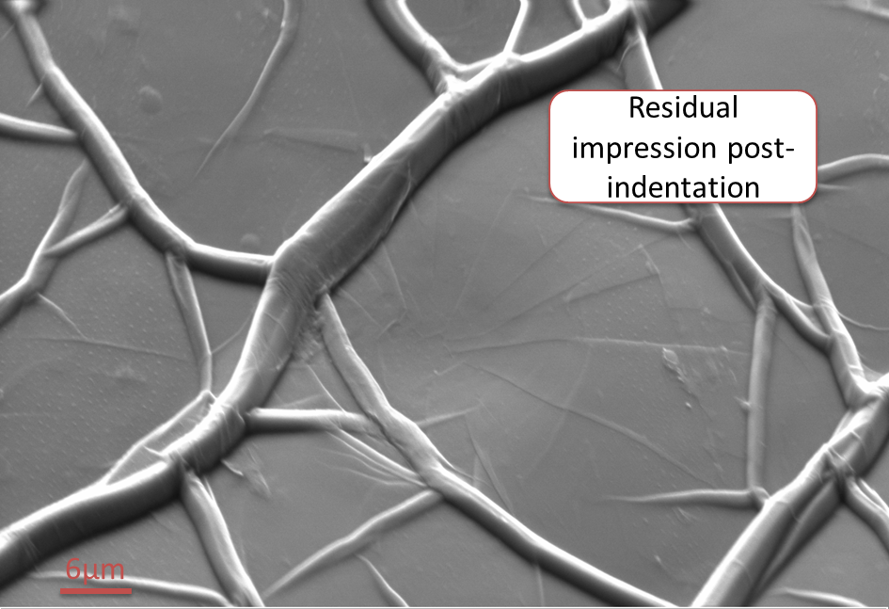
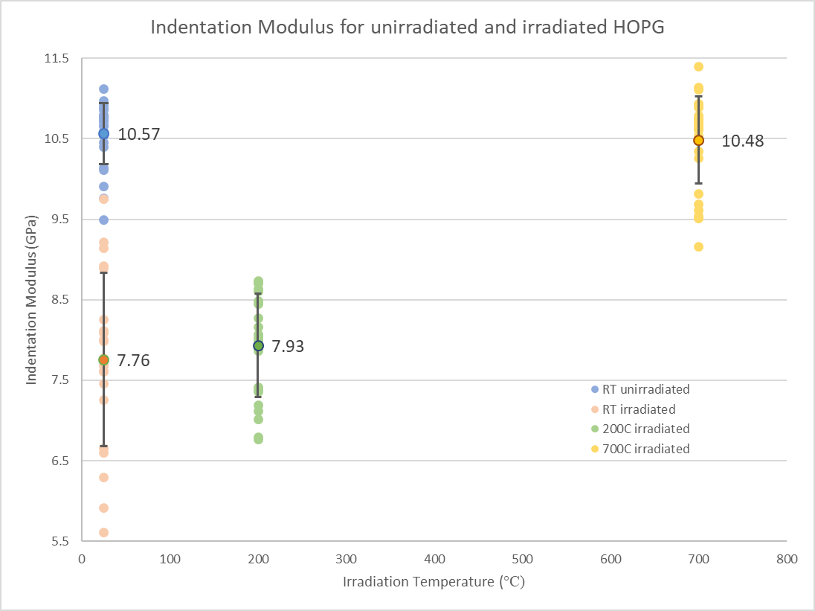
Ion-Irradiation (Dalton)
HOPG irradiated to 1 dpa by C²⁺ ions at: 25°C (RT), 200°C, 400°C and 700°C
Irradiation decreases modulus!
Continuous stiffness measurement
Irradiated (RT)

Slide 8
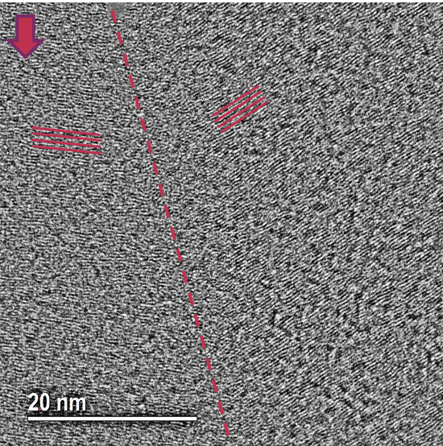
Cross-Section TEM (room temp indentations)
Irradiation causes change in kink band size
Non-irradiated
Irradiated (RT)

Slide 9
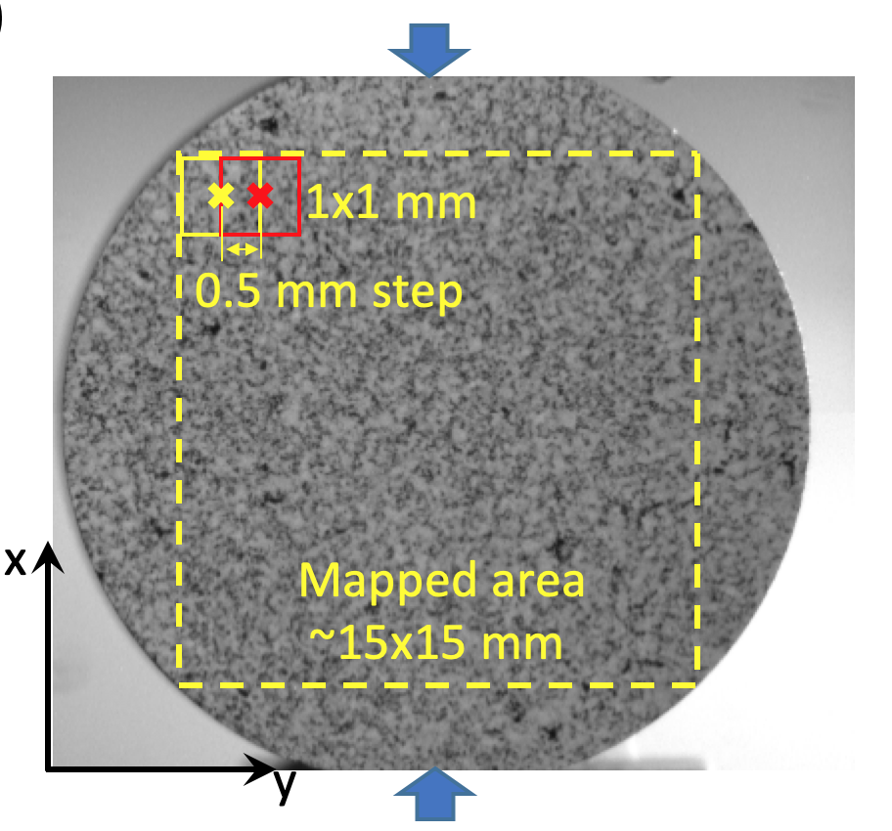
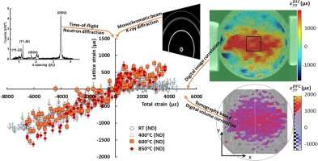
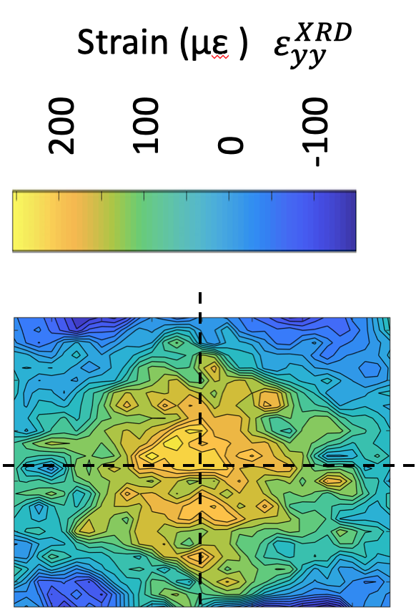
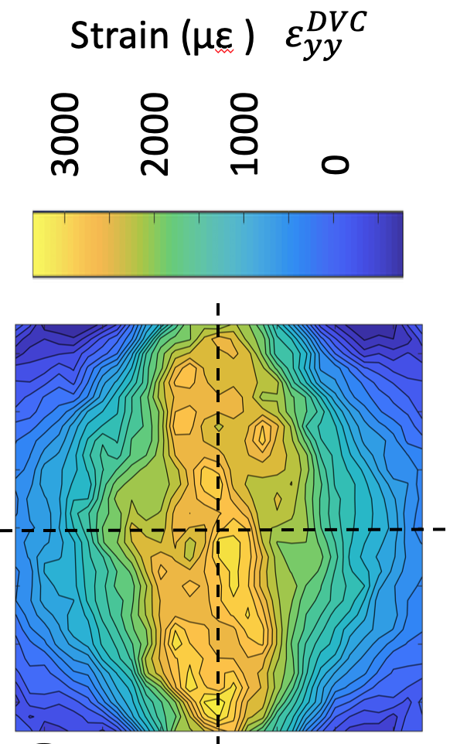
Work in Progress
﻿10.1016/j.carbon.2020.03.020
Bulk Graphite
Indentation (and annealing) of irradiated HOPG up to 700°C
Post-indentation cross-sectional TEM (no pop-in)
Gilsocarbon (ambient T)
Neutron and X-ray diffraction
Imaging
Diffraction

Slide 10
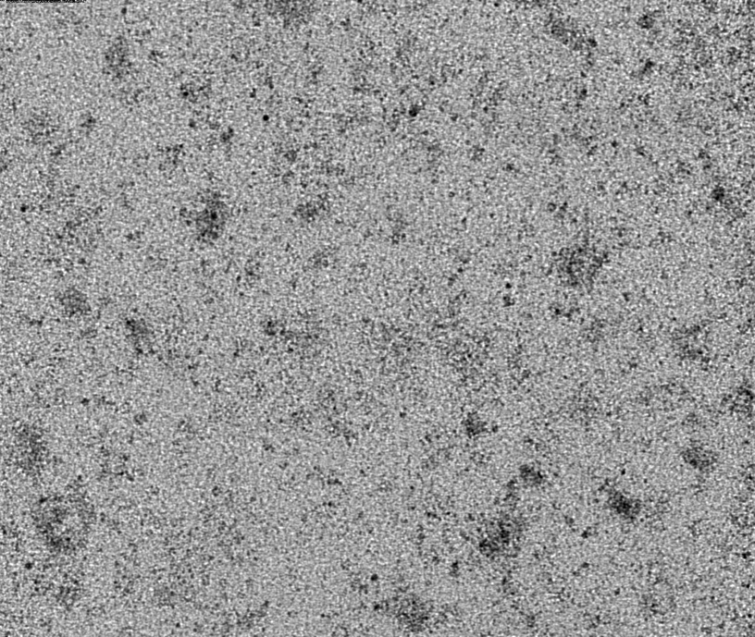
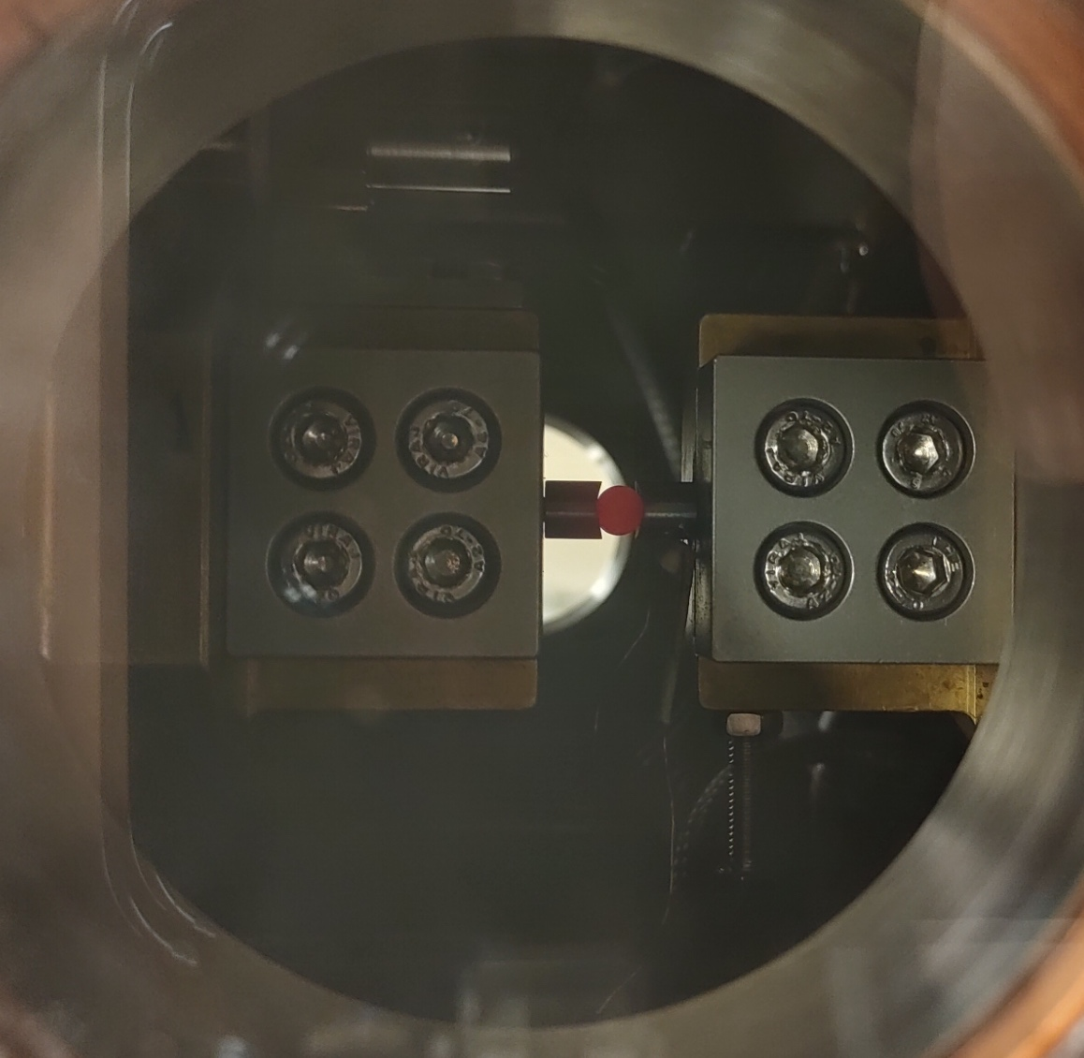
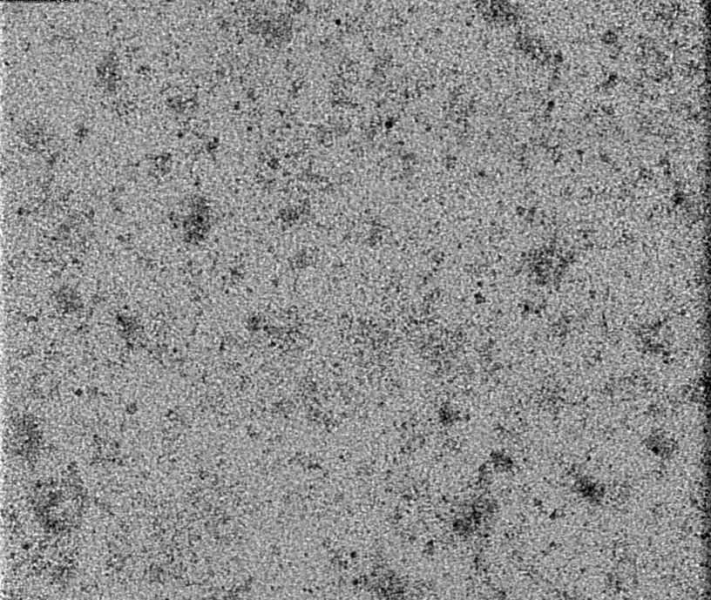

Gen IV Graphite (high T)
Unloaded (RT)
Electrically heated, Mechanically loaded
Disc Compression
  5 mm diameter
  2.8 mm thickness
  SNG742
1 mm
W-powder ‘speckle’
Loaded (RT)
Strain Mapping by Imaging
Diamond Light Source, UK, (Preliminary tests: Nov 2021
Continuation: Dec 2022)
~700°C
60 keV monochromatic X-rays
Radiography (3.3 x 2.8 mm)

Slide 11
Gen IV Graphite (high T)
Stress Mapping by Diffraction
Unloaded (RT)
Diffraction
(00.2)
(00.2)
Test specimen
Azimuthal integration
Mapped Area
2.5 mm x 2.5 mm
Raw data (2D diffraction, 100 µm x 100 µm slits
60 keV monochromatic X-rays
Work in progress

Slide 12
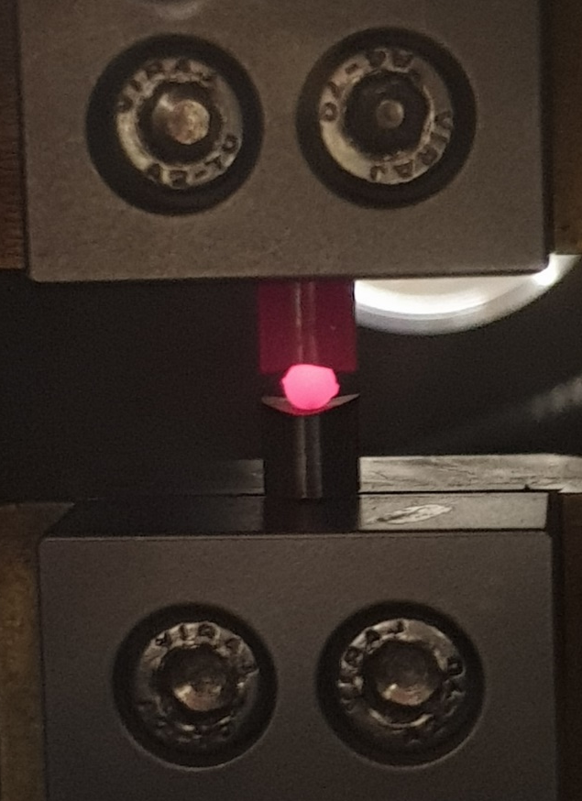
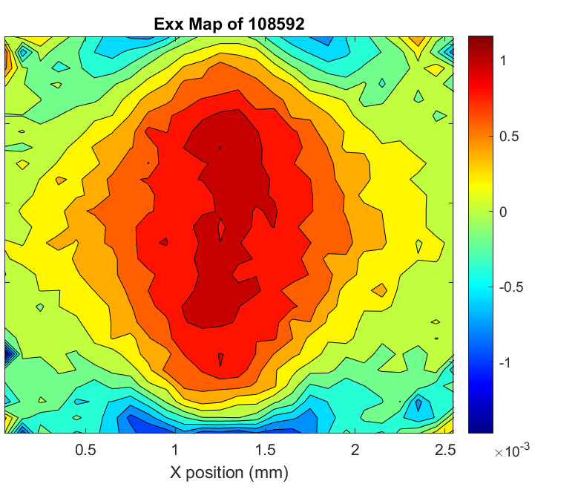
Graphite: Conclusion
On-going work to investigate effects of temperature and irradiation on HOPG (‘single’ crystal)
On-going work to investigate effect of temperature on deformation of fine-grained polygranular graphites
Other studies:
  Neutron Bragg edge imaging to investigate crystal reorientation under load
  Crack nucleation and propagation in graphite (in situ µXCT)
  MAX-phase ceramics
    High T indentation, x-section TEM, ion-irradiation
    In situ synchrotron X-ray radiography and diffraction for strain mapping at high temperature

Slide 13


Meso-scale Mechanical Testing of Proton Beam Window Materials
Lazuardi Pujilaksono, Angus J Wilkinson, Jicheng Gong
Micromechanics Group, Oxford University

Slide 14
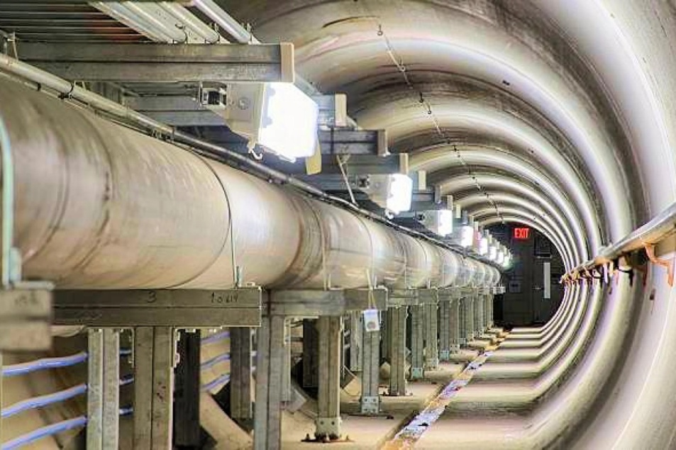
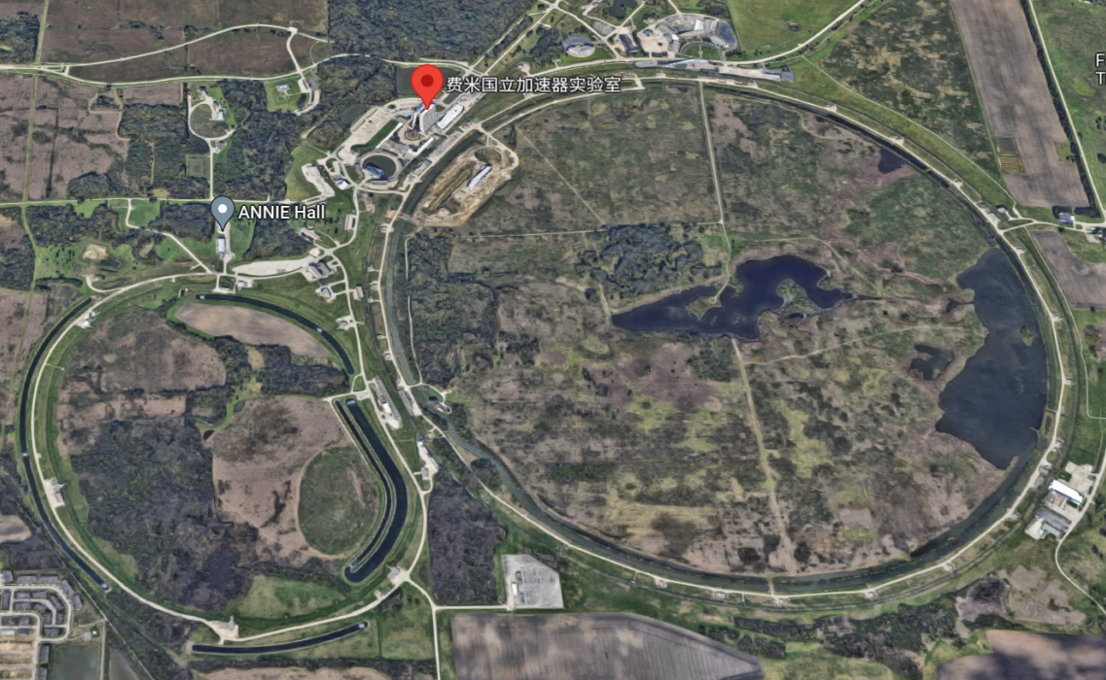
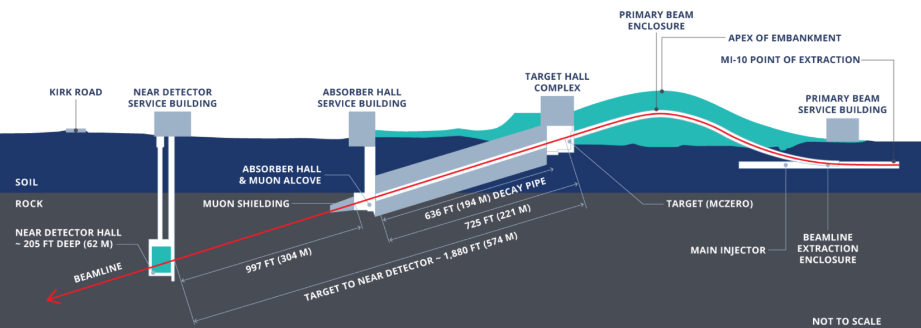
Proton accelerator

Slide 15
Ti-6Al-4V window for the proton beam
Pulsed proton beam
The proton pulses lead to thermally induced high-cycle fatigue loads on the beam window

Slide 16
Driving force
The pulsed proton beam energy will be increased to 1.2 MW in the Long Baseline Neutrino Facility (LBNF)
Will further upgrade from 1.2MW to 2.4 MW in the future
Super-K aims to increase the proton beam power from 500 KW to the 1.3 MW level

Slide 17
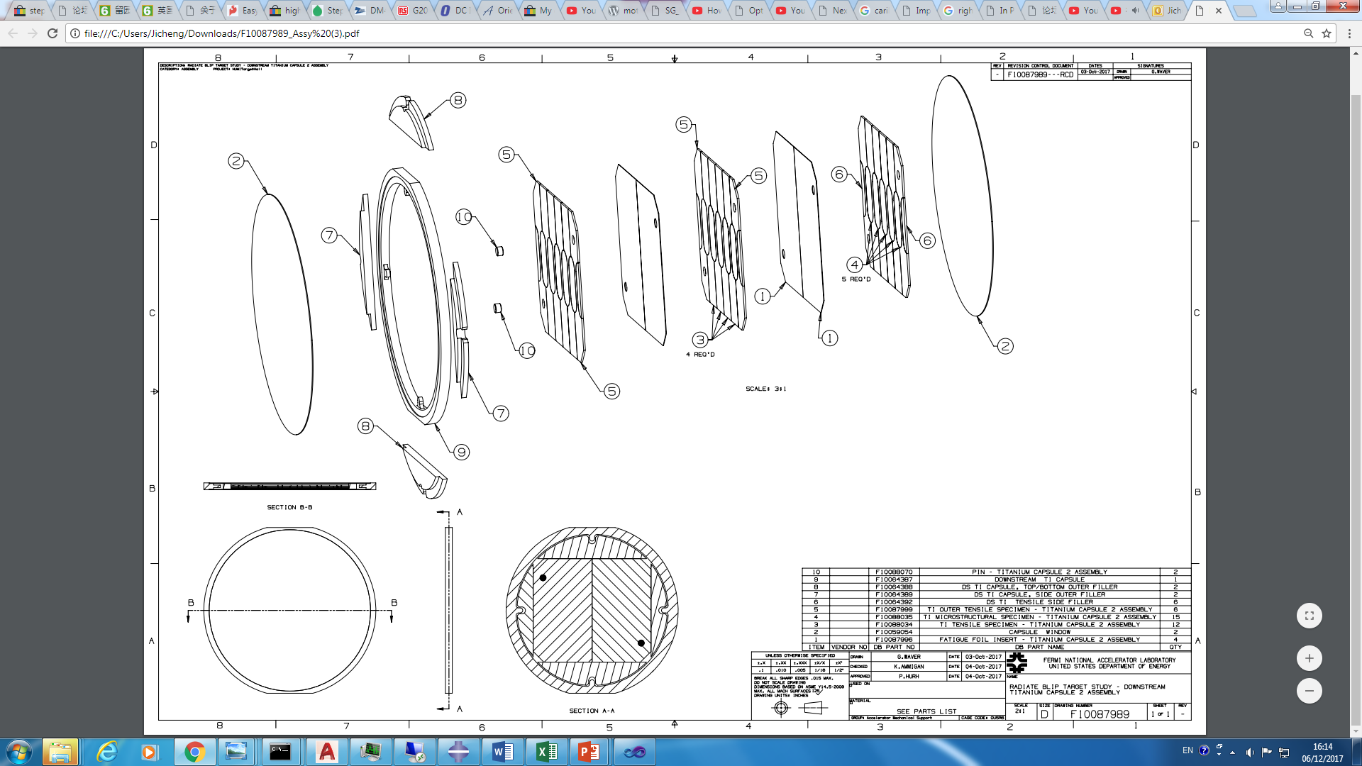
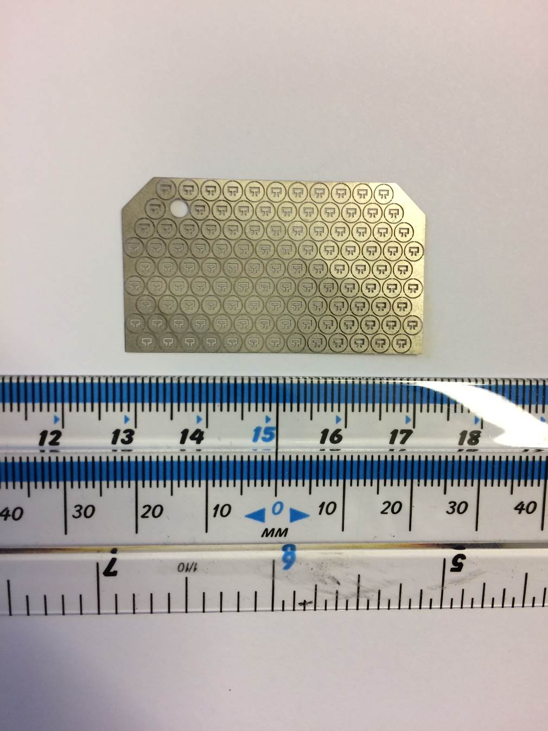
Why meso-scale mechanical tests?
Significantly more specimens
1000 times smaller. Low activity and easy to handle and dispose
Low cost
More flexibility
The size is comparable to the real component
Bulk specimens
Meso specimens
2.7 mm

Slide 18
Materials
Current proton beam window materials:
Ti-6Al-4V
Interested materials:
CP-Ti
Ti-6Al-4V with different heat treatment
Beta Titanium including Ti15 and Ti-333

Slide 19
Two batches of irradiated titanium meso-cantilevers
Down stream Ti1: Ti-6Al-4V. This is the same material as the proton beam window at J-PARC. The irradiation level is 0.25 DPA
Down stream Ti2: Expanded the materials from Ti-6Al-4V to CP-Ti and Beta titanium alloys. The irradiation level is 1 DPA.

Slide 20
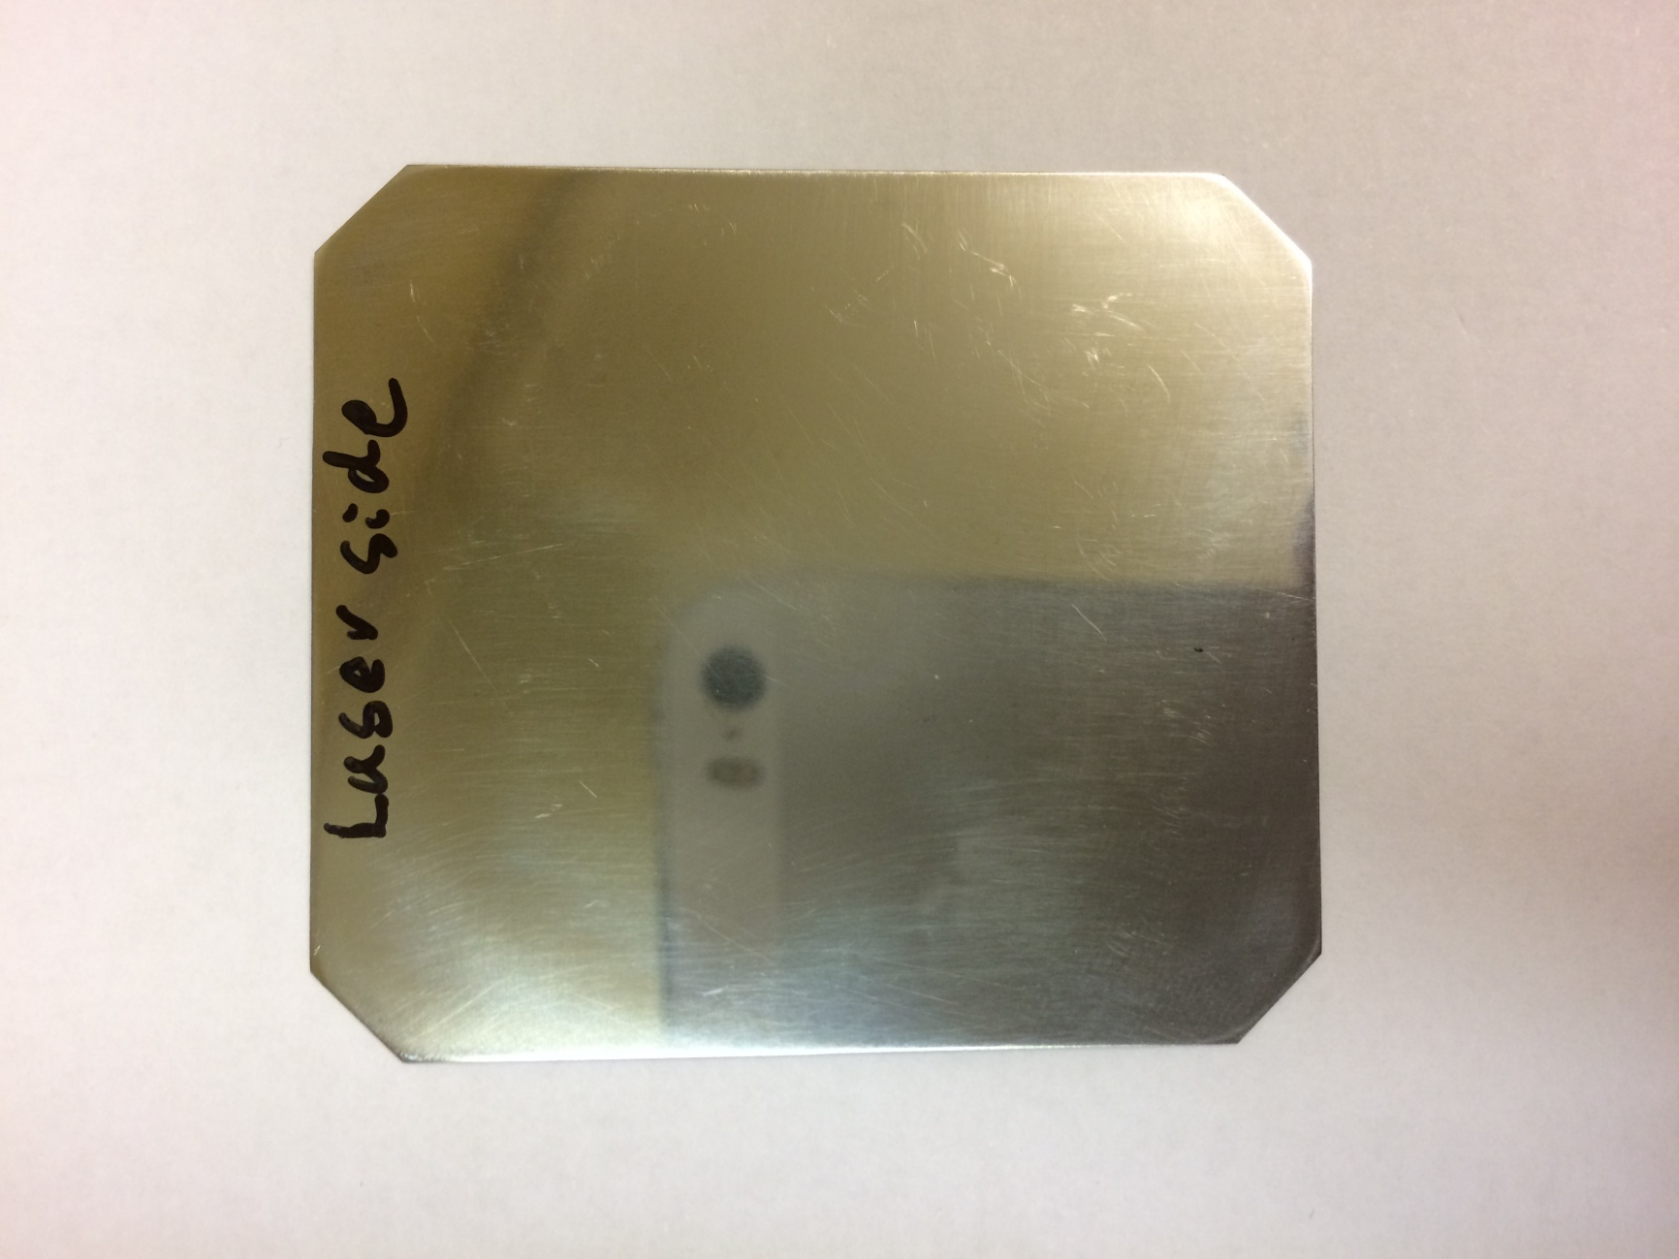
1st batch: Ti-6Al-4V beam window materials, 0.25 DPA
Thickness measurements (µm)
253
257
262
262
252
257
257
256
255
255
260
253
257
259
261
258
253
257
259
257
258
260
260
256
243
48 mm

Slide 21
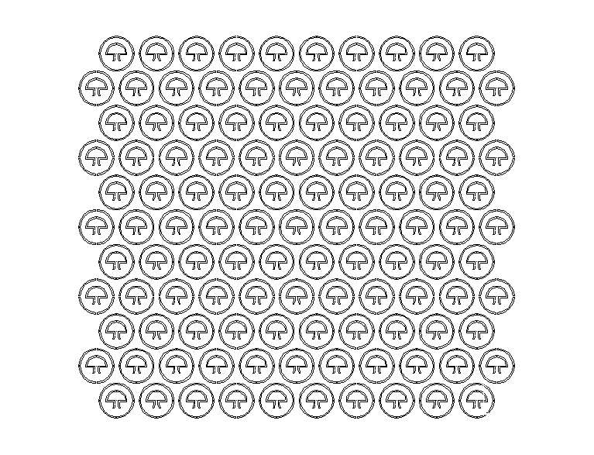
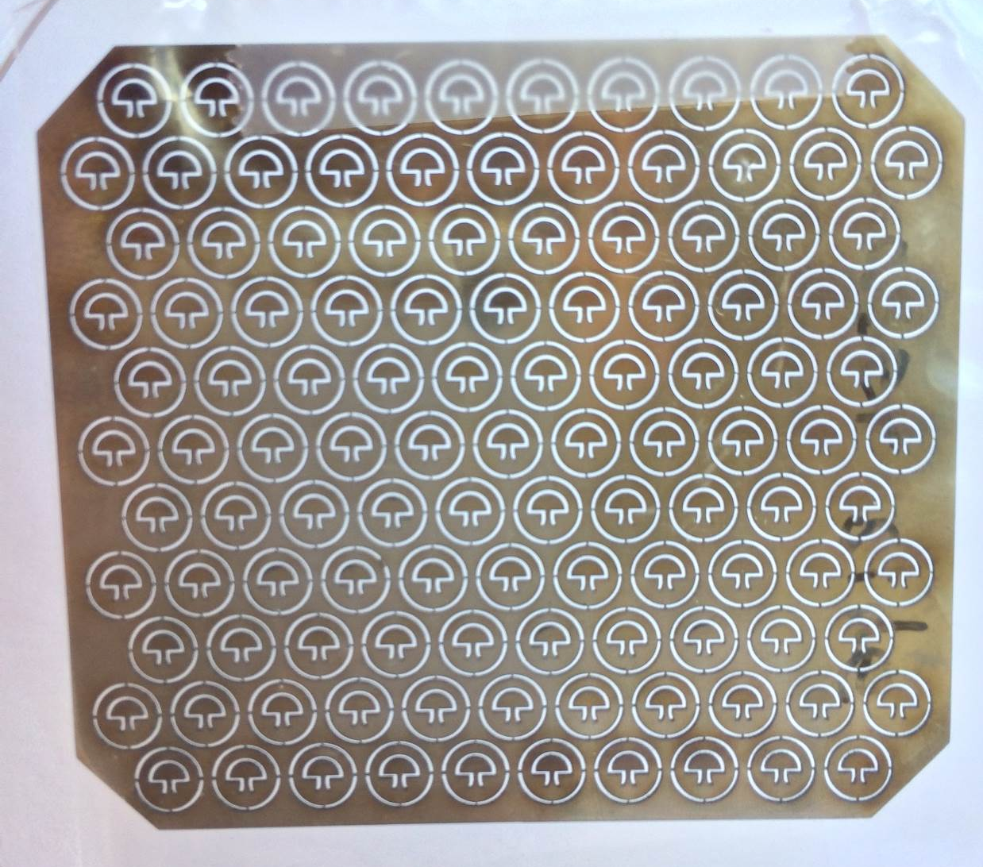
1st batch: specimen design, layout and micro-laser machining
3.4 mm

Slide 22
2nd batch of proton irradiated titanium (Part II BLIP irradiation run), 0.95 DPA
250 μm = 150 μm + 100 μm
Layer two
Four half foils in total
Layer one

Slide 23
Five foils of different titanium materials or heat treatment
 | Material | Thickness (μm) | Dimensions (μm×μm) | Resonant frequency (Hz) | Irradiated?
Foil one | Grade 2 CP-Ti Cold rolling and annealed | 100 | 1000 × 400 | 31113 | Yes
Foil two | Ti15 Solution treated | 100 | 800 × 400 | 30155 | Yes
Foil three | Ti-64 Annealed at 595 ⁰C for 3 hours | 132 | 1000 × 600 | 30160 | No
Foil four | Ti-64 Annealed at 595 ⁰C for 3 hours | 148 | 1000 × 650 | 31207 | Yes
Foil five | Ti-64 | 153 | 1000 × 675 | 31186 | Yes

Slide 24
2nd batch, design, layout and micro-laser machining
116 specimens on a half foil
22 – 27 specimens in the R12 mm hot area
78 specimens without radiation
D 24 mm

Slide 25
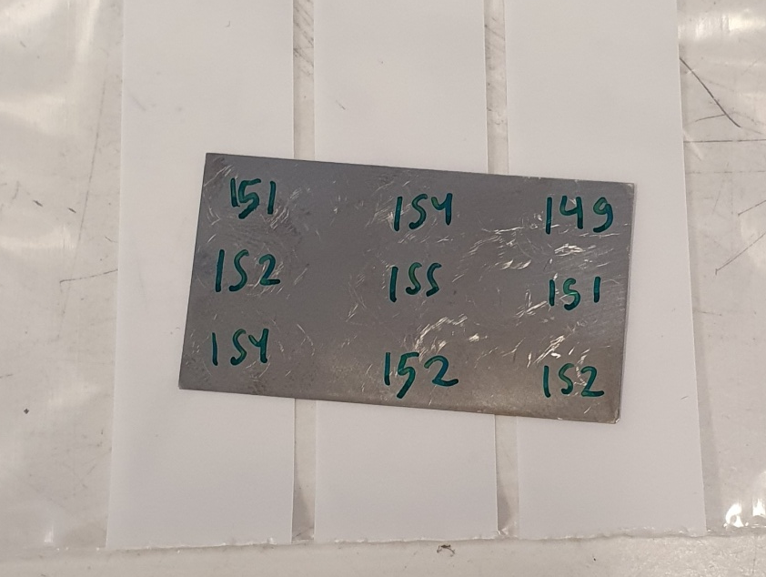
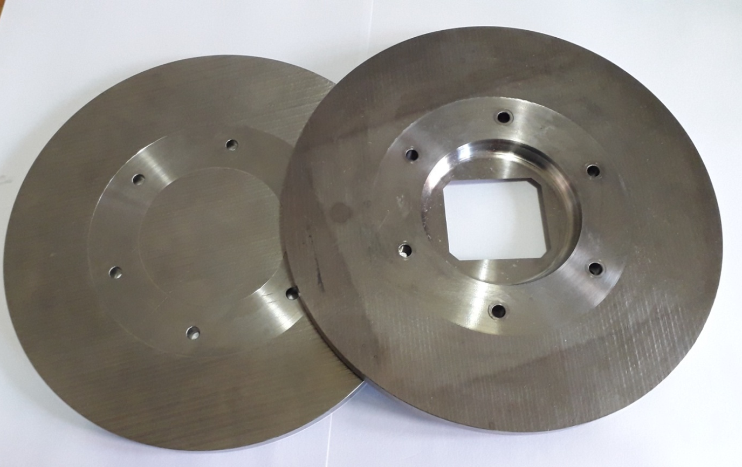
Current work on pre-irradiated Ti-6Al-4V materials from RAL
Dummy proton beam windows
Machined into foils
2.25 cm
4 cm
The samples used in this study came from new Ti-6Al-4V beam windows; therefore, the studies we conduct have identical microstructures to real components

Slide 26
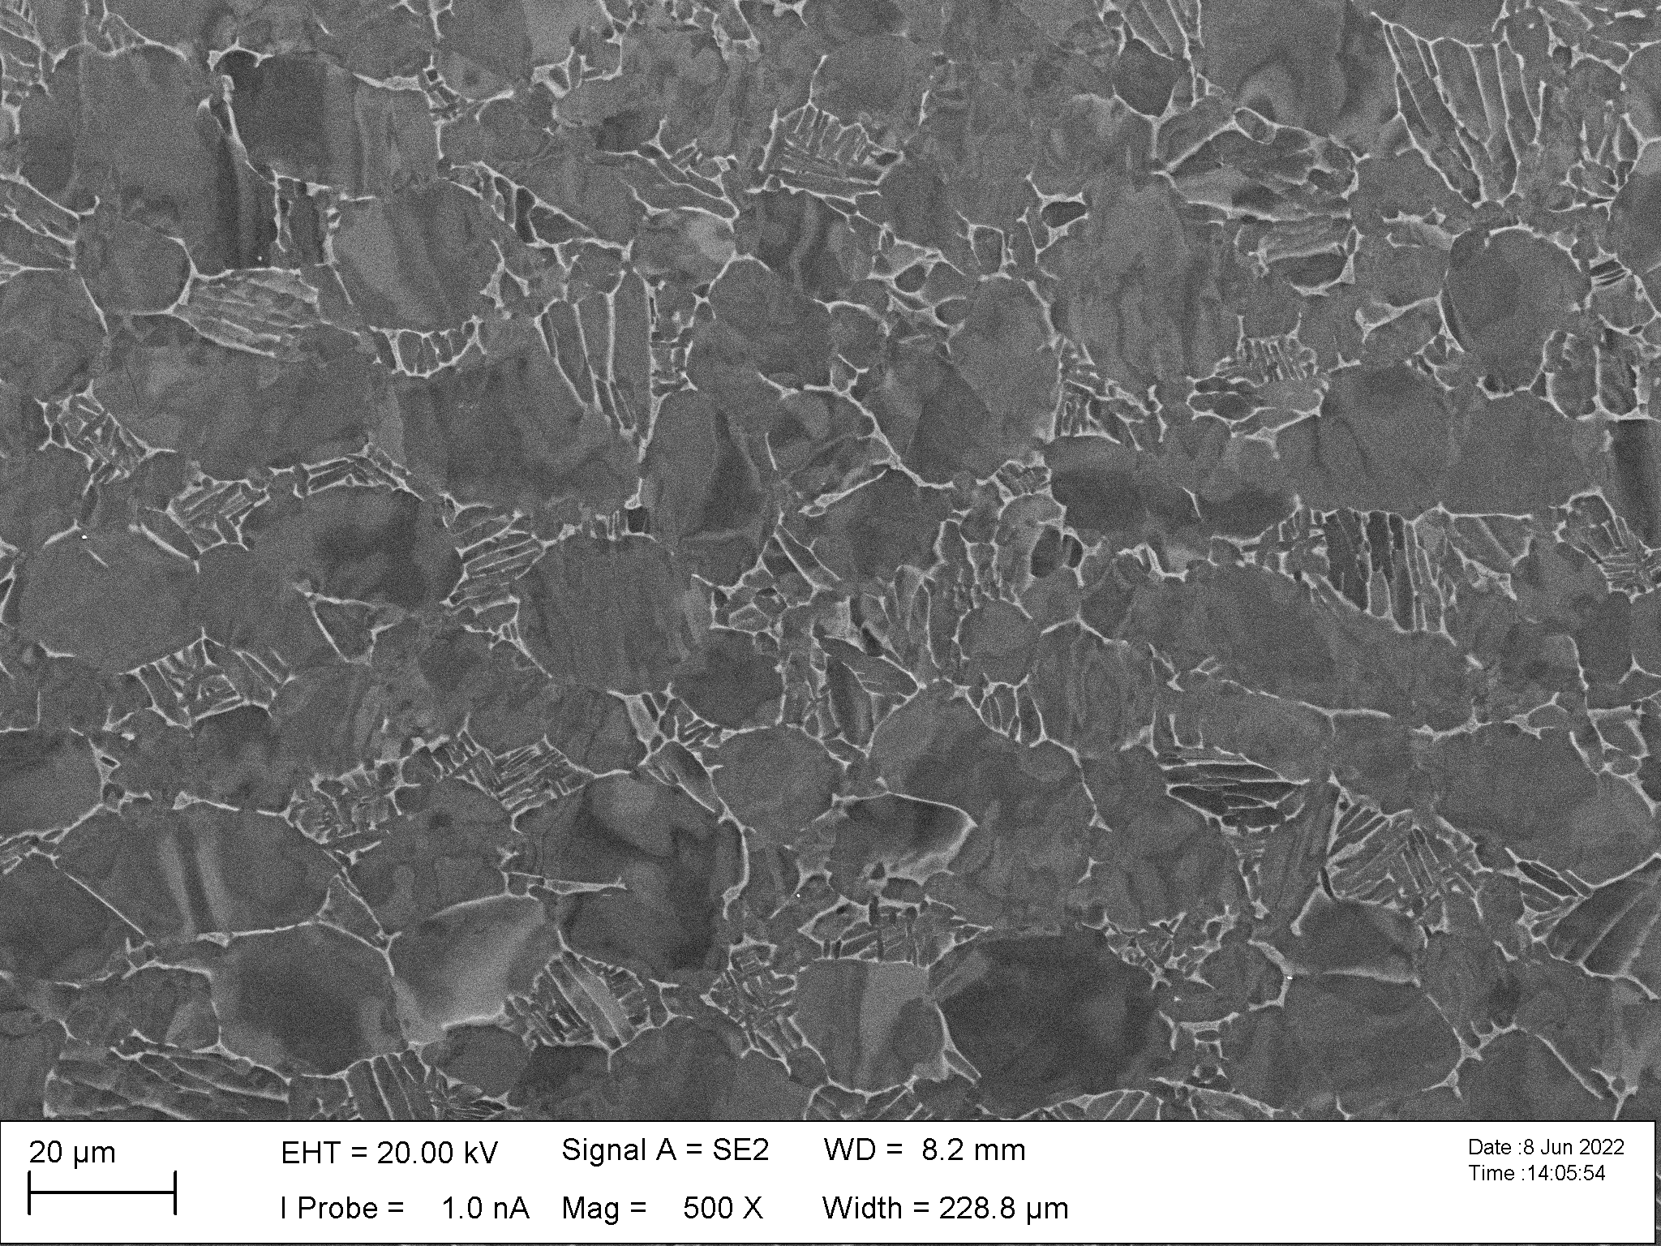
Bimodal microstructure of Ti-6Al-4V
Transformed β
Primary α

Slide 27
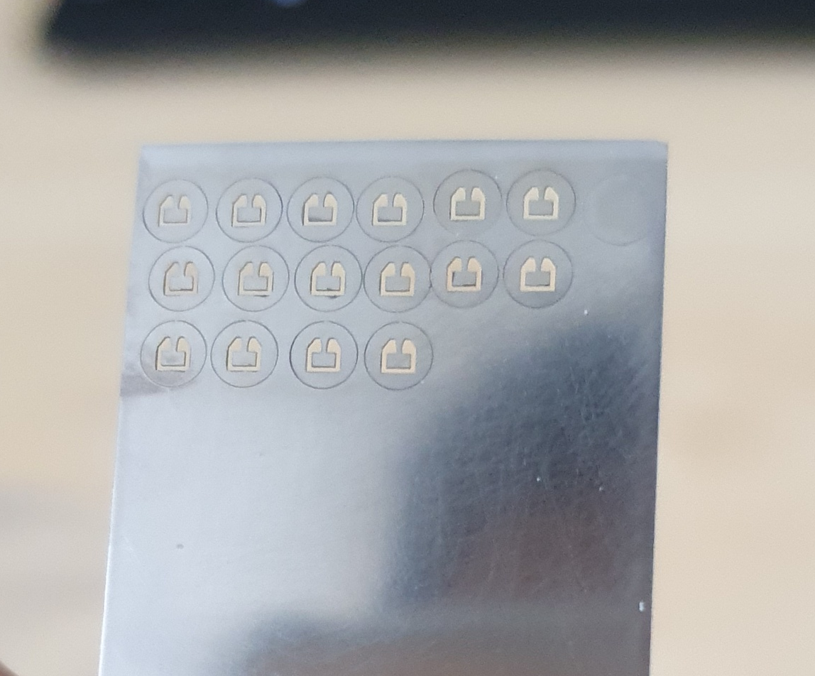
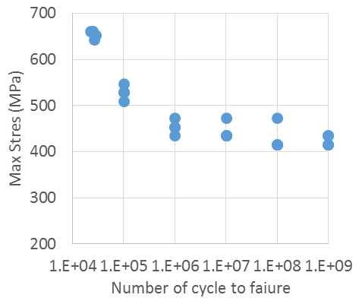
Ti-6Al-4V Meso-cantilevers from dummy beam windows

Slide 28
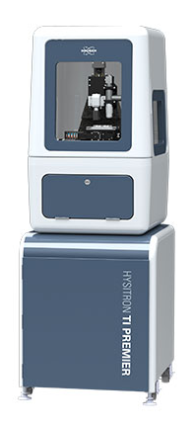
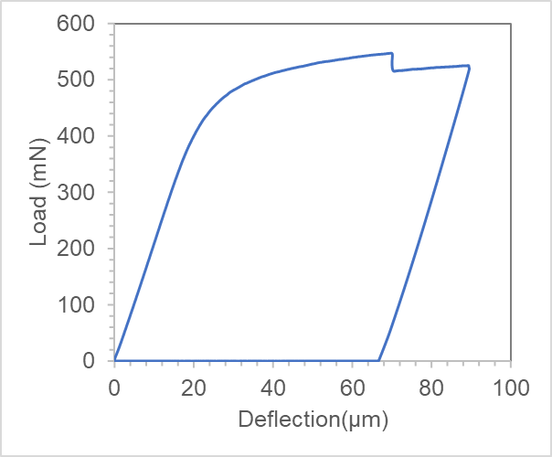
Future plan 1: Static meso-cantilever tests, irradiated vs. non-irradiated
Premier nanoindenter
 | Material
Foil one | Grade 2 CP-Ti Cold rolling and annealed
Foil two | Ti15 Solution treated
Foil three | Ti-64 Annealed at 595 ⁰C for 3 hours
Foil four | Ti-64 Annealed at 595 ⁰C for 3 hours
Foil five | Ti-64
Load displacement response of a meso-cantilever
Static deflections tests of five proton irradiated materials and make comparison with non-irradiated titanium

Slide 29
Future plan 2: Ultrasonic fatigue testing of irradiated meso-cantilevers
Meso S-N Curve of Ti-6Al-4V
 | Material
Foil one | Grade 2 CP-Ti Cold rolling and annealed
Foil two | Ti15 Solution treated
Foil three | Ti-64 Annealed at 595 ⁰C for 3 hours
Foil four | Ti-64 Annealed at 595 ⁰C for 3 hours
Foil five | Ti-64
High cycle fatigue tests of two candidate materials (Ti6Al4V and one other Ti material)

Slide 30
Future plan 3: Design foils that can be irradiated at the cyclotron irradiation facility (MC40 ) at the University of Birmingham
Help design the foils, enabling irradiation of meso-cantilevers at the cyclotron irradiation facility at the University of Birmingham

Slide 31
Thanks for your attention!

