Slide 1

Radiation damage R&D
Fermilab Updates
Sujit Bidhar
Target Systems
Sep. 22, 2022
RADIATE Workshop

Slide 2
Outline
HiRadMat -43 test Beryllium profilometry
Nanofiber target R&D
Graphite ion irradiation Implementation of new technique-
  Transient Grating Spectroscopy to graphite swelling
  LDV (Laser Doppler Vibrometer) to electron irradiated graphite
Titanium fatigue and fatigue tester development
High Entropy alloy

Slide 3




Beryllium PIE HiRADMat-43
Yield strength :
: Equiv. plastic strain
: Plastic strain rate
: Homologous temperature
A : 432 MPa
B :1280 MPa
C : 0.009
n : 0.5
m : 1.3
Evaluated experimentally by split-Hopkinson pressure-bar test for unirradiated S200FH*
Tensile tests @PNNL
40-45% increase in yield strength due to irradiation
Implemented the increase in yield strength in J-C material model for out of plane deformation simulation

Slide 4

HRMT 43- Beryllium Array1-288bunch- Irradiated
Beam on 8.37 µsec
Peak energy deposit 6.28e14 w/m3
Peak Temp. 1065 C
Simulation correctly predicted experimentally observed out of plane deformation for irradiated samples
Unirradiated sample shows reverse trend→ under further investigation

Slide 5
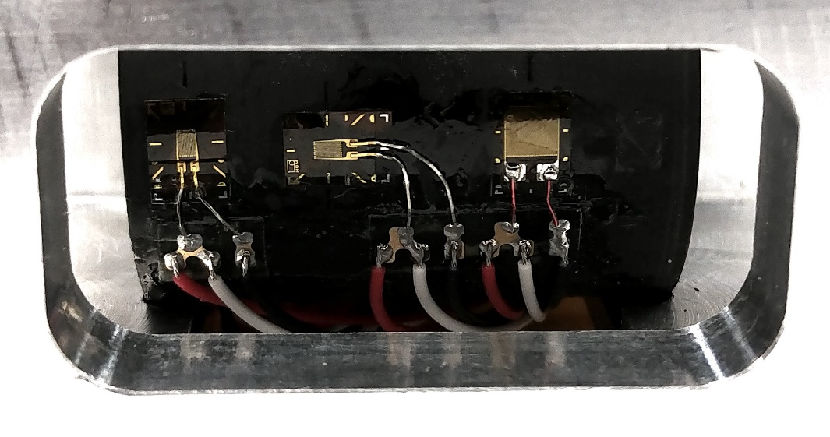
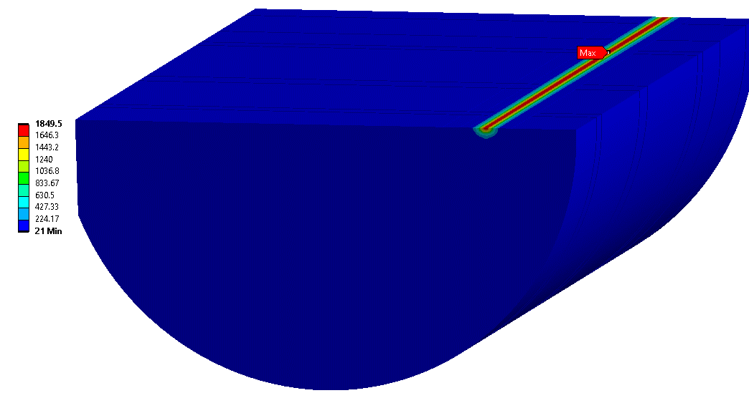
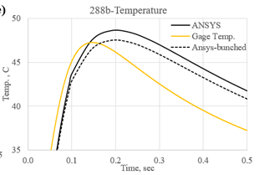

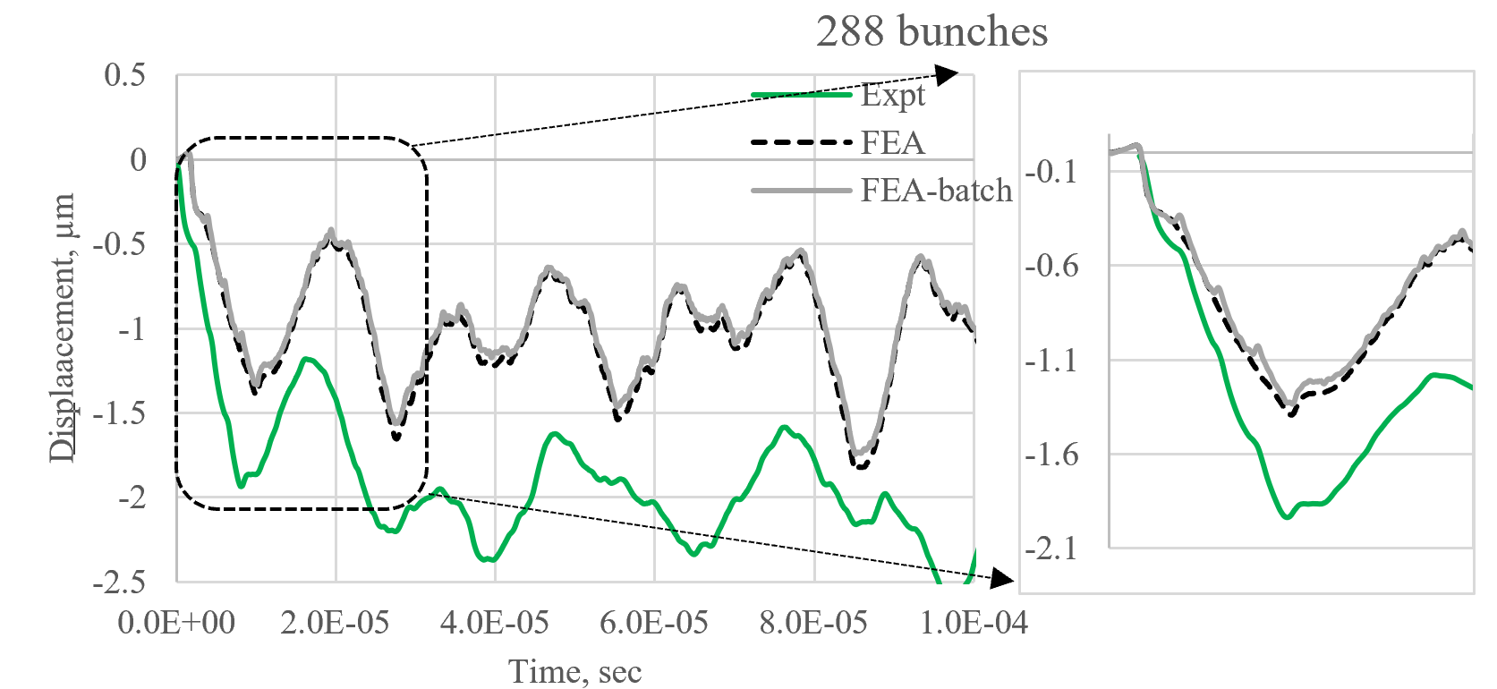
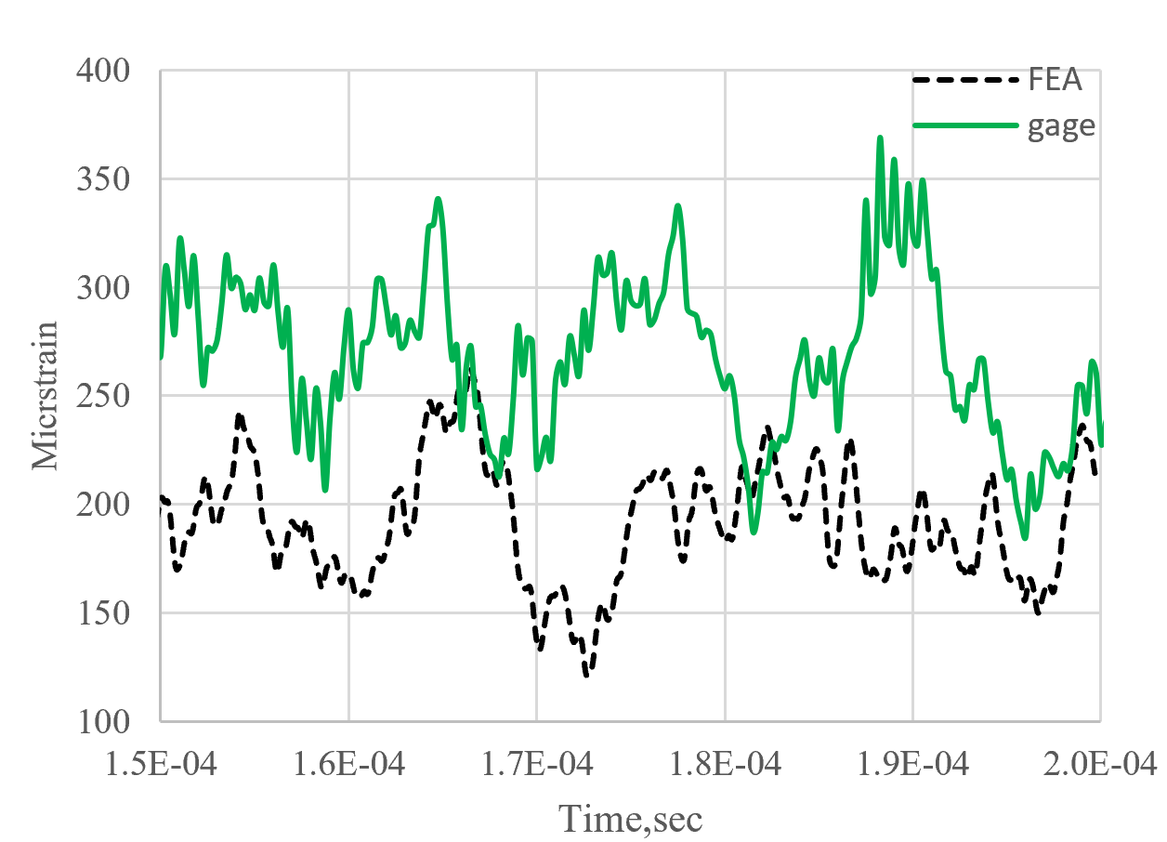
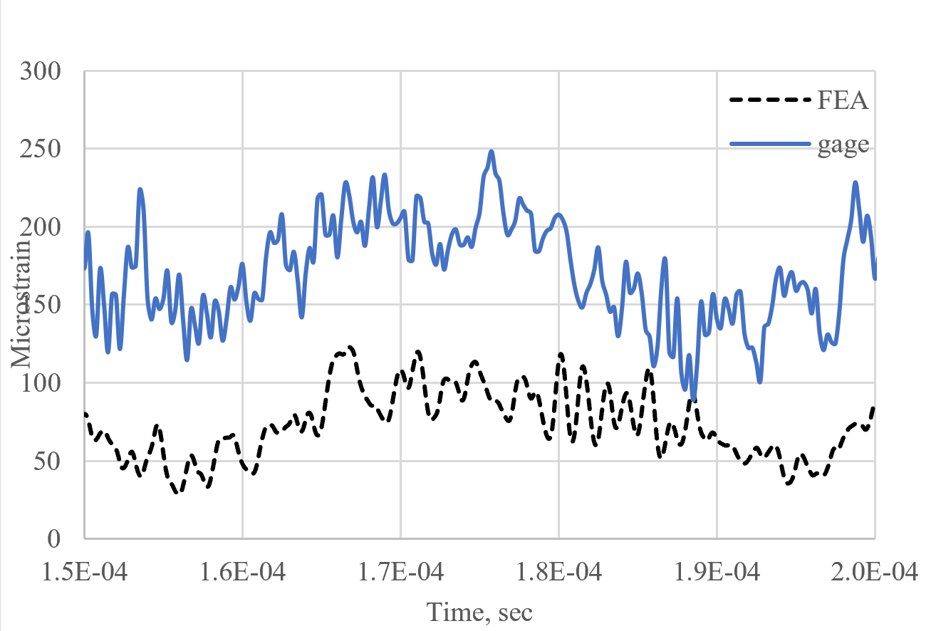
HiRadMaT 43 Graphite Slug Analysis
strain gage
Temperature gage
LDV
Temperature distribution at end of beam heating
Circumferencial strain
Axial strain
Better result incorporating batched beam structure.
Difference in base line of simulation and experimental result due to sudden beam interaction with strain gage.

Slide 6
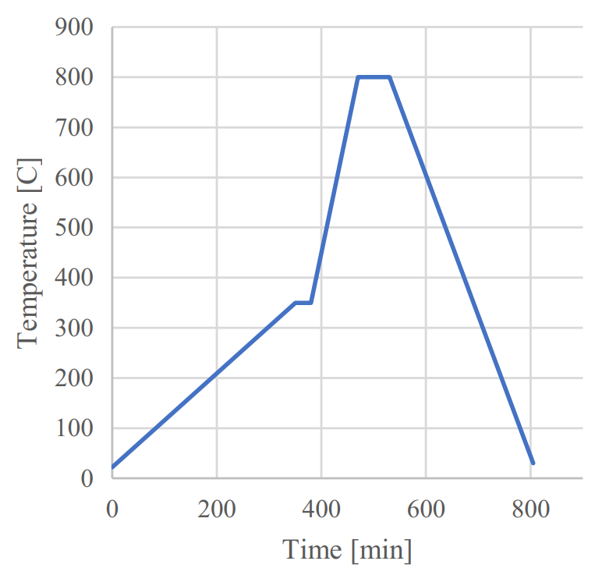
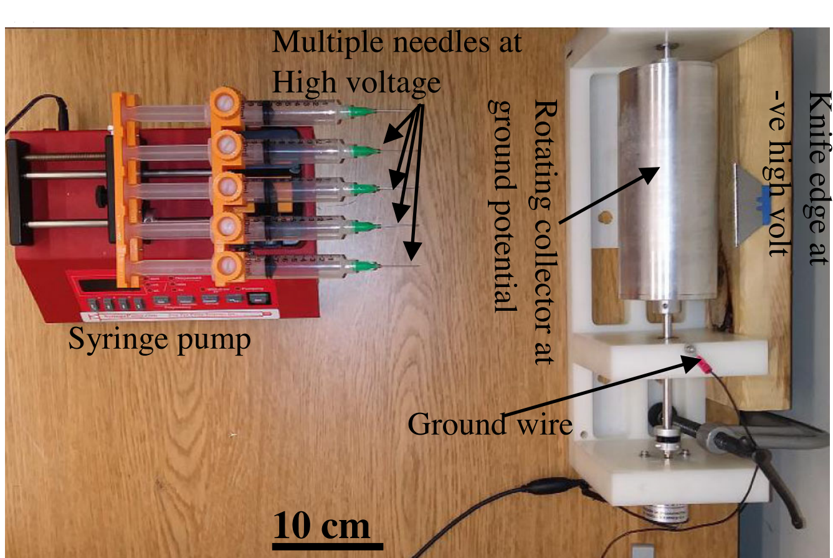
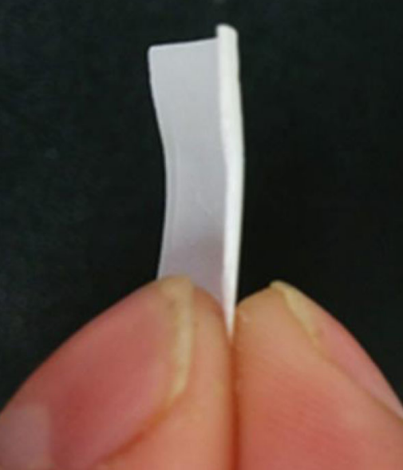
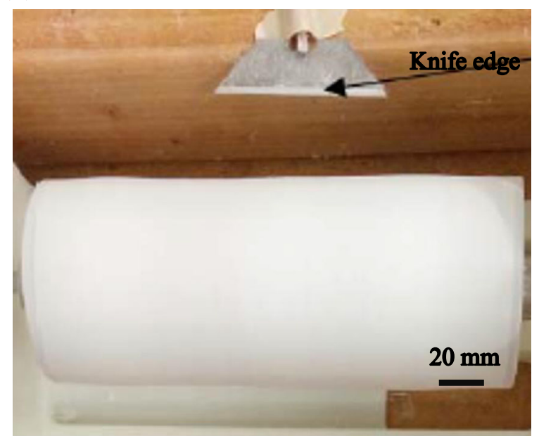
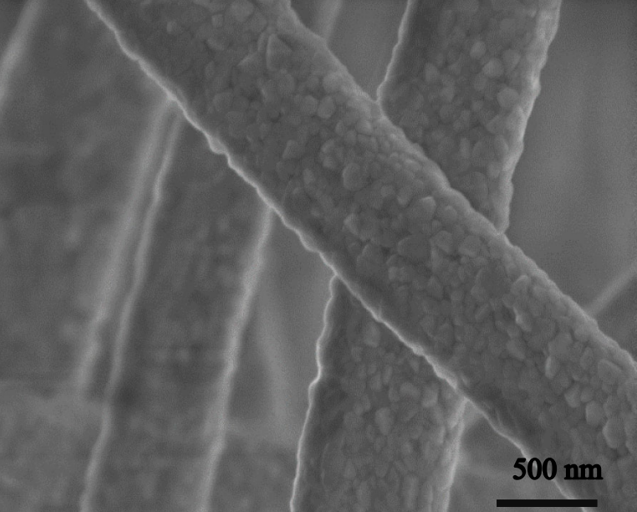

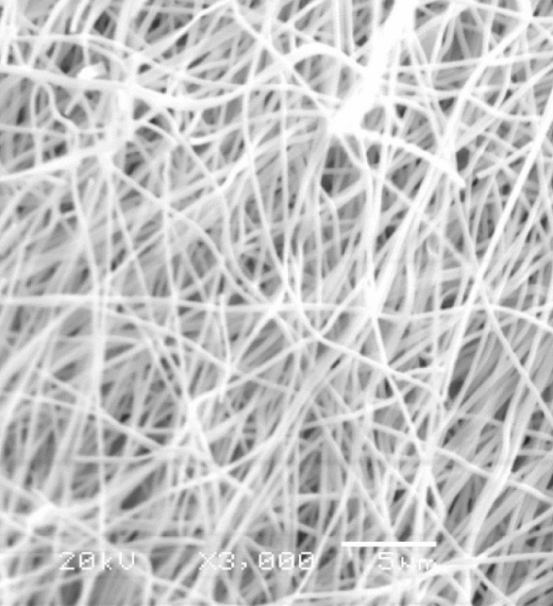
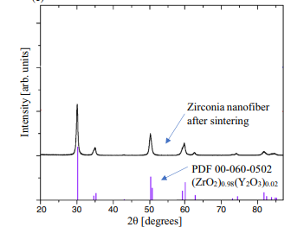
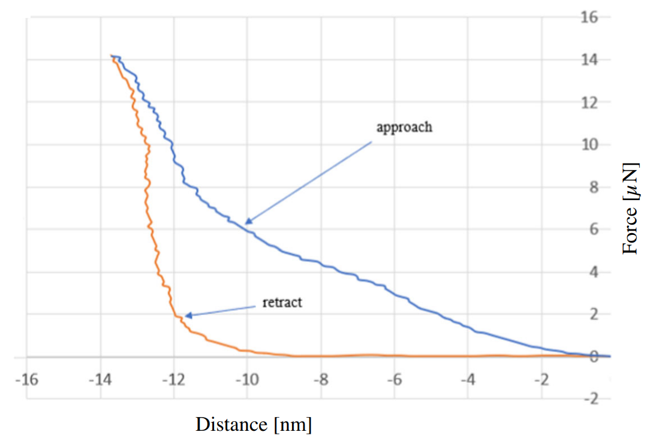
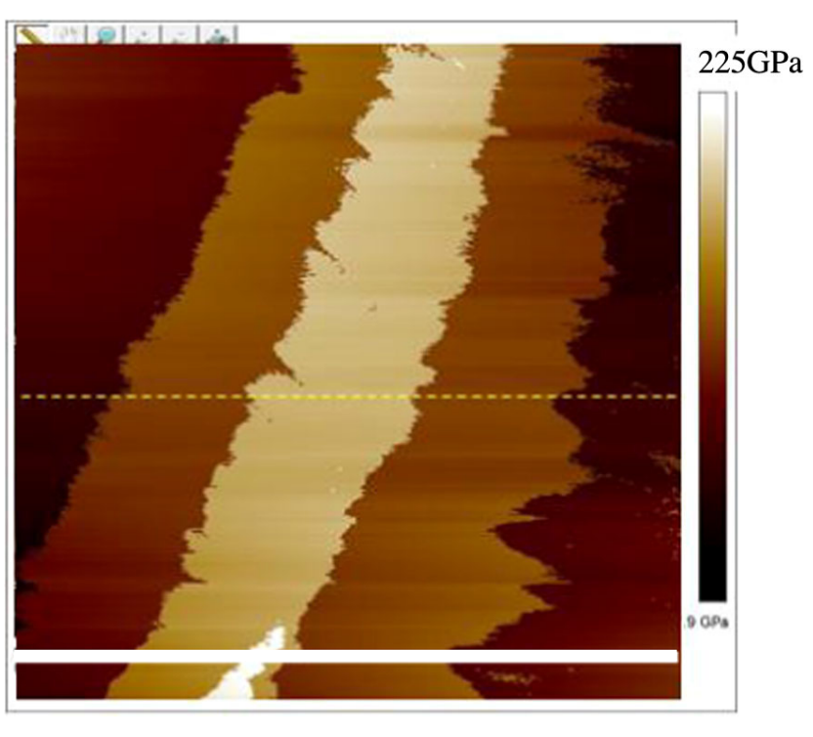
Nanofiber target
To negate thermal stress wave and high cycle fatigue
Electrospinning Set up
1mm thick nanofiber coat
Sintering
Production
AFM on single nanofiber
Modulus mapping
XRD
Single point indentation
Characterization
Modulus same as bulk

Slide 7

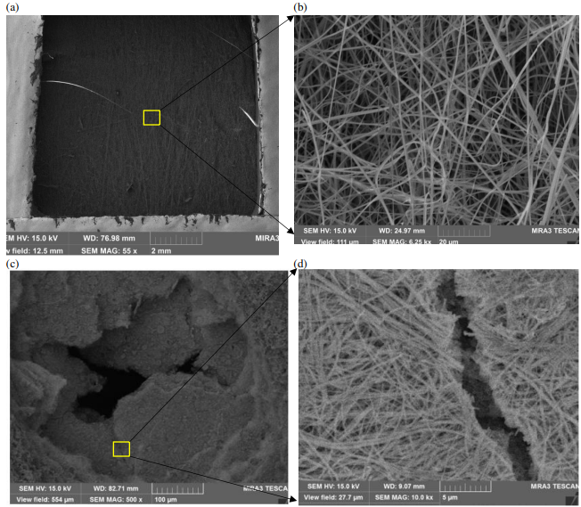
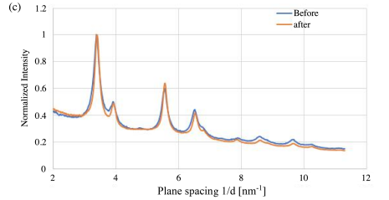
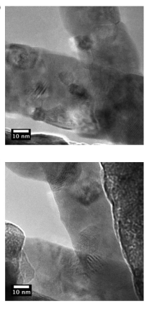

Beam test on nanofiber
Ion irradiation(in-situ TEM)
Thermal shock expt- HiRADMat-43 (CERN)
TEM before irradiation
Low packing density
TEM after irradiation
1 MeV Kr²⁺ ion
3.25x10¹⁵ ions/cm² → 5dpa equiv
No measurable change in lattice parameter.
No defects formation.
Nanofiber may offer better resistance to radiation damage.
High packing density
Proton beam 440 GeV, Beam σ 0.25mm
1.21x10¹³ protons on nanofiber in 4µsec
Low packing density samples survived.
Holes, crack in higher density samples

Slide 8

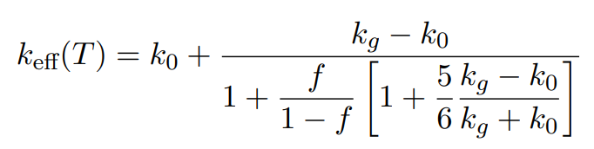

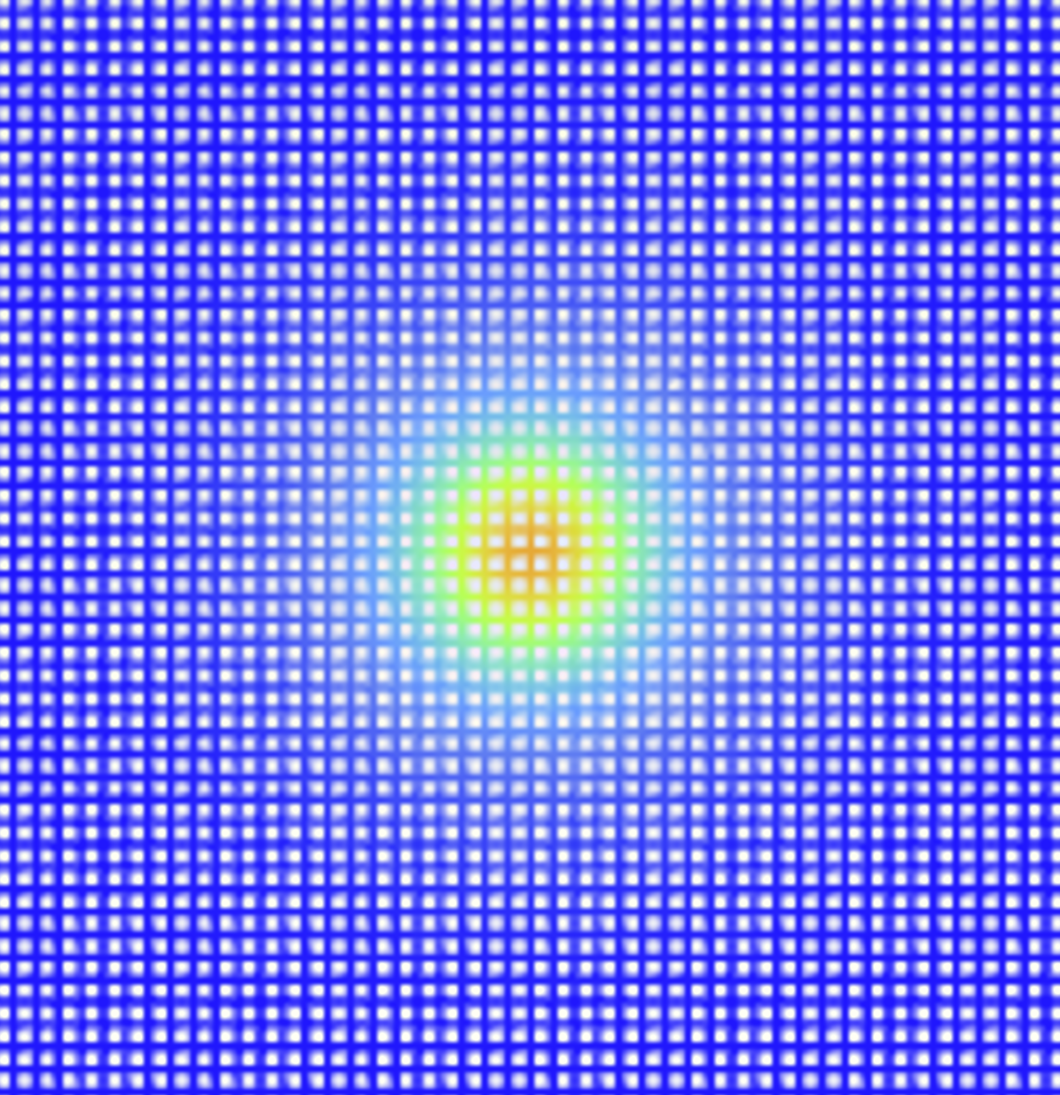
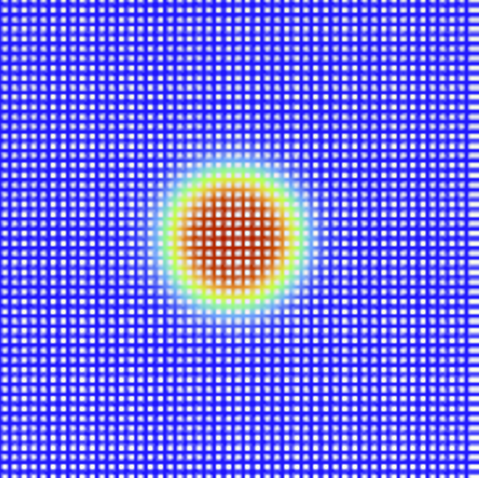
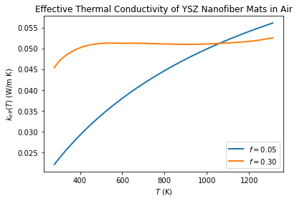
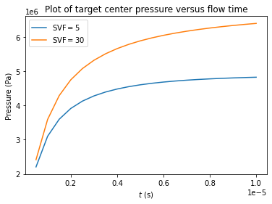
Thermal shock simulation on nanofiber mat- HiRADMat -43
2D meso scale simulation (ANSYS FLUENT)
Bhattacharya model:
X10⁶ Pa
Low packing density
High packing density
10
8
6
4
2
0
Pressure distribution@ end of beam heating
Rapid heating of target →pressure shockwave for a higher packing density target
Higher packing density reduces airflow induced by beam heating (natural convection) which exerts higher pressure on fibers
3D- fiber level simulation in progress

Slide 9
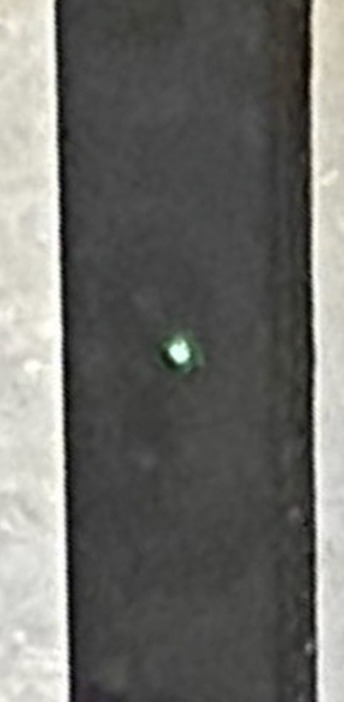
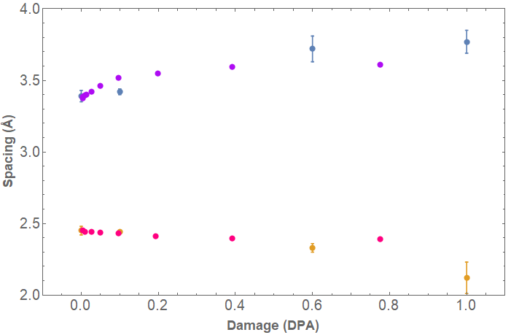
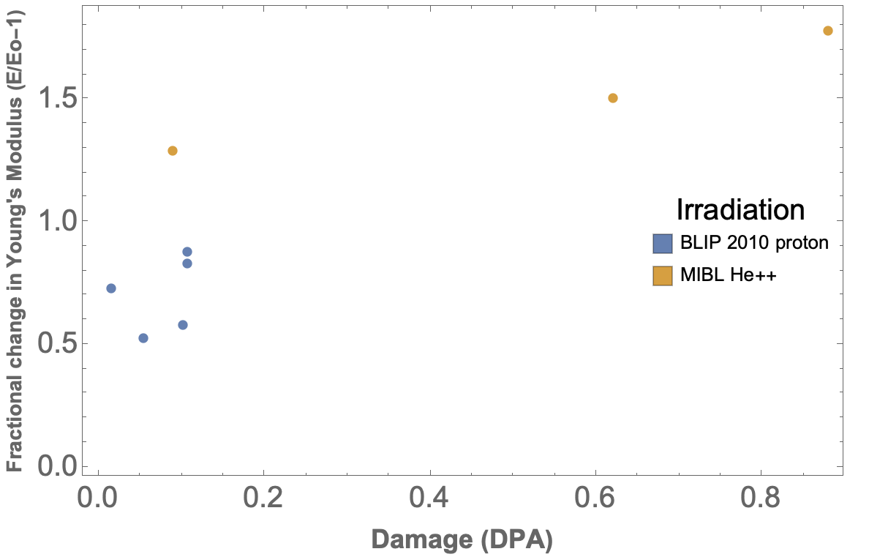


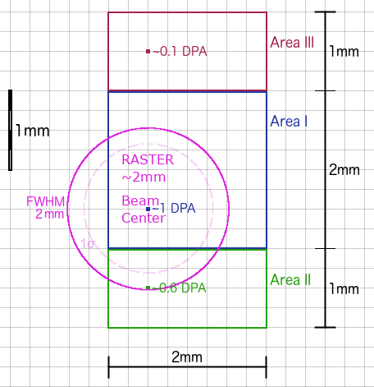
Graphite Irradiation Studies with Low Energy Heavy Ions
@ Michigan Ion Beam Lab 4.5MeV He⁺⁺
Can low energy heavy ion mimic high energy proton beam?
Lattice parameter Vs dpa
Modulus Vs dpa
POCO ZXF5Q
Comparable lattice parameter change.
Similar changes in Young’s modulus.
Further verification required:
Compare type of defects and number density of defects
Other physical properties → failure strength, yielding, K,CTE
Irradiation temp. 100⁰C

Slide 10
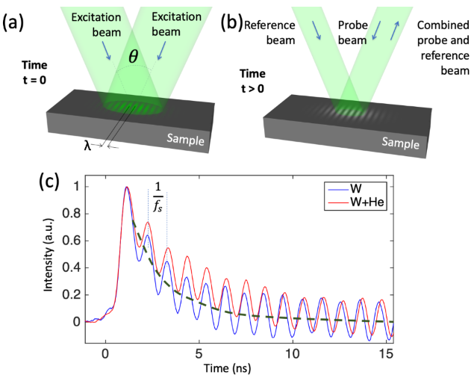



Transient Grating Spectroscopy (TGS) on proton-irradiated Graphite (NTO2)
Pulsed laser beams, 500 ps, λ500nm, few mJ
Interference generate periodic pattern
Absorption of the light within the intensity grating
Spot Size: 50~500 µm
spatially periodic temperature profile
SAWs
rapid thermal expansion creates two monochromatic, counter-propagating SAWs
Slow decay →low stiffness
Surface Acoustic Wave (SAW) velocity,

Slide 11
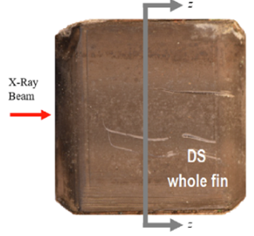
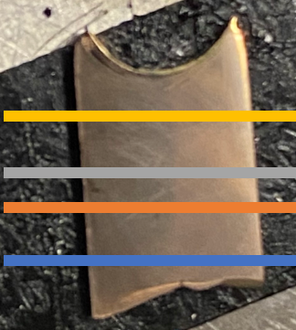
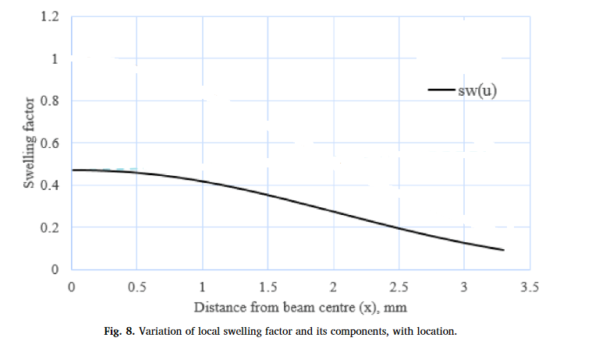
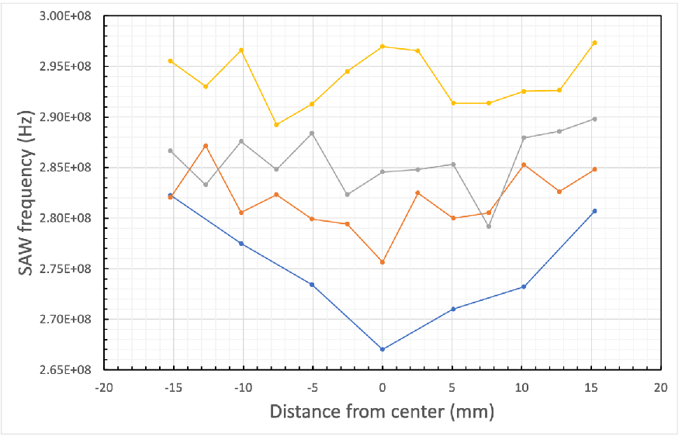
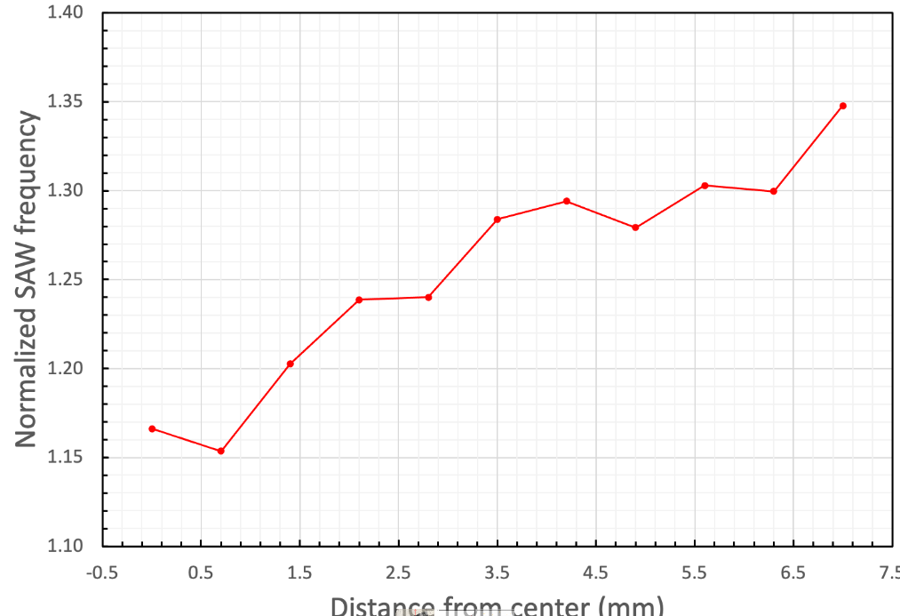
Sensitivity of TGS
Gaussian beam in x direction
sigma 1.1mm
Proton beam 120GeV
Peak Fluence: 8.6x10²¹/cm²
y
S.Bidhar, NME 2020
50% swelling
x
10% swelling
y
TGS is sensitive to slight change in mechanical property.
z
He filled Frankel defect →Lattice swelling and reduction of SAW speed
Along horizontal direction
Along vertical direction

Slide 12
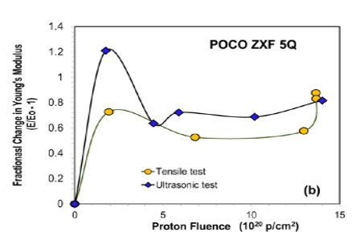
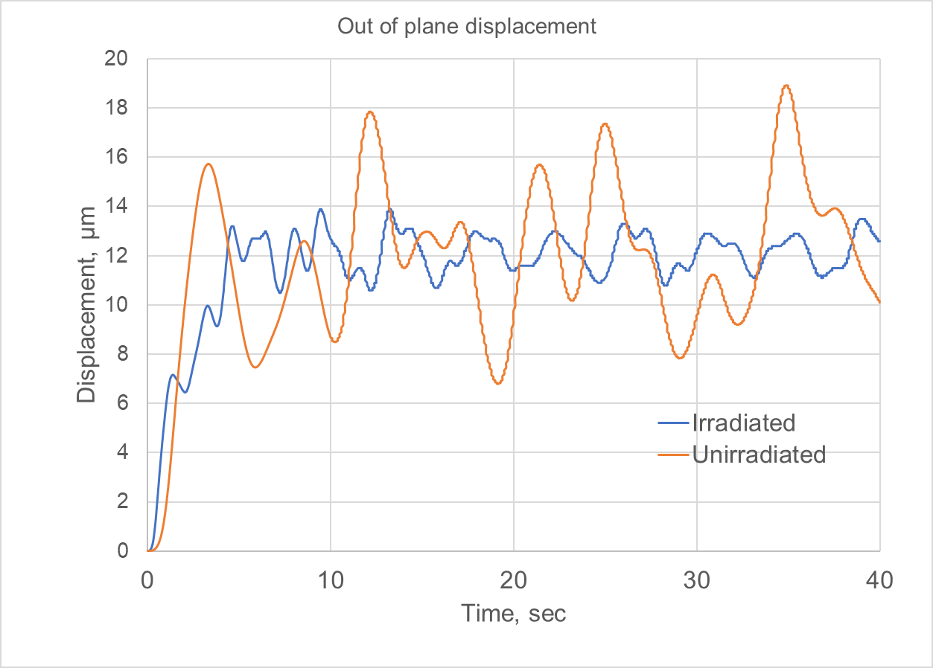
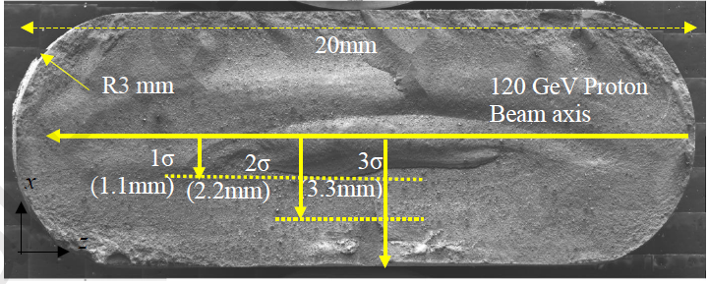
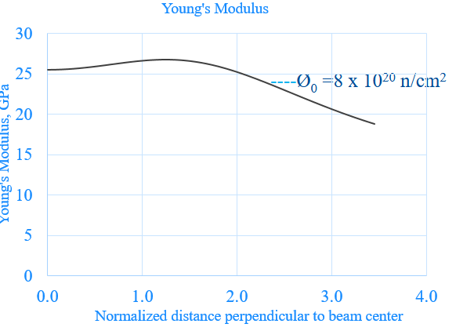
LDV for in-situ target health monitoring
NTO2 Target Fin
Transient thermal-structural analysis
There is clear change in frequency and magnitude of displacement

Slide 13
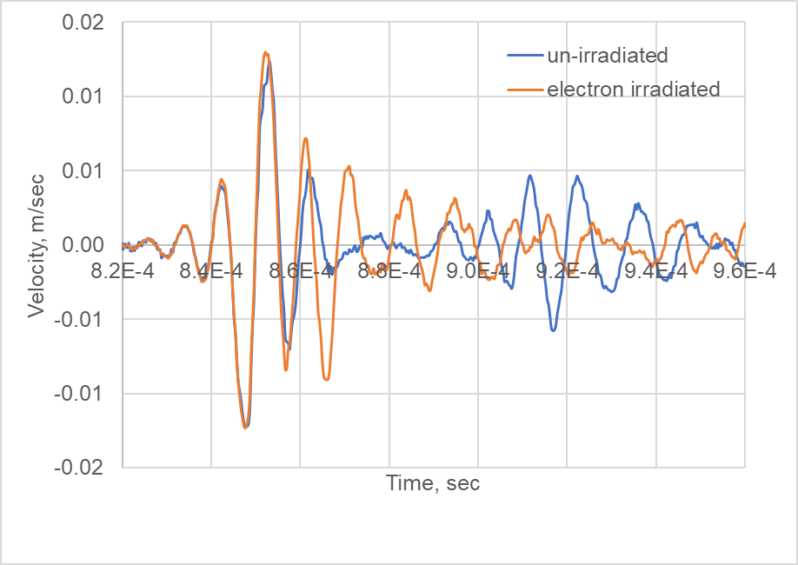
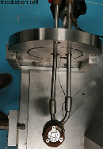
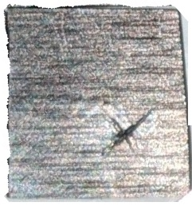
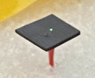
LDV on electron-irradiated graphite
Electron Irradiation at SIRIUS (Ecole Polytechnique)
Energy : 2.5MeV
Fluence: 3.4x10¹⁹/cm² ~0.017dpa
Irradiation area : 19x19 mm
LDV Measurement by Polytec
Excitation : 100 kHz
Piezoelectric at bottom
10mm
There is a difference in amplitude and frequency of LDV velocity due to electron irradiation

Slide 14
Titanium Fatigue- SN Curve- all specimen
R=0.45
Irradiation reduced fatigue life.
Spread is too much in unirradiated samples.
No. of sample tested are few.
Non Irradiated
Gr5-Batch3
Need to benchmark the results of custom-fatigue tester.
Gr5-Batch2
Gr23
Irradiated
Gr23

Slide 15

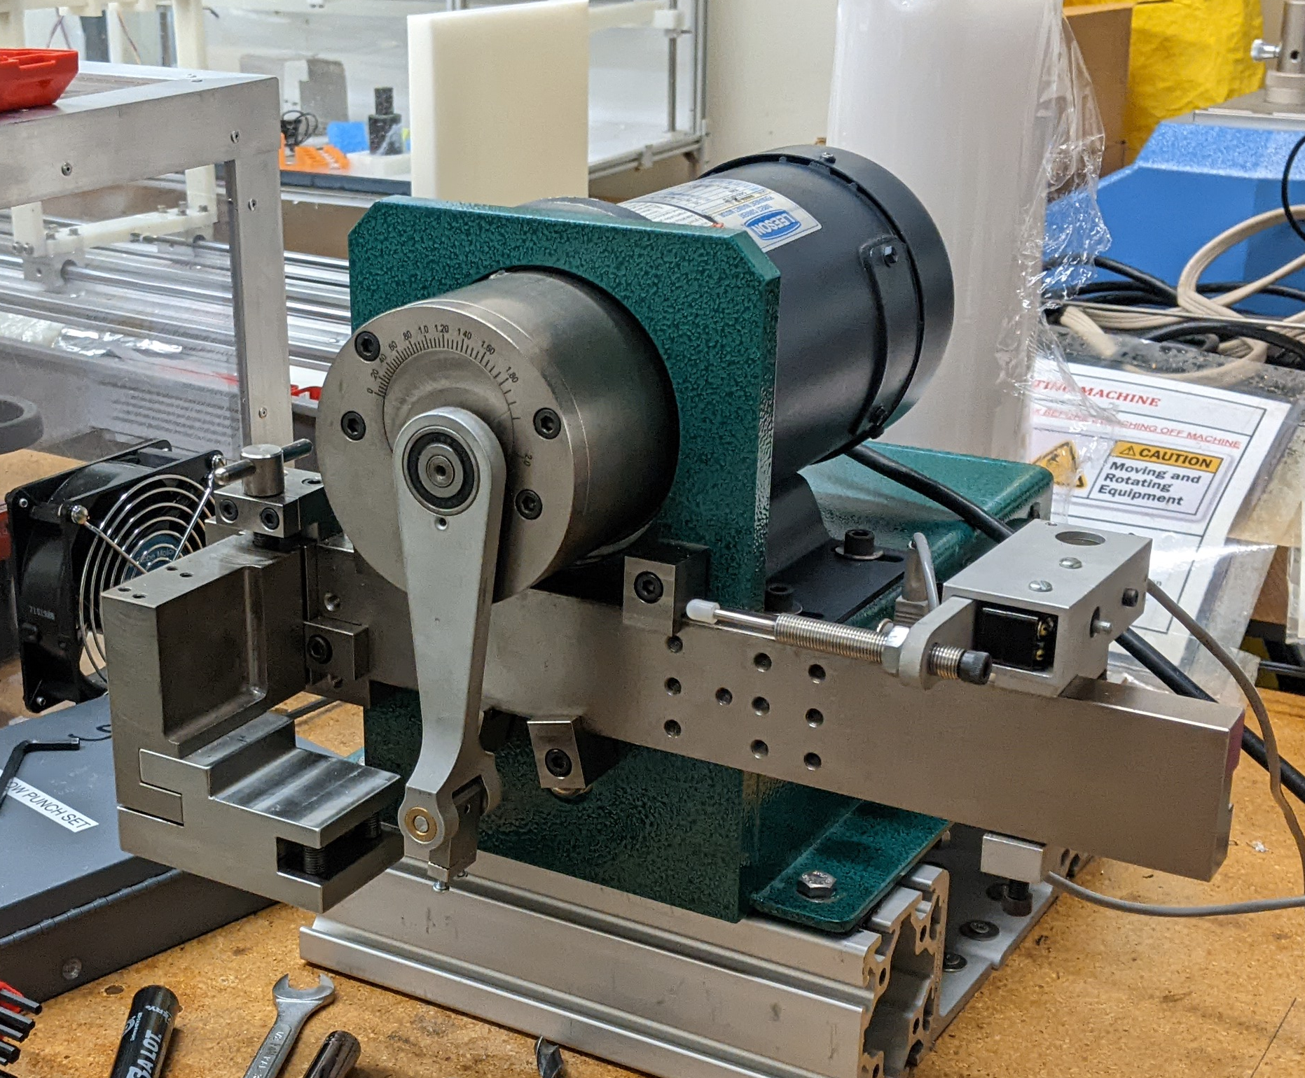
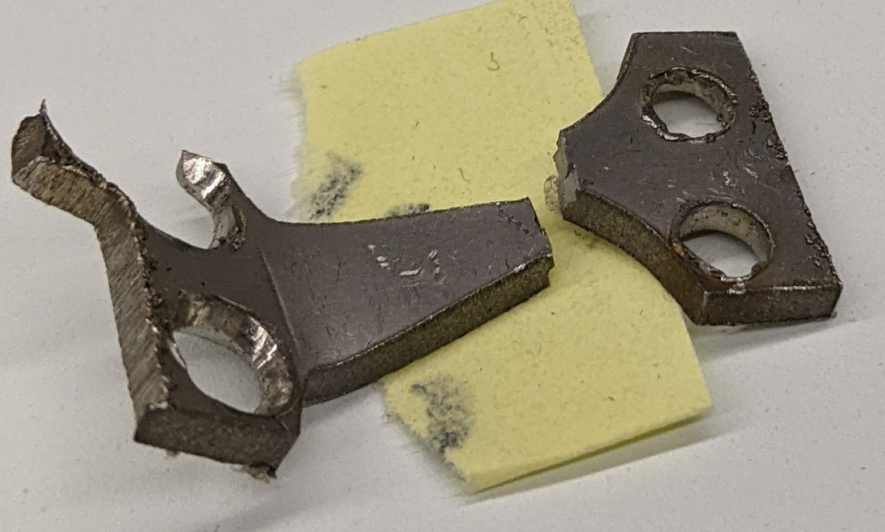
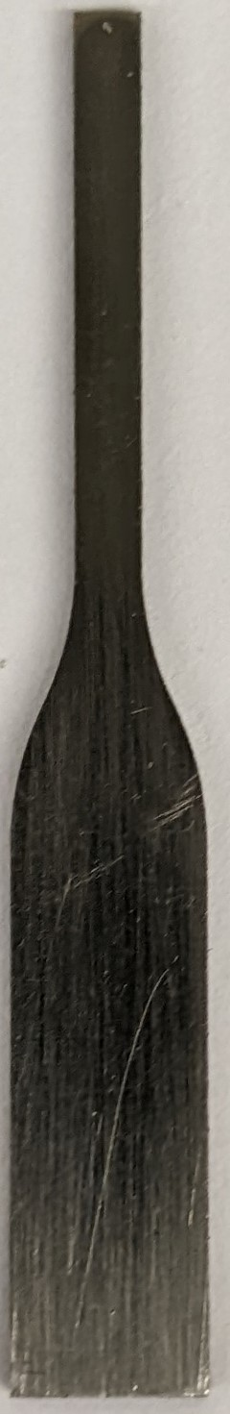
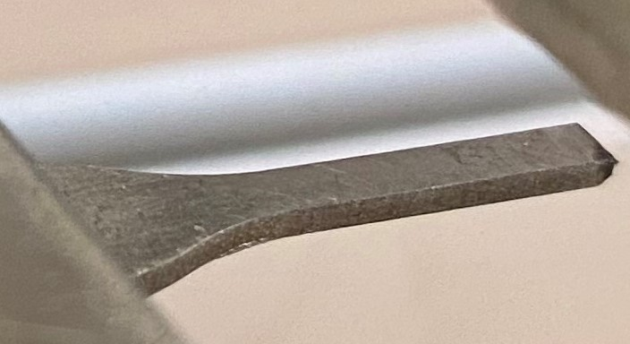
Upgrading a commercial bend fatigue tester
ASTM B592
Extra moment
Should have failed here
Should have failed here
Limit switch for cut-off
Missouri state university
Instead, failed here
ASTM standard sample failure in unexpected mode
Mechanical cut-off switch which only activated when failed catastrophically (safety issues)
Fatigue machine needed some modification

Slide 16
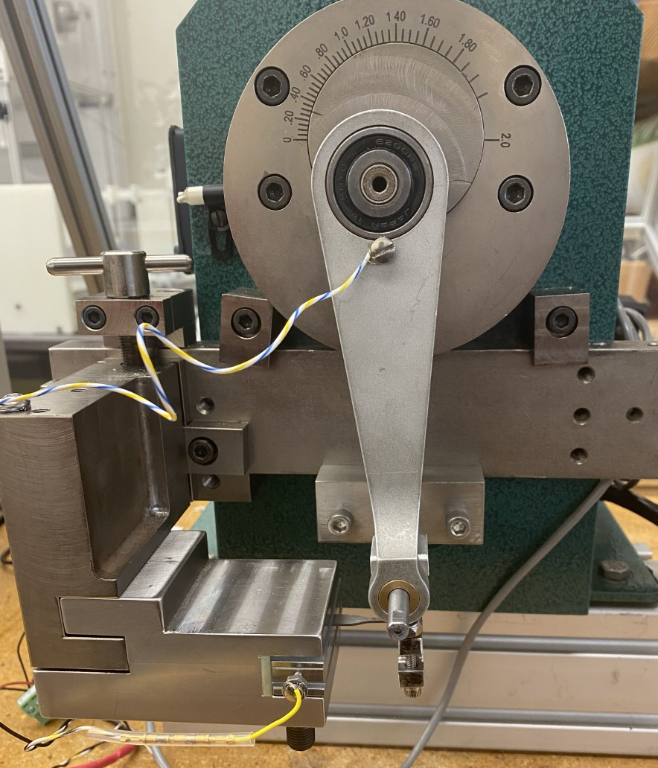

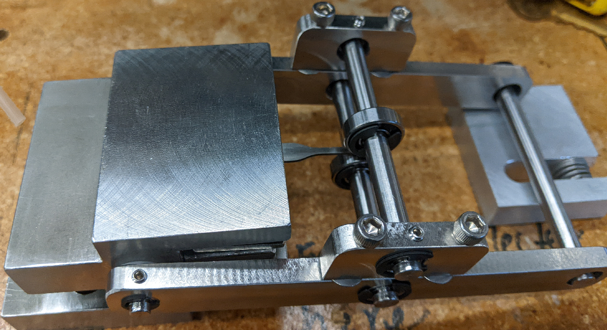
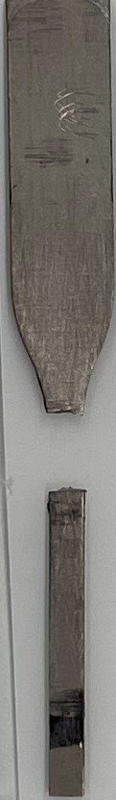
Upgrading a Bend fatigue tester
To connecting rod
Double bearing grip for sample tip
Grip location detached from connecting rod pin
Electronic cut-off switch for automatic crack detection
Failure at expected location
Prof. Abiodun Fasoro, Univ. Visiting faculty Program

Slide 17
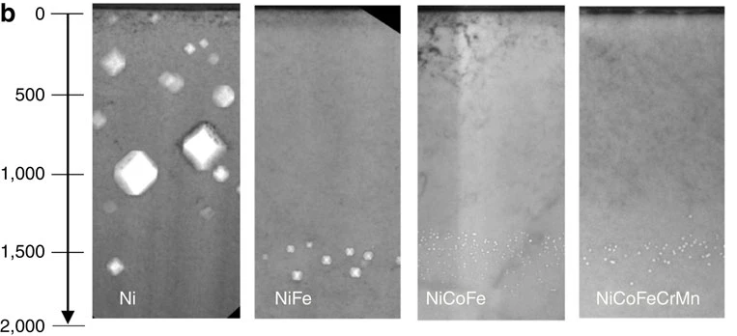
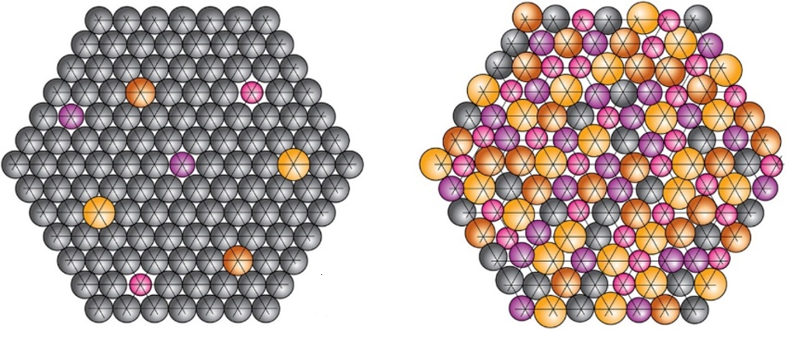
Novel Material (Nanofiber, HEAs) Development
Kavin Ammigan was awarded with Early Carrier Award (ECO)
  $2.5M for 5 years
Simulations on radiation damage in HEAs planned to start this year (October) with the hiring of a postdoc
    Alloys consisting of 3 or more principal elements
    Excellent inherent properties including enhanced radiation damage resistance
(a)
(b)
A. Couet
Reduction in irradiation-induced void distribution in nickel and multi-component HEAs after 3-MeV Ni+ ion irradiation at 773 K
(a) Conventional alloy,
(b) High-entropy alloy (Miracle & Senkov, 2016)
C. Lu, L. Et al., Nat. Commun., 7 (2016), p. 13564

Slide 18
Next HiRADMat test- HRMT-60
Beam parameter: 288 bunches, σ: 0.25mm, POT 3.7x10¹³ /7.85µsec
Beam time : 4th week of October 2022
List of materials to be tested :
Unirradiated : Graphite (POCO-ZXF5Q, IG430), nanofiber (ZrO2, ZrO2-SiO2, ZrO2-TiO2),Beryllium
(PF60, S200F), Sigraflex , Ti6Al4V, Timet 1100, Ti6246,Ti15-3, DAT54, High
Entropy Alloys, TFGR, pure W, Slugs (Beryllium, Ti6Al4V, NITE)
Irradiated : Graphite (POCO-ZXF5Q, IG430), MoGr, Sigraflex, Beryllium( S200FH, S200F),
Ti6Al4V( Gr 23, Gr5, Gr6), Ti15-3
Instrumentation (strain/ temperature gages) installed ,tested on slugs.
All samples were packed in holders inside array boxes and on their way to CERN

Slide 19
Collaboration activities with other institutes
Simulation He bubble in Beryllium→ Jianqi Xi at Univ of Wisconsin
Raman spectroscopy on Nuclear graphite→ Eric/Dong Liu at Univ. of Bristol
BLIP irradiated Beryllium PIE → Dave/Andy at PNNL
Profilometry, microhardness of BLIP/HRMT Beryllium → Slava at MRF
High Entropy Alloy (HEA) development → Adrien Couet at Univ. of Wisconsin
A. Couet
D. Liu
A. Casella
S. Kuksenko
A. Couet

Slide 20
Thanks for your attention!

