Slide 1










RaDIATE
STFC status
Chris Densham
for T2K-UK and LBNF-UK project teams and ISIS at STFC Rutherford Appleton Laboratory

Slide 2
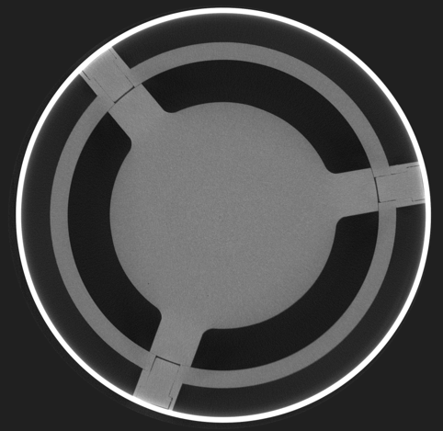
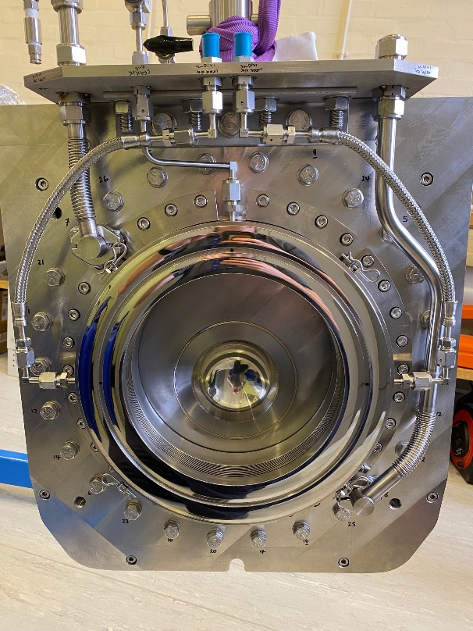
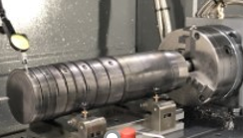
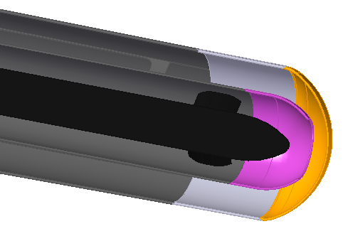
T2K
ISIS
LBNF
Overlapping Interests in RaDIATE for STFC Projects and Facilities
Titanium, Graphite
Tungsten,
Beryllium
Materials
Facilities, Techniques
RaDIATE

Slide 3
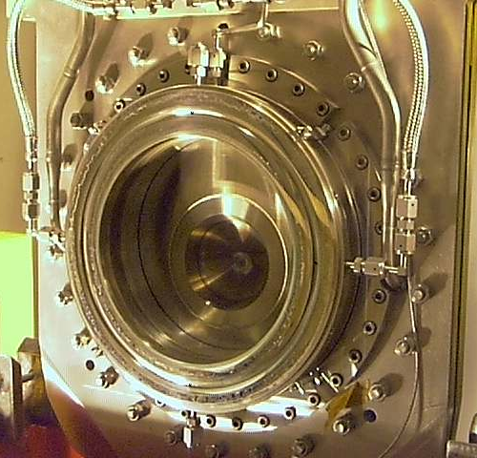
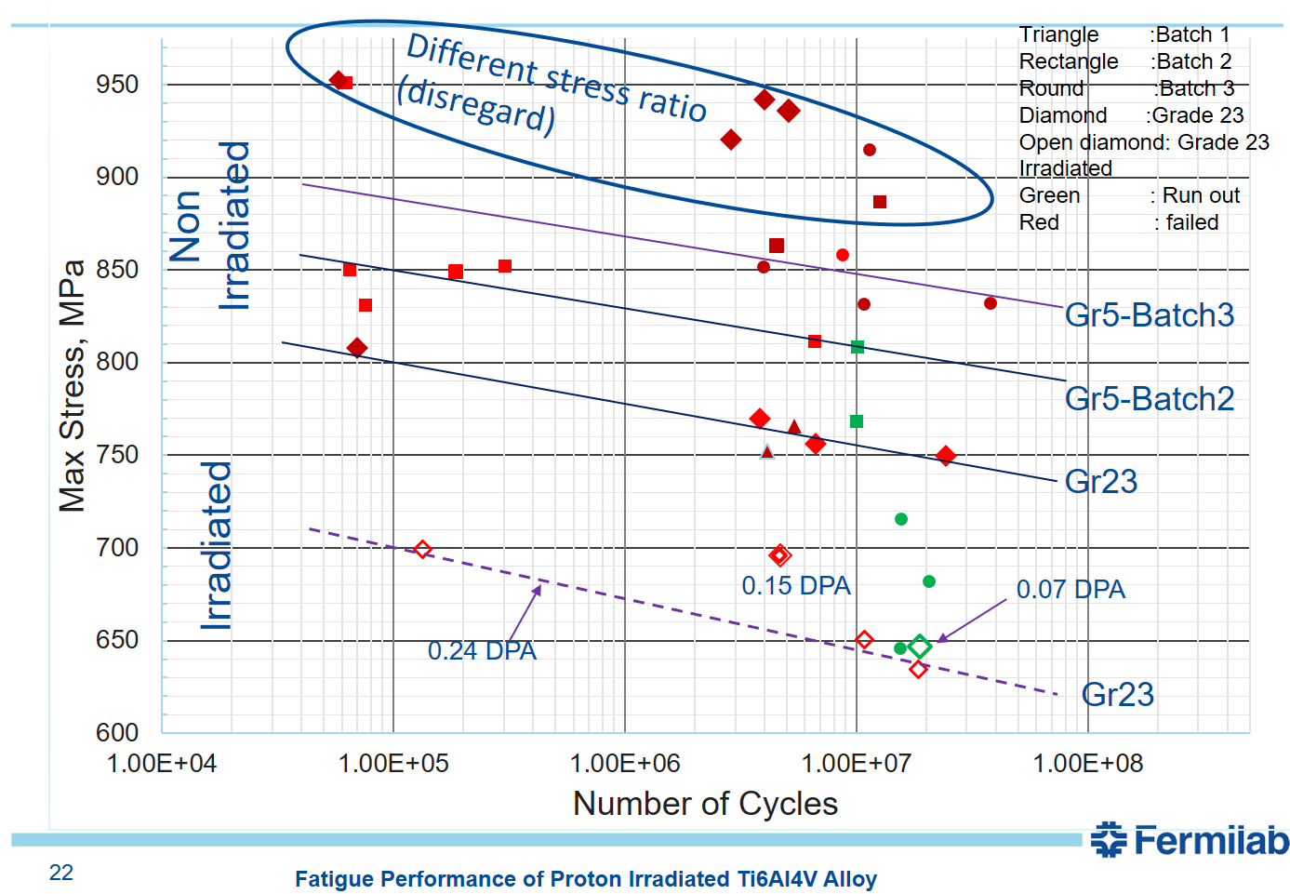
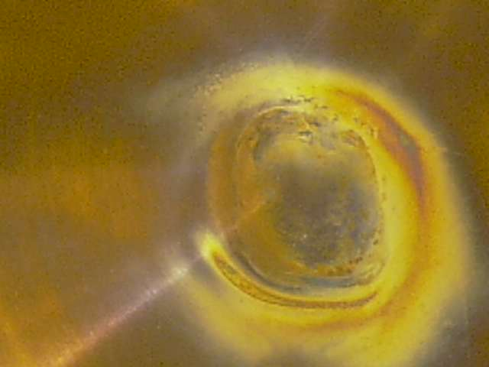
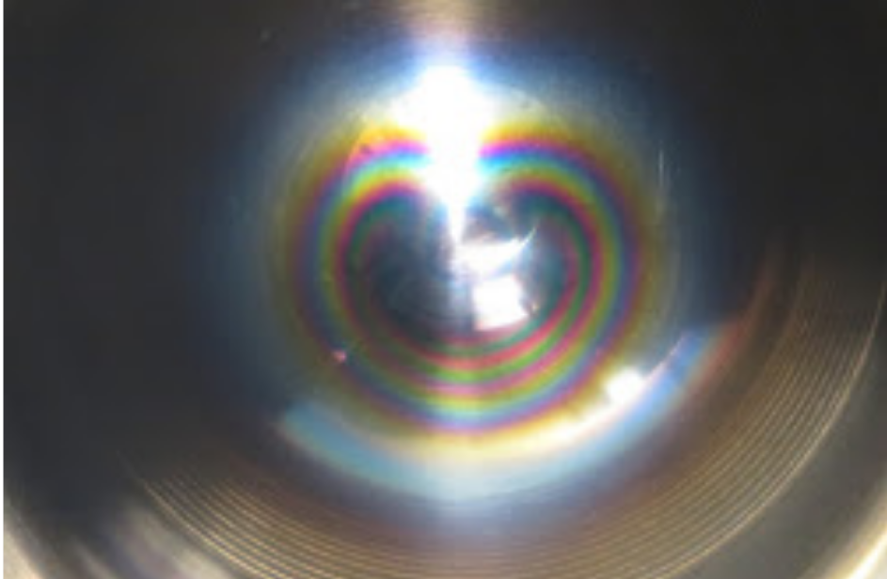
Lifetime limits: Radiation Damage of T2K Titanium Windows
Sparse data on prototypic radiation damage of titanium to date
Grade 23 shows a ≈15% reduction in fatigue strength at 10^8 cycles after proton irradiation to 0.24 DPA
T2K beam window #1 (DS) after c.2e21 POT
Grade 5 Ti-6Al-4V
T2K beam window #2 (US) after c.1.6e21 POT
“Fatigue Performance of Proton Irradiated Ti6Al4V Alloy”, Sujit Bidhar, 6th RaDIATE Collaboration Meeting, Dec 10, 2019

Slide 4
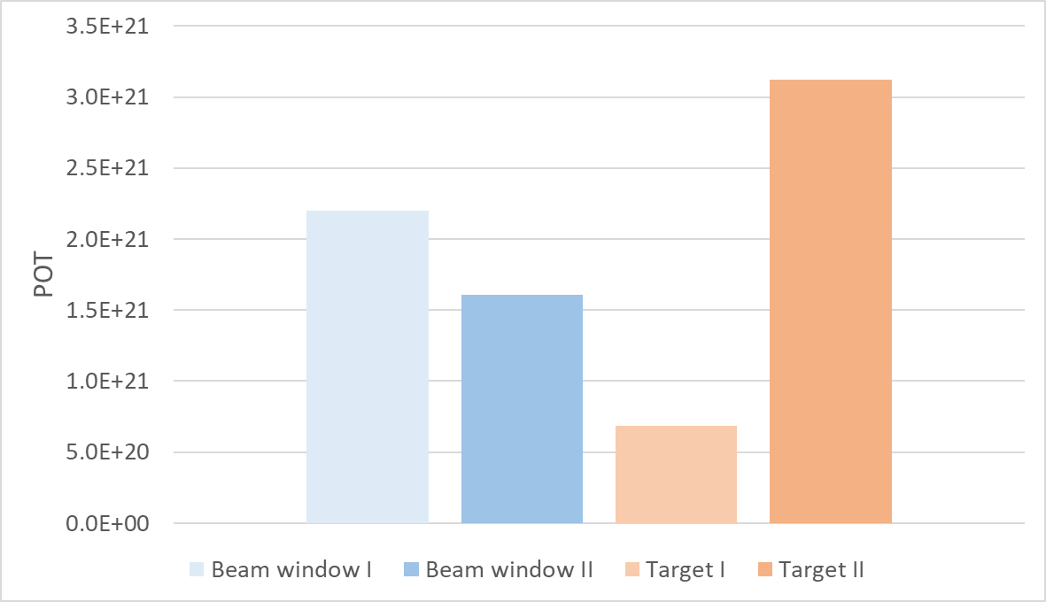
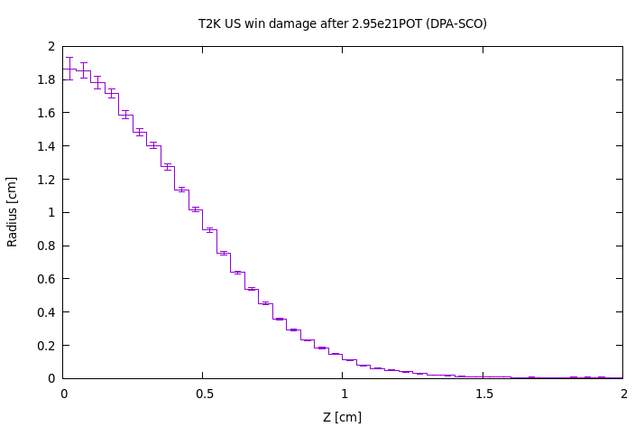
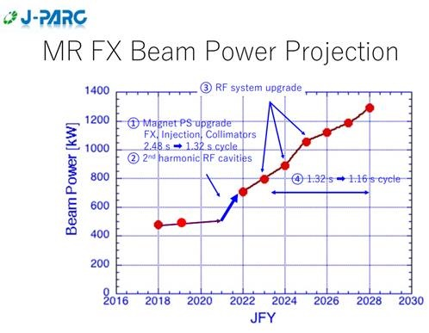
Good experience so far on T2K at 500 kW
How long will a Ti-6Al-4V window/target last?
Target currently has highest POT ~3 x 10²¹ POT
C.2 DPA – c.10x BLIP sample data so far(c.0.24 DPA)
3.1x10²¹
1.6x10²¹
FLUKA estimate current target window @ 1.9DPA
Damage threshold = 40eV
Replaced before failure
Replaced before failure
Replaced before failure
In service
Similar DPA/year for LBNF at 1.2 MW

Slide 5
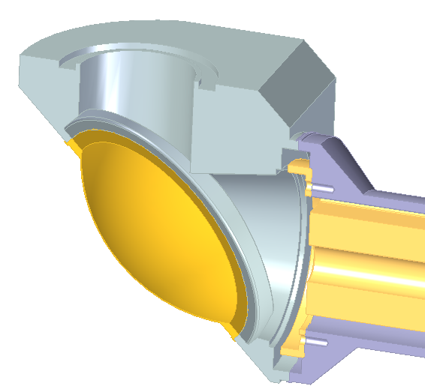
LBNF: Beam Window Ti alloy/grade Selection
Windows have higher temperature, radiation damage and fatigue than the container
Available radiation damage data: up to 0.24 dpa, mostly for grades 5 and 23
Peak dose: 0.14dpa/yr in container, 2.5 dpa/yr in upstream window
Downstream Window
t_{min} = 0.4mm
Dose = 0.7dpa/yr
T_{max} = 150°C steady state, 175°C peak
ΔT = 55°C/pulse
Upstream Window
t_{min} = 0.3mm
Dose = 2.5dpa/yr
T_{max} = 115°C steady state, 150°C peak
ΔT = 70°C/pulse

Slide 6
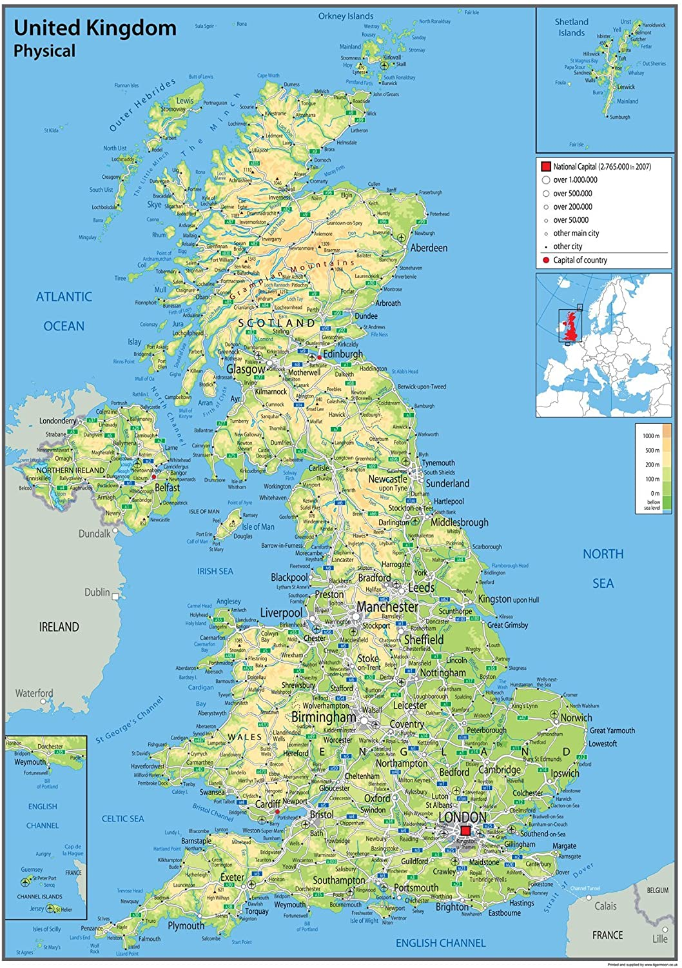
STFC support and coordination of target & window materials research
Contributions to RaDIATE materials science program
Initial funding via HyperK-UK project
  Kick-started academic materials science projects
Project now supported by LBNF-UK
  Supports all outstanding HK-UK activities (ie BLIP irradiated samples)
Coordinate activities with US-JP collaboration
Birmingham University, PDRA (MC40 cyclotron for sample irradiation, c.30 MeV protons)
Oxford University
PDRA (micromechanics) PhD (titanium - our irradiated samples)
RAL (UK coordination)
ISIS (Bristol study of NuMI graphite on ISIS/ENGIN-X instrument approved)
Culham Laboratory
(Materials Research Facility for all Post-Irradiation Examination)
Bristol University (graphite research)

Slide 7
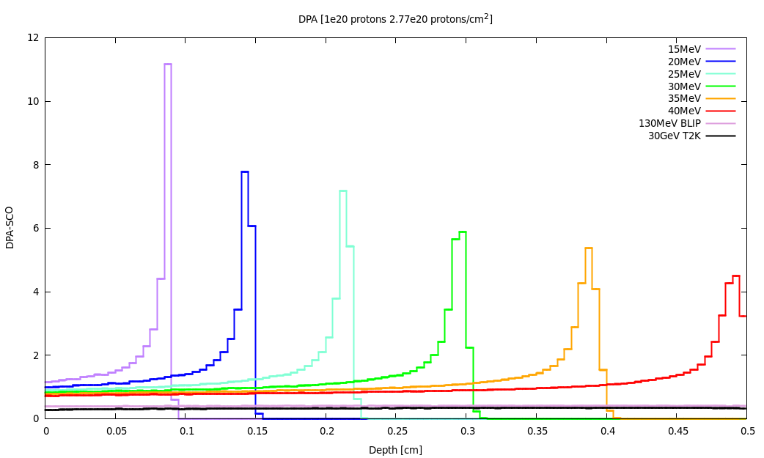
Irradiation of titanium test samples at Birmingham MC40 cyclotron
Optimum performance of cyclotron c. 28-30MeV, maximum beam current 30uA
Ti Damage threshold used = 30eV
30 days irradiation: ~1DPA in titanium.
Damage is higher at Bragg peak but gas production is unrealistic (next slide)
At 30MeV the range in titanium is approximately 3mm
c/o Mike Fitton

Slide 8
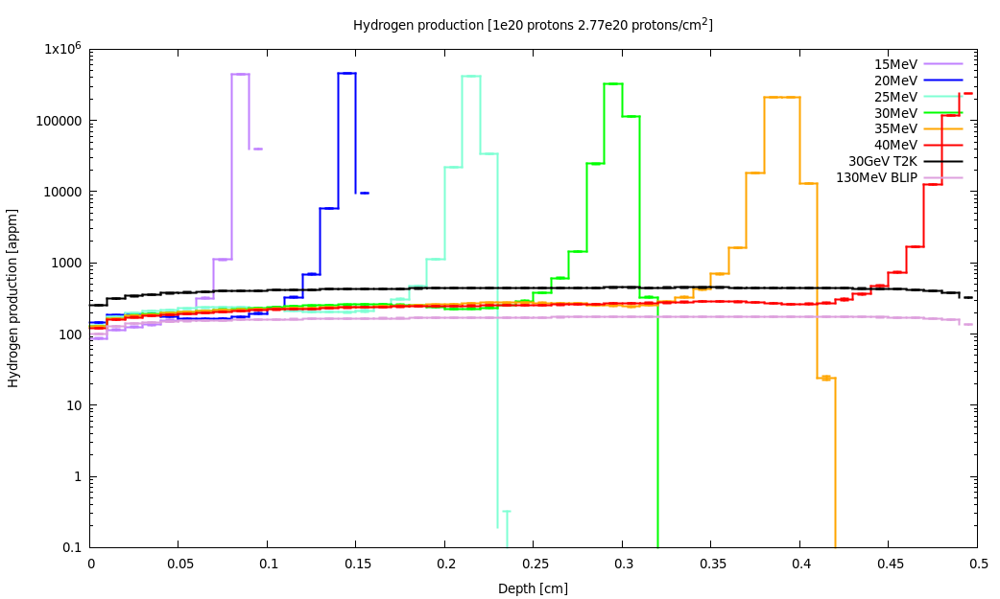
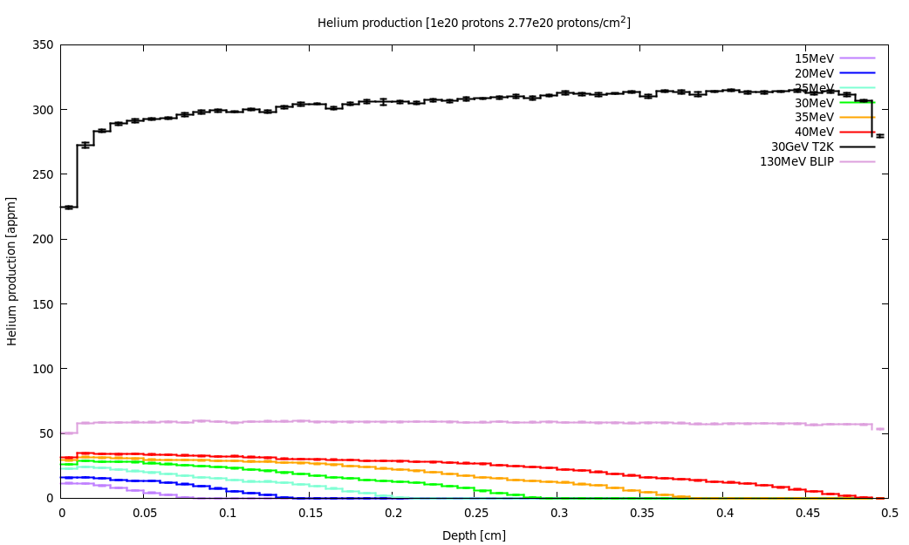
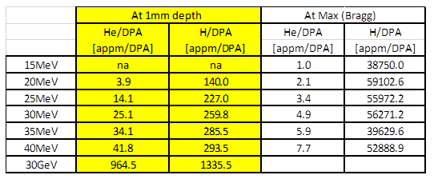
He & H production in titanium test samples at Birmingham MC40 cyclotron
H / He production
Hydrogen production is slightly lower (~1/5th) at 10’s MeV compared to T2K (30GeV) except at the Bragg peak where it is much higher (x45+!)
Avoid the Bragg peak as H production is unrealistic. This could cause swelling, cracking, etc
Helium production is much lower (~1/30th) with lower energy irradiation
Could implant He but range is limited
30 GeV
30 MeV
30 GeV (T2K)
130 MeV (BLIP)
30 MeV (MC40 at B’ham)
c/o Mike Fitton

Slide 9
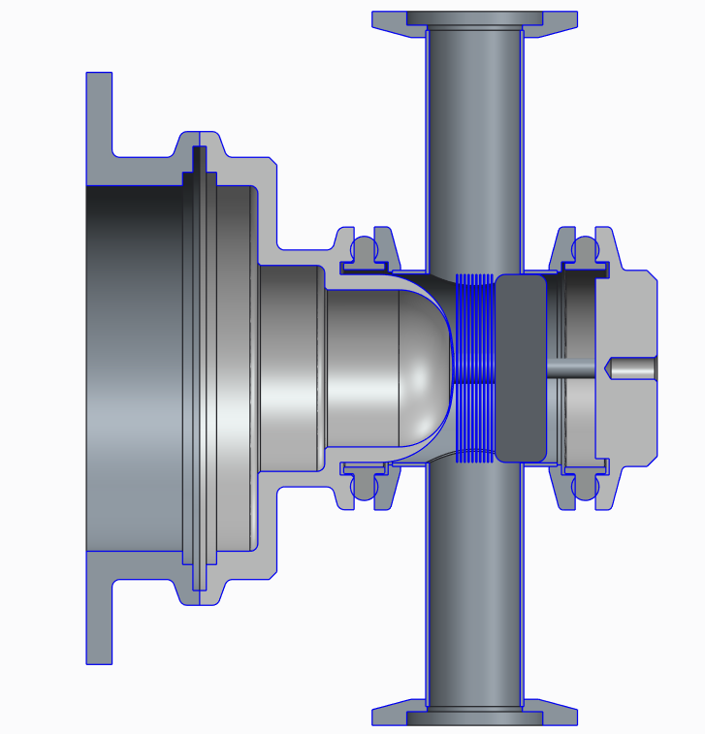
Conceptual design of MC40 sample environment
Beam Dump
- Graphite dump to absorb Bragg Peak
- Opportunity to compare performance of different graphite grades
Collimator
Eliminates activation outside of the sample area
Ti sample foils
- Need careful design to include active (nitrogen gas?) cooling
c/o Eric Harvey-Fishenden

Slide 10
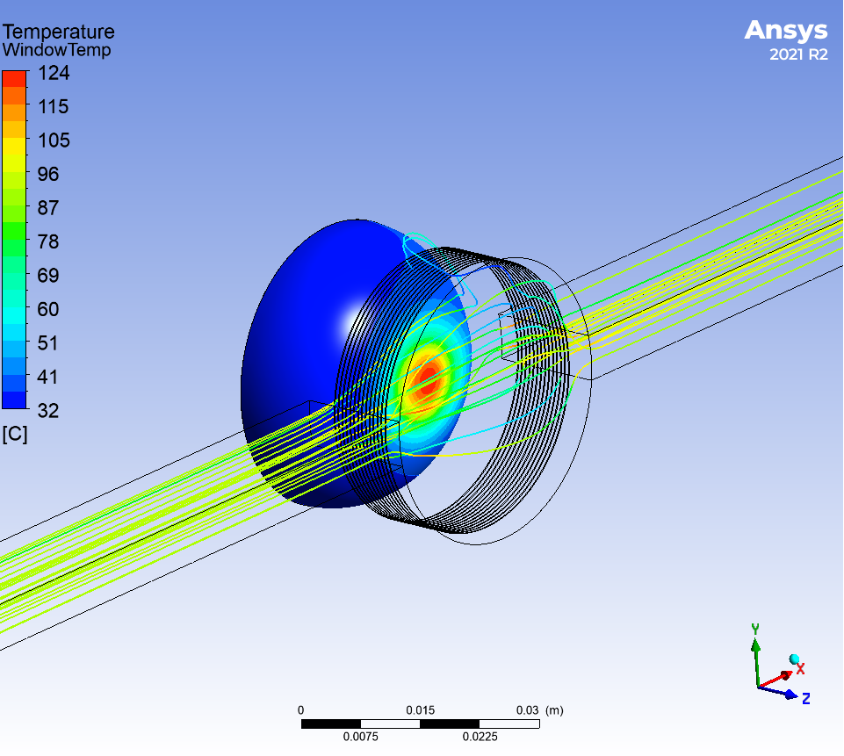
Helium or nitrogen cooling?
Beam Current (uA) | Coolant gas | Flowrate (g/s) | Outlet Pressure (BarG) | Window Temperature (°C) | Sample Temperature (°C) | Graphite Temperature (°C) | dP (Bar)
30 | Nitrogen | 80 | 10 | 124 | 111 | 149 | 0.84
15 | Nitrogen | 40 | 5 | 90 | 97 | 114 | 0.41
30 | Helium | 15 | 10 | 105 | 84 | 123 | 0.24
30 | Helium | 11 | 5 | 117 | 105 | 140 | 0.25
Aluminium window
Should be 100-120°C Max
Due to material strength
Aiming for 100-150°
Temp of typical beam window
Helium cooling safest (lower activation)
Nitrogen cooling would reproduce LBNF target window environment
Compressor specification for either Nitrogen or Helium look quite demanding.
Carrying out study to test vibration of samples by gas flow (Richard Cowan)
May need to reduce beam current
c/o Eric Harvey-Fishenden

Slide 11
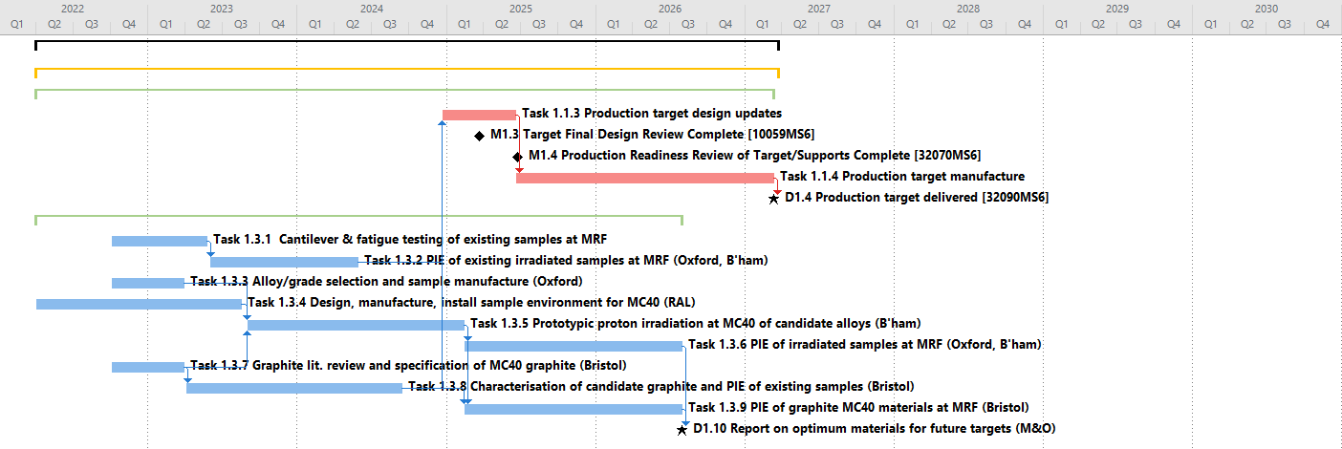

RaDIATE-UK Material Science Plan
Literature reviews and testing of existing graphite and titanium samples feed into production target design
NB following feedback from previous meeting (Culham, May 10th) have proposed a partial decoupling of the materials
science subproject from the first operating target manufacture
MC40 sample environment design already started (RAL)
TITANIUM
Knowledge from PIE of new “MC40” graphite and titanium samples feeds into report for future M&O targets
GRAPHITE
TITANIUM
GRAPHITE

Slide 12




Slide 13
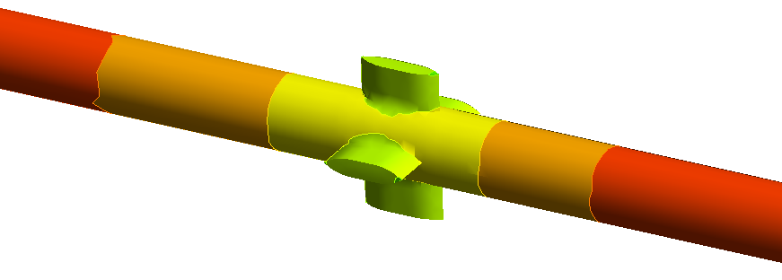
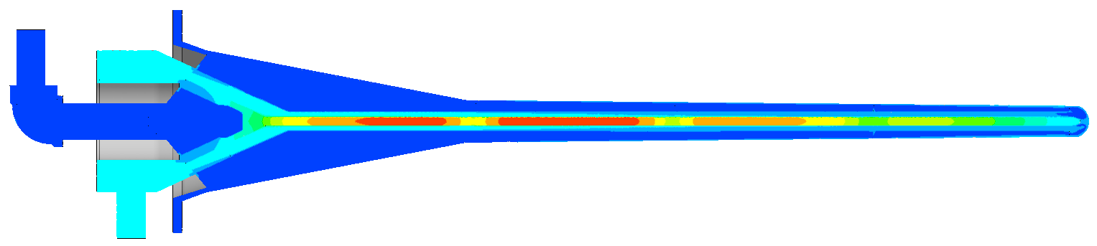
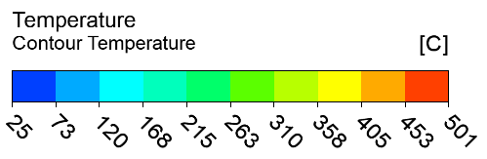
Thermal Results (Graphite)
Target length = 1.5m
Beam power = 1.2MW
Inlet temperature = 35°C
Helium mass flowrate = 40g/s
Back-pressure at outlet = 4.5barA

Slide 14
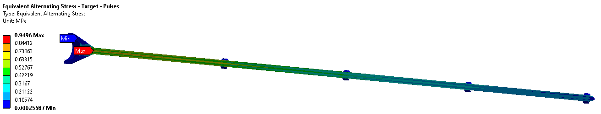
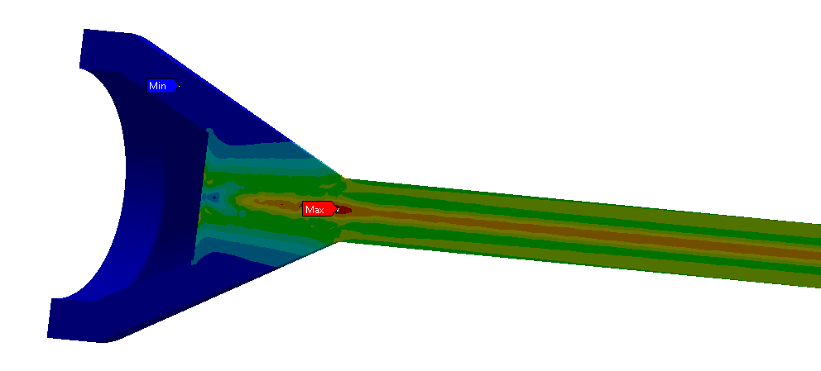
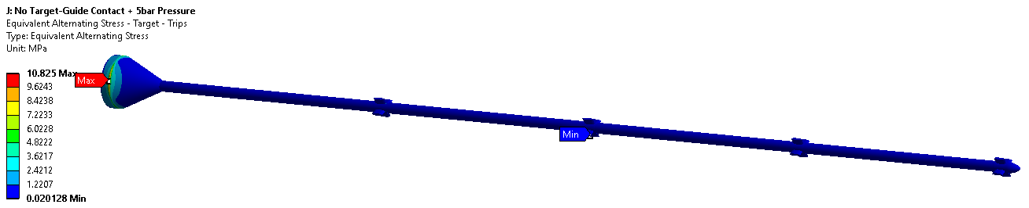
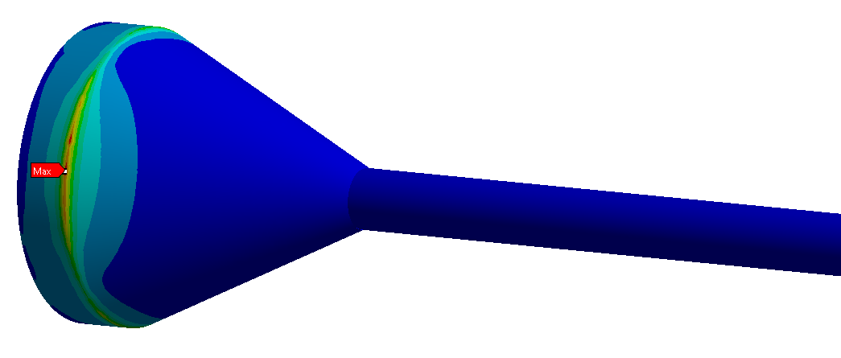
Fatigue Results – Graphite
Goodman equivalent alternating stress results
 | SE (MPa)
Target Pulses | 0.9
Target Trips | 10.8
Target Trips, No Stress Conc. | 1.0

Slide 15
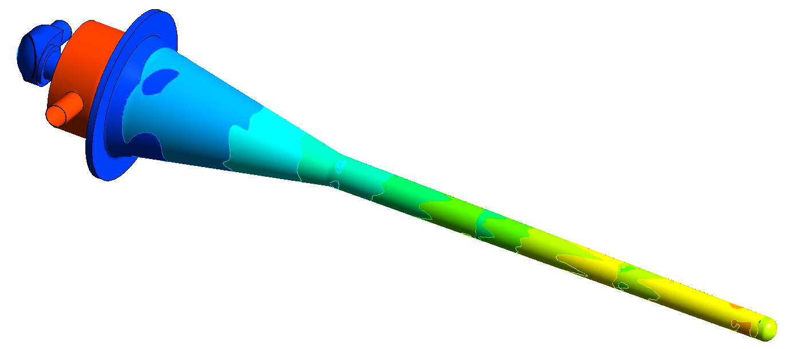
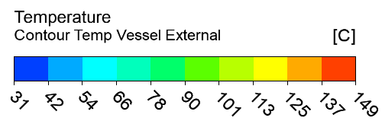
Thermal Results (titanium)
Target length = 1.5m
Beam power = 1.2MW
Inlet temperature = 35°C
Helium mass flowrate = 40g/s
Back-pressure at outlet = 4.5barA

Slide 16
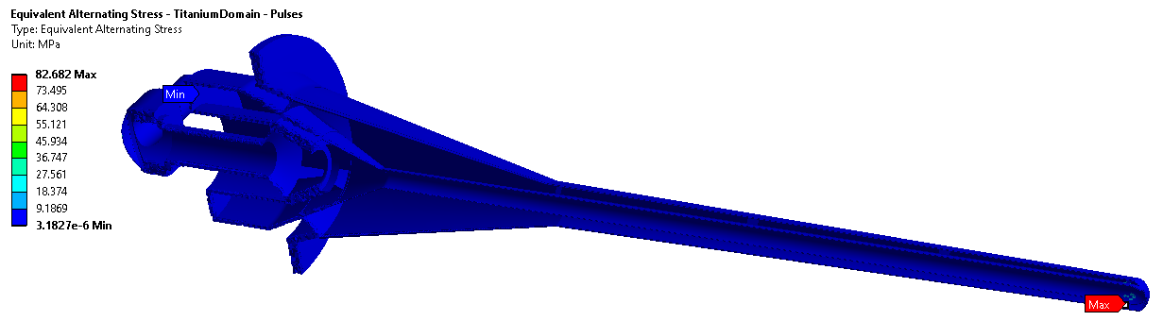
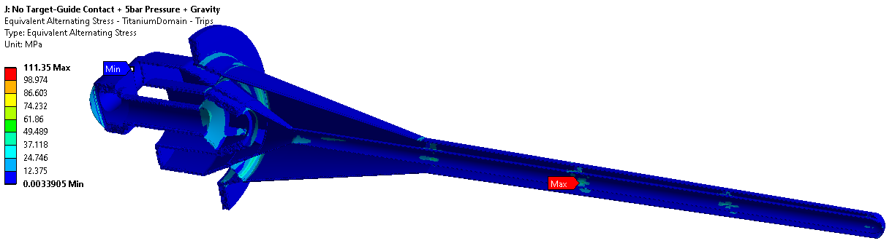
Fatigue Results – Titanium
Goodman equivalent alternating stress results
 | SE (MPa)
Titanium Pulses | 82.7
Titanium Trips | 111.3
Ignoring stress concentrations, peak stresses in titanium occur at the upstream window

Slide 17
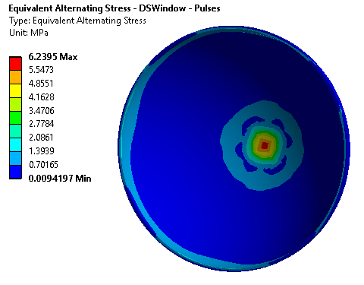
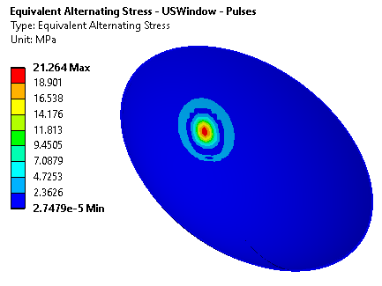
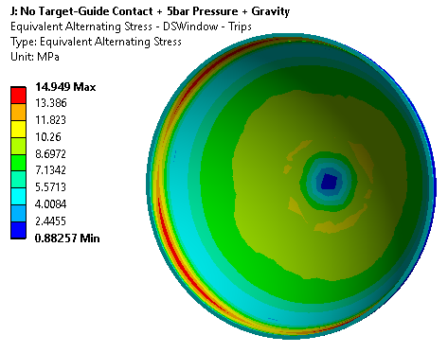
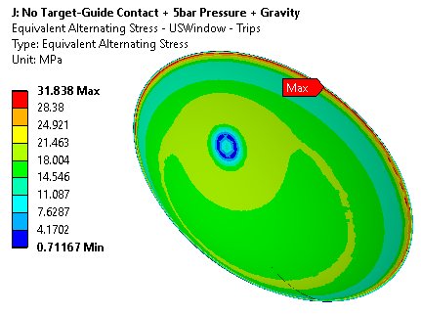
Fatigue Results – Beam Windows
Goodman equivalent alternating stress results
 | SE (MPa)
USWin Pulses | 21.3
USWin Trips | 31.8
USWin Trips, No Stress Conc. | 28.0
 | SE (MPa)
DSWin Pulses | 6.2
DSWin Trips | 14.9
DSWin Trips, No Stress Conc. | 10.8

