Slide 1
IRRADIATION and characterization for MATERIAL SCIENCE at CIRIL-GANIL FACILITY
Platform for welcoming interdisciplinary researches at GANIL, CIRIL
Research center on Ions, Materials and Photonic, CIMAP
Dr Clara GRYGIEL
IRRSUD beamline coordinator
Deputy director of EMIR&A network
grygiel@ganil.fr

Slide 2
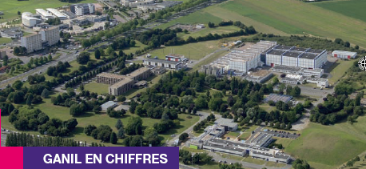
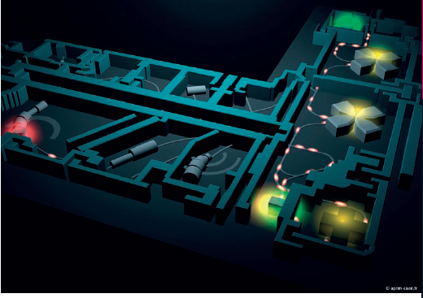
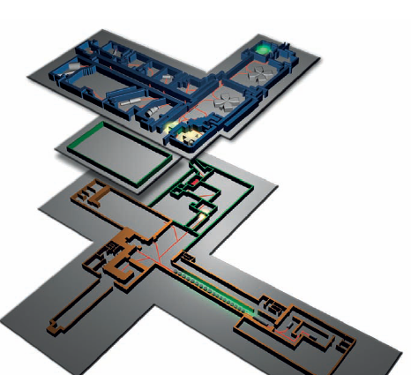
GANIL campus
GANIL + SPIRAL1
1983: First experiment
39 years of running
Users: 600 physicists (50% foreigners)
Beam: about 5500 hours per year
2000 hours per year as pilot # High Energy
+ 1000 hours in parallel: Medium Energy
+ 1500 hours in IRRSUD
+ 1000 hours in ARIBE
SPIRAL2
Average numbers
Run the accelerator facility and Nuclear physics research
Run interdisciplinary physics research
(materials science, astrophysics, atomic physics and radiobiology)
2

Slide 3
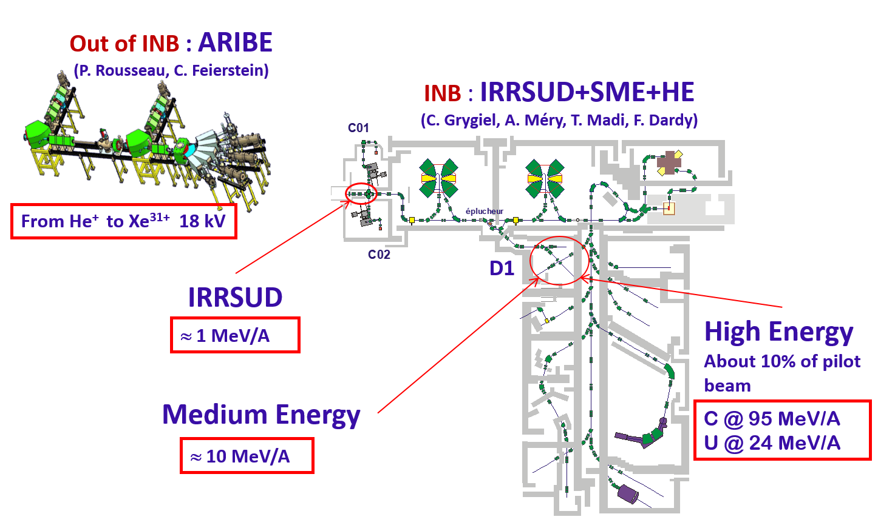
Beamlines for Interdisciplinary Research
CIRIL platform (J. Rangama, F. Ropars)

Slide 4
High energies with CYCLOTRONS
Heavy ions at higher energies (from C to U)
flux up to 10¹⁰ ions.cm⁻².s⁻¹
Rp to some hundred microns
Continuous measurement of flux
Beam sweeping up to 30cm²
D1
IRRSUD
≈ 1 MeV/A
HE
C @ 95 MeV/A
U @ 24 MeV/A
SME
≈ 10 MeV/A
4

Slide 5
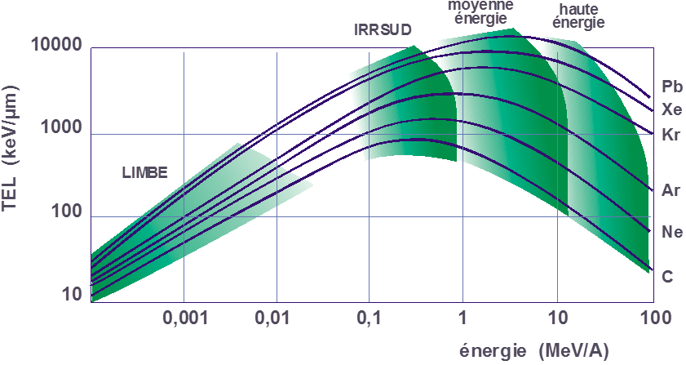
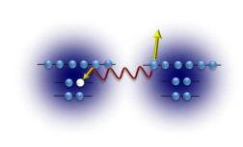
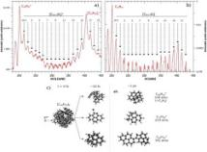
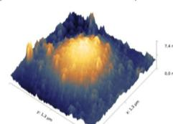
Interdisciplinary physics at GANIL Energy range
Swift heavy ions
Electronic excitations
Highly charged ions
Potential energy
ARIBE
surface
5 µm
> 10¹⁵ cm⁻²
100 µm
1500 µm
10¹³ cm⁻²
5

Slide 6
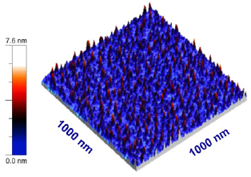
GANIL facility beamlines vs material modifications
medium energy
IRRSUD
high energy
LET (keV/µm)
ARIBE
∼ nm
energy (MeV/A)
Potential energy deposition E_{P}
Gd₂Ti₂O₇ 119MeV U
Capture, decay, emission, sputtering
>> Nanostructure formation
SrTiO₃
Xe³¹⁺ E = 110 keV
El Said et al, NIMB 269-1234(2011)
Aumayr et al, JPCPM 23-393001(2011)

Slide 7
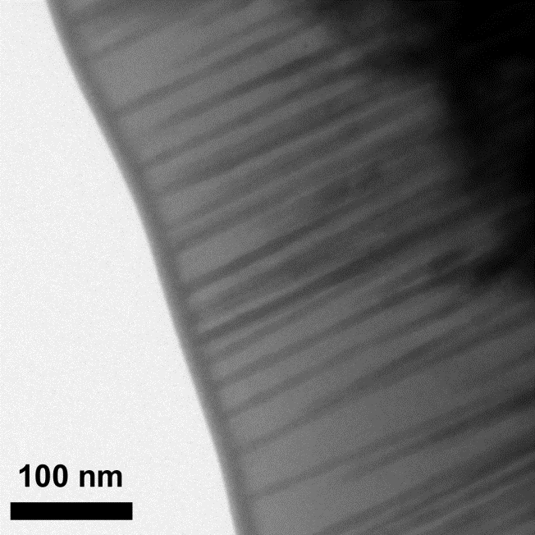
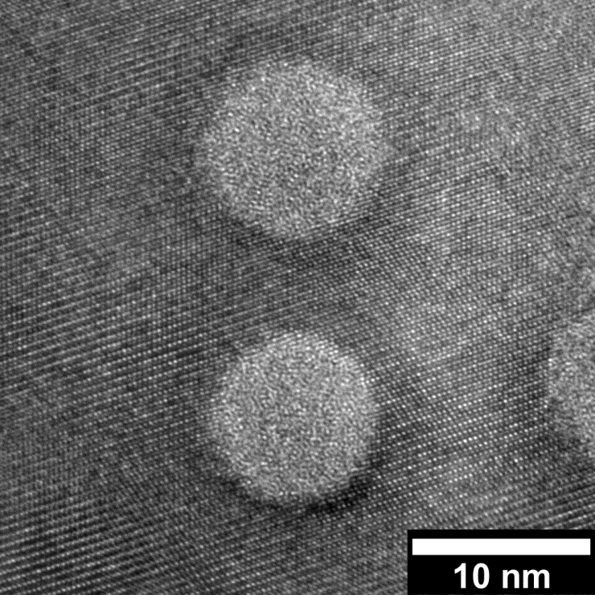
GANIL facility beamlines vs material modifications
medium energy
IRRSUD
high energy
LET (keV/µm)
ARIBE
5 µm
100 µm
1500 µm
∼ nm
energy (MeV/A)
Potential energy deposition E_{P}
Electronic energy loss S_{e}
Gd₂Ti₂O₇ 119MeV U
Capture, decay, emission, sputtering
Defect formation by radiolysis
Collective effect: atomic motions by intense electronic excitations -> extended defects
>> Nanostructure formation
SrTiO₃
Xe³¹⁺ E = 110 keV
>> Track formation, disorder, phase transitions, surface nanostructures
El Said et al, NIMB 269-1234(2011)
Aumayr et al, JPCPM 23-393001(2011)
Sattonnay et al, Acta Mat 60-22 (2012)

Slide 8
GANIL facility beamlines vs material modifications
Nuclear energy loss S_{n}
medium energy
<<< µm
IRRSUD
high energy
LET (keV/µm)
ARIBE
Frenkel pairs, Displacement cascades
5 µm
>> Cavities, bubbles, dislocation loops, segregation, precipitation, amorphization, phase transitions
100 µm
1500 µm
∼ nm
energy (MeV/A)
Potential energy deposition E_{P}
Electronic energy loss S_{e}
Gd₂Ti₂O₇ 119MeV U
Capture, decay, emission, sputtering
Defect formation by radiolysis
Collective effect: atomic motions by intense electronic excitations -> extended defects
>> Nanostructure formation
SrTiO₃
Xe³¹⁺ E = 110 keV
>> Track formation, disorder, phase transitions, surface nanostructures
El Said et al, NIMB 269-1234(2011)
Aumayr et al, JPCPM 23-393001(2011)
Sattonnay et al, Acta Mat 60-22 (2012)

Slide 9
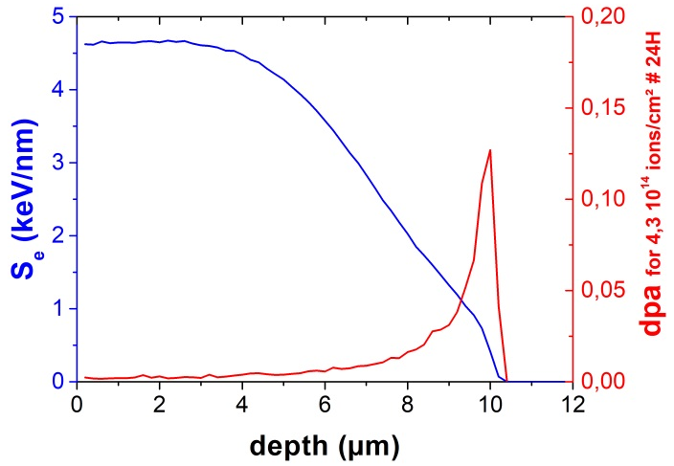
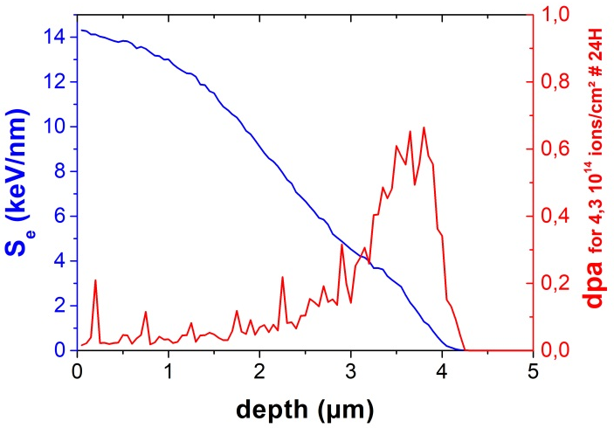
IRRSUD : Some numbers
SRIM
C 1,8g/cc
W 19,35g/cc
³⁶Ar¹⁰⁺
0,98 MeV/A
# 35 MeV
Rp | 10,4 µm
Se | 4,61 keV/nm
Sn | 0,0079 keV/nm
ENSP surface | 584
Rp | 4,2 µm
Se | 14,24 keV/nm
Sn | 0,0417 keV/nm
ENSP surface | 341
average flux, RT: 5e9 ions/cm².s
In 24H : fluence 4,3e14ions/cm²
at IRRSUD
(Rastered beam on 25cm²)
Max: 5e10-1e11ions/cm².s
9

Slide 10
In-beam conditions
Ions: C to U multicharged
Energy: keV up to 0.3 – 100 MeV/A
Online setups for material characterizations:
Beam scanning
XRD
ALIX IRRSUD
FTIR
UV-Vis
CASIMIR 15-300K
CESIR RT
DETAIL up to 1400K
Temperature
8 - 1300K
Absorption spectro
Incidence
90° - 0°
Emission spectro
Gas release
FTIR
Mass spectroscopy
Gas partial pressure
TOF or catchers
AODO (X-Y TOF SIMS in situ LEED Auger)
Sputtering
+ Nuclear materials
External user setups
ex: MiniMecaSiC (CEA-DEN) or Raman (Orléans)
10

Slide 11
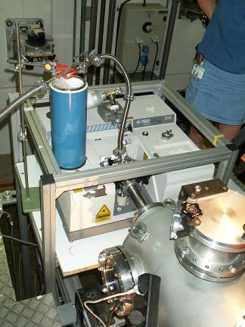
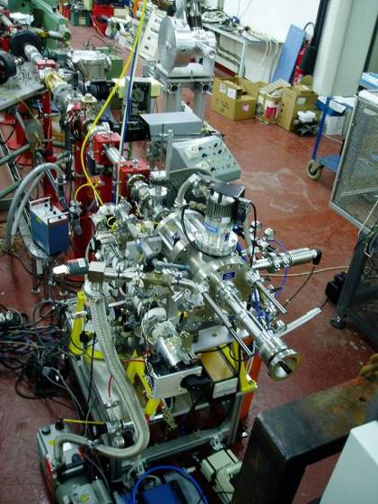
Gas release
GRAL
FTIR absorption of the gas mixture
Small hydrocarbons (up to 3 Carbons)
→Track creation at high stopping power in organic compounds
CIGAL
mass spectrometry
H₂ formation, O₂ consumption, CO, CO₂
→Gas production during nuclear waste storage of organic compounds contaminated with actinides as Pu (gloves, ...)
Picq et al, NIM B 151 - 76 (1999)
Dely et al, NIM B 236 - 145 (2005)
11

Slide 12
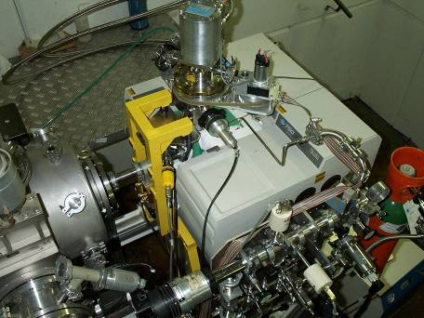
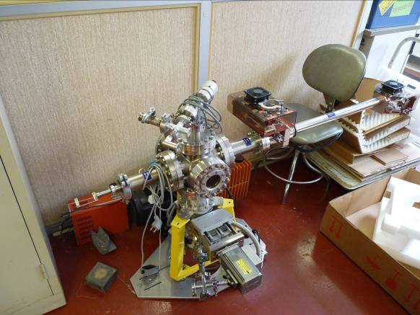
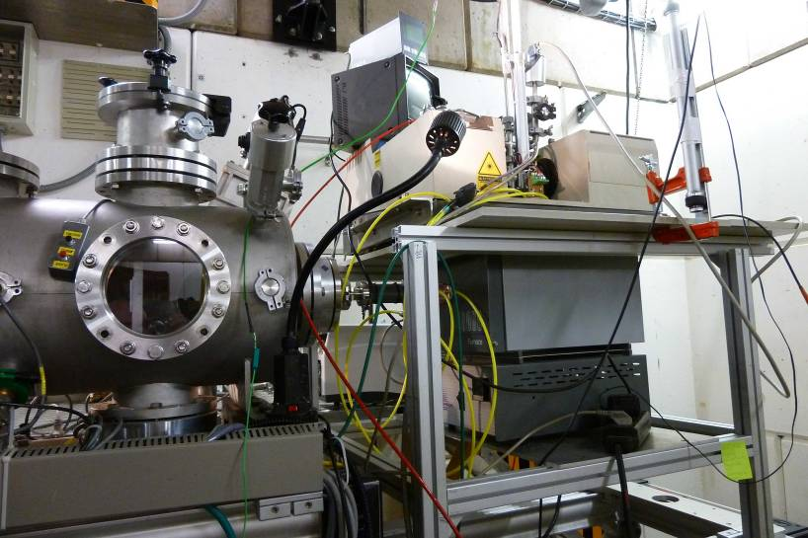
Absorption spectroscopy
Vibrationnal spectroscopy: FTIR, 8000 - 400 cm⁻¹ Electronic spectroscopy: UV-vis 200 – 900 nm
CASIMIR
15 K - 300 K
→Nitrides
→ Polymers, fundamental mechanims
→ Effects in solids relevant to astrophysics and astrochemistry
CESIR
Room temperature
DETAIL
High temperature & FTIR
Up to 1100 °C
CHESOI
Special low volume chamber for
rare gas atmospheres (¹⁸O₂)
Sall et al, EPL 102- 26002 (2013)
Balanzat et al, NIM B 105 - 1 (1995)
Pilling et al, Astronom & Astrophys 509 – A87 (2010)
Melot et al, NIM B 208 - 345 (2003)
12

Slide 13
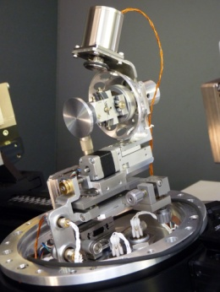
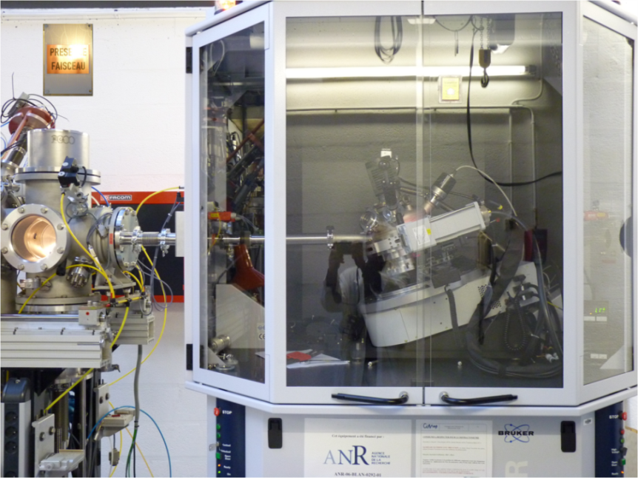
Structural - microstructural analyses
X-ray powder diffraction
“ALIX” setup
Only on IRRSUD
grazing incidence diffraction
simultaneous or sequential
→ Phase transition & structural modifications
→ Kinetics studies
Grygiel et al, RSI 83-013902 (2012)
Sattonnay et al, Acta Mat (2013)
Grygiel et al, Acta Mat 140, 157 (2017)
CHEXPIR, on ME not anymore available
13

Slide 14
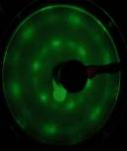
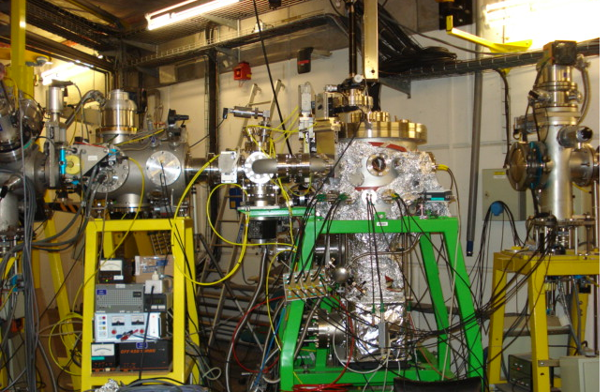
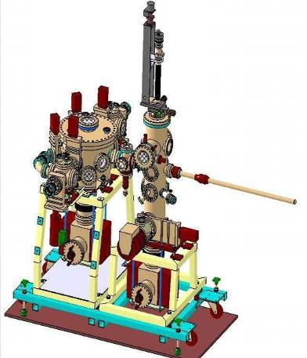
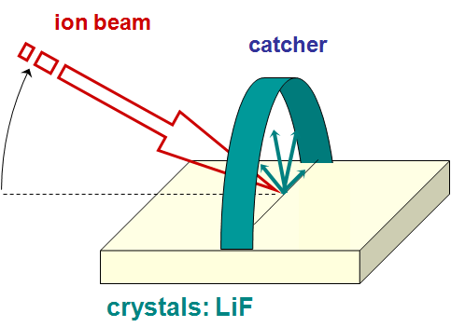
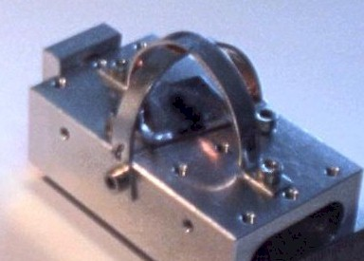
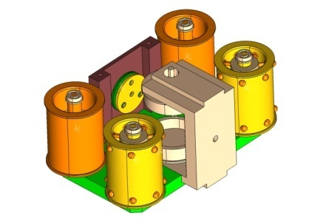
Sputtering
High energy
Low energy
AODO
(X-Y TOF SIMS)
Time of flight
UHV
In-situ LEED - Auger
charged particles
Hijazi et al, NIM B 269 – 1003 (2011)
Catcher
neutrals
Ex-situ analysis by RBS, ERDA, …
In-situ Auger
Toulemonde et al, NIM B 212 – 346 (2013)
Salou et al, RSI 84-095115 (2013)
14

Slide 15
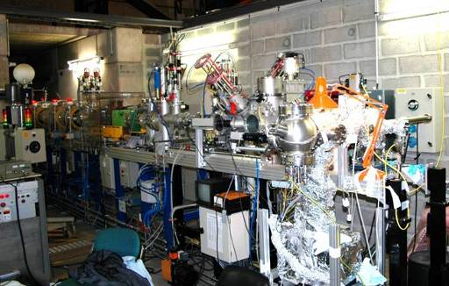
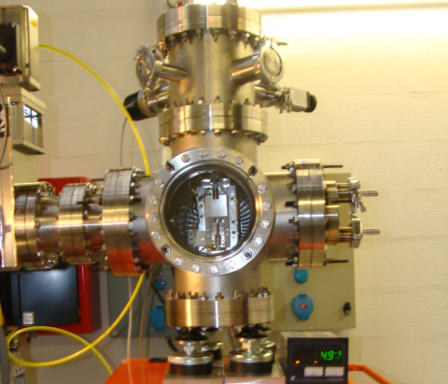
User’s instrumentation
In-situ UHV AFM
→ Creation of multiple nanodots by single ions, foldings on 2D
Akcoeltekin et al, Nature Nanotech 2 - 290 (2007)
H Lebius, M Schleberger Nature Nanotech 2, 290(2007), New J Phys 10-053007(2008)
E Gruber et al, J. Phys.: Condens. Matter 28, 405001 (2016); 30, 285001 (2018)
Collab Prof M. Schleberger, Uni. Duisburg-Essen, Germany
In-situ traction on SiC fibers
Jankowiak et al, NIM B (2013)
15

Slide 16
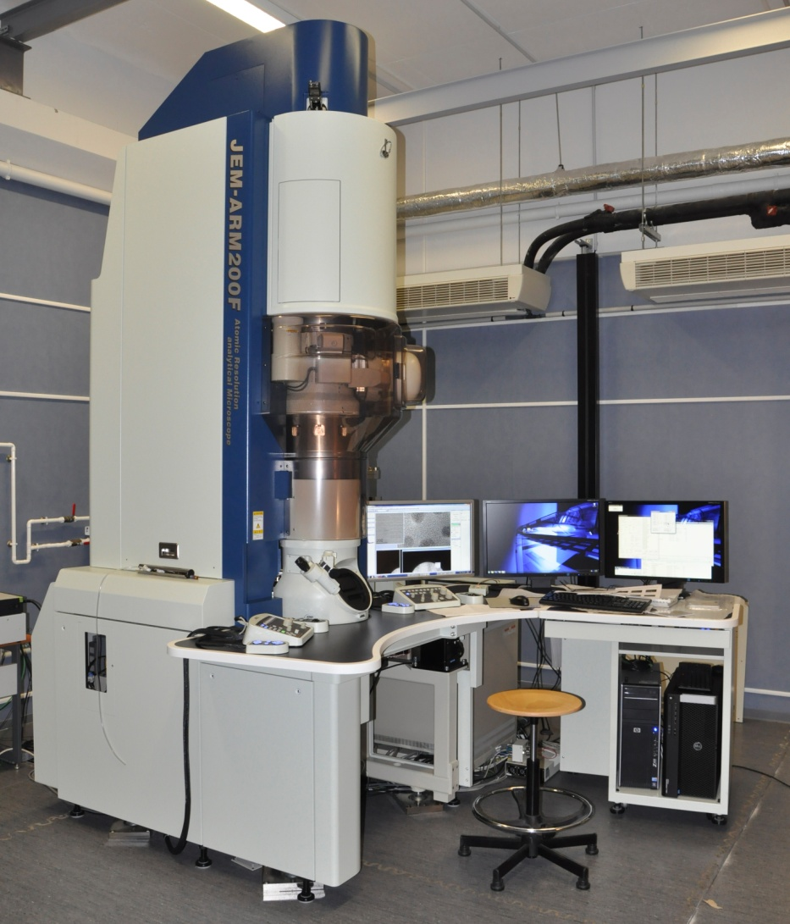
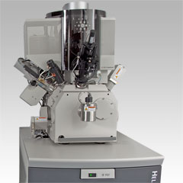
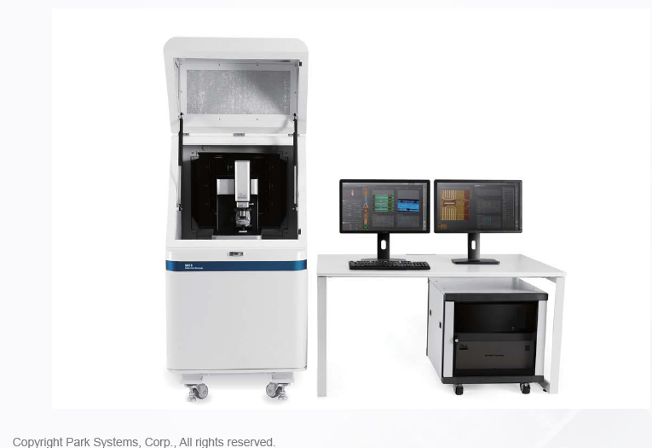
Post-Irradiation Experiment techniques
Structural Characterizations:
High Resolution X-Ray Diffraction
D8 discover Bruker, Cu anode
4-circles, in-plane geometry
Transmission/Scanning Electron Microscopy and FIB
ARM JEOL 200kV equipped with EELS (Gatan)
HELIOS NANOLAB 660 FIB
PIPS II Gatan
Raman spectroscopy
Atom Force Microscopy
NX10 Parks Systems
- - and many others…
Surface Characterizations:
16

Slide 17
CIMAP-GANIL FACILITY
4 Beam lines/4 Energy ranges
Access through call for proposals (iPAC, EMIR&A, RADIATE)
Accepted proposals: beamtime during 3 years in backlog
2023: 4/5 months of beamtime (march -> july)
Beamline renovation work: IRRSUD 2022, ME 2023, HE 2024
Cyclotron renovation at GANIL (not yet scheduled)
Beamtime free for scientific collaborations
In-situ and Post-irradiation techniques are available
PIE: various costs depending on techniques (mainly for MEB/FIB/TEM)
17

Slide 18
IRRSUD and ME beamlines part of EMIR&A
Director: Dr Nathalie MONCOFFRE
Deputy directors: Dr Marie-France BARTHE
Dr Clara GRYGIEL

Slide 19
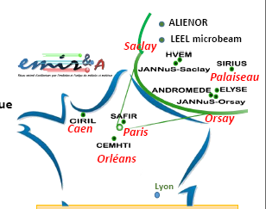
EMIR&A network
Research Federation (FR) of CNRS, linked mainly to 3 Institutes :
Institute of Physics (INP), Institute of Nuclear and Particle Physics (IN₂P₃) and Institute of Chemistry (INC)
Research Infrastructure on the MESRI National roadmap
15 accelerators, 11 ion and electron irradiation platforms on 6 sites
From fundamental research to Applications
Irradiation effect in materials and molecules (including radiolysis)
Ion beam analysis

Slide 20
EMIR&A network

Slide 21
EMIR&A network
https://emira.in2p3.fr/

Slide 22
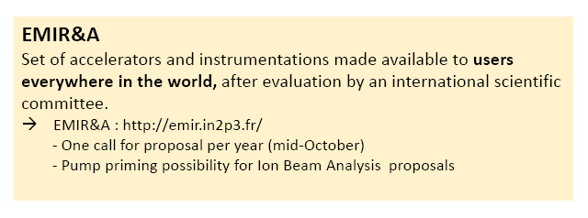
EMIR&A network

Slide 23
Thank you for your attention
http://cimap.ensicaen.fr/
https://www.ganil-spiral2.eu/
https://emira.in2p3.fr/

