Slide 1
TRIUMF Material Irradiation and PIE –
Capabilities and Status
Alexander Gottberg
Department Head, Targets and Ion Sources, TRIUMF
Adjunct Professor, University of Victoria
ARIEL Program Leader
September 22, 2022

Slide 2



Canada’s Particle Accelerator Centre is Governed by its 21 Member Universities
400 staff, 200 students & post-doctoral researchers
Member Universities
1100 scientific visitors from 39 countries per year
Discovery,
accelerated
Notes:
Comment: 21 member universities. McMaster just joined on April 12th, 2019

Slide 3
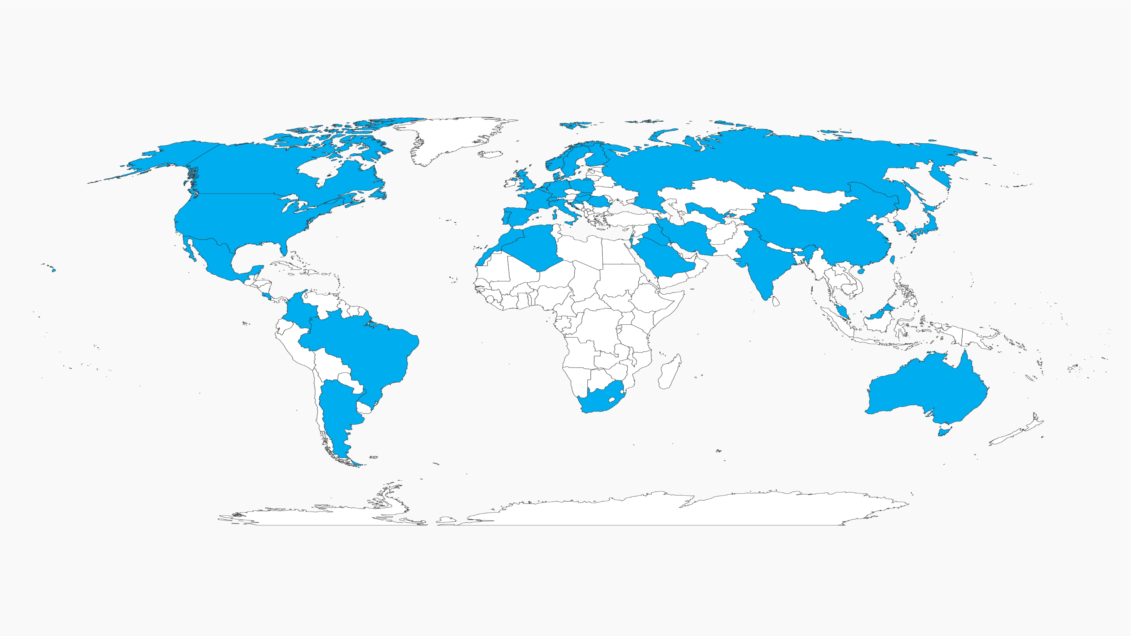
Global Reach
TRIUMF Users come from over 40 countries
In 2019, TRIUMF hosted >1000 Scientific Visitors & Users

Slide 4
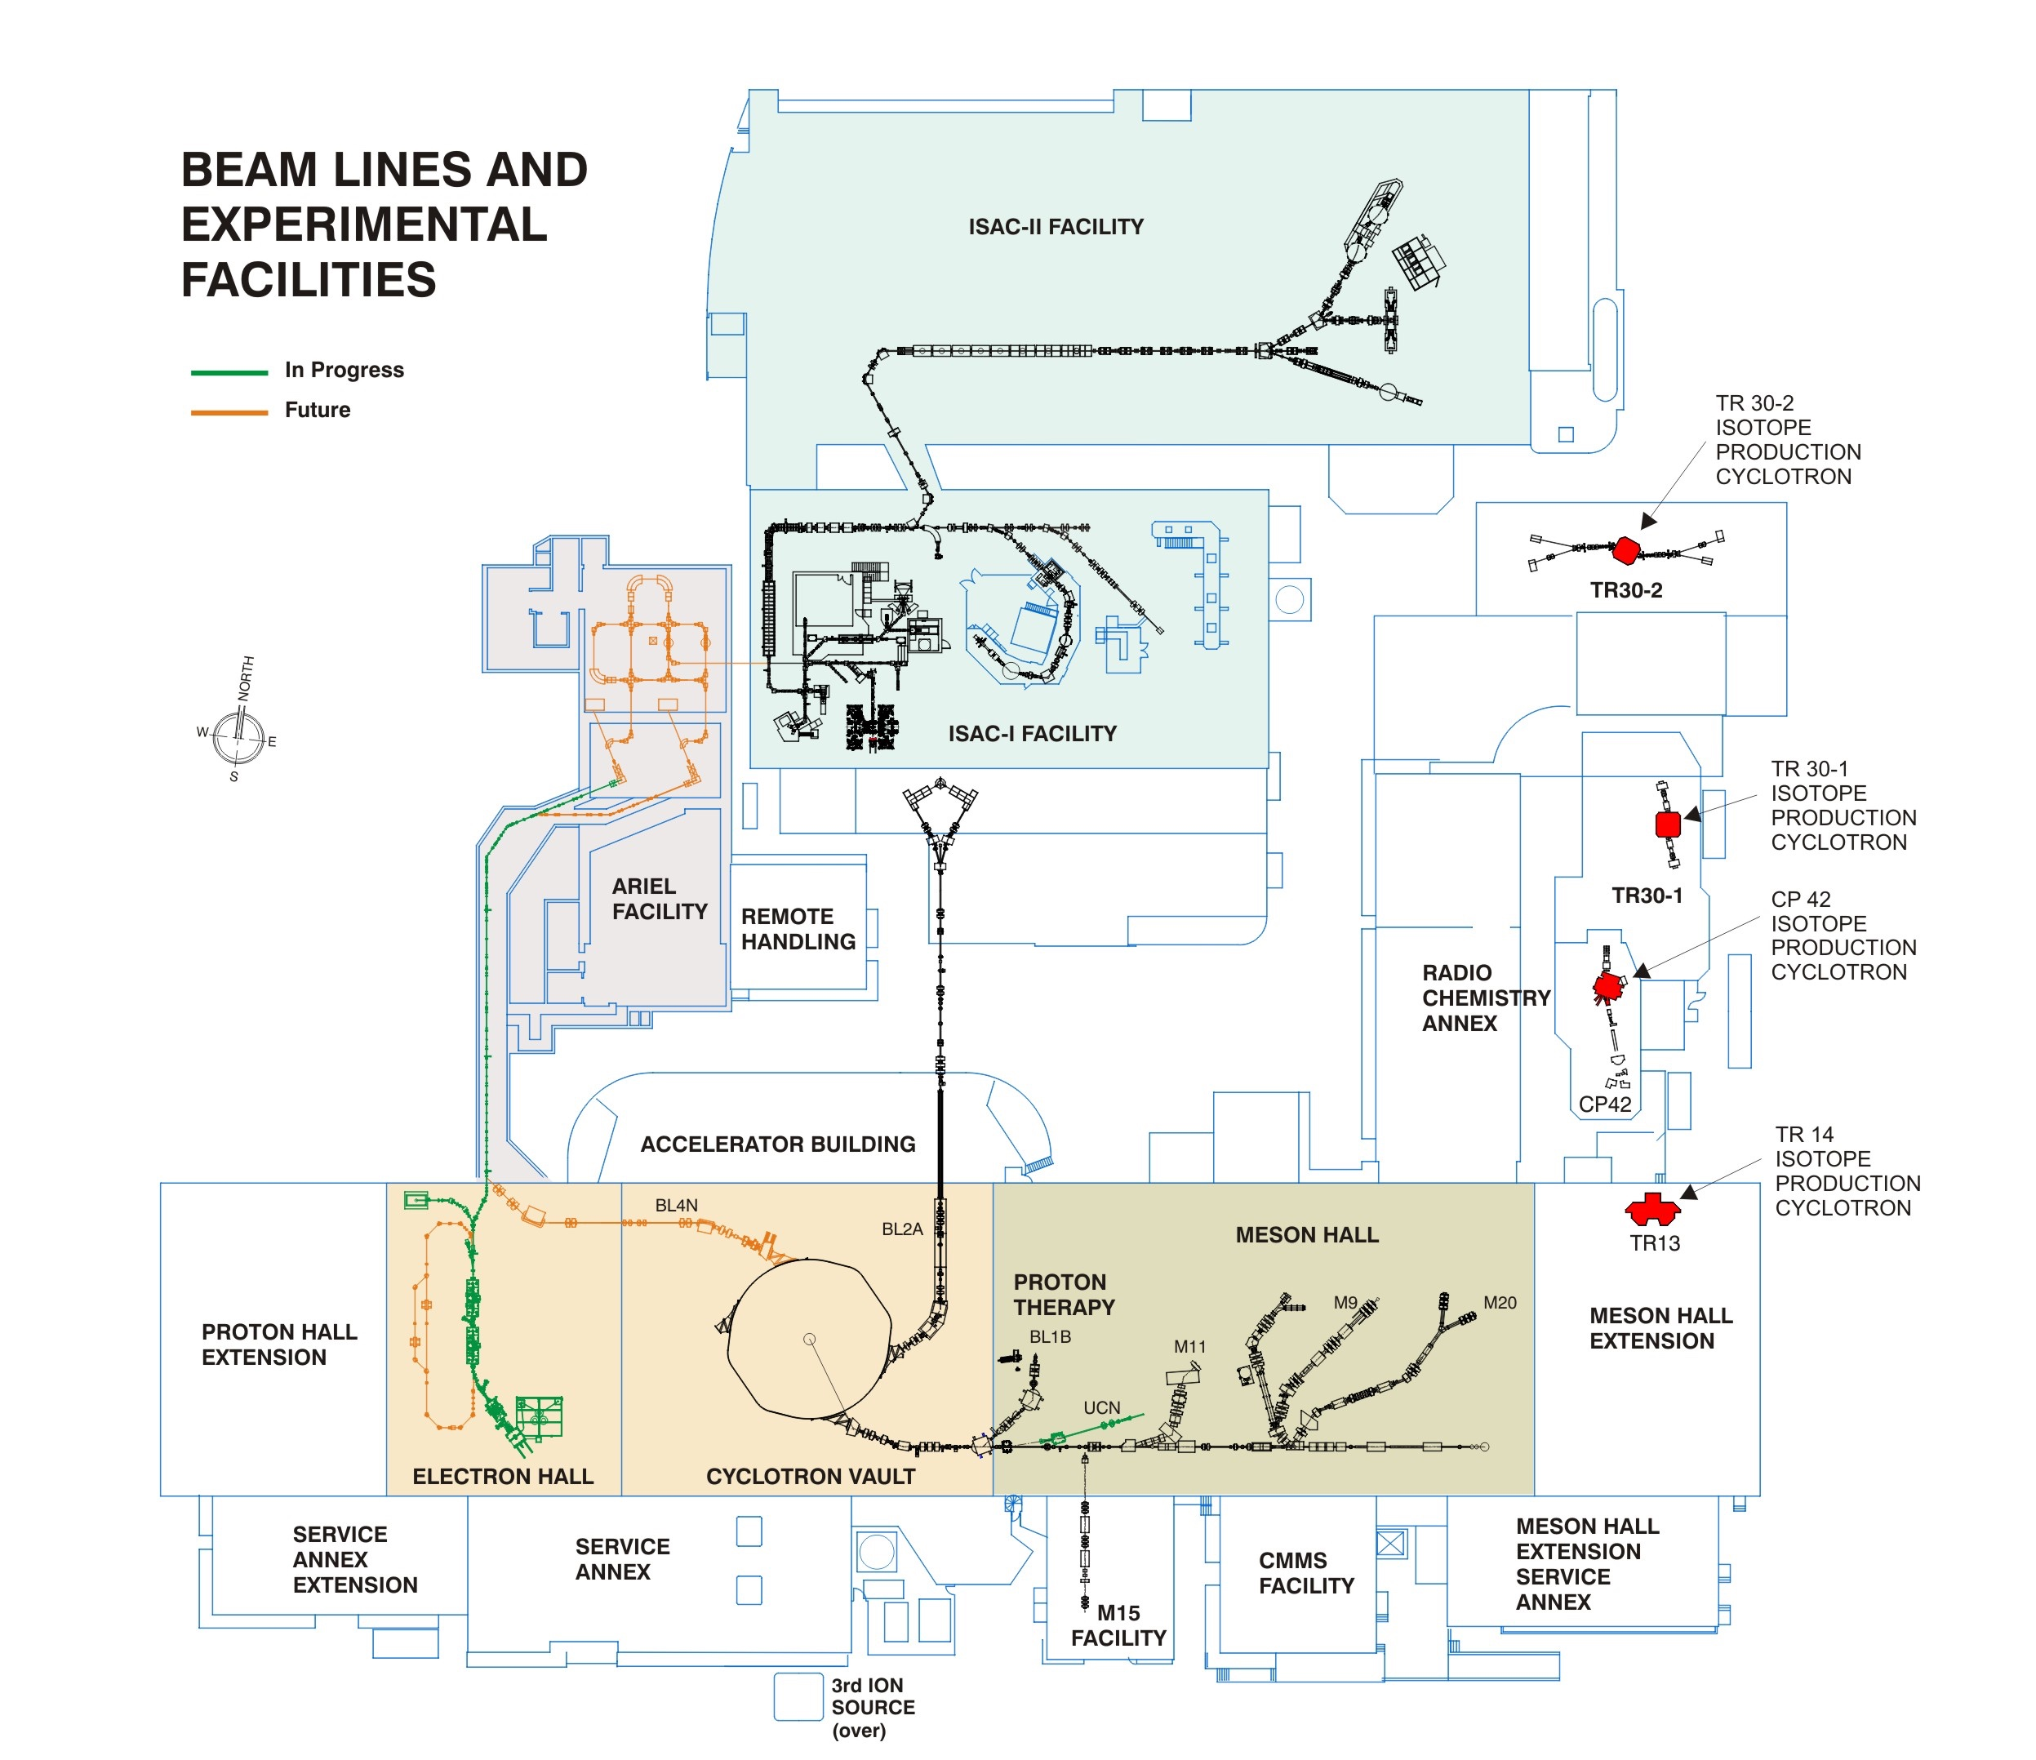
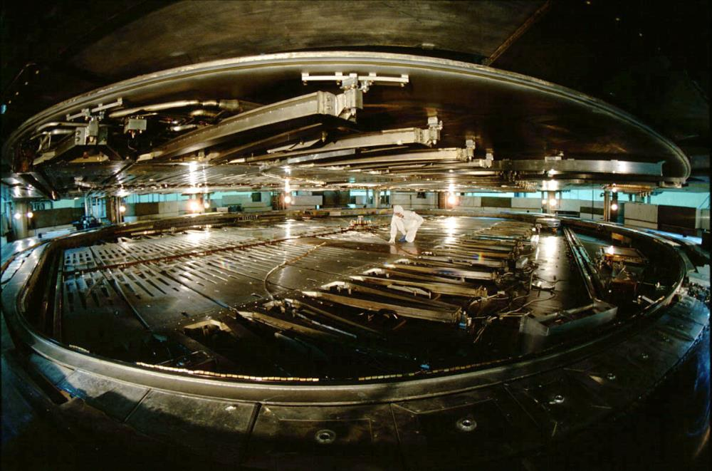

Primary and Secondary Particle Accelerators at TRIUMF
TRIUMF accelerators
520 MeV, 200 kW cyclotron
50 MeV, 100 kW electron linac
Cyclotrons: TR30-1, TR30-2, TR14, TR24, CP42
Heavy ion accelerators, up to 16 MeV/u
520 MeV H⁻ cyclotron
5500 hours per year:
ISOL RIB (50 kW protons)
π and µ (60 kW)
Medical isotopes (50 kW)
Ultra-cold neutrons (20 kW)
Proton therapy studies (50 W)
IAMI
TR24

Slide 5
TRIUMF’s Proton, Neutron, Pion, Muon Programs
Beamline 1
Nine secondary channels
UCN (Ultra Cold Neutrons) for nEDM measurement
Pions, muons for material and fundamental science
Neutrons for electronics irradiations services
Cyclotron
M11
M20
UCN
M9
NIF
M15
IAMI
TR24

Slide 6

TRIUMF’s Medical Isotope Factory
UBC
hospital (3 km)
Five H⁻ medical cyclotrons
TR30-1, TR30-2, CP42, 250 µA – 1 mA
(solid, liquid and gas targets)
  Operated by ATG for
  2M doses annually
  ¹⁰³Pd, ¹¹¹In, ¹²³I, others…
TR13, <100 µA (solid, liquid and gas targets)
  ¹¹C, ¹⁸F, ⁶⁴Cu, ⁶⁸Ga, others…
TR24, 1 mA (gas, solid, liquid targets)
  Future for IAMI
Protons from 90-500 MeV, 300 µA cyclotron
⁸²Sr / ⁸²Rb production
²¹²Pb, ²¹³Bi, ²²⁵Ac production
Exotic medical isotope R&D, fission and spallation with optional isotope separation
UBC Centre for Brain Health
(3 km)
International shipment of 2M patient doses of isotopes and generators
UBC Centre for Comparative Medicine (500 m)
Coming 2023
IAMI
TR24

Slide 7
Radioisotopes for Science
Only purpose build multi-user radioisotope beam facility world-wide
Two independent high-power drivers:
  50 kW, 500 MeV protons
  100 kW, 30 MeV from superconducting e-linac to AETE
Four target stations for >9000 h/y to existing nuclear physics experiments
Symbiotic medical isotope production target system
IAMI
TR24

Slide 8
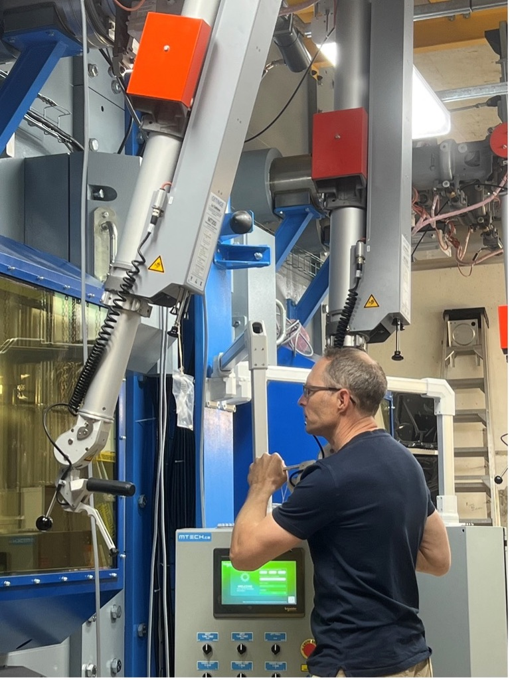
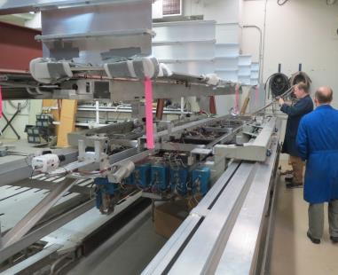
TRIUMF Remote Handling
Hot cell design, operation and development of systems for operation in kGy – PGy dose fields.
  Mechatronics and robotics development
  Dedicated training programs on prototypes and hot cells
  International collaborations
  Daily shipments of radioactive materials
ARIEL Hot Cell Commissioning
TRIUMF RH specialists assisting in
T2K target repair
RH robotics development

Slide 9
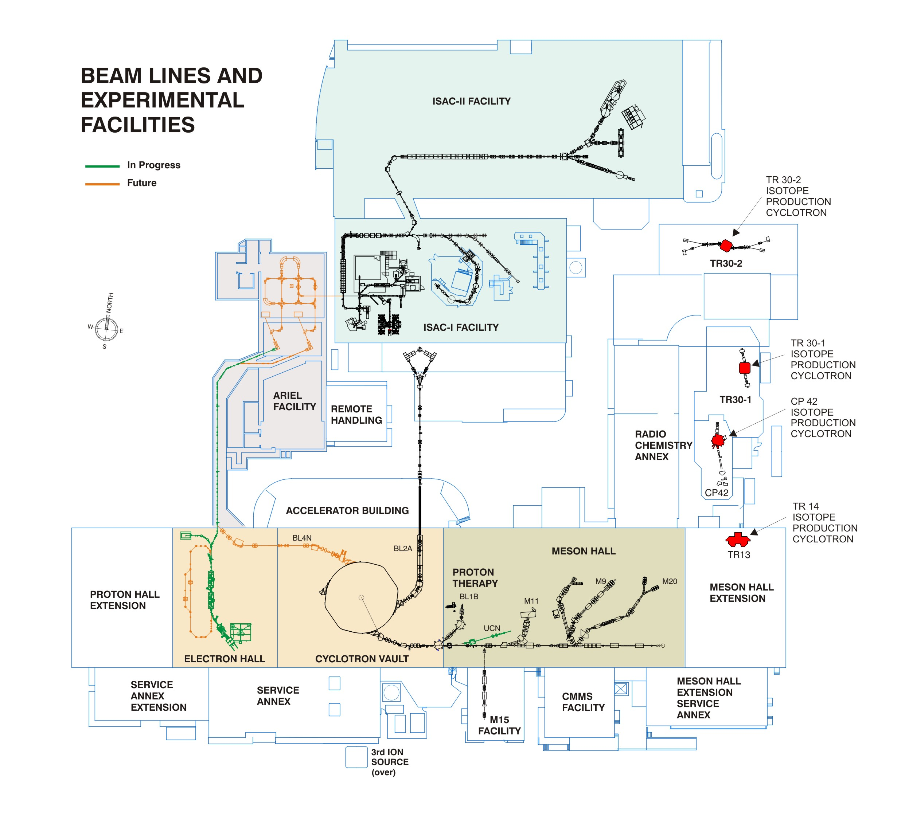
Material Irradiation Locations
ISAC, 480 MeV protons, ≤100 µA
ARIEL, 480 MeV protons, ≤100 µA
CTS, 300 keV – 35 MeV electrons,
≤10 mA, µs – s pulses
NBF, 450-480 MeV protons, ~3 nA
PIF, 5-500 MeV, ≤ 10 nA
IPF, 430 MeV protons, ~70 µA
NIF, near-terr. neutrons, 3·10⁶ n/cm²/s
Isotope production cyclotrons,
13-30 MeV, 1-1000 µA
2
1
8
3
5
4
6
7
IAMI
TR24

Slide 10
Overview of Irradiation Conditions at TRIUMF
 | 1. ISAC | 2. ARIEL | 3. IPF | 4. PIF | 5. NBF | 6. NIF | 7. CTS | 8. TR13-30
Particle | Protons | Protons | Protons | Protons | Hydrogen | Neutrons | Electrons | Protons
Energy [MeV] | 470 | 470 | 430 | 5 – 500 | 480 | Terrestrial | 0.3 - 30 | 13-30
Intensity | 5-100 µA | 5-100 µA | 70 µA | 0.1 - 10 nA | 200 nA |  | 10 nA - 10 mA | 1-1000 µA
Time structure | CW | CW | CW | 100 ms - CW | CW | CW | 1 µs - CW | CW
Beam size [mm] | 10 FWHM | 10 FWHM | 12 FWHM | 10 - 70 | 20 x 100 | 200 | 1 - 12 | 20 x 7.5
Flux [/cm²/s] | 10¹³ - 10¹⁵ | 10¹³ - 10¹⁵ | 3·10¹⁴ | 10⁵ - 10¹¹ | 6·10⁹ | 2·10⁶ | 10¹³ - 10¹⁹ | 10¹³ - 10¹⁵
Dose rate if out of beam position [kGy/h] | 1 - 10⁶ mixed | 1 - 10⁶ mixed | 1,000 mixed | 1-10 neutrons | 10 neutrons | 1 neutrons | 10,000 gammas | -
Availability [h\y] | 2 x 2000 | 2 x 2000 | 4500 | 1500 | 5500 | 4500 | 500 | 3456
Available integrated [particles\y] | ~3·10²¹ | ~3·10²¹ | ~1·10²² | ~3·10¹⁶ | 2·10¹⁹ | 10¹⁶ | 10²³ | 10²²

Slide 11
Material Irradiation Locations
ISAC, 480 MeV protons, ≤100 µA
ARIEL, 480 MeV protons, ≤100 µA
CTS, 300 keV – 35 MeV electrons,
≤10 mA, µs – s pulses
NBF, 450-480 MeV protons, ~3 nA
PIF, 5-500 MeV, ≤ 10 nA
IPF, 430 MeV protons, ~70 µA
NIF, near-terr. neutrons, 3·10⁶ n/cm²/s
Isotope production cyclotrons, 30MeV-300uA up to 100mAh
3
IAMI
TR24

Slide 12
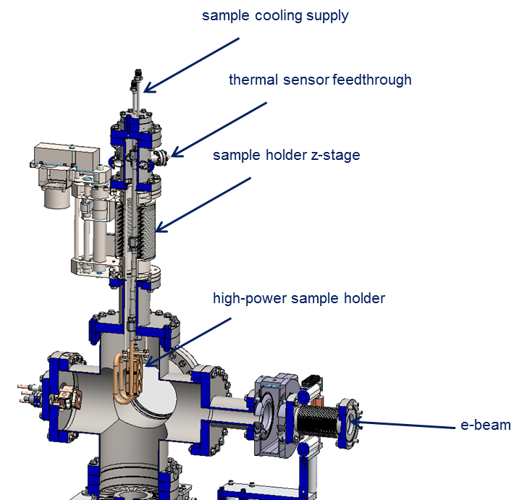
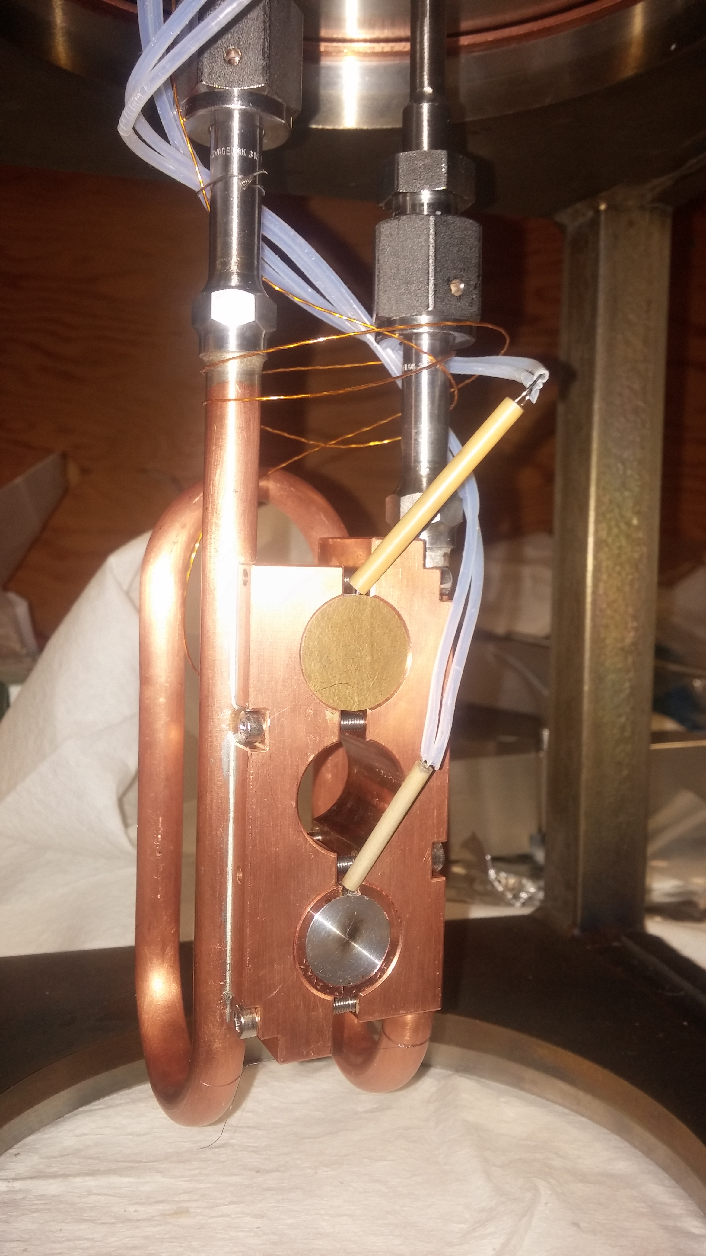
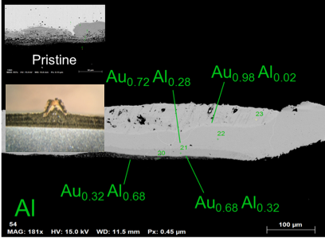
ARIEL e-γ Converter Test Stand
Development motivations
  Thermal stresses (100 kW beam, thermal cycles)
  Radiation damage / radiochemistry
  Irradiations of up to 3 weeks
Experimental setup:
  Water-cooled sample holder
  Power deposition density of up to several MW/cm³
  300 keV beam to avoid activation (30 MeV possible)
e⁻
300 keV to 30 MeV,
up to 10²² electrons/day, 0.1 – 12 mm FWHM
variable thermal shocks studies

Slide 13
Material Irradiation Locations
ISAC, 480 MeV protons, ≤100 µA
ARIEL, 480 MeV protons, ≤100 µA
CTS, 300 keV – 35 MeV electrons,
≤10 mA, µs – s pulses
NBF, 450-480 MeV protons, ~3 nA
PIF, 5-500 MeV, ≤ 10 nA
IPF, 430 MeV protons, ~70 µA
NIF, near-terr. neutrons, 3·10⁶ n/cm²/s
Isotope production cyclotrons, 30MeV-300uA up to 100mAh
1
IAMI
TR24

Slide 14
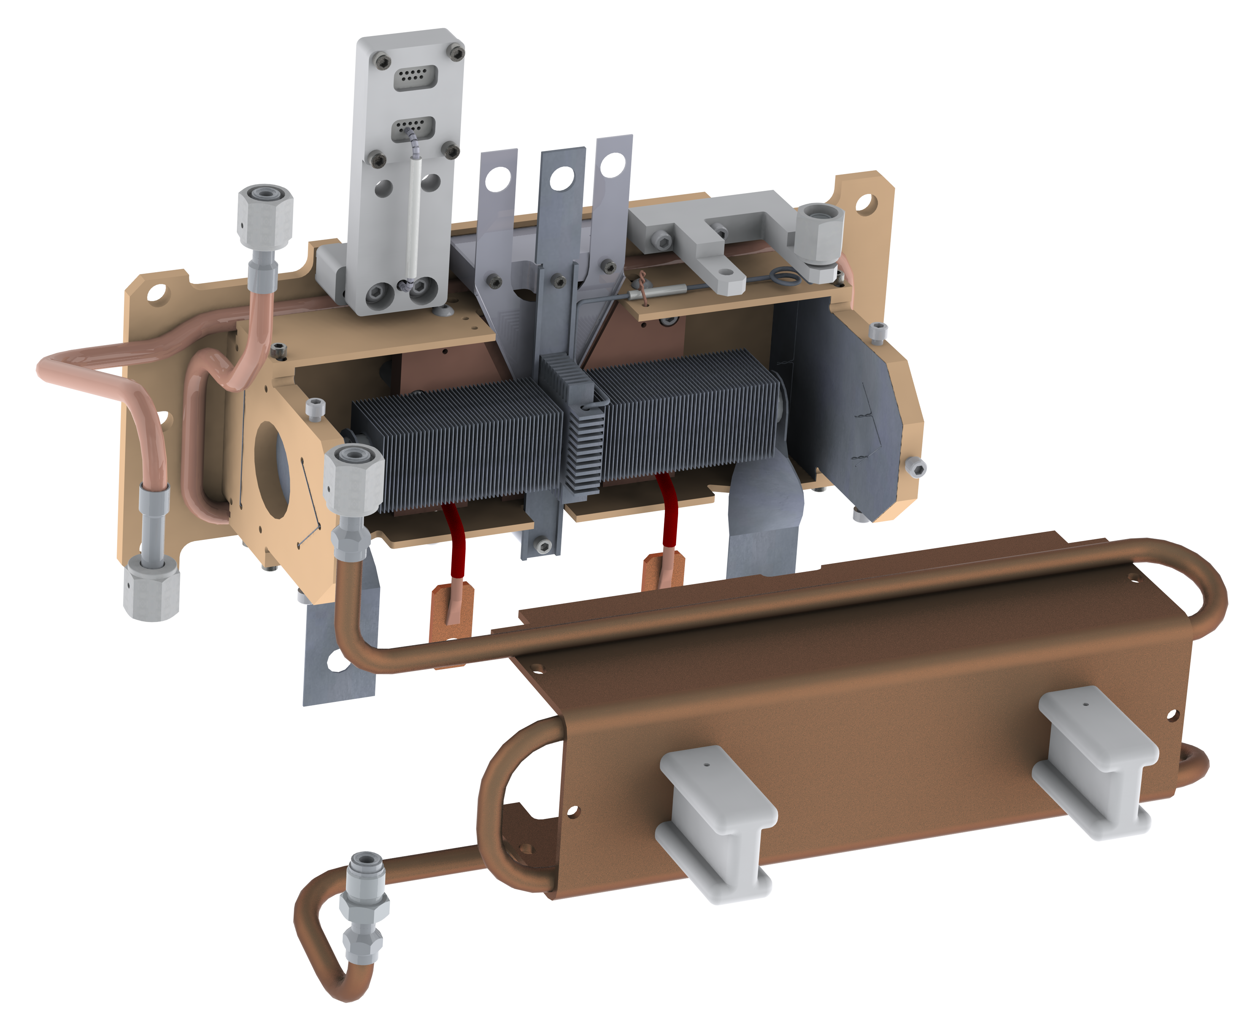
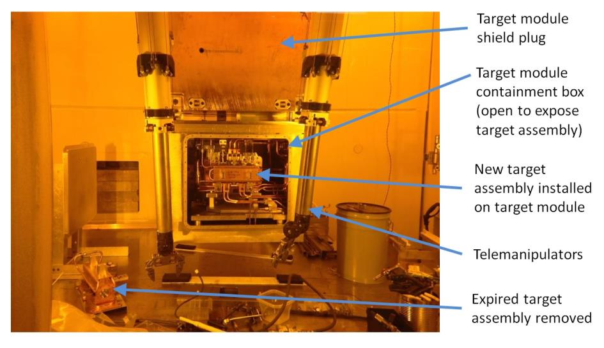
ISAC targets
Target exchange in hot cell every 2-5 weeks
9 – 12 targets per year
PIE on every target
Target ion source service connections
target container ~2000 °C
(Ø 20 mm, 60 cm³)
Water-cooled heat shields
500 MeV protons
7 mm FWHM
2932µAh
6599µAh
15969µAh
5750µAh
6003µAh
15197µAh
4710µAh
5769µAh
13891µAh
2021
Ucx-P2N
UCx
Ta
UCx
SiC
C
UCx
UCx
Ta
ITW
40573µAh
ITE
33315µAh

Slide 15
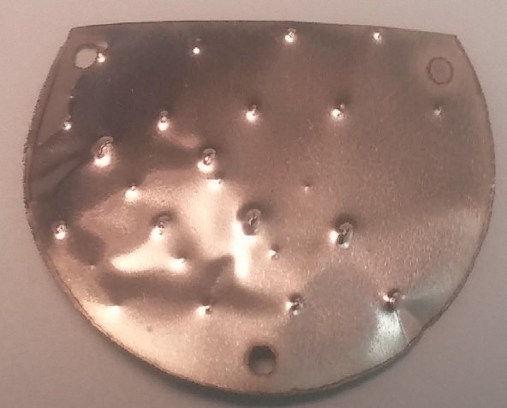
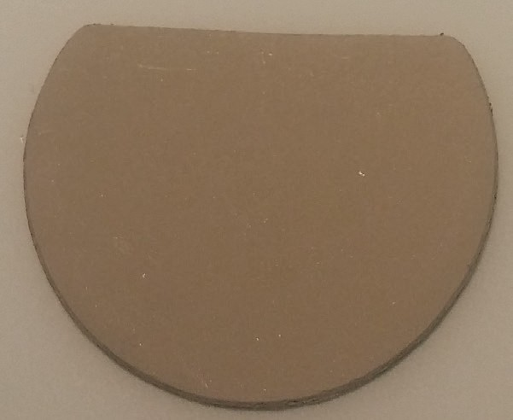
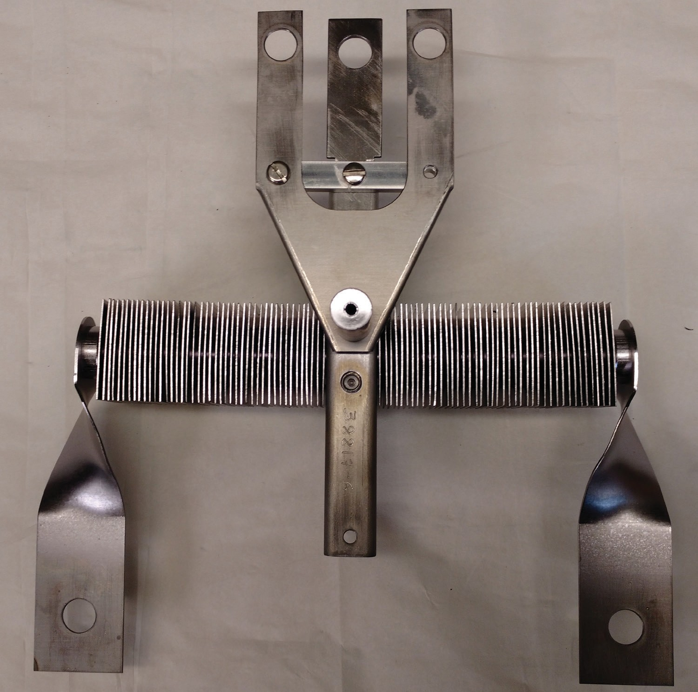



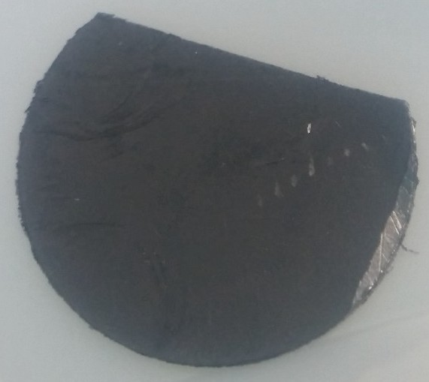
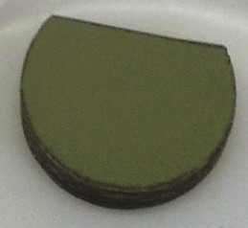
Selected ISAC Target Materials
Axial proton irradiation, used with 500 MeV, up to 100 μA proton driver beams. Target exchanged every 3-5 weeks.
2000: Tantalum or niobium foil discs packed within the tantalum target container.
High-power (50 kW) target design
2008: Discs of SiC_{x}, TiC_{x} or ZrC_{x} cast onto exfoliated graphite foils and packed within the tantalum target container.
Ion source heating (I)
⌀ 20 mm
cylindrical tantalum container
500 MeV
50 kW p⁺
2013: Discs of UC_{x} cast onto exfoliated graphite foils and packed within the tantalum target container.
55 mm x
55 mm tantalum fins
2015: Discs of NiO cast onto niobium foils and packed within the tantalum target container.
Target heating (I)
Porous materials for optimized release of short-lived radioisotopes on backing foils for high conductive heat transfer into tantalum container
2019: Discs of electro-spun SiC nanoparticles co-spun with carbon fibers and packed within the tantalum container.

Slide 16
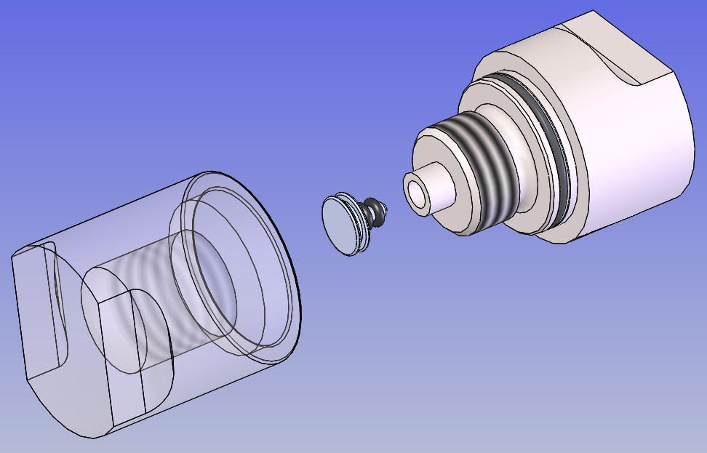
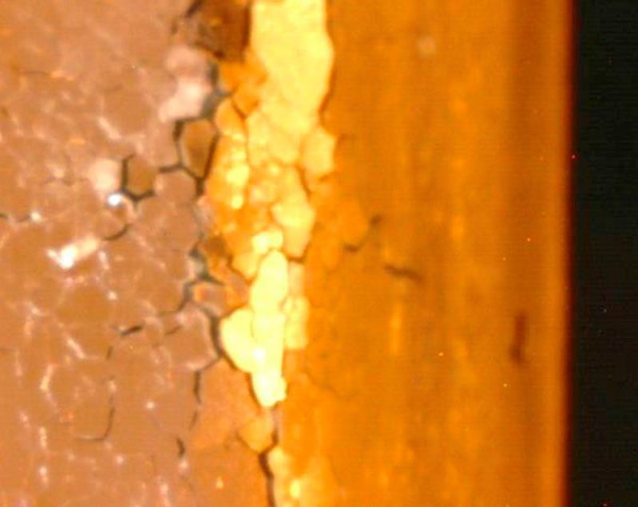
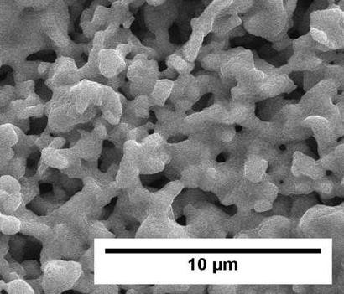
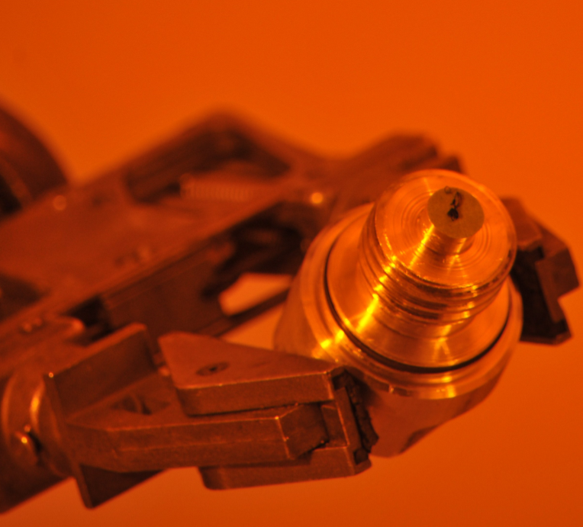
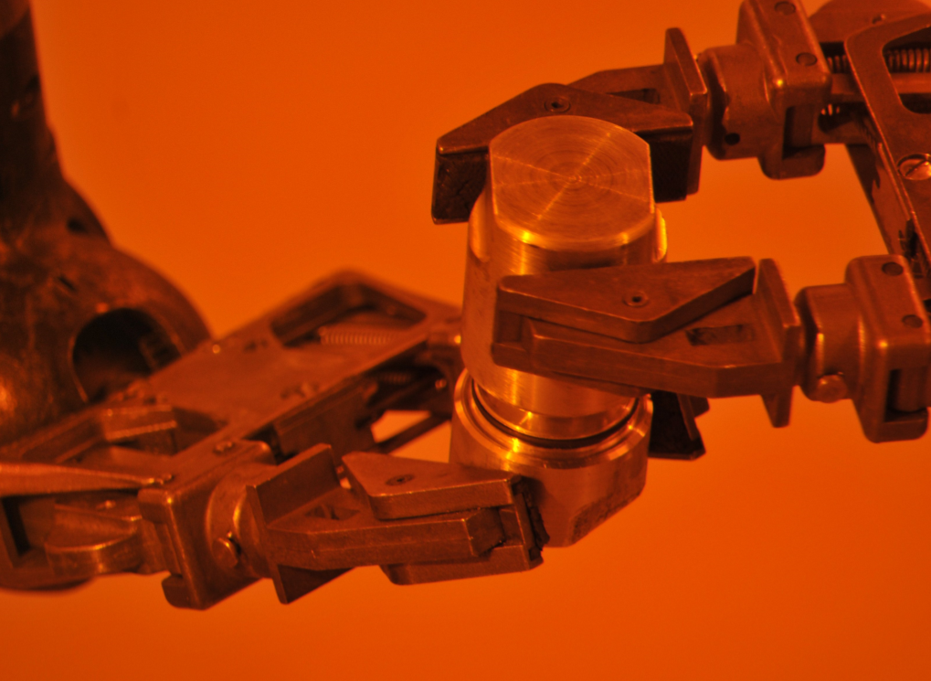
Post-Irradiation Examination and Sample Extraction
Available in ISAC
radiation laboratories:
Available in vicinity for activated
samples (< 100 µSv/h):
extraction tools for irradiated materials
XRF, SEM, TEM
SPT
Optical microscopy
Pycnometer
2000ºC furnaces, diffusion studies
Emissivity, heat conductivity meas.
Type A and B packaging and shipping
TEM, SEM, FIB, AFM
XRD
Tensile, impact strength, hardness, corrosion testing
…
UCx sample after irradiation

Slide 17
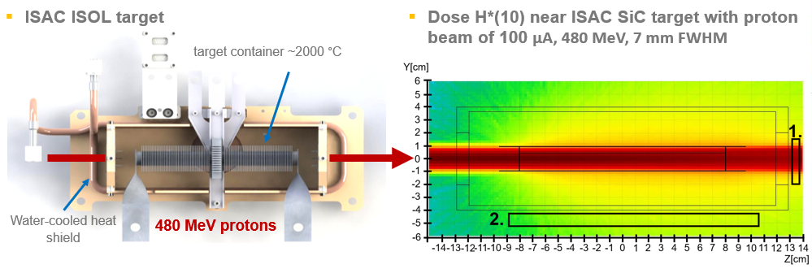

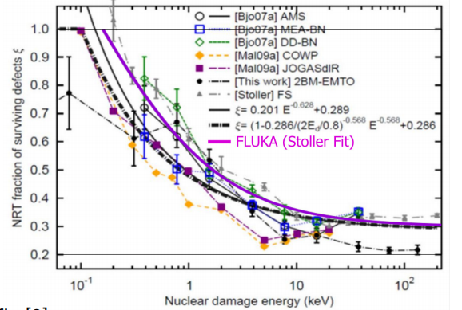

Parasitic irradiations at ISAC
Gy/h
Analysis of parasitic irradiations by
MonteCarlo simulations
DPA-FLUKA
Helium ~10appm/mAh (residual nuclei in FLUKA)
~100appm/DPA-FLUKA
Prog. Nucl. Sci. Technol. 2, 769–775 (2011)
$E_{th} f$rom Nucl. Energy Technol. 3, 169–175 (2017)

Slide 18
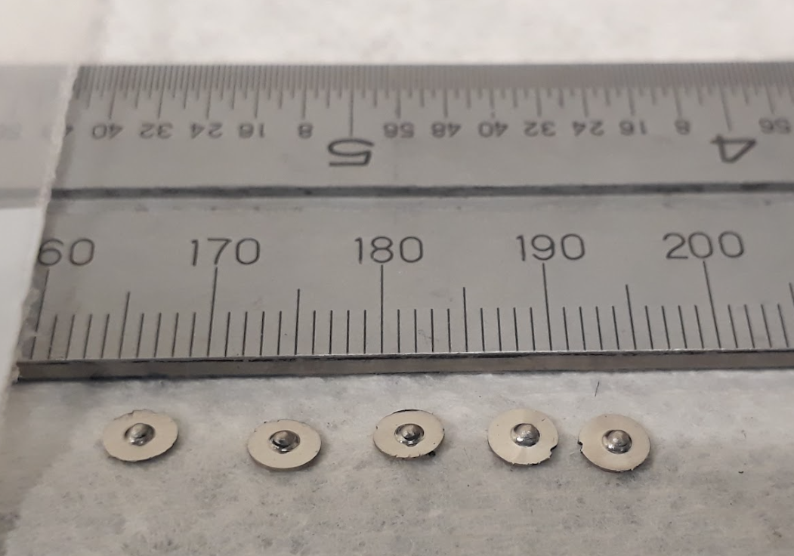
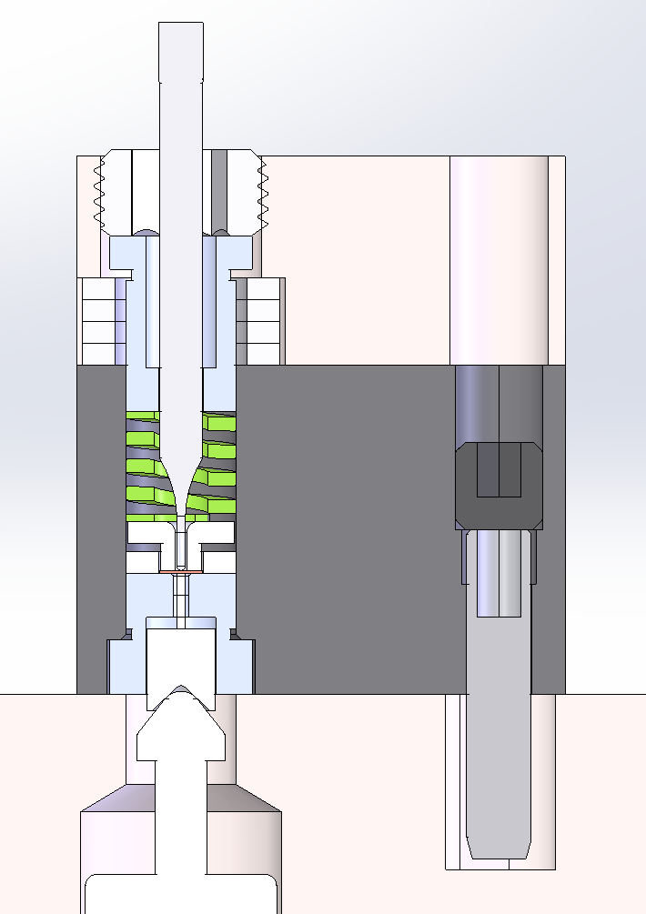
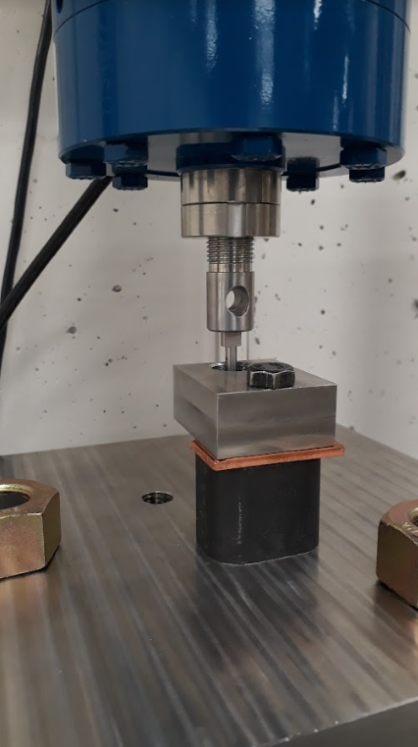
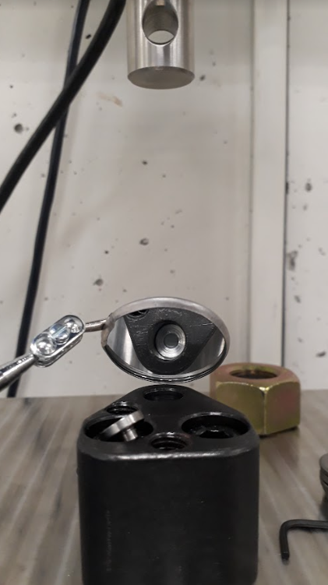
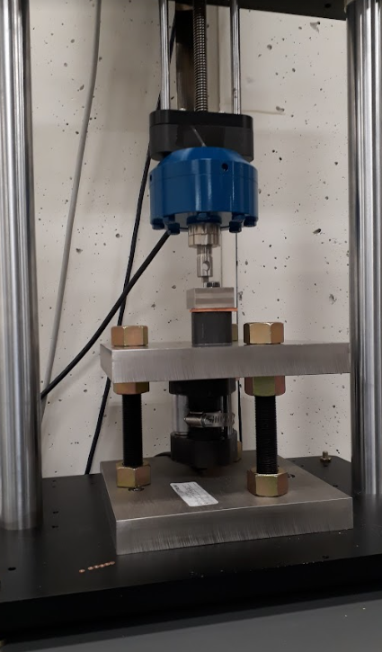
Hot Cell Based Small Punch Test
800H samples
Small punch test stand
Mechanical actuator, load cell and LVDT acquired
Sample holder assembled
Punch
Punch guide
Clamping spring
Sample
LVDT

Slide 19
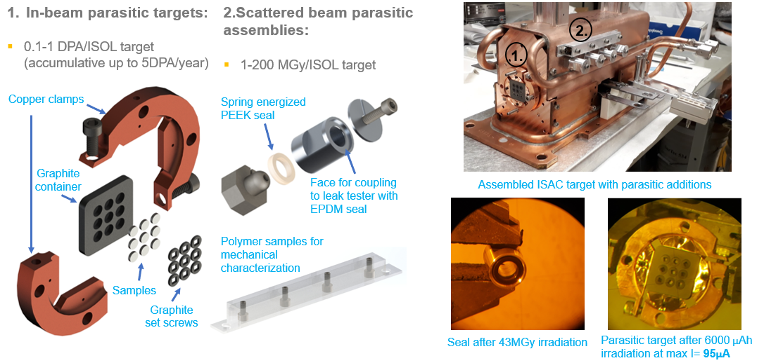
Parasitic irradiations at ISAC 2021-2022
0.1-1 DPA-FLUKA/year
100-400 ºC depending on sample material
Close to room temperature
6x10¹⁴ 480MeV protons/s

Slide 20
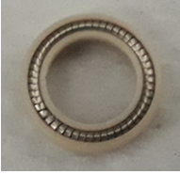
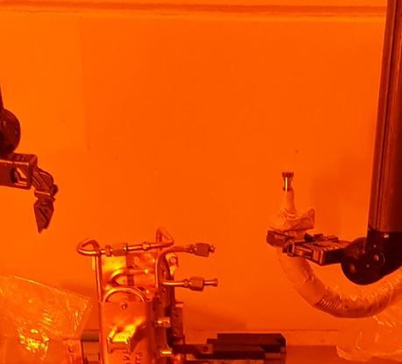
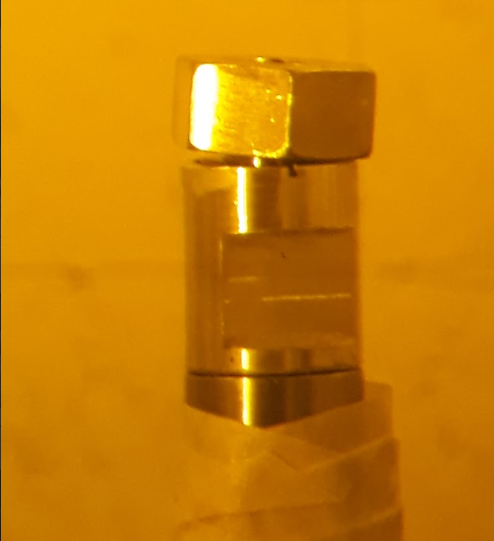
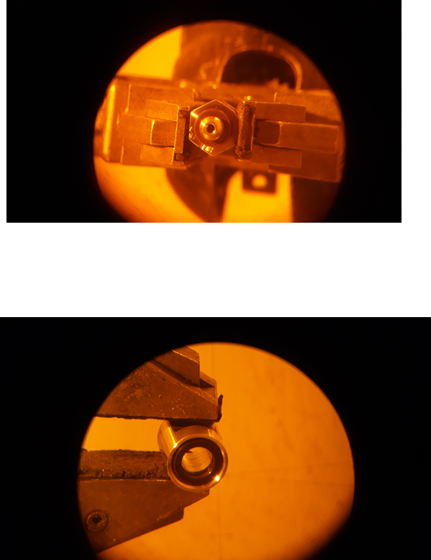
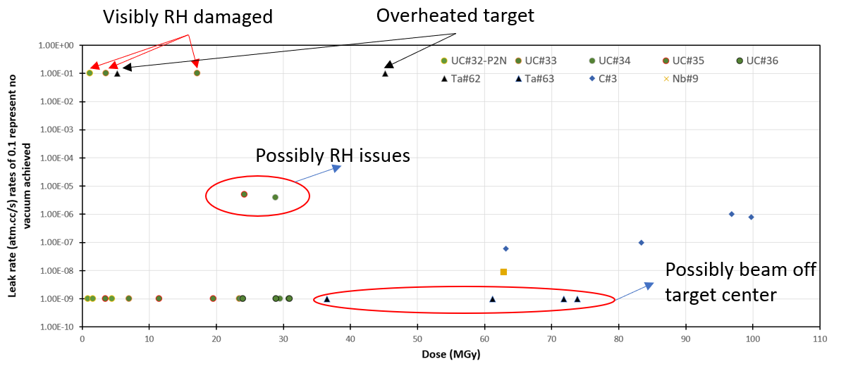
Out of Beam Samples
Radiation resistance of spring energized PEEK seals
Non-irradiated
7.3MGy
45.2MGy
Leak rate of irradiated seals
30 seals tested
Remote handling issues during testing
Target operation related issues
New design in 2022 to reduce RH issues.

Slide 21
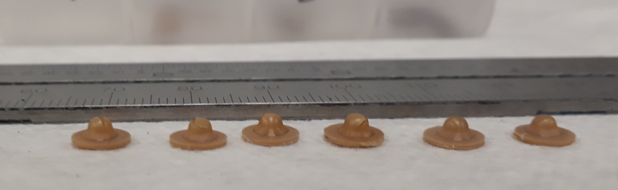
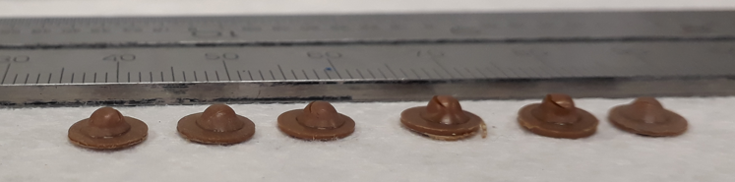
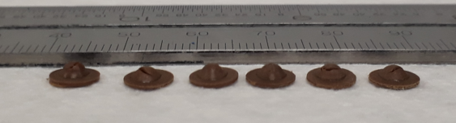
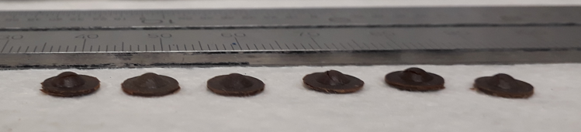
PEEK
0
0.86
3.6
17.2
23.91
36.49
73.8
(MGy)
Load/thickness^2 (N/mm^2)
Displacement (mm)
Molecular weight measurements to come

Slide 22
2021 & 2022 parasitic irradiation campaign at ISAC
2021
Parasitic target # | Sample materials | Irrad. (μAh) | DPA-NRT
#1-P | Al6061-AlSi10Mg(AM) | 2934 | [0.01-0.025]
#2-P | Al6061-AlSi10Mg(AM) | 33315 | [0.12-0.62]
#3-P | CrMnFeCoNi (Cantor) - SS316L | 40573 | [0.91-3.52]
#4-P | CrMnFeCoNi (Cantor) - SS316L | 11772 | [0.24-1.05]
#5-P | CrFeCoNiCu - CrMnFeNi (Co-less Cantor) | 13891 | [0.32-0.90]
2022
Parasitic target # | Sample materials | Estimated Irrad. (μAh) | Estimated DPA-NRT
#6-P | CuCrZr | 21613 | [0.48-1.87]
#7-P | SS310, 800H | 24290 | [0.54-2.1]
#8-P | cold sprayed Cu alloy | 24290 | [0.54-2.1]
#9-P | Al alloy | 3000 | [0.01-0.055]
#10-P | Cantor, SS316L | 43058 | [0.96-3.73]
#11-P | Al6061 | 43058 | [0.15-0.8]
#12-P | Cantor, SS316L | 8308 | [0.19-0.72]

Slide 23
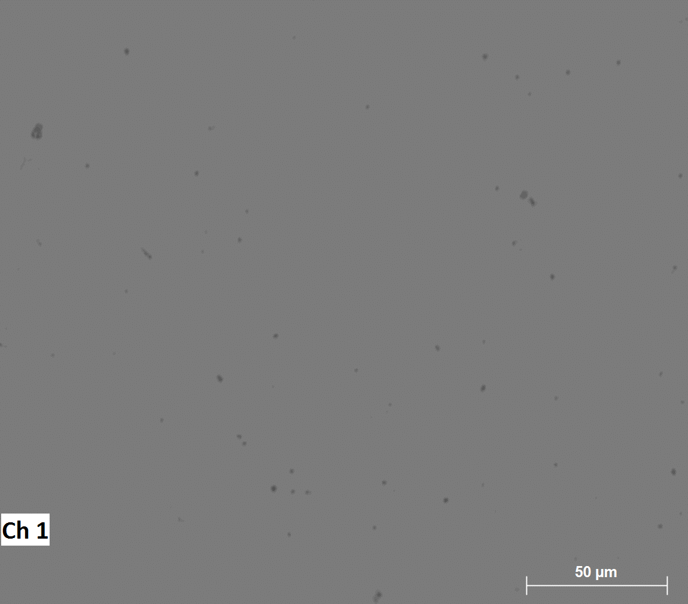
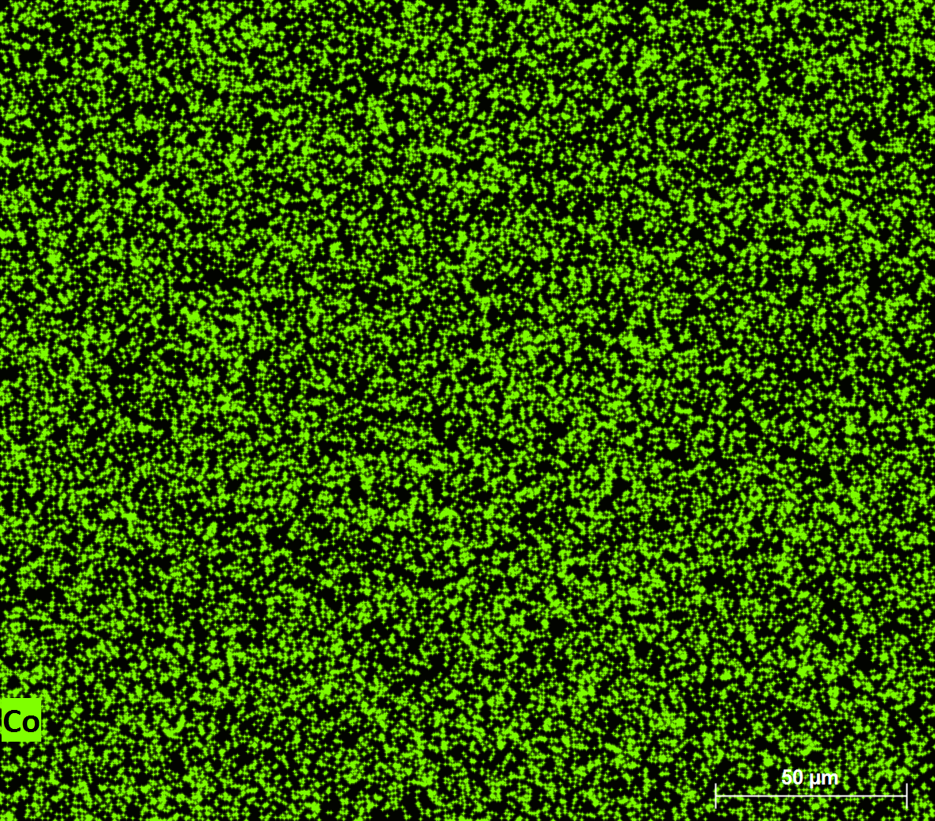
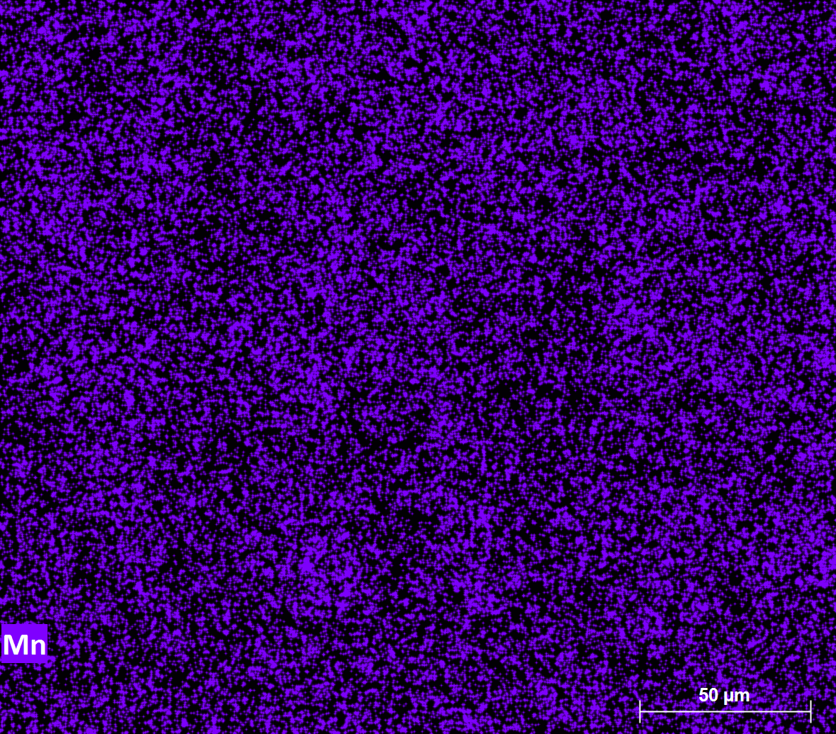
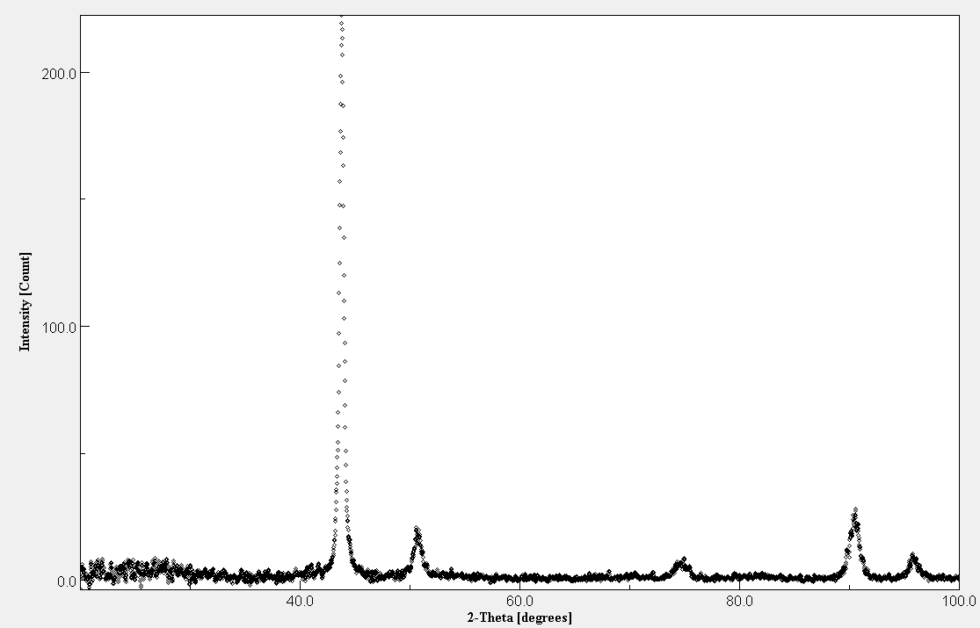
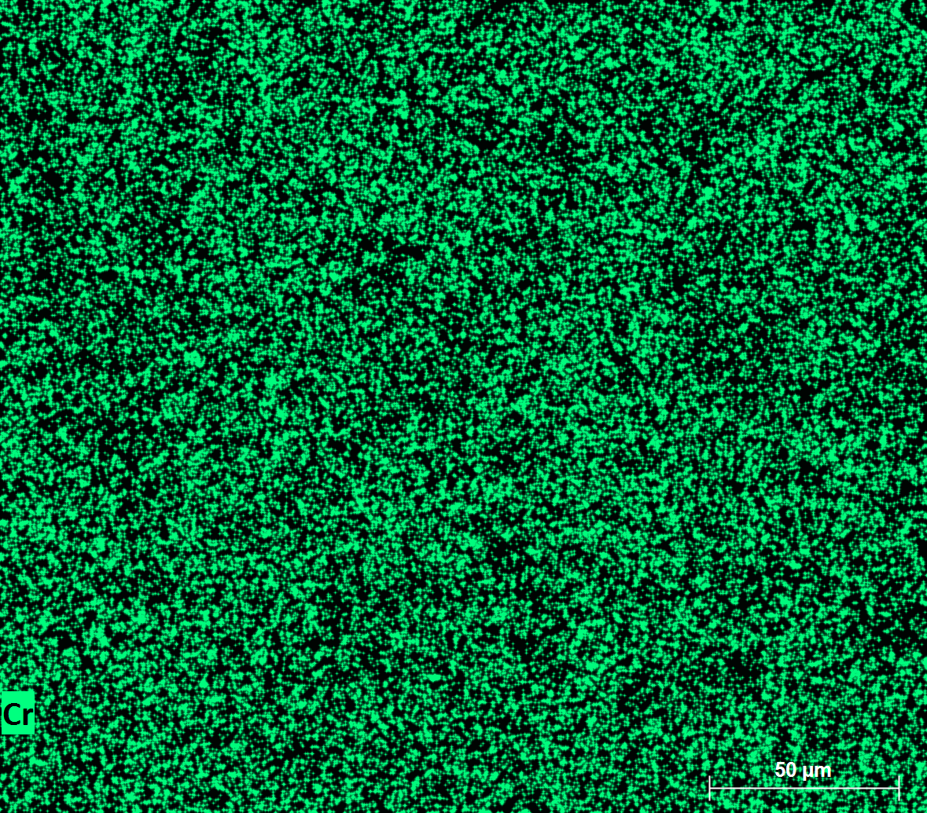
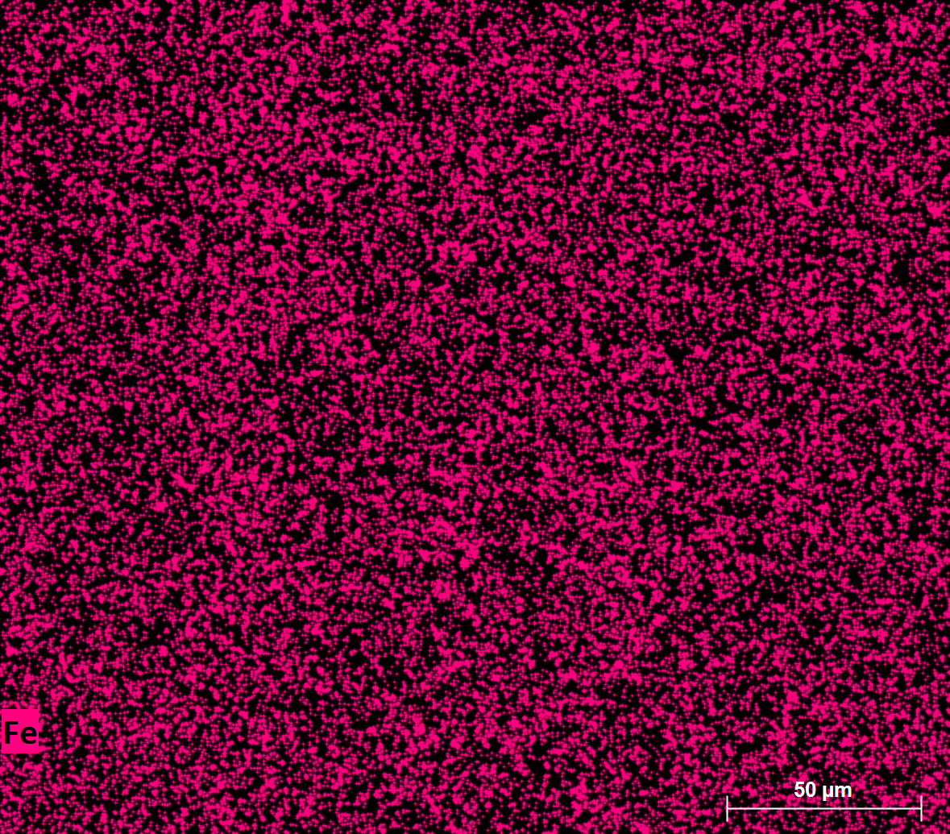
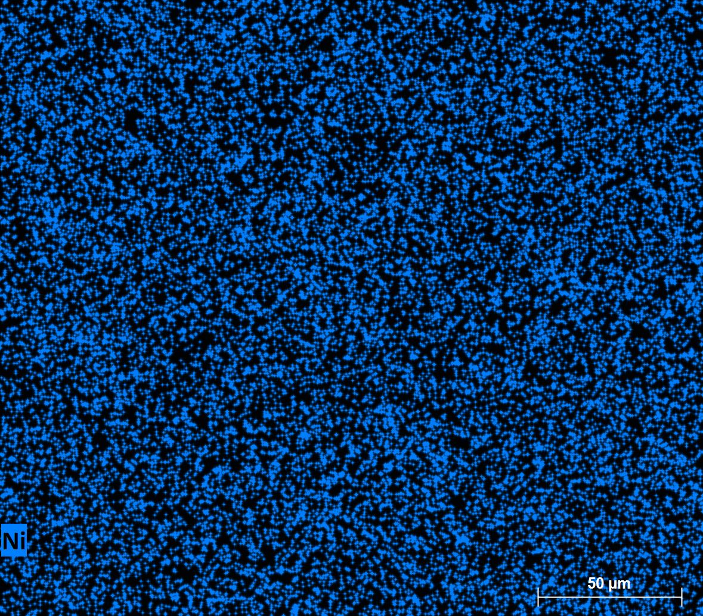
Cantor HEA
(111)
(200)
(220)
(311)
(222)

Slide 24
Cantor HEA and SS316 Pilot irradiation 2021:
0.24
0.47
0.91
1.05
1.59
3.52
DPA-NRT
DPA-NRT simulated with FLUKA
No temperature effects accounted (from simulation up to 400ºC), online measurements soon
~50 appm He/DPA-NRT
Data from 2 parasitic targets (11,772 µAh (35 days in beam, 2.5 months total time) and 40,573 µAh (79 days in beam, 5 months total time)
SS316L
Load/thickness^2 (N/mm^2)
Cantor HEA
Displacement (mm)
Max load
SPT Yield

Slide 25
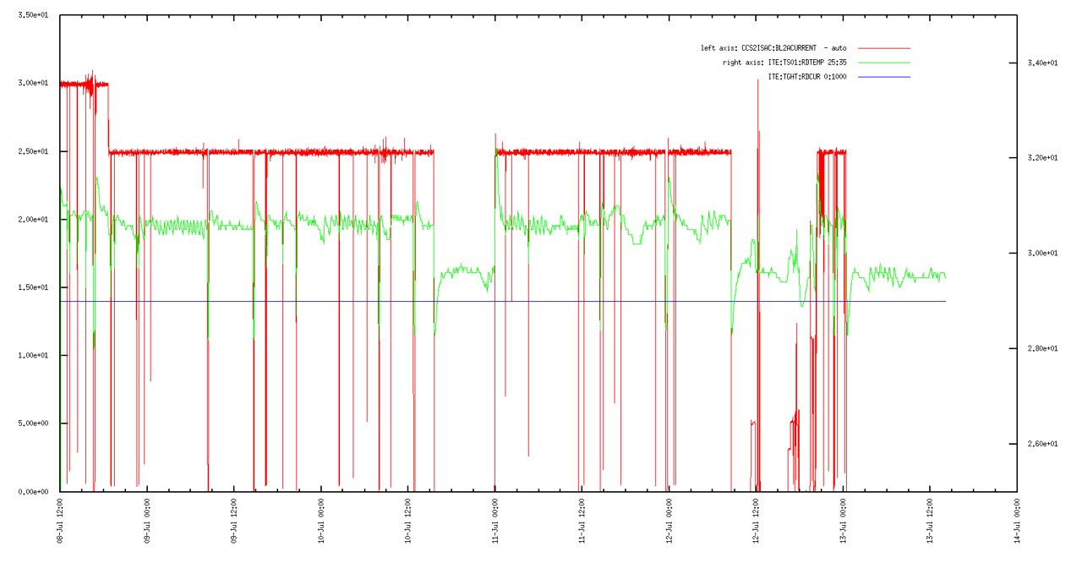
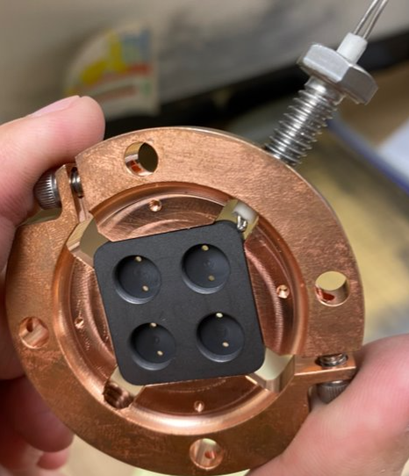
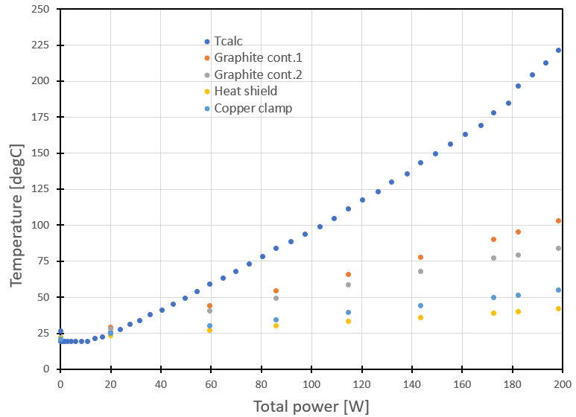
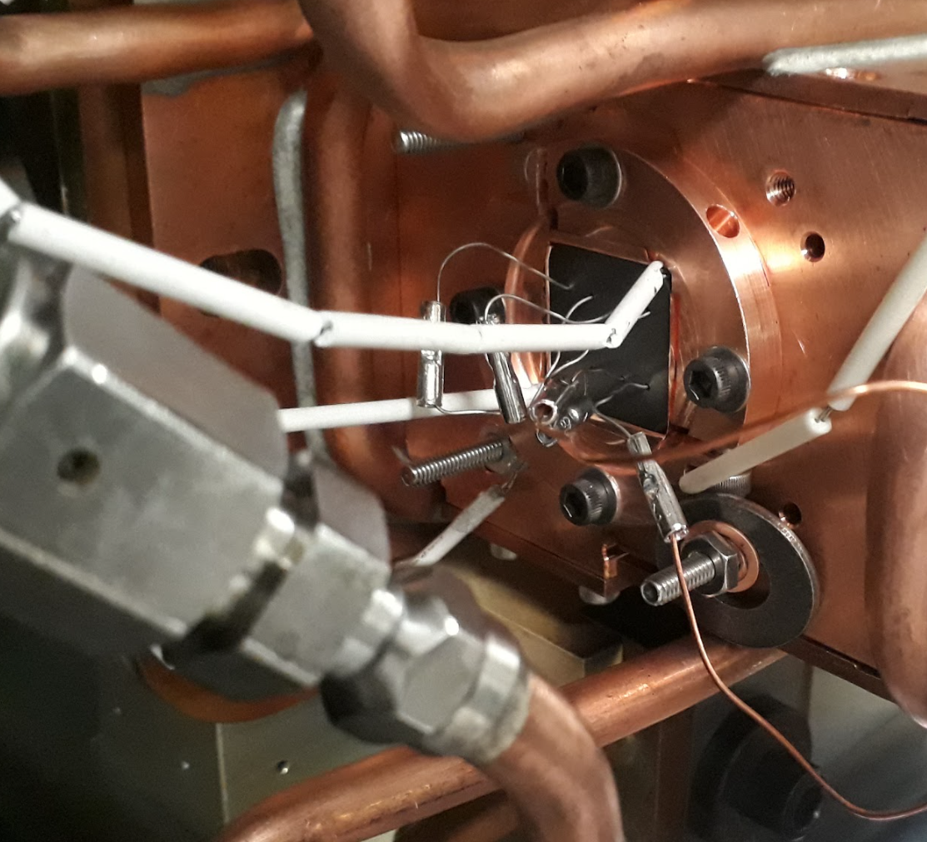
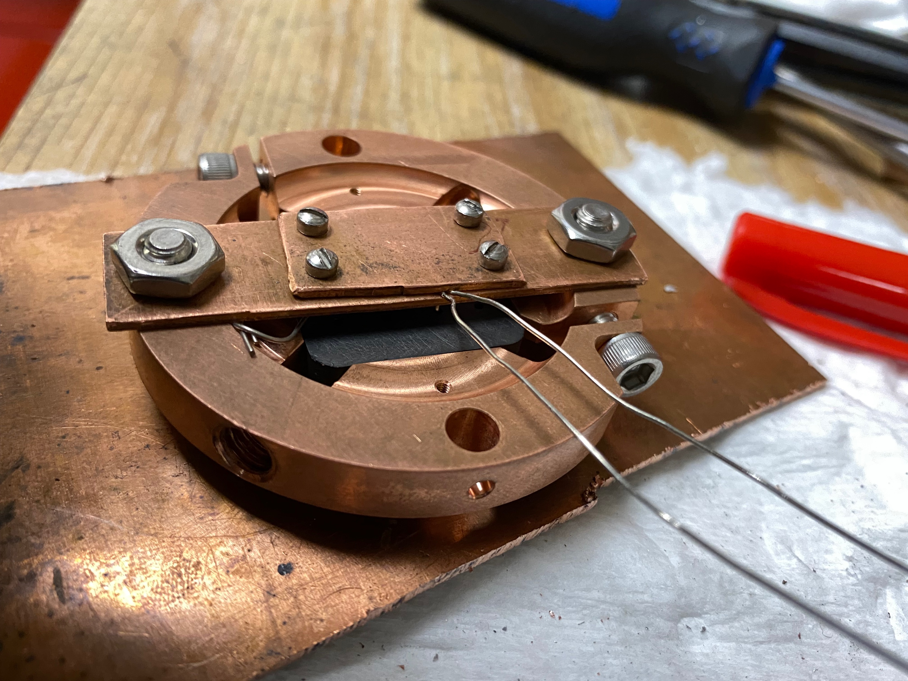

Online temperature measurements
Previous attempt
Ideas to experimentally obtain irradiation temperatures, to be implemented Oct-Dec.
RTD measurement
Simple design
Welded to dummy sample

Slide 26










Thank you
Merci
www.triumf.ca
Follow us @TRIUMFLab

Slide 27

Al alloy
Soon:
ISAC Al6061 beam windows, exchanged every ~7years -> ~0.5Ah -> 6DPA-NRT max in center

Slide 28

Initial slope
Max load
Load (N)
Max displacement
Yield
thickness/10
(from literature)
Displacement (mm)

Slide 29



2021 & 2022 parasitic irradiation campaign at ISAC
2021
Total of 170 SPT samples
2022
FWHM=7mm, DPA-FLUKA on Cu(Eth=40eV) @10mAh
CNL collaboration -> 800H and SS310
Ariel beam window -> CuCrZr, Cu AM
Downstream
Upstream
Developments ongoing:
Thermocouples
Upstream irradiations
Temperature control (TC + heating elements)

Slide 30
Material Irradiation Locations
ISAC, 480 MeV protons, ≤100 µA
ARIEL, 480 MeV protons, ≤100 µA
CTS, 300 keV – 35 MeV electrons,
≤10 mA, µs – s pulses
NBF, 450-480 MeV protons, ~3 nA
PIF, 5-500 MeV, ≤ 10 nA
IPF, 430 MeV protons, ~70 µA
NIF, near-terr. neutrons, 3·10⁶ n/cm²/s
Isotope production cyclotrons, 30MeV-300uA up to 100mAh
2
IAMI
TR24

Slide 31

Use of the ARIEL Proton Waste Beam: ARIEL Parasitic Target (2025)
At ARIEL: <70 MeV stopped in target
Pneumatic transfer between 100 µA, 420 MeV proton waste beam and inert gas hot cell
10²⁰ protons per cm² per week
Routinely available
Additional position for long-term studies in tunable kGy/h – GGy/h dose rates
Parasitic irradiation setup in electron station

Slide 32



TRIUMF-ISAC
Modular target station
2 symmetric stations operated consecutively
30-100mAh/year/station
480 MeV ≤100 µA

Slide 33
Material Irradiation Locations
ISAC, 480 MeV protons, ≤100 µA
ARIEL, 480 MeV protons, ≤100 µA
CTS, 300 keV – 35 MeV electrons,
≤10 mA, µs – s pulses
NBF, 450-480 MeV protons, ~3 nA
PIF, 5-500 MeV, ≤ 10 nA
IPF, 430 MeV protons, ~70 µA
NIF, near-terr. neutrons, 3·10⁶ n/cm²/s
Isotope production cyclotrons, 30MeV-300uA up to 100mAh
3
IAMI
TR24

Slide 34
ARIEL e-γ Converter Test Stand
Development motivations
  Thermal stresses (100 kW beam, thermal cycles)
  Radiation damage / radiochemistry
  Irradiations of up to 3 weeks
Experimental setup:
  Water-cooled sample holder
  Power deposition density of up to several MW/cm³
  300 keV beam to avoid activation (30 MeV possible)
e⁻
300 keV to 30 MeV,
up to 10²² electrons/day, 0.1 – 12 mm FWHM
variable thermal shocks studies

Slide 35
Material Irradiation Locations
ISAC, 480 MeV protons, ≤100 µA
ARIEL, 480 MeV protons, ≤100 µA
CTS, 300 keV – 35 MeV electrons,
≤10 mA, µs – s pulses
NBF, 450-480 MeV protons, ~3 nA
PIF, 5-500 MeV, ≤ 10 nA
IPF, 430 MeV protons, ~70 µA
NIF, near-terr. neutrons, 3·10⁶ n/cm²/s
Isotope production cyclotrons, 30MeV-300uA up to 100mAh
4
IAMI
TR24

Slide 36


NBIF – Neutral beam irradiation facility
H⁻ beam at 450 - 500 MeV EM stripped in highest magnetic field and emerges as a fan of Hº beam ~ 2 cm x 100 cm ~ 1 nA/cm²
10¹⁷ p/cm² per year, 4 GGy
Coil samples to 500 MGy

Slide 37
Material Irradiation Locations
ISAC, 480 MeV protons, ≤100 µA
ARIEL, 480 MeV protons, ≤100 µA
CTS, 300 keV – 35 MeV electrons,
≤10 mA, µs – s pulses
NBF, 450-480 MeV protons, ~3 nA
PIF, 5-500 MeV, ≤ 10 nA
IPF, 430 MeV protons, ~70 µA
NIF, near-terr. neutrons, 3·10⁶ n/cm²/s
Isotope production cyclotrons, 30MeV-300uA up to 100mAh
5
IAMI
TR24

Slide 38



PIF Test Area
2 proton beamlines, BL2C and BL1B:
  5 MeV to 500 MeV, 0.1 nA – 10 nA
  Mostly for electronics testing and radiotherapy
Large, uniform beam (easily up to 7 cm x 7cm)
Low flux (~ 10⁸ p/cm²/s), low maximum fluence
(<< 10¹³ p/cm²)
Neutron converters for large area neutron beam

Slide 39
Possible Irradiation Locations
ISAC, 480 MeV protons, ≤100 µA
ARIEL, 480 MeV protons, ≤100 µA
CTS, 300 keV – 35 MeV electrons,
≤10 mA, µs – s pulses
NBF, 450-480 MeV protons, ~3 nA
PIF, 5-500 MeV, ≤ 10 nA
IPF, 430 MeV protons, ~70 µA
NIF, near-terr. neutrons, 3·10⁶ n/cm²/s
Isotope production cyclotrons, 30MeV-300uA up to 100mAh
6
IAMI
TR24

Slide 40



Phase 2: IPF (Isotope Production Facility) Targets
100 µA
T1
T2
~ 70 µA
IPF
Hot cell view
Target containers in target station
~ 430 MeV, 70 µA, 12 mm FWHM
Parasitic irradiations
Station available for R&D
Irradiation of up to 6 samples simultaneously
Samples inside a water-cooled container
Thermocouple reading at the sample holder
Has been used for radioisotope release studies

Slide 41
Material Irradiation Locations
ISAC, 480 MeV protons, ≤100 µA
ARIEL, 480 MeV protons, ≤100 µA
CTS, 300 keV – 35 MeV electrons,
≤10 mA, µs – s pulses
NBF, 450-480 MeV protons, ~3 nA
PIF, 5-500 MeV, ≤ 10 nA
IPF, 430 MeV protons, ~70 µA
NIF, near-terr. neutrons, 3·10⁶ n/cm²/s
Isotope production cyclotrons, 30MeV-300uA up to 100mAh
7
IAMI
TR24

Slide 42
Neutron Beam Test Area
2·10⁶ neutrons /cm²/s
(ISS mission rate simulated in 1 h irradiation)

Slide 43
Material Irradiation Locations
ISAC, 480 MeV protons, ≤100 µA
ARIEL, 480 MeV protons, ≤100 µA
CTS, 300 keV – 35 MeV electrons,
≤10 mA, µs – s pulses
NBF, 450-480 MeV protons, ~3 nA
PIF, 5-500 MeV, ≤ 10 nA
IPF, 430 MeV protons, ~70 µA
NIF, near-terr. neutrons, 3·10⁶ n/cm²/s
Isotope production cyclotrons, 15-30MeV, 300uA up to 100mAh
8
IAMI
TR24

Slide 44


Isotope production cyclotrons
TR-30
15-30 MeV cyclotron for commercial production of radio-isotopes.
300uA up to 100mAh
Opportunistically it can support research activities
Strict control of radionuclide inventories
Rigid system:
Beam at 5° for normal operation
Electroplated targets

Slide 45
Handling and PIE capabilities

Slide 46



ARIEL Hot Cell Facility
TRIUMF is internationally recognized for its leading role in remote handling, hot cell design, operation and isotope processing. We are eager to co-develop and share expertise.
ARIEL hot cell facility currently being commissioned

Slide 47





Material Development for High-Power Accelerator Applications
Materials development for ARIEL
Target station dose rates
(damage in insulators and seals ~1MGy-500MGy )
CuCrZr ARIEL beam window
allowing higher power operation
~10DPA-FLUKA/year range
Complex in-beam geometries
High thermo-mechanical loads from high power driver beams
+
Material aging due to radiation induced defects
Research on radiation resistant materials
Polymeric materials
HEA alloys
AM manufacturing techniques
Understanding differences between low energy ion, high energy proton and neutron irradiations
Experimental data from parasitic irradiations:
Save beam time
High power beam conditions

Slide 48

Examples Target Damage Learning Experience
Be muon target
6 positions for targets Be, C, Cu,
After installation of target protection by 4 segment halo monitor.
Be targets lifetime: 10²⁴ p/cm² 800 mA-h
Irradiation damage - misaligned target and protect monitor

Slide 49
Radiation Damage Issues
Proc. 2005 PAC
Pyrolytic graphite vacuum brazed to TiCuSi foil and soldered to copper saddle
Radiation-cooled thin graphite targets 2 mm at 100 μA lasted for many weeks but eroded at 120 μA and small beam size.
Failure of 1 cm water-cooled graphite target after 1-2 weeks at 120 μA – thermal + radiation damage
300-350 ºC for 1 mm proton beam

