Slide 1



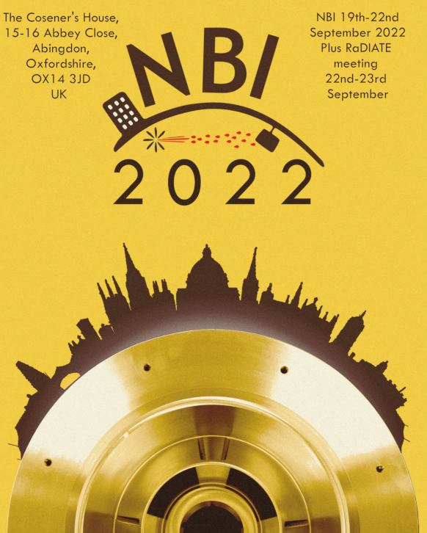
J-PARC Main Ring Abort Dump Upgrade Plans
Chris Densham, Mike Fitton, Eric Harvey-Fishenden
RAL High Power Targets Group
in collaboration with
Masashi Shirakata, Kotomi Kadowaki, Susumu Igarashi, Yoichi Sato and Megan Friend
Notes:
The abstract pattern can be removed or repositioned if required. Be careful to ‘Send to Back’ so that it does not obscure any important information.

Slide 2
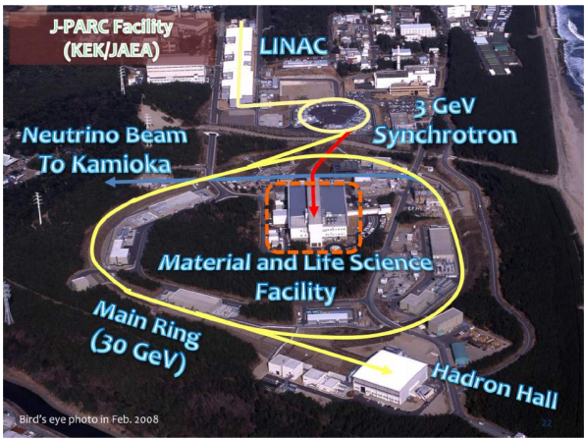
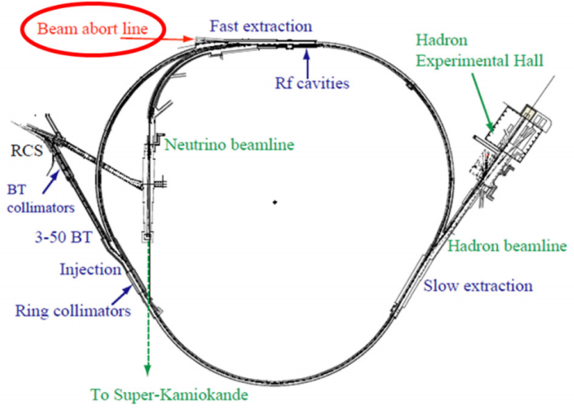
J-PARC Main ring & Abort dump
Approx. 510m
Main ring circumference = 1.56km
Abort dump is a device to safely absorb the beam energy without damaging the accelerator or experiments.
      Its main purpose it to allow accelerator tuning studies when increasing beam power.
      It is also used as a Main Ring beam protection device during operation
      JPARC beam is 3.2x1014protons per pulse @ 30GeV → 1.4MJ per pulse

Slide 3
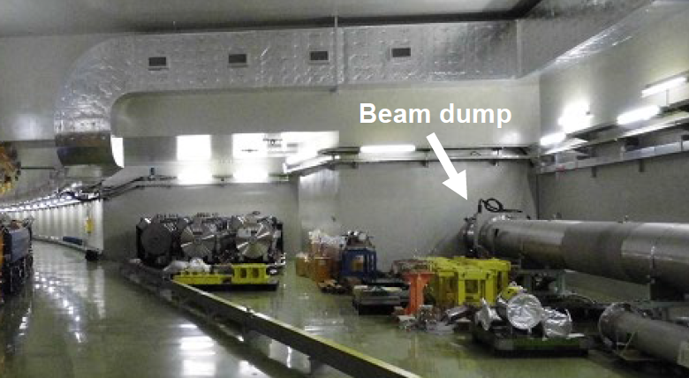
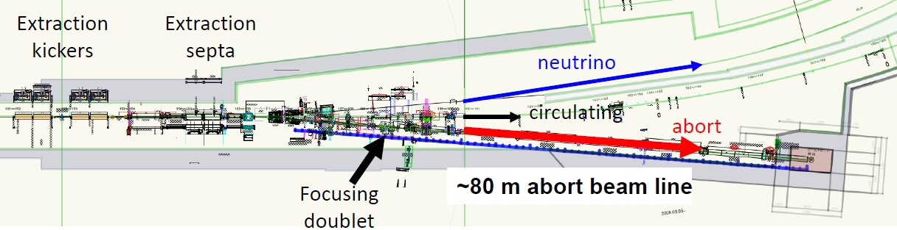
The problem, why an upgrade is required
Current main ring abort dump is limited to 7.5kW heat load (has no active cooling)
This limits its usage to ~18 shots per hour which make beam tuning very time consuming
Can be a limitation on continuous high power operation
As beam power is increases, more tuning and accelerator studies are required
but fewer shots are permitted
What are we trying to achieve?
The desired upgrade should:
Allow 3-4 times more shots per hour to enable effective beam tuning and reliable continuous operation
Be installed inside the existing beam dump stainless steel pipe (already radioactive)
Minimise backscattered neutrons and radiation in the tunnel
Minimise isotope production in coolant (e.g Tritium production)
FX abort dump
Iron block of 3.3 x 3.3 x 6 m in the concrete wall

Slide 4
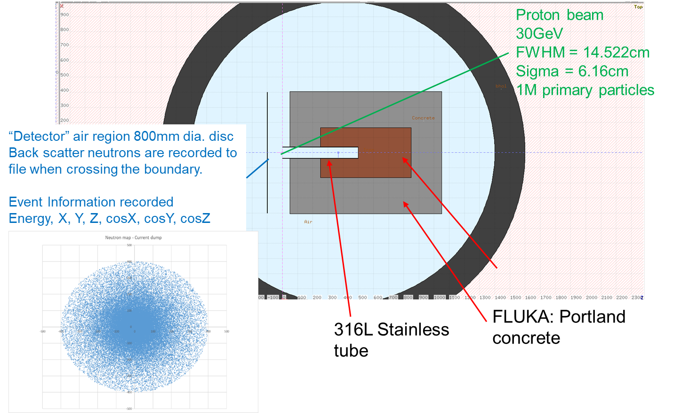
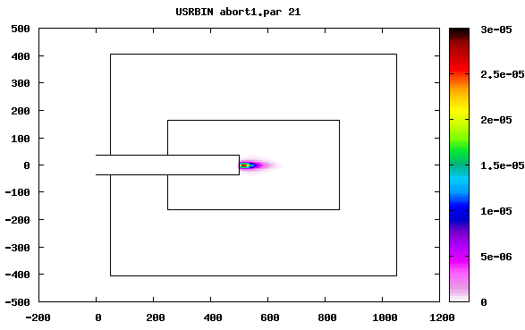
FLUKA Monte Carlo studies – Current beam dump
The code FLUKA has been run on the STFC SCARF cluster to study:
the effectiveness of our dump insert designs
the heat loads in the materials
the effect on backscattered neutrons
Current dump
Nearly all energy deposited in steel
22°C per pulse
18 shot limit (~450°C and YS)
Steel

Slide 5
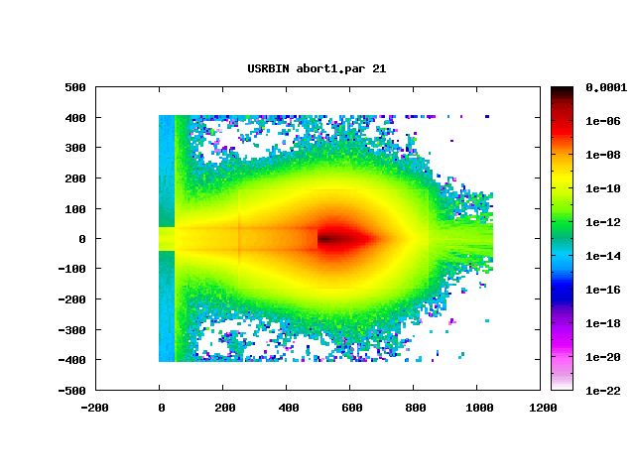
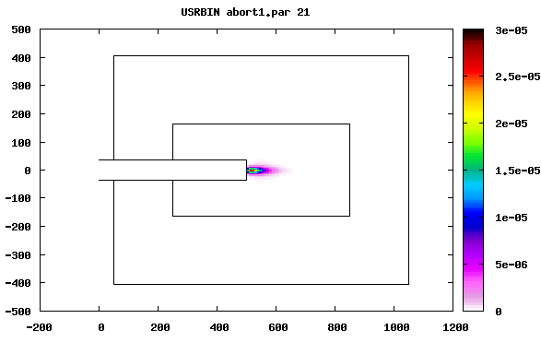
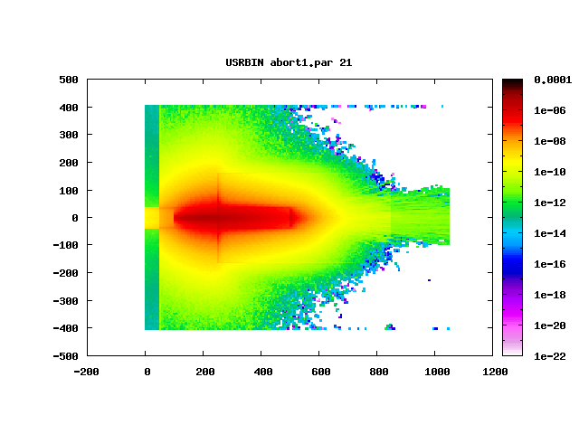
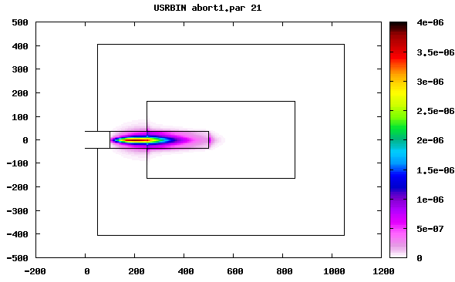
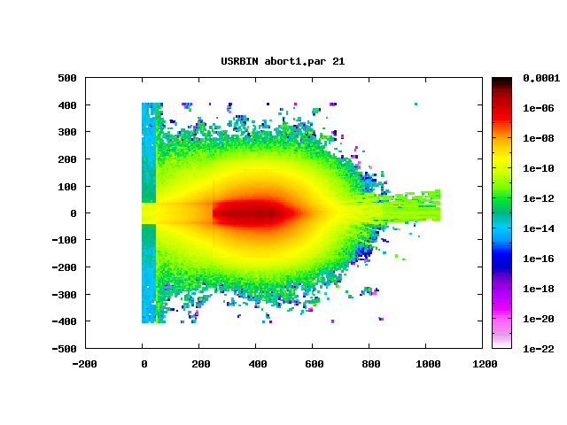
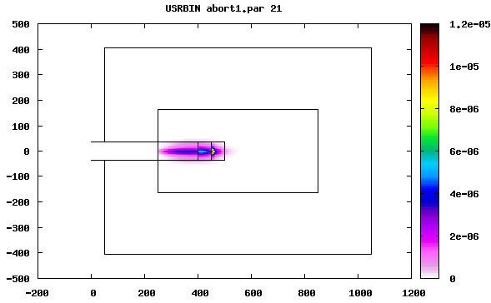
FLUKA Studies
Many configurations were studied to find an optimum design:
Optimum design has to:
Absorb maximal proportion of beam energy
Be mechanically feasible within temperature and stress limits of proposed materials
Minimise backscattered neutrons
Current Design
4m Graphite
1.5m Graphite 0.5m Copper
0.5m Aluminium

Slide 6
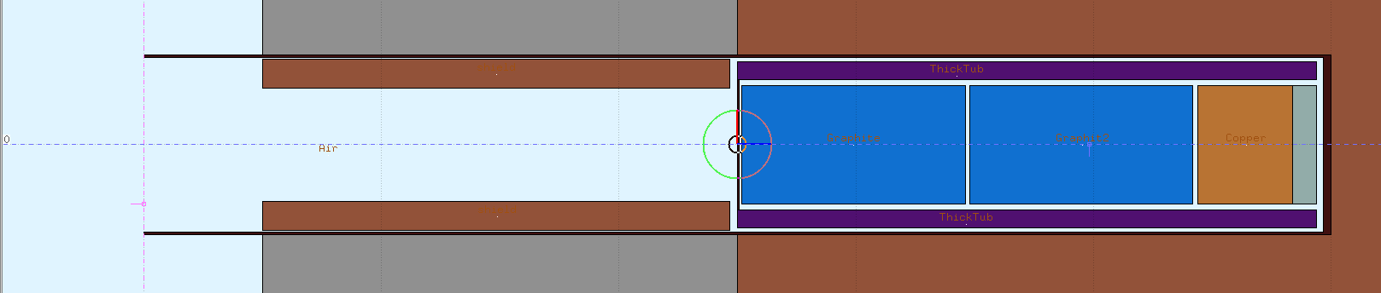
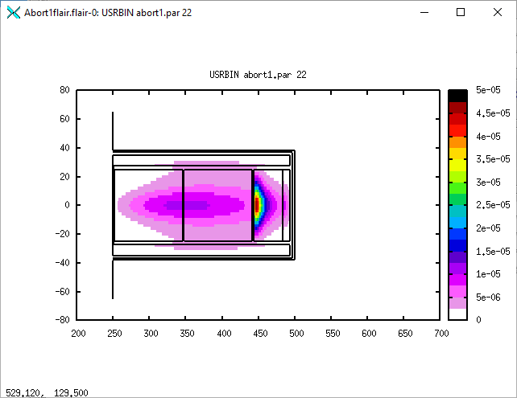
FLUKA Monte Carlo studies – Dump insert design
FLUKA has been used to reduce the amount of heat deposited in the fixed steel and concrete of the dump as well as reduce the backscattered neutrons. Below is one of the highest performance configurations.
Thick tube (bronze) reduces heat in surrounding steel
Iron ring to shield cooling channel gaps
High density material at end of dump core stops majority of remaining beam (Cu then W)
Graphite absorbs energy and “blows up” beam
Highest performing option isn’t always the most viable:
Tungsten and Bronze would have significant cost impacts
Similar performance can be obtained with similar density grading using more conventional materials (Steel/Graphite/Copper)
New design
91% of energy absorbed by new dump core
7°C per pulse in copper
138 shot limit (7.6x improvement)

Slide 7
FLUKA Monte Carlo studies – Dump insert design
Below is one example of many designs studied
Thick tube reduces heat in surrounding steel
Proton beam
Iron ring to shield cooling channel gaps
High density material at end of dump core stops majority of remaining beam
Graphite absorbs energy and “blows up” beam
New design
91% of energy absorbed by new dump core
7°C per pulse in copper
138 shot per hour limit (7.6x improvement)

Slide 8
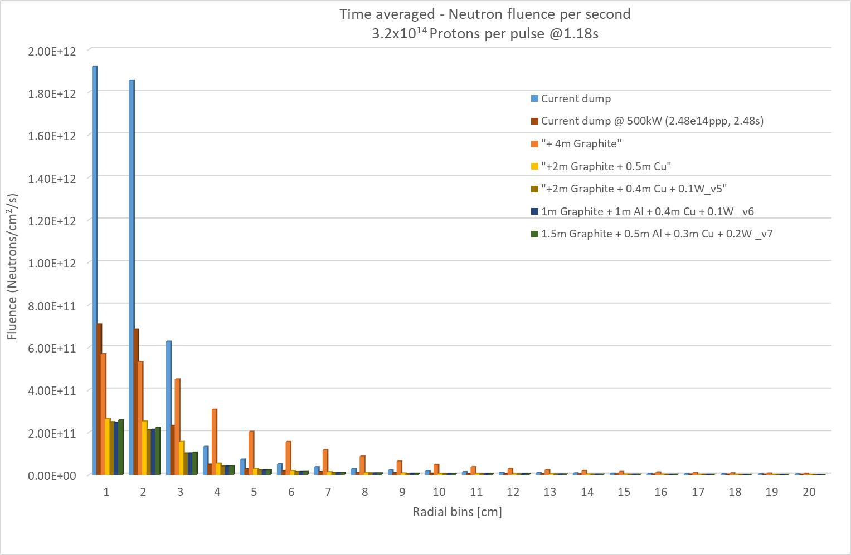
FLUKA Monte Carlo studies – Backscattered Neutrons
New design reduces the backscattered neutron count to 1/5 of the current dump
Current dump at 1.3MW
Current dump at 500kW
Dump with insert at 1.3MW

Slide 9
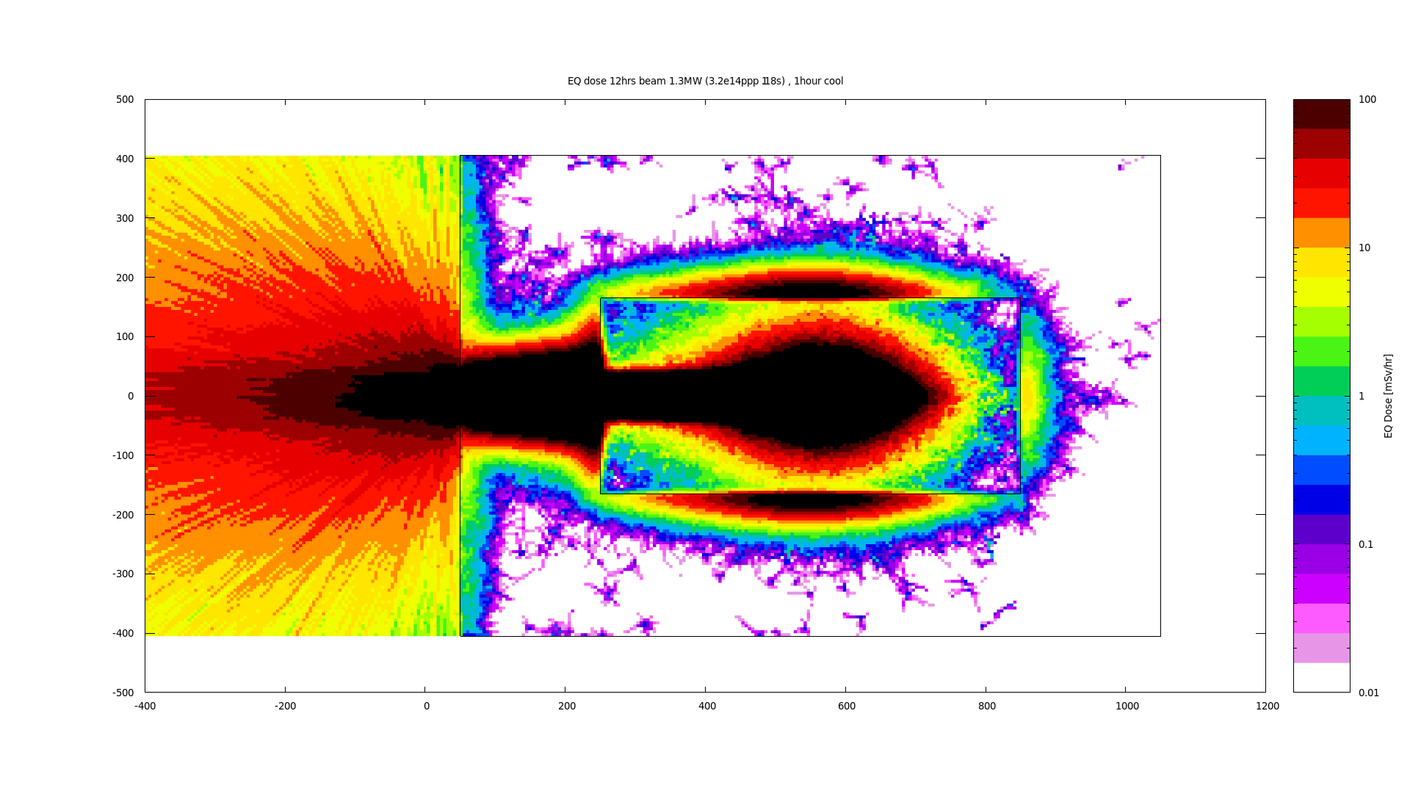
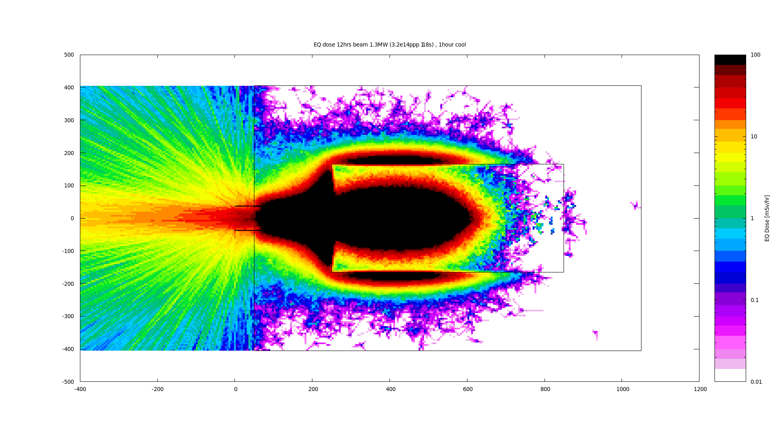
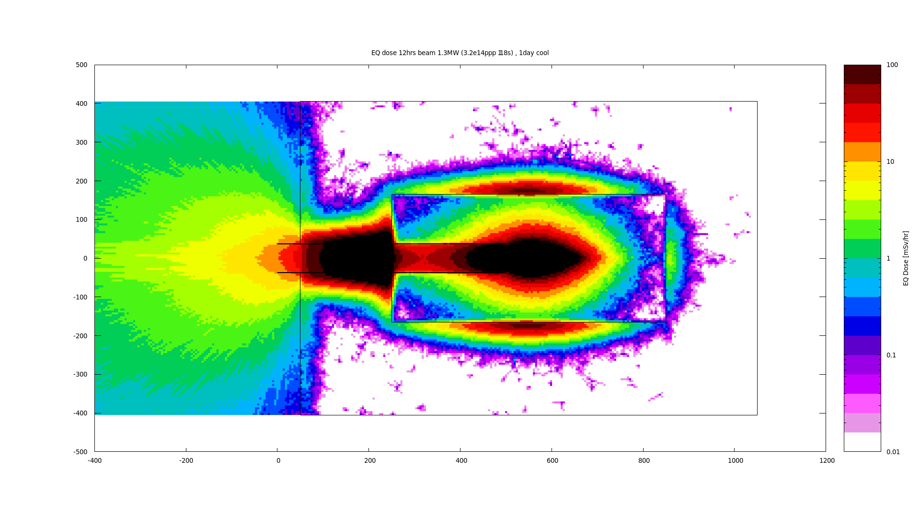
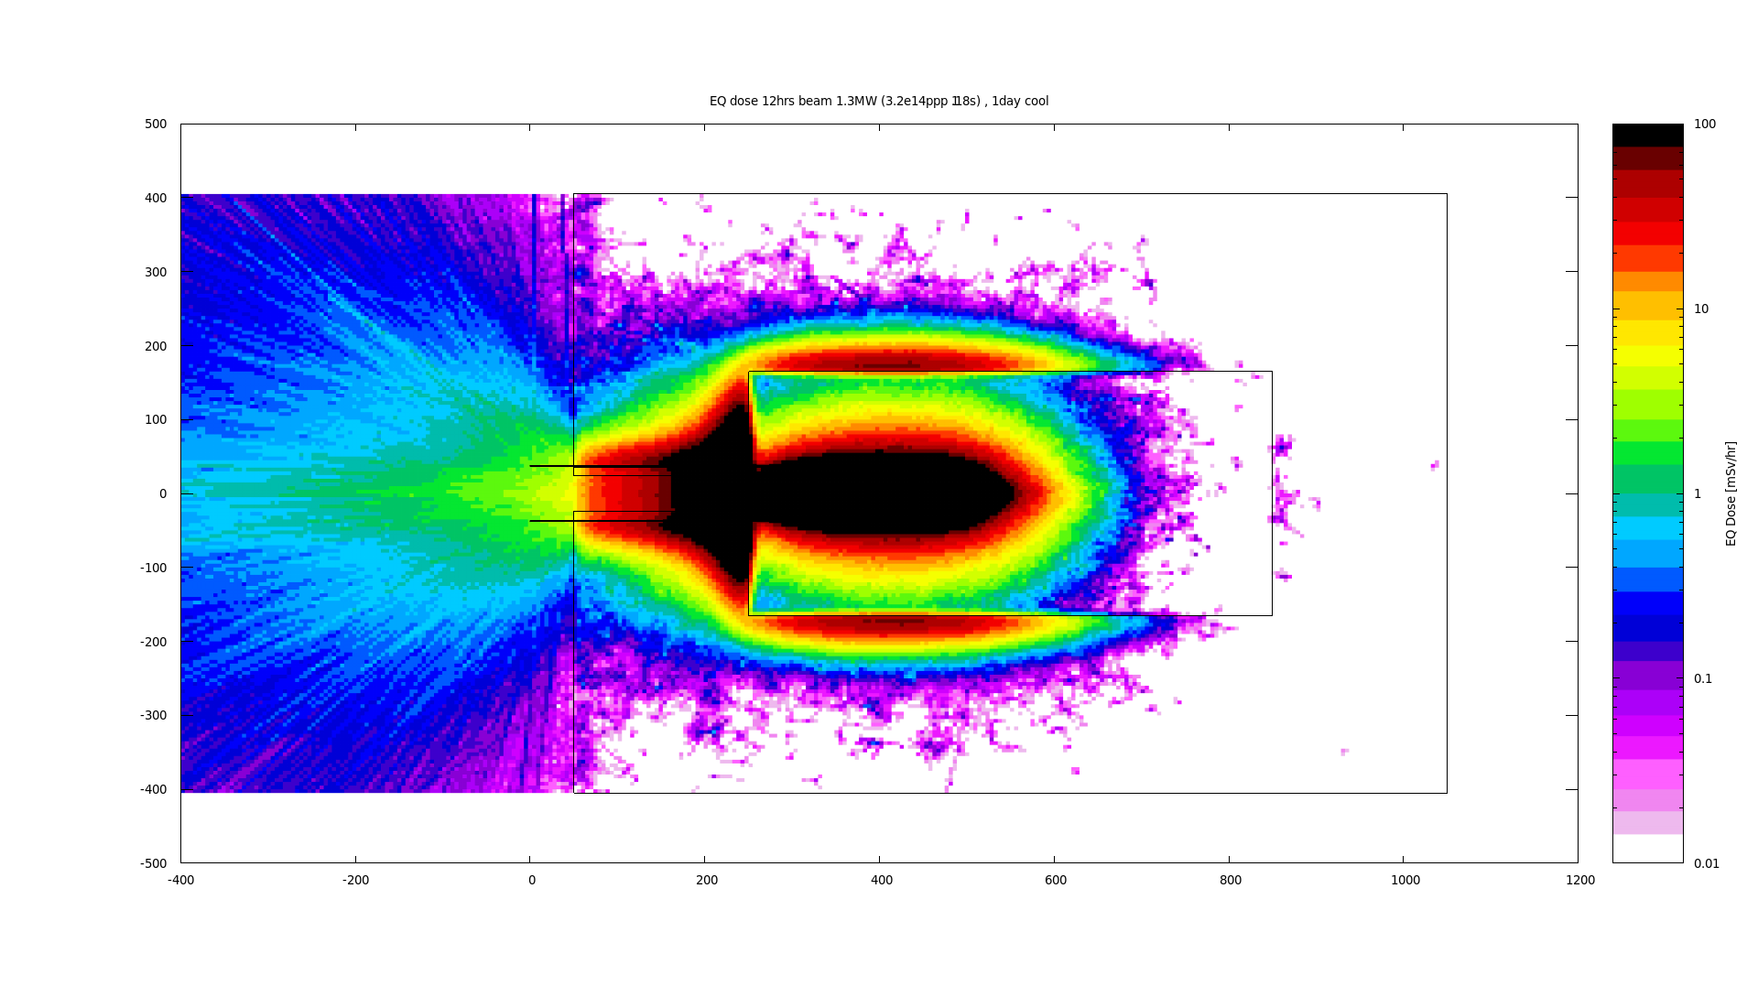
Equivalent dose rates after 12hr beam at 1.3MW
Location 2m from beam pipe in tunnel
Current dump
With dump insert
1 hour
25mSv/hr
1 hour
3.5mSv/hr
1 day
2.7mSv/hr
1 day
0.6mSv/hr
ISIS exposure limit (whole body) = 1mSv/year
Significant reduction in dose rate in main ring tunnel

Slide 10
Proposed JPARC main ring abort dump insert
Copper (0.5m)
Graphite (1m)
Graphite (1m)
Cast Steel Shield/Flow Guide
Inlet/Outlet Manifolds
Beam Window
Ø0.5m
Proton beam
75mm
120mm
4.5m
Thermal simulations show Air (or Nitrogen) cooling is possible:
Lower activation and less tritium production than water cooling
Simpler Design – tolerant to leaks, etc.
Can install the main part in one piece (existing dump is radioactive!)
Centre of gravity is reasonable -> Dump insert supported by tube in concrete
Total dump insert mass = 6907kg
Vacuum
Air

Slide 11
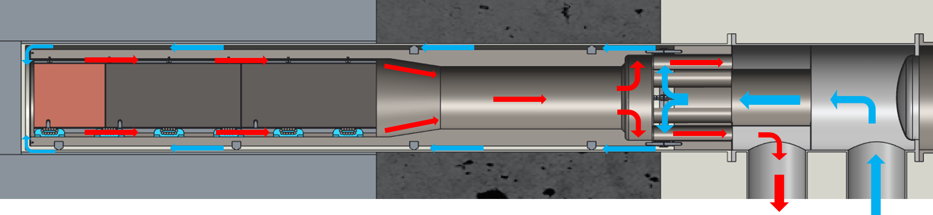
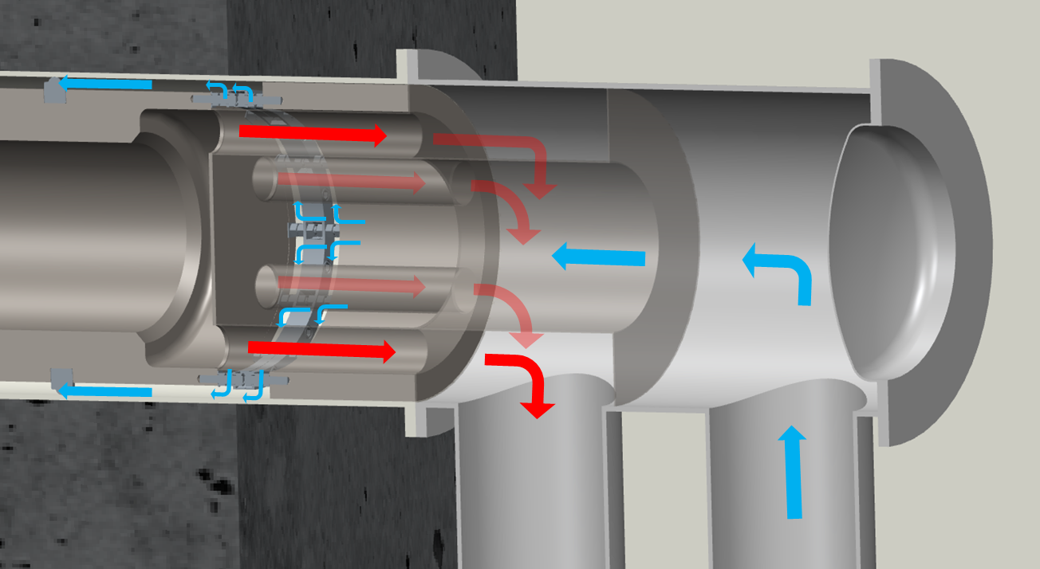
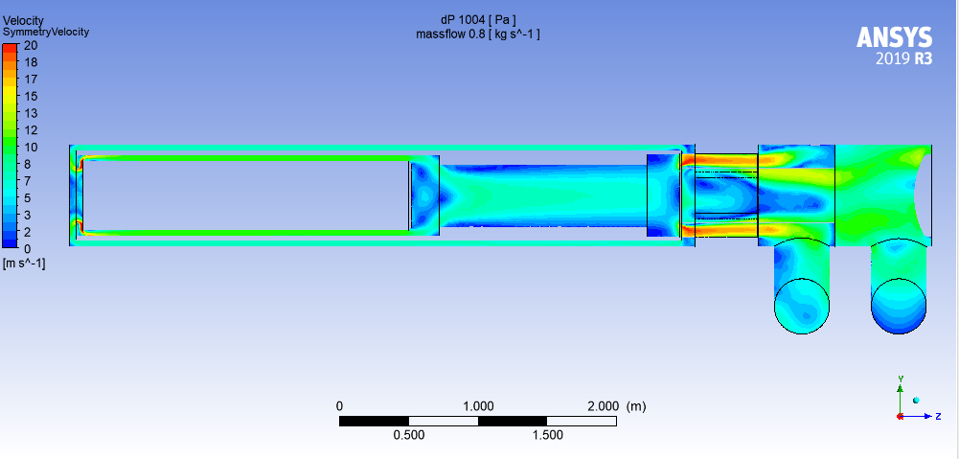
Flow Path

Slide 12
Thermal Analysis
Steady state, 50kW beam power
Approx. 120 shots per hour (@3.2E14ppp)
Exhaust air at 70°C
Core temperatures are acceptable for this configuration
Some finning of copper blocks required
Pressure drop is small – can use high flow rate blower

Slide 13
Future work
We plan to take this proposal forwards – collaboration between KEK and RAL
Outstanding issues:
Sign off of radiation safety calculations
  Back scattered neutrons
  Activation of beam window
  Tritium/N0x production in air circuit
Air cooling circuit design
- Cost/performance optimisation vs budget

