Slide 1
LBNF Beam Windows and Window Remote Handling
NBI 2022
Quinn Peterson - Technical Manager
Accelerator Division, Target Systems Department

Slide 2
Contents of Talk
Primary Beam Window and Cartridge Assembly
Downstream Decay Pipe Window (DSDP Window)
Upstream Decay Pipe Window (USDP Window)
USDP Window Remote Handling System

Slide 3
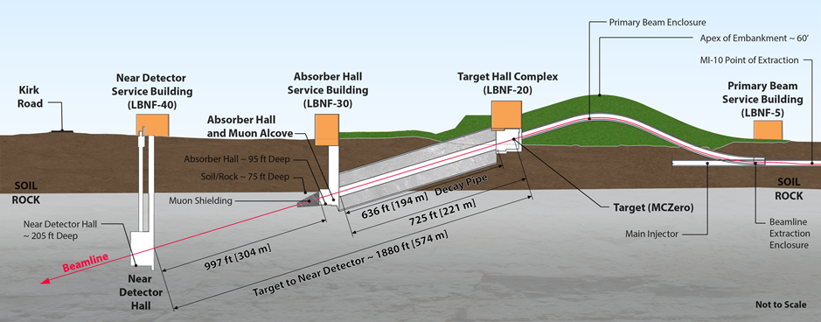
Beam Windows Locations Overview
3 Windows make up the Beam Windows for the LBNF experiment:
Primary Beam Window
Upstream Decay Pipe Window (USDP Window)
Downstream Decay Pipe Window (DSDP Window)
Downstream Decay Pipe Window (DSDP Window)
Primary Beam Window
Upstream Decay Pipe Window (USDP Window)

Slide 4
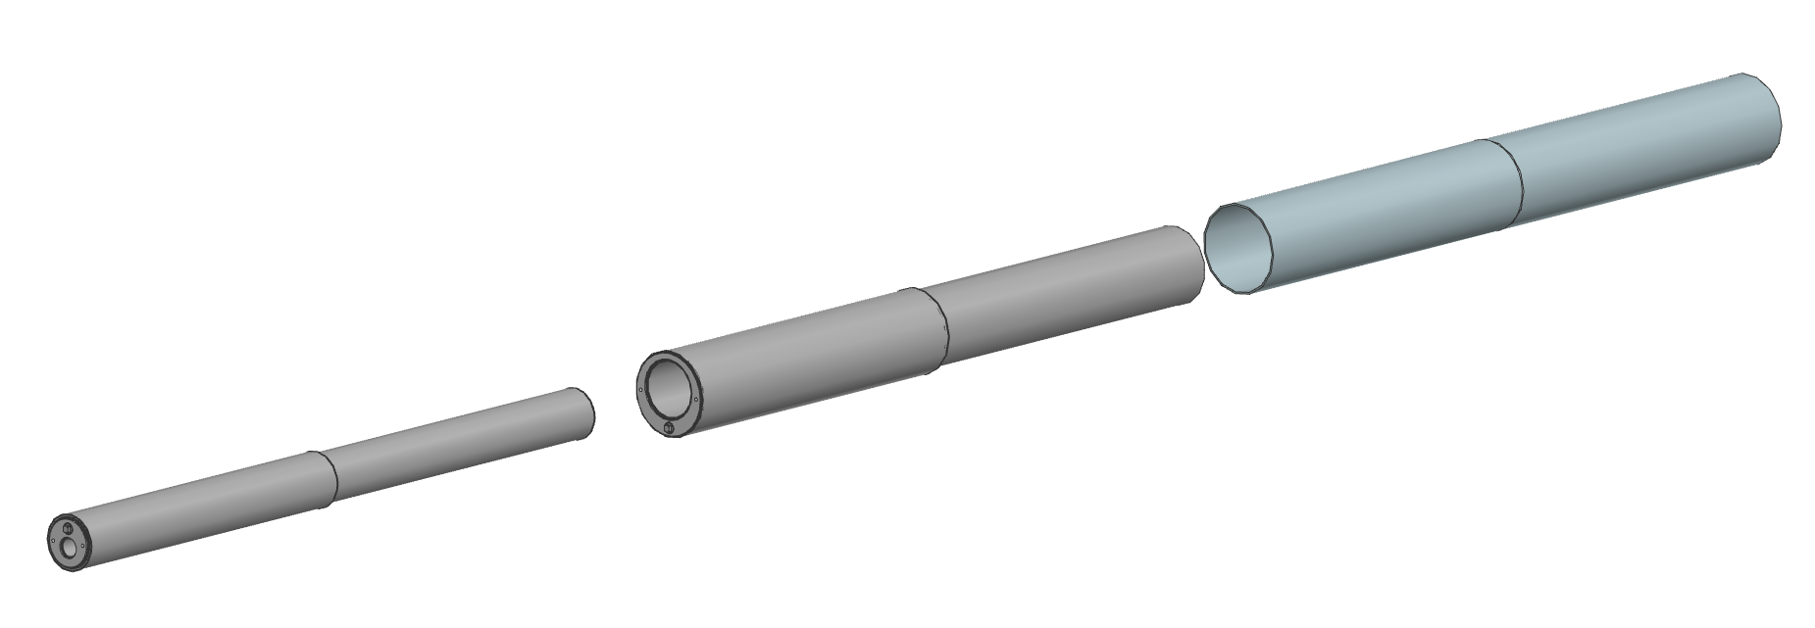
Primary Beam Window

Slide 5
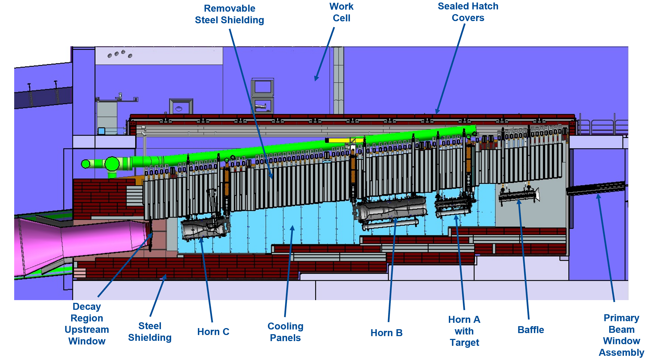
Semi-Left Section View of Decay Region Structure and LBNF-30 Absorber Complex

Slide 6
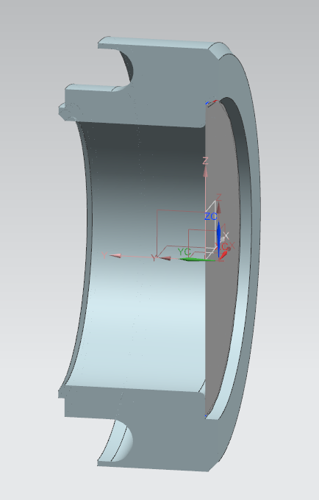
Primary Beam Window
Vacuum on the left hand side
3 psig on the right hand side
Housing is 304 stainless steel
Membrane is beryllium
Fixed restraint
Location for cooling tubing
Membrane inner diameter = 63.5 mm (~2.5 inches), outer diameter = 74.93 mm (2.95 inches)
Hole thru housing is 63.5 mm (2.5 inches) in diameter
Membrane thickness = 0.024 inches
(0.61 mm) Per FESHM 5033.1
Designed for 18.7 psi delta P Target Chase is pressurized at 4 psig max)

Slide 7
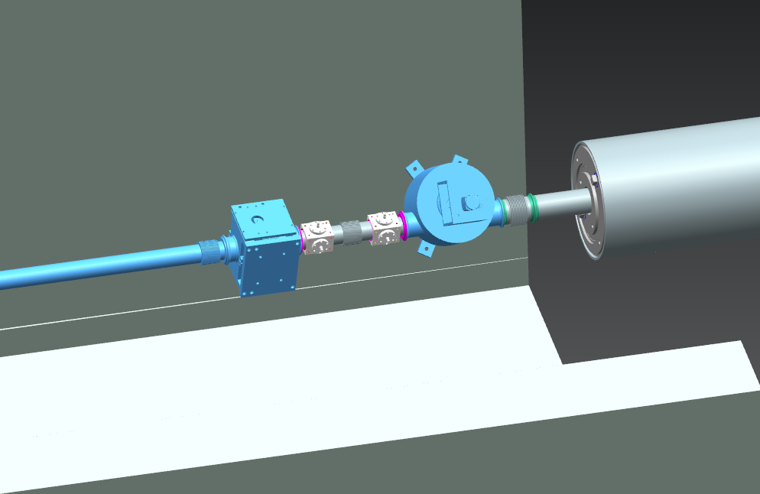
Primary Beam Window Interface to Primary Beam Elements

Slide 8
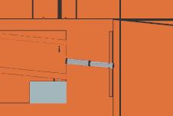
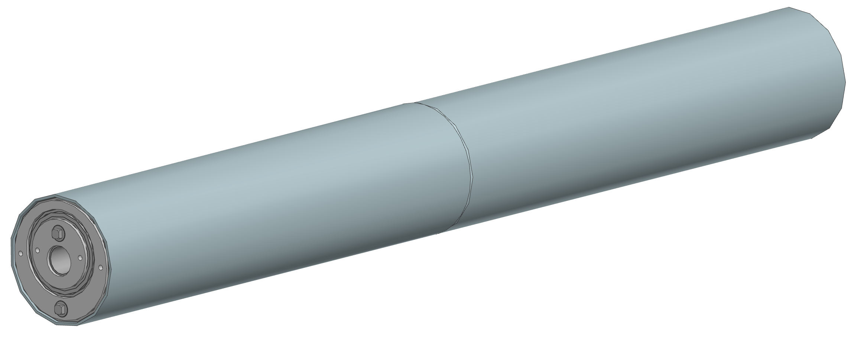
Primary Beam Window Cartridge Assembly
Cartridge is an assembly that allows the beam pipe and attached window to be fine tuned in its position.
Civil construction tolerances
Settlement of the building and enclosures over time
Minor changes to the beam optics
Initial adjustments addressed when cartridge is installed initially
Typical adjustment range of application:
+/- 1 in (25.4 mm)
Adjustments are always possible from Pre-Target side

Slide 9
Cartridge Made from Steel Tubes, Filled with Marble

Slide 10
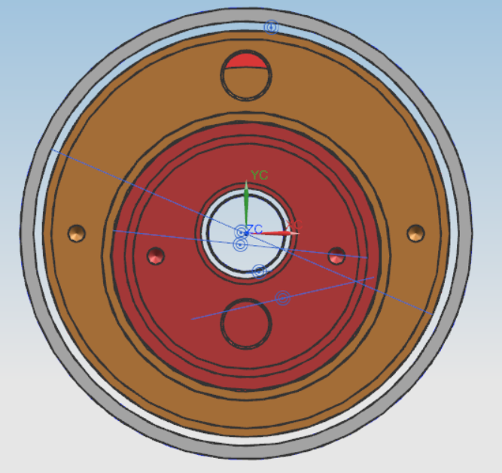
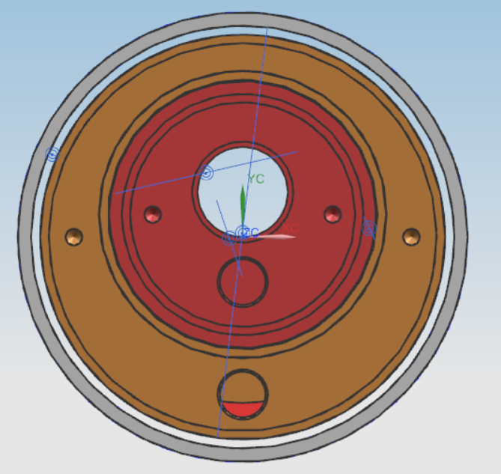
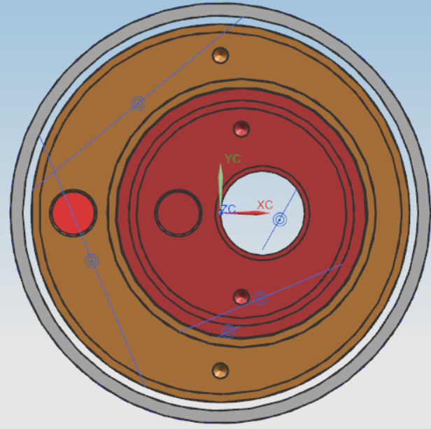
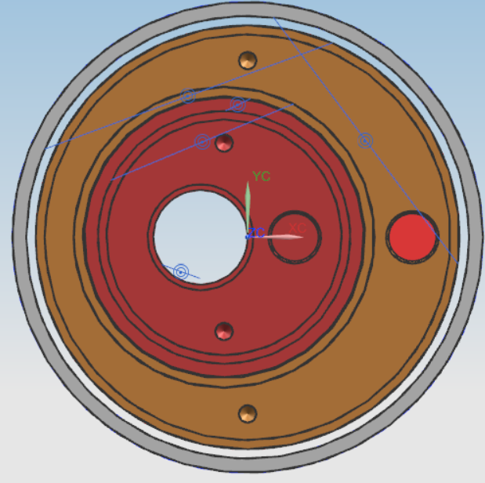
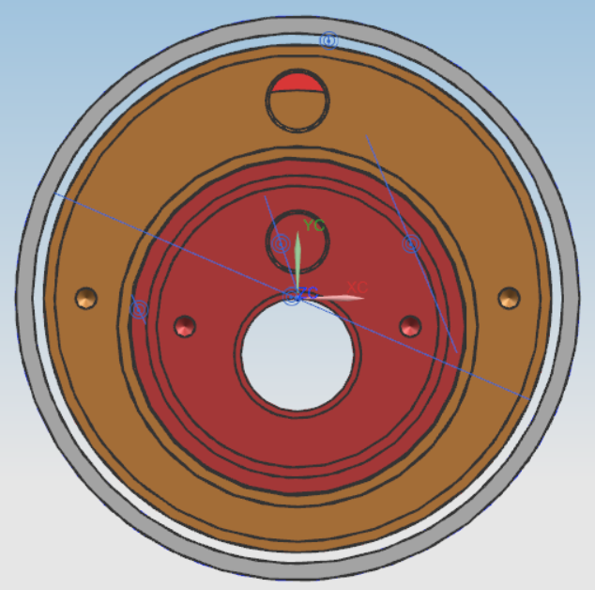
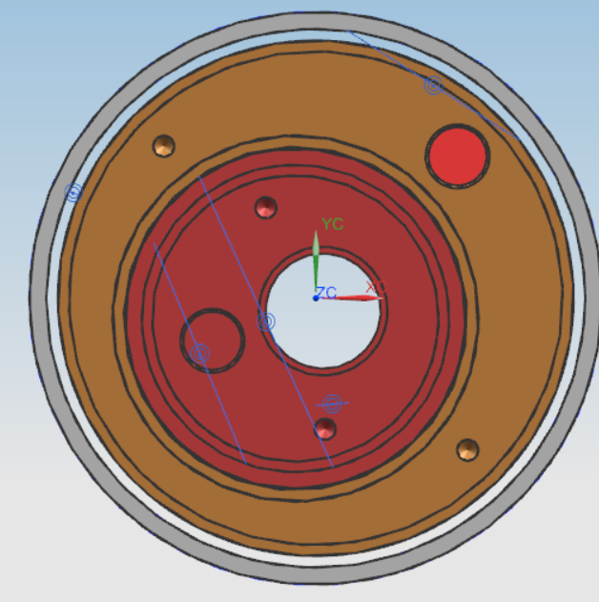
Cartridge Eccentrics Allow Transverse Positioning

Slide 11
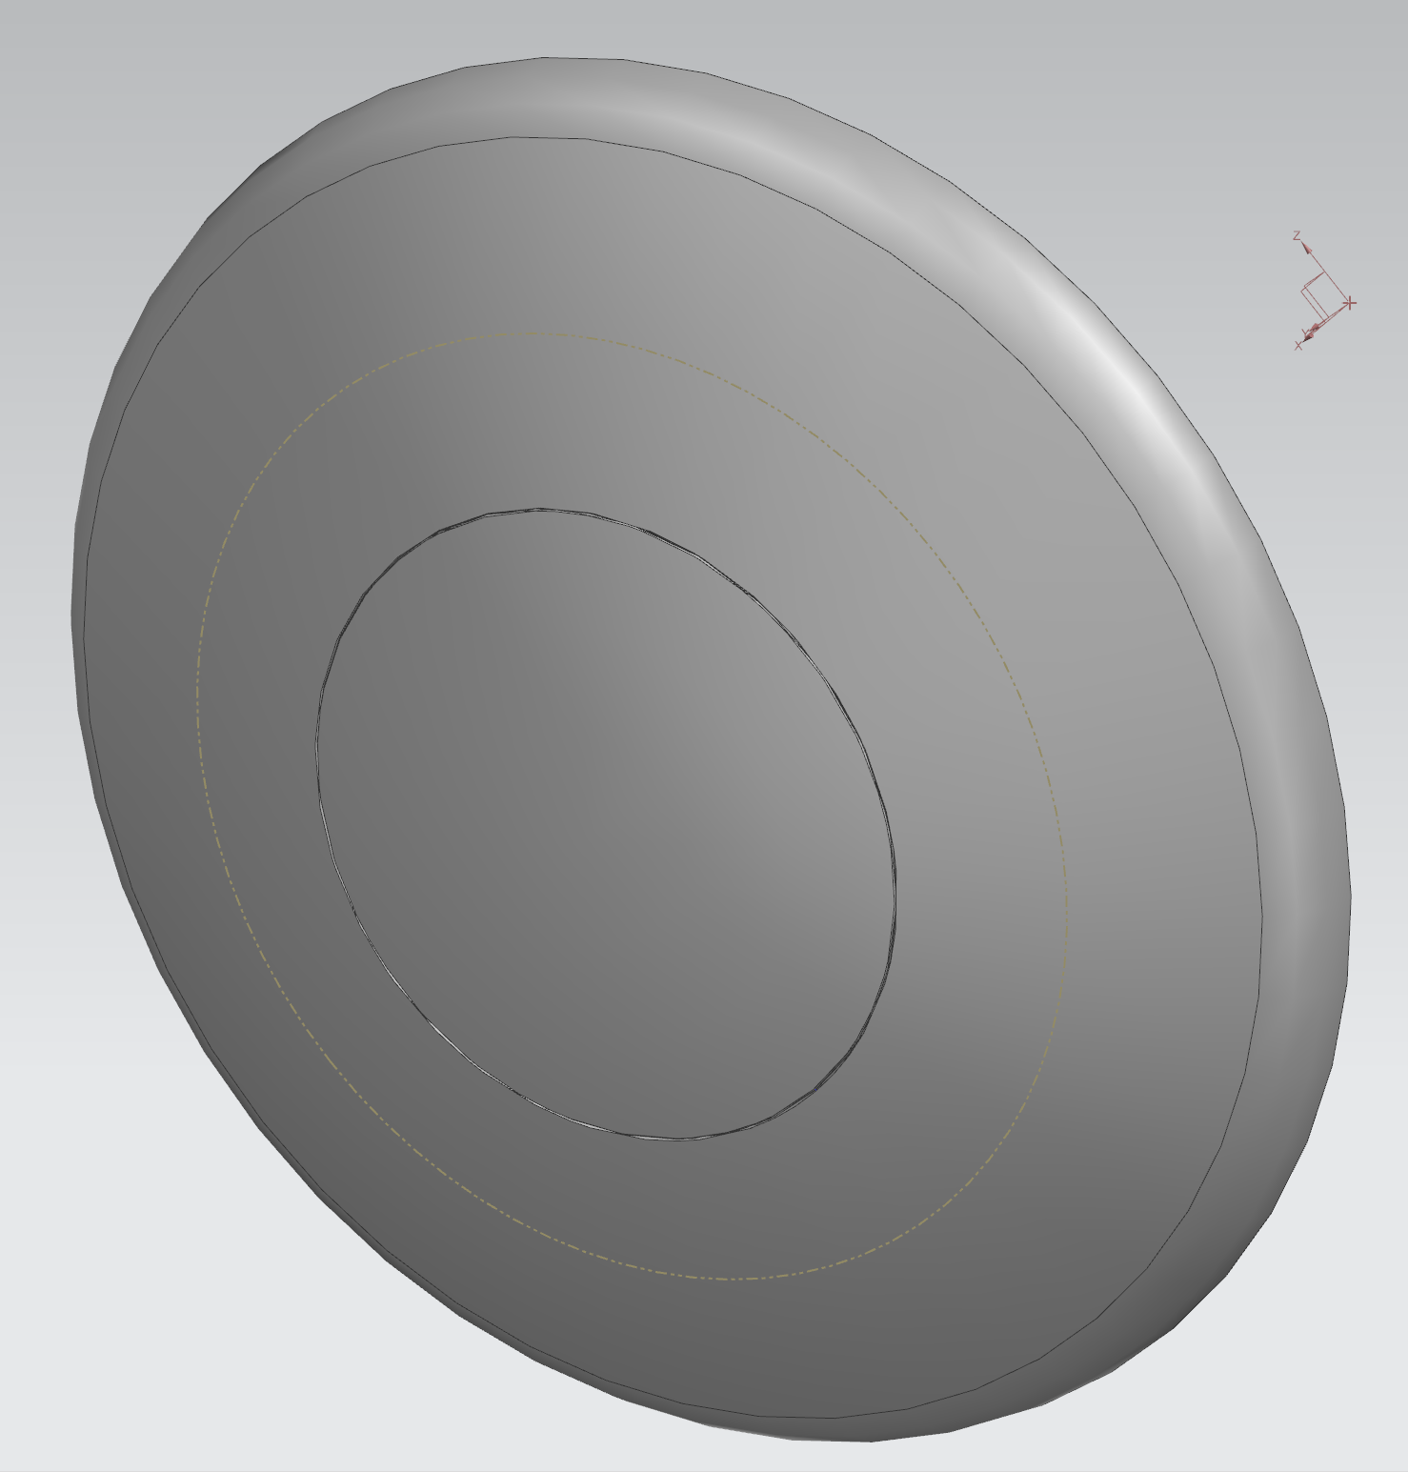
DSDP Window

Slide 12
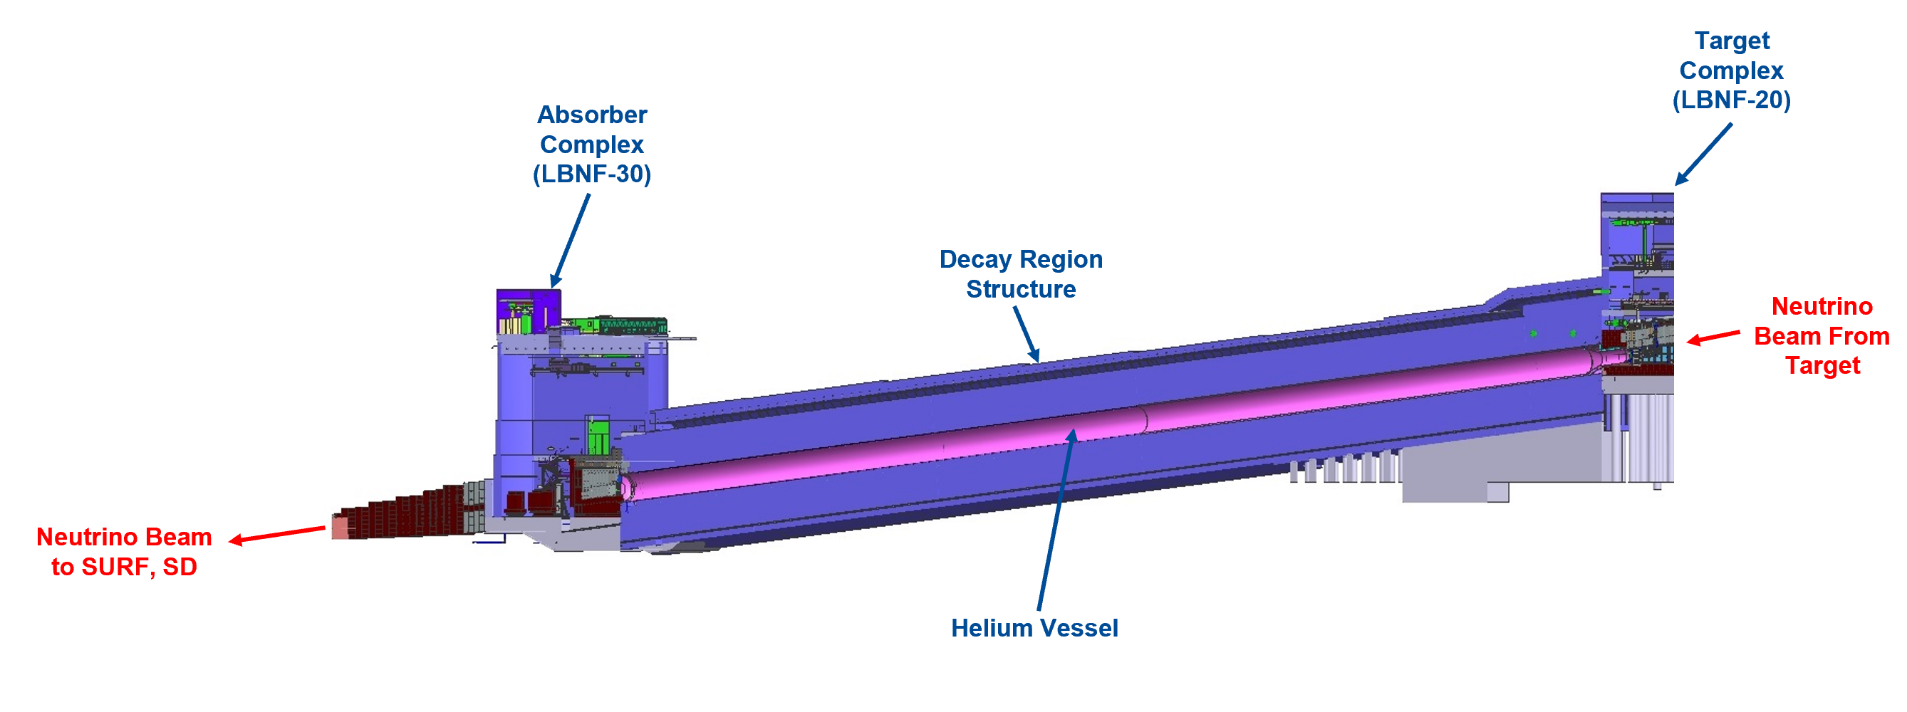
Semi-Left Section View of Decay Region Structure and LBNF-30 Absorber Complex

Slide 13
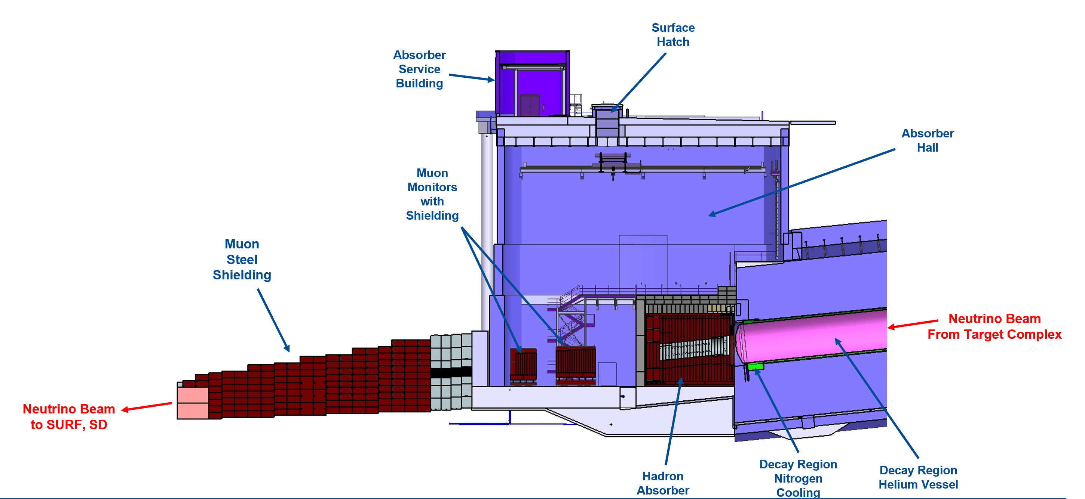
Left Section View of LBNF-30 Absorber Complex

Slide 14
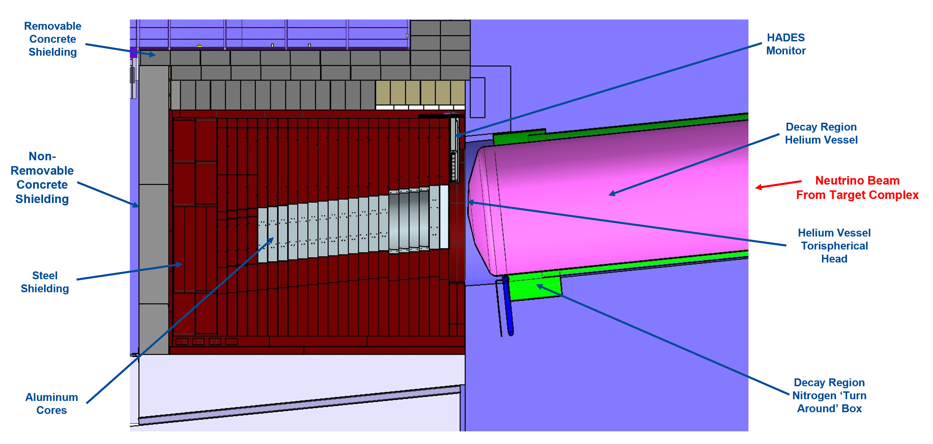
Left Section View of LBNF-30 Absorber Complex

Slide 15
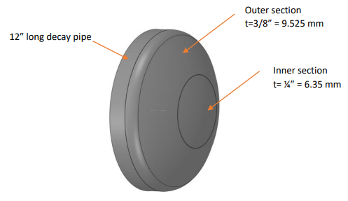
DSDP Window Design Overview
As this “Window” design is a weldment on the downstream end of the Decay Pipe, this assembly is considered a part of the pressure vessel and characteristics are controlled by AECOM.
Material: S304L Stainless Steel
Thickness: Varies among sections
Diameter Decay Pipe Connection: 4019.53 mm (13’ – 2.25”)
Outer Section Diameter: 2743.2 mm (9’)
Inner Section Diameter: 1828.8 mm (6’)

Slide 16
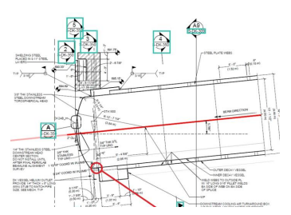
Decay Pipe Downstream Window Analysis Under 2.5 MW
Analysis was conducted to determine the DSDP Window thermal and structural performance for nominal operating and accident condition under 2.4 MW beam power with a 1.5 m Target.
120 GeV proton beam
1.2 second spill cycle
1.5e14 protons/spill

Slide 17
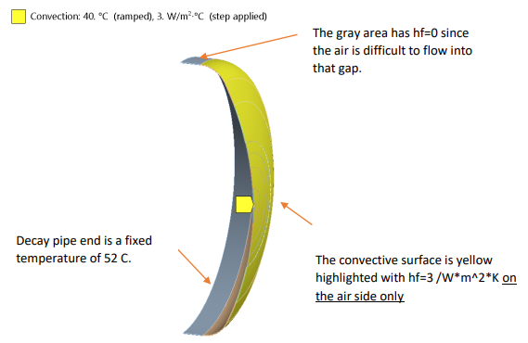
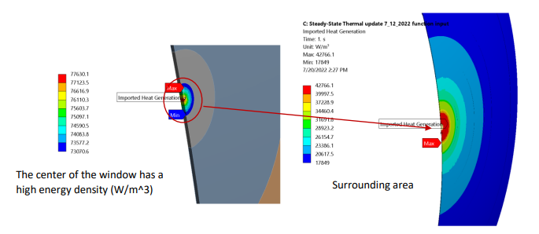
Decay Pipe Downstream Window Analysis Under 2.5 MW
Thermal Results:
Maximum Temperature (Tmax): ~107 C (224.6 F)
Tmax after 2 accident pulses: 155 C (311 F)
Tmax after 5 accident pulses: 214 C (417.2 F)
Temp. change due to pulses: ~23 C/pulse (73.4 F)
Consistent with theoretical calculations
Off Axis (72 cm) Tmax after 2 and 5 accident pusles:
Tmax 2 pulses: 158 C (316.4 F)
Tmax 5 pulses: 198 C (388.4 F)
Additional case study where window is initially cool everywhere is also included

Slide 18
Decay Pipe Downstream Window Analysis Under 2.5 MW
Structural Requirements:
Min. tensile ultimate strength: 70 ksi
Min. tensile yield strength: 25 ksi
ASME VIII, Div II, Part 5 Max Stress: 16.7 ksi
Maximum use temperature: 348 C (1200 F)
Method:
1st Load Step: 5 psi internal pressure only
2nd Load Step: 5 psi + thermal load
3rd Load Step: 5 psi + thermal load + gravity

Slide 19
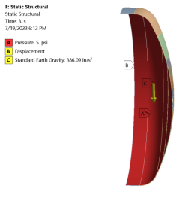
Decay Pipe Downstream Window Analysis Under 2.5 MW
Structural Results:
For normal operating case (Tmax = 107 C): ~4.3 ksi
Well below allowable of 16.7 ksi
Deflection is ~0.1” (2.54 mm)
After 2 accident pulses:
On Axis: 13.5 ksi
Off Axis: 10.1 ksi
After 5 accident pulses:
On Axis: 28.2 ksi
Off Axis: 25.2 ksi
Per ASME VIII, DIV 2, part 5, allowable is 49.5 ksi
Stress around weld joint area is ~2.2 ksi regardless of normal or accident cases
Even after severe accident cases, the window remains functional
Analysis present in Dune docDB 26309

Slide 20
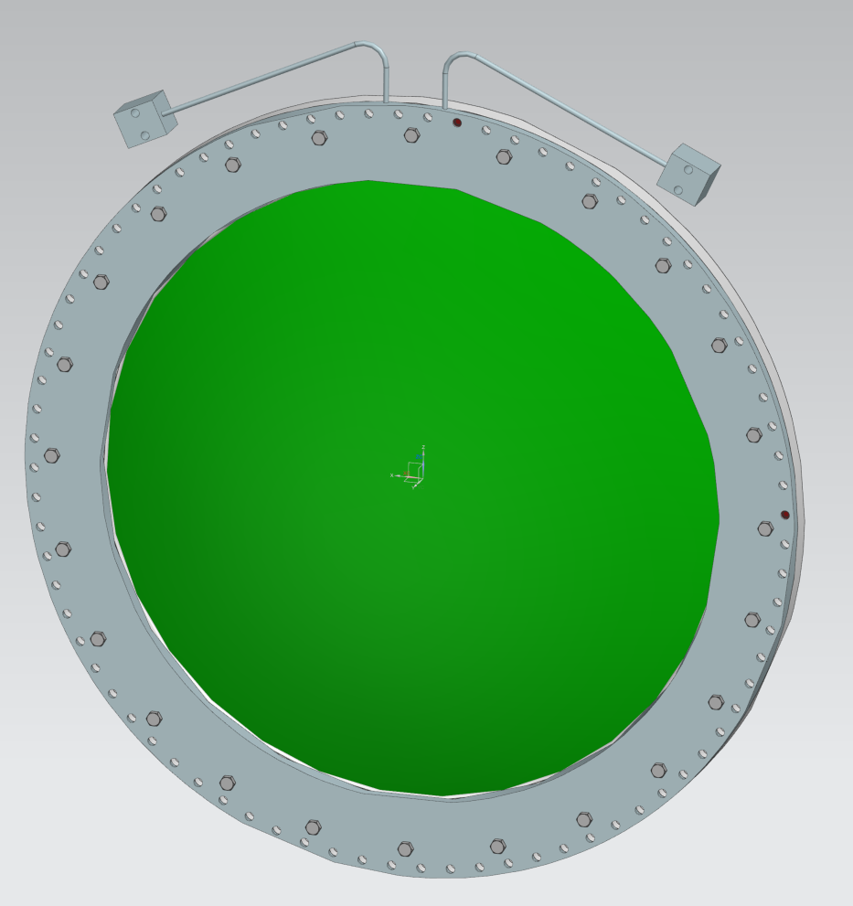
USDP Window

Slide 21
Semi-Left Section View of Decay Region Structure and LBNF-30 Absorber Complex

Slide 22
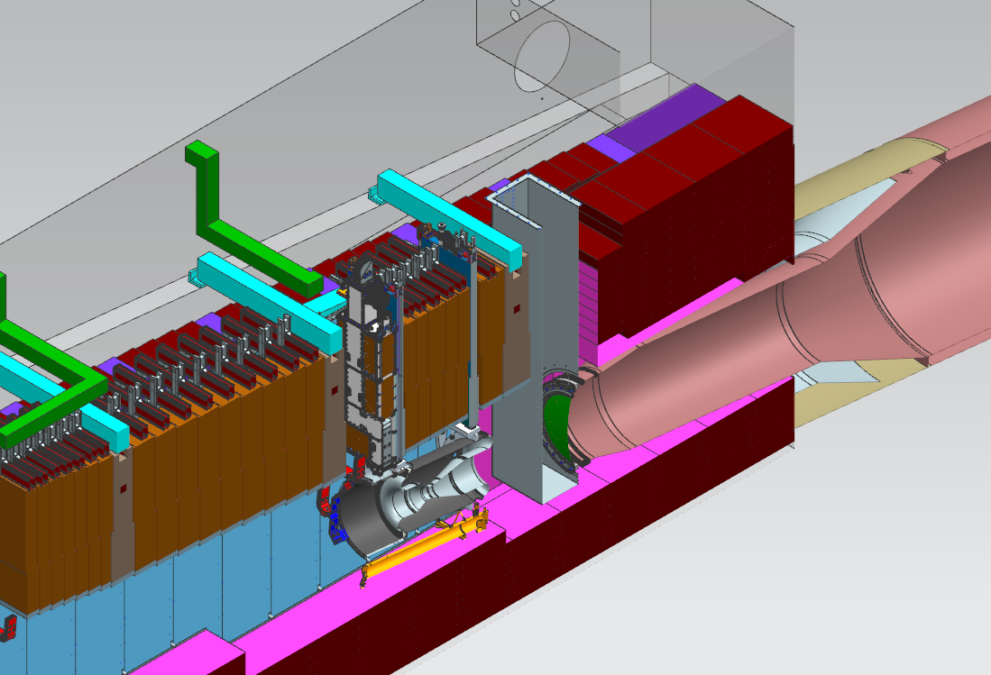
USDP Window System/Interface Overview
T Block Shielding
USDP Window
Remote Handling Chute

Slide 23
USDP Window Design Overview
Total Internal pressure against window.
Ranges from 3 to 5 psig
Bolt hole pattern diameter
70 in (1.78 m)
Bolts screw into stainless tapped holes in Decay Pipe snout and Mating Flange.
Aluminum Window Diameter:
1.5 m (~4.9 ft)
Aluminum Window Thickness:
1.5 mm (~0.06 in)
Outer Flange Diameter:
1.8 m (~5.9 ft)
Outer Flange Thickness:
75.8 mm (~3 in)
Window Weight:
81.2 kg (179 lbs)
Outer Flange
Aluminum Window

Slide 24
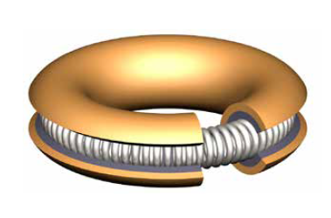
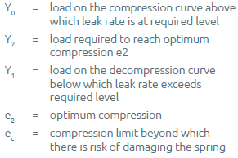
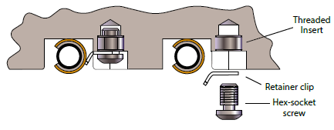
The Seal – Helicoflex Seal
Aluminum Ring Seal:
1542 lbs/in Compression Force
27.5 kg/mm
5 psi differential across seal
Total circumference = 222.61 in (5.65 m)
Total Seal Compression
343269.64 lbs (155704 kg)
w/ 80 bolts = 4290.87 lbs/bolt
Held into place with tabs installed onto window flange

Slide 25
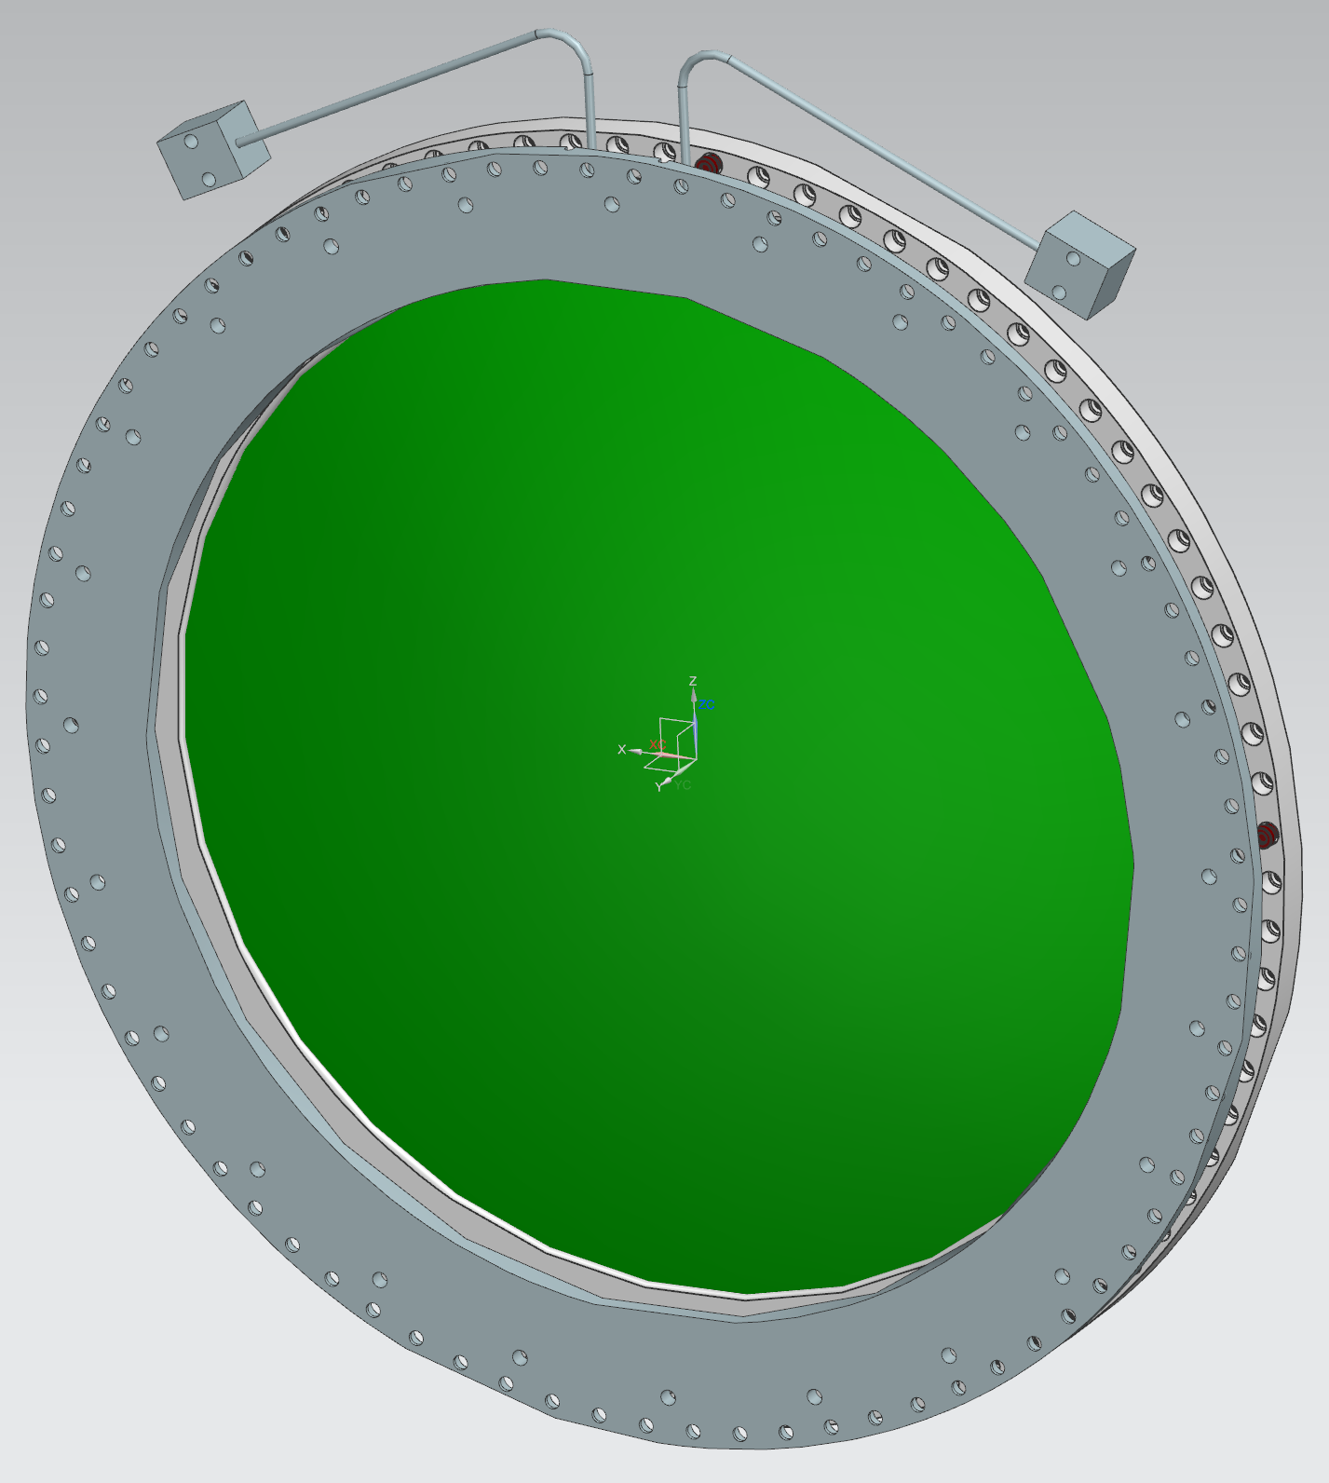
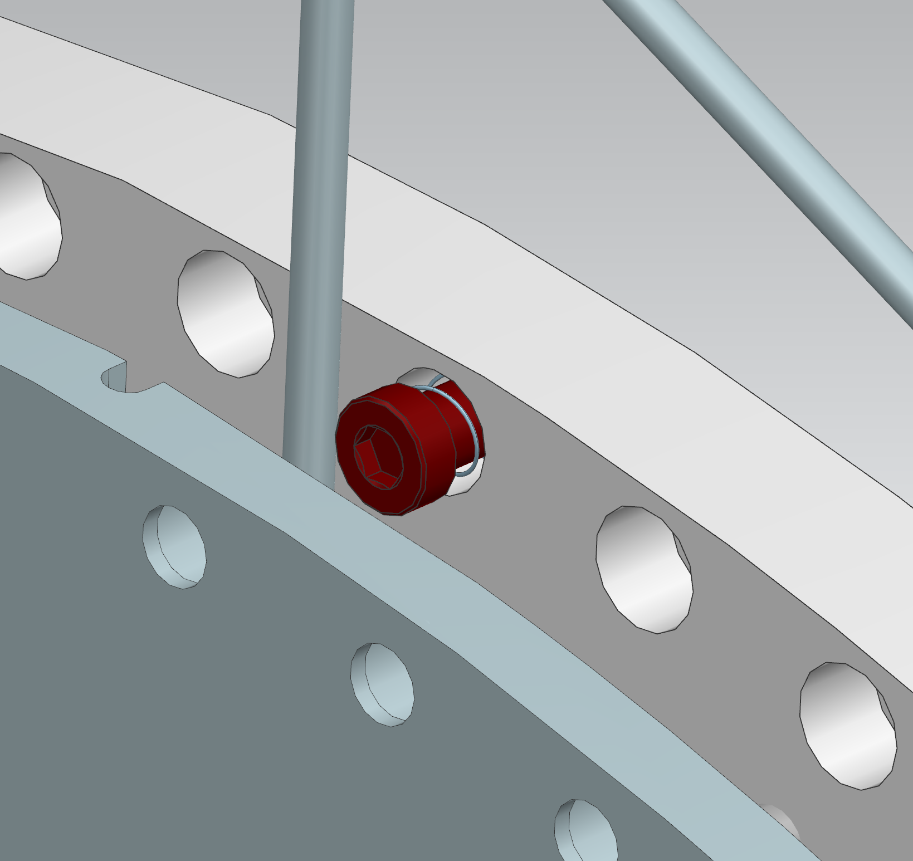
Capture Bolts
Inspired by Mu2e window
Allows for bolts to remain seated within the window
Material Information:
Grade 5 Titanium
Material is radiation hard
Higher strength than stainless
Corrosion Resistance
Stainless Steel creates galling issues and is weaker

Slide 26
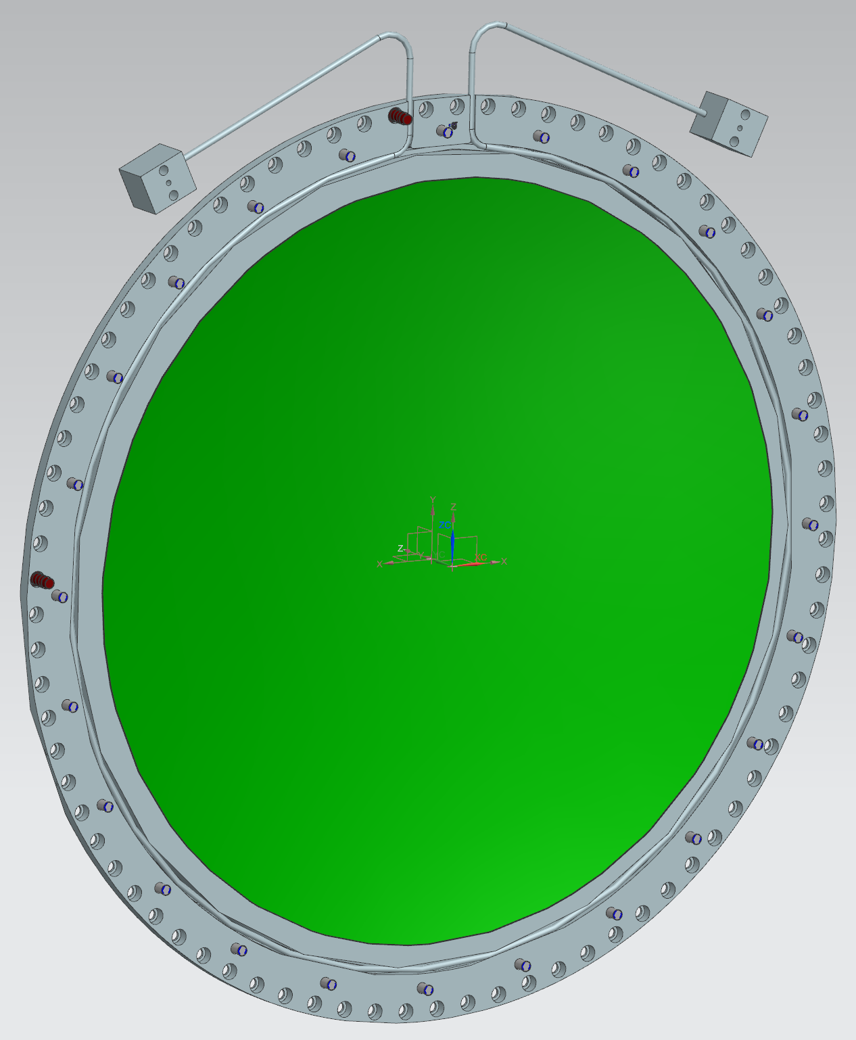
Water Line Cooling
Thermal Analysis from prior to 2017:
Need for additional cooling to decay pipe snout and flange assembly
Design currently is developed to place cooling lines in the flange of the window.
This would require the ability for remote connection and disconnection.
Excess water will be present in lines which could possibly lead to contamination during window removal.
Investigating feasibility of water cooling on flange itself.
Intake
Return

Slide 27
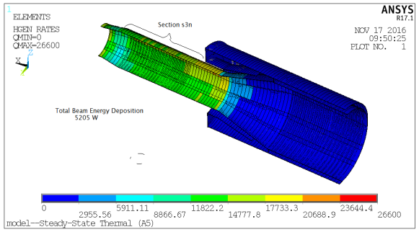
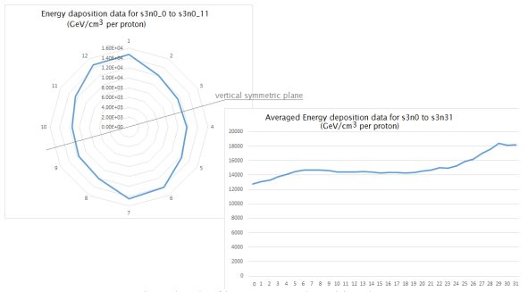
Thermal Analysis of LBNF Snout for Optimized Configuration
Thermal Analysis Results:
Total Heating (Half Model): 5205 W
Total Heating (Full): 10410 W
Maximum Temperature: 64 C (147.2 F)
Due to changes in geometry since 2016, this analysis will be reconducted to provide a more accurate representation
Thickness of Mating Flange has increased
Additional analysis will be similar to DSDP thermal and structural analysis
Will most likely result in changes to size of water lines and flow rate

Slide 28
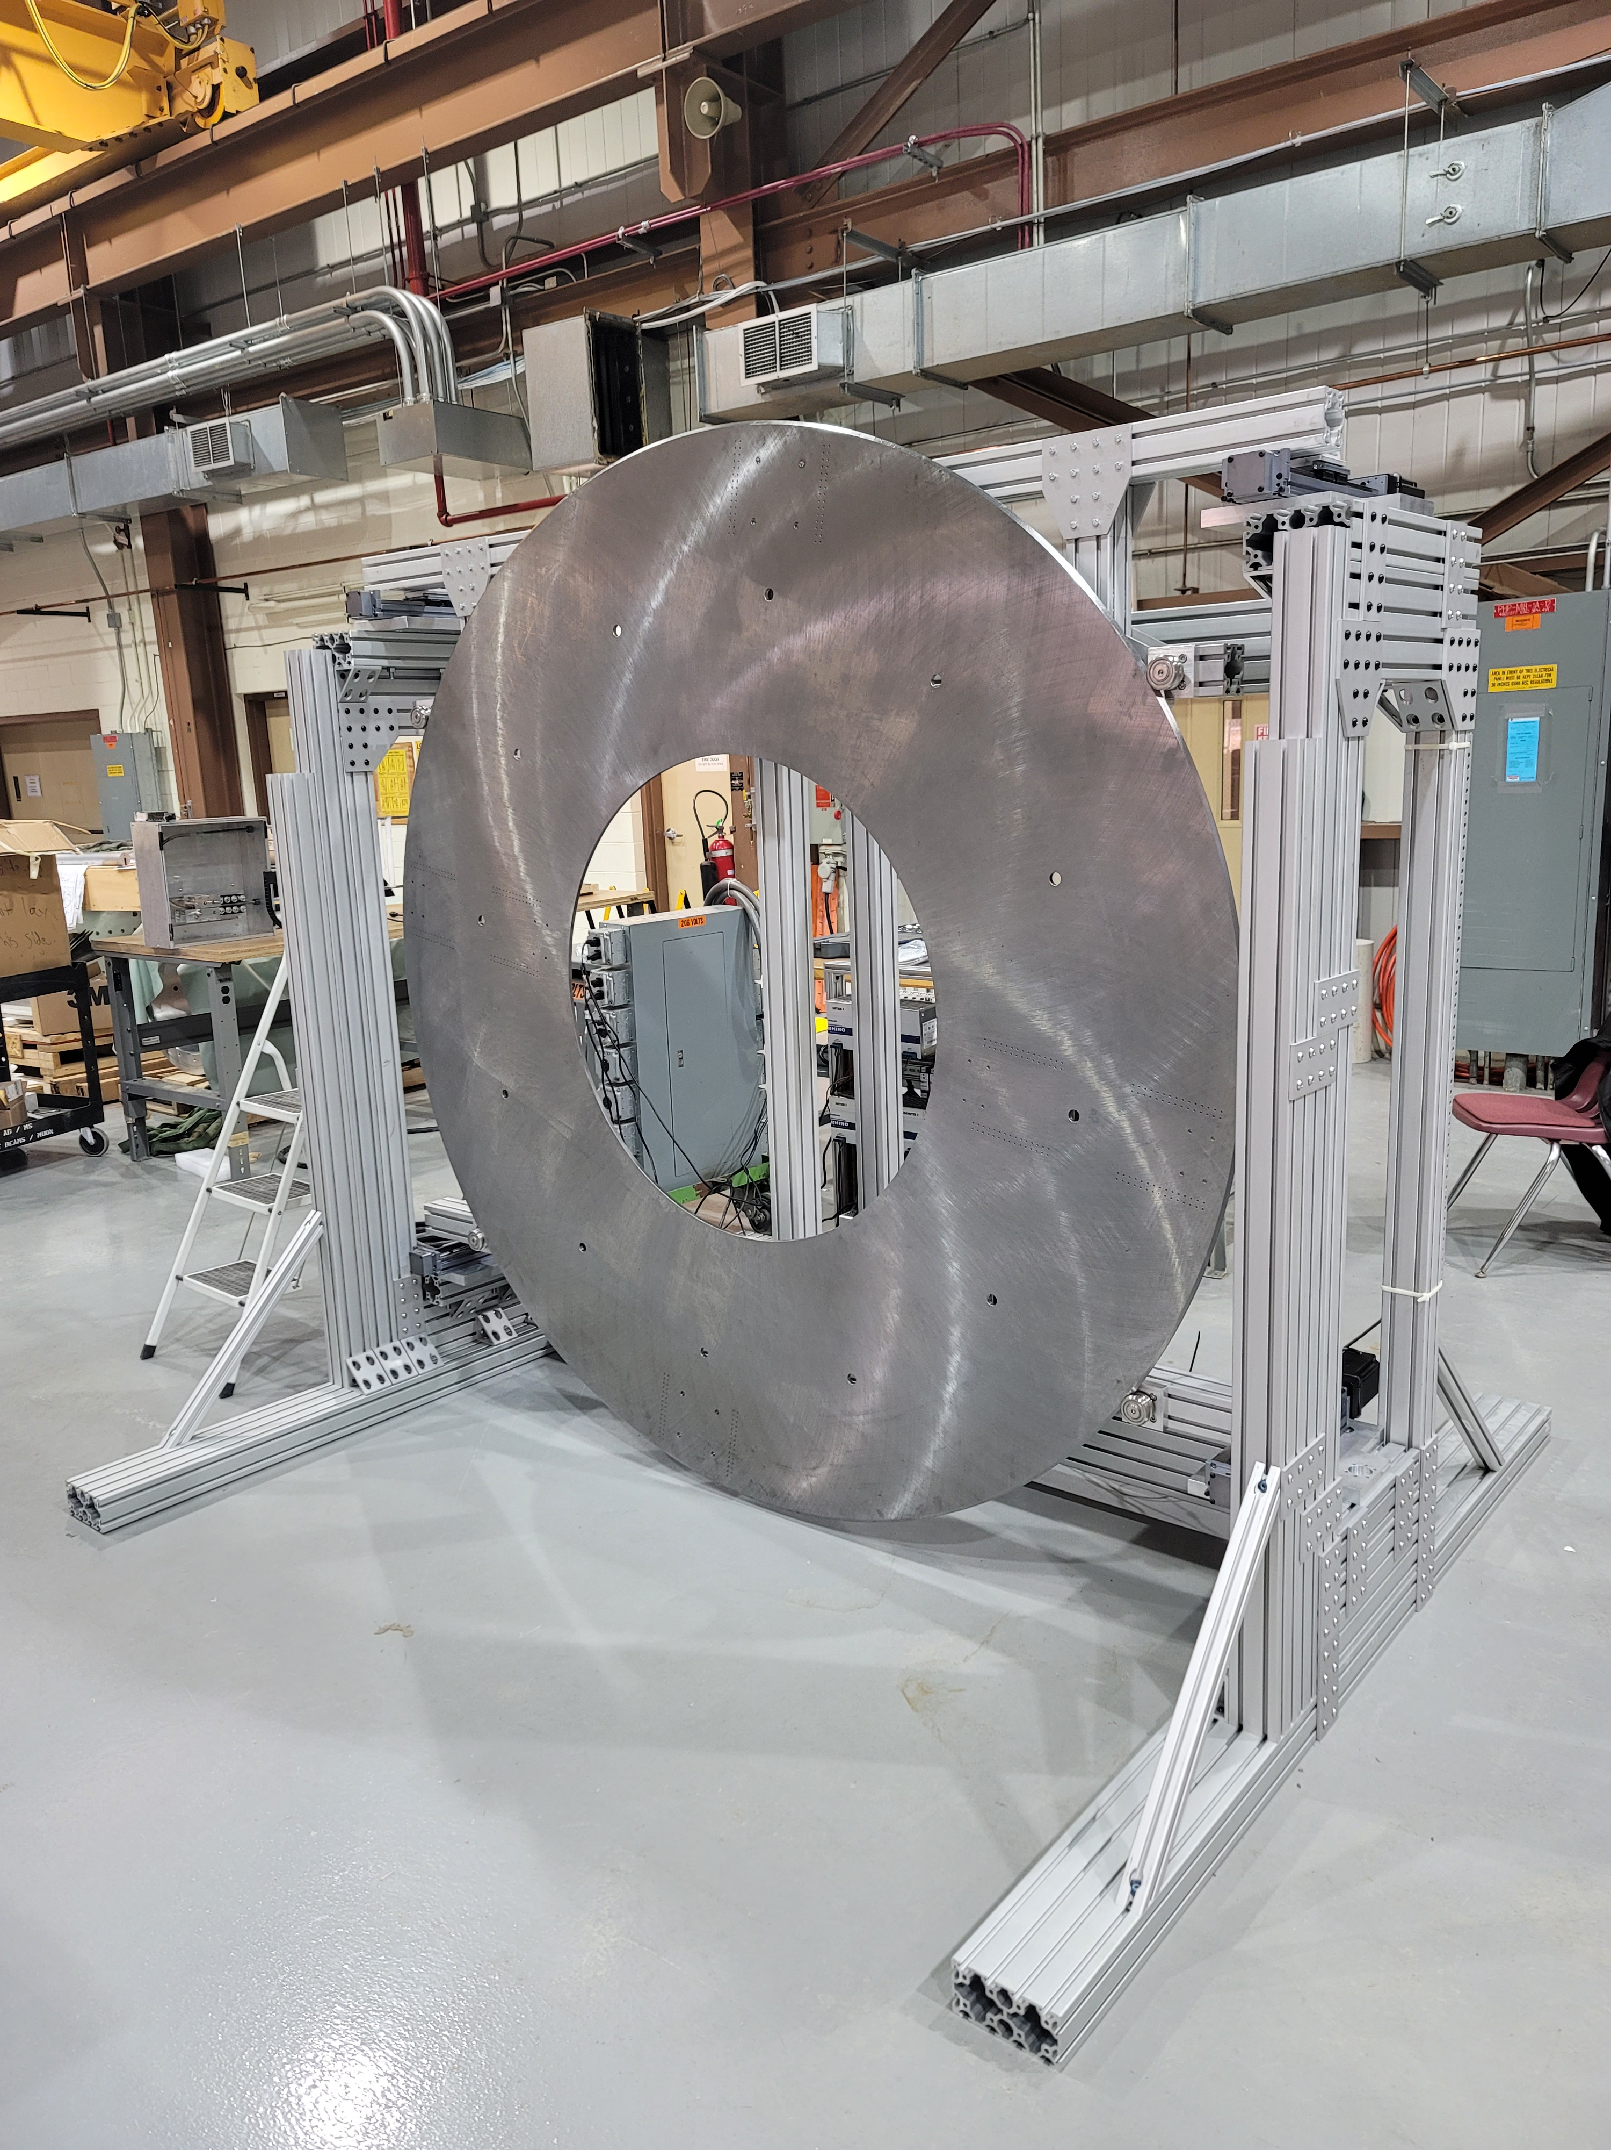
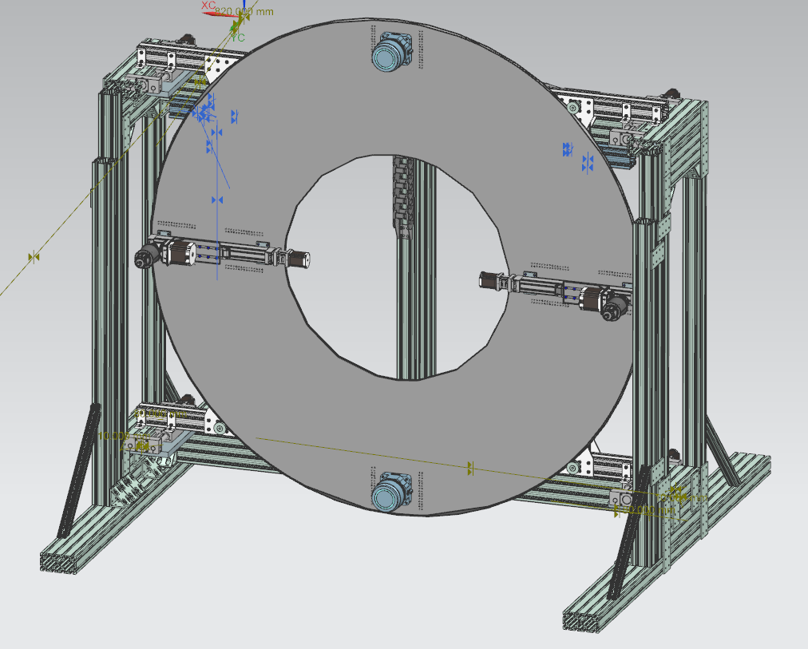
USDP Window Remote Handling System

Slide 29
USDP Window Remote Handling System
Objective: Design mechanism that is capable of accessing the Decay Pipe Window and remotely removing and replacing it in the event of seal leakage. Chamber is highly radioactive after beam on activity, so no human contact is allowable.
Parameters:
Must maintain pressurized helium in decay pipe
Be able to reach optimal seal compression on window
Fit within tight space of shaft leading into target chase
Components survive 100 hours of radiation exposure
Must be remotely operable

Slide 30
USDP Window System/Interface Overview
T Block Shielding
USDP Window
Remote Handling Chute
Limited space to operate and transport window.
2480mm x 880mm (8.1 ft x 2.9 ft)

Slide 31
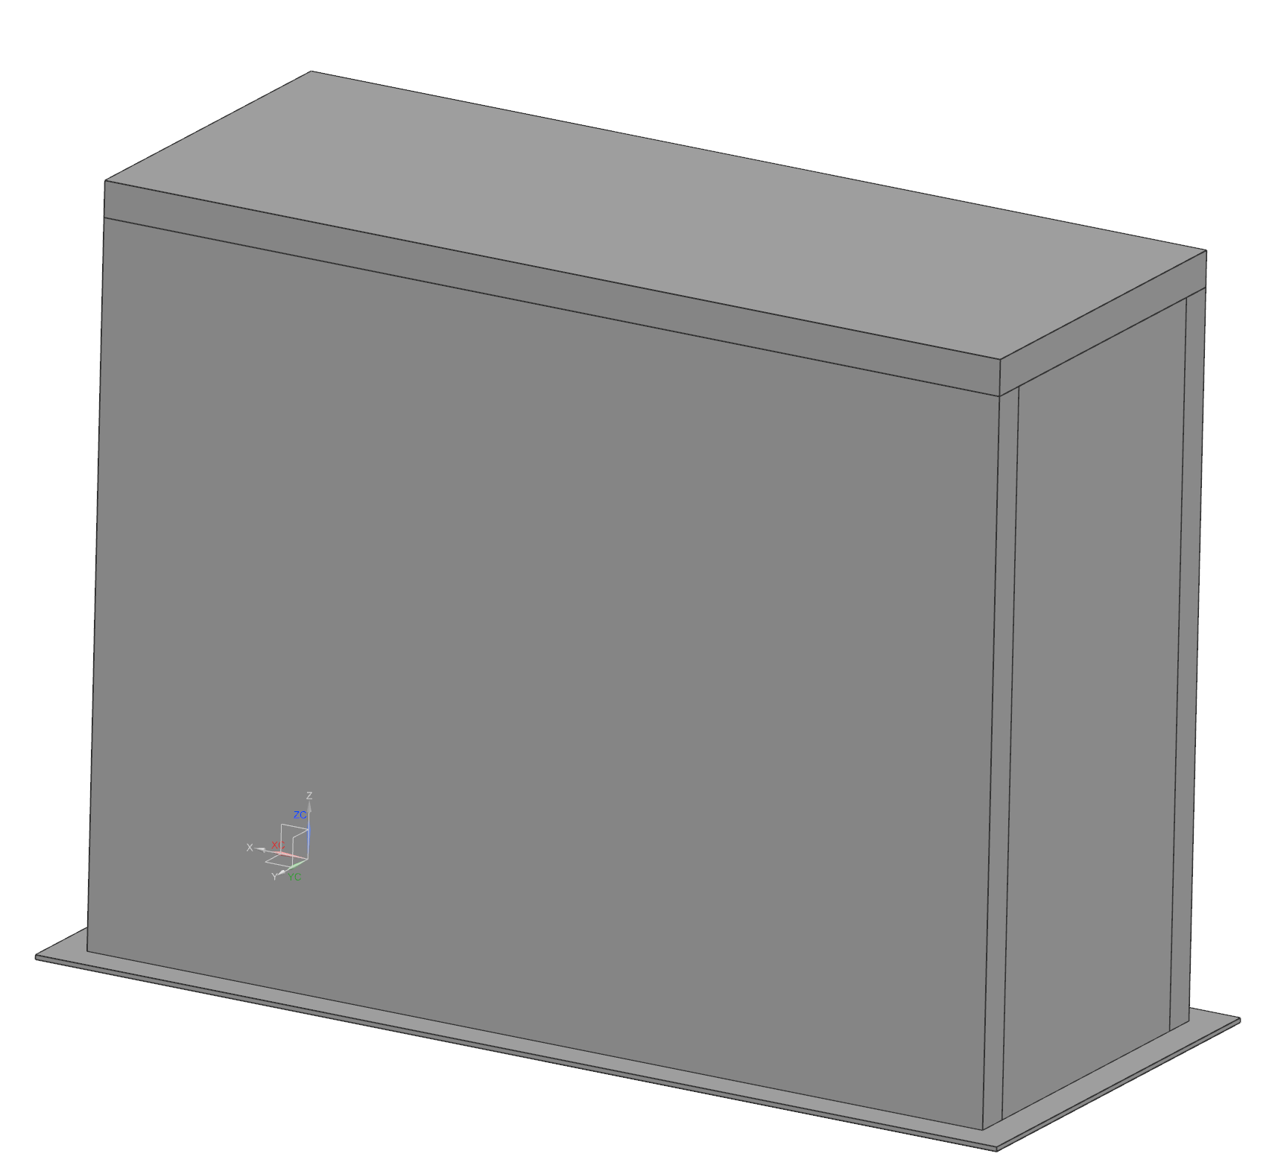
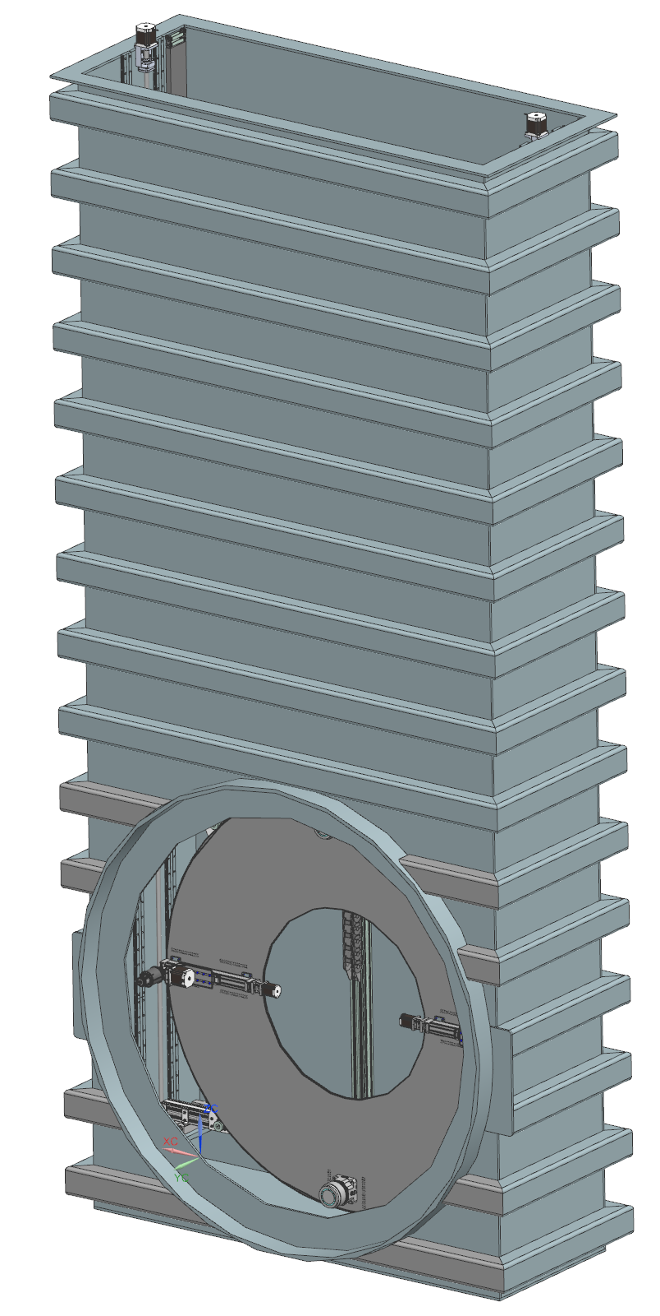
Pressure Vessel – The Chute
Designed to contain pressure of the Decay Pipe.
5psi internal pressure
Remote Handling Mechanism will ride within
Must be vacuum tight to allow for purging of atmosphere within and introduction of a Helium environment.
Disposal required for irradiated window
Vessel separated into two chambers with the “Upper Chute” acting as disposal cask
The “Lower Chute” will then function as the interface point to USDP Snout

Slide 32
Radiation Analysis
Changeout Procedure Time:
50hrs to 100hrs
Dosage within target hall:
500mSv/hr to 6000mSv/hr
Total dosage over procedure:
At 50 hours: 25Sv to 300Sv
At 100 hours: 50Sv to 600Sv
1 Sv = 100 Rad
References for Material Radiation Hardness:
CERN: Compilation of Radiation Damage Data

Slide 33
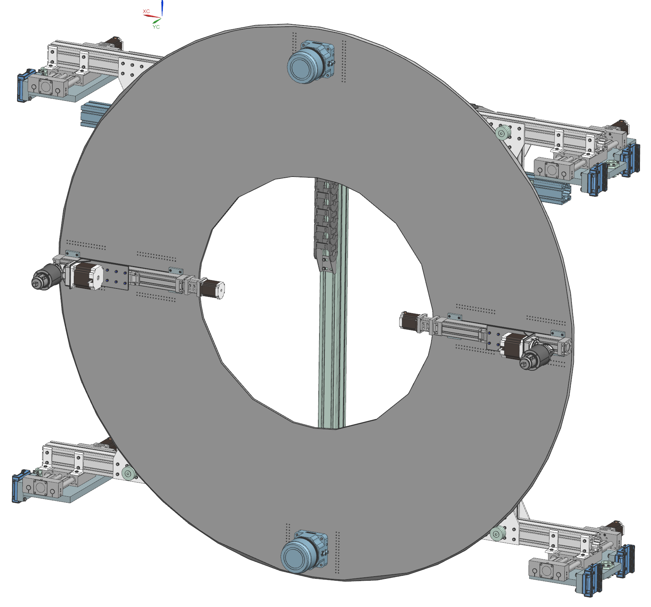
Remote Handling Design Overview
Mechanism will:
secure the chute to a mating flange and
conduct the changeout procedure within a pressurized helium environment.
Mechanism will be operated remotely from a safe area to ensure operator radiation dose is minimized.

Slide 34
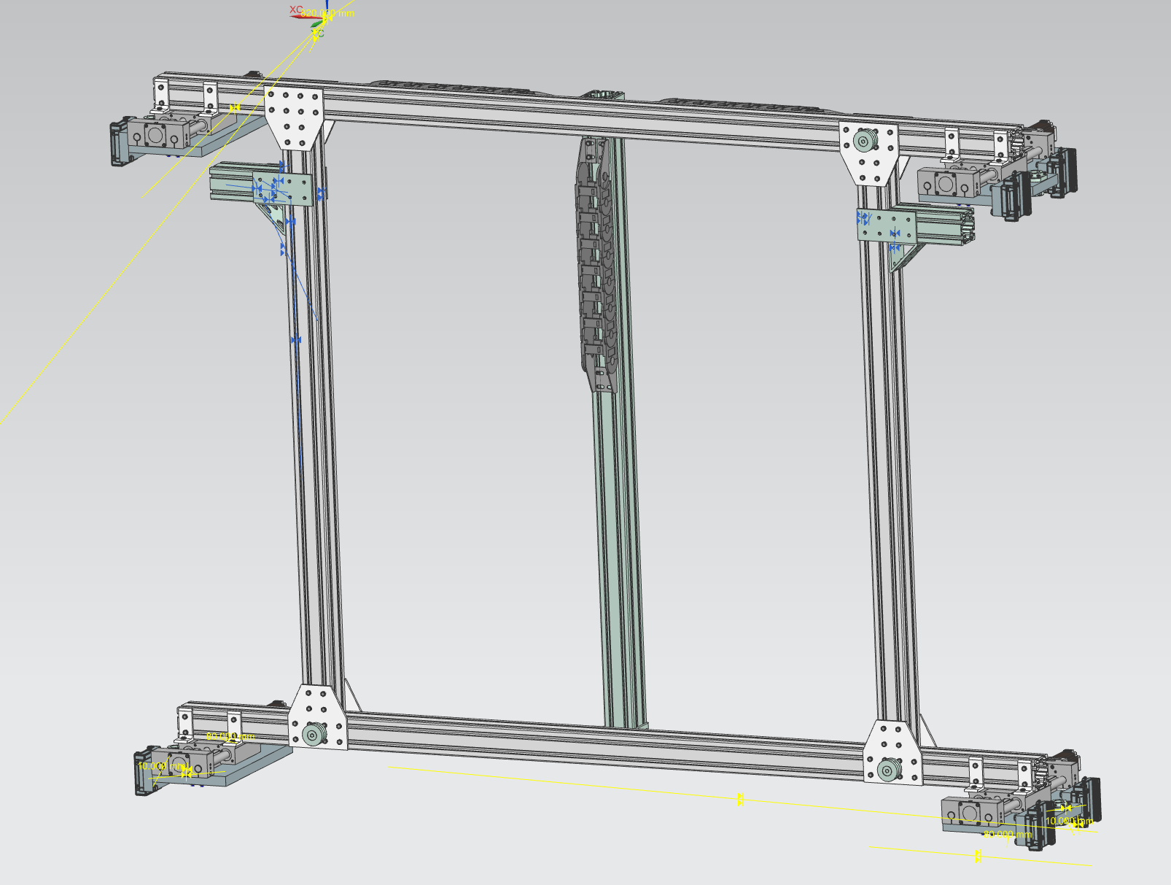
Remote Handling Design Overview
The frame of the mechanism will be 80/20 to enable ease of mounting of all components.
Disk will rotate on 4 high capacity bearings to position components.
Linear actuators mounted on disk will change the radial position of the bolting gearboxes.
4 Linear actuators positioned at the 4 corners of the mechanism will control the position along the target chase
Magnetic Grippers will attach to the window for transport

Slide 35
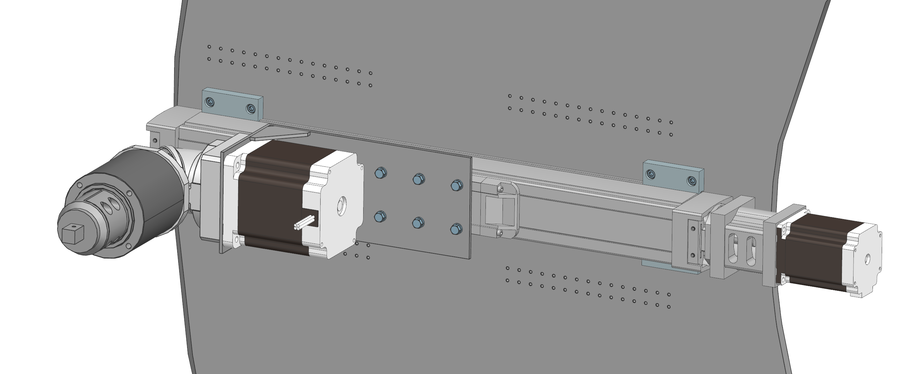
Bolting Mechanism Design Overview

Slide 36
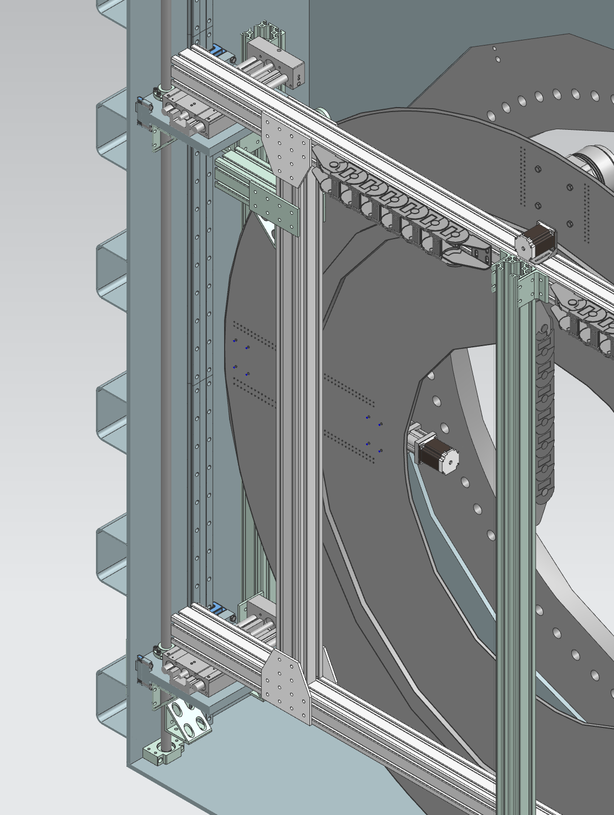
Remote Handling Vertical Motion
Initial vertical motion design consisted of a ball screw in tension spanning the length of the Lower Chute and carriage rails
Problem arises due to the need for upper and lower chute to be seperable
Redesign being considered and researched:
Rack and Pinion system
Allows for separation at the interface between Upper and Lower Chute

Slide 37
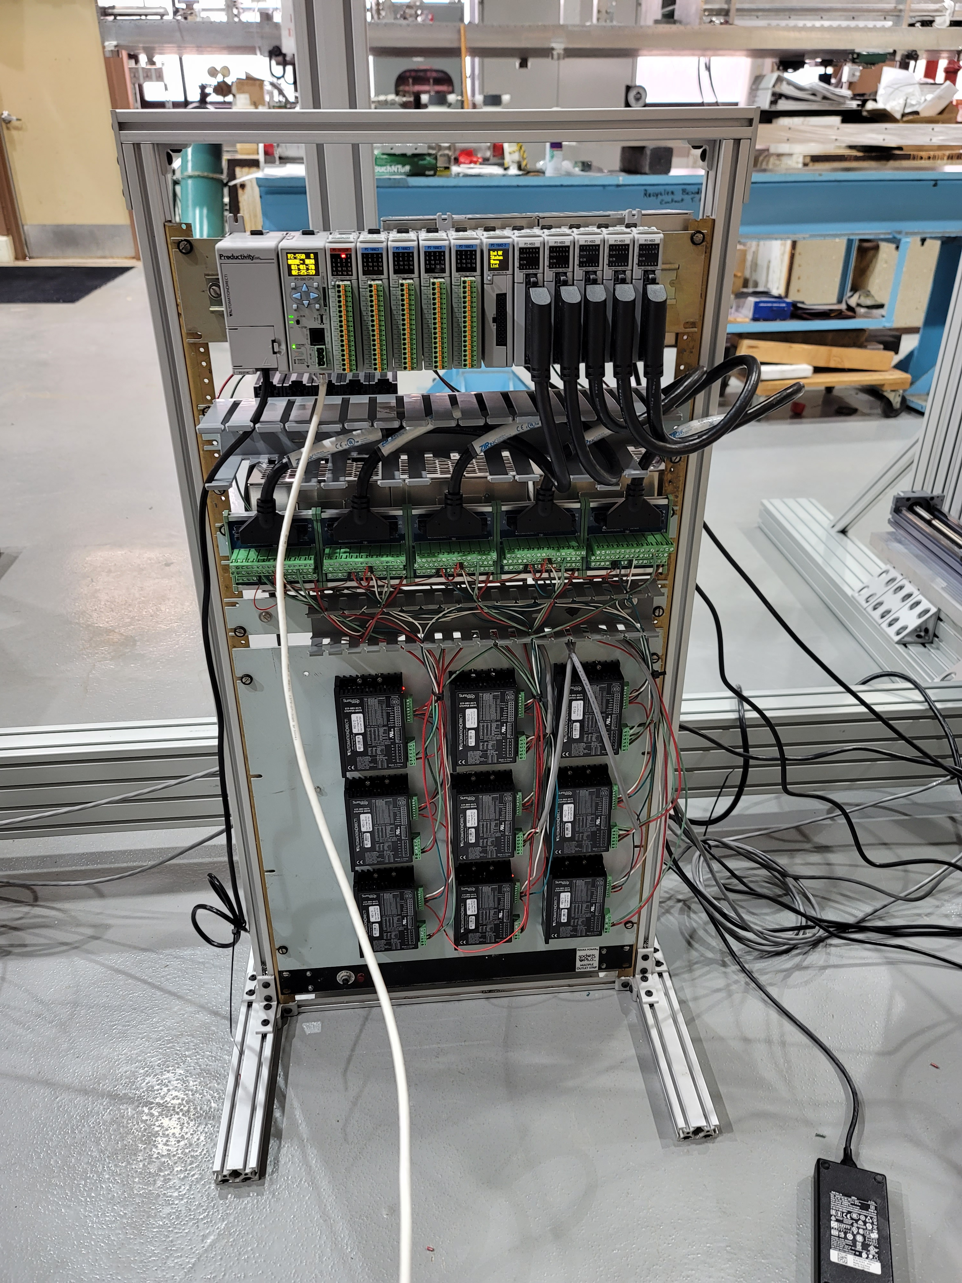
Prototyping and Controls of Remote Handling Mechanism
Prototyping of “The Donut” is underway at Fermilab’s MI-8 facility
Productivity Suite PLC systems used for controls of stepper motors
Prototype Testing Goals:
Motion along beamline
Rotation of component disk
Adjustment of bolting diameter
Interfacing with bolt pattern test fabrication to simulate bolting procedure

Slide 38
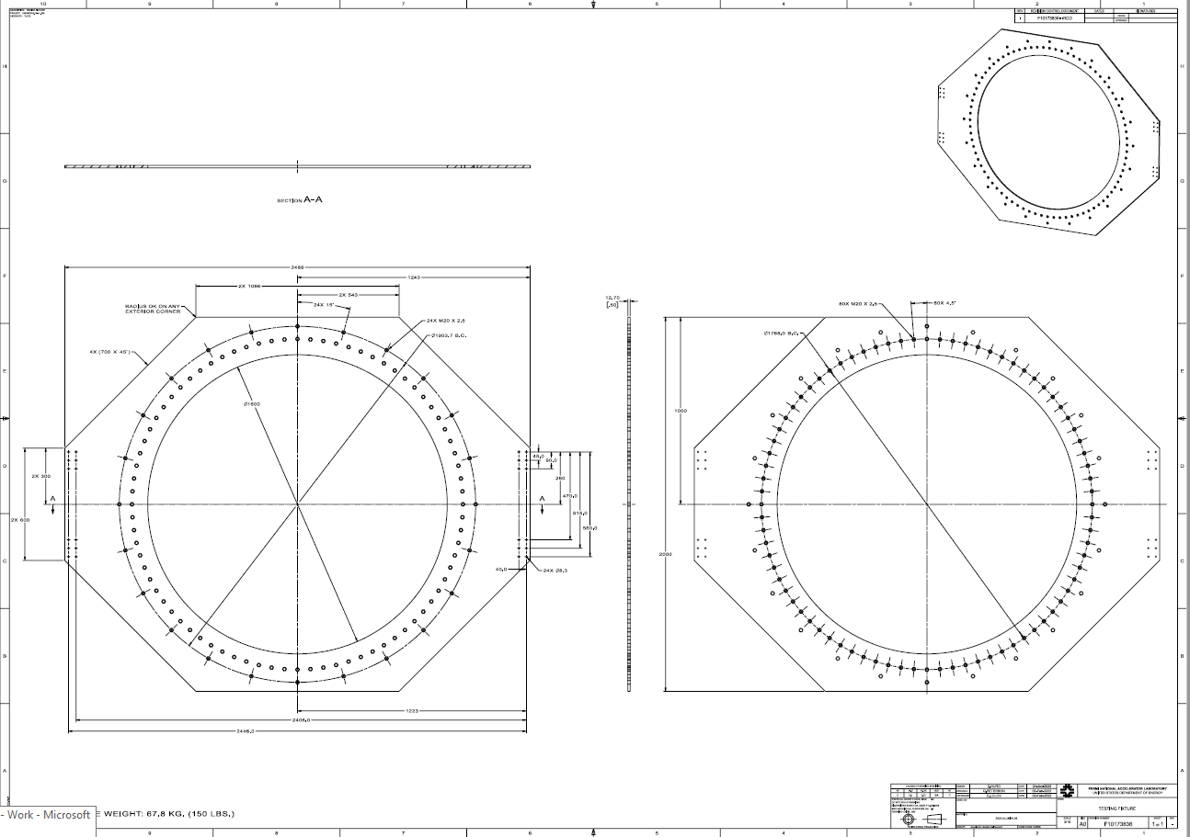
Testing Fixture
Testing Fixture design completed at the end of January
Fixture will attach to the front of the Test Stand and bolt directly onto 8020 frame.

Slide 39
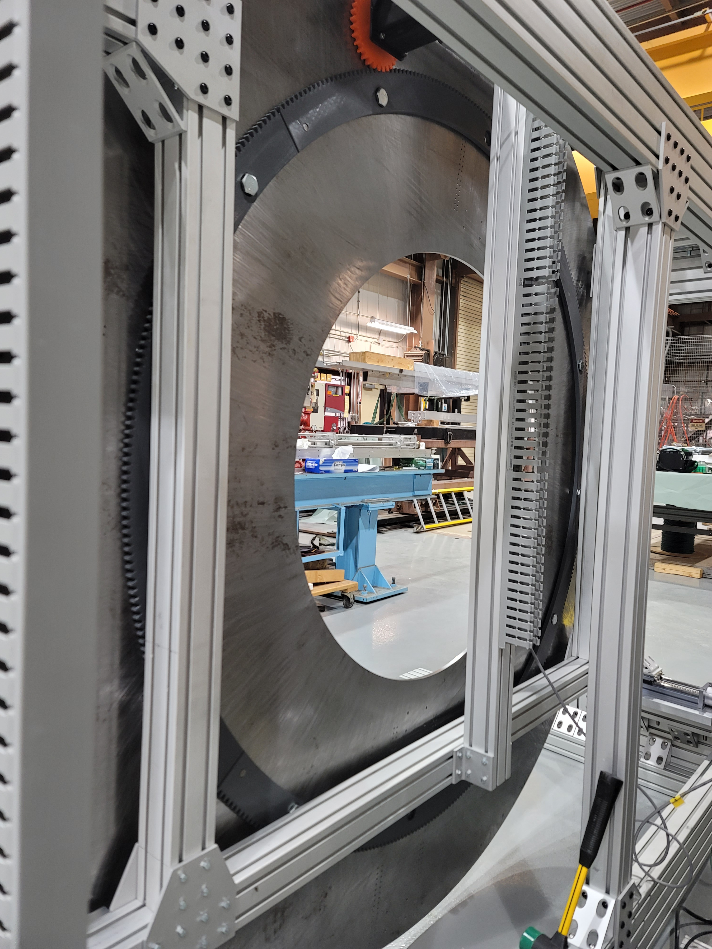
Prototype Testing: Disk Rotation
Discovered a warp in the disk causing the distance between pinion and ring gear to drift by a half inch throughout complete rotation
Warp causing disk to not spin as freely on bearings causing motor to not be able to compensate for additional torque required
When manually turning pinion, ring gear and pinion were able to turn the disk without the plastic breaking

Slide 40
Conclusion
Primary Beam Window and Cartridge Assembly has been developed and undergone final design. Prototyped assembly currently being developed.
Downstream Decay Pipe Window (DSDP Window) geometries confirmed by AECOM and analysis indicates no deficiencies
Upstream Decay Pipe Window (USDP Window) design continuing to be developed with
USDP Window Remote Handling System design and component research continuing. Problems discovered during prototyping being investigated.

Slide 41
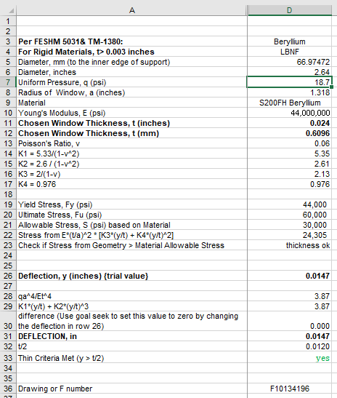
Q2a: Does the window meet the FESHM safety requirements?
FESHM 5033.1 applies to thin vacuum windows
Key Engineering Note Calculation shown at right:
EN04530 in Teamcenter has these calculations as required by 5033.1
Note Uniform pressure includes additional pressure from N2 in target chase.
5033.1 Required Thermal analysis performed and documented in DUNE docdb 20503
This meets FESHM 5033.1

Slide 42
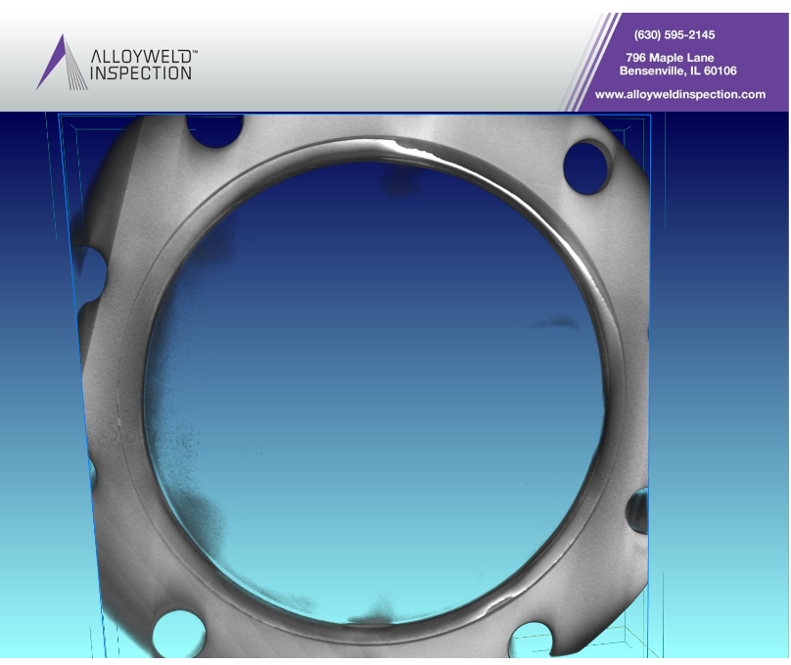
Q2b: Have all ESH and Quality issues been identified and planned for?
Building Primary beam vacuum windows is well established.
Window data base includes approximately 76 windows
All existing drawings studied as part of this design effort.
LBNF window process based on NuMI / NOvA / ANU windows.
QA plan includes CT scans of a completed window
This has become a standard practice.
Included in cost and schedule
CT scan results for a titanium vacuum window brazed to a stainless steel conflat made by Omley Industries showing defects in the braze. Window size similar to the LBNF window.

Slide 43
Q3: Does the window meet the beam aperture requirements for both normal operations and beam scans?
Yes.
Beam Scanning requirements are why this window is physically larger than the NuMI / ANU window.
In addition, provisions for a beryllium catcher screen were added to the beam pipe following the discussion in September
Item 5 in assembly F10136776
Not explicitly required by FESHM or other source.

Slide 44
Q4:Does a viable plan exist for replacing the window in accordance with ALARA principles?
LBNF window will be replaced using a plan very similar to that used in MI-65.
Beam pipe and window are extracted into the primary beam enclosure and into a shielding cask, allowing worker to be in a relatively benign environment.
Design of the cask and cask transport equipment occurs later in the project and are not included in this design review.
LBNF cartridge installation will be similar to the sleeve installation performed at NuMI circa 2003-2004.
Installing the cartridge and primary beam window occurs in approximately 4 to 5 years (2025) and the procedure for these tasks are not included in this design review.

Slide 45
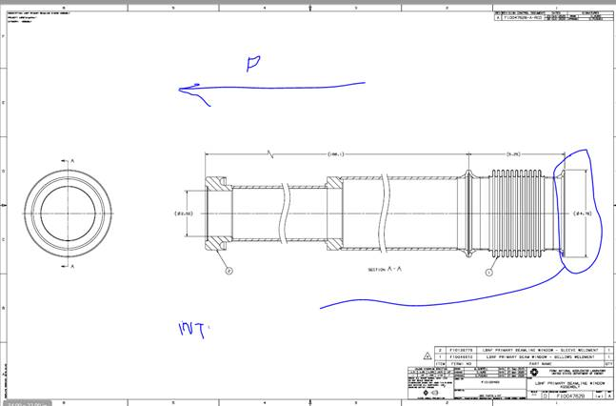
Q5: Are the interfaces identified and documented appropriately??
Interfaces to CF and primary beam identified.
F10128502 is the assembly model file.
Image on the right show the interfaces between the primary beam window assembly and the primary beam elements.
Flange at end of F10047628 is the agreed to interface point.

Slide 46
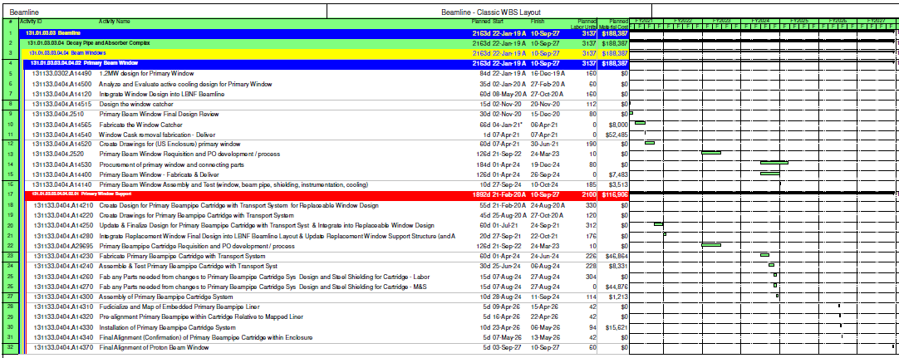
Q6a: Is the final cost and schedule reasonable? Q6b: Are procurements well planned?
Excerpt from Schedule shown below and PDF in docdb 20825.
Note ample float.

Slide 47
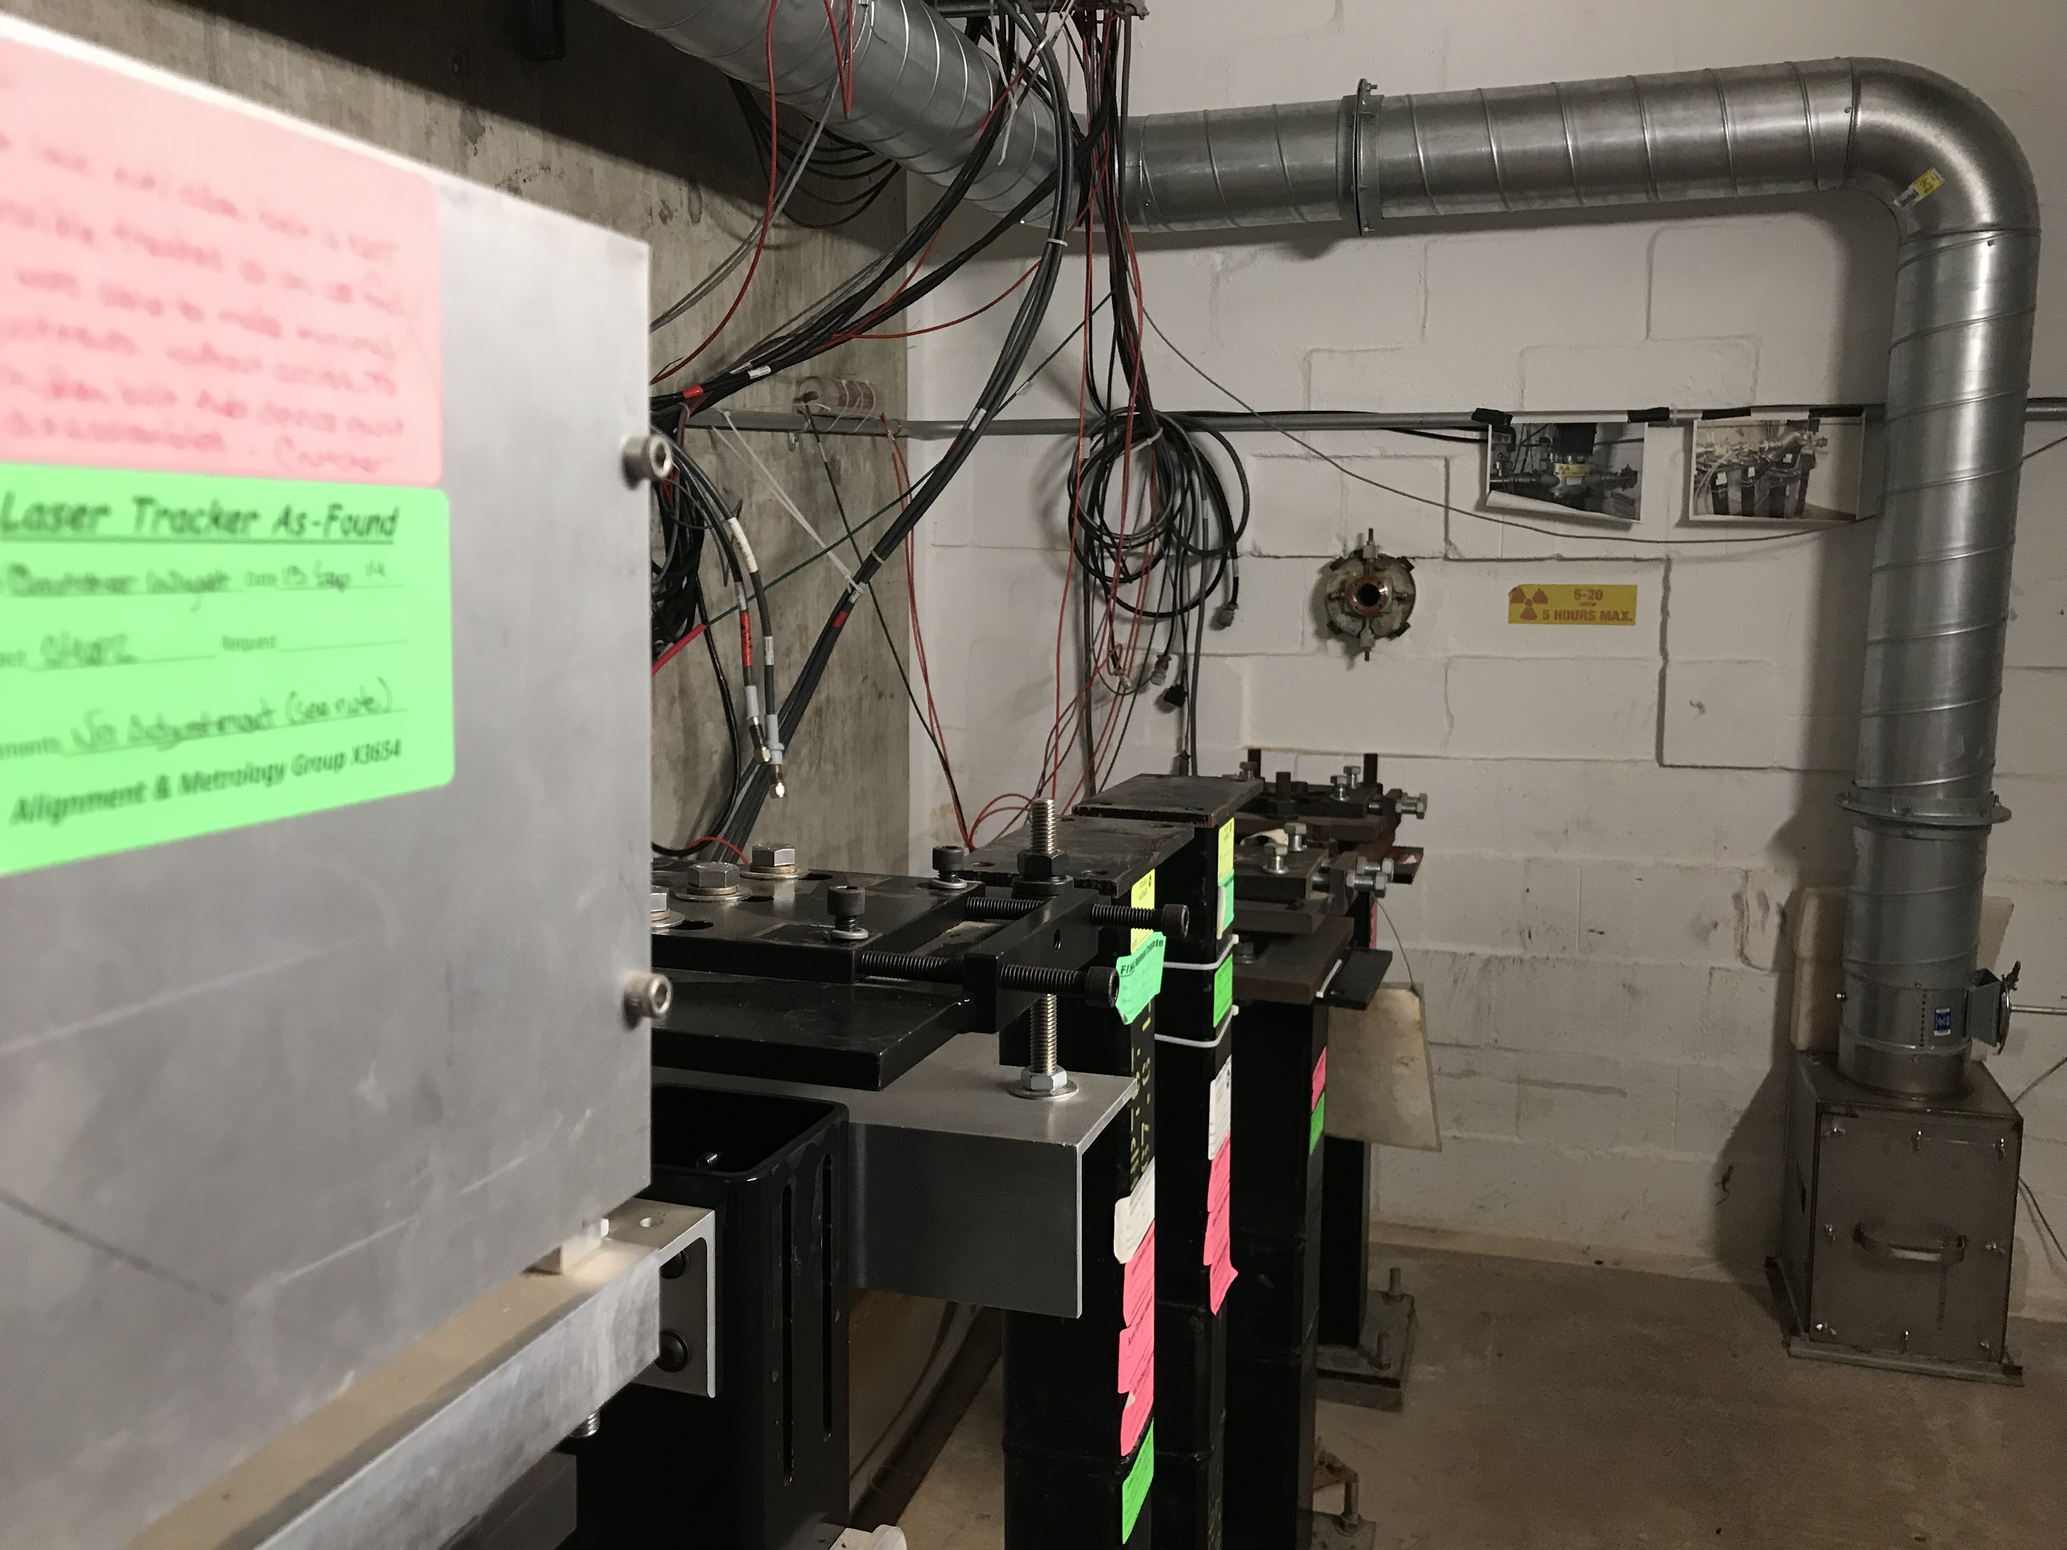
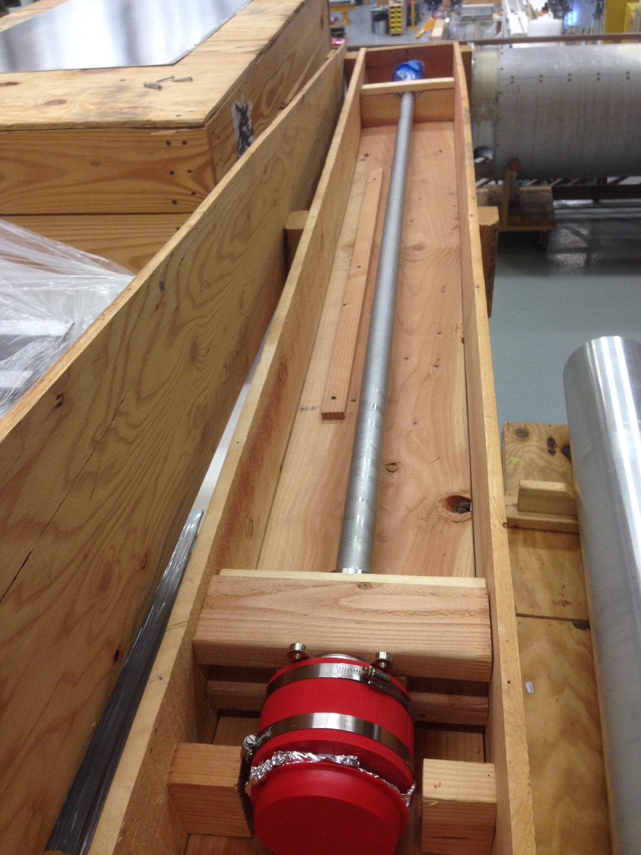
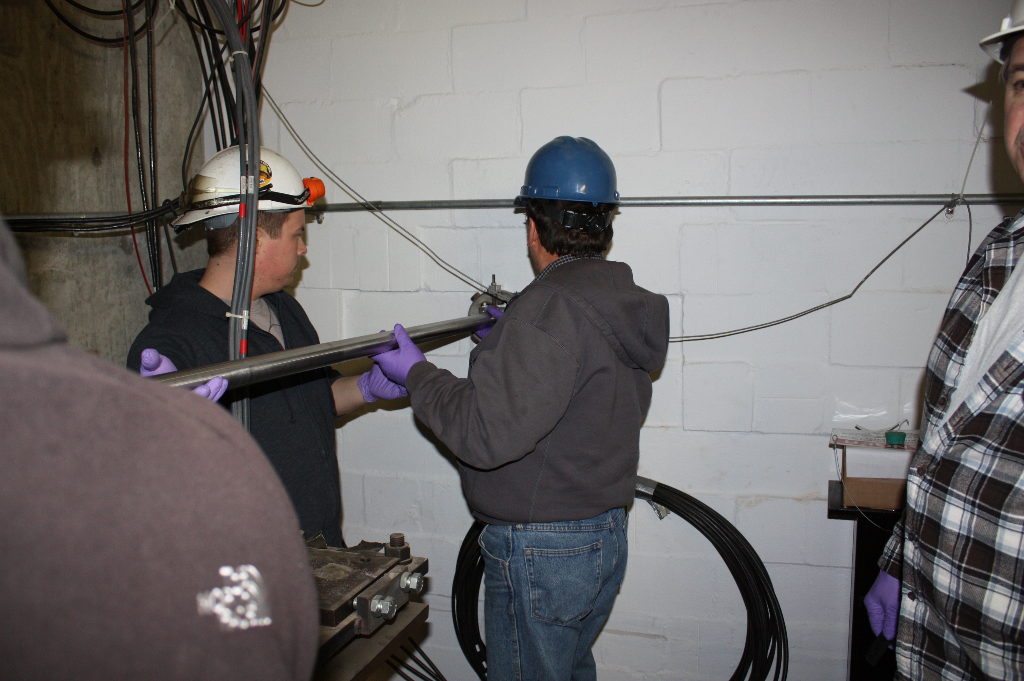
Q7a: Is the installation thought out and planned for? Q7b: Potential problems identified?
Yes, the installation has been thought out and planned for
The plan mirrors plans previously successfully used in MI-65
Generous provisions provided for cartridge installation grouting will accommodate greater than expected CF placement errors.
IMPACT tool use will be required prior to performing this work many, many months from now.
Potential problems are considered again using this tool.
HA for NuMI window change at https://ad.fnal.gov/cgi-bin/admin/haForm.pl?haID=1590 is a starting point.

Slide 48
Q8: Are the documents (requirements, specifications, schematics, engineering notes, procedures, and drawings) at the appropriate level for a final design?
Drawing are released in TC
Stand Alone Specifications are not needed (key specification are embedded in the drawings & QA plan.)

Slide 49
The end

Slide 50
Back-up material on a Beryllium Catcher:
A “beryllium catcher” is a second window, located on the beam line side of a primary beam exit window, designed to limit the propagation of beryllium chards into the beamline in the event of a failure of a beryllium window.
There is no requirement for a beryllium catcher in FESHM.
One was installed in NuMI because it was thought to be a good idea.
A beryllium primary beam exit window failed in the MI abort when someone poked at it with a tool.
Very thin beryllium windows in a vacuum vessel in MTA were exposed to high differential (well above the design) when the vessel was pressurized causing a titanium window to fail. This is a very different situation from a primary beam exit window.
A catcher window sees beam heating, but has little effective cooling (it is in a vacuum).
The NuMI catcher has openings around the perimeter to allow the downstream vacuum to be evacuated.
The LBNF design includes provision for a screen to serve as a catcher, while allowing more effective conductance for evacuation.
The laboratory requirements for a catcher need to be better defined and the pros and cons associated with a catcher need to be investigated and documented.

Slide 51
Decay Pipe Downstream Window Analysis Under 2.5 MW

Slide 52
Decay Pipe Downstream Window Analysis Under 2.5 MW

Slide 53
Decay Pipe Downstream Window Analysis Under 2.5 MW

Slide 54
Decay Pipe Downstream Window Analysis Under 2.5 MW

Slide 55
Decay Pipe Downstream Window Analysis Under 2.5 MW

Slide 56
Decay Pipe Downstream Window Analysis Under 2.5 MW

Slide 57
Decay Pipe Downstream Window Analysis Under 2.5 MW

Slide 58
High Capacity Bearings
Hepco Motion Bearing:
28 mm Diameter
Max Load 8000 N
Weight of Disk, Components, and Window:
400 kg or 3922.66 N

Slide 59
EMH 114-B Magnetic Gripper
Max Vertical Payload:
70lbs
Allows for handling of the window during changeout procedure.
Will magnetize to tabs attached to the sides of the window.
In the plots below, “s” is the distance of the magnet to the material, and “T” is the thickness of the material.

Slide 60
Ring Gearing Prototyping
Gear Parameters:
OD: 1700mm
ID: 1550mm
Number of Teeth: 400
Pitch Diameter: 66.6
Diametral Pitch: 6
Pressure Angle: 20 Degrees
4 Pieces
Total Print Time: 72 Hours
Pieces will be pinned together by dowels

Slide 61
Pinion Prototyping
Gear Parameters:
OD: 68mm
Number of Teeth: 30
Pitch Diameter: 5
Diametral Pitch: 6
Pressure Angle: 20 Degrees
1 Piece
Total Print Time: 24 Hours

Slide 62
Window Change Phases

Slide 63
Window Change Phase 0 (Beam On)
During beam on, T block shielding is installed over the beamline and the chute is stored elsewhere
The chute and window storage box will be held in storage area until a changeout procedure is necessary.

Slide 64
Window Change Phase 1
In the event of unacceptably high helium leakage, this mechanism will be used to replace the window.
A cooldown period of 7 days or more is held before procedure begins.
Shielding is removed over the upstream decay pipe window and the chute is lowered into the target chase.

Slide 65
Window Change Phase 2
Once the chute is in place, the window storage box will be placed over the chute to seal the interior.

Slide 66
Window Change Phase 3
The bolting mechanism will then move to the window and fasten the chute to the decay pipe mating flange.

Slide 67
Window Change Phase 4
After the chute is secured, the chamber will then be pressurized to match the internal pressure of the decay pipe.

Slide 68
Window Change Phase 5
Once the chute has been pressurized, the window can then be removed.
The bolting gearboxes are then repositioned to access the bolt pattern of the window.

Slide 69
Window Change Phase 6
Once the bolting gearboxes are in the correct position, the window is then unbolted from its housing.
Each gearbox will unbolt 40 bolts around the window before operation is complete.

Slide 70
Window Change Phase 7
Once all bolts have been removed, the window will be retrieved with the magnetic gripping system.

Slide 71
Window Change Phase 8
Once the window is obtained, the mechanism will then raise to the top of the chute.

Slide 72
Window Change Phase 9
The window storage box will then lower its cradle so that the bolting mechanism can deposit the damaged window.
The storage box will then raise the damaged window into itself to await removal.

Slide 73
Window Change Phase 10
Now that the damaged window has been stored, the bolting mechanism will move to retrieve the replacement window stored within the chute.
Once the mechanism is in place, the magnetic grippers will activate to retrieve the new window.

Slide 74
Window Change Phase 11
The new window will then be lowered into the chute and placed into the window housing.
The tabs on the side of the window will be used to position the window with the housing to insure the bolt patterns align.

Slide 75
Window Change Phase 12
Now that the window is seated within the housing, the mechanism will proceed with the bolting procedure.

Slide 76
Window Change Phase 13
With the new window secured to the decay pipe, air will be reintroduced into the chute to purge the helium within the chamber.
Before the chute is detached, a sniffer test will be conducted to check the new seal around the window.
With the chamber depressurized, the chute can then be detached from the decay pipe and the window storage box removed.

Slide 77
Window Change Phase 14
The window storage box will be removed first and brought and put into storage to await removal of the damaged window.

Slide 78
Window Change Phase 15
To detach the chute from the decay pipe, the mechanism will adjust its bolting gearboxes to reach the bolt pattern of the chute.
After aligning with the chute bolt pattern, the mechanism will proceed with unbolting.

Slide 79
Window Change Phase 16
Now that the chute is detached, the mechanism will rise and the chute will be retrieved and shielding put back into place.

