Slide 1
NUMI Absorber Operation Experience and LBNF Absorber Mechanical Design
Abhishek Deshpande and Vladimir Sidorov
NBI 2022
September 19-22, 2022

Slide 2
Overview
1. NUMI absorber operation experience
2. LBNF Absorber mechanical design
3. Absorber core
4. Absorber Core blocks
5. Absorber core modules assembly
8. Absorber Steel shielding
9. Hadron Alignment Detector System
10. HADES Retractive system
11. HADES and Core blocks Remote Handling
12. Energy deposition, temperatures, and stresses in the core
10. Absorber core cooling system
11. Steel shielding air cooling
12. Beam interlock hardware system
13. Absorber core thermocouple layout
14. Radiological protection
15. Core block prototyping and weld samples
16. LBNF Absorber Status.

Slide 3
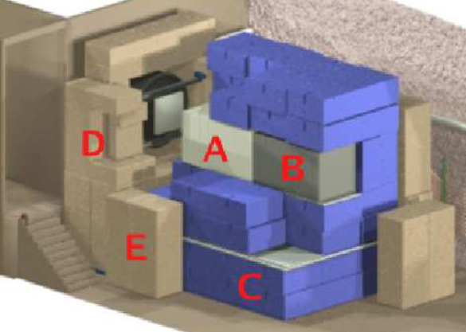
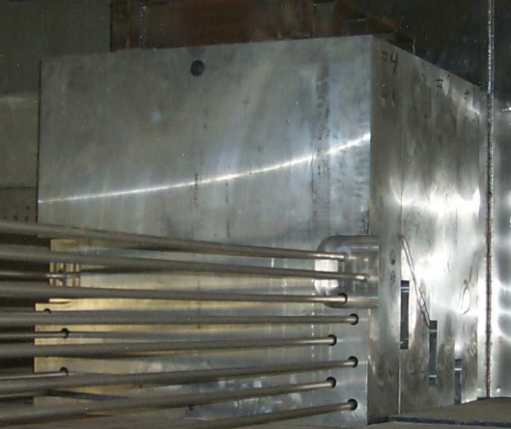
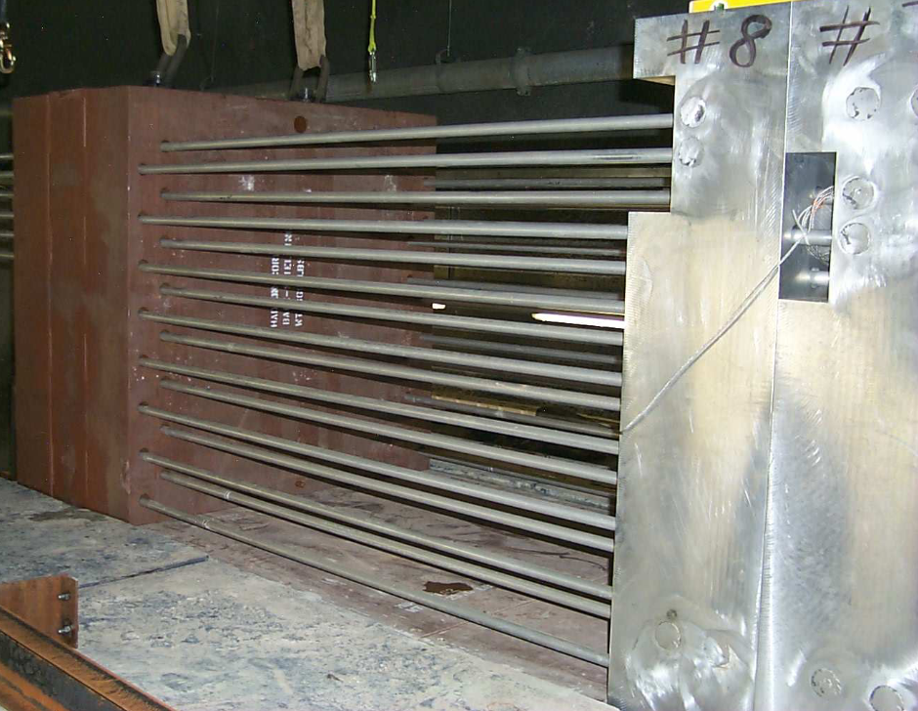
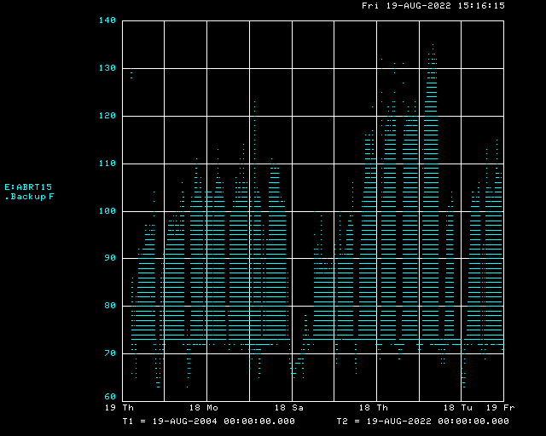
NuMI Absorber operation experience
Jim Hylen
Absorbs the leftover hadronic and E.M. radiation at the end of the NuMI decay vessel. Protects surroundings from prompt and residual radiation. During normal operation, about 1/6 of beam power is deposited in the absorber
Water-cooled Aluminum core
Steel core
“Blue Block” steel shielding
Access door to Hadron Monitor
Concrete shielding
Aluminum core is assembled from 8 12” x 51” x51” blocks
Each block has two independent gun-drilled internal water loops, welded to aluminum piping extending out the back
Steel core is assembled from 10 9.1” x 51” x51” blocks.Steel blocks have holes to let aluminum core cooling pipes through
18 year plot of temperature at shower max.
During 18 years of operation, NuMI has accumulated 3 MW-yr of integrated beam power. No known problems with absorber over that period.
In particular : No water leaks
All four thermocouples still working
NuMI has 2 thermocouples
centered at shower max (block 3)
and 2 thermocouples centered on block 8.
(blocks 4,5,6 etc. not shown)

Slide 4
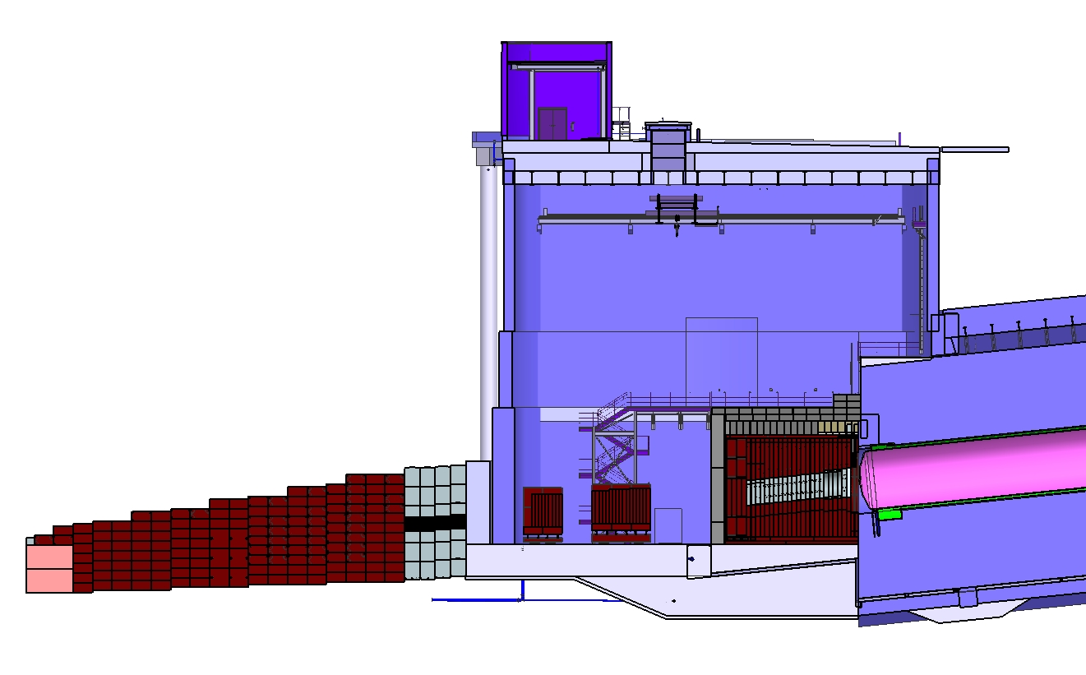
LBNF Absorber mechanical design
Surface
Hatch
Absorber
Service
Building
Located directly downstream of the decay pipe –made up of actively cooled Aluminum and Steel blocks surrounded by concrete.
Provides radiation protection to people and keeps soil/groundwater activation levels to below allowable limits.
Designed for the worst case condition at 2.4 MW operation:
    Decay distance is 221m from MCZero9Target) to end of decay vessel.
    Helium filled decay pipe
    For a 1.5-m RAL style target, longer target options are less severe for the absorber
    Designed to sustain 2 successive beam accident pulses - interlock system limits the accent pulses to 1"
Absorber
Hall
Muon
Monitors
with
Shielding
Neutrino Beam
From Target Complex
Neutrino Beam
to SURF, SD
Muon
Steel
Shielding
Decay Region
Nitrogen
Cooling
Decay Region
Helium Vessel
Hadron
Absorber

Slide 5
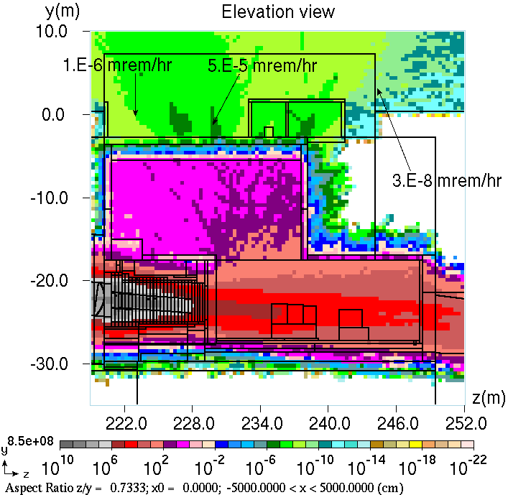
LBNF Absorber mechanical design
The configuration of the Absorber is determined through an iterative process between the engineering design, radiological safety, MARS modeling, and the beamline groups.
Designed for the optimized beam condition (Dune-doc-294):
Energy deposition in the Absorber and radiological parameters are determined by MARS. They are a function of the type of Target used in the Target Hall.
Proton beam energy (Gev) | Protons per cycle | Cycle time (Sec) | Beam power (MW)
120 | 1.5E+14 | 1.2 | 2.4
MARS calculated distribution prompt
dose (mSv/hr) in the HA complex

Slide 6
LBNF Absorber mechanical design
The mechanical design uses experience from NuMI and MiniBooNE design and operations.
The materials specified for different components of the Absorber have been used successfully at the lab previously.
Its two major components are the water-cooled core and the surrounding steel which is air-cooled. Following is the distribution of heat load for 2.4 MW and 1.5-m RAL target case:
Component | Heat load, kW | Reference
Aluminum spoiler and core | 228.7 | Dune-doc-17064
Absorber steel | 244.0 | Dune-doc-17064
Concrete shielding | 3.0 | Dune-doc-17064
Hadron Absorber hall | 41.00 | Dune-doc-17064
Muon Kern | 1.14 | Dune-doc-17064
Miscellaneous | 4.16 | Dune-doc-17064
Absorber Complex Total | 522

Slide 7
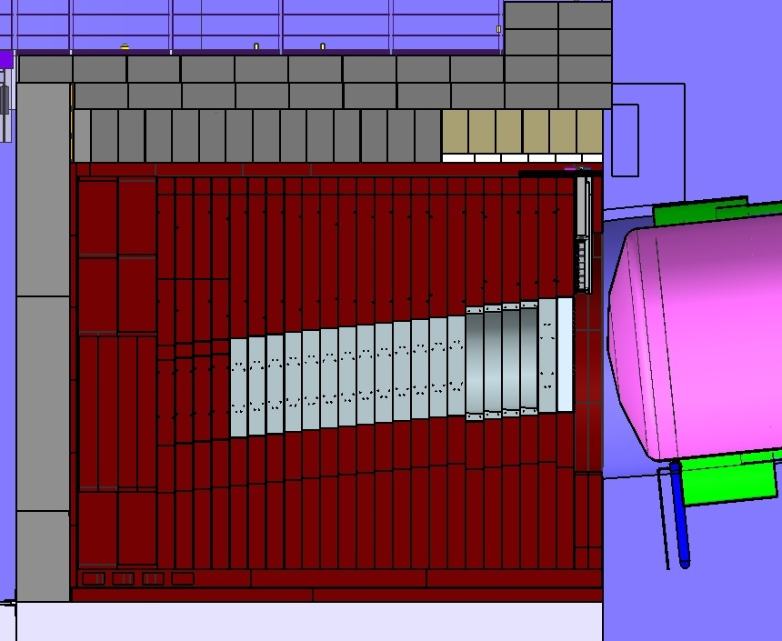
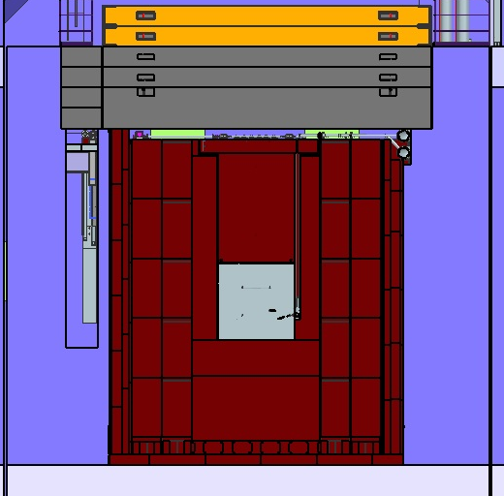
Absorber Core
The absorber core includes: The Aluminum Spoiler, four Aluminum Masks and thirteen Aluminum blocks.
Five millimeters gap between two neighbor core blocks is made during installation.
Removable
Concrete
Shielding
Removable
Concrete
Shielding
Decay Vessel
Concrete shielding
HADES
Monitor
Non- Removable Concrete Shielding
Morgue
Decay Region
Helium Vessel
Air box
Steel
Shielding
Neutrino Beam
Aluminum
Spoiler
Aluminum
Masks
Aluminum
Cores Blocks
Decay Region
Nitrogen ‘Turn Around’ Box
Cores Blocks
Module

Slide 8
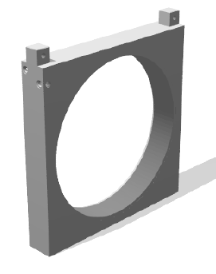
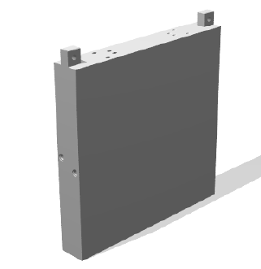
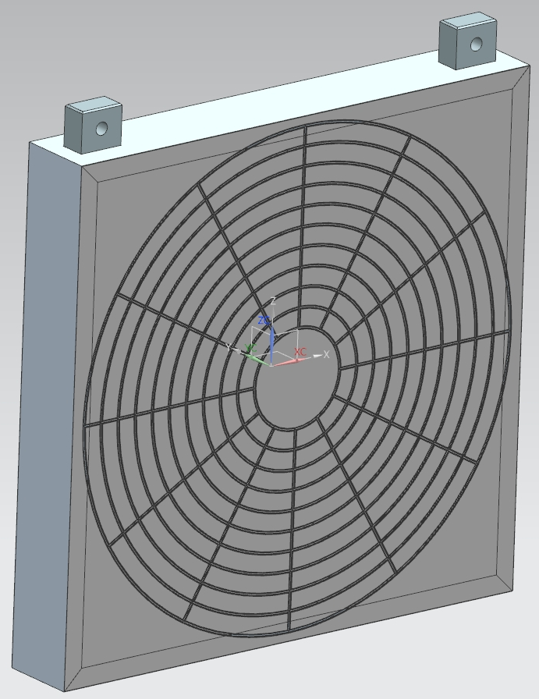
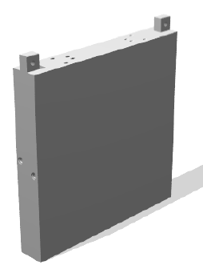
Absorber core blocks
Absorber core is water cooled. All Aluminum blocks have gun-drilled cooling lines.
Air box is welded from aluminum channels covered with thin aluminum sheets
Spoiler
Mask
Core Block
Air box
67”
Material: 6061-T6 Aluminum
Quantity: 1
Dimensions: 79”W X 77”H X 12”
Cooling lines: 4
Weight: 7150 lb
Material: 6061-T6 Aluminum
Quantity: 4
Dimensions: 77”-79”W X 77”H X 12”
Cooling lines: 2
Weight: 2800 lb
Material: 6061-T6 Aluminum
Quantity: 13
Dimensions: 67”-69”W X 67”H X 12”
Cooling lines: 4
Weight: 5180 lb
Material: 6061-T6 Aluminum
Quantity: 1
Dimensions: 77”W X 77”H X 12”

Slide 9
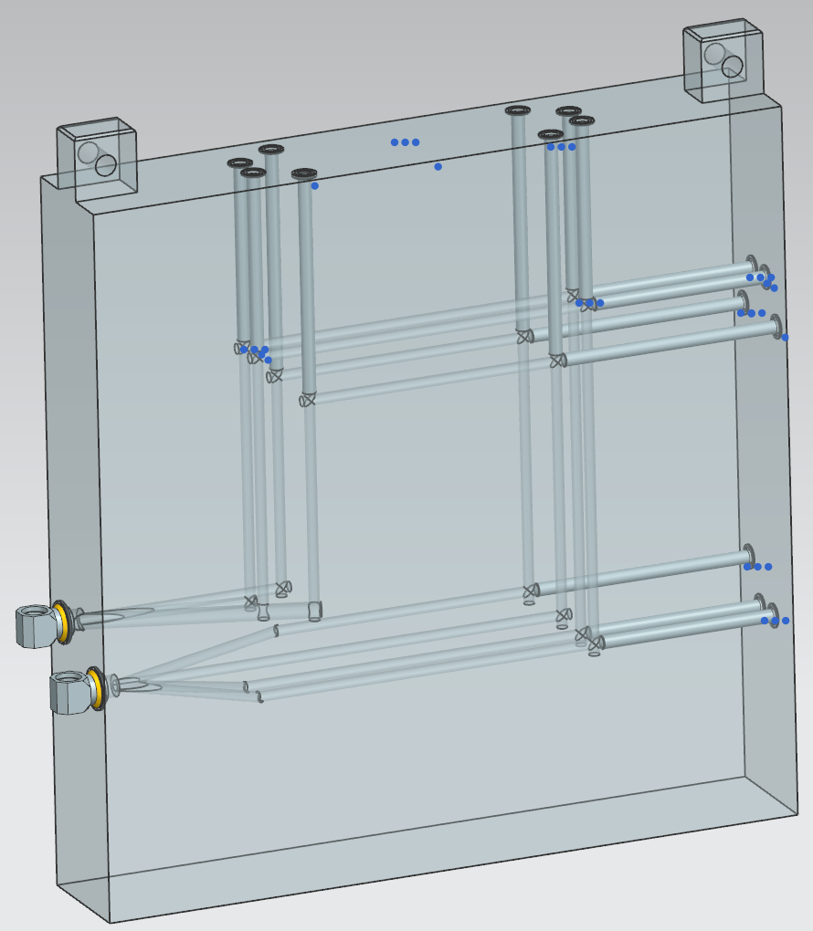
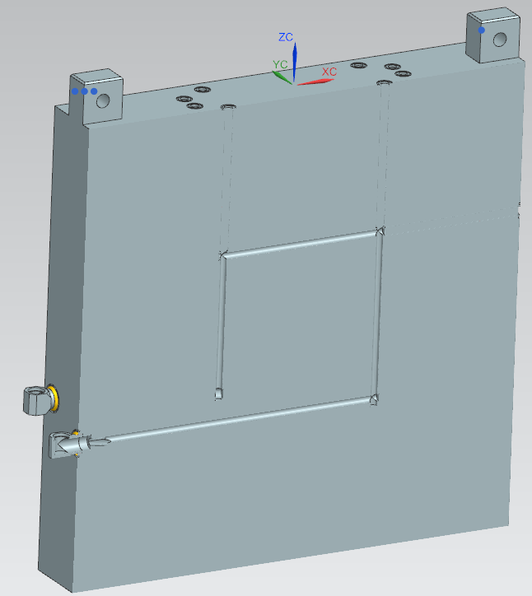

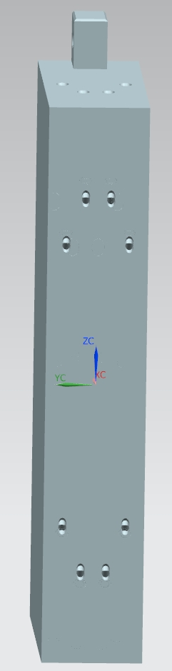
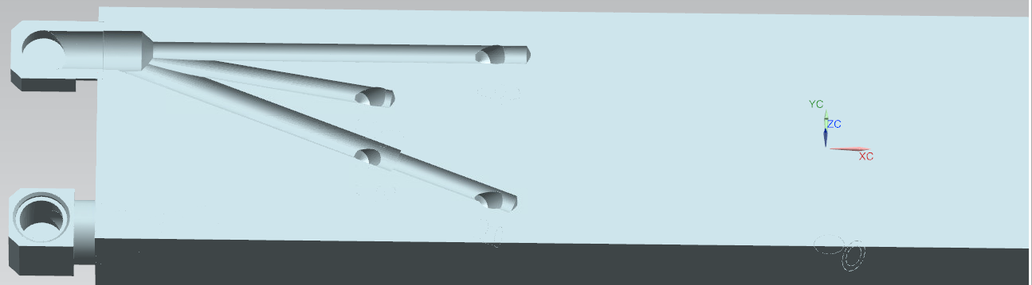
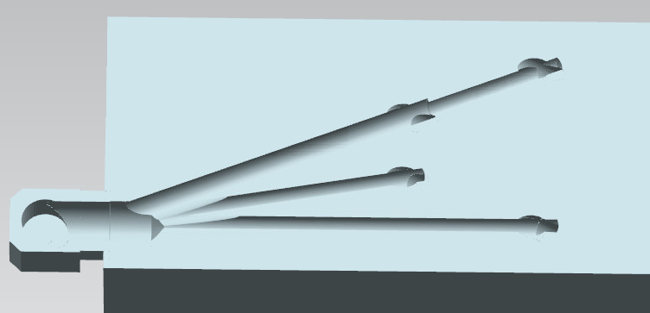
Aluminum Core Block
The four water lines are drilled in the absorber aluminum core block and plugged by Al rods creating water loops. Three hole are drilled through the inlet and outlet ports for loops connection. Two elbows are welded to the block ports and connected to the manifold with pipes.
Plug
Loop24”x24”
Loop
32”x32”
Elbow
Supply Port
holes
Return Port
holes

Slide 10
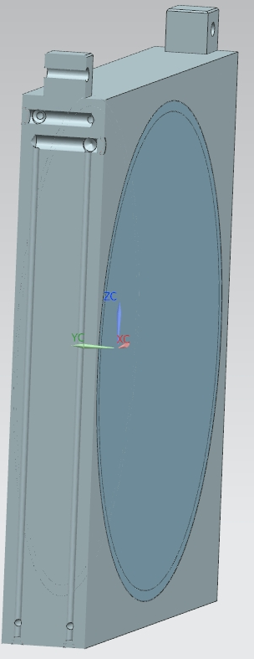
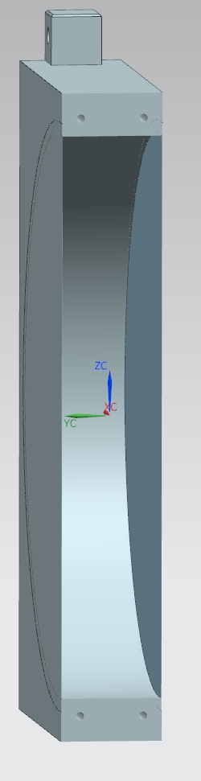
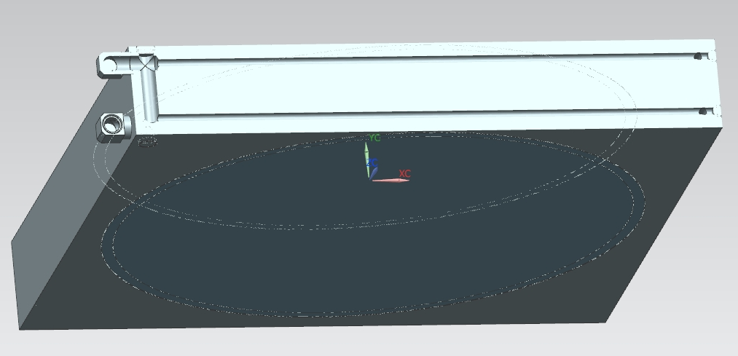
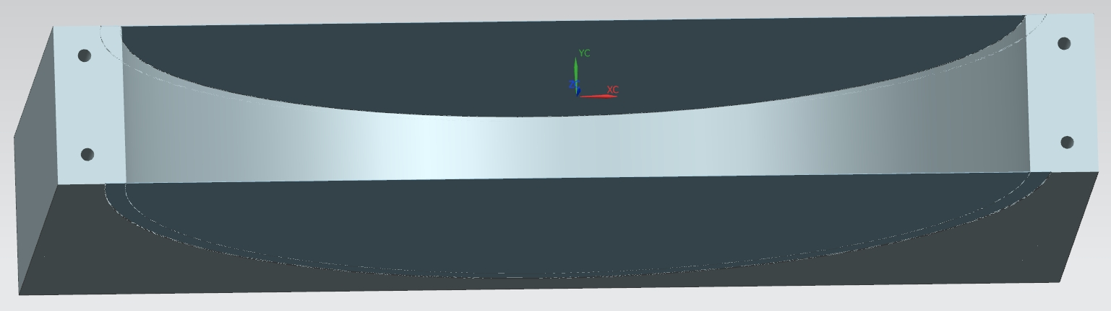
Mask Core Block
The mask blocks are made from aluminum, dimensions 77”-79”Wx77”Hx12”.
The 67” diameter hole is covered with two thin 1/16”disks to keep the radioactive air inside the mask.
Two water loops holes are drilled in the mask block.
Elbow
Water loops
Plug
1/16” disk
Plug

Slide 11
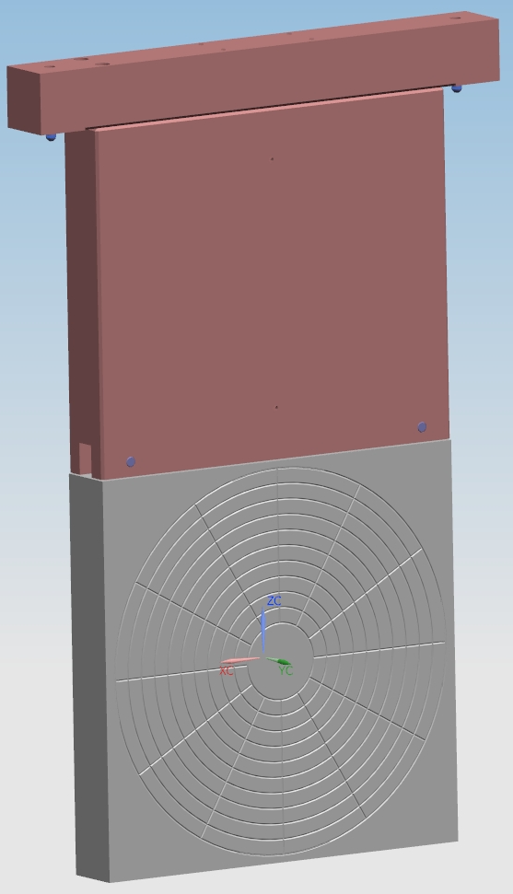
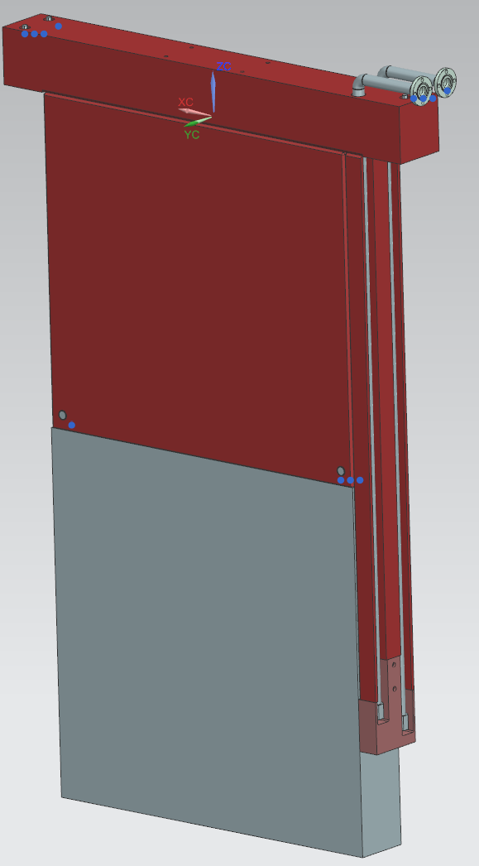
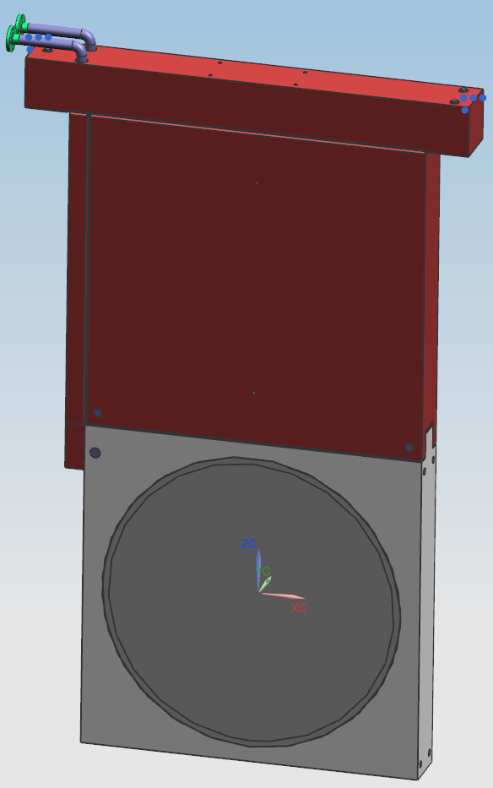
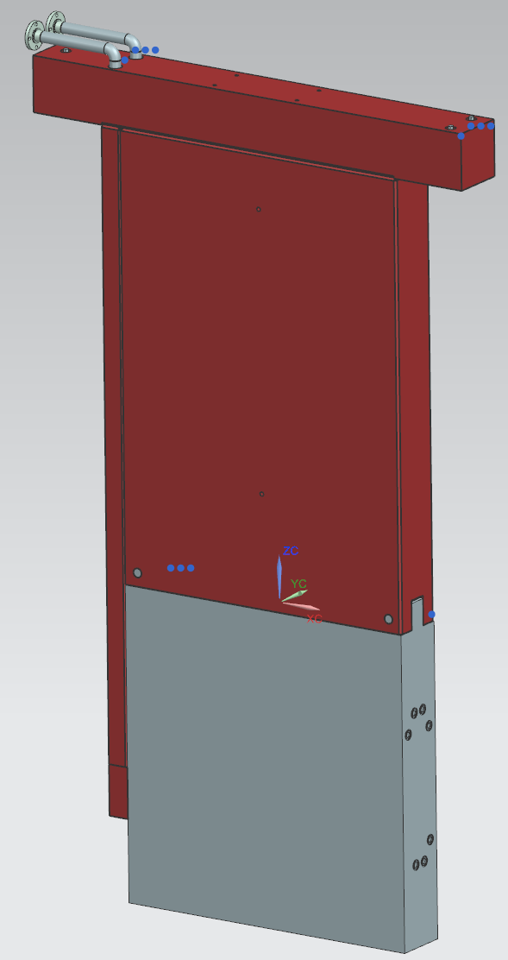
Absorber core modules assembly
Four types of modules are installed in the absorber Air box, Spoiler, Mask, and Aluminum core block.
Air box module
Spoiler module
Mask module
Aluminum Core block module
158.5”
160.5-163”
160.4-175.25”
159.25”
77”
77”
77”
67”
77”
79”
67”-69”
77”-79”

Slide 12
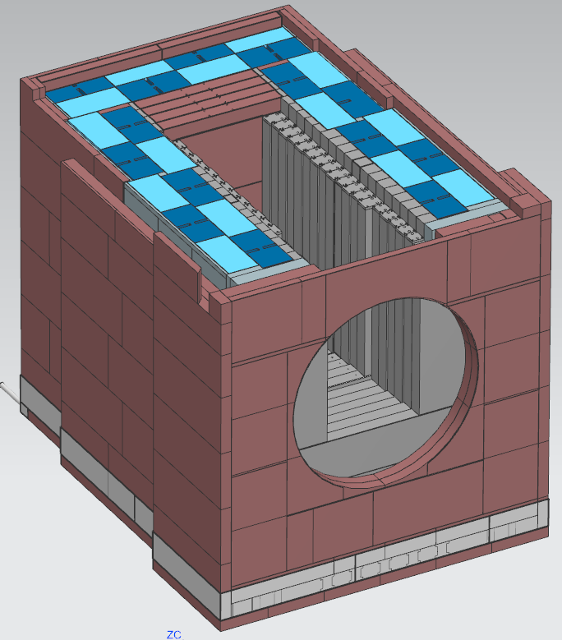
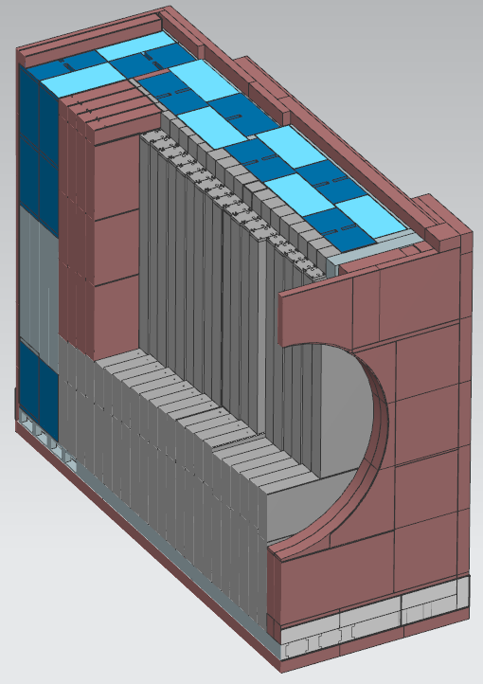
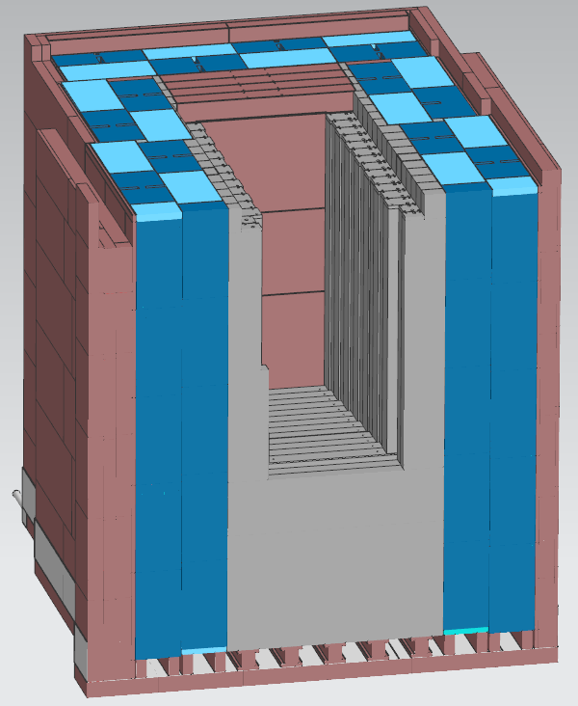
Absorber steel shielding
About 6 million pound of steel are used in the absorber shielding. The most of shielding is made from cheap 9.11 steel and blue blocks . The center module supporting structure is welded from 12” thick low carbon steel plates. Four removable T- blocks are installed in the downstream end of the absorber pile. They can be replaced with water cooled core blocks in the future if it will be required. There is 5mm gap between blue blocks and support structure weldment for the air travel.
Blue blocks
T-block
9.11”
Water
collecting pan
Module support
structure
Air
channels

Slide 13
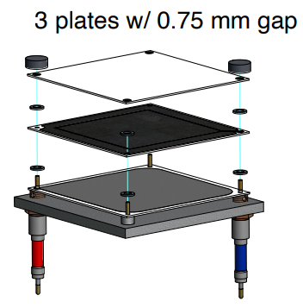
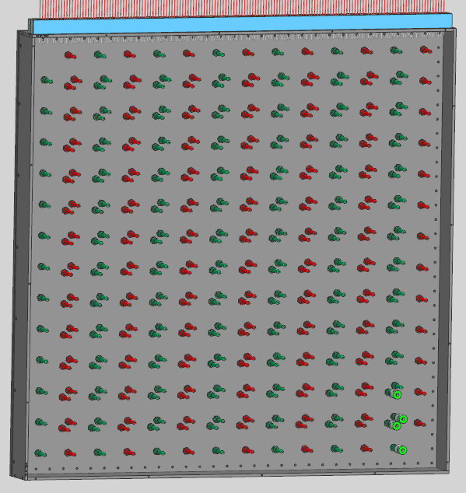
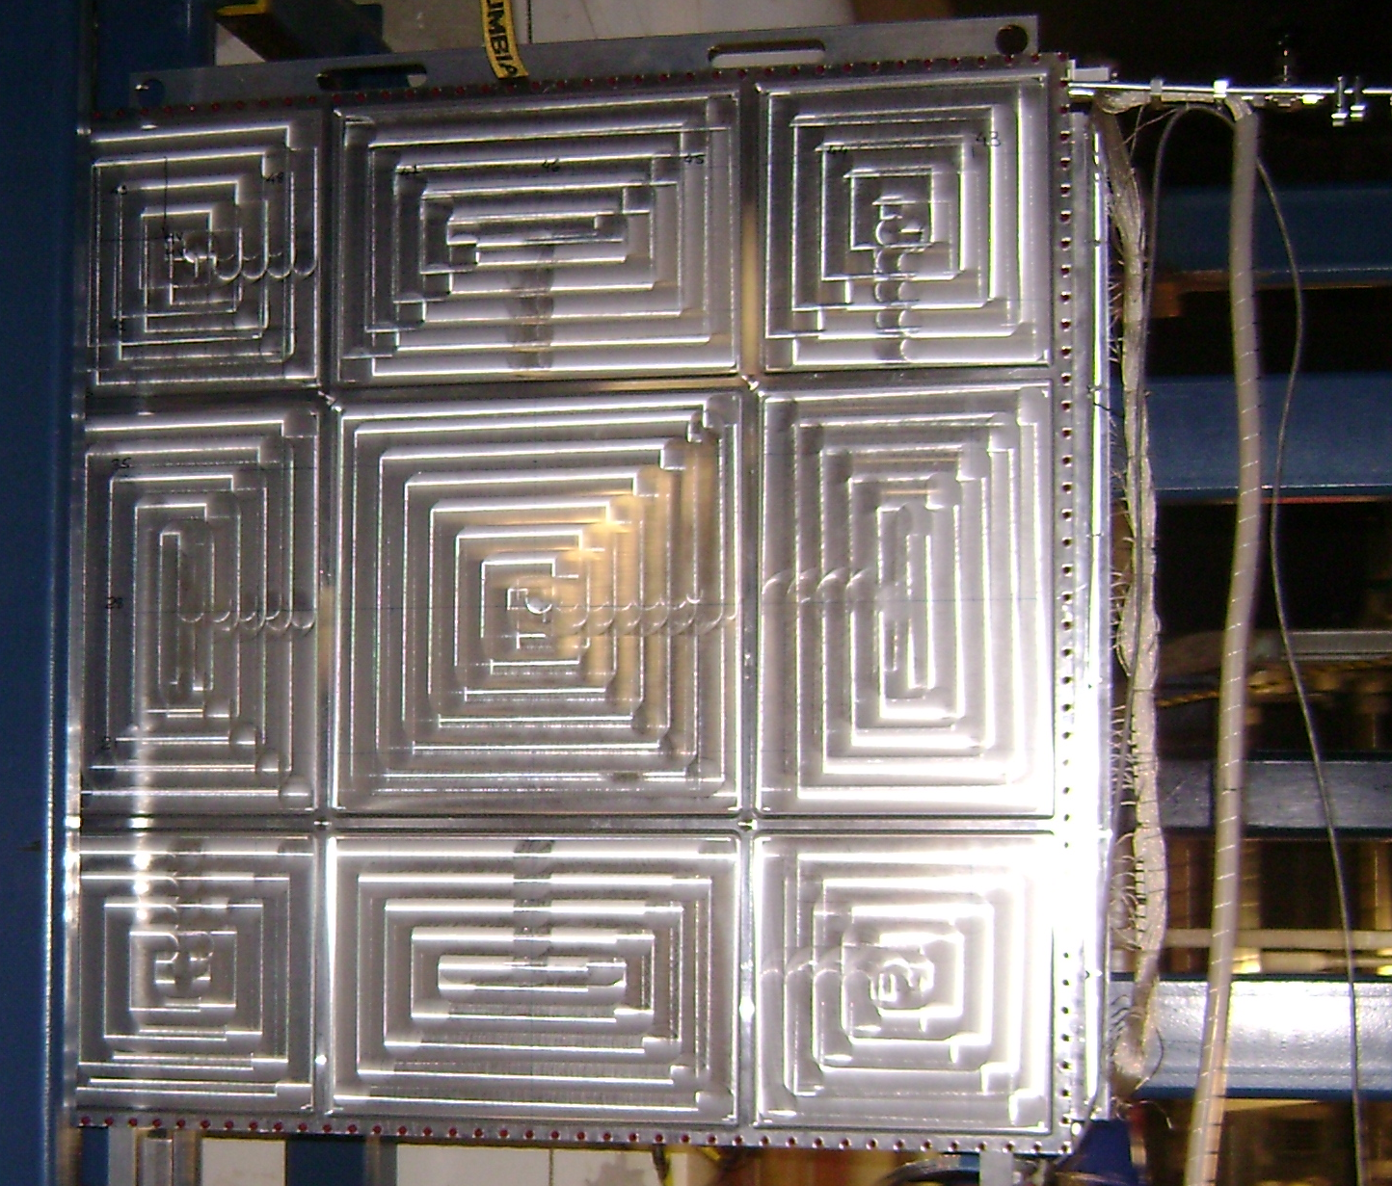
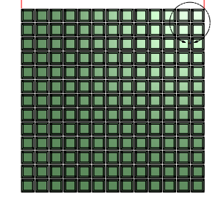
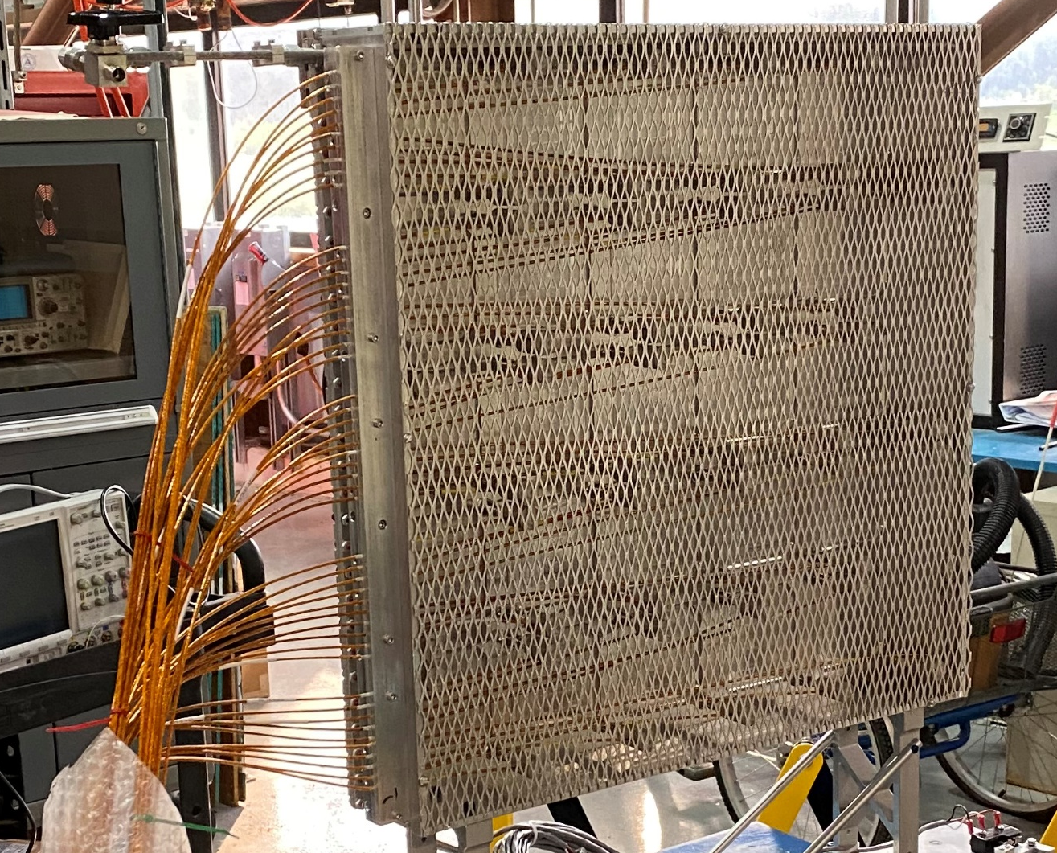
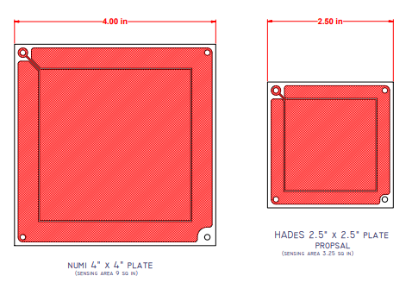
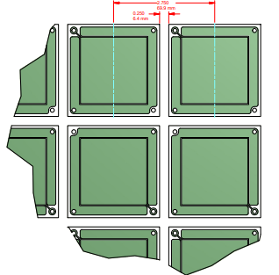
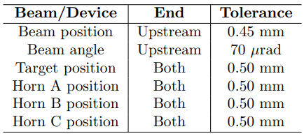
Hadron Alignment Detector System
The HADES design is based on technology used in NuMI. Hades is a segmented gas ionization chamber using helium, The HADES must be capable of measuring the angle of the primary proton beam to within 70mrad, the position of cross-hairs on horns B and C , the vertical and horizontal edges of bafflette and target, the vertical and horizontal edges of baffle and target with 0.5 mm accuracy.
35.5”
901.7mm
NUMI original 7x7 hadron monitor
Built by UT Austin
2.75”
LBNF proposed HM 13x13 array
Modified HM 5x5 pixel array
Installed in 2021

Slide 14
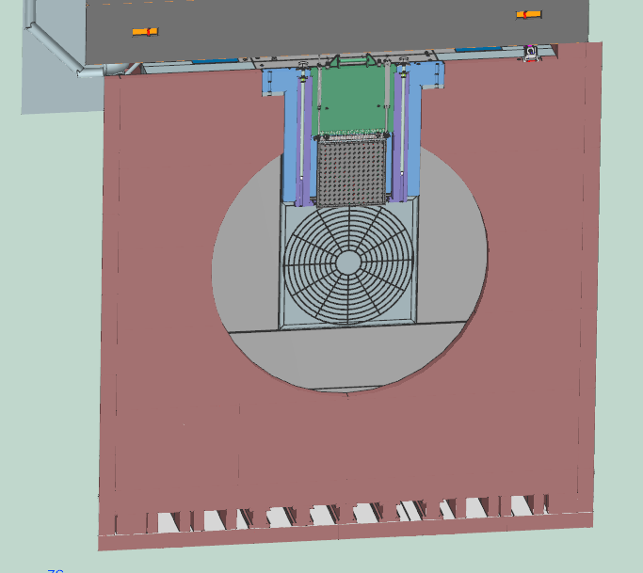
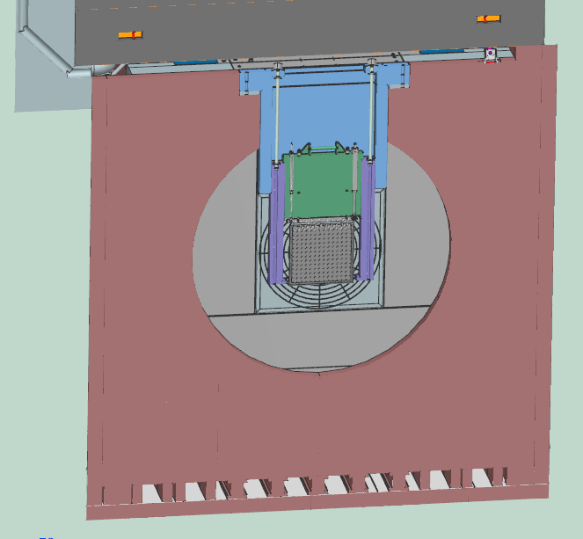
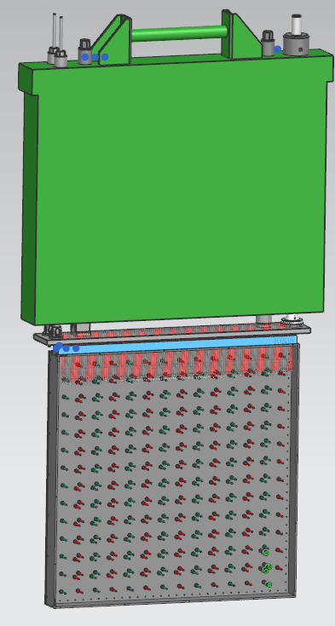
HADES Retractive system
The HADES is installed in the front of the absorber core blocks. The HADES Retractive system delivers the HADES to
the beam center line with tolerance +/- 0.5 mm for the beam parameters measurement.
The HADES is located inside of the Retractive system support block during the operation time .
Concrete G-blocks
HADES Module
HADES Cable
penetration
Steel
shielding
HADES
Inside support block
Absorber
core
Concrete
bunker
HADES in measurement
position
Steel block
HADES

Slide 15
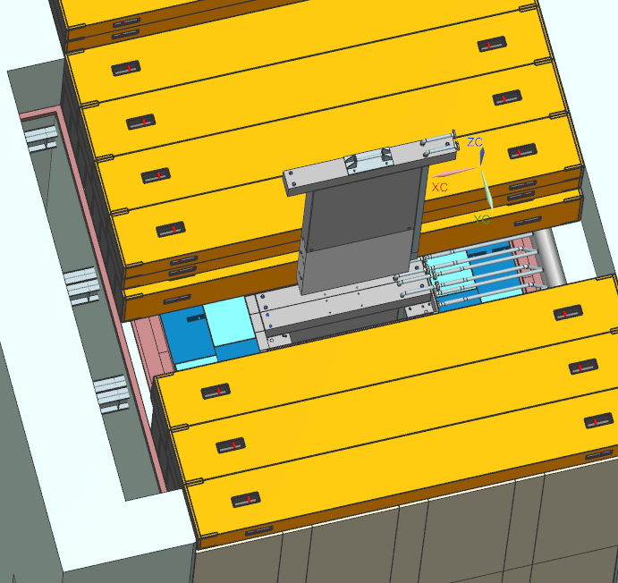
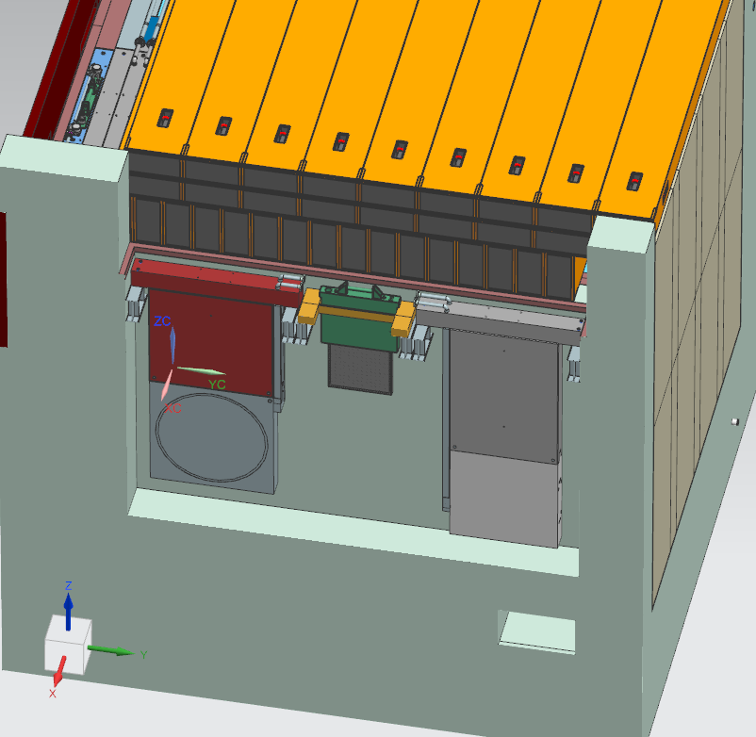
HADES and Core blocks Remote Handling
The HADES life has limit and in case of a failure it is replaced. The HADES Remote handling procedure is required.
Core blocks don’t have life limit and take beam during the project operation period . If the core leak occur during the operation, any core block module can be removed and stored in the morgue . The morgue is located in the concrete bunker beside the absorber steel shielding . Two section of the morgue can be occupied by four absorber core blocks with modules and middle section is storage of any broken hadron monitors.
HADES
G-blocks
HADES
module
Morgue
Core block
module
Absorber
bunker
Morgue

Slide 16
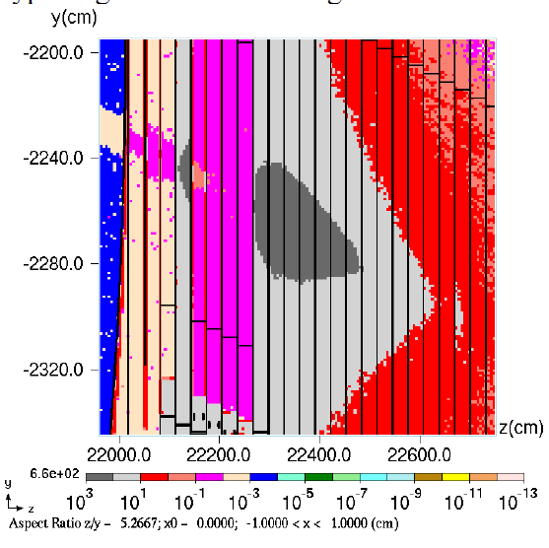
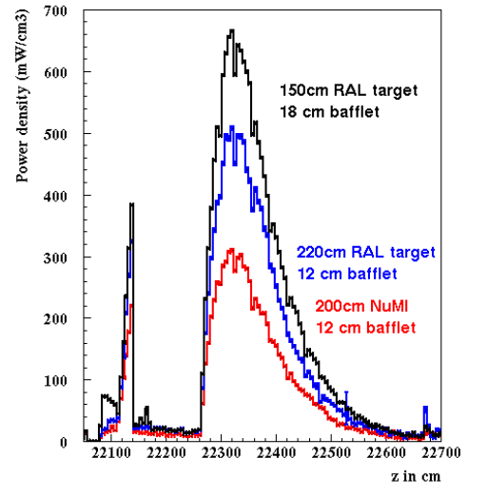
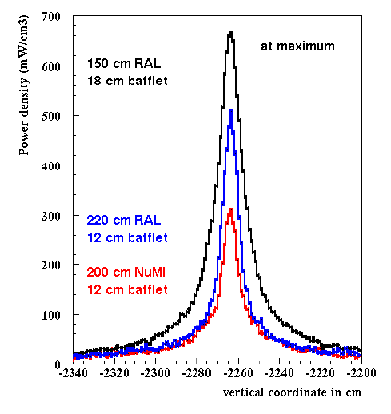
Energy deposition, temperatures, and stresses in the core
Sergi Striganov
The energy deposition in the Absorber strongly depends on the target design.
Several target designs have been considered, The current target is the 1.5-m RAL target.

Slide 17
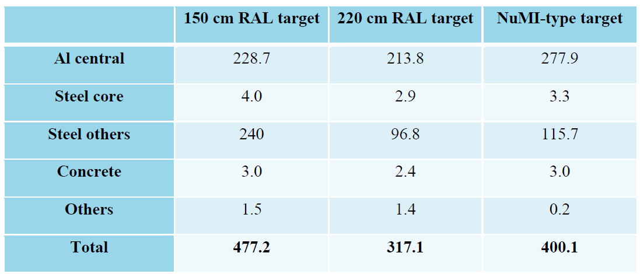
Energy deposition, temperatures, and stresses in the core
The power deposited in individual Absorber components (kW):

Slide 18
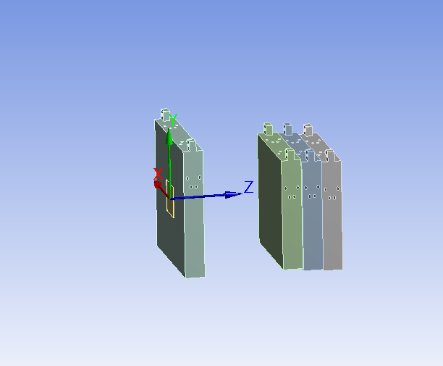
Summary of Result _ Rectangular Cooling Circuit
(for the 1.5-m RAL Target _ 2.4 MW)
Ang Lee
1 cm bin in the center
 | Rectangular Cooling Circuit _ The Latest Design Dec 2020
 | Maximum temperature ( C ) | FEA heat reaction (KW) | MARS data | Ratio | Stress (psi) | Total deflection (mm)
Spoiler | 57.58 | 27.05 | 27.32 | 99.01% | 11.3 | 1.3
Aluminum_1 | 59.21 | 28.547 | 29.27 | 97.53% | 13.6 | 0.969
Aluminum_2 | 70.651 | 31.688 | 32.18 | 98.47% | 12.01 | 0.946
Aluminum_3 | 69.121 | 28.092 | 28.67 | 97.98% | 9.97 | 0.953
Al Spoiler
Al block
Material is Al 6061-T6. with the yield stress of 40 ksi.
The 13.6 ksi (mostly from the thermal loading) << 40 ksi.
Only Aluminum spoiler and Aluminum block are considered for the rectangular cooling circuit. No change for the steel block

Slide 19
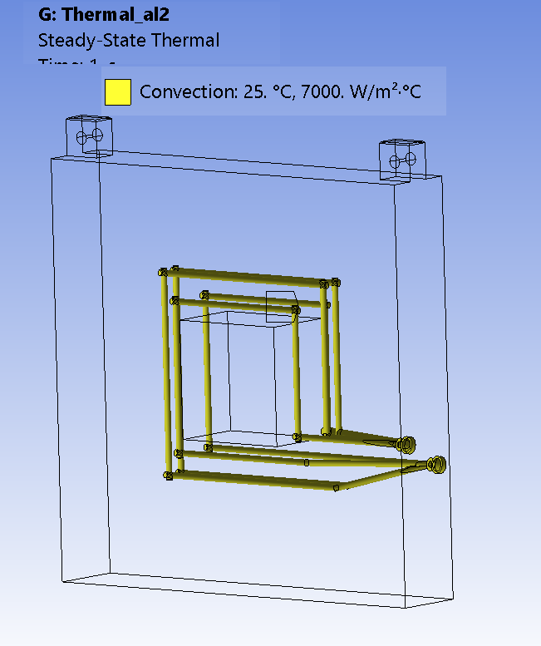
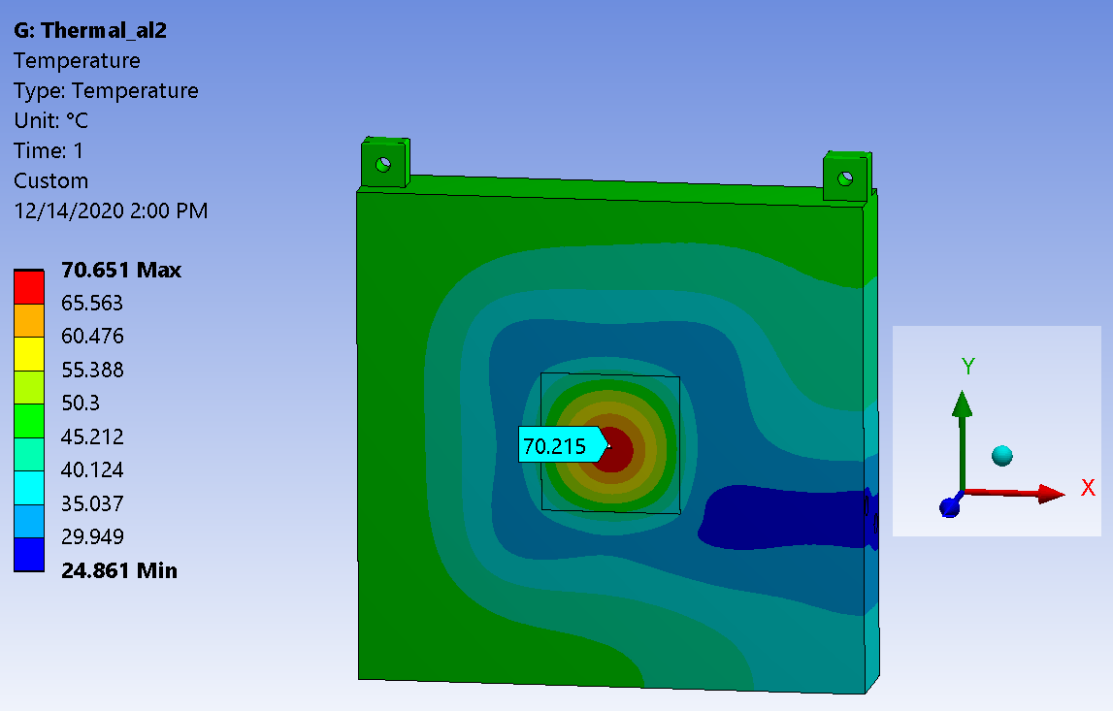
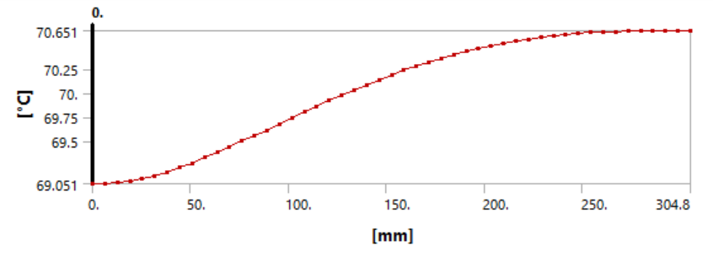
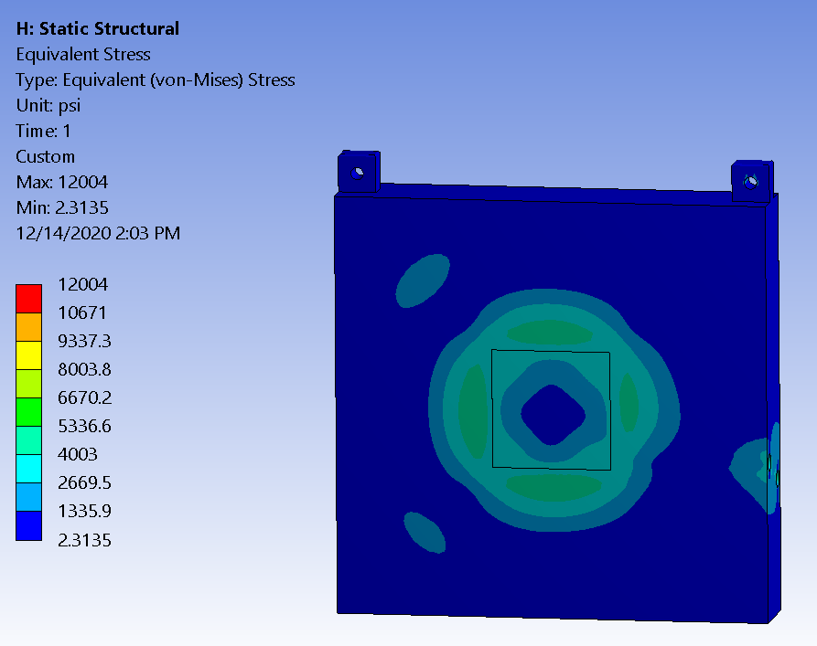


2nd aluminum block temperature, stress and deflection
Ang Lee
Cooling circuit
Stress ~12 ksi <<40 ksi
Vertical deflection ~0.89 mm
Total deflection ~0.94 mm

Slide 20



Absorber core cooling: System layout
Piping layout in LBNF Absorber Hall
Valves removed after PDR recommendation to make design simpler
10” SS IPS RAW
Supply/return
RAW Manifold
2” Cooling
lines
Core block
module
All piping parts and materials have been used without any failures on NuMI RAW systems since 2007.
304L SS flanged connections to 6061-T6 flanged connections exist in the NuMI Absorber hall. Worked well since 2007.

Slide 21
Absorber core cooling
Requirement of the system is to provide temperature regulated DI water to the core.
Maintain an average velocity of 5-7 ft/s ( 1.5-2.13m/c) in all the gun-drilled cooling channels in core components.
Parameter | Value | Units | Remarks
System volume | 1325 | Gal. | 5016L
System design temperature | 130 | F | 54.4C
System operation temperature | 80 | F | 26.7C
Maximum available working pressure | 75 | Psig | 517.1kPa
System operating pressure | 44 | Psig | 303.4kPa
System pump design horse power | 50 | Hp | 1 pump running, 1 stand by
System design flow | 1310 | Gpm | 4959 Lpm

Slide 22



Steel shielding air cooling
An air cooling system, designed by CF, delivers 25,000 CFM of air which blows in on top of the absorber blocks and passes through the 5-mm gaps between the blocks. Collects in the air channels at the bottom and enters the return duct at the back of the Absorber.
Air delivery
holes9”x48”
Air travels downwards at ~ 15 m/s through the 5 mm gaps
Enters air passageways at the bottom. Air channels connected to an exhaust duct. Air exhaust temperature ~ 44 ⁰C
Exhaust duct

Slide 23



Steel shielding air cooling
Thermal/CFD analysis for the region with max EDEP was performed:
Total air flow for the air-cooling system: 25,000 CFM.
Steel temperature predictions for NuMI were ~158 ⁰C. And the limit for the anti-rust paint is 260 ⁰C.
Dune-doc-20831

Slide 24

Beam interlock hardware system
Jim Hylen
Three independent systems provide redundancy to pull beam permit quickly in non-normal condition .

Slide 25


Beam interlock hardware system
Two thermocouple array installed in Al core block 2.
Permit is pulled on absolute temperature limits and also on comparison of temperatures before and after each pulse.
System designed to pull the beam permit after 1 accident pulse.
Ungrounded, 1/16”, J-type thermocouples used in NuMI will be specified. They have a 0.3 sec response to dT in surrounding material.
Thermocouples array
Core block 2

Slide 26








Absorber core thermocouple layout
Total of 224 thermocouples in bars slotted in front and back of block 2
Front array
8.255 cm
square grid
4”
Within R<49 cm of center,
nowhere is further than
4 cm from a thermocouple
3.25”
Both arrays
(back array
is offset
from font)
3.25”
TC tips
Expect thermocouples to last lifetime of facility, but
each thermocouple bar is individually replaceable
without removing block from absorber
Thermocouple bar is 5/8” thick

Slide 27


Radiological protection
Igor Rakhno and Nikilai Mokhov
One of the requirements of the Absorber is to provide radiation protection to people in compliance with FRCM.
Residual dose rates in Beam OFF areas need to be less than 20 mrem/hr. Max is 10 mrem/hr as shown below.
Beam ON prompt dose rates in the Absorber service building do not exceed 5 x 10⁻⁵ mrem/hr.
Max: 10 mrem/hr

Slide 28





Qualifying weld procedure for all types of welds
6 out of 6 pipe to block weld coupons passed ASME B31.3 Normal Fluid Service criteria.
Welds were done as per WPS: ED0017753-LBNF Absorber Aluminum Core Block Pipe to Block WPS.
6 out of 6 plug weld coupons passed ASME B31.3 Normal Fluid Service criteria. Welds were done as per WPS: ED0017773-LBNF Absorber Aluminum Core Block Plug Welds WPS.
Sample coupons
Radiographs
2”pipe
Elbow
Core block
Weld
Samples welding box

Slide 29
LBNF Absorber Status
The preliminary design of the LBNF Absorber is completed.
The Final Design Review is scheduled in April 2023.

Slide 30
Back up Slides

Slide 31

LBNF-30 Absorber Complex
Introduction
Neutrino Beam
to SURF, SD
Absorber Complex
(LBNF-30)
Decay Region
Target
Complex
(LBNF-20)
Primary
Beamline
Enclosure
Located directly downstream of the decay pipe –made up of actively cooled Aluminum and Steel blocks surrounded by concrete.
Provides radiation protection to people and keeps soil/groundwater activation levels to below allowable limits.
Designed for the worst case condition at 2.4 MW operation:
    Decay distance is 221m from MCZero9Target) to end of decay vessel.
    Helium filled decay pipe
    For a 1.5-m RAL style target, longer target options are less severe for the absorber
    Designed to sustain 2 successive beam accident pulses - interlock system limits the accent pulses to 1"
Primary Beam Service Building
(LBNF-5)
Major
Vehicle
Access
Fermilab
Main Injector
Tunnel
Extraction
Enclosure
Proton Beam
From MI-10

Slide 32


Absorber Complex – Support Rooms
Absorber
Service
Building
Utility Shaft
Elevator Shaft
Instrumentation
Room
Mechanical
Room
RAW Room
Air Handling
Room
Hadron
Absorber
Pump Room

Slide 33



Spoiler
The spoiler design is identical with the core block design, overall dimensions are larger 79”Wx77”H.
Loop
41.5”x41.5”
Loop24”x24”

Slide 34


The air box is designed to keep the radioactive air inside the absorber . The air box is located in the front of the absorber core blocks. Air box dimensions: 77”Wx77”Hx12”
Thickness-0.05”
Al channel

Slide 35
Energy flux at absorber entrance
100 cm NuMI target
43 GeV/POT
200 cm NuMItarget
21 GeV/POT
150 cm RAL target
26 GeV/POT
220 cm RAL target
17 GeV/POT

Slide 36






Spoiler temperature C stress and deflection
Stress 11.3 ksi <<40 ksi
Total deflection ~1.3 mm
Vertical deflection ~1.16 mm

Slide 37






1st aluminum block temperature, stress and deflection
Cooling circuit
Stress 13.6 ksi <<40 ksi
Total deflection ~0.968mm
Vertical deflection ~0.89 mm

Slide 38






3rd aluminum block temperature, stress and deflection
Beam direction +Z
Beam direction
Cooling circuit
Stress ~9.7 ksi <<40 ksi
Total deflection ~0.95 mm
Vertical deflection ~0.85 mm

Slide 39


Scenario 4, variation, on-beam-axis accident including CFD
On-axis accident was also simulated.
dT for accident pulse (without target) matches off-axis case just shown.
However, the steady state
used here as a starting
point was from a different
target configuration, and
final temperatures would be
somewhat higher for current
target design.
None-the-less, do not expect
any significant damage from
2 on-axis accident pulses.
CFD was used to simulate temperatures in the aluminum block for the on-axis accident condition described in Dune-doc-7317.
120 GeV beam, 10 us spill, cycle time: 1.2 Sec, and total spills: 2.
Steady state energy deposition for block 1 and accident energy deposition for block 2 was used. Water temp: 25 ⁰C. HTC~7000 W/m²-K.
End of first pulse. Max temp~116 ⁰C
End of second pulse. Max temp~172 ⁰C
Source: Abhishek Deshpande, DUNE DocDB: 9670

Slide 40


Surrounding steel cooling
CFD simulations show the velocity profiles in the 5-mm gaps between Absorber components are uniform.
Sensitivity analysis to show that air velocity is adequate if the air gap sizes become non-uniform was also done.
The below analysis is for an older version of the steel shielding which used 9-11 steel components.
Dune-doc-431

Slide 41


Radioactive water collecting pan
The pan is welded from the 48”x120”x ¼” stainless steel base plates and side plates 24 “ height and 1/8” thickness. The final weld of the pan is made in the absorber hall.
286”
Side plates are welded to the penetrated into the concrete steel strips.
234”
258”
Steel
strip
Weld

Slide 42


NUMI HM replacing fixture
NUMI Hadron Monitor

Slide 43



NUMI Hadron Monitor Installation

Slide 44


Absorber core cooling system
AFT Fathom Therma/Fluid Model
3D Model of RAW Skid

Slide 45



Absorber core cooling
Requirement of the system is to provide temperature regulated DI water to the core.
Maintain an average velocity of 5-7 ft/s in all the gun-drilled cooling channels in core components.
Minimum flow requirement for Absorber core components:
RAW pump Operating here: 1310 Gpm @ 83 Ft.

Slide 46

Lower part of concrete blocks – temporal dependence of contact residual dose at hot spots
Configuration with 8 BMCN blocks
Temporal dependence of contact residual dose in a hot spot A 100-day irradiation and various cooling times Statistical uncertainty of the calculated dose is 15-20%
Cooling time | Fraction of the 100-d/4-hr dose (%) | Absolute value (mrem/hr)
4 hours | 100 | 150
3 days | 25 | 40
7 days | 15 | 23

Slide 47

Jonathan Paley

Slide 48


HADES Retractive system
The HADES Retractive system delivers the HADES to the beam center line with tolerance +/- 0.5 mm for the beam parameters measurement. During the operation the HADES is located inside of the Retractive system support block.
Screw jack
Drive mechanism
HADES Module
Support
block
Moving
block
Hadron
monitor
HADES

Slide 49



Qualifying weld procedure for all types of welds
Welding procedure was qualified for both pipe and plug weld designs.
6 out of 6 pipe to block weld coupons passed ASME B31.3 Normal Fluid Service criteria. Welds were done as per WPS: ED0017753-LBNF Absorber Aluminum Core Block Pipe to Block WPS.
6 out of 6 plug weld coupons passed ASME B31.3 Normal Fluid Service criteria. Welds were done as per WPS: ED0017773-LBNF Absorber Aluminum Core Block Plug Welds WPS.

