Slide 1
Operation & upgrades on the T2K hadron absorber towards 1.3 MW operation
T. Nakadaira
High Energy Accelerator Research Organization (KEK) IPNS / J-PARC
for
J-PARC neutrino facility

Slide 2
Contents
Overview of beam dump @ J-PARC neutrino beam-line
Operation experience
Upgrade for 1.3MW operation

Slide 3
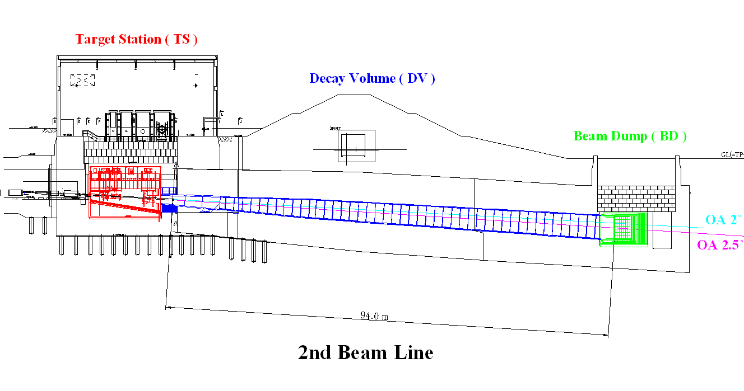
Overview
Target Station
Secondary beam line
Facility equipment for 2ndary BL is installed in TS and two utility buildings.
Beam dump
Decay Volume
Neutrino Utility Building #2
“NU2”
↓
↑
“NU3”
Neutrino Utility Building #3

Slide 4
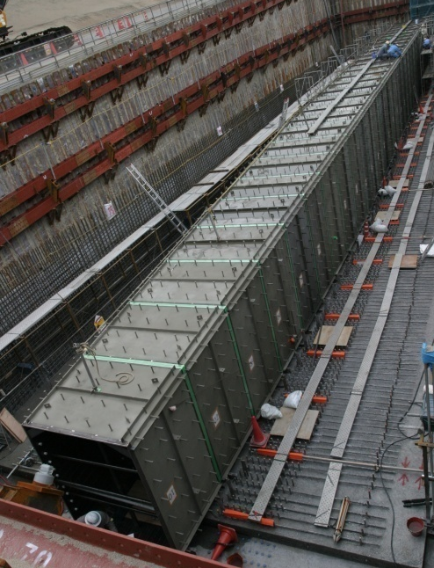
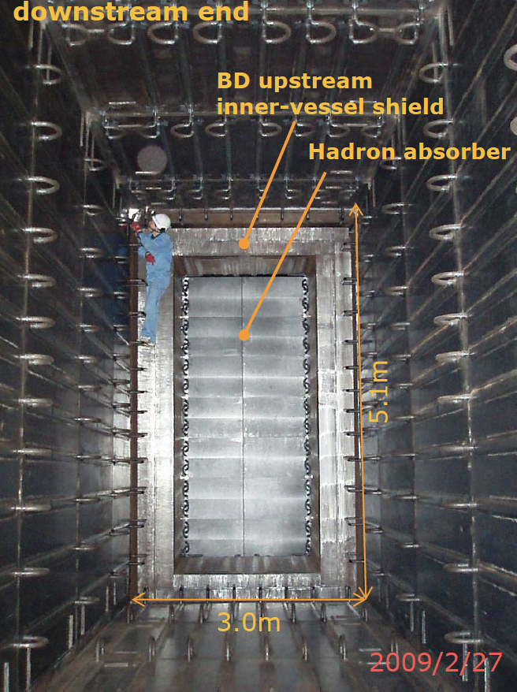
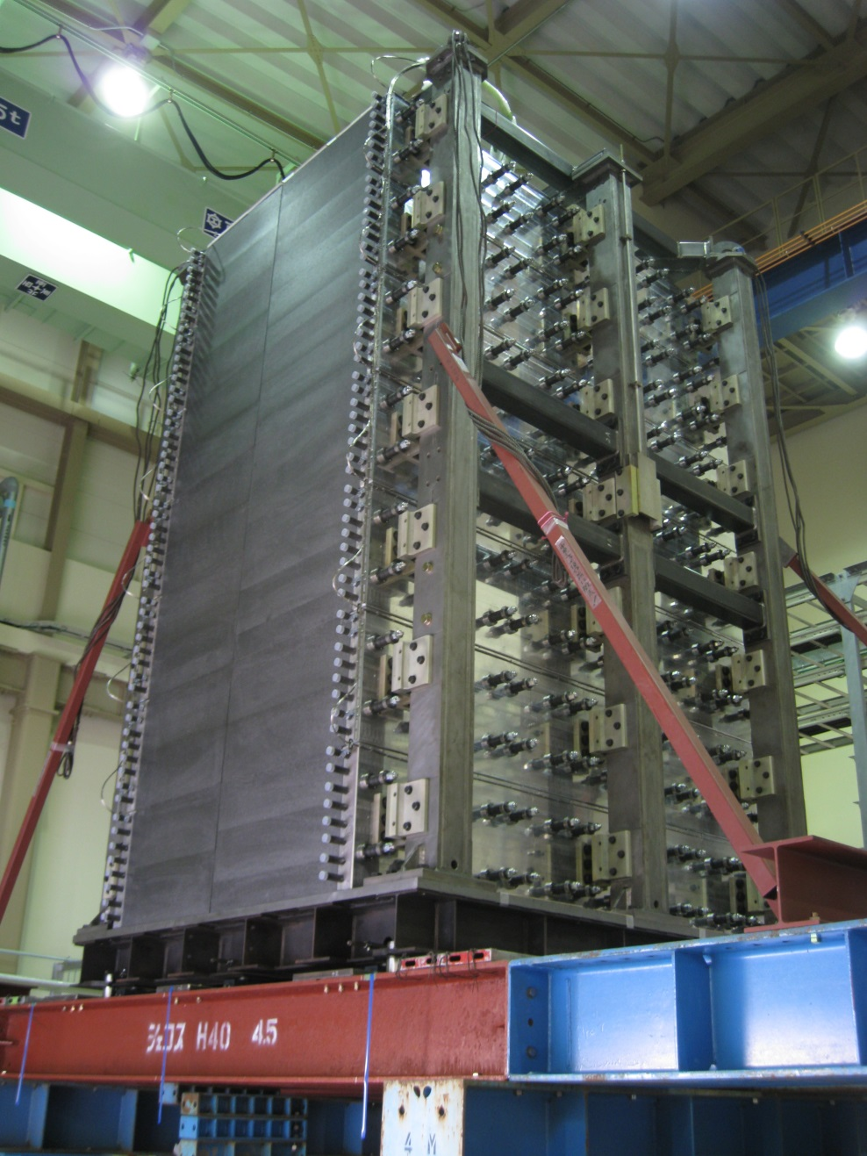
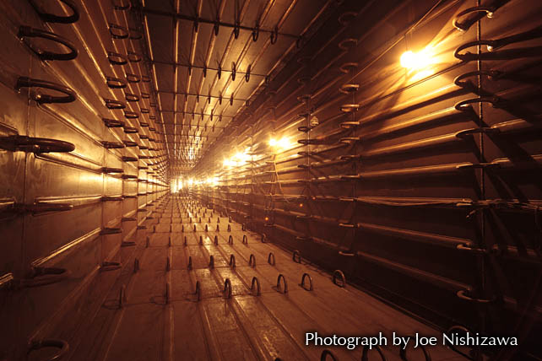
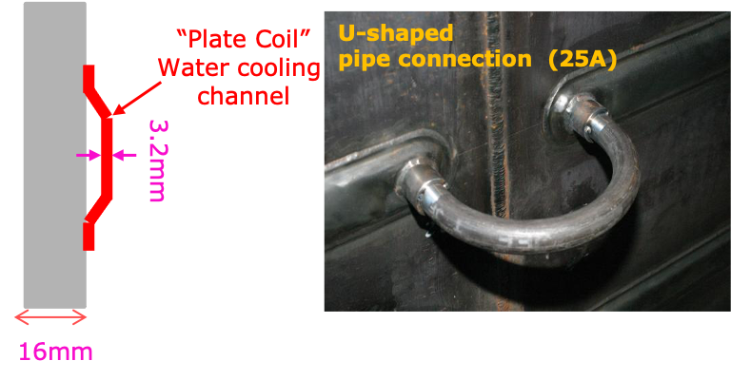
DV & BD
Target Station
Beam dump
Secondary beam line
Beam dump
Decay Volume

Slide 5
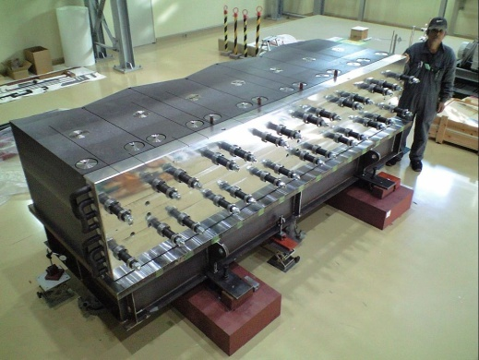
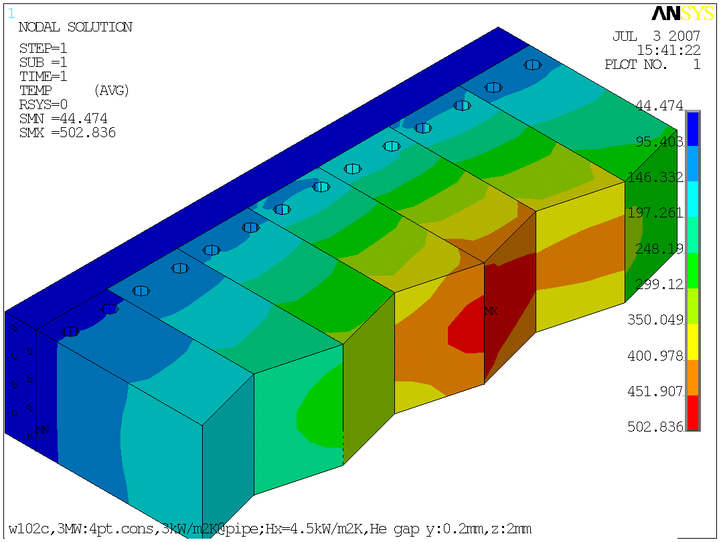
Hadron absorber: Segmented graphite w/ Al cooling block
DV and Beam damp designed for 3MW beam power.
2 (H)× 7 (V)
= 14 modules
Gap ΔＹ 0.2mm
Assuming heat transfer coefficient between the graphite block and the cooling module = 4.5kW/m²K
beam axis
~ 500 deg.

Slide 6
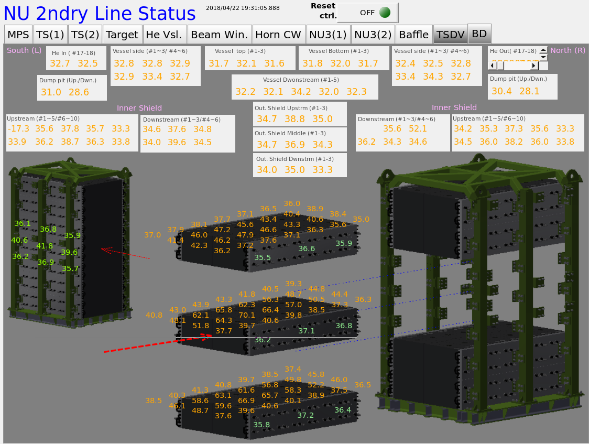
BD: Temperature monitoring
Screen shot during ~490kW beam operation.

Slide 7
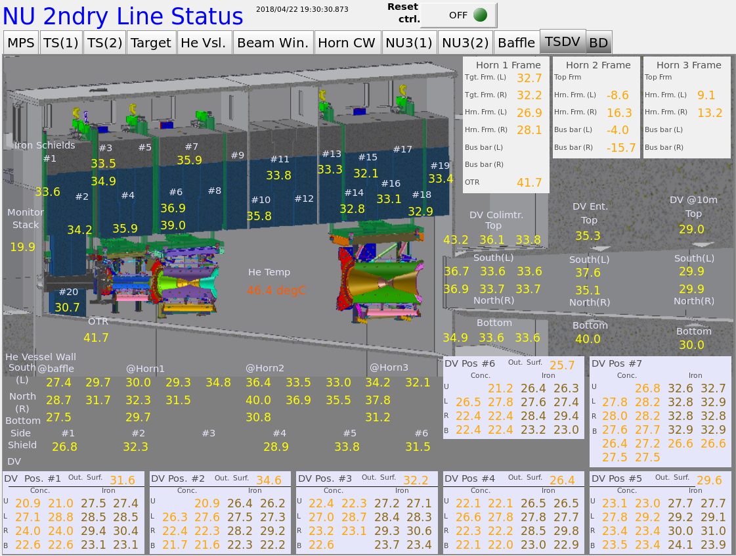
DV: Temperature monitoring
Screen shot during ~490kW beam operation.

Slide 8
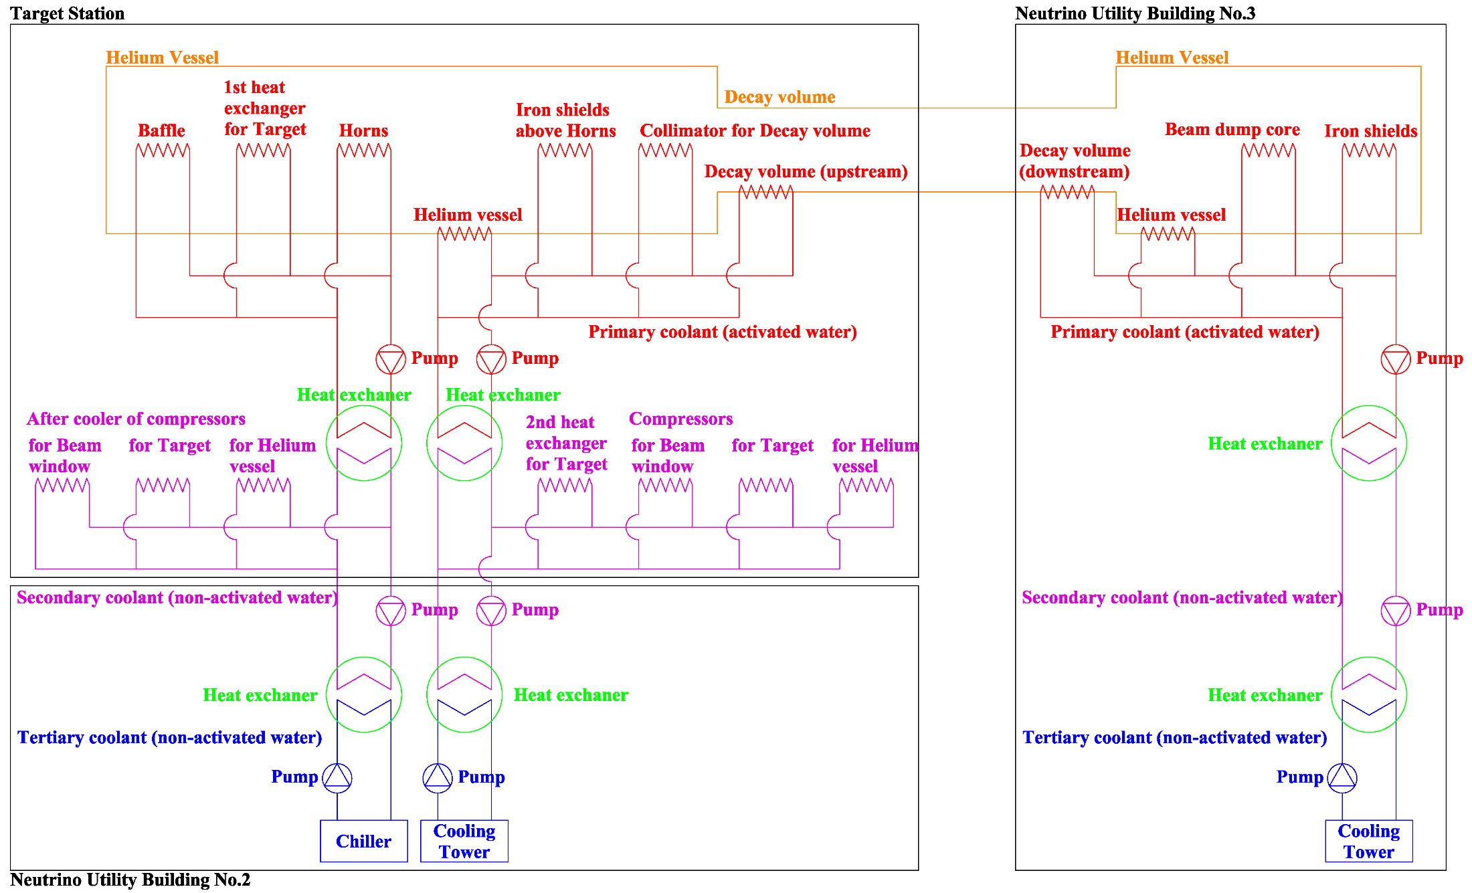
CW system
Target Station
Secondary beam line
Separated 2 systems
Beam dump
Decay Volume
Cooling system in TS & NU2
for upstream part
Cooling system in NU3
for downstream part

Slide 9
Upgrade water cooling system ( 750kW → 1MW )
The circulation pumps and the heat exchangers will be replaced to more large capacity ones
Chillers and cooling towers will be added.
Procurement of equipment is on going. → Installation in ~2025.

Slide 10
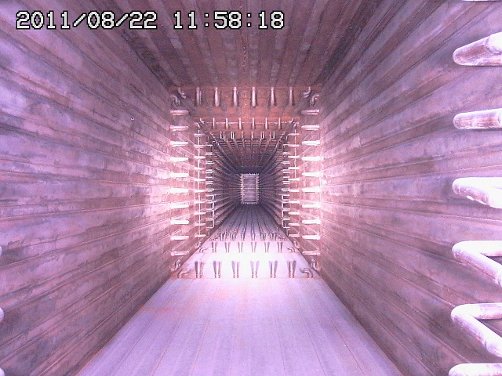
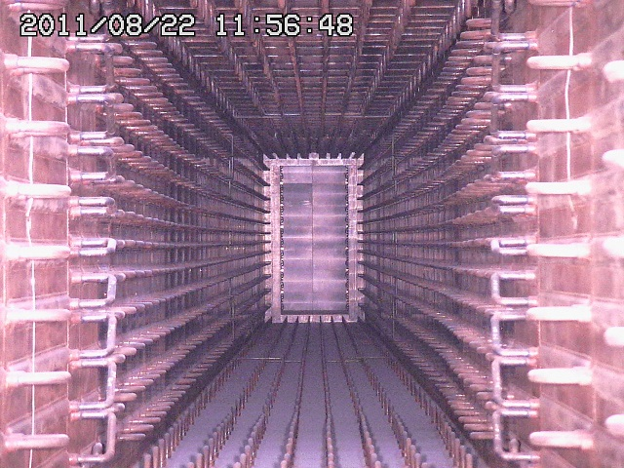
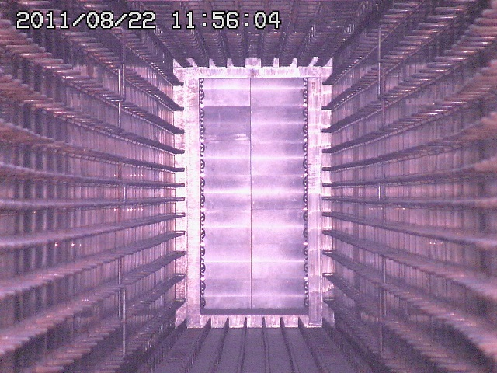
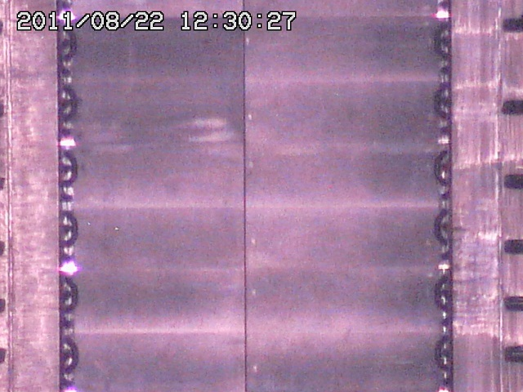
DV&BD is working well in 510kW operation.
No water leak happened inside He vessel (except for horns).
Vessel filled w 1atm. He gas
L=~110m,V=1,600m³
Target Station
Muon pit
Beam Transport
From RCS to MLF
Beam Dump
Decay Volume
OA2º
OA2.5º
OA3º
6m-thick concrete wall
Water leak can be detected at drain ports at TS-B2 machine room and muon pit.
Inspection after the big earthquake in 2011.

Slide 11
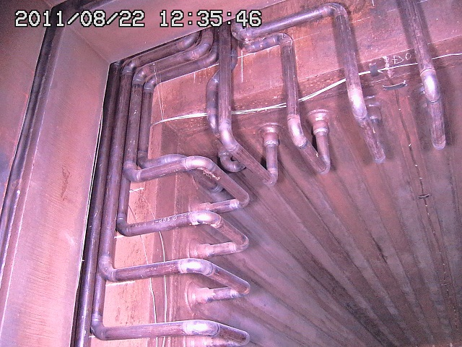
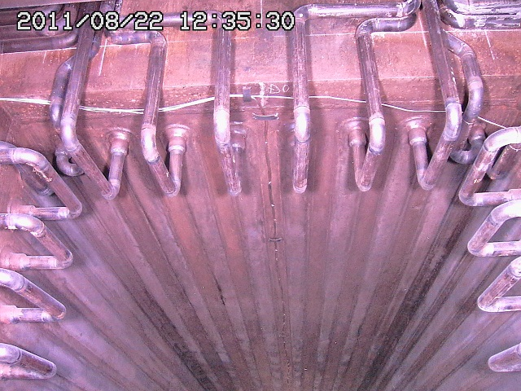
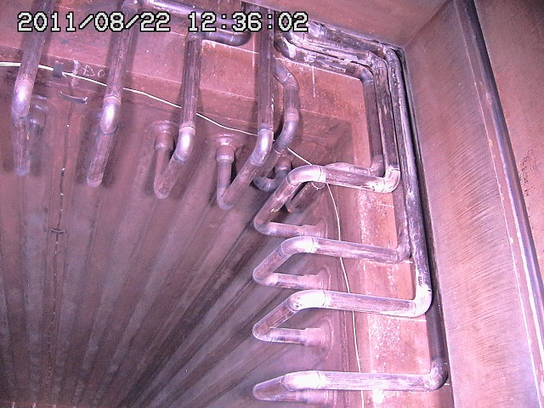
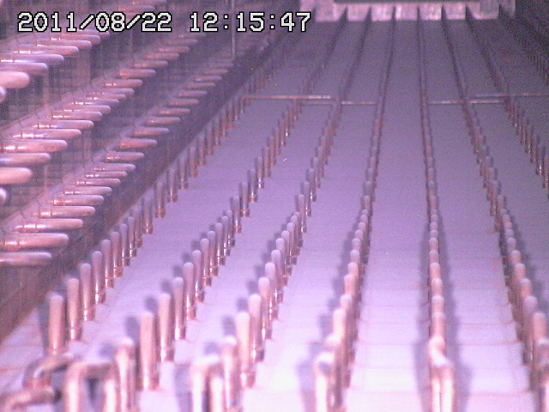
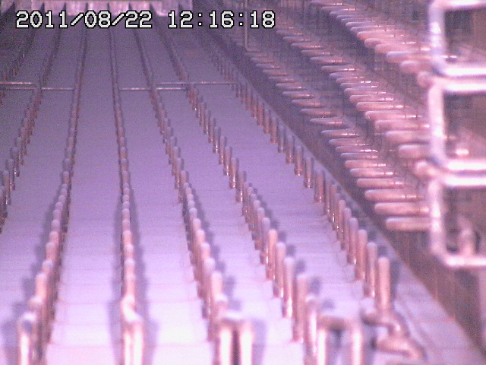
Redundant CW channels for 1.3MW
If water leak happen, we can run without troubled water loop by closing the valves .

Slide 12
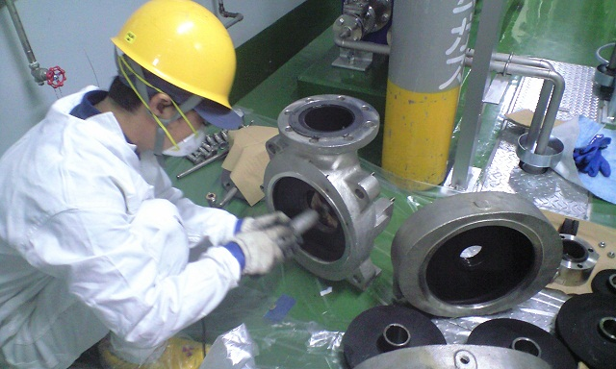
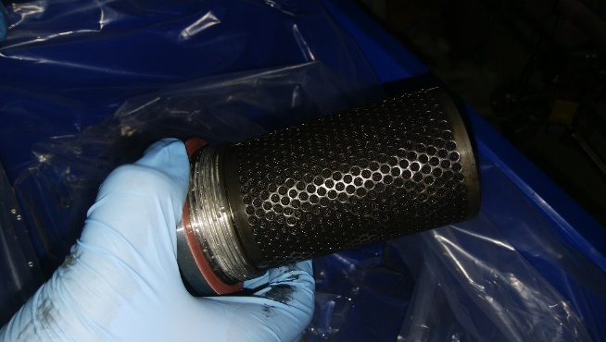
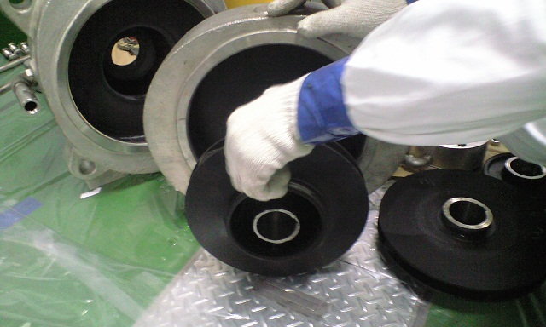
Issues for CW system for DV & BD.
Due to the beam operation, the pre-filters for degasfiers are clogged by “black material”. → It is necessary to adjust CW system regulally.
We have tried several filter configuration (mesh size: 0.5μm/1.0μm/10μm and their combination) but issue not solved yet. We have to open bypass of filters. → The membrane degasfier has been radio-activated
Black material is also adhere to strainer, pump, etc. → Additional (radiation) work for maintenance.
CW pump maintenance
Pre-filter + Degasifier
Strainer coated
by black color

Slide 13
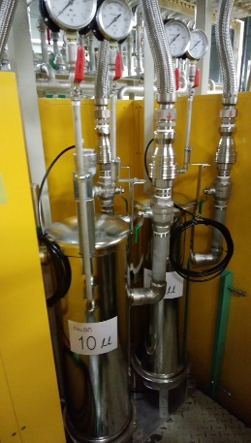
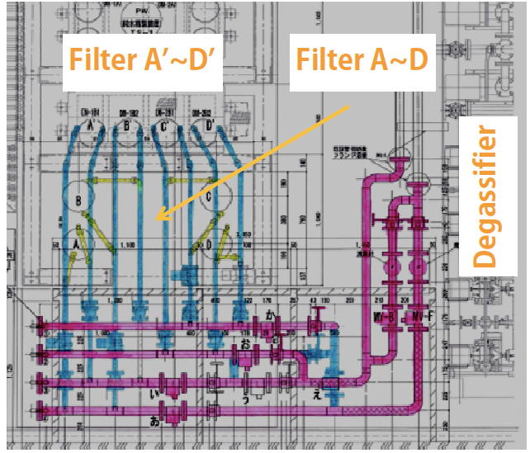
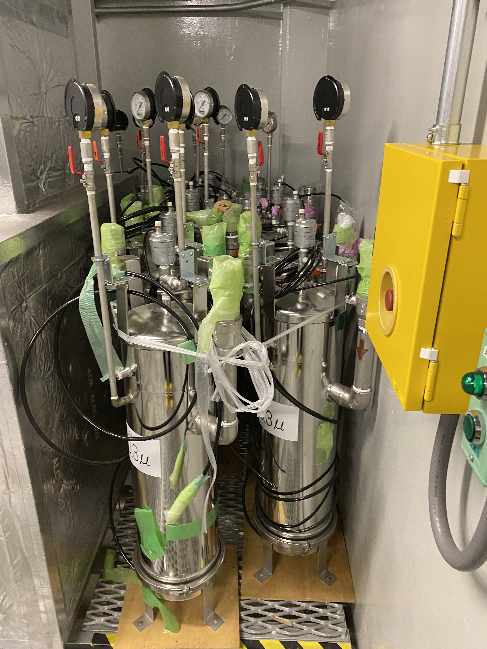
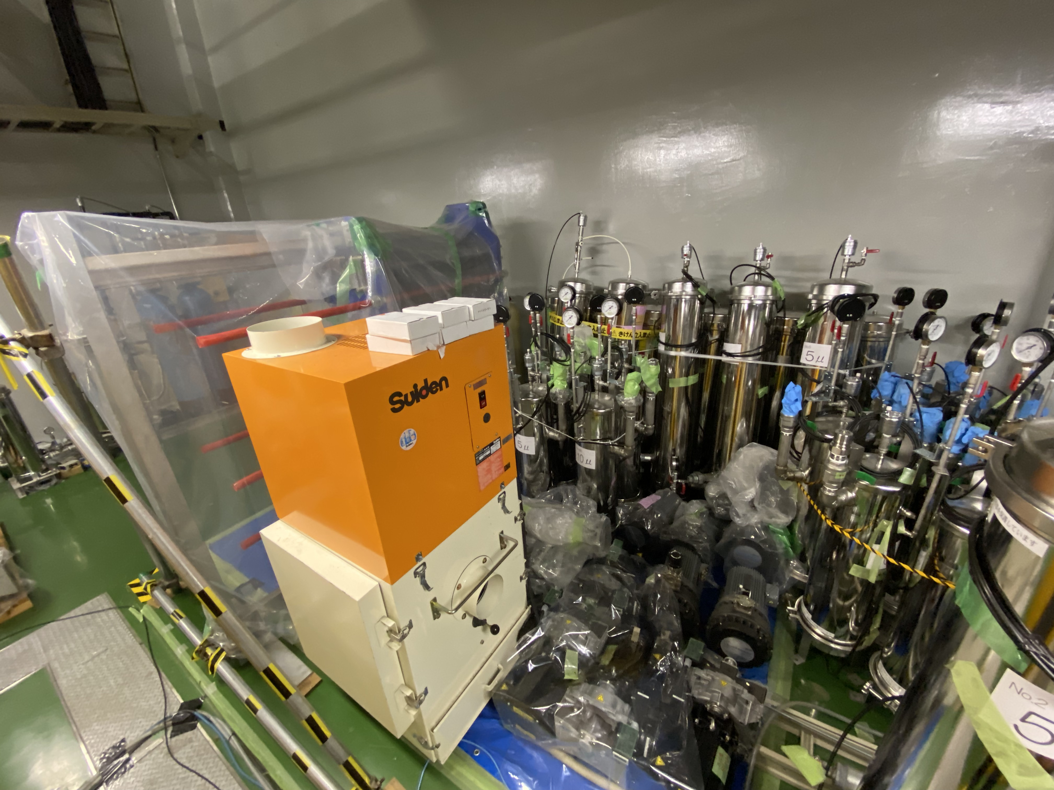
CW “Black” issues
It is necessary to adjust flow-rate for pre-filters/by-pass periodically during the beam operation period. → It is necessary to stop beam for >8hours because it is installed in access controlled area. - Remote adjustment system is implemented for TS and is under preparation for NU3.
We should replace filters by new one every year. → Piles of garbage become higher and higher.
We plan to try “magnetic strainer” to solve this issue.
Pump
Every rooms in NU3 are occupied by used pre-filters.
Bag-type
filter/strainer (5um)
Serial Pleats filters(0.5um)
B2F

Slide 14
Summary
Decay Volume and Hadron absorber (Beam dump) of J-PARC neutrino beam-line is designed for 3MW. → Cooling capability has redundancy for 1.3MW operation.
Cooling water system for secondary beam-line will be reinforced for 1.3MW. Procurement of equipment is on going and will be installed in ~2025.
So far, DV and beam dump systems are working well without water leak in the He vessel.
Unexpected issue: “Black material” in CW is still under investigation.
Countermeasures to deal with work under high radiation environment is considered.
Accumulating activated waste is a real pain in the neck. To be solved.

Slide 15
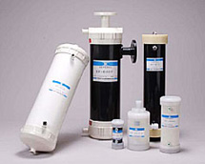
Black layer problem in carbon steel water cooling pipes
Ion Exchanger
(Not used: it will erode
Carbon steel)
Pre-filter + Degasifier
Hollow fiber membrane
Strainer coated by black color
Irradiation
By Be7(53d) + Mn54(1yr)
3~4mSv/h on contact
Decrease of flow rate
Clogging by colloidal Be7 (+ black skin) by 1~2month
Open Bypass
** Flowrate recovers when beam is off

