Slide 1
Radiation protection challenges at CERN’s north experimental areas
Elzbieta Nowak, Claudia Ahdida, Heinz Vincke, Helmut Vincke
21st September 2022

Slide 2
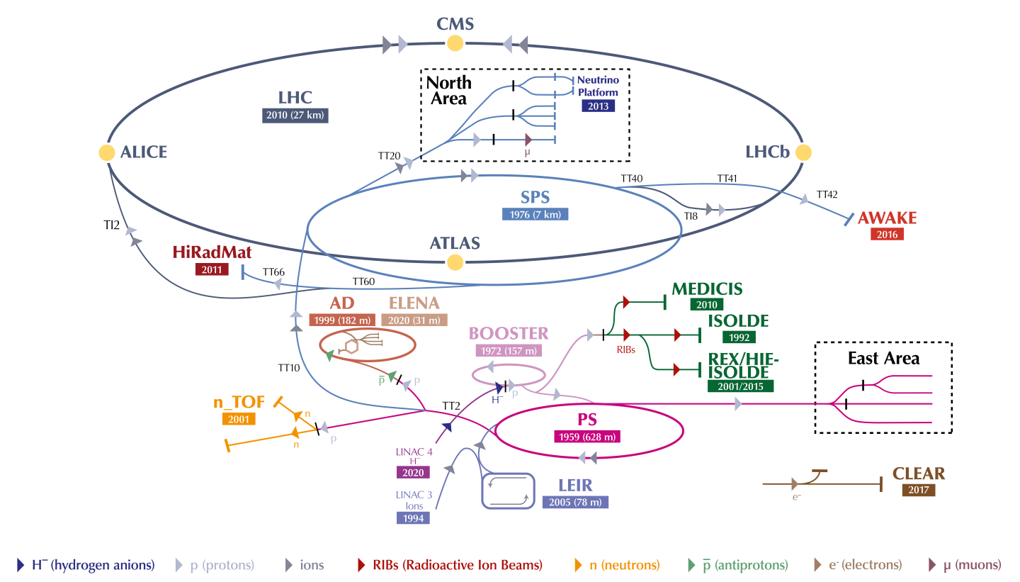
21st September 2022

Slide 3
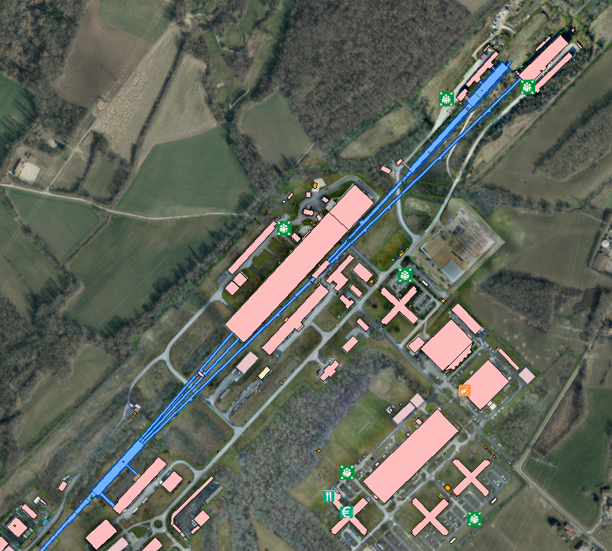
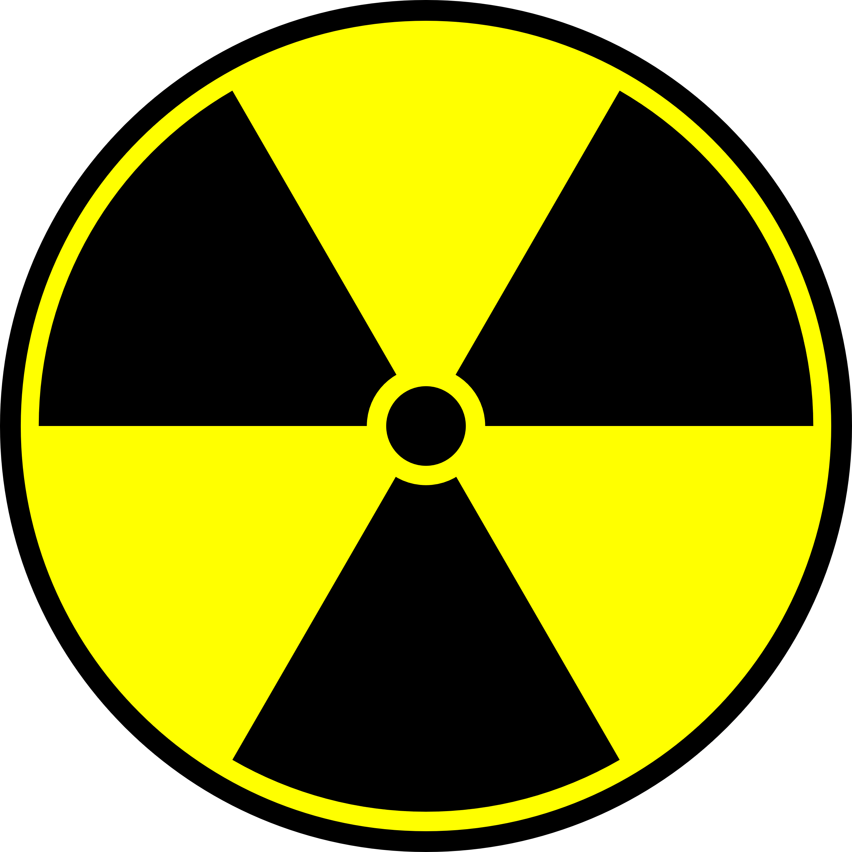
North Experimental
Area
DIRAC++
NA62/HIKE/KLEVER
BDF
SHADOWS
TAUFV
ECN3
EHN2
COMPASS/AMBER
MuonE
NA64++ (µ)
  Primary proton beam from SPS, up to 450 GeV energy
  Intensity up to 4e13 p/spill
  3 primary targets – 6 beams (H2,H4,H6,H8,M2,P42)
  Secondary targets and tertiary beams (lead ions, kaons, muons, mixed hadrons)
  New experiments and upgrades of the existing ones require RP studies on:
  Prompt and residual radiation in the facility and within CERN fence
  Environmental release aspects: earth, air activation and stray radiation to the public areas
  Beam transfer lines: accidental and continues beam losses at the critical locations (e.g. for P42 beam line to ECN3: ECN1 ramp and bridge)
ProtoDune
NA61/NA61++
NA64/NA64++ (e,h)
EHN1
GIF++
NA60+
CERF
TCC2
TDC2

Slide 4
General Principles of Radiation Protection
Justification
  Any exposure of persons to ionizing radiation has to be justified
Limitation
  The personal doses have to be kept below the legal limits
Optimization
  The personal doses and collective doses have to be kept as low as reasonably achievable (ALARA)
Safety Code F [1]

Slide 5
Dose limits and dose optimization at CERN
CERN workers
Population
Unacceptable risk
Radiation
Workers
Other
Workers
Dose limit
20 mSv/yr*
1 mSv/yr
300 µSv/yr
Tolerable risk
Dose constraint
3 mSv/yr
100 µSv/yr
10 µSv/yr
Individual risk level
Optimization process
ALARA Level
100 µSv/yr
10 µSv/yr
10 µSv/yr
Acceptable risk
*Category A – 20 mSv/y, Category B – 6 mSv/y
*Apprentices and students (age 16-18): 6 mSv/yr
*Pregnant women: 1mSv/yr
1 Sv = 100 rem

Slide 6

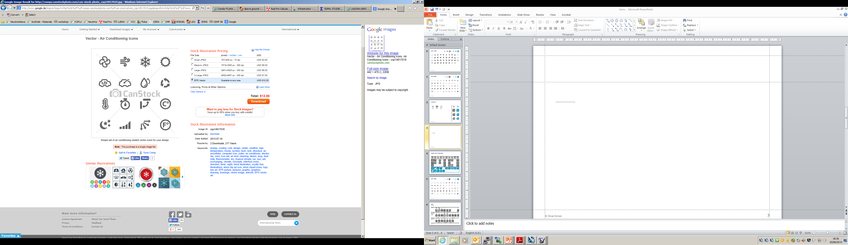

General RP considerations
Both prompt and residual dose rates need to be optimized for commissioning, operation, maintenance and accidents
  Studies for nominal, ultimate and accidental beam parameters
  Study of accidental beam loss
Adequate shielding needs to be designed and installed in view of operation and maintenance:
  Prompt radiation: strongly depends on the access need over operation and RP area classification
  Residual radiation: important for maintenance works, urgent reparations, etc. (cooling time plays role)
Depending on residual dose and contamination levels manual interventions should be partially or completely replaced by remote maintenance/repair work
Activation properties of materials must be optimized as may have direct impact on later handling and waste disposal (ActiWiz)
Prompt and residual radiation
Air and He
activation
Radiation Protection
Water and Ground activation
Radioactive waste

Slide 7
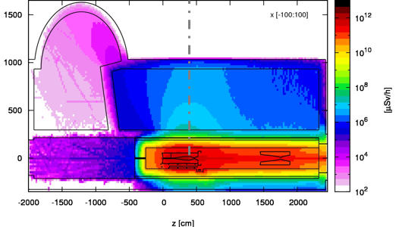
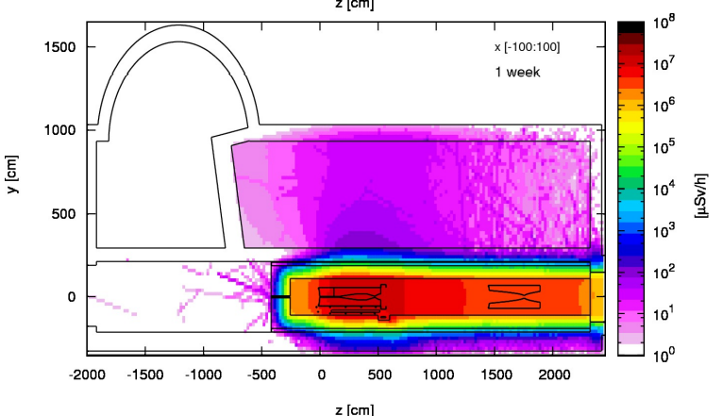
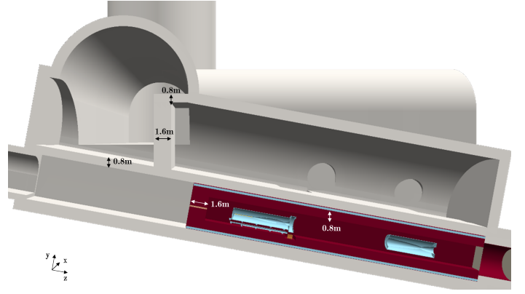
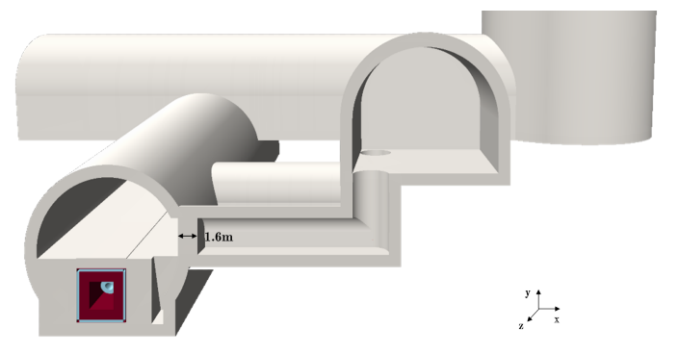
LAGUNA-LBNO (Long-Baseline Neutrino Beam Facility) CERN site
[2]
Fully underground target facility at CERN (2014), beam power up to 4 MW (50 GeV beam), 2.4e14 p/s or 750 kW (400 GeV beam) for 1.7e13p/s
Deep underground location of 80-100m in impermeable molasse to avoid ground water activation/contamination and minimize prompt dose constraints
Challenges arising from highly elevated prompt and residual dose rates:
  necessity of considerable shielding to reduce prompt dose and as a result activation
  levels of the surrounding infrastructure and molasse (0.8m Fe on top/bottom plus concrete)
  radiation streaming to service gallery needed to be sufficiently reduced
  necessity of remote handling of the target area equipment (target, horn, reflector)
  a morgue room was foreseen for temporary storage and cool-down of hot equipment
  risk of highly radioactive air, replaced with He in the target chamber
  He vessel to reduce air activation and mitigate oxidation/corrosion
10s Sv/h
Prompt H*(10)
1e6 Sv/h
Service gallery
Transport tunnel
100 uSv/h
Residual H*(10)
iron shielding
1.6m
0.8m
0.8m
1.6m
10 Sv/h
2.1m
Target and horns vault
concrete shielding

Slide 8
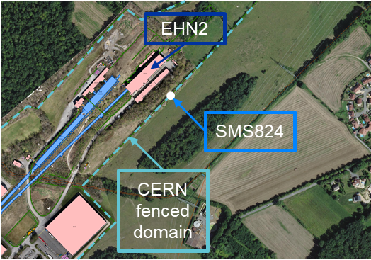
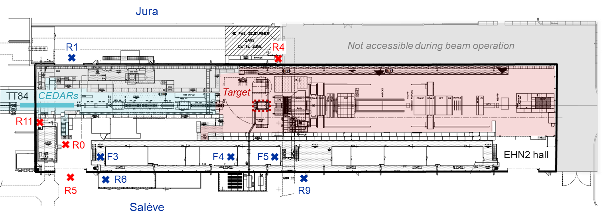
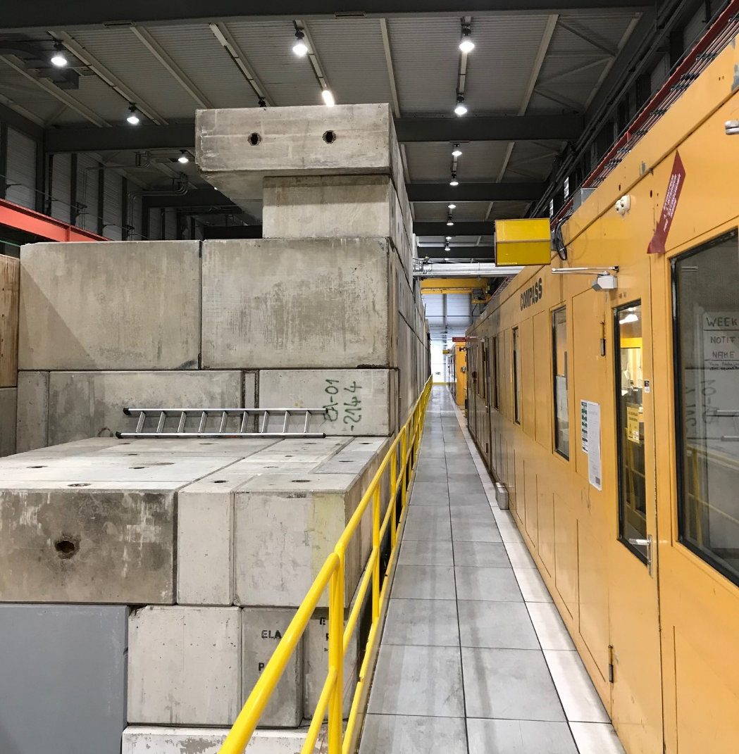
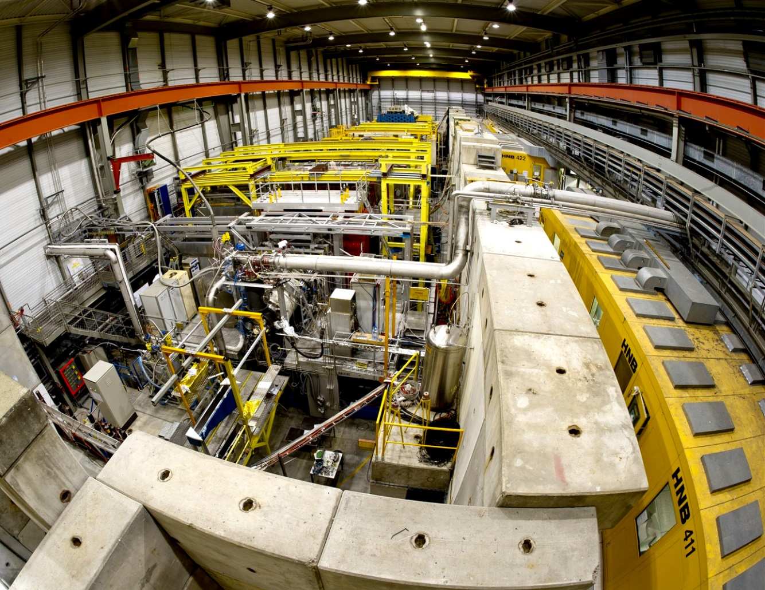
COMPASS/AMBER DRELL- YAN runs in EHN2
COMPASS in EHN2 hall, Pion- 4.2e8 p/spill @190 GeV, 1.83e14 POT/y (2018)
Challenges: elevated radiation in EHN2 accessible areas over operation, nearby public areas
2015 (1st DY run) 1.7e14 POT/y: environmental monitoring at CERN fence reached 75% of dose limit of 1 mSv
2017: additional shielding installed and counting rooms moved to different location, no target roof
2018 intensity increased by 23% and an RP survey was performed to verify dose levels in EHN2 and outside
→ elevated radiation (close to/above area classification limits) found in several locations which triggered detailed studies on the required shielding and origin of the beam loss
65 m
Shielding improvement required
particularly in the beamline region
2.4 m
1.6 m
Position | R4 | R0 | R11 | R5
Dose rate (µSv/h) | 45 | 15 | 16 | 4 (3*)
Limit (µSv/h) | - | 15 | 15 | 2.5
[3,4]
2017
Additional shielding installation
Pressent open target

Slide 9
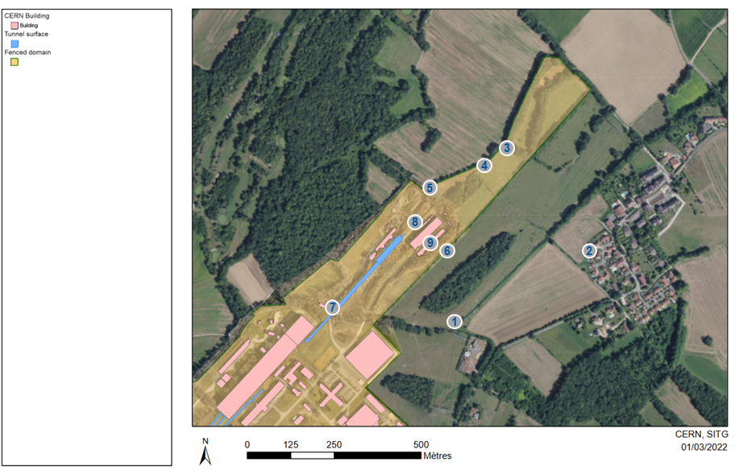
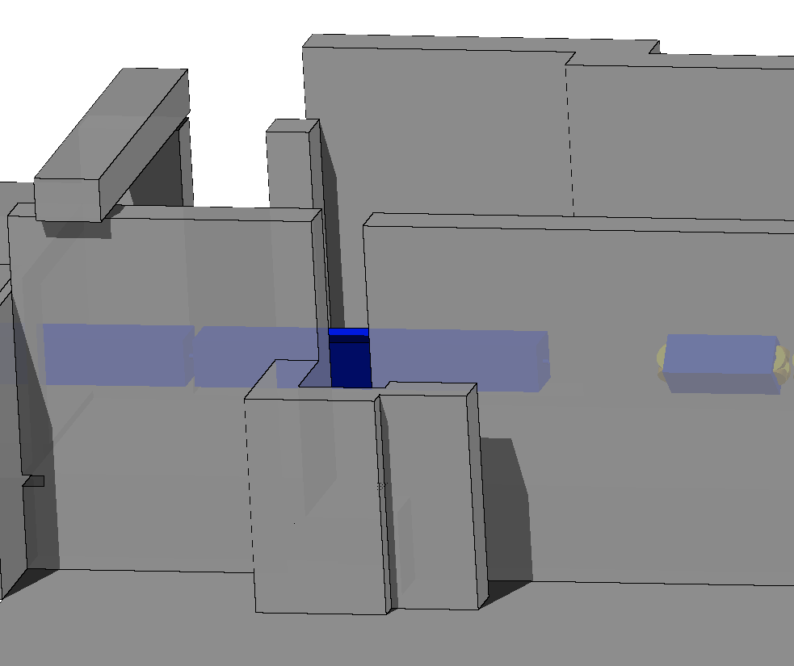
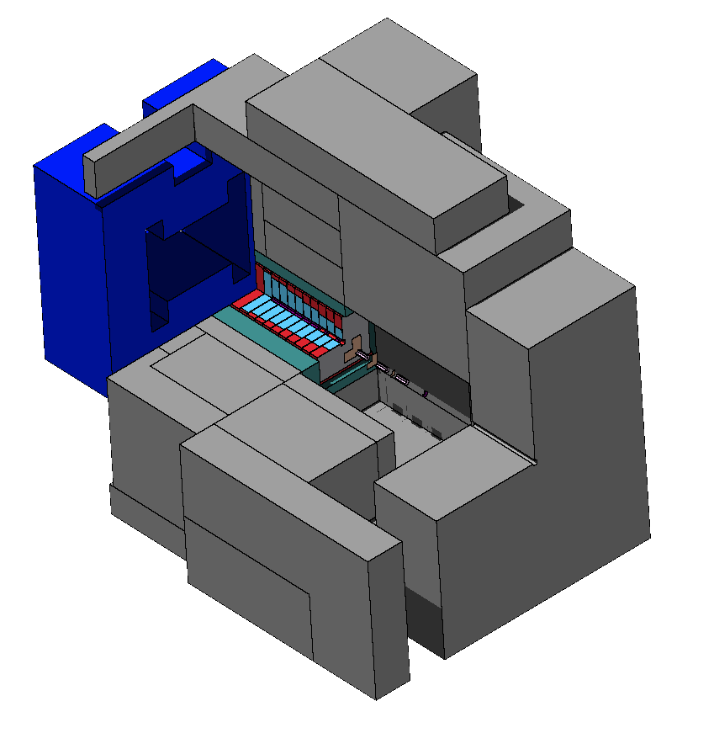
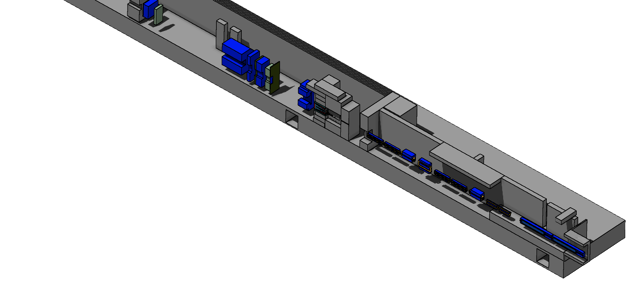
AMBER DRELL- YAN runs in EHN2
AMBER (as of 2023) : 1e9 pi-/spill, 3.07e14 POT (68% higher wrt COMPASS 2018 run)
Complex MC FLUKA studies have been triggered after the survey in 2018 and in view of future intensity upgrade
Additional shielding at strategic EHN2 locations to comply with radiation area classification and 1 mSv limit at CERN fence
Design new shielding bunker for AMBER Drell-Yan to cope with higher intensity runs
Assess environmental impact outside of CERN fence to respect dose objective for the public:
  stray radiation
  skyshine optimization
  air activation
Effective dose to the members of the public in nearby areas
to respect the dose objective of 10 µSv/year from all facilities at CERN
CERN
fence
Public
New access
chicane
  π⁻
FLUKA hosted by CERN (FLUKA v4-2.2) [5-7]
FLUKA geometry created using FLAIR [8]
New target bunker

Slide 10
  Air volumes should be minimized in hot areas or replaced by vacuum or helium environment
  Static confinement - air areas should be separated by physical barriers from adjacent areas and the outside
  Dynamic confinement by a ventilation system guaranteeing a pressure cascade from low to high contaminated areas
  Air extraction systems should be equipped with HEPA (High Efficiency Particle and Aerosols) filters on exhaust and air monitoring systems (in North Area: target areas, high intensity ECN3 cavern and new facilities)
  Access to an area can only be given if the committed effective dose per hour of stay originating from the activated air is < 1 µSv
Prompt and residual radiation
Air and He
activation
Radiation Protection
Water and Ground activation
Radioactive waste

Slide 11
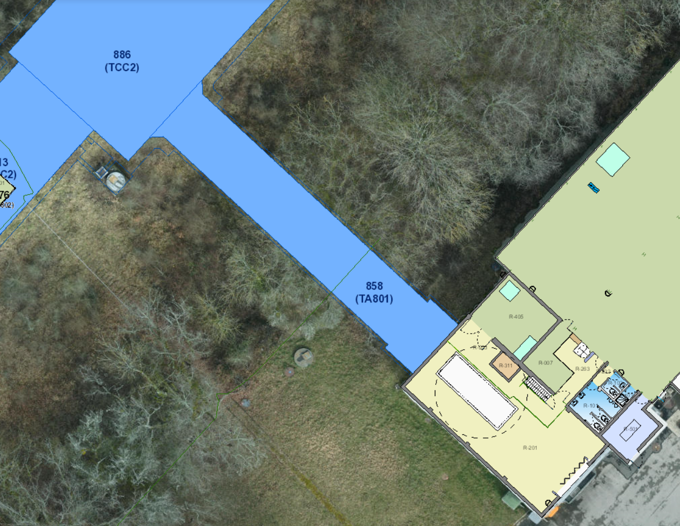
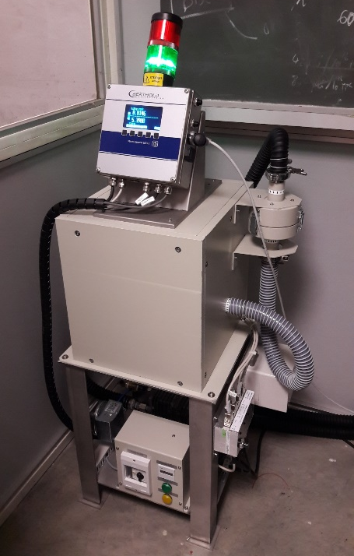
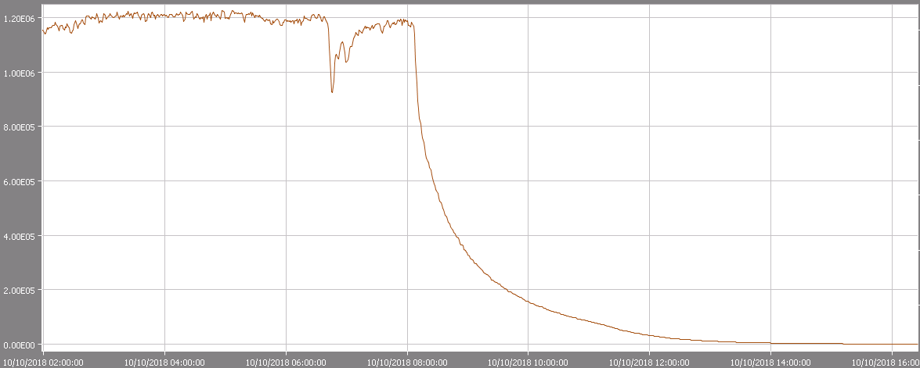
BA80 (surface of TCC2 area)
TCC2
Controlled
Limited stay area
Gases can’t be retained by filters thus the only way to reduce their activity is by a delayed release or by a long duct (long transport time) for short lived ones
  Short lived gases: C-11, N-13, O-15 (half-life minutes scale) (in the form of CO, CO2, N2, O2, NOx), Ar-41(1.83h)
  Issues with long lived ones e.g. H-3(12.3y) (HT, HTO), C-14(5700y), Ar-37(35d), Ar-39(269y), Cl-36(5e5y)
Radionuclides attaching to aerosols: Be-7, P-32, P-33, S-35 and Na-22 can be retained by high efficiency particles and aerosols HEPA filters. In addition, dust, corrosion, erosion particles containing Mn-54, Co-60.
Solutions for TCC2/TDC2:
Access to TDC2/TCC2 can be given after 2 hours of waiting + 2 hours of flush after beam operation
Air activation monitor installed in BA80 and operational since mid-2018 allows to sample air from TCC2 target (via CV) region before access and is connected to REMUS (global RP monitoring system)
Recent ventilation system (in surface building) issue provoked air drawing in from TCC2 towards the surface building/access point) → RP monitoring alarm of the air activation monitor was triggered
TDC2
Controlled
High radiation area
BA80
Bq/m³
Air flushing

Slide 12
Minimize the risk of earth activation by using appropriate shielding
Minimize ground water contamination – depending on the hydrogeological properties of the facility surroundings:
  Deep impermeable molasse with no contact with shallower aquifers in moraine above and not suitable for drinking water exploitation
  Less deep locations in semi/permeable moraine require complex studies:
    For a new facility: hydrogeological studies, geo-membrane may be a solution, soil composition should be evaluated
    Na-22 and H-3 with high affinity to water passing aquifers (leaching from rock) are the most concerning ones
    Limits of 2 Bq/kg for Na-22 and 10 Bq/kg for H-3 must be respected (proposed in 2014 for CENF Neutrino Facility [9]) unless further information (e.g. dedicated hydrogeological study) exists allowing to reduce the risks
Water cooling circuits for highly radioactive elements (such as targets, dumps) should be closed and separated from others (retention tanks) to avoid environmental leak (ideally to be avoided)
Prompt and residual radiation
Air and He
activation
Radiation Protection
Water and Ground activation
Radioactive waste

Slide 13
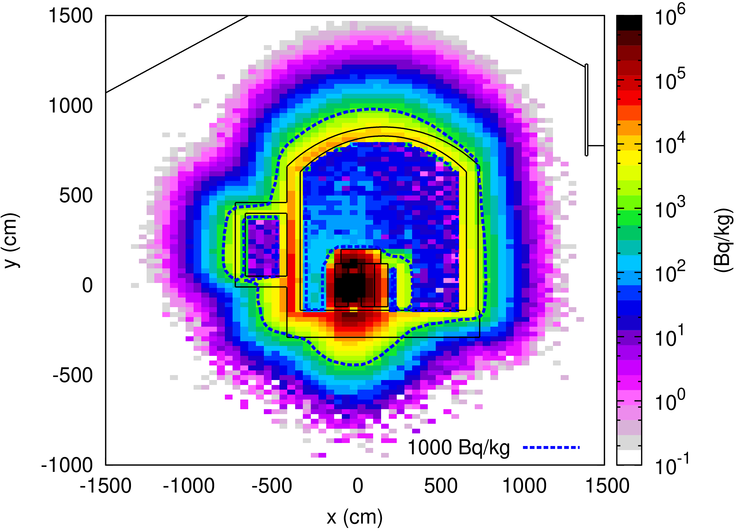
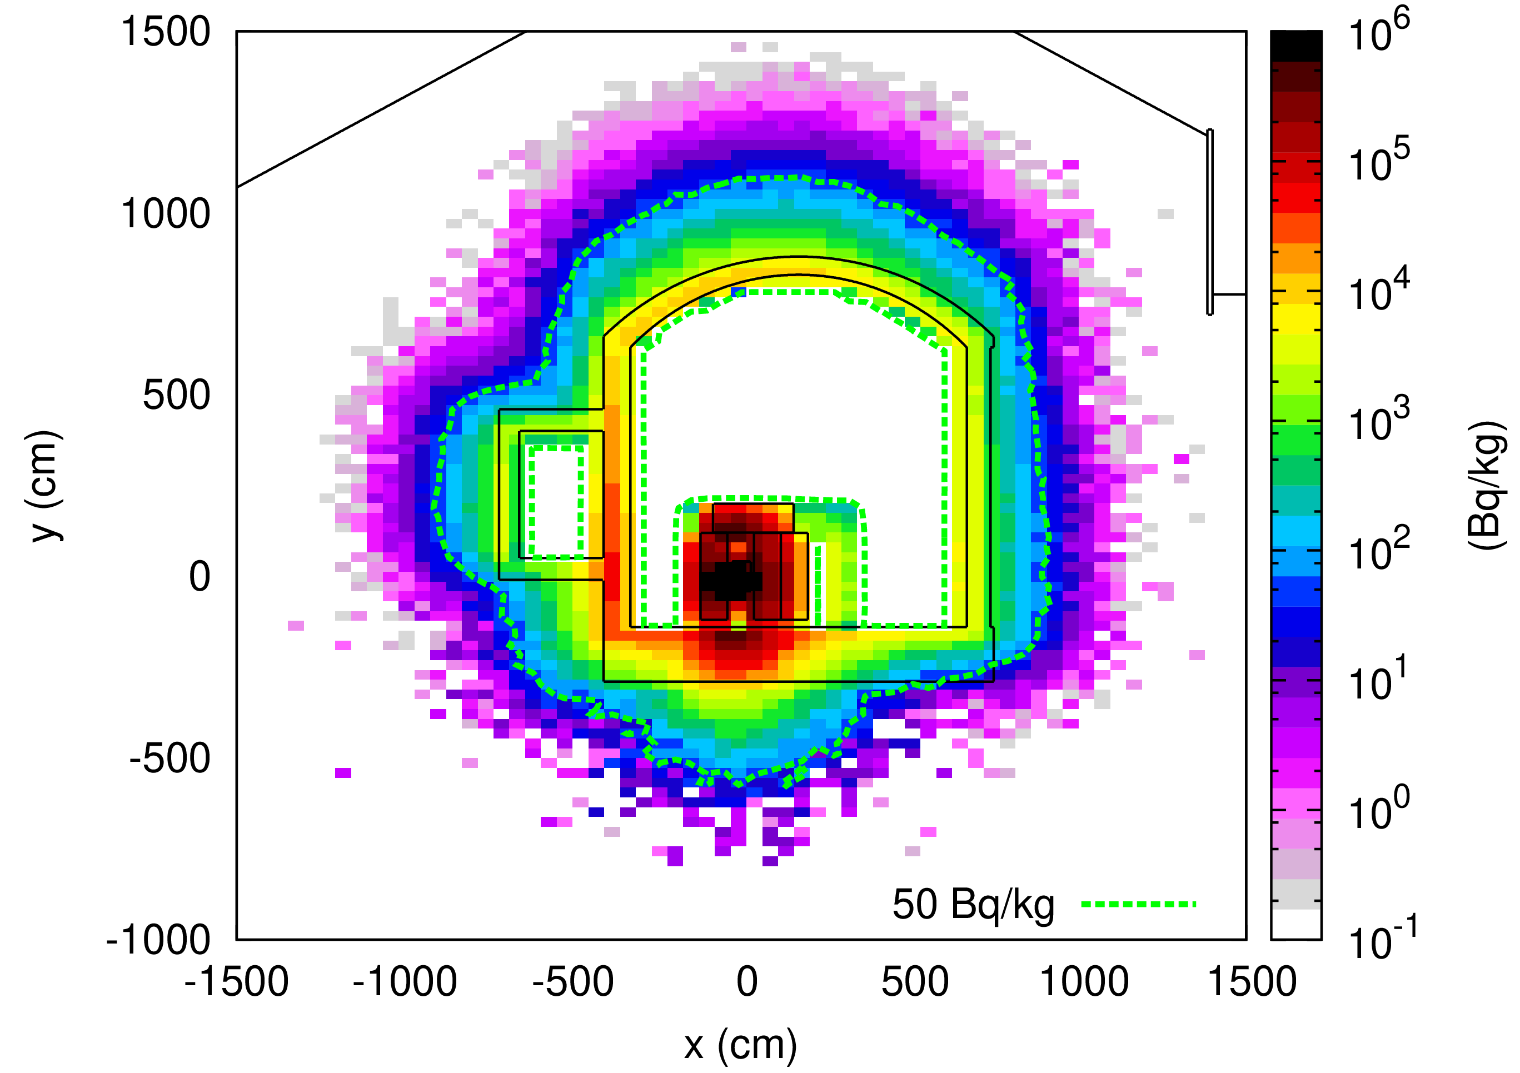
Earth activation and water contamination
ECN3 study case
ECN3 located 19 m underground (8 m of moraine above)
400 GeV, 2e13 p/spill, 1e19 POT/year for future HIKE experiment (NA62 intensity increase 3.5 times)
Assuming 4 years of operation (180 days/year) moraine gets activated to extensive levels in terms of Na-22 (T1/2=2.6y) and H-3 (T1/2=12y)
Conservative limits for Na-22: 2 Bq/kg and H-3: 10 Bq/kg established for CENF exceeded by more than 1000 times in target and TAX region (Na-22 of particular concern) (here non-diluted water intake assumed, 100% leaching)
New limits proposed (based on Swiss RP Ordinance/Annex7/ Immission limits for water and other factors taken into account) Na-22: 50 Bq/kg and H-3: 1000 Bq/kg – but still exceeded in the target/TAX region (geological studies done in the past and no deep aquifer found, moraine of low permeability) [10]
Na-22 and H-3 specific activity (Bq/kg) at the target area
H-3
Na-22
Still 2.2 m on top and 2.8 m bottom layer exceeds the limit
with max up to
3700 Bq/kg (bottom)
Cooling time of 1 s (

Slide 14
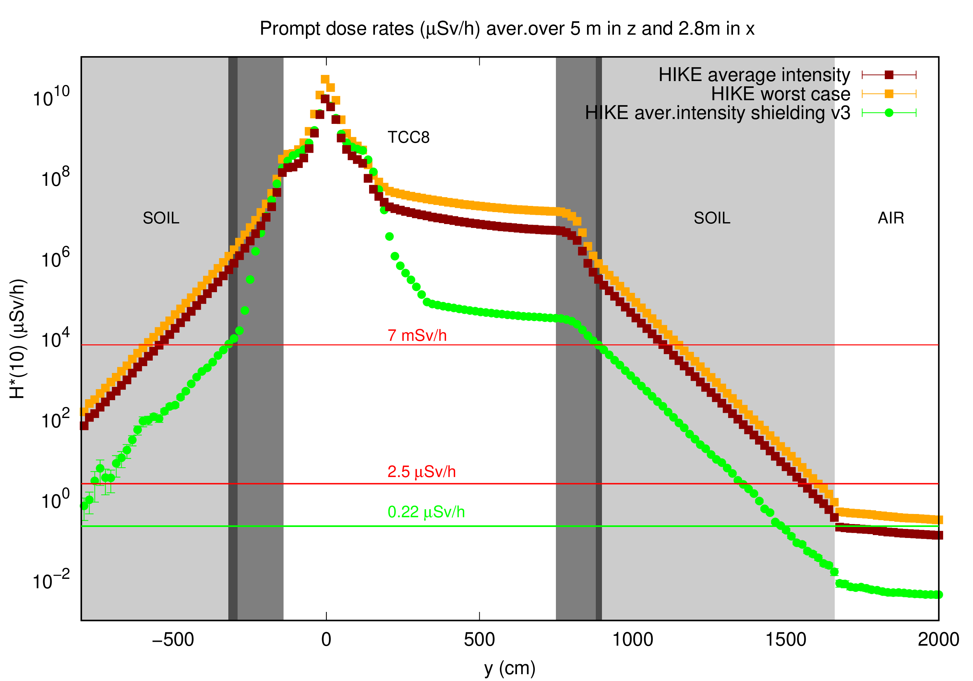
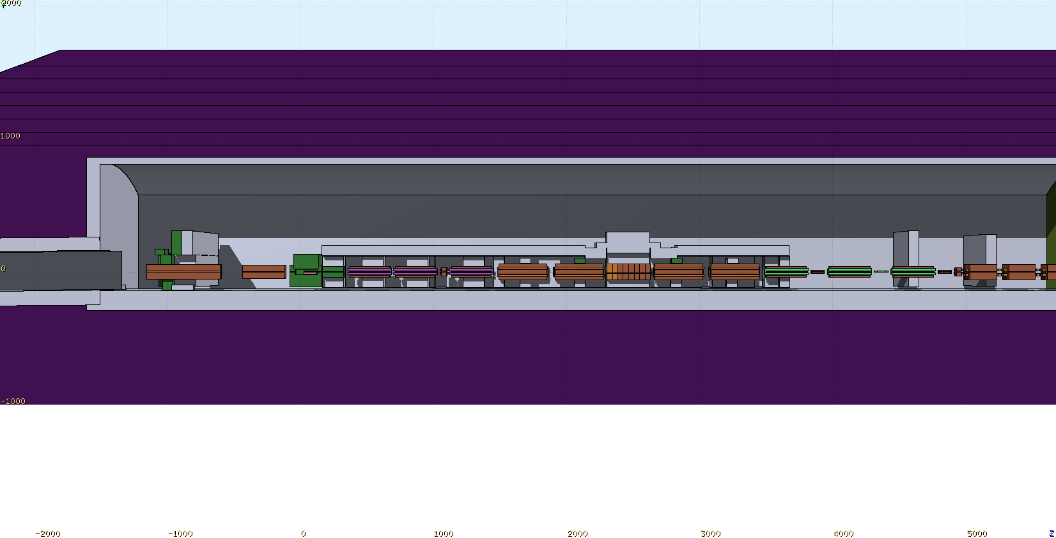
Earth activation and water contamination
ECN3 study case
Correlation of the limits of soil activation with the H*(10) prompt dose at the critical location (target: bottom soil and top soil):
Na-22 (50 Bq/kg) – 7 mSv/h H-3 (1000 Bq/kg) – 50 mSv/h
CHALLANGE: Necessity of an adequate shielding to reduce prompt dose
and in consequence bring down soil activation to the limits
Present ECN3: NA62 MC FLUKA model
Shielding (side view)
7 mSv/h
H*(10) - 1D in Y
Shielding optimization is ongoing :
Semi-Optimized shielding design assumes:
0.8 m – 1 m of Fe floor shielding for the target and TAX region
0.4 m Fe and 1.4 m of concrete on the target top
Target to TAX – floor shielding 0.4- 0.6 m of iron

Slide 15


A new facility design must consider minimalization, decommissioning and dismantling process of radioactive waste
  Cost of materials used vs cost of waste disposal
  Lessons learned from previous dismantling: (CV should be preserved to avoid degradation and corrosion - WANF)
Material minimalization – usage of materials of low activation level, as may have a direct impact on later handling and waste disposal
  particle field dependent
  high purity, low critical impurities as cobalt
  ActiWiz tool to compare operational aspects and radioactive waste produced at different location with different materials used – General Hazard Factors [11]
  E.g. modular equipment and shielding, easily separated parts
Good practice to avoid unnecessary equipment activation: only absolutely necessary equipment should be installed in areas of high radiation levels.
Prompt and residual radiation
Air and He
activation
Radiation Protection
Water and Ground activation
Radioactive waste
$$\sum_{i}^{n}{\frac{A_{i}}{{LL}_{i}}}>1$$
H*(10)@10cm distance > 0.1 µSv/h
$$\sum_{i}^{n}{\frac{c_{i}}{{CS}_{i}}}>1$$
or
or
LL – swiss clearance limit for a radioisotope i (Bq/g)
Ai – specific activity of a radioisotope i
Ci – limit for surface contamination for a radioisotope i (Bq/cm2)
Csi – surface contamination of a radioisotope i (Bq/cm2)

Slide 16
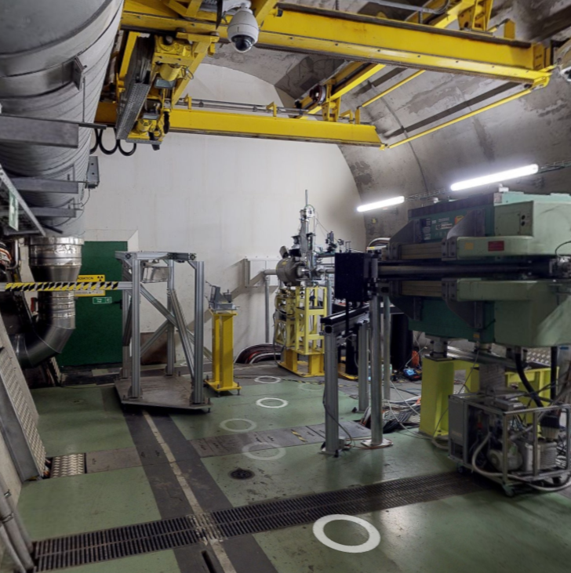
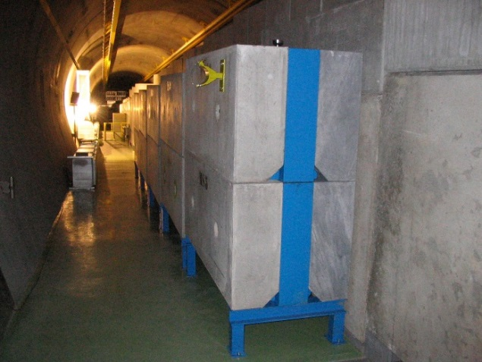
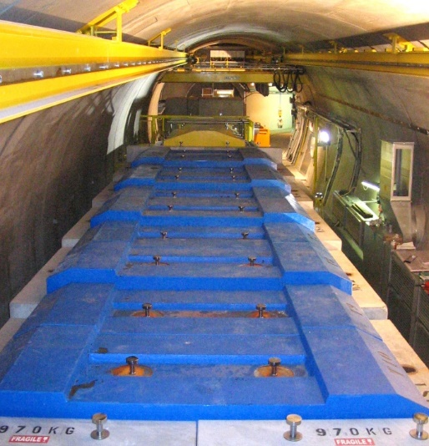
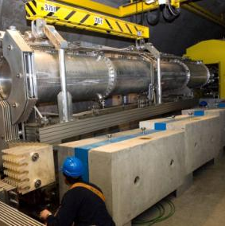
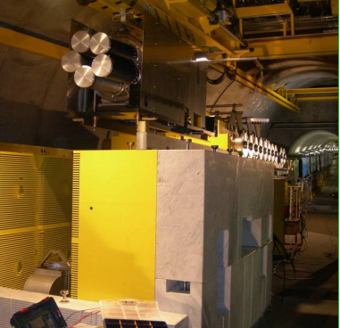
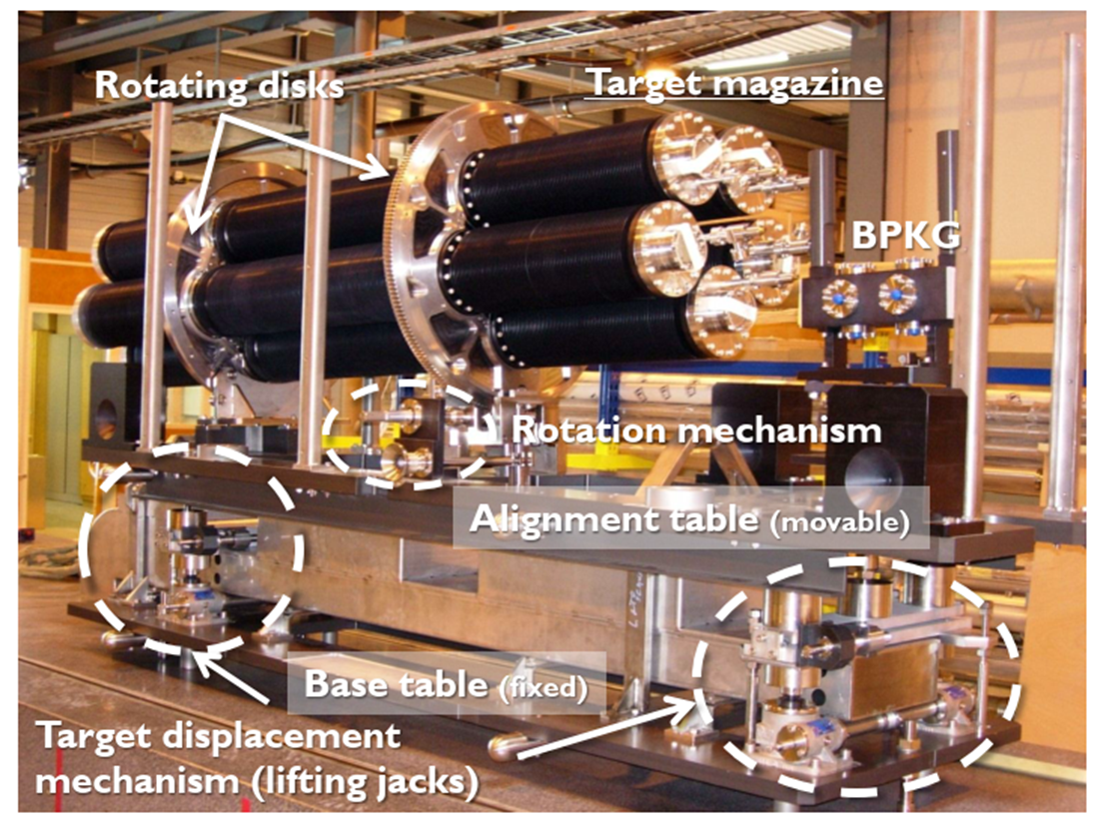
Cern Neutrino to Gran Sasso experiment dismantling
[12]
CNGS in operation from 2008-2012, 2.25e20 POT, 160 kW (500 kW), 60 m underground
100 m beam line equipment in TCC4 cavern still radioactive despite 9.5 y of cooling
To be dismantled and disposed: target, horns (7m), beam monitor, helium vessel (70m), shielding blocks
High contact dose rates: up to 50 mSv/h at the target tube
No direct access to the beam line and any possibility to measure dose rates close to the beam - MC FLUKA and ACTIWIZ calculations essential!
Requires preparation on waste classification and management strategy work → classification based on radionuclide inventories and residual dose rates to establish elimination pathways (huge computational work)
CERN site: RWTC Radioactive Waste Treatment Center at CERN has limited space (temporary storage only)
a new storage building in proximity required
Each step of dismantling: decontamination, transport, storage, processing, volume reduction and final disposal
each action respecting the ALARA principle (risk due to contamination and irradiation)
Particular concern for highly activated items – target, horn, beam monitor but also huge items
to be processed and further disposed – detailed procedures
High cost of radioactive waste disposal in general but reuse of concrete blocks in other CERN’s
experiments/upgrades allows to save ~4MCHF!
AWAKE
premises
CNGS
AWAKE
Challenges
Horn
top
shielding
CNGS Target Area in 2006
Target unit
Horn

Slide 17
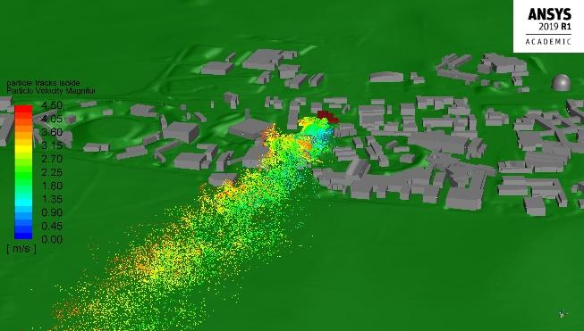
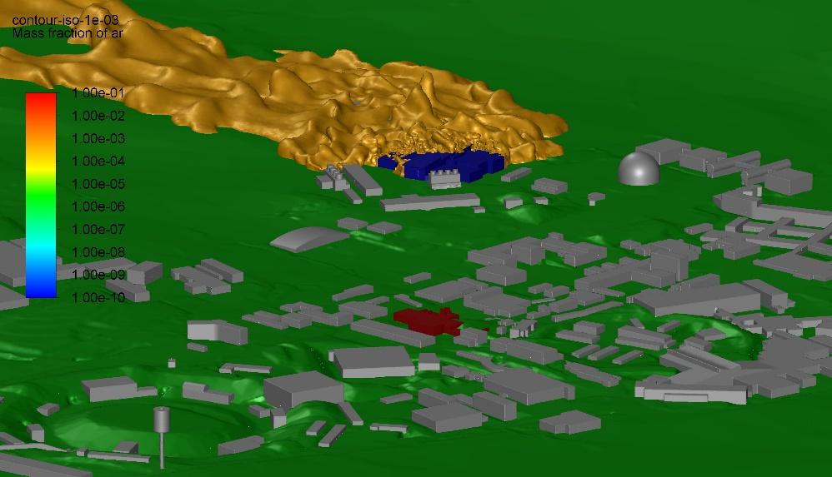
Environmental impact assessments – accidents involving fire in CERN’s accelerator facilities
FIRIA (Fire Integrated Radiological Impact Assessment) multidisciplinary project (2018-2025)
Fire safety and radiological impact of radioactive substances discharged to the environment
Fire engineers, CFD modelers, RP physicists, fire intervention planners
Exposure of: a bystander (inhalation of smoke) and a resident member of the public (ingestion of a locally produced food )
Aim: Mitigation and protective measures
https://hse.cern/content/firia
  Pilot case ISOLDE:
  Fire of contaminated oil in target vacuum pumps
  Water/air leak to a UC₄, (La, Th) targets with loss of target integrity
  Cable fire: Insulation + RNs outgassed from activated wires
  Pilot case ATLAS:
  Fire of the ITk detector
  Rupture of the LAr Calorimeter with discharge of all activated Ar gas
  and other Ar activation products to the environment
  CMS currently under study
North area’s TCC2/TDC2 will be the next!
ISOLDE - smoke
ATLAS - Ar

Slide 18
Conclusions
Each new facility requires complex RP studies and limitation and optimization significantly affect the design: target area, shielding, auxiliary infrastructure
  For each upgrade of the existing facility (as shown for high beam power cavern ECN3) or surface EHN2: RP limitation and optimization need to be fulfilled:
      area classification revision
      effective dose limit 1 mSv per year at the CERN fence
      environmental releases: radioactive air and stray radiation → objective of 10 µSv/y to the public
      Earth/ground water activation should stay below the CERN defined limits for Na-22 and H-3
  Air induced radioactivity pose problems for zones of high dose levels/target areas: air compartments should be kept at lower pressure than adjacent compartments and connected CV circuits – air activation monitoring essential
  Dismantling of the radioactive facilities must be well planned and follow the ALARA principle
    Pre-studies are important for radioactive waste classification, transport, storage and disposal

Slide 19
References
[1] CERN Radiation Protection Safety Code F
[2] The CERN Neutrino Beam to Pyhasalmi – CN2PY : Conceptual Design report
[3] C. Ahdida, M. Casolino, H. Morimoto, COMPASS - 2018 Radiation Protection Survey, CERN internal Survey Note (2019)
[4] C. Ahdida, H. Morimoto, COMPASS - 2018 Radiation Protection Survey 2, CERN internal Survey Note (2021)
[5] Website: https://fluka.cern
[6] C. Ahdida, D. Bozzato, D. Calzolari, F. Cerutti, N. Charitonidis, A. Cimmino, A. Coronetti, G. L. D’Alessandro, A. Donadon Servelle, L. S. Esposito, R. Froeschl, R. García Alía, A. Gerbershagen, S. Gilardoni, D. Horváth, G. Hugo, A. Infantino, V. Kouskoura, A. Lechner, B. Lefebvre, G. Lerner, M. Magistris, A. Manousos, G. Moryc, F. Ogallar Ruiz, F. Pozzi, D. Prelipcean, S. Roesler, R. Rossi, M. Sabaté Gilarte, F. Salvat Pujol, P. Schoofs, V. Stránský, C. Theis, A. Tsinganis, R. Versaci, V. Vlachoudis, A. Waets, M. Widorski, New Capabilities of the FLUKA Multi-Purpose Code, Frontiers in Physics 9, 788253 (2022)
[7] G. Battistoni, T. Boehlen, F. Cerutti, P.W. Chin, L.S. Esposito, A. Fassò, A. Ferrari, A. Lechner, A. Empl, A. Mairani, A. Mereghetti, P. Garcia Ortega, J. Ranft, S. Roesler, P.R. Sala, V. Vlachoudis, G. Smirnov, Overview of the FLUKA code, Annals of Nuclear Energy 82, 10-18 (2015)
[8] V. Vlachoudis, FLAIR: A Powerful But User Friendly Graphical Interface For FLUKA, in Proc. Int. Conf. on Mathematics, Computational Methods & Reactor Physics (M&C 2009), Saratoga Springs, New York (2009)
[9] P. Vojtyla, C. Strabel, H. Vincke, CENF radiological environmental considerations – CERN Internal Report (2015)
[10] Swiss Radiation Protection Ordinance (2017)
[11] H. Vincke, C. Theis, ActiWiz – optimizing your nuclide inventory at proton accelerators with a computer code, Progress in Nuclear Science and Technology (2014)
[12] E. Nowak, C. Ahdida, H. Vincke, C. Saury, Characterization o the radiological CNGS environment, CERN Internal Note (2021)

Slide 21
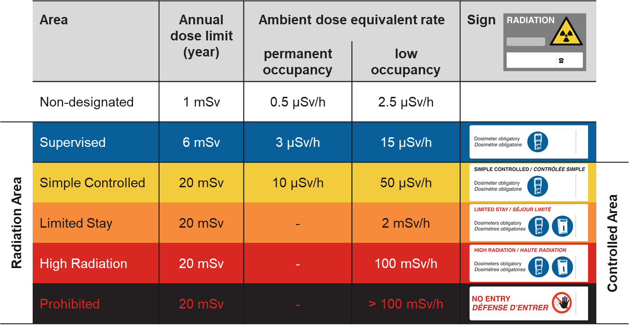
Limitation – Area Classification (external exposure)

Slide 22
Limitation – Area Classification (internal exposure)
 | Area | Annual dose limit (year) | Specific airborne radioactivity | Specific surface contamination
 | Non-designated | 1 mSv | 0.05 CA | 1 CS
Radiation Area | Supervised | 6 mSv | 0.1 CA | 1 CS
 | Simple Controlled | 20 mSv | 0.1 CA | 1 CS | Controlled Area
 | Limited Stay | 20 mSv | 100 CA | 4000 CS
 | High Radiation | 20 mSv | 1000 CA | 40000 CS
 | Prohibited | 20 mSv | > 1000 CA | > 40000 CS
CS, CA: Nuclide-specific Guidance values from Swiss legislation
Specific airborne radioactivity
1 CA = effective committed dose of 20 mSv for a stay of 2000 hours/year
Specific surface contamination
1 CS = 1/10th of dose limit to skin and/or 0.5 mSv/year for daily ingestion of contamination on 10 cm²
“No contamination”
  < 1 CS for identified isotopes
  < 1 Bq/cm² for non-identified gamma and beta emitters
  < 0.1 Bq/cm² for non-identified alpha emitters

