Slide 1
LBNF Radiation Safety Issues
S.D. Reitzner, N. Mokhov, I. Rakhno, I. Tropin, and K. Vaziri
NBI 2022
September 21, 2022

Slide 2
Introduction
Beamline Overview
Radiation transport modeling parameters
Prompt radiation
Residual radiation
Ground water protection
Activated air release
Conclusion

Slide 3
LBNF Beamline Components
Neutrino Beam
to SURF, SD
Absorber Complex
(LBNF-30)
Target
Complex
(LBNF-20)
Primary
Beamline
Enclosure
Decay Region
Primary Beam Service Building
(LBNF-5)
Fermilab
Main Injector
Tunnel

Slide 4
Radiation Transport Modeling Parameters
Radiological safeguards designs based on 2.4 MW operation
120 GeV protons @ 1.5×10¹⁴ p / 1.2 s
56% duty factor
Model radiation transport using MARS
2.2 m target for target hall calculations
1.5 m target for decay pipe and absorber

Slide 5
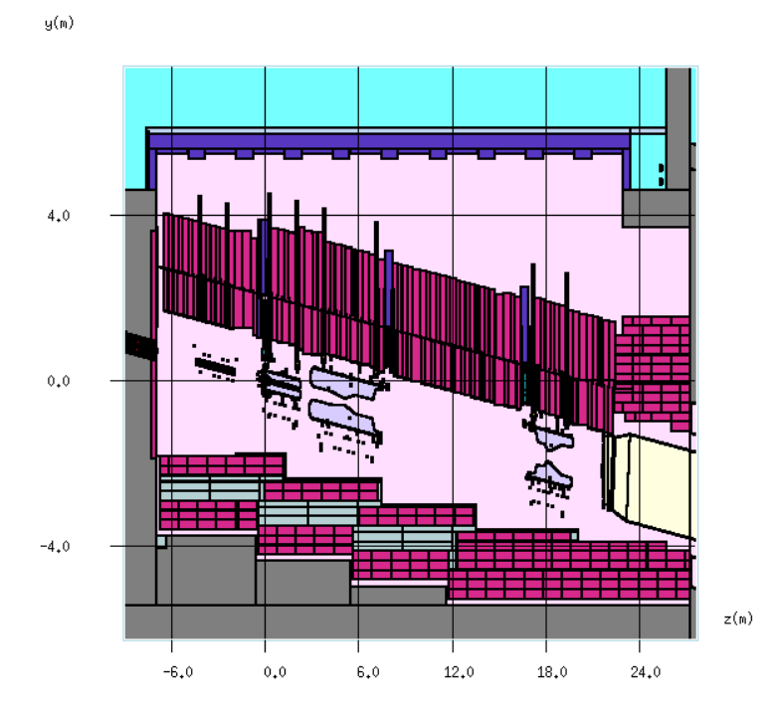
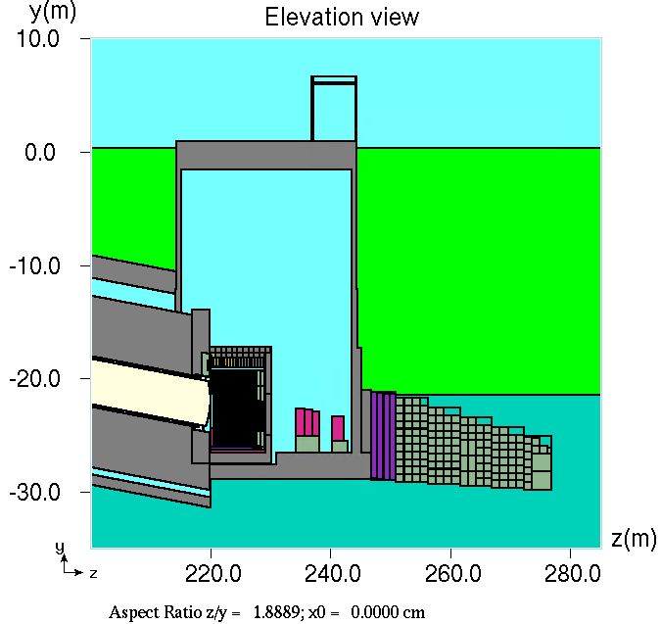
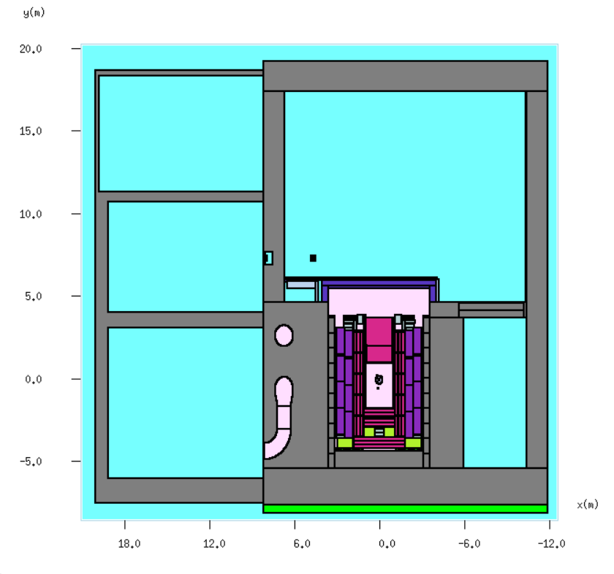
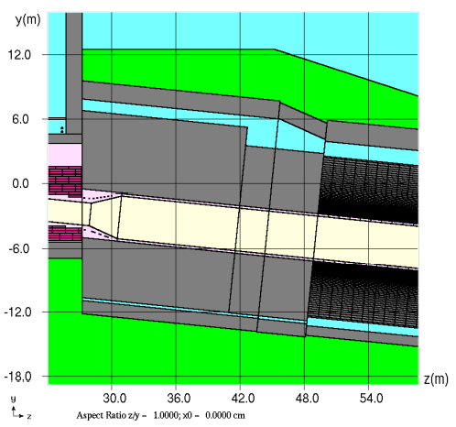
LBNF MARS Model
Target Station
Absorber Hall
Target
Hall
Decay
Pipe

Slide 6
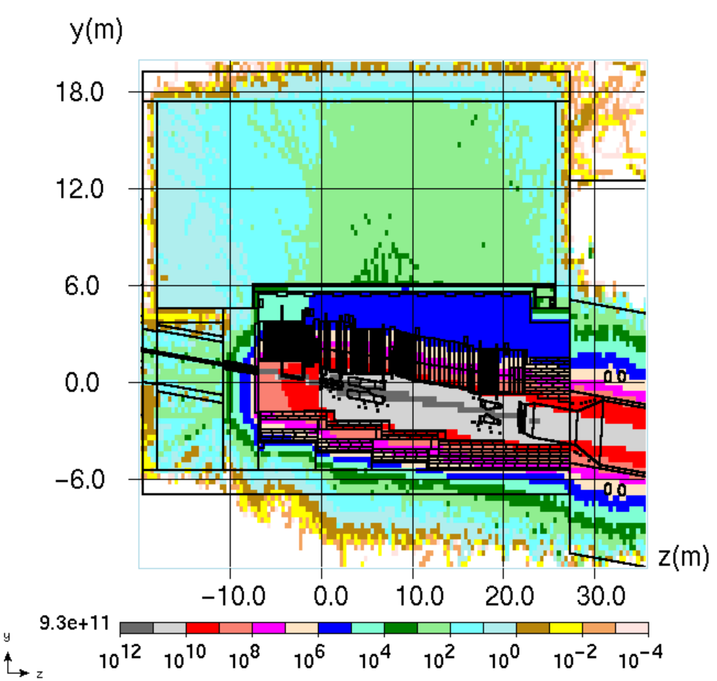
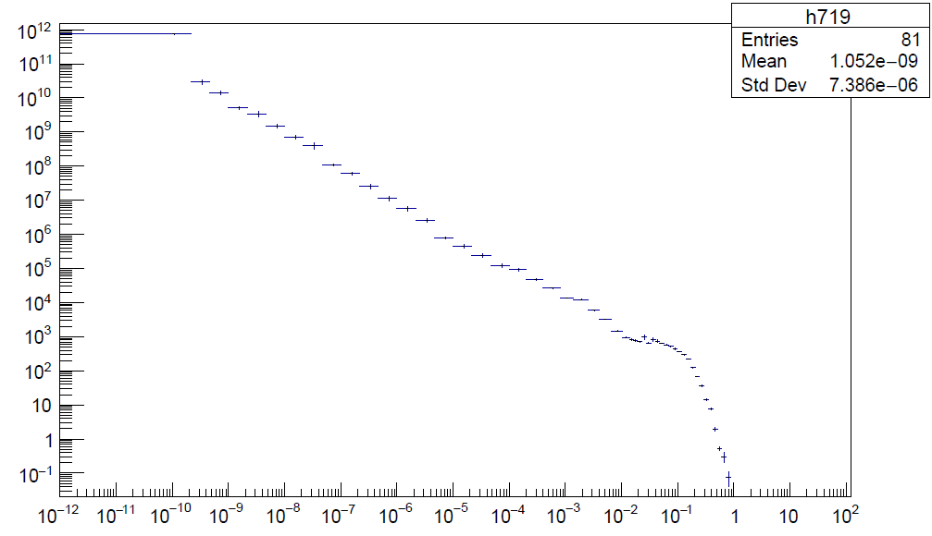
Prompt Dose
10 mrem/year from entire lab at site boundary.
0.25 mrem/hr for rad worker
50 μrem/hr for non rad workers
7 ft thick ceiling
5 ft thick walls
166 mrem/hr
Neutrons/GeV/cm²/s
mrem/hr
No access during operation.
Energy (GeV)

Slide 7
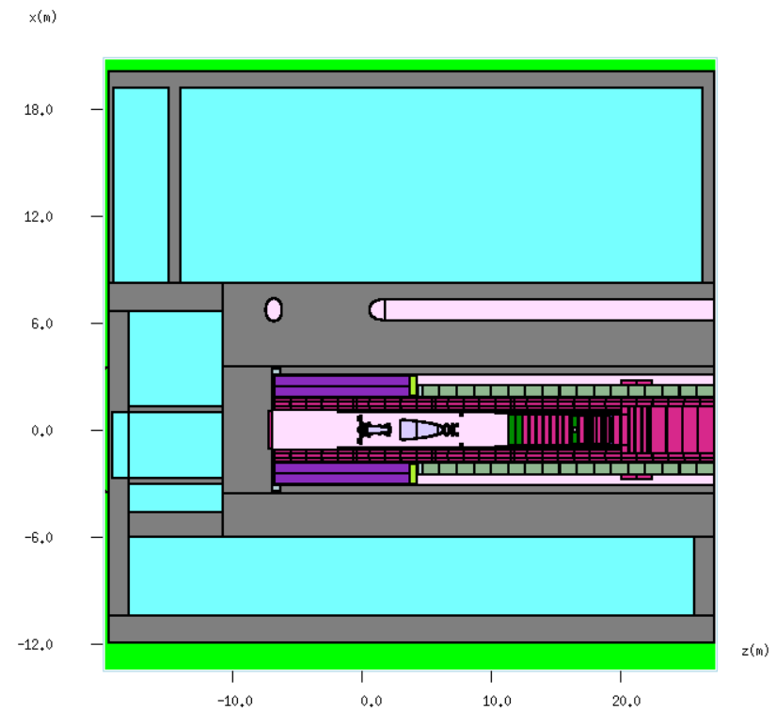
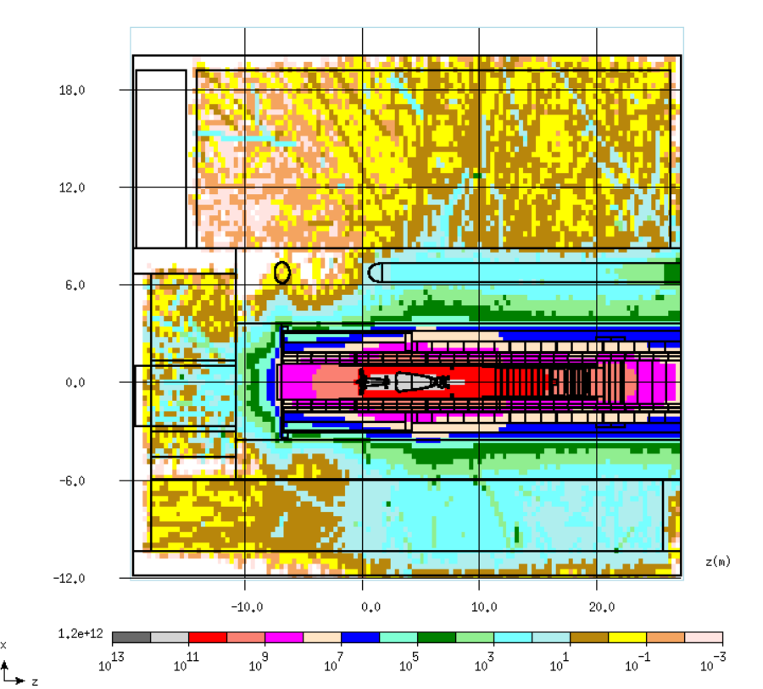
Prompt Dose at Nitrogen Handling Room Level
Y = 0 m
2.5 mrem/hr
Nitrogen handling
room (NHR)
Morgue
Pretarget
mrem/hr
53 mrem/hr
No access in pretarget
or NHR during beam on
86 mrem/hr

Slide 8
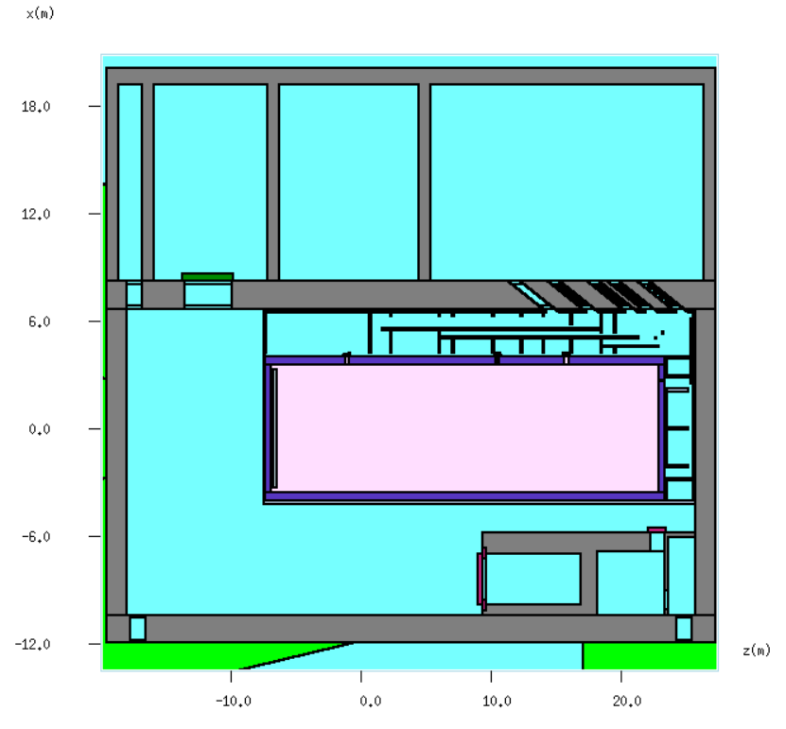
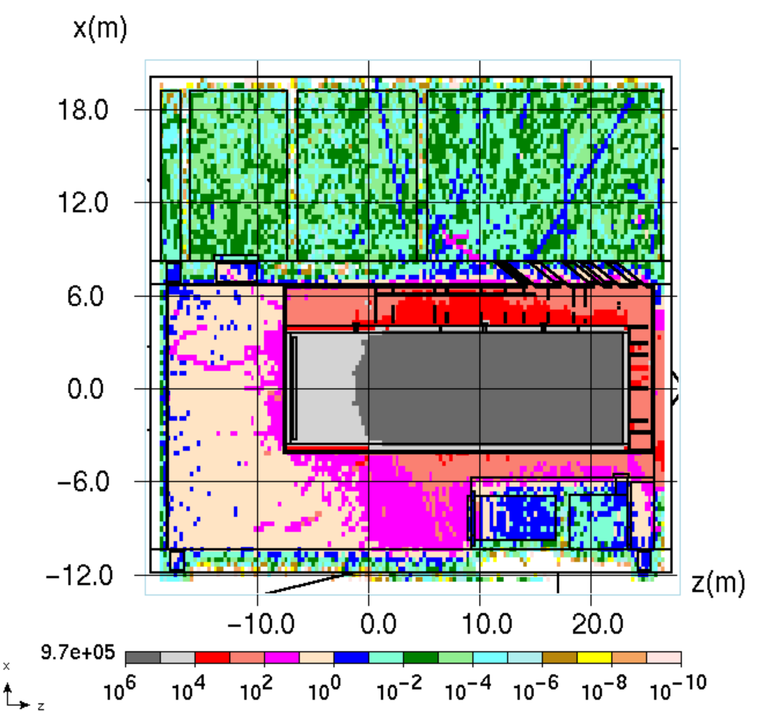
Prompt Dose at Battlement Level
Access
Corridor
Y = 4.9 m
54 μrem/hr
Power
Supply
Radioactivate
Water (RAW)
N₂ fill
Borated
poly cover
Work Cell
mrem/hr
Battlement
Rad worker access to
support rooms except RAW
y = 4.9 m

Slide 9
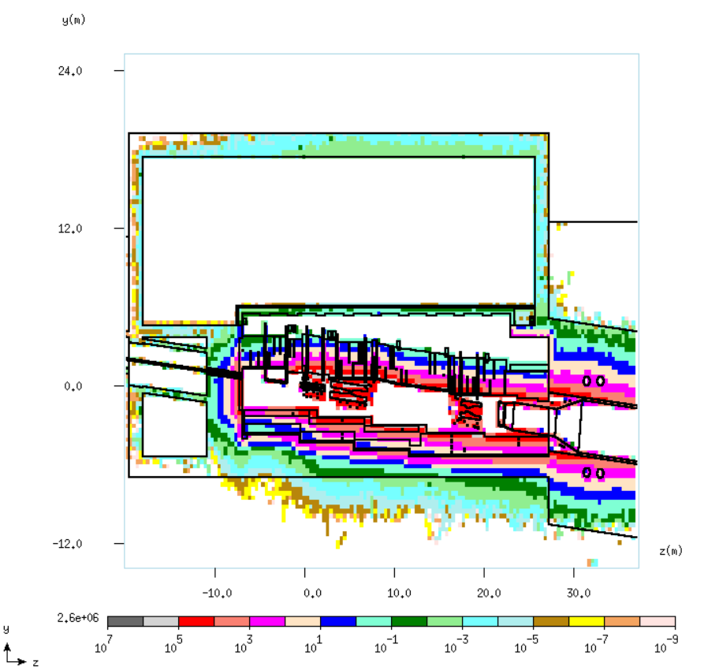
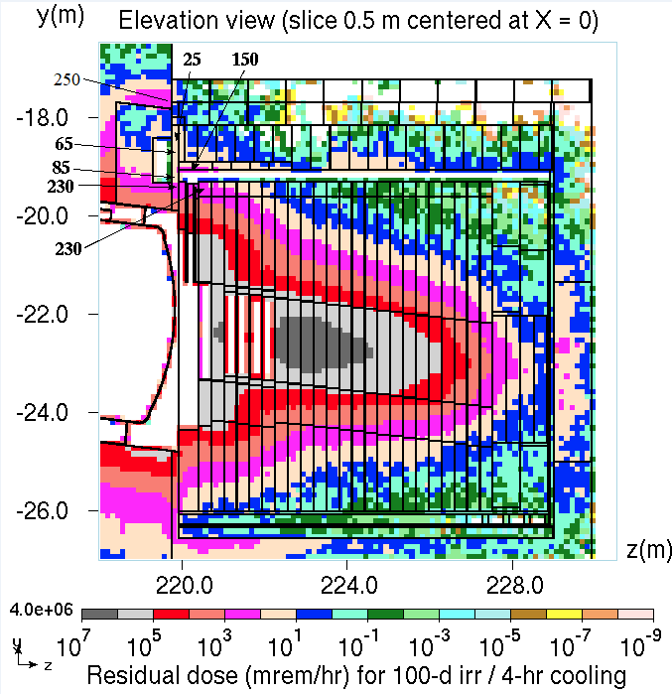
Residual Dose
<200 mrem/hr top
of shield pile
150 mrem/hr max
on concrete blocks
230 mrem/hr
max top of steel
100-d irr/4-hr cooling
mrem/hr
200 rem/hr max
t-blocks
800 rem/hr max
cooling panels

Slide 10
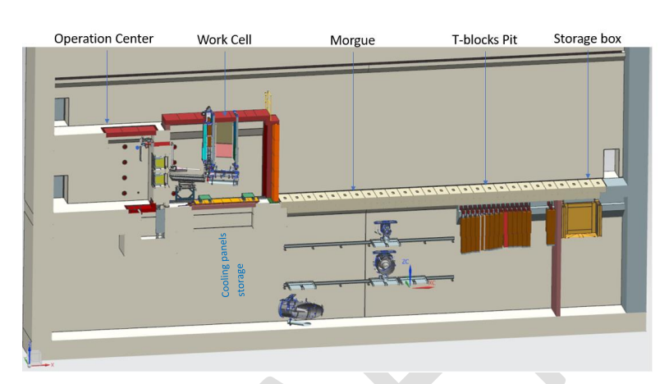
Remote Handling and Storage
Work cell is designed for 4000 rad/hr on contact object.
2000 R/hr activity estimated for Horn B or Horn A and target
Work cell and morgue located in target hall.
Target hall will be shielded enough to handle unshielded moves.

Slide 11
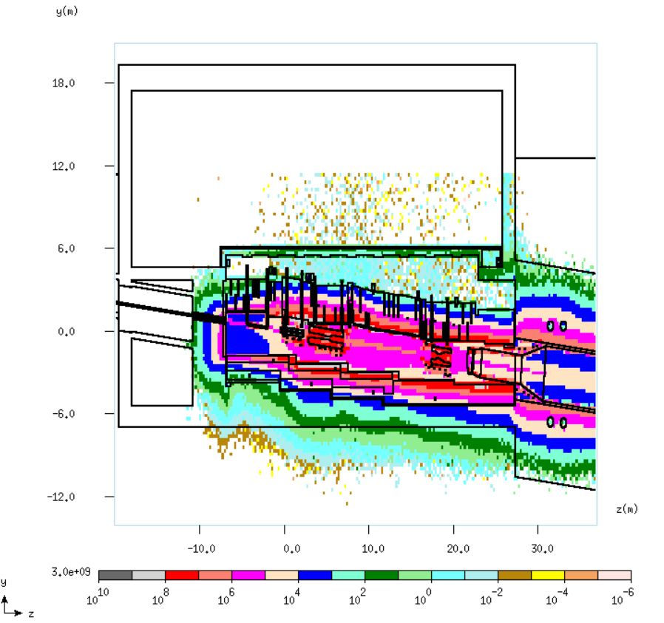
Ground Water Protection for Target Hall
Federal surface water limits:
³H < 2600 pCi/mL
²²Na < 16 pCi/mL
Potential transmission to ground water via support piles.
Shield to meet groundwater limit.
Groundwater limit below limit of detection
³H <1 pCi/mL
²²Na <0.04 pCi/mL
Underdrain system to reduce buildup.
stars cm⁻³s⁻¹

Slide 12
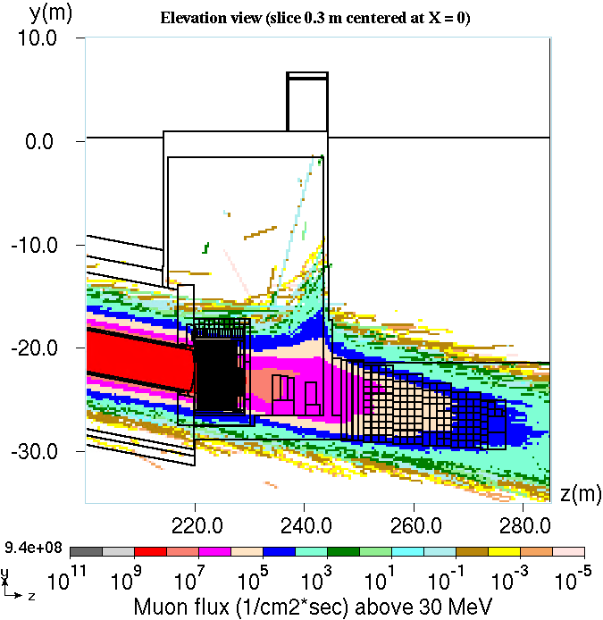
Ground Water Protection Absorber Hall
Shield to meet groundwater limit.
Steel kern downstream to protect from muons
170’ length
10’ diameter
Barrier to prevent tritium diffusing from shielding into environment.
Monitoring wells to be used to detect any contamination.

Slide 13
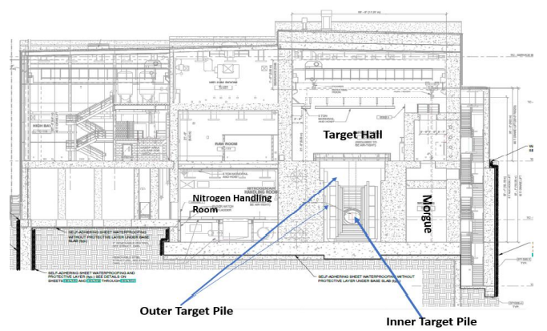
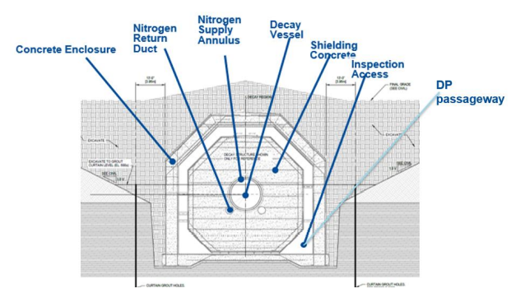
Air Activation
Air emission permit of 0.1 mrem/year annual sitewide release (EPA)
LBNF annual release goal to be < 30 μrem/year to the public.
Nitrogen cooling for the target hall and decay pipe will maintain LBNF air releases within budget.
Maintain negative pressure in areas of activated air.

Slide 14
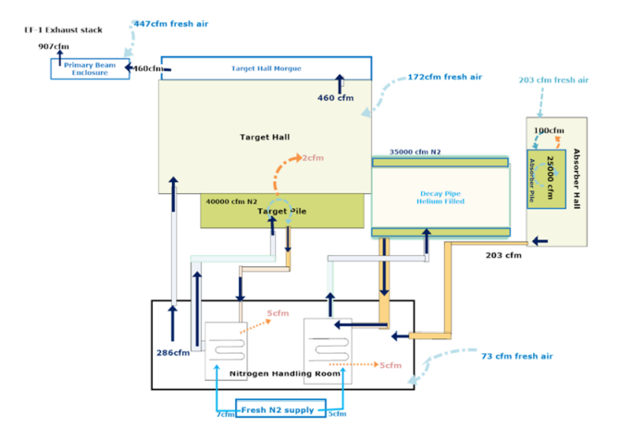
Air Release Path

Slide 15
Total Air Releases
Exit (Ci/yr) | ³H | ¹¹C | ¹³N | ¹⁵O | ⁴¹Ar
Absorber Hall | 7.08×10⁻² | 2.37×10⁻⁴ | 1.59×10⁻¹² | 2.23×10⁻⁷⁰ | 2.54
NHR | 1.03 | 1.41 | 1.32×10⁻⁴ | 5.09×10⁻³¹ | 1.36
Target Hall | 1.16 | 2.42×10² | 1.4×10¹ | 8.60×10⁻⁵ | 1.98
Morgue | 1.16 | 2.78×10¹ | 1.68×10⁻¹ | 4.21×10⁻¹² | 1.29
Primary Encl | 1.16 | 5.53 | 7.78×10⁻³ | 8.77×10⁻⁹ | 9.59×10⁻¹
⁴¹Ar from RAW | 0.96 Ci/yr
0.49% FNAL Site Limit
Tritium from other sources
³H Source | Activity (Ci/yr)
Target Pile | 540
Decay Pipe | 152
Absorber Pile | 156
Tgt He Cooling | 0.015
Total release:
30.66% of
FNAL Site Limit
28.25% of
FNAL Site
Limit

Slide 16
Wait Time Access Due to Activated Air
No access to area until air activity below 0.1 DAC after beam off.
DAC: Derived Air Concentration
DAC = $\sum{\frac{C_{i}}{C_{Ri}}}$
C_{i} = concentration of i^{th} isotope
C_{Ri} = concentration of i^{th} isotope which gives 5000 mrem effective dose from a 2000 hr exposure.
Location | Wait Time
Absorber Hall | 6 hrs
NHR | 45 min
Target Hall | 1.5 hrs
Primary Encl | 1.5 hrs

Slide 17
Conclusion
Appropriate selection of shielding to maintain prompt dose below limits set by FNAL policy.
Model for 120 GeV, 2.4 MW operation.
Shielding and underdrains will be used to maintain concentration of radioactive isotopes below regulatory limits for surface and ground water.
Morgue and work cell in target hall to allow for unshielded moves.
Use of nitrogen for cooling and long transit times in ventilation to maintain activated air releases below regulatory limit.

