Slide 1
Remote handling at CERN New SPS internal beam dump Beam Dump Facility proposal NBI 2022 – Abingdon (UK)
M. Calviani, R. Franqueira Ximenes, J-L. Grenard, D. Grenier, J M. Martin Ruiz, A. Perillo Marcone - CERN
21-09-2022

Slide 2
Outline
New SPS beam dump and it remote handling infrastructure
Beam Dump Facility proposal

Slide 3
New SPS internal beam dump
Objectives for the New SPS beam dump
Capability to accept HL-LHC and high-power FT beams
Decoupling injection systems from dumping systems
Improve radiation environment in the tunnel
Improve exchange procedure applying ALARA principle
Project completed during LS2 within LIU upgrade

Slide 4
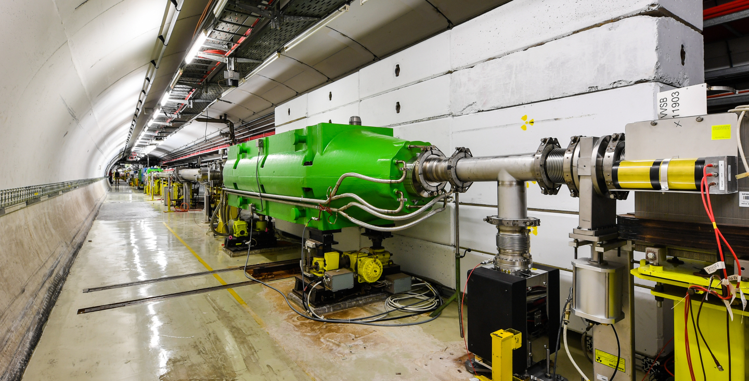
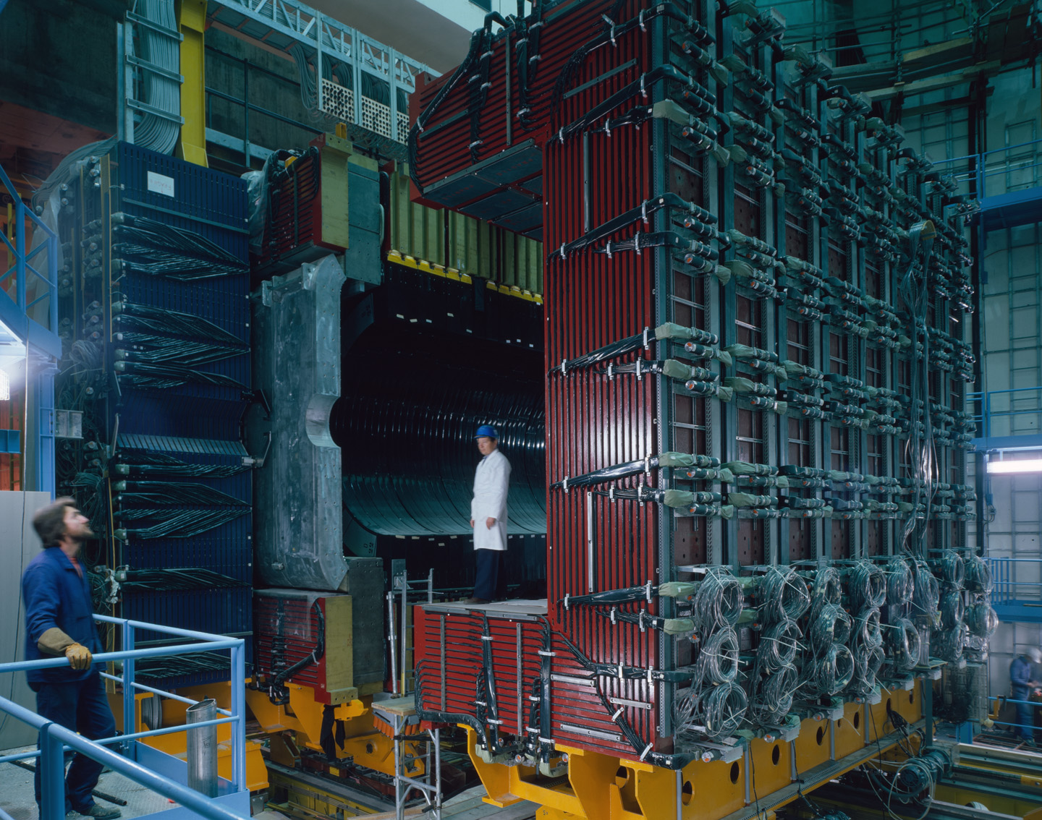
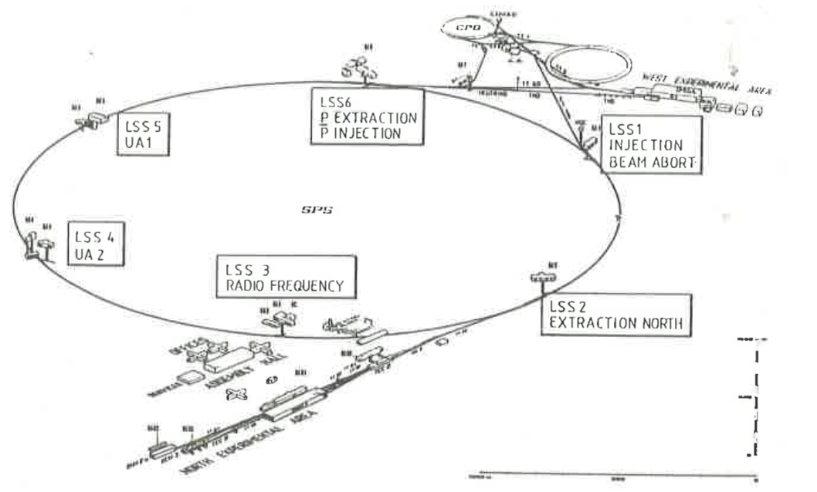
SPS internal beam dump
UA1 experiment
1981-1990
SPS original design

Slide 5
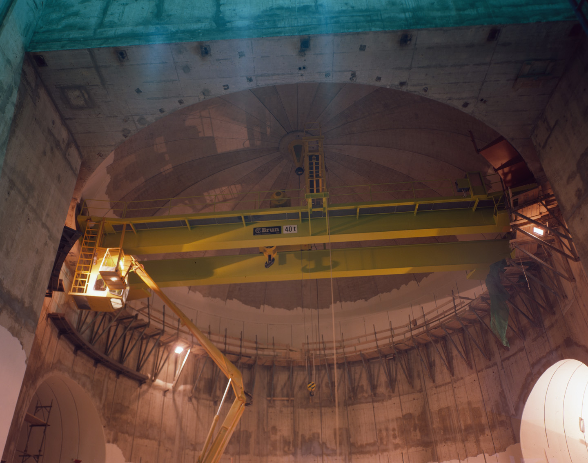
Constrains from the original infrastructure
Cavern built end of 70’s (former location of UA1 experiment)
Overhead polar crane of 40t capacity from the end of the 70’ (not at all designed for remote handling)
Access shaft equipped with an overhead traveling crane of 75t aside of the cavern separated by a massive dismountable shielding wall
Cavern almost centred across the SPS beam line (keeping the transport passage free for maintenance of the accelerator)

Slide 6
Integration of SPS dump system
Dump shielding space for exchange
Dump
Dump
Abutment
Dump cooling skid
Quadrupole
Quadrupole
Instrumentation
Vertical Kickers
Horizontal Dilution Kickers
Transport & Beamline Bridges
Secondary Masks
Space for Dump exchange
Tunnel Enlargement

Slide 7
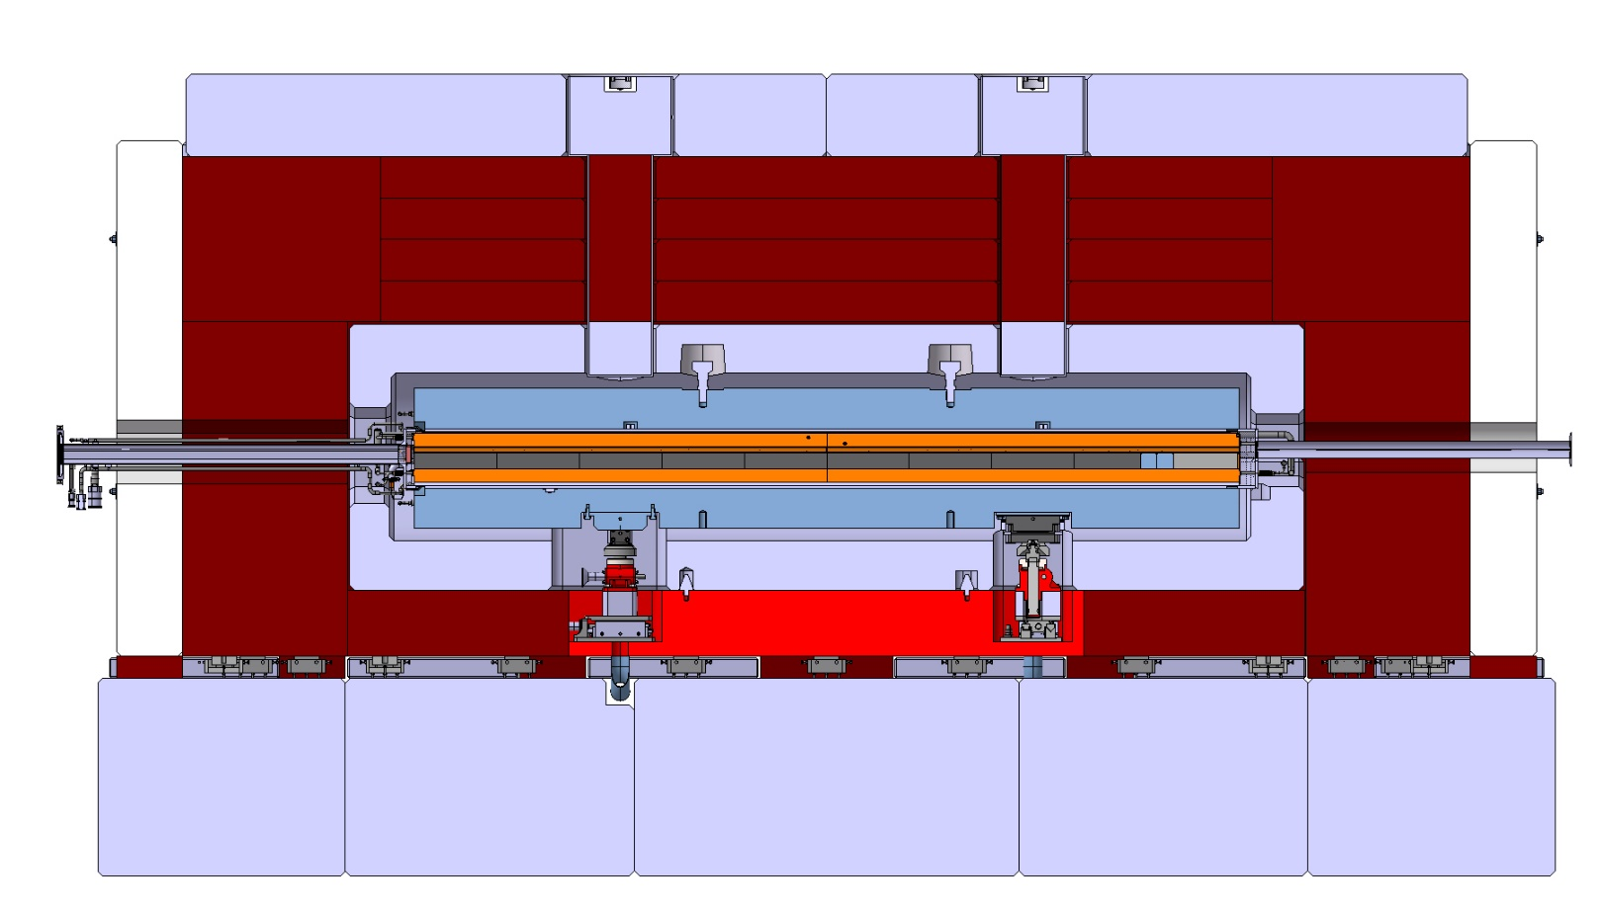
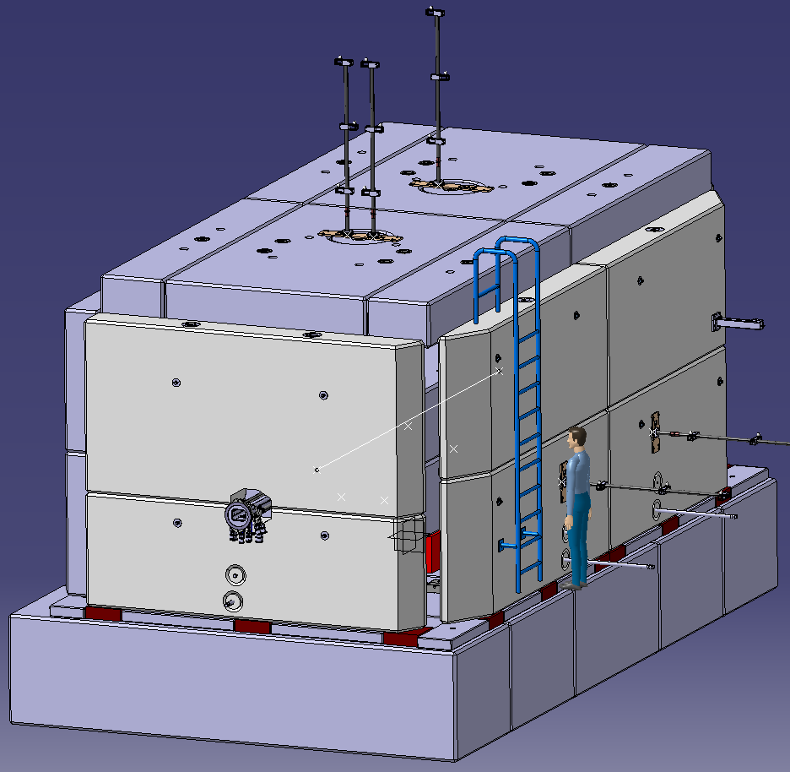
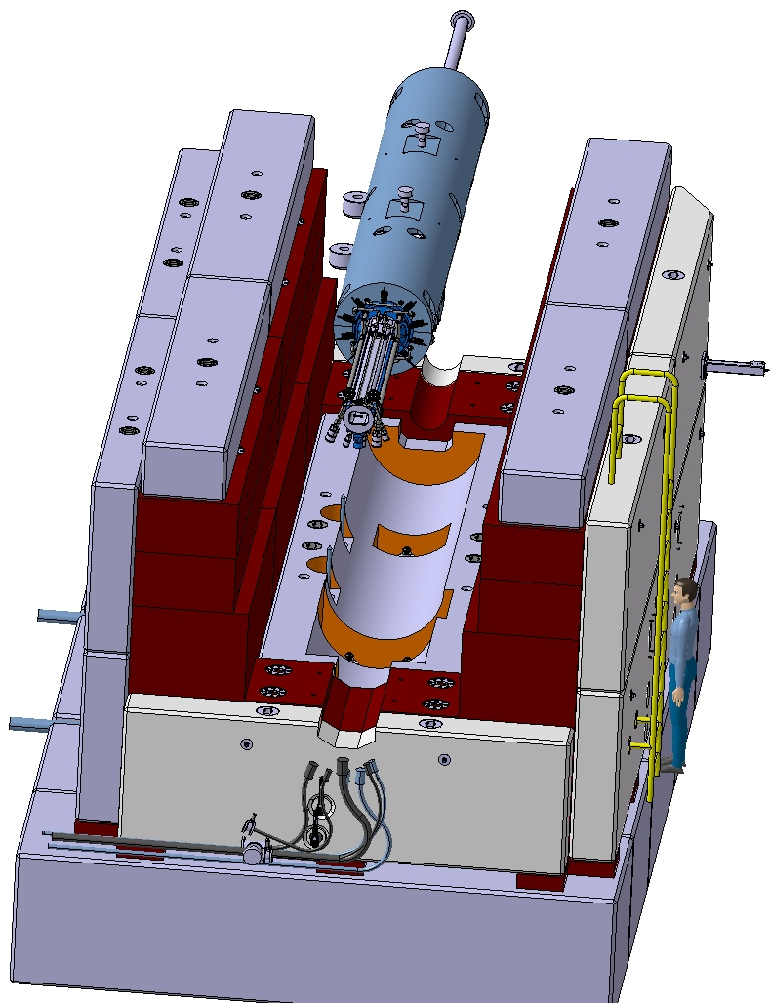
Integration of SPS dump system
Marble shielding
Concrete shielding
Cast iron shielding
Dump core

Slide 8
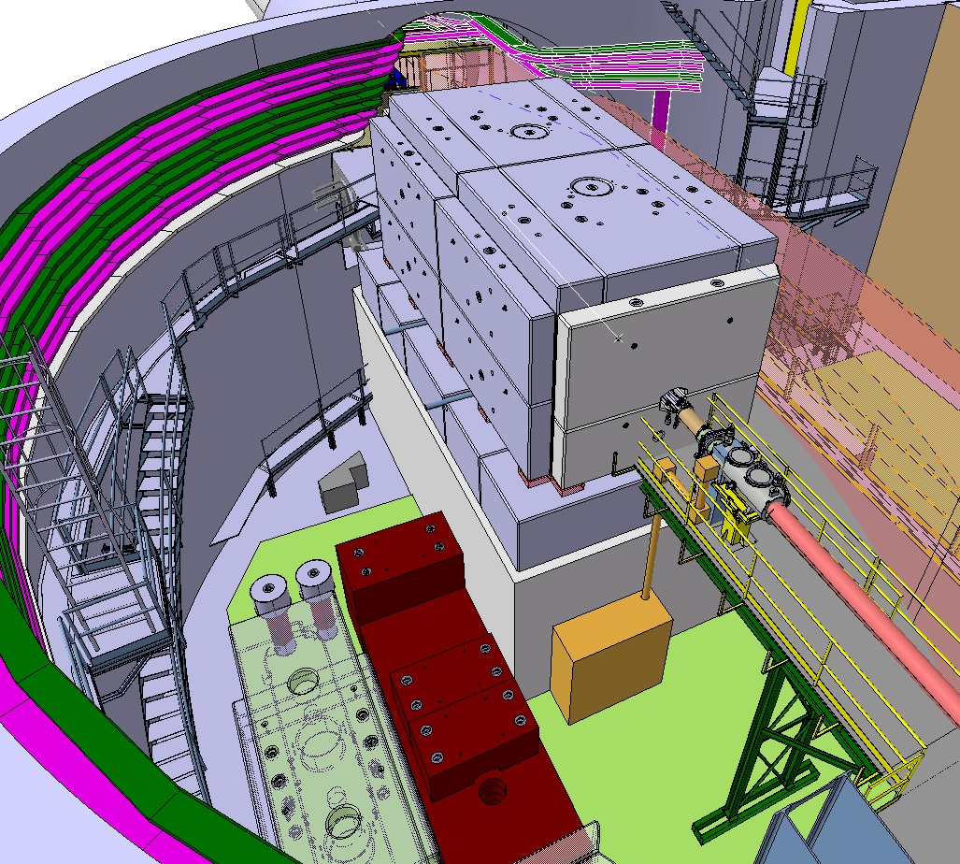
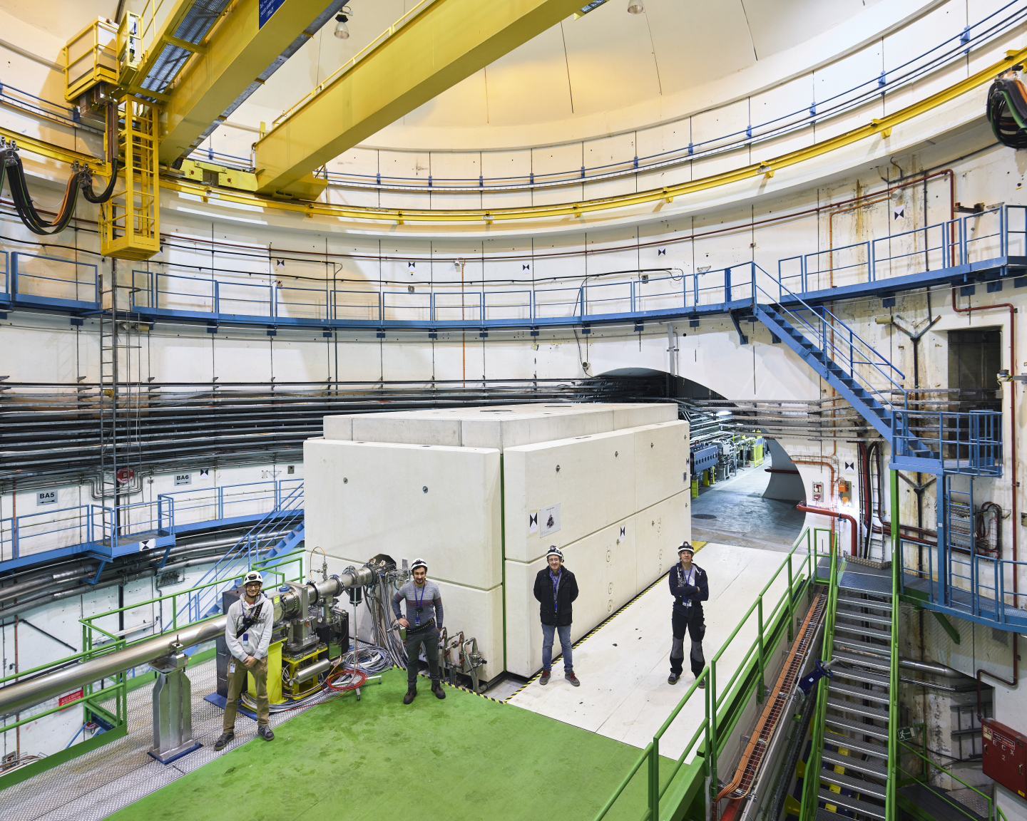
Integration of SPS dump system
8.8m
4m
600t cast iron
140t concrete
30t marble
4.8m

Slide 9
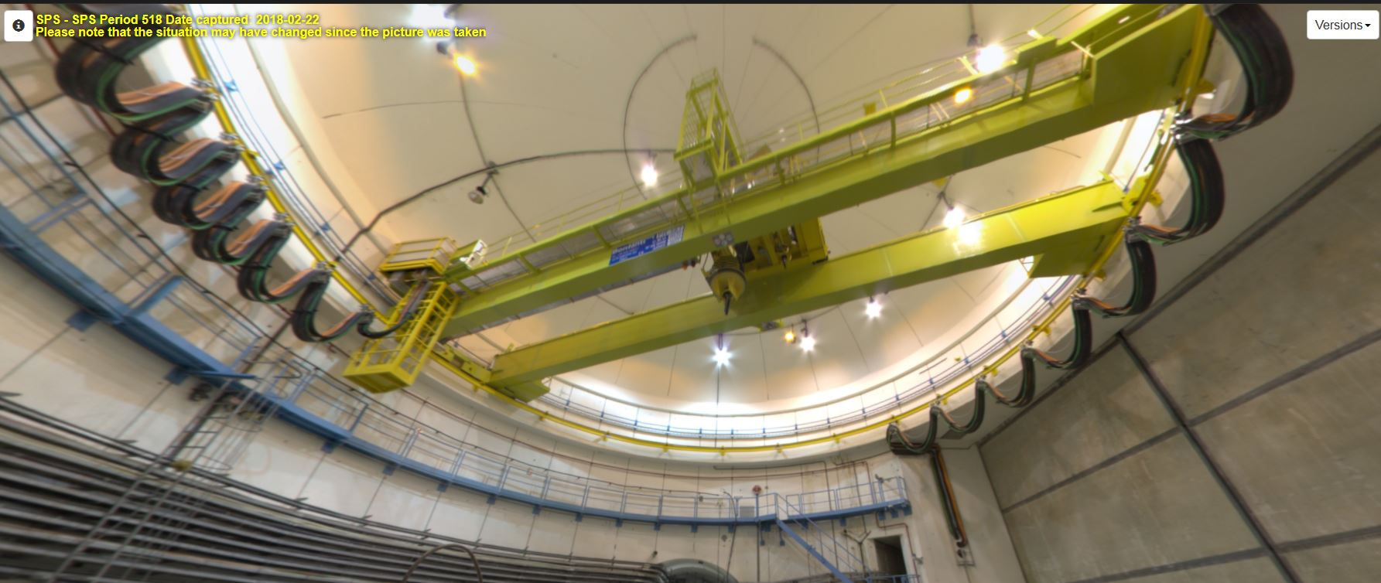
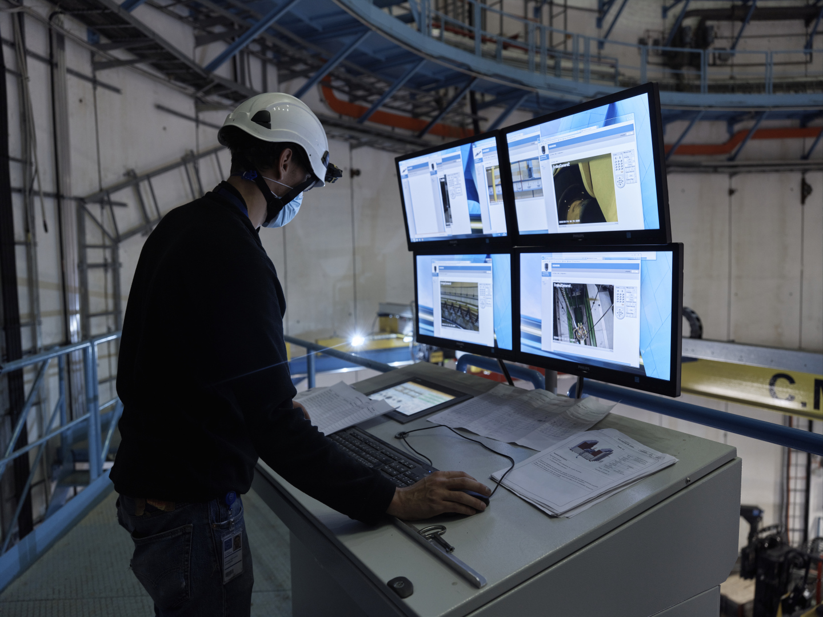
Upgrade of the handling infrastructure
Complete revamping of crane
Complete replacement of the hoist and auxiliary hoist
Integration of redundancy on the 3 movements of the crane
Integration of a motorised hook
Integration of a video system
Integration of a positioning system for the 3 movements
Off-board control cubicles
Remote tools connection on the hook

Slide 10
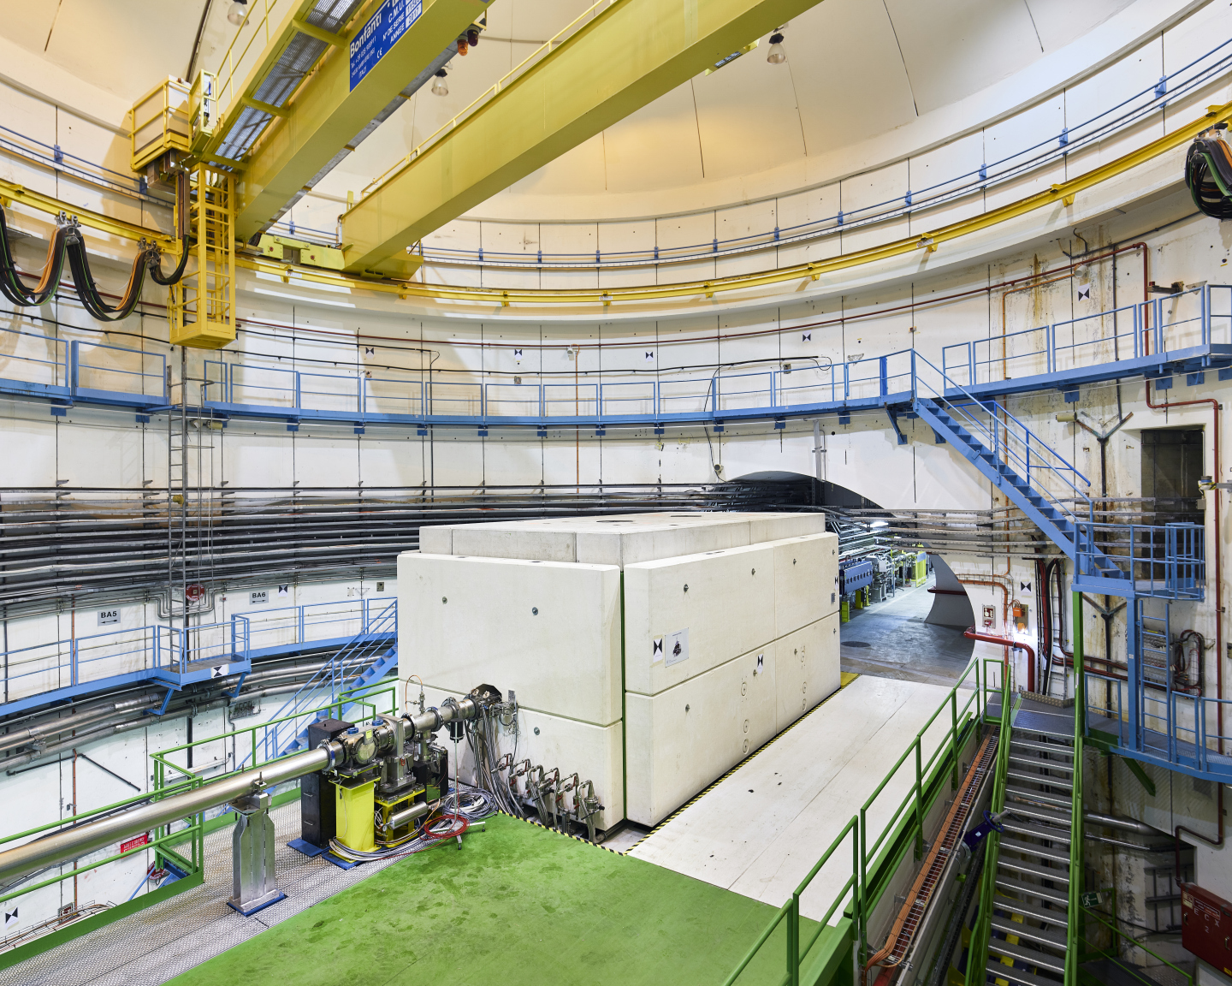
Beam dump utilities connections
All utilities located outside the shielding in ‘’a human’’ accessible environment

Slide 11
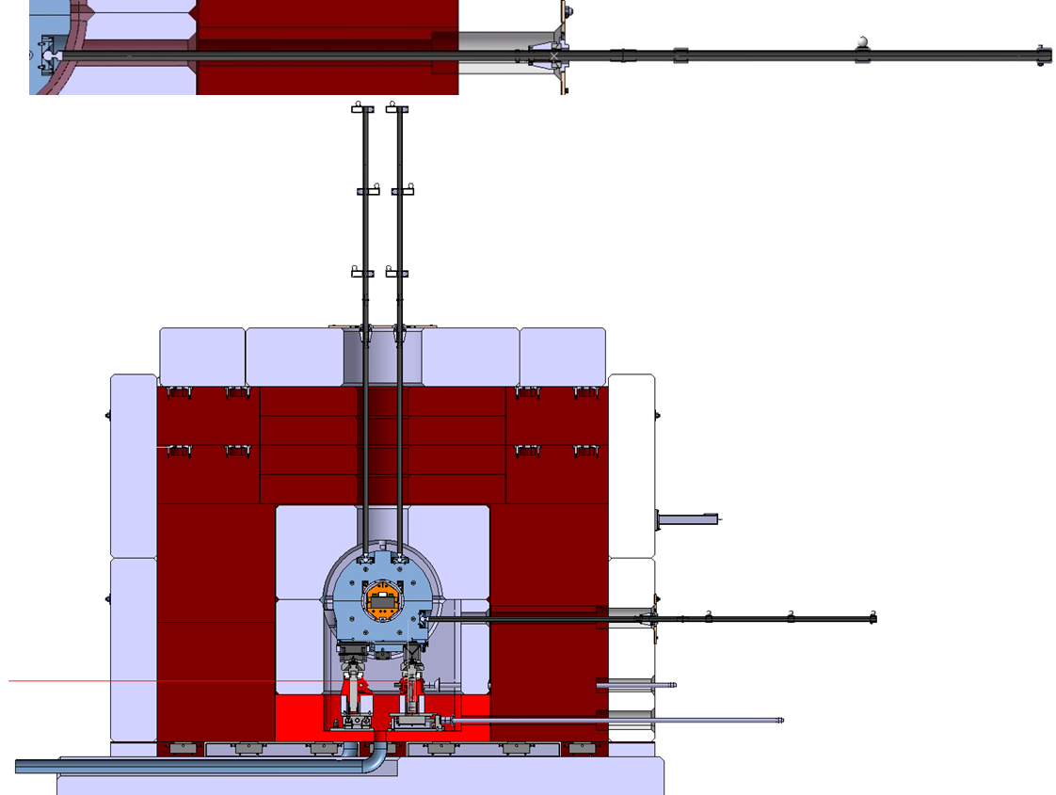
Remote measurement and alignment capabilities
Capability to measure and align the beam dump without full shielding opening
Removable shielding plugs
Remote measurement bars
Remote support actuators

Slide 12
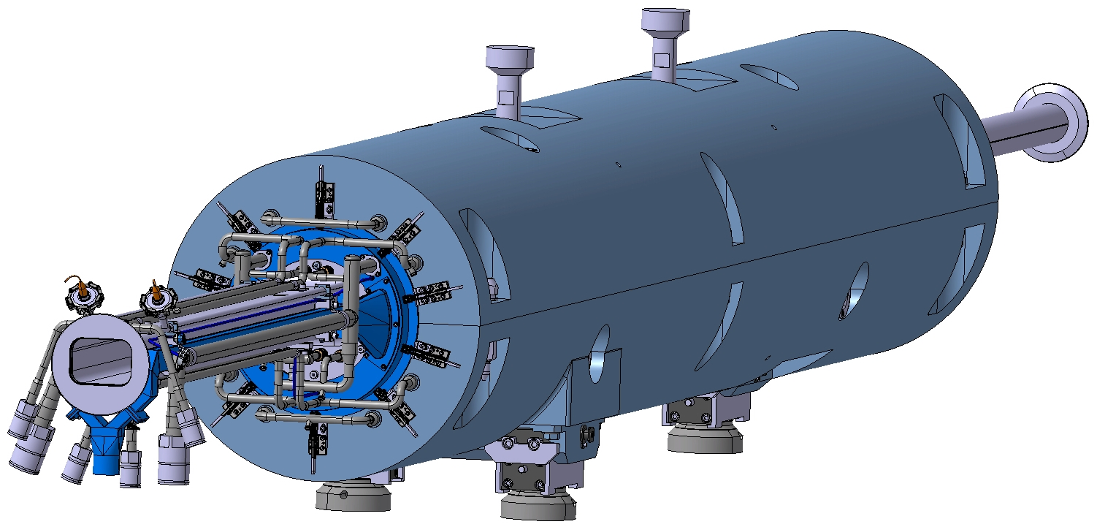
Beam dump remote handling features
Dump core and primary shielding
~22t
Lifting points
Pre guides pins
Support points

Slide 13
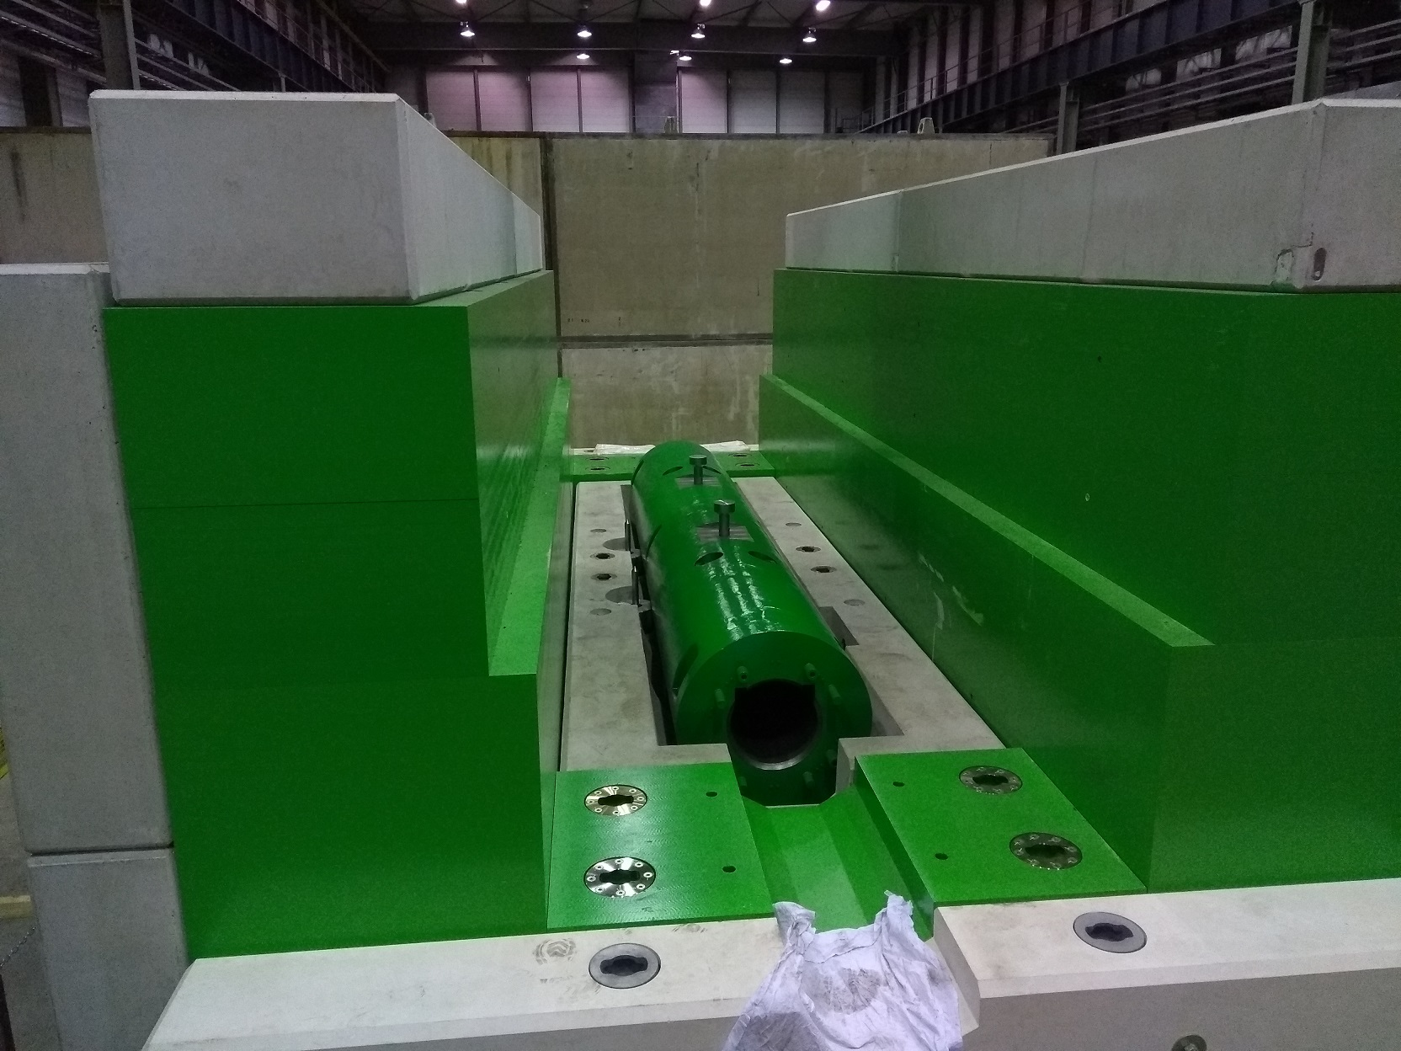
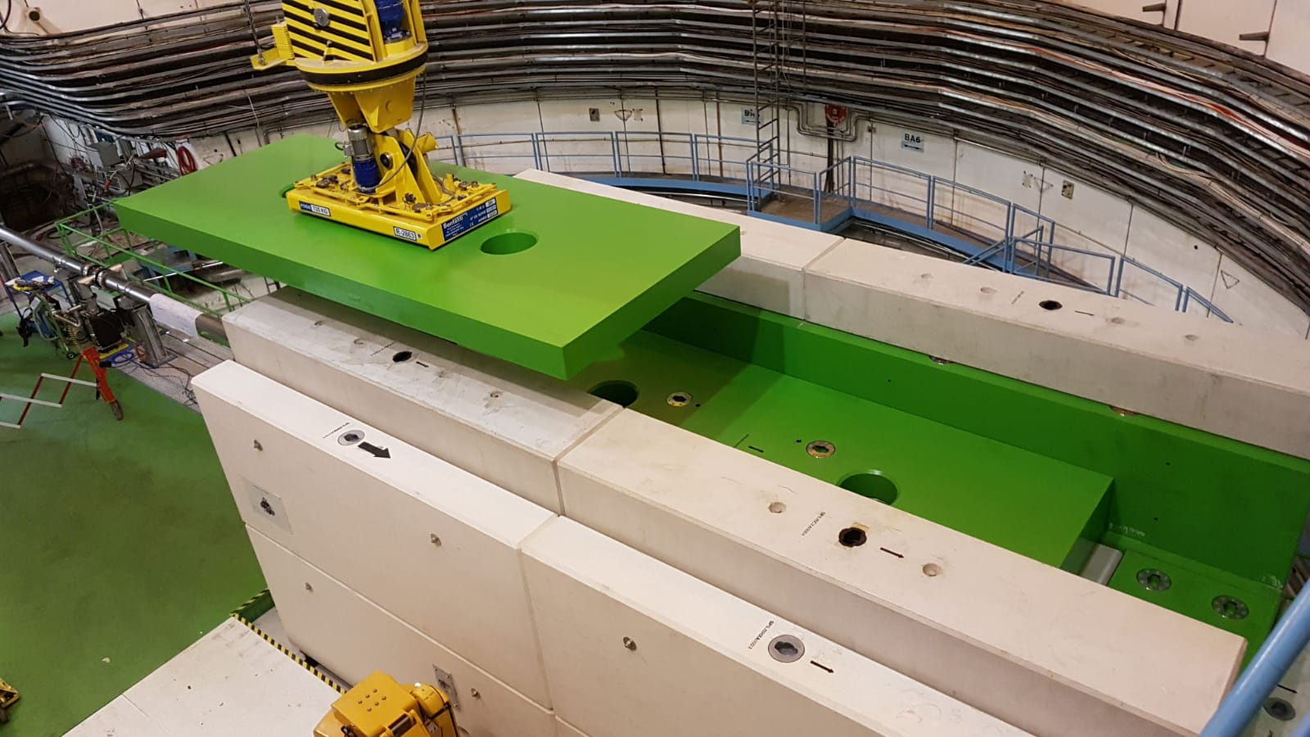
Beam dump remote handling features
Lifting point lifting mushrooms and twist lock CERN style
Pre alignment guides

Slide 14
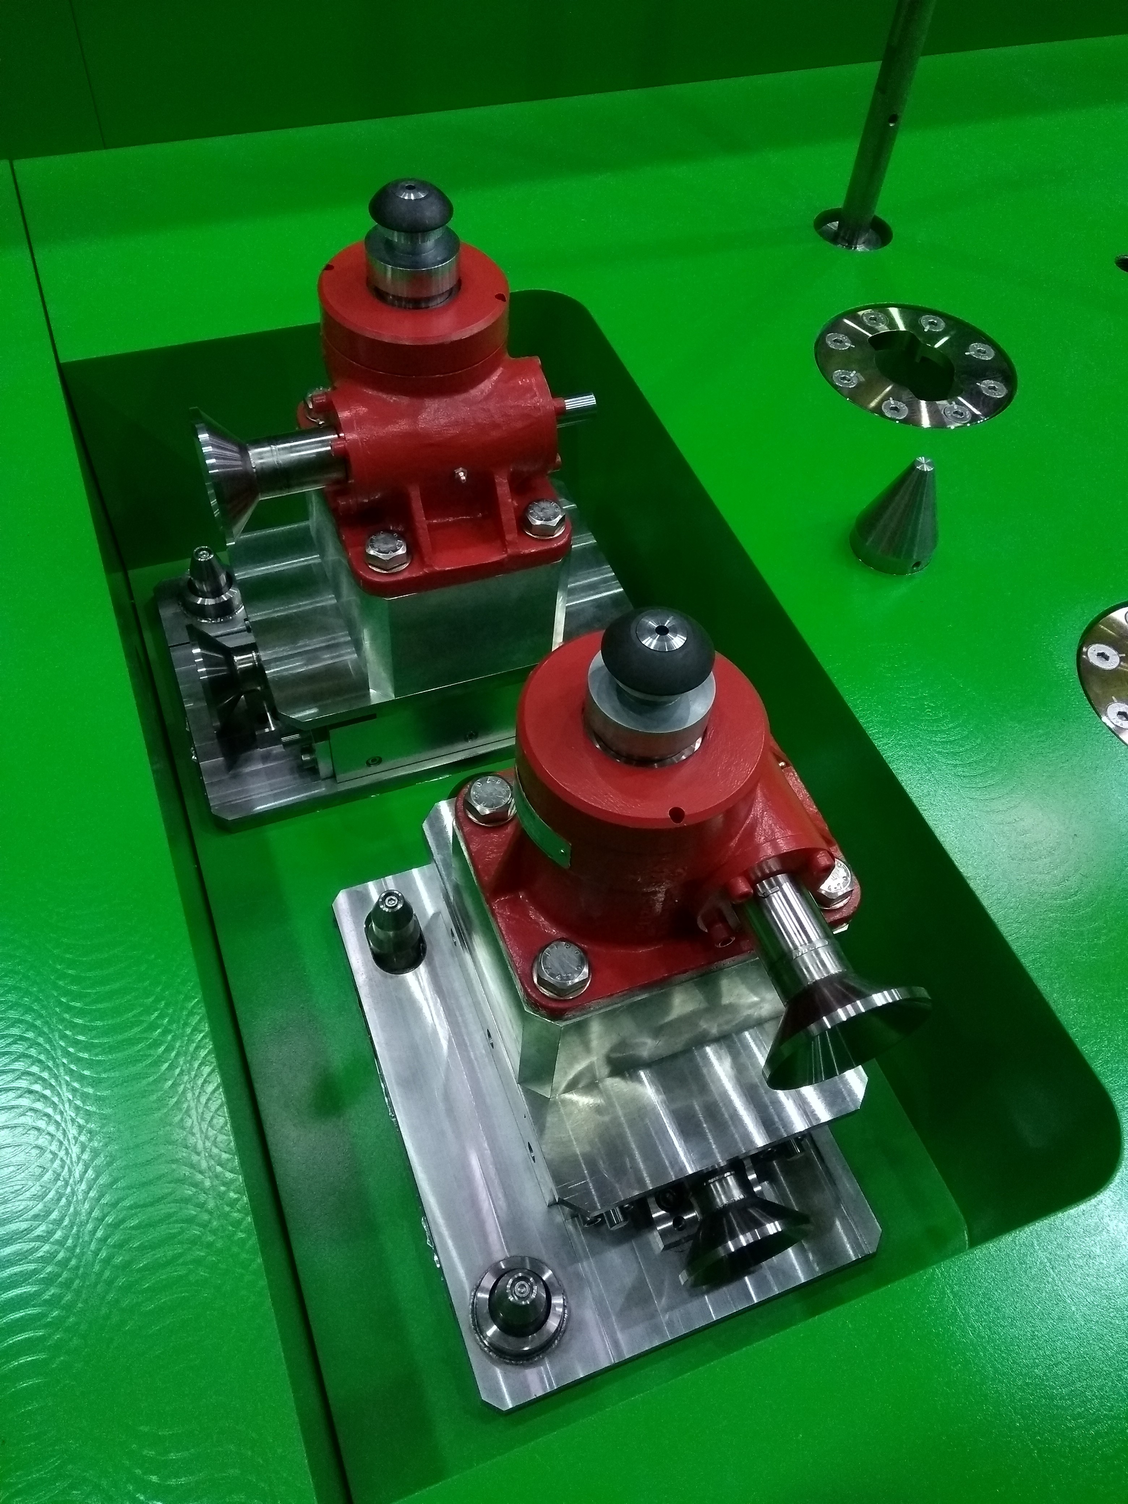
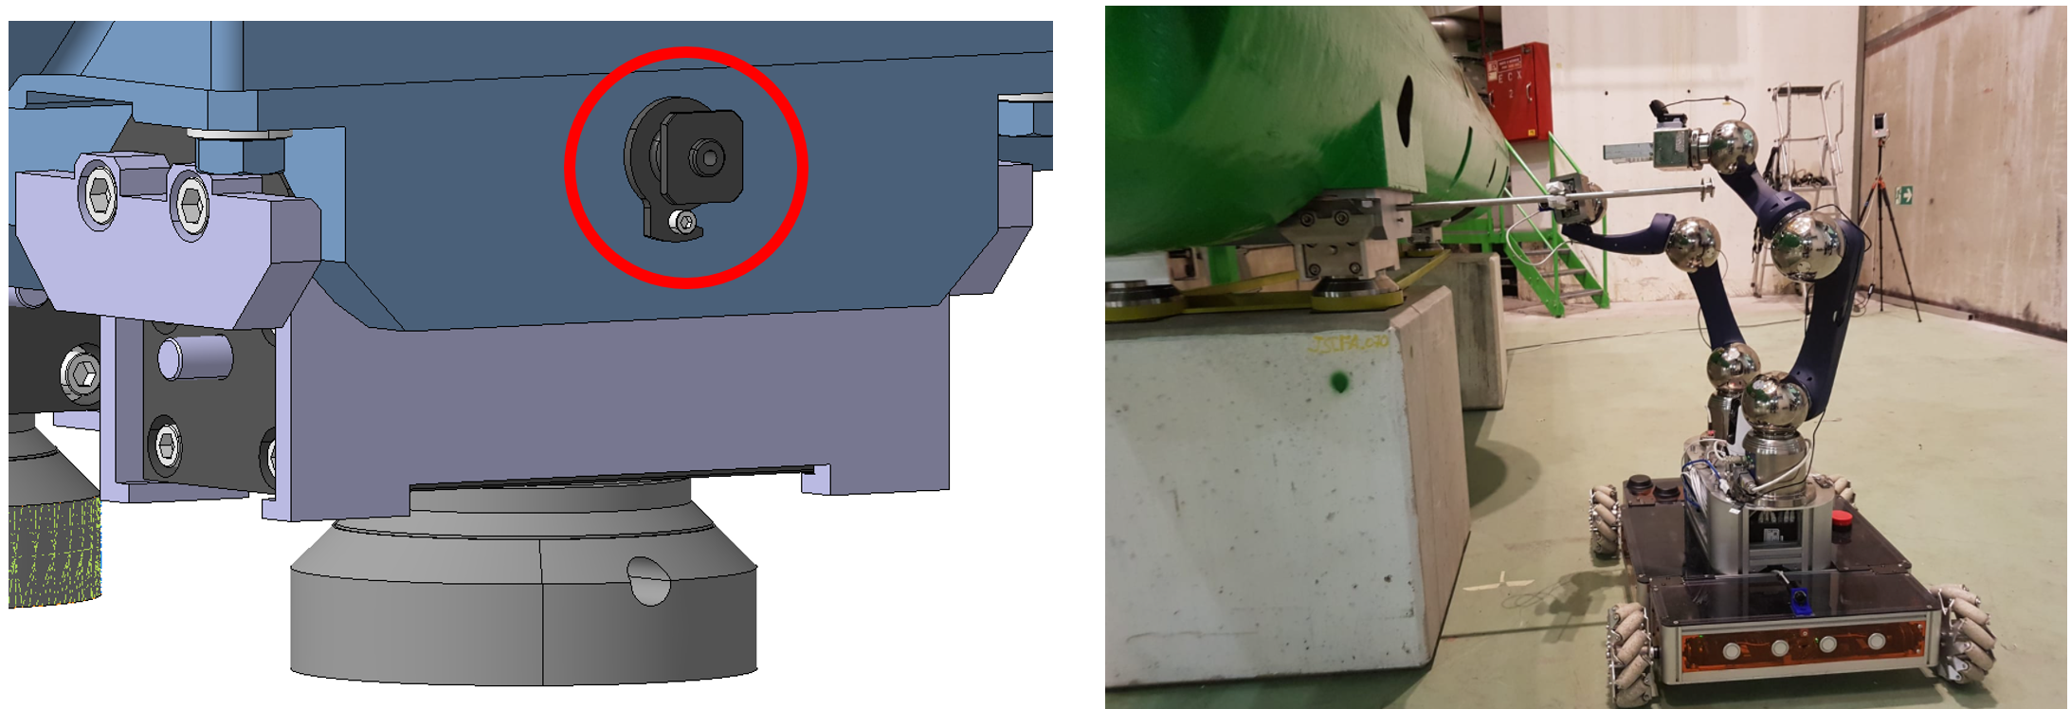
Supports remote exchange
Radiation tolerant alignment support
Full remote exchange of the supports included in the design

Slide 15
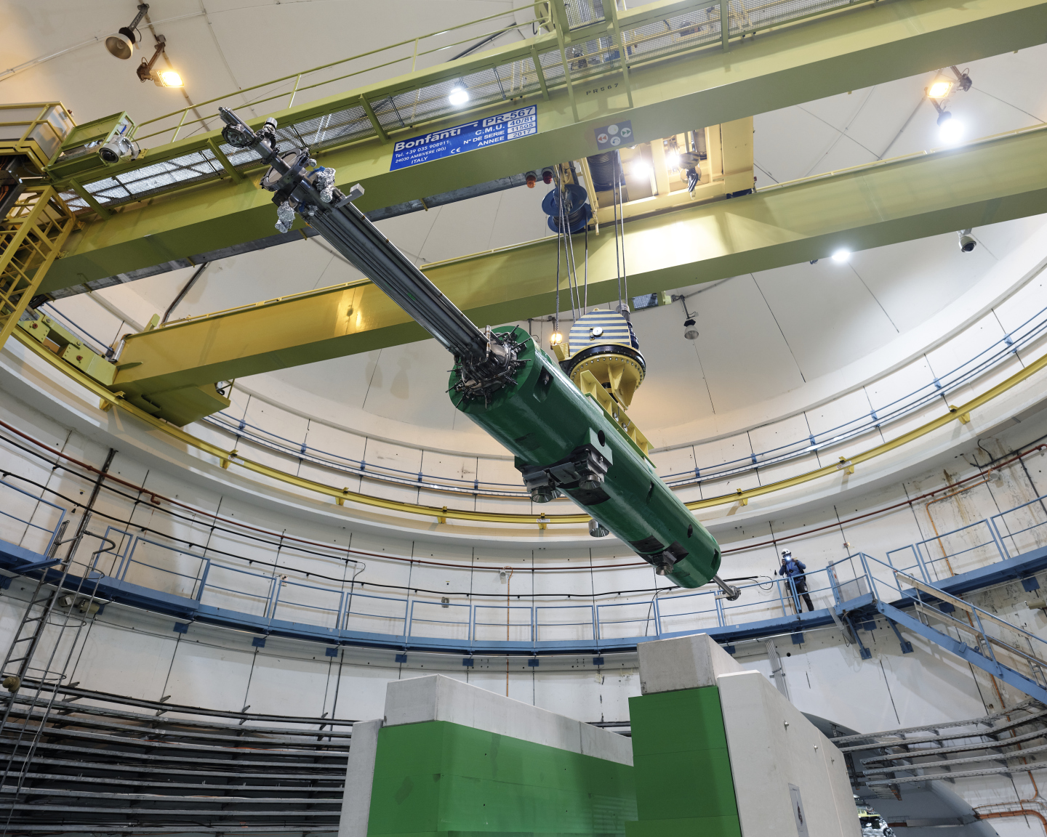
Beam dump remote handling features

Slide 16
New SPS Beam dump summary
System designed respect to the ALARA principle
Full assembly of the system prior to final installation the tunnel
Optimization of schedule (work performed in parallel to infrastructure modifications)
Preliminary test of procedures
Full rehearsal of beam dump replacement including ancillaries held in the tunnel
Huge know how gain over the implementation of such system reusing an already built infrastructure

Slide 17
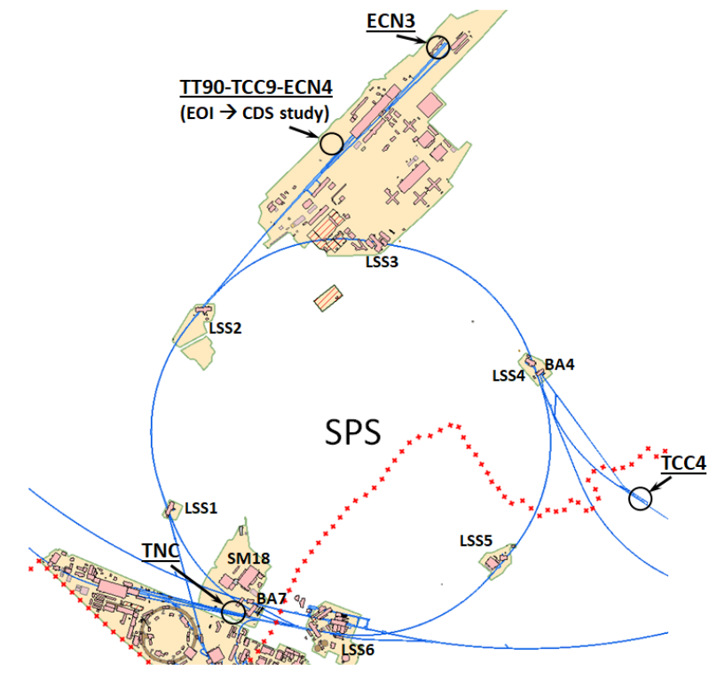
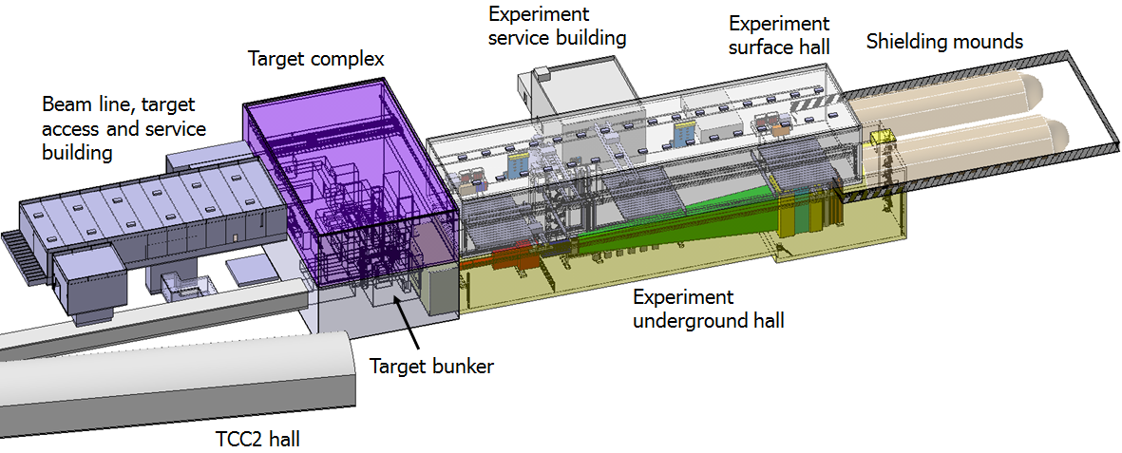
BDF target complex
Design of the target complex linked to the experiment SHIP
Search for Hidden Particles at the SPS Beam Dump Facility R. Jacobsson 19.09

Slide 18
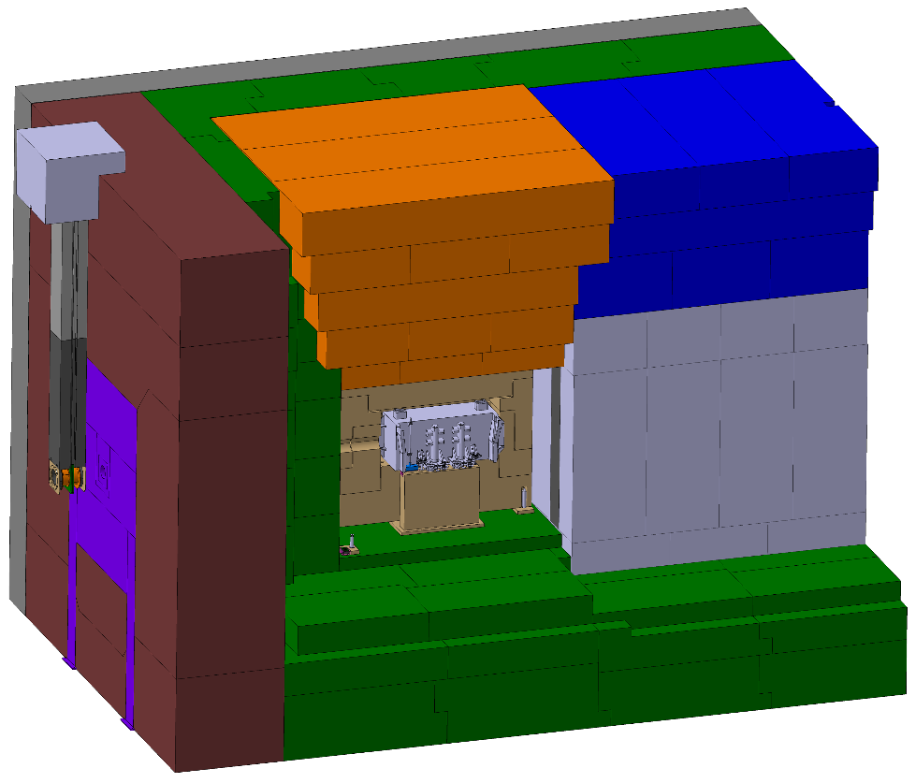
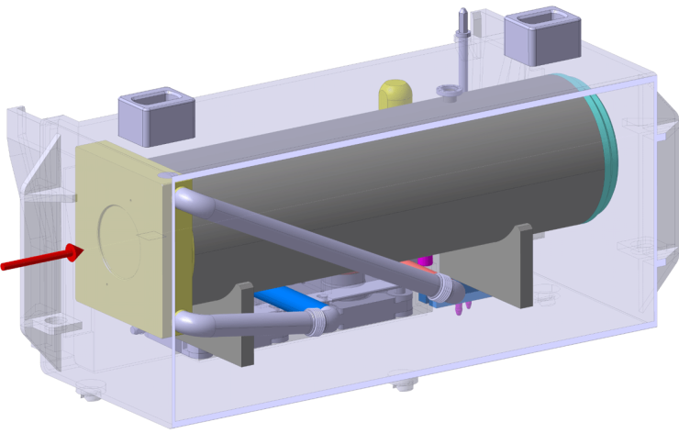
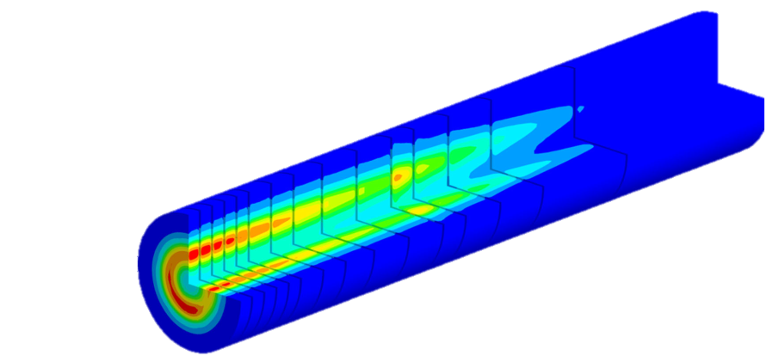
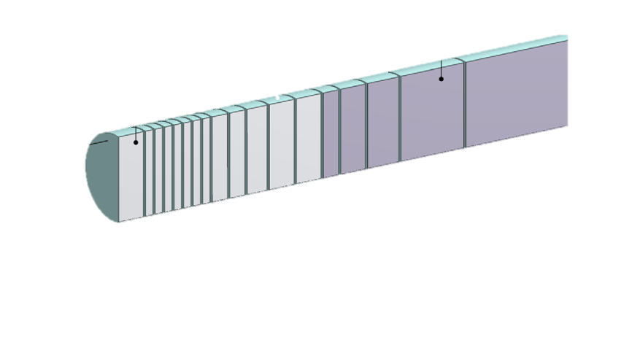
BDF target complex TT90 concept
Upstream Shielding
Mobile Shielding
Above Coil Shielding
Whole target complex embedded in a large Helium vessel
Direct accessibility of equipment from surface
Concept base on having a possible ‘’green’’ facility after decommissioning
Design development for the beam dump facility target complex at CERN J. Instrum. 13, P10011 (2018)
Design of a high power production target for the beam dump facility at CERN Phys. Rev. Accel. Beams 22, 113001 (2019)
Beam Window Assembly
US1010 Shielding
Collimator and Shielding
Target
Proximity Shielding
5x W blocks (Ø250 x780 mm)
~1.5m long
13 x TZM blocks (Ø250 x580 mm)

Slide 19
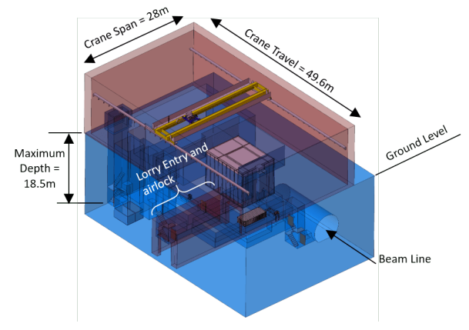
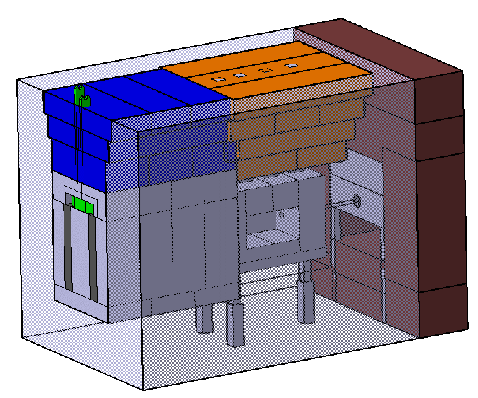
BDF target complex from TT90 concept
Comprehensive Design Study
http://cds.cern.ch/record/2703984/files/106-92-PB.pdf
Dedicated new building designed around the target complex
Interfaces, tooling, maintenance sequence already defined
7.9m
6.8m
11.2m

Slide 20
BDF target complex alternative location study - Outcomes
Alternative additional locations studied for BDF/SHIP
Advanced detailed preliminary study performed for TCC8 – ECN3
Benefit of reusing an existing cavern and it more comfortable size
Taking advantage of the shielding created by the soil above the cavern (~8m)
https://cds.cern.ch/record/2802705/files/2022_03_01_BDF_location_study_CDS.pdf
Target complex in TCC8

Slide 21
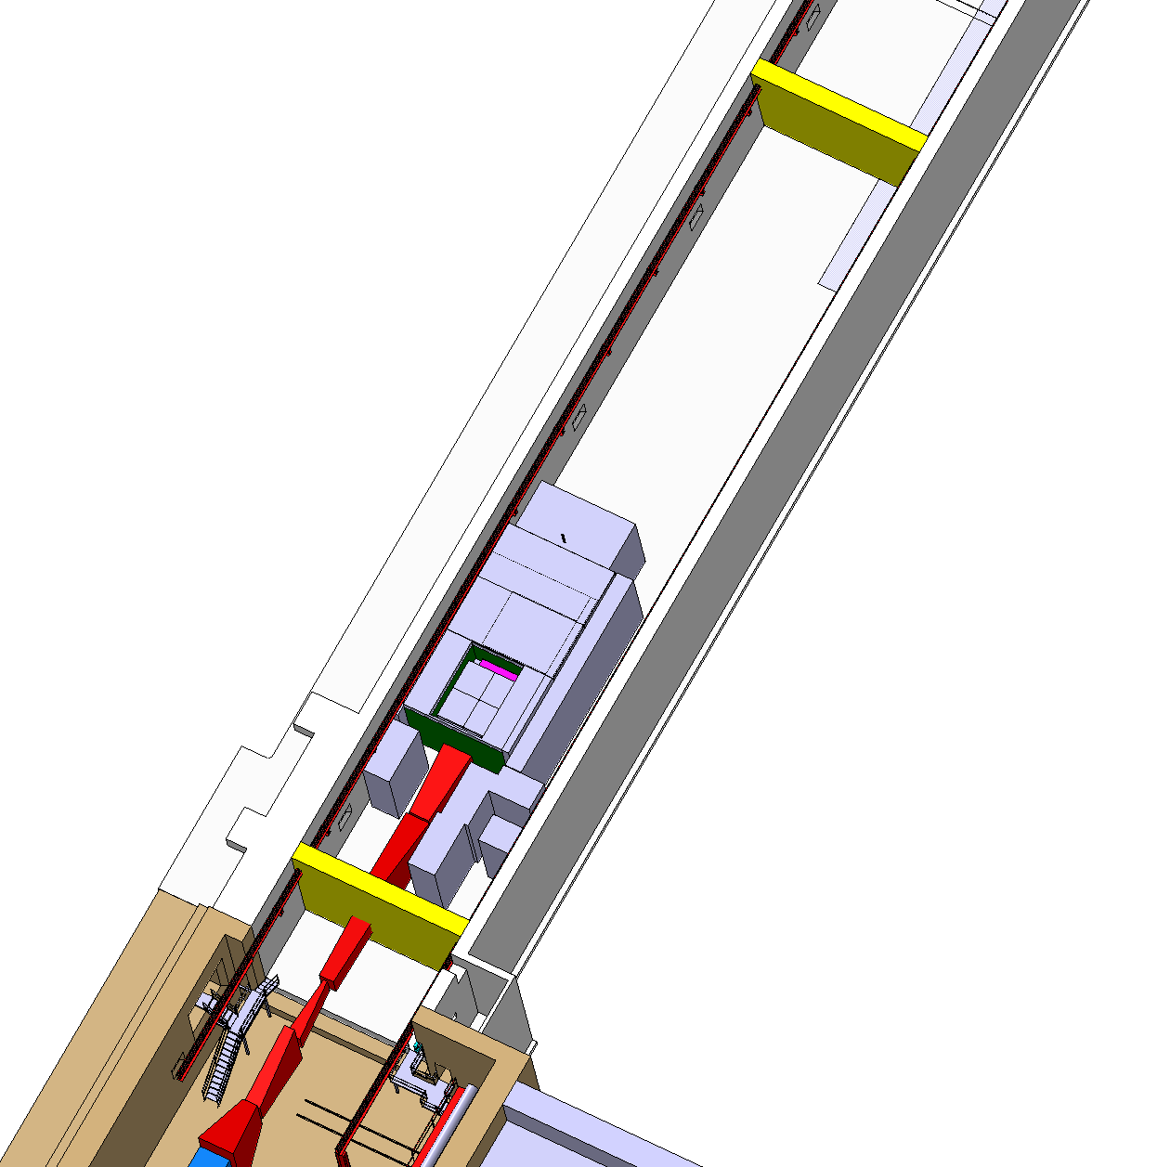
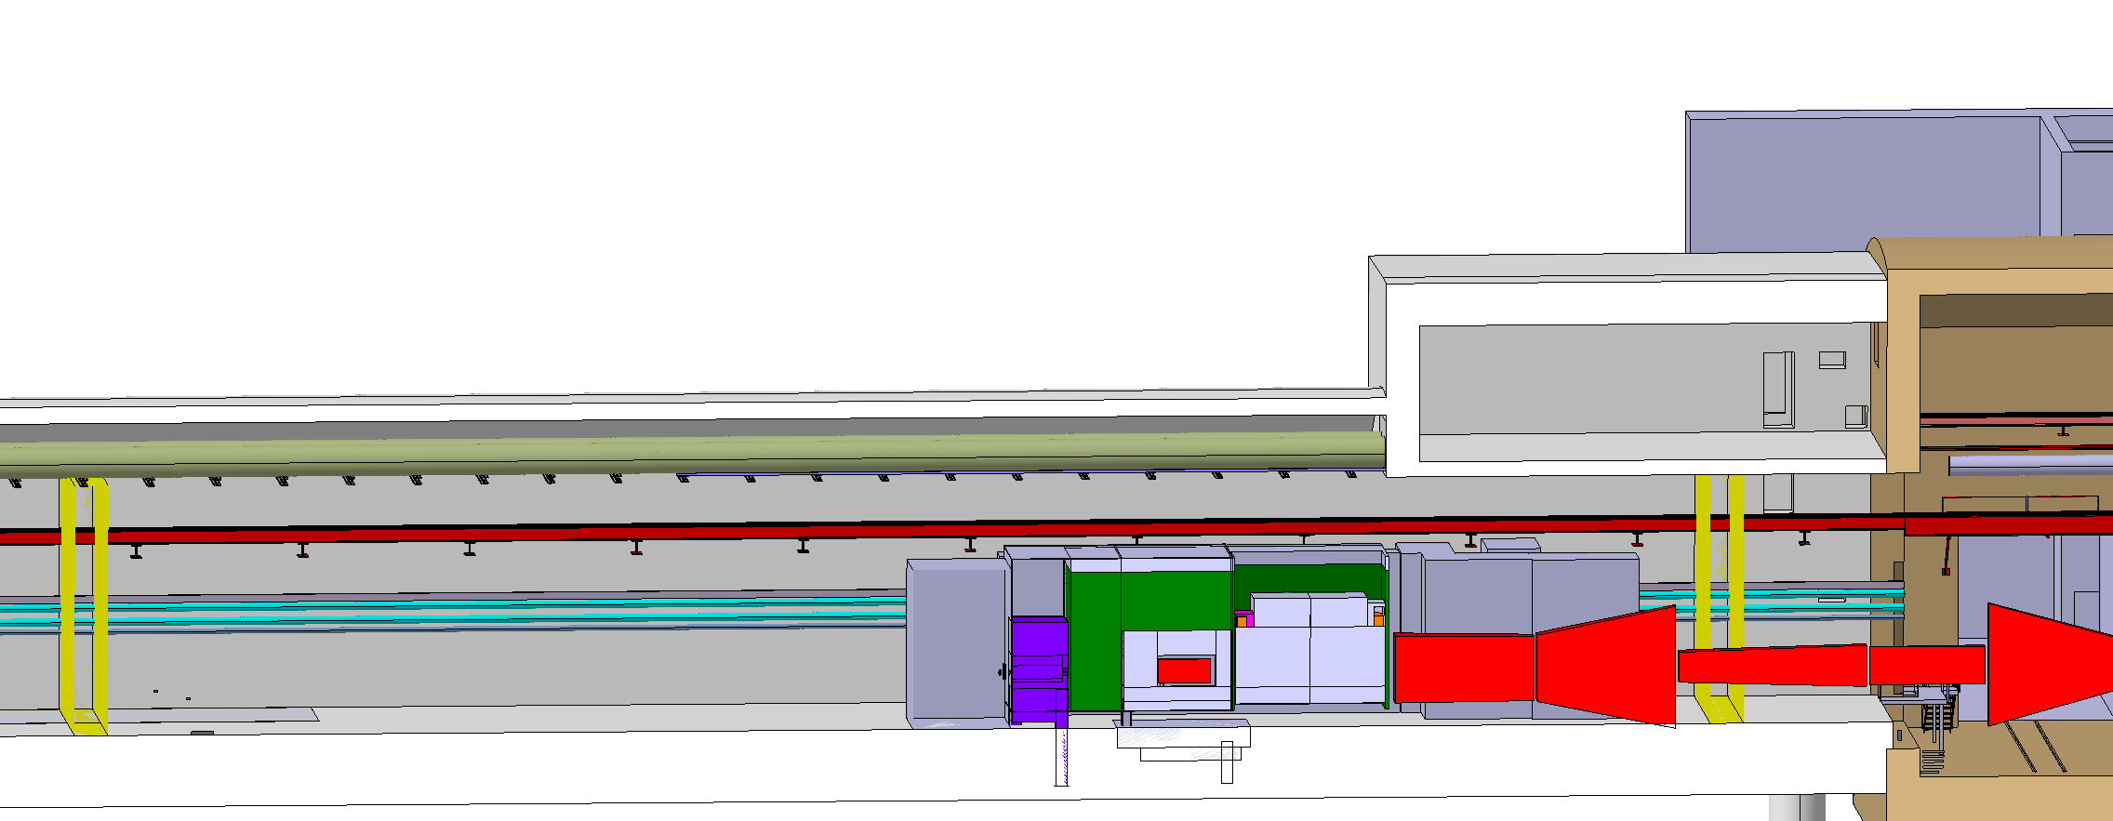
BDF Target complex integration
Upstream Shielding
Mobile Shielding
Above Coil Shielding
Space for shielding temporary storage
Beam Window Assembly
Magnetized
shielding
Diluted Proton beam from SPS
Target area
Confinement walls
Collimator and Shielding
Target
Water cooled proximity shielding
Access chicane
Target station
SHIP experiment
~11m
*detail of the confinement under study

Slide 22
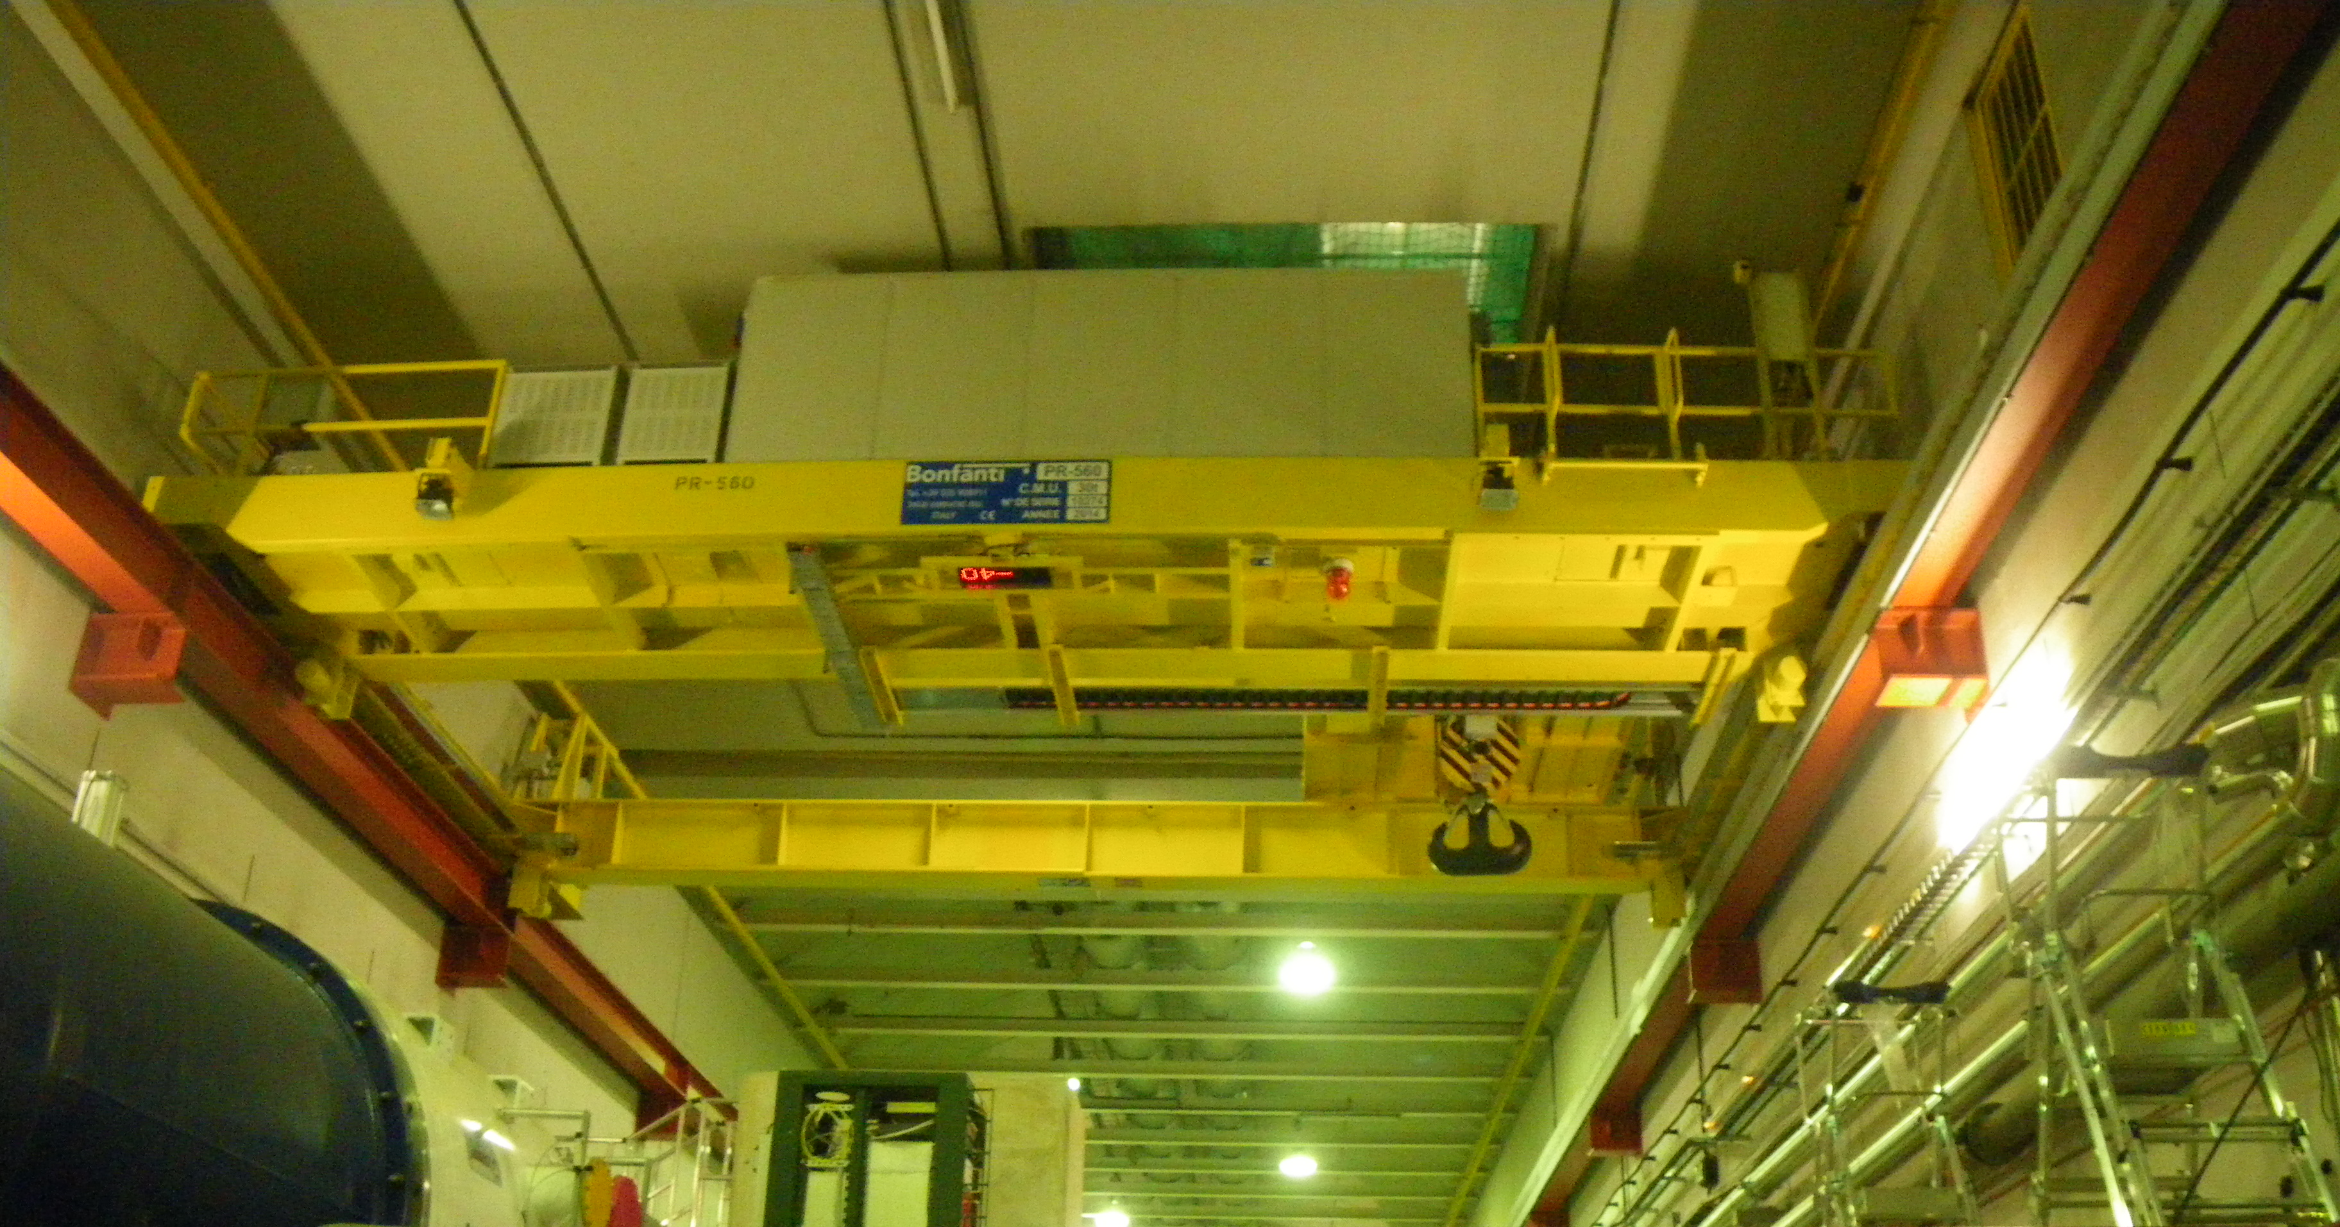
Target Complex @ ECN3
Existing overhead travelling crane 30t capacity
8m soil
TCC8 cross section

Slide 23
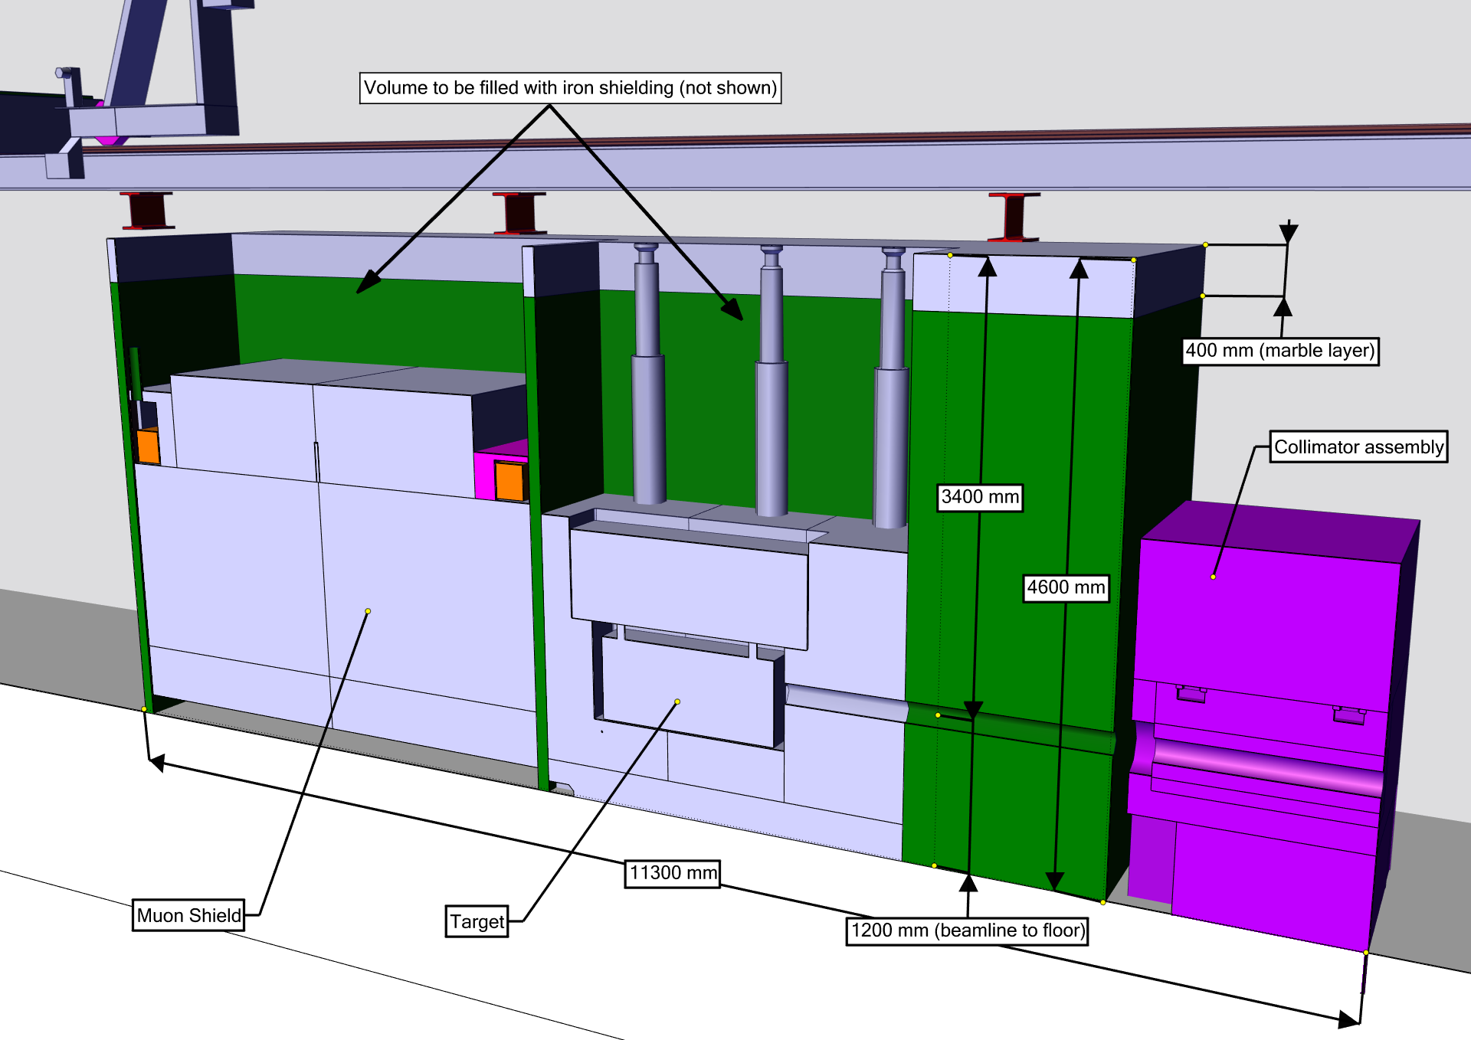
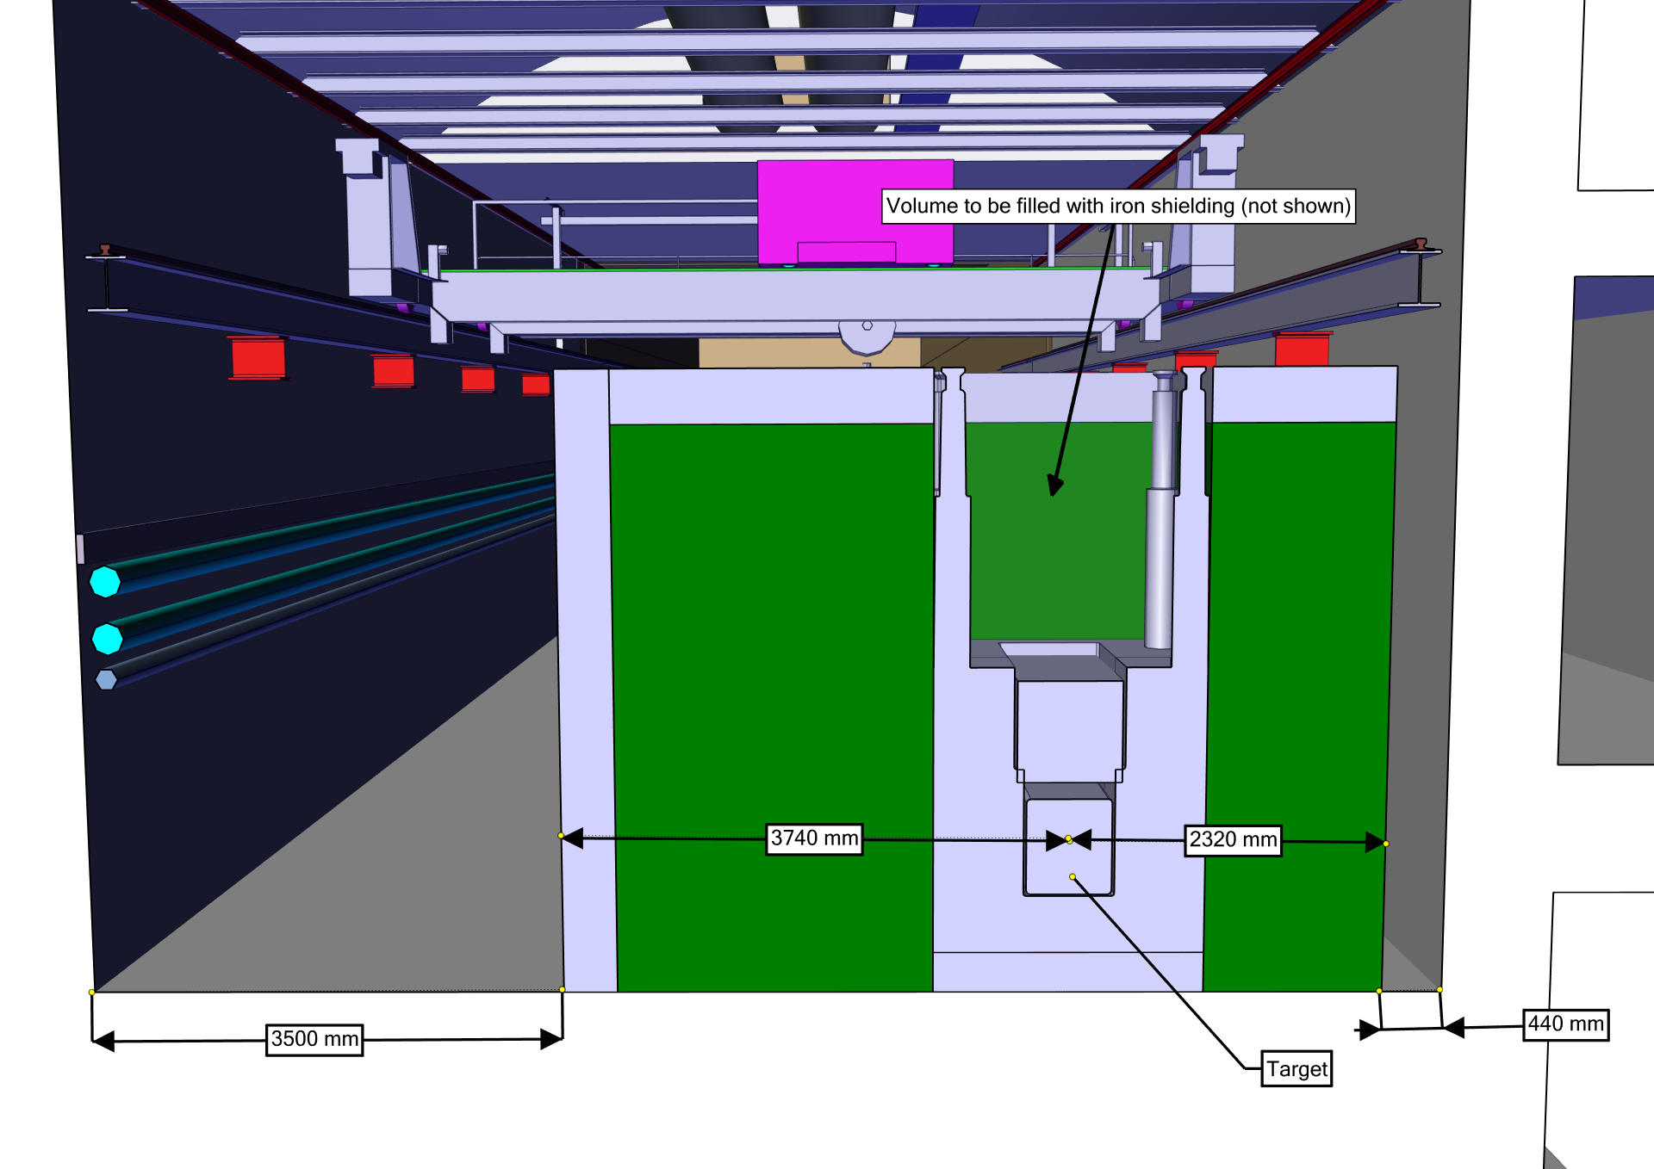
Current development of Target Complex @ ECN3
Overall integration of the target complex
Definition of key volumes respect to RP requirement
Already irradiated underground
infrastructure since 40 years
Triggered optimization of shielding

Slide 24
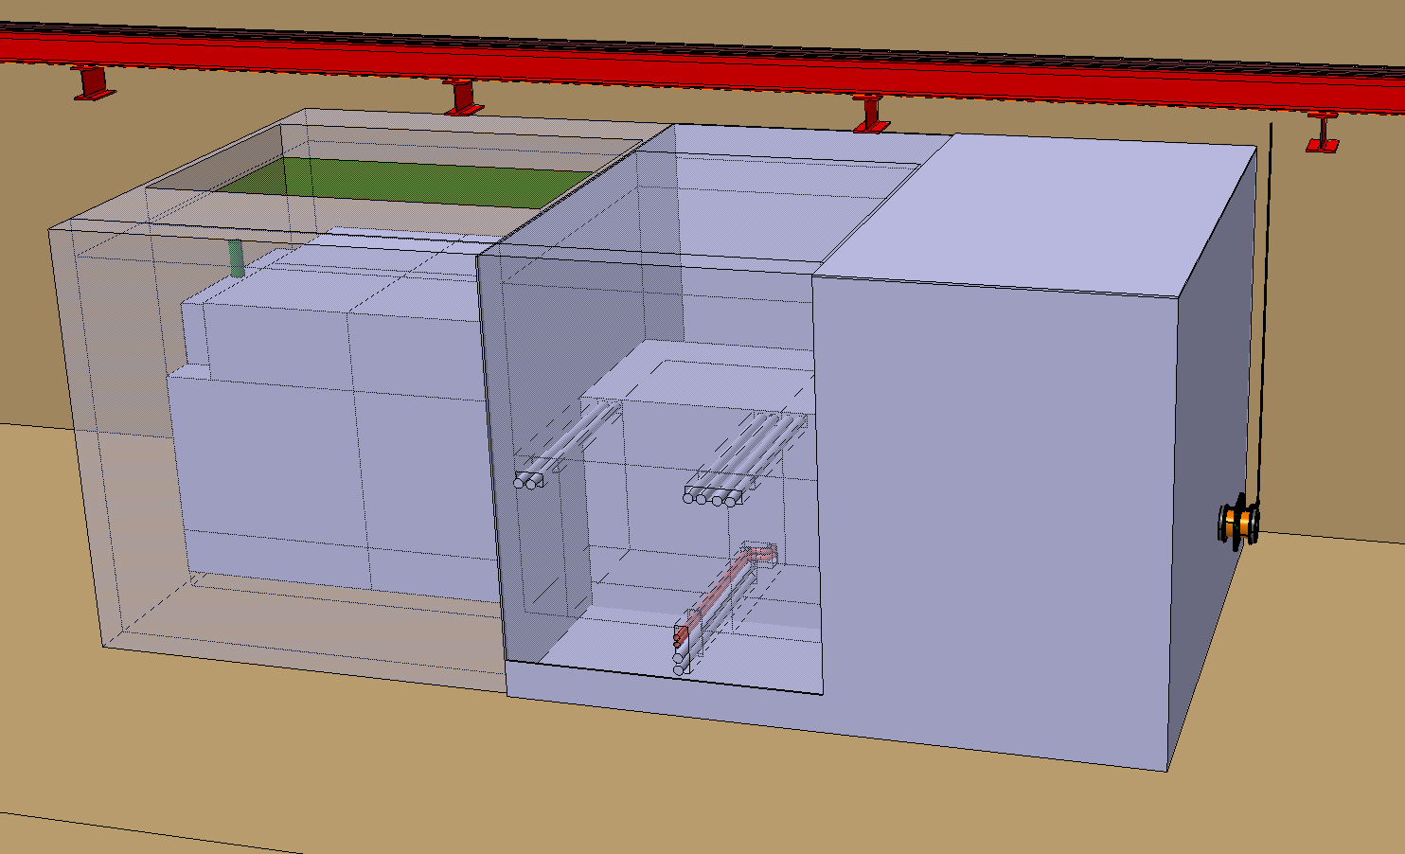
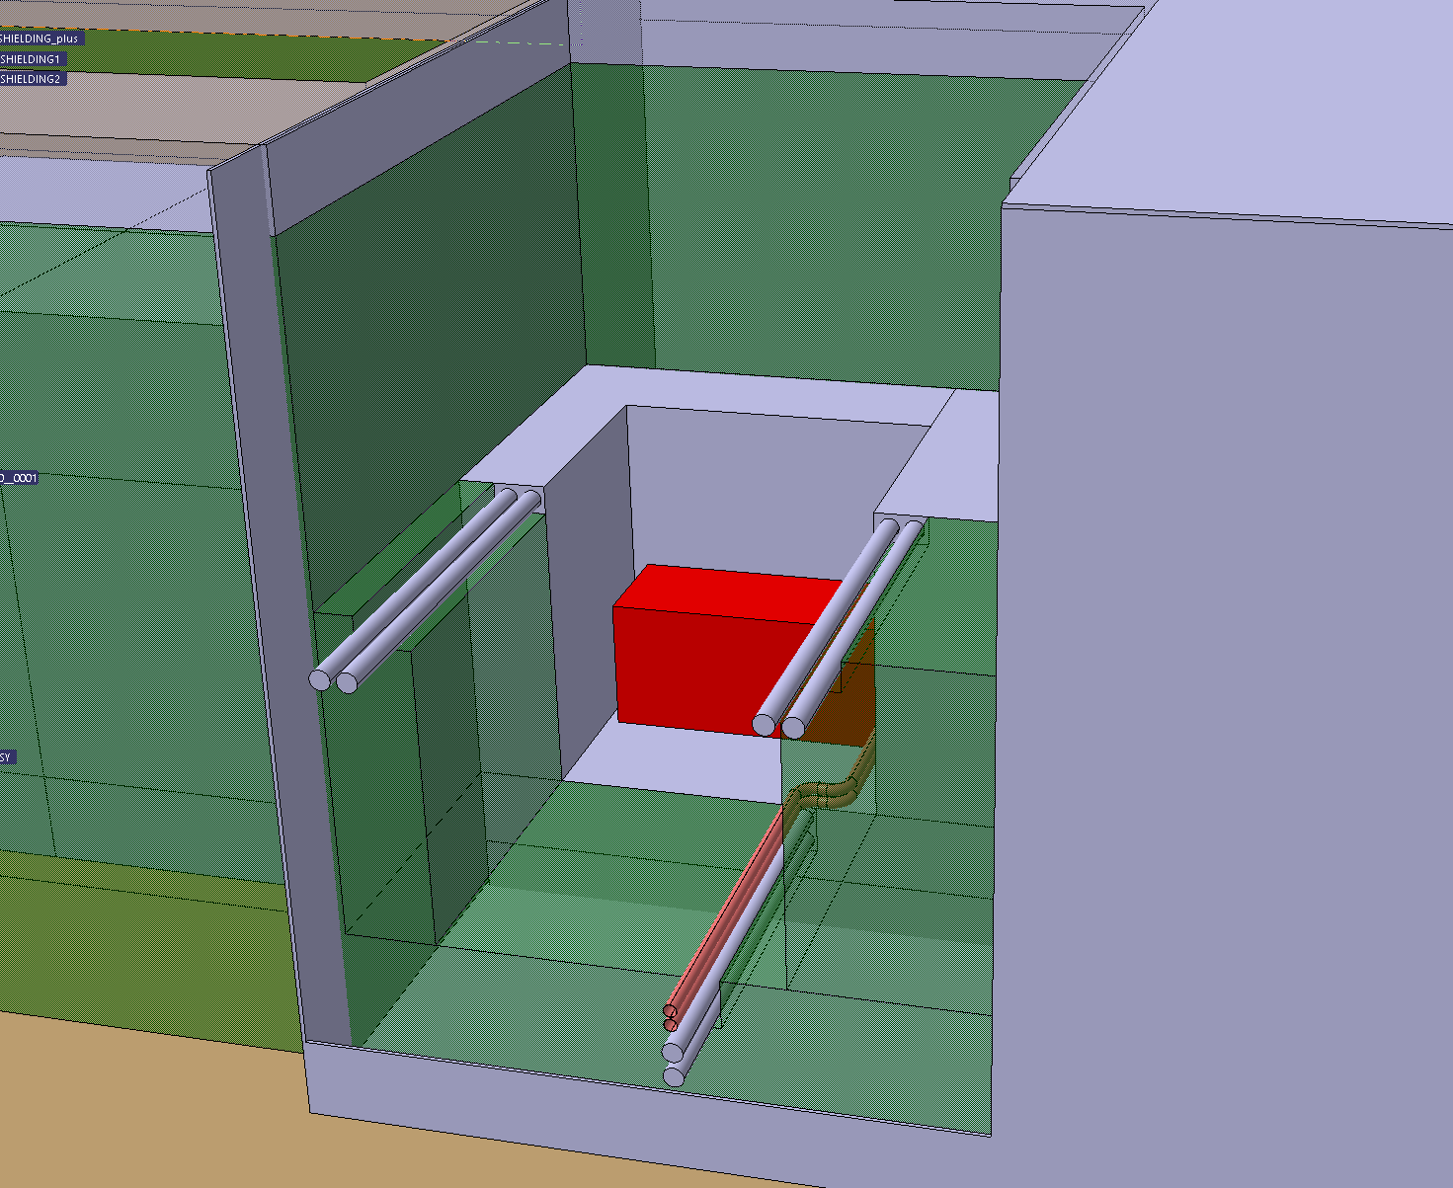
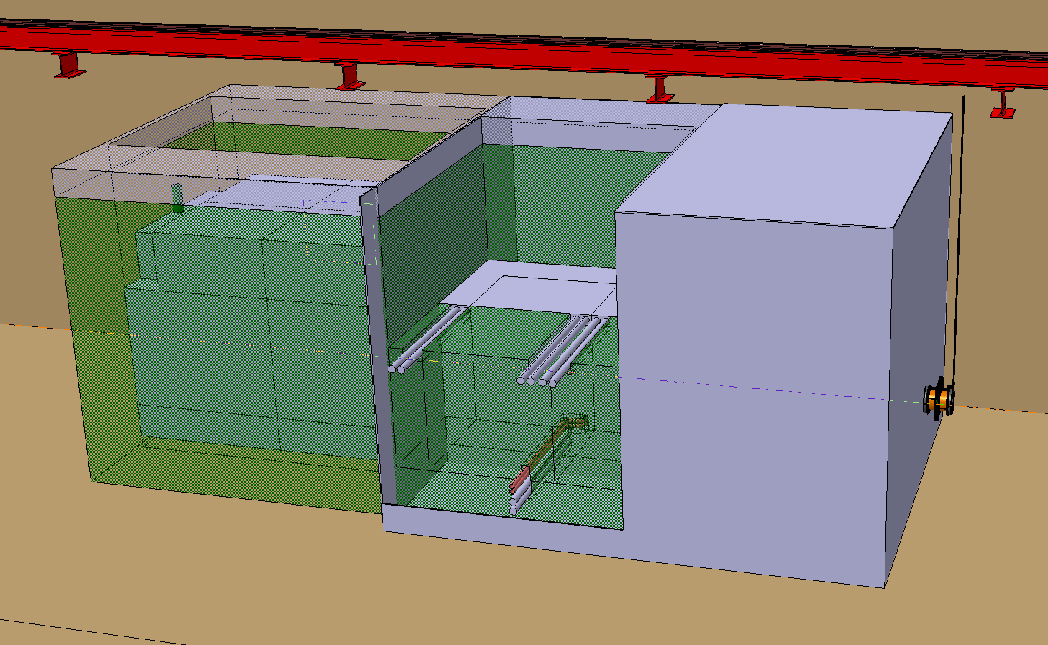
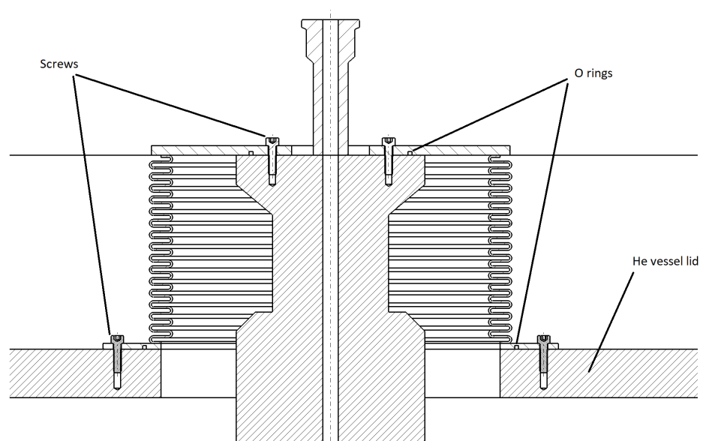
Current development of the Target Complex @ ECN3
Target and associated shielding blocks handling concept
Preliminary routing of cooling circuit on the side of the target
Due to limited height services routing on side
Identification of steps to perform a target exchange

Slide 25
Target complex integration
Shielding volumes for the target complex:
Iron (+ stainless steel for the Proximity Shielding and US1010 for Muon Shield): 182 m3 (1310 t)
Concrete: 360 m3 (864 t) (includes chicane)
Volume inside nitrogen confinement: 6.6 x 6.3 x 4.8 m (200 m3)
Moving from He to N2 a benefit of installing the target in an underground cavern
N2 tightness easier achievable

Slide 26
General development of BDF Target Complex
Optimization of the shielding
Driving parameters of the cost
Optimization of usage of raw material (cast iron VS concrete)
ECN3 configuration optimization of Iron volume
Shielding embedded in an optimized Nitrogen confinement
Optimization of overall infrastructure
Reuse of the current civil engineering (with minor modifications) and main infrastructure
Reuse of current overhead travelling crane with slight modifications (redundancy of movement, vision system, of board control cubicles…)
Reuse of ventilation system for the area outside the target complex

Slide 27
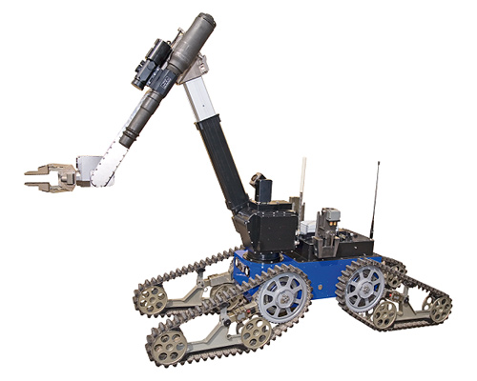
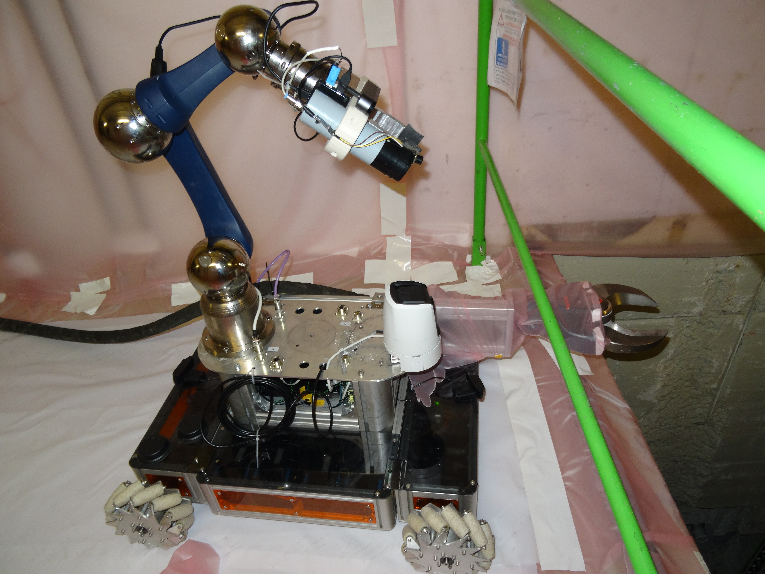
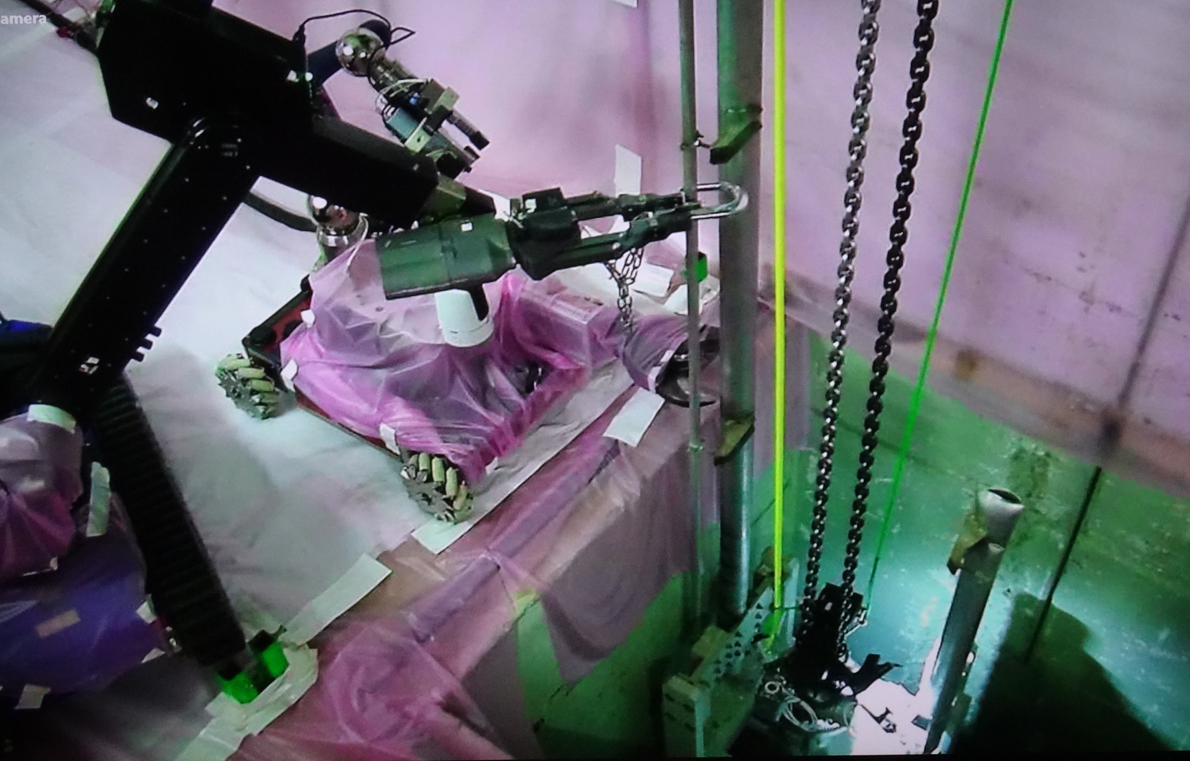
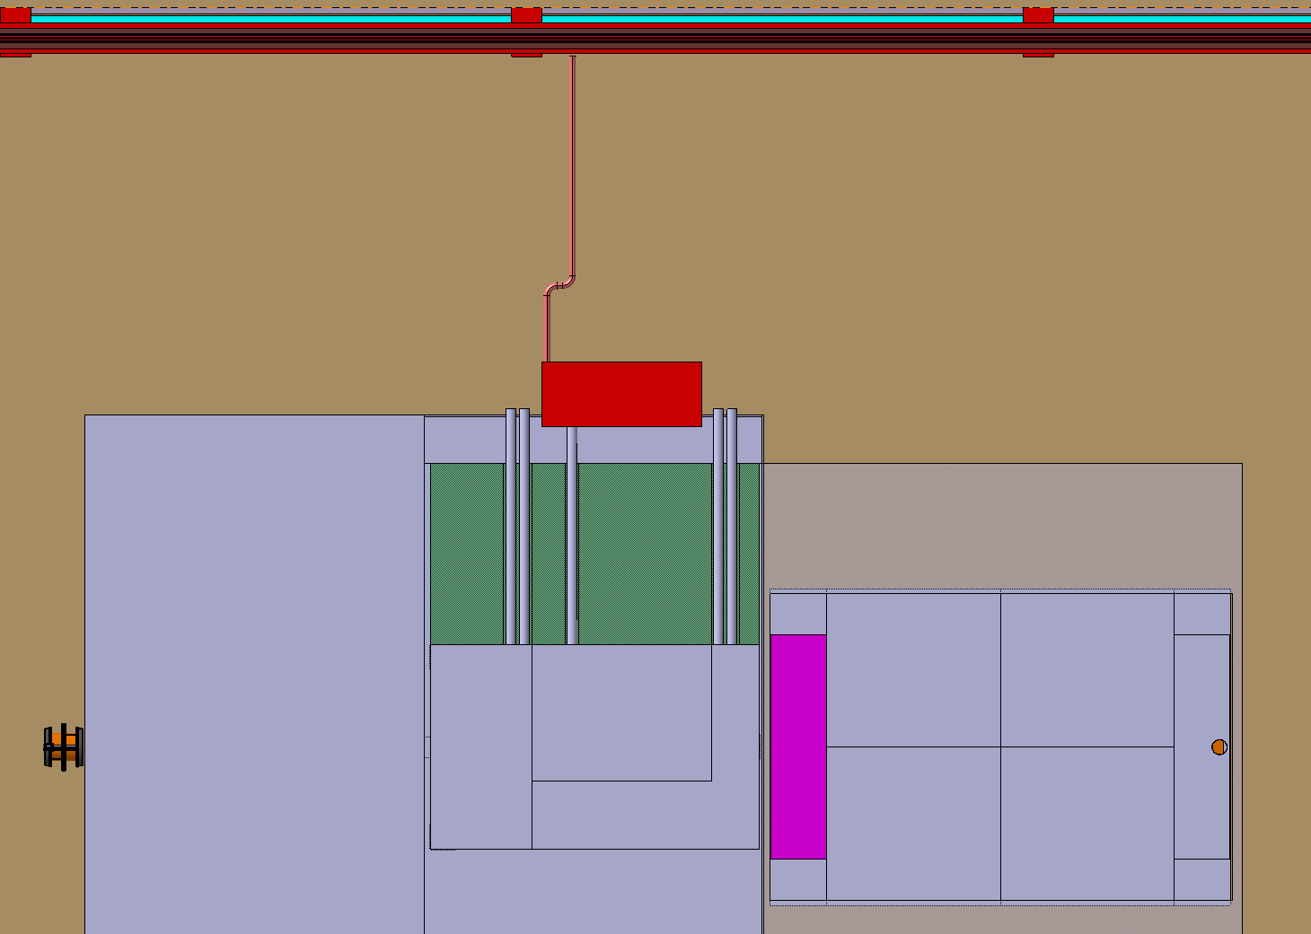
How we would maintain the target complex?
Target exchange
Connections of utilities located in ‘’human’’ accessible environment
Remote handling features for the connections
Support of remotely controlled crane and ROVs
Size reduction for final disposal by shearing
Transfer from the underground to surface in shielded casks
n-TOF target#2 pipes reduction with ROVs

Slide 28
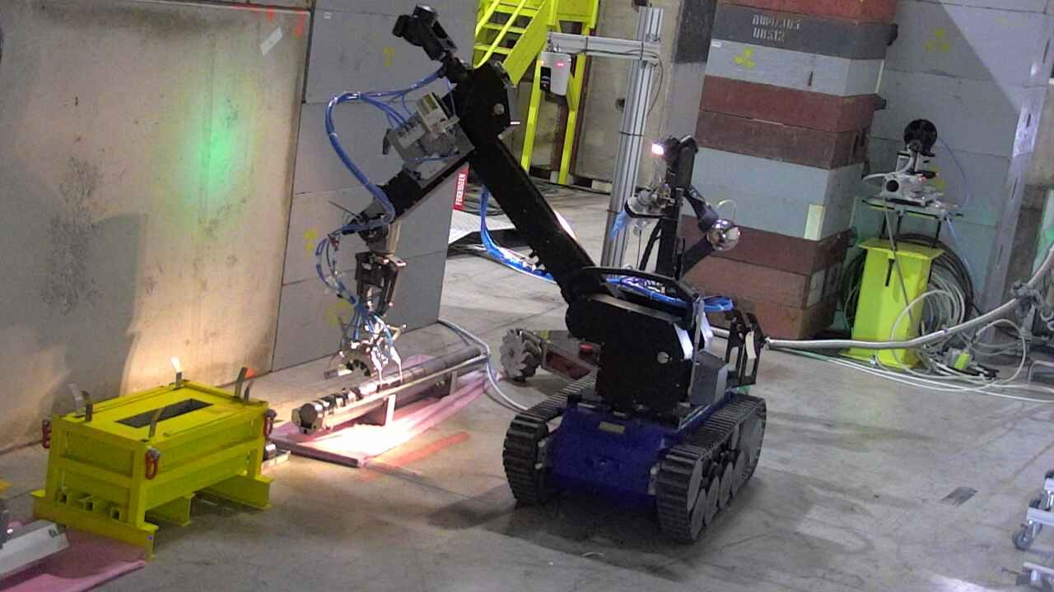
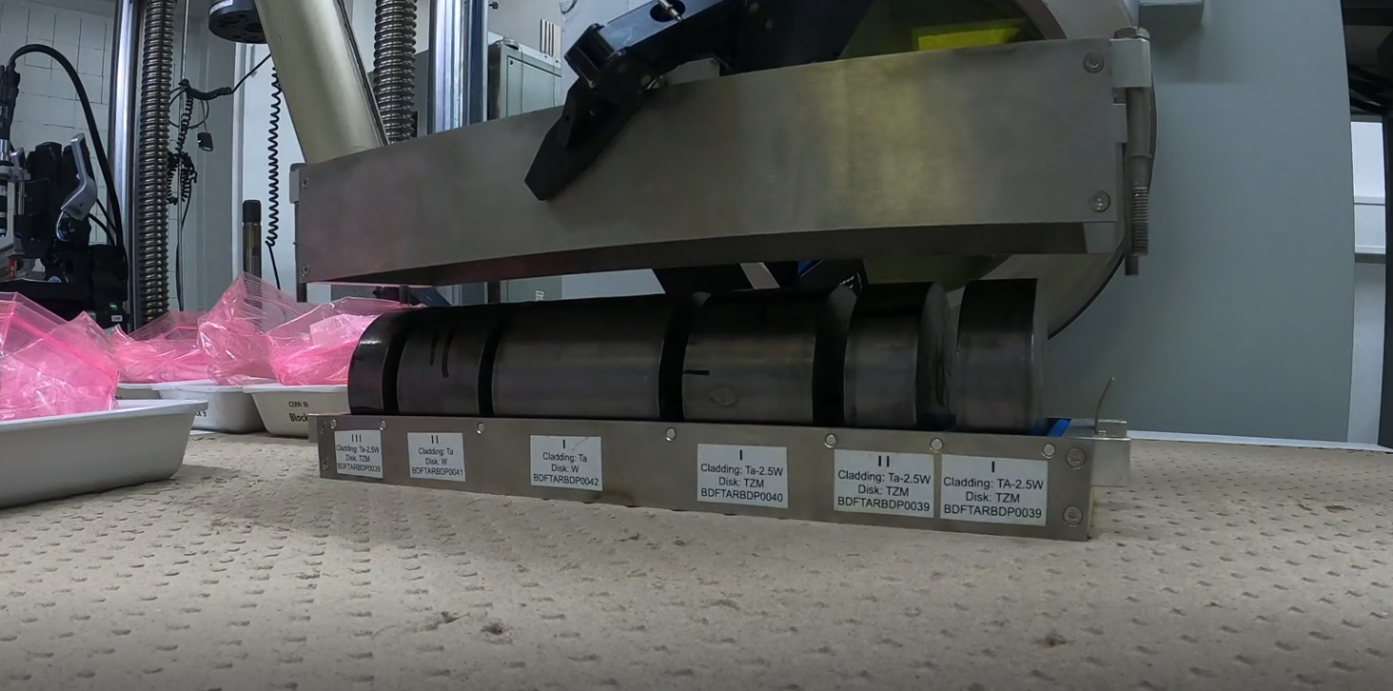
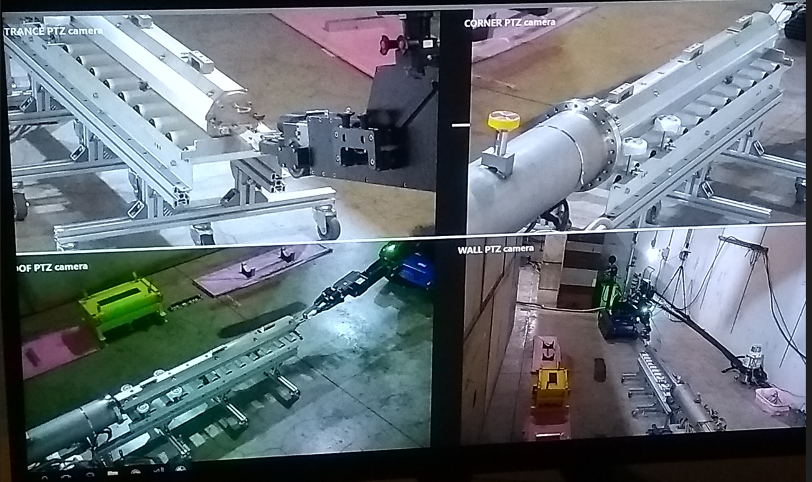
How we would maintain the target complex?
Post Irradiation Examination of defective components
Procedure of extraction of samples tested with prototype target
PIE of prototype target in a hot cell (outsourced)
Remote handling technics being developed for various PIE projects abroad CERN

Slide 29
BDF target complex summary
Pure vertical handling would have been more comfortable
Slight interest by reusing an existing infrastructure
Some constrains given this infrastructure (i.e. target replacement scheme)
Experience gain over SPS beam dump relocation
Remote handling technics being developed across various projects will be beneficial for BDF

